Slide 1
Georgia Alternate Assessment
Fall Resources & Support Training
Alignment & Documentation
November 2, 2017

Slide 2
Today’s Presentation
Today’s presentation addresses:
Key Dates
Quick look at 2017-2018 Examiner’s Manual
Review of alignment and documentation
Ideas for submitting scorable entries
Audience:
All Teachers who administer the GAA
Peer Reviewers and Trainers
Special Education Directors and Coordinators
Test Coordinators
Building Administrators

Slide 3
Key Dates for GAA
Administration Window:
September 5, 2017– March 23, 2018
Materials arrive:
Pre-ID Labels, Student Demographic Information Forms
Blue - K, 3-8
Orange – HS
Return Kits
February 1 – 5, 2018
Systems return materials to Questar for Scoring:
Completed portfolios may be shipped as early as March 1, 2018.
The last date to ship materials is March 23, 2018.
Systems receive GAA Score Reports:
June 1-7, 2018
Notes:
Materials were shipped to districts during the last week of August 2017.
We encourage systems to send completed GAA portfolios to the scoring center earlier than the March 23, 2018 deadline, if possible.

Slide 4
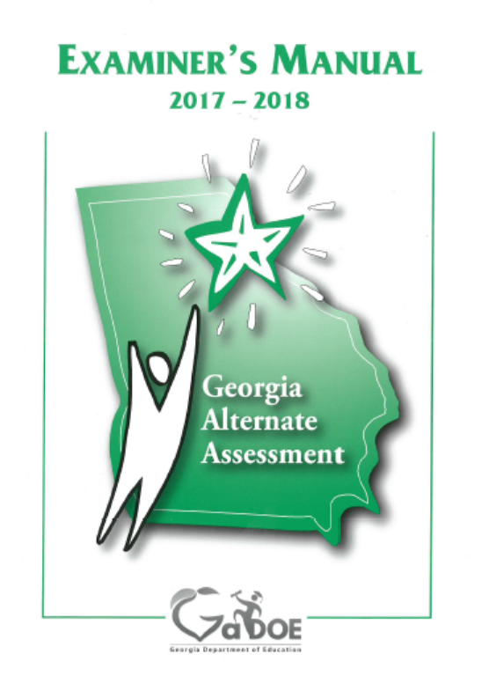
GAA Examiner’s Manual
Quick-Glance Index (p. iii)
Key Dates (p. 1)
Updates for 2017 – 2018 (p. 2)
Participation Guidelines (pp. 8-10)
Portfolio Components (pp. 9, 11)
Alignment (pp. 5, 10, 12, 65, 70)
Blueprint (pp. 89-99)
Standards (pp. 101-203)
Glossary (pp. 69-74)
Tips and Tools (pp. 42-57)
Notes:
The Examiner’s Manual (EM) should be used in conjunction with the other resources available on the GaDOE’s website (School & System Test Coordinator’s Manual, supporting ancillary documents, etc.). It is important to be familiar with all of the contents of the Examiner’s Manual. Here are some quick references:
The Quick-Glance Index - includes some of the key concepts related to the GAA
Key Dates – page 1
Updates - Resource Guide
Participation Guidelines- The first steps in identifying students for the GAA. Each GAA student should meet these guidelines.
Portfolio Components – Teachers are strongly encouraged to use these in conjunction with the Blueprint and Standards when putting together portfolios. Careful assembly of portfolios will help to avoid nonscorables like OG (Off-Grade), IS (Ineligible Standard), or ES (Entry Sheet Errors).
Alignment – Understanding alignment and its importance in the GAA is vital for success.
Blueprint – Should be used to find eligible standards and elements/indicators.
Content Standards- Should be used to find text of standards and elements/indicators.
Sample Entries –Sample entries are no longer included in the Examiner’s Manual. The student samples are now located in the Student Sample Resource Guide 2017-2018 (SSRG) posted to the GaDOE’s Resources website.
Glossary – Defines common GAA terms
Tips and Tools –Final review pages for teachers to use while in the process of compiling portfolios. These pages are meant to help peer/portfolio reviewers. This section walks through the evidence and documentation requirements and it provides checklists and planning pages with some suggested steps for compiling portfolios.

Slide 5
Assessment Tasks
Assessment tasks should be meaningful, purposeful and challenging for the individual student.
Plan the type of evidence that best documents the student’s participation and performance of that task (e.g., captioned photos, audio recordings, work samples).
Evidence may not be photocopied. Submit original student work.
Refer to pp. 14-31 in the Examiner’s Manual for more information.
Notes:
Evidence included in the GAA portfolio must be the student’s original work. It is not acceptable to submit photocopies of evidence. Student evidence should never be altered in any way, e.g., covering names or dates with correction fluid and writing new information on evidence is not permitted.

Slide 6
Nonscorable Categories
Missing Entry (ME)
Off Grade (OG)
Ineligible Standard (IS)
Entry Sheet Errors (ES)
Insufficient Time (IT)
Not Aligned (NA)
Insufficient Evidence (IE)
Notes:
There are 7 nonscorable codes and 22 subcodes.
A description of each nonscorable code and subcode can be found in the 2017-2018 Score Interpretation Guide. This document will be posted on the GaDOE’s Resources Website: http://www.gadoe.org/Curriculum-Instruction-and-Assessment/Assessment/Pages/GAA-Resources.aspx

Slide 7
Alignment to State-Mandated Content Standards
Assessment tasks may align at an access level, but they must be clearly connected to the grade-level standard. All students are assessed on grade-level standards.
All 4 assessment tasks must connect to the intent of the standard and element/indicator.

Slide 8
Alignment– Identifying the Skills
Some of the state-mandated standards are quite broad and encompass more than one skill, while others are very specific.
For many GAA students, it is most appropriate to choose a single skill around which to design the 4 assessment tasks. It is not necessary for assessment tasks to encompass everything mentioned in the standard.
The same skill(s) must be demonstrated in both collection periods.
Additional skills can be added in the second collection period.
Tasks which align to standards of one grade level may not align to standards of different grade levels.
Notes:
Example: If, in a math entry, only addition is being covered in the Collection Period 1 tasks, then subtraction problems could be added to Collection Period 2 to increase complexity. However, it is essential that addition problems are also included in the Collection Period 2 tasks so that there is at least one comparable skill in both collection periods.

Slide 9
Nonscorable Entries
If the evidence, which includes the student’s task and the teacher’s annotation, does not clearly demonstrate alignment to the content standard, then it may not be possible to score an entry.
If a scorer cannot find a connection between the student’s evidence and the grade-level standard, then the entry is referred to a Team Leader, Scoring Director, and/or GaDOE representative to determine whether it can be scored.
Only a Team Leader, Scoring Director, or Project Manager can assign a nonscorable code.

Slide 10
Alignment and Nonscorables
Not Aligned (NA)
Tasks are not aligned to standard and/or indicator
All 4 assessment tasks in each entry must show a connection between the tasks and the standard and element/indicator. Not all standards have elements or indicators.
GAA tasks must be assessment tasks, not instructional tasks. (What was the student asked to do?)

Slide 11
Insufficient Evidence and Nonscorables
Insufficient Evidence (IE)
Primary Evidence does not meet evidence requirements or is missing from the portfolio
Only Secondary Evidence is included
Fewer than 2 captioned photos are included.
Media were submitted without a script.
Photocopies of student work, data or other documentation are not permitted in a GAA portfolio.
Notes:
A “series of captioned photos” must include at least two photographs. It is acceptable to include more. Ideally the photos will show the student in the process of completing the task and at the end of the task. If the photos you take are less than perfect, they may still be suitable for inclusion in the portfolio. Be sure your captions describe clearly what the student was doing to complete the assessment task.

Slide 12
Insufficient Evidence and Nonscorables
Insufficient Evidence (IE)
Secondary Evidence does not meet evidence requirements or is missing from portfolio
Observation Sheet or Interview Sheet cannot be scored because of the absence of proper documentation.
A data sheet is submitted with fewer than 3 dates on which evidence of student performance was collected.
Notes:
A data sheet should include at least 3 discrete dates on which evidence of the student’s work was collected. None of the 3 dates should be the same as the date of the Primary Evidence from the same Collection Period.

Slide 13
Insufficient Evidence and Nonscorables
Insufficient Evidence (IE)
Secondary Evidence may not redocument Primary Evidence
Secondary Evidence must represent a separate and distinct event, different materials must be used, and/or the student must perform a different activity.
A task that takes multiple days to complete is still considered a single task. Please do not submit each day’s work as a separate task.
A work sample (Primary Evidence) and an observation (Secondary Evidence) of the student completing that same work sample is an example of redocumentation.
Notes:
A single task which is documented by a work sample (primary evidence) and again by an observation form (secondary evidence) cannot be called two assessment tasks. If one task is presented in two ways (student’s worksheet as primary evidence and teacher’s observation of the student’s work as secondary evidence), the entry will receive a redocumentation nonscorable code.
If the same worksheet is given a second time to the student on the same day, using the same materials, the same amount of prompting and in the same setting, that would be considered redocumentation. In addition, a student’s assessment task must have a clear and distinct beginning and ending. One assessment task should be entirely complete before another task starts. It is not recommended that students be given two assessment tasks on the same day.
An activity that is repeated on a different day with the same materials is still scorable, particularly with low functioning students. For example, if the teacher is doing comprehension activities on adapted text, the same symbols and picture representations of the characters, events, and settings are used throughout the unit.

Slide 14
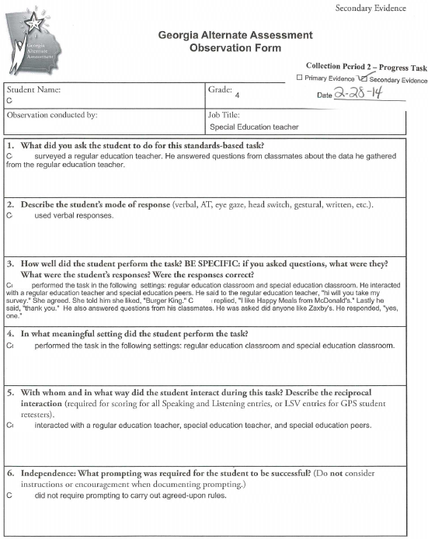
Insufficient Evidence and Nonscorables Example of Redocumentation
Redocumentation
Notes:
The student’s Collection Period 2 Primary Evidence (captioned photos) is on the left side of this slide. The student’s Collection Period 2 Secondary Evidence (observation form) is on the right side of this slide. The student performed a single task, but it was documented in the GAA portfolio in two ways.
Photos are present in the original evidence. Since the parent did not sign a Release Form to allow photos of student to be used in training, the pictures are not included in this PowerPoint.

Slide 15
Insufficient Evidence and Nonscorables
Insufficient Evidence (IE)
Cannot determine the correctness of student response on one or more pieces of evidence
If there is no score or answer key, then it is not possible for a scorer to determine if the student’s responses are correct.
Example: The student is measuring objects in the classroom, but the work is not graded and no answer key is provided.
Example: The annotation states that the student completed the task, but the work is not graded and there is no statement regarding its correctness.
Notes:
An annotation that states the student received a score of “100% for participation” is incomplete and insufficient for scoring. In order to be considered for scoring, it must be clear what criteria are being used to assess the student’s performance on the assessment task. In what way did the student participate? How is the task related to the standard and indicator? What was the student’s response, and was that response correct?

Slide 16
Seven Steps to Effective Documentation
1. The assessment tasks must align to the standard and element/indicator.
The task should focus on the standards-based skill chosen by the teacher.
The connection between the task and the standard should be clearly described in the annotation.
What was the student asked to do and how does the student’s task connect to the standard and element/indicator?
Notes:
Be sure someone who is not familiar with the student and his/her work could discern what the student was asked to do. The connection of the student’s task to the standard and element/indicator should not require explanation; it should be clear even to a casual observer how the student’s work connects to the standard and element/indicator.

Slide 17
Seven Steps to Effective Documentation
2. The specific questions asked of the student and the student’s responses should be clearly described.
What kind of question – multiple choice, fill-in-the-blank, ordering sentence strips, short answer…?
Is the student writing by choosing and placing pictures, symbols, words or sentences on the page?
How many questions/steps/actions were asked of the student?
Which questions did the student answer correctly? Incorrectly?

Slide 18
Seven Steps to Effective Documentation
The depth of knowledge the student demonstrated should be described.
What level of understanding of the content standard and element/indicator has the student demonstrated in each of the 4 tasks?
Can the student answer true-false or multiple choice questions? Does the student respond to more complicated questions (short-answer or open-ended) in the Collection Period 2 tasks?
Can the student choose between two or more options presented by the teacher?
Did the student use color-coded materials and/or a word bank in Collection Period 1 but not in Collection Period 2?
Is the student performing tasks at or approaching basic grade level, or is the student working at an access level?
Notes:
One way for the student to demonstrate Achievement/Progress is to perform tasks in Collection Period 2 which require a greater depth of knowledge that the tasks which were performed in Collection Period 1.

Slide 19
Seven Steps to Effective Documentation
The correctness of the student’s responses must be documented.
Student work must be graded; the number and/or percentage of correct answers must be noted.
Accuracy and prompting should be documented separately.

Slide 20
Seven Steps to Effective Documentation
The student’s level of independence must be documented. What type and frequency of prompting were required for the student to respond?
Types of prompting
Verbal, Gestural, Model, Physical
Frequency of prompting
Limited, Frequent, or Continuous
A student who needs no prompting to complete an assessment task is Independent.
Notes:
A student who received, for example, “Limited Verbal Prompting” cannot also be described as “Independent.” Only if a student needs no prompting can he or she be described as independent.
Prompting is guidance which leads a student to the correct answer (notice the minus sign on that math problem; look again at this page of the story to find the name of the main character; look again at the map of Georgia to find the Okefenokee Swamp; and so on). Instruction and assistance (turn to page 32; be sure you have a sharpened pencil; please don’t talk to your neighbor; you have 15 more minutes to complete your work; and so on) are not prompts.

Slide 21
Seven Steps to Effective Documentation
Interactions that occurred during the assessment tasks must be documented. With whom did the student work during the assessment tasks?
The interaction must occur during the assessment task and it must be related to the performance of the task. Saying hello to a classmate while performing a math task alone is not an interaction. Working together with a classmate on math problems is an interaction.
Please do not provide a list of all the people who were in the room with the student. Please do mention all of the people who worked with the student on the assessment task. “Working together” does not mean a peer buddy provided the answers to the student who is being assessed.
The peer may assist with manipulating materials, recording answers generated by the student, reading questions, and prompting the student to stay on task.

Slide 22
Seven Steps to Effective Documentation
Settings where the student performed each assessment task must be documented.
The setting in which the task was completed should be purposeful to the task.
All settings where assessment tasks took place are considered in the calculation of the Generalization score.
Acronyms and locations specific to a school should be defined.
Notes:
For example, doing a math worksheet alone at a desk in the hallway is NOT a purposeful setting for a math task.
If using acronyms or terms that may not be universally understood, please define the terms. E.g., if the annotation says “Mr. Smith’s classroom,” please state if the room is a special education or a general education setting.

Slide 23
Electronic Entry Sheet
The Electronic Entry Sheet and instructions can be found on the Resources page of the GaDOE Web site at:
http://www.gadoe.org/Curriculum-Instruction-and-Assessment/Assessment/Pages/GAA-Resources.aspx

Slide 24
Extended Content Standards
The Extended Content Standards: A Support Resource for the Georgia Alternate Assessment is a new document available in 2017-2018
Extending content standards is one way to illustrate aligned skills.
Levels are included within the Extended Content Standards to show the progression of complexity of skills aligned to the standard:
http://www.gadoe.org/Curriculum-Instruction-and-Assessment/Assessment/Pages/GAA-Resources.aspx
Notes:
The Extended Content Standards document will give you a range of tasks which will align to individual content standards. The Extended Content Standards describe tasks which have different degrees of complexity.

Slide 25
Tasks in This Presentation
ELA 2 (Speaking and Listening) Grade 3 Standard SL.2 Slides 26-29
ELA 2 (Writing) Grade 7 Standard W.2.b Slides 30-35
Writing guidance Slides 36-37
Mathematics 1 (Expressions and Equations) Grade 6 Standard EE.7 Slides 38-41
Mathematics 1 (Coordinate Algebra) Grade HS Standard F.IF.2 Slides 42-45
Science (Life Science) Grade 5 Standard S5L1a Slides 46-49
Science (Life Science) Grade 5 Standard S5L3a Slides 50-53
Science (Physical Science) Grade 8 Standard S8P1b Slides 54-57
Science (Physical Science) Grade 8 Standard S8P1d Slides 58-61
Science 1 (Biology) Grade HS Standard SB5b Slides 62-65
Science 2 (Physical Science) Grade HS Standard SPS6b Slides 66-69
Social Studies (Historical Understandings) Grade 5 Standard SS5H4d Slides 70-73
Social Studies (Economic Understandings) Grade 8 Standard SS8E2c Slides 74-77
Social Studies 1 (United States History) Grade HS Standard SSUSH16c Slides 78-81
Social Studies 2 (Economics) Grade HS Standard SSEPF6a Slides 82-85
Notes:
Since time is limited, this presentation devotes more time to Science and Social Studies tasks. Tasks which align to the “new” Science and Social Studies standards will be part of the GAA for the first time in 2017-2018. There are no longer any co-requisite Characteristics of Science.

Slide 26
Grade 3 English Language Arts 2 Example
Speaking and Listening
 | ELAGSE3.SL.2 Determine the main ideas and supporting details of a text read aloud or information presented in diverse media and formats, including visually, quantitatively, and orally.
 | This standard has no indicators.

Slide 27
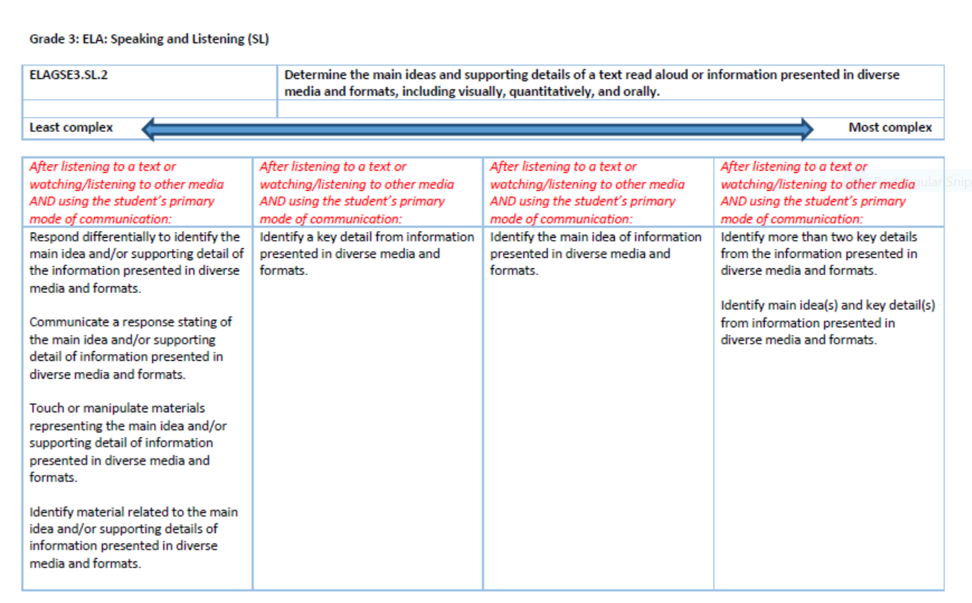
The task shown on the next two slides aligns to this extension.
Notes:
Tasks which align to this content standard are presented on a continuum, shown here with the least complex tasks in the column on the far left.

Slide 28
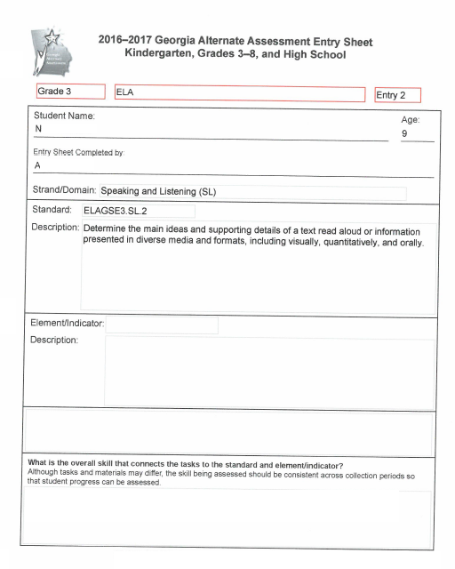
Example
ELA 2 - Speaking and Listening
Grade 3
Tasks which align to this standard will involve the student responding differentially to identify the main idea and/or to identify one or more supporting details of a text read aloud.
A student may perform assessment tasks which align only to part of the standard. All four of the assessment tasks must align to the same part of the standard.
The teacher should document that the student was speaking during the assessment task. The student must speak in all four assessment tasks. Speech includes verbal exchanges between the student and another person. It also includes communication via nodding, pointing, gesturing, eye gazing, signing with American Sign Language (ASL), and/or communicating with an augmentative device. A student’s verbal responses may be scribed by another person.

Slide 29
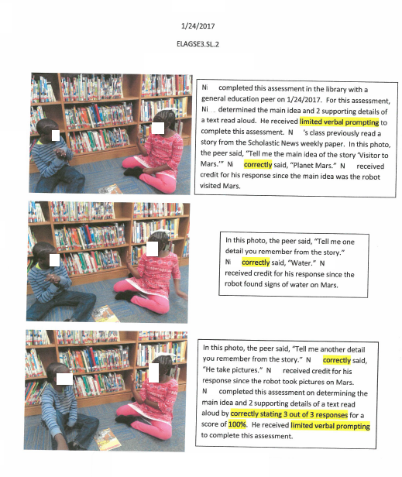
ELA 2 – Grade 3 (continued)
The student was asked to identify the main idea and two supporting details in a text which was read aloud to him. He responded verbally.
Notes:
The student whose work is seen here is able to speak verbally. The students who are assessed on the GAA who are unable to express themselves in this way can still “speak” by nodding, pointing, using American Sign Language, using eye gaze and/or using an assistive device.

Slide 30
Grade 7 English Language Arts 2 Example
Writing
 | ELAGSE7.W.2 Write informative/explanatory texts to examine a topic and convey ideas, concepts, and information through the selection, organization, and analysis of relevant content.
 | b. Develop the topic with relevant facts, definitions, concrete details, quotations, or other information and examples.

Slide 31
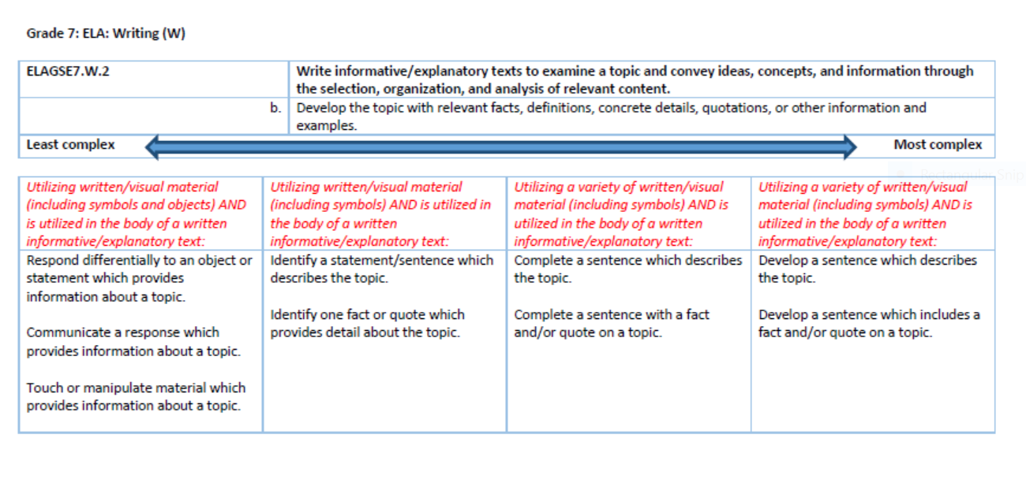
The task shown on the next four slides aligns to this extension.

Slide 32
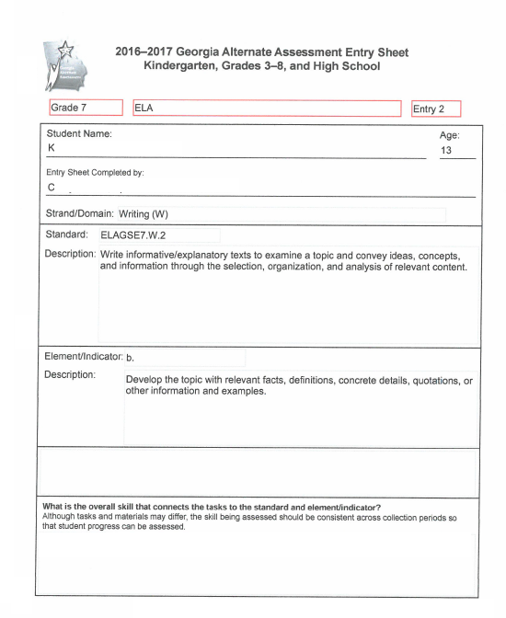
Example
ELA 2 - Writing
Grade 7
Tasks which align to this standard and indicator will involve writing about a topic using facts, details and/or other kinds of information.
The student used cut-out words and phrases to develop the topic of the Wright Brothers.

Slide 34
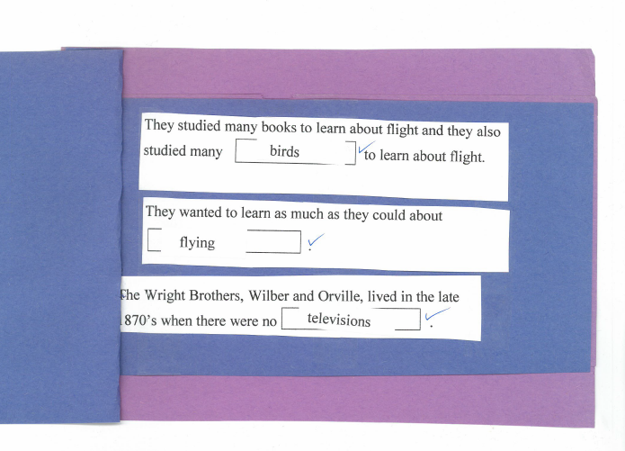
Notes:
The student chose words and phrases which were cut out by the teacher to write about the Wright Brothers.

Slide 35
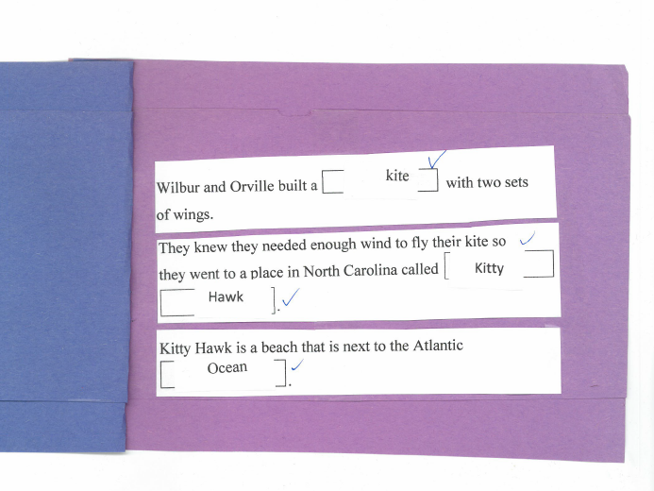

Slide 36
Some notes on Writing tasks in all grades
All Writing tasks in all grades must involve the production of some form of “written” product by the student. A student’s writing must be a visual product that can be interpreted by the reader when the student is not present.
Writing is:
Typing, writing or printing words, phrases or sentences
Dictating words, phrases or sentences which are scribed by another person
Using a computer or speech-to-text assistive technology to produce readable text
Completing a “written” phrase to convey information with a phrase, word, communication symbol(s), pictures or objects in logical order
Telling a story or giving information by appropriately placing phrases, words, sentences, communication symbols, pictures or objects in logical order
Organizing information to be communicated on a graphic organizer such as an outline or Venn diagram
Writing is not completing a worksheet by:
Matching activities
Selecting answers to multiple choice questions
Numbering sentences
Circling words, phrases or sentences

Slide 37
Some notes on Writing tasks in all grades
In Writing entries in all grades, students must produce a permanent product which another person can read and understand, whether or not the writer is present. A written permanent product is defined as a sentence, paragraph, essay handwritten or typed by the student, dictation to a scribe, symbols, picture or object representation.
It is not necessary for a student to be able to print, handwrite or use a keyboard. A student with extremely severe cognitive or physical disabilities may utilize words, picture icons, Boardmaker symbols, or sentence strips when writing a response. A teacher or peer buddy may then paste the student-selected items on the page in accordance with the student’s direction. Students may dictate their writing verbally, by using American Sign Language (ASL), or by using an augmentative communication device. Another person may act as a student’s scribe and type or print the student’s work.
Writing a recipe or daily schedule by indicating the information that is to be included and in the correct order is one way for a student to write. Using pictures, with or without text, to write a story is also acceptable.
It is not acceptable to put numbers in front of sentences (e.g., 2,4,5,1,3) to show the order of sentences in a paragraph. Matching and multiple choice tasks are also considered not to be writing tasks.

Slide 38
Grade 6 Mathematics 1 Example
Expressions and Equations
 | MGSE6.EE.7 Solve real-world and mathematical problems by writing and solving equations of the form x + p = q and px = q for cases in which p, q and x are all nonnegative rational numbers.
 | This standard has no indicators.

Slide 39
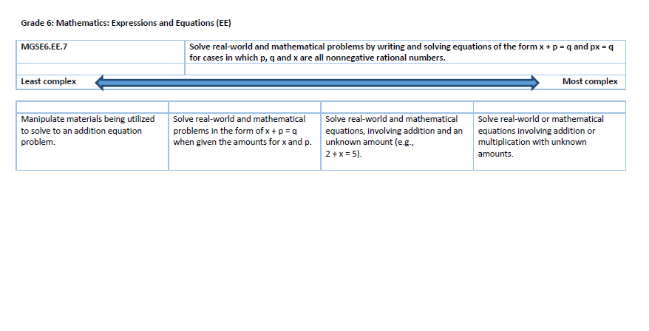
The task shown on the next two slides aligns to this extension.

Slide 40
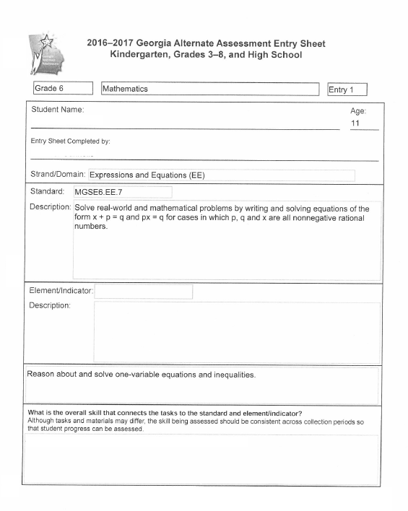
Example
Mathematics 1
Grade 6
Tasks which align to this standard involve the student in writing and/or solving equations.
In this task, the student was given an equation which the teacher created. He was asked to solve it so he would know how much more money he needed in order to buy what he wanted at KFC.
The student’s task involved a real-world task (he needed to solve the equation before he could order and pay for his food) which makes this a purposeful, real-world application.
.

Slide 41
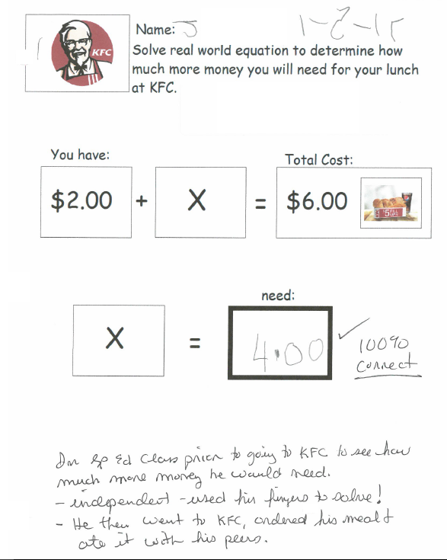
Mathematics 1 – Grade 6 (continued)
The student was given an equation created by the teacher. He already had two dollars. He needed to calculate how much more money he needed so that he would have enough to buy a meal that cost six dollars.
Notes:
This student’s Mathematics 1 entry received a “4” in Context because the student performed a purposeful, real-world application. He needed to make the calculation shown on the worksheet before he went with his classmates to KFC in order to know how much more money he needed.

Slide 42
Grade HS Mathematics 1 Example
Coordinate Algebra
 | MGSE9-12.F.IF.2 Use function notation, evaluate functions for inputs in their domains, and interpret statements that use function notation in terms of a context.
 | This standard has no indicators.

Slide 43
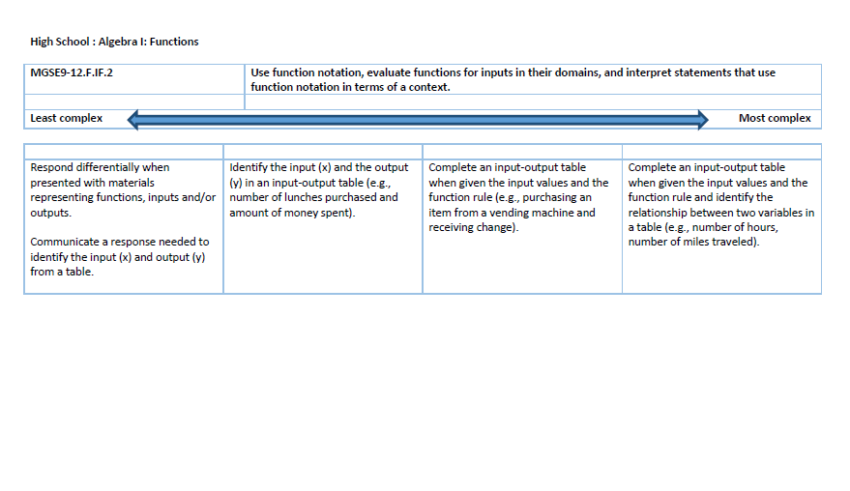
The task shown on the next two slides aligns to this extension.

Slide 44
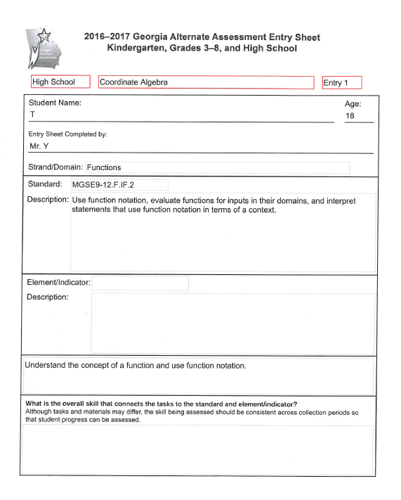
Sample Task
Mathematics 1
Grade HS
Tasks which align to this standard will involve the student in identifying the input and/or output or completing an input-output table.

Slide 45
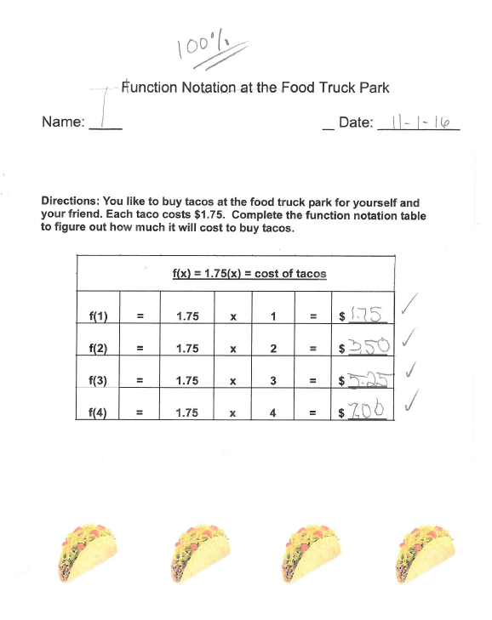
The student was given a function table and was asked to calculate four outputs.
Notes:
The function table was set up for the student by the teacher.

Slide 46
Grade 5 Science Example
Life Science
 | S5L1 Obtain, evaluate and communicate information to group organisms using scientific classification procedures.
 | a. Develop a model that illustrates how animals are sorted into groups (vertebrates and invertebrates) and how vertebrates are sorted into groups (fish, amphibian, reptile, bird, and mammal) using data from multiple sources.

Slide 47
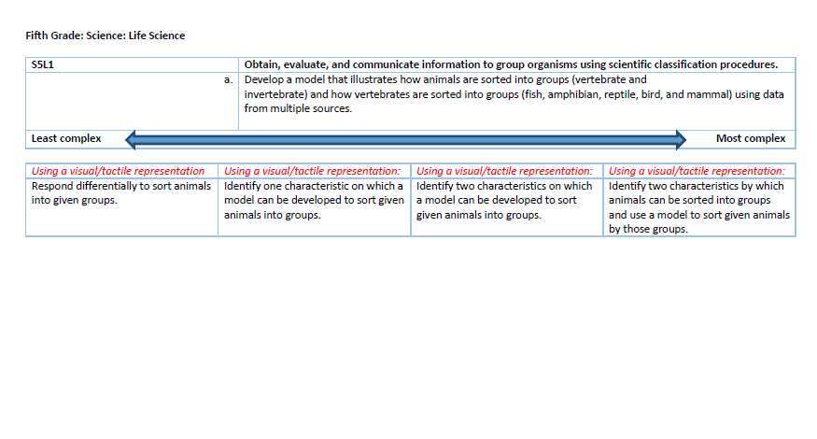
The task shown on the next two slides aligns to this extension.
Notes:
This is a screen shot of a page from the Extended Content Standards document. The task you will see on the next two slides aligns to the “least complex” extension for this Grade 5 Science content standard. The teacher could have made the task more complex by asking the student to identify one characteristic (“backbone” or “no backbone”) which differentiates vertebrates from invertebrates. An even more complex task would ask the student to identify two characteristics (“backbone” and “no backbone) which characterize vertebrates and invertebrates. A student who is able to perform the most complex task could be asked to identify two characteristics and to use a model to sort the animals into groups.

Slide 48
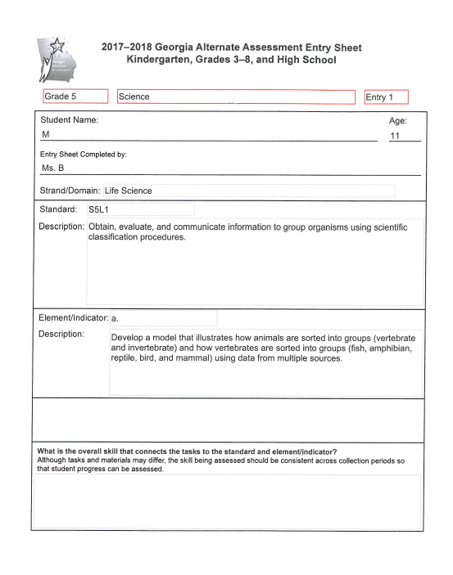
Example
Science (Life Science)
Grade 5
Tasks which align to this standard and element involve distinguishing between vertebrates and invertebrates and/or categorizing vertebrates as fish, amphibians, reptiles, birds or mammals.
In this entry, the teacher chose to have the student focus only on distinguishing between vertebrates and invertebrates.

Slide 49
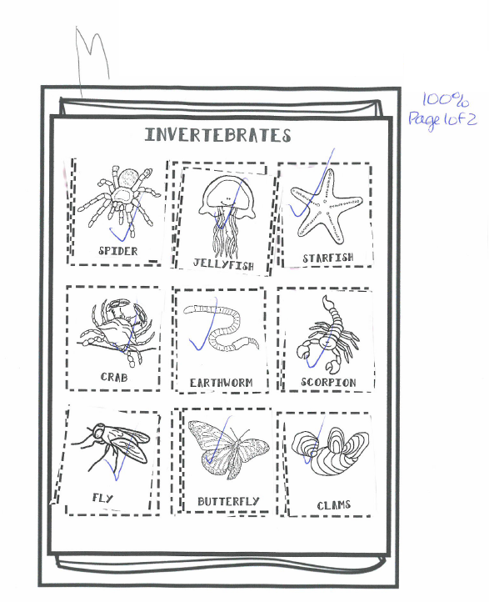
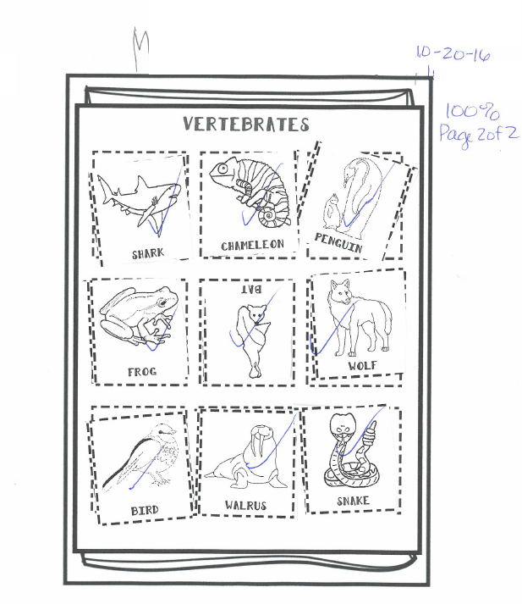
Life Science – Grade 5 (continued)

Slide 50
Grade 5 Science Example
Life Science
 | S5L3 Obtain, evaluate and communicate information to compare and contrast the parts of plant and animal cells.
 | a. Develop a model to identify and label parts of a plant cell (membrane, wall, cytoplasm, nucleus, chloroplasts) and of an animal cell (membrane, cytoplasm, and nucleus).

Slide 51
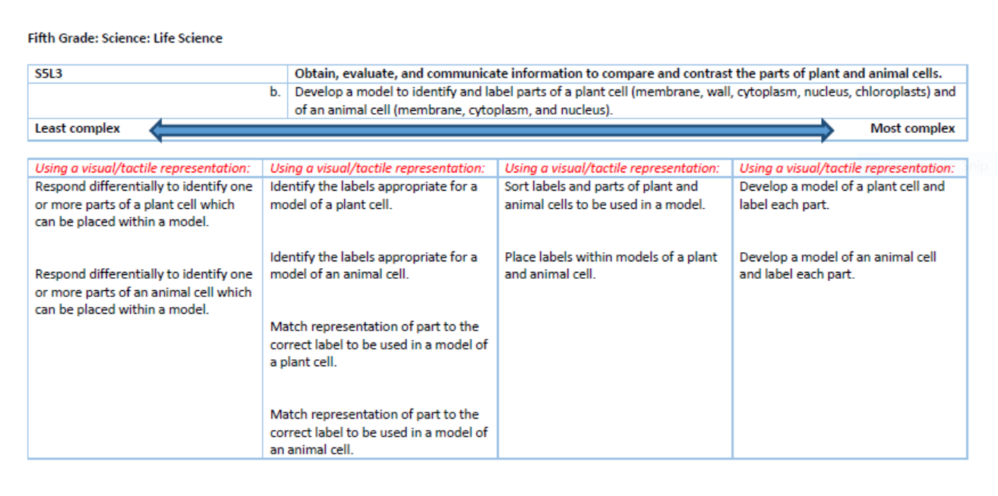
The task shown on the next two slides aligns to this extension.
Notes:
The student was asked to label parts of both an animal cell and a plant cell.

Slide 52
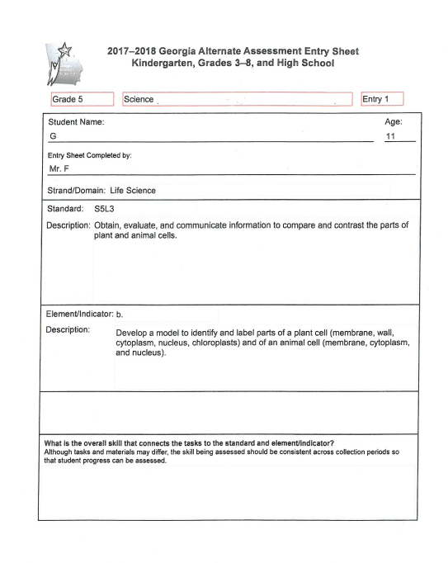
Example
Science (Life Science)
Grade 5
Tasks which align to this standard and element involve identifying or labeling parts of plant and/or animal cells.
The student whose work is seen in this example was asked to label the parts of both plant and animal cells.

Slide 53
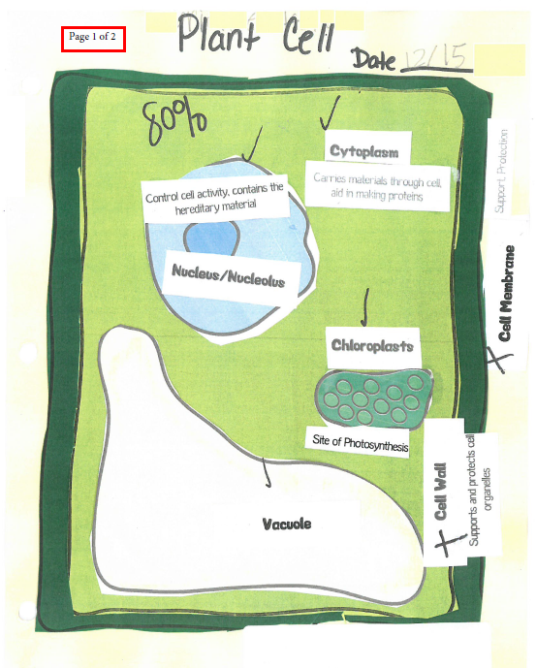
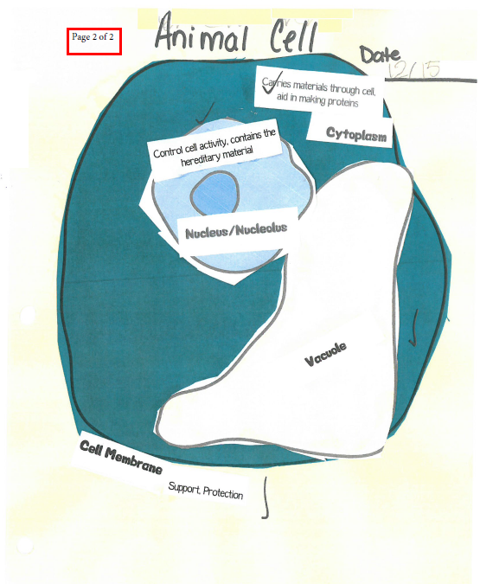
Life Science – Grade 5 (continued)
Notes:
The student used cut-out words, phrases, and drawings to make and label his models of a plant cell and an animal cell.

Slide 54
Grade 8 Science Example
Physical Science
 | S8P1 Obtain, evaluate and communicate information about the structure and properties of matter.
 | b. Develop and use models to describe the movement of particles in solids, liquids, gases and plasma states when thermal energy is added or removed.

Slide 55
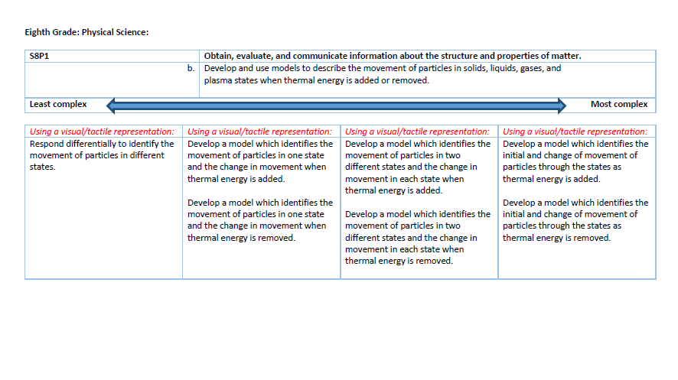
The task shown on the next two slides aligns to this extension.
Notes:
The student whose work is seen on the next two slides is not developing a model. The student’s task is to identify the movement of particles, one of the least complex tasks which is aligned to the content standard and element. Students who are able to perform more complex tasks could be asked to develop models to describe the movement of particles in just one state (solid, liquid, plasma or gas). The most complex tasks which will align to this standard and element will involve the student in performing a multi-part activity: developing a model; identifying the initial movement of particles in solids, liquids, plasmas, and gases; identifying the change of movement of particles in solids, liquids, plasmas, and gases; and explaining what happens when thermal energy is added or removed.

Slide 56
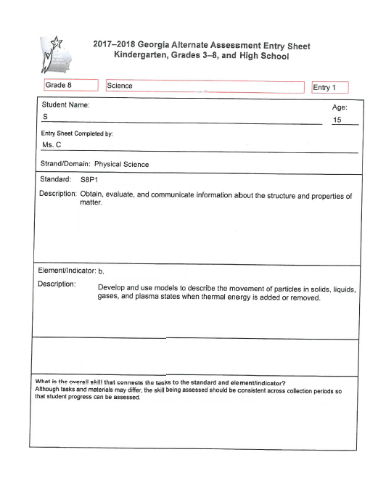
Sample Task
Science (Physical Science)
Grade 8
The student in this example performed an aligned task which represents the least complex part of the continuum of tasks. (See previous slide which show the Extended Standards tasks.)
The student was given a graphic organizer and was asked to write a word or phrase to describe the movement of particles in solids, liquids and gases.

Slide 57
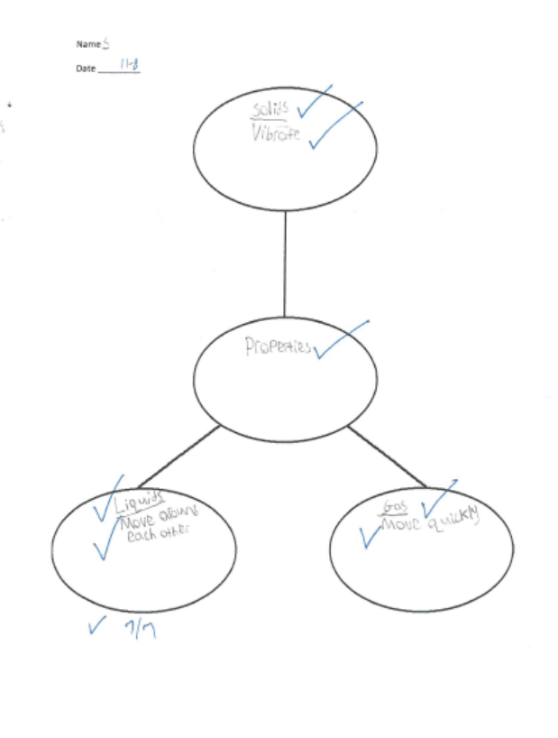
Physical Science – Grade 8 (continued)
The student completed a graphic organizer to describe properties of solids, liquids and gases.
Notes:
The student is responding differentially, which is the least complex task on the continuum established in the Extended Standards. A somewhat higher-functioning student might be asked by the teacher to develop or to use a model (verbiage from the text of the element) but it is not required that a GAA student do those higher level tasks. A longer explanation of the range of tasks available to students who are assessed on this content standard and element can be seen in the notes under Slide 51.

Slide 58
Grade 8 Science Example
Physical Science
 | S8P1 Obtain, evaluate and communicate information about the structure and properties of matter.
 | d. Construct an argument based on observational evidence to support the claim that when a change in a substance occurs, it can be classified as either chemical or physical. (Clarification statement: Evidence could include ability to separate mixtures, development of a gas, formation of a precipitate, change in energy, color and/or form..

Slide 59
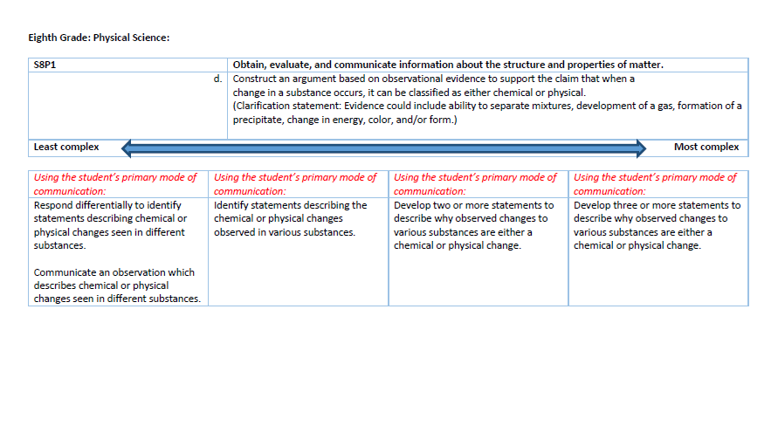
The task shown on the next two slides aligns to this extension.
Notes:
The task represented on the next two slides asks the student to identify statements describing chemical and physical changes. Students who are able to perform more complex tasks could be asked to develop their own statement(s) to describe why changes they have observed are with chemical or physical changes. Students may write their own statements or choose from a phrase bank. Examples of statements which describe chemical change include forms a new substance (bake batter to make cookies), cannot be reversed (rotting food), and reaction produces heat or light (burning wood). Examples of statements which describe physical change include substance stays the same (broken glass is still glass) and is reversible (ice cubes become water but the water can be frozen again).

Slide 60
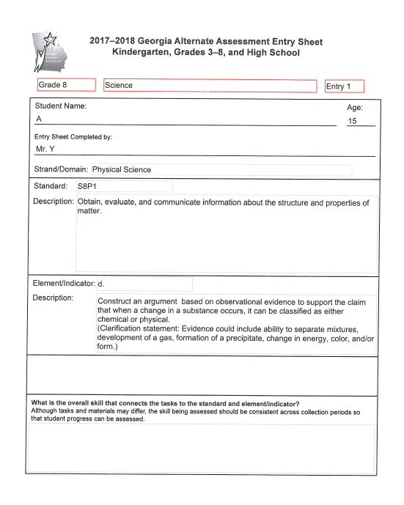
Example
Science (Physical Science)
Grade 8
Students may “construct an argument” by identifying statements describing the chemical or physical changes observed in various substances.

Slide 61
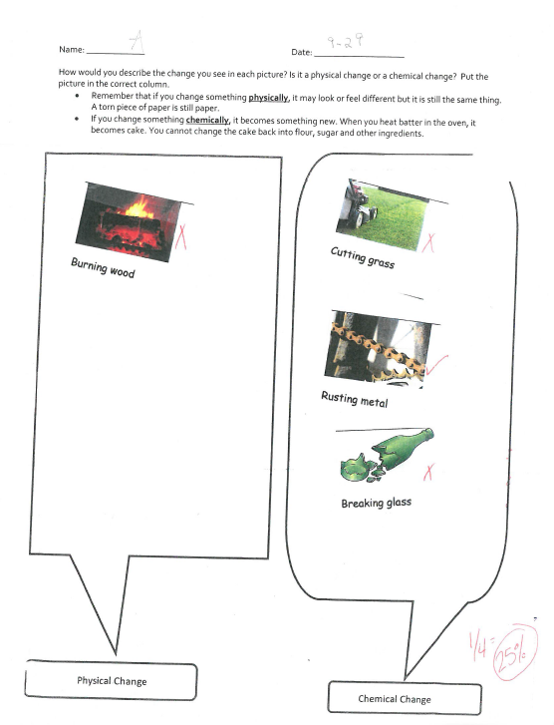
Physical Science –
Grade 8 (continued)
The student was asked to describe physical and chemical changes by placing pictures in the appropriate columns.
Notes:
The student is identifying examples of physical and chemical changes.

Slide 62
Grade HS Science 1 Example
Biology
 | SB5 Obtain, evaluate and communicate information to assess the interdependence of all organisms on one another and their environment.
 | Develop and use models to analyze the cycling of matter and flow of energy within ecosystems through the processes of photosynthesis and respiration. Arranging components of a food web according to energy flow. Comparing the quantity of energy in the steps of an energy pyramid. Explaining the need for cycling of major biochemical elements (C, O, N, P, and H).

Slide 63
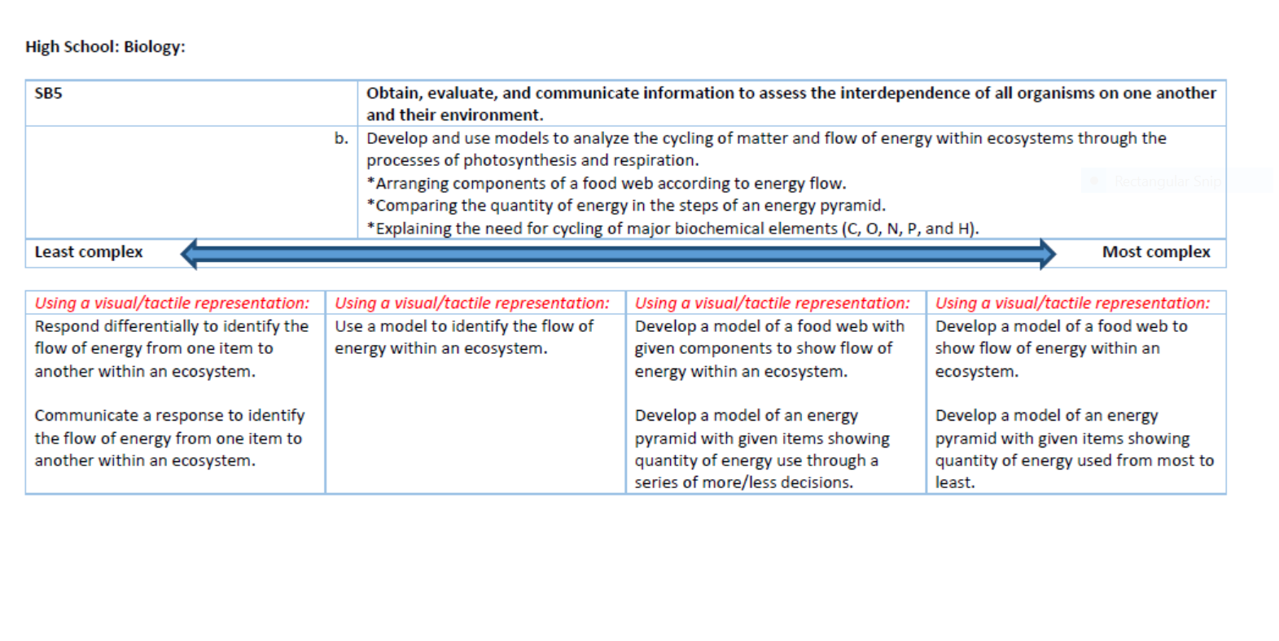
The task shown on the next two slides aligns to this extension.
Notes:
The student’s task on the next two slides involves identifying the flow of energy in a food web, one of the least complex tasks which aligns to this content standard and element. Students who are able to perform more difficult tasks could be asked to use models to identify the flow of energy. The most complex tasks which align to this content standard and element will ask students to develop their own models of food webs or energy pyramids.

Slide 64
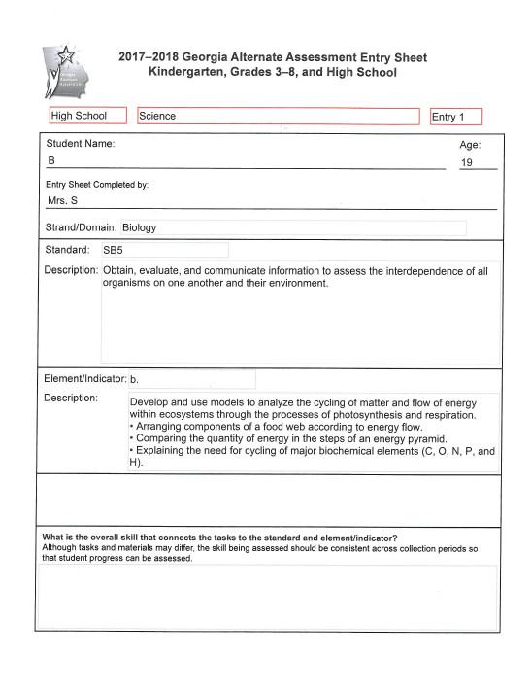
Example
Science 1 (Biology)
Grade HS
A student may communicate a response to identify the flow of energy within an ecosystem. More complex tasks would involve the student in using a model or developing a model.

Slide 65
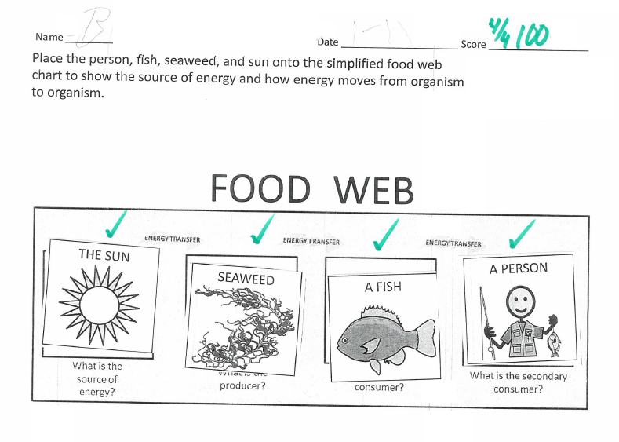
Biology – Grade HS (continued)
The student sequenced drawings of the sun, seaweed, a fish and a person to represent a food web.
Notes:
The student is identifying the flow of energy in a food web.

Slide 66
Grade HS Science 2 Example
Physical Science
 | SPS6 Obtain, evaluate and communicate information to explain the properties of solutions.
 | b. Plan and carry out investigations to determine how temperature, surface area, and agitation affect the rate solutes dissolve in a specific solvent.

Slide 67
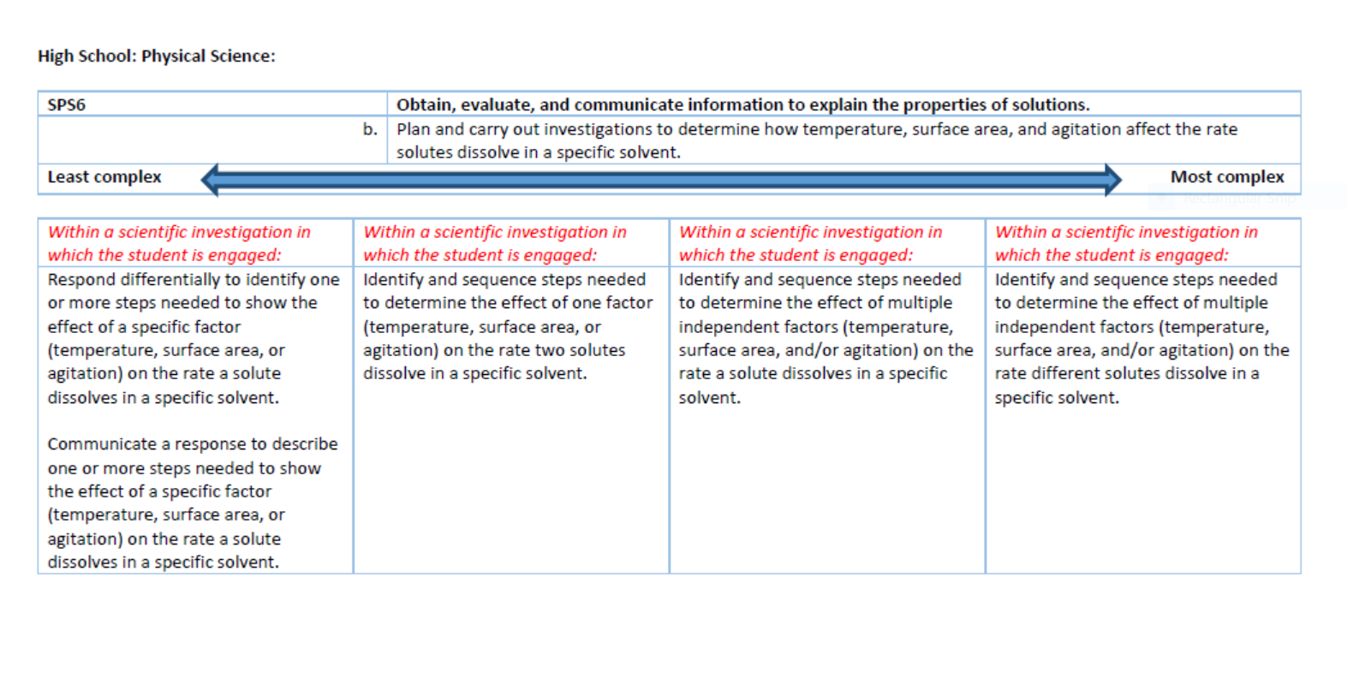
The task shown on the next two slides aligns to this extension.
Notes:
The student whose task is represented on the next two slides was asked to determine the effect of just one factor (temperature) on the rate of dissolution. Students who are able to perform more complex tasks could be asked to determine the effect of multiple independent factors (temperature, surface area and/or agitation) on the rate of dissolution.

Slide 68
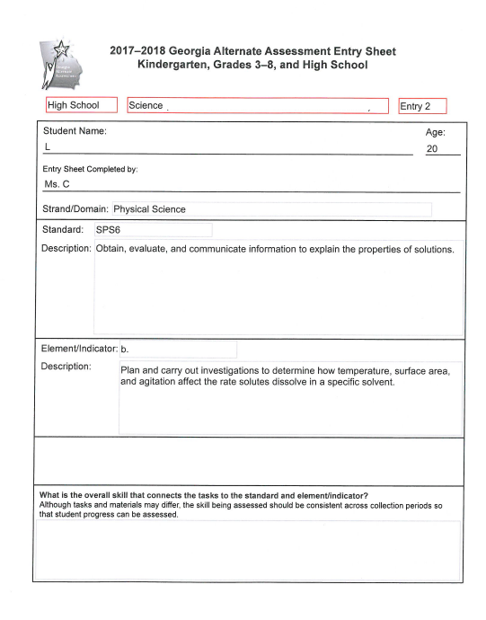
Sample Task
Science 2 (Physical Science)
Grade HS
The student’s task involved observing the effect of one factor (temperature) on the rate that a solute dissolves in a solvent.

Slide 69
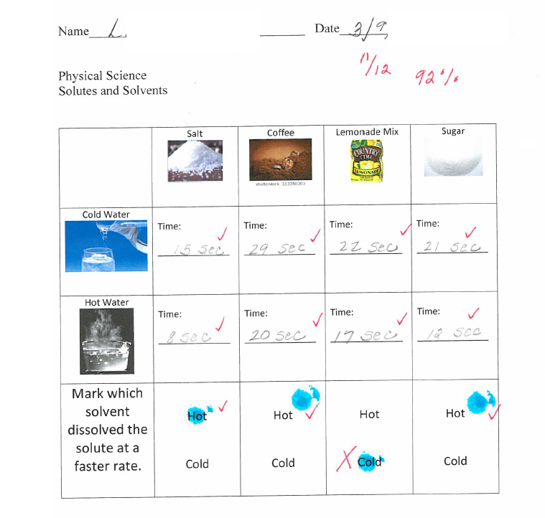
Science 2
Grade HS (continued)
The teacher’s annotation says that she and a general education peer worked with the student to perform each step of the experiment in the correct sequence. The general education peer held the stopwatch and the student observed how much time elapsed in each of the eight trials. The peer scribed the student’s verbal responses. The student used a blue marker to indicate which of the two solvents (cold water or hot water) caused each solute to dissolve faster.
Notes:
A task like this one requires a great deal of preliminary work by the teacher to set up the task and to be sure all of the materials are ready for the student. The additional work allows a student with very limited fine motor skills to perform a fairly complicated task. The general education peer also assisted by scribing the student’s answers, but the teacher’s annotation makes it clear that the student himself answered the questions. He just needed the help of someone who could record his answers.

Slide 70
Grade 5 Social Studies Example
Historical Understandings
 | SS5H4 Explain America’s involvement in World War II.
 | d. Identify Roosevelt, Stalin, Churchill, Hirohito, Truman, Mussolini and Hitler.

Slide 71
The task shown on the next two slides aligns to this extension.

Slide 72
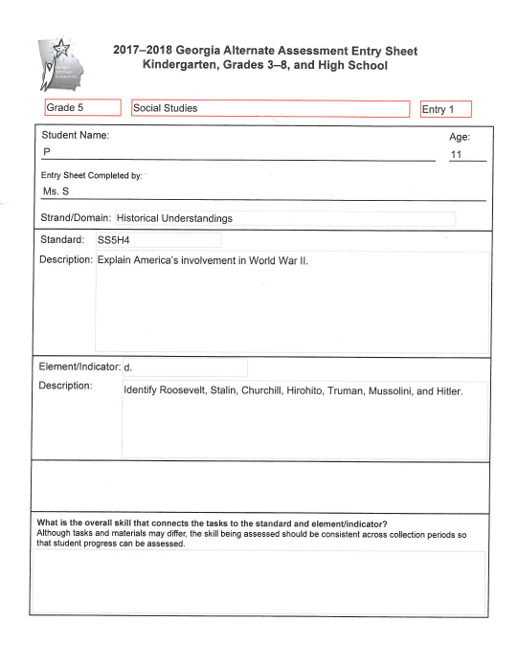
Example
Social Studies
Grade 5
Tasks which align to this standard and element will involve identifying at least one of the historic figures mentioned in the element by matching or describing at least one fact about the individual(s).

Slide 73
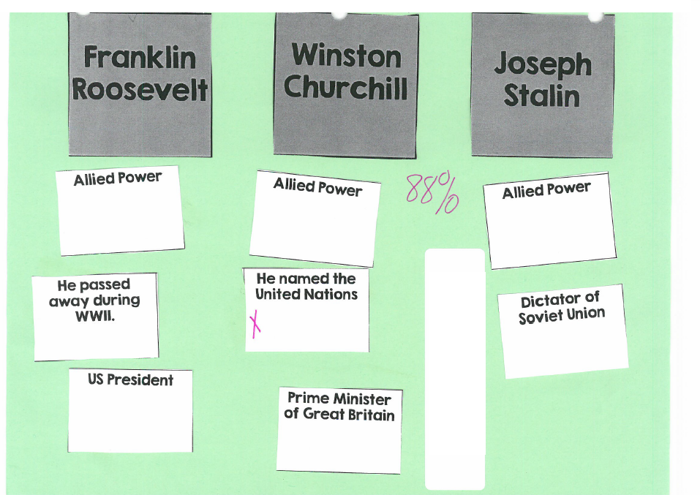
Social Studies – Grade 5 (continued)
The student matched seven of eight cards correctly. She did choose one of the distractors.
Notes:
The teacher chose to assess the student on her knowledge of three of the individuals mentioned in the element. Had the teacher chosen just one of the men (say, Franklin Roosevelt) the task would still have been aligned. It is not necessary for the student’s work to encompass every aspect of an element or indicator.

Slide 74
Grade 8 Social Studies Example
Economic Understandings
 | SS8E2 Evaluate the influence of Georgia-based businesses on the state’s economic growth and development.
 | c. Evaluate the economic impact of various industries in Georgia including agricultural, entertainment, manufacturing, service, and technology.

Slide 75
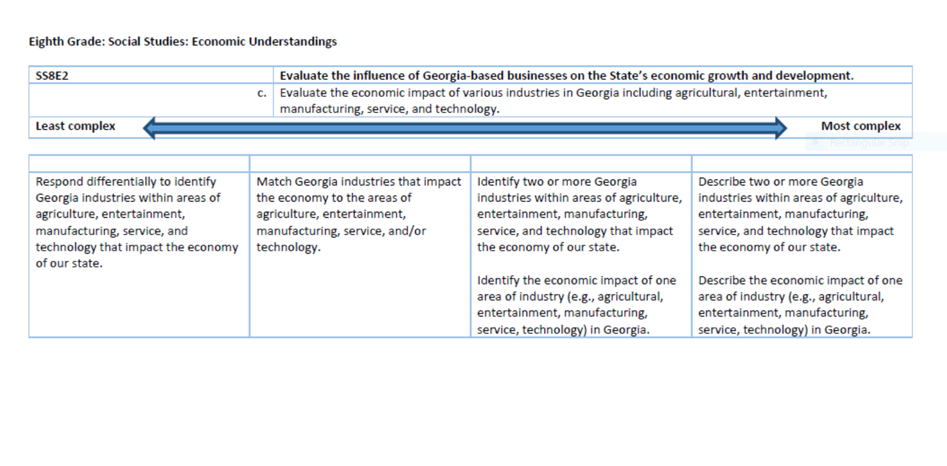
The task shown on the next two slides aligns to this extension.

Slide 76
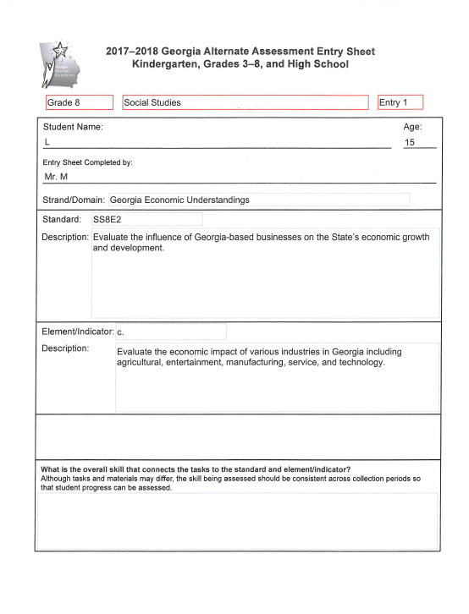
Example
Social Studies
Grade 8
Tasks which align to this standard and element will involve matching, identifying or describing Georgia industries and their economic effects on the state of Georgia.

Slide 77
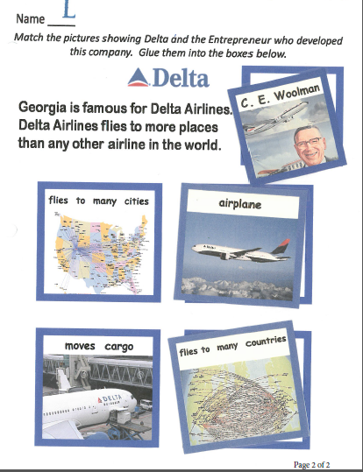
Social Studies – Grade 8 (continued)
Notes:
The teacher reduced the difficulty of the task by using color-coding.

Slide 78
Grade HS Social Studies 1 Example
United States History
 | SSUSH16 Investigate how political, economic, and cultural developments after WW I led to a shared national identity.
 | c. Examine how mass production and advertising led to increasing consumerism, including Henry Ford and the automobile.

Slide 79
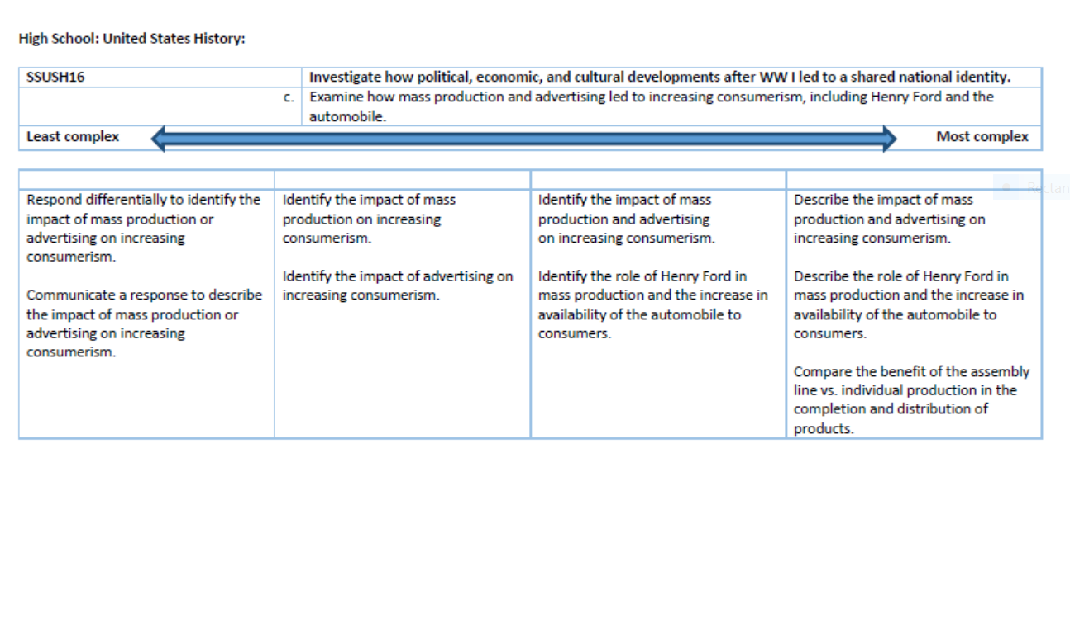
The task shown on the next two slides aligns to this extension.

Slide 80
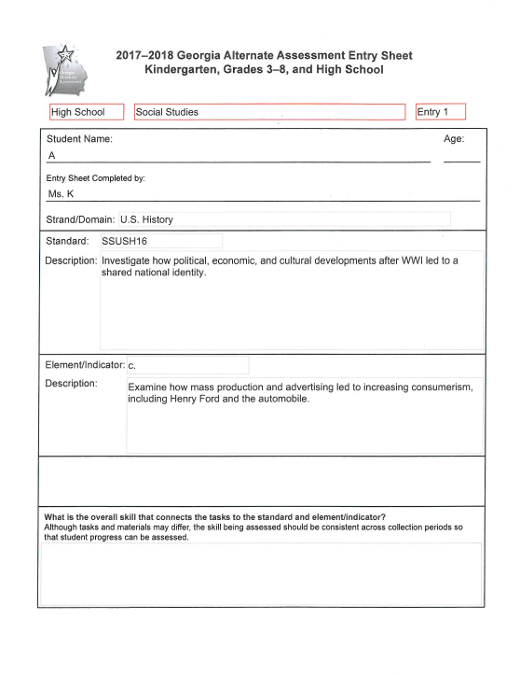
Example
Social Studies 1
U.S. History
Grade HS
The student’s task is to identify changes brought about in the United States by the use of the automobile.

Slide 82
Grade HS Social Studies 2 Example
Economics
 | SSEPF6 Describe how the earnings of workers are determined in the marketplace.
 | a. Identify skills that are required to be successful in the workplace, including positive work ethics, punctuality, time management, teamwork, communication skills, and good character..

Slide 83
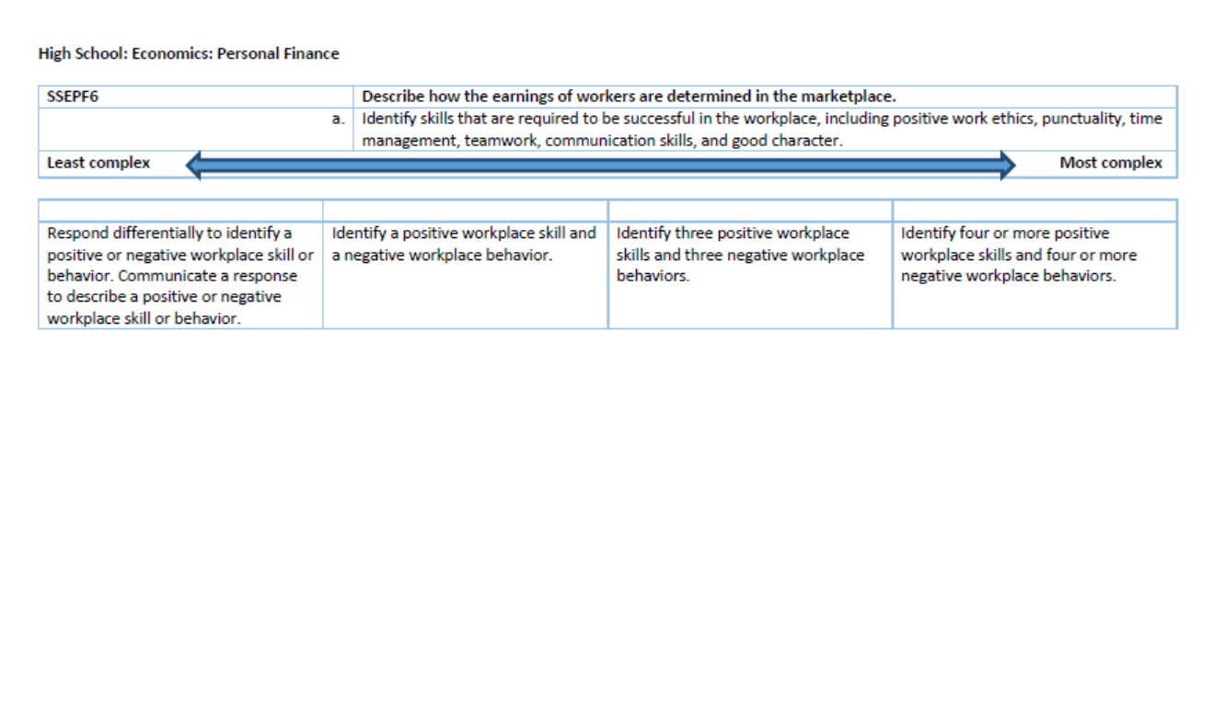
The task shown on the next two slides aligns to this extension.

Slide 84
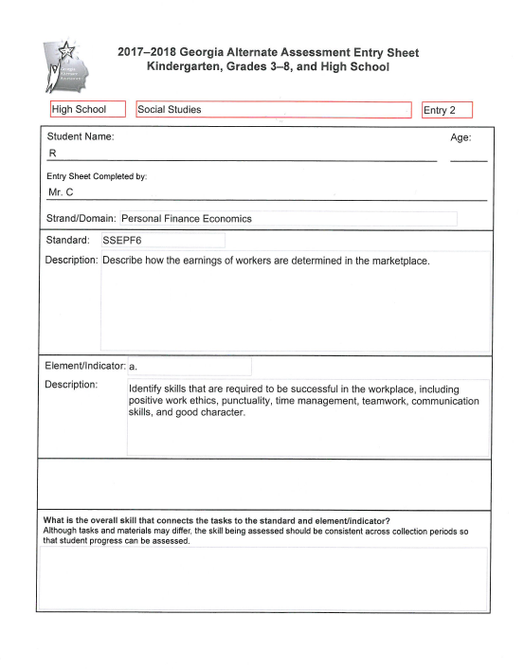
Example
Social Studies 2
Economics
Grade HS
The student was asked to describe positive behaviors in the workplace.

Slide 85
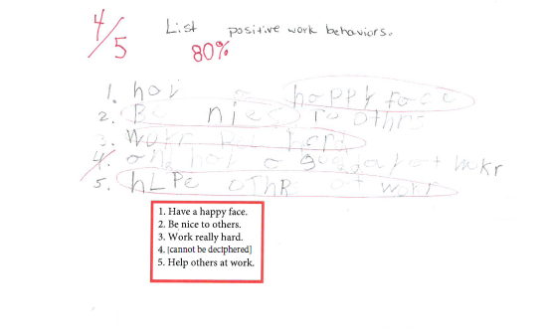
The student’s handwriting is very faint, so his answers were transcribed and highlighted in the red box on the worksheet. Misspelled words and errors in word order have been corrected. The student was asked to write five phrases to describe positive work behaviors.
Notes:
The teacher could have reduced the difficulty of the task by asking the student to use sentence strips or picture icons to describe positive behaviors in the workplace.

Slide 86
Evidence Requirements
Each type of evidence, whether Primary or Secondary, has specific requirements that must be met in order to be scorable.
Explanations and samples of each type of evidence are included in the 2017-2018 GAA Examiner’s Manual.
It can be helpful to share proofreading and reviewing responsibilities among several individuals.

Slide 87
Evidence Requirements
Recommendations as to when and how to use each type of evidence can be found on pages 14-31 of the Examiner’s Manual.
Use the GAA Evidence Checklist in order to familiarize test examiners and portfolio reviewers with the conditions that must be met for each type of evidence. It can be found on pages 52-55 of the manual.

Slide 88
The Importance of Portfolio Review
When reviewing evidence documentation, the teachers and portfolio reviewers must ask themselves the following questions:
What, specifically, was the student asked to do as it aligns to the standard and indicator?
What were the actual questions/actions asked of the student?
What were the student’s answers?
Were the answers/responses correct? Has evaluation of student performance by the teacher been clearly documented?
What were the type and frequency of prompting required for the student to successfully complete the task?
Notes:
Colleagues who are not especially familiar with your students and their work can be helpful in identifying annotations and other parts of students’ portfolios which may be difficult for scorers to understand.

Slide 89
The Importance of Portfolio Review
Task descriptions should be clear and should describe how the task connects to the intent of the standard and element/indicator.
Observation and Interview Forms should describe the specific responses and level of performance of each individual student.
If conducting a group activity, be specific about what was asked of the individual student, how and in what manner he/she responded, and whether his/her responses were correct.
Copying group work from the board will not satisfy GAA requirements.

Slide 90
Contact Information
Questions About the Administration of the GAA
GaDOE Assessment Division
(800) 634-4106
Deborah Houston, Assessment Specialist
(404) 657-0251
dhouston@doe.k12.ga.us

Slide 91
Contact Information
For information about:
Access to the state-mandated content standards for students with significant cognitive disabilities
Resource Board
TEACHER’S RESOURCE LINK (TRL)
Crystal Callaway, Division for Special Education Services and Supports
(404) 657-9969
ccallaway@doe.k12.ga.us

Slide 92
Contact Information
Questions about materials, distribution, or collection:
Questar’s GAA Customer Service
(866) 997-0698
GA@QuestarAI.com

Slide 93
Webinar Survey
http://gadoe.org/surveys/AsAc-H8PBVZM

