Slide 1
Refining Georgia’s Accountability Platform to Reflect School Performance
10th Annual State of Education in Georgia Conference
The University of Georgia
September 21, 2017

Slide 2
Objectives
Provide an overview of ESSA and the development of Georgia’s state plan for ESSA
Discuss the redesigned CCRPI under ESSA
Address your questions and areas of interest as they arise

Slide 3
ESSA
The development of Georgia’s state plan

Slide 4
Elementary and Secondary Education Act (ESEA)
Signed into law in 1965 to ensure educational opportunity for every child and provide support for schools
Main federal law governing public education
Reauthorized in different versions:
No Child Left Behind (2001)
Every Student Succeeds Act (2015)

Slide 5
Our Opportunity
ESSA is an opportunity for Georgia – Georgians are expecting more from their education system
Our Mission
Offering a holistic education to each and every child in the state.
Our Vision
Educating Georgia’s Future by graduating students who are ready to learn, ready to live, and ready to lead.

Slide 6
Stakeholder Feedback
A plan for Georgians, by Georgians
8 stakeholder feedback sessions across the state; social media outreach; email feedback; survey responses
Advisory councils – superintendents, parents, teachers, and students
Civil rights organizations, business & industry
State agencies, organizations, nonprofits, and stakeholders were at the table
Meetings: RESAs, conferences, Lt. Gov Business & Industry Summit, Metro Chamber, GPEE, etc.

Slide 7
State Advisory Committee
40 members
State agencies, organizations, students, parents, teachers, superintendents, advocacy groups
Facilitated by the Carl Vinson Institute of the University of Georgia
Charge
Develop areas of focus and guiding principles
Receive and discuss stakeholder feedback
Review the draft of Georgia’s ESSA State Plan
Provide feedback regarding the draft of Georgia’s ESSA State Plan

Slide 8
Working Committees
6 working committees
Accountability
Assessment
Federal Programs to Support School Improvement
Education of the Whole Child
Educator & Leader Development
Communications
20 members
5 GaDOE staff; 15 stakeholders
Scope
Develop feedback questions for stakeholders
Discuss stakeholder input, USED’s regulations and guidance, areas of focus, and assigned portions of ESSA
Coordinate with other working committees to write Georgia’s draft state plan

Slide 9
Accountability Working Committee
Chairs:
Allison Timberlake, Ph.D.
Director of Accountability
Molly Howard, Ph.D.
Superintendent of Jefferson County School District
Members of the committee included:
3 Superintendents or Assistant Superintendents;
6 District Administrators – Assessment, Accountability, and/or Data; School Improvement; Special Education; Instruction; and STEM;
3 Principals or Assistant Principals;
1 Teachers;
1 RESA Representative;
1 GOSA Representative; and
5 GaDOE staff focusing on assessment and accountability; research and policy; data collections and privacy; special education; and career, technical, and agricultural education

Slide 10
Georgia’s Plan
Georgia’s draft ESSA plan was posted in June 2017 for a 30-day public comment period
Working committees reviewed received feedback and recommended changes
Georgia’s revised draft ESSA plan was submitted to Governor Nathan Deal in August 2017 for a 30-day review period
Georgia’ final ESSA plan was submitted to the U.S. Department of Education on September 18, 2017
USED has 120 days to review and approve Georgia’s plan

Slide 11
Accountability
Redesigning the CCRPI

Slide 12
Background
Georgia’s College and Career Ready Performance Index (CCRPI) was first implemented in 2012 as an alternative to No Child Left Behind’s Adequate Yearly Progress (AYP).
Georgia’s Elementary and Secondary Education Act (ESEA) Waiver provided the opportunity to implement a new accountability system that included multiple measures, provided a more holistic picture of school performance, and addressed several shortcomings of the AYP system.
While ESSA’s new accountability provisions represent a substantial departure from No Child Left Behind’s AYP, they are more closely aligned with the CCRPI system already in place in Georgia.
With ESSA, Georgia seized the opportunity to reflect on six years of CCRPI implementation, and, in consultation with stakeholders across the state, to revise CCRPI to expand upon its successes and address its shortcomings.

Slide 13
Role of Accountability
Accountability should play a supporting role in assisting schools, districts, and the state to reach its mission of offering a holistic education to every child and preparing them for college, career, and life.
Accountability should not be the driving force behind decisions about educating children.
The purpose of CCRPI is to provide an objective measure of the extent to which schools, districts, and the state are succeeding in providing high-quality opportunities and outcomes for students that can be used for communication and continuous improvement.

Slide 14
Redesigned CCRPI
Content Mastery
Are students achieving at the level necessary to be prepared for the next grade, college, or career?
Progress
How much growth are students demonstrating relative to academically-similar students?
CCRPI
Score
Closing
Gaps
Are all students and all student subgroups making improvements in achievement rates?
Readiness
Are students participating in activities preparing them for and demonstrating readiness for the next level, college, or career?
Graduation Rate
Are students graduating from high school with a regular diploma in four or five years?
Draft 2018 CCRPI based on ESSA Plan submitted to USED for review.

Slide 15
Redesigned CCRPI
Content Mastery
Progress
Closing
Gaps
Readiness
Graduation Rate
Content Mastery
Progress
Closing
Gaps
Readiness
Graduation Rate
Draft 2018 CCRPI based on ESSA Plan submitted to USED for review.

Slide 16
Redesigned CCRPI
Content Mastery
Progress
Closing
Gaps
Readiness
Graduation Rate
Achievement scores in English Language Arts, mathematics, science, and social studies
Utilize weights based on achievement level, where Beginning Learners earn 0 points, Developing Learners earn 0.5 points, Proficient Learners earn 1.0 point, and Distinguished Learners earn 1.5 points
Incentivizes moving all students to the next level
Content areas for all three grade bands will be weighted according to the number of state tests administered within each grade band
Draft 2018 CCRPI based on ESSA Plan submitted to USED for review.

Slide 17
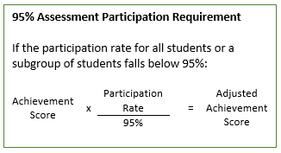
Redesigned CCRPI
Content Mastery
Progress
Closing
Gaps
Readiness
Graduation Rate
If the participation rate for all students or a subgroup of students falls below 95%, the achievement score for that group of students will be multiplied by the actual participation rate divided by 95%.
This ensures the adjustment is proportional to the extent to which the 95% participation rate was not attained.
The adjusted achievement score will be utilized in CCRPI calculations.
Draft 2018 CCRPI based on ESSA Plan submitted to USED for review.

Slide 18
Redesigned CCRPI
Content Mastery
Progress
Closing
Gaps
Readiness
Graduation Rate
Progress scores in English/language arts, mathematics, and progress towards English language proficiency (EL students)
Utilize weights based on level of growth; incentivizes moving all students to the next level
ELA and mathematics will receive 90% of the weight, and progress towards English language proficiency will receive 10% of the weight
ELA and Mathematics SGPs
EL Progress Towards Proficiency – ACCESS for ELLs
SGP Range | Point Value
1-29 | 0
30-40 | .5
41-65 | 1
66-99 | 1.5
Performance Band Movement | Point Value
No positive movement | 0
Moved less than one band | .5
Moved one band | 1
Moved more than one band | 1.5
Draft 2018 CCRPI based on ESSA Plan submitted to USED for review.

Slide 19
Redesigned CCRPI
Content Mastery
Progress
Closing
Gaps
Readiness
Graduation Rate
Based on new CCRPI improvement targets, which are represented by improvement flags
School- and district-level targets based on 3% of the gap between baseline achievement rates (2017) and 100%
For each achievement improvement target, 1 point is earned when the target is met (green flag), 0.5 points are earned when progress is made but the target is not met (yellow flag), and 0 points are earned when performance does not improve (red flag).
ED, EL, and SWD subgroups can earn 1.5 points when a 6% improvement target is met.
Sets an expectation of improvement or maintenance of high achievement for all students; provides an opportunity for schools to demonstrate improvements in performance; and provides better alignment between CCRPI and improvement flags
Draft 2018 CCRPI based on ESSA Plan submitted to USED for review.

Slide 20
Redesigned CCRPI
Content Mastery
Progress
Closing
Gaps
Readiness
Graduation Rate
Elementary and middle school readiness focus on foundational skills, such as literacy, attendance, and enrichment beyond the traditional core.
In high school, literacy and attendance continue to be critical indicators of postsecondary readiness. Students should also participate in accelerated enrollment opportunities – academic or technical; complete a pathway; and demonstrate college or career readiness.
Readiness indicators will be weighted equally.
DEFINING READINESS
Early grades: Foundational skills and concepts
Later grades: Multiple paths to succeed by expanding opportunities and personalizing learning
Graduates are college and/or career ready
Life-long learning
Draft 2018 CCRPI based on ESSA Plan submitted to USED for review.

Slide 21
Redesigned CCRPI
Content Mastery
Progress
Closing
Gaps
Readiness
Graduation Rate
CCRPI Readiness Indicators
Elementary School
Literacy: Percent of students in grades 3-5 demonstrating reading comprehension at or above the midpoint of the College & Career Ready “Stretch” Lexile Band for each grade level. Student Attendance: Percent of students in grades K-5 absent less than 10% of enrolled days. Beyond the Core: Percent of students earning a passing score in fine arts or world language.
Middle School
Literacy: Percent of students in grades 6-8 demonstrating reading comprehension at or above the midpoint of the College & Career Ready “Stretch” Lexile Band for each grade level. Student Attendance: Percent of students in grades 6-8 absent less than 10% of enrolled days. Beyond the Core: Percent of students earning a passing score in fine arts, world language, physical education/health, or career exploratory.
Draft 2018 CCRPI based on ESSA Plan submitted to USED for review.

Slide 22
Redesigned CCRPI
Content Mastery
Progress
Closing
Gaps
Readiness
Graduation Rate
CCRPI Readiness Indicators
High School
Literacy: Percent of students in 9th Grade Literature and American Literature demonstrating reading comprehension at or above the midpoint of the College & Career Ready “Stretch” Lexile Band for each course. Student Attendance: Percent of students in grades 9-12 absent less than 10% of enrolled days. Accelerated Enrollment: Percent of graduates earning credit for accelerated enrollment via Dual Enrollment, Advanced Placement, or International Baccalaureate courses. Pathway Completion: Percent of graduates completing an advanced academic, CTAE, fine arts, or world language pathway. College and Career Readiness: Percent of graduates entering TCSG/USG without needing remediation; achieving a readiness score on the ACT, SAT, two or more AP exams, or two or more IB exams; passing a pathway-aligned end of pathway assessment (EOPA) resulting in a national or state credential; or completing a work-based learning program.
Draft 2018 CCRPI based on ESSA Plan submitted to USED for review.

Slide 23
Redesigned CCRPI
Content Mastery
Progress
Closing
Gaps
Readiness
Graduation Rate
High schools only
Includes both the four-year and five-year adjusted cohort graduation rate
Emphasizes graduating in four years while placing value on continuing to work with and graduate students who need more time
The four-year graduation rate will be worth 2/3 of the points and the five-year graduation rate will be worth 1/3 of the points
Draft 2018 CCRPI based on ESSA Plan submitted to USED for review.

Slide 24
Balancing College and Career Readiness
In addition to content mastery and high school graduation, CCRPI includes multiple measures of college and career readiness and values multiple pathways to success.
Literacy
Student Attendance
Accelerated Enrollment
Pathway Completion
College and Career Readiness
Entering TCSG/USG without remediation
ACT, SAT, AP, IB
National or state credential (end of pathway assessment)
Work-based learning
College and Career Readiness
Draft 2018 CCRPI based on ESSA Plan submitted to USED for review.

Slide 25
Scoring and Reporting
Consistent with state law (O.C.G.A. § 20-14-33), the overall CCRPI score will be reported on a 0-100 scale.
To increase ease of understanding and interpretation, each CCRPI indicator and component will also be reported on a 0-100 scale, with additional points possible in Content Mastery, Progress, and Closing Gaps.
Components will be weighted and combined according to the weights defined in the table to the right to determine the overall CCRPI score.
 | Elementary | Middle | High
Content Mastery | 30% | 30% | 30%
Progress | 35% | 35% | 30%
Closing Gaps | 15% | 15% | 10%
Readiness | 20% | 20% | 15%
Graduation Rate | -- | -- | 15%
Draft 2018 CCRPI based on ESSA Plan submitted to USED for review.

Slide 26
2018 CCRPI
Content Mastery
English Language Arts achievement
Mathematics achievement
Science achievement
Social studies achievement
Progress
English Language Arts growth
Mathematics growth
Progress towards English language proficiency (EL students)
CCRPI
Score
Closing
Gaps
Meeting achievement improvement targets
Elementary: Literacy, student attendance, beyond the core
Middle: Literacy, student attendance, beyond the core
High: Literacy, student attendance, accelerated enrollment, pathway completion, college and career readiness
Readiness
Graduation Rate
High School Only
4-year adjusted cohort graduation rate
5-year adjusted cohort graduation rate
Draft 2018 CCRPI based on ESSA Plan submitted to USED for review.

Slide 27
Highlights of the Redesigned CCRPI
The redesigned CCRPI is simplified, streamlined, and reflects stakeholder feedback and the recommendations of the Accountability Working Committee.
The index focuses on the opportunities and outcomes expected of all students.
Maximizes local flexibility to determine the programs and policies that best meet the needs of students.
Schools should not feel pressured to “chase points” by adopting a particular program or policy because it earns extra points on CCRPI.
The index includes multiple measures.
Different ways of looking at student performance – content mastery, student growth, improvement – and non-test based indicators of opportunities and outcomes

Slide 28
Highlights of the Redesigned CCRPI
The redesigned CCRPI values educating the whole child.
Exposure to a well rounded curriculum (Beyond the Core)
Engagement/climate and skills for success (Student Attendance)
Relevance (Pathway Completion)
Accelerated enrollment opportunities (AP, IB, DE)
Postsecondary readiness (College and Career Readiness – multiple opportunities to demonstrate readiness)
The index is designed to award points where possible as opposed to denying points when expectations are not met.
Partial points when progress is made but targets are not met
Extra points when targets are exceeded
Progress and Closing Gaps capture growth and improvement

Slide 29
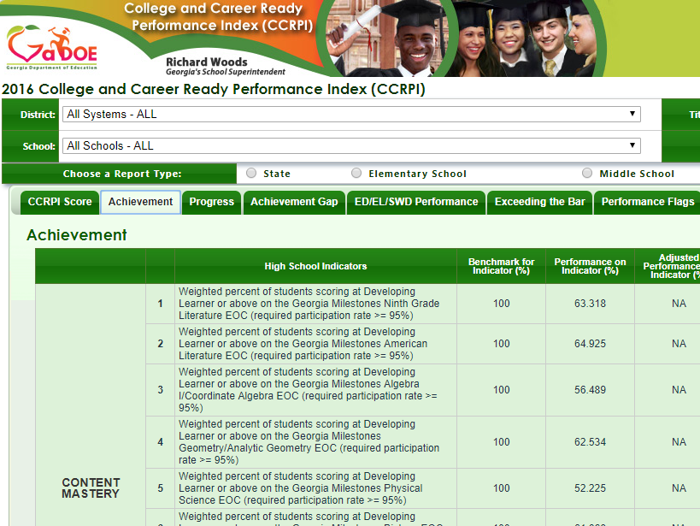
Designing New CCRPI Reports
Prior to and throughout the ESSA process, we received feedback that the current CCRPI online reports are too complicated, difficult to navigate, and do not provide enough context.
While the redesigned CCRPI itself is simplified and streamlined, new online reports are needed to improve communication and utilization of data.

Slide 30
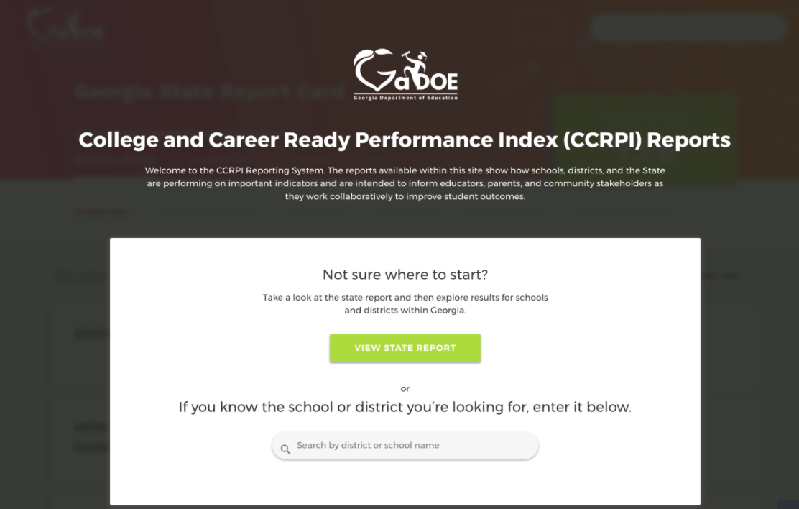
Designing New CCRPI Reports
We are pleased to present a prototype of the new CCRPI online reports.
We need your feedback to finalize the design to ensure it meets your needs.
Please watch a video overview, tour the prototype, and submit your feedback at accountability.gadoe.org.

Slide 31
Moving Forward
While the redesigned CCRPI will be a significantly improved accountability system for Georgia, the most critical piece is changing the conversation about student performance in our state.
CCRPI can shine a light on the great work schools are doing and areas in need of improvement, but it must be used as a tool by communities and other stakeholders to engage in meaningful conversations around how to improve student opportunities, outcomes, and preparedness for college, career, and life.

Slide 32
More Information
Information about the 2018 CCRPI can be found in Georgia’s ESSA Plan that is being submitted to USED on September 18, 2017
gadoe.org/essa
USED has 120 days after submission to review/approve plan.
Additional documentation is on the accountability website
accountability.gadoe.org
Redesigned CCRPI Overview; Redesigned CCRPI Indicators; CCRPI Key Changes; CCRPI Side-by-Side

Slide 33
Accountability Team
Allison Timberlake, Ph.D., Director of Accountability
atimberlake@doe.k12.ga.us or (404) 463-6666
Kris Floyd, Accountability Specialist
kfloyd@doe.k12.ga.us or (404) 463-1175
Nicholas Handville, Accountability Specialist
nhandville@doe.k12.ga.us or (404) 657-4122
August Ogletree, Ph.D., Accountability Research Specialist
aogletree@doe.k12.ga.us or (404) 463-6675
Qi Qin, Assessment Specialist, Growth Model
qqin@doe.k12.ga.us or (404) 657-0311
Tianna Sims, Ph.D., Accountability Research Specialist
tsims@doe.k12.ga.us or (404) 463-1166
Paula Swartzberg, Program Manager
pswartzberg@doe.k12.ga.us or (404) 463-1539
Melissa Fincher, Ph.D., Deputy Superintendent for Assessment and Accountability
mfincher@doe.k12.ga.us or (404) 651-9405
GaDOE Customer Service Survey: http://gadoe.org/surveys/AsAc-H8PBVZM

