Slide 1
The How To for
Specific, Clear, and Concise
Documentation
Module A
Georgia Alternate Assessment
Making a Do out of a Don’t

Slide 2
Welcome to Module A
The How To of Documentation
This session will begin at 1:00 p.m.
The PowerPoint is located in the GAA Presentations Portlet at this location:
  http://www.gadoe.org/Curriculum-Instruction-and-Assessment/Assessment/Pages/GAA-Presentations.aspx
While you are waiting, please do the following:
Use the Audio Setup Wizard in the Tools Menu to configure and test your audio settings before the presentation begins.
Confirm your connection speed by going to:
  Tools – Preferences – Connection speed
To eliminate interference from background noise in your area, leave the Talk Button on mute.
Due to the number of participants, we request that questions are submitted via the Chat Box.
Logon with your name and the name of your district beside it (e. g., Deborah Houston – Elbert County). If you have already logged on, place your name and district name in the Chat Box.

Slide 3
2012-2013 GAA
This slide presentation is designed to inform
  designated trainers
  teachers who administer the GAA
  portfolio reviewers
Companion presentations will be available for more in-depth training on additional topics that will assist test administrators.
All presentations will be posted on the GaDOE website.
3

Slide 4
2012-2013 GAA
This presentation serves as an introductory component for training system staff.
  Hard copy of this PowerPoint presentation should be provided to everyone who participates in the webinar as well as to attendees of the system/school training sessions.
Reading and understanding the GAA Examiner’s Manual 2012-2013 and the materials provided through the webinar trainings is necessary to understand the policies and procedures required for the GAA.
  Manuals should be brought to all training sessions.
Notes:
Manuals are provided for each teacher administering the GAA. If you have not received your own copy of the manual, please see your test coordinator immediately.

Slide 5
In this Presentation
Tips for effective documentation
Documentation Dos and Don’ts
Examples: Making a Do out of a Don’t
5

Slide 6
How to Document Effectively
Complete and thorough documentation of evidence is critical to the student receiving the most appropriate score!
  Incomplete, ineffective, or generic documentation can result in lower scores or in the entry being Nonscorable.
  Documentation should be clear and concise.
Less can be more; do not include unnecessary information.
Review the documentation–without explanation, will someone else be able to understand what the student was asked to do and the connection to the standard and element/indicator?
Notes:
Documentation that is unclear, contradictory, or superfluous can result in lower scores for the student–or in the entry being nonscorable

Slide 7
How to Document Effectively
When annotating evidence, effective documentation should answer the following 7 questions:
  What, specifically, was the student asked to do as it aligns to the standard and element/indicator?
  What were the actual questions/actions asked of the student?
  What were the student’s answers? How did he/she respond?
  Were the answers/responses correct? Has evaluation of student performance by the teacher been clearly documented?

Slide 8
How to Document Effectively
  What were the type and frequency of prompting required for the student to complete the task?
  What were the nature of interactions with instructional personnel, peers with or without disabilities, and/or community members as they occurred during the assessment task?
  What was the setting in which the task was completed?
Notes:
If any of this information is missing, incomplete, or contradictory to other documentation included with the entry, the evidence could contribute to a lower score or result in the entry being nonscorable.
This review must be done for each of the four assessment tasks.

Slide 9
How to Document Effectively
The assessment task should be designed to demonstrate what the student knows and can do in relation to the standard.
  The task description should focus on the standards-based skill being addressed.
  Be specific. The connection (alignment) between the task and the standard should be at the core of the description.

Slide 10
How to Document Effectively
  The complexity of the task cannot be determined without knowing the nature of the of the questions/actions asked of the student. The actual questions or actions student should be provided.
  What kind of question– multiple choice, fill-in-the-blank, ordering sentence strips, short answer…?
  How difficult is the question–matching vs. identifying vs. describing vs. interpreting…?
  How many questions/steps/actions?
Notes:
As we will discuss later in the module on scoring, knowing the complexity of the task is very important to being able to give the student the appropriate credit when considering achievement/progress.

Slide 11
How to Document Effectively
Knowing how the student responded and the depth of knowledge demonstrated by the answer given is also necessary to understanding both the accuracy and the complexity of the task.
  What level of understanding has the student demonstrated– one word answer vs. description; partial vs. thorough…?
Notes:
Depending on how the question has been presented to the student and what answer choices were provided- what has the student shown?

Slide 12
How to Document Effectively
The correctness of the student’s response(s) must be documented in order for the entry to be scorable.
  The criteria on which the student is being graded should be clear.
  For each of the responses provided by the student, record whether they were correct or incorrect.
  Grade the student work; record the number and/or percentage of correct answers provided by the student.
  Documentation of accuracy and prompting should be done separately.

Slide 13
How to Document Effectively
Document the student’s level of independence. What type and frequency of prompting were required for the student to respond?
Type
Frequency
Physical
Model
Gestural
Verbal
Independent
Continuous
Frequent
Limited
Independent
Notes:
If no prompting was required, the student responded independently.

Slide 14
How to Document Effectively
Documentation of interactions–In order to demonstrate Generalization, annotation of interactions must describe the nature of the interaction.
  the interaction must occur during and related to the performance of the task
  do not provide a list of all the people with whom the student has interacted without describing how that interaction occurred during the assessment task
Notes:
When documenting interactions for Listening and Speaking, it is required that the reciprocal interaction-who said what to whom- in reference to the task be documented.
Differentiate between prompting and interaction when documenting for the Listening and Speaking strand/domain.

Slide 15
How to Document Effectively
Documentation of settings–in order to demonstrate generalization, the setting in which the student completed the assessment task must be recorded.
  The setting in which the task was completed should be purposeful to the task.
  The assessment task must be completed in the documented setting in order for it to be counted for scoring Generalization.
Notes:
If using and acronym or terminology may not be universally understood, it is a good idea to define it. (e.g., If TGC means Third Grade Classroom, make sure you define that so that the student receives credit for the new setting).
For example- doing a math worksheet alone at a desk in the hallway is NOT a purposeful setting for the task.

Slide 16
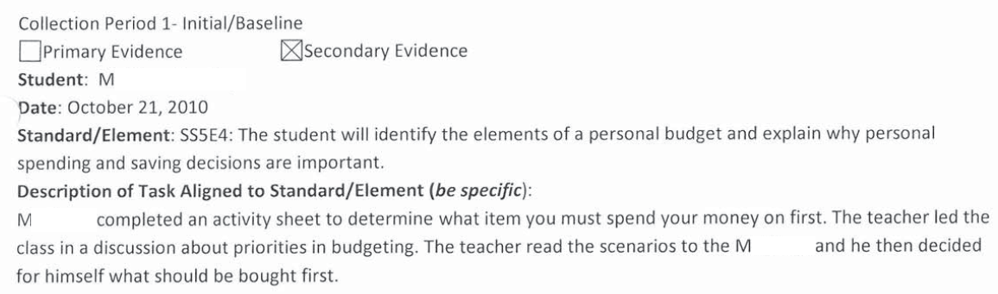
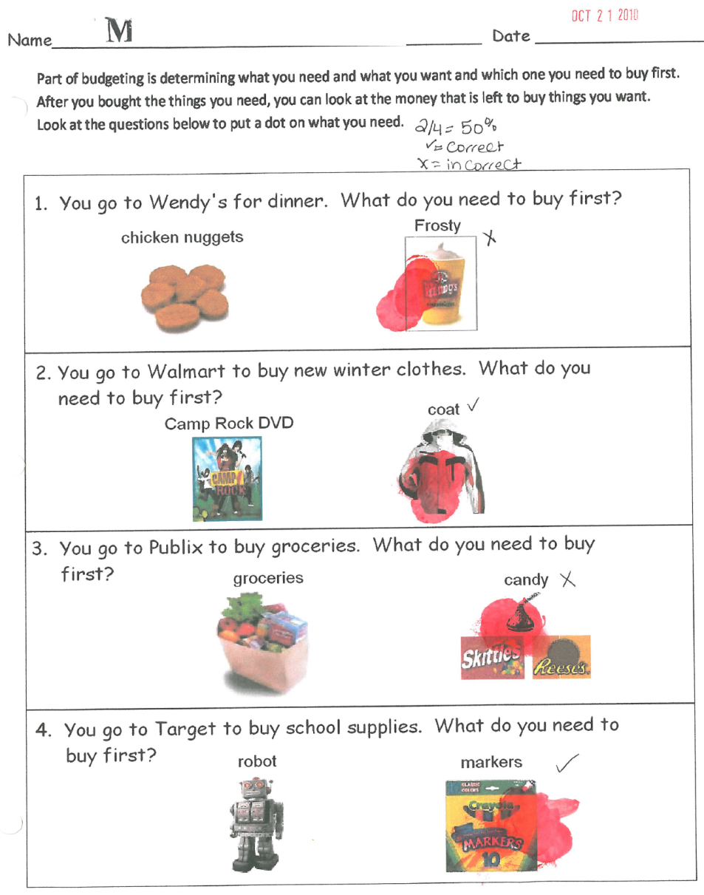
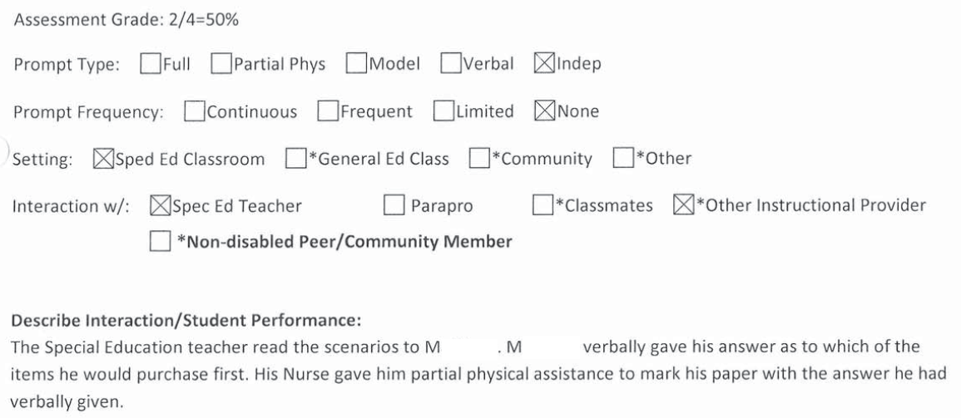
Documentation Dos–Work Samples
4
2
1
3
5
7
6
Notes:
The task description is written to address the standards-based task- in this case, making personal budget decisions regarding needs and wants.
The questions asked of the student have been provided.
The student’s responses are recorded on the work sample.
The correctness of the student response has been marked (✓ for correct; x for incorrect) and his score has been documented (2/4 = 50%)
The type and frequency of prompting has been recorded (Independent/None; “…decided for himself what should be bought first); no contradictions or extraneous annotations.
The nature of the interaction has been recorded (special ed teacher read the questions…M verbally gave his answers; Nurse provided physical assistance to mark). In this case, the physical assistance provided by the nurse is an interaction that occurred during the task but is NOT counted as prompting as her assistance occurred after he answered the questions).
Setting is noted.
No contradictory information!!

Slide 17
Documentation Dos
Task description is clearly stated and specific to the standards-based skill being assessed.
  After a discussion on personal budgets, determined which item he should spend his money on first given 2 choices on an activity sheet
Student work has been clearly evaluated.
  Answered 2 out of 4 correctly for an accuracy of 50%
Prompting has been clearly documented.
  Type: Independent
  Frequency: None (the student required no prompting)
Interactions: Special Ed teacher and nurse with explanations
Setting: Special Ed classroom
Notes:
Information on annotation page is consistent with information on student work. Documentation is clear and concise and does not contradict itself.
Interaction with nurse is specifically documented

Slide 18
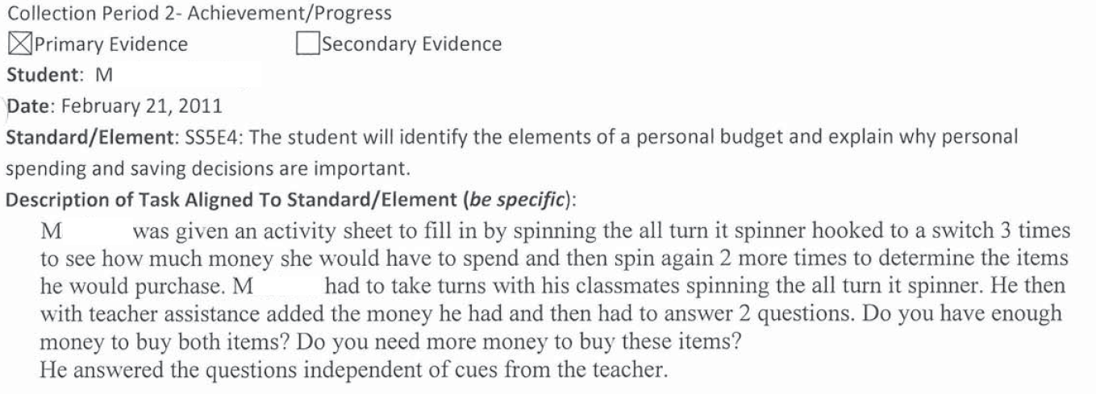
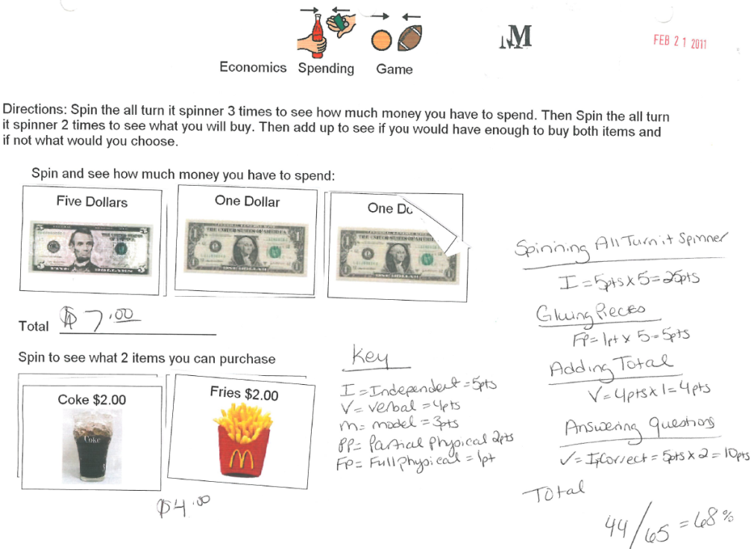
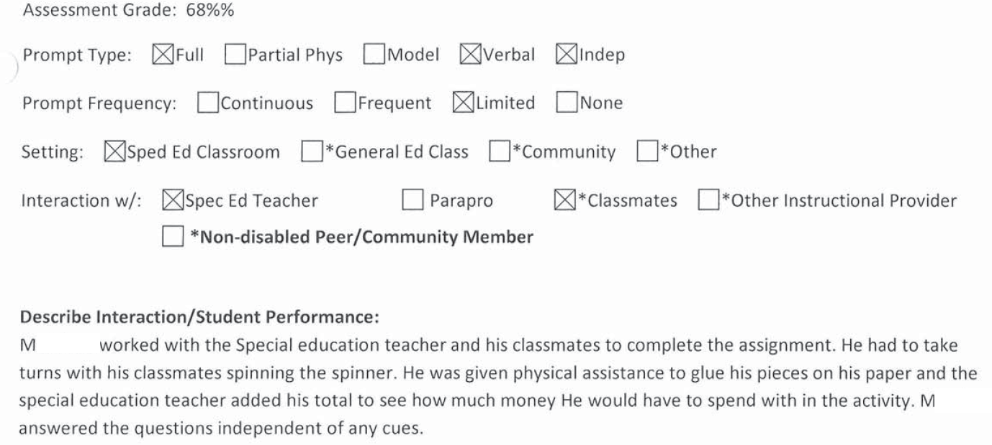
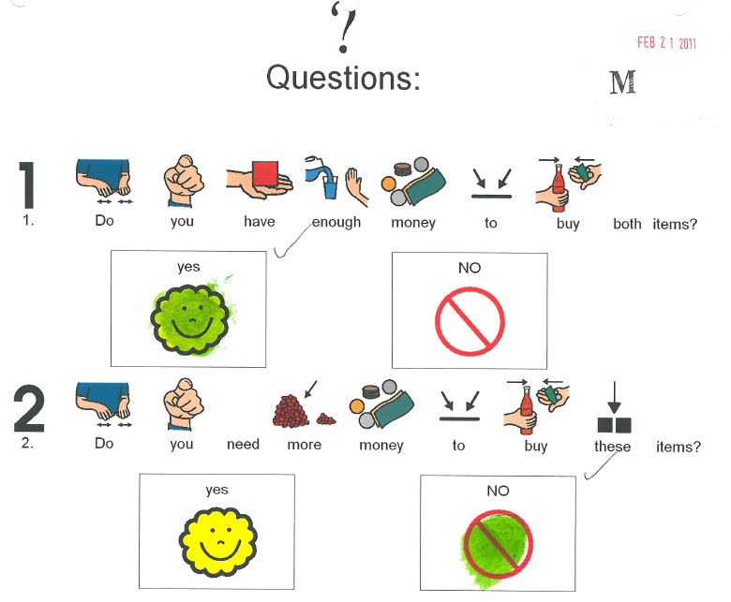
Documentation Don’ts–
Work Samples
?
?
?
?

Slide 19
Documentation Don’ts
Task description is very broad; it is unclear on what standards-based skill the student is being evaluated.
  Spinning the Spinner? Gluing? Adding the money? Answering questions about spending within his budget?
Evaluation of student work combines accuracy and prompting on multiple aspects of the task.
  Accuracy: 44/65 pts. = 68%
  Spinning: Independent = 5 pts. x 5 = 25 pts.
  Gluing: Full Physical = 1 pt. x 5 = 5 pts.
  Adding Total: Verbal = 4 pts. X 1 = 4 pts.
  Answering Questions: Independent = 5 pts. X 2 = 10 pts.
Notes:
The description of the assessment task should make clear what the student is being evaluated on as it relates to the curriculum standard and element/indicator.
Many of these steps, such as spinning the spinner and gluing down pieces are immaterial to the student’s ability to demonstrate his knowledge of spending within a personal budget.
Combining documentation of accuracy and prompting will not lead to a nonscorable entry and is done at the discretion of the teacher. However, it can lead to a lower score.

Slide 20
Documentation Don’ts
Documentation of Prompting on the annotation page is confusing
  Type: Full, Verbal, Independent
  Frequency: Limited
  “Answered the questions independent of any clues.”
On the work sample, Accuracy and Level of Independence have been combined into one score.
The evaluation of the student’s accuracy should relate solely to how he performed on the standards-based skill.
Documentation of prompting should be provided separately.

Slide 21
Making a Do out of a Don’t
Task description is specific to the standards-based skill on which the student is being assessed.
1
Evaluation of the student’s performance is specific to his accuracy on the questions he answered.
3
2
2
Type and Frequency of Prompting is documented separately from accuracy.
3
6
7
4
5
Notes:
Task description is clear and focused on standards-based skill (personal budget questions about spending and saving).
Questions have been provided; Information about the multiple steps involved in the spending game will be considered as part of the task complexity.
Student’s responses are clearly marked (colored responses with a marker).
Correctness of the response has been documented (✓ for correct; 2/2- 100%).
Prompting has been documented separately from accuracy; documentation is consistent between the annotation page and the evidence.
Nature of the interactions has been described (interacted with classmates during the game; special ed teacher added the money and asked the questions).
Setting documented (Special Ed Classroom).

Slide 22
Documentation Dos
Although the task is the same, the task description is now specific to the standards-based skill on which the student is being assessed.
The focus is now on the student’s ability to answer questions about making spending decisions within a personal budget. As such, he can demonstrate a higher level of accuracy and greater independence thus contributing to a higher score in Achievement/ Progress.
  Accuracy: 2/2 for a score of 100%
  Complexity: Answered 2 Yes/No questions after completing a multi-part task.
  Independence: Answered questions independently

Slide 23
Documentation Dos–
Observation Forms
Observation and interview forms can be submitted as a secondary type of evidence to document either a pre-planned or naturally occurring event that demonstrates a student’s ability on a task that is aligned to a standard and element/indicator.
In the absence of direct student work, however, it is very important that the information requested on the forms be filled out completely, specifically, and concisely in order for the student to get the appropriate score.

Slide 24
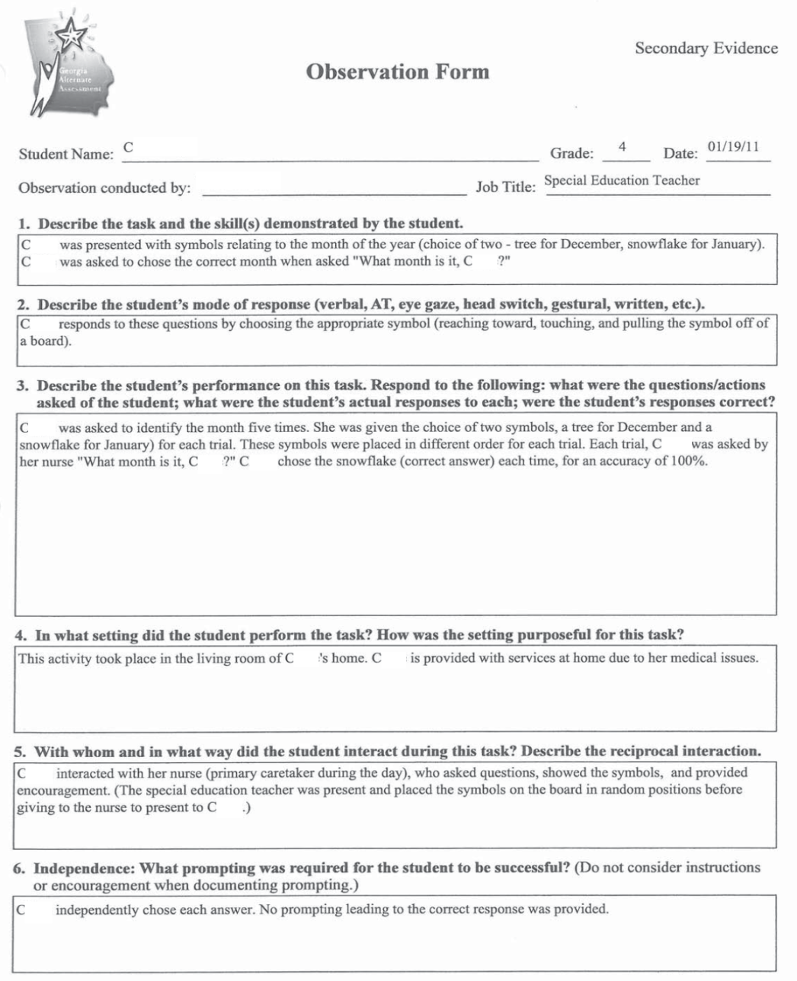
Documentation Dos
ELACC.4.SL.1 c. Pose and respond to specific questions to clarify or follow up on information and make comments that contribute to the discussion and link to the remarks of others.
The task description is concise and specific. The student is to respond to verbally presented questions by choosing the correct symbol from a choice of (2) two.
The documentation specifically addresses the information requested.
What were the questions asked of the student: “What month is it? (asked 5 times)
What were the student’s responses:
Chose the snowflake (January) each time
Were the student’s responses correct:
Correct answers for an accuracy of 100% (5/5)
The nature of the interaction is described.
Interacted with nurse who asked the questions.
Prompting is clearly annotated (separate from accuracy). Independently chose each answer

Slide 25
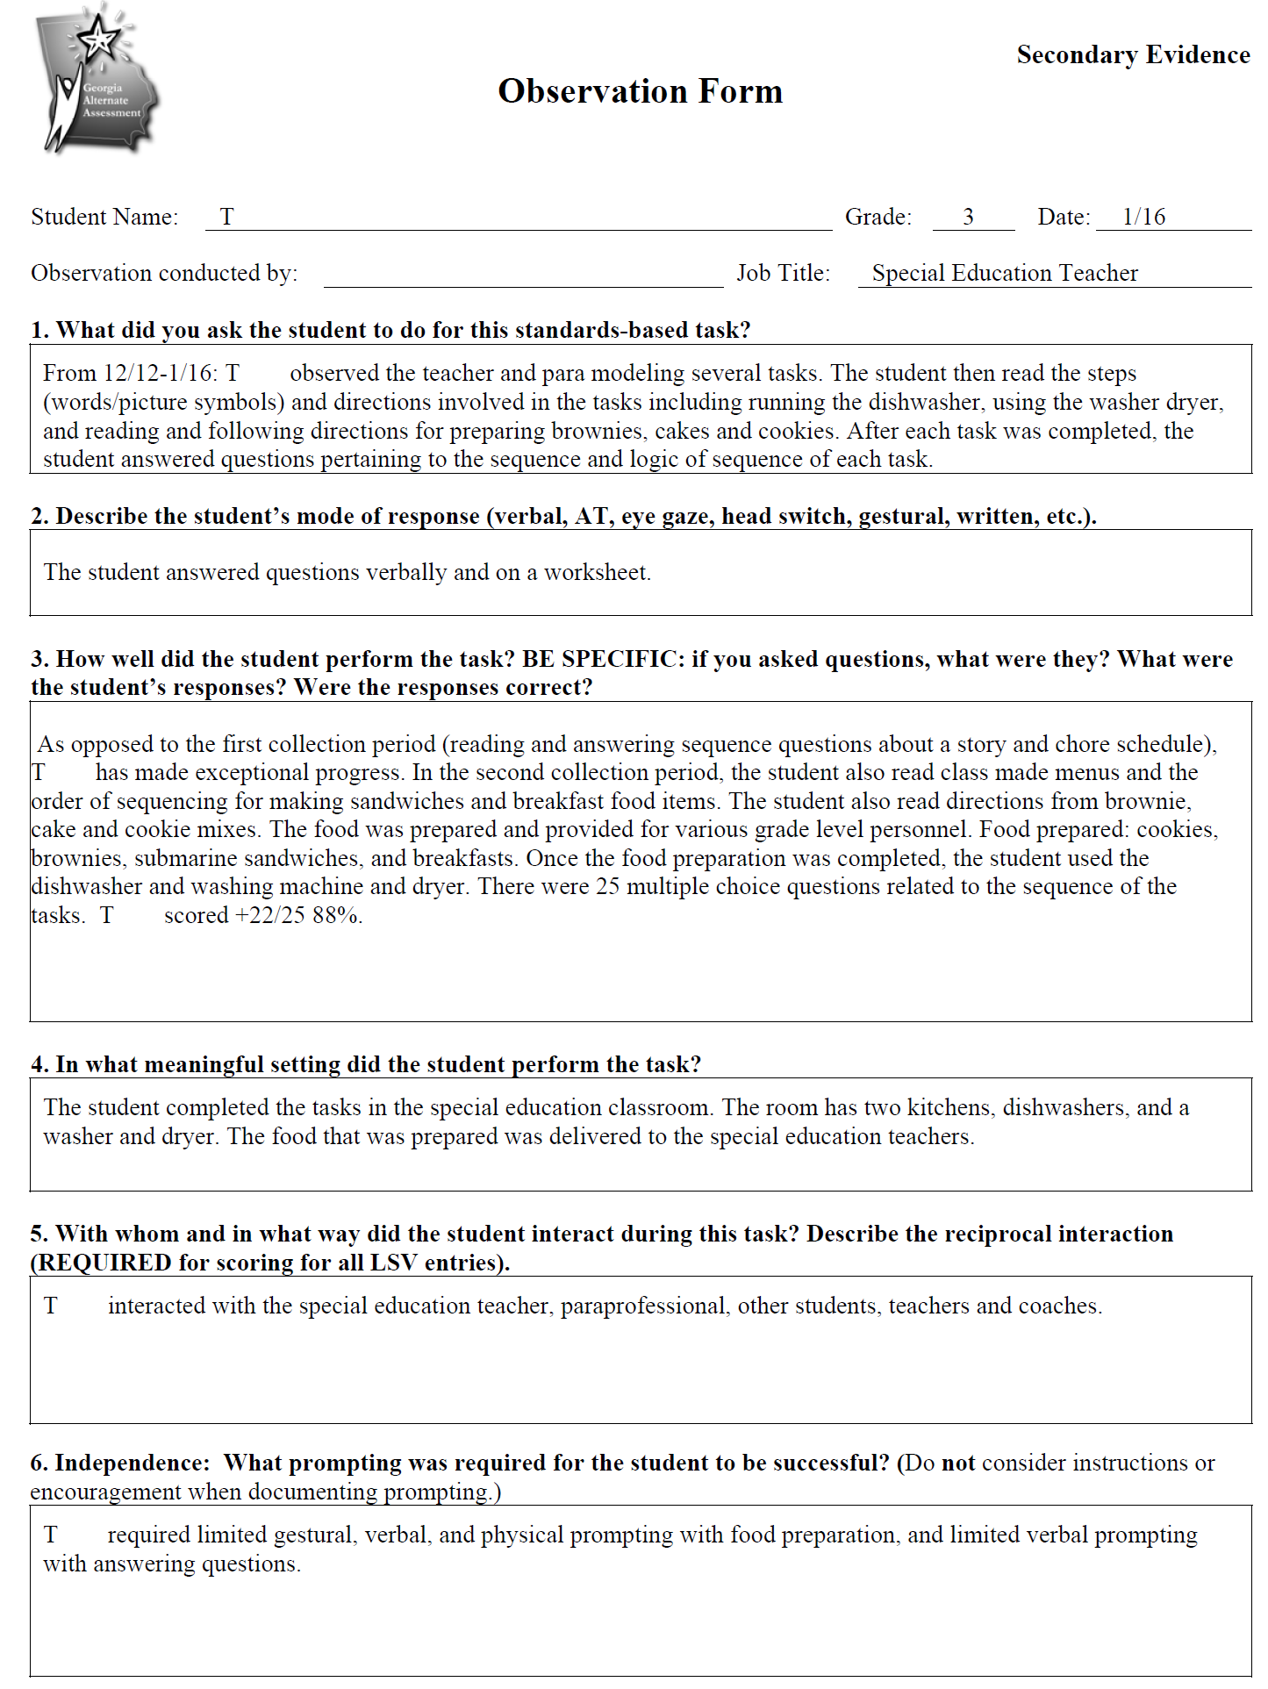
Documentation Don’ts
ELACC.3.RI.8: Describe the logical connection between particular sentences and paragraphs in a text (e.g., comparison, cause/effect, first/second/third in a sequence).
The task description is generic to cover a number of separate tasks. It is unclear what the specific task is or how it aligns to the standard and element.
The documentation does NOT address the information requested–
What were the questions asked of the student: ? What were the student’s responses: ?
Were the student’s responses correct: 22/25 ?
There is no documentation to address how the student interacted with all of these people during the assessment task.
Was the same type and frequency required each time the student answered questions on the different topics? Prompting required for food preparation should NOT have been included.
Notes:
Multiple dates would be better documented via a Data Sheet.
For the purpose of scoring, it was assumed that the student was answering questions about logical order to demonstrate reading comprehension.
Documentation of interaction should be specific to that which occurred during the instructional task. This annotation provides a list of people with whom he interacted with no description of the quality of the interaction or how it was relevant to the instructional task.
It is clear from this documentation that the student required only limited verbal prompting to answer the questions. Use caution when providing unnecessary annotation about prompting about parts of the task that do not demonstrate the student’s knowledge and skill related to the standard and element (e.g., food prep, gluing, encouragement, etc. )

Slide 26
Documentation Don’ts
Had the Observation Form documented a specific task that demonstrates a standards-based skill, this evidence could have contributed to a higher overall score in Achievement/Progress.
  Accuracy: + 22/25 for a score of 88%
    Was this 25 questions total, 25 questions for each of the many tasks the student completed, or 25 questions for one particular task not specifically described?
  Complexity: ?
    Without knowing what the questions are, how difficult the questions are, how many answer choices are provided, or how similar the distractors are, it is impossible to gauge the true complexity of the task.
  Independence: Limited verbal prompting
    Was the same prompting required each time?
Notes:
The limited gestural, verbal, and physical prompting required for the food preparation does not need to be documented.

Slide 27
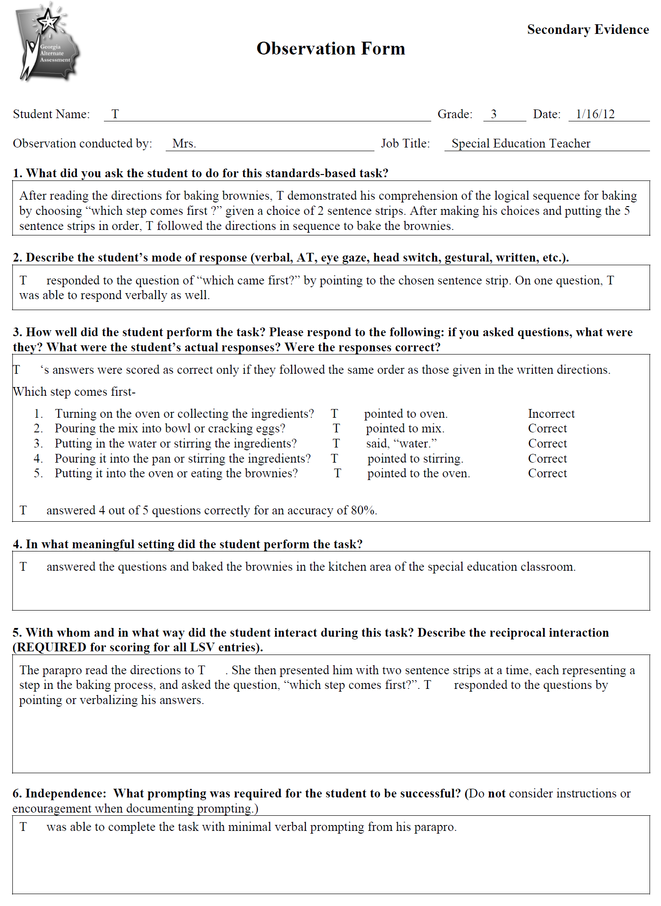
Making a Do out of a Don’t
ELACC.3.RI.8: Describe the logical connection between particular sentences and paragraphs in a text (e.g., comparison, cause/effect, first/second/third in a sequence).
The task description is specific and describes the task as it addresses the standard being assessed.
The documentation specifically addresses all of the information requested–
What were the questions asked of the student:
The 5 questions asked of the student are provided.
What were the student’s responses:
The student’s responses as well as the correctness of the responses have been provided.
Were the student’s responses correct: 4/5, 80%
The documentation clearly describes with whom the student interacted and the nature of the interaction.
The type and frequency of prompting required for the student to complete the task has been provided with no superfluous information.
Notes:
The criterion for correctness has been documented- “answers were scored as correct only if they followed the same order as those given in the written directions.”

Slide 28
Making a Do out of a Don’t
The documentation provided for this task is clear and concise.
  Describes a specific task completed on a specific date.
The questions posed atop each text box have been answered specifically with no extraneous or contradictory information.
The scores received by the student will reflect his knowledge and ability on this standards-based task.
  Accuracy: 4/5 for a score of 88%
  Complexity:
    5 questions (“which step comes first?”)
    2 options provided each time
  Independence: Limited verbal prompting
Notes:
The accuracy, task complexity, and level of independence demonstrated by the student is considered for each task. The change in each dimension from Collection Period 1 to Collection Period 2 is considered together to determine the student’s score.

Slide 29
The Dos and Don’ts of Documentation
Documentation Dos
Provide all necessary and required documentation
Documentation is specific to the individual student
Documentation should be clear and concise
Document accuracy and prompting separately
Documentation Don’ts
Contradictory or superfluous annotations
Documentation of encouragement, directions, or supports (physical assistance) that do not lead the student toward an answer
Notes:
Don’ts- Contradictory or superfluous annotations can lead to lower scores; including instructions or encouragement as part of prompting can lead to lower scores.

Slide 30
The Dos and Don’ts of Documentation
Physical Prompts
Physical Assistance
Most intrusive level of prompting
Leads the student towards the correct answer
Ensures correct responding
Used if student does not respond to less intrusive forms of prompting (verbal, model, etc.)
Hand-over-hand to indicate a response is physical prompting
Provided by holding the child’s arms or wrists to facilitate movement
Does not lead the student toward an answer
Aids the child to “independently” indicate an answer or make a selection
Used if student requires partial or full support of body
Notes:
NAAC Video- Beatles

Slide 31
Contact Information
People, contact information
    Deborah Houston, GaDOE Assessment Division
      Dhouston@doe.k12.ga.us
      (404) 657-0251
    Kayse Harshaw, Division for Special Education Services Questions about curriculum access for students with significant cognitive disabilities
      Kharshaw@doe.k12.ga.us
      (404) 463-5281
    Questar GAA Customer Service Hotline
      GA@QuestarAI.com
      Toll free (866) 997-0698
Notes:
Mention Evaluation link at the end of the presentation

Slide 32
GAA Resources
The following materials are available from the GAA web page:
http://www.doe.k12.ga.us/Curriculum-Instruction-and-Assessment/Assessment/Pages/GAA.aspx
  PowerPoints on previously presented topics
  Examiner’s Manual
  School and System Test Coordinator’s Manual
  Score Interpretation Guide
  Forms
  Blueprint
Division for Special Education Services and Supports
  Access to the Georgia Performance Standards (GPS) for Students with Significant Cognitive Disabilities can found at
  http://www.gadoe.org/Curriculum-Instruction-and-Assessment/Special-Education-Services/Pages/Curriculum-Access-for-Students-with-Significant-Cognitive-Disabilities-.aspx
  The CCGPS/GPS Resource Board -A repository of activities that are aligned at an access level to the CCGPS (Math and English Language Arts), and the GPS (Science, Social Studies, and High School Math).
Notes:
Double click on the link

Slide 33
Access to CCGPS/GPS Resources
Recorded Webinars
Check schedule for recorded webinars and upcoming live webinars:
  http://www.gadoe.org/Curriculum-Instruction-and-Assessment/Special-Education-Services/Pages/Recorded-Webinars.aspx
  Suggested webinars:
Giving Access to Science Standards - Linking Science and Life Skills and Experiences, November 5, 2009
Giving Access to Social Studies Standards - Relating Themes in Social Studies to Relevant Life Skills and Experiences, December 10, 2009
Access to ELA: Writing Skills for Students with Significant Cognitive Disabilities , January 24, 2011
Additional webinars and information for CCGPS ELA and Mathematics activities are being developed and will be announced soon by the Division for Special Education Services .

Slide 34
Access to CCGPS/GPS Resources
Electronic Resource Board for Access to the CCGPS/GPS for
Students with Significant Cognitive Disabilities
The Access to the CCGPS/GPS Resource Board contains: Free downloadable activities and materials for use with students with significant cognitive disabilities across grade levels and curricular areas
  Resources (internet, literature, etc.) to provide access to the general education curriculum
  Adapted stories for all grade levels and directions on acquiring adapted literature
    Instructions for acquiring adapted books
  Instructional strategies and best practice guidelines
  Data Sheets
  Georgia Alternate Assessment (GAA) suggestions/tips
  Georgia Project for Assistive Technology (GPAT) information
  Activities and materials for High School Access Courses
To register and receive your password for the Access to the CCGPS/GPS Resource Board for Students with Significant Cognitive Disabilities:
  send an e-mail with your first/last name and your preferred e-mail address to one of the following persons:
    Kayse Harshaw (sharshaw@doe.k12.ga.us)
    Debbie Reagin (dreagin@doe.k12.ga.us)

Slide 35
Georgia Alternate Assessment
A Review of Scoring
Module B
Scoring Dimensions
How They Work Together:
Accuracy, Complexity, Level of Independence

Slide 36
Welcome to Module B
A Review of Scoring
This session will begin at 2:45 p.m.
The PowerPoint is located in the GAA Presentations Portlet at this location:
  http://www.gadoe.org/Curriculum-Instruction-and-Assessment/Assessment/Pages/GAA-Presentations.aspx
While you are waiting, please do the following:
Use the Audio Setup Wizard in the Tools Menu to configure and test your audio settings before the presentation begins.
Confirm your connection speed by going to:
  Tools – Preferences – Connection speed
To eliminate interference from background noise in your area, leave the Talk Button on mute.
Due to the number of participants, we request that questions are submitted via the Chat Box.
Logon with your name and the name of your district beside it (e. g., Deborah Houston – Elbert County). If you have already logged on, place your name and district name in the Chat Box.

Slide 37
2012-2013 GAA
This slide presentation is designed to inform
  designated trainers and portfolio reviewers,
  teachers who administer the GAA,
  Special Education Directors,
  Test Coordinators, and
  Building Administrators.
Companion presentations will be available for more in-depth training on topics that will assist test administrators.
All presentations will be posted on the GaDOE website.
37

Slide 38
Scoring Demystified
The purpose of this presentation is NOT to teach you how to score the GAA.
The purpose of this presentation is to take the mystery out of the scoring process by explaining how everything works together to determine the final dimension scores assigned to a student for each entry.
Notes:
For those of you who logged on for Module A on Documentation, we intentionally paired these two presentations to reinforce the idea that everything works together- from the way annotations are recorded to how the pieces of evidence are considered together first within and then across collection periods- to determine the final score assigned to the student.

Slide 39
Scoring Demystified
Scoring for the GAA is guided by decisions made in Rangefinding by a committee of Georgia educators.
  Supported by state Content Specialists
The committee reviews portfolio entries from the current administration and assigns scores following all scoring rules and consistent with decisions they have made in previous years.
These scored entries are then included in the materials that are used to train the Questar readers assigned to score the GAA.
Notes:
The scores that have been assigned to these entries were determined by a rangefinding committee of Georgia educators.

Slide 40
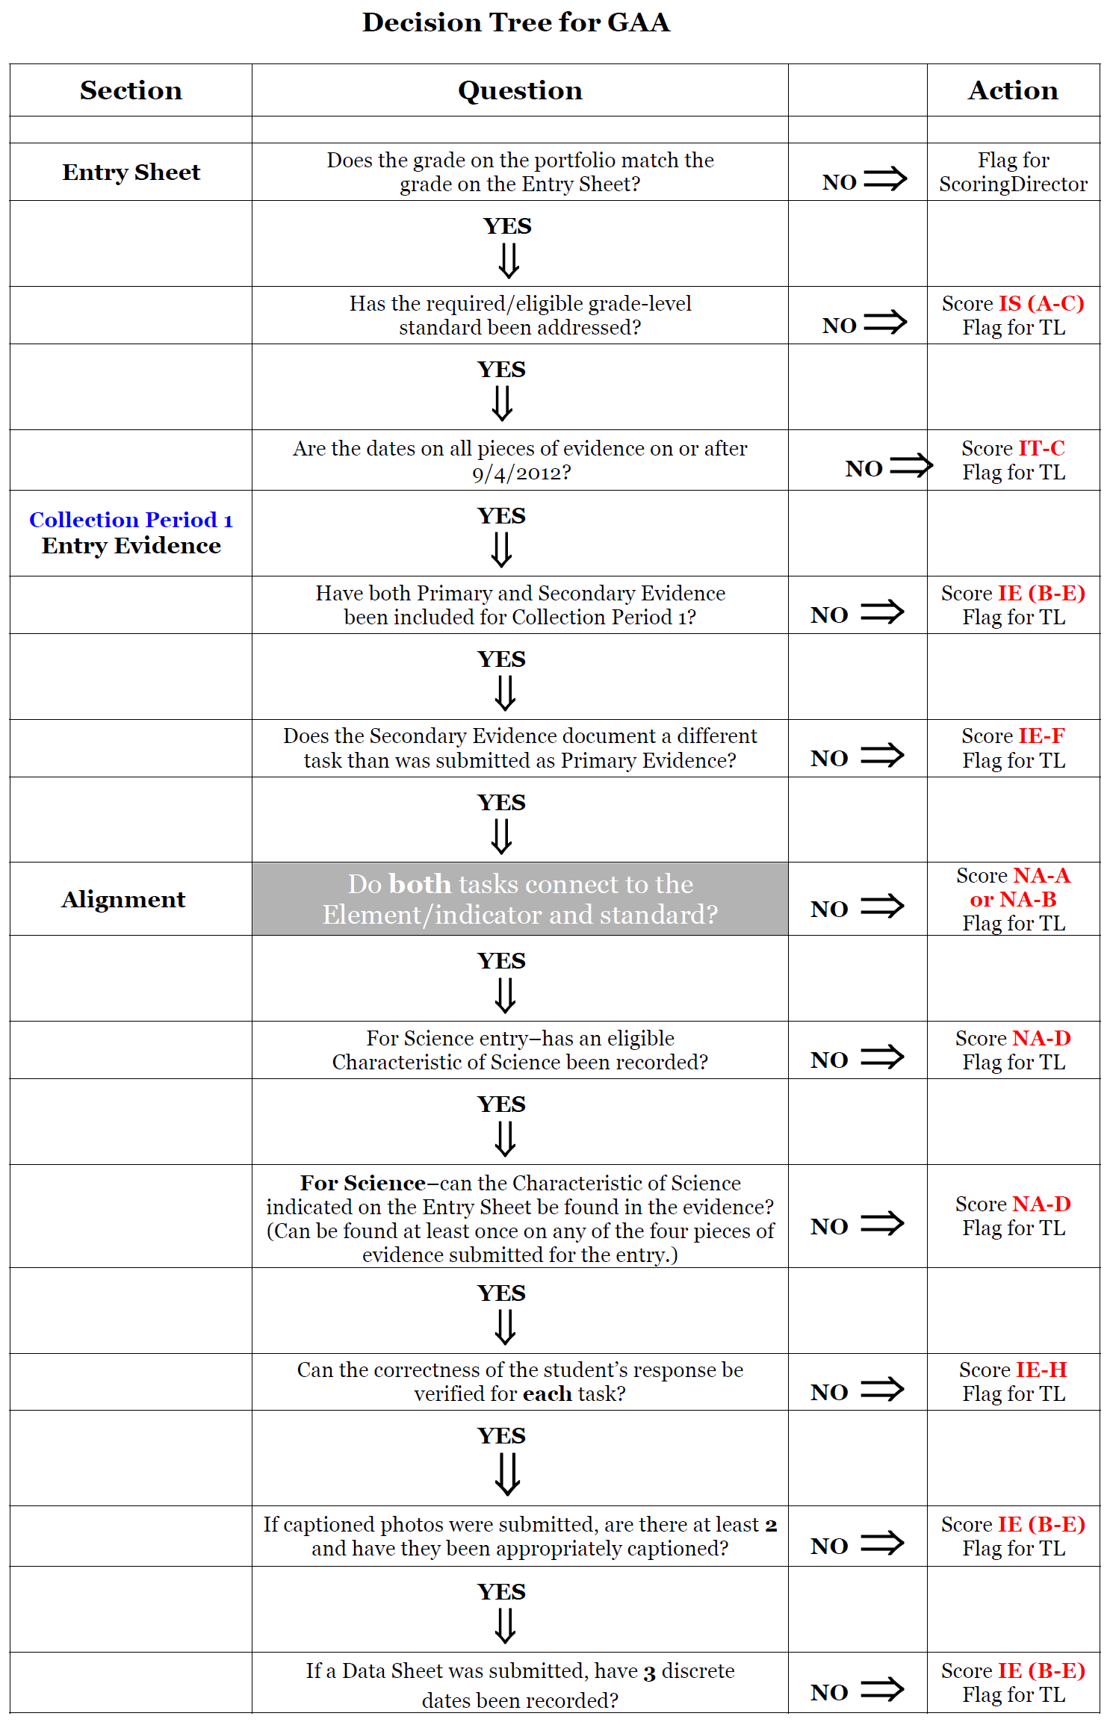
Decision Tree for the GAA
This decision tree is used by readers as a verification tool during scoring.
It is broken down by the questions that must be asked for each piece of evidence for each collection period.
It could be used as part of the portfolio review process to ensure that entry and evidence requirements have been met prior to submitting the portfolio.

Slide 41
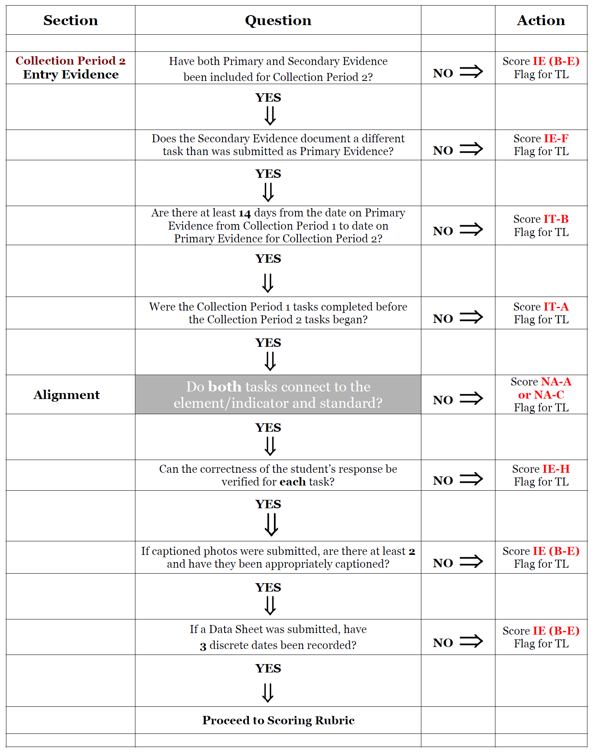
Decision Tree
for Collection Period 2
Entry Evidence
Once it has been determined that all of the requirements for scoring have been met, scores will be given based on the GAA Scoring Rubric.
Notes:
Nonscorable entries due to insufficient evidence or procedures can be avoided by following this checklist and being well versed in the evidence requirements.
Reminder- only Team Leaders, the Scoring Director, the GAA Project Manager or GaDOE personnel can verify a nonscorable code for a portfolio entry. If a reader feels that any of the criteria in the decision tree has not been met, he/she will flag the entry for a Team Leader who will verify the nonscorable nature of the issue before sending it through.

Slide 42
Dimension Scoring
GAA Portfolios are scored for 4 discrete dimensions:
  Fidelity to Standard
  Context
  Achievement/ Progress
  Generalization

Slide 43
Dimension Scoring
Each entry is scored for Fidelity to Standard, Context, and Achievement/Progress.
A score for Generalization is given considering all of the scorable entries in the portfolio.
Scoring is holistic – all pieces of evidence are considered and the totality of the information we have about the student’s achievement is used to make scoring decisions.

Slide 44
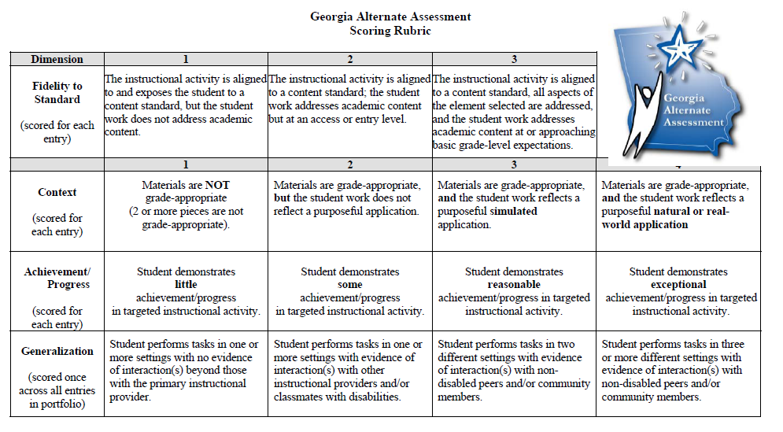
Notes:
Fidelity to Standard is scored on a 3-point scale
Context, Achievement/Progress, and Generalization are scored on a 4-point scale.

Slide 45
Questions to Consider When Scoring
Fidelity to Standard
Fidelity to Standard assesses the degree to which the student’s work addresses the grade-level standard to which it is aligned.
  Does the assessment task demonstrate a clear connection to the standard and element/indicator?
  Is the student work academic?
  Is the student work focused on academic content at an access/entry level?
  Is the student work focused on academic content at or approaching the student’s basic grade level?
  Does the student work address all aspects of the element/indicator (or all aspects of the standard in the absence of indicators) ?
Notes:
These questions must be asked for each piece of evidence submitted for the entry.
If even one task does not align, the entry is nonscorable.
If the tasks align, but the work produced by the student is not academic, the entry would receive a score of “1” in Fidelity.
If the student work is at a prerequisite or entry level, the entry would receive a score of “2” in Fidelity.
If the student work is approaching basic grade level expectations BUT all aspects of the element (or standard) have not been addressed, the entry would receive a score of “2” in Fidelity.
If all aspects of the element are addressed AND the student work is approaching basic grade level expectations, the entry would receive a score of “3” in Fidelity.

Slide 46
Questions to Consider When Scoring
Context
Context assesses the degree to which the student work exhibits the use of grade-appropriate materials in a purposeful and natural/real-world application.
  Are all the materials grade appropriate?
  Is the instructional activity a purposeful means through which the student can learn and demonstrate what they know and can do?
  Is the student working in a simulated (practice) situation?
    Almost all classroom instruction is considered “simulated.”
  Is the student working in a real-world (following a list to purchase groceries) or natural situation (working in the general education classroom on the same activity as general education peers)?
Notes:
These questions must be asked for each piece of evidence submitted for the entry.
If two or more of the materials used in the assessment task are not grade appropriate, the entry receives the score of “1” in Context.
If the tasks are not purposeful for the student, either because the standards-based skill is being taught incorrectly or because the student was not given an opportunity to learn (all tasks too hard, all tasks too easy), the entry would receive a score of “2” in Context.
If the student is doing a simulated task- meaning that it is a part of practice or classroom instruction- the entry would receive a score of “3” in context.
If the student demonstrating knowledge of the standards-based skill in a real world situation (e.g. adding bowling scores in the bowling alley) OR if the student is doing a task in the general ed setting that is also being done by the general ed students (same task, same place, same time), the entry will receive a score of “4” in Context.

Slide 47
Questions to Consider When Scoring
Achievement/Progress
Achievement/Progress assesses the increase in the student’s proficiency of skill across the two collection periods.
  Are the skills assessed across the collection periods similar enough to reliably assess progress?
  Is there an increase in accuracy from one collection period to another?
  Is there an increase in the complexity of the tasks from one collection period to another?
  Is there an increase in independence from one collection period to another?
  When accuracy, complexity, and independence are considered together, how much progress has the student shown?
Notes:
The change in accuracy, complexity, and level of independence from CP1 to CP2 are considered together when determining the score for A/P.
If there is no change in either accuracy, complexity, or independence, the entry receives a score of “1” in A/P.
If the tasks from one collection period to the other are too different , the entry receives a score of “1” in A/P. (The standards-based skills, although aligned, are not consistent across collection periods.)
If there is some increase in accuracy, complexity, and/or level of independence from Collection Period 1 to Collection Period 2, the entry receives a score of “2” in A/P.
If there is a reasonable increase in accuracy, complexity, and/or level of independence from Collection Period 1 to Collection Period 2, the entry receives a score of “3” in A/P.
If there is an exceptional increase in accuracy, complexity, and/or level of independence from Collection Period 1 to Collection Period 2, the entry receives a score of “4” in A/P.

Slide 48
Questions to Consider When Scoring
Generalization
Generalization assesses the student’s opportunity to apply the learned skill in other settings and/or with various individuals in addition to the teacher or paraprofessional.
  In what meaningful settings is the student performing the activities?
    The setting should be purposeful for the instructional task.
  With whom and it what way is the student interacting during the standards-based instructional activity?
Notes:
Discrete settings are counted toward the generalization score only if the assessment task was completed in that setting.
The nature of the interaction should be documented. We frequently see annotations that say the student interacted with multiple people during the task, however it is only counted toward the Generalization score if the interactions were specifically geared towards the completion of the standards-based task.
If an entry is found to be nonscorable, the settings and interactions documented in that entry will not be considered when determining the Generalization score.

Slide 49
Demonstrating Achievement/Progress
Accuracy
Complexity
Level of Independence

Slide 50
Demonstrating Achievement/Progress
All students progress at different rates.
It is important that the tasks on which the student is assessed demonstrate an appropriate level of challenge for the student and represent the student’s true knowledge and skill on the standard/element.
The evidence submitted should be an authentic representation of the student’s ability.
A student may show more progress in one content area than another or in one strand than another.
A student who demonstrates “some” progress (A/P “2”) is showing progress- a “2” is good!

Slide 51
Demonstrating Achievement/Progress
Achievement/Progress assesses the increase in the
student’s proficiency of skill in the aligned standards-
based tasks across the two collection periods.
Increase in the Accuracy of student responses
Increase in the Complexity of the tasks
Increase in the student’s level of Independence as demonstrated through a decrease in the type and frequency of prompting

Slide 52
Demonstrating Achievement/Progress
Achievement/Progress is scored by evaluating the net change in accuracy, complexity, and independence from Collection Period 1 to Collection Period 2.
Both tasks in each collection period are considered together when evaluating the student’s ability.
The greater the positive increase in these dimensions, the higher the Achievement/Progress score.
Notes:
All pieces of evidence are considered and the totality of the information we have about the student’s achievement is used
A positive increase in one (1), two (2), or all of these dimensions from the first collection period to the second demonstrates student progress.

Slide 53
Achievement/Progress: Accuracy
Accuracy
Accuracy of student work is considered across both pieces of evidence submitted for each collection period.
Consider the following examples:
  More correct responses in Collection Period 2 than in Collection Period 1; higher percentage of correct responses
  Accuracy that stays the same across both collection periods
  Decrease in accuracy from CP1 to CP2
Notes:
Reminder: Accuracy/correctness of the student response should be documented separately from the type and frequency of prompting that led the student to the correct response.
Type and Frequency of prompting is used to determine the student’s level of independence and should be documented separately.

Slide 54
Achievement/Progress: Accuracy
 | Example 1 |  |  | Example 2 |  |  | Example 3
CP1 Primary | 50% | 58% |  | 100% | 100% |  | 96% | 97%
CP1 Secondary | 65% |  |  | 100% |  |  | 98%
CP2 Primary | 88% | 92% |  | 100% | 100% |  | 65% | 70%
CP2 Secondary | 96% |  |  | 100% |  |  | 75%
 | Accuracy |  |  | Accuracy |  |  | Accuracy
Notes:
Accuracy that is low in CP1 because the student is doing a very complex task and high in CP2 because the student is doing an easier task could result in a lower score in A/P as accuracy and complexity are considered together.
It is important that the tasks on which the student is assessed demonstrate an appropriate level of challenge for the student and represent the student’s true knowledge and skill on the standard/element.

Slide 55
Achievement/Progress: Complexity
Complexity
The complexity of the tasks are considered across both pieces of evidence submitted for each collection period.
Many ways to demonstrate an increase in complexity
  More questions or answer choices
    5 questions to 10 questions
    2 choices to 4 choices
  Different types of answer choices provided
    Matching vs. Multiple Choice vs. Short Answer
    Pictures vs. words

Slide 56
Achievement/Progress: Complexity
Complexity (continued)
  Greater similarity between distractors
    Boy vs. Tree to Boy vs. Man
    Correct plus unlikely to all similar/possible
  Move from concrete to abstract concepts
    Manipulatives to pictures to words/numbers
    Concrete to representational to abstract
  Deeper level of knowledge within the same skill; moving from prerequisite skill to application closer to standard/element
    Describe to explain to interpret
    Label to compare to analyze

Slide 57
Achievement/Progress: Independence
Level of Independence is demonstrated through the type and frequency of prompting required by the student for each assessment task.
Types
Frequency
Physical
Model
Gestural
Verbal
Independent
Continuous
Frequent
Limited
Independent
Notes:
It is at the discretion of the teacher as to the terminology used to document type and frequency of prompting. However, as you will see when you are reviewing the scoring exercises at the end of this presentation, there are many things to consider when scoring. Consistent terminology- especially that used within and entry and across pieces of evidence- paints a clearer picture of the student’s true level of performance.
As we said before, Accuracy should be documented separately from the type and frequency of prompting.

Slide 58
Achievement/Progress: Independence
Level of Independence
  Increased independence, whether during academic or functional tasks, is a primary goal for our students and an effective way through which to demonstrate Achievement/Progress.
  Tasks should be designed to demonstrate the highest level of independent response of which the student is capable.
Notes:
If the student can demonstrate a differentiated response via eye gaze, gesture, vocalization, or assistive technology, the student’s performance should be a reflection of that independent response before full physical prompting is employed.

Slide 59
Achievement/Progress: Independence
Independence
The student’s level of independence is considered across both pieces of evidence submitted for each collection period.
Consider the following examples:
  Decrease in the type and/or frequency of prompting.
  Move from independent on a CP1 task to prompted on both CP2 tasks.
  Move from prompted in both CP1 tasks to independent on one or both CP2 tasks.
Notes:
Accuracy/correctness of the student response should be documented separately from the type and frequency of prompting that led the student to the correct response.
Type and Frequency of prompting is used to determine the student’s level of independence and should be documented separately.

Slide 60
Achievement/Progress: Independence
 | Example 1 |  | Example 2 |  | Example 3
CP1 Primary | -Frequent Verbal -Limited Gestural | -Continuous Verbal -Frequent Verbal -Limited Gestural -Partial Physical | -Limited Verbal -Limited Gestural | -Limited Verbal -Limited Gestural Independent | -Continuous Verbal | -Continuous Verbal -Frequent Verbal
CP1 Secondary | -Partial Physical -Continuous Verbal |  | Independent |  | -Frequent Verbal
CP2 Primary | -Limited Verbal -Limited Gestural | -Limited Verbal -Limited Gestural | -Limited Verbal | -Limited Verbal -Limited Gestural | - Limited Verbal | -Limited Verbal Independent
CP2 Secondary | --Limited Verbal |  | -Limited Verbal -Limited Gestural |  | Independent
 | Independence |  | Independence |  | Independence

Slide 61
Demonstrating Achievement/Progress
If there is no change in either accuracy, complexity, or independence, A/P score is “1.”
If the tasks from one collection period to the other are too different, A/P score is “1.”
  No consistent skill to evaluate across the two collection periods
Notes:
If there is no change in either accuracy, complexity, or independence, the entry receives a score of “1” in A/P.
If the tasks from one collection period to the other are too different , the entry receives a score of “1” in A/P. (The standards-based skills, although aligned, are not consistent across collection periods.)

Slide 62
You Score It
2
3
3
Now, it’s your turn...
Review the following student entries and assign scores for Fidelity to Standard, Context, and Achievement/Progress.
Discuss as a group.
Notes:
Each dimension scored separately – once we decide an entry is scorable, each dimension is open to all score points.
Reminder: the scores that have been assigned to these entries were determined by a rangefinding committee of Georgia educators.

Slide 63
You Score It
Sample Entry 1
Grade: 4 Numbers and Operations in Base 10
Standard: MCC.4.NBT.2 Read and write multi-digit whole numbers using base-ten numerals, number names, and expanded form. Compare two multi-digit numbers based on meanings of the digits in each place, using >, +, and < symbols to record the results of comparisons.
Element/Indicator: N/A
Notes:
Because there is no element/indicator for this standard, alignment of all 4 tasks must go directly back to the standard.

Slide 64
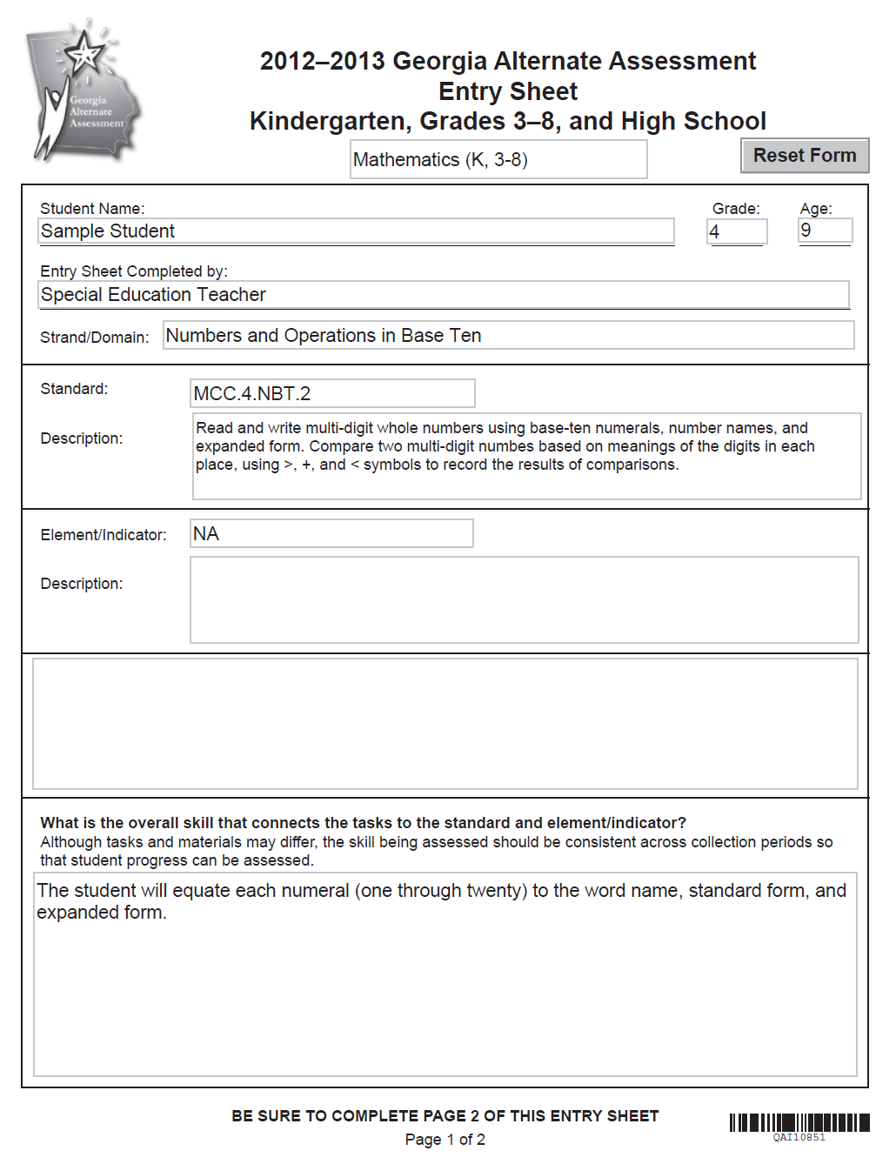
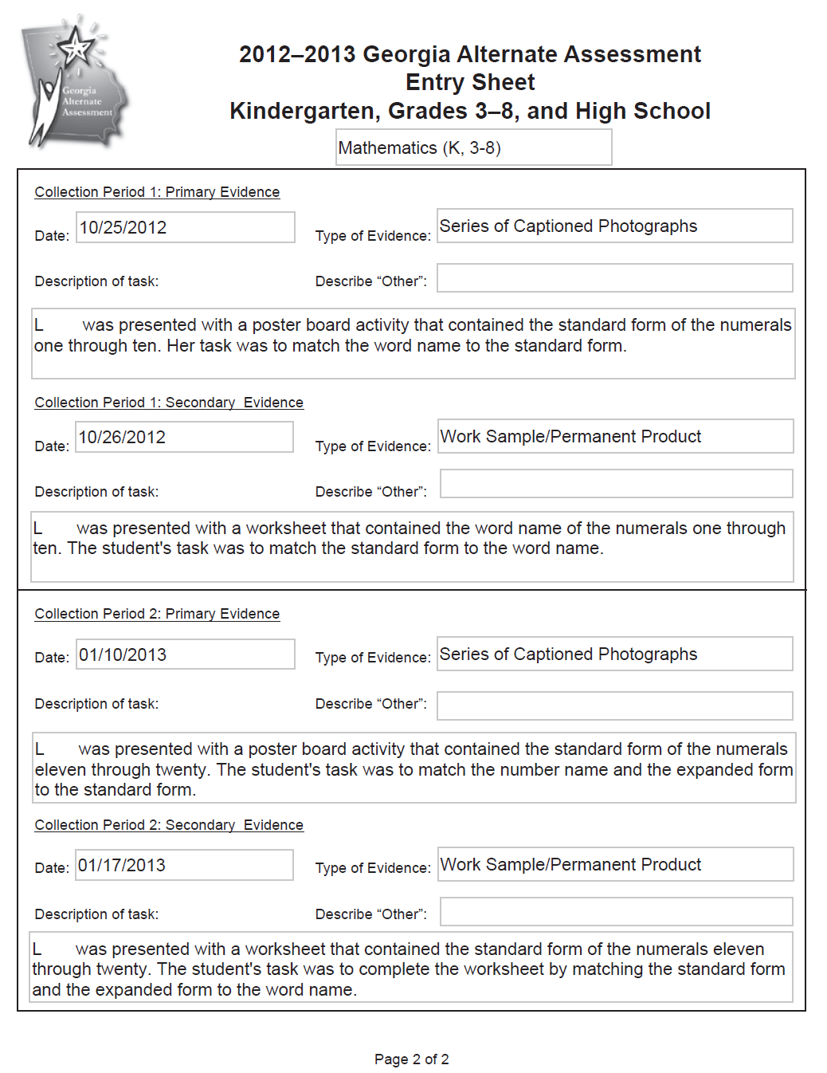
Notes:
This example can be found beginning on page 112 of the 2012-2013 GAA Examiner’s Manual. When doing this activity during retraining, it is recommended that teachers review the evidence by using the larger pages in the Examiner’s Manual.

Slide 65
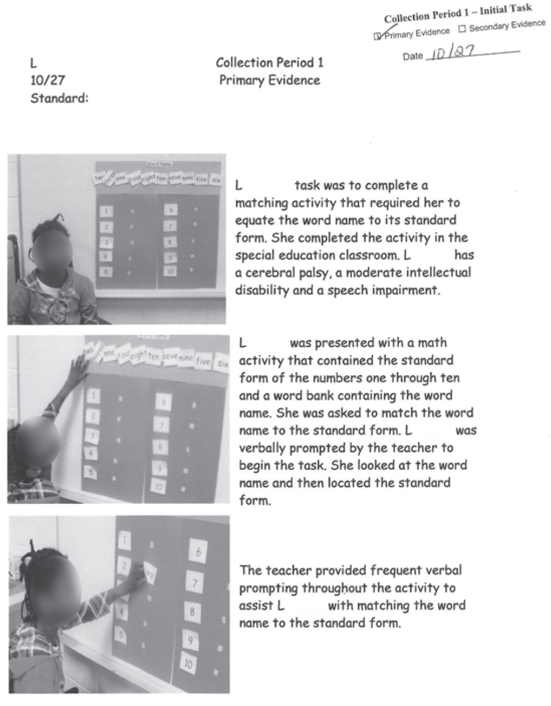
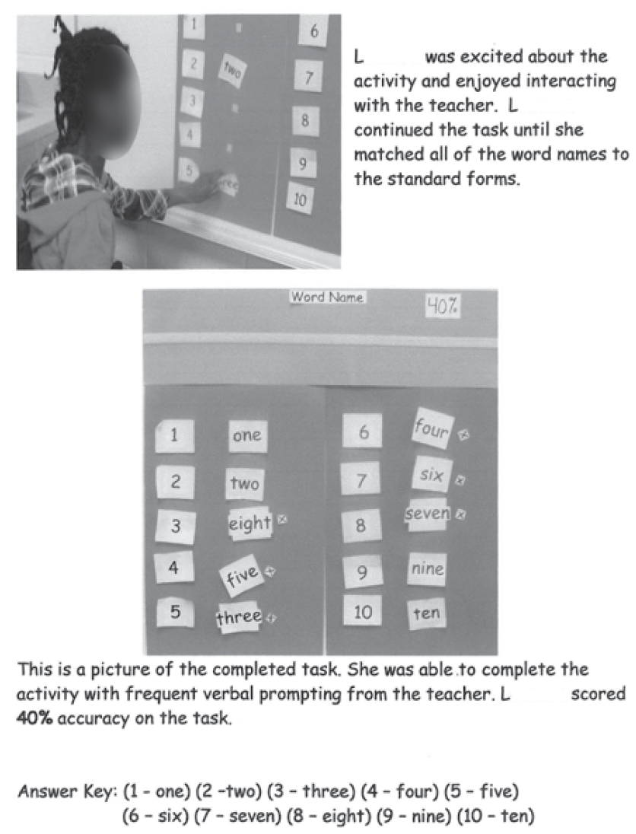
Collection Period 1 Primary Evidence

Slide 66
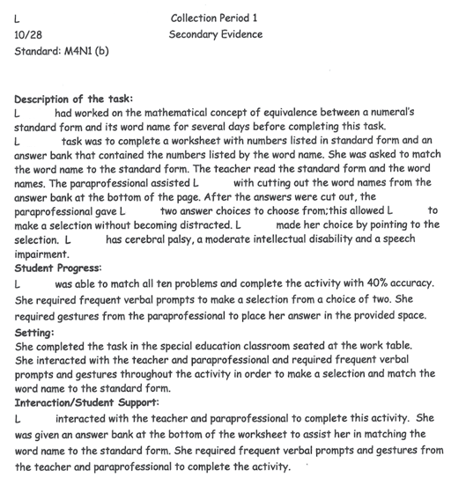
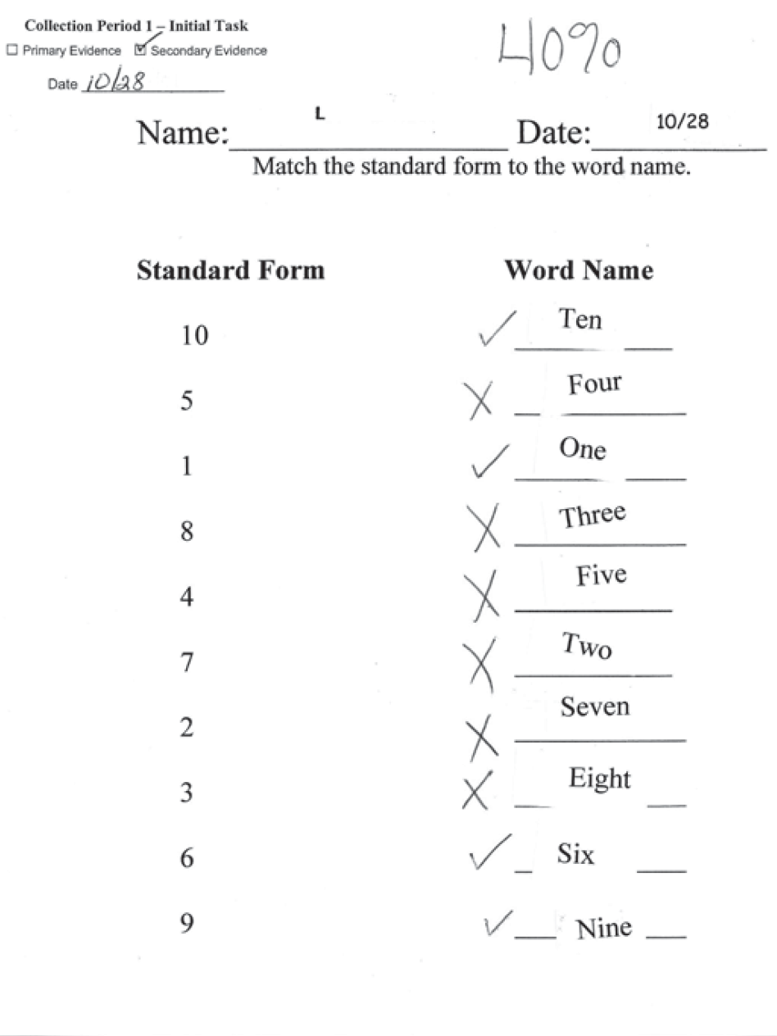
Collection Period 1 Secondary Evidence

Slide 67
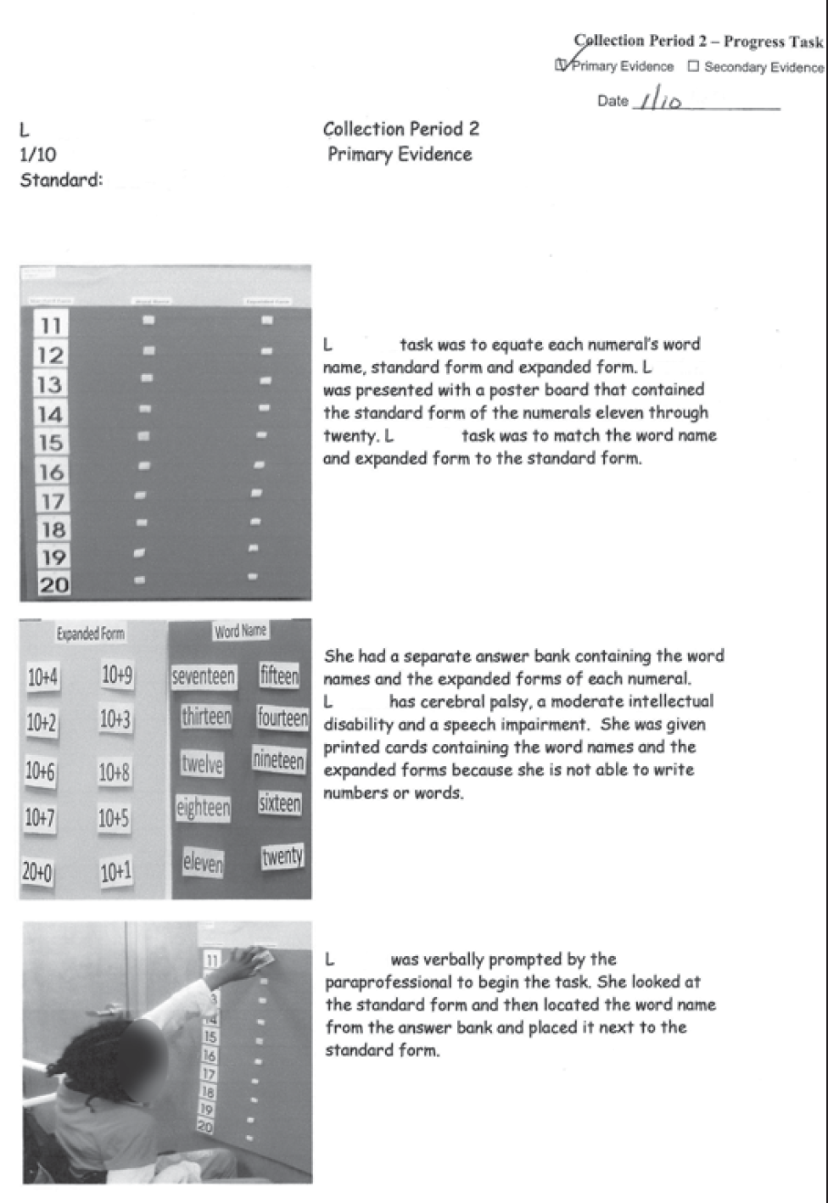
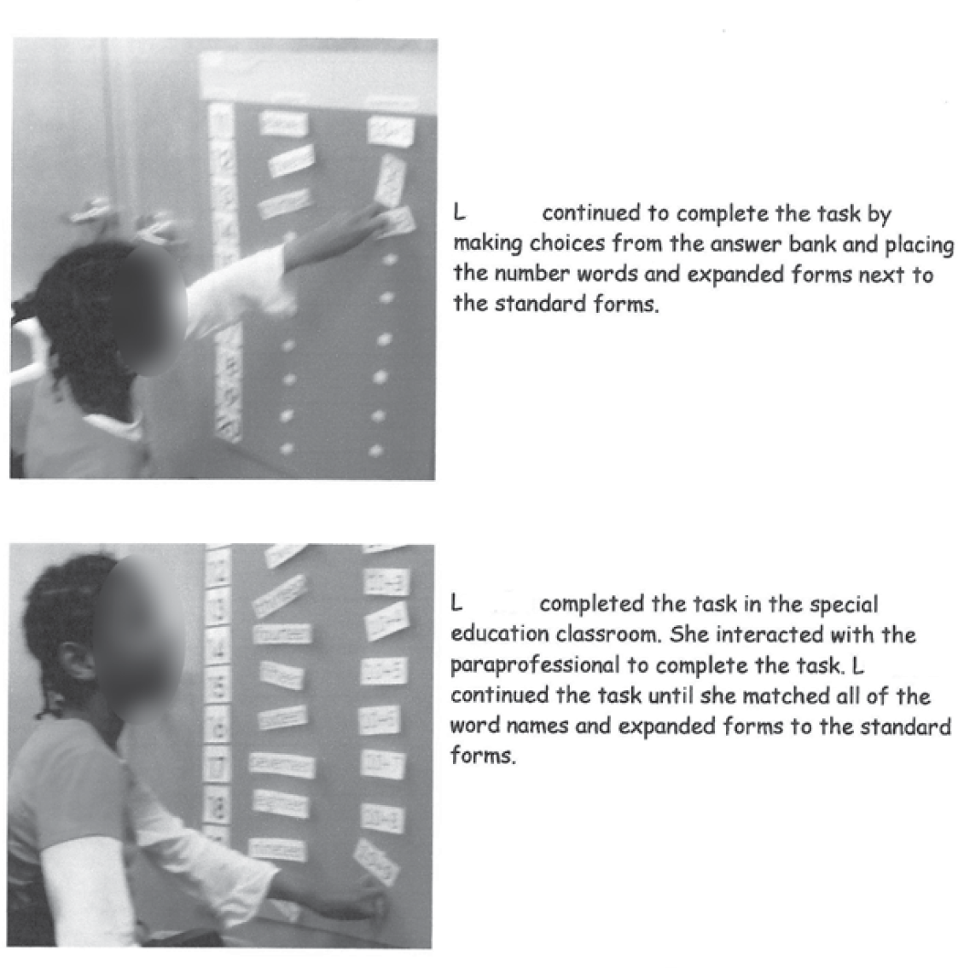
Collection Period 2 Primary Evidence

Slide 68
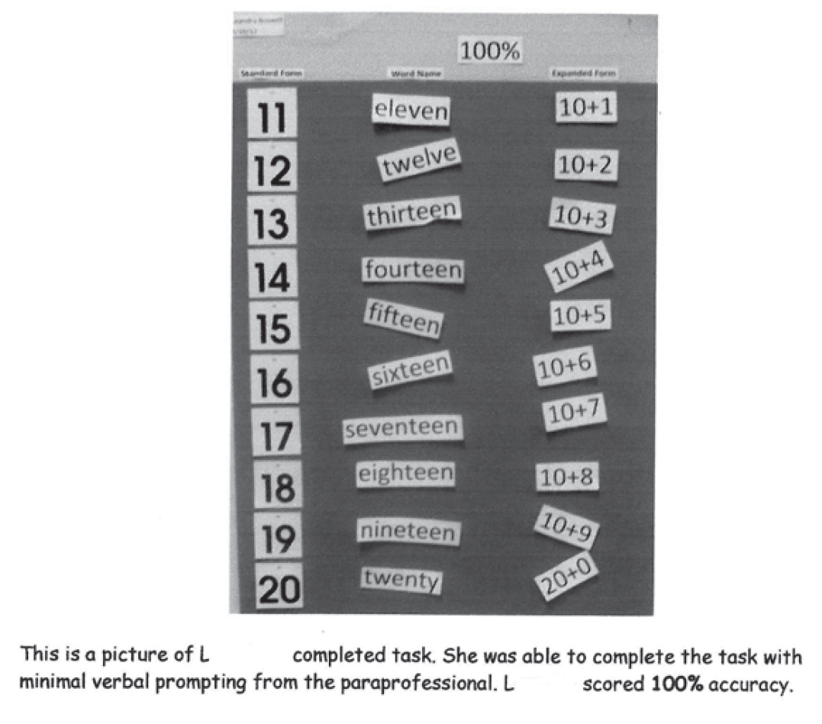
Collection Period 2 Primary Evidence

Slide 69
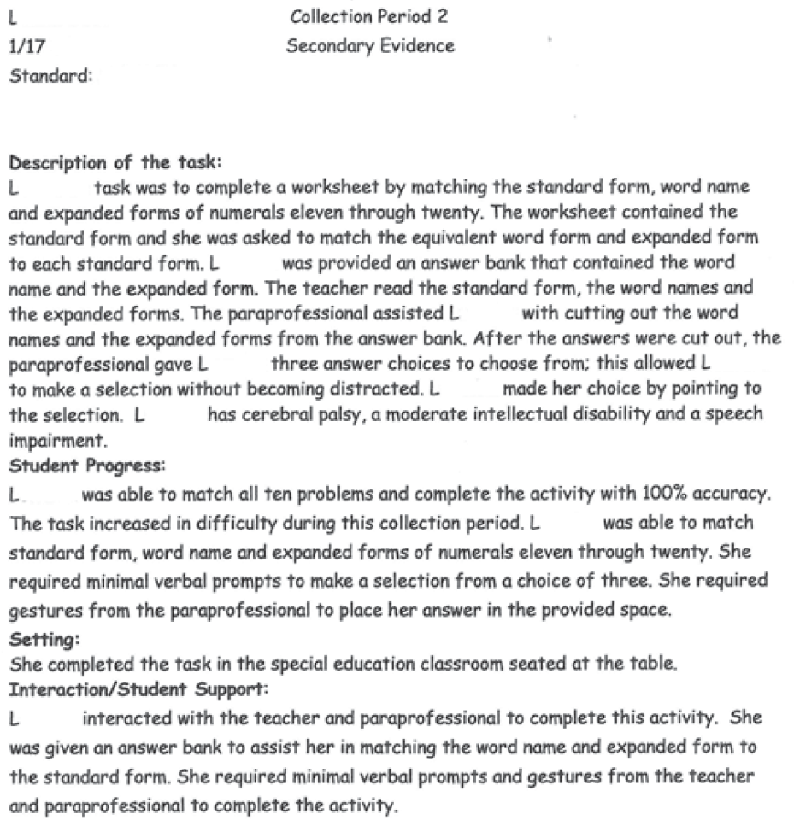
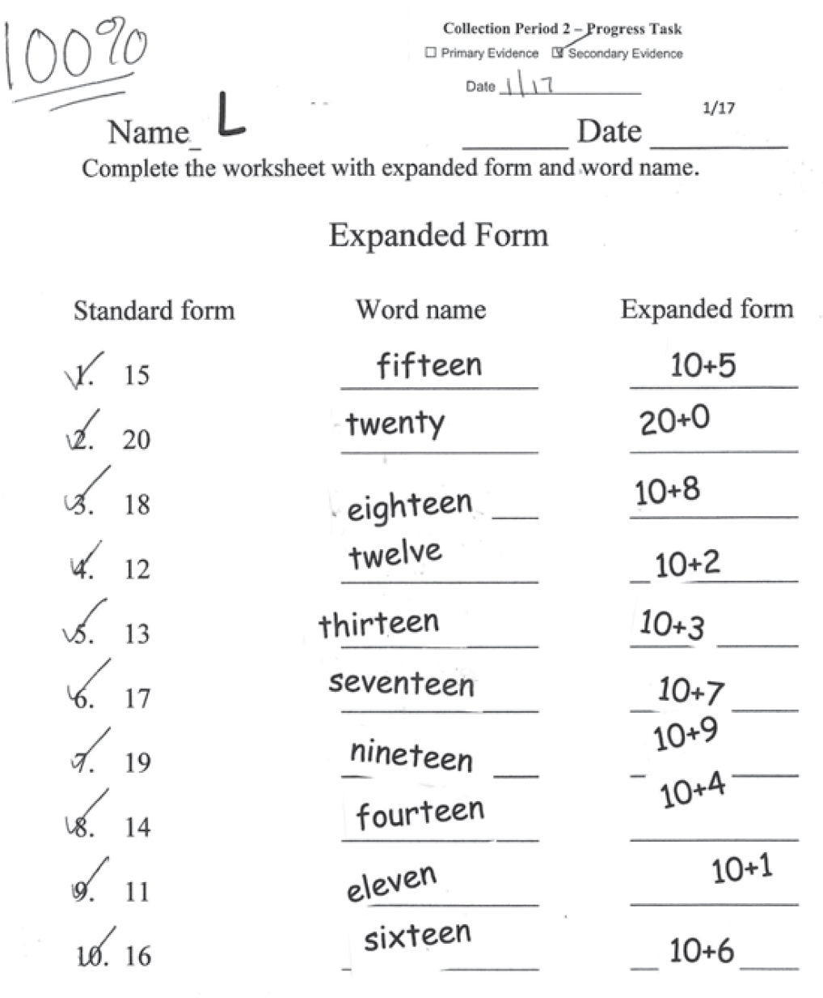
Collection Period 2 Primary Evidence

Slide 70
You Score It
Fidelity | Context | A/P
2 | 3 | 3
Scores for Sample Entry 1:
Fidelity to Standard: 2
All 4 assessment tasks (matching the base 10 numeral to its number name and expanded form) are aligned to the CCGPS content standard. Some aspects of the standard have not been covered, but the student work addresses academic content on an entry level.
Context: 3
The materials used are grade appropriate. The student work reflects a purposeful simulated application.

Slide 71
You Score It
Achievement/Progress: 3
The student work increases in accuracy from Collection Period 1 to Collection Period 2. The student improves from an average of 40% across both tasks in Collection Period 1 to an average of 100% in Collection Period 2.
The tasks increase in complexity as the student is asked to provide both the word name and the expanded form for a different set of two-digit numbers in the second collection period.
There is some increase in independence as the frequency of prompting decreased in Collection Period 2.
With some increase in accuracy, complexity and independence, the student demonstrates reasonable Achievement/Progress.

Slide 72
You Score It
Sample Entry 2
English Language Arts- Speaking and Listening
Grade: 5
Standard: ELACC5.SL.1
Engage effectively in a range of collaborative discussions (one-on-one, in groups, and teacher-led) with diverse partners on grade 5 topics and texts, building on others' ideas and expressing their own clearly.
Element/Indicator: c
Pose and respond to specific questions by making comments that contribute to the discussion and elaborate on the remarks of others.

Slide 73
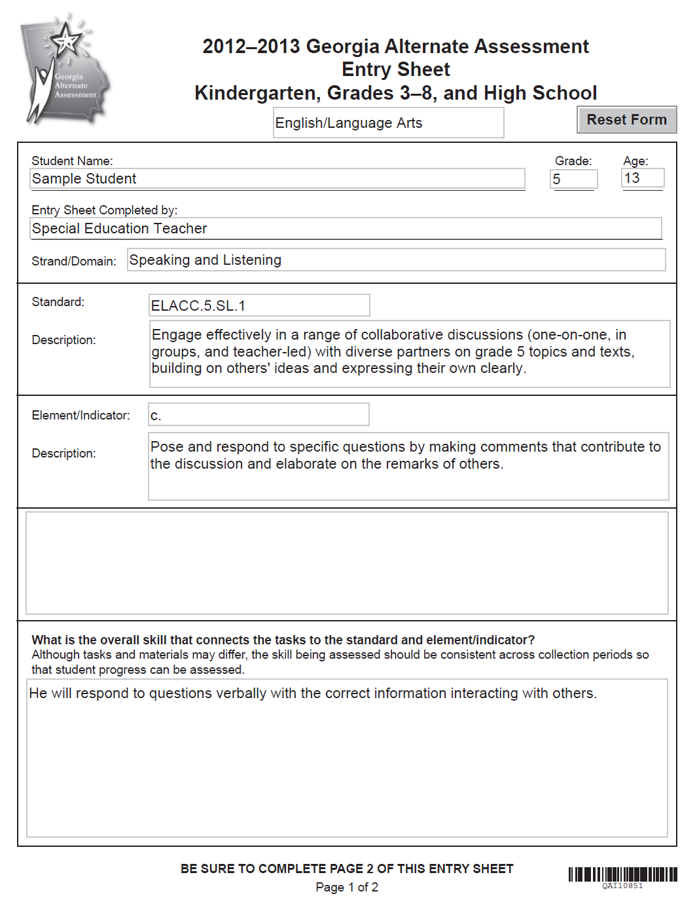
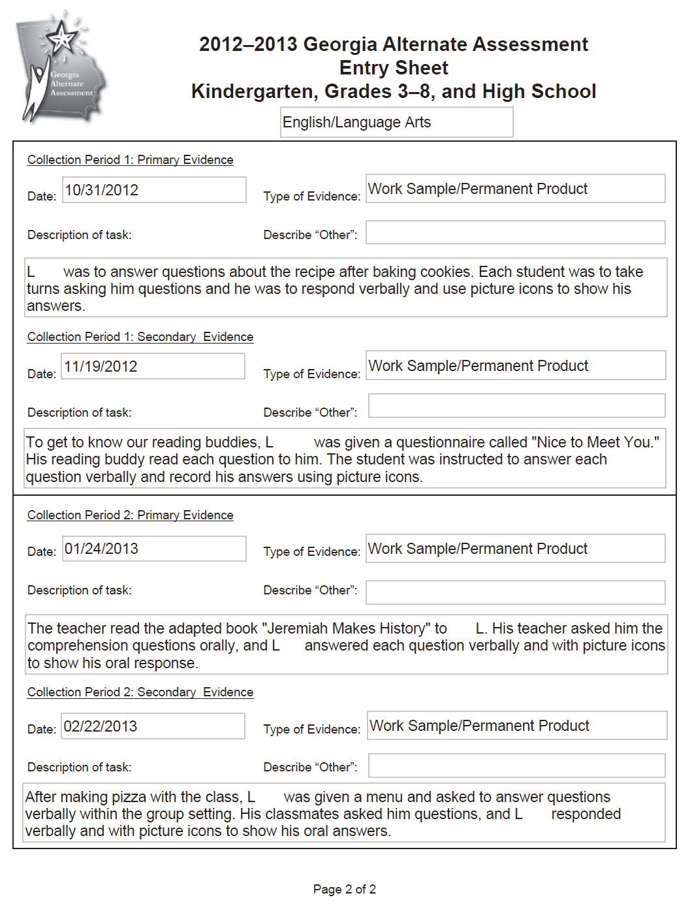
Notes:
This example can be found beginning on page 87 of the 2012-2013 GAA Examiner’s Manual.

Slide 74
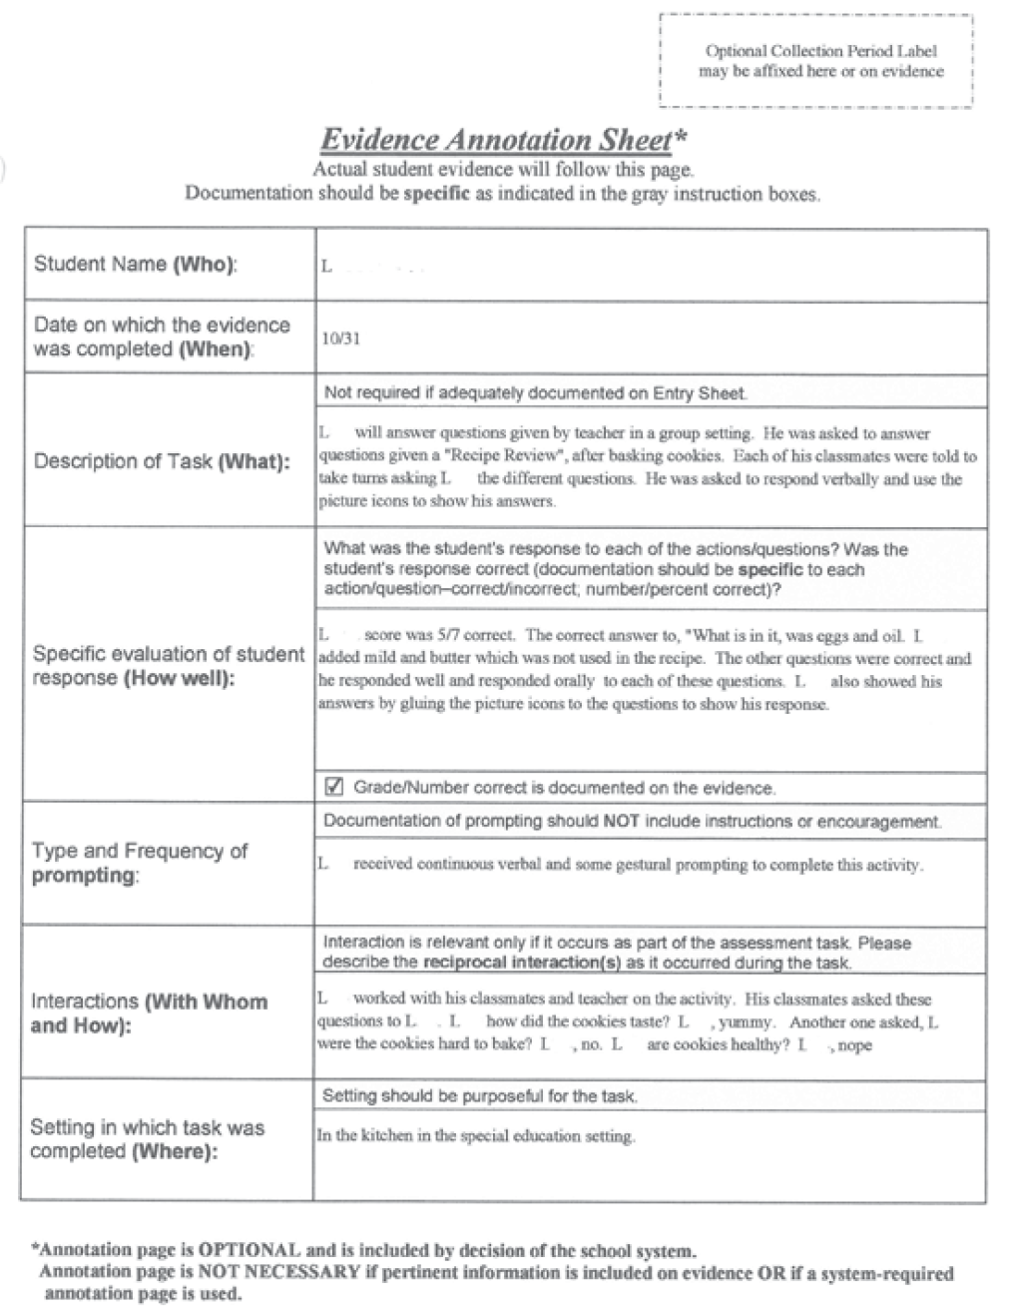
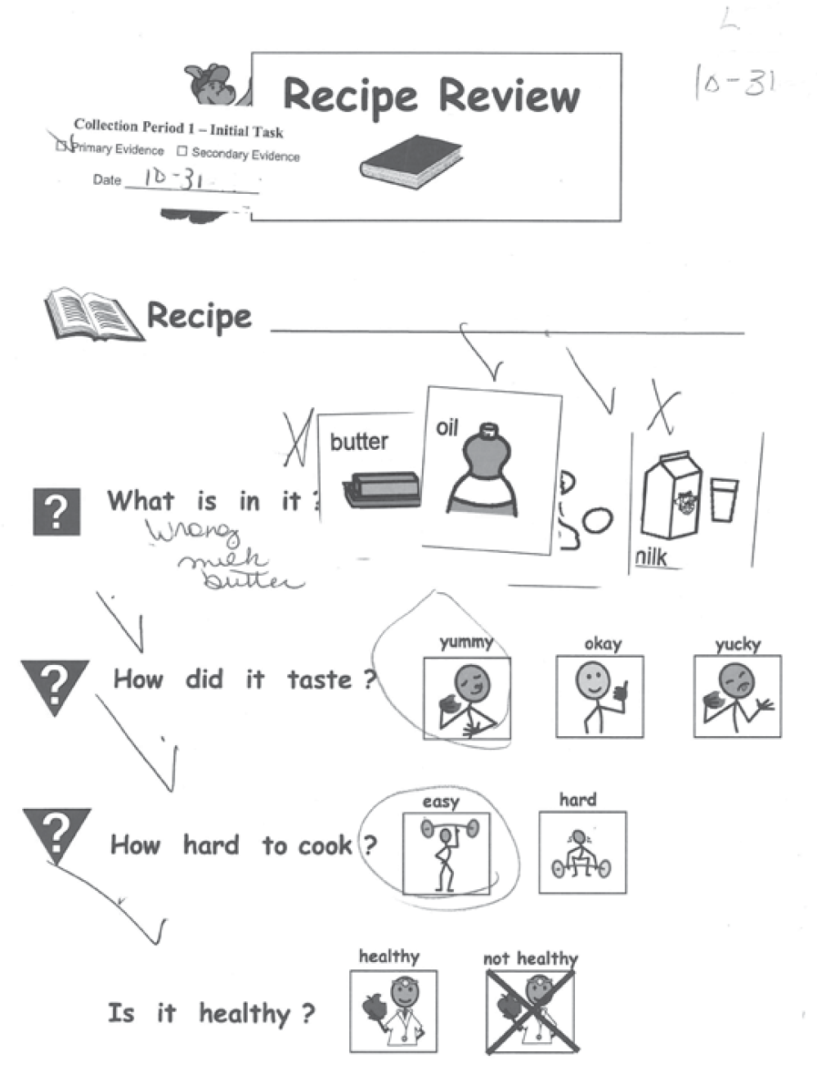
Collection Period 1 Primary Evidence

Slide 75
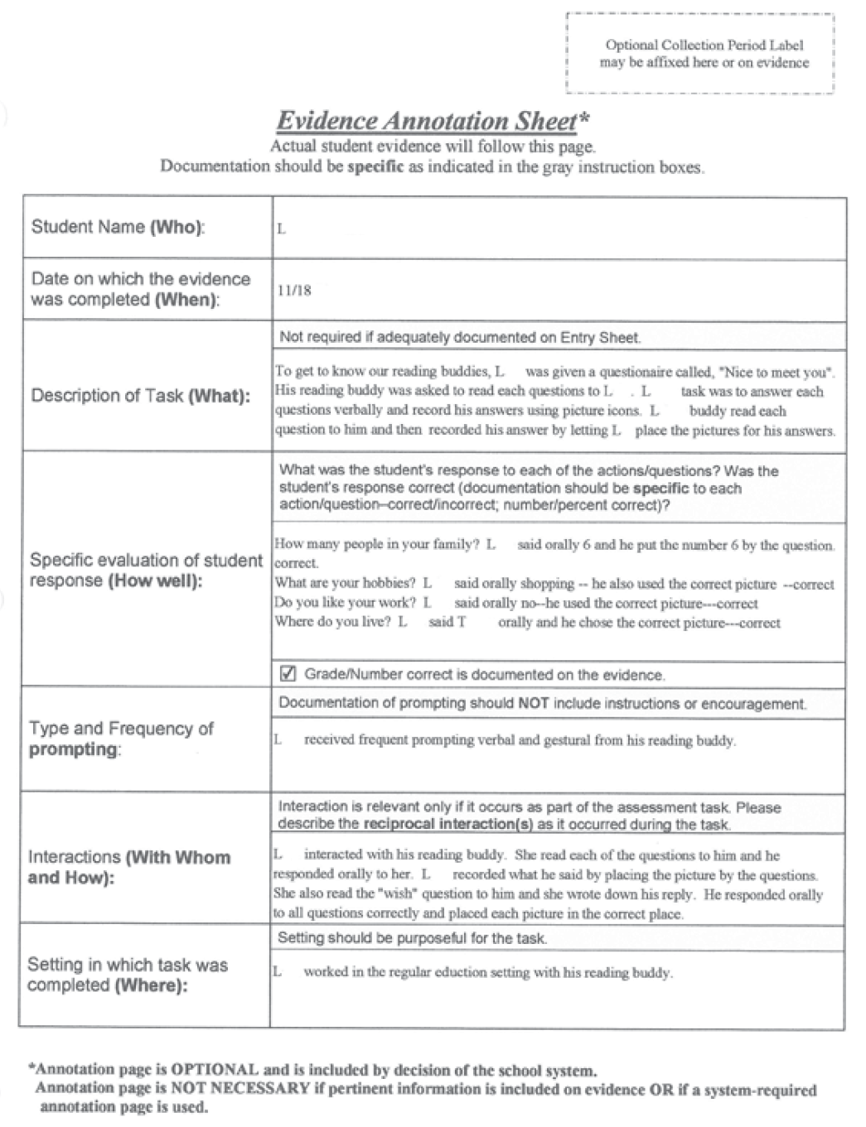
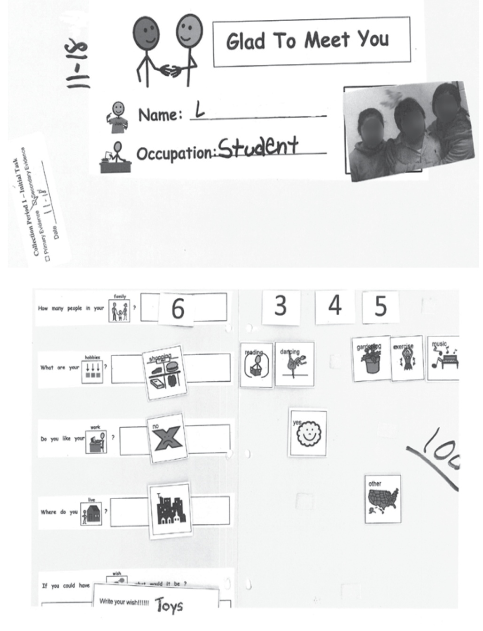
Collection Period 1 Secondary Evidence

Slide 76
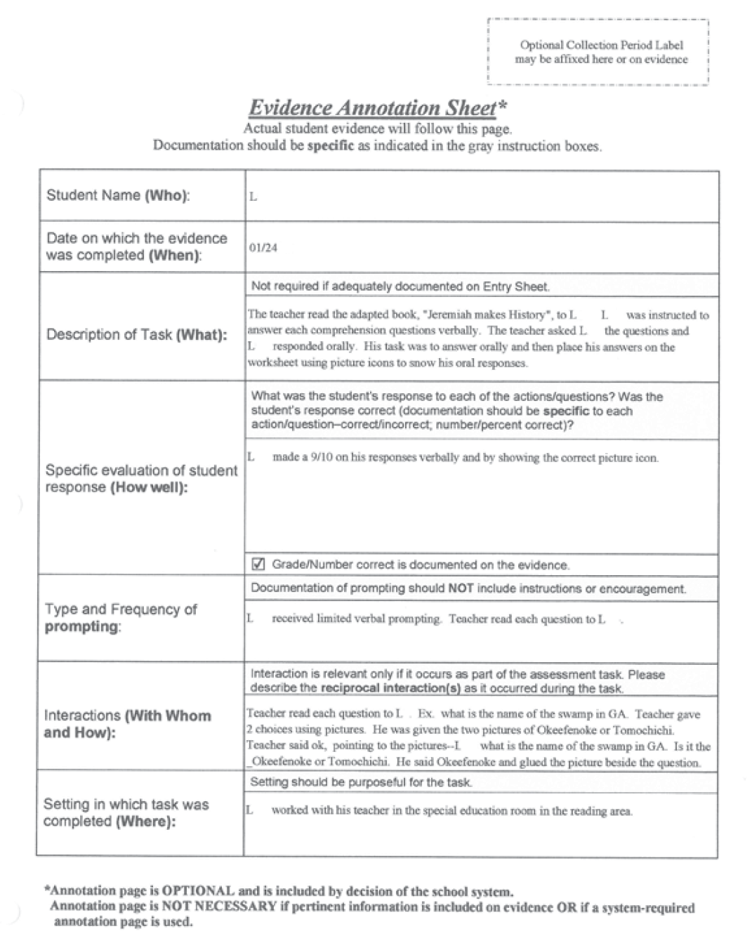
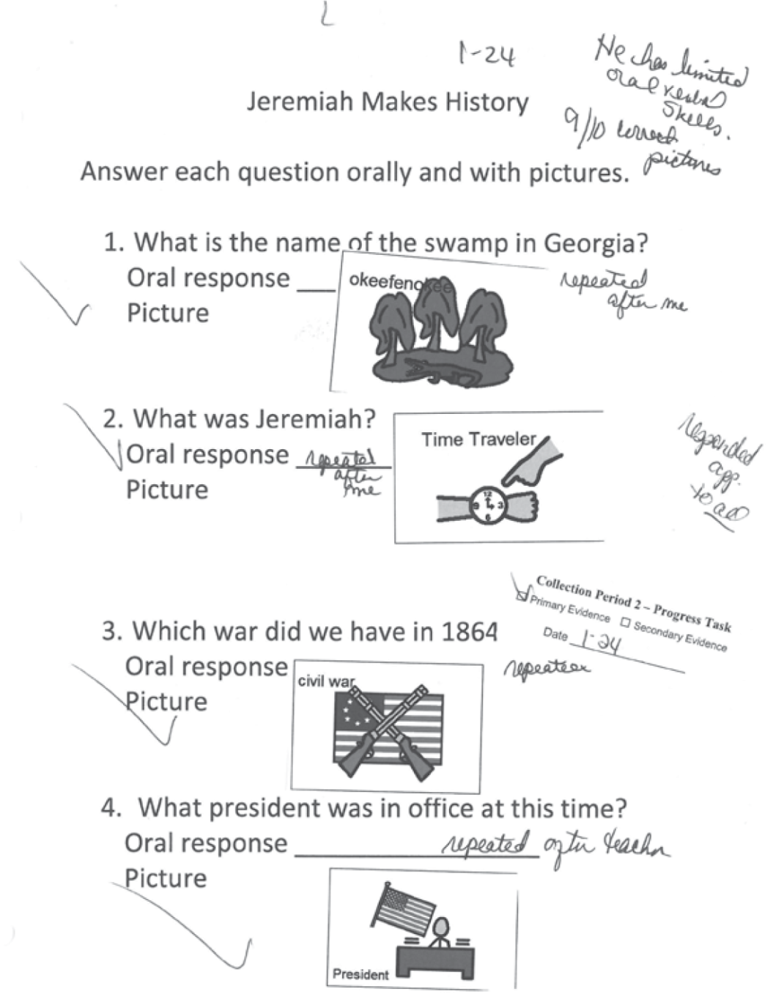
Collection Period 2 Primary Evidence

Slide 77
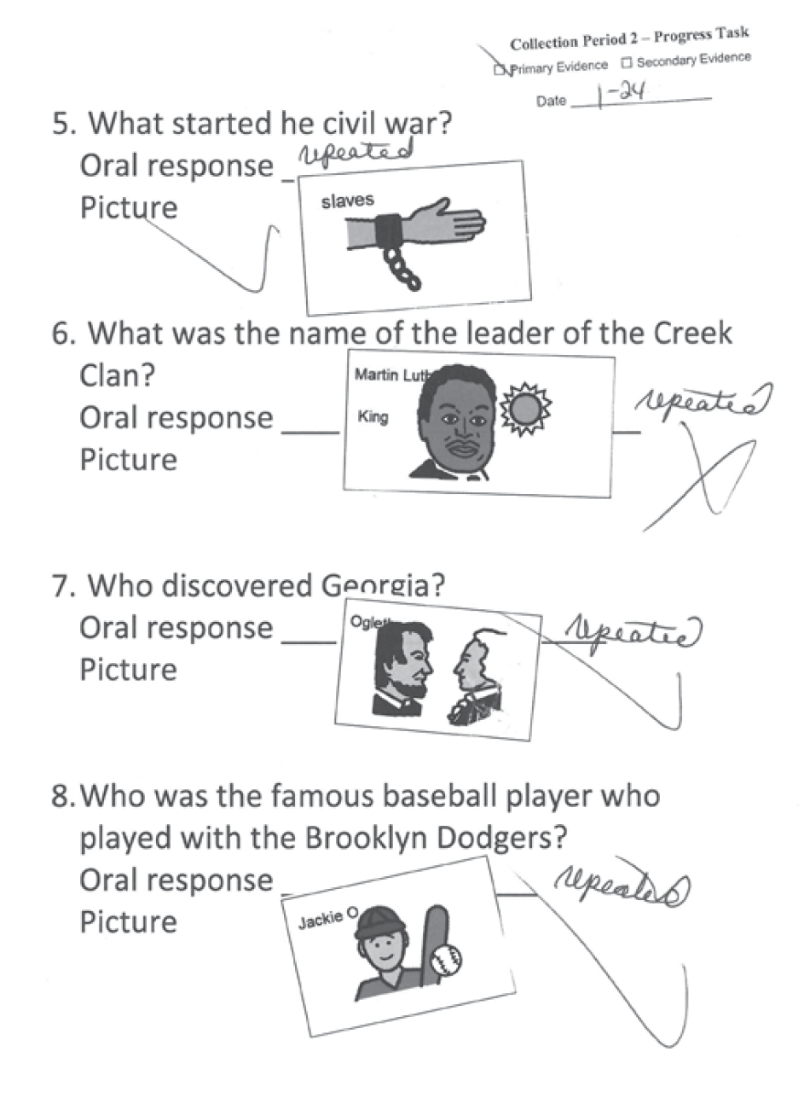
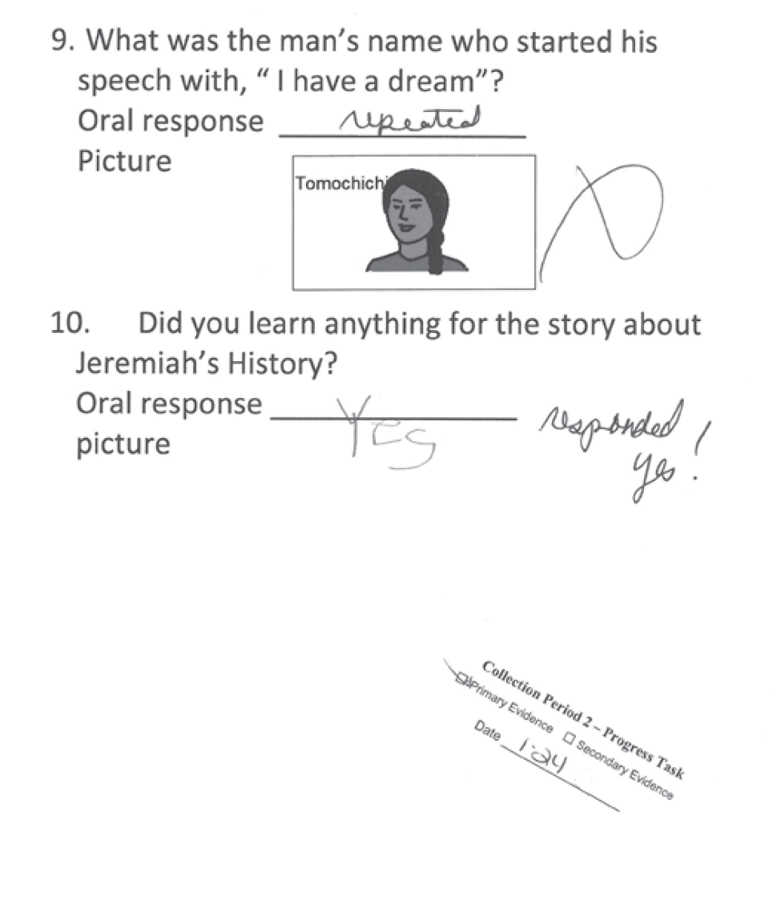
Collection Period 2 Primary Evidence

Slide 78
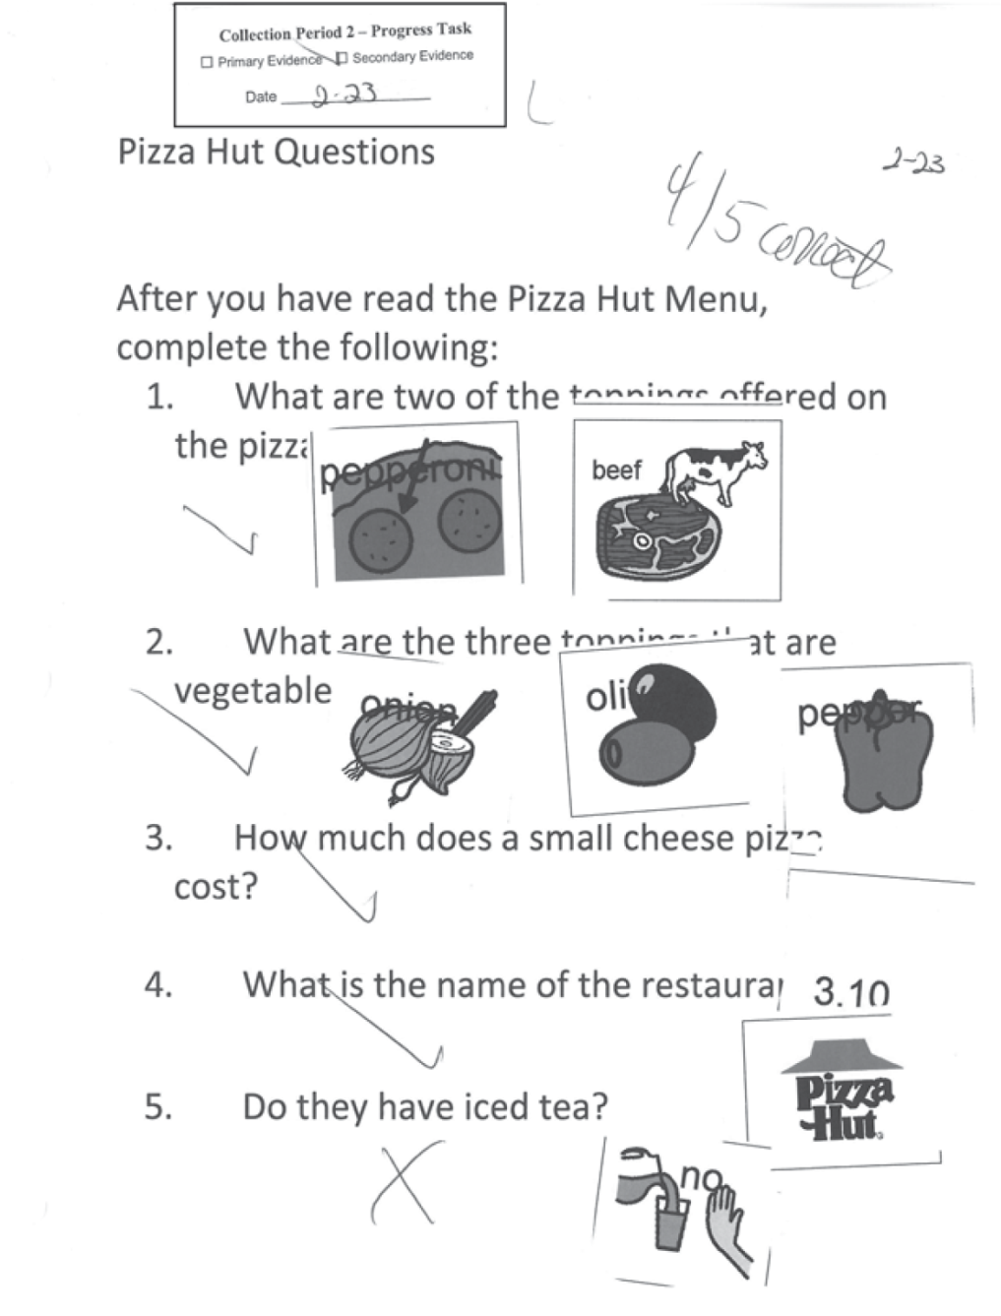
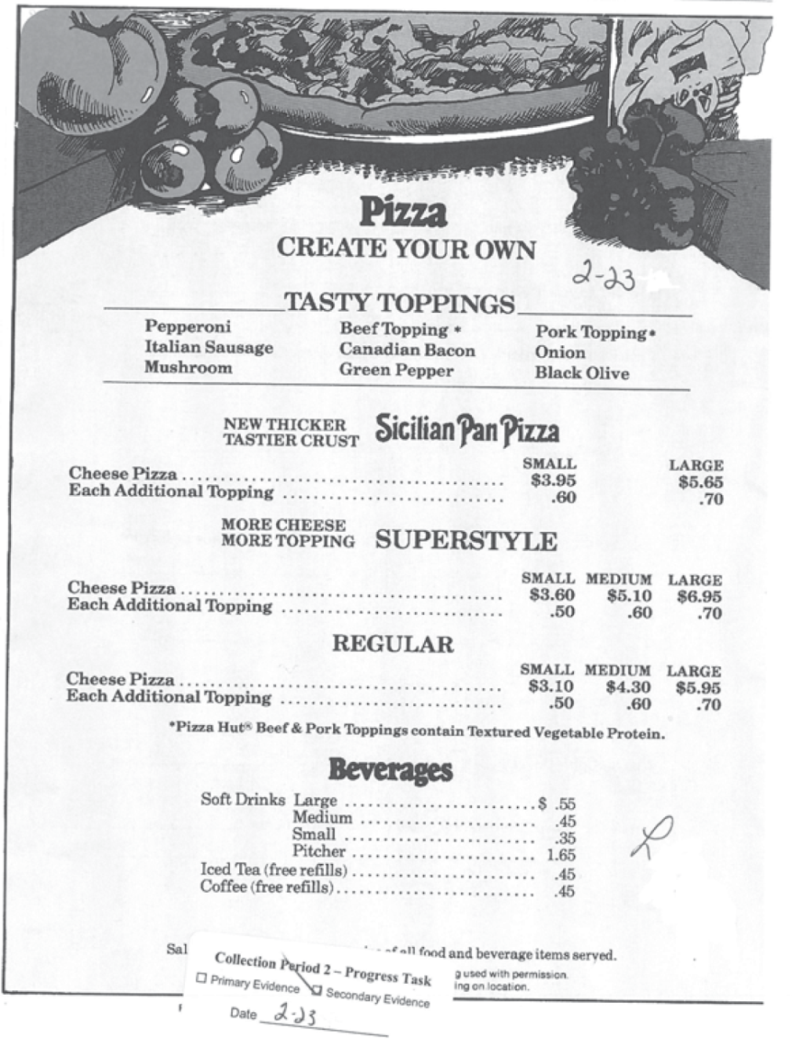
Collection Period 2 Secondary Evidence

Slide 79
You Score It
Fidelity | Context | A/P
2 | 3 | 2
Score for Sample Entry 2:
Fidelity to Standard: 2
All 4 assessment tasks (verbally responding to orally presented questions) are aligned to the CCGPS content standard. Some aspects of the standard have not been covered (does not pose questions or elaborate on the remarks of others), and the student work addresses academic content on an entry level.
Context: 3
The materials used are grade appropriate. The student work reflects a purposeful simulated application.

Slide 80
You Score It
Achievement/Progress: 2
The student work is completed with no increase in accuracy from Collection Period 1 to Collection Period 2 (from an average of 85.5% accuracy across both tasks in Collection Period 1 to 85% accuracy across both tasks in Collection Period 2).
The tasks increase in complexity as the student answers questions on a variety of subjects and answers four more questions in Collection Period 2 (7 and 4 to 10 and 5) then were presented in Collection Period 1. There is no increase in complexity attributed to the different settings and interactions as it is in CP1 that the student is in the general education classroom interacting with a non-disabled Peer Buddy, while he is back in the Special Education classroom in CP2.
Although the student requires verbal prompting throughout, there is some decrease in the frequency of prompting needed for the student to answer the questions.
With no increase in accuracy, and some increase in complexity and level of independence, the student demonstrates some Achievement/Progress.

Slide 81
Contact Information
People, contact information
    Deborah Houston, GaDOE Assessment Division
      Dhouston@doe.k12.ga.us
      (404) 657-0251
    Kayse Harshaw, Division for Special Education Services Questions about curriculum access for students with significant cognitive disabilities
      Kharshaw@doe.k12.ga.us
      (404) 463-5281
    Questar GAA Customer Service Hotline
      GA@QuestarAI.com
      Toll free (866) 997-0698
Notes:
Mention Evaluation link at the end of the presentation

Slide 82
GAA Resources
The following materials are available from the GAA web page:
http://www.doe.k12.ga.us/Curriculum-Instruction-and-Assessment/Assessment/Pages/GAA.aspx
  PowerPoints on previously presented topics
  Examiner’s Manual
  School and System Test Coordinator’s Manual
  Score Interpretation Guide
  Forms
  Blueprint
Division for Special Education Services and Supports
  Access to the Georgia Performance Standards (GPS) for Students with Significant Cognitive Disabilities can found at
  http://www.gadoe.org/Curriculum-Instruction-and-Assessment/Special-Education-Services/Pages/Curriculum-Access-for-Students-with-Significant-Cognitive-Disabilities-.aspx
  The CCGPS/GPS Resource Board -A repository of activities that are aligned at an access level to the CCGPS (Math and English Language Arts), and the GPS (Science, Social Studies, and High School Math).
Notes:
Double click on the link

Slide 83
Access to CCGPS/GPS Resources
Recorded Webinars
Check schedule for recorded webinars and upcoming live webinars:
  http://www.gadoe.org/Curriculum-Instruction-and-Assessment/Special-Education-Services/Pages/Recorded-Webinars.aspx
  Suggested webinars:
Giving Access to Science Standards - Linking Science and Life Skills and Experiences, November 5, 2009
Giving Access to Social Studies Standards - Relating Themes in Social Studies to Relevant Life Skills and Experiences, December 10, 2009
Access to ELA: Writing Skills for Students with Significant Cognitive Disabilities , January 24, 2011
Additional webinars and information for CCGPS ELA and Mathematics activities are being developed and will be announced soon by the Division for Special Education Services .

Slide 84
Access to CCGPS/GPS Resources
Electronic Resource Board for Access to the CCGPS/GPS for
Students with Significant Cognitive Disabilities
The Access to the CCGPS/GPS Resource Board contains: Free downloadable activities and materials for use with students with significant cognitive disabilities across grade levels and curricular areas
  Resources (internet, literature, etc.) to provide access to the general education curriculum
  Adapted stories for all grade levels and directions on acquiring adapted literature
    Instructions for acquiring adapted books
  Instructional strategies and best practice guidelines
  Data Sheets
  Georgia Alternate Assessment (GAA) suggestions/tips
  Georgia Project for Assistive Technology (GPAT) information
  Activities and materials for High School Access Courses
To register and receive your password for the Access to the CCGPS/GPS Resource Board for Students with Significant Cognitive Disabilities:
  send an e-mail with your first/last name and your preferred e-mail address to one of the following persons:
    Kayse Harshaw (sharshaw@doe.k12.ga.us)
    Debbie Reagin (dreagin@doe.k12.ga.us)

