Slide 1
Georgia Alternate Assessment
Preparing Students for Assessment
Module A
Modes of Communication
Instruction vs. Assessment
Live Session:
https://sas.elluminate.com/m.jnlp?password=M.6DEC6E1CE2F36EDF6ED95F790271B0&sid=2012003
Recording:
https://sas.elluminate.com/mr.jnlp?suid=M.886B7382A724A671C8DAA64A5D0E91&sid=2012003

Slide 2
Welcome to Module A
Preparing Students for Assessment
This session will begin at 1:00 p.m.
The PowerPoint is located in the GAA Presentations Portlet at this location:
  http://www.gadoe.org/Curriculum-Instruction-and-Assessment/Assessment/Pages/GAA-Presentations.aspx
While you are waiting, please do the following:
Use the Audio Setup Wizard in the Tools Menu to configure and test your audio settings before the presentation begins.
Confirm your connection speed by going to:
  Tools – Preferences – Connection speed
To eliminate interference from background noise in your area, leave the Talk Button on mute.
Due to the number of participants, we request that questions are submitted via the Chat Box.
Logon with your name and the name of your district beside it (e. g., Deborah Houston – Elbert County). If you have already logged on, place your name and district name in the Chat Box.

Slide 3
Modes of Communication
Communication and Assessment

Slide 4
Communication and Assessment
Assessment of a student’s knowledge is demonstrated through the student’s communication.
  Communication is how the student lets others know what he knows or understands.
All students communicate.
  “One cannot not communicate!”
            Paul Watzlawick
What behaviors does your student exhibit in response to interaction?
  How can you shape those behaviors to respond to standards based activities?
Notes:
Most consistent method of communication—this may not be the new AAC device that you are trying to get the student to use. Are they fluent with the system you are using?
Verbal—Is that the most easily understood?

Slide 5
Communication responses
How can a student demonstrate what he knows?
  Typical responses may include:
    Verbal
    Written
    Signing
    Augmentative and Alternative Communication Device (AAC)
    Pointing, gesturing
    Eye gaze
    Facial expression
    Body movement
    Vocalizations
Notes:
We know the obvious means of communication used by most learners in an assessment: Responses that are verbal or written. Students with cognitive and communication disabilities may use alternate means to communicate. Some may have augmentative and alternative communication. This could be a computerized device programmed to speak for the student, a communication board or notebook with symbols that the student uses to indicate what he wants to say. The student may do this by touching, pointing, gesturing, or even with eye gaze if physical limitations are present.
This may be from an array of many symbols or even just a simple choice of two, or even looking or not looking at one item. Some students may require tactile cues, such as students with visual impairments or with such significant cognitive disabilities that additional sensory input is needed for attending or to aid in discrimination.
Students who have significant multiple disabilities who have not demonstrated choice making skills may make a discriminative response to confirm presence or awareness of a specific stimuli. For example, the student who vocalizes, smiles or arches his body when he hears a familiar voice is communicating discriminative recognition.

Slide 6
Making an assessment response
Students’ responses to assessment activities must demonstrate “what they know” about the concept in the standard/element/indicator.
Receptive behaviors indicate engagement but do not communicate knowledge of concept:
  Attending behaviors may indicate
    participation or listening
    receiving information
Expressive communication is interpreted to measure assessment responses and are:
  Observable behaviors that indicate a discriminative response
  Measurable and indicate understanding or knowledge of a concept.
Notes:
Most consistent method of communication—this may not be the new AAC device that you are trying to get the student to use. Are they fluent with the system you are using?
Verbal—Is that the most easily understood?
Observable behaviors—you can clearly see or hear the response
Measurable—you can record or measure the response and interpret its meaning

Slide 7
Communication Do’s
(and a few don’ts....)
Familiar communication system and response:
  Use communication mode that the student is comfortable with and uses the most accurately and consistently.
Familiar symbols
  Use symbols or modes of communication during the testing activity that have been used during instruction.
    Don’t introduce symbols or responses never used before.
Consistency leads to success
  Use the communication response that the student uses most consistently and successfully on a daily basis.
Give students every opportunity to communicate throughout the day!
Notes:
Most consistent method of communication—this may not be the new AAC device that you are trying to get the student to use. Are they fluent with the system you are using?
Verbal—Is that the most easily understood? Is eye gaze more consistent than pointing?
Teaching a new device or method of response can be used during instruction and in highly reinforcing activities but may not yield the best results for assessment.
E.g. Student may be successful at eye gaze but not yet with scanning with a switch to operate an AAC device
Having student make a choice from 2-4 items may have a high percentage of correct answers but student is not yet fluent answering with a dynamic display device.
E.g. Don’t use a yes/no response if the student does not use that fluently during a variety of activities.
Making choices and identifying objects during highly reinforcing activities such as snack time, leisure, etc., builds expectations for communication responses.

Slide 8

Communication Do’s
Model, model, model the communication mode you expect the student to use as you communicate with the student.
  Point to the symbols/objects as you communicate
  Use the AAC device yourself as you talk to the student
Notes:
Use her communication mode if you want her to use it!
Just as you would speak German if teaching a student to speak German, you must model the use of the “language” of the AAC device.

Slide 9

Making an assessment response
To demonstrate student knowledge and skills related to the curriculum standard,
  an assessment task must require the student to provide an answer or to exhibit a differentiated response.
Discriminative/differentiated responses for students with the most significant cognitive disabilities can involve making a choice or discriminating between possible answers or stimuli.
  Making a choice
    E.g., Eye gaze or physical movement toward correct response
      Given choice of two or more responses
      Given choice of correct response and a neutral stimulus, e.g. 1/8 vs. blank piece of paper

Slide 10
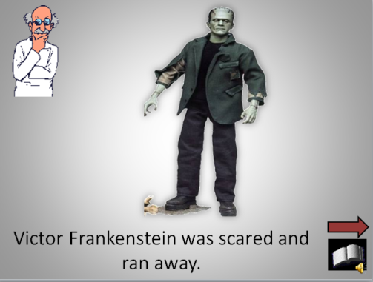
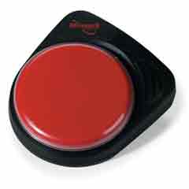

Making an assessment response
  Positive response to one stimulus over another
    e.g. Identifying the main character in the story by giving a different response (smile, eyes widening, etc.) when the object representing that character is presented than is made when a non-related object is presented.
      E.g. Giving a response such as pressing the switch, vocalizing, or smiling when Frankenstein appears in PowerPoint story presentation
Notes:
Stimulus can be presented visually or physically so the student can touch or hold it to demonstrate a response.
One student was assessed on character recognition after being read the adapted story of Alice in Wonderland many times. Each time the teacher mentioned the Cheshire cat, she allowed the student to hold and touch a furry cat that represented the character of the Cheshire cat. Eventually, the student began to positively respond when Cheshire Cat was mentioned and Cheshire Cat was placed under her arms. When the teacher asked “Where’s Cheshire Cat ?” and placed Cheshire Cat under her arms, she smiled and vocalized. If she asked the same question and placed a ball under her arms, the student didn’t give the same response. Therefore, the teacher interpreted this response as character recognition for that student.

Slide 11
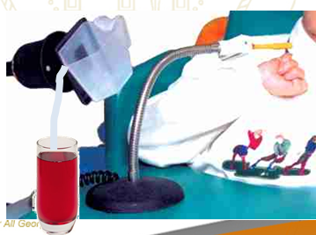
Making an assessment response
  Completion of a physical task to demonstrate understanding
  Voluntary movement to participate in the completion of a task (choice is to press switch or not press switch)
    e.g. When asked, “Show me how to make a solution,” the student presses the switch to activate the pouring device which will pour the solvent (water) into the glass with the solute (drink mix).

Slide 12
Making an assessment response
In each of the preceding examples, evaluation of the student’s response must be based on the correctness of the discrimination.
  Given a choice of 2 picture symbols, the student chose the correct answer via eye gaze 3 out of 4 times.
  The student responded to the figure representing the Cheshire cat by smiling and vocalizing. The student responded to the distractor (ball) by turning away.
  The student answered the question “How do you make a solution” correctly by activating the switch to activate the pouring device.

Slide 13
Providing Learning Opportunities through Instruction
Teach, then Assess!

Slide 14
Giving Students
Opportunities to Learn
The purpose of the GAA is to measure student achievement and progress relative to selected skills that are aligned to grade level CCGPS/GPS.
  The expectations can be different in terms of depth and/or complexity.
Assistive technology and adapted materials may be needed to give access.
The focus may be on prerequisite skills, but must apply to the intent of the grade level content and standard.
The level of instruction must be appropriately challenging for each individual student.
Notes:
14

Slide 15
Giving Students
Opportunities to Learn
Access to the curriculum should be a part of ongoing instruction and should not be limited to singular events represented by the assessment tasks on the GAA.
It is vital that students participate in instructional activities prior to assessment in order to give the students the greatest opportunity to learn and retain knowledge and skills related to the academic curriculum.
Notes:
Access to the curriculum should be a part of ongoing instruction.
--not a single task/event used as an assessment task for GAA
Students participate in instructional activities prior to assessment to allow opportunities for learning concepts and skills related to the standards
I
15

Slide 16
Common Core GPS/GPS
Accessible
Instructional Practices
and Resources
Opportunities to Learn
Georgia Alternate Assessment
Notes:
16

Slide 17
Providing Opportunities to learn
Students must be provided
  Accessible instructional materials (representation)
  Way to communicate and show what they know (expression)
  Ways to interact with instructional materials (representation and engagement)
  Way to remain interested and engaged long enough to learn (engagement)
  These concepts are linked to National Center and State Collaborative (NCSC) and Principles of Universal Design for Learning (www.cast.org)

Slide 18
Understanding the
Common Core GPS and the GPS
In order to best serve our students, it is vital that teachers are provided with the necessary resources and training opportunities to enable them to understand the Big Ideas of the CCGPS and indicators and the GPS and elements.
Big Ideas are key concepts– the intent of the standard and element/indicator.
  Look for big ideas in key nouns found in the standard and indicator/element

Slide 19
Teach first, then Assess!
Teach
Assess
Learn
Collection Period 1
GAA
Collection Period 2
Learn
Assess
Teach

Slide 20
Teach first, then Assess!
Opportunities for learning
  Exposure to materials
  Activities for learning and practice
Assessment
  Student demonstrates knowledge about the content and meaning of the standard and element/indicator
Teaching
Exposure
Practice
Assessment
What I have learned
How I show you
Notes:
20

Slide 21
Teach first, then Assess!
Access to the curriculum should be a part of ongoing instruction.
  not a single task/event used as an assessment task for GAA
Students participate in instructional activities prior to assessment to allow opportunities for learning concepts and skills related to the standards.

Slide 22
Teach, then Assess!
The opportunity to learn via the academic curriculum should be provided throughout the school year.
  Ongoing academic instruction should provide access to a variety of standards from the curriculum–not just those assessed on the GAA.
  Instruction between collection periods will allow students to demonstrate the greatest amount of progress in the standards and elements/indicators on which they were assessed.

Slide 23
Teach, then Assess!
The student’s knowledge, as demonstrated through Collection Period 1 evidence, demonstrates the student’s initial skill on a task that clearly connects to the intent of the standard and element/indicator.
Assessment tasks for Collection Period 1 may occur:
    After introductory lessons
    At the end of a unit
    Prior to teaching a new unit that builds on previous skills
Notes:
The assessment task for Collection period 1 should show student performance on a task that the student has not yet mastered. It is preferable that the student have some familiarity with the context or method of presentation of the material in order to be able to demonstrate their level of knowledge regarding that skill. For example, presenting a worksheet to a student who is not capable of reading or writing is not an adequate method of assessing if the student is capable of understanding material presented with adapted text. Another example: If you are assessing if a student can compare and contrast two characters in a story (ELACC.5RL3) the student must have read the story in order to assess if they can compare characters. They must be familiar with the materials and some aspect of the lesson in order to understand what is asked of them.
23

Slide 24
Teach, then Assess!
Additional tasks that provide exposure or practice with vocabulary or concepts related to the standards can be done for instructional purposes, but should not be used for assessment purposes.
  Example: a Bingo activity may provide additional practice with vocabulary related to the Civil War but is not an assessment of knowledge of the standard.

Slide 25
Teach, then Assess!
Consider the following:
  Matching vocabulary words such as measure, point, and distance before or as the student determines the distance between two points
  Learning to read a map key or compass rose before locating GA on a map
  Identifying <,>,= symbols before using them to compare numbers
  Word searches, crossword puzzles, word banks that expose students to the concepts of character, plot, and setting
Notes:
25

Slide 26
Teach, then Assess!
The preceding tasks could be helpful to familiarize the student with the terms, materials, and concepts used to access the standard.
Learning vocabulary prior to teaching and assessing a task is important
These concepts could also be taught in conjunction with the task that is to be assessed.
However, the tasks DO NOT, in and of themselves, constitute aligned tasks for purposes of assessment.

Slide 27
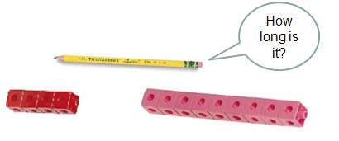
Teach, then Assess!
  Matching vocabulary words such as measure, point, and distance before the student determines the distance between two points.
    Matching vocabulary is not necessary for measurement.
    E.g., a student can measure by comparison and matching.

Slide 28
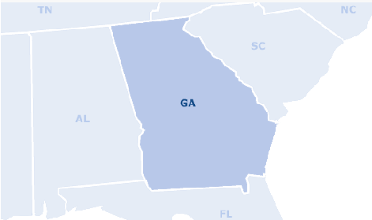
Teach, then Assess!
  Learning to read a map key or compass rose before locating GA on a map
    Georgia can be located without a map key or knowledge of a compass rose

Slide 29
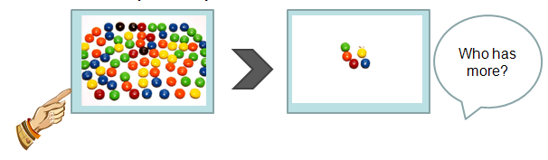
Teach, then Assess!
  Identifying <,>,= symbols before using them to compare numbers
    Math symbol recognition is not necessary to compare numbers. The symbols can be learned while number comparison is being practiced, but it is not a prerequisite skill.
Notes:
29

Slide 30
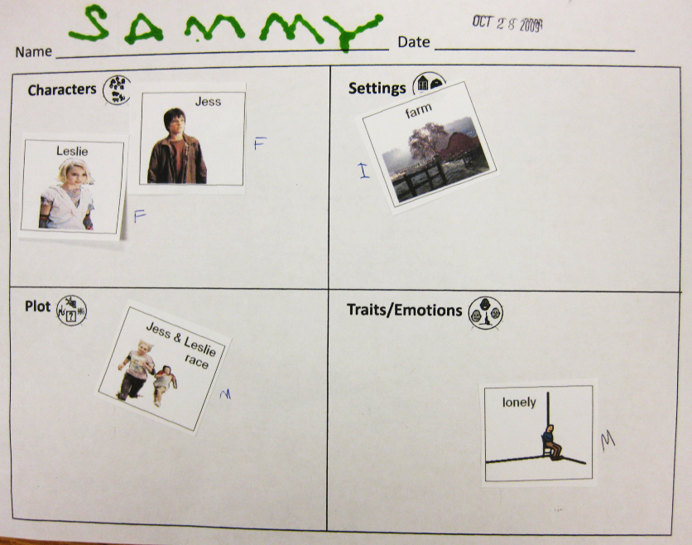
Teach, then Assess!
  Word searches, crossword puzzles, word banks that expose students to the concepts of character, plot, and setting.
    Students should show differentiated responses that give an indication of understanding.

Slide 31
Contact Information
Questions About Test Administration
Call: GaDOE Assessment Administration Division
Toll free (800) 634-4106
Call: Deborah Houston, Assessment Specialist (404) 657-0251
Email: dhouston@doe.k12.ga.us

Slide 32
Contact Information
For information about access to the CCGPS/GPS for students with significant cognitive disabilities
Contact: Kayse Harshaw
Division for Special Education Services
Call: (404) 463-5281
E-Mail: Sharshaw@doe.k12.ga.us

Slide 33
Contact Information
Questions About
Materials, Distribution, or Collection
Call: Questar’s GAA Customer Service Toll free (866) 997-0698
Email: Questar’s GAA Customer Service GA@QuestarAI.com

Slide 34
GAA Resources
The following materials are available from the GAA web page:
http://www.doe.k12.ga.us/Curriculum-Instruction-and-Assessment/Assessment/Pages/GAA.aspx
  PowerPoints on previously presented topics
  Examiner’s Manual
  School and System Test Coordinator’s Manual
  Score Interpretation Guide
  Forms
  Blueprint
Notes:
Double click on the link

Slide 35
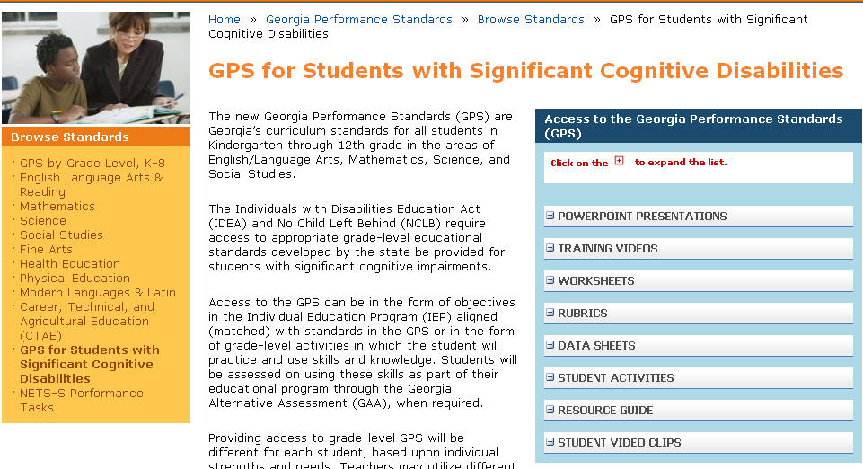
Access to GPS Resources
Georgia Performance Standards (GPS) for Students with Significant Cognitive Disabilities
https://www.georgiastandards.org/standards/pages/BrowseStandards/GPS-Impairment.aspx
Notes:
Double click o the link
Slides 109-112 provide additional resources and links to support teachers in instruction and assessment in the GPS standards for Students with Significant Cognitive Disabilities.

Slide 36
Access to CCGPS/GPS Resources
Electronic Resource Board for Access to the CCGPS/GPS for
Students with Significant Cognitive Disabilities
The Access to the CCGPS/GPS Resource Board contains: Free downloadable activities and materials for use with students with significant cognitive disabilities across grade levels and curricular areas
  Resources (internet, literature, etc.) to provide access to the general education curriculum
  Adapted stories for all grade levels and directions on acquiring adapted literature
    Instructions for acquiring adapted books
  Instructional strategies and best practice guidelines
  Data Sheets
  Georgia Alternate Assessment (GAA) suggestions/tips
  Georgia Project for Assistive Technology (GPAT) information
  Activities and materials for High School Access Courses
To register and receive your password for the Access to the CCGPS/GPS Resource Board for Students with Significant Cognitive Disabilities:
  send an e-mail with your first/last name and your preferred e-mail address to one of the following persons:
    Debbie Reagin (dreagin@doe.k12.ga.us)
    Kayse Harshaw (sharshaw@doe.k12.ga.us)

Slide 37
Access to CCGPS/GPS Resources
Recorded Webinars
Check schedule for recorded webinars and upcoming live webinars:
  http://www.gadoe.org/Curriculum-Instruction-and-Assessment/Special-Education-Services/Pages/Recorded-Webinars.aspx
  Suggested webinars:
Giving Access to Science Standards - Linking Science and Life Skills and Experiences, November 5, 2009
Giving Access to Social Studies Standards - Relating Themes in Social Studies to Relevant Life Skills and Experiences, December 10, 2009
Access to ELA: Writing Skills for Students with Significant Cognitive Disabilities , January 24, 2011
Additional webinars and information for CCGPS ELA and Mathematics activities are being developed and will be announced soon.

Slide 38
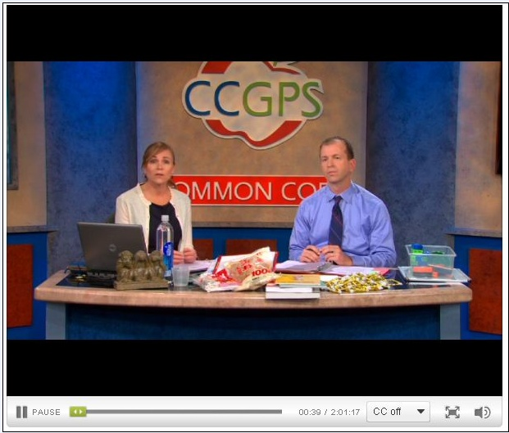
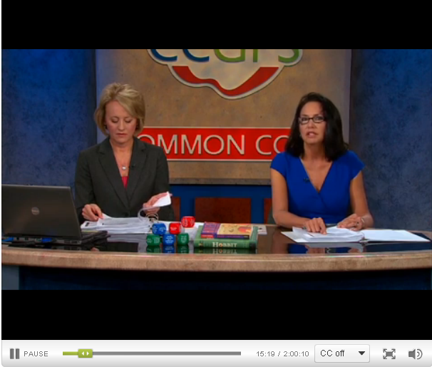
CCGPS Resources
Georgia Public Broadcasting/GaDOE
  http://www.gpb.org/education/common-core
GeorgiaStandards.org
  https://www.georgiastandards.org/Pages/default.aspx

Slide 39
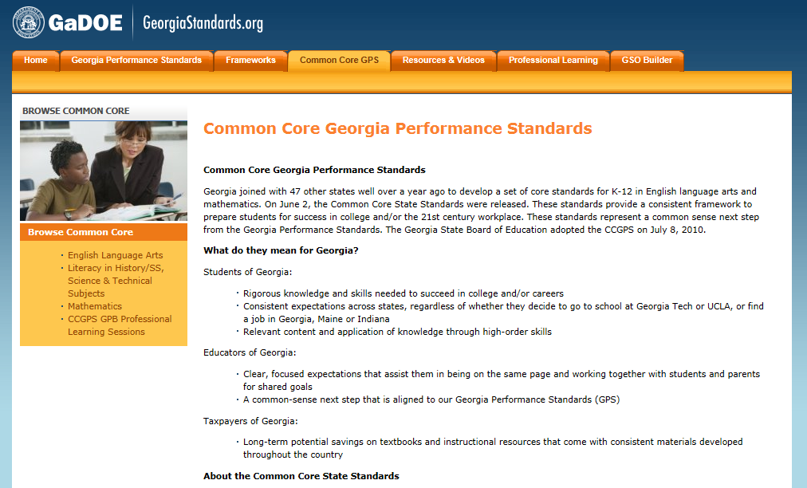
CCGPS Website
https://www.georgiastandards.org/Common-Core/Pages/default.aspx

Slide 40
CCGPS Links
CCGPS
http://www.gadoe.org/Curriculum-Instruction-and-Assessment/Curriculum-and-Instruction/Pages/CCGPS.aspx
ELA
https://www.georgiastandards.org/Common-Core/Pages/ELA.aspx
Mathematics
https://www.georgiastandards.org/Common-Core/Pages/Math.aspx
GeorgiaStandards.org– Links to GPS and CCGPS
https://www.georgiastandards.org/Pages/default.aspx

Slide 41
Welcome to Module B
Aligning Assessment Tasks to CCGPS
This session will begin at 2:45 p.m.
The PowerPoint is located in the GAA Presentations Portlet at this location:
  http://www.gadoe.org/Curriculum-Instruction-and-Assessment/Assessment/Pages/GAA-Presentations.aspx
While you are waiting, please do the following:
Use the Audio Setup Wizard in the Tools Menu to configure and test your audio settings before the presentation begins.
Confirm your connection speed by going to:
  Tools – Preferences – Connection speed
To eliminate interference from background noise in your area, leave the Talk Button on mute.
Due to the number of participants, we request that questions are submitted via the Chat Box.
Logon with your name and the name of your district beside it (e. g., Deborah Houston – Elbert County). If you have already logged on, place your name and district name in the Chat Box.

Slide 42
Aligning Assessment Tasks to the CCGPS and GPS
Georgia Alternate Assessment
Transition to the CCPGS
Unpacking the Standards
Is it a Prerequisite Skill?

Slide 43
Transition to the CCGPS
Beginning with the 2012-2013 administration, Georgia will implement the Common Core Georgia Performance Standards (CCGPS).
All students taking the GAA will be instructed and assessed on the CCGPS in English Language Arts.
Students in Kindergarten and grades 3-8 will be instructed and assessed on the CCGPS in Mathematics.
High School students will continue to be assessed on the GPS in Mathematics for the 2012-2013 administration.
Students in grades 3-8 and High School will continue to be assessed on the GPS in Science and Social Studies.
Notes:
The required and eligible standards are provided on the GAA Blueprint (Appendix D of the 2012-2013 GAA Examiner’s Manual) as well as on the GAA standards document (Appendix E). Both documents are clearly marked designating the content area to be assessed, by grade, as either CCGPS or GPS.

Slide 44
Transition to the CCGPS
The GAA Blueprint was revised for the 2012-2013 administration to incorporate the CCGPS standards that most closely mirror and align to the GPS standards previously assessed.
This was necessary to ensure consistency of the assessment across administrations without making major changes that would necessitate standards being reset.
The majority of CCGPS standards on the GAA blueprint represent the same skills that were previously assessed.
Although some standards may no longer be included or available at a particular grade level, the revised blueprint still offers many options.
Notes:
GaDOE Curriculum Division has developed crosswalks between the GPS and the CCSS.
Used the crosswalks and the current blueprint to identify each standard on the current GAA that has a CCSS equivalent.

Slide 45
What does this mean for teachers?
Teachers must first check the 2012-2013 GAA blueprint when choosing a standard for assessment.
Some activities that were used for testing last year at certain grade levels or of certain standards no longer eligible may not be applicable this year for GAA.
  Instruction covers all standards; Assessment covers only selected standards
GaDOE Division for Special Education Services and Supports is working hard to revamp the Resource Board and to provide examples of activities that can be used for instruction on the CCGPS.
Notes:
Resources and helpful links are provided at the end of this presentation.

Slide 46
What is Alignment?
Alignment is the connection between the written, taught, and tested curriculum. *
Curriculum Standard
Instruction
Assessed Task
In order for an assessment task to be considered aligned, it must demonstrate a clear connection to the Academic Content Standard and element/indicator being tested.
*Diane Browder, UNCC, 2006

Slide 47
Validation Check for Alignment
Have opportunities for teaching and learning of the content to be assessed been provided?
When looking at the skill in isolation, can you still identify the academic domain?
Could a curriculum content expert link it back to the specific state standard?
Has the intent of the standard and element/indicator been addressed?
Is the skill being taught in the context of the grade-level standard?
Do all four assessment tasks align?
Notes:
Is it Math or is it Science?
Is the standard intent of the standard to teach fractions or addition of whole numbers?
(Intent refers back to the “Big Ideas” or essence of the standard)

Slide 48
Alignment to the CCGPS
Alignment of assessment tasks to the CCGPS is based on the same principles as alignment to the GPS.
Alignment is to the grade level curriculum standard.
Assessment tasks can be decreased in depth, breadth, and complexity.
Alignment of all 4 assessment tasks must be to the “Big Idea” (intent/essence) of the standard.
  The standards-based skill being addressed by the assessment task must still connect back to the intent of the standard and element/indicator and be taught in the context of the standard.
Notes:
Karen Erickson, Ph.D. Center for Literacy & Disability Studies, University of North Carolina at Chapel Hill
Transitioning from an emphasis on ACCESS to an emphasis on LEARNING
From mastery of skills in sequence to application of knowledge and skills

Slide 49
Unpacking the Standards
To understand the essence of the standards as that which they are designed to teach, teachers need to unpack them.
Take a marker and highlight key words and phrases
  Look at the noun: What is the student to know?
  Look at the verb: What is the student to do?
Understanding the intent of the standard is necessary to choosing the standards-based skill for assessment.

Slide 50
Unpacking the Standards
CCGPS Grade 4 Mathematics:
What is the noun? Fractions
What is the verb? Solve
What are the supporting concepts:
  Same whole
  Like denominators
  Addition; subtraction
  Word problems

Slide 51
Unpacking the Standards
What is the “Big Picture” of the standard?
  Fractions as parts of a whole
    Same denominator (same whole is equally divided)
    Adding and/or subtracting fractions (Addition and subtraction without fractions is NOT ALIGNED!)
Once the intent of the standard has been determined, choose the standards-based skill that will connect all four assessment tasks across the two collection periods.
Notes:
The skill should be taught in the context of the grade-level standard and carried across both collection periods.

Slide 52
Choosing the standards-based skill for assessment
Essential Skills:
I can demonstrate my understanding of fractions
I can recognize fractions with like denominators as part of the same whole.
I can add and/or subtract fractions with like denominators.
I can solve word problems involving fractions.
How:
I can use visual fraction models and/or equations to represent a problem.

Slide 53
Choosing the standards-based skill for assessment
The learning target for each student will be determined by the level at which the student is able to access the standards-based skill.
What type of skill will the student use to access this math standard?
  Addition of fractions
How will the student provide a response?
  Verbal, written, gestural, eye gaze?
  Augmentative communication device?
What type of supports does the student need?
  Manipulatives, visual representations, number lines?
Notes:
The learning target should represent the appropriate level of challenge for each student. This may change as the student has opportunity for exposure to concepts, terminology and materials before the first collection period and the opportunity for instruction before the second collection period. In this case, the skill that will be evaluated across both collection period will be the addition of fractions.

Slide 54
Choosing the standards-based skill for assessment
Skill to be assessed across all 4 assessment tasks:
Adding fractions with the same denominator
 | Collection Period 1 Primary Task | Collection Period 1 Secondary Task | Collection Period 2 Primary Task | Collection Period 1 Secondary Task
Skill | Addition of fractions with like denominators | Addition of fraction with like denominators | Addition of fractions with like denominators | Addition and subtraction of fractions with like denominators
Task | Using fraction circles, the student will add fractions with like denominators. | Using fraction circles and fraction number lines, the student will add fractions with like denominators. | During a game of table top bowling, the student will add the fractions that represent the number of pins knocked down in each frame (x/10+y/10=z/10) | The student will solve word problems by adding and subtracting fractions using a fractional pizza chart.
Mode of Response | gestural | verbal, gestural | verbal, gestural | verbal, gestural
Supports | Fraction Circles | Fraction Circles Fraction Number Line | Bowling pin paper cut outs Velcro board Fraction Number Line | Pizza chart Fraction Number Line
Notes:
In the last assessment task, the student has added the skill of subtraction. Because the student is adding fractions in the first collection period and adding fractions in the second collection period, we can evaluate the student’s progress from CP1 To CP2. Because the student is also assessed on the skill of subtracting fractions in CP2, we can evaluate the student’s knowledge of both skills, therefore adding complexity to the CP2 tasks.
However, if the student had added fractions in the first collection period and subtracted fractions in the second collection period, we would not be able to evaluate progress as he is demonstrating two different skills. We don’t know how well he was able to subtract fractions in the first collection period, and we don’t know how much progress he has made in the addition of fractions in the second collection period. Addition and subtraction are two different skills.

Slide 55
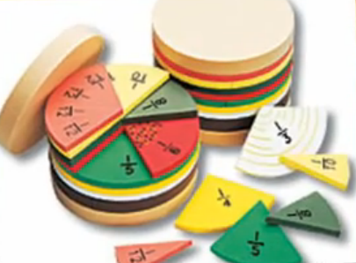
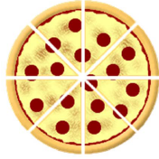
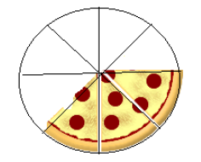
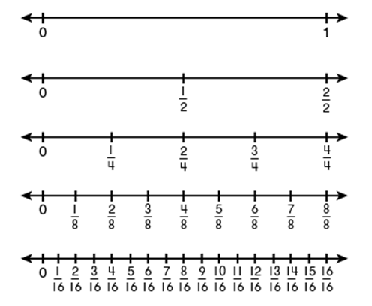
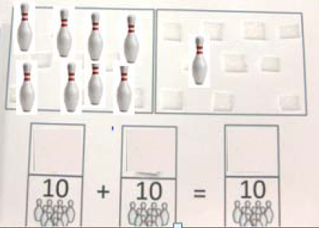

Choosing the standards-based skill for assessment
Collection Period 1 Supports
Collection Period 2 Supports

Slide 56
Choosing the standards-based skill for assessment
Some of the CCGPS standards are broader and encompass more skills within a standard than was the case with the GPS.
  There can be more than one “Big Idea” and a number of standards-based skills within the same CCGPS standard.
It is appropriate for many of our students to choose one skill around which to design the assessment tasks.
It is critical that all 4 assessment tasks submitted for that standard demonstrate a connection to the same standards-based skill.
  The same skill (s) must be demonstrated in both collection periods.
  Additional skills can be added in the second collection period.

Slide 57
Choosing the standards-based skill for assessment
Essential Skills:
I can identify the theme or central idea of a text.
I can show how the theme is communicated through details in the text.
I can provide a summary of the text.
I can discriminate between summary that does and does not include personal opinions or judgments.

Slide 58
Choosing the standards-based skill for assessment
Skill: determine theme or central idea
Skill: summarize text
What is the noun? theme
What is the verb? determine
What are the supporting concepts:
            details
What is the noun? summary
What is the verb? summarize
What are the supporting concepts:
opinions and/or judgments

Slide 59
Choosing the standards-based skill for assessment
For some students, it may be appropriate to focus only on the “Big Idea” of theme/central idea in a text.
For some students, it may be appropriate to focus only on the “Big Idea” of summarizing a text.
Some students may be able to identify the theme/central idea of a text and provide a summary.
Skill | Identify central idea | Identify central idea | Identify central idea | Identify central idea
Skill | Summarize text | Summarize text | Summarize text | Summarize text
Skill | Identify central idea | Identify central idea | Identify central idea and Summarize text | Identify central idea and Summarize text
Notes:
As you can see in the last example, the skill of identifying the central idea will be assessed in both collection periods. The skill of summarizing the text was added in the second collection period to demonstrate the student’s knowledge of both skills, therefore adding complexity to the CP2 tasks.

Slide 60
Choosing the standards-based skill for assessment
Reminder!
In order to demonstrate achievement/progress, it is critical that all 4 assessment tasks submitted for that standard demonstrate a connection to the same standards-based skill.
Although all 4 tasks in the following example are aligned to a “Big idea” from the standard, a student can’t show progress in the Collection Period 1 skill unless that skill is also assessed in Collection Period 2.
  Are the above skills all aligned to the standard?
  Can the student demonstrate progress form CP1 to CP2?
Skill | Identify central idea | Identify central idea | Summarize text | Summarize text
Yes
No
Notes:
Unless the student identifies the central idea of the text while providing the summary in Collection Period 2 (as in the 3rd example on slide 15), he is being assessed on different skills across the 2 collection periods. As per the GAA scoring decisions, if the skills assessed from one collection to the other are too different, progress cannot be evaluated, and the student will receive a score of “1” in Achievement/Progress.

Slide 61
Choosing the standards-based skill for assessment
When designing assessment tasks for each collection period, ask yourself the following questions:
  Do all 4 assessment tasks align to the intent of the standard?
  Do the assessment tasks in Collection Period 2 allow the student to demonstrate progress on the skill(s) assessed in collection period 1?
If the tasks from one collection period to the other are too different to reliably assess progress, the A/P score is “1.”
  No consistent skill to evaluate across the two collection periods

Slide 62
Alignment through Prerequisite Skills
Looking at the skill in the context of the standard

Slide 63
Alignment through
Prerequisite Skills
Tasks submitted for the assessment can focus on prerequisite skills that allow the student to be exposed to and assessed on the standard/element at a level that is meaningful and purposeful for the student.
Prerequisite skills must still focus on the intent of the grade level standard and element/indicator.
Notes:
63
In the both the CCGPS and the GPS curriculum training, the focus is on “Big Ideas”– what we are referring to here as the “intent” of the standards.
It is a misunderstanding to say that a student has to be able to identify letters or to decode words in order to access text and to demonstrate reading comprehension. Although it may be an important part of the student’s academic instruction to work on these skills, in and of themselves, they do not represent aligned tasks.

Slide 64
Prerequisite Skills
A Prerequisite Skill is one that is essential to the acquisition of the standard and element/indicator.
  addresses the intent of the standard and element/indicator being assessed
  that which separates one standard from another
Notes:
The biggest misunderstanding when it comes to the concept of prerequisite skill is that there is a linear hierarchy to learning that must be followed and that anything that comes earlier on in that hierarchy is a prerequisite. We think that children should learn to crawl and then to walk and then to run, but that does not make crawling a prerequisite to running. We think that children need to decode letters before they can read and that they need to be able to read before they can demonstrate comprehension of text, but we know that students can demonstrate comprehension without ever being able to identify or decode letters.
Since Mathematics is the science of numbers and their operations, should any task involving numbers be seen as a prerequisite to any and all math standard?
In order to be considered a prerequisite to a standard, the skill being assessed must be essential to the specific intent of the standard-that is what separates one standard from another.

Slide 65
Is it a Prerequisite Skill?
To determine if a skill is truly a prerequisite to learning the targeted skill, the following questions should be asked :
  Should acquisition of the skill be part of the instruction that precedes the assessment?
    If so, DO NOT submit the task as evidence of assessment.
  Is the skill essential to understanding the intent of the standard and element/indicator?
  Can working on this skill eventually lead to the standards-based skill targeted by the standard (at a less complex level)?
Notes:
65
If the skill is associated with that task but is not required to show the main concept, it is in itself not aligned when taught in isolation. The skill must be assessed in the context of the standard.

Slide 66
Is it a Prerequisite Skill?
Start with the Big Idea: Fractions
Task: Student is working on counting skills.
  Counting could be a part of the ongoing instruction that precedes the assessment , but it is not sufficient as a task for this standard if it is not assessed in the context of the standard .
  The ability to count is not essential to the understanding of fractions.
  Does counting alone ever get the student closer to an understanding of fractions?
  NO
Notes:
66
Counting in isolation is NOT a prerequisite. If the student is working on counting as a precursor to addition, it should be taught prior to the assessment. In order to be aligned, the prerequisite skill must still be assessed in the context of the standard. It would be acceptable to assess a student’s ability to do addition of fractions by counting along a fraction number line to add the numerator. But it is critical that this counting be done in the context of the standard- in this case adding the numerators of fractions with the same denominator. Counting in and of itself is not an aligned prerequisite.

Slide 67
Is it a Prerequisite Skill?
Task: Student is using manipulatives to demonstrate fractional representation based on parts of a whole.
  Putting together pieces of a whole via manipulatives is akin to addition of the fractional pieces. This can be considered addition of fractions at a more simplified level (i.e., decreased depth and complexity).
  This skill is a prerequisite as it addresses the intent of the standard and is assessed in the context of the standard–fractions.
  Can repeated exposure to parts of a whole ever get the student closer to an understanding of fractions?
  Yes
Notes:
Essential Skills:
I can demonstrate my understanding of fractions
I can recognize fractions with like denominators as part of the same whole.
I can add and/or subtract fractions with like denominators.
I can solve word problems involving fractions.
67

Slide 68
Is it a Prerequisite Skill?
Georgia Studies–Economic Understandings (GPS)
SS8E5 – The student will explain personal money management choices in terms of income, spending, credit, saving, and investing.
  What is the intent of this standard?
  What are some ways this standard can be accessed by students with significant cognitive disabilities (SWSD)?
Notes:
This is the standard description. There are no elements for this particular standard, so alignment must go directly back to the intent of the standard.
The intent of this standard is to introduce the student to the concepts of personal money management- earning, saving, spending.
Students can earn points, stickers, classroom “dollars” that can be used to “buy” a favorite activity or treat.

Slide 69
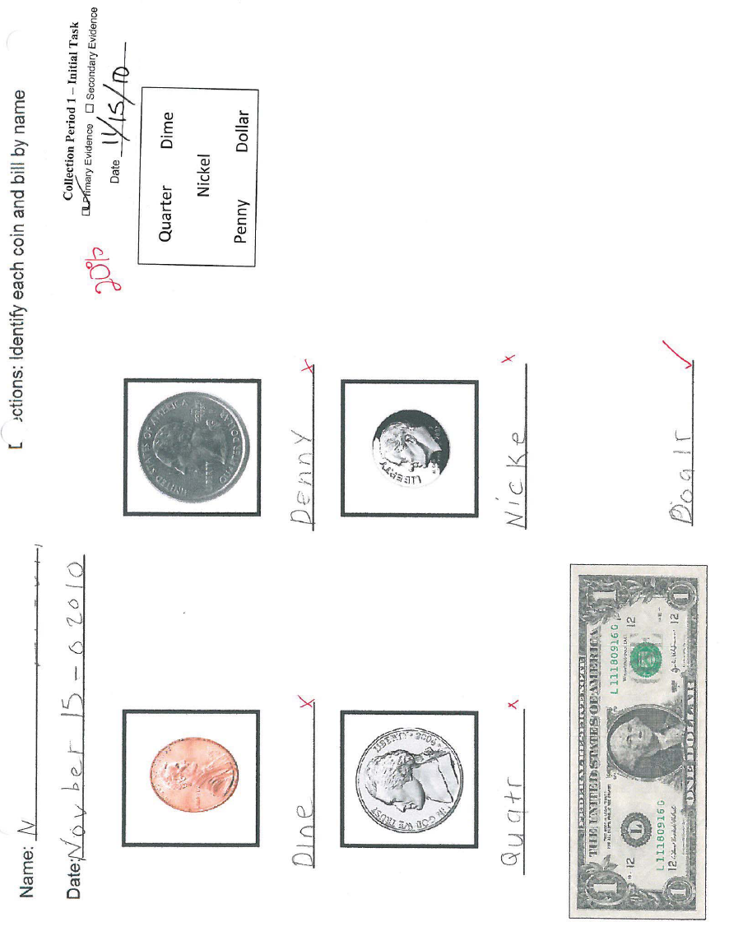
  “N completed a worksheet where she had to identify
  coins and dollar bills by name.”

Slide 70
Is it a Prerequisite Skill?
Task: Student is identifying coins and bills by name.
  If this is a skill you would like to integrate into the student’s skill set to later use it in the context of the standard, it should be taught prior to the assessment .
  Being able to identify coins and bills by name is not essential to the understanding of personal budget.
  Does money identification alone ever get the student closer to an understanding of personal money management?
  NO. This task is not aligned.
Notes:
Looks more like a math task than a Social Studies task.
There is nothing in the task or the task description that would allow a curriculum expert to identify this task as aligned to this Social Studies Standard.
The intent of the standard is to allow the student to learn about personal money management. A SWSD may never be able to identify coins or have the computation skills necessary to use money independently, but he can learn about earning and spending (point systems, reward charts, saving for a special treat or activity, etc.).
This is a preliminary skill tied to this particular task. It may be a prerequisite to later tasks in which the student uses coins to buy things, but it is NOT a prerequisite to the intent of the standard.

Slide 71
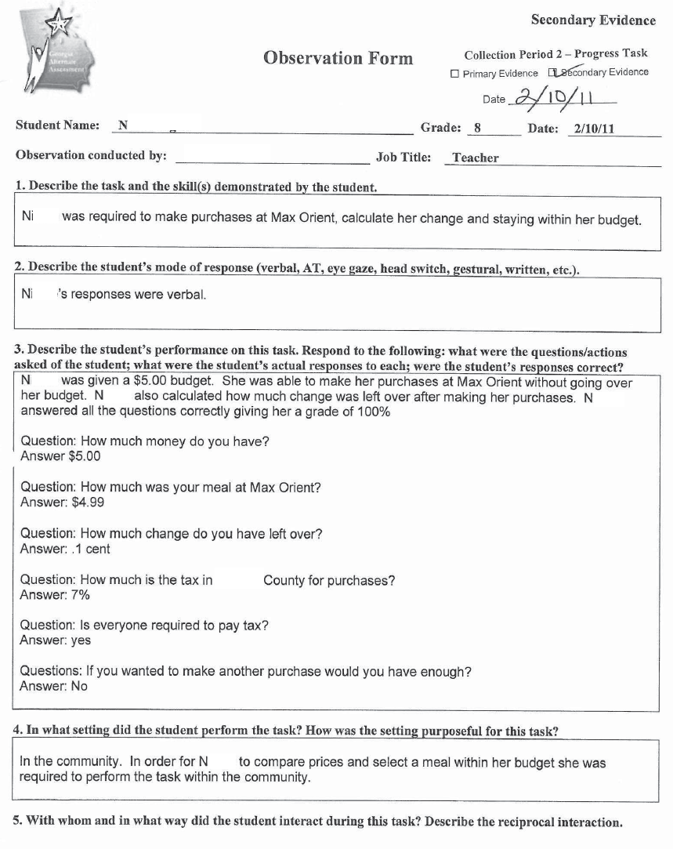
“N was required to make a purchase, calculate her change, and stay within her budget.”
This task was submitted for the same student for Collection Period 2.

Slide 72
Is it a Prerequisite Skill?
Task: Student is making spending choices while staying within her budget.
  This skill is being taught in the context of the standard.
  Being able to recognize whether or not you have the funds to make a purchase is essential to understanding essential to the understanding of personal money management.
  Will practice in making saving and spending decisions in a variety of situations get the student closer to an understanding of personal money management?
  YES. This task is aligned.
Notes:
The word “budget” in the task description helps to tie it to the Social Studies domain within personal money management.
Assessment tasks involving budgets could work for mathematics, but the concept of personal money management is specific to social studies.
The intent is for students to learn about managing their personal finances; staying within a budget falls within that category.
Although the task is simplified to one instance in which she has to make a single purchase without going over her budget, it is demonstrates a beginning understanding of spending within a personal budget.

Slide 73
Alignment to the Characteristic of Science

Slide 74
Characteristic of Science
Science consists of a way of thinking and investigating, as well a growing body of knowledge about the natural world.
To become literate in science, therefore, students need to acquire an understanding of both the Characteristics of Science and its Content.
The Georgia Performance Standards for Science require that instruction be organized so that these are treated together.
Therefore, A CONTENT STANDARD IS NOT MET UNLESS APPLICABLE CHARACTERISTICS OF SCIENCE ARE ALSO ADDRESSED AT THE SAME TIME. For this reason they are presented as co-requisites.
https://www.georgiastandards.org/Standards/Pages/BrowseStandards/ScienceStandards.aspx
Notes:
This text is provided on the Georgia Standards website.

Slide 75
Characteristic of Science
Students taking the GAA must be assessed on the same academic curriculum as their General Education Peers.
  this includes the co-requisite Characteristic of Science
The Characteristics of Science incorporates hands-on, student-centered, and inquiry-based approaches.
  the process of science
A co-requisite Characteristic of Science standard must be addressed as part of the GAA science assessment entry on at least one piece of evidence submitted for the science entry.

Slide 76
Characteristic of Science
For all students assessed in Science (grades 3–8 and high school), a Characteristic of Science must be recorded/written on the Science Entry Sheet.
The Characteristic Of Science recorded on the Entry Sheet must be identifiable and documented in the evidence.
Even if all four assessment tasks submitted for a science entry align and are scorable, if either of the above conditions is not met, the entry is nonscorable.
  Nonscorable Code of NA-D

Slide 77
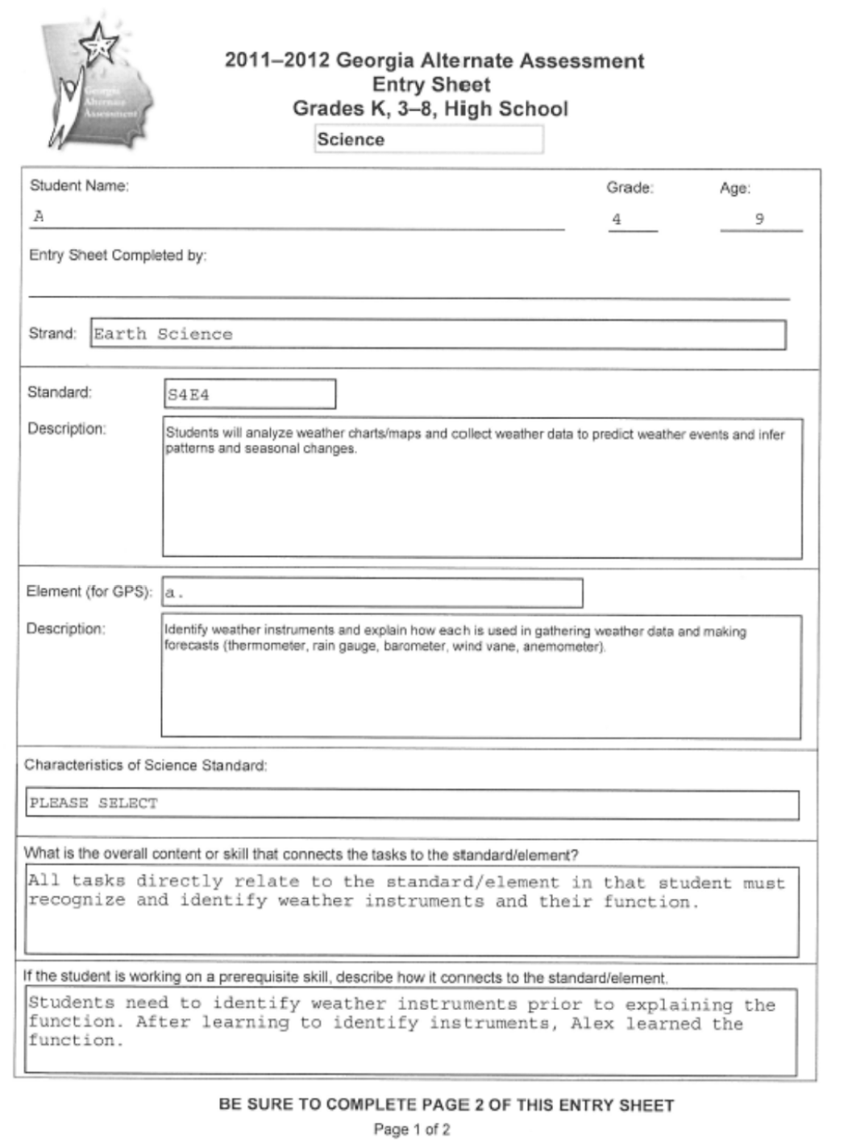
Characteristic of Science
Characteristic of Science on the Entry Sheet
This is a scan of an Entry Sheet submitted for a Science entry. The Characteristic of Science box was not completed, making the entry nonscorable.
Notes:
Once the grade and content area of Science is chosen on the Entry Sheet, a drop-down menu populates allowing teachers to choose the Characteristic of Science being assessed. The drop-down choices include only those eligible as the co-requisite standards for that grade. Since this functionality was provided, nonscorables due to the CoS not being recorded on the Entry Sheet have dropped dramatically.

Slide 78
Characteristic of Science
Characteristic of Science indicated must be visible in the evidence as the student’s participation in the process of science. For example:
Uses safety techniques | Including safe use, storage, and disposal of materials must be observed ; use of safety techniques must be in evidence
Uses scientific tools | Tools and instruments for observing, measuring, and manipulating scientific equipment and materials; use of tools must be in evidence
Uses technology | Using scientific technology such as a computer program that analyzes data (not just to research info on the web), using a balance to measure, thermometer, etc. ***This does NOT mean assistive technology or instructional technology. E.g., NOT using a PowerPoint to view information, NOT using a computer to look up information, NOT using an electronic whiteboard, etc.
Organizes data into graphs, tables, and charts | Places information from scientific inquiry or investigation into a table, chart, or graph format; chart/table/graph must be included in the evidence
Notes:
If the Characteristic of Science indicated on the Entry Sheet is not found in the evidence, the entry is nonscorable.
For example: We frequently see the Characteristic of Science of “Uses Safety Techniques,” but instead of seeing evidence or documentation of how safety techniques were used while doing a hands-on investigation,

Slide 79
Tips for the Characteristic of Science
It is recommended that the Characteristic of Science (CoS) be identified on the evidence on which it is included.
  Although this is NOT a requirement, it would serve as an reminder to the teacher that the Characteristic of Science indicated on the Entry Sheet is present in the evidence
  AND it would help the portfolio reviewer whose job it is to look for the co-requisite CoS as part of the documentation.
Remember to reset the Entry Sheet when you move on to the next student to avoid having the wrong CoS recorded.

Slide 80
Contact Information
People, contact information
    Deborah Houston, GaDOE Assessment Division
      Dhouston@doe.k12.ga.us
      (404) 657-0251
    Kayse Harshaw, Division for Special Education Services Questions about curriculum access for students with significant cognitive disabilities
      Kharshaw@doe.k12.ga.us
      (404) 463-5281
    Questar GAA Customer Service Hotline
      GA@QuestarAI.com
      Toll free (866) 997-0698
Notes:
Mention Evaluation link at the end of the presentation

Slide 81
GAA Resources
The following materials are available from the GAA web page:
http://www.doe.k12.ga.us/Curriculum-Instruction-and-Assessment/Assessment/Pages/GAA.aspx
  PowerPoints on previously presented topics
  Examiner’s Manual
  School and System Test Coordinator’s Manual
  Score Interpretation Guide
  Forms
  Blueprint
Notes:
Double click on the link

Slide 82
Access to GPS Resources
Georgia Performance Standards (GPS) for Students with Significant Cognitive Disabilities
https://www.georgiastandards.org/standards/pages/BrowseStandards/GPS-Impairment.aspx
Notes:
Double click o the link
Slides 109-112 provide additional resources and links to support teachers in instruction and assessment in the GPS standards for Students with Significant Cognitive Disabilities.

Slide 83
Access to CCGPS/GPS Resources
Electronic Resource Board for Access to the CCGPS/GPS for
Students with Significant Cognitive Disabilities
The Access to the CCGPS/GPS Resource Board contains: Free downloadable activities and materials for use with students with significant cognitive disabilities across grade levels and curricular areas
  Resources (internet, literature, etc.) to provide access to the general education curriculum
  Adapted stories for all grade levels and directions on acquiring adapted literature
    Instructions for acquiring adapted books
  Instructional strategies and best practice guidelines
  Data Sheets
  Georgia Alternate Assessment (GAA) suggestions/tips
  Georgia Project for Assistive Technology (GPAT) information
  Activities and materials for High School Access Courses
To register and receive your password for the Access to the CCGPS/GPS Resource Board for Students with Significant Cognitive Disabilities:
  send an e-mail with your first/last name and your preferred e-mail address to one of the following persons:
    Debbie Reagin (dreagin@doe.k12.ga.us)
    Kayse Harshaw (sharshaw@doe.k12.ga.us)

Slide 84
Access to CCGPS/GPS Resources
Recorded Webinars
Check schedule for recorded webinars and upcoming live webinars:
  http://www.gadoe.org/Curriculum-Instruction-and-Assessment/Special-Education-Services/Pages/Recorded-Webinars.aspx
  Suggested webinars:
Giving Access to Science Standards - Linking Science and Life Skills and Experiences, November 5, 2009
Giving Access to Social Studies Standards - Relating Themes in Social Studies to Relevant Life Skills and Experiences, December 10, 2009
Access to ELA: Writing Skills for Students with Significant Cognitive Disabilities , January 24, 2011
Additional webinars and information for CCGPS ELA and Mathematics activities are being developed and will be announced soon.

Slide 85
CCGPS Resources
Georgia Public Broadcasting/GaDOE
  http://www.gpb.org/education/common-core
GeorgiaStandards.org
  https://www.georgiastandards.org/Pages/default.aspx

Slide 86
CCGPS Website
https://www.georgiastandards.org/Common-Core/Pages/default.aspx

Slide 87
CCGPS Links
CCGPS
http://www.gadoe.org/Curriculum-Instruction-and-Assessment/Curriculum-and-Instruction/Pages/CCGPS.aspx
ELA
https://www.georgiastandards.org/Common-Core/Pages/ELA.aspx
Mathematics
https://www.georgiastandards.org/Common-Core/Pages/Math.aspx
GeorgiaStandards.org– Links to GPS and CCGPS
https://www.georgiastandards.org/Pages/default.aspx

