Slide 1
Aligning Assessment Tasks for the GAA
Session 7
Georgia Alternate Assessment
Unpacking the Standards
Selecting the Target Skill for Assessment
Prerequisite Skills
Characteristic of Science
Recording:
https://sas.elluminate.com/mr.jnlp?suid=M.B005CF15F467B44684BB131F278E0D&sid=2012003

Slide 2
Welcome to Session 7
Alignment
This session will begin at 1:00 p.m.
The power point is located in the GAA Presentations Portlet at this location:
  http://www.gadoe.org/Curriculum-Instruction-and-Assessment/Assessment/Pages/GAA-Presentations.aspx
Webinar Etiquette:
Please use the Audio Setup Wizard in the Tools Menu to configure and test your audio settings before the presentation begins.
To eliminate interference from background noise in your area, please leave the Talk Button on mute if you are not speaking.
Due to the number of participants, we request that questions be submitted via Chat.
You will receive a prompt to download this PowerPoint. You can also go to Window, File Transfer to download any files sent through this webinar.
Please log-in with your name and the name of your district beside it (e. g., Joni Smith–Henry County). If you have already logged-in, please place your name and district in the chat box.

Slide 3
2013-2014 GAA
The 2013-2014 series of webinars (Sessions 1-8) serve as introductory components for informing and training system staff in the planning, implementation, and submission of the GAA portfolios.
Reading and understanding the GAA Examiner’s Manual 2013-2014 and the materials provided through the webinar trainings are necessary to understand the policies and procedures required for the administration of the GAA.

Slide 4
Overview of This Presentation
This presentation will cover the following topics:
  Unpacking the standards
  Selecting the target skill for assessment
  Prerequisite skills
  Aligning to the Characteristic of Science
It is designed to inform:
  All teachers who administer the GAA,
  Peer Reviewers and designated trainers,
  Special Education Directors,
  Test Coordinators, and
  Building Administrators.
Notes:
Review of portfolios as well as teacher feedback found these areas of concern:
Need for additional curriculum training in the state-mandated content standards to strengthen content knowledge
Need for more guidance in alignment of assessment tasks to the content standards
Need for more examples of tasks aligned to the state mandated content standards

Slide 5
Alignment to State-Mandated Content Standards
Alignment is to the grade level content standard.
  Assessment tasks may be at a more simplified level but must still connect to the grade-level standard.
Alignment of all 4 assessment tasks must be to the “Big Idea” (intent/essence) of the standard.
  The standards-based skill being addressed by the assessment task must still connect back to the intent of the standard and element/indicator and be taught in the context of the standard.
Notes:
Alignment of assessment tasks to the state-mandated content standards is based on the same principles as alignment to the GPS.

Slide 6
Alignment to State-Mandated Content Standards
The content standards are the goals for instruction, learning, and assessment.
Elements/indicators are the specific concepts and skills that make up the content standards.
Not all standards are broken down into elements/indicators.

Slide 7
Alignment–Identifying the Skills
  When the standard is NOT broken down into elements/indicators:
    If there are no elements/indicators, alignment goes directly back to the standard.
  What are the specific components that make-up the standard?
    Focus on the language/terminology as written.

Slide 8
Alignment–Identifying the Skills
  When the standard IS broken down into elements/ indicators:
    Achievement of the concepts and skills inherent in the element/indicator leads to the achievement of the overall standard.
    Although assessment tasks must align to the distinct aspects of the element/indicator, they must do so under the umbrella of the standard.
  What are the specific components that make-up the standard and element/indicator?
    Focus on the language/terminology as written.

Slide 9
Alignment–Identifying the Skills
Some of the current state standards are broader and encompass more skills within a standard.
  There can be more than one “Big Idea” and a number of standards-based skills within the same standard.
It is appropriate for many of our students to choose one skill around which to design the assessment tasks.
It is critical that all 4 assessment tasks submitted for that standard demonstrate a connection to the same standards-based skill.
  The same skill(s) must be demonstrated across both collection periods.
  Additional skills can be added in the second collection period.

Slide 10
Essential Skills
Task Design
Writing the Task Description
Unpacking the Standards

Slide 11


Unpacking the Standards
To understand the intent of the standards, teachers need to unpack them.
Take a marker and highlight key words and phrases.
  Look at the noun: What is the student to know?
  Look at the verb: What is the student to do?
Understanding the intent of the standard is necessary to choosing the standards-based skill for assessment.
Notes:
The nouns tell us what students are required to know.
The verbs tell us how the student will show what is required.

Slide 12
Unpacking the Standards
Unpack the standard
  What are the essential skills?
  Is there an Element/Indicator?
Choose the standards-based skill for assessment
  Do all four tasks connect to the same skill(s)?
Design the assessment task
  Does the task description relate back to the intent of the standard and element/indicator?
Notes:
Before choosing an assessment task, it is critical that the teacher understand the essential skills inherent in the standard and then choose the skill that presents the most appropriate level of challenge for the individual student. From there, the assessment task should be designed being mindful of the best way for the student to demonstrate what he/she knows and can do IN RELATION TO THE STANDARD.

Slide 13
Unpacking the Standards– ELA
English Language Arts
ELACC.7.RI.2 | Determine two or more central ideas in a text and analyze their development over the course of the text; provide an objective summary of the text.
What are the nouns? Central idea; summary
What are the verbs? Determine; analyze; summarize
Notes:
Suggestion: Be sure to explain since "summarize" isn't used in the standard.
While summarize isn’t a verb, to provide an objective summary is to summarize, so it is referred to here as “Summarize”

Slide 14
Unpacking the Standards
What are the Essential Skills?
  I can determine the central idea from a text.
    I can determine two or more central ideas from the text.
    I can analyze the development of the central idea(s).
  I can summarize the text.
    I can provide an objective summary of the text.

Slide 15
Unpacking the Standards
Defining the nouns
Central idea: the central, unifying idea of the informational text
  Ties together all the other ideas
Summary: a concise retelling of a text

Slide 16
Unpacking the Standards
Defining the verbs
Determine: to find out or ascertain information from the text (e.g., central idea)
Analyze: to look critically at the different parts of the text, that together, build to one central idea
Summarize: to retell the main points of the text succinctly (e.g., what was the text about?)
Notes:
For students at an access level, this may be a simplified explanation of what the text is about.
What was text about?—should not be a one word answer, should briefly retell the text.

Slide 17
Choosing the Standards-Based
Skill for Assessment
Skill: determine central idea
Skill: summarize text
What is the noun? central idea
What is the verb? determine
What are the supporting concepts:
development
What is the noun? summary
What is the verb? summarize
What are the supporting concepts:
objectivity
Notes:
Reminder!
When designing assessment tasks for each collection period, ask yourself the following questions:
Do all 4 assessment tasks align to the intent of the standard?
Do the assessment tasks in Collection Period 2 allow the student to demonstrate progress on the skill(s) assessed in Collection Period 1?
In order to demonstrate achievement/progress, it is critical that the same standards-based skill is present in both collection periods.
Although all 4 tasks in the following example are aligned to a “Big Idea” from the standard, a student can’t show progress in the Collection Period 1 skill unless that skill is also assessed in Collection Period 2.

Slide 18
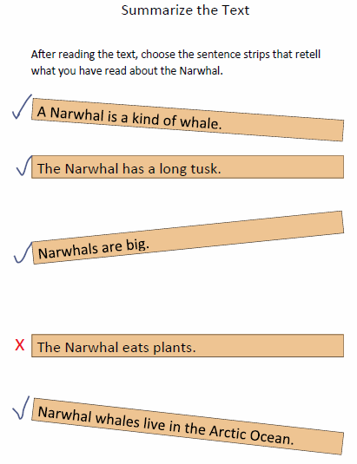
Designing the Assessment Task
Students can demonstrate knowledge of this ELA standard through identification of the central idea OR through summary.
This assessment task addresses an essential skill of the standard as it requires the student to provide a summary of the informational text. In order to align, it is essential that the summary link directly back to the text the student has read/had read to him.
The task can be adapted to the appropriate level of challenge in the way in which students retell the facts. As presented here, students can choose sentence strips. They can also write their own summary, have a verbal summary scribed, or complete a summary with appropriate picture symbols.
Notes:
It is appropriate for many of our students to choose one skill around which to design the assessment tasks. In this case, the essential skill of summarizing was chosen for this assessment task. In order to show progress, it is important that the same skill be carried across both Collection Periods.

Slide 19
Describing the Assessment Task as it Relates to the Standard
The task description MUST relate back to the intent of the standard and element/indicator.
  The student can access a task in a variety of ways and levels as appropriate to the individual student.
  However, it is crucial the task description focus on the skill as it connects to the standard.
  Try to use words from the standard/element that best demonstrate the essence.
Notes:
What was the student asked to do as it connects to the standard. It is from this point that alignment is determined

Slide 20
Describing the Assessment Task as it Relates to the Standard
In the preceding example, the task description should be written to include the most important terms - the nouns (summary, text).
  It should be clear that the student “read” a text.
  It should be clear that the student was asked to summarize the text.
  The description should then recount how the student summarized the text.
  “After reading “Narwhal- Unicorn of the Sea,” Joe will choose from provided sentence strips to retell information to summarize the text. The sentence strips will include both statements from the text and distractors.”
Notes:
Writing the Task Description is an important part in setting up the assessment task. In describing the skill being assessed, first describe “what, then describe “how.”
Why does this matter? If the task description accompanying this activity stated that the student was asked to order sentence strips, the task would not align as this is not a skill required for this standard. If, however, the task description said that the student had to read a text and them summarize it by choosing from provided sentence strips, the connection is made clear.

Slide 21
Unpacking the Standards - Math
Mathematics
MCC6.SP.4 | Display numerical data in dot plots on a number line, including dot plots, histograms, and box plots.
What are the nouns? Numerical data, number line
What are the verbs? Display
Supporting concepts:
  dot plots, histograms, box plots
Notes:
Cluster- Summarize and describe distributions

Slide 22
Unpacking the Standards
What are the Essential Skills?
  I can display numerical data.
    data must be on a number line
  I can display numerical data on a dot plot, histogram, or box plot.
    data must be numerical, not categorical

Slide 23
Unpacking the Standards
Defining the Nouns
Numerical data: data consisting of numbers, not categories.
  heights of students in the class is numerical
  types of music students in the class listen to is categorical
Number line: a picture of a straight line on which every point is assumed to correspond to a real number and every real number to a point.
Notes:
Categorical data is not aligned for this standard.

Slide 24
Unpacking the Standards
Defining the Verbs
Display: to make something visible
  In Mathematics: to depict numerical data in graphic form
  Supporting Concepts
  Dot Plot: A method of displaying the distribution of numerical values in which each dot represents each value of the variable.
    each value is shown as a dot or mark above a number line.

Slide 25
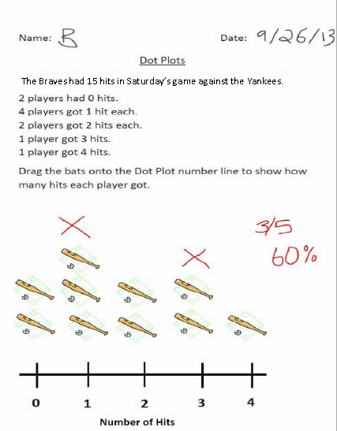
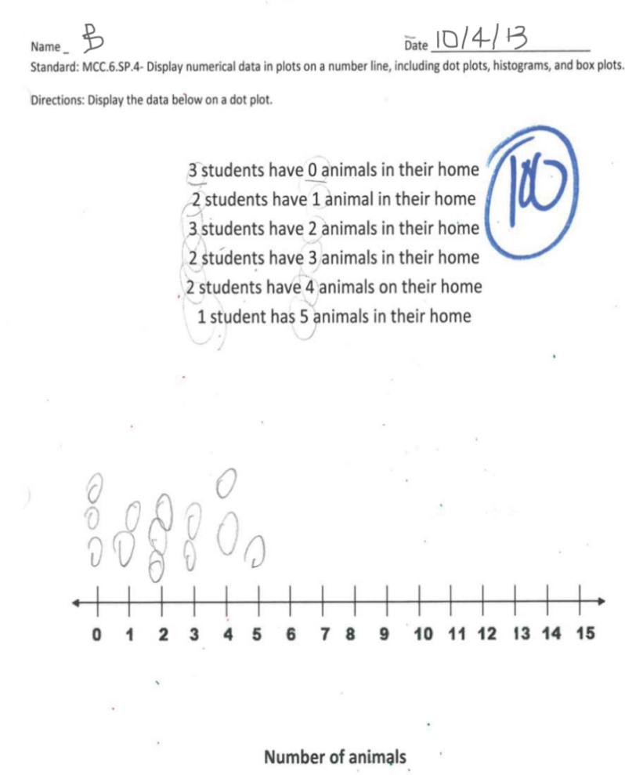
Designing the Assessment Task
These assessment tasks address the essential skill of the standard as they require the student to display numerical data on a number line in the form of Dot Plots.
In order to align, it is important that the data be on a number line. In order to demonstrate knowledge of Dot Plots, it is important that the numbers on the number line represent the variable, and the “dots” represent the number of each.
Notes:
In the examples above, the variable represented by the number line in the first piece of evidence is “number of hits.” The variable represented by the number line in the second piece is “number of animals.” Each dot/mark/symbol represents how many players/students were represented by each numerical value.
M6D1 –Pose questions, collect data, represent and analyze the data, and interpret results.
b. –Using data, construct frequency distributions, frequency tables, and graphs.
c.

Slide 26
Describing the Assessment Task as it Relates to the Standard
In the preceding example, the task description should be written to include the most important terms - the nouns (numerical data display).
  It should be clear that the student was asked to work with numerical data; data must be on a number line.
  The description should then recount how the student displayed the data - via a Dot Plot.
  “Given numerical data, Billy will use the SmartBoard Dot Plot to display the data with each value represented along the number line. Billy will drag a bat above the number that shows how many hits the player got (each bat represents one player).”
Notes:
The number line represents the number of hits players got in the game; the bats each represent one player.

Slide 27
Unpacking the Standards - Math
Mathematics
MCC3.MD.7 | Relate area to the operations of multiplication and addition.
 | a. Find the area of a rectangle with whole-number side lengths by tiling it, and show that the area is the same as would be found by multiplying the side lengths.
What are the nouns? Area; rectangle
What are the verbs? Find; tiling; show; multiplying
Supporting concepts:
  whole-number side lengths

Slide 28
Unpacking the Standards
What are the Essential Skills?
  I can find (calculate, determine) the area of a rectangle.
    I can use tiling to find the area of a rectangle.
  I can show that the same answer can be found by tiling as through multiplication.

Slide 29
Unpacking the Standards
Defining the Nouns
Area: the quantity expressing the two-dimensional size of a defined surface
  area of a plane figure refers to the number of square units the figure covers
Rectangle: a quadrilateral with 2 pairs of parallel sides
Notes:
The area is the inside shape or space measured in square units. In rectangles and in squares, a simple calculation of length times width will give the number of square units.

Slide 30
Unpacking the Standards
Defining the Verbs
Find: to determine, calculate, compute, or ascertain through mathematical methods.
Tiling: filling the area of a flat space with individual unit tiles (of equal length and width) fit or placed together with no gaps or overlaps.
Show: to demonstrate or prove through mathematical methods (e.g., multiplication).
Notes:
Find: the student can “find” the area in a variety of ways, from using manipulatives to more abstract forms of calculation.

Slide 31
Choosing the Standards-Based
Skill for Assessment
Skill: find the area of the rectangle by tiling.
Skill: show that the same answer can be found by multiplying as by adding.
What is the noun? area
What is the verb? find
What are the supporting concepts: Rectangle, tiling
What is the noun? area
What is the verb? show, multiply
What are the supporting concepts:
Area/answer is the same
Notes:
Reminder!
When designing assessment tasks for each collection period, ask yourself the following questions:
Do all 4 assessment tasks align to the intent of the standard?
Do the assessment tasks in Collection Period 2 allow the student to demonstrate progress on the skill(s) assessed in Collection Period 1?
In order to demonstrate achievement/progress, it is critical that the same standards-based skill is present in both collection periods.
Although all 4 tasks in the following example are aligned to a “Big Idea” from the standard, a student can’t show progress in the Collection Period 1 skill unless that skill is also assessed in Collection Period 2.
The answer is the same.

Slide 32
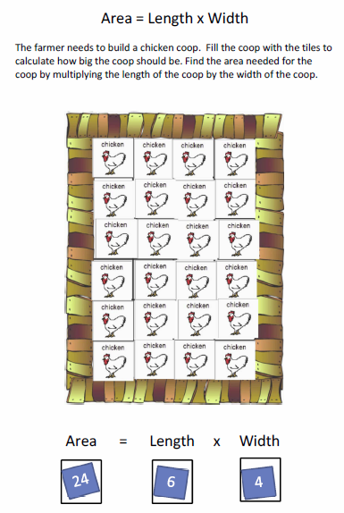
Designing the Assessment Task
The assessment task addresses the essential skills of the standard and element/indicator by requiring the student to use tiling to calculate area.
The task can be adapted to provide the appropriate level of challenge to students. They can calculate, multiply, count, or they can be provided with choices that they can eye gaze or cut and paste.
As an additional proof, students can count by column and row to show that the same answer can be found by adding as by multiplying.
Notes:
The counting can be accomplished through one to one correspondence matching tiles to a number line to determine the total number of tiles.

Slide 33
Describing the Assessment Task as it Relates to the Standard
In the preceding example, the task description should be written to include the most important terms - the nouns (area, rectangle).
  It should be clear that the student was asked to find/determine area.
  It should be clear that the shape was a rectangle.
  The description should then recount how the student found the area.
  “Sandy will use tiles to determine the area of a rectangle. She will count the number of tiles required to fill the “chicken coop” and then use a calculator to multiply the length times the width.”
Notes:
Multiplying length times the width will show that the area is the same through counting as by multiplying.
This same assessment task can be modified to meet the needs and abilities of a variety of students. The task, and therefore the description, should be adapted to be appropriate for the student yet still focus on the intent of the standard.

Slide 34
Unpacking the Standards - Science
Science
What are the nouns? Organisms, physical characteristics
What are the verbs? Classify
Supporting Concepts
  Dichotomous Key
  Six Kingdom System
Notes:
S7L1. Students will investigate the diversity of living organisms and how they can be compared scientifically.

Slide 35
Unpacking the Standards
What are the Essential Skills?
  I can classify organisms based on physical characteristics.
    I can use a dichotomous key to classify organisms.
    I can classify organisms using a dichotomous key of the six kingdom system.

Slide 36
Unpacking the Standards
Defining the Nouns
Organism: a living thing (e.g. a plant, animal, or bacterium).
Physical Characteristics: an observable trait that distinguishes one organism from another.

Slide 37
Unpacking the Standards
Defining the Nouns
Dichotomous key: a tool that allows the user to determine the identity of items in the natural world, such as trees, wildflowers, mammals, reptiles, and fish.
  Keys consist of a series of choices that lead the user to the correct name of a given item.
  "Dichotomous" means "divided into two parts." Therefore, dichotomous keys always give two choices in each step.

Slide 38
Unpacking the Standards
Defining the Verbs
Classify: to assign organisms to categories according to shared physical characteristics.

Slide 39
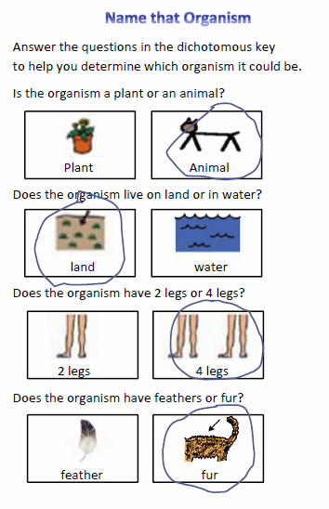
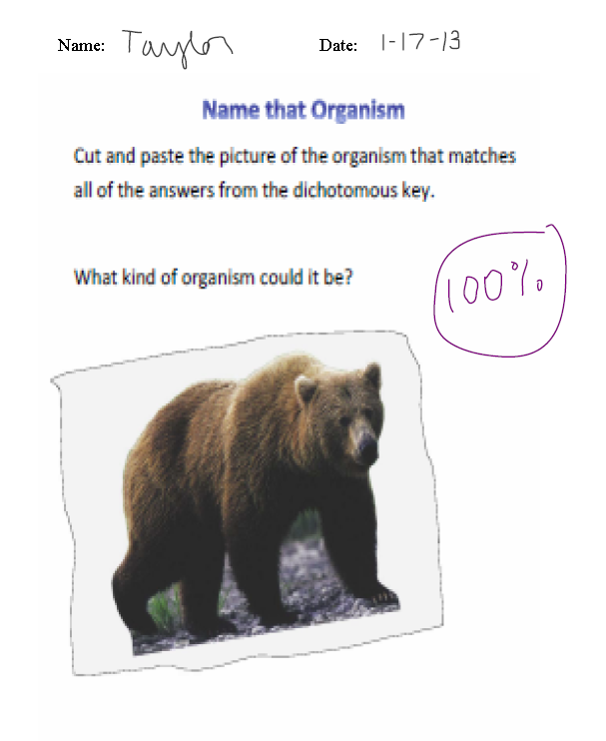
Designing the Assessment Task
The assessment task is designed to address the essential skills of the standard as the student is required to look at the characteristics of the organism to make decisions.
In this task, the student uses the questions in the dichotomous key as a tool to classify an organism.
The first question, which asks whether the organism is a plant or an animal, exposes the student to classification through the six kingdom system.
Notes:
Remember that it is a requirement that each science entry include at least one piece of evidence that addresses the corequisite Characteristic of Science. The Characteristics of Science incorporates hands-on, student-centered, and inquiry-based approaches; this is the process of science.
Although this particular piece does not fulfill the CoS requirement, this task could be modified for the second collection period by having the student develop the questions for the dichotomous key (Asks quality questions).

Slide 40
Describing the Assessment Task as it Relates to the Standard
In the preceding example, the task description should be written to include the most important terms - nouns (organism, physical characteristics).
  It should be clear that the student was asked to recognize the physical characteristics of organisms.
  It should be clear that the student classified an organism(s).
  The description should then recount how the student classified the organism based on its physical characteristics.
  “Taylor will use the dichotomous key to choose the physical characteristics of an organism. She will then use those choices to identify organism that matches those characteristics.”
Notes:
Depending on the student, the physical characteristics can be provided for the student to choose from or can be generated by the student as he uses them to classify the organism.

Slide 41
Unpacking the Standards –
Social Studies
Social Studies – Personal Finance Economics
What are the nouns? Decision making model
What are the verbs? Use; select
Supporting Concepts
  Spending and savings choices

Slide 42
Unpacking the Standards
What are the Essential Skills?
  I can use a decision making model to help me select the best option (i.e., make good choices).
  I can decide when I need to save and when it is OK to spend (personal spending and saving choices).

Slide 43
Unpacking the Standards
Defining the Nouns
Decision Making Model: means through which spending and savings decisions can be made.
  i.e., wants vs. needs; affordability; pros and cons

Slide 44
Unpacking the Standards
Understanding the verbs
Use: to employ for some purpose.
Select: to choose in preference to another or others.

Slide 45
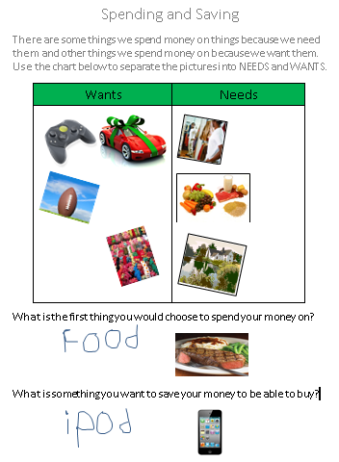
Designing the Assessment Task
This assessment task addresses the essential skills of the standard by requiring the student to use a decision making model (needs vs. wants) to make spending and saving choices.
The task can be modified to provide an appropriate level of challenge for students by providing pictures, as was done here, by having them cut and paste pictures of their choosing, or by having them generate their own lists.
This task could also be expanded to have a student create a budget from which spending and savings decisions can be made.

Slide 46
Describing the Assessment Task as it Relates to the Standard
In the preceding example, the task description should be written to include the most important terms - the nouns (decision making model).
  It should be clear that the student used a decision making model.
  It should be clear if/how the student is making spending and savings choices.
  “Sam will use a decision making model based on wants and needs to make spending and savings choices. After separating pictures into the categories of “wants” and “needs,” he will answer questions about his choices.”
Notes:
It is very important that the standard to be assessed is chosen carefully and that the assessment task relates to the essential elements of that standard. We have seen similar tasks regarding wants and needs submitted as evidence for SS4E2- The student will identify the elements of a personal budget and explain why personal spending and saving decisions are important. Although there is potential for this to work, it must be clear that what the student is asked to do and that the task description is worded to include those essential elements.

Slide 47
Alignment through Prerequisite Skills
Looking at the Skill in the Context of the Standard

Slide 48
Alignment Through
Prerequisite Skills
Tasks submitted for the assessment can focus on prerequisite skills that allow the student to be exposed to and assessed on the standard/element at a level that is meaningful and purposeful for the student.
Prerequisite skills must still focus on the intent of the grade level standard and element/indicator.
When assessing students via prerequisite tasks, it is important that the task be specific to the essence of the standard and demonstrate the student’s knowledge and skills as they relate to the strand being assessed.
Notes:
48
In curriculum training, the focus is on “Big Ideas”– what we are referring to here as the “intent” of the standards.
It is a misunderstanding to say that a student has to be able to identify letters or to decode words in order to access text and to demonstrate reading comprehension. Although it may be an important part of the student’s academic instruction to work on these skills, in and of themselves, they do not represent aligned tasks.

Slide 49
Prerequisite Skills
A Prerequisite Skill is one that is essential to the acquisition of the standard and element/indicator.
  addresses the intent of the standard and element/indicator being assessed
Notes:
The biggest misunderstanding when it comes to the concept of a prerequisite skill is that there is a linear hierarchy to learning that must be followed and that anything that comes earlier on in that hierarchy is a prerequisite. We think that children should learn to crawl and then to walk and then to run, but that does not make crawling a prerequisite to running. We think that children need to decode letters before they can read and that they need to be able to read before they can demonstrate comprehension of text, but we know that students can demonstrate comprehension without ever being able to identify or decode letters.
Since Mathematics is the science of numbers and their operations, should any task involving numbers be seen as a prerequisite to any and all math standard?
In order to be considered a prerequisite to a standard, the skill being assessed must be essential to the specific intent of the standard-that is what separates one standard from another.

Slide 50
Is it a Prerequisite Skill?
To determine if a skill is truly a prerequisite to learning the targeted skill, the following questions should be asked :
  Is the skill essential to understanding the intent of the standard and element/indicator?
  Can working on this skill eventually lead to the standards-based skill targeted by the standard (at a less complex level)?
Notes:
50
If the skill is associated with that task but is not required to show the main concept, it is in itself not aligned when taught in Isolation. The skill must be assessed in the context of the standard.
Should acquisition of the skill be part of the instruction that precedes the assessment?
If so, DO NOT submit the task as evidence of assessment.
This is not clear what this means here. Can you give an example here to clarify? You and I know where it is coming from, but not someone not

Slide 51
Is it a Prerequisite Skill?
Math I- Geometry
MM1G1 Student will investigate properties of geometric figures in the coordinate plane.
a. Determine the distance between two points.
  What is the intent of this standard?
  What are some ways this standard can be accessed by students with significant cognitive disabilities (SWSD)?
Consider the following examples:
Notes:
The intent of this element, as it says, is to determine the distance between two specified end points. Under the umbrella of the standard, the student should be working toward finding this distance in a coordinate plane.
For General Ed students, this would mean employing the distance formula. For SWSCD, using line segments on graph paper or a number line (representing the x- and/or y-axis) on which the student can count units from one identified end point to another is one possible way to access the standard at a prerequisite level.

Slide 52
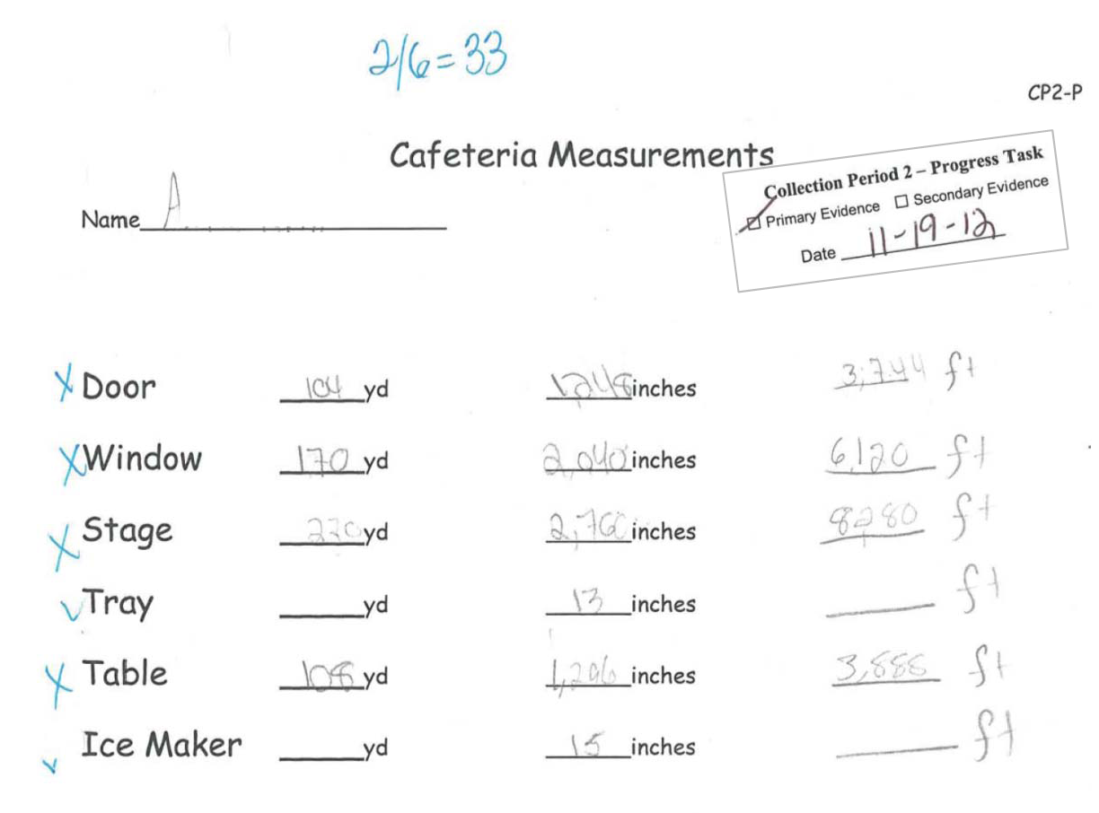
Task:
“A will be given a list of items found in the cafeteria to measure using a yard stick. She will indicate the proper length in feet and inches.”
Notes:
This task description clearly describes a measurement task. When assessing students via prerequisite tasks, it is important that the task be specific to the essence of the standard and demonstrate the student’s knowledge and skills as they relate to the strand being assessed- in this case, Geometry in the coordinate plane. Although it can be argued that distance and length are the same thing, it is crucial for alignment to this standard and element that length refer to the length of a line segment with identified end points. Otherwise, it is just measurement- which does not relate to this strand or standard.

Slide 53
Is it a Prerequisite Skill?
Task: Measuring objects in the cafeteria.
  Is using a measurement tool (such as a ruler, yard stick, or tape measure) a necessary skill for this Geometry standard?
  Have end points from which distance can be calculated been provided on any of the objects being measured?
  Can repeated exposure to measurement tasks ever get the student closer to an understanding of distance on a coordinate plane?
  NO. This task is not aligned.
Notes:
Using the criteria we posed earlier in our check for alignment-
This looks like a measurement task. Measurement in and of itself is a skill assessed in grades 5 and below. In order to work for this High School standard, it would have to be tied back to Geometry with specific end points indicated and the measuring tool used as the units- as on a number line or grid.
There is nothing in the task or the task description that would allow a curriculum expert to identify this task as aligned to this as a Geometry task.
The intent of the standard is to
This is a preliminary skill tied to this particular task. It is NOT a prerequisite to the intent of the standard.

Slide 54
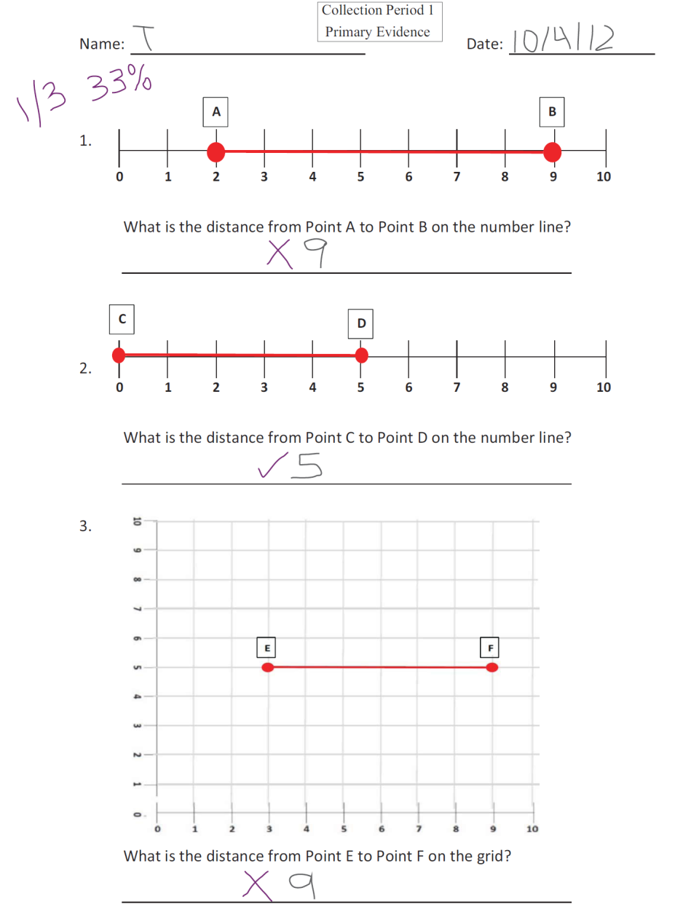
Task:
“ T will find the distance between two points on a number line and on a grid.”
Notes:
Collection Period 1 Evidence: Whenever the line segments are horizontal or vertical, the distance between the end points can be obtained by counting. When we need to find distance (the length of a segment ), such as the distance from point A to point B, the student can simply COUNT. Although the student is counting, this is considered a prerequisite skill to determining distance because the student is counting from one end point to another on the number line/grid.
Unfortunately, the counting approach does NOT work to calculate distance for diagonal segments, but it would be acceptable for the student to count to note the rise (distance on the y-axis) and the run (distance on the x-axis) as an access level task to determining distance.
Given the opportunity for instruction between collection periods, some students might be ready to move from using the number line in the first collection period, to counting the distance from one point to another on a coordinate grid in the second, while still others may be ready to move to diagonal line segments.

Slide 55
Is it a Prerequisite Skill?
Task: Finding the distance between points on a number line and a grid.
  This skill is being assessed within the context of the strand and standard.
  Distance can be determined by counting from one point to another; end points from which distance can be calculated have been provided.
  Can repeated exposure to finding the distance between points on a number line ever get the student closer to an understanding of distance on a coordinate plane?
  YES. This task is aligned.

Slide 56
Is it a Prerequisite Skill?
Georgia Studies – Economic Understandings
SS8E5 The student will explain personal money management choices in terms of income, spending, credit, saving, and investing.
  What is the intent of this standard?
  What are some ways this standard can be accessed by students with significant cognitive disabilities (SWSD)?
  Consider the following examples:
Notes:
This is the standard description. There are no elements for this particular standard, so alignment must go directly back to the intent of the standard.
The intent of this standard is to introduce the student to the concepts of personal money management- earning, saving, spending.
Students can earn points, stickers, classroom “dollars” that can be used to “buy” a favorite activity or treat.

Slide 57
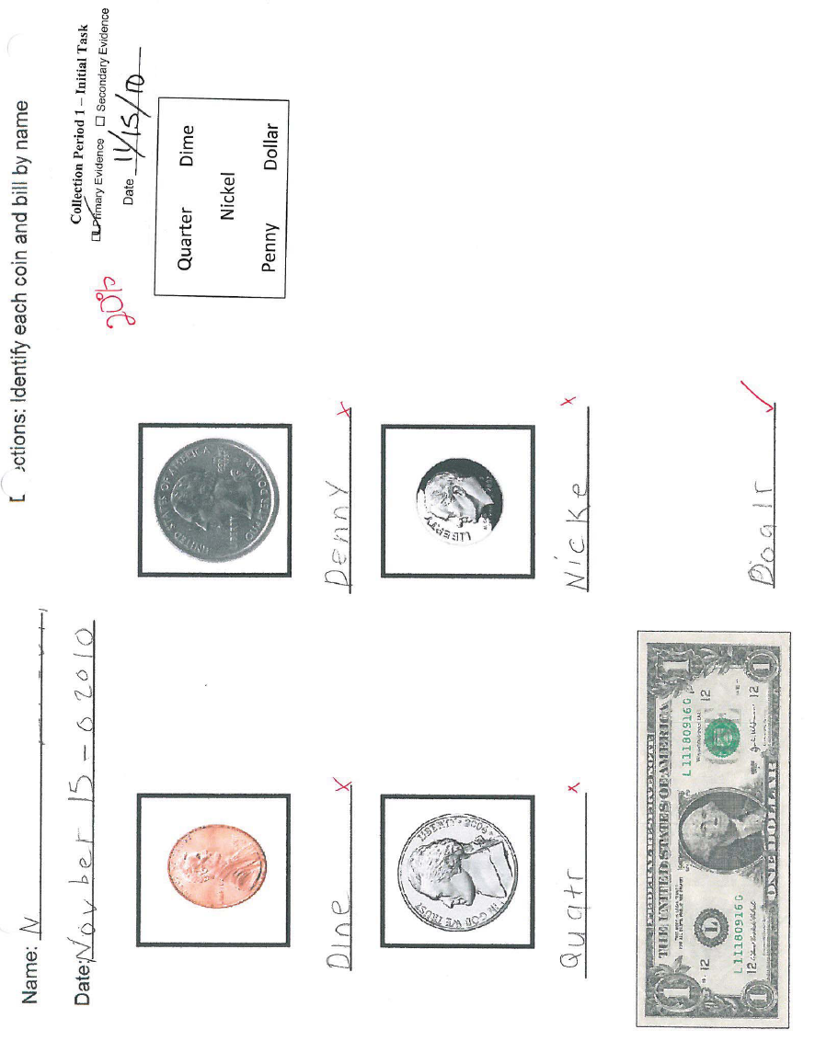
  Task:
  “N completed a worksheet where she had to identify coins and dollar bills by name.”

Slide 58
Is it a Prerequisite Skill?
Task: Identifying coins and bills by name.
  If this is a skill you would like to integrate into the student’s skill set to later use it in the context of the standard, it should be taught prior to the assessment .
  Being able to identify coins and bills by name is not essential to the understanding of personal budget.
  Does money identification alone ever get the student closer to an understanding of personal money management?
  NO. This task is not aligned.
Notes:
Looks more like a math task than a Social Studies task.
There is nothing in the task or the task description that would allow a curriculum expert to identify this task as aligned to this Social Studies Standard.
The intent of the standard is to allow the student to learn about personal money management. A SWSD may never be able to identify coins or have the computation skills necessary to use money independently, but he can learn about earning and spending (point systems, reward charts, saving for a special treat or activity, etc.).

Slide 59
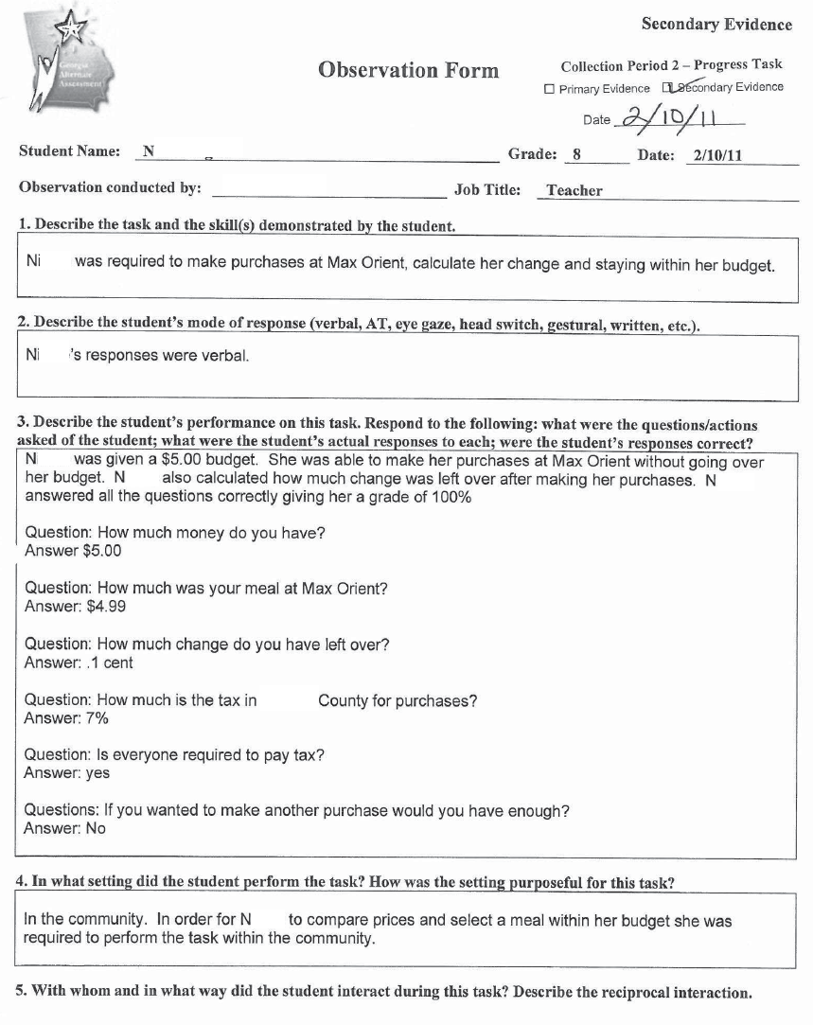
Task:
“N was required to make a purchase, calculate her change, and stay within her budget.”
Notes:
This task was submitted for the same student for Collection Period 2.

Slide 60
Is it a Prerequisite Skill?
Task: Making spending choices while staying within a budget.
  This skill is being assessed within the context of the strand and standard.
  Being able to recognize whether or not you have the funds to make a purchase is essential to the understanding of personal money management.
  Will practice in making saving and spending decisions in a variety of situations get the student closer to an understanding of personal money management?
  YES. This task is aligned.
Notes:
The word “budget” in the task description helps to tie it to the Social Studies domain within personal money management.
Assessment tasks involving budgets could work for mathematics, but the concept of personal money management is specific to social studies.
The intent is for students to learn about managing their personal finances; staying within a budget falls within that category.
Although the task is simplified to one instance in which she has to make a single purchase without going over her budget, it is demonstrates a beginning understanding of spending within a personal budget.

Slide 61
Alignment to the Characteristic of Science
(CoS)

Slide 62
Characteristic of Science
Science consists of a way of thinking and investigating, as well as a growing body of knowledge about the natural world.
To become literate in science, therefore, students need to acquire an understanding of both the Characteristics of Science and its Content.
The Georgia Performance Standards for Science require that instruction be organized so that these are treated together.
Thus, A CONTENT STANDARD IS NOT MET UNLESS APPLICABLE CHARACTERISTICS OF SCIENCE ARE ALSO ADDRESSED AT THE SAME TIME. For this reason they are presented as co-requisites.
https://www.georgiastandards.org/Standards/Pages/BrowseStandards/ScienceStandards.aspx
Notes:
This text is provided on the Georgia Standards website.

Slide 63
Characteristic of Science
Students taking the GAA must be assessed on the same academic content standards as their General Education Peers.
  this includes the co-requisite Characteristic of Science
The Characteristics of Science incorporate hands-on, student-centered, and inquiry-based approaches.
  the process of science
A co-requisite Characteristic of Science standard must be addressed as part of the GAA science assessment entry on at least one piece of evidence submitted for the science entry.

Slide 64
Characteristic of Science
For all students assessed in Science (grades 3-8 and high school), a Characteristic of Science must be recorded/written on the Science Entry Sheet.
The Characteristic of Science recorded on the Entry Sheet must be identifiable and documented in the evidence.
Even if all four assessment tasks submitted for a science entry align and are scorable, if either of the above conditions are not met, the entry is nonscorable.
  Nonscorable Code of NA-D

Slide 65
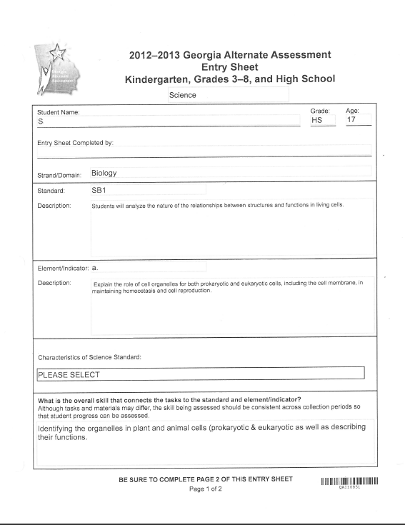
Characteristic of Science
Characteristic of Science on the Entry Sheet
This is a scan of an Entry Sheet submitted for a Science entry.
The Characteristic of Science box was not completed, thus making the entry nonscorable.
Notes:
Once the grade and content area of Science is chosen on the Entry Sheet, a drop-down menu populates allowing teachers to choose the Characteristic of Science being assessed. The drop-down choices include only those eligible as the co-requisite standards for that grade. Since this functionality was provided, nonscorables due to the CoS not being recorded on the Entry Sheet have dropped dramatically.

Slide 66
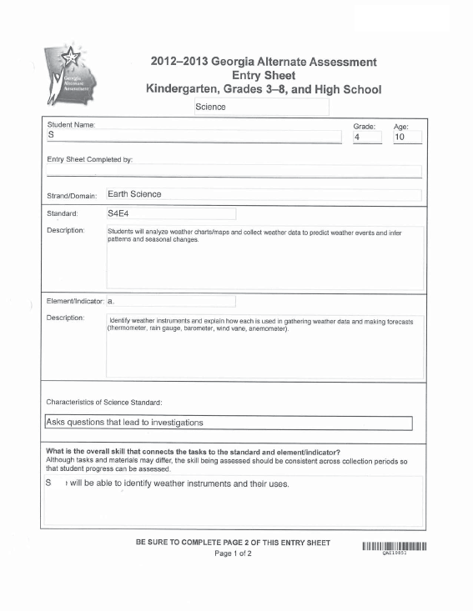
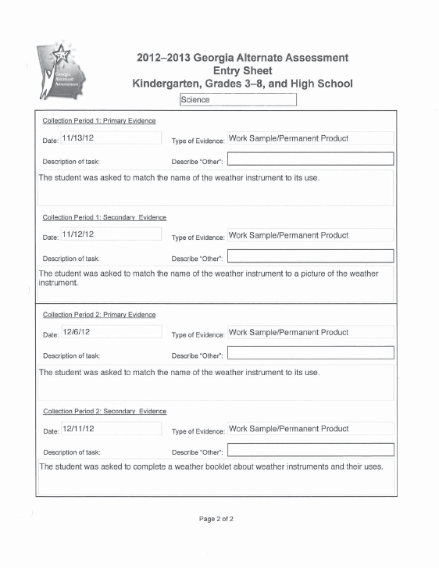
Characteristics of Science
This CoS was not found in any of the evidence.
The Characteristic of Science chosen is “asks questions that lead to investigations.” At least one piece of evidence must document the student asking questions pertinent to the scientific process.
Notes:
The task descriptions on the second page of the Entry Sheet may include information about the of the Characteristic of Science, but it is necessary that it also be found in the evidence for at least one task. In this example- all four tasks for this Entry were completed using work samples or permanent products. None of the tasks include description of any type of investigation or scientific process, and there was no documentation that the student was asking questions. There was no opportunity within these tasks to incorporate the CoS.
Perhaps a better choice might have been “Uses Scientific Tools” in which the student could identify the tool and use it to demonstrate its purpose.

Slide 67
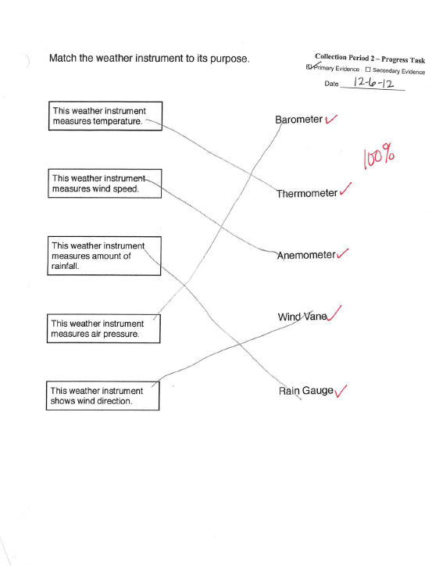
Characteristic of Science
Four worksheets were submitted as evidence for this standard. In each, the student identified the purpose of the weather instruments- all aligned tasks.
Even though all four tasks align to the standard and element, it is still a requirement that the co-requisite Characteristic of Science be demonstrated in at least one assessment task.
Without the CoS, the entire entry is nonscorable.
Notes:
The Characteristic of Science could not be found in any of the four pieces of evidence. This example shows the Primary evidence submitted for Collection Period 2, but all pieces of evidence were similar work products, and none of the four tasks were setup to align with the CoS chosen.

Slide 68
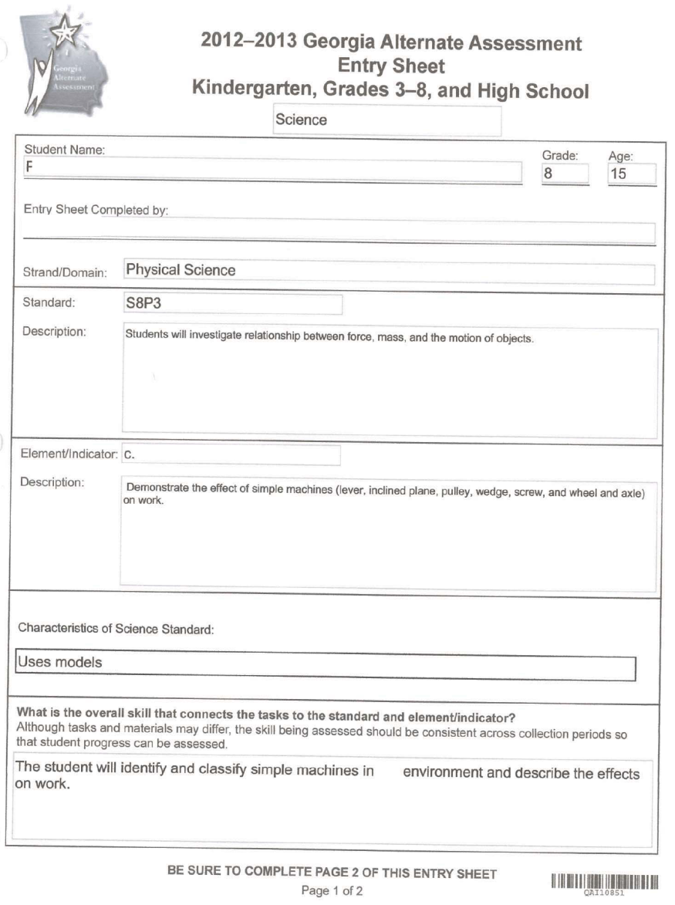
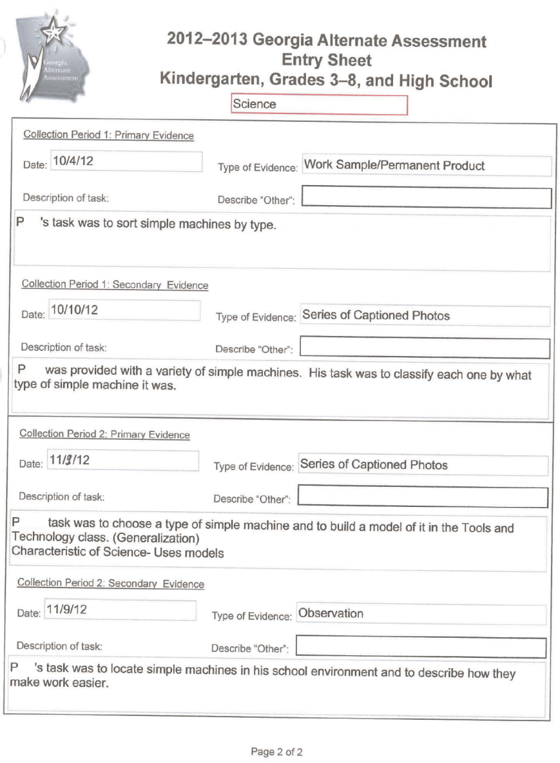
Characteristic of Science
CoS chosen
CoS chosen
In this example, the Characteristic of Science chosen is documented in the task description and identified in the entry in which the CoS will be assessed.

Slide 69
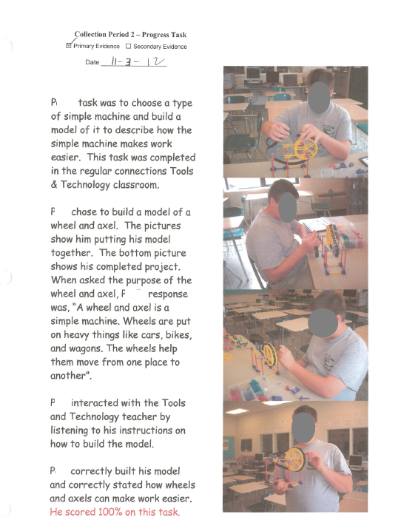
Characteristic of Science
The Characteristic of Science documented in the task description on the entry sheet is also apparent in the evidence.
The pictures clearly show the student building a model of a simple machine which he uses to demonstrate his understanding of how simple machines make work easier.
CoS
Notes:
The teacher setup a task where the student actually builds a model of a simple machine. This satisfies the CoS and the captions clearly describe a task that aligns to the standard and element/indicator.

Slide 70
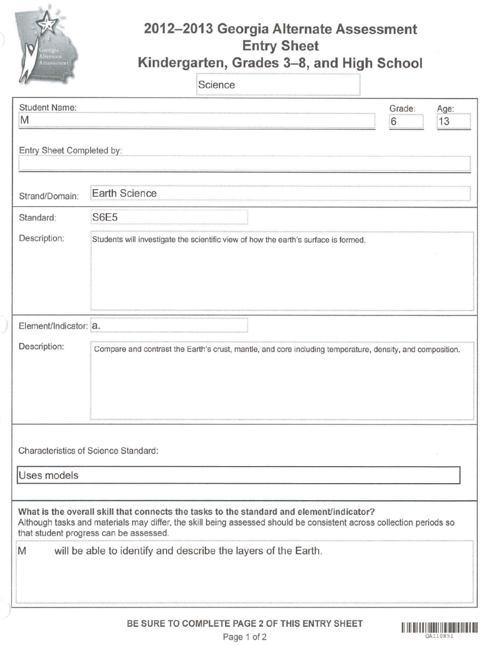
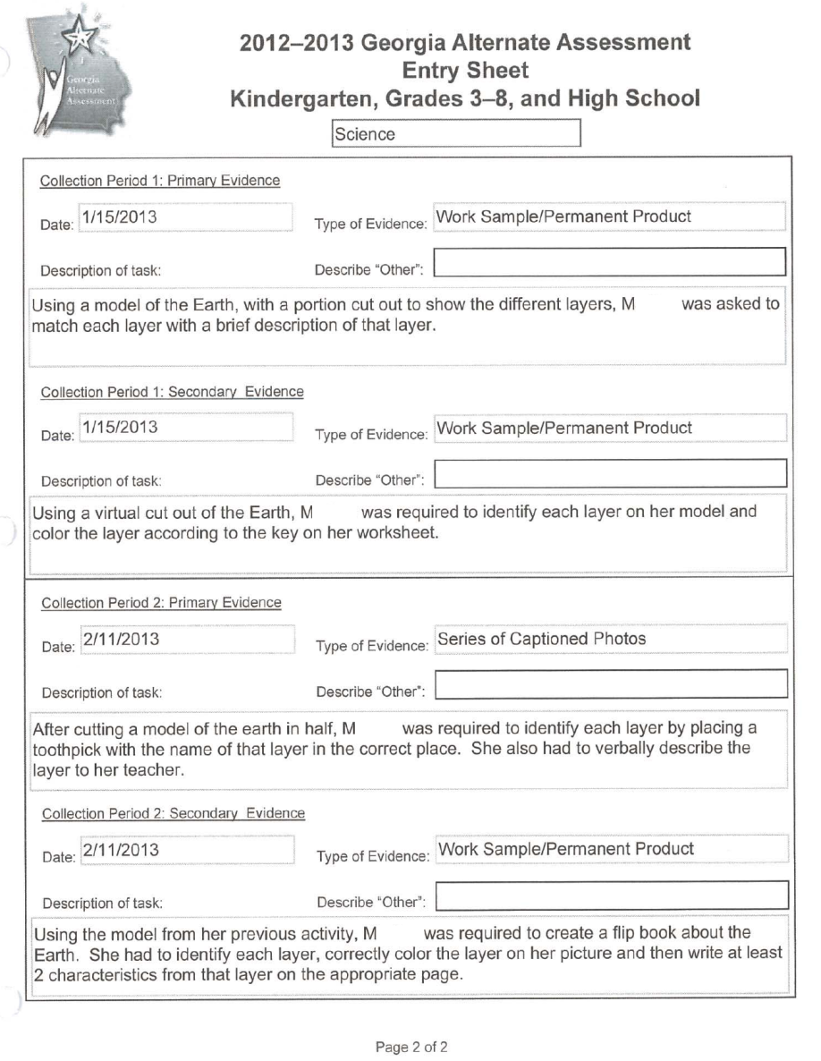
Characteristic of Science
CoS chosen
In this example, the Characteristic of Science chosen is also documented in the task descriptions.
Notes:
Although it is required that the Characteristic of Science be evident in only one assessment task, in this example, models have been incorporated into all four.

Slide 71
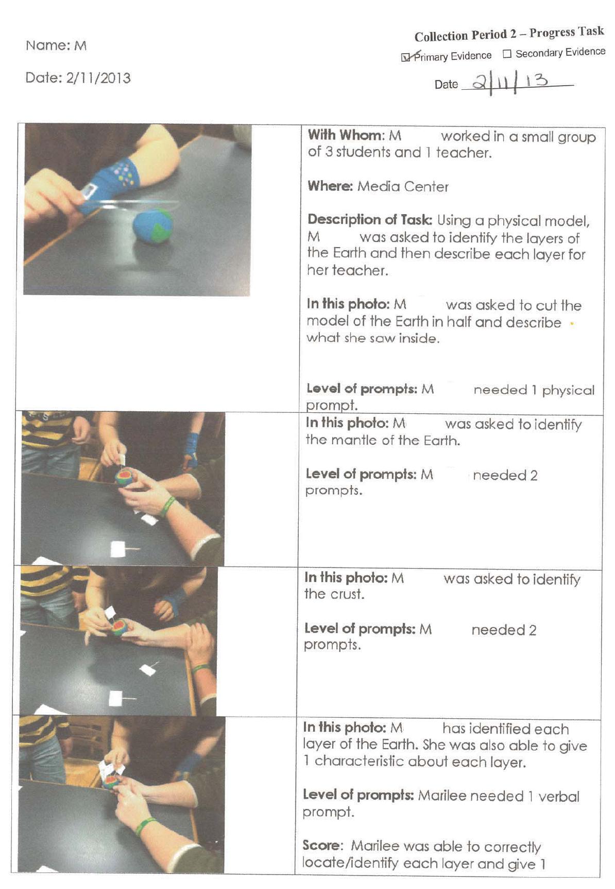
Characteristic of Science
The Characteristic of Science documented in the task description on the entry sheet is also apparent in the evidence.
The pictures clearly show the student working with a model of the earth which she uses to demonstrate her understanding of the interior layers.

Slide 72
Characteristic of Science
Characteristic of Science indicated must be visible in the evidence as part of the student’s participation in the process of science. For example:
Uses safety techniques | Including safe use, storage, and disposal of materials must be observed ; use of safety techniques must be in evidence
Uses scientific tools | Tools and instruments for observing, measuring, and manipulating scientific equipment and materials; use of tools must be in evidence
Uses technology | Using scientific technology such as a computer program that analyzes data (not just to research info on the web), using a balance to measure, thermometer, etc. ***This does NOT mean assistive technology or instructional technology. Scientific technology does NOT include using a PowerPoint to view information, using a computer to look up information, or using an electronic whiteboard, etc.
Organizes data into graphs, tables, and charts | Places information from scientific inquiry or investigation into a table, chart, or graph format; chart/table/graph must be included in the evidence
Notes:
If the Characteristic of Science indicated on the Entry Sheet is not found in the evidence, the entry is nonscorable.
For example: We frequently see the Characteristic of Science of “Uses Safety Techniques,” but instead of seeing evidence or documentation of how safety techniques were used while doing a hands-on investigation. We sometimes see evidence aligned to the CoS, but not aligned to the standard/element (e.g., terminology related to safety techniques, such as “goggles are used to protect the eyes.”) We also sometimes see task descriptions that include a CoS that is not identifiable or documented within the evidence.

Slide 73
Tips for the Characteristic of Science
It is recommended that the Characteristic of Science (CoS) be identified on the evidence on which it is included.
  Although this is NOT a requirement, it would serve as a reminder to the teacher that the Characteristic of Science indicated on the Entry Sheet is present in the evidence,
  AND it would help the portfolio reviewer whose job it is to look for the co-requisite CoS as part of the documentation.
Remember to reset the Entry Sheet when you move on to the next student to avoid having the wrong CoS recorded.

Slide 74
Contact Information
Questions About Test Administration
Call: GaDOE Assessment Administration Division
Toll free (800) 634-4106
Contact: Deborah Houston, Assessment Specialist (404) 657-0251
Email: dhouston@doe.k12.ga.us

Slide 75
Contact Information
  For information about access to the state-mandated content standards for students with significant cognitive disabilities
Contact: Kayse Harshaw
Division for Special Education Services
Call: (404) 463-5281
E-Mail: Sharshaw@doe.k12.ga.us

Slide 76
Contact Information
Questions About Materials, Distribution, or Collection
Call: Questar’s GAA Customer Service Toll free (866) 997-0698
Email: Questar’s GAA Customer Service GA@QuestarAI.com

Slide 77
Lessons Learned: Looking Forward to the 2013-2014 Administration of the GAA
Session 8 (2:30 PM) https://sas.elluminate.com/m.jnlp?sid=2012003&password=M.CBD17DD65C44B55EA718E7E33FAB50
Georgia Alternate Assessment

