Slide 1
Assessment for Learning Series Module 4: Working through Complex Issues Related to Student Responses to Constructed Response Items
Georgia Department of Education
Assessment and Accountability Division

Slide 2
Definition
Constructed response is a general term for items that require the student to generate a response as opposed to selecting a response. Constructed response items require more elaborate answers and explanations of reasoning. They allow for multiple correct answers and/or varying methods of arriving at the correct answer.
Examples of skills required on constructed response tasks include, but are not limited to:
English Language Arts
Utilize close analytic reading
Compare and contrast ideas and themes
Synthesize ideas and concepts across a single or multiple texts
Mathematics
Apply mathematical procedures and skills to real world problems
Express mathematical reasoning by showing work or explaining an answer

Slide 3
Using Assessment for Learning in Classrooms: A Continuous Cycle
Assess Current
Knowledge
Redesign and Teach
Create Lesson & Assessment
Deconstruct
Standard
Provide Feedback
Teach
Assess Learning

Slide 4
Summary of Topics
How to develop rubrics for constructed response tasks
How to score student responses for constructed response tasks
How to differentiate constructed response tasks for varying student ability

Slide 5
How to Develop Rubrics for Constructed Response Tasks
Define the task which defines the learning standards being taught
Identify the concepts or skills students need to demonstrate
Determine the number of distinct performance levels for the task
Identify the criteria for each level of performance

Slide 6
Grade 8 Math Example

Slide 7
Task
While she was on vacation, Tara sent 14 friends either a letter or a postcard. She spent $3.84 on postage. If it costs $0.20 to mail a postcard and $0.33 to mail a letter, how many letters did Tara send? Show what you did to get your answer.

Slide 8
Skills to be Demonstrated
Build a function that models a relationship between two quantities.
Develop a method to solve a system of two equations with two variables.

Slide 9
Number of Performance Levels Identified
Interpretation of task processes
Range of accuracy for processes
Representation of task strategies and computations
Accuracy of computations

Slide 10
Defined Performance Levels
Satisfactory
Partial
Minimal
Unsatisfactory

Slide 11
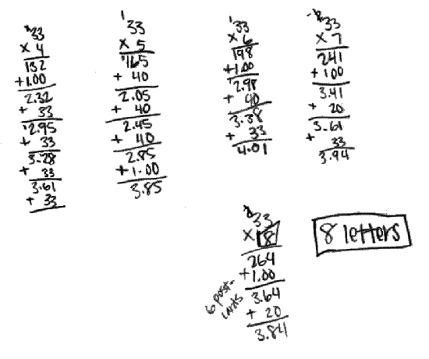
Example of Satisfactory Performance Level Response

Slide 12
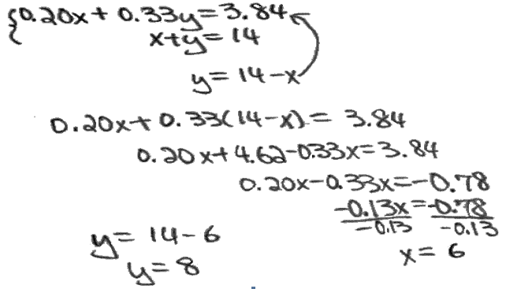
Example of Partial Performance Level Response

Slide 13
Example of Minimal Performance Level Response

Slide 14
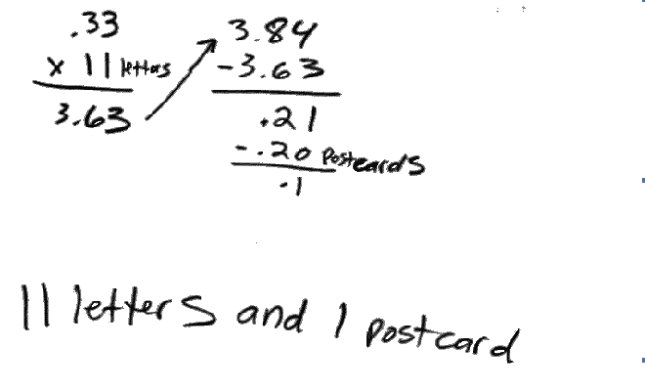
Exercise 1: Determine Performance Level of Response Shown

Slide 15
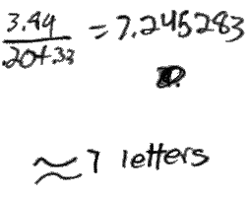
Exercise 2: Determine Performance Level of Response Shown

Slide 16
8th Grade Reading Example

Slide 17
Description of Passage
The “Alligator Poem ” describes an encounter with an alligator as the author leans down at a water source to take a drink. Detailed descriptions are given of the surroundings, the alligator’s physical characteristics, and the drinker’s response to the encounter.

Slide 18
Task
Describe what happens to the speaker of the poem and explain what this experience makes the speaker realize.

Slide 19
Skills to be Demonstrated
Cite the textual evidence that most strongly supports an analysis of what the text says explicitly as well as inferences drawn from the text.
Produce clear and coherent writing in which the development, organization and style are appropriate to the purpose of the task.

Slide 20
Number of Performance Levels Identified
Number of parts requested in the task
Range of responses for each part of the task
Accuracy of responses for each part of the task

Slide 21
Definition of Satisfactory Performance Level
Responses at this level describe what happens to the speaker of the poem and explain what this experience makes the speaker realize.

Slide 22
Example of Satisfactory Performance Level Response
“The speaker was drinking some water from a lake when an alligator comes up with its mouth open ready to eat the speaker. The speaker falls to the ground and avoids the alligator. After that event, the speaker realizes how lucky he is to be alive. He looks around and see the nature’s true beauty. How beautiful the birds and flowers are. How the water just ripples back to normal where the alligator just was.”

Slide 23
Definition of Partial Performance Level
Responses at this level describe what happens to the speaker of the poem, but the explanation of what this experience makes the speaker realize is general. Or, the explanation may simply repeat lines from the poem without interpreting them.

Slide 24
Example of Partial Performance Level Response
“In the poem the speaker is nearly attacked by an alligator. This makes the speaker think of the world differently.”

Slide 25
Definition of Minimal Performance Level
Responses at this level provide irrelevant details or personal opinions or may simply repeat the question.

Slide 26
Example of Minimal Performance Level Response
“The speaker was bird watching and an alligator crashed out of the water and onto land and the speaker was scared. After the alligator went back in the water all the birds flew out of the trees like a waterfall!!”

Slide 27
Example of Unacceptable Response
“The speaker didn’t have anything happen to him. He was just having a dream, thinking it was real. But it wasn’t.”

Slide 28
How to Score Student Answers for Constructed Response Tasks
Review, if available, an exemplary response
Identify the key elements of an exemplary response
Identify the quality of the key elements
Match key elements and their characteristics to scoring rubric

Slide 29
How to Differentiate Constructed Response Tasks for Varying Ability Levels
Math Task
Provide interpretation of task
Suggest representations for strategies
Simplified computations
Reading Task
Small parts of reading passage at one time
Look for identified key elements in each reading portion
Underline key vocabulary words and phrases

Slide 30
Close-out
Constructed response items require students to construct an answer for the formative task and are scored based on criteria defined in rubrics.
Constructed response items can be used formatively to learn how well students are progressing in mastery of standards.
Student performance on constructed response items gives teachers information to adjust instruction and know if students are able to demonstrate complex thinking.

Slide 31
References
Ericsson, K. A., & et al., (1993). The role of deliberate practice in the acquisition of expert performance. Psychological Review, 100(3), 363-406.
Georgia FIP Module 4: Analyzing evidence and providing effective feedback. www.gadoe.org/GeorgiaFIP
Smarter Balanced Assessment Consortium General Item Specifications. (April 2012). Retrieved from: http://www.smarterbalanced.org/wordpress/wp-content/uploads/2012/05/TaskItemSpecifications/ItemSpecifications/GeneralItemSpecifications.pdf
Universal design for learning. Center for Applied Special Technology (CAST) http://www.cast.org/udl/index.html

