Slide 1
Georgia
Alternate Assessment
2013-14
Post Assessment Webinar

Slide 2
Georgia Alternate Assessment (GAA)
Post Assessment Webinar, June 11-13, 2014
  Welcome!
  The power point presentation is available as a link on the
  GAA Presentations webpage at:
http://www.doe.k12.ga.us/Curriculum-Instruction-and-Assessment/Assessment/Pages/GAA-Presentations.aspx
Webinar Etiquette:
Please use the Audio Setup Wizard in the Tools Menu to configure and test your audio settings before the presentation begins.
To eliminate interference from background noise in your area, please leave the Talk Button on mute if you are not speaking.
Due to the number of participants, we request that questions be submitted via Chat.
You will receive a prompt to download this PowerPoint. You can also go to Window, File Transfer to download any files sent through this webinar.
Please log-in with your name and the name of your district beside it (e. g., John Smith– Appling). If you have already logged-in, please place your name and district in the chat box.

Slide 3
Post Assessment Webinar
The purpose of this workshop is to provide System and School personnel with information to interpret reports and data related to the Georgia Alternate Assessment (GAA).
The purpose of the GAA is to ensure that students with
significant cognitive disabilities are:
  Provided access to the state-mandated content standards.
  Given the opportunity to demonstrate progress toward achievement of content standard knowledge, concepts, and skills.

Slide 4
Topics that will be presented and discussed
The Georgia Alternate Assessment
  The Use of Alternate Assessments and GAA Scores
  GAA Scoring Rubric
Portfolios Submitted
  2013-14 vs. 2012-13
Nonscorables
How Scores Are Calculated
Samples of GAA Score Reports
Interpreting the GAA Scores

Slide 5
The Use of Alternate Assessments and GAA Scores
The GAA serves as one indicator of student achievement and progress and should be interpreted in conjunction with other available information about the student.
While the GAA is not a direct evaluation of the progress a student makes on IEP goals and objectives, IEP goals remain important and should be considered along with GAA scores.

Slide 6
Rubric Dimensions
Fidelity to Standard:
  A dimension of the scoring rubric that assesses the degree to which the instructional activity, as demonstrated by student work, addresses the grade-level standard.
Context:
  A dimension of the scoring rubric that assesses the degree to which the student work exhibits the use of grade-appropriate materials that reflect a purposeful and natural/real-world application.
Achievement/Progress:
  A dimension of the scoring rubric that assesses the measurable, forward movement of a student’s performance of a standards-based instructional task as documented by increased proficiency over time. Progress will be assessed from the first collection period, which will demonstrate the student’s initial skill level, to the second collection period, which will demonstrate a more advanced level of skill development.
Generalization:
  A dimension of the scoring rubric that assesses the student’s opportunity to apply learned skills in other settings and with various individuals in addition to the teacher or paraprofessional. Generalization is scored once across the portfolio.

Slide 7
Possible scores for each dimension:
Dimension | Possible Points
Fidelity to Standard | 1-3
Context | 1-4
Achievement/Progress | 1-4
Generalization | 1-4
Fidelity to Standard, Context, and Achievement/Progress are scored for each entry.
Generalization is scored once across the entire portfolio.

Slide 8

Georgia Alternate Assessment Scoring Rubric
Dimension | 1 | 2 | 3
Fidelity to Standard (scored for each entry) | The instructional activity is aligned to and exposes the student to a content standard, but the student work does not address academic content. | The instructional activity is aligned to a content standard; the student work addresses academic content but at an access or entry level. | The instructional activity is aligned to a content standard, all aspects of the element selected are addressed, and the student work addresses academic content at or approaching basic grade-level expectations.
 | 1 | 2 | 3 | 4
Context (scored for each entry) | Materials are not grade-appropriate. | Materials are grade-appropriate, but the student work does not reflect a purposeful application. | Materials are grade-appropriate, and the student work reflects a purposeful simulated application. | Materials are grade-appropriate, and the student work reflects a purposeful natural/real-world application.
Achievement/ Progress (scored for each entry) | Student demonstrates little achievement/progress in targeted instructional activity. | Student demonstrates some achievement/progress in targeted instructional activity. | Student demonstrates reasonable achievement/progress in targeted instructional activity. | Student demonstrates exceptional achievement/progress in targeted instructional activity.
Generalization (scored once across all entries in portfolio) | Student performs tasks in one or more settings with no evidence of interaction(s) beyond those with the primary instructional provider. | Student performs tasks in one or more settings with evidence of interaction (s) with other instructional providers and/or disabled classmates. | Student performs tasks in two different settings with evidence of interaction(s) with non-disabled peers and/or community members. | Student performs tasks in three or more different settings with evidence of interaction(s) with non-disabled peers and/or community members.

Slide 9
GAA Portfolios Submitted
10,663 portfolios were submitted in 2013-2014 compared to 10,278 submitted in 2012-2013. This table provides a breakdown, by grade, including the total number of entries for both 2013-2014 and 2012-2013.
298 High School Retest portfolios were submitted in Spring 2014.

Slide 10
What We Found
In general, the portfolios were complete and well executed.
The portfolios provided valuable information as to areas of focus for upcoming training.
  Training will continue to focus on alignment, documentation, and evidence requirements.
Across all grades and content areas, the vast majority of students met or exceeded expectations as demonstrated by their Performance Level Indicator.
Number and percent of nonscorables continues to be low.

Slide 11
Frequency of Nonscorables
The majority of Nonscorables received a code of Not Aligned (NA).
  The vast majority of these were because one or more of the instructional tasks (not all) were not aligned to the content standard and/or indicator and thus received the code of NA.
The next highest number of nonscorable entries received the code of Insufficient Evidence (IE).
  A significant decrease was also found in this category from the previous administrations.

Slide 12
Grade 7 Math
Increase in percentage of students in Emerging Progress.
Some of this increase is related to a higher frequency of non-scorables in Grade 7 Math.
Contributing factors may include:
  MCC.7.G.1 (solve problems involving scale drawings of geometric figures), non-geometric figures were accepted; however
  MCC.7.G.2 (describe the two-dimensional figures…), three-dimensional figures were not accepted.
The apparent need for clarity relative to the standards has been noted for our August 2014 fall trainings.

Slide 13
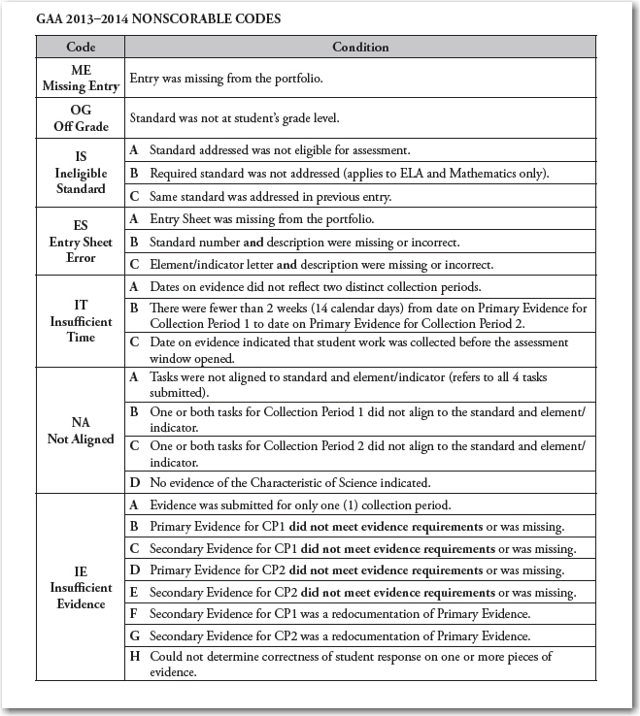
Nonscorable
Codes Chart
Should a student receive a Nonscorable Code for an entry, the code and it’s definition will be provided on side 2 of the Individual Student Report.
The Nonscorable Codes and Definitions are also provided in the following places:
On side 2 of the Student Roster
Page 13 of the Score Interpretation Guide

Slide 14
Frequency of Nonscorables by Number and Percent
2013-14 First Time Test Takers
NS Code | Frequency | Percent of NS | Percent of all entries
ME | 140 | 1.77% | 0.21%
ES | 103 | 1.30% | 0.16%
NA | 6471 | 81.75% | 9.74%
IE | 1061 | 13.40% | 1.60%
IT | 77 | 0.97% | 0.12%
OG | 20 | 0.25% | 0.03%
IS | 44 | 0.56% | 0.06%
Total | 7916 | 100.0% | 11.92%
7,916 of 66,416 entries received NS codes

Slide 15
How Scores are Calculated
Kindergarten
  Each portfolio consisted of four entries:
    two ELA / two Mathematics
Grades 3-8
  Each portfolio consisted of six entries:
    two ELA / two Mathematics / one Science / one Social Studies
Each entry was scored for each of the three rubric dimensions: Fidelity to Standard, Context, and Achievement/Progress
The fourth rubric dimension, Generalization,
  Scored once across the scorable entries for the entire portfolio

Slide 16
How Scores are Calculated
High School
  Each portfolio consisted of eight entries:
    two ELA/ two Mathematics / two Science / two Social Studies
Each entry is scored by two independent readers
Each entry was scored for each of the three rubric dimensions: Fidelity to Standard, Context, and Achievement/Progress
The fourth rubric dimension, Generalization,
  Scored once across the scorable entries for the entire portfolio

Slide 17
Score Calculation for
Kindergarten and 3-8
Fidelity to Standard, Context, Achievement/Progress
A total score for each dimension within each content area is calculated as the
average of the two entry scores rounded to the nearest whole point. If one entry
is nonscorable, that entry is treated as having a score of zero for the purpose of
calculating the average.
Dimension Score = Entry 1 Score + Entry 2 Score (rounded)
2
Score calculations for Mathematics, Science, and Social Studies are the same
as the ELA examples on the following slides.

Slide 18
Score Calculation for
Kindergarten and 3-8
Fidelity to Standard, Context, Achievement/Progress
Examples:
Rubric Dimension: Fidelity to Standard
ELA Entry 1 score: 2
ELA Entry 2 score: 3
Total score = (2 + 3) / 2 = 2.5
2.5 rounds to 3
Total Fidelity to Standard Dimension score = 3
Rubric Dimension: Context
ELA Entry 1 Score: 1
ELA Entry 2 score: 1
Total score = (1 + 1) / 2 = 1
Total Context Dimension score = 1
Rubric Dimension: Achievement/Progress
ELA Entry 1 Score: 4
ELA Entry 2 Score: 4
Total Score = (4 + 4) / 2 = 4
Total Achievement/Progress Dimension score = 4

Slide 19
Score Calculation for
Kindergarten and 3-8
Generalization (is scored once across all scorable entries)
Dimension score = Generalization score
The Generalization score assesses a student’s opportunity for interaction with others, as well as the diversity of settings across all content areas and entries in the portfolio.
Finally, the scores for each of the dimensions are not combined to form a single numeric score, but are reported separately.
Example: Student’s ELA Scores Student’s
by Dimension ELA Score
Fidelity: 3
Context: 1
Achievement/Progress: 4
Generalization: 2
3142

Slide 20
Score Calculation for High School
Fidelity to Standard, Context, Achievement/Progress
For High School, two independent readers score each entry of the student’s portfolio in the three rubric dimensions of Fidelity to Standard, Context, and Achievement/Progress. Each reader scores Generalization once across the entire portfolio. The entry score is determined by averaging the scores from reader one and reader two.
Note: For each content area requiring a retest, both entries for the content
area must be submitted.
Entry Score = Reader 1 Score + Reader 2 Score (unrounded)
2

Slide 21
Score Calculation for High School
Fidelity to Standard, Context, Achievement/Progress
Entry Score = Reader 1 Score + Reader 2 Score (unrounded)
2
Example:
Rubric Dimension: Fidelity to Standard
Reader 1 ELA Entry 1 score: 3
Reader 2 ELA Entry 1 score: 2
ELA Entry 1 Score = (3 + 2) / 2 = 2.5
Reader 1 ELA Entry 2 score: 3
Reader 2 ELA Entry 2 score: 3
ELA Entry 2 Score = (3 + 3) / 2 = 3

Slide 22
Score Calculation for High School
Fidelity to Standard, Context, Achievement/Progress
After the entry scores are determined for each content area, a total score for
each dimension within each content area is calculated as the average of the
entry scores rounded to the nearest whole point. If one entry is nonscorable, that
entry is treated as having a score of zero for the purpose of calculating the
average.
Dimension Score = Entry 1 Score + Entry 2 Score 2
(rounded)
Score calculations for Mathematics, Science, and Social Studies are the same
as the ELA examples on the following slides.

Slide 23
Score Calculation for High School
Fidelity to Standard, Context, Achievement/Progress
Examples:
Rubric Dimension: Fidelity to Standard
ELA Entry 1 score: 2.5
ELA Entry 2 score: 3
Total score = (2.5 + 3) / 2 = 2.75
2.75 rounds to 3
Total Fidelity to Standard Dimension score = 3
Rubric Dimension: Context
ELA Entry 1 Score: 1
ELA Entry 2 score: 1
Total score = (1 + 1) / 2 = 1
Total Context Dimension score = 1
Rubric Dimension: Achievement/Progress
ELA Entry 1 Score: 2
ELA Entry 2 Score: 3
Total Score = (2 + 3) / 2 = 2.5
2.5 rounds to 3
Total Achievement/Progress Dimension score = 3

Slide 24
Score Calculation for High School
Generalization (scored once across all scorable entries)
Dimension score = Generalization score
The Generalization score assesses a student’s opportunity for interaction with others, as well as the diversity of settings across all content areas and entries in the portfolio.
Finally, the scores for each of the dimensions are not combined to form a single numeric score, but are reported separately.
Example: Student’s ELA Scores Student’s
by Dimension ELA Score
Fidelity: 3
Context: 1
Achievement/Progress: 3
Generalization: 2
3132

Slide 25
GAA Score Reports
GAA score reports provide information on the Stage of Progress achieved by each student in each content area, as well as the assigned score for each rubric dimension.

Slide 26
Electronic Data Files
A data file format document is included in each system data file package. This file is the key to the system data file including what data is included in the various columns.
Please note some key column headings:
1) SSPELA - BT
2) SSPMath - BU
3) SSPSCI - BV
4) SSPSS - BW
E1 = Emerging Progress; E2 = Established Progress;
E3 = Extending Progress
For more information, refer to the Score Interpretation Guide, 2013-2014 page 31.

Slide 27
School and System Report Shipments
Reports are provided at the student, school, and system levels.
The school report shipment contains:
  Individual Student Reports (ISRs)
  Individual Student Labels
  School Summary of Student Performance–Roster
  School Summary of Student Performance–Profile
The system report shipment contains:
  System Summary– Overall Summary of Performance
  System Summary–
  By Grade
  System Performance–
  By Strand
  School Summary of Student Performance–Roster
  School Summary of Student Performance– Profile

Slide 28
Secure Summary Reports
Due to the small numbers of students participating in the GAA, all summary reports are marked as secure.
Any report that identifies an individual student is a secure report and must be treated in a way to protect the privacy of the student.
The following statement appears on each Summary report:
  “Secure Report— Not for public distribution due to limited number of students; caution should be used when interpreting summary data.”

Slide 29
Individual Student Reports
The Student Score Report is designed for parents and provides feedback on how the student performed on the GAA.

Slide 30
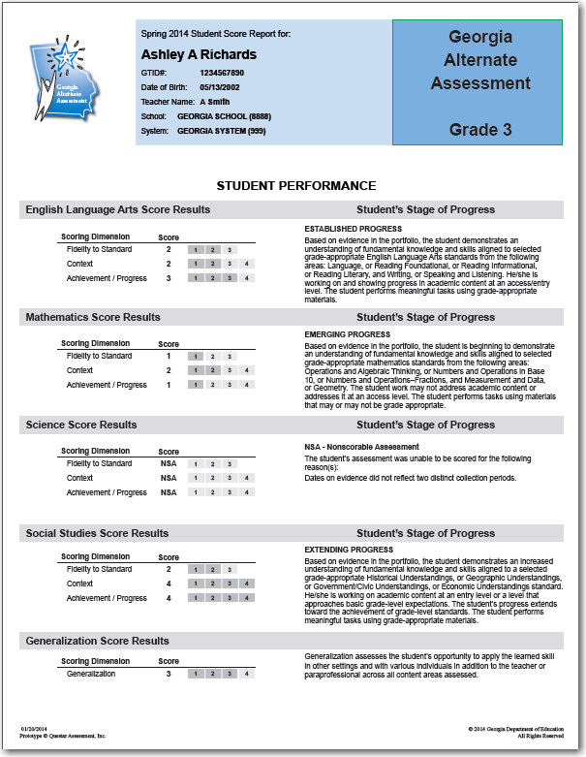
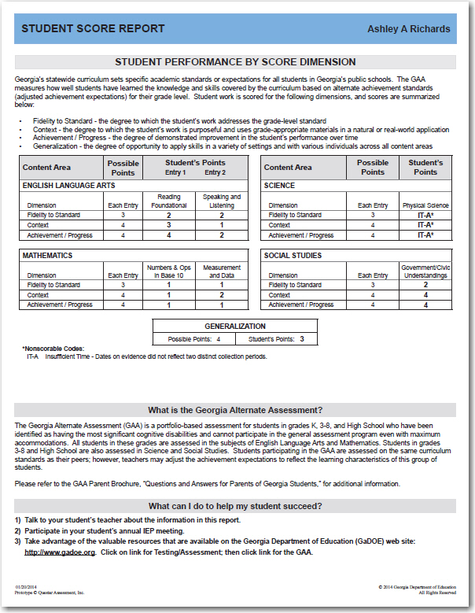
Kindergarten, 3-8 Individual Student Report
Individual Student Report – Side 1
Individual Student Report – Side 2

Slide 31
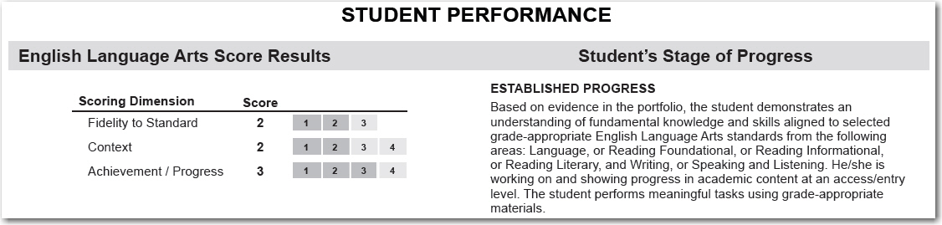
Individual Student Report
Side One:
  Scores for each content area assessed by dimension
    Fidelity to Standard
    Context
    Achievement/Progress
  Description of the student's Stage of Progress (performance level)
    Extending Progress
    Established Progress
    Emerging Progress

Slide 32
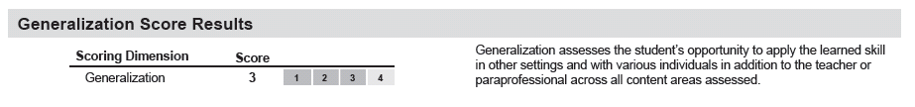
Individual Student Report
Side One:
  The dimension score earned for Generalization

Slide 33
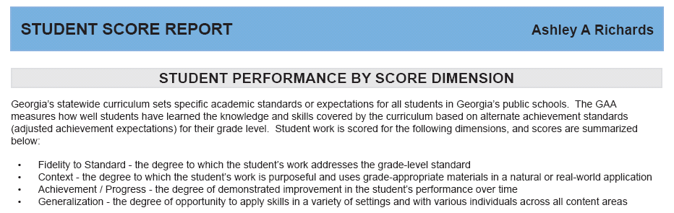
Individual Student Report
Side Two:
  Definitions of the four scoring dimensions

Slide 34
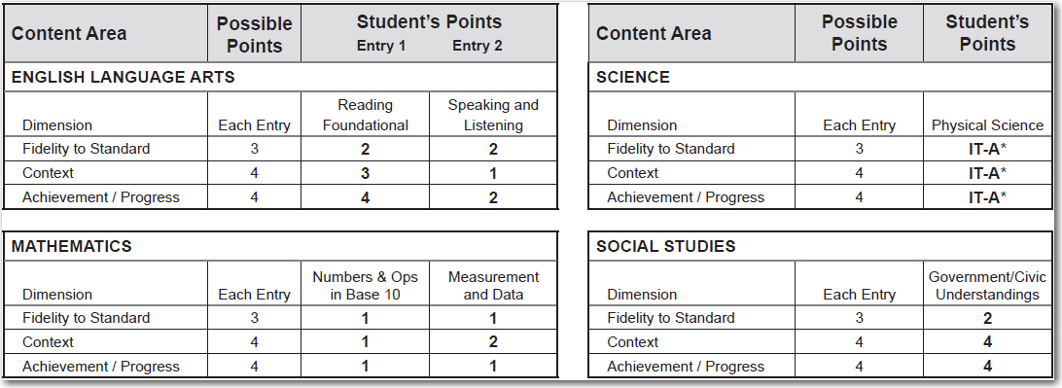
Individual Student Report
Side Two:
  The total possible points and the actual points the student earned for each entry
  The strand assessed for the entry

Slide 35
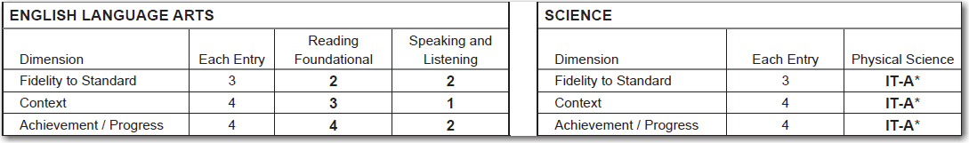
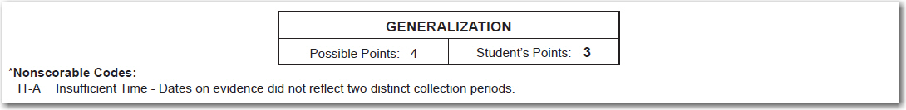
Individual Student Report
Side Two:
  Student’s Generalization score
  Any Nonscorable codes issued for the student entries are listed and defined

Slide 36
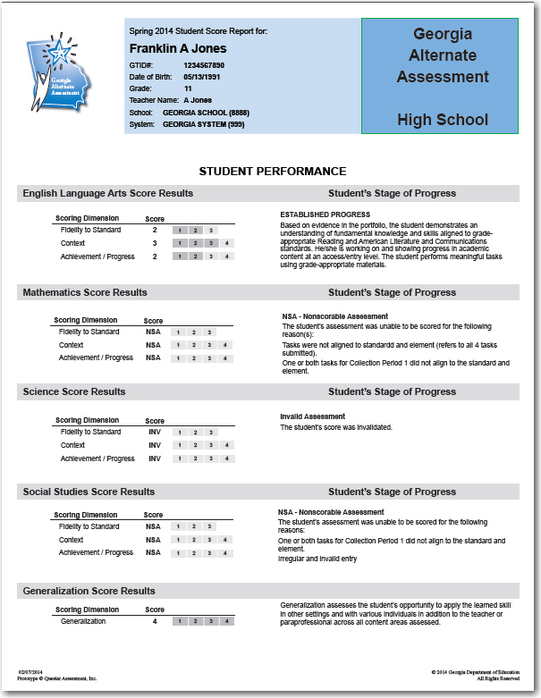
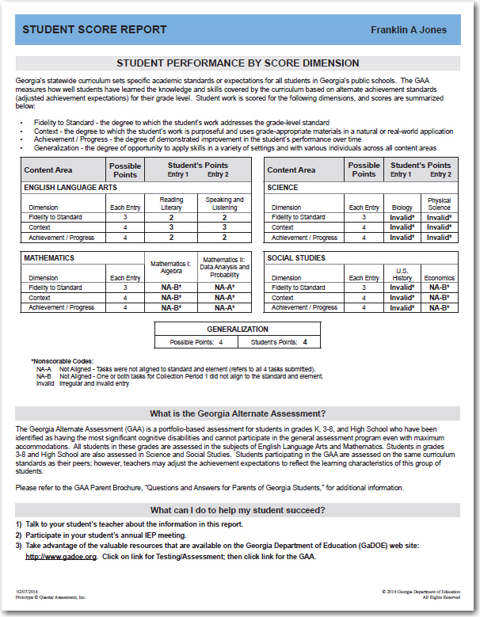
High School Individual Student Report
Individual Student Report – Side 1
Individual Student Report – Side 2

Slide 37
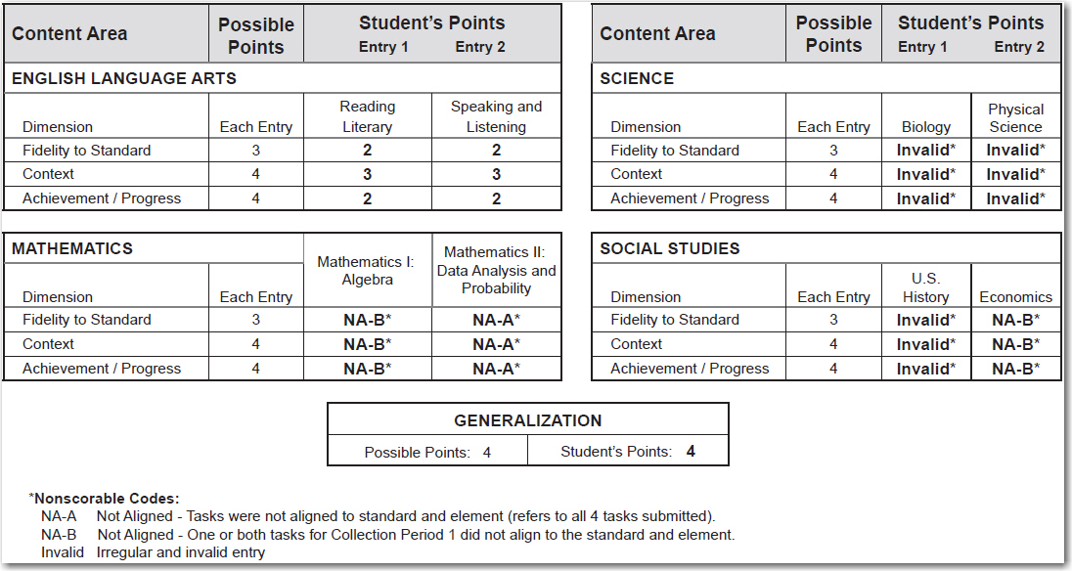
High School Individual Student Report
Side Two:
Science and Social Studies have 2 entries

Slide 38
Individual Student Labels
The Individual Student Label presents summary information similar to that contained on the Student Score Report but on a small label appropriate for use in a student’s permanent record folder.

Slide 39
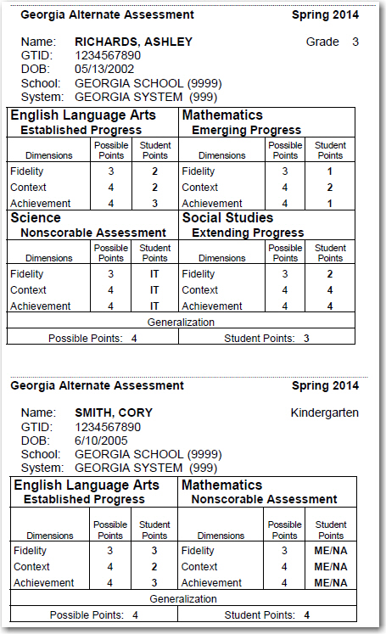
Individual
Student
Labels
Grade 3 Example
Kindergarten Example

Slide 40
School Reports
The School Summary of Student Performance, organized by grade, is made up of two parts:
  School Summary of Student Performance– Roster
  School Summary of Student Performance– Profile

Slide 41
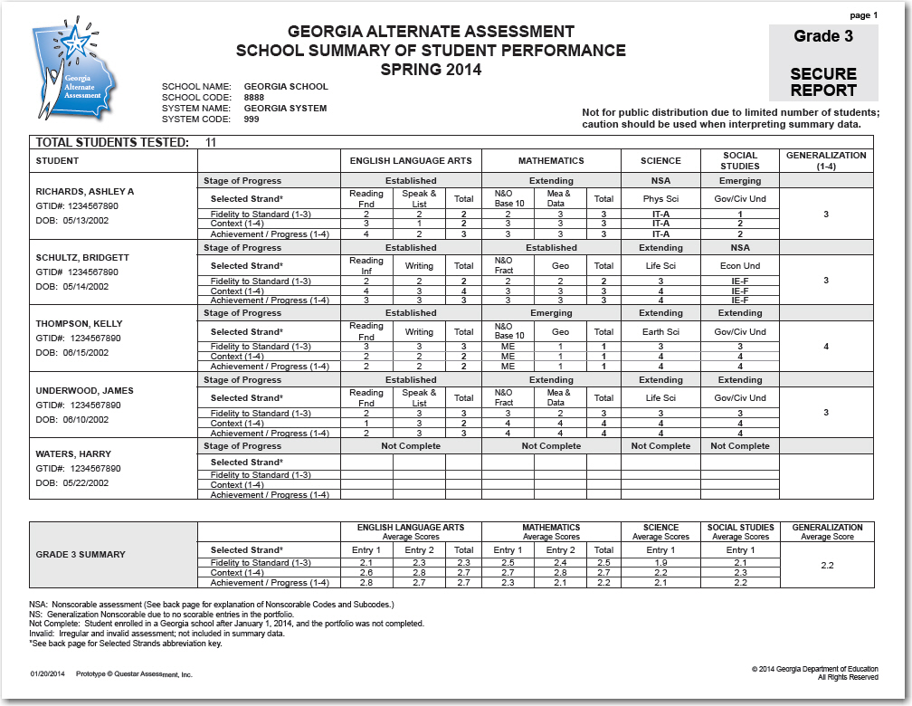
School Summary of Student Performance–Roster
Side 1

Slide 42
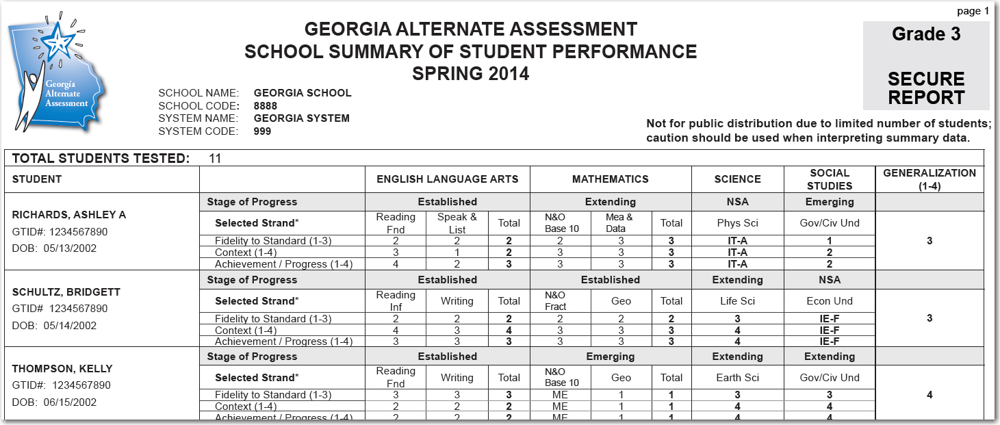
School Summary of Student Performance–Roster
Each student in that grade who participated in the GAA is listed
Student’s Stage of Progress by content area
Strand assessed for each entry
Student’s dimension scores or nonscorable code by entry and total dimension scores by content area
Student’s generalization score

Slide 43
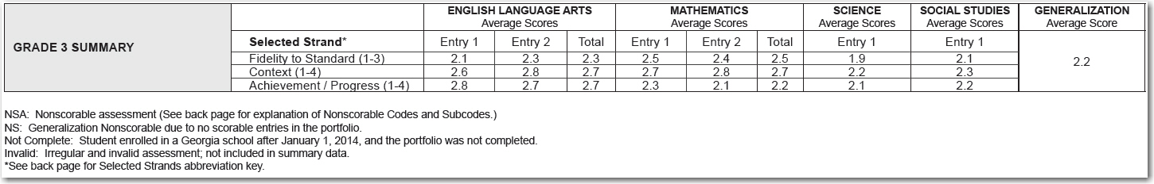
School Summary of Student Performance–Roster
Average scores are summarized at the bottom of side one for each content area.
Average entry scores for each dimension
  Average generalization score

Slide 44
School Summary of Student Performance–Roster
Student Roster– side 2:
  provides a “Strand Abbreviation Key” and the “Nonscorable Codes and Definitions”

Slide 45
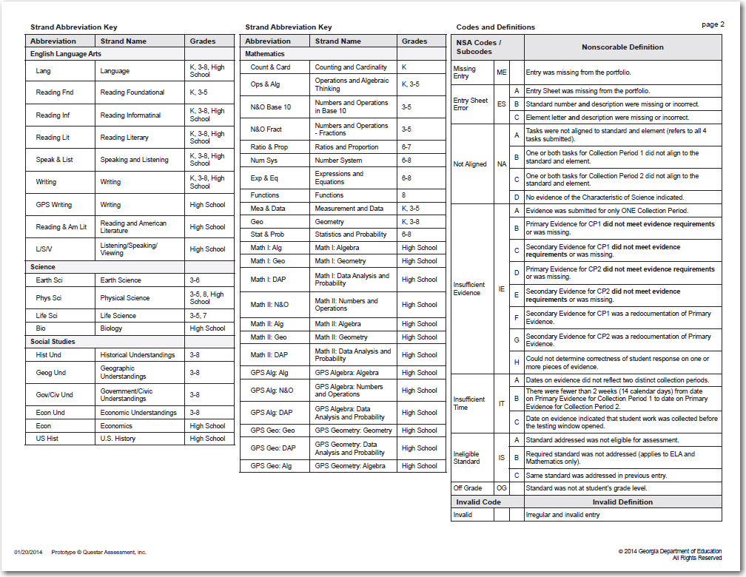
School Summary of Student Performance–Roster
Side 2

Slide 46
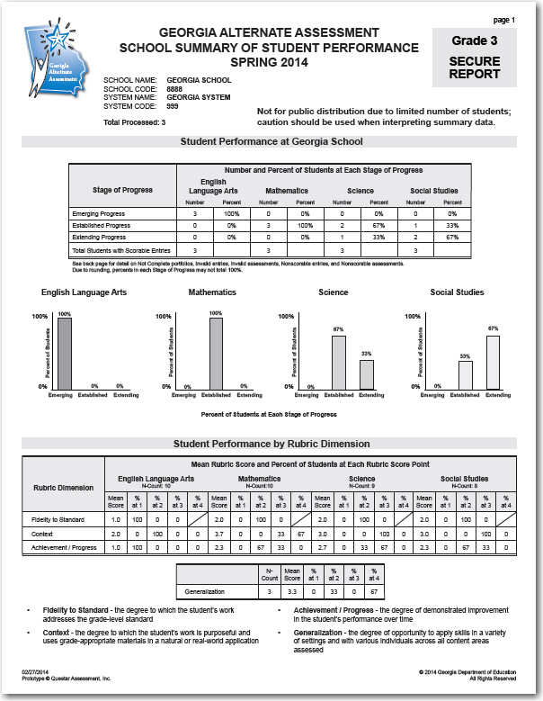
School Summary of Student Performance–Profile
The Profile is organized by
grade and presents summary
data for the school on two
sides.
Profile– side 1:
Number and percent of students at each Stage of Progress by content area
Percent of students at each Stage of Progress in bar-graph format
Student performance by rubric dimension data

Slide 47
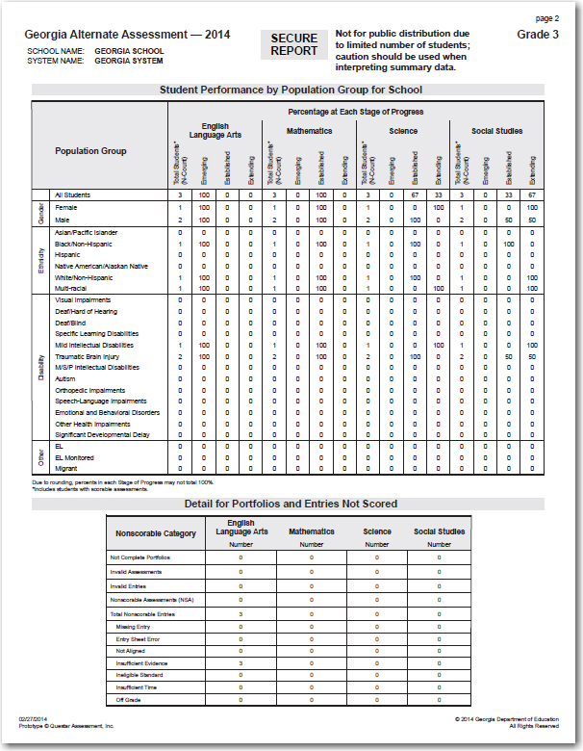
School Summary of Student Performance–Profile
Profile– side 2:
Student Performance by Population Group for School
  N-counts
  Percent at each Stage of Progress
Detail for Portfolios and Entries Not Scored
  Not Complete Portfolios
  Invalidations
  Nonscorable Assessments and breakdown by Nonscorable Code

Slide 48
System Reports
The System Summary Report is made up of two parts:
  Overall Summary of Performance
  System Summary by Grade
Data are presented for all students tested in the system and are also broken down by grade.
Caution must be taken when interpreting summary data.

Slide 49
System Report–
Overall Summary of Performance
Overall Summary of Performance lists system-wide performance of students taking the GAA by content area.

Slide 50
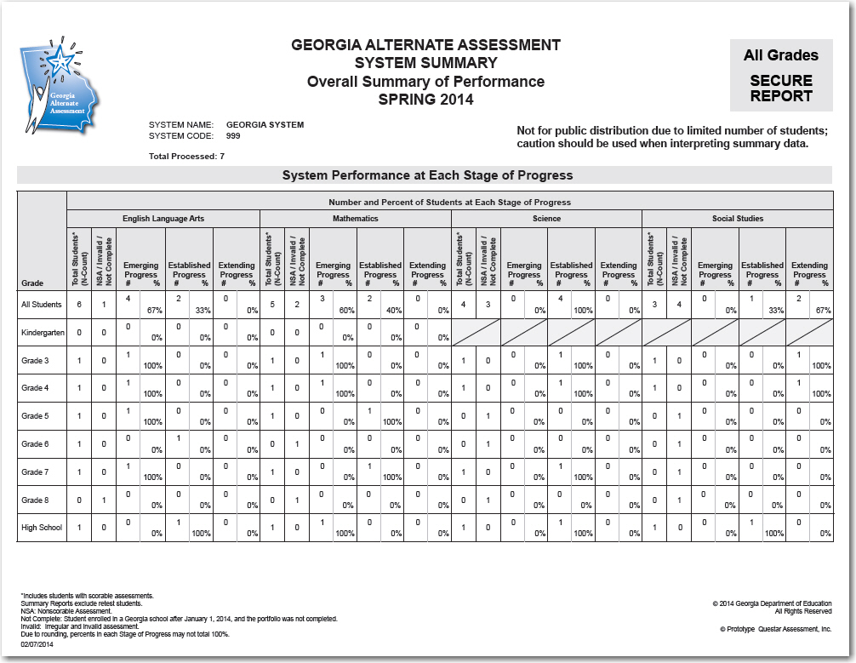
System Summary – Overall Summary of Performance

Slide 51
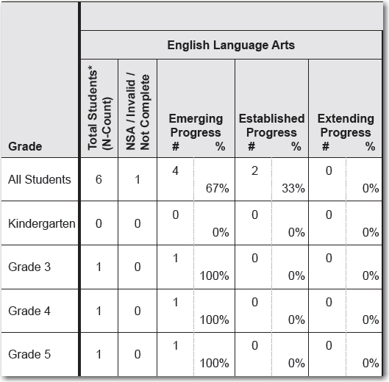
System Summary – Overall Summary of Performance
The number of portfolios returned that could not be scored
The number and percent of students at each stage of progress
The total number of students
All grades
Each grade

Slide 52
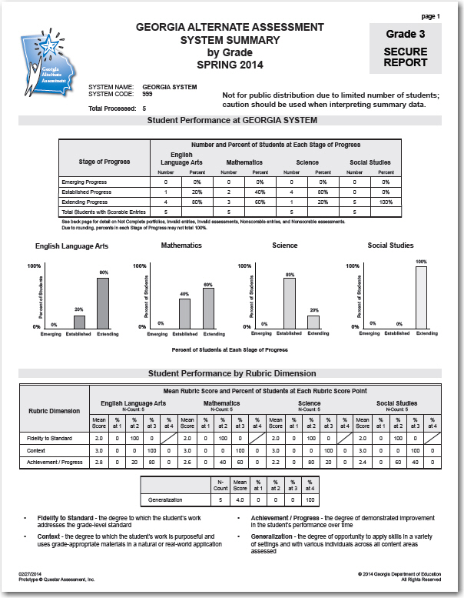
System Summary–System Summary by Grade
System Summary by Grade presents summary data for the system on two sides.
System Summary– side 1:
Number and percent of students at each Stage of Progress by content area
Percent of students at each Stage of Progress in bar-graph format
Student performance by rubric dimension data

Slide 53
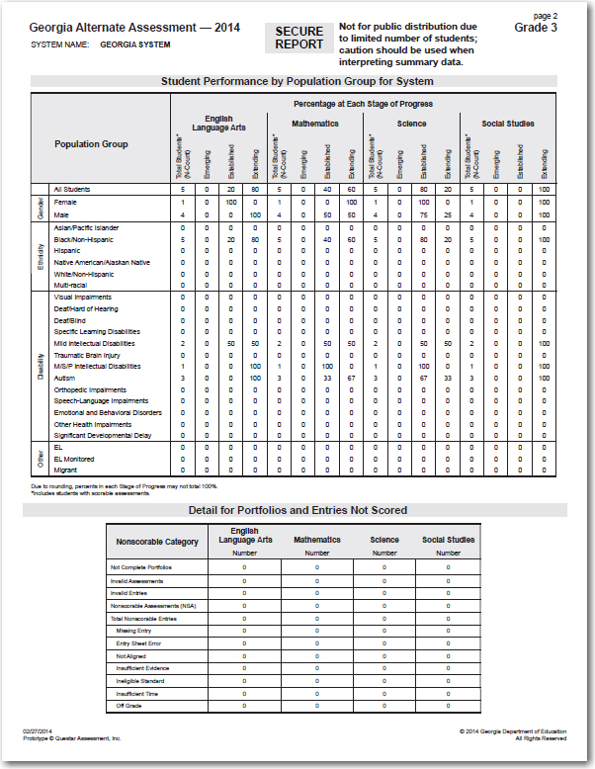
System Summary–System Summary by Grade
System Summary – side 2:
Student Performance by Population Group for System
  N-counts
  Percent at each Stage of Progress
Detail for Portfolios and Entries Not Scored
  Not Complete Portfolios
  Invalidations
  Nonscorable Assessments and breakdown by Nonscorable Code

Slide 54
System Reports–System Performance by Strand
System Performance by Strand provides a summary of student’s scores by content area and strand for each of the rubric dimensions.
  Content area/strand data is collected from the Student Demographic Information Forms (SDIFs) that were completed at the school level and returned with each portfolio.
    The total number of students tested for each content area and strand indicated on the report may not equal the actual number of students tested if the SDIFs were not completed correctly.

Slide 55
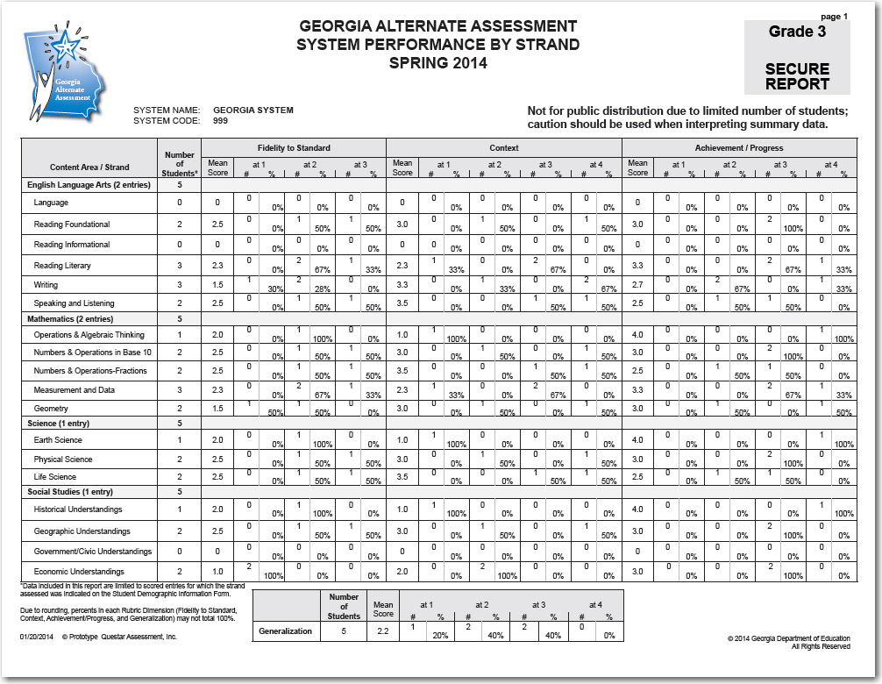
System Performance by Strand

Slide 56
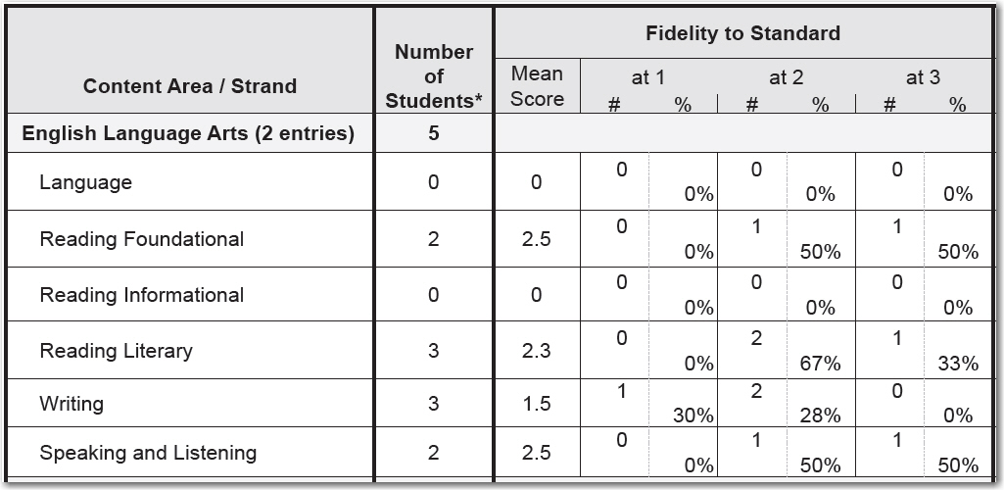
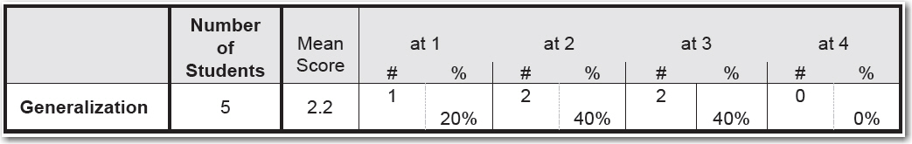
System Performance by Strand
The total number of students evaluated in each content area and strand
The number and percent at each score point for each dimension
Strands
Table summarizing student performance for Generalization

Slide 57
Interpreting GAA Scores

Slide 58
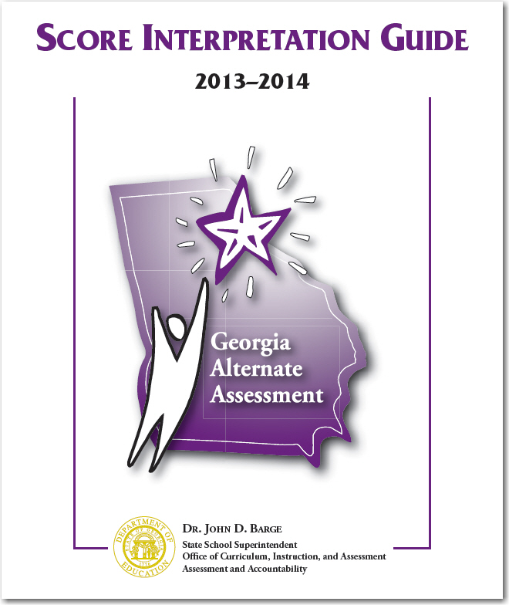
GAA Score Interpretation Guide
The purpose of this guide is to provide system and school personnel with information to interpret reports and data related to the Georgia Alternate Assessment (GAA).

Slide 59
GAA Performance Level Classification
Performance level standards were approved by the State Superintendent of Schools and adopted by the State Board of Education in May 2007. The same standards have been applied throughout all operational assessments.
Standards were set by content area and grade band.
Four grade bands were identified based on similarity of their content and skills inherent in the curriculum standards:
  Kindergarten
  Grades 3 – 5
  Grades 6 – 8
  High School

Slide 60
GAA Performance Level Classification
To give meaning to the many different combinations of rubric scores, each was assigned a performance level determined during standard setting.
Performance Levels for GAA are distinguished by 3 Stages of Progress.
The three Stages of Progress are:
  Extending Progress (E3)
  Established Progress (E2)
  Emerging Progress (E1)

Slide 61
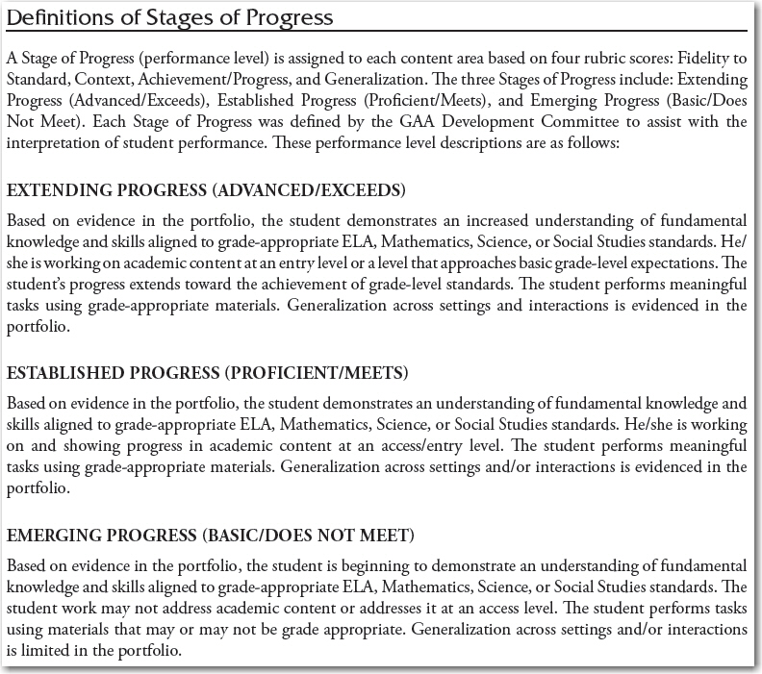

Slide 62
GAA Performance Level Classification
Stages of Progress are indicated in a chart in the Score Interpretation Guide by an alphanumeric code:
  E1 = Emerging Progress (Basic/Does Not Meet)
  E2 = Established Progress (Proficient/Meets)
  E3 = Extending Progress (Advanced/Exceeds)

Slide 63
GAA Performance Level Classification
Refer to the chart on pages 32–36 of the Score Interpretation Guide to look up a student’s Stage of Progress.
The chart displays:
  a row for each possible score
  a column for each content area and grade band combination.

Slide 64
GAA Performance Level Classification
Score patterns are organized by rubric dimension, reading left to right:
Fidelity to Standard
◉
2332
Context
◉
2332
Achievement/Progress
◉
2332
Generalization
◉
2332

Slide 65
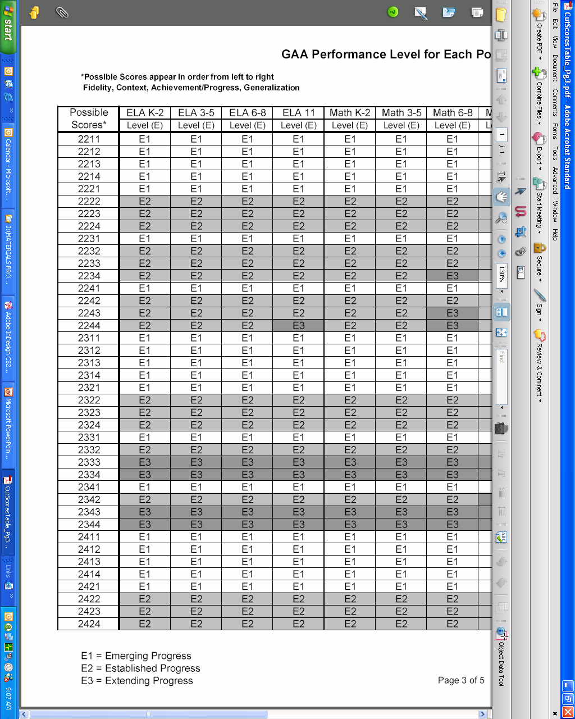
GAA Performance Level Classification
Use the chart to look up the Stage of Progress corresponding to the Score Pattern and Content Area/ Grade Band combination.
In this example, a 3rd
grade student with a
score of 2332 has a
Stage of Progress of
E2, Established
Progress, for ELA.
◉
○

Slide 66
Using the Score Reports to
Improve Performance
It is important that the score reports be provided to and reviewed with teachers to ensure that they understand how the overall scores and Performance Levels were arrived at and what they mean regarding student performance.
  Teachers are often called upon by parents to assist the parents in interpreting the scores.
  Results can be used to inform and improve best instructional practice as well as more effective test administration.

Slide 67
Using the Score Reports to
Improve Performance
Information from the reports, especially regarding Emerging (below basic/does not meet) performance levels or nonscorable entries, should be discussed to determine what supports either the student or the teacher need to improve performance.
The primary focus should be on student progress and performance.

Slide 68
Reminders
2013-14 GAA Blueprint by Grade
  Available in the 2013-14 GAA Examiner’s Manual, Appendix D
Spring 2014 Rescore requests must be submitted between June 4 and August 15, 2014
  Rescore requests are submitted by the System Test Coordinator using the Rescore Form on the MyGaDOE portal
  Once the request and PO have both been submitted to Questar, the rescore should be completed in approximately twenty business days

Slide 69
Additional GAA Resources
The following resources, which include information on the GAA and the state-mandated content standards, are available for local systems and educators.
  The https://www.georgiastandards.org/Pages/default.aspx website hosts the state-mandated standards.
  The Resource Board is a forum for teachers to discuss the curriculum and access and post ideas. To enroll on the Resource Board, contact Debbie Reagin at the Division for Special Education Services.
  The http://www.gadoe.org/Curriculum-Instruction-and-Assessment/Assessment/Pages/GAA.aspx website contains a variety of general GAA administration information including electronic versions of manuals and forms.

Slide 70
Fall 2014 Training Webinars
Training Dates: August 13th (Wed.); August 14th (Thurs.);
August 21st (Thur.); August 27th (Wed.)
Topics to be presented include:
Updates for the GAA 2014-15 Administration
Use of entry sheets and Student Demographic Information Forms (SDIF)
High School Mathematics transition to state-mandated content standards (CCGPS)
Alignment & designing tasks
“Big Idea” – intent of the standard and indicator
Requirements for Retest
New teacher training
Prerequisite skills (instruction precedes assessment)
The basics of Scoring and avoiding nonscorable entries

Slide 71
Contact Information
Georgia Department of Education
  Deborah Houston, Assessment Specialist GaDOE
  404-657-0251; dhouston@doe.ga.k12.us
Questar Assessment, Inc.
  Mark Phipps, Program Manager
  866-997-0698; GA@questarai.com

Slide 72
Evaluation Survey
https://www.surveymonkey.com/s/C66D6Z9
To Exit this session, go to:
File (in the upper left corner of screen), then select, Exit.
Thank you for attending this webinar!

