Slide 1
Georgia Alternate Assessment
Overview of High School Mathematics
in 2016-2017
Session 3

Slide 2
2016-2017 GAA Purpose
The 2016-2017 webinars (Sessions 1-5) explain how to prepare and submit GAA portfolios.
http://www.gadoe.org/Curriculum-Instruction-and-Assessment/Assessment/Pages/GAA-Presentations.aspx
Information pertaining to the GAA can also be found in the 2016-2017 GAA Examiner’s Manual.
http://www.gadoe.org/Curriculum-Instruction-and-Assessment/Assessment/Pages/GAA-Resources.aspx

Slide 3
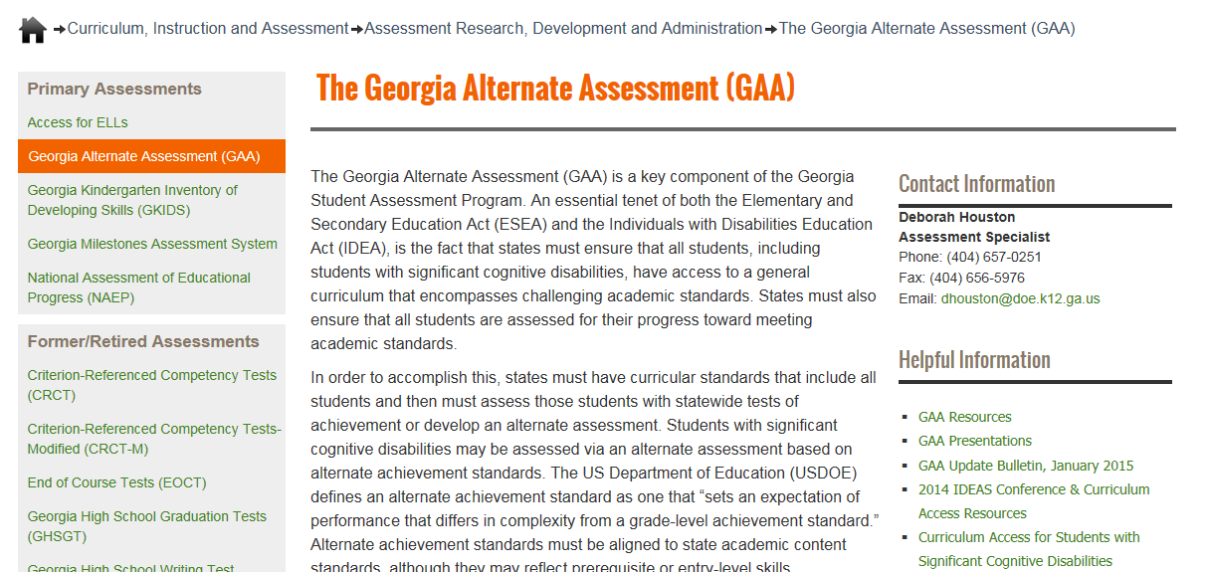
Links to Presentations are on the GaDOE website (shown below)
http://www.gadoe.org/Curriculum-Instruction-and-Assessment/Assessment/Pages/GAA.aspx
Notes:
The GAA Presentations link will take you to Fall Training presentations (past and present), mid-year and post-administration presentations, and other presentations such as “Unpacking the Standards.”

Slide 4
Questions & Answers
You are invited to submit questions you may have using the “Questions” feature of the GoToWebinar anytime throughout each session.
The “Questions” feature will be monitored throughout the session and questions will be addressed.

Slide 5
GAA 2016-2017 Key Dates
August 30 – September 2, 2016:
Manuals, Administration forms, and binders arrive
September 6, 2016 – March 24, 2017:
Administration window

Slide 6
Topics in this Presentation
It is designed to inform:
High school teachers who administer the GAA
Peer reviewers and designated trainers
Special education directors
Test coordinators
Building administrators
Topics in this training session:
Overview of HS Mathematics Content Standards
(New curricula for HS students)
Coordinate Algebra (Math Entry 1) and Analytic Geometry (Math Entry 2)
OR
Algebra I (Math Entry 1) and Geometry (Math Entry 2)
Sample Mathematics tasks

Slide 7
Requirements
States must ensure that all students, including students with significant cognitive disabilities, have access to challenging academic standards.
The GAA ensures that all students have the opportunity to learn.
Notes:
GAA meets the requirements of federal and state laws. States must ensure that all students, including students with significant cognitive disabilities, have access to challenging academic standards.

Slide 8
Requirements for all GAA entries
The Georgia Alternate Assessment was designed with the assistance of Georgia general and special educators. It is a portfolio-based assessment which allows students to show their progress in acquiring skills and knowledge aligned to the Georgia content standards in English Language Arts, Mathematics, Science and Social Studies.
Teachers collect evidence of student work during two collection periods. Collection Period 1 represents a student’s baseline skill level. Collection Period 2 provides evidence of a student’s achievement/progress.

Slide 9
Overview of HS Mathematics Content Standards

Slide 10
2016-2017 GAA High School Mathematics Blueprint
The Blueprint outlines the requirements of the 2016-2017 GAA for High School math.
The Blueprint identifies the content standards that are eligible for assessment on the GAA.
The Blueprint, by grade, can be found in Appendix D of the GAA Examiner’s Manual, 2016-2017.
Note: Do not use Blueprints from previous years

Slide 11
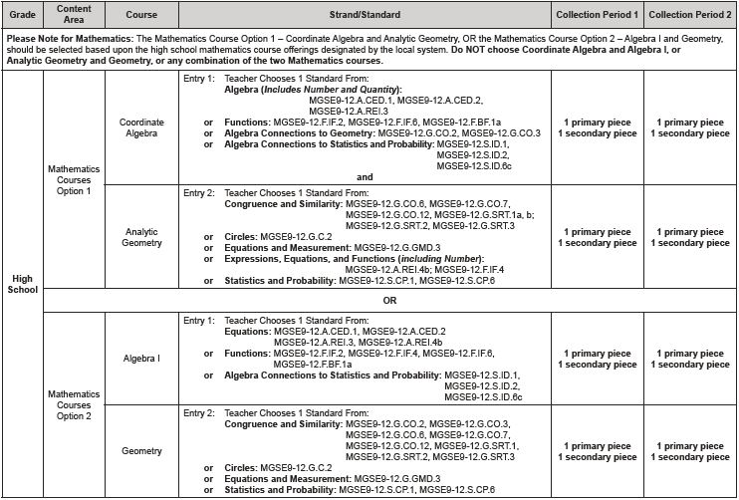
2016-2017 Blueprint
High School Blueprint, Mathematics
GAA students in high school must submit two Mathematics entries.
NEW THIS YEAR: Math Entry 1 and Math Entry 2 must use one of the two course options shown here. They are: Coordinate Algebra and Analytic Geometry
OR
Algebra 1 and Geometry
Notes:
The same standards are used in each curriculum, but they are organized in different ways. Example: Standard A.REI.4 (solve quadratic equations in one variable) is in the Analytic Geometry course in Course Option 1. The same standard is in the Algebra I course in Course Option 2. Check carefully to be sure you are using Course Option 1 OR Course Option 2.

Slide 12
2016-2017 Standards
GAA High School Standards, Coordinate Algebra (Course Option 1, Math 1)
Notes:
Please note that strikethrough text is present and indicates inapplicable parts of the standard.

Slide 13
2016-2017 Standards
GAA High School Standards, Analytic Geometry (Course Option 1, Math 2)

Slide 14
2016-2017 Standards
GAA High School Standards, Analytic Geometry (Course Option 1, Math 2)

Slide 15
2016-2017 Standards
GAA High School Standards, Algebra I (Course Option 2, Math 1)

Slide 16
2016-2017 Standards
GAA High School Standards, Geometry (Course Option 2, Math 2)

Slide 17
2016-2017 Standards
GAA High School Standards, Geometry (Course Option 2, Math 2)

Slide 18
Alignment
Alignment is the connection between the written, taught, and tested curriculum.
Alignment demonstrates the linkage of the activities (student work) to the intent of the grade-level standard and indicator on which the student is being assessed.
Each of the four tasks in an entry must align to the standard and indicator.
Assessment tasks should be designed to address the standards-based skill being evaluated.
Alignment is the subject of Session 4 on Wednesday, August 24.
Notes:
Intent - what are the standard and indicator designed to teach?
If the standard or element/indicator address multiple skills, the student’s assessment tasks may address only one of those skills. If the teacher chooses to assess a student on just one part of an element/indicator, it is essential that the same part be assessed in each of the four tasks.
Consider alignment first when designing assessment tasks.
The assessment task must be true to the standard.
The task must address the distinct characteristics of the indicator or the standard when there are no indicators.
The task must be appropriately challenging for the individual student.
Both Collection Periods must provide evidence of what the student knows and can do across the same skill(s).

Slide 19
Sample Mathematics Tasks

Slide 20
Sample High School Mathematics Tasks
Slides Standard Cluster Statement
21-22 G.GMD.3 Explain volume formulas and use them to solve problems
23-24 F.IF.4 Interpret functions that arise in applications in terms of the context
25-26 S.ID.1 Summarize, represent, and interpret data on a single count or measurement variable
27-28 S.CP.1 Understand independence and conditional probability and use them to interpret data
29-30 A.REI.3 Solve equations and inequalities in one variable
31-32 G.CO.6 Understand congruence in terms of rigid motions
33-34 G.CO.6 Understand congruence in terms of rigid motions
35-36 S.ID.2 Summarize, represent, and interpret data on a single count or measurement variable
37-39 F.IF.2 Understand the concept of a function and use function notation

Slide 21
HS Mathematics Example
Course Option 1 – Analytic Geometry - Math Entry 2
Equations and Measurement
Course Option 2 – Geometry - Math Entry 2
Equations and Measurement
 | Explain volume formulas and use them to solve problems.
 | MGSE9-12.G.GMD.3 Use volume formulas for cylinders, pyramids, cones, and spheres to solve problems.

Slide 22
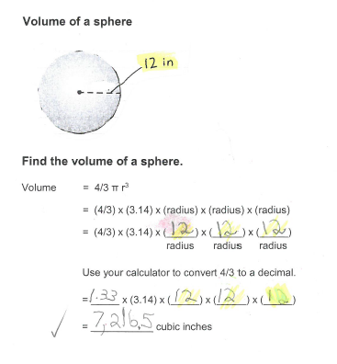
Sample Evidence
In this two-page worksheet, the student was asked to calculate the volume of a cylinder and the volume of a sphere. Formulas were given and steps were color-coded.

Slide 23
HS Mathematics Example
Course Option 1 – Analytic Geometry - Math Entry 2
Expressions, Equations, and Functions (Including Number)
Course Option 2 – Algebra I - Math Entry 1
Functions
 | Interpret functions that arise in applications in terms of the context.
 | MGSE9-12.F.IF.4 For a function that models a relationship between two quantities, interpret key features of graphs and tables in terms of the quantities, and sketch graphs showing key features given a verbal description of the relationship. Key features include: intercepts; intervals where the function is increasing, decreasing, positive or negative; relative maximums and minimums; symmetries; end behavior.

Slide 24
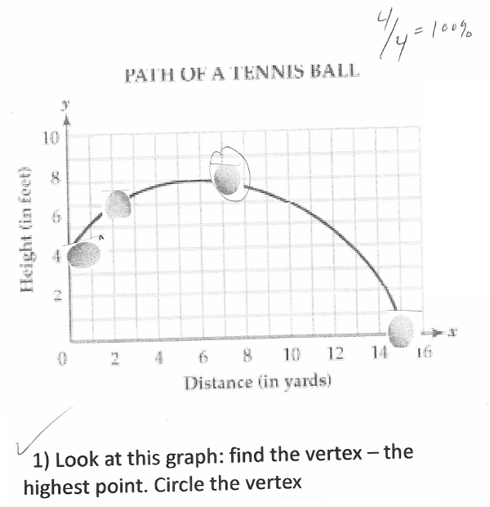
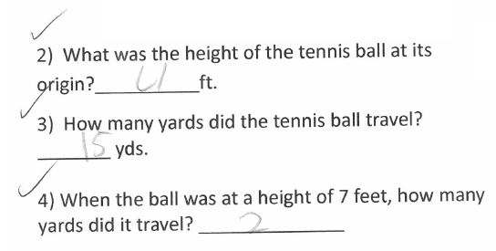
Sample Evidence
The student’s task was to interpret the graph in order to answer the four questions.

Slide 25
HS Mathematics Example
Course Option 1 – Coordinate Algebra - Math Entry 1
Algebra Connections to Statistics and Probability
Course Option 2 – Algebra I - Math Entry 1
Algebra Connections to Statistics and Probability
 | Summarize, represent, and interpret data on a single count or measurement variable.
 | MGSE9-12.S.ID.1 Represent data with plots on the real number line (dot plots, histograms, and box plots).

Slide 26
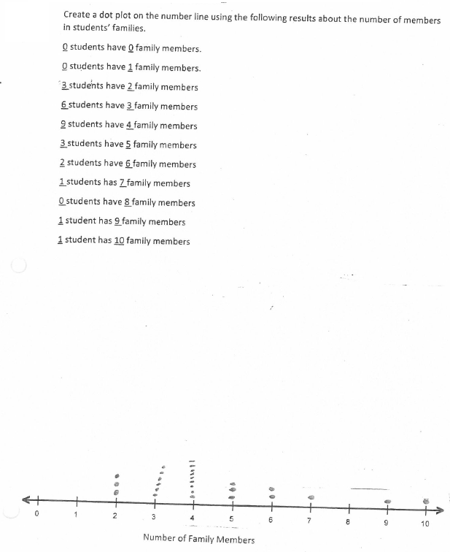
Sample Evidence
The student was given numerical data and was asked to plot them on the number line. Note that data must be numerical, not categorical, if the task is to align to this standard.
It is acceptable for students to gather data themselves and to plot the data on a number line, but gathering data is not required. Plotting the data on the number line is the essence of this standard.
Numerical data

Slide 27
HS Mathematics Example
Course Option 1 – Analytic Geometry - Math Entry 2
Statistics and Probability
Course Option 2 – Geometry - Math Entry 2
Statistics and Probability
 | Understand independence and conditional probability and use them to interpret data.
 | MGSE9-12.S.CP.1 Describe events as subsets of a sample space (the set of outcomes) using characteristics (or categories) of the outcomes, or as unions, intersections, or complements of other events (“or,” “and,” “not”).

Slide 28
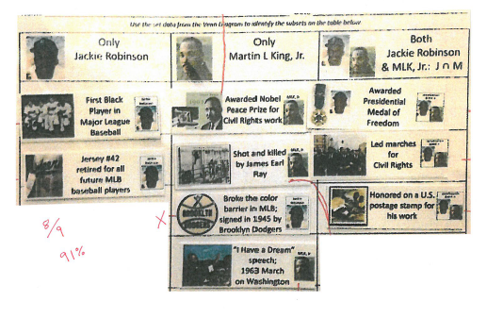
Sample Evidence
The student was given cut-out phrases and pictures which describe qualities or accomplishments of Jackie Robinson, Martin Luther King Jr., or both men. In the third column of this chart, the student identified the intersection of the two sets (the three actions or awards which involved both men).

Slide 29
HS Mathematics Example
Course Option 1 – Coordinate Algebra - Math Entry 1
Algebra (Includes Number and Quantity)
Course Option 2 – Algebra I - Math Entry 1
Equations
 | Solve equations and inequalities in one variable.
 | MGSE9-12.A.REI.3 Solve linear equations and inequalities in one variable, including equations with coefficients represented by letters.

Slide 30
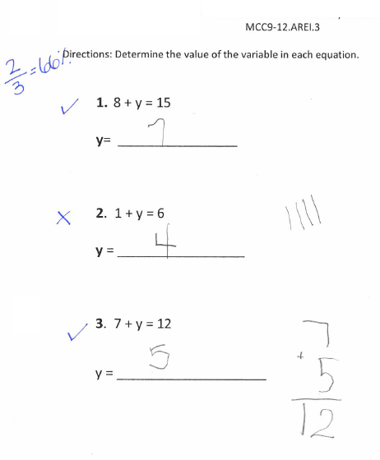
Sample Evidence
The student was asked to solve three linear equations.
#1 You have 8 cupcakes. How many more cupcakes do you need so everyone in your class can have one cupcake? There are 15 students in your class.
#2 There are 6 chairs at your table in the cafeteria. If you sit on one of the chairs, how many chairs are left for other students?
#3 You have saved $7. The gift you want to buy for your friend costs $12. How much more money do you need to save?
Note that it is not necessary for a student to create an equation to satisfy the requirement of this standard.
There are two other Algebra standards (A.CED.1 and A.CED.2) which say “create equations….” If either of those standards is chosen for assessment, it will be necessary for the student to create an equation in each task.

Slide 31
HS Mathematics Example
Course Option 1 – Analytic Geometry - Math Entry 2
Congruence and Similarity
Course Option 2 – Geometry - Math Entry 2
Congruence and Similarity
 | Understand congruence in terms of rigid motions.
 | MGSE9-12.G.CO.6 Use geometric descriptions of rigid motions to transform figures and to predict the effect of a given rigid motion on a given figure; given two figures, use the definition of congruence in terms of rigid motions to decide if they are congruent.

Slide 32
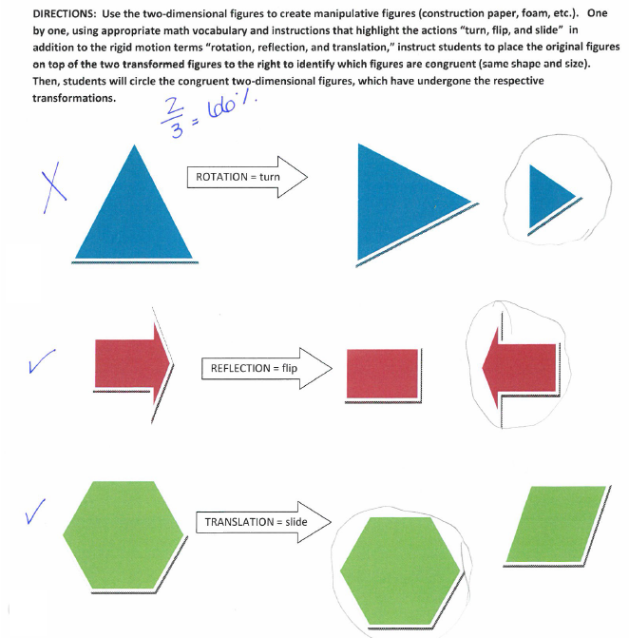
Sample Evidence
The student was asked to choose which one of two figures represents a rotation, reflection, and transformation.
Notes:
.

Slide 33
HS Mathematics Example
Course Option 1 – Analytic Geometry - Math Entry 2
Congruence and Similarity
Course Option 2 – Geometry - Math Entry 2
Congruence and Similarity
 | Understand congruence in terms of rigid motions.
 | MGSE9-12.G.CO.6 Use geometric descriptions of rigid motions to transform figures and to predict the effect of a given rigid motion on a given figure, given two figures, use the definition of congruence in terms of rigid motions to decide if they are congruent.

Slide 34
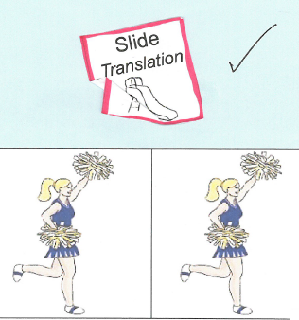
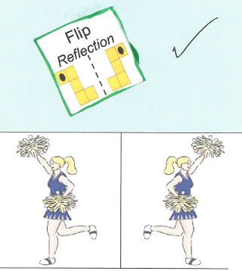
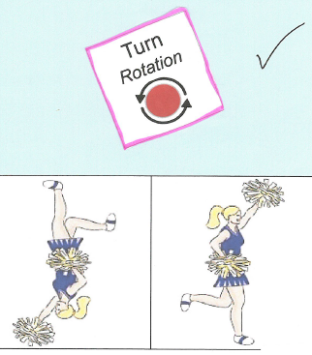
Sample Evidence
The student was given three sets of figures and was asked to identify each of them as a translation, reflection or rotation. The teacher added the words “slide,” “flip,” and “turn” to the answer choices to help the student recognize which rigid motion was the correct choice.

Slide 35
HS Mathematics Example
Course Option 1 – Coordinate Algebra - Math Entry 1
Algebra Connections to Statistics and Probability
Course Option 2 – Algebra I - Math Entry 1
Algebra Connections to Statistics and Probability
 | Summarize, represent, and interpret data on a single count or measurement variable.
 | MGSE9-12.S.ID.2 Use statistics appropriate to the shape of the data distribution to compare center (median, mean) and spread (interquartile range) of two or more different data sets.

Slide 36
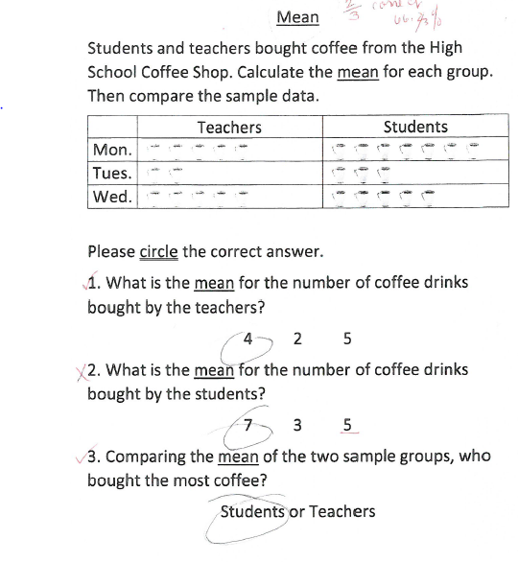
Sample Evidence
The student was given data about coffee purchases by students and teachers. The student was asked to calculate the mean number of coffee drinks bought by the two groups. The student was also asked which of the two groups bought more coffee.

Slide 37
HS Mathematics Example
Course Option 1 – Coordinate Algebra - Math Entry 1
Functions
Course Option 2 – Algebra I - Math Entry 1
Functions
 | Understand the concept of a function and use function notation.
 | MGSE9-12.F.IF.2 Use function notation, evaluate functions for inputs in their domains, and interpret statements that use function notation in terms of a context.

Slide 38
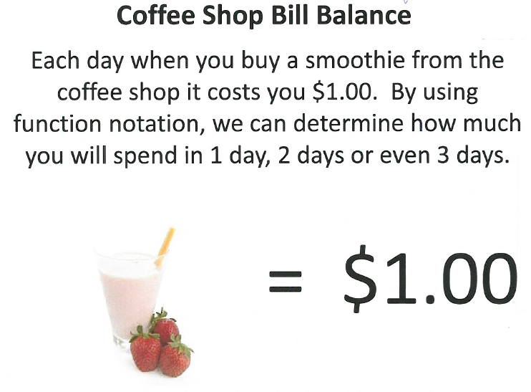
Sample Evidence – page 1 of 2
The student was given a word problem and was told to use function notation to determine how much smoothies will cost over a period of three days.

Slide 39
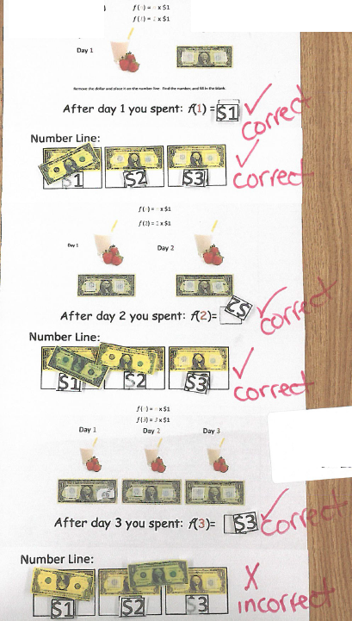
Sample
Evidence – page 2 of 2
The student was given a laminated worksheet and was asked to use manipulatives to make the calculations.

Slide 40
Contact Information
Questions about how to administer the GAA?
GaDOE Assessment Administration Division
(800) 634-4106
Deborah Houston, Assessment Specialist
(404) 657-0251
dhouston@doe.k12.ga.us

Slide 41
Contact Information
Need information about access to the state-mandated content standards for students with significant cognitive disabilities?
Kayse Harshaw, Division for Special Education Services
(404) 463-5281
sharshaw@doe.k12.ga.us
kharshaw@doe.k12.ga.us

Slide 42
Contact Information
Questions About Materials, Distribution, or Collection?
Questar’s GAA Customer Service
(866) 997-0698
GA@QuestarAI.com

Slide 43
Webinar Survey
We Want your Feedback!
Please use the below link to provide feedback regarding this GAA training session.
http://gadoe.org/surveys/AsAc-H8PBVZM

