Slide 1
Looking Ahead 2015-2016 Administration Session 1
Georgia Alternate Assessment

Slide 2
2015-2016 GAA
Purpose:
The 2015-2016 webinars (Sessions 1-5) explain how to prepare and submit GAA portfolios.
http://www.gadoe.org/Curriculum-Instruction-and-Assessment/Assessment/Pages/GAA-Presentations.aspx
Information pertaining to the GAA can also be found in the 2015-2016 GAA Examiner’s Manual.
http://www.gadoe.org/Curriculum-Instruction-and-Assessment/Assessment/Pages/GAA-Resources.aspx
Notes:
Please remember that when the PPT is open you may highlight the link and right click in order to “Open Hyperlink” and gain access to the links and websites.

Slide 3
2015-2016 GAA
Looking ahead:
Additional sessions will be available for more in-depth training on topics that will assist test administrators and educators.

Slide 4
Overview of this Presentation
This presentation will cover the following topics:
General Information about the 2015-2016 GAA
Updates and Reminders
Lessons Learned from the 2014-2015 Administration
Ethics and Test Security
Portfolio/Peer Review
It is designed to inform:
All teachers who administer the GAA
Peer Reviewers and designated trainers
Special Education Directors
System and Test Coordinators
Building Administrators

Slide 5
2015-2016 Review of Standards
Georgia Standards of Excellence (GSE)
The GAA continues in its current form as a portfolio-based assessment.
As a result of the State Board's adoption of the Georgia Standards of Excellence, content standards for ELA and Mathematics (K, 3-8) had name changes, replacing "CC" with "GSE."
The basic intent and standard language have not changed from last year, but some standards have been relocated and/or had precision edits.
It is imperative that the 2015-2016 Blueprint and Standards be used when assessing GAA students.
Notes:
Please attend Session 2 for information and examples regarding HS math.
Please refer to Session 3 (“The Basics”) for general information on the GAA. This presentation gives detailed information on compiling portfolios as well as defining GAA terminology.

Slide 6
2015-2016 Review to Standards
Added language, including more opportunities for deeper understanding
New standard eligible for GAA assessment
Notes:
This slide gives two examples of some the changes that occurred to the GAA Blueprint.

Slide 7
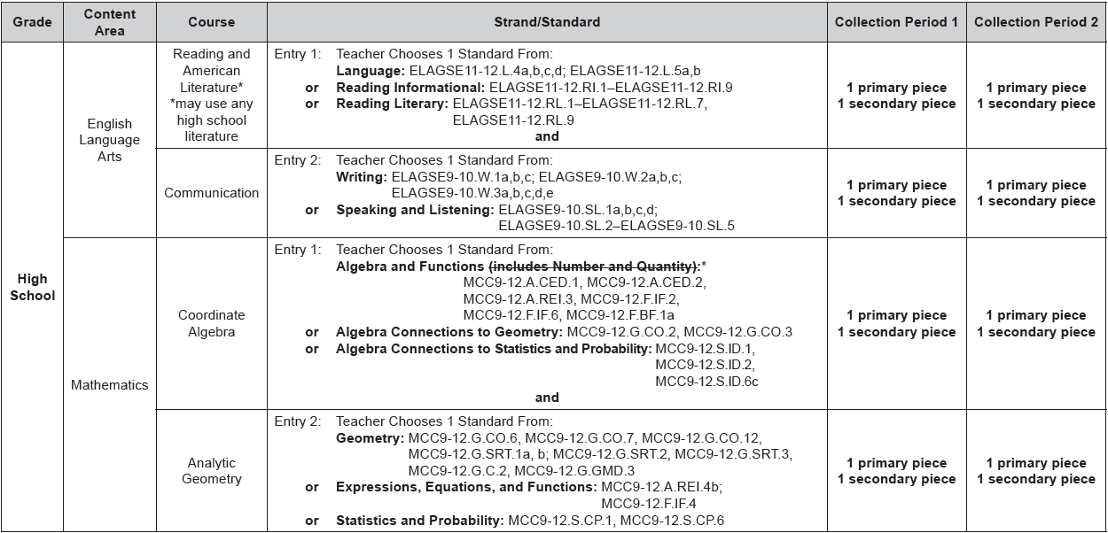
2015-2016 Blueprint
Name change
Example: High School Blueprint, page 1
Same name
Notes:
Two entries in ELA and two entries in Math, which use the appropriate grade-level standards, are required for all GAA students.

Slide 8
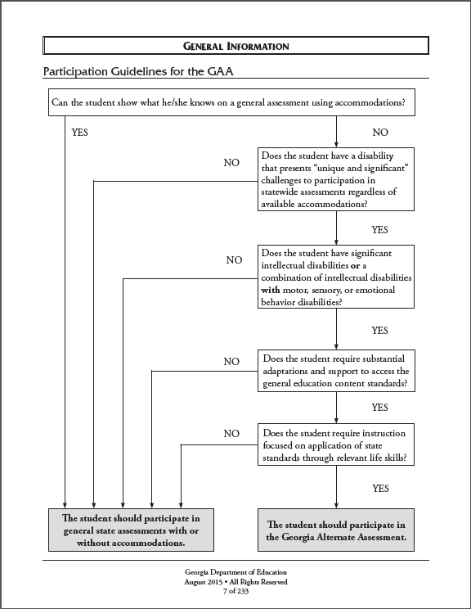
Participation Criteria
The student’s IEP Team determines how the student shall participate in Georgia’s student assessment program(s).
The student may be considered for participation in the GAA only if:
all participation criteria have been met, and
the IEP team determines that a student cannot meaningfully access the general statewide assessments, even with maximum & appropriate accommodations.
Notes:
In general, the GAA is appropriate only for the small number of students who have the most significant cognitive disabilities—those who cannot participate in general assessments, even with maximum appropriate accommodations. These students participate in state-mandated content standards through the alternate assessment. Teachers may adjust learning expectations to meet the needs and learning styles of the unique and diverse group of students who participate in alternate assessments. Students who are assessed on the GAA often communicate using assistive technology. Students with significant cognitive disabilities generally cannot respond to questions using a bubble sheet. In addition to a cognitive disability, these students may also have other physical disabilities and may be visually or hearing impaired.
Assessment design and tasks may differ from the general education population in depth, breadth, and complexity. This is the essence of the alternate assessment.
Participation Guidelines may be found on p.7 of the 2015-2016 Examiner’s Manual

Slide 9
State-Mandated Content Standards
In 2012-2013 Georgia began implementing the current state-mandated content standards in ELA (all grades) and Math (K, 3-8).
Since the fall of 2012 the GAA has used these content standards.
During the 2014-2015 school year High School Math began using the new courses of Coordinate Algebra and Analytic Geometry.
The content standards selected for assessment on the GAA were reviewed and approved by a committee of Georgia educators.
Notes:
All standards on the GAA Blueprint may be referred to as the state-mandated content standards. They include the Georgia Performance Standards (GPS), which are assessed in Science and Social Studies, as well as the Georgia Standards of Excellence, which are assessed in ELA and Math.

Slide 10
State-Mandated Content Standards
The content standards for Science and Social Studies are unchanged for the 2015-2016 school year.
The Blueprint for the GAA, including the current state-mandated content standards, is available in Appendix D (p.93)of the GAA Examiner’s Manual, 2015-2016 and on the GaDOE website.
http://www.gadoe.org/Curriculum-Instruction-and-Assessment/Assessment/Pages/GAA-Resources.aspx

Slide 11
General Information
Key Dates for the 2015-2016 GAA

Slide 12
Looking Ahead to the 2015-2016
GAA Administration

Slide 13
Moving Forward
The contents of the portfolios, as well as feedback from teachers and test coordinators, provides valuable information as to areas of focus for training.
Continued training is needed to support teachers in their understanding of the current state-mandated content standards and the intent of the standards and elements/indicators.

Slide 14
Moving Forward
Nonscorable entries account for only a small percentage of the total entries submitted.
Analysis of nonscorable entries provides valuable information regarding issues and trends noted for this administration.
Nine years of assessment provides ample information for ongoing training.
Notes:
Local resources at the school or system level: General Education Teachers, Content-Driven Presentations, Fall Trainings, etc.
The Resource Board provides suggested activities (please remember, activities on the Resource Board are suggestions and must be individually tailored for each student to show alignment to the standard and indicator) and may lead to other ideas for the students and portfolio-based assessment: http://admin.doe.k12.ga.us/gadoe/sla/agps.nsf/($All)?OpenView

Slide 15
Moving Forward
Assessment tasks that aligned to previous GAA standards/elements do not necessarily align to the current content standards. Successful tasks for previously assessed standards may need to be redesigned to align to comparable current standards.
All assessment tasks must align to the content standard and element/indicator that are declared on the Entry Sheet. In addition, all Science entries must include a co-requisite Characteristic of Science (CoS). The student must exemplify the CoS at least once while performing the four assessment tasks in each Science entry.
Notes:
Please refer to the session on Alignment (1:00 PM on Wednesday, August 26) for further information on the CoS and how it must be presented in the evidence.

Slide 16
Updates for 2015-2016
The High School Retest option will no longer be available for the GAA.
The criteria for achieving a general education diploma no longer includes passing GHSGT/GHSWT assessments which includes the High School GAA.
General education diplomas may still be earned through other means including coursework and curriculum-based grades.

Slide 17
Updates & Reminders
Entry Sheet: there is one Entry Sheet for all students. Drop-down boxes and instructions will guide you through the process of completing the Entry Sheet.
The GAA Examiner’s Manual, 2015-2016, will retain its smaller size because the sample entries will remain in the Student Samples Resource Guide. The SSRG will be available on the GaDOE website. Some samples will remain and NEW samples will be added.
Please visit the state’s website to view important trainings and presentations, for access level examples and the IDEAS presentations and PPTs (for the HS math courses). It may be found here under the section, “Handouts”: http://www.gadoe.org/Curriculum-Instruction-and-Assessment/Special-Education-Services/Pages/IDEAS-2014-Handouts.aspx
Notes:
The IDEAS presentations may also be found from visiting the GAA Presentation link: http://www.gadoe.org/Curriculum-Instruction-and-Assessment/Assessment/Pages/GAA-Presentations.aspx
Please view Session 3, “The Basics,” for detailed instructions on filling out the updated Electronic Entry Sheet.

Slide 18
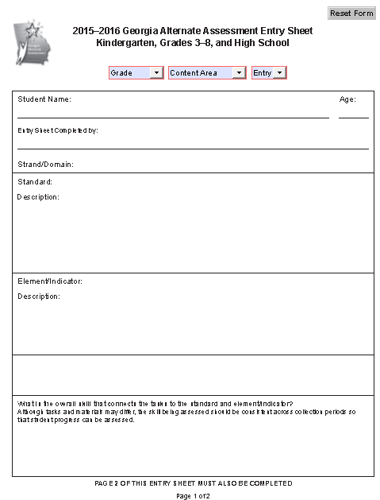
Updates for 2015-2016
NOTE: No HS Retest Category
All Grades: K, 3-8, and High School may be entered into the 2015-2016 Entry Sheet
By choosing the Grade, Content Area, and Entry #, only those domains and standards eligible for assessment for that entry will be available in the drop-down menu as per the 2015-2016 GAA Blueprint.
CoS
The Characteristics of Science options will activate once Science is selected as the Content Area
Notes:
Choose the grade for the student being assessed; choose the Content Area; Choose the Entry (applies to all grades in ELA, Math and all of HS content areas). Proceed with the remaining available drop-down menus.
Select Entry # from the drop-down menu. The Entry # chosen will determine which strands/domains and standards will be available in the drop-down menus. For example, when assessing a student in grade 8, you will choose: Grade: 8, Content Area: English Language Arts. If you choose Entry 1, only the appropriate Language and Reading Comprehension (Informational or Literary) domains will be available in the Strand/Domain drop-down box. Writing and Speaking and Listening will not be available until you choose Entry 2.
Since 2 entries are required for ELA and Math for all grades and for Science and Social Studies in High School - when looking at the Entry Sheet, a teacher or reviewer will quickly be able to see if, for example, two Entry 1 standards were assessed. It will also be a good visible reminder as to how entries should be ordered when organizing the portfolio for submission.

Slide 19
Updates for 2015-2016
Reminders:
One Entry Sheet for all GAA students:
http://www.gadoe.org/Curriculum-Instruction-and-Assessment/Assessment/Pages/GAA-Resources.aspx
Be sure to discard previous templates and use only the Entry Sheet for 2015-2016!
Use the electronic Entry Sheet to avoid Entry Sheet errors. Please proofread carefully.
Check to make sure all Science Entry Sheets have a Characteristic of Science chosen and the submitted evidence reflects that selection.
Notes:
Please refer to Session 3, ”The Basics,” for a clear understanding as to how to fill-out the Electronic Entry Sheet.

Slide 20
Updates for 2015-2016
Some definitions for the Characteristics of Science (CoS) have been added to Appendix A of the Examiner’s Manual (p. 67).
These are very useful for understanding the essence of the CoS.
These definitions can reveal possible tasks that get students involved in the process of Science, which is one main goal and naturally occurring event while teaching science.

Slide 21
Lessons Learned from the 2014-2015 Administration
Congratulations!
2014-2015 marked the ninth successful administration of the Georgia Alternate Assessment!
Assessment tasks and the quality of the portfolio entries continue to improve.
Special Note: An overall reduction of 2.31% in NS assignments in 2014-2015! Great work everyone!
Notes:
Please continue to consult general education teachers (for all 4 content areas) as valuable resources to check alignment of assessment tasks and to understand the intent of each standard chosen. Peer and Portfolio review is also an important step before submitting portfolios.

Slide 22
GAA Portfolios Submitted
11,115 portfolios were submitted in 2014-2015 compared to 10,663 submitted in 2013-2014. This table provides a breakdown, by grade, including the total number of entries for both 2014-2015 and 2013-2014.
Notes:
354 High School Retest portfolios were submitted in Spring 2015, whereas 298 were submitted in Spring 2014.

Slide 23
Student Proficiency on the 2014-2015 GAA
Across all grades and content areas, the vast majority of students met or exceeded expectations as demonstrated by their Performance Level Indicator.
ELA: ≈ 85% Established or Extending Progress
Mathematics: ≈ 84% Established or Extending Progress
Science: ≈ 95% Established or Extending Progress
Social Studies: ≈ 96% Established or Extending Progress
Notes:
Performance Level indicator is synonymous with “Stage of Progress.”

Slide 24
Test Security

Slide 25
Test Security
Maintaining security of all student materials is crucial to obtaining valid and reliable assessment results.
While the GAA materials themselves are not considered secure materials, student work and entries are secure once they have been chosen as assessment evidence and placed in the GAA portfolio binder.
Original student work or photos/videos of original student work (permanent products) must be submitted.
GAA evidence may not be photocopied and retained.
Photocopied permanent products may not be submitted as evidence. A photograph of a permanent product is acceptable.
Notes:
Given the unique features of the GAA (such as the test window), test security must be considered and attended to throughout the school year and not just during the portfolio submission phase.

Slide 26
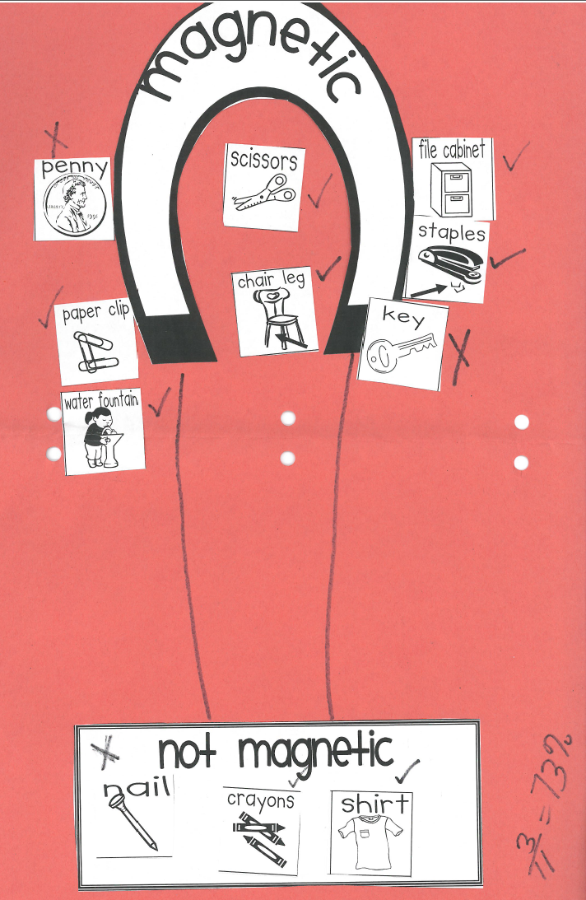
Permanent Product
This piece of evidence was submitted as folded construction paper. It was preceded by an annotation page describing the task and included all necessary information, including:
Task description
Level of prompting required
Correctness of the student’s response
With whom the student interacted
The setting in which the assessment task took place.
If a permanent product is not appropriate to submit in a 3-ring binder, a photograph may be taken. It must be unique to the student being assessed.
Notes:
This piece of evidence is from a Grade 3 Science entry which uses Physical Science standard S3P2 (students will investigate magnets and how they affect other magnets and common objects) and element a (investigate to find common objects that are attracted to magnets). The characteristic of science is communicates findings

Slide 27
Test Security
Once placed in the portfolio, student work and materials being used for the purposes of the GAA must be kept in locked storage within the classroom – except during use.
Access to those materials must be restricted to authorized individuals only.
Notes:
Just as you would not photocopy a Georgia Milestones answer document, photocopying evidence to be used for this assessment is strictly prohibited. Only original student work should be submitted. If the original student work is too large or too fragile to be submitted in the portfolio, a photograph of the original work product should be submitted. Examples of products appropriate for photographing include three-dimensional models, extremely large posters, or tactile products that do not fit in the binder. In all other cases, original student work must be submitted.

Slide 28
Test Security
The assessment binder should not be removed from the school building, except when sign-out procedures are in effect for the purpose of peer reviews.
It is the direct responsibility of all individuals who administer the assessment to follow security procedures and protect the integrity of the assessment process.
Notes:
One suggestion is to create a folder for each student (expandable folders work well) in which to collect work samples prior to their inclusion in the portfolio. Keep the materials in the folder until you have chosen the final pieces of evidence to be submitted in the portfolio. Remember that the student work becomes secure test material once it has been placed in the 3-ring binder. Follow the instructions regarding Test Security in the GAA Examiner’s Manual on starting on page 4.

Slide 29
Test Security
Any action which compromises assessment security or leads to the invalidation of an individual student’s or a group of students’ test scores will be viewed by the Georgia Department of Education (GaDOE) as inappropriate use or handling of tests and will be treated as such.
Any concern regarding test security must be reported to GaDOE immediately.
Assessment Administration Division staff members are available to help system personnel develop and implement appropriate assessment security procedures.

Slide 30
Portfolio Validation

Slide 31
2015-2016 Validation Form
The Validation Form was designed to address certain issues that should not occur during the assembly of a student’s portfolio, including:
Fabricating or altering evidence of student work
Making and retaining photocopies of contents
Submitting photocopies of student work
Signatures of the Test Administrator and Building Administrator are required.

Slide 32
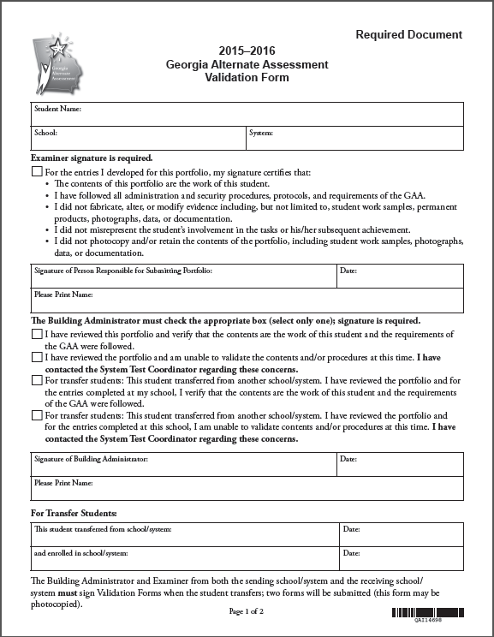
The GAA Validation Form was provided in the portfolio binder to verify that all requirements and procedures have been followed and that the contents are the work of the student being assessed.
This is an important step – the signatures validate the contents of the portfolio.
Be certain that signatures have been obtained from both the person submitting the portfolio and the Building Administrator.
For transfer students, two Validation Forms must be submitted – one by the sending school/system and one by the receiving school/system.
Test Administrator
checks one box
Required signature
Building Administrator
checks one box
Required signature
Notes:
By signing the Validation Form, both the Building Administrator and the person responsible for submitting the portfolio attest:
The contents of the portfolio are the work of the student being assessed.
Original student work has been included; photocopies have not been made, submitted and/or retained.
No evidence was fabricated, altered, or modified.
Portfolio evidence is an accurate depiction of student’s involvement and achievement/progress in tasks.
All procedures and protocols have been followed.

Slide 33
Portfolio Validation
The portfolio validation process requires signatures on the Validation Form which authenticates the student work included in the portfolio.
This form is a required document that must be completed and signed by both the Building Administrator and the person responsible for submitting the portfolio.
Refusal to sign the Validation Form is NOT an option
This is a secure document which will be checked upon receipt.
In the case of transfer students, two Validation Forms must be submitted (one from the original school and one from the new school).
Notes:
Reminder: In the case of transfer students, two Validation Forms must be submitted (one from the original school and one from the new school). By signing the Validation Form for a transfer student the teacher certifies that, for all entries that they are responsible for submitting, the work is that of the student.

Slide 34
Portfolio Validation
Violation of any of the aforementioned requirements for compiling student work for the GAA may result in the portfolio being invalidated and could result in additional actions or consequences.
Should the Building Administrator, Portfolio Reviewer, or STC discover any irregularities, the portfolio can be returned to the teacher for correction.
If it is too late in the process or not feasible to return the portfolio to the school/teacher, an Irregularity Form must be completed by the System Test Coordinator alerting the GaDOE to the problem.

Slide 35
Ethics
Portfolio Invalidations

Slide 36
Ethics
The Georgia Alternate Assessment is a state and federally mandated assessment for students with significant cognitive disabilities who have met the participation guidelines and have been determined appropriate for the assessment by their IEP teams.
This assessment must adhere to all of the protocols and procedures required for the general assessments.
A breach of any of the validation or security policies constitutes both a procedural and ethical violation necessitating an investigation and possible consequences.

Slide 37
Portfolio Invalidation
Should an investigation of any of the aforementioned issues determine that a breach has occurred, one possible consequence is invalidation of the portfolio.
In such a case, the scores for the entry/entries in question are wiped out, and it is reported as an invalid assessment.

Slide 38
Issues Resulting in Invalidation
Irregularities and questions about evidence authenticity are sometimes discovered and self-reported by schools and/or systems.
brought to light during portfolio review process
noted by Building Administrators during validation process
reported, sometimes anonymously, by various school personnel
If these irregularities are discovered, addressed, and corrected prior to portfolio submission, it is unnecessary to report them to the state as long as they are dealt with at the school/system level.

Slide 39
Issues Resulting in Invalidation
Issues regarding evidence authenticity and possible fabrication can also be discovered during scoring.
Problems most frequently seen include:
Dates changed, erased, and rewritten or covered over with correction fluid or collection period labels
Observation and interview forms with identical information attributed to multiple students
Identical permanent products attributed to multiple students (not group work)
These issues will result in the portfolio being invalidated.

Slide 40
Issues Resulting in Invalidation
The vast majority of portfolios submitted for the 2014-2015 GAA were compiled following prescribed policies and procedures, and the evidence submitted represented authentic student work.
Actually, the number of invalidated portfolios has decreased slightly over the last three administrations.
Careful attention to validation and evidence requirements during portfolio review will help to ensure that this trend continues.
Notes:
Decrease in invalidations may be due to several factors: 1) Teachers having a better understanding of evidence requirements and the validation process; 2) Careful portfolio review by trained reviewers; 3) Annotations that are distinct and tied to each individual student being assessed.

Slide 41
Portfolio Review Process

Slide 42
GAA Portfolio Review
A great deal of time and effort goes into compiling the portfolio of student work that showcases the progress a student has made in knowledge and skills in the academic content standards.
Portfolio reviewers provide an invaluable service as they work to support teachers before final submission of GAA portfolios by making sure that all requirements have been met.
42

Slide 43
Portfolio Review Prior to Submission
It is critical that the portfolio be reviewed both during the collection of evidence and immediately before it is submitted to be certain that everything is complete, Entry Sheets are completely and correctly filled in, tasks align, and evidence requirements have been met.
To this end, it is imperative that portfolio reviewers participate in training and become very familiar with all requirements as outlined in the Examiner’s Manual and the webinar trainings.
Notes:
The importance of peer/portfolio review during and after completion of a portfolio cannot be overstated! It is critical that the review process go beyond counting pieces of evidence and that all portfolio requirements are considered.

Slide 44
Portfolio Review by the Teacher
Portfolio review by the teacher should be an ongoing process throughout evidence collection.
Have I selected the best standard and indicator for this student?
Does he/she seem engaged?
Is he/she making progress?
Are the tasks and materials appropriate?
Is he/she able to demonstrate what he/she knows?
Can he/she communicate with a reliable response?
Should I replace this evidence and design a task that is more appropriate for the individual student?

Slide 45
Structuring a Portfolio Review
Who should conduct the portfolio review?
Trained GAA Administrator
Designated GAA Trainer
Core Access Teacher
School Test Coordinator
SPED Coordinator
Building Administrator
Notes:
All portfolio reviewers must participate in training and know the requirements for assessment task design (including alignment), evidence requirements and collection, documentation, and portfolio organization.
Core access teachers should review portfolios in their own school district. GaDOE is not encouraging other districts to ask them to review portfolios.

Slide 46
Structuring a Portfolio Review
When should the reviews be conducted?
1st Review: mid-administration, after Collection Period 1 evidence has been compiled
Final Review: before submission, after all evidence has been compiled and organized in the portfolio binder
Notes:
Systems have the flexibility to determine the best time to schedule reviews. Some recommendations include staggering reviews so as not to back log the reviewer, providing timely feedback so that teachers can make necessary changes within the collection windows, and returning portfolios quickly after the review is complete.

Slide 47
Portfolio Review
Steps to complete a peer review of the portfolio:
1. Carefully review the Entry Sheet
Student name
Teacher name
Required standard
Eligible standard
Strand/domain, standard, element/indicator match up
Characteristic of Science
Task Descriptions

Slide 48
Portfolio Review
2. Consider all aspects of the evidence requirements
All four pieces of evidence must align to standard and element/indicator
Primary and Secondary Evidence must be included for each collection period
Original student work, not photocopies, must be submitted.
At least 14 calendar days between the two pieces of primary evidence
Types of evidence are the best choices to clearly demonstrate the student’s responses
Grade-appropriate materials

Slide 49
Portfolio Review
3. Review documentation to ensure that all necessary annotation has been provided somewhere on the evidence
Name (Who)
Dates (When)
Task (What)
Setting (Where)
Student performance (How well)
Interactions (With Whom and Describe)
Independence (Prompts)
Collection period labels (Optional but helpful)
Notes:
Scorers make an effort to score the portfolios as presented. E.g., if evidence is out of order, all attempts will be made to correct and connect task descriptions with the evidence. E.g.,#2 If an Observation Form is listed as Primary Evidence and a Work Sample listed as Secondary Evidence, the scorer will flag this for Team Leader review and a Team Leader will make sure that dates of evidence meet GAA requirements (including two distinct Collection Periods). If requirements are met, the entry may still be scorable.

Slide 50
Portfolio Review
4. Sign and date Checklist for Teachers and Portfolio Reviewers
5. Validation Form must be signed by Building Administrator and Person Responsible for Submitting the Portfolio (Test Administrator)
6. Recommend or verify that the Release to use Portfolio for Training has been signed and included in portfolio

Slide 51
Validation Check for Alignment
The vast majority of nonscorables on the GAA are assigned in the Not Aligned (NA) category.
In the 2014-2015 administration, over 80% of all nonscorables were the result of alignment issues.
In a majority of these instances, only one or two of the four tasks did not align.
This indicates that in many of the entries that received a Not –Aligned nonscorable code, one or more pieces of evidence were aligned.
It is critical that the portfolio reviewers evaluate each task individually to determine alignment of all four tasks to the standard and indicator.
Notes:
Can someone else reviewing the entries see how the student’s submitted work connects to the standard and element/indicator?

Slide 52
Validation Check for Alignment
Have opportunities for teaching and learning, aligned to the assessed content, been provided?
When looking at the assessment task in isolation, can you identify the content standard/academic domain?
Could a curriculum content expert link the task back to the specific state standard?
Have the essential components of the standard (element/indicator) been addressed?
What are the specific characteristics that make up the standard?
Focus on the language/terminology as written.
Do all four assessment tasks align to the intent of the element as it applies to the specified content standard?

Slide 53
Reviewing Documentation
When reviewing evidence documentation, the teacher and portfolio reviewer must ask themselves the following questions:
What, specifically, was the student asked to do as it aligns to the standard and indicator?
What were the actual questions/actions asked of the student?
What were the student’s answers? How did he/she respond?
Were the answers/responses correct? Has evaluation of student performance by the teacher been clearly documented? Grades for participation are not sufficient.
What were the type and frequency of prompting required for the student to successfully complete each task?

Slide 54
Reviewing Documentation
Review to ensure that all necessary documentation has been provided.
It is very important that documentation be clear and concise.
Contradictory or unnecessary annotations can lead to lower scores.
Accuracy or correctness of the student response should be documented separately from the type and frequency of prompting that led the student to the correct response.
Notes:
I’d like to stress the importance of the last bullet point. It benefits the student when accuracy and prompting are separated. Do not explain the student received 100% with prompting and 0% without. Include the prompting that was necessary (prompting is that which leads a student to a correct answer) and then separately document the student’s performance by including an answer key or noting a percentage of accuracy (e.g., 66%). Even if prompting is required for all four tasks, Achievement/Progress may still be exhibited by a reduction in prompting, an increase in the complexity of the tasks from CP1 to CP2, and/or an increase in the student’s accuracy. E.g., removal of color-cues or color coding in CP2.

Slide 55
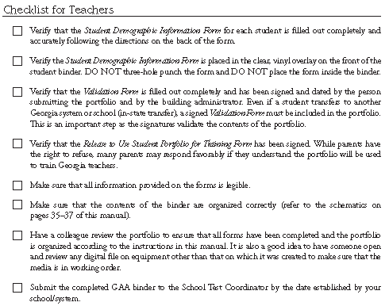
Checklist for Teachers and Portfolio Reviewers
Notes:
Checklists for Teachers and Portfolio Reviewers is provided in the portfolio binder and on page 40, 52, and 56 of the Examiner's Manual. GAA Planning Sheets may also be found in the Tips and Tools section of the Examiner’s Manual starting on p.49.

Slide 56
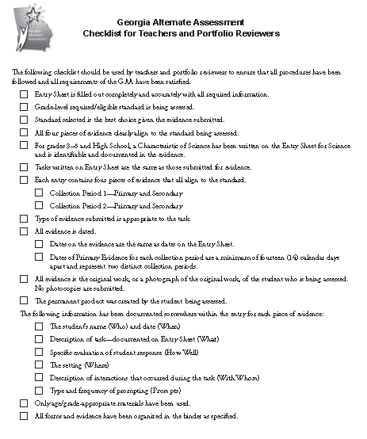
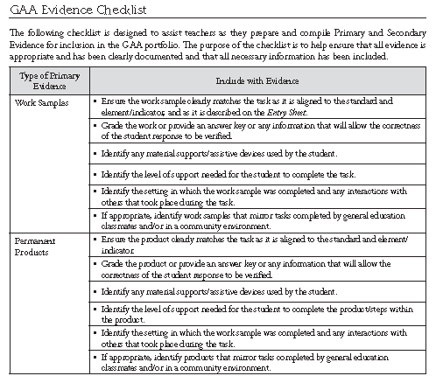
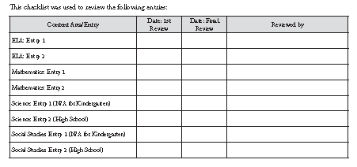
Checklist for Teachers and Portfolio Reviewers (continued)

Slide 57
Checklist for Teachers and Portfolio Reviewers
The Checklist for Teachers and Portfolio Reviewers is provided in the portfolio binder to ensure that all procedures and requirements have been satisfied before the portfolio is submitted.
The checklist should be part of the portfolio validation and review process as the reviewer signs and dates the form after each content area entry is checked.
It is recommended that the portfolio be reviewed twice – once after the first collection period has been completed and again before the portfolio is submitted.
The GAA Evidence Checklist, specific to each type of evidence submitted, can be found on pages 52-55 of the GAA Examiner’s Manual, 2015-2016.

Slide 58
Avoiding Invalidations
Reminder:
If irregularities are discovered, addressed, and corrected prior to portfolio submission, it is unnecessary to report them to the state as long as they are dealt with at the school/system level.
Systems can and should attempt to rectify them. However, as with all irregularities, they should be reported to Deborah Houston. They may or may not require a Portal record.

Slide 59
Ensuring a Successful Administration
Principals are critical!
The GAA must be given the same consideration, resources, and support provided for all programs.
Teachers need support
Planning time needs to be scheduled; substitutes provided.
Collaboration and training with content experts to facilitate understanding of content standards.
Collaboration with other special educators to discuss/share/review aligned tasks.
Professional development concerning curriculum access.
Notes:
Administrators and examiners alike must see the GAA as every bit as important as the Georgia Milestones or any other assessment.

Slide 60
Ensuring a Successful Administration
Training and support will continue to be provided on the state level in the form of:
GAA Fall Workshops via Go-To Webinar presentations.
Webinars focusing on GAA administration as well as access to the curriculum.
GAA Resource Board and portfolio review by peers and building examiners.

Slide 61
Contact Information
Questions About Test Administration
Call: GaDOE Assessment Administration Division
Toll free (800) 634-4106
Contact: Deborah Houston, Assessment Specialist (404) 657-0251
Email: dhouston@doe.k12.ga.us

Slide 62
Contact Information
Information about access to the state-mandated content standards for students with significant cognitive disabilities
Contact: Kayse Harshaw, Division for Special Education Services
Call: (404) 463-5281
E-Mail: sharshaw@doe.k12.ga.us
kharshaw@doe.k12.ga.us

Slide 63
Contact Information
Questions About Materials, Distribution, or Collection
Call: Questar’s GAA Customer Service Toll free (866) 997-0698
Email: Questar’s GAA Customer Service GA@QuestarAI.com

Slide 64
Questions & Answers
Please use the link below to submit any questions you may have related to Sessions: 1 - 4.
2015 GAA Fall Training Questions and Answers for Sessions 1–4
Notes:
This is a link to Survey Monkey and will allow GAA affiliates to submit questions germane to the 2015 Fall Training Sessions. Questions will be answered in the final Fall Training Session (Session 5) To gain access: please highlight the link, right click, and “Open hyperlink.”

