Slide 1
Georgia Alternate Assessment Understanding the Basics of the GAA Session 3

Slide 2
2015-2016 GAA
Purpose:
The 2015-2016 webinars (Sessions 1-5) explain how to prepare and submit GAA portfolios.
http://www.gadoe.org/Curriculum-Instruction-and-Assessment/Assessment/Pages/GAA-Presentations.aspx
Information pertaining to the GAA can also be found in the 2015-2016 GAA Examiner’s Manual.
http://www.gadoe.org/Curriculum-Instruction-and-Assessment/Assessment/Pages/GAA-Resources.aspx
Notes:
To access websites from a static PPT: Please highlight the web address, right click, and “Open Hyperlink.”

Slide 3
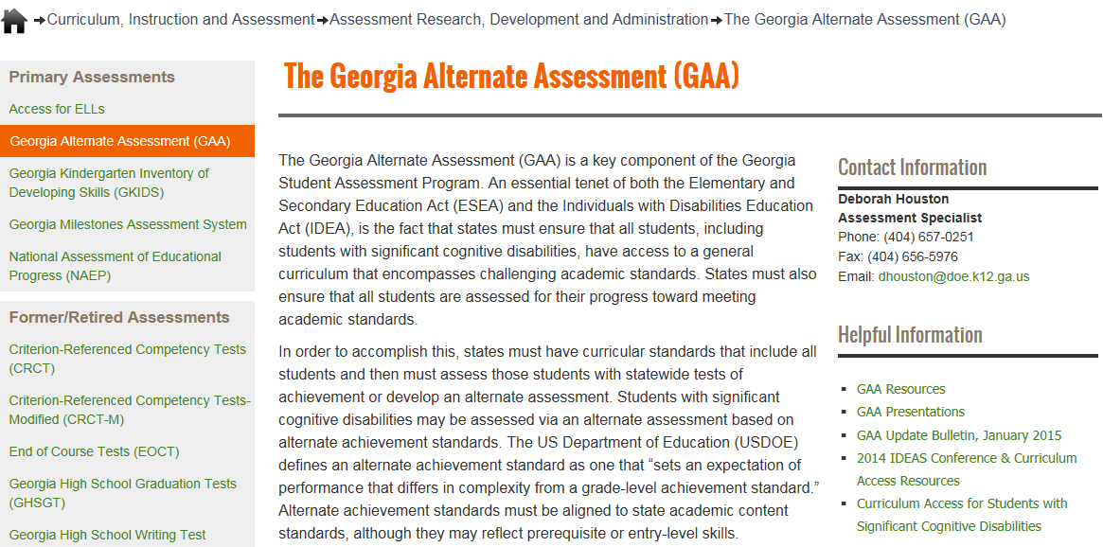
Links to Presentations are on
the GaDOE website (shown below)
http://www.gadoe.org/Curriculum-Instruction-and-Assessment/Assessment/Pages/GAA.aspx
Notes:
All Fall Training presentations will be posted on the GaDOE website at:
http://www.gadoe.org/Curriculum-Instruction-and-Assessment/Assessment/Pages/GAA-Presentations.aspx
The GAA Resources link will bring you to Manuals, Electronic Forms (such as the Entry Sheet), Score Interpretation Guides, and Other Ancillary Documents.
The GAA Presentations link will bring you to Fall Training Presentations (past and present), Mid-Year and Post Administration Presentations, and Other Presentations such as “Unpacking the Standards.”

Slide 4
Overview of this Presentation
This presentation provides information and tools that will help both new and experienced examiners in the preparation of portfolios.
Topics covered in this training:
Overview of the GAA
GAA Blueprint and Portfolio Components
Terminology for the GAA
Descriptions and Examples of Types of Evidence
Alignment/Documentation
Effective Evidence Documentation
Completing the Entry Sheet and Demographic Forms
Organizing and Submitting the Portfolio

Slide 5
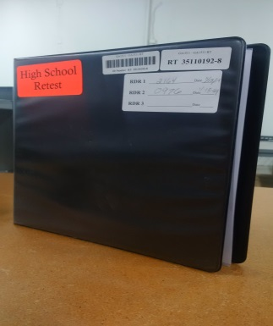
Overview of the GAA
Black, High School Retest portfolios will no longer be used.
The GAA administration window for the 2015-2016 school year opens on September 1, 2015 and closes on March 25, 2016.
Students in Grades K, 3-8 and High School (first time on the GAA) must be assessed during this open window.
Note: The High School Retest component has been removed from the GAA.
Notes:
The portfolio is a collection of student work for each assessed content area that is compiled within a 3-ring binder.

Slide 6
Overview of the GAA
The GAA is a portfolio-based assessment comprised of student work provided as evidence that a student is making progress toward grade-level academic standards, often at a prerequisite or entry level.
Evidence provided must show student work that is aligned to specific grade-level content standards, adapted to meet the student’s cognitive, communication, physical, and/or sensory impairments.
The Georgia Alternate Assessment meets ESEA and IDEA mandates.
Notes:
The portfolio is a collection of student work for each assessed content area that is compiled within a 3-ring binder.

Slide 7
Overview of the GAA
The portfolio system is flexible to allow for the diversity of the students participating in the GAA.
Evidence for the portfolio is collected throughout the assessment window (September 1, 2015–March 25, 2016).
This type of assessment allows for the individual student’s work to be submitted as evidence, demonstrating what the student knows and can do as related to the content standards and elements/indicators being assessed for the portfolio.
Students will be assessed in the same content areas and standards as their peers.
Notes:
Special Ed. students are assessed on the same content standards as their gen. ed. peers, but they may access the standards at an entry level and prerequisite skills may be used.

Slide 8
GAA Blueprint and
Portfolio Components

Slide 9
2015-2016 GAA Blueprint
The Blueprint outlines the requirements of the 2015-2016 GAA.
The Blueprint identifies the content areas and standards that are eligible for assessment on the GAA
The Blueprint, by grade, can be found in Appendix D of the GAA Examiner’s Manual, 2015-2016.
Note: Do not use Blueprints from previous years!
Notes:
The GAA Blueprint starts on p.93 and the Standards start on p.105 in the 2015-2016 Examiner’s Manual

Slide 10
Content Standards and Elements/Indicators
The state’s content standards are the goals for instruction, learning, and assessment in each of the four content areas (English Language Arts, Mathematics, Science, and Social Studies).
Elements/indicators are the specific concepts and skills that make up the state’s content standards.
The content standard and element/indicator descriptions, by grade, can be found in Appendix E of the GAA Examiner's Manual, 2015-2016.
Notes:
*The Blueprint does not give detailed descriptions of the standards, but rather a condensed layout of eligible standards by Grade/Content Area/ and Domain.
The GAA Blueprint starts on p.93 and the Standards start on p. 105 in the 2015-2016 Examiner’s Manual

Slide 11
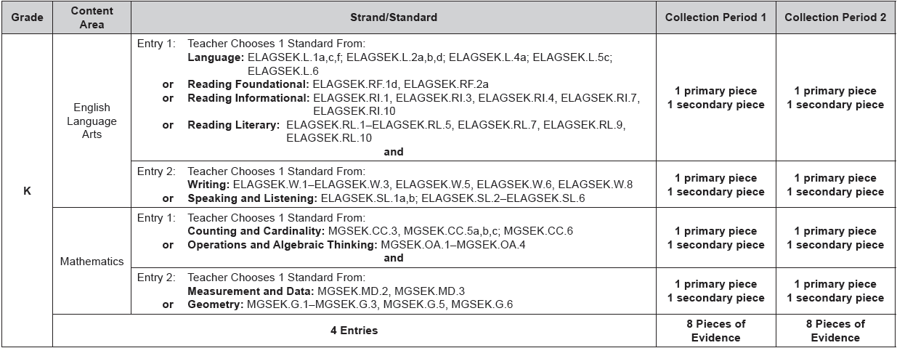
2015-2016 Blueprint
Example: Kindergarten Blueprint
Notes:
There are two entries in ELA and two entries in Math for Kindergarten students.

Slide 12
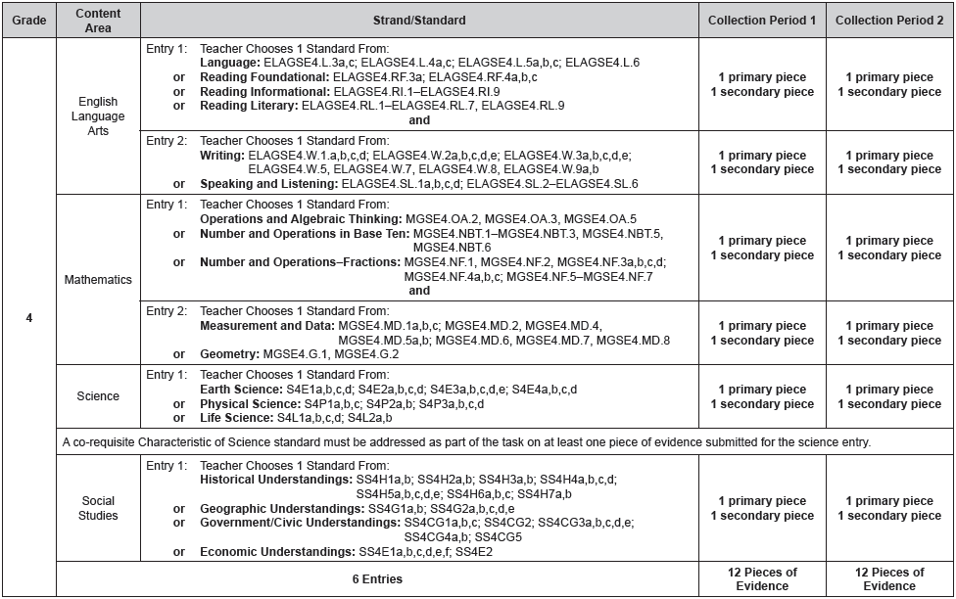
2015-2016 Blueprint
Example: Grade 4 Blueprint
Notes:
In Grades 3-8 there are two entries in ELA, two entries in Math, one entry in Science and one entry in Social Studies. This slide shows the Grade 4 blueprint.

Slide 13
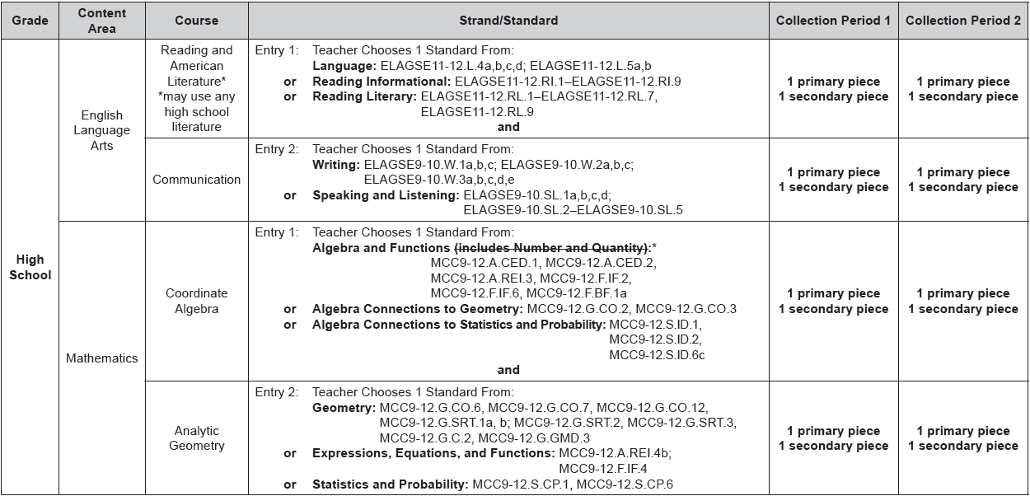
2015-2016 Blueprint
Example: High School Blueprint, page 1
Notes:
There are eight entries in a high school student’s portfolio. There are two entries in ELA and two entries in Math and (see next slide)…

Slide 14
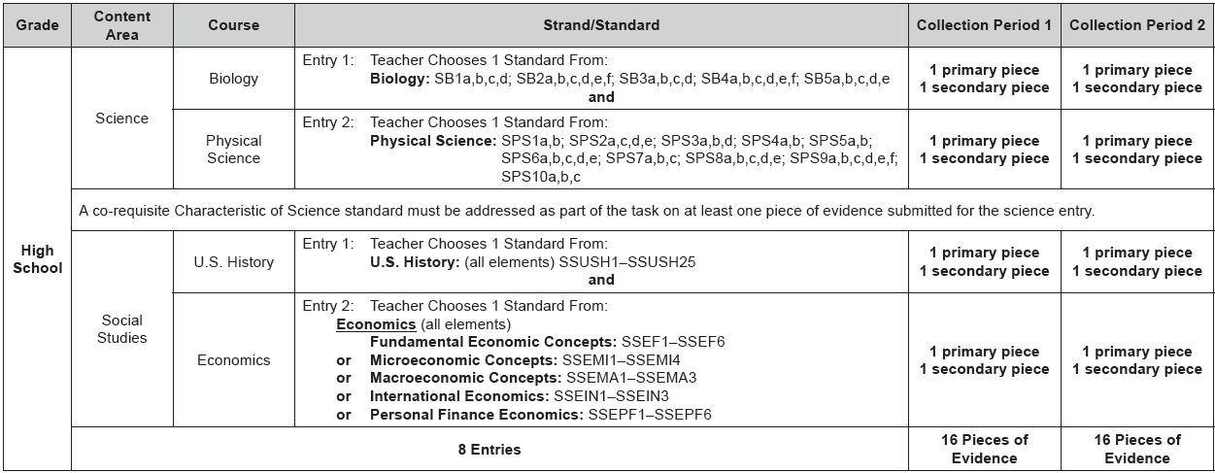
2015-2016 Blueprint
Example: High School Blueprint, page 2
Notes:
In addition, HS students also have two entries in Science and two entries in Social Studies. See previous slide also.

Slide 15
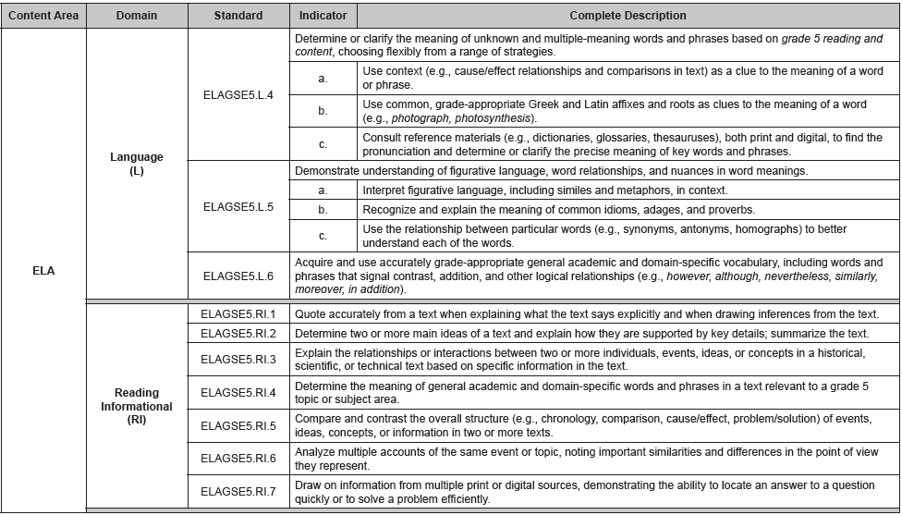
Appendix E–Standards
Example: Grade 5, ELA 1 Entry
Standard description
Standard
Indicators
Domain
Notes:
Standard Descriptions are also included. . . Above elements/indicators.

Slide 16
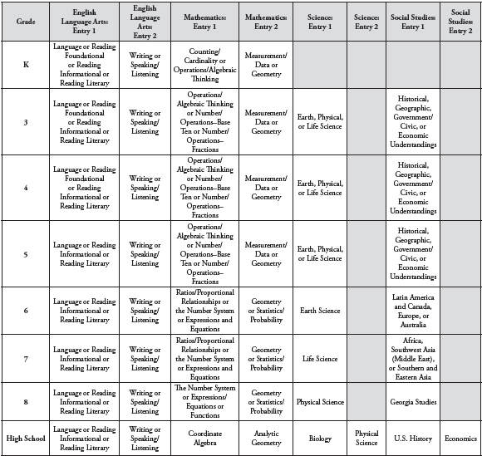
Portfolio Components
Entry 1
Entry 2
State-mandated Content Standards
Examiner’s Manual - 2015-2016, page 9
Notes:
To read this chart -- Grades run along the side/vertical axis. Content Areas, divided by Entry, run along the top axis. The domains eligible for assessment for each entry are included in the chart and will automatically appear in the electronic Entry Sheet once the grade and content area are selected.
Example: The domains of Language, Reading Foundational, Reading Informational, and Reading Literary are the ELA Entry 1 options for Kindergarten and grades 3 and 4. It is important that the first entry be chosen ONLY from the standards eligible for Entry 1. The standard assessed for ELA Entry 2 (all grades) will then be chosen from the Writing or Speaking and Listening domains.

Slide 17
Terminology for the GAA

Slide 18
Terminology for the GAA
Entry
Entry Sheet
Assessment Task
Evidence
Collection Periods
Collection Period Label
Primary Evidence
Work Sample
Permanent Product
Audio/Video File
Series of Captioned Photos
Secondary Evidence
Observation Form
Interview Form
Data Sheet
Additional piece of Primary Evidence
Alignment
Prerequisite Skills

Slide 19
Entry and Entry Sheet
Entry
An entry includes the Entry Sheet and four pieces of evidence. The first two pieces of evidence show the student's baseline skill, while the last two pieces of evidence show the student's progress.
Entry Sheet
An Entry Sheet is a 2-page document that must be completed and placed in front of the evidence for that entry.
It serves as a table of contents for the entry.
Notes:
Please remember, the task descriptions on the 2nd page of the Entry Sheet should be brief summaries of the assessment activity for each of the four pieces of evidence. Please note that scoring criteria such as dates, settings and interactions, student’s grades, and prompting must be annotated on the evidence itself. Scorers cannot use statements made on the Entry Sheet as evidence of the student’s performance. The task descriptions are used to support what the student’s tasks are, but statements written on the Entry Sheets are not by themselves evidence of the student’s performance.
The Entry Sheet is a two-page document. The first page includes information about the student and the entry (student name, content area, standard to be assessed and so on). The second page requires the teacher or administrator to write brief descriptions of each of the student's four assessment tasks. Do not include descriptions of prompting and/or grades in the task descriptions.

Slide 20
Assessment Task
An assessment task is any standards-based activity that is performed by the student.
Evidence of the student’s performance on the task is submitted in the portfolio for scoring.
Tasks must demonstrate a clear alignment/ connection to the content standard and element/indicator being assessed.
Look at the nouns- what were the standard and element/indicator designed to teach?
It is to the intent of the element/indicator that the tasks must align.
If there are no elements/indicators, alignment goes directly back to the standard.
Notes:
Please keep in mind the GAA structure and flow for alignment: Content Areas/Domains/Standards/Indicators. Each of these categories should have a direct correlation and tie-in to the preceding category. Therefore, when thinking about the concept of aligning assessment tasks to the standard and indicator, also keep in mind the domain and content area. E.g.: In ELA, ELAGSE8.W.2 (e.) calls for students to “Establish and maintain a formal style.” This could pertain to speech or writing. Looking back at the standard language “Write informative/explanatory texts to examine a topic and convey ideas, concepts, and information through the selection, organization, and analysis of relevant content.” It’s clear that this is in the context of Writing and therefore submitted evidence must be student writing. E.g. #2 ELAGSE8.W.7: “Conduct short research projects to answer a question (including a self-generated question), drawing on several sources and generating additional related, focused questions that allow for multiple avenues of exploration.” Research projects or snip-its from such research that are included as evidence should be captured via student writing.
Another example:
Understanding the standard & indicator and the essence of both are vital to developing aligned tasks.
For example: HS SS standard SSEPF5 (a.): The student will describe how insurance and other risk-management strategies protect against financial loss. (a.): List various types of insurance such as automobile, health, life, disability, and property. The essence of this element is not to list insurance providers: Geico, Liberty Mutual, Allstate, Farmers, etc., NOR is it to list types of insurance per se, but rather to assess the student on their knowledge of how insurance can protect people and businesses from possible financial loss – the costs and benefits of insurance. Students could match types of insurance to their corresponding claims, etc.
“As people begin to acquire assets and an income, they begin to think about how to protect what they have from loss. Toward this end, many people buy insurance. This lesson tells how insurance works and provides an overview of the different types of insurance. Students participate in a simulation that allows them to practice their understanding of the costs and benefits associated with purchasing insurance.” – Content Area Frameworks, https://www.georgiastandards.org/Frameworks/Pages/BrowseFrameworks/socialstudies9-12.aspx
The Content Area Frameworks are a wonderful resource to utilize. The Frameworks can assist teachers in identifying and allowing students access to the essence of the standard and element/indicator as well as interpreting the standard and element/indicator as intended.
Tasks must be distinct from each other.

Slide 21
Entry Evidence
Evidence
Shows or describes the student’s performance on tasks aligned to the selected standard/indicator.
Primary Evidence
Work Sample
Permanent Product
Series of Captioned Photos (minimum of 2)
Media (audio or video) -include a script
Secondary Evidence
Observation Form
Interview Form
Data Sheet
An additional piece of Primary Evidence
Notes:
Recommend three photos or more for captioned photos. Three photos allow students to be shown beginning the task, amidst the task, and completing the task.

Slide 22
Collection Periods
For each entry, there are two collection periods.
Collection Period 1 shows the student’s initial skill.
Collection Period 2 shows the student’s progress.
For each collection period, there must be two pieces of evidence: Primary Evidence and Secondary Evidence.
Therefore, there are 4 pieces of evidence in each entry.

Slide 23
Collection Periods
Date on the Primary Evidence for Collection Period 2 must be a minimum of 14 calendar days after the date on the Primary Evidence for Collection Period 1.
Both pieces of Collection Period 1 evidence must be complete before either piece of Collection Period 2 evidence is collected.
All 4 pieces of evidence must represent different, distinct, complete events.
Notes:
There may not be an overlap of Collection Periods. E.g., Technically, Secondary Evidence in CP2 could be completed a day after CP1 ends, but this is not recommended.
Although it is not recommended, it is permissible that both pieces of evidence for a collection period be collected on the same day. In order to be scored as two separate assessment tasks, the evidence must document two completely separate and distinct events. A task that is begun in the morning and completed in the afternoon is not two separate tasks. The assessment tasks must utilize different materials or a different (but related) concept and each must demonstrate a clear beginning and end.

Slide 24
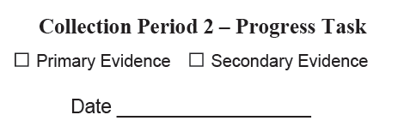
Collection Period Label
Collection Period Labels are provided in the front pocket of the portfolio binder to help the teacher label and organize the portfolio evidence.
Check the appropriate box and write the date the evidence was collected.

Slide 25
The Anatomy of a GAA Entry
Collection Period 1
Initial/Baseline
Primary Evidence
Secondary Evidence
Entry
(e.g., Reading
Literary
Standard)
14 calendar days
Primary Evidence
Collection Period 2
Progress
Secondary Evidence
Note: There must be 14 days between Primary Evidence in CP1 and Primary Evidence in CP2.
There must be two distinct collection periods; CP1 must be completed before CP2 begins.

Slide 26
Primary and Secondary Types of Evidence
Descriptions and Examples

Slide 27
Primary Evidence
Demonstrates knowledge/skills by showing the student’s engagement in tasks
“Primary” refers to the type of evidence; it does not mean that it has to be dated earlier than the Secondary Evidence in that collection period.
It is important that the type of evidence used is the appropriate choice to clearly demonstrate the student’s response.

Slide 28
Student Work Sample Primary Evidence
Work samples are items completed or created by the student.
Examples:
Writing samples
Graphic organizers
Worksheets (whether commercial or teacher made)
Work samples must be annotated, either on the student work or on a separate annotation page to provide the necessary information for scoring.
Notes:
The annotation sheets submitted are also considered part of the evidence. This is where scoring criteria such as thorough task descriptions, student performance (grade, score, percentage, or answer key), settings and interactions, and prompting can be documented. Scoring criteria may be written directly on student work, if the teacher prefers not to submit a separate annotation page.

Slide 29
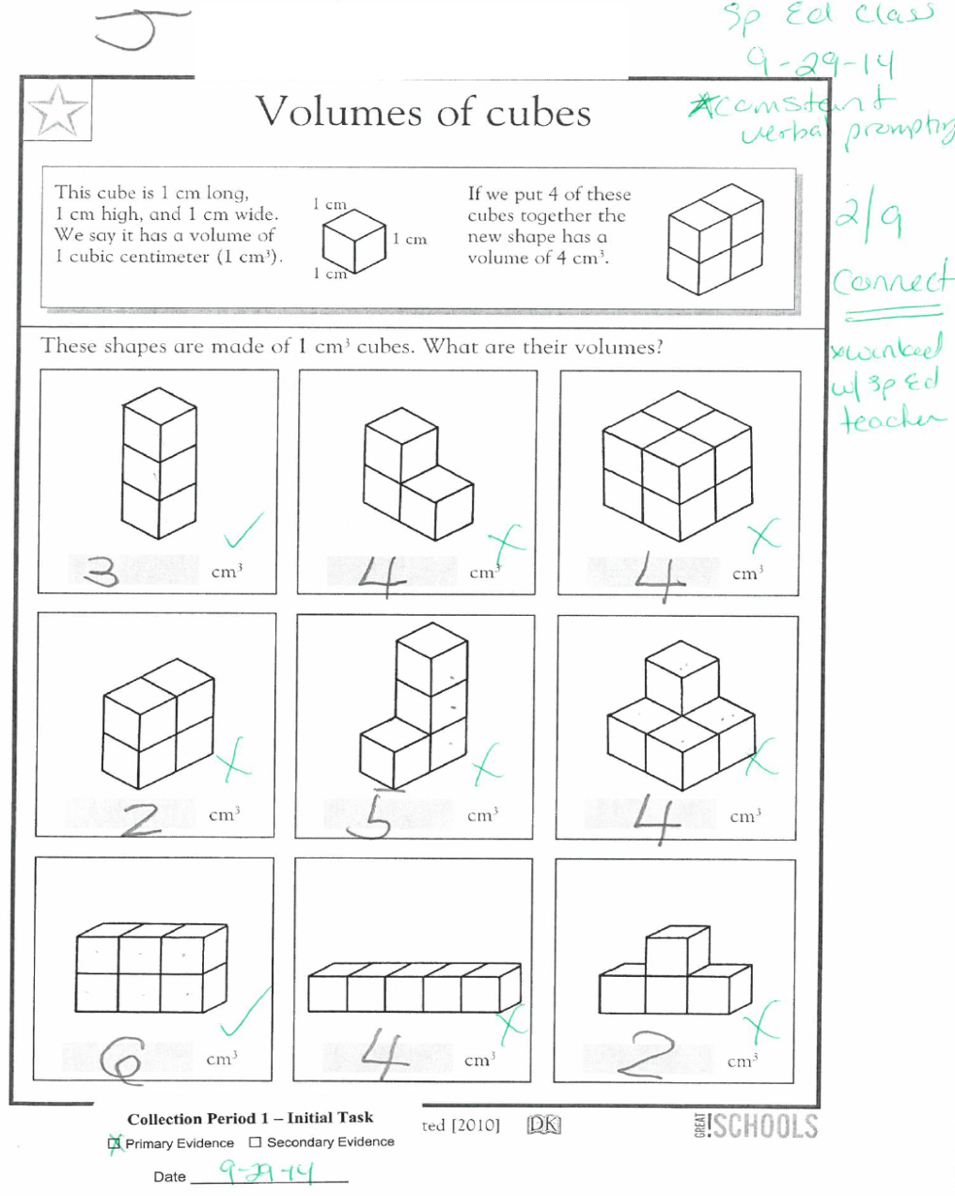
Student Work Sample Primary Evidence
Who
Where
What
Work Sample
This work sample was submitted as a piece of Primary Evidence and includes all information necessary for scoring. The teacher has provided the student’s name, the Collection Period Label, the date on which it was completed, the grade the student received, and the level of prompting.
When
Prompts
How well
With whom
When

Slide 30
Permanent Product Primary Evidence
Permanent products are items created by the student (e.g., murals, drawings, or models).
Many times, a permanent product may be too large or of a nature that prevents the teacher from sending in the actual work.
In these cases, the teacher should photograph (not photocopy) the student’s work, date it, and label it “permanent product.”
A single photo is acceptable only for permanent products.
Permanent products should have annotations in order to be accurately scored.
(GAA Examiner's Manual, 2015-2016, pages 20 & 21)
Notes:
If a permanent product is too large or too fragile to be shipped with the portfolio, then the teacher should photograph it and include the photo in the entry. A single photo of a permanent product is acceptable.

Slide 31
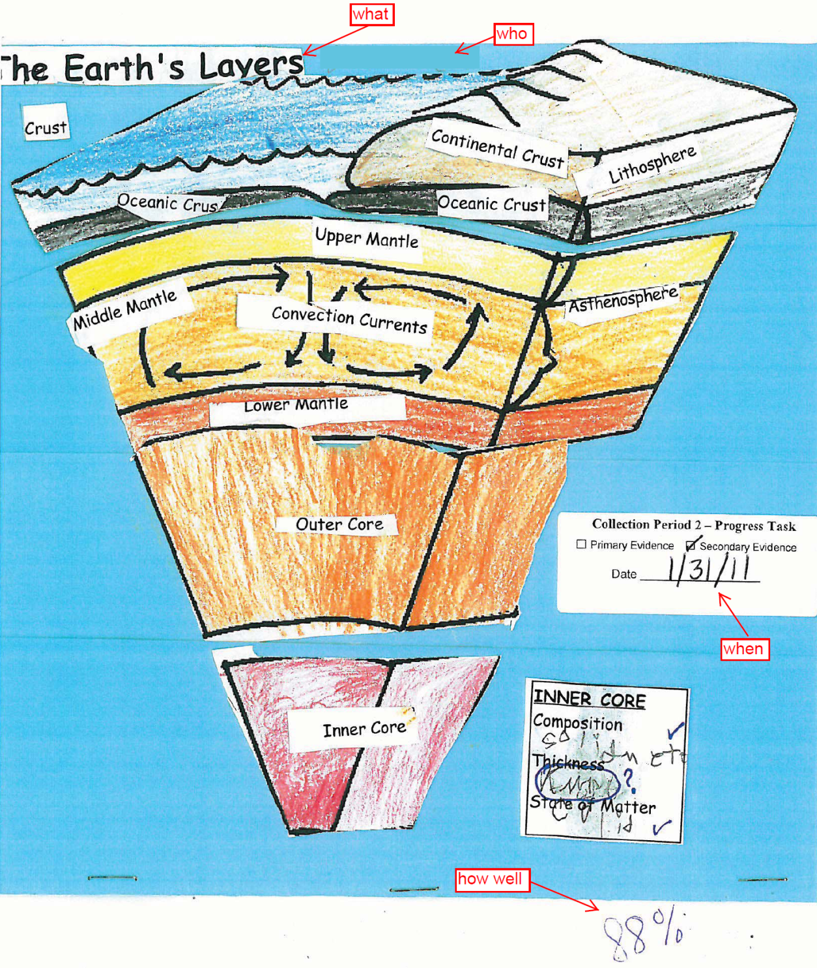
Permanent Product
This permanent product was submitted as Secondary Evidence. The teacher has provided the student’s name and the date, affixed the appropriate collection period label, and has scored the student’s work.

Slide 32
Series of Captioned Photos Primary Evidence
A series of captioned photographs means at least two photographs must be submitted (three or more are recommended).
The photos should clearly depict the student in the process of the task as well as the completion of the task.
Captions should state what assessment task the student is performing. If the student is photographed with other people, the captions should say what the student who is being assessed is doing. A group activity, in which the individual student’s task is unclear, is not suitable for assessment.
The caption should include information regarding the activity in which the student is engaged, the student’s level of success, the setting and interactions, and the type and frequency of prompting, if any, that were provided to the student.

Slide 33
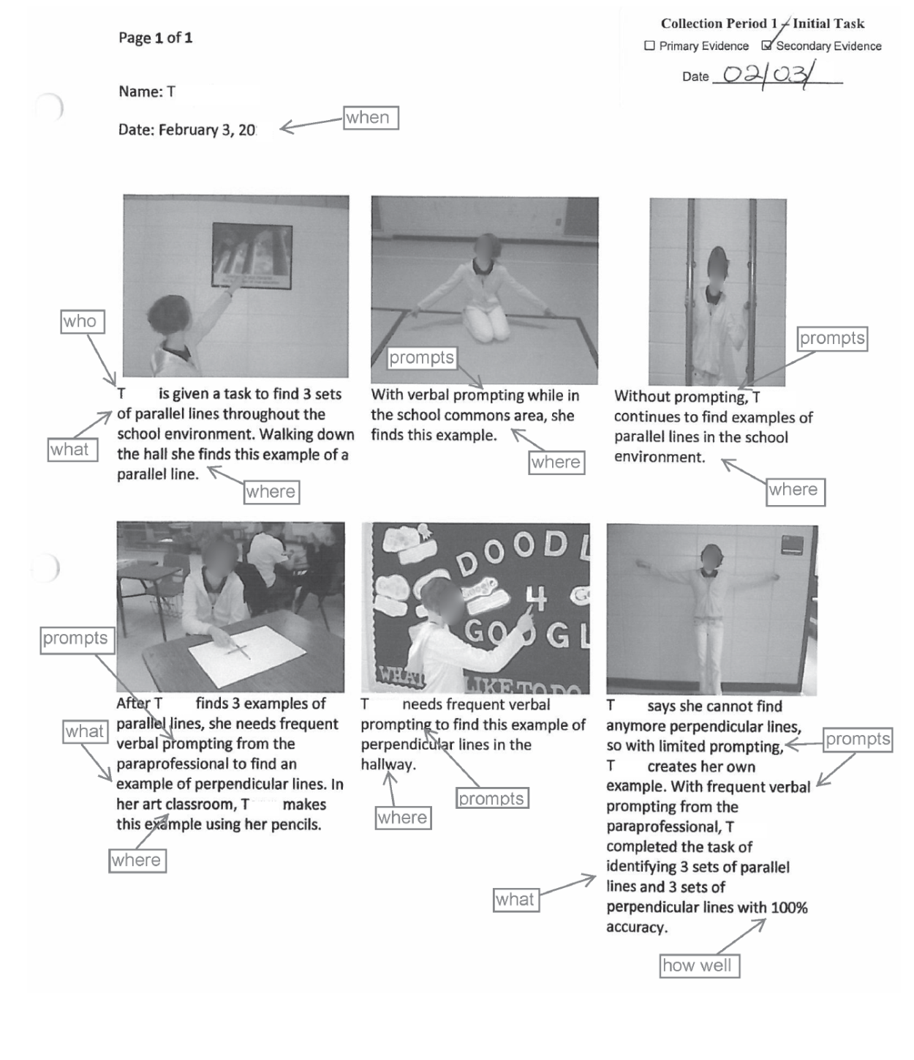
A series of captioned photos was submitted as Secondary Evidence for this student. The photos clearly depict the student in the process of the task and show her response at each phase. The captions describe each step of the task and annotate the student’s success. The teacher has provided information about the setting and interactions with the paraprofessional as well as the level of prompting required for the student.
Notes:
Remember: Any Primary type of evidence can also serve as a Secondary type.

Slide 34
Media–Audio/Video Accompanied by a Script Primary Evidence
Audio, Video, CDs, Flash Drives, and DVDs can be effective ways to demonstrate students’ skills when tasks involve multiple steps, “verbal” responses, or interaction with others.
It is important to provide a script so that, in the event there are technical problems with viewing or listening to the media, the script can be used for scoring.
The media must be labeled with the student’s name in order to avoid confusion should the media become separated from the portfolio. If there are multiple students in the video, it must be made clear which student should be observed.

Slide 35
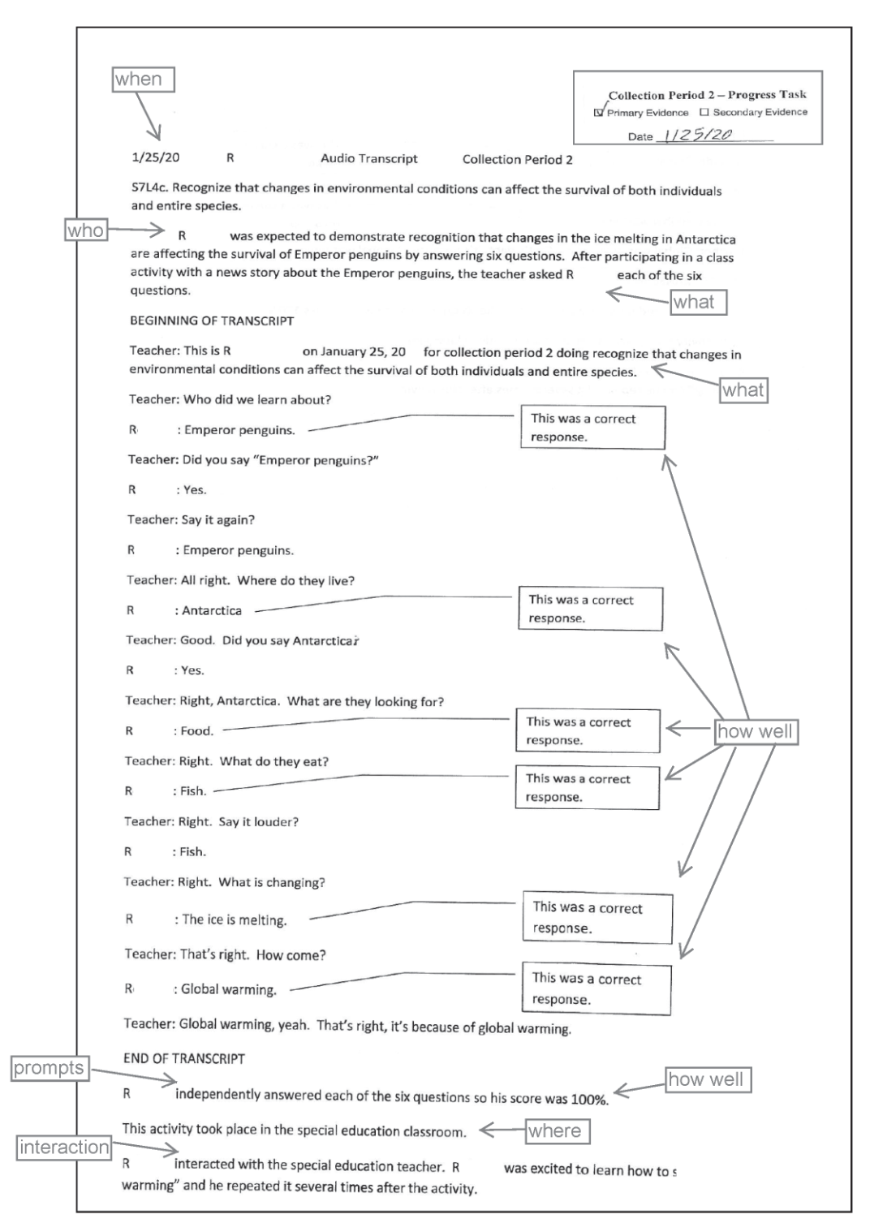
A video was submitted as Primary Evidence for this student. The video file was labeled with the student’s name, grade, and school. A script was also included that documented the evidence recorded, the student’s name, the date, and the Collection Period. It also provided a description of the task, the setting and interactions, an evaluation of the student’s level of success, and the level of prompting that was provided.

Slide 36
Secondary Evidence
Reports knowledge/skills by documenting, charting, or interpreting the student’s performance
Secondary Evidence refers to the type of evidence, not to the date or order in which evidence was collected.
Notes:
Secondary Evidence documents, relates, charts, or interprets the student’s performance on assessment tasks and is based on tasks or activities related to but different from those submitted as Primary Evidence. The tasks can differ in terms of the complexity of the activity, the materials used, or the type and frequency of prompting (i.e., the amount of support a student requires and is given to accurately complete a task).

Slide 37
Data Sheet Secondary Evidence
The data sheet should include a clear description of the task, analysis of the student performance, and a key. It should also include information on the setting, interactions with peers (both with and without disabilities) and community members, and the type and frequency of prompting, if any, that was provided.
A minimum of 3 distinct dates on which evidence was collected is required for a data sheet.
Notes:
Please remember that there must be three distinct dates separate from the date on which the Primary Evidence was collected for the same collection period. A data sheet may record what was conducted for the Primary Evidence, but that would mean there would need to be at least 4 distinct dates on the Data Sheet (Secondary Evidence).

Slide 38
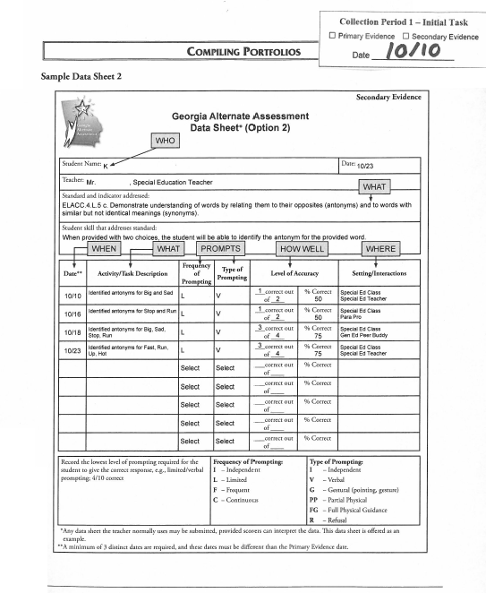
Data Sheet This data sheet was submitted as Secondary Evidence for this student. It includes the student’s name, a description of the task, and the dates on which the tasks were completed. The collection period label has been affixed so as to clearly depict the type of evidence and collection period. A key has been provided for prompting and accuracy so that the student’s achievement/progress can be evaluated.
Notes:
There must be a minimum of 3 discrete dates on which data was collected for the skill being assessed. If the Primary Evidence task is included on the Data Sheet, there must be an additional 3 discrete dates in order for the Data Sheet to be eligible for scoring.

Slide 39
Interview Form Secondary Evidence
Typically, this method of documentation is used when the performance occurs in a community or home setting in which the teacher who is assessing the student is not present (e.g., on a work site, at a restaurant, etc.).
The parent, another educator, peer helper, employer, related service staff, or other individual who is in a position to describe the student’s performance is asked a structured set of questions to enable the teacher to document the student’s performance.
Specific information regarding student performance, setting, and interactions with peers (both with and without disabilities) and community members should be included.

Slide 40
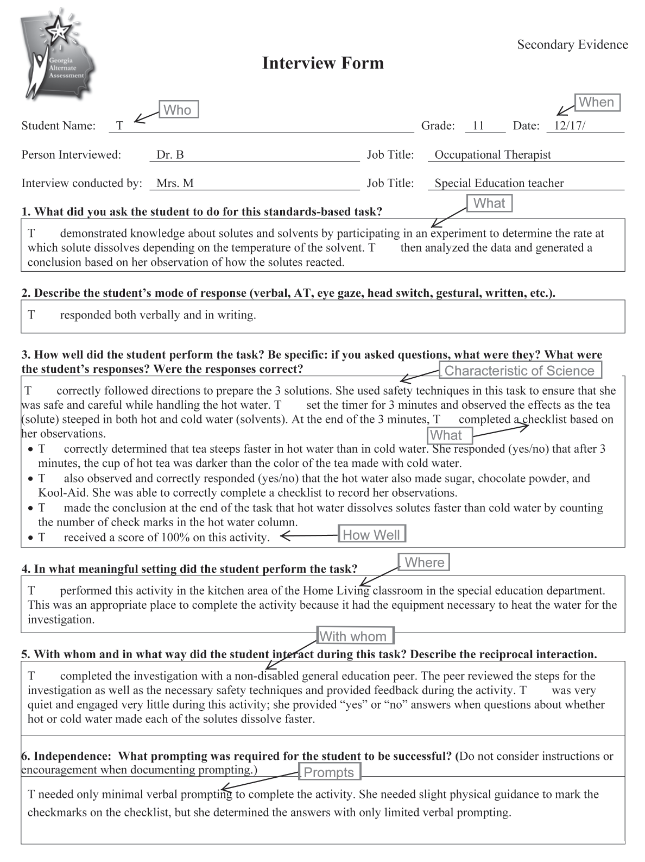
Interview Form
All necessary information has been completed for this interview. The teacher described the task and clearly evaluated the student’s performance (this is of key importance). Further, the teacher provided the setting in which the task was completed, the interactions that took place, and the type and frequency of prompting necessary for the student to complete the task.

Slide 41
Observation Form Secondary Evidence
The teacher or para-pro uses the observation form to record the student’s performance on an assessment task.
Be sure to include specific information regarding student performance, setting, and interactions with peers (both with and without disabilities) and community members.
Do not include an observation of an event for which Primary Evidence has already been submitted.
Notes:
If an observation form is used to re-document what occurred during the Primary task, the entry will receive a nonscorable code.

Slide 42
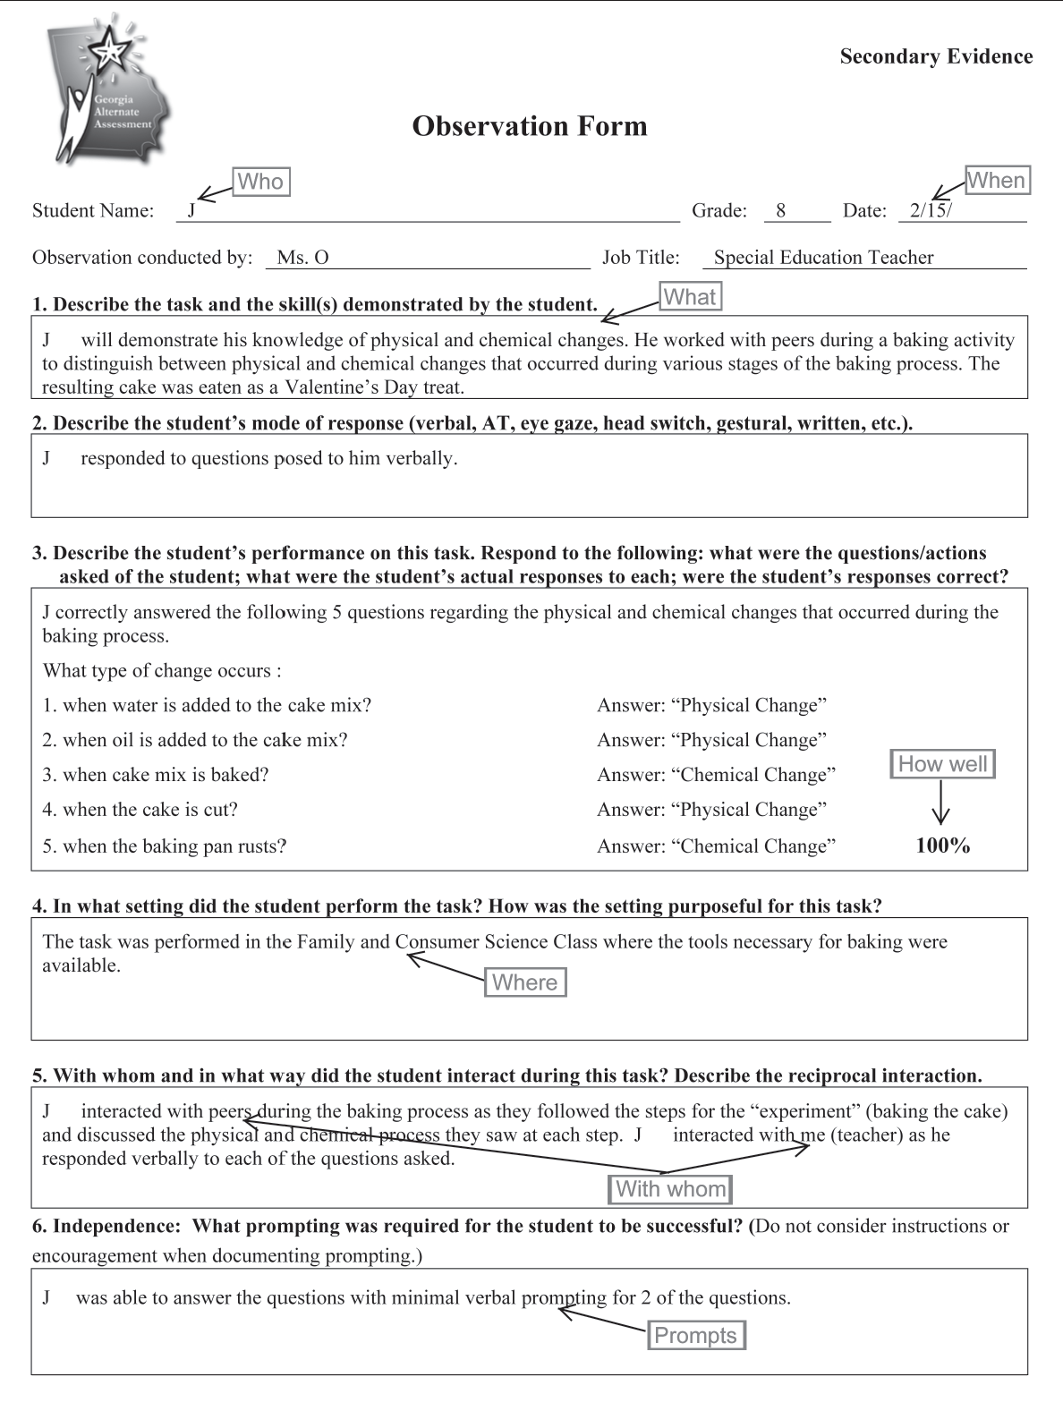
Observation Form All necessary information has been completed for this observation. The teacher described the task and clearly evaluated the student’s performance. Further, the teacher provided the setting in which the task was completed, the interactions that took place, and the type and frequency of prompting necessary for the student to complete the task.

Slide 43
Alignment
Choosing the Standard for Assessment
Alignment to the Intent of the Standard
Notes:
This is just a brief introduction to alignment. Further discussion about alignment and designing tasks to address the standards-based skills will be covered in greater detail in the August 26th presentation 1:00-3:00 PM.

Slide 44
Alignment
Alignment is the connection between the written, taught, and tested curriculum.
Alignment demonstrates the linkage of the activities (student work) to the intent of the grade-level standard and element/indicator on which the student is being assessed.
In order for an entry to be scorable, all four (4) tasks must align to the standard and element/indicator.
Assessment tasks should be designed and task descriptions written to specifically address the standards-based skill being evaluated.
Notes:
Intent- what are the standard and element designed to teach?
Consider alignment first and foremost when designing assessment tasks.
The task must be true to the standard.
The task must address the distinct aspects of the element (focusing on one is acceptable).
The task must be appropriately challenging for the individual student.
All four tasks, though distinct events, must provide evidence of what the student knows and can do across the same skill.
A consistent skill must be present and carried across both collection periods

Slide 45
Alignment–Prerequisite Skills
A prerequisite skill is one that is essential to the acquisition of the standard and element/indicator.
Tasks submitted for the assessment can focus on prerequisite skills that allow the student to be exposed to and assessed on the standard/element at a level that is meaningful and purposeful for the student.
Prerequisite skills must still focus on the intent of the grade level standard and element.
Can working on this skill eventually lead the student to the skill targeted by the standard and indicator?
Notes:
Access at a prerequisite level must still demonstrate relevance to the intent of the standard -- e.g., Identifying numbers is NOT a prerequisite skill for understanding fractions as parts of a whole.
Identifying letters or decoding words is NOT a prerequisite for understanding character, plot, or setting from a text.

Slide 46
Alignment - Choosing the Best Standard and Indicator for Assessment
Create a preliminary plan to map out the standards that are appropriate to be assessed for the student.
Think about assessment tasks that will allow the student to demonstrate knowledge and achievement related to the standard.
Construct assessment tasks in a format that best allows the student to demonstrate skills related to the standard.
Planning Sheets are provided beginning on page 49 of the GAA Examiner’s Manual, 2015-2016.
Notes:
Creating units and activities that can be used for multiple students is acceptable; however, the activities must be tailored to the needs and the abilities of the individual student.
Think about the student first when planning tasks that allow access to the standard. What may be appropriate for one student may not be appropriate for another.
Think about the best way to show the student’s skill when deciding the type of evidence to include.

Slide 47
Alignment - the Intent of the Standard and Indicator
The intent of the standard and indicator refers to the “Big Idea”– that which they were designed to teach.
e.g., ELACC.7.L.4 (c) Consult general and specialized reference materials (e.g., dictionaries, glossaries, thesauruses), both print and digital to find the pronunciation of a word or determine or clarify its precise meaning or its part of speech.
The intent of this Language standard is for the student to use reference materials to enhance their knowledge of the English language.
Notes:
Talk about SL.1 for all grades, mention that not all aspects of a standard or element/indicator need to be addressed in order to be aligned.

Slide 48
Effective Evidence Documentation

Slide 49
Effective Documentation
The following information must be documented on each piece of evidence within an Entry:
the student's name (Who) and date (When)
description of task–documented on Entry Sheet and evidence (What)
the setting in which the task was completed (Where)
specific evaluation of student response (How Well)
nature of the interaction as it occurred during the task (With Whom and Describe Interaction)
Independence–type and frequency of prompting (Prompts)
Notes:
What - The task description should be concise but specific to the standard and indicator.
Where - The setting should be purposeful to the task (e.g., doing a math worksheet in the hallway is NOT allowing the student to generalize the skill in a different setting).
How Well - All student responses should be present in the evidence and must be graded.
With Whom - The nature of the interaction should be documented and relevant to the task as it relates to the standard.
Prompts - Both type and frequency of prompting must be documented. Prompting refers to assistance that leads the student toward the correct answer. DO NOT include information regarding instructions, encouragement, behavioral interventions, or supports as part of your documentation on type and frequency of prompting.

Slide 50
Completing the Entry Sheet and the Student Demographic Information Form (SDIF)

Slide 51
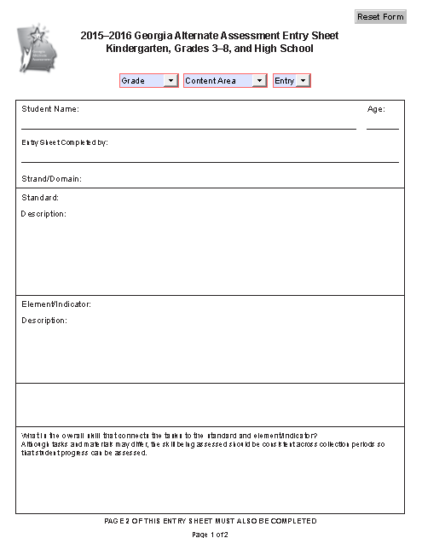
Select Grade, Content Area, Entry # (1 or 2) from Drop-downs. Proceed with selecting the standard and indicator (if applicable).
Notes:
There is one Entry Sheet this year for all students. The Retest Category drop-down does not exist with the removal of the HS Retest.

Slide 52
Completing the Entry Sheet
Select Grade at which student meets FTE from the drop-down menu
Select Content Area from the drop‐down menu
Select Entry # from the drop-down menu
Entry 1 or Entry 2 per the GAA Blueprint
Type student’s full name
Type student’s age
Type teacher’s name and position
Notes:
FTE = Full-Time Equivalent

Slide 53
Completing the Entry Sheet
Select Strand/Domain from drop‐down menu
Select Standard from drop‐down menu
The standard must be chosen from the GAA Blueprint for the student’s recorded grade.
Click on MUST SELECT. The eligible standards will appear on the screen. Select the standard you have chosen for your student.
Once you have chosen the standard by letter and number, the text of the standard will appear automatically on the screen.

Slide 54
Completing the Entry Sheet
Select Element/Indicator from the drop-down menu
The element/indicator must be chosen from the GAA Blueprint for the student’s recorded grade.
Click on MUST SELECT. The eligible standards will appear on the screen. Select the element/indicator you have chosen for your student .
Once you have chosen the element/indicator, its text will appear automatically on the screen.
If there is no element/indicator for the chosen standard, the drop-down menu and box will be inactive.

Slide 55
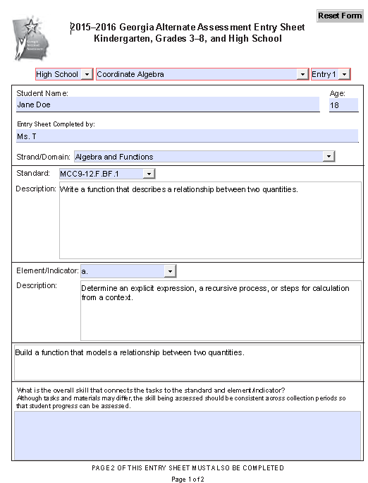
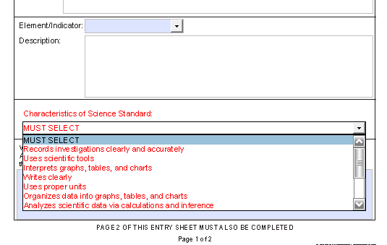
Select Grade, Content Area, and Entry # from Drop-down menus
Completing the Entry Sheet
(page 1)
Grade at which student meets FTE
No Retest Category
Student’s first and last name
Instructor's Name and Position
Strand/Domain must be chosen
Element/Indicator must be chosen from the GAA Blueprint for the student’s recorded grade. If applicable, drop-down choices will appear once the standard has been chosen, and the description will auto-populate. If the Element/Indicator box remains blank, there are none for the chosen standard.
Standard must be chosen from the GAA Blueprint for the student’s recorded grade. Drop-down choices will appear once Grade, Content Area, Entry #, and Strand /Domain have been chosen. Description will auto-populate.
Characteristics of Science options
Cluster statement auto-populates once the standard has been selected. If a Science Entry, Characteristic of Science drop-down menu will appear.
This box is available to explain the overall skill demonstrated by the student that focuses on standard and indicator.
Notes:
For HS Math students, Coordinate Algebra will always be Entry 1 and Analytic Geometry will always be Entry 2. Do not submit two entries from the same Course.

Slide 56
Completing the Entry Sheet
Special Features
When assessing mathematics, a note will auto-populate with information about the cluster statement from which the math standard is derived.
When assessing science, the words Characteristic of Science will appear along with a drop-down menu of the co-requisite science process that must be selected on the Entry Sheet and exhibited in at least one of the four pieces of evidence submitted for the science entry.

Slide 57
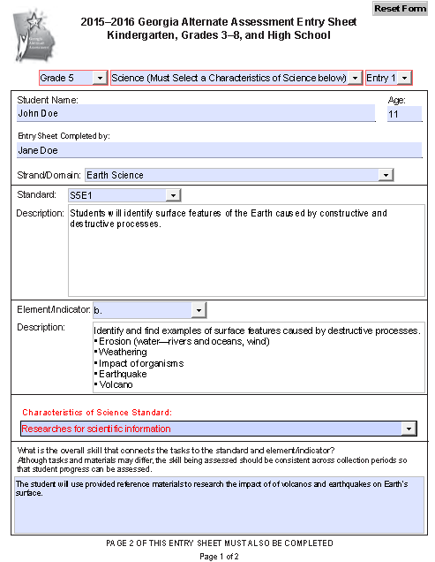
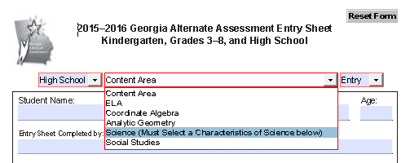
Completing the Entry Sheet
Characteristics of Science
Once Science has been chosen as the Content Area, the drop-down list appears.
Notes:
You MUST choose one Characteristic of Science (science process task) from this list. The Characteristic of Science recorded on the Entry Sheet MUST be found and exhibited in at least one piece of evidence.
The Characteristic of Science should be selected at the same time that instruction is planned to ensure the correct characteristic is selected and can be demonstrated and documented correctly for the assessment.
Refer to Session 4 (Alignment) for further information on the CoS.

Slide 58
Completing the Entry Sheet
Continue to page 2 of the Entry Sheet and complete all required fields for Primary and Secondary Evidence for both collection periods.
Type the date in the “Date” box.
Select the type of evidence being submitted from the “Type of Evidence” drop-down.
Type the task description into the “Description of Task” box.
The description of the assessment task should relate the task to the specific standard/indicator being assessed.
Do NOT include evaluation of the student’s work, documentation of the type and frequency of prompting, or information about settings or interactions. This documentation must be found within the evidence.
Notes:
Information used for scoring, such as the grade the student received and the type and frequency of prompting, MUST be documented within the evidence.

Slide 59
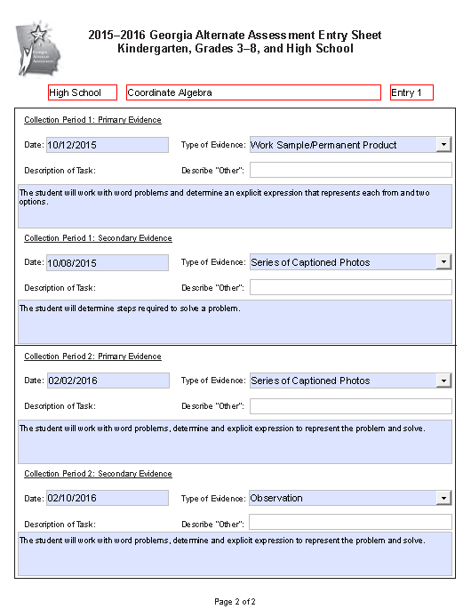
Completing the Entry Sheet
(page 2)
These fields auto-populate when chosen on Side 1 of the Entry Sheet.
Please make sure the dates on the evidence match the dates given on the Entry Sheet.
Please make sure the Primary Evidence in CP2 is dated at least 14 calendar days after the date for CP1 Primary Evidence.
Please make sure that all of Collection Period 1 evidence has been completed prior to starting Collection Period 2.
Type in the date; choose the Type of Evidence from the drop-down menu for all four pieces of evidence.
Notes:
Please remember that when entering the date, the Entry Sheet requires a four digit year.

Slide 60
Student Demographic Information Form
Two different SDIFs will be utilized for the 2015-2016 administration of the GAA.
SDIF for grades Kindergarten and 3-8
Form is MAROON
SDIF for High School
Form is ORANGE

Slide 61
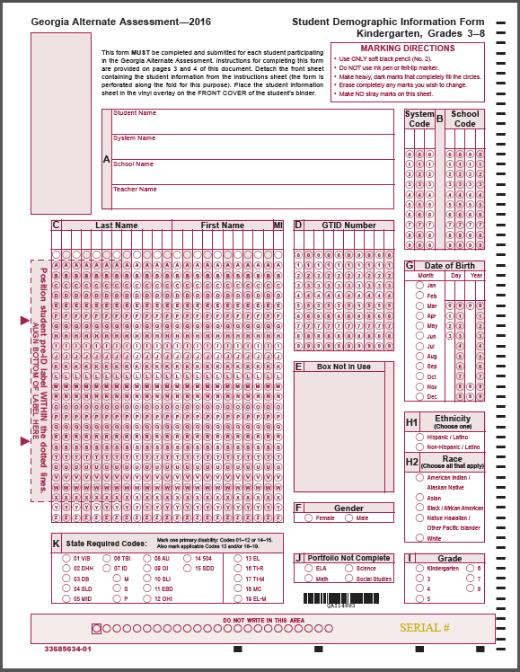
K and 3-8
SDIF for
Kindergarten
and Grades 3-8
Affix the Pre-Id label to the front of the SDIF.
Pre-ID Label
Maroon Form
Notes:
Complete all necessary fields on both sides as required on the SDIF instruction page.
Place the SDIF under the clear, vinyl overlay on the front of the student’s binder.
Do not 3-hole punch, and do not place it inside the binder.

Slide 62
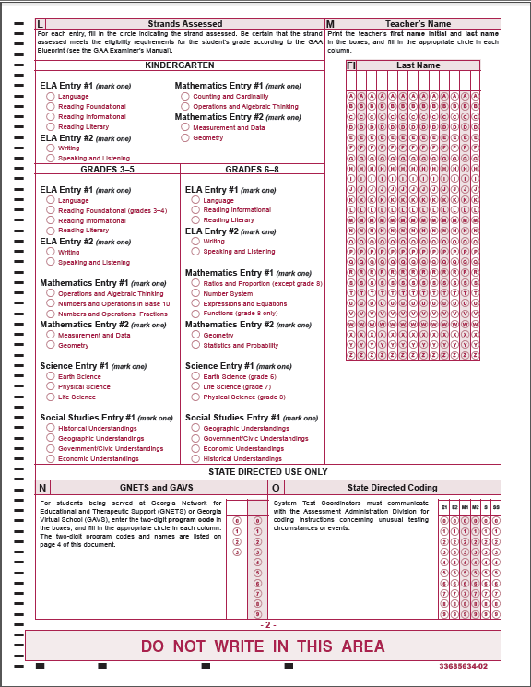
SDIF for Kindergarten and Grades 3-8
Page 2

Slide 63
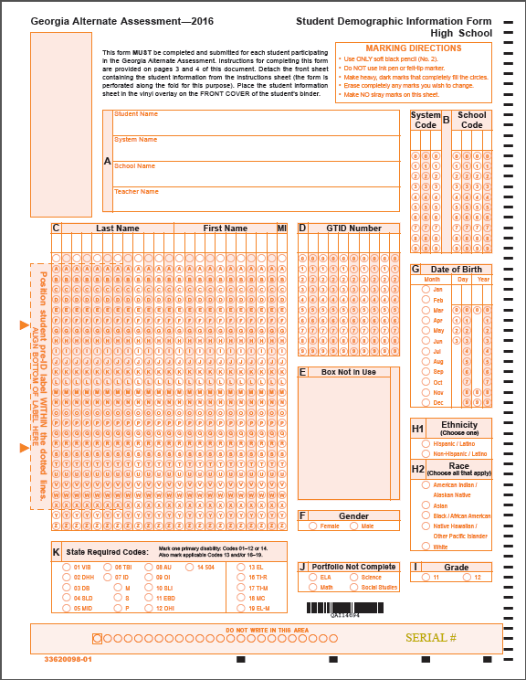
High School
SDIF for
High School
Affix the Pre-Id label to the front of the SDIF.
Pre-ID Label
Orange Form
63
Notes:
Complete all necessary fields on both sides as required on the SDIF instruction page.
Place the SDIF under the clear, vinyl overlay on the front of the student’s binder.
Do not 3-hole punch, and do not place it inside the binder.
Be certain that the SDIF form marked High School is only used for High School students.

Slide 64
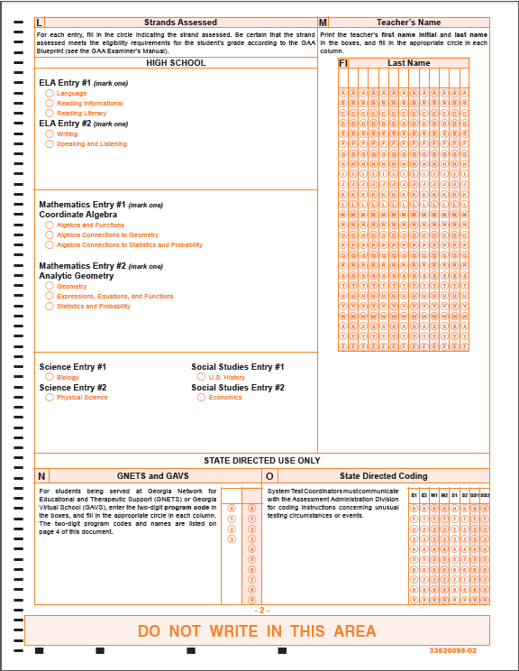
ELA GSE
Coordinate Algebra and Analytic Geometry
GPS
SDIF for
High School
Page 2
Notes:
High School students will be assessed on Coordinate Algebra and Analytic Geometry.

Slide 65
Organizing and Submitting the Portfolio

Slide 66
Organize the Portfolio
Review the evidence to ensure that you have used only grade-appropriate materials and that you have provided opportunities for generalization of skills in different settings and with different people.
Replace any evidence you have collected that does not clearly illustrate the student’s initial skill or progress on the tasks.
Date your evidence and affix the appropriate collection period labels (optional) to all evidence being submitted – Primary and Secondary.
There must be at least 14 calendar days between the Primary Evidence for Collection Period 1 and the Primary Evidence for Collection Period 2.
There must be two distinct collection periods; CP1 must be completed before CP2 begins.

Slide 67
Organize the Portfolio
Affix the Pre-ID Label to the Student Demographic Information Form (SDIF) in the correct location.
If a pre-ID label is not available for a student or if the information is not correct, complete all of the student demographic information according to the instructions.
Complete the Validation Form.
Make sure that it is signed by the test administrator and the building administrator.
Place it behind Divider One (Student Information).
Complete the Release to Use Portfolio for Training.
Place it behind Divider One (Student Information).
Notes:
We encourage parents to sign the Release to Use Portfolio for Training form; however, the portfolio will be scored without a parent’s signature.

Slide 68
Student Demographic Information Form
Affix the Pre-Id label to the front of the SDIF.
Complete all necessary fields on both sides as required on the SDIF instruction page.
Place the SDIF under the clear, vinyl overlay on the front of the student’s binder.
Do not 3-hole punch, and do not place the SDIF inside the binder.
Pre-ID Label

Slide 69
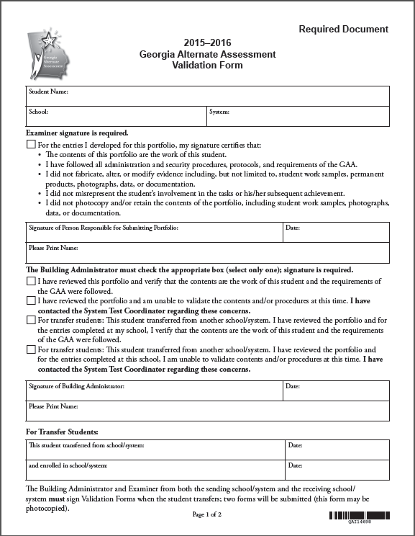
Divider 1 Student Information
Validation Form
Test Administrator Section
Building Administrator Section
Notes:
The Validation Form can be found in the front pocket of the portfolio binder. It is a useful tool to help you ensure that all requirements have been met before you submit the portfolio. After completing the form, place it in the binder behind Divider 1, Student Information. Be certain that signatures have been obtained from both the person submitting the portfolio and the building administrator. This is an important step - the signatures validate the contents of the portfolio and attest that all procedures have been followed and the work is that of the student for whom you are submitting the portfolio.
A signed Validation Form must be submitted or the portfolio cannot be scored.

Slide 70
Divider 1 Student Information
Release to Use Portfolio for Training
Required Signature
Required Signature
Notes:
The Release Form can be found in the front pocket of the portfolio binder. This release form is an important piece that allows portfolios containing photographic evidence to be used to train Georgia teachers. It is not required for scoring.

Slide 71
Divider 2 English Language Arts (Grades K, 3-8, HS)
Entry Sheet 1
English Language Arts
Entry Sheet 2
English Language Arts
Collection Period 1
Primary Evidence
Primary Evidence
Secondary Evidence
Secondary Evidence
Primary Evidence
Primary Evidence
Secondary Evidence
Secondary Evidence
Collection Period 1
Collection Period 2
Collection Period 2
Notes:
Two ELA entries must be submitted for all grades.

Slide 72
Divider 3 Mathematics (Grades K, 3-8, HS)
Collection Period 1
Entry Sheet 1
Mathematics
Entry Sheet 2
Mathematics
Primary Evidence
Primary Evidence
Secondary Evidence
Secondary Evidence
Primary Evidence
Primary Evidence
Secondary Evidence
Secondary Evidence
Collection Period 1
Collection Period 2
Collection Period 2
Notes:
Two mathematics entries must be submitted for all grades.

Slide 73
Divider 4 Science (Grades 3-8)
Entry Sheet
Science
Primary Evidence
Secondary Evidence
Primary Evidence
Secondary Evidence
Collection Period 1
Collection Period 2
Notes:
One Science entry is submitted for students in grades 3-8.

Slide 74
Divider 4 Science (High School)
Collection Period 1
Entry Sheet 1
Science
Entry Sheet 2
Science
Primary Evidence
Primary Evidence
Secondary Evidence
Secondary Evidence
Primary Evidence
Primary Evidence
Secondary Evidence
Secondary Evidence
Collection Period 1
Collection Period 2
Collection Period 2
Notes:
Two Science entries must be submitted for High School students.
Entry 1 is always BIOLOGY
Entry 2 is always PHYSICAL SCIENCE

Slide 75
Divider 5 Social Studies (Grades 3-8)
Entry Sheet
Social Studies
Primary Evidence
Secondary Evidence
Primary Evidence
Collection Period 1
Secondary Evidence
Collection Period 2
Notes:
One Science entry is submitted for students in grades 3-8.

Slide 76
Divider 5 Social Studies (High School)
Collection Period 1
Entry Sheet 1
Social Studies
Entry Sheet 2
Social Studies
Primary Evidence
Primary Evidence
Collection Period 1
Secondary Evidence
Secondary Evidence
Primary Evidence
Primary Evidence
Secondary Evidence
Secondary Evidence
Collection Period 2
Collection Period 2
Notes:
Two Social Studies entries must be submitted for High School students.
Entry 1 is always U.S. HISTORY
Entry 2 is always ECONOMICS

Slide 77
Submitting the Portfolio
Review each entry before submitting the portfolio
All 4 pieces of evidence align to the standard and element
Primary and Secondary Evidence for each collection period (4 pieces of evidence)
Documentation is clear and concise
Entry Sheets have been filled out correctly
SDIF has been completed correctly and placed under the clear vinyl overlay on the front of the binder
Validation Form and Release to Use Portfolio for Training have been signed and placed behind the Student Information tab
Notes:
14 calendar days from Primary to Primary; Type of evidence is the best choice to clearly demonstrate the student response; Grade-appropriate materials
Would someone else reading the documentation understand what the task was, its connection to the standard, and how well the student performed?

Slide 78
Submitting the Portfolio
Check with your School Test Coordinator for information about portfolio review procedures and schedules within your school/system.
Follow the protocol determined by your system for the Portfolio Review Process.
Submit the binder to your School Test Coordinator by the date specified by your school system.

Slide 79
Contact Information
Questions About Test Administration
Call: GaDOE Assessment Administration Division
Toll free (800) 634-4106
Contact: Deborah Houston, Assessment Specialist (404) 657-0251
Email: dhouston@doe.k12.ga.us

Slide 80
Contact Information
For information about access to the
state-mandated content standards for students with significant cognitive disabilities
Contact: Kayse Harshaw
Division for Special Education Services
Call: (404) 463-5281
E-Mail: sharshaw@doe.k12.ga.us
kharshaw@doe.k12.ga.us

Slide 81
Contact Information
Questions About Materials, Distribution, or Collection
Call: Questar’s GAA Customer Service Toll free (866) 997-0698
Email: Questar’s GAA Customer Service GA@QuestarAI.com

Slide 82
Questions & Answers
Please use the link below to submit any questions you may have related to Sessions 1 - 4.
2015 GAA Fall Training Questions and Answers for Sessions 1–4
Notes:
This is a link to Survey Monkey and will allow GAA affiliates to submit questions germane to the 2015 Fall Training Sessions. Questions will be answered in the final Fall Training Session. To gain access, please highlight the link, right click, and “Open hyperlink.”

