Slide 1
Introduction to the
Georgia Online Formative Assessment Resource (GOFAR) and TestPad
GA FIP Online Professional Learning
Fall 2018 Webinar
Joe Blessing
Kelli Harris-Wright

Slide 2
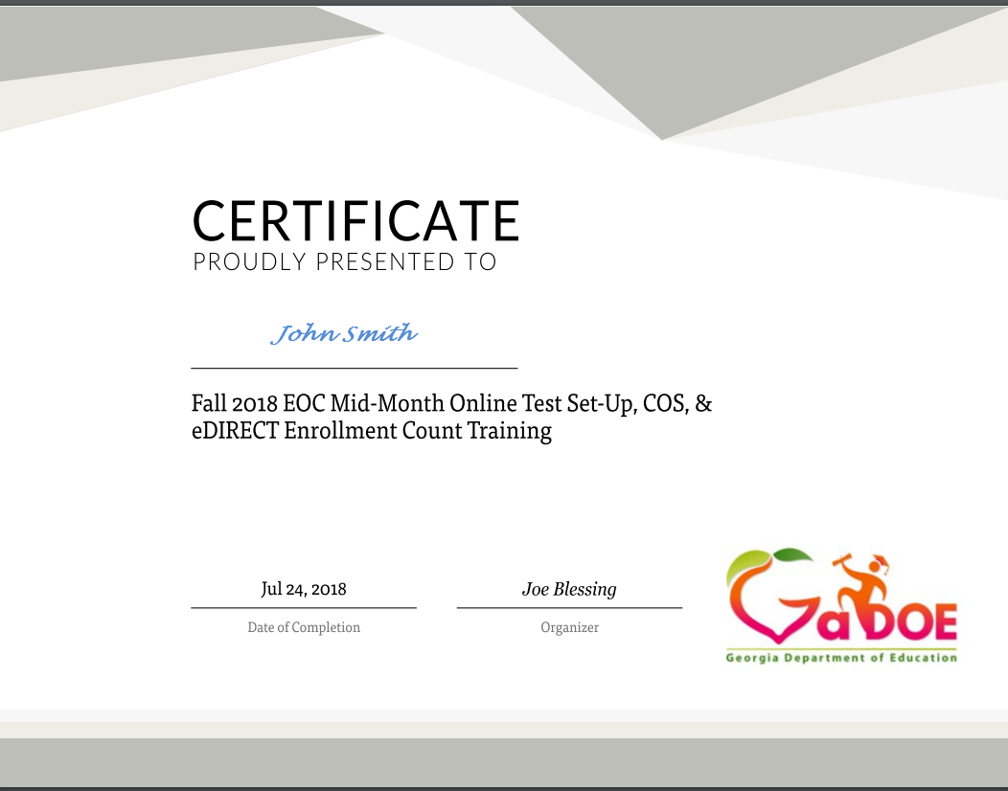
Webinar
All webinar recordings are available the day after the presentation. Click on the original registration link for any Assessment webinar to access the recording.
  August 14: https://attendee.gotowebinar.com/register/820543929001008130
  August 16: https://attendee.gotowebinar.com/register/2630997576273478658
PowerPoint can be found at: http://www.gadoe.org/Curriculum-Instruction-and-Assessment/Assessment/Pages/Georgia-Online-Formative-Assessment-Resource.aspx
Certificates are now sent from GoToWebinar after live training sessions. Those watching recordings will not receive a certificate.

Slide 3
GOFAR
The Georgia Online Formative Assessment Resource (GOFAR) provides the ability for Districts and Schools to assign benchmark and formative test items/tests to students in order to obtain information about student progress and instructional practice.
GOFAR allows educators, and their students, to have access to a variety of test items – selected response and constructed response – that are aligned to the State-adopted content standards for Georgia’s elementary, middle, and high schools.

Slide 4
GOFAR Highlights
Students, staff and classes are prepopulated and maintained through the State Longitudinal Data System (SLDS).
  In order for this to work, systems need to make sure their Student Class File is updated regularly.
Teachers and Administrators may view Exemplars and Rubrics in Item Preview.
A scoring code may be distributed at a local level to help score constructed response items.
TestPad will be coming this fall which will allow for users to create their own items and passages.

Slide 5
Formative Assessment Toolbox
An expansive bank of formative instructional assessment items/tasks in ELA and Mathematics as a teacher resource
A set of benchmark assessments in ELA and Math for grades 3 through HS
An assessment literacy professional learning opportunity that focuses on implementation of evidence-based formative instructional practices (FIP)
  http://www.gadoe.org/Curriculum-Instruction-and-Assessment/Assessment/Pages/GeorgiaFIP.aspx

Slide 6
Item Formats
Multiple Choice
Constructed-Response
  Extended Response
  Scaffolded
Constructed-response items require students to provide explanations/rationales, provide evidence, and/or to show work
Provide teachers with evidence of true student understanding of content and process

Slide 7
GOFAR State Developed Assessments
Formative Benchmarks (20 benchmarks with 2 parts each)
  ELA Grades 3-8, 9th Grade Lit, American Lit
  Mathematics Grades 3-8, Coordinate Algebra, Analytic Geometry

Slide 8
Example of Extended Response Item
ELA—Grades 9 – 10
9th/10th Grade ELA Standards RI.9.8; RI9.1; L9.1; L9.2; DOK 4
Passage Title: Juliette Gordon Lowe
Part A
Identify at least two arguments Juliette Gordon Low used as reasons to begin the Girl Scouts.
Part B
Evaluate whether or not these arguments are valid and whether there is enough evidence in the article to support them.
Be sure to complete ALL parts of the task. Use details from the text to support your answer. Answer with complete sentences, and use correct punctuation and grammar.

Slide 9
Example of Extended Response Item
Math—Advanced Algebra
Advanced Algebra, Standards A.REI.2; A.REI.4; A.APR.6, A.REI.1; DOK 3

Slide 10
Example of Rubric
Mathematics—Grade 5
Rubric
Score | Designation | Description
4 | Thoroughly Demonstrated | The student successfully completes all elements of the item by demonstrating knowledge and application of measuring volumes by counting unit cubes, using cubic cm, cubic in, cubic ft, and improvised units (5.MD.4), applying the formulas V = l × w × h and V = b × h for rectangular prisms to find volumes of right rectangular prisms with whole number edge lengths in the context of solving real world and mathematical problems (5.MD.5b), and adding, subtracting, multiplying, and dividing decimals to hundredths, using concrete models or drawings and strategies based on place value, properties of operations, and/or the relationship between addition and subtraction; relating the strategy to a written method and explain the reasoning used (5.NBT.7).
3 | Clearly Demonstrated | The student shows clear understanding of the standards listed above, but one of the explanations or work shown is insufficient or weak Or All parts of the item are correctly done except for a minor computational error Or The student successfully completes two of the three parts of the item and partially completes the other part.
2 | Basically Demonstrated | The student shows basic understanding of the standards listed above, but two of the explanations or work shown are insufficient or weak Or The student successfully completes one of the three parts of the item and partially completes the other parts.
1 | Minimally Demonstrated | The student shows minimal understanding of the standards listed above and completes only one of the three parts Or The student partially completes two of the three parts.
0 | Incorrect or irrelevant | The response is incorrect or irrelevant to the skill or concept being measured.

Slide 11
Exemplar Papers
Prototype answer – the “ideal” response
Set of responses from actual Georgia students, collected during item pilots
Samples scored by trained raters using rubric
Papers allow teachers to review and compare their own students’ work to the sample responses for each score point
  Helps standardize expectations of the standards
Score point and annotations provided for each sample item response
Note: The pilot was conducted using standard administration procedures in order to ensure that results were comparable across the state. When items/tasks are used during instruction, these administration rules do not have to apply and student results may vary; thus, teachers may want to modify the rubrics and even raise expectations. Rubrics and exemplars should remain focused on high expectations.

Slide 12
Exemplar Paper
Mathematics—Grade 5

Slide 13
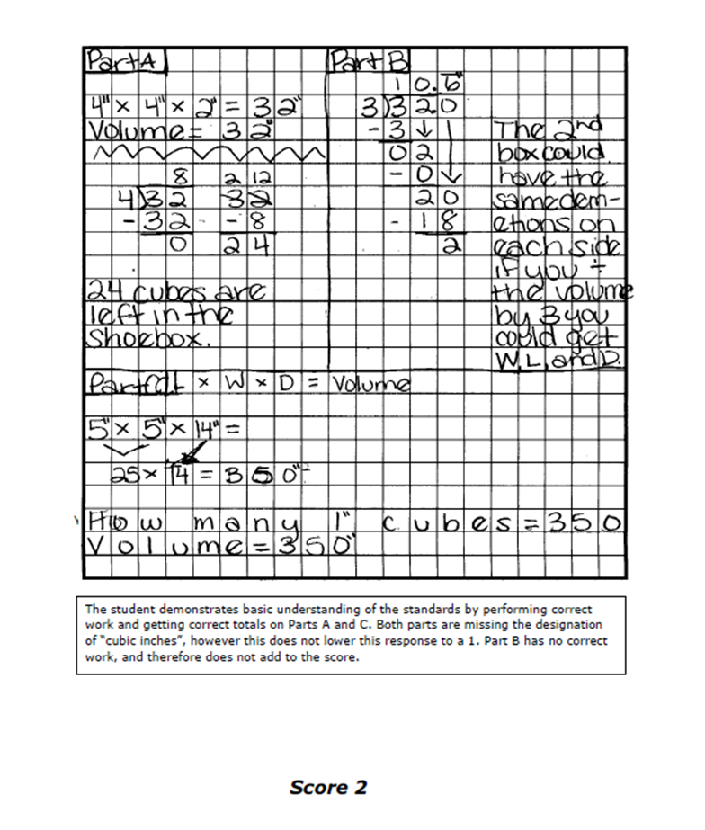
Student Anchor Papers
Student Response
Scorer’s Annotation
Score based upon rubric

Slide 14
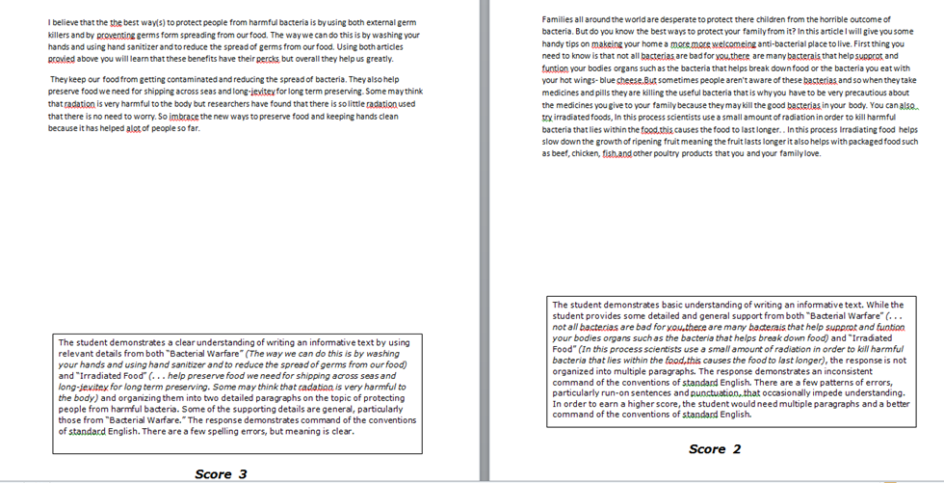
Student Anchor Papers

Slide 15
District, School and Teacher Functions

Slide 16

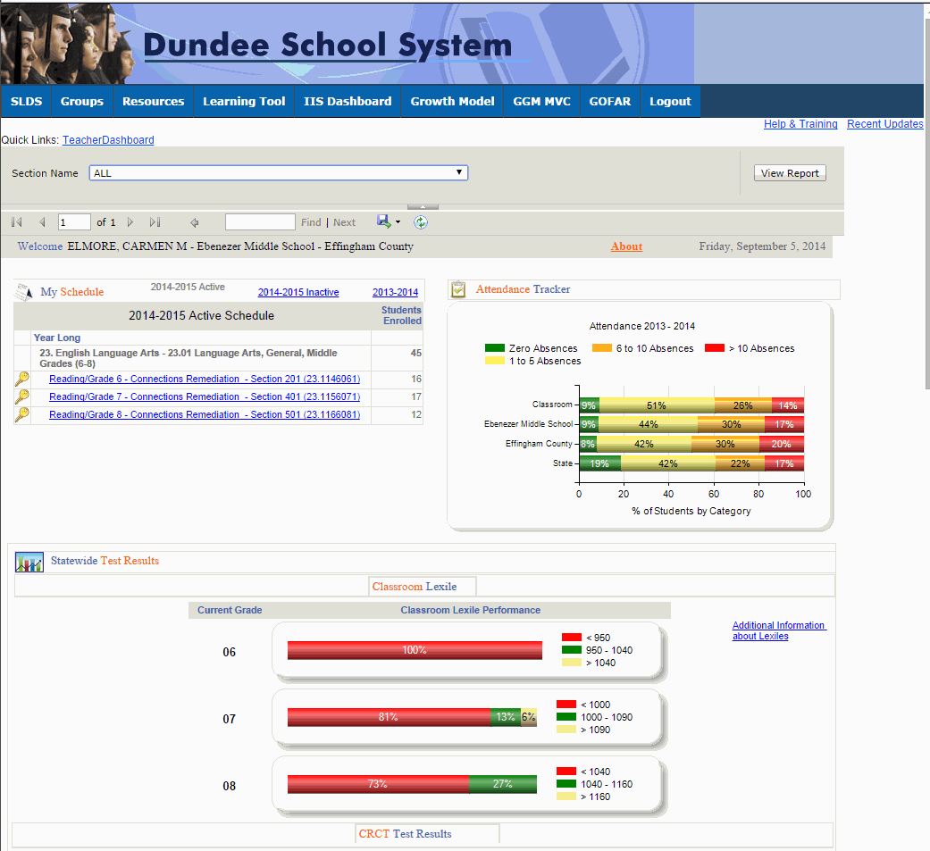


GOFAR Access for District,
School and Teacher
Log on to your Student Information System (SIS). Select the State Longitudinal Data System (SLDS) link. The SLDS main window opens. Click GOFAR on the menu. The GOFAR main window appears.
 | This is the default view for the Teachers dashboard. The Teacher may view a variety of reports related to the test assessments in this window.

Slide 17
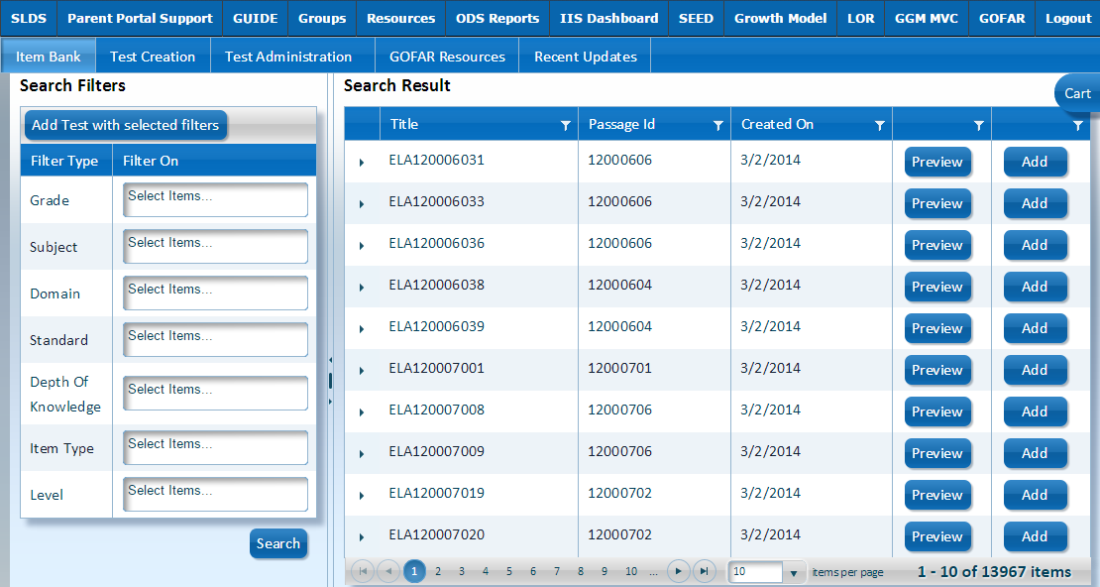
GOFAR Main Window
The Item Bank contains all the items available for a teacher to create a student test. The Item Bank tab is the default view when accessing the GOFAR system.
 | This is the landing page for teachers using the GOFAR system.

Slide 18
GOFAR Teacher Dashboard
The Teacher Dashboard enables the teacher to create, modify and assign tests to students, as well as perform administration tasks. The Teacher Dashboard is comprised of the following components:
Component | Description
Item Bank | Contains items that Teachers can select to add to a test.
Test Creation | Enables the Teacher to create, edit, clone, preview or delete a test.
Test Administration | Enables the Teacher to assign, manage, report, print and score a test.

Slide 19
Working in the Item Bank Tab

Slide 20
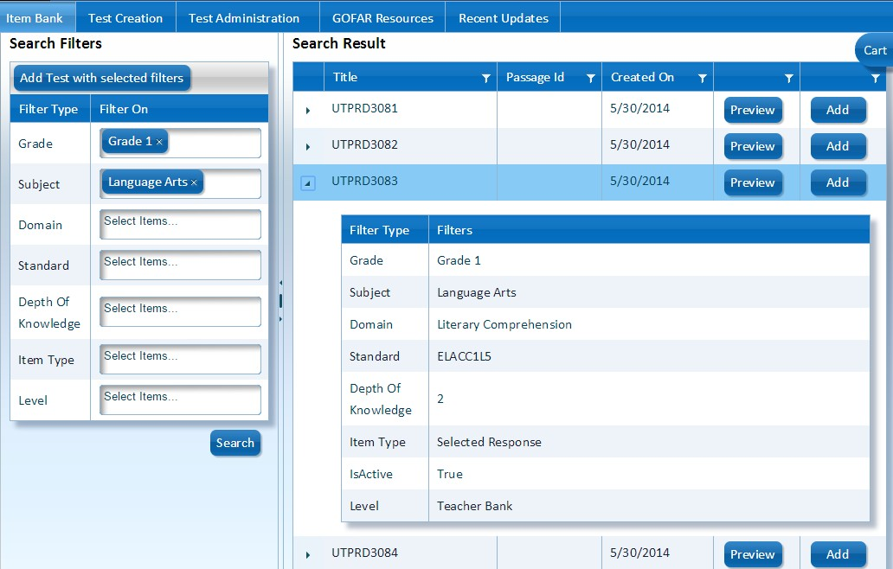
Viewing the Metadata in the Item Bank
Click the arrow next to the item title to expand and view the metadata for that item. Click the arrow again to collapse the filter information.
Click the arrow to expand or collapse the filter data for the test item.

Slide 21

Viewing a Test Item
Click Preview to view a test item. The test item appears in the Question Preview box.
Click Preview to view the test item.

Slide 22
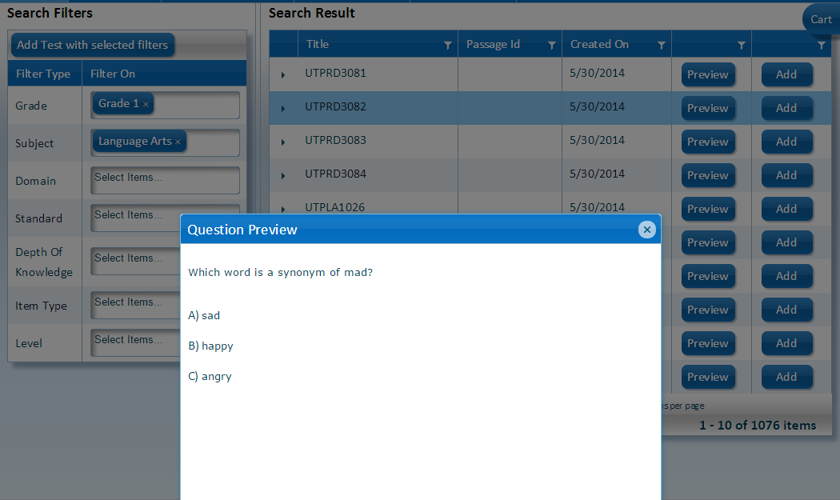
Preview a Selected Response Test Item
View the contents of Question Preview box to see the test item. Click the X to close the Question Preview box.
Click the X to close the Question Preview window.

Slide 23
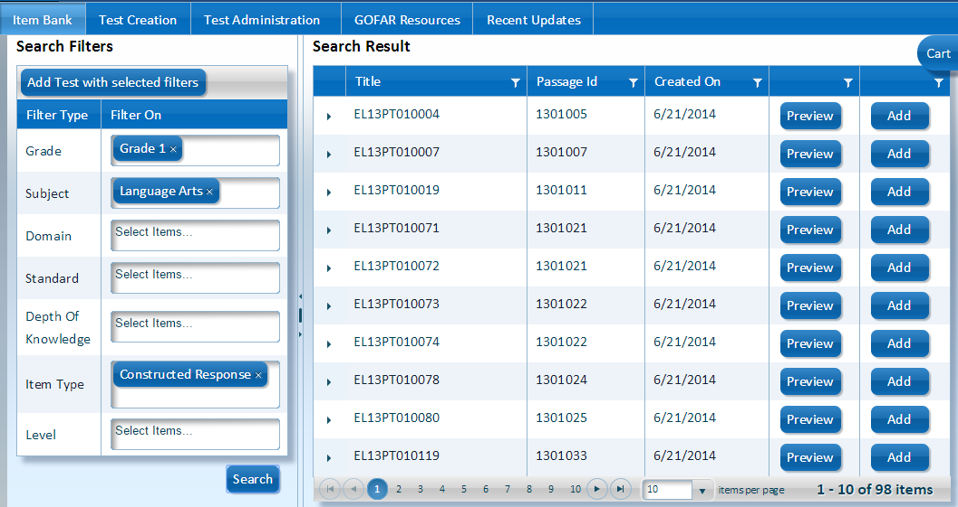
Preview a Constructed Response Test Item
From the Item Bank under Search Filters, select Constructed Response from the Item Style list. Click Search. Under the Search Result list, click Preview in the desired row.
Click Preview to view the Constructed Response item.

Slide 24
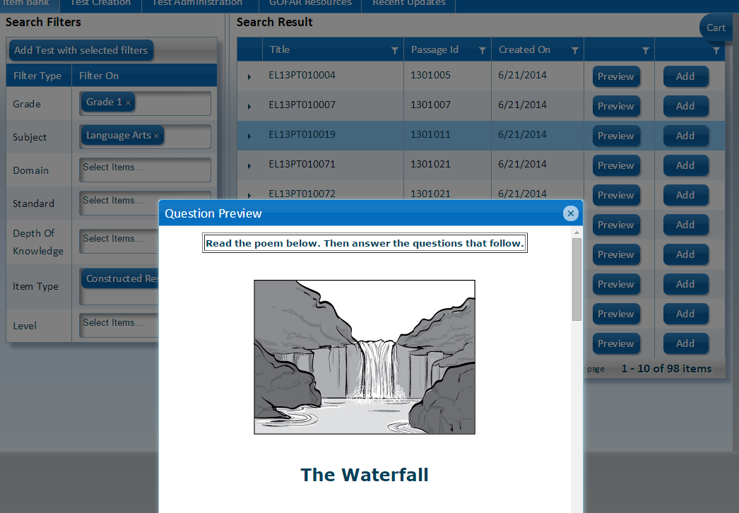
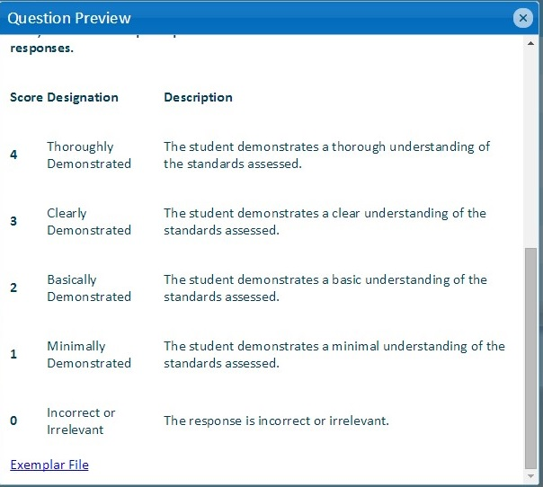
Preview a Constructed Response Item (cont’d)
The Constructed Response question is shown in the Question Preview box. | Scroll down to view the rubric. Click the X to close the Question Preview box.

Slide 25
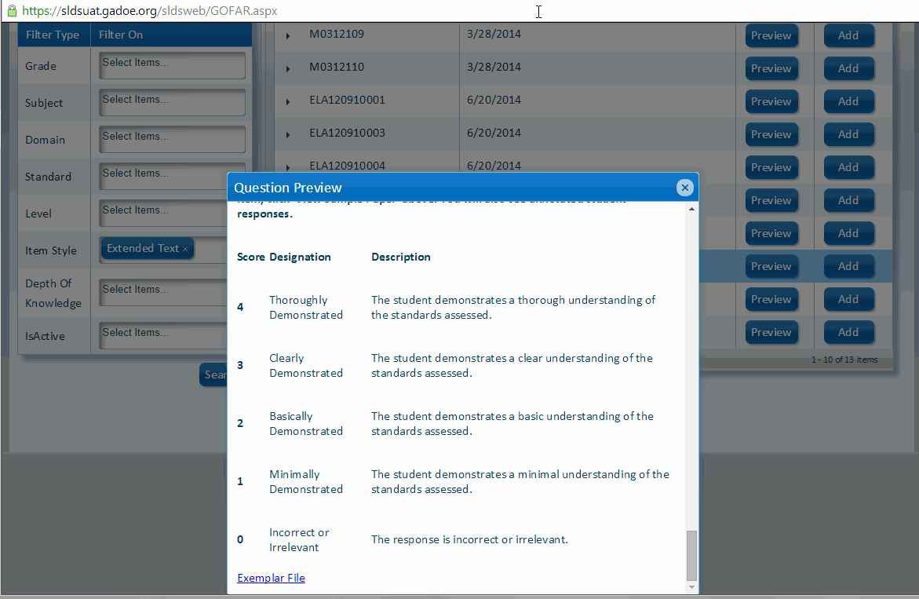
View Exemplar File
An Exemplar file contains a set of responses from actual Georgia students, that were scored by trained raters using the rubric posted. These papers allow teachers to review and compare their own students’ work to the sample responses for each score point which will help standardize expectations of the standards.
To view an Exemplar File, perform the following tasks. From the Item Bank window, under Search Filters, select the Constructed Response option from the Item Style. Click Search. Click Preview in any row of the Search Results list. The Question Preview window appears. Scroll down to the bottom of the question until you see a link for the Exemplar File. Click the Exemplar File link. A window opens with the Exemplar file.

Slide 26
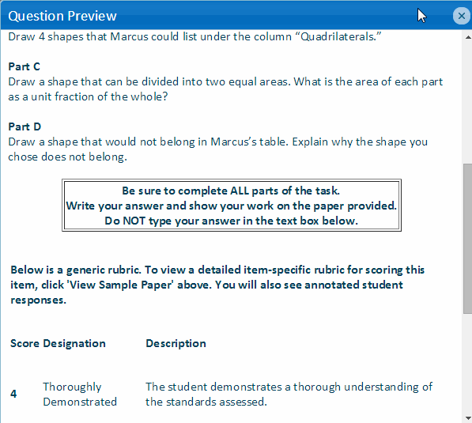

Math Question Preview Item
 | GOFAR will accept electronic input for math level items in the near future that require math symbols. However, at this time a message displays when viewing a math item stating that the student can work on the paper that has been provided to record their answer. The content of this message appearing in the box will be removed in the near future.

Slide 27
GOFAR Test Creation Options
GOFAR provides 3 options for Teachers to create assessment tests.
Option | Description
Create a Test using Filters | Enables you to create a test using filter options (i.e., grade, subject, domain, etc.).
Create a Test using the Cart | Enables you to add Items and create a test from the items in the cart.
Create a Test using the Test Creation Tab | Enables you to create a new test.

Slide 28
Create a Test using Filters

Slide 29
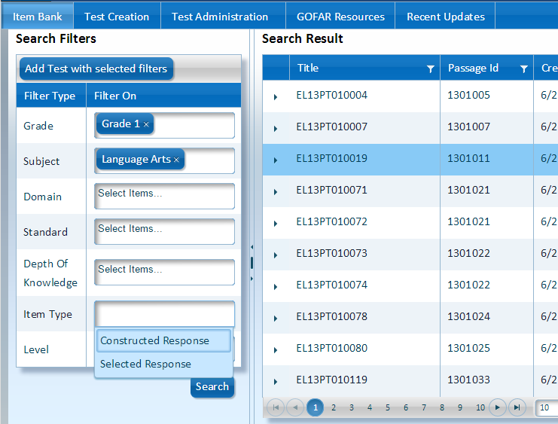
Using Filters to Create a Test
You can create a student test by selecting items from the question bank to add to the test. You may choose to use the search filter option to regulate the items that you select for the test along with the items that appear in the Search Result area.
Under Search Filters in the Filter Type row, select an option from the Filter On list. In the Item Style row select the Constructed Response or Selected Response option if you want to filter on the question style. Click Search after selecting the desired filter (s). The available test items appear in the Search Result area on the right side of the window.

Slide 30
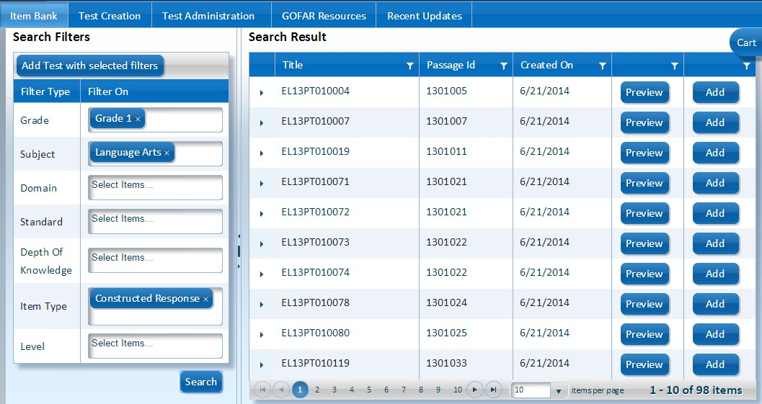
Creating a New Test using Filters
To create a new test using the filters, in the Filter On column select a filter option in the desired row. Click Add Test with selected filters. The Random Test Creation window appears. Items can also be added using the Add buttons

Slide 31
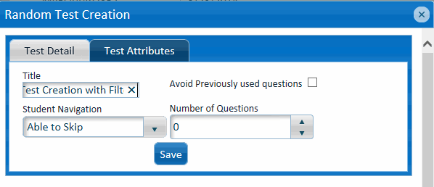
Test Creation –
Test Detail
In the Test Detail tab, under Title enter a name for the test. Select the desired option from the Student Navigation box. Under Number of Questions enter the number of questions or use the up / down arrows to select the desired number of questions to include. Select the Avoid Previously used questions option to avoid duplication of questions in the test. Click Save to save the test. The Random Test Creation window appears with additional test creation options.
 | Student Navigation options are:
 | No Skipping – Student must answer question before further navigation is allowed (previous / forward). Able to Skip – Student has the option to continue navigation in the test (previous / forward).

Slide 32
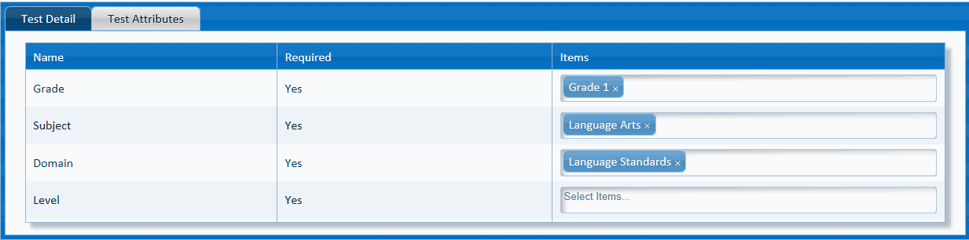
Test Creation –
Test Attributes
The Test Attributes tab contains the default values selected for the test. Select the Test Detail tab to save the test. The Random Test Creation window appears after the test is saved, providing additional test creation options.

Slide 33
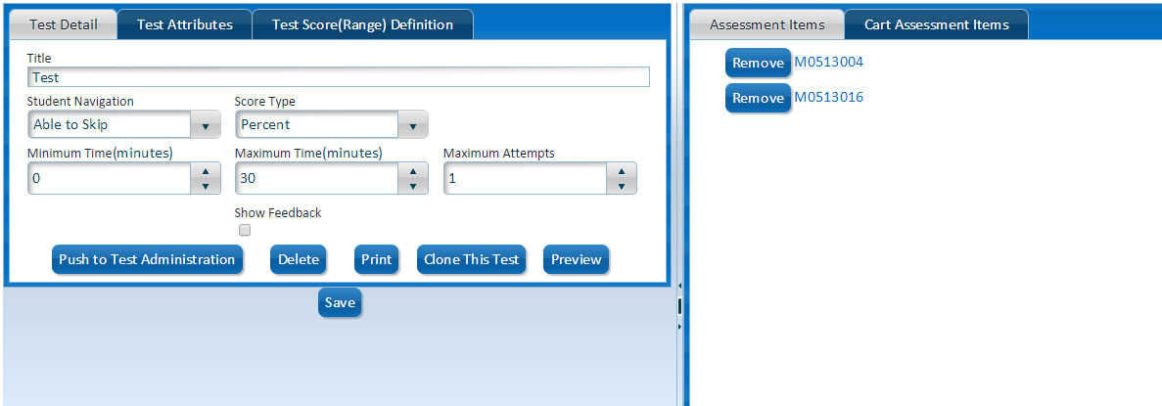
Test Creation Test Detail Tab Creation Options
Upon completion of creating and saving the details for the new test, you are provided with additional test creation options. See the next 2 slides for further details on working in the Test Detail tab.

Slide 34
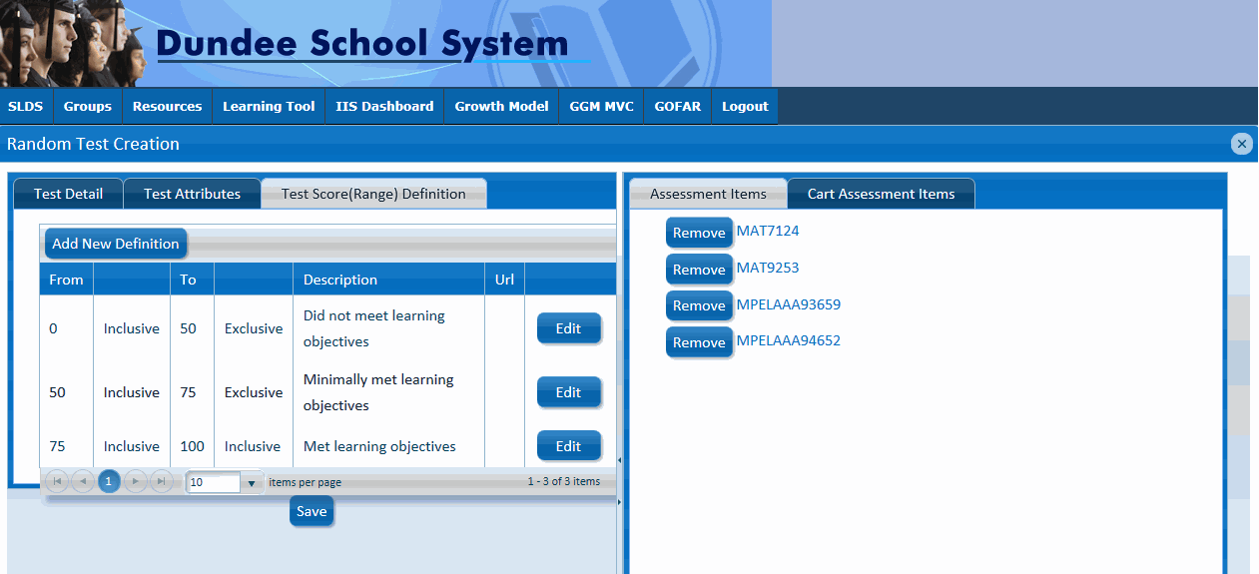
Test Creation Test Score (Range) Definition
The Test Score (Range) Definition tab provides the option to modify the student test score range objectives.
To modify the range definitions, click Edit. The Add / Edit Definition dialog box appears.

Slide 35
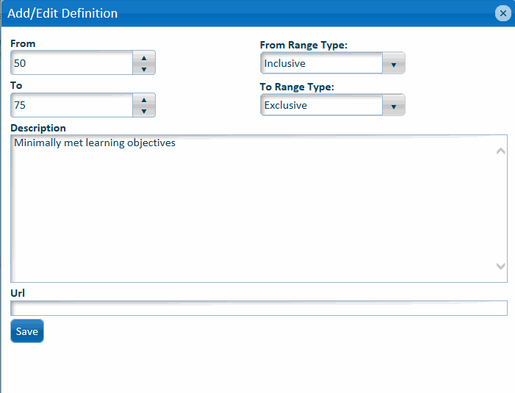
Test Creation Test Score (Range) Definition
In the Add / Edit Definition dialog box make the desired changes to the range definitions. Click Save in the Add / Edit Definition dialog box. Click Save in the Test Score (Range) Definition tab.

Slide 36
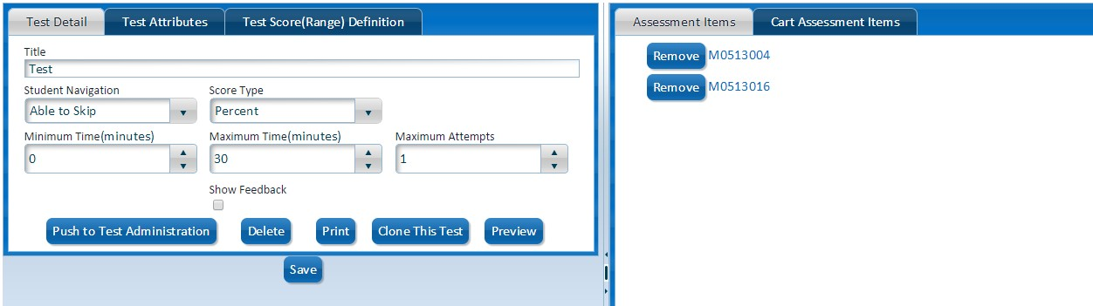
Test Creation - Assessment and Cart Assessment Items
The Assessment Items tab contain the selected test items for the student test. You can use the Cart Assessment Items tab to build the final student test.
The Assessment Items reflect the test items that you have selected for the student test. You can remove an item in the Assessment Items list.
The Cart Assessment Items tab enables you to add the test items to the student test.
To view the item click the item title.
To print a student test with or without a key or rubric, click “Print” in “Test Creation”.

Slide 37
Create a Test using the Cart

Slide 38
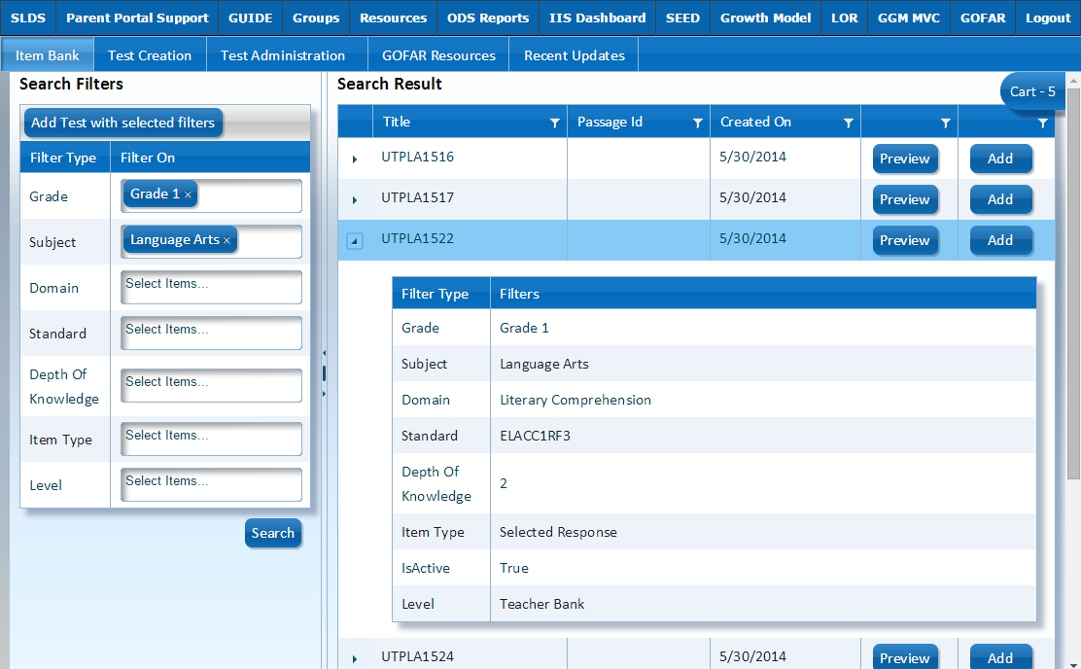
Creating a New Test using the Cart
Click Add to add the question to the cart.
The cart shows the number of question items in the cart.
To create a new test using the cart you must have items in the cart. Click Add in the row of the item to add an item to the cart. The cart reflects the number of items added. Click the Cart in the Search Result area. The Cart window appears.

Slide 39
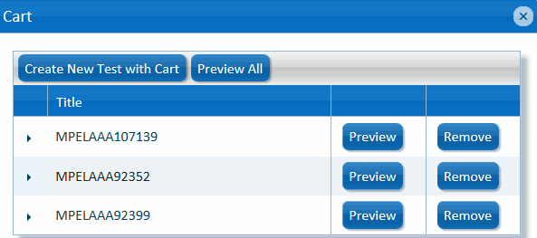
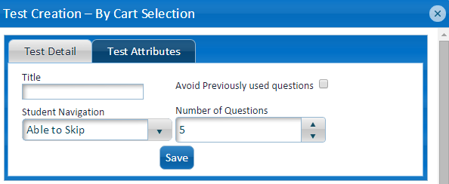
Working in the Cart Window
Click Create New Test with Cart. The Random Test Creation window appears. To view all the test questions, click Preview All. After you Create New Test, you can add a title and Test Details
 | The Preview button enables you to view a single test question. The Remove button enables you to delete a question from the test.

Slide 40
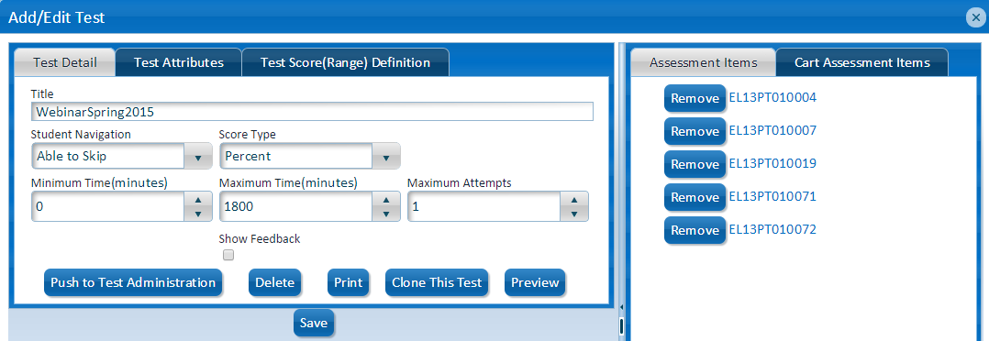
Preview the Test
To view or remove the assessment items in the Assessment Items tab perform the following tasks:
To view the assessment test click Preview. The student test appears.
Click Preview to view and navigate through the test.
To print a student test with or without a key, click “Print” in “Test Creation”.

Slide 41
Push to Test Administration
Before administering a test, you will first need to Push to Test Administration.
When all test attributes are finalized, click Push to Test Administration. Note, the test will not be available to students yet. Next you will need to go to Test Administration to Administer the test.
When the test is complete, Push to Test Administration

Slide 42
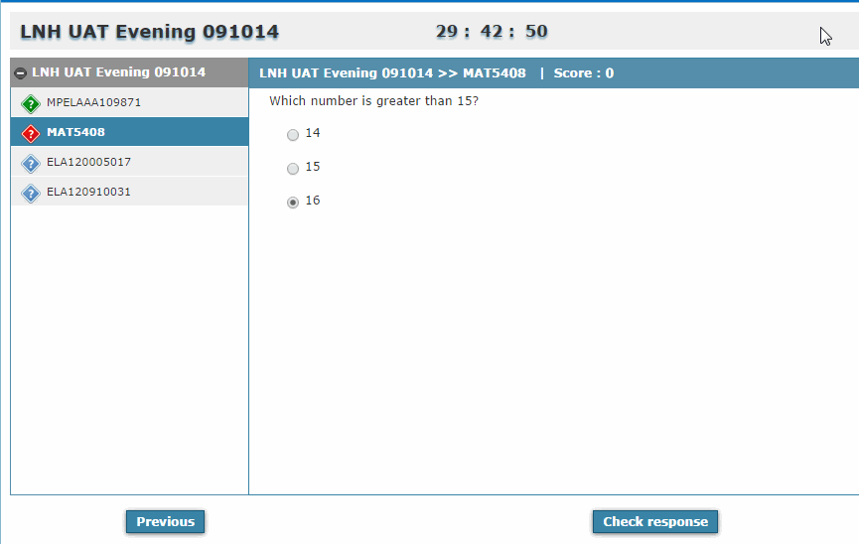

Navigating through the Test
You can view and navigate through the test to understand the student’s experience. Click Previous to navigate to the previous item in the test. Click Next to navigate to the next item in the test. Please note that the answer is captured. Click Check response to activate the response validation indicator in the left navigation of the window. Please note that the answer is captured. Click Finish Test when complete or to view the test assessment results. A confirmation message appears.
 | Item Response Indicator Legend Blue – indicates the question has not been answered. Red – indicates question is active or has not been answered. Green – indicates question answered (correct or incorrect response). Orange – indicates that the Next button was selected after answer selection.

Slide 43
Test Administration

Slide 44
About Test Administration
The Test Administration tab provides the teacher with the following options:
Option | Description
Test Assignment | Enables the teacher to view tests and assign them to students, identify test information such as start and end date, test day and time, as well as view student information, such as course sections, GTID, and test status. The teacher also has the ability to remove a student from an assigned test.
Test Management | Enables the teacher to manage, score, report and print existing tests.
Test Scoring | The teacher can grade student tests as well as support the District in grading student test.

Slide 45
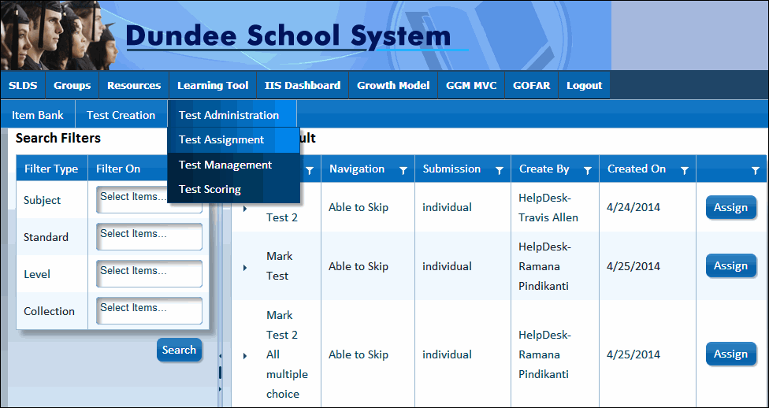
Assigning a Test to Students
From the Test Administration menu, click Test Assignment. To select a filter for the test, select an item from the Subject, Standard, Level or Collection rows to filter on. Click Search. The search results appear in the Search Result area on the right. Click Assign next to the desired test to view the Test Information, Student Information and the course sections.

Slide 46
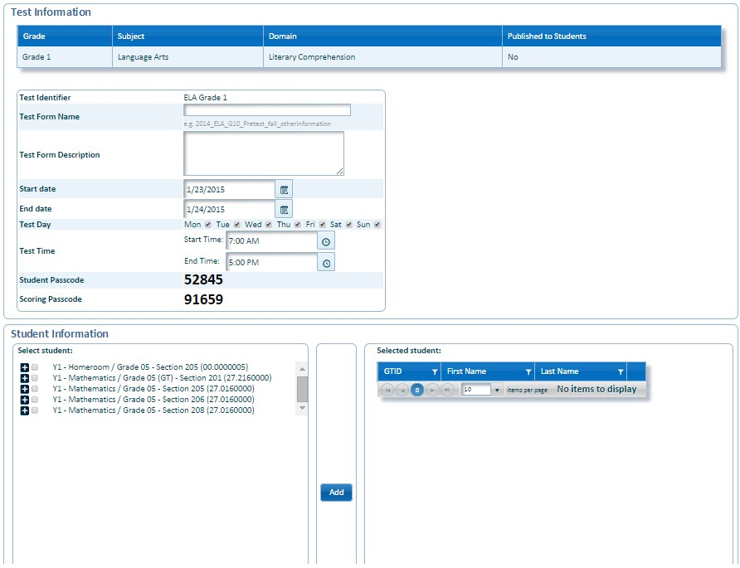
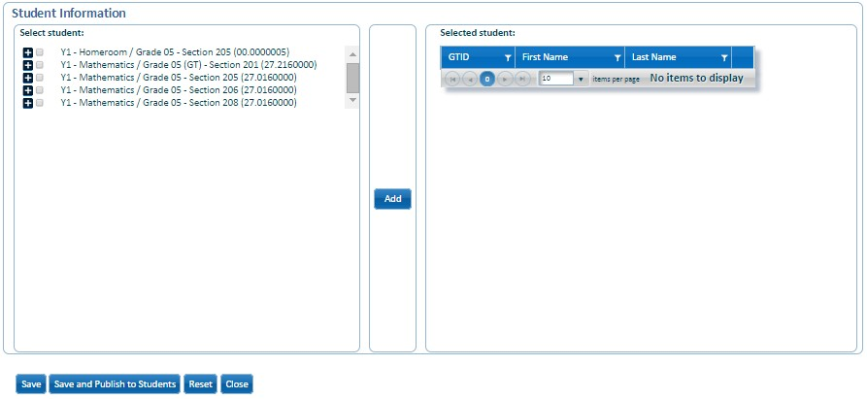
Assigning a Test to Students (cont’d)
Under Test Information, enter a name in the Test Form Name. Select the box in the Published? row to ensure that the test is available to the student. Select a start and end date in the Start Date and End Date fields. In Test Day select the appropriate days for the test.
 | GOFAR generates a 5-digit passcode for the student. The teacher provides this number to the student for teacher assigned assessment tests.

Slide 47
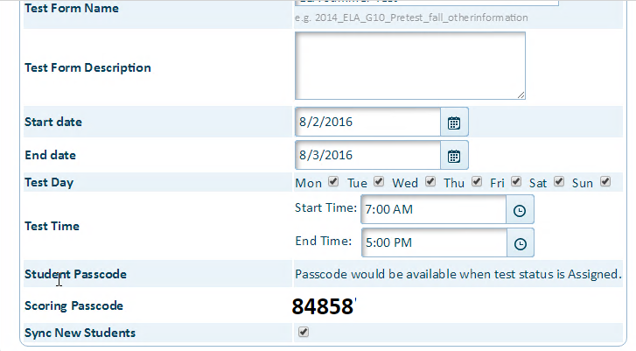
Assigning a Test to Students (cont’d)
Passcodes will be shown after test is assigned. This will keep students from attempting to start a test before the assignment is complete. Test examiner should check for the Student Passcode in Test Management. Go to the Test Administration drop down and click on Test Management. Find the correct test and click Manage. New: Students will automatically be synced at all levels.

Slide 48
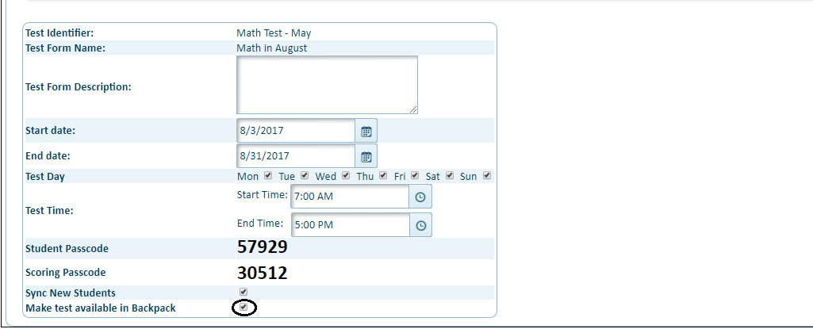
Assigning a Test to Students (cont’d)
Under Student Information, click the + (plus) sign to expand the list and view the available students. Select the desired student or select multiple students for the test. Click Add. The selected student (s) is populated in the Selected student area with their Georgia Test Identifier (GTID), First Name, and Last Name.
Student will access GOFAR under the Testing page in Backpack

Slide 49
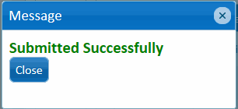
Assigning a Test to Students (cont’d)
Click Save. A Submitted Successfully message appears. Click Close. The Test Management tab appears.
Please allow 10 minutes for the test to become active in GOFAR prior to students testing.

Slide 50
Create a Test using TestPad

Slide 51
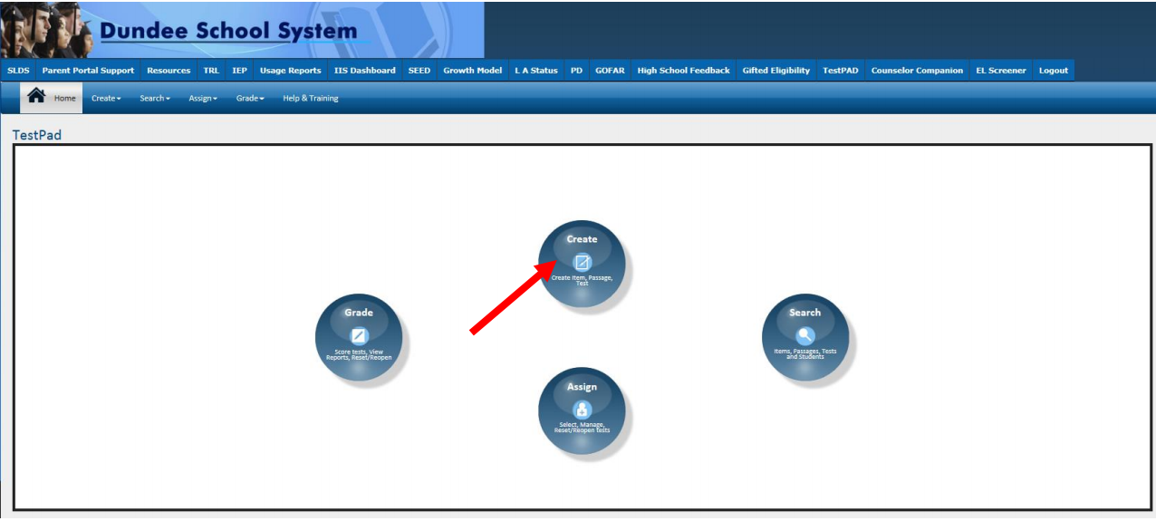
Landing Page

Slide 52
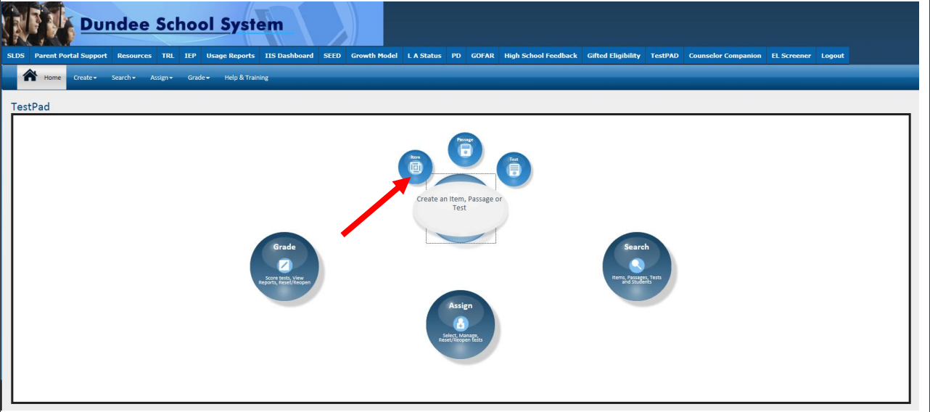
Create an Item

Slide 53
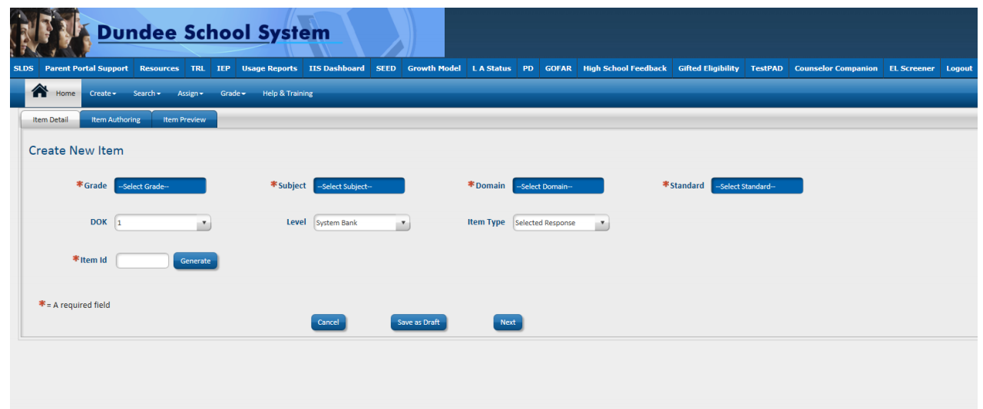
Item Detail Screen

Slide 54
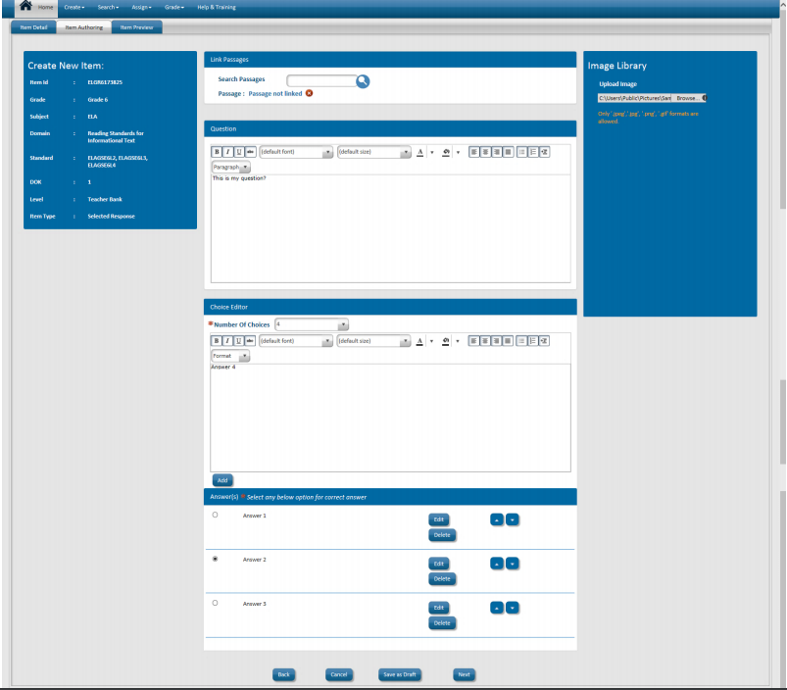
Item Authoring Screen

Slide 55
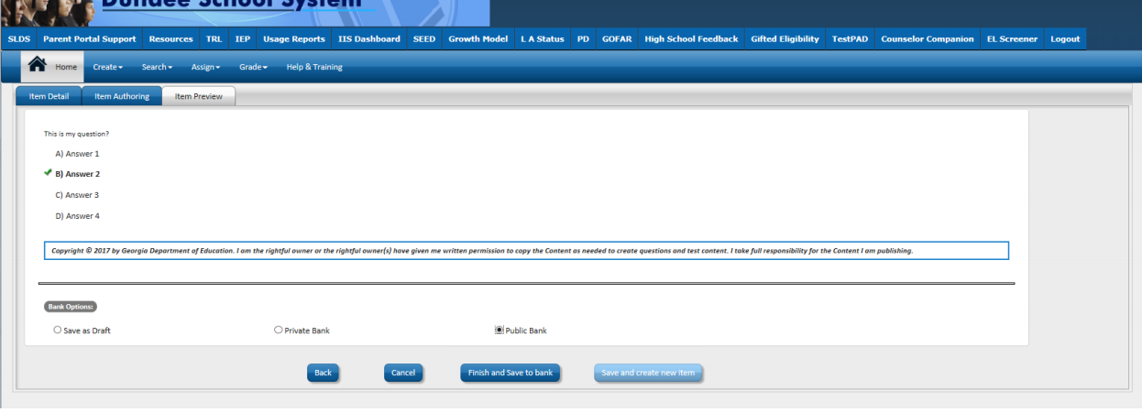
Item Preview Screen

Slide 56
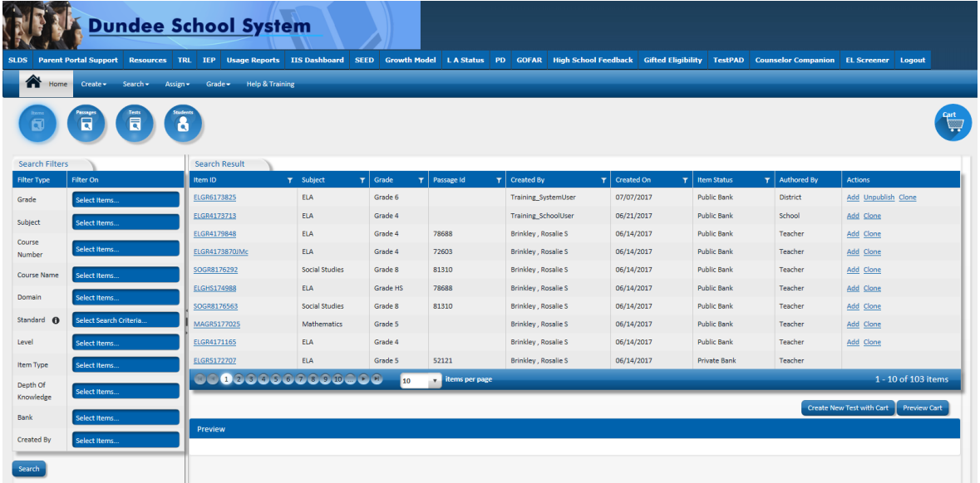
Item Bank

Slide 57
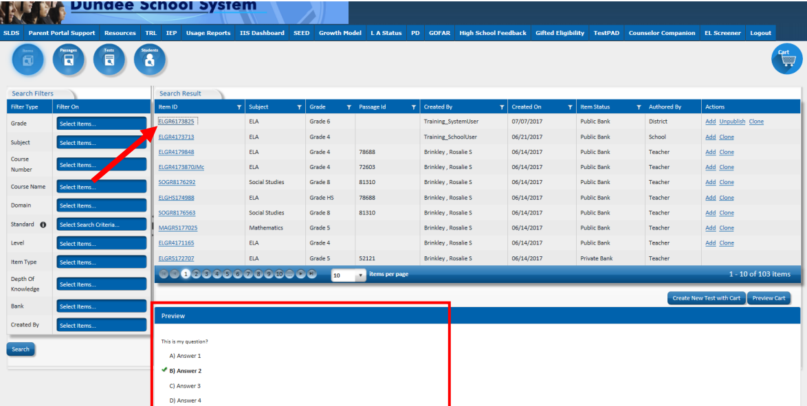
Preview Item

Slide 58
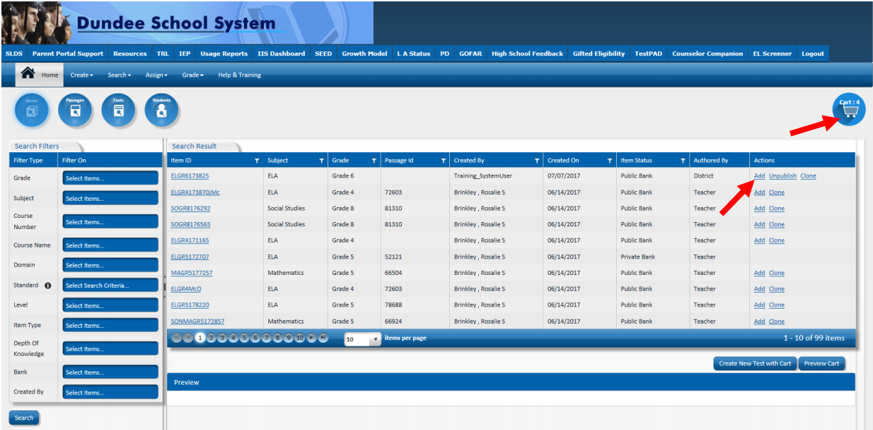
Add Items to Test

Slide 59
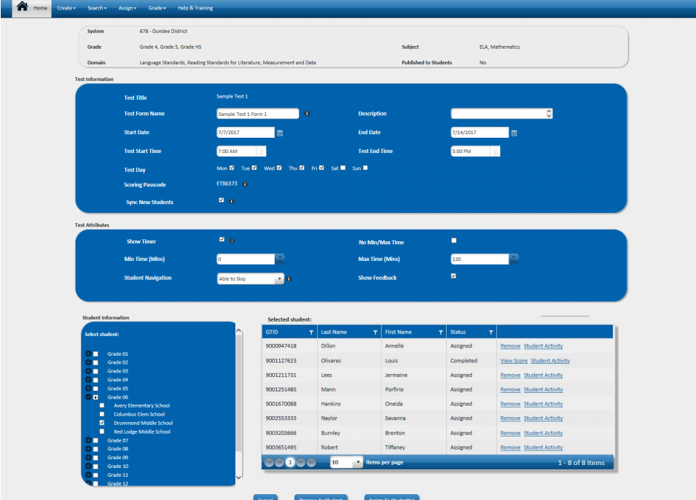
Assign Test

Slide 60
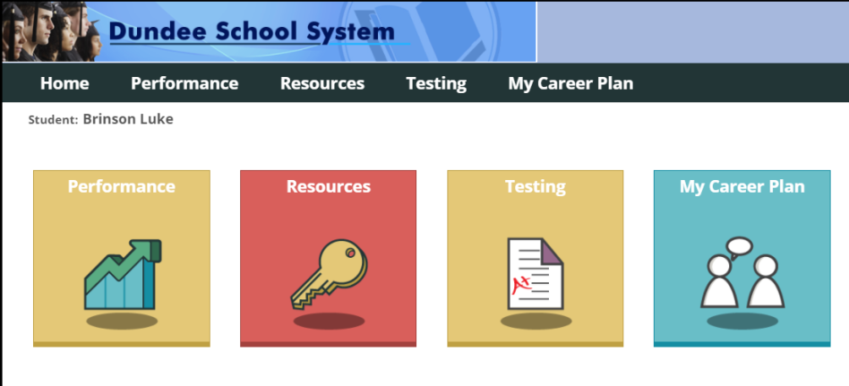
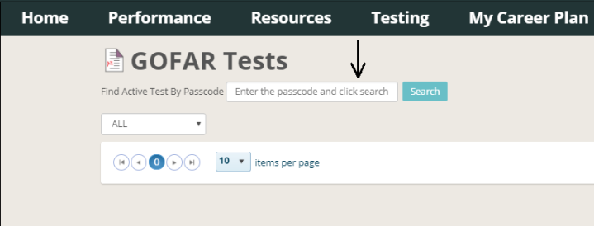
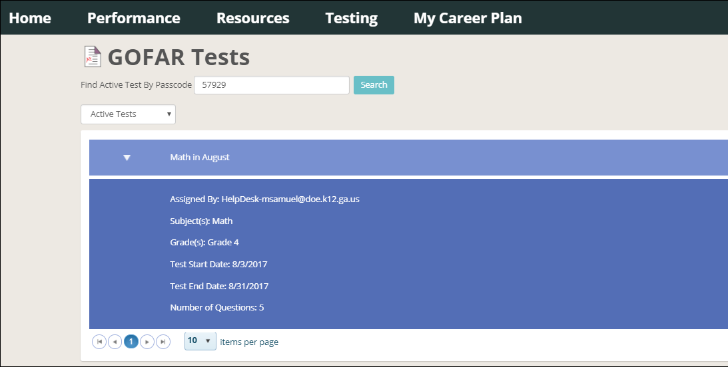
GFOAR Tests in Backpack
Student viewing Backpack will access Gofar tests under the Testing page
Use Student passcode that the teacher provides to view an Active test
Click on Take Test button to begin test.

Slide 61
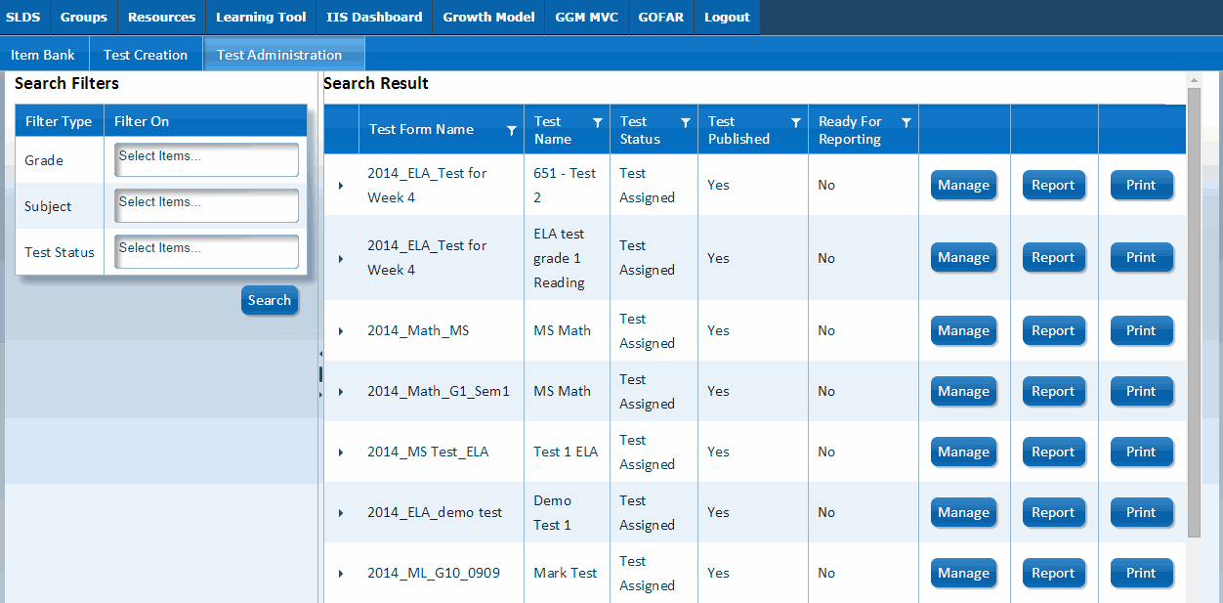
Manage Assigned Tests
From the Test Administration tab select the Test Management option. Click Manage in the row where you would like to view the student assessment test status. The Test Management window appears with the test information for the selected course.

Slide 62
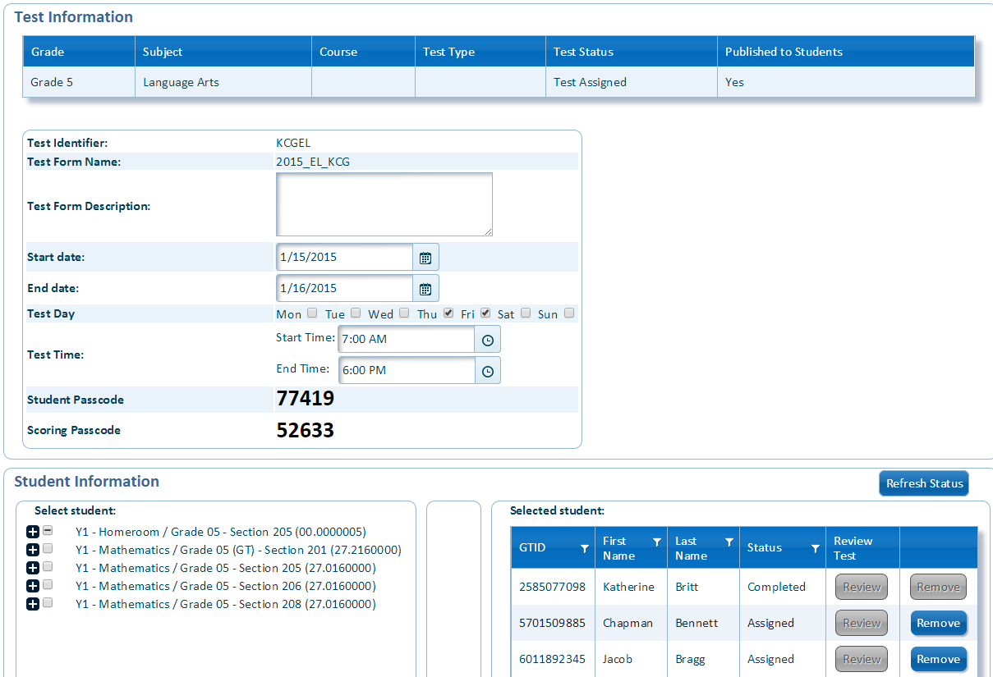
Manage Assigned Tests (cont’d)
The Student Information section of the Test Management window provides an assessment status for the student(s). For assigned tests that have not yet been taken you can choose to delete (Remove) the test from the student assignment list. Click Save to save any changes that were made. You also have the option to Close the window or Print the information.

Slide 63
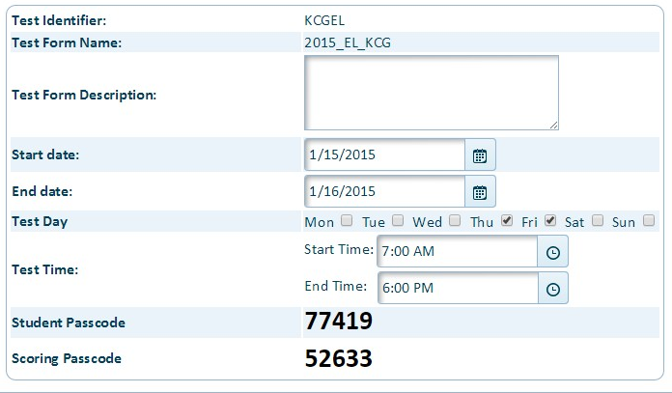
Test Scoring
District level assessment tests are assigned to hundreds of students. With such a large number of tests to manage, it becomes difficult for the District resource to score all the assessment tests.
District Admin View The Districts have access to 2 passcodes: Passcode for this test - Student passcode that is used to log in and take the test Scoring Passcode - The teacher shared passcode is provided to the teacher to assist the District in scoring the assessment tests, after the student has taken the test.
The passcode will show after the test is scheduled. The passcode is presented in Test Management.

Slide 64
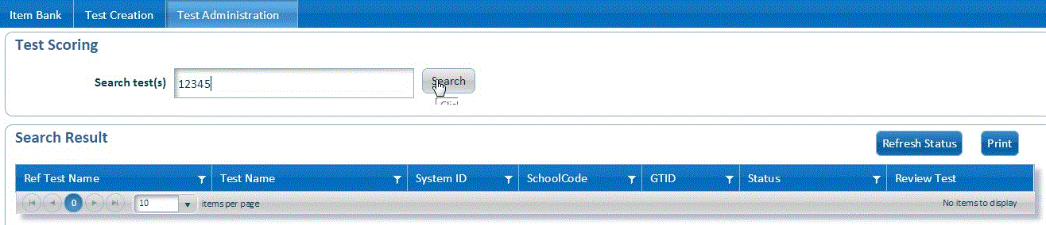
Test Scoring (cont’d)
When a teacher provides support to the District in scoring the student test, they are provided a scoring passcode. Enter the scoring passcode in the Search test (s) field and click Search to retrieve the student test.

Slide 65
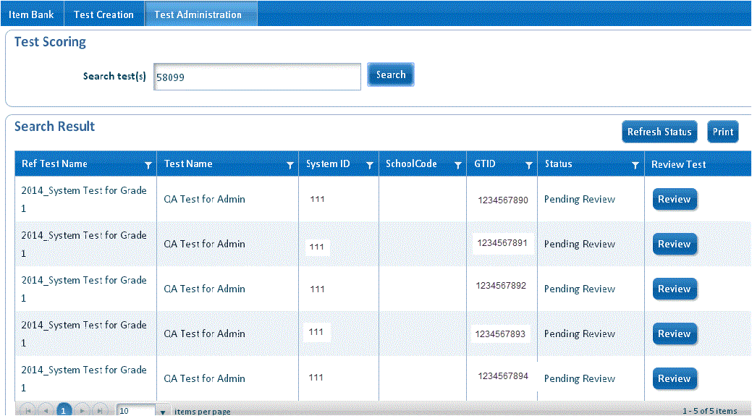
Test Scoring (cont’d)
The teacher clicks review to grade the test for each student.
The Status will change to complete after the teacher reviews the test.

Slide 66
Scoring Constructed Response Tests
The Constructed Response tests contain questions that require additional responses from the student. The Teacher can score these tests in GOFAR when the student has completed the assessment test.
To score a Constructed Response test, perform the following tasks. From the Test Administration tab, click Test Management. In Search Filters, select the desired filters and click Search. In the Search Result area locate the test you want to score. Click Manage to view the test information. The Test Management window with the Test Information appears.

Slide 67
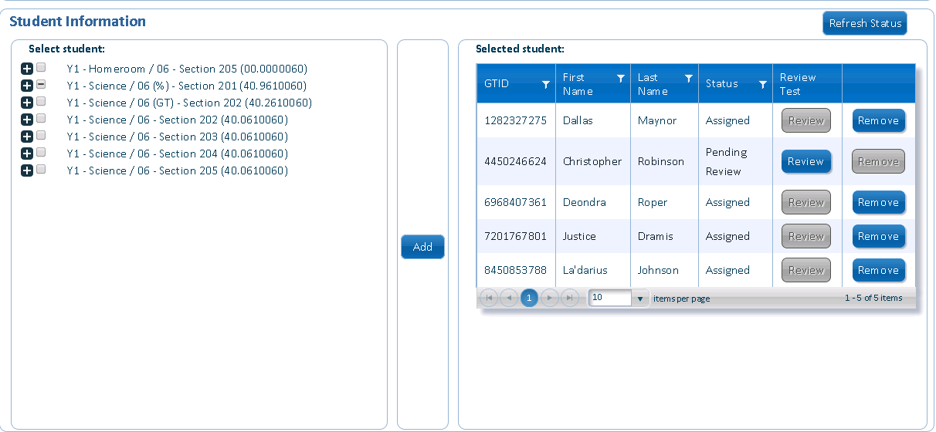

Scoring Constructed Response Tests (cont’d)
Under Selected student click the Review button. The Review window appears. The status must equal Completed. See the table below for Status field definitions.
Status | Description
Pending Registration | Test has not been assigned to a student / group.
Assigned | Test assigned by a teacher to a group of students.
Registered | Student logs in to take the test.
Pending review | Student submits test with constructed response items for review by a teacher.
Completed | Student completes a constructed response item. Teacher completes grading an constructed response item.
Users will be able to View Score after completing scoring.

Slide 68
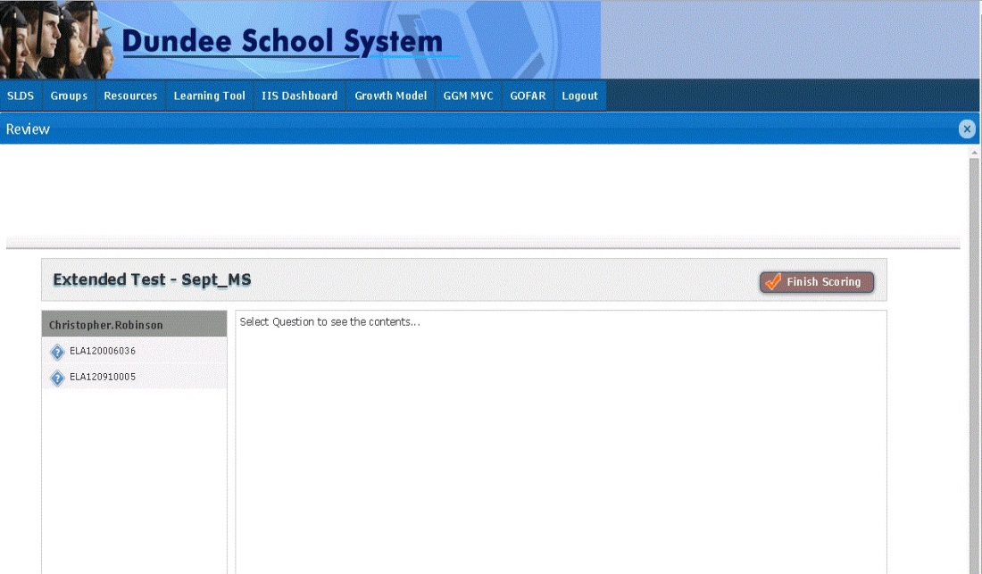
Scoring Constructed Response Tests (cont’d)
Select an constructed response question to view the student’s responses. The question contents appears in the window.
 | The teacher can grade the constructed response item when the status equals Completed and the Review button is active.
Select a constructed response question.

Slide 69

Scoring Constructed Response Tests (cont’d)
Scroll down to view the rubric. Select the appropriate response in the rubric based on the student response to the question. To see student samples, click the Exemplar File link. Click Submit.

Slide 70
District Level Administration

Slide 71
District Administration
Your GOFAR/SLDS district contact gives rights to district level access.
Creating a test works the same for district users.
District level users can assign to entire grade levels at schools.
District level users can either create their own assessments or assign state created assessments.

Slide 72

District Administration contd.
When you assign at a district level, you assign to an entire school by grade level.

Slide 73
District Administration contd.
Teachers do not manage district level tests.
The district user should distribute the Student Passcode to teachers who will administer the test.
Distribute the scoring Passcode if there are constructed response items.

Slide 74
Assessment Proficiency Reports

Slide 75
Assessment Proficiency Reports
GOFAR provides assessment reports that provide key metrics data for the teacher on the skill level of the students. The reports are accessed from the Teacher Dashboard in SLDS via the Test Management option in GOFAR. The student proficiency reports provide assessment data based on the following categories:
  Test Name
  Test Domain
  Standard
  Item

Slide 76

Assessment Proficiency Reports (District View)
To view reports, return to the SLDS. Choose the Operational Dashboard and click on GOFAR Assessment

Slide 77


Assessment Proficiency Reports (Teacher View)
To view reports, return to the SLDS. Choose Georgia Online Formative Assessment Resource in Other Features

Slide 78
Assessment Proficiency Reports (cont’d)
The proficiency reports provide multiple levels of reporting.
Student Assessment metrics include:
  % Correct – Represents the % of students with the correct response in a test group.
  % Of Correct Response – A graphical representation of the % of students with the correct response in a test group.
  Proficient
  Not Proficient
Assessment Reporting | Provides overall assessment metrics for the test name, domain, standard and the item levels.
Student Reporting | Provides assessment metrics for individual students parallel to the assessment category (e.g. test name, domain, standard and item).

Slide 79


Assessment Proficiency Reports (cont’d)
Report Navigation for the Assessment Proficiency Reports
Category View | Graphical View
Shown on the left side of the Assessment Proficiency Report | Bar graph indicating percent correct and percent incorrect per category.
Click the category link to drill down to the next category and view assessment proficiency report results. | Click the bar graph to drill down to the next category and view student proficiency report metrics.
Domain category link.
Click bar graph to view student assessment metrics.

Slide 80

Understanding the Information in the Assessment Proficiency Reports
Click the arrow to navigate through the report levels .
Click the link for the test name to view Domain information.
Click a bar graph to view a student metrics report for the assessment category.

Slide 81


Viewing the Student Proficiency Reports
The Student Proficiency Report shown below provides % Proficient assessment metrics by student. | The Student Proficiency Report shown below provides % Not Proficient assessment metrics by student.
 | The bar graphs shown in the Test view are represented in detail by student in the Student Proficiency reports below.

Slide 82
View Assessment Proficiency Report by Domain
Click a test name in the list to view the assessment metrics by Domain. You can view the % Correct and the % of Correct Response for the selected Domain. Click the bar graph to view assessment metrics by student.
% Correct and % Of Correct Response metrics.
View assessment metrics by student.

Slide 83

View Student Proficiency Report by Domain
The Student Proficiency reports are available when a bar graph is selected from one of the Assessment categories. It provides proficiency metrics for each student that has taken the test.
Provides student names for the assessment category.
Click the domain to view student metrics by item for this assessment category.

Slide 84
Student Functions

Slide 85
GOFAR Student Dashboard
GOFAR enables students in Georgia's public schools to access teacher, district or state created tests.
After taking an assessment, students can view reports aligned to the state curriculum that show instructional strengths and needs.

Slide 86

Student Access to GOFAR
Enter the student URL in the address bar. The GOFAR main window appears. Teacher or district Assigned Test For Teacher assigned tests, enter your Georgia Test Identifier (GTID) in the box for teacher assigned tests. Enter the Test Pass Code. Click Submit. The filter selection window appears.
https://gofar.gadoe.org/GOFARWeb/

Slide 87

Teacher Assigns Test to a Student
The teacher may assign an assessment test to a student as required.
The student will be notified by the teacher that they have been assigned an assessment test to complete and they are provided a test passcode.
Enter the student URL in the address bar. The GOFAR student dashboard main window appears. Enter your Georgia Test Identifier (GTID) in the box for teacher assigned tests. Enter the Test Pass Code. Click Submit. The filter selection window appears.

Slide 88

Student Takes Teacher Assigned Assessment Test
Click Take Test. The test appears.

Slide 89

Student Assigned Test Results
Navigate through the test until complete. Click Finish Test when complete. A Confirmation Required message appears. Click Confirm to complete the test. The Assessment Result message appears. Click OK. A message indicating that the student successfully completed the assessment appears. Close the message window when complete. The student is logged out of GOFAR.

Slide 90

Taking an Assigned Constructed Response Test
When the student takes a Constructed Response test, a message is shown indicating that the teacher must verify some of the assessment items. Click OK. Click Finish Test when complete. A Confirmation Required message appears.
 | The student must complete the test by clicking Finish Test. Test continuation is not available after closing the window or clicking Finish Test.

Slide 91
Redelivery Resources
GOFAR User Guide
GOFAR District Quick Start Guide
GOFAR Student Quick Start Guide
GOFAR Teacher Quick Start Guide
GOFAR Test Creation Quick Start Guide
GOFAR Assessment Proficiency Reports Quick Start Guide
GOFAR Teacher Assessment Proficiency Reports Quick Start Guide
GOFAR Foundations of Algebra Quick Start Guide
GOFAR District Test Assignment Quick Start Guide
Create and Administer a Test (Tutorial)
System Administration (Tutorial)
Overview of GOFAR Fall 2018
Overview of GOFAR Fall 2018 (webinar recording)

Slide 92
Let’s Talk about GA FIP
Blended Model of Professional Learning
Kelli Harris-Wright, Ed.S.
GaDOE Assessment Specialist for GA FIP
kharris-wright@doe.k12.ga.us
August 14th and 16th, 2018

Slide 93
Today’s Topics
GA FIP Online Learning
Define GA FIP Online Professional Learning as Evidence-Based Practice
Share the available course content in GA FIP
Communicate how to access the original GA FIP online learning modules and resources in the SLDS, and the revised GA FIP modules and resources at http://www.gadoe.org/Curriculum-Instruction-and-Assessment/Assessment/Pages/GeorgiaFIP.aspx
Communicate GaDOE Portal location of FIP Access Codes
Share how FIP supports educators with the PSC professional learning rule
Share results from 2017-2018 FIP Teacher Feedback Survey
Respond to your questions

Slide 94
Purpose of GA FIP Online Professional Learning

Slide 95
Formative Instructional Practices Defined
It is not the instrument that is formative; it is the use of the information gathered. (Chappuis, 2009)
Formative Instructional Practices (FIP) are intentional behaviors that teachers and students use to gather and respond to evidence of student learning.
Georgia FIP is a blended model for professional development about formative instructional practices.
The four major components of GA FIP are:
Creating and using clear learning targets
Collecting and documenting evidence of student learning
Using evidence and feedback to increase learning
Preparing students to take ownership of their learning through reflection, peer feedback, self- assessment

Slide 96
The most important question to ask before deciding the type of formative assessment to use is:
How will the results be used?
Instructional
Predictive
Evaluative
Tell me how well students are learning each day and where to adjust teaching to close gaps or offer more challenging learning activities?
GA FIP & FIB
Tell me how students are likely to perform on the end-of-year assessment?
GOFAR Benchmarks
Tell me which instructional program, approach or teacher was most successful?
GA Milestones Assessment System
Formative
Formative
Summative
160 days 10 days Your Testing Window
Adapted from: Gong, B., Marion, S. & Perle, M. (2007). A framework for considering interim assessments. Denver, CO: National Center for the Improvement of Educational Assessment.

Slide 97
Dylan Wiliam’s final comment… http://www.dylanwiliamcenter.com/webinars/
Where is the “HOW?” Many of my fellow
teachers and I understand the need for
more rigor and challenging our students
to help them achieve. We get it. What
is lacking is the “how.” How is teaching
with the new standards different from
teaching with the old?
Teachers need models and training to
help them step back to the role of skilled
facilitators, to guide students to take
ownership of their own learning.
Source: Marzano, R. J. and Toth, M. D. (2014). Teaching for rigor: A call for a critical instructional shift. West Palm Beach, FL: Learning Sciences International.
http://www.marzanocenter.com/essentials/mini-whitepaper-dl/?mkt_tok=3RkMMJWWfF9wsRokv63BZKXonjHpfsX54%2BwoXKe0lMI%2F0ER3fOvrPUfGjI4CSMNmI%2BSLDwEYGJlv6SgFQrbFMbRh0LgKXhY%3D
10 years of deliberate practice is required to become expert for other domains as well as teaching
Even the best teachers need to practice to become better
Most teachers make exponential improvement in years 1 to 3, and often go into auto-pilot mode if not pushed and encouraged to get better
Some teachers are motivated to get better on their own
Create the conditions for teachers continue to improve well beyond their current levels

Slide 98
Goals of GA FIP Online Professional Learning
Provides the content and “how to” for using standards to plan and deliver instruction with lesson-based formative assessment
Supports the delivery of quality instruction and rigorous student learning
  Creates a stronger alignment between curriculum, instruction and assessment
  Supports the development of great teachers and leaders, and the TKES and LKES process
  Supports educators in meeting PSC rule 505-2-.36

Slide 99

Tier 1 Evidence-based Practice:
One of the best ways to improve student learning is by learning to use formative instructional practices accurately. ~Dylan Wiliam

Slide 100
GA FIP Courses

Slide 101
FIP Foundations Courses
(Begin with the 5 core courses and take them in sequence)
1. Introducing Formative Instructional Practices
Creating and Using Clear Learning Targets
Collecting and Documenting Evidence of Student Learning
Using Evidence and Feedback to Increase Learning
Fostering Student Ownership of Learning
Leading Formative Instructional Practices
Core for Teachers, Coaches &
Leaders
Leaders & Coaches

Slide 102

Example of FIP Content from: Clear Learning Targets
Standard ELAGSE6RI8
Learning targets and progressions come from the standards. Student learning is assessed for each learning target.
Each target is intentionally planned for teaching and formative assessment.
Note: Green text added by Kelli Harris-Wright

Slide 103
FIP, the Formative Item Bank (FIB) or GOFAR could be used to gather information about student learning for this standard
Standard ELAGSE6RI8
Grade 6
Strand: Reading Informational Text
Topic: Integration of Knowledge and Skills
Standard: Trace and evaluate the argument and specific claims in a text, distinguishing claims that are supported by reasons and evidence from claims that are not.

Slide 104
Additional GA FIP Courses
after the Foundations Series

Slide 105
Creating Clear Learning Targets and Reaching Every Student Course Series
Clear Learning Targets
Creating Clear Learning Targets for ELA in Elementary School
Creating Clear Learning Targets for ELA in Middle School
Creating Clear Learning Targets for ELA in High School
Creating Clear Learning Targets for Math in Elementary School
Creating Clear Learning Targets for Math in Middle School
Creating Clear Learning Targets for Math in High School
Non-Core: Creating Clear Learning Targets in Physical Education
Reaching Every Student Courses
Formative Instructional Practices: Reaching Students with Disabilities
Formative Instructional Practices: Reaching English Language Learners
Formative Instructional Practices: Reaching Gifted Students

Slide 106
Designing Sound Assessment Course Series
Designing Sound Assessments Overview
Creating and Using Rubrics
Creating and Using Master Rubrics
Creating and Using Assessment Blueprints
Creating and Using Written Response Assessments
Creating and Using Verbal Response Assessments
Creating and Using Performance Assessments
Creating and Using Selected Response Assessments
Designing and Critiquing Sound Assessments: Putting the Pieces Together
Stand-alone Course: Implementing Evidenced-Based Grading

Slide 107


Downloadable PLC Facilitation Guides and Participant Handouts for FIP Courses

Slide 108
Accessing GA FIP Courses
SLDS
or
Enhanced GA FIP Portal

Slide 109
Key Points about Accessing FIP courses in the SLDS and FIP Portal
2013-2014 through 2015-2016 original modules for the five FIP Foundations series, Module 6 for Leaders, Module 7 for Coaches, and the FIP in Action series were retired, and no longer available in the revised FIP Portal at: http://www.gadoe.org/Curriculum-Instruction-and-Assessment/Assessment/Pages/GeorgiaFIP.aspx
2013-2014 through 2015-2016 original modules for the five FIP Foundations series, Module 6 for Leaders, Module 7 for Coaches, and the FIP in Action series remain available in the SLDS under the PD tab. No access code is needed to participate in FIP online professional learning through the SLDS.
The five FIP Foundations Courses, Module 6 for Leaders and Coaches, and the Facilitation Guides and Participant Handouts were revised for FY’17, and are available by using unique district and school access codes at: http://www.gadoe.org/Curriculum-Instruction-and-Assessment/Assessment/Pages/GeorgiaFIP.aspx
All earned original FIP course completion certificates and transcripts remain available for downloading in the revised FIP Portal at: http://www.gadoe.org/Curriculum-Instruction-and-Assessment/Assessment/Pages/GeorgiaFIP.aspx

Slide 110

Note: Requires a unique district or school access code http://www.gadoe.org/Curriculum-Instruction-and-Assessment/Assessment/Pages/GeorgiaFIP.aspx

Slide 111

Where are my district and school FIP Access Codes?
Unique FIP codes are in the GaDOE Portal Account of the district’s Test Coordinator who has the appropriate security access with GaDOE.
Go to District Assessments. Look in the “Custom Folder” for zip files of FIP Administrative and Learner Access Codes.

Slide 112
Two Types of FIP Access Codes
(FIP portal populates when accounts are created with the appropriate role-based access code and the educator’s district email address)
•FIP Access codes are unique to each district and each school.
•Access codes include the three-digit district identifier number and the four-digit school identifier number embedded in the location-specific FIP code.
•Administrative Access Codes end with “-P” (999-0575-P)
•Administrative accounts allow the leader to take FIP courses and engage in online monitoring of the faculty’s course progress through the “Management and Reports” tab. This function IS NOT available in FIP Learner accounts.
•Learner Access Codes end with “-FP” (999-0575-FP)
•Central Office has a FIP Administrative Access Code, and a Learner Access Code.

Slide 113
FIP Supports Educators
PSC Professional Learning Rule 502-2-.36

Slide 114
PSC Professional Learning Rule 505-2-.36 for Certificate Renewal
The goal of certificate renewal and professional learning is for educators within a Georgia local unit of administration (LUA) to work together to enhance established educational goals for the individual educator, the school and the LUA to assist students in meeting state standards for student achievement.
Setting written Professional Learning Goals (PLGs) or developing a written Professional Learning Plan (PLP), and making acceptable progress.
Professional learning is to be primarily job-embedded and done in the context of the school learning community. Other forms of professional learning such as workshops shall be for the purpose of supporting job-embedded learning.

Slide 115

Sample Goal for Leaders using FIP Available from:
http://www.gadoe.org/Curriculum-Instruction-and-Assessment/Assessment/Pages/GeorgiaFIP.aspx

Slide 116

Page 2 of Sample Goal for Leaders using FIP

Slide 117

Sample PLG for Teachers Using FIP Available from:
http://www.gadoe.org/Curriculum-Instruction-and-Assessment/Assessment/Pages/GeorgiaFIP.aspx

Slide 118

Page 2 of Sample Goal for Teachers using FIP

Slide 119
2017-2018
FIP Teacher Survey Results

Slide 120
2017-2018 FIP Teacher Feedback Survey (10 Questions)
Please identify the Regional Education Service Agency (RESA) that supports your school district.
Please select one answer choice below that best describes your role as an educator.*
How were you initially made aware of Georgia FIP online professional learning?
Please check the appropriate box to indicate your current status in GA FIP professional learning OR identify ALL GA FIP online learning courses that you have completed.*
Please rate your perception of the usefulness of the content in Georgia FIP to your classroom work with students. *
Please rate your perception of the usefulness of learning about FIP through a professional learning community (PLC)?
Please list any changes that you've made in your work that is a direct result of participating in Georgia FIP professional learning. If you have not made any changes to your teaching practice, write N/A. *
If you serve as the Instructional Coach/Teacher-leader for Georgia FIP professional learning, please rate your experience using the Facilitators' Guides and Resources.
Please share any additional feedback about your experience with Georgia FIP professional learning in the comment box below. If you have not taken FIP courses, enter N/A.
What suggestions can you share that would enhance GA FIP professional learning?

Slide 121
Teacher Participation in 2017-2018 FIP Feedback Survey
N = 460
Q2: Please select one answer choice below that best describes your role as an educator.*
Answer Choices | Responses
Pre-Kindergarten Teacher | 4 (0.89%)
Elementary Teacher | 164 (36.61%)
Middle School Teacher | 79 (17.63%)
High School Teacher | 120 (23.18%)
Special Education Teacher | 47 (10.49%)
Special Area Teacher (Title I, Intervention, Gifted, Music, CTAE) | 22 (4.91%)
Instructional Coach or Teacher-Leader | 12 (2.68%)
Total: | 448 (97%)
Note: 12 other educators used the comment field to self-identify as either a
District Administrator, Curriculum Director, ELL Teacher, RESA Staff, CTI Coordinator, Media Specialist or Paraprofessional.

Slide 122

Q4: Please check the appropriate box to indicate your current status in GA FIP professional learning OR identify ALL GA FIP online learning courses that you have completed. *

Slide 123
2017-2018 Teacher Survey about FIP
Q5: Please rate your perception of the usefulness of the content in Georgia FIP to your classroom work with students. *
91% of 460 teachers reported that FIP professional learning has been useful to their classroom work with students as of 5-31-18.
Answer Choices | Responses | Number
Highly useful to my classroom practice | 41.30% | 190
Moderately useful to my classroom practice | 49.78% | 229
Not useful to my classroom practice | 6.96% | 32
Not applicable because I serve in another role | 1.96% | 9
Total | 100% | 460

Slide 124
Sample Teacher Comments Q5
My students were able to see how they were going to be scored in a real life situation. They are served in an MID classroom and are on a modified rubric for their grades.
The information was excellent, presented in a quality manner, and directly applicable to what I am doing. Now, I just have to incorporate it into my teaching practices.
By using formative practices, I am able to tell how successful the students are with the current standard/element which is being taught. By providing effective feedback, the students are able to learn from their mistakes and we are able to discuss what they do not understand. Students are able to show ownership in what they have learned by verbalizing their reasons for choosing their answers which allows for discussion with effective feedback being utilized.
This course should be presented before a new teacher steps into the classroom. Great material.

Slide 125
Sample Teacher Comments Q5
I made a rubric for a semester project using the three column style, and it is very clear on where I should grade.
I have used what I learned in FIP to write student friendly Learning Targets that I use everyday. In addition, I wasn't sure how to collect or use data. I have created a tracking sheet for students to track their data, but for me to use to guide instructions. Furthermore, I would not create rubrics for assignments but find them extremely helpful when assigning projects.
I found the content in Georgia FIP to be useful in my classroom practice; however, with co-teaching I also have to adapt and work with the general education teacher (who may not be as receptive to new ideas).
I found the information very helpful, but am still struggling to find a way to incorporate the use of rubrics in high school mathematics with my students. My students have issues with communication and social interactions and therefore, peer assessment and self-assessment are also difficult for them.
The information is good, but we do not have time to plan and use the modules correctly. Our time only allows for compliance.
I wish there was more time to implement.

Slide 126
Q7: Please list any changes that you've made in your work that is a direct result of participating in Georgia FIP professional learning. If you have not made any changes to your teaching practice, write N/A. *
Of the 460 responses received as of 5-31-18 for Q7, 35 participants or 6% indicated that they have not made changes in their teaching practice as a direct result of participating in FIP online professional learning.
Response | Number
N/A | 13
“None” | 21
“Not Much” | 1

Slide 127
Q7: Please list any changes that you've made in your work that is a direct result of participating in Georgia FIP professional learning. If you have not made any changes to your teaching practice, write N/A.
I have created more specific learning targets. Scaffold learning targets for SPED students.
I have including more opportunities for student to self assess their work.
I make sure my students are aware of the learning targets and what goals we are trying to achieve. I am also trying to do a better job about making the students think and reflect on their learning.
Students in my class often peer and self assess their work because FIP has taught me the importance of student buy in.
I changed the way I created rubrics and what assignments needed rubrics.
Returned assignments more promptly with more appropriate and detailed feedback
I have modified my formative assessments to be more explicitly aligned with learning targets.
Better helping students to take ownership of learning, also a better understanding of student friendly learning targets, documenting evidence of student learning.
I am looking into changing the way I create assessments. I plan to start grouping questions by learning target to help myself and students see what they know and what they need help with.
It has made me more aware of how decisions in my lessons affect my students.
After participating, I have made sure to really break down my standards to the students and place a greater role on each one to track their understanding.

Slide 128
Contact Information
Questions Regarding GA FIP Online Professional Learning contact:
  Kelli Harris-Wright
  404-463-5047
  kharris-wright@doe.k12.ga.us
Questions Regarding GOFAR’s Content & School/System Usage contact:
Joseph Blessing
  404-232-1208
  jblessing@doe.k12.ga.us
Questions Regarding GOFAR’s Functionality/Technical Support contact:
GaDOE Help Desk
  1-800-869-1011
  gofar.support@doe.k12.ga.us​ ​

Slide 129
Questions

