Slide 1
Introduction to the Georgia Student Growth Model
Understanding and Using SGPs to Improve Student Performance

Slide 2
Why focus on student growth?
Previously, we have focused on status…
What percentage of students met state expectations?
Did more students meet expectations this year compared to last year?
Now, we can incorporate growth…
Did this student grow more or less than academically-similar students?
How much progress has a student made, taking their starting point into consideration?
Are students growing as much in math as in reading?
Are students on track to reach or exceed proficiency?
The GSGM provides student-level diagnostic information, supports teaching and learning, enhances accountability (CCRPI), and serves as one of multiple indicators of educator effectiveness (TKES and LKES).

Slide 3
Growth Under NCLB
How many students have made it over the proficiency bar (% Meets/Exceeds)?
Inferences about growth are made longitudinally across different cohorts of students
School | 2008 | 2009 | 2010 | 2011
Acme ES | 80 | 85 | 91 | 96
Clubhouse ES | 75 | 79 | 86 | 90
Fraggle ES | 73 | 75 | 74 | 71
Fast growth, different starting points
No growth?

Slide 4
What do we know about student-level growth?
Grade | 4 | 5 | 6 | 7 | 8
Marvin M. | Meets | Meets | DNM | DNM | DNM
Olive O. | Meets | Meets | Meets | Meets | Meets
Donald D. | Meets | Meets | Meets | Exceeds | Exceeds
All information about student test performance has been collapsed into 3 criterion-referenced levels
We cannot compare scale scores as the tests are not vertically scaled
Leaves many important questions about progress unanswered

Slide 5
Understanding Percentiles
50th percentile
50%
50%
A distribution, for example, of height, weight, or academic growth
The 50th percentile is the value below which 50% of the distribution lies.
Notes:
Most of us are very familiar with a commonly used application of percentiles – height and weight charts. When kids go to the doctor for their well visits, the doctor measures their height and weight and describes them in terms of percentiles. For example, a kid may be at the 75% percentile for height. That means that compared to kids his age, he is taller than 75% of them.
The same concept is used here to refer to academic growth. A student at the 75th percentile grew more than 75% of his or her academic peers.

Slide 6
Student Change in Status
16%
50%
If a student goes from scoring better than 16% of all students in grade 4 to scoring better than 50% of students in grade 5, would this be evidence that growth had occurred?

Slide 7
What we miss if we focus on the proficiency bar…
16%
50%
If the red line marks the cut point for “Meets,” this is a student who was below “Meets” each year. But there is clear evidence that great progress has been made.

Slide 8
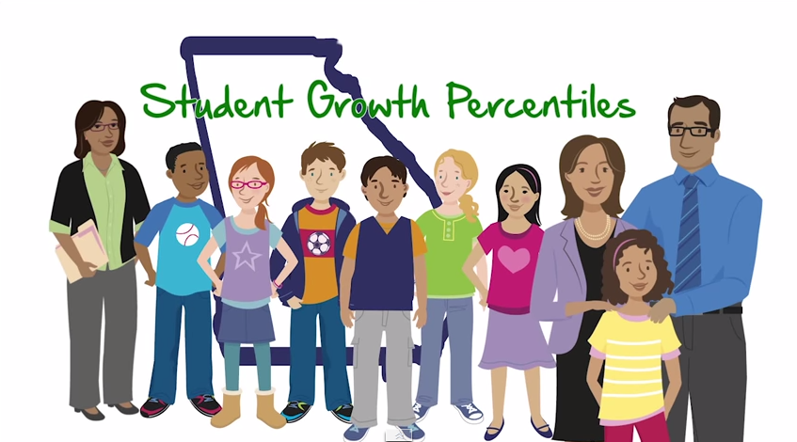
Introduction to the GSGM
Watch Video

Slide 9
Student Growth Percentiles
A student growth percentile (SGP) describes a student’s growth relative to academic peers
Academic peers are other students statewide with a similar score history
This ensures a student’s starting point is considered when measuring his or her growth
Growth percentiles range from 1 to 99
Lower percentiles indicate lower academic growth and higher percentiles indicate higher academic growth
All students, regardless of their achievement level, have the ability to demonstrate all levels of growth

Slide 10
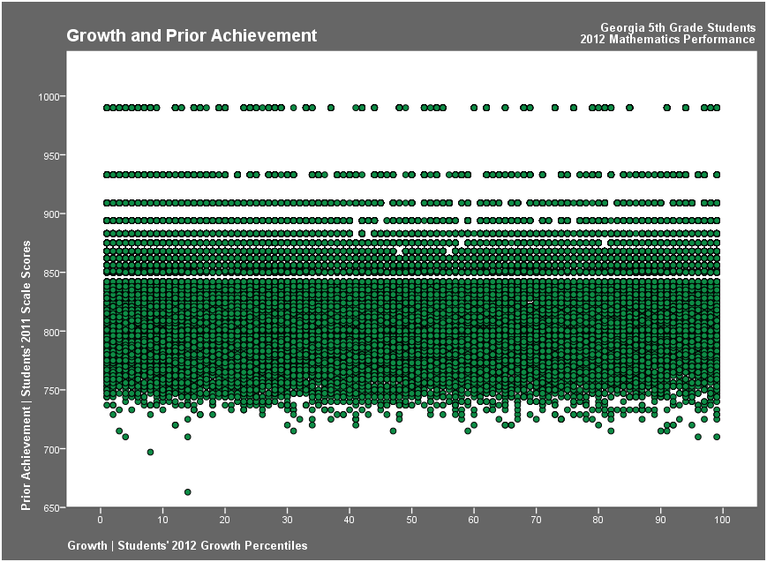
All students can demonstrate all levels of growth – regardless of their achievement level
2012 SGP = 1
2011 4th Grade Math Scale Score = 990
2012 5th Grade Math Scale Score = 847
2012 SGP = 99
2011 4th Grade Math Scale Score = 990
2012 5th Grade Math Scale Score = 990
2012 SGP = 1
2011 4th Grade Math Scale Score = 744
2012 5th Grade Math Scale Score = 734
2012 SGP = 99
2011 4th Grade Math Scale Score = 744
2012 5th Grade Math Scale Score = 843
Notes:
This chart plots current SGPs on the X axis and prior year scale scores on the Y axis.
It shows that for every level of prior achievement, students demonstrate all levels of growth. In other words, no matter how a student scored on the CRCT one year, it is possible to grow at any rate the next year.

Slide 11
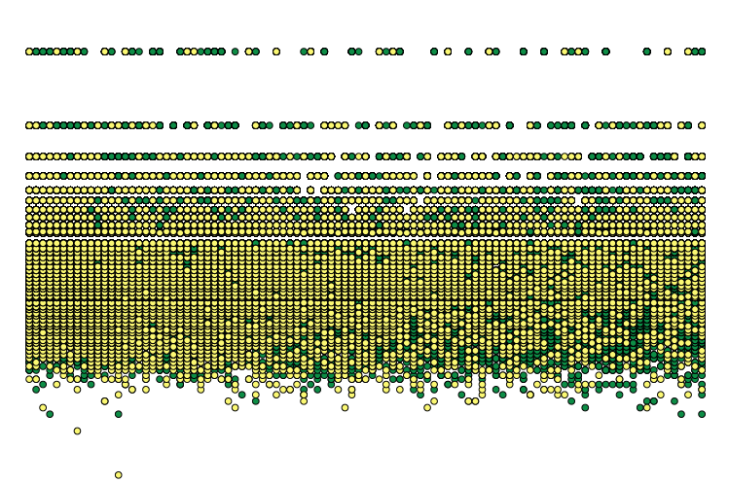
All students can demonstrate all levels of growth – regardless of their achievement level
Students with Disabilities (SWD)
Notes:
SWD – ED - ELL

Slide 12
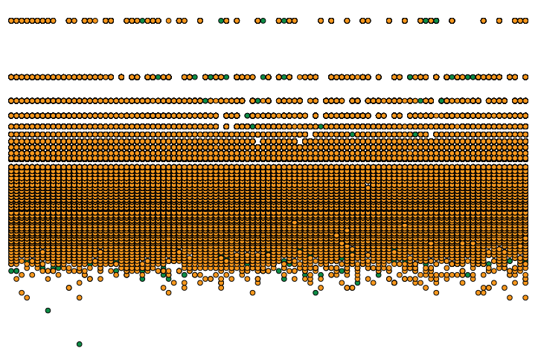
All students can demonstrate all levels of growth – regardless of their achievement level
Economically Disadvantaged (ED)
Notes:
SWD – ED - ELL

Slide 13
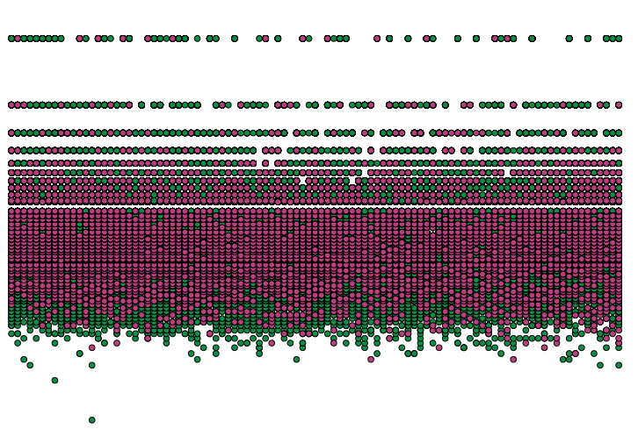
All students can demonstrate all levels of growth – regardless of their achievement level
English Language Learners (ELL)
Notes:
SWD – ED - ELL

Slide 14
Achievement vs. Growth
Achievement
How well students are meeting or exceeding state expectations
Snapshot look at student performance
Growth
How students are progressing from year to year
Takes students’ starting points into consideration
GSGM ≠ gain score model
Georgia’s assessments are vertically aligned but not vertically scaled
Growth is independent of proficiency cuts

Slide 15
Achievement vs. Growth
6th Grade
7th Grade
950
Elmer
and his academic peers
Elmer
Scale Score | SGP
810 | 62
5th Grade Math | 6th Grade Math
810 | 825
650

Slide 16
Transitioning to New Assessments
What happens to SGPs when we transition to Georgia Milestones?
SGPs will continue to be calculated without interruption
Until we have enough years of implementation, baselines, targets and projections will be delayed
CRCT/EOCT scores will be used as priors for new Milestones scores until they can be phased out
Will SGPs go down as a result of the increased rigor of Georgia Milestones?
No because…

Slide 17
Transitioning to New Assessments
8th Grade
Math I
600
450
Daisy
Daisy
and her academic peers
400
Scale Score | SGP
430 | 59
7th Grade Math | 8th Grade Math
815 | 830
200

Slide 18
Transitioning to New Assessments
8th Grade
Coordinate Algebra
600
450
Daisy
and her academic peers
400
Daisy
7th Grade Math | 8th Grade Math
815 | 830
Scale Score | SGP
390 | 59
200

Slide 19
EOCT Test Progressions
For EOCTs, both prior achievement and test sequence (including year taken) must be considered.
While most EOCT students will receive SGPs, those participating in uncommon sequences (small N) will not receive SGPs
Most common sequences:
ELA: CRCT reading/ELA → 9th Grade Lit → American Lit
Math: CRCT math → Coordinate Algebra → Analytic Geometry
Science: CRCT science → Physical Science/Biology → Biology/Physical Science
Social Studies: CRCT social studies → US History → Economics

Slide 20
Cohort- and Baseline-Referenced SGPs
Cohort-referenced SGPs
A student’s growth is relative to academically-similar students in the state that year
Student and school growth is relative to the state
Can continue to be reported during an assessment transition
Baseline-reference SGPs
A baseline is used as a reference point so change in statewide growth can be used from year to year
A student’s growth is relative to academically-similar students from the baseline
All students can demonstrate lower or higher growth than students in the baseline
Cannot continue to be reported during an assessment transition

Slide 21
Growth to Proficiency
How do we know if a student’s growth is enough to be on track to reach or exceed proficiency?
SGPs analyze historical student assessment data to model how students perform on and grow in between assessments
This information is used to create growth projections and growth targets for each student
The growth projection tells us where on the assessment scale a student may score next year for all levels of possible growth (1st-99th percentile)
The growth target tells us, based on where students are now, how much they need to grow to reach or exceed proficiency in the future

Slide 22
Growth Projections and Targets
Exceeds
Meets
Does Not Meet
High
“Exceeds” Target
Typical
“Meets” Target
Low
This Year Future

Slide 23
Student Growth Levels
Low (1-34), Typical (35-65), and High (66-99)
Levels were set using information about the interaction between student growth and status-based achievement
A student who demonstrates low growth generally will regress academically (i.e., not maintain his/her current level of achievement)
A student who demonstrates typical growth generally will maintain or improve academically
A student who demonstrates high growth generally will make greater improvement academically

Slide 24
CRCT SGP Example
Example 1 (real data, fake names)
Acme Middle School
Only middle school in district
Has 3 6th-grade mathematics teachers
Mr. W.E. Coyote
Taught 6th grade mathematics in 2012
Taught 116 students in 5 classes

Slide 25
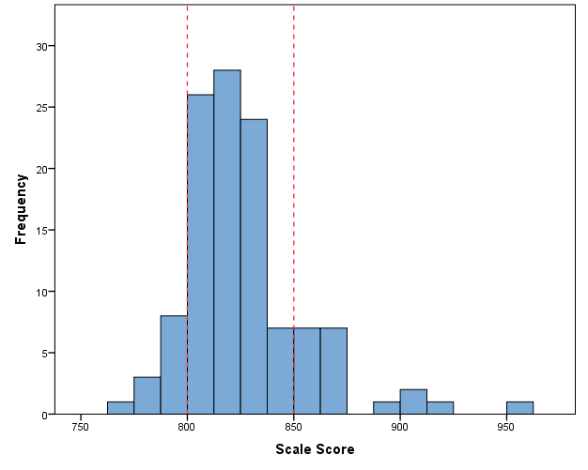
How did Mr. Coyote’s students do on the 6th grade mathematics CRCT?
85 scored Meets
90% of students (104 of 116) met the state standard
12 scored Does Not Meet
19 scored Exceeds

Slide 26
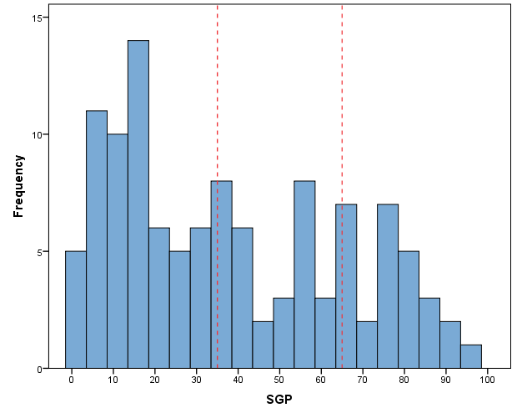
But did these students grow?
59 demonstrated
low growth
32 demonstrated typical growth
25 demonstrated
high growth
Not really –
50% demonstrated low growth

Slide 27
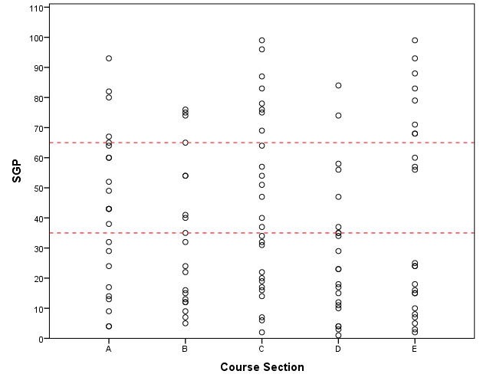
Was there a difference across Mr. Coyote’s classes?
Sections C and E have some students demonstrating high growth
But Sections B and D have more students demonstrating low growth
Section E is particularly interesting – students either grew very little or a lot

Slide 28
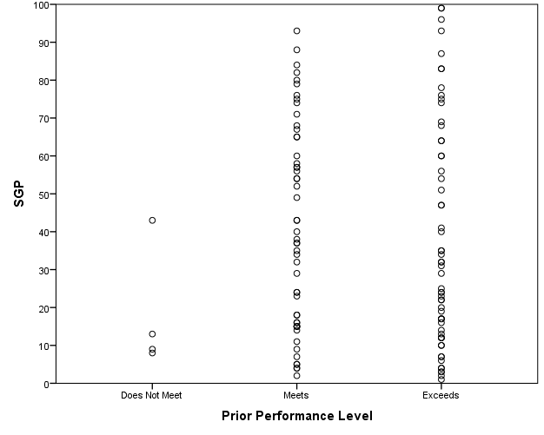
Was there a difference across student performance levels?
Why did these students grow more than other students with the same prior performance level?
Why did students who started the year below standards not grow much with this teacher?

Slide 29
What about the other 6th grade math teachers in the school?
Mr. Coyote –
high proficiency (90%), low growth (MGP = 34)
Lower proficiency (77%), lower growth (MGP = 20)
Lower proficiency (70%), better growth (MGP = 43.5)

Slide 30
What about other schools/districts?
6th Grade Proficiency
Even though Acme MS has a relatively high proficiency rate, other schools/districts are showing much more growth among 6th graders in math (and also have high proficiency rates).
6th Grade Growth

Slide 31
What if we consider where our students started?
5th Grade Proficiency
When we look at where students started, Acme MS had much lower growth than most other schools/districts who started in the same place.
6th Grade Growth

Slide 32
EOCT SGP Example
Example 2 (real data, fake names)
Clubhouse High School
Urban
One of many high schools in district
Has 12 9th-Grade Literature teachers in 2012
Ms. M. Mouse
Taught 9th Grade Literature in 2012
Taught 28 students in 3 classes

Slide 33
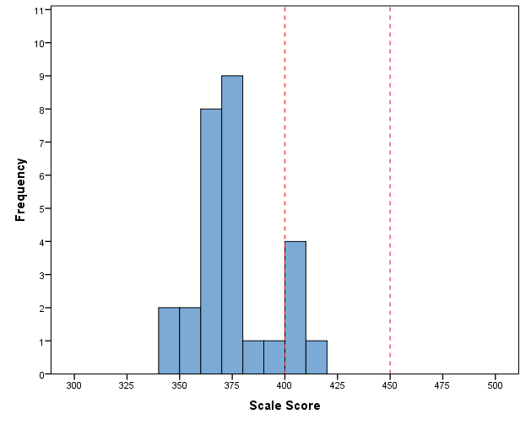
How did Ms. Mouse’s students do on the 9th Grade Lit EOCT?
18% of students (5 of 23) met the state standard
5 scored Meets
18 scored Does Not Meet
0 scored Exceeds

Slide 34
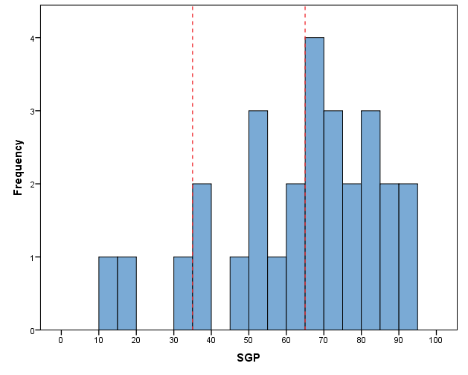
But did these students grow?
3 demonstrated
low growth
11 demonstrated typical growth
14 demonstrated
high growth
Yes – 89% demonstrated typical or high growth
MGP = 66

Slide 35
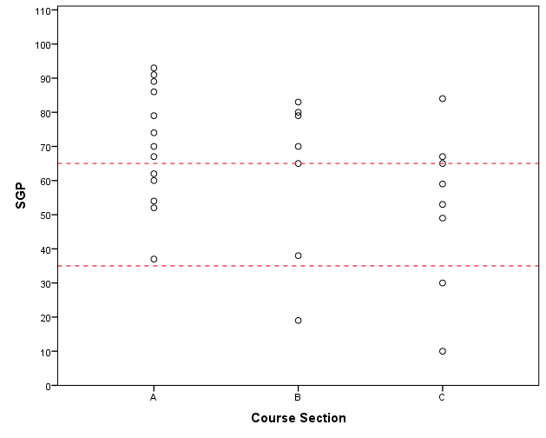
Was there a difference across Ms. Mouse’s classes?
All students in Section A demonstrate typical or high growth
Some students in Sections B and C didn’t grow quite as much

Slide 36
What about the other 9th Grade Lit teachers in the school?
9th Grade Lit Proficiency
Ms. Mouse –
low proficiency (18%), high growth (MGP = 66)
9th Grade Lit Growth

Slide 37
What if we consider where students started?
8th Grade Proficiency
Ms. Mouse –
She taught most of the low-achieving students, but they still demonstrated high growth
9th Grade Lit Growth

Slide 38
What if we consider where students started – across the district?
8th Grade Proficiency
Ms. Mouse –
Had more student growth than most other teachers with students of similar prior achievement levels
All 9th Grade Lit teachers in this district
9th Grade Lit Growth

Slide 39
Resources
Introduction to SGPs video
GSGM Visualization Tool (SLDS)
Information restricted based on role
Additional enhancements in development
Student growth reports for parents
Sample reports
Sample letter
Interpretation videos
GSGM tutorial series
Coming soon – public visualization tool (school- and district-level results only)

Slide 40
Questions?
For questions regarding the Georgia Student Growth Model, please contact:
Melissa Fincher, Ph.D.
Associate Superintendent of Assessment and Accountability
mfincher@doe.k12.ga.us or (404) 651-9405
Allison Timberlake, Ph.D.
Program Manager, Growth Model
atimberlake@doe.k12.ga.us or (404) 463-6666
gsgm.gadoe.org

