Slide 1
Assessment and Accountability Updates and Q&A
North Georgia RESA
2019 Leadership Summit
June 5, 2019

Slide 2
Topics
Georgia Milestones
GAA 2.0
GKIDS 2.0
Keenville
CCRPI
Policy Updates
Q&A

Slide 3
Spring 2019 Update
Georgia Milestones
Spring 2019 Testing Volume
Approximately 2.82 million tests administered, scored, and reported
Online Testing
This spring, districts assessed 100% of students online.
Peak concurrency saw 205,417 students testing simultaneously.
We topped last year’s peak concurrency on 10 different days.
There have been no major statewide issues.
Georgia Milestones | Peak Concurrency Date | Peak Concurrency Simultaneous Students
Spring 2019 | Tuesday, April 23, 2019 | 205,417 = 45.69% increase
Spring 2018 | Tuesday, April 24, 2018 | 141,000

Slide 4
Spring 2019 Update
Georgia Milestones
State Testing Windows (Spring 2019)
EOG: April 8 – May 17
EOC: April 22 – May 31
141,000 (2018 peak)
EOG only
205,417 (2019 peak)
EOG and EOC
EOC only

Slide 5
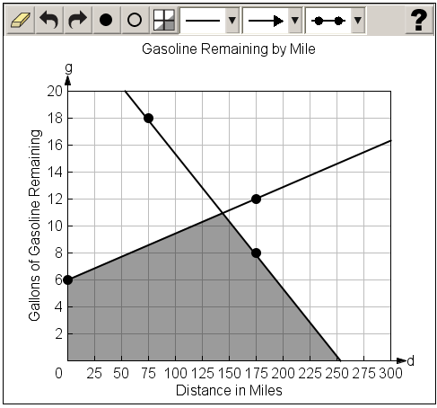
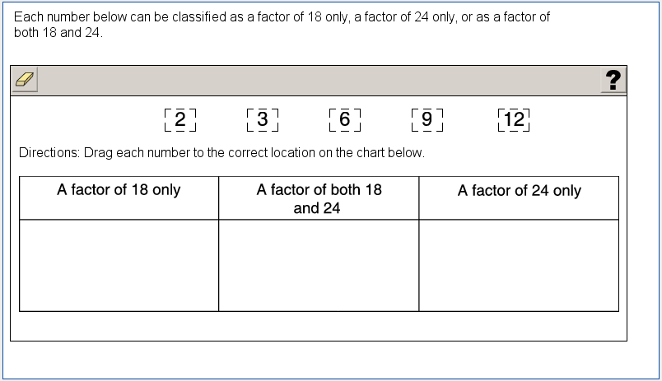
2019-2020 Updates
Georgia Milestones
Technology Enhanced Items – Operational Use
Two types of TE items field-tested in 2018-2019 will be eligible for operational use in 2019-2020.
Graphing (mathematics)
Allows students to graph and label points and lines and shade regions
Allows students to demonstrate depth of understanding and ability through performance on math tasks
Drag and drop (mathematics, science, social studies)
Response choices (such as numbers, words, or phrases) can be moved and placed in another location (such as a chart or map)
Allows students to demonstrate depth of understanding by identifying, classifying, comparing, or organizing information

Slide 6
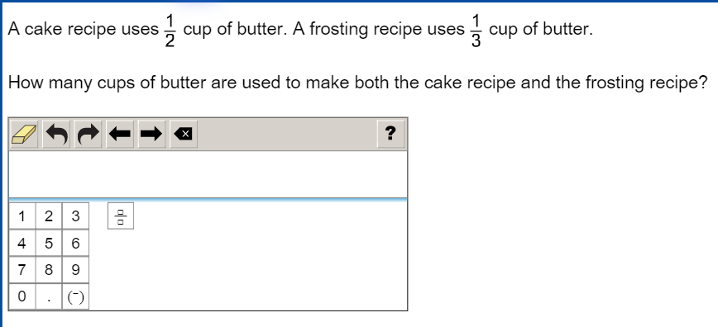
2019-2020 Updates
Georgia Milestones
Technology Enhanced Items – Field Test Only
Two new types of TE items will be field-tested in 2019-2020.
Drag and drop (ELA)
Drop down input
Allows a student to select the word, number, or symbol to complete a sentence, table, or equation
Scorable equation (mathematics)
Allows a student to input numbers, symbols, equations, or inequalities with a configurable scoring engine that can find equivalencies

Slide 7
2019-2020 Updates
Georgia Milestones
Narrative Writing Resources
Based on recent feedback around narrative writing, the following additional resources are in development:
Narrative Writing Checklist
Similar to the Writer’s Checklist provided for the extended writing prompt, this resource will support students in responding to the narrative writing prompt.
A unique checklist will be developed for each grade/course, based on the narrative writing rubric.
Narrative Writing Item & Scoring Sampler
1 narrative prompt per grade/course with 3 annotated student responses per score point (high, mid, low)
Study Guide – Narrative Section
Creating a Writing Unit within the Study Guide to include opinion/argumentative, informational/explanatory, and narrative

Slide 8
GAA 2.0
Georgia Alternate Assessment 2.0
The Georgia Alternate Assessment (GAA) 2.0 is the state’s AA-AAAS for those students with significant cognitive disabilities who cannot participate in the general statewide assessment program, even with maximum allowable accommodations.
The GAA 2.0 has been developed to ensure that students with the most significant cognitive disabilities are provided access to the state academic content standards and given the opportunity to demonstrate achievement of the knowledge, concepts, and skills inherent in the standards.
The GAA 2.0 was administered for the first time from March 25 – May 3, 2019.

Slide 9
GAA 2.0
Georgia Alternate Assessment 2.0
Design
Standardized and scripted tasks with multiple access points.
Each content area assessment includes 10 tasks and 1 field test task
Each task includes a scenario and three parts
Each task includes built-in supports and additional scaffolding, when applicable
Features
Use of scenarios to engage student interest and activate background knowledge
Large simple graphics
Accessible font size
Short simple sentences
Avoids extraneous wording
Use of common proper nouns (names)
Directive questions

Slide 10
GAA 2.0
Georgia Alternate Assessment 2.0
Following the Spring 2019 administration, GaDOE collected educator feedback to determine areas of potential program improvement.
More than 1,000 educators from across the state provided feedback.

Slide 11
GAA 2.0
Georgia Alternate Assessment 2.0
Preliminary analyses suggest the following overall themes:
Training (sample tasks, videos, and supplemental resources would support the training and preparation process)
Administration rules (provide more detailed information)
Layout and format (present question/answer options on same page, reduce flipping, color code books and answer documents, indicate page turns in script, more visuals)
Content (simplify vocabulary, reduce complexity where possible, reduce length of scenarios and questions, replace text with visuals)

Slide 12
GKIDS 2.0
GKIDS 2.0
Operational Statewide in 2019-2020!
A progression-based formative assessment, integrated into classroom work, that is aligned to the state content standards.
A big idea describes the integration of concepts and skills from the kindergarten standards that are most important for success in first grade.
A learning progression shows where the student is in the learning continuum of content and reasoning development regarding the big idea from the GSE.
Provides the big picture of what is to be learned across the year, relates standards across grades and increased reasoning of standards within the grades, and supports instructional planning.
Provides teachers with one source of real-time information to adjust instruction
Identifies what a student already knows, what the student needs next, and allows teachers to monitor growth

Slide 13
Teacher Training Course
GKIDS 2.0
The GKIDS 2.0 Teacher Training Course is now available via SLDS.
Overview of GKIDS 2.0
GKIDS 2.0 Data Collection Platform
English Language Arts
Phonemic Awareness, Phonics, High-Frequency Words, Comprehension, Writing
Mathematics
Shapes, Counting – Numbers, Counting – Objects, Compare, Addition & Subtraction
Science
Social Studies
Non-Academic Domains
Approaches to Learning, Personal and Social Development, Motor Skills

Slide 14
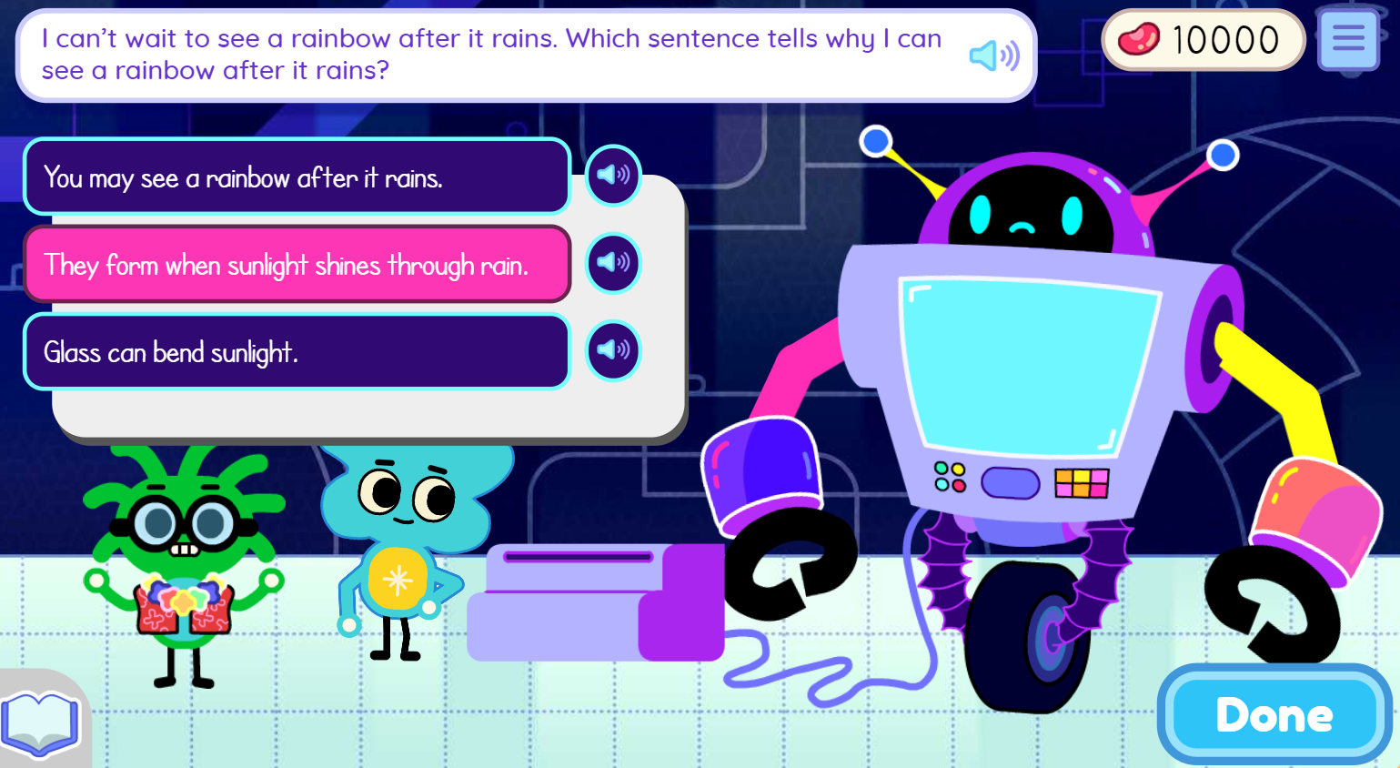
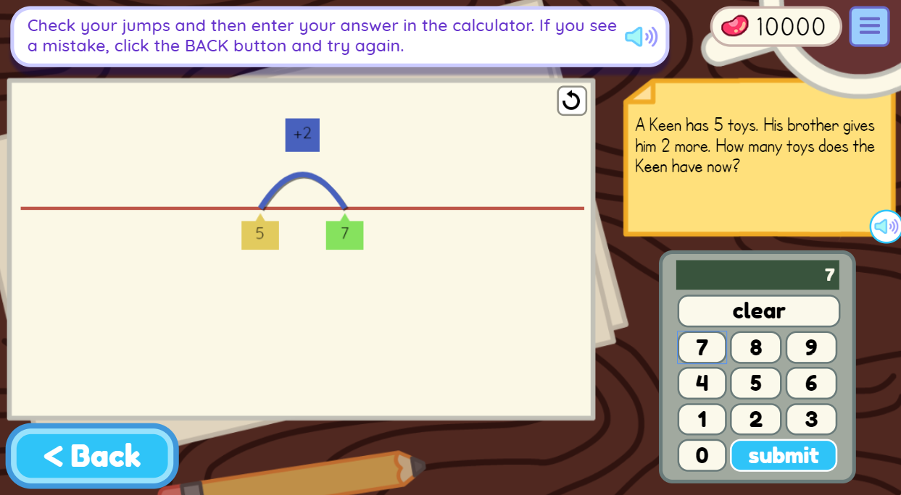
Welcome to Keenville!
Keenville
Keenville is Georgia’s game-based, formative assessment in literacy and mathematics for grades 1 and 2.
It is accessible via the Statewide Longitudinal Data System (SLDS).
New games and dashboards will arrive this spring and summer.
Keenville will be fully operational for the 2019-2020 school year.
Notes:
We are nearing completion of the development of Keenville, Georgia’s game-based formative assessment in literacy and mathematics for grades 1 and 2. New games and dashboards will arrive this spring and summer. The assessment will be fully operational for the 2019-2020 school year.
We are excited about the new games and have received excellent feedback from the teachers and students who participated in development and testing. Upcoming enhancements to the teacher dashboards include features such as student progress reports, play history, and item-level details. School and district leaders will soon have access to real-time dashboards featuring data for students in their school or district. We appreciate the ongoing feedback we are receiving from your districts to help us make refinements and enhancements to this assessment system.

Slide 15
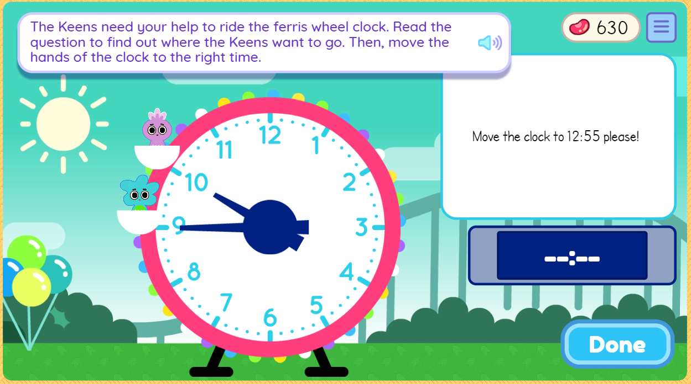
Main Features
Keenville
Designed to engage students through features such as an avatar builder; earning rewards; decorating their house; and fun sights, sounds, and reactions
Students receive ongoing support through motivational prompts and feedback
Games often include Georgia-specific themes and integrate other standards and initiatives, such as science, arts, and nutrition.
Teachers can access interactive dashboards that provide real-time data to help guide instruction and enhance instructional practices.
Each game is designed with multiple levels of learning to:
identify students’ current level of knowledge, skill, and concept development.
provide students, with varying abilities, access to content based on their learning needs.

Slide 16
What’s in Keenville?
Keenville
English Language Arts
Mathematics
16 games that focus on:
Literary reading comprehension
Informational reading comprehension
Phonics and word recognition
Language acquisition
15 games that focus on:
Addition/subtraction
Time, money, and measurement
Graphing, line plots, and data
Sorting 2D/3D shapes and fractional parts to whole
Repeat addition to multiplication building arrays
Reading and recognizing numbers and numerals

Slide 17
A Few ELA Games…
Keenville
In Keenbot, students read about science phenomena and teach Keenbot to help make him the smartest robot in Keenville.
In Harbor Phonics, students use phonics skills to create words.

Slide 18
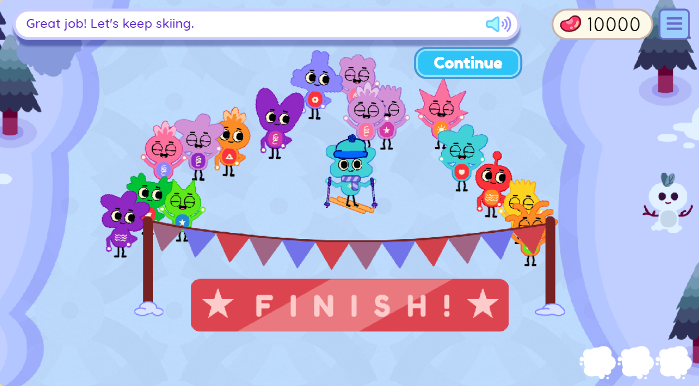
A Few More ELA Games…
Keenville
In Keenville Action News, students use their reading comprehension skills to create news stories for the nightly news in Keenville.
In Downhill Skiing, students ski through flags to group words that fit in the same category.

Slide 19
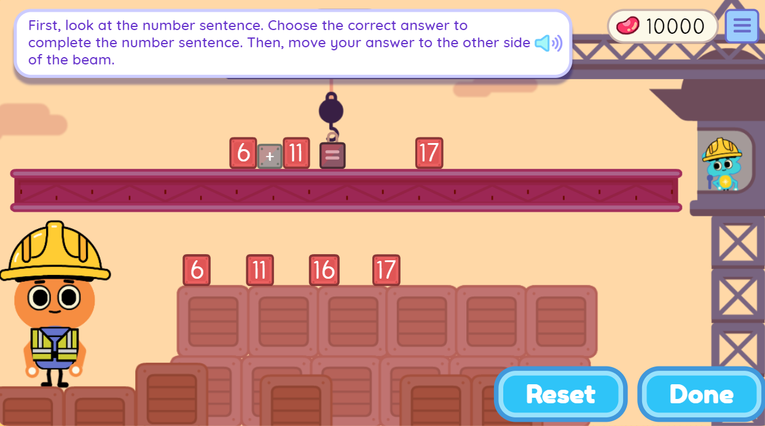
A Few Mathematics Games…
Keenville
In Guitar Maker, students sort shapes to determine what the Peachlings like to make their guitars.
In High-Rise Builders, students solve expressions and show the strategies they used to get their answers.

Slide 20
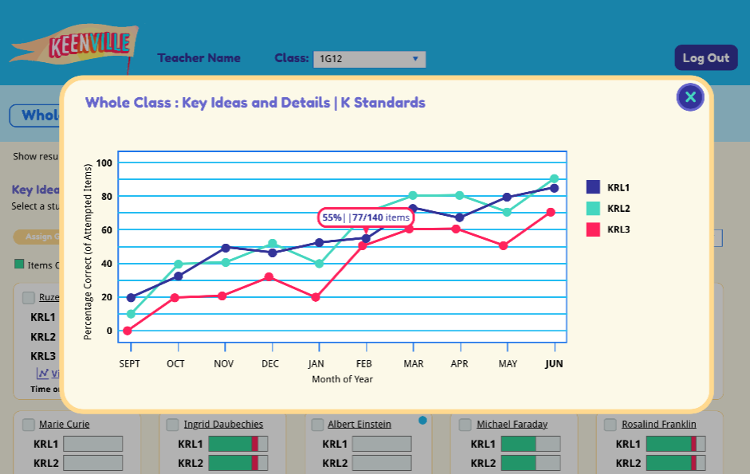
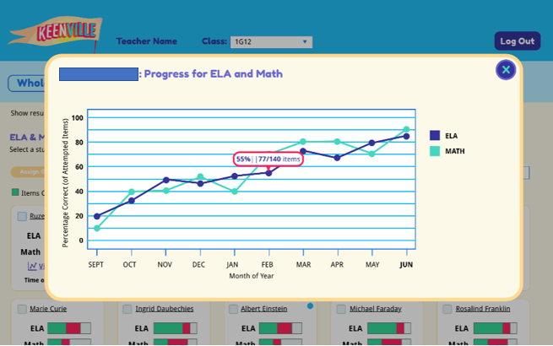
New Dashboard Features
Now Available!
Keenville
Recent enhancements to the teacher dashboards include features such as student progress reports, play history, and item-level details.
School and district leaders now have access to real-time dashboards featuring data for students in their school or district.

Slide 21
Resources and Training
Keenville
Coming in August!
Resources
User Guide – overview, game descriptions, how to play, accessing Keenville
Individual Game Summaries (one-pagers)
Training Modules
Overview – orientation to Keenville
Domains – description of standards assessed, games assessing the standards
Dashboards – accessing and using dashboards
Understanding Reports – how to interpret results

Slide 22
2019 CCRPI Calendar
CCRPI
Activity | Start | End
GAA Participation Application | December, 2018 | January 17, 2019
Assessment Matching 1 | March 5, 2019 | August
Live Portal Data | Early May | Static when SR and SC close
Student Record and Student Class Close | Ongoing | June
Assessment Matching 2 | August | August
Non-Participation Application | July | August
Summer Graduate Collection | Early July | Early August
Cohort Withdrawal Update | Early July | Early August
Graduation Rate Public Release | - | September
CCRPI Public Release | - | Late October

Slide 23
Live Portal Data Tool
CCRPI
The tool is designed to assist districts and schools in checking the accuracy of the data that are submitted in Student Record and Student Class before the collections close. Data are updated nightly until the close of Student Record and Student Class.
All data issues must be resolved prior to the close of Student Record and the close of Student Class.
There will be no data correction window for the 2019 CCRPI – Live Portal Data is the “correction window.”
Since Live Portal Data is NOT an application, there is no superintendent sign-off on the tool.

Slide 24
1% Alternate Assessment Waiver
Policy Updates
The U.S. Department of Education (ED) has approved Georgia’s request to extend its waiver of the statewide alternate assessment 1.0 percent participation cap for the 2018-2019 school year.
ED expressed concern that the percentage of students assessed via the GAA did not decrease from 2017 to 2018 (it remained at 1.3%).
We ask for districts’ continued partnership in ensuring state guidelines are followed when making the decision to place students on the GAA.
Later this summer we will provide districts with your 2019 GAA participation data as well as open the CCRPI GAA Participation Application.

Slide 25
ESSA Amendment
Policy Updates
GaDOE is seeking an amendment to our ESSA plan to create an alternate diploma option for students with significant cognitive disabilities assessed on the GAA.
These students can currently receive a regular diploma and count in the graduation rate. USED has informed GaDOE we can no longer include them as graduates in the adjusted cohort 4-year graduation rate.
USED will allow alternate diploma graduates to count in the 4-year graduation rate.
Additionally, GaDOE will ask to include students with significant cognitive disabilities who receive regular diplomas in the 4-year graduation rate calculation until the first cohort of alternate diploma graduates finish.
If this “hold harmless” portion of the amendment is not approved, graduation rates could be negatively impacted on the 2019 CCRPI.

Slide 26
ESSA Amendment
Policy Updates
Date/Timeframe | Action | Status
April/May 2019 | Notify school districts and other stakeholders of GaDOE’s intention to submit an ESSA amendment. Meet with the Special Education State Advisory Panel to discuss amendment. | Completed
May 2019 | Develop proposed amendment language. Approval from Superintendent. | In Progress
May 2019 | Consult with Governor, GOSA, and SBOE on Alternate Diploma amendment. | Upcoming
May – June 2019 | 30-day public review of ESSA Amendment. | Upcoming
June/July 2019 | Submit ESSA Amendment to USED. | Upcoming
Fall 2020 | If the ESSA Amendment is approved, the first cohort of students to receive the Alternate Diploma begins 9th grade. | Upcoming
Also in May – the accountability team posted an Excel file in CCRPI Resources in the MyGaDOE portal showing schools and districts how 4-year graduation rates would have been impacted had GAA graduates been removed from the numerator in 2018. 2018 graduation rates will not change.

