Slide 1
An Approach for Developing a District Assessment Plan: Collaboratively Putting the Pieces Together
FY19 Data Conference
Sandra Greene, Ed.D. Director of Assessment Administration
Joe Blessing Program Manager, Assessment Administration

Slide 2
Agenda
District Assessment Planning
Developing the Local Testing Calendar
Technology and Site Readiness
Site Technology Readiness Checklist
Training Expectations
Communications
Creating a School Assessment Plan

Slide 3
Developing the Local Testing Calendar

Slide 4
State Mandated Tests: Who, What, and Why
Students | Assessment | Reason
K-12 ELs in the ESOL program | ACCESS for ELLs 2.0 | Determine English proficiency in the areas of speaking, listening, reading and writing
ELs with significant cognitive disabilities | Alternate ACCESS for ELLs | Determine English proficiency in the areas of speaking, listening, reading and writing
Students with significant cognitive disabilities | Georgia Alternate Assessment (GAA 2.0) | Provides meaningful information about classroom instruction and identifies students’ areas of strength and improvement
All Kindergarten Students | Georgia Kindergarten Inventory of Developing Skills (GKIDS 2.0) | Documents and communicates students’ progress on the Kindergarten instructional standards
All Kindergarten Students | GKIDS 2.0 Readiness Check | Provides information about the skills of students entering kindergarten
All 3-8 and high school students except those eligible for GAA 2.0 | Georgia Milestones Assessment System End of Grade and End of Course | Measures knowledge and skills outlined in the state-adopted content standards in English language arts, mathematics, science, and social studies. EOG – promotion in grades 3, 5, and 8 EOC – 20% of the final course grade
Selected Students in grades 4, 8, and 12 or ages 9, 13, and 17 | National Assessment of Educational Progress (NAEP) | Obtains comprehensive and dependable achievement data on a national basis

Slide 5
Fitting Partnerships Together
System Test Coordinator (STC)
GKIDS 2.0 –
SIS Coordinators
Georgia Milestones – Technology Directors
NAEP –
Principals and School Test Coordinators
ACCESS for ELLs 2.0 –
ESOL/Title III Coordinators
GAA 2.0 –
Special Education Directors
District Holidays –
School Board
District Benchmarks – Curriculum Directors
Other Tests – ACT, AP, SAT, PSAT – Curriculum Directors
Keenville -
SIS Coordinator; SLDS access

Slide 6
Back Map Your Calendar Based on Instructional Progress and Need for Student Results
Testing Calendar
(Reports, Retest, End of Year Activities, Graduation, Close of school)
Training – District and School Level
Communications with schools, parents, staff
Assessment Reports
Student Instruction and Assessment
Review of Technology

Slide 7
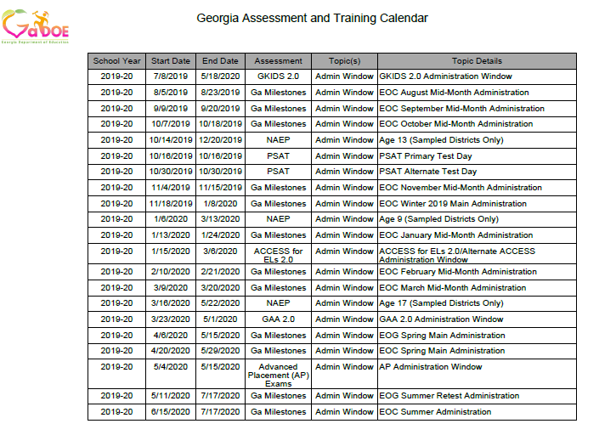
Central source for administration windows, training dates, checkpoints…
http://www.gadoe.org/Curriculum-Instruction-and-Assessment/Assessment/Pages/Information-For-Educators.aspx

Slide 8
Reporting Expectations for Reference
Assessment | Preliminary | Final
ACCESS for ELs 2.0 | N/A | Mid-May
Georgia Milestones EOC Winter 2019 | Business days after submission Math and ELA - 10 Science and Social Studies - 5 | Mid-February
Georgia Milestones EOC Spring 2020 | Business days after submission Math and ELA – 12 Science and Social Studies – 5 | Late July
Georgia Milestones EOG Spring 2020 | Business days after submission ELA and Math G 3, 5, 8 - 11 ELA and Math G 4, 6, 7 – 16 Science and Social Studies - 5 | Early July
Georgia Alternate Assessment 2.0 | N/A | June
GKIDS 2.0 | Available throughout the year | Determined by school system
NAEP | N/A | Fall 2019
Keenville | Available throughout the year | Determined by school system

Slide 9
Visualizing the State Testing Windows – Yearlong
September 2019 EOC MM
January 2020 EOC MM
9/9-20/2019
1/13-24/2020
October 2019 EOC MM
February 2020 EOC MM
10/7-18/2019
2/10-21/2020
August 2019 EOC MM
November 2019 EOC MM
March 2020 EOC MM
8/5-23/2019
11/4-15/2019
3/9-20/2020
Jul
Sep
Nov
2020
Mar
May
Jul
2020
Today
Winter 2019 EOC
11/18/2019 - 1/8/2020
ACCESS for ELs 2.0
1/15/2020 - 3/6/2020
Spring 2020 GAA 2.0
3/23/2020 - 5/1/2020
Spring 2020 EOG
4/6/2020 - 5/15/2020
Spring 2020 EOC
4/20/2020 - 5/29/2020
Summer Retest 2020 EOG
5/11/2020 - 7/17/2020
2019
Summer 2020 EOC
6/15/2020 - 7/17/2020
GKIDS 2.0
7/8/2019 - 5/18/2020
51 days
52 days
40 days
40 days
40 days
68 days
33 days
316 days

Slide 10
Focus on GKIDS 2.0
Mid-year checkpoint (Webinar only, no datafile provided)
2/11/2020
Website closes for the 2019-2020 school year.
Pre-Administration Training
Mid-Administration Training
7/30/2019
2/11/2020
6/10/2020
Jul
Aug
Sep
Oct
Nov
Dec
2020
Feb
Mar
Apr
May
Jun
2020
Today
GKIDS Readiness Check Data Entered
7/8/2019 - 10/18/2019
Must be completed six weeks after school start date.
Entries may be entered for the current school year after the Readiness Check Data has been entered.
7/8/2019 - 5/18/2020
2019
103 days
316 days

Slide 11
Focus on Georgia Milestones – Jul-Dec 2019
INSIGHT/eDIRECT Training
9/24/2019
EOC Winter 2019/Spring 2020 MM Pre-Admin Training
10/15/2019
Fall 2019 EOC MM Online Test Setup & eDIRECT Enrollment Count Training
Winter 2019/Spring 2020 EOC MM Online Test Set-Up Training
7/23/2019
10/22/2019
Jul
Aug
Sep
Oct
Nov
Dec
2020
2020
Today
August 2019 EOC MM
8/5/2019 - 8/23/2019
September 2019 EOC MM
9/9/2019 - 9/20/2019
October 2019 EOC MM
10/7/2019 - 10/18/2019
November 2019 EOC MM
11/4/2019 - 11/15/2019
Winter 2019 EOC
11/18/2019 - 1/8/2020
2019
19 days
12 days
12 days
12 days
52 days

Slide 12
Focus on Georgia Milestones – Jan-Jul 2020
eDIRECT Enrollment Count Training
1/7/2020
INSIGHT/eDIRECT Training
2/11/2020
Spring/Summer 2020 EOG & EOC Pre-Admin Training
2/25/2020
Spring/Summer 2020 EOC & EOG Online Test Set-Up Training
EOG/EOC Post-Assessment Training
3/3/2020
5/26/2020
Jan
Feb
Mar
Apr
May
Jun
Jul
2020
January 2020 EOC MM
1/13/2020 - 1/24/2020
February 2020 EOC MM
2/10/2020 - 2/21/2020
March 2020 EOC MM
3/9/2020 - 3/20/2020
Spring 2020 EOG
4/6/2020 - 5/15/2020
2020
Spring 2020 EOC
4/20/2020 - 5/29/2020
Today
Summer Retest 2020 EOG
5/11/2020 - 7/17/2020
12 days
Summer 2020 EOC
6/15/2020 - 7/17/2020
12 days
12 days
40 days
40 days
68 days
33 days

Slide 13
Focus on NAEP
Training (Age 9 Sampled Systems Only)
10/8/2019
Training (Age 13 Sampled Systems Only)
Training (Age 17 Sampled Systems Only)
8/7/2019
12/11/2019
Aug
Sep
Oct
Nov
Dec
2020
Feb
Mar
Apr
May
2020
Today
Age 13 (Sampled Districts Only) Assessment Window
10/14/2019 - 12/20/2019
Age 9 (Sampled Districts Only) Assessment Window
1/6/2020 - 3/13/2020
Age 17 (Sampled Districts Only) Assessment Window
3/16/2020 - 5/22/2020
2019
67 days
67 days
68 days

Slide 14
Focus on ACCESS for ELLs 2.0
Return Materials to DRC
3/13/2020
Score Reports Available (Online)
ACCESS for ELLs 2.0 Pre-Administration Training
5/7/2020
10/9/2019
ACCESS and Alt ACCESS for ELLs 2.0 Post Assessment Training
Alt ACCESS for ELLS 2.0 Pre-Administration Training
10/11/2019
WIDA Training: Alt ACCESS for ELLs Test Admin
5/15/2020
12/3/2019
Score Reports Available (Paper)
Georgia-Specific Guidance Training
Materials Arrival
8/27/2019
1/6/2020
5/15/2020
Aug
Sep
Oct
Nov
Dec
2020
Feb
Mar
Apr
May
2020
Today
2019
Material Ordering & LEA Pre-ID
10/9/2019 - 11/25/2019
WIDA AMS Test Setup
12/5/2019 - 3/6/2020
Administration Window
1/15/2020 - 3/6/2020
48 days
LEA Data Validation (Pre-Reporting)
4/6/2020 - 4/17/2020
93 days
LEA Data Validation (Post-Reporting)
5/11/2020 - 5/22/2020
51 days
11 days
11 days

Slide 15
Focus on GAA 2.0
Test Administration Procedures Part 2 Training
10/1/2019
Nextera Training
Test Administration Procedures Part 1 Training
1/6/2020
Pre-Administration Training
8/20/2019
2/18/2020
Aug
Sep
Oct
Nov
Dec
2020
Feb
Mar
Apr
May
2020
Today
Administration Window
3/23/2020 - 5/1/2020
2019
39 days

Slide 16
Focus on GAA 2.0
Possible District Training Redelivery
Test Administration Procedures Part 2 Training
10/1/2019
Nextera Training
Test Administration Procedures Part 1 Training
1/6/2020
Pre-Administration Training
8/20/2019
2/18/2020
Aug
Sep
Oct
Nov
Dec
2020
Feb
Mar
Apr
May
2020
Today
Administration Window
3/23/2020 - 5/1/2020
District Redelivery Option
10/1/2019 - 11/29/2019
District Redelivery Option
3/1/2020 - 3/31/2020
2019
39 days
60 days
31 days

Slide 17
Develop a District Timeline
Sample Monthly District Schedule
August 2019
Training
Fall Conference – Part 1
NAEP Pre-Admin
Keenville Pre-Admin
WIDA Online Screener
TestPad/FIP Overview
GKIDS 2.0/GKIDS Readiness Check Pre-Admin
GAA 2.0 Test Admin Part 1
WIDA Paper Screener
Georgia Specific ACCESS for ELs 2.0
Administration Task
GKIDS 2.0 User Account assignments
eDIRECT User Account assignments (EOC)
GKIDS 2.0 Readiness Check Data Entry
EOC Winter Enrollment Window in eDirect Open
eDIRECT Test Set-up Fall Mid-month
Administration Window
GKIDS 2.0 – Readiness Check
EOC Mid-Month
Which district or school-level staff need to be involved each month?

Slide 18
Technology and Site Readiness

Slide 19
Building a Tech Team for Assessment
Members
System Test Coordinator (STC)
Special Education Director/ESOL Coordinator
School Test Coordinators
System Technology Coordinator
School-level Technical Staff
Meet Regularly
Share training opportunities
Share technology requirements
Share testing windows and numbers of test takers

Slide 20
Georgia Online Assessment Overview
Assessment | Vendor | Management System | Local Content Caching | Response Source
ACCESS for ELLs 2.0 | WIDA/DRC | WIDA AMS | Central Office Services* | Student login to INSIGHT*
Georgia Milestones | DRC | eDIRECT | Central Office Services* | Student login to INSIGHT*
Georgia Alternate Assessment 2.0 | Questar | Nextera | None | Teacher through website
GKIDS 2.0 | Georgia Center for Assessment | GKIDS 2.0 Data Entry and Reporting Website | None | Teacher through website
NAEP | NCES | None | None | Student login
Keenville | Georgia Center for Assessment | SLDS | None | Student login
*Software installation required

Slide 21
OS Breakdown Spring 2018-19 Milestones
EOG and EOC
Chrome
Windows
Mac
iPad

Slide 22
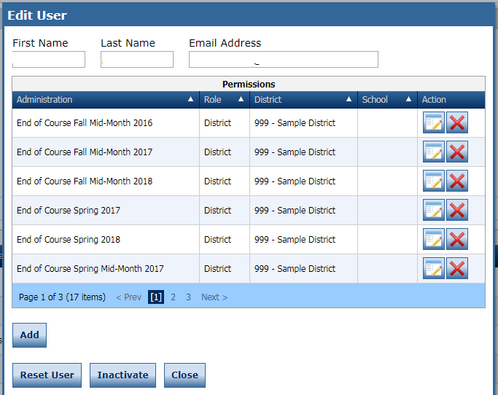
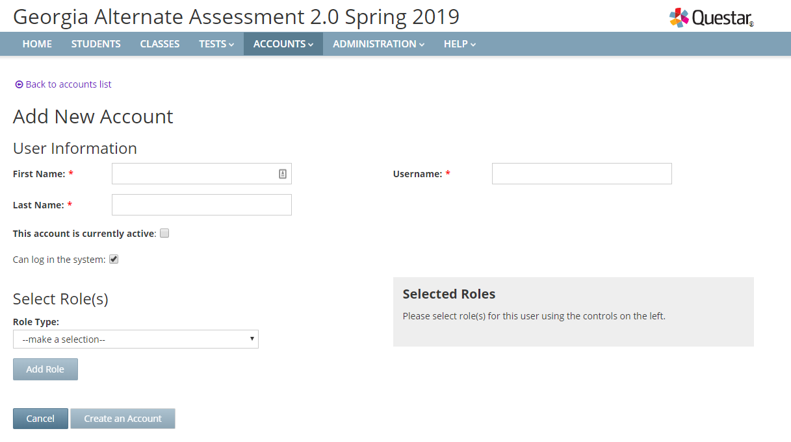
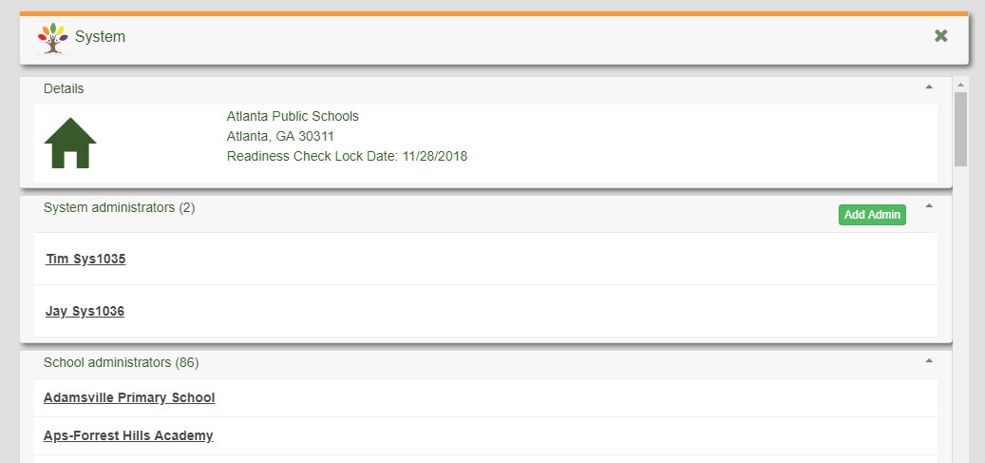
User Accounts
District STCs are responsible for ensuring administrator accounts are current.
Legacy user accounts could have access to student information.
STCs manage district level accounts. School Test Coordinators manage teacher accounts on some programs.
Milestones/ACCESS
GAA 2.0
MyGaDOE Portal
GKIDS 2.0/GKIDS Readiness Check

Slide 23
Site Technology Readiness Checklist
Site Readiness Checklist
The following slides are a broad outline taken from the DRC Site Readiness Checklist

Slide 24
Site Technology Readiness Checklist
Site planning team
Teachers, Test Administrators, Technology Coordinators, District Assessment Coordinators, EL Directors, Principals, Curriculum Directors
Consider Timeframes
2-3 Months Before Testing
1-2 Months Before Testing
2-4 Weeks Before Testing
1-2 Weeks Before Testing
Day of Testing
Categories
Communication
Site Planning, Scheduling, and Logistics
Technology – Device Setup
Technology – Network Configuration
Technology – COS Setup
Training

Slide 25
Technology Planning
2-3 Months Out
Meet with technology team to create awareness and define roles.
Identify device options for testing
Verify student data sources.
Verify students are in appropriate sessions.
Install and/or configure COS Service Devices.
Perform initial testing device setup for workstation.
Perform System Readiness Check to verify setup.

Slide 26
Technology Planning
1-2 Months Before Testing
Upload students and verify schedules
Perform an end-to-end test of the system using practice tests.
Confirm network capacity assessment (LAN, WAN and ISP) has been performed.
Verify that the firewall and filters are configured to communicate with online filters
Perform System Readiness Check on each device.
Inventory technology to verify availability for assessment activities
Verify all correct URLs are whitelisted

Slide 27
Technology Planning
2-4 Weeks Before Testing
Confirm that all installations have been completed including COS and INSIGHT browser.
Verify all technology while students take practice tests.
Work with technology staff to develop a support plan to handle testing issues and irregularities.
Verify that other activities in the building will not require heavy network usage.
Complete a wireless survey to ensure that there is enough wireless coverage in testing areas
Confirm headsets and other peripherals work with Online Tools Training practice test

Slide 28
Technology Planning
1-2 Weeks Before Testing
Send a reminder email to staff to avoid intensive network activity during testing dates.
Conduct a final technology work through.
Verify that COS Service Device status and content are shown as green.
Account for any cell phones and other devices that students, proctors, and teachers have connected.
Inventory peripherals (headsets, mice, keyboards, etc.)
Use network traffic shaping to give DRC INSIGHT testing traffic a priority.

Slide 29
Technology Planning
Day of Testing
Send a reminder to staff to avoid bandwidth-intensive projects during testing.
Perform a System Readiness Check on at least one device.
Verify battery power on laptops.
Stagger logins to the testing system.
Implement support plans.
Monitor network

Slide 30
Training Expectations

Slide 31
Develop a Training Hierarchy and Timeline
State Training to
System Test and Technology Coordinator
District Staff as Appropriate
School A Test Coordinator and Technology Specialist
School B Test Coordinator and Technology Specialist
School C Test Coordinator and Technology Specialist
All - Test Security
Examiners – Administration
Students – Online Items and Tools
All - Test Security
Examiners – Administration
Students – Online Items and Tools
All - Test Security
Examiners – Administration
Students – Online Items and Tools

Slide 32
Back map local training schedule
Test Date
Train extra examiners and proctors
Student/ Examiner Training
Enough in advance of test date to allow for make up training
School Coordinator Training
Use resources and materials from GaDOE training
System Coordinator Training from GaDOE
Reiterate test security at ever level
Test and technology setup
Administration procedures
4-6 weeks prior start of state window

Slide 33
Test Security
Guiding Principles
The primary goal of assessment security is to protect the integrity of the assessment and to assure that results are accurate and meaningful.
State assessments are an important and a required tool used to monitor state, district, school, and student achievement results.
For assessments to yield fair, accurate, and valid results, they must be administered under the same standardized conditions to all students.
Notes:
Presenter: Sandy Greene
Understanding the guiding principles related to test security help to STCs plan for training activities and support school test coordinators and test examiners in understanding assessments in the district.
Review the slide contents.

Slide 34
Test Security
Code of Ethics for Georgia Educators
Standard 10: Testing – An educator shall administer state-mandated assessments fairly and ethically.
Unethical conduct includes but is not limited to: committing any act that breaches Test Security; and compromising the integrity of the assessment.
GaPSC Ethics Division (Jan, 2018):
Notes:
The Georgia Professional Standards Commission includes as part of the Code of Ethics for Educators, Standard 10 which is specific to testing. An educator shall administer state-mandated assessment fairly and ethically. Local training should include a discussion of this standard and should focus on supporting examiners in administering, managing and monitoring assessment appropriately.
There are occasions that an incident occurs that warrants an investigation and referral to GaPSC. The GaDOE has made referrals to the GaPSC; however, we do support investigations by district Human Resource departments and the decision to refer to the GaPSC.

Slide 35
Test Security
Assessment Administration
Readiness
Detection
Investigation
Remediation
Notes:
Test Security is achieved through collaborative planning that involves a team of individuals at the district and local school level. If the focus for training is in readiness through a thorough knowledge of administration of any assessment, the valid and reliable results may be achieved to support the classroom teacher and leaders in making quality instructional and programmatic and/or resource-related decisions. Much less time will be needed for detection, investigation, or remediation of issues that may occur if a view focusing on readiness is taken.

Slide 36
The System Test Coordinator should…
Review of resources available for System Test Coordinators
All training documentation including presentations, handouts, and sign-in sheets must be kept on file locally.
If requested, provide copies these materials to the state to confirm that the training was appropriate and adequate.
Provide professional ethics and security training to all staff, both veteran and new staff.
Participate in all GaDOE webinars and training sessions
Redeliver training for administration procedures to School Test Coordinators

Slide 37
Test Security across Assessments
Training Expectations
Training
Test Administration policies, protocols, and procedures
Student Assessment Handbook
Accessibility Manual
System Test Coordinator and Test Examiner Manuals
GaDOE Webinar and Local Training Sessions
Student Accessibility and Accommodations
Student Assessment Handbook
Accessibility Manual
System Test Coordinator and Test Examiner Manuals
Review of IEP/IAP and EL/TPC plans
Notes:
Discuss general remediation options.

Slide 38
School Test Coordinator Should…

Slide 39
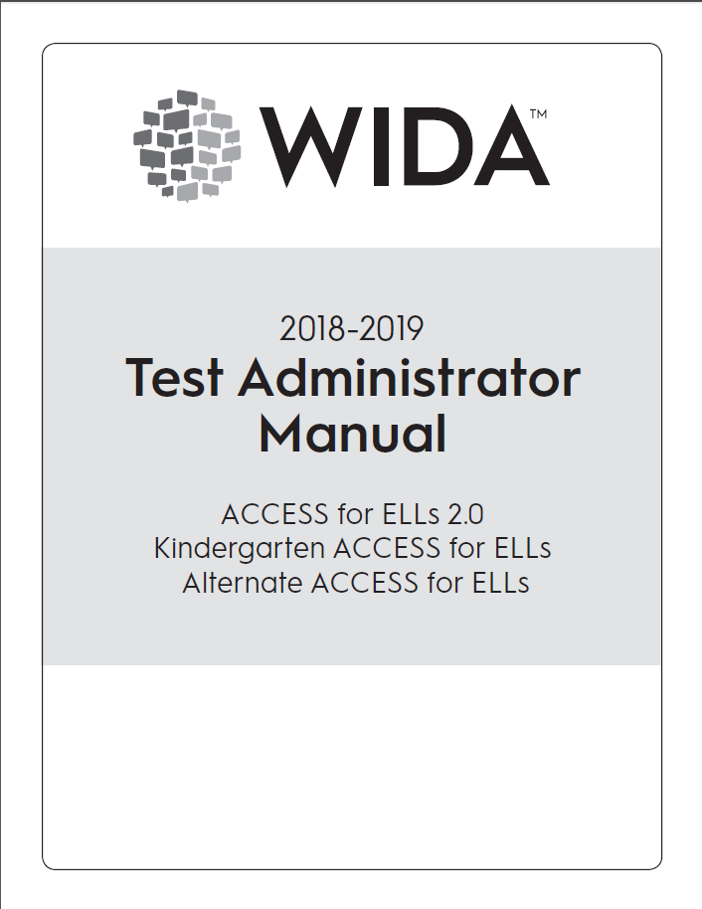
Test Examiner Manual
Train examiners about administration procedures using the Test Administration Manual

Slide 40
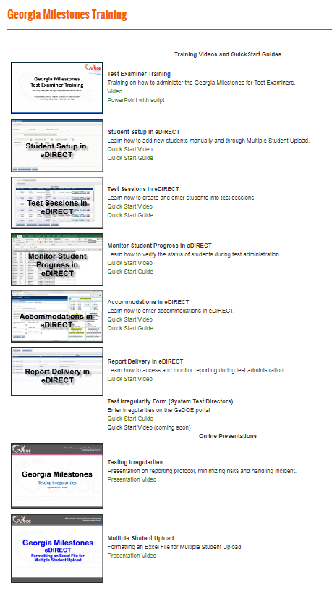
Take Advantage of QuickStart Videos and Guides
Test Examiner Training
Student Setup
Test Sessions
Monitor Student Progress
Accommodations
Report Delivery
Online Presentations
Testing Irregularities
Multiple Student Upload
Can be found off the EOG Resources or EOC Resources pages.
http://www.gadoe.org/Curriculum-Instruction-and-Assessment/Assessment/Pages/Milestones_Training.aspx

Slide 41
Based on System Level Training, the School Test Coordinator Should
Setup
Coordinate with Technology Specialist the setup of testing devices Oversee the setup of test sessions including and importantly assigning online accommodations prior to student login
Training
Train in the use of test-taking strategies, test item format, and universal tools Train in the use of Assessment Guides, Study Guides, and other GaDOE posted Resources Train and provide guidance regarding communication plans for students, parents, and the public including what state assessments entail, when and how the tests will be administered, and how the results will be appropriately used. Train on test security and maintaining appropriate test environments
Monitoring
Arrange for supervision of testing locations including hall monitors Use reporting resources in eDIRECT to monitor student progress

Slide 42
Test Examiners should..

Slide 43
The School Test Coordinator Should
Train Students and Teachers on Strategies, Item Formats and Universal Tools
Orient students to testing via an online platform:
Experience Online Testing Georgia: http://www.gaexperienceonline.com
Secure Practice Tests in INSIGHT
Notes:
Students should be comfortable with the format of the Georgia Milestones assessment as well as the INSIGHT program and all available tools. Districts should set up practice sessions with students using the Secure Practice Tests. Teachers, students and parents can experience the format of the test and the INSIGHT program anywhere anytime through Experience Online Testing Georgia.

Slide 44
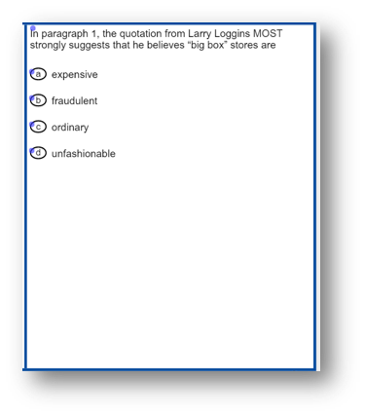
Strategies, Item Formats, and Universal Tools
Accommodations Examples: Text-to-Speech (TTS)
Must be assigned before student begins testing.
Pre-recorded computer voice.
Audio plays automatically for each page.
Can be restarted for the whole page or at Start Points.
Each passage contains at least one Start Point per page

Slide 45
Strategies, Item Formats, and Universal Tools
Desmos Calculator Coming with the Winter 2019 EOC
After feedback from school districts, we are replacing the DRC calculators with the Desmos Calculator.
Teachers and students can utilize the free Desmos calculator in the classroom.
The Desmos INSIGHT calculator is slightly different from the online version.
INSIGHT version will be available in online test preparation resources in November
www.desmos.com

Slide 46
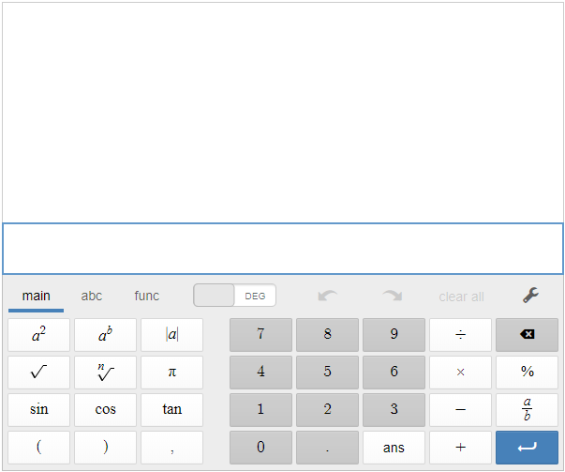
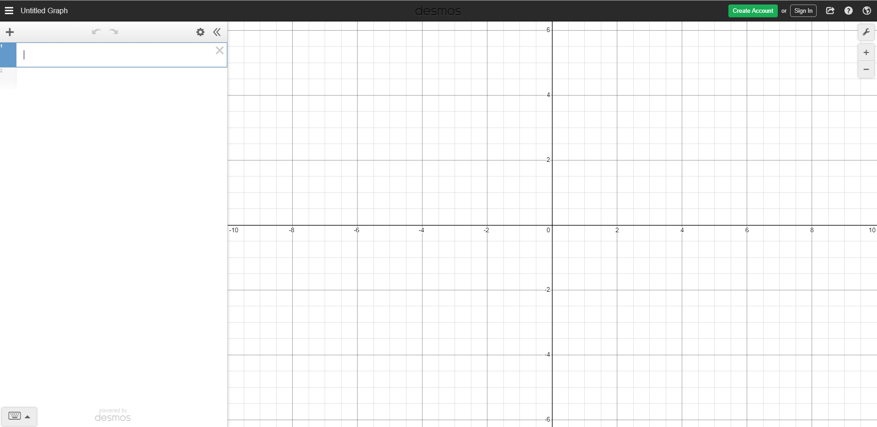
Strategies, Item Formats, and Universal Tools
Desmos Calculator Coming with the Winter 2019 EOC
Basic
Scientific
Graphing

Slide 47
Communications

Slide 48
Communicate Your Calendar
What
Testing Dates
Training Dates
Requirements
Reporting Dates
Who
Principals
District Administrators
Teachers
Parents
Community
How
Emails
Website
Flyers
Social Media

Slide 49
Communication Suggestions
Testing calendar and reporting plan easily accessible on the system’s and schools’ website
Depending on the assessment, the calendar should be grade and content specific
Include contact information should parents have questions
Include links to GaDOE parent and student resources
Try to provide preliminary report results and prominently and clearly communicate a plan for distributing final reports

Slide 50
Communicating Test Results
Summary Reports are embargoed until they are released by the GaDOE.
Do not share embargoed data at public board meetings or with the media until the GaDOE releases data for that program.
Do share with parents, students, teachers and staff related to the student as soon as they are received.

Slide 51
Communicating Test Results
Preliminary Reports Can Be Shared
Preliminary individual student data
Preliminary EOC student reports
counts as 20% of the course grade
may be reported to parents/guardians and students
Preliminary EOG student reports
promotion determinations for Grades 3, 5, and 8 based on state rule or local policy
may be reported to parents/guardians and students
Class rosters can be shared with teachers and administrators
Inform school and system level staff how results will be distributed to parents
Be sure summer school staff know reporting timelines

Slide 52
Creating a School Assessment Plan

Slide 53
Assessment Plan
School Assessment Plan
Assessment Plan
Completed Plan Template
Copies of Communications
Training Materials and sign-ins
Testing Schedule

Slide 54
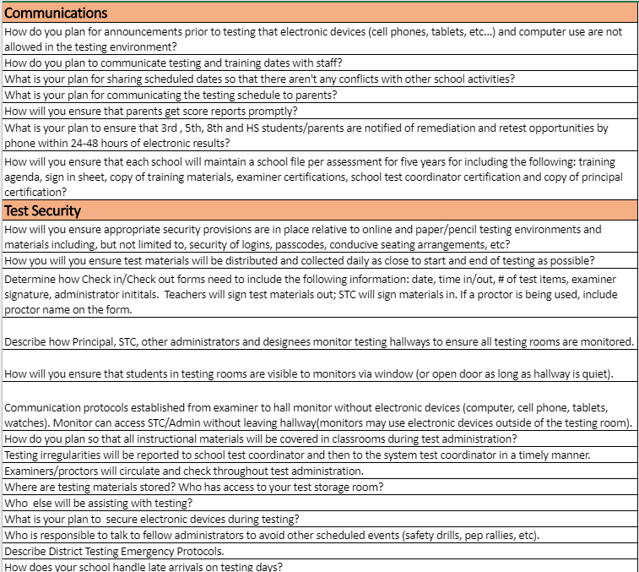
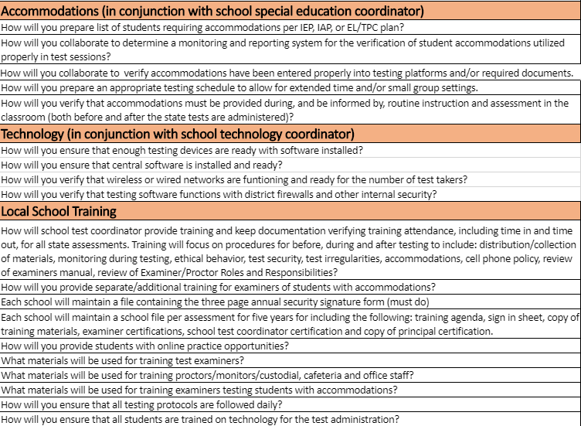
Assessment Plan
School Assessment Plan Template

Slide 55
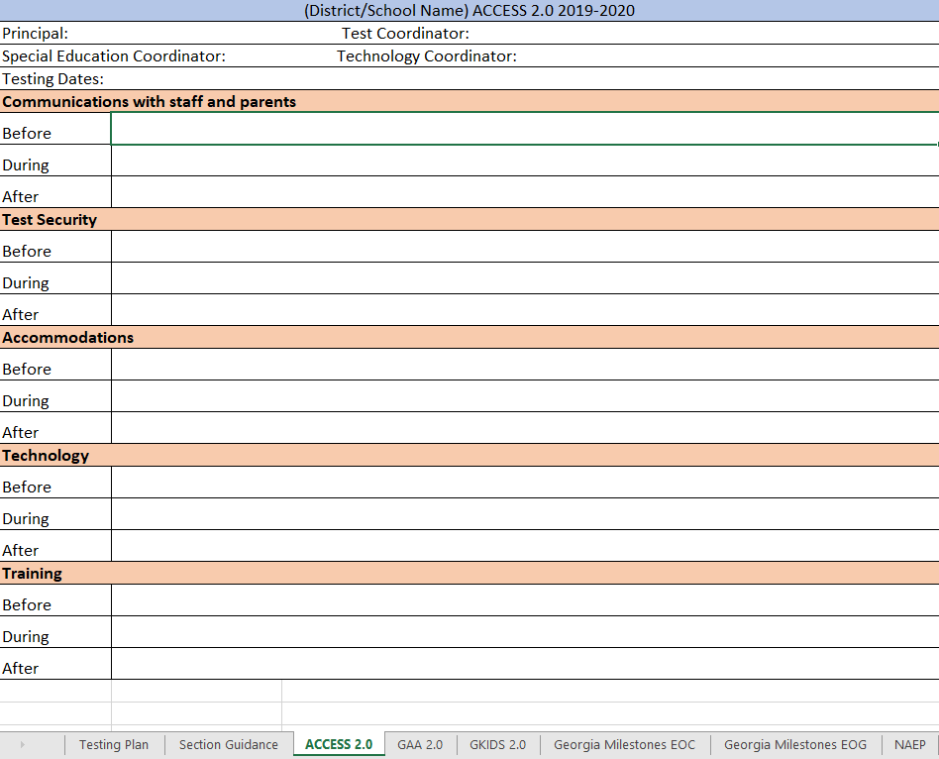
Assessment Plan
School Assessment Plan Template

Slide 56
Assessment Administration Contact Information
http://testing.gadoe.org
Toll-Free (800) 634-4106 and (404) 656-2668
Sandy Greene, Ed.D., Director of Assessment Administration 404-656-0478; sgreene@doe.k12.ga.us
Taiesha Adams, Ed.D., Assessment Specialist, Georgia Milestones 404-656-5975; taadams@doe.k12.ga.us
Bobbie Bable, Assessment Specialist, National Assessment of Educational Progress (NAEP), Georgia Kindergarten Inventory of Developing Skills (GKIDS 2.0), Assessment Literacy Resources 404-657-6168; bbable@doe.k12.ga.us
Joe Blessing, Program Manager, Georgia Milestones, TestPad 404-232-1208; jblessing@doe.k12.ga.us
Kelli Harris-Wright, Assessment Specialist, Formative Instructional Practices (FIP) 404-463-5047; kharris-wright@doe.k12.ga.us
Robert McLeod, Ed.D., Assessment Specialist, Georgia Milestones 404-656-2589; rmcleod@doe.k12.ga.us
Mary Nesbit-McBride, Ph.D., Assessment Specialist, ACCESS for ELLs 2.0, Georgia Alternate Assessment 2.0 (GAA 2.0) 404-232-1207; mnesbit@doe.k12.ga.us
Missy Shealy, Project Manager, Georgia Milestones 404-657-7651; mshealy@doe.k12.ga.us

Slide 57
Questions

