Slide 1
Fall Assessment Conference Part 1
August 11, 2020
Notes:
Sandy
Welcome to the Fall Assessment Conference, Part 1. We welcome you to this new school year and hope that all goes well as your students return to learning in virtual or face-to-face environments.

Slide 2
Agenda
Updates in Policy for 2020-2021
Assessment Administration Resources
Formative Assessments
Formative Assessment Resources
Summative Assessments
Test Security and the Student Assessment Handbook
Updates to Accessibility and Accommodations Tables
Questions
Notes:
This year, we in the Assessment Division have attempted to minimize some of our webinar trainings and condense them where we can. The Fall Conferences will be held in two parts rather than the three in the past. Fall Assessment Conference, Part 1, is focused on an overview of the state assessments; formative assessment resources and tools, a review of test security, the Student Assessment Handbook, accommodations tables, and related best practices across the assessments. Part 2 will primarily focus on developing and implementing your district assessment plan and focus on the Accessibility & Accommodations Manual along with the Assessment Administration Protocol Manual. Both sessions are intended to support you as the System Test Coordinator in preparing for and implementing the state mandated assessments across the academic year.

Slide 3
SB 367
Signature
Governor Kemp has signed SB 367 into law, which requires the following:
Elimination of the grade 5 social studies End of Grade assessment;
Elimination of four high school End of Course assessments; and
Local school systems administer the End of Grade assessments within 25 school days of the school system’s last school day of the regular school year.

Slide 4
SB 367
Actions
As a result of this new law, the following actions will take place:
Updated requirements for End of Grade assessments for Grade 5 include English Language Arts (ELA), mathematics, and science.
Four high school End of Course assessments will be determined by the State Board of Education.
The state End of Grade Spring 2021 Assessment window has been changed to begin one week later and begins on April 12 and extends through May 21, 2021.

Slide 5
SB 367
Policy Changes
Georgia’s middle school assessment flexibility waiver no longer applies.
One of the requirements to be eligible for this waiver is that there be a higher-level test for students to take in high school that is used for accountability.
With only one set of EOCs, Georgia no longer qualifies for this waiver.
Beginning in 2020-2021, advanced middle school students enrolled in EOC-required high school courses are expected to take both the EOG and the EOC.

Slide 6
SB 367
Policy Changes
Students enrolled in the Dual Enrollment (DE), Advanced Placement (AP), or International Baccalaureate (IB) version of EOC-required courses in ELA, mathematics, and science will no longer be exempt from taking the associated EOC.
The DE/AP/IB version of the EOC-required course in social studies will still be eligible for the exemption.
GaDOE has begun the process of amending the SBOE Testing Rule to account for this update.

Slide 7
Georgia’s Request for a Federal Waiver
Georgia is seeking a waiver of the high-stakes assessment and accountability requirements of the Every Student Succeeds Act for the 2020-2021 school year.
While we await a ruling from the U.S. Department of Education, it is necessary that we proceed with current assessment and accountability requirements.
2021 Georgia’s Assessment and Accountability Waiver Request

Slide 8
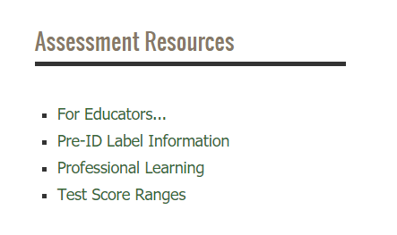
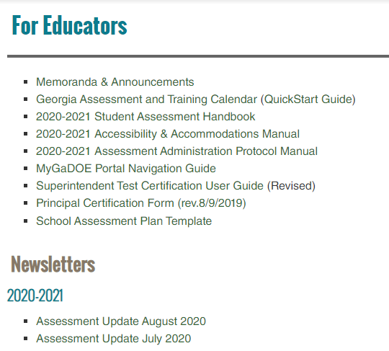
Assessment Administration Resources
testing.gadoe.org
Notes:
Sandy
Very often, we get questions regarding where assessment administration resources may be found. When looking for these resources, you will need to go to the Testing/Assessment website at testing.gadoe.org. From there you may find links in the left-hand column to Georgia Milestones. In the right-hand column System Test Coordinators should look for Assessment Resources and click on the For Educators link there. This link opens the page to the state assessment and training calendar as well as the main manuals for administering assessments. In addition, this page include links to the monthly Assessment Updates.

Slide 9
2020-2021 Lunch and Learns
Assessment
Date | Time | Link
Friday, 9/11/2020 | 12 – 1 p.m. | September 2020 Assessment Lunch and Learn
Friday, 10/16/2020 | 12 – 1 p.m. | October 2020 Assessment Lunch and Learn
Friday, 11/13/2020 | 12 – 1 p.m. | November 2020 Assessment Lunch and Learn
Notes:
Lunch and Learns are webinars that give current information about the statewide testing program and actually continue through March 2021. All dates are currently on the posted online calendar. We will post these sessions with registration links provided in the Assessment Updates.

Slide 10
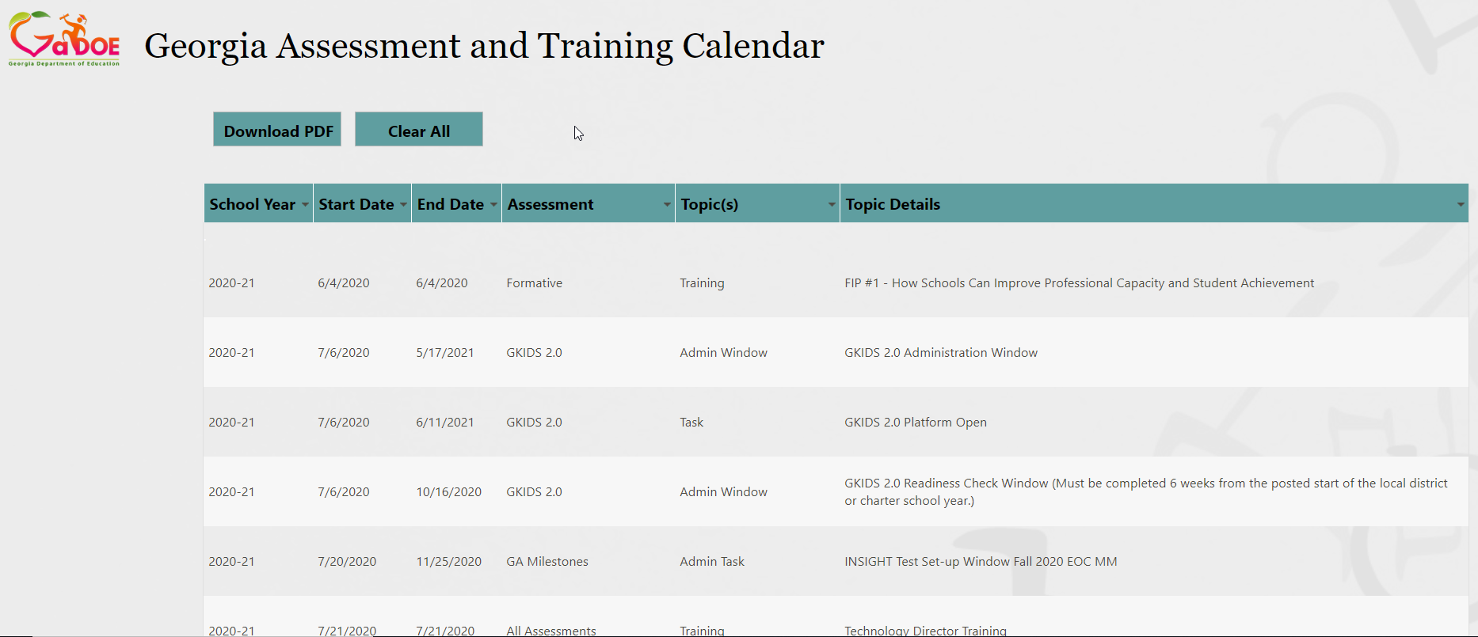
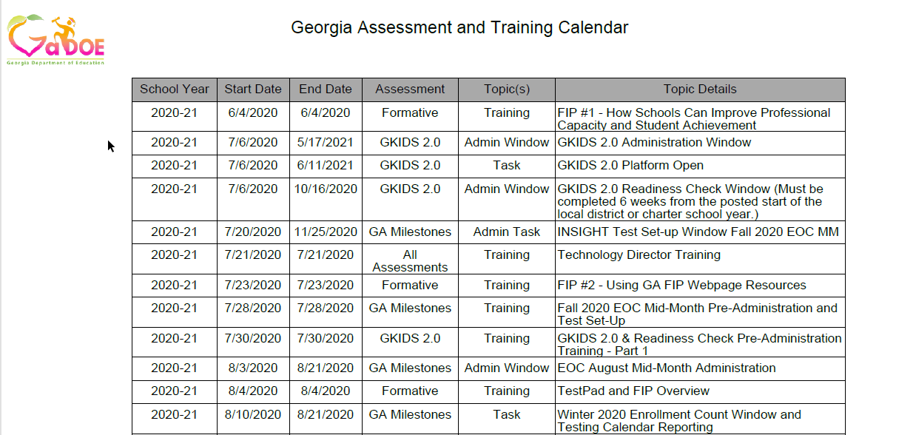
Assessment Administration Resources
Allows filtering by assessment, date, task, and topic
Downloadable PDF
Notes:
The Georgia Assessment and Training calendar allows filtering by each column. Results can be exported to a PDF.

Slide 11
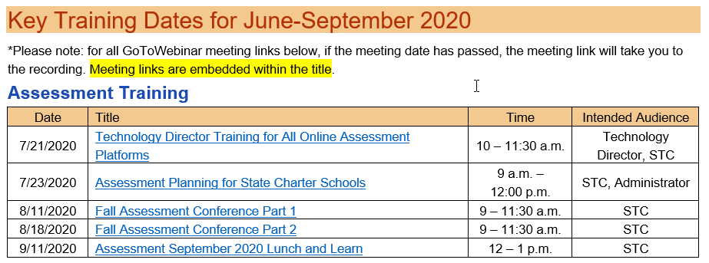
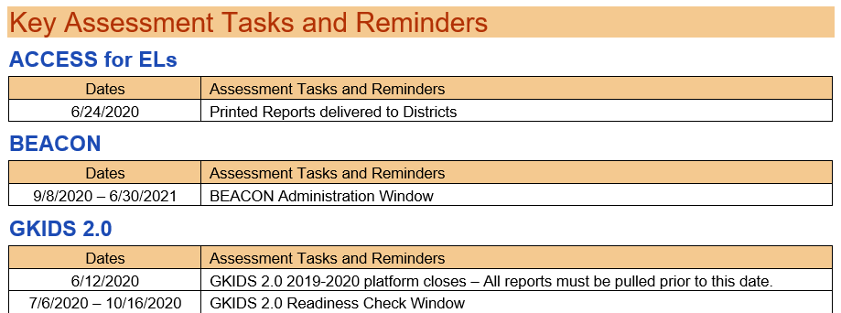
Assessment Administration Resources
Notes:
The assessment updates include relevant content for all testing programs including upcoming training, tasks and announcements.

Slide 12
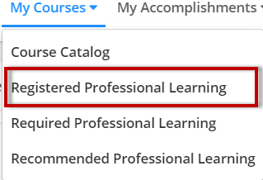
Online Training Courses
System Test Coordinator Training Course
Georgia Milestones Spring School Test Coordinator Course
Log into SLDS
Click on PL
To find the course, you choose “Course Title” search box, enter “test coordinator” and click the magnifying glass.
Register for the course.
Find the course under Registered Training.
When you have finished the course and received 100% on the quiz, you can print your certificate.
Quick Start Guide for accessing the course can be found on Training Resources page.
Notes:
Two online Moodle training courses are offered through SLDS. The System Test Coordinator training course allows new and returning system coordinators a location to access the training and resources for implementing all the state testing programs. The School Test Coordinator training course is design to walk school leaders through the state requirements for Georgia Milestones administration. We have included a quiz and a certificate for completing the course and passing the quiz.

Slide 13
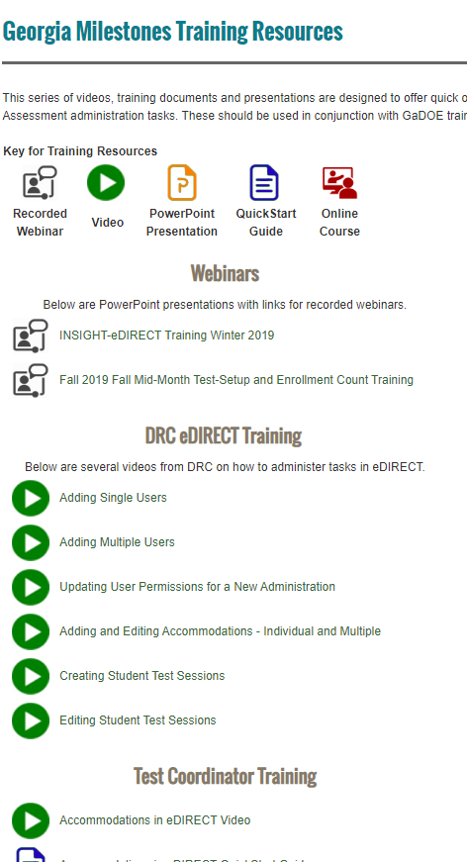
Training Resources
Georgia Milestones Training Resource Page
Training Types
 | Recorded Webinars
 | Videos
 | PowerPoints
 | QuickStart Guides
 | Online Courses
Training Topics
Webinars
DRC eDIRECT Training
Test Coordinator Training
Test Examiner Training
Student Training
Notes:
A variety of resources are offered for training. The Recorded Webinars include presentations delivered by the GaDOE. Also provided as a series of short video presentations covering variety of assessment topics. The PowerPoint documents for many of these presentations are posted here so districts can redeliver topics locally – many of which include the script to aid in redelivery. QuickStart Guides are short pdf documents with information to quickly guide users on training topics.

Slide 14
MyGaDOE Portal and Vendor Contact Information
Assessment | Vendor | Contact
MyGaDOE Portal/All | Georgia Department of Education https://portal.doe.k12.ga.us/login.aspx | Local System Technology Coordinator (STC)
ACCESS for ELLs 2.0 | WIDA (for WIDA.us) Data Recognition Corporation (DRC) (for the WIDA Assessment Management System, WIDA AMS) | WIDA Customer Service (866) 276-7735 help@wida.us DRC Customer Service (855) 787-9615 WIDA@datarecognitioncorp.com
GAA 2.0 | Questar | Questar Customer Service GA@QuestarAI.com (866) 997-0698
GKIDS 2.0 | Georgia Center for Assessment (GCA) https://gkids.gadoe.org | Georgia Center for Assessment (GCA) (888) 392-8977
Georgia Milestones BEACON | Data Recognition Corporation (DRC) | Data Recognition Corporation (DRC) (866) 282-2249 gahelpdesk@datarecognitioncorp.com
Notes:
This table includes contact information for the MyGaDOE portal and vendors for our major testing programs.

Slide 15
Overview
Formative
GKIDS Readiness Check
GKIDS 2.0
Keenville
DRC BEACON
TestPad
FIP
K
Summative
ACCESS for ELLs
GAA 2.0
Georgia Milestones EOG/EOC
12
Notes:
Georgia offers a wide range of formative and summative testing programs from Kindergarten through 12th grade.

Slide 16
Formative Assessments
Georgia Kindergarten Inventory of Developing Skills (GKIDS 2.0)
Keenville
Notes:
Joe

Slide 17
GKIDS 2.0
Overview
GKIDS 2.0 is a progression-based formative assessment, integrated into classroom work, that is aligned to the state content standards.
GKIDS 2.0 is a state-mandated assessment.
GKIDS 2.0 includes the GKIDS Readiness Check.
The Readiness Check administration window is unique to each district. The window:
is based on the district’s start date; and
closes 6 weeks (30 school days) from the start date.
The ability to enter student data is not available after the end date of the district’s GKIDS Readiness Check administration window.
Notes:
Read slide
Add "you can see the closing date for your Readiness Check window from your system dashboard. If the closing date is showing as 6/1/2020, that is an indicator that your district has not submitted your calendar to the policy division for this year. Please contact them at policy@doe.k12.ga.us to get this information submitted. The full calendar of holidays and testing dates needs to be included in the calendar in order to program the Readiness Check window for your district. "

Slide 18
GKIDS 2.0
Student Support
GKIDS 2.0 is designed to provide information for ALL students enrolled in kindergarten by allowing students of varying levels of ability to participate in all activities with the use of supports.
Universal Allowances
May be used, as needed, with all students for all performance tasks
Aligned to best practices for access to instruction and assessment
Provide for a range of actions, material presentations, procedures, and settings
Comprehensive Supports
Provide access to a performance task but may substantially alter what the student is expected to do.
If utilizing comprehensive supports, care should be taken when interpreting a student’s progress within the learning progression.

Slide 19
GKIDS 2.0 and Readiness Check
Key Administration Tasks and Training
Date Range | Task
July 6, 2020 – October 19, 2020 (based on local calendar) | GKIDS 2.0 Readiness Check data entry period
January 28, 2021 (Webinar only, no datafile provided) | Mid-year checkpoint
July 6, 2020 – May 14, 2021 | Administration Window
June 11, 2021 | Platform closes for data entry
Dates | Title | Location
Available | Teacher Training Modules | SLDS
7/30/2020 | Pre-Administration – Part 1 | Assessment Update
8/13/2020 | Pre-Administration – Part 2 | Assessment Update
10/1/2020 | Data Entry and Reports | Assessment Update
1/28/2021 | Mid-year Data and Reports | Assessment Update
4/28/2021 | Review/End-of-year Reports | Assessment Update
Notes:
These are the important dates to add to your calendar for this year for the GKIDS assessment. The closing date for the Readiness Check window is based on the anticipated start dates for all the districts. Delayed start times could impact this timeline so be sure to notify us if your district's start date has changed so your 6 week window and the overall window for the entire RC period can be revised.

Slide 20
Keenville
Overview
Keenville is Georgia’s game-based formative assessment in literacy and mathematics for first and second grade students.
Keenville is accessible via the Statewide Longitudinal Data System (SLDS).
Notes:
Read slide.

Slide 21
Keenville
Purpose
Provide
educators a formative measure on essential literacy and numeracy skills in the early grades.
Promote
teaching and learning by guiding differentiated instructional practices to maximize student learning.
Engage
young learners through a series of interactive challenges that directly align to Georgia content standards.
Notes:
Read slide.

Slide 22
Formative Assessment Resources
Formative Instructional Practices (FIP)
TestPad
DRC BEACON

Slide 23
Formative Assessment Resources
TestPad (in SLDS)
Item and test content in TestPad
Benchmark development tool
Item and passage creation
Formative Instructional Practices (FIP)
Online professional learning for teachers, coaches, and leaders
Notes:
Georgia Offers formative resources for classroom teachers. TestPad contains test items related to content areas assessed by the Georgia Milestones Assessment System and NAEP. Teachers and administrators​ can utilize TestPad to develop formative and summative assessments, aligned to the state-adopted content standards, to assist in informing daily instruction.
Formative Instructional Practices offers Online professional learning for teachers, coaches, and leaders

Slide 24
Formative Instructional Practices (FIP)
Online and blended model of professional learning to develop educators’ knowledge and use of lesson-based formative assessment
FIP Training Series
6/4/2020 | FIP - How Schools Can Improve Professional Capacity and Student Achievement
7/23/2020 | Using Georgia FIP Web Page Resources for Improvement Planning
8/20/2020 | Using FIP Courses to Design Better Classroom-based Formative Assessments
9/17/2020 | Creating Optimal Opportunities to Lead FIP Professional Learning
10/22/2020 | FIP - Leading Teachers to help Students Revise their Thinking Using Formative Assessment
12/3/2020 | FIP - Organizing to Help Teachers Facilitate Student Ownership of Learning
Notes:
Formative Instructional Practices (FIP) utilize an online and blended model of professional learning to develop educators’ knowledge and use of lesson-based formative assessment. FIP practices create a better balance across daily, interim and summative assessments with daily assessments providing the greatest opportunity to offer immediate feedback to students to increase learning or address as correct misconceptions. We started a training set June 4 and will continue this through December as indicated here in the chart.

Slide 25
Accessing GA FIP Online Learning
K-12 public school educators can access courses at the GaDOE website for GA FIP when they have a unique access code and use their work email address to create an online learning account. Click the login link and have in hand your central office or school-unique FIP access code. Obtain access codes from the district-level Test Coordinator. Access codes are in the Test Coordinator’s GaDOE Portal Account.
https://www.gadoe.org/Curriculum-Instruction-and-Assessment/Assessment/Pages/GeorgiaFIP.aspx
Notes:
Read page content

Slide 26
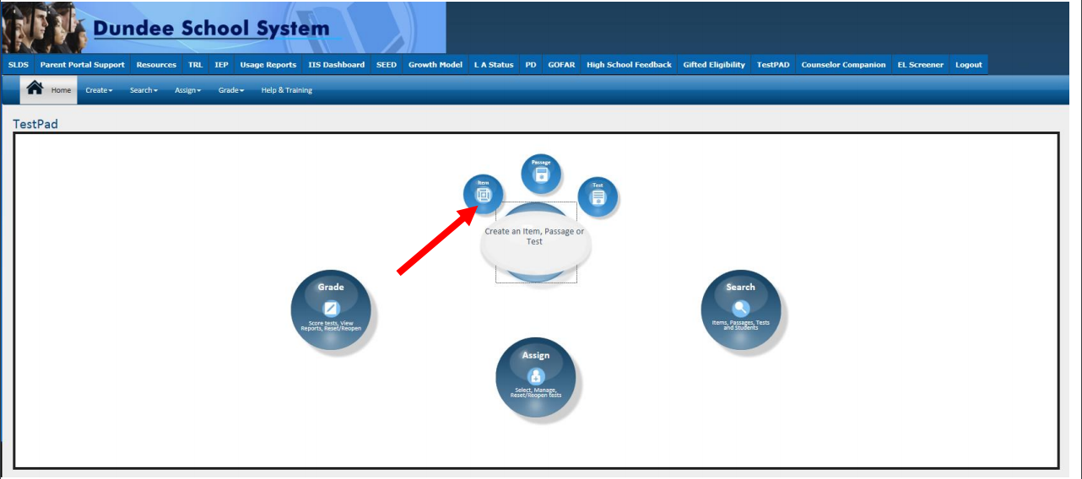
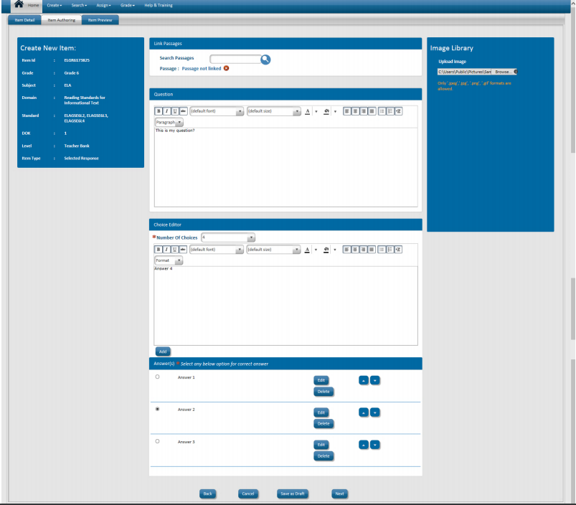
TestPad
Create and manage tests
Create Test Items, Passages and Rubrics
Notes:
TestPad allows teachers and administrators to create custom assessments for formative purposes and is available to teachers through the SLDS portal. There is a bank of test items aligned to state standards. Users can create their own items. Students can take assessments through the student backpack in the SLDS portal.

Slide 27
Key Features
Formative Assessment Resource
Introducing DRC BEACON as a Formative Assessment Resource
Aligned to GSE standards
Ongoing field testing of newly-developed DRC BEACON items allows for future alignment to standards, when the GSE are revised.
Truly formative – not high-stakes or used for accountability
The shortened Georgia Milestones continues to fulfill state and federal testing and accountability requirements.
Aligned with Georgia Milestones – standards, item types, delivery platform, accessibility tools and accommodations, estimated performance
Immediate and detailed results to inform instruction
Can administer full content area assessments or “testlets”
Provided free to all Georgia districts and schools as an optional formative assessment resource
Window opens September 9, 2020
Notes:
New this year, DRC BEACON is a formative assessment resource that will be available through the DRC INSIGHT portal September 8.
This tool will be truly formative – it will not be used for high-stakes purposes such as student or school accountability. DRC BEACON is aligned to the GSE standards. Ongoing field testing of newly-developed BEACON items will allow for future alignment to our standards when the GSE are revised.
BEACON is aligned with Georgia Milestones in multiple ways, including the standards assessed, item types administered, delivery platform used, and tools and accommodations available. In year 2 it will also provide estimated performance on the end-of-year Georgia Milestones assessment.
BEACON will provide detailed results to inform instruction. Administration options are flexible based on the needs of the district, school, or teacher and may be administered as full content area assessments in ELA and/or mathematics or as “testlets” in specified domains. In addition, it may be administered to a full class, in small groups, or to individual students as needed.
BEACON is being provided free to all Georgia districts and schools as an optional formative assessment resource.

Slide 28
Possible Scheduling Ideas
Option 2
Option 1
Instruction
Remediate based on need
Accelerate based on mastery
ELA Testlets
Instruction
Remediate based on need
Accelerate based on mastery
Administer based on Domain
Mathematics Testlets
Administer based on Domain
Cycle 1
ELA/Math Fall
Review data
Accelerate
Cycle 2
ELA/Math Winter
Review progress
Accelerate
Georgia Milestones
Review successes
Inform instructional program
Remediate
Remediate
Notes:
Districts have flexibility in determining how best to utilize BEACON. One possible idea indicated on the left shows, teachers can administer full content area assessments 2-3 times per year to track student understanding and progress. This data would be used to adjust instruction as it is still occurring.
The second idea shown on the right allows teachers the ability to utilize domain-specific testlets in between instruction to assess learning as frequently as needed. This approach allows for some progress monitoring and can support students who may need remediation or acceleration individually or in small groups within the classroom.
The two approaches can also be combined to work-in individual or small group testlets between full cycles, as needed, to provide remediation or acceleration.
The final assessment would then be the spring Georgia Milestones, which provides end of year summative data on student mastery. Data from these assessments may be used to review successes and inform the instructional program for the following school year.
With any schedule, districts and schools must consider the total amount of time they want to spend on such testing as well as their capacity in terms of time and devices.

Slide 29
Important Dates and Training
DRC BEACON
Date | Event | Targeted Audience
Tues., 8/25/2020 | DRC BEACON Overview & Pre-Administration Training | STCs, District, and School-level leadership
Tues., 9/8/2020 | DRC BEACON Launch | All Districts
Tues., 9/15/2020 | DRC BEACON Overview & Pre-Administration Training (Live Repeat) | STCs, District, and School-level leadership
Tues., 11/10/2020 | Using DRC BEACON to Inform Instruction Training | STCs, District, and School-level leadership
Tues., 1/12/2021 | Technology Director Training to Successfully Connect to All Online Assessment Platforms (Live Repeat) | Tech Directors and STCs
Tues., 2/2/2021 | DRC BEACON Training - Mid-Year Guidance & Reporting | STCs, District, and School-level leadership
Tues., 5/25/2021 | Post-Assessment Training | STCs
Notes:
We will be providing a variety of training sessions for BEACON beginning in July and continuing throughout the 2020-2021 school year. All training dates and links will be posted in the Assessment Updates each month as well as posted on the training calendar found on the GaDOE Assessment webpage under the For Educators link.

Slide 30
Contacts
GKIDS 2.0 Bobbie Bable, National Assessment of Educational Progress (NAEP), Georgia Kindergarten Inventory of Developing Skills (GKIDS) 404-657-6168; bbable@doe.k12.ga.us | TestPad Web Site http://www.gadoe.org/Technology-Services/SLDS/Pages/TestPAD-Training-and-Support.aspx TestPad Training Site http://sldstrn.gadoe.org/SLDSDemoWeb/TP.aspx
DRC BEACON Taiesha Adams, Ed.D., Assessment Specialist 404-656-5975 taadams@doe.k12.ga.us | Questions Regarding TestPad Content & School/System Usage Joe Blessing, Program Manager 404-232-1208 jblessing@doe.k12.ga.us
Joe Blessing, Program Manager 404-232-1208 jblessing@doe.k12.ga.us | Questions Regarding TestPad Functionality/Technical Support 1-800-869-1011 slds@doe.k12.ga.us
Keenville Lisa Hardman, Ed.S., K-5 Assessment Specialist 404-651-9405 lhardman@doe.k12.ga.us | FIP Kelli Harris-Wright, Ed.S. Assessment Specialist – GA FIP 404-463-5047 kharris-wright@doe.k12.ga.us

Slide 31
Summative Assessment Overview
ACCESS for ELLs 2.0
Alternate ACCESS for ELLs
Georgia Alternate Assessment
(GAA 2.0)
Georgia Milestones
NAEP
Notes:
Joe

Slide 32
ACCESS for ELLs & Alternate Access
Overview
ACCESS for ELLs measures the English language proficiency levels and progress of ELs in the domains of speaking, listening, reading, and writing.
Tasks replicate the language needed to communicate in school.
Alternate ACCESS measures how EL students with significant cognitive disabilities develop the language proficiency needed to participate in classroom instruction.
Test Window – January 13 – March 5, 2021
Test Administration Manuals will be available digitally
Notes:
ACCESS for ELLs is an English language proficiency assessment administered to K through 12th grade students who have been identified as English language learners. ACCESS for ELLs measures language development in the domains of Listening, Reading, Writing, and Speaking. This assessment is given annually to monitor students' progress in acquiring academic English.
There is also an Alternate form of the ACCESS for ELLs test for students with significant cognitive disabilities. Alternate ACCESS for ELLs aligns with the WIDA Alternate English Language Proficiency levels. Information about participation criteria and test administration of the Alternate ACCESS test can be found on the WIDA website under the Assessment tab.
The test administration window for ACCESS and Alternate ACCESS is January 13 – March 5, 2021.

Slide 33
ACCESS for ELLs & Alternate ACCESS
Resources
WIDA Resources
Family Engagement
Accessibility Guidance
Score Interpretation
Test Demo
WIDA Screener
ACCESS
Sample Items
WIDA AMS
User Management
Material Management
Reporting
Screener Scoring
WIDA Secure Portal
Test Administration Manuals
Webinar Recordings
Technology Resources
Notes:
There are many helpful resources on the web. The first two links are open to the public. You will find resources aimed at helping educators communicate information about the assessment to teachers and families. Teachers should use the test demo link to assess applications designed to familiarize students with the testing platform and format of test items.
The WIDA AMS link is secure, so STCs will need login credentials to manage users, order test material, obtain score reports. You will also need login credentials to access the WIDA Secure Portal. The WIDA Secure Portal houses test administration manuals, training modules, webinar recordings.

Slide 34
GAA 2.0
Overview
The purpose of the GAA 2.0 is to ensure that students with significant cognitive disabilities are:
provided access to the state-mandated content standards.
given an opportunity to show what they know and can do.
Only students meeting GAA 2.0 Eligibility Criteria may participate in the assessment.
Kindergarten students will no longer be assessed with GAA 2.0 and must be assessed with GKIDS 2.0 and Readiness Check.
Notes:
The Georgia Alternate Assessment was designed to ensure that students with significant cognitive disabilities in grades 3 through 12 are provided access to state-mandated content standards and are given an opportunity to demonstrate classroom learning. Participation is limited to those students whose IEP teams have determined they meet the eligibility criteria.
Beginning this fall, Kindergarten students with significant cognitive disabilities will take GKIDS instead of GAA 2.0.

Slide 35
GAA 2.0
Web-based Resources and Training
Teacher Resources
Sample Tasks
Vocabulary Lists
Extended Content Standards
Test Blueprints
Test Administration Manuals
Forms
Learner Characteristics Inventory (LCI)
Eligibility Criteria
Technology
Nextera Set-up and Installation Guide
Date | Event
GAA 2.0 Test Administration Procedures | October 8, 2020
GAA 2.0 Nextera Platform Training | January 21, 2021
GAA 2.0 Pre-Administration Webinar | February 18, 2021
GAA 2.0 Administration Window | March 22 – April 30, 2021
Notes:
Read slide content

Slide 36
Georgia Milestones
Georgia Milestones is designed to provide information about how well students are mastering the state-adopted content standards in the core content areas of English Language Arts, Mathematics, Science, and Social Studies.
Georgia Milestones is designed to provide students with critical information about their own achievement and their readiness for their next level of learning.
Notes:
Read slide content

Slide 37
Georgia Milestones
EOG | EOC
Grades 3–8 English Language Arts Mathematics Grades 5 Science Grade 8 Science Social Studies | Ninth Grade Literature & Composition American Literature & Composition Coordinate Algebra Analytic Geometry Algebra I Geometry Biology Physical Science United States History Economics/Business/Free Enterprise
Note: The list of EOC courses will be updated following SBOE action.
Notes:
Please read the listed courses

Slide 38
Georgia Milestones
Georgia Milestones is administered 100% online.
Online administrations allow for flexible scheduling, different item types, ease of administration, accessibility tools and rapid return of scoring.
Online administrations allow for additional scheduling flexibility for EOG.
Notes:
Read content of slide.

Slide 39
Georgia Milestones Updates
2020-2021 School Year
We are excited to announce several Georgia Milestones enhancements beginning in 2020-2021!
The goal of these updates is to reduce time spent on summative testing and return that time to instruction and formative feedback.
These updates do not substantively change the Georgia Milestones test design. Students will continue to have the same, but shortened, testing experience. Year-to-year comparability of results will not be impacted.

Slide 40
Georgia Milestones
Reduced Testing Times
Content Area | Section | Typical Testing Time | Max Testing Time
ELA | 1 | 45-65 | 90
 | 2 | 40-60 | 80
 | 3 | 40-60 | 80
Math | 1 | 30-50 | 65
 | 2 | 30-50 | 65
Science | 1 | 20-30 | 40
 | 2 | 20-30 | 40
Social Studies | 1 | 15-25 | 35
 | 2 | 15-25 | 35
Notes:
Testing times have been reduced this year to reflect the shortened test design. Based on analyses of prior years’ testing, adjusted for the new test design, we have determined the typical amount time in which most student should complete testing. If needed, however, students are allowed up to the maximum time shown here.

Slide 41
Georgia Milestones
Changes effective Winter 2020 EOC forward
To reduce the amount of time students spend on end-of-year Georgia Milestones assessments, we have:
Replaced all Constructed-Response (CR) items with Technology-Enhanced (TE) items in mathematics
Replaced some CR items with TE items in ELA
Section 1 (Reading and Evidence-Based Writing) and the Narrative Writing Prompt remain unchanged.
2-point CRs (which assess reading comprehension) in Sections 2 and 3 have been replaced with TE items.
Reduced the total number of points in science and social studies
Reduced field test positions
Eliminated norm-referenced items in all content areas

Slide 42
Reduced Testing Time
Technology-Enhanced (TE) Items
TE items allow us to elicit evidence of student learning in a fashion similar to that of current CR items.
Maintains quality of assessment while reducing testing and score return times.
TE item types
Evidence-based selected response, multi-part, multi-select, graphing, drag and drop, drop down list, keypad input

Slide 43
Enhanced ELA Reporting
Reporting Categories
Current Reporting Categories | New Reporting Categories
Reading and Vocabulary | Key Ideas and Details
 | Craft and Structure/Integration of Knowledge and Ideas
 | Vocabulary Acquisition and Use
 | Reading and Vocabulary will also be reported by Reading Informational Text and Reading Literary Text.
Writing and Language | Writing
 | Language
Notes:
In addition to reducing testing time, we have also enhanced the ELA reporting categories. Previously, the ELA assessment reporting categories were simply Reading and Vocabulary and Writing and Language. These categories have been expanded to include Key Ideas and Details, Craft and Structure/Integration of Knowledge and Ideas, Vocabulary Acquisition and Use, Writing, and Language. Reading and Vocabulary will also be reported by Reading Informational Text and Reading Literary Text.

Slide 44
Georgia Milestones
Paper forms are available for those students who cannot access the online assessment due to their disability.
Test Administration Manuals will be available digitally only.
Local decisions will need to be made regarding printing and distribution of manuals to Test Examiners
Digital presentation of the manual and/or script is an allowable option.
Printed ISR reports and labels will no longer be provided.
ISRs will be placed by GaDOE in the SLDS Parent Portal
Local decisions will need to be made regarding the need for printing and distribution to parents.

Slide 45
Georgia Milestones
Georgia Milestones Resources
Educator Resources
Administrator Resources
Student Resources
Technology Resources
Milestones Training Resources
Webinars
DRC INSIGHT Portal Training
Test Coordinator Training
Test Examiner Training
Student Training
DRC INSIGHT Portal
Participant Preparation
Test Preparation
Post-Test Action
Scoring and Reporting
General Information
Technology Setup
Notes:
A variety of resources are available including The Georgia Milestones Resources, Training Resources and the DRC INSIGHT portal.

Slide 46
PRE-ID Collection Windows
Georgia Milestones and DRC BEACON
Districts may elect to transmit Pre-ID data files to GaDOE Data Collections for 2020-21.
Districts have the option of transmitting the Multiple Student Upload (MSU) data file directly to DRC through INSIGHT instead of a Pre-ID file.
The MSU and Pre-ID data files have the exact same layout; the only difference is that the Pre-ID file is in .txt format and the MSU file is in .csv format.
2020-21 will be the final year that Pre-ID file submission will be accepted.

Slide 47
NAEP
2021 Assessment
Administration Schedule
January 25 – March 19, 2021
Assessed Subjects – Grades 4 and 8
Mathematics
Reading
Resources
Results: https://nces.ed.gov/nationsreportcard/
Data Explorer: https://nces.ed.gov/nationsreportcard/data/
Questions Tool: https://nces.ed.gov/NationsReportCard/nqt/
Notes:
It is anticipated that the NAEP testing will proceed as scheduled for 2021. The final decision from Congress and USED should be made by the end of August and selected districts and schools will be notified at that time.
Read Slide

Slide 48
National Assessment of Educational Progress (NAEP)
Managed through the US Department of Education
National assessment since 1969
Representative sample in each state
Measure achievement in 4th, 8th, and 12th grades OR ages 9, 13 and 17
State and national results in various subjects
School and teacher questionnaires
Results released as The Nation’s Report Card
Notes:
There are many areas in which NAEP differs from state assessments. Read Slide.

Slide 49
Contacts
ACCESS for ELLs/Alternate ACCESS for ELLs Mary Nesbit-McBride, Ph.D., Assessment Specialist, ACCESS for ELLs 2.0, Georgia Alternate Assessment (GAA) 404-232-1207 mnesbit@doe.k12.ga.us | Georgia Alternate Assessment (GAA 2.0) Mary Nesbit-McBride, Ph.D., Assessment Specialist, ACCESS for ELLs 2.0, Georgia Alternate Assessment (GAA) 404-232-1207 mnesbit@doe.k12.ga.us
Georgia Milestones – EOG/EOC Joe Blessing, Program Manager 404-232-1208 jblessing@doe.k12.ga.us Taiesha Adams, Ed.D., Assessment Specialist 404-656-5975 taadams@doe.k12.ga.us | NAEP Bobbie Bable, National Assessment of Educational Progress (NAEP), Georgia Kindergarten Inventory of Developing Skills (GKIDS) 404-657-6168 bbable@doe.k12.ga.us

Slide 50
Accessibility & Accommodations
Notes:
Taiesha

Slide 51
General Principles
Under the federal Individuals with Disabilities Education Act (IDEA), the Every Student Succeeds Act (ESSA) and the Georgia State Board of Education (SBOE) Rule 160-3-1- .07, all students, including students with disabilities (SWD) and English learners (ELs), must participate in the state’s academic content standards and assessments.
Notes:
According to Federal and state law and federal guidance all students must participate in the state’s academic content standards and assessments. To this end, the state designs assessments with features that address the access needs of the broadest range of students. To ensure students participate to the fullest extent possible in all statewide assessments, educators must also participate in a planning process that addresses the educational needs of all students, including English Learners and students with disabilities.

Slide 52
District Responsibilities
Local School Systems must have policies and procedures that require the administration of assessments that are not part of the state assessment program.
Students with disabilities may not be excluded from assessments administered to all students in a grade, class, or school.
Local school systems must continue to review all assessments administered at the system’s discretion and plan for accommodations and alternate assessment.
Notes:
Districts must have policies and procedures that also address the learner needs of all students. Students with disabilities may not be excluded from local assessments administered to all students in a grade, class, or school. Local school systems must continue to review all assessments administered at the system’s discretion and plan for accommodations and alternate assessments.

Slide 53
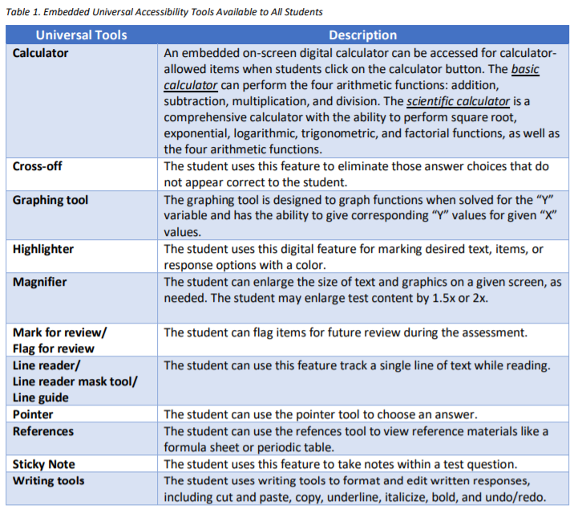
Universal Tools
Notes:
Universal tools are available to students participating in the Georgia assessment program to address their individual accessibility needs as they access instructional or assessment content. These supports are either embedded in the online test or provided by a test administrator at the local level during testing (i.e., scratch paper). Beginning with the 2020-2021 school year, the “line reader mask tool” also simply referred to as “masking” is not included in the list of embedded universal tools and will no longer be considered an accommodation.

Slide 54
Accessibility and Accommodations
Resources
Resource | Purpose | Location
Student Assessment Handbook | Policy Guidance | For Educators
Accessibility & Accommodations Manual | Types of Support Guidance in Choosing Supports | For Educators
Assessment Administration Protocol Manual | Monitoring Procedures before, during, and after assessments | For Educators
Test Administration Manuals | Specific test administration protocols by assessment | Program Sites
Notes:
We provide a variety of resources to educators involved with making decisions for students with disabilities. A summary of those resources are listed here including, their purpose and location on our websites.

Slide 55
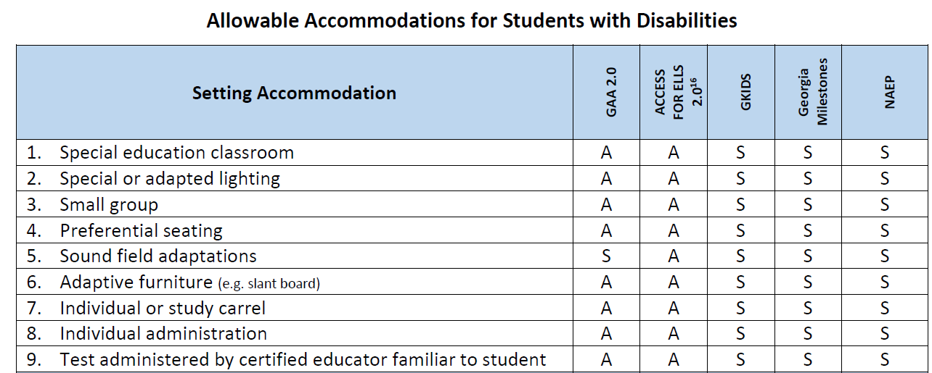
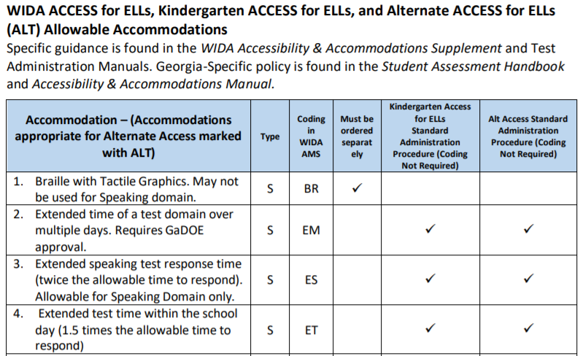
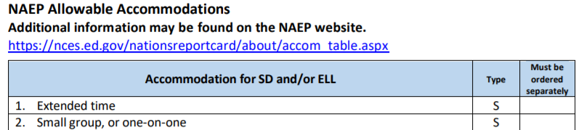
Allowable Accommodations Chart
Summary of Changes
Notes:
We have made a variety of changes to the Allowable Accommodations Chart for students with disabilities that participate in Georgia statewide assessments. In years past, accommodations for all assessment programs were recorded in a single chart. However, this no longer the case. You will notice, starting on page 91 of the SAH, that the chart has been separated by assessment programs in this manner (click): Georgia Milestones and & GAA 2.0 (click); then WIDA ACCESS for ELLs, Kindergarten ACCESS for ELLs, and Alternate ACCESS for ELLs (ALT) (click); and lastly NAEP with it’s own chart. It is imperative that school and district personnel become familiar with the newly designed charts so that they are well aware of the changes. We’ll discuss the most noted changes in the next few slides and will deeper into the discussion of accommodations in our Fall Conference 2. We are also preparing a crosswalk of the more subtle changes to assist you navigating the charts.

Slide 56
Allowable Accommodations Chart
Navigating the Chart: Georgia Milestones & GAA 2.0
Notes:
One purpose of redesigning the charts was to improve readability, thus improving user experience. So, let’s start by taking a look at the chart for Milestones and GAA 2.0. The first column lists all accommodations, grouped by type: setting, presentation, response and scheduling. The second column tells the type of accommodation – S for Standard and C – for Conditional. The next column is “coding required in online platform.” The check mark indicates that the accommodation will need to be coded in either INSIGHT (Milestones) or Nextera (GAA 2.0). The last column in the table indicates how the identified support is categorized/designated for GAA 2.0. Please note that most supports for GAA 2.0 are considered test administration procedures and can be provided to the student as they are in the classroom.

Slide 57
Allowable Accommodations Chart
Navigating the Chart: Georgia Milestones & GAA 2.0
2019-2020
2020-2021
Notes:
Let’s take a look at a few examples of specific changes to the Georgia Milestones and GAA 2.0 chart for some commonly used accommodations, particularly under the Presentation Accommodation column. Starting with the chart to the left (click), the “Large Font/Large Print” accommodation now reads as (click) “Enlarged font” with additional guidance related to magnification, scaling, and paper-pencil forms. Additionally (click), the “Sign ELA passages” accommodation now reads as (click) “Video Sign Language/Sign ELA passages” with a note to refer to the guidelines outlined in the SAH or Accessibility & Accommodations Manual. Of note, the charts no longer include a Footnotes section.

Slide 58
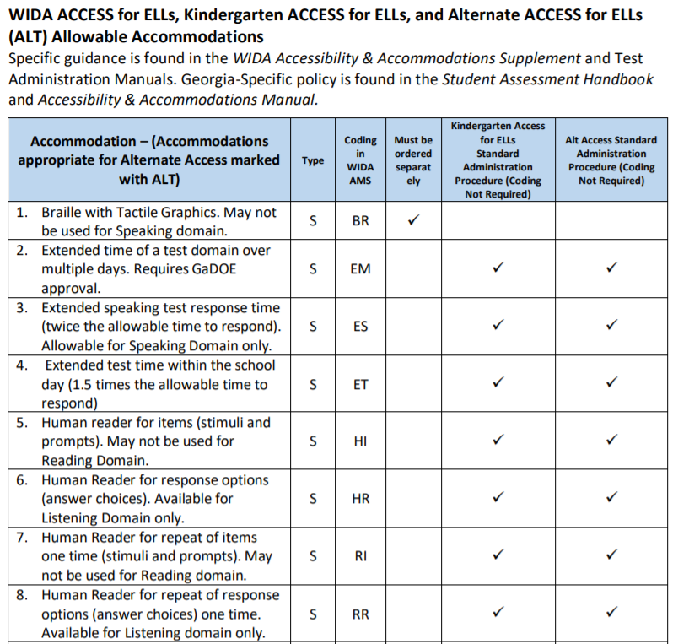
Allowable Accommodations Chart
Navigating the Chart: WIDA ACCESS & Alt ACCESS
Notes:
In addition to the new design, what is new for the WIDA ACCESS for ELs accommodations chart is a column (click) that helps educators identify supports for Alternate ACCESS. Similar to the GAA 2.0 column, the check mark indicates that the accommodation will need to be coded in WIDA AMS. Of note, all supports are presented as they are in the WIDA Accessibility Supplement.

Slide 59
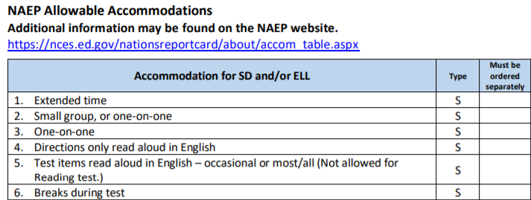
Allowable Accommodations Chart
Navigating the Chart: NAEP
Notes:
The NAEP accommodations chart includes a column that lists the accommodation and two additional columns labeled, “Type” and “Must be ordered separately.” For NAEP, all accommodations are standard as indicated with the ‘S” in the “Type” column. A check in the last column indicates that the accommodation must be ordered separately.

Slide 60
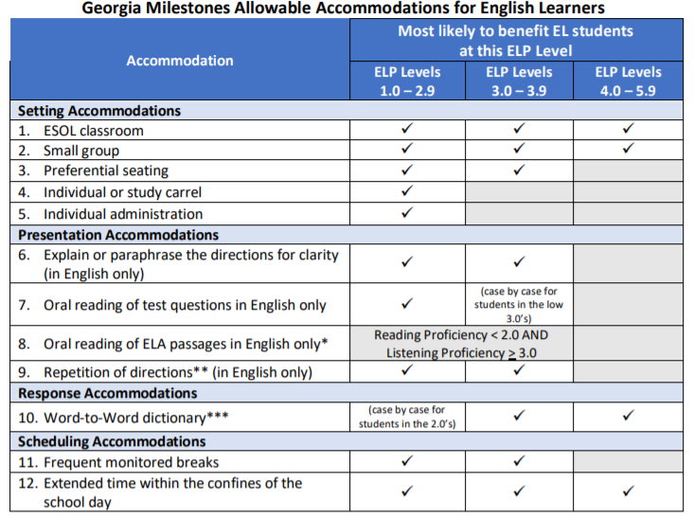
Allowable Accommodations Chart
Navigating the Chart: EL/TPC Teams
Notes:
This slide shows the newly revised ESOL Accommodations chart for EL/TPC teams and IEP teams to use when making accommodations decisions for EL students specific to Georgia Milestones. Decisions regarding accommodations should be made as required for individual students and based on appropriate data. Additional guidance is found in the Student Assessment Handbook and Accessibility and Accommodations Manual.

Slide 61
Test Security

Slide 62
Test Security
Guiding Principles
The primary goal of assessment security is to protect the integrity of the assessment and to assure that results are accurate and meaningful.
State assessments are an important and a required tool used to monitor state, district, school, and student achievement results.
For assessments to yield fair, accurate, and valid results, they must be administered under the same standardized conditions to all students.
Notes:
Understanding the guiding principles related to test security help to STCs plan for training activities and support school test coordinators and test examiners in understanding assessments in the district.
Review the slide contents.

Slide 63
New System Test Coordinators
Superintendent emails GaDOE Director of Assessment Administration the name and contact information for the STC
District security officer assigns the STC the role of Assessment Director in the MyGaDOE portal.
State Charter School security officers assign the role of Charter School Administrator to STCs in the MyGaDOE portal.
GaDOE notifies vendors of the addition/deletion of STC. New accounts are created, and login credentials are sent via email directly from vendors.
Notes:
Frequently, we receive emails from former and new STCs regarding a change in role. However, we cannot make any changes in STCs until the Superintendent of a district or charter school notifies this office of the change in STC. In addition, the Superintendent must contact the security officer for the district to request the additional role of Assessment Director in the MyGaDOE portal for the new System Test Coordinator. State Charter School roles are requested differently. State Charter School Superintendents must direct the security officer to request the role of Charter School Administrator for the new System Test Coordinator. In both cases, this will allow the new System Test Coordinator to receive information and emails from this office through the listserv.
It is important to note that issues of FERPA must be considered when assigning this role due to the level of access to confidential student data across the district and required for this individual through the MyGaDOE portal. It is recommended that only those directly related to assessment and assessment-related activities should maintain this role. A frequent review by the security officer may be needed to purge those who may no longer be associated with the district or who may no longer be associated with district-level student assessment.

Slide 64
Assessment Administration Resources
MyGaDOE Portal Login Page
Notes:
The MyGaDOE portal offers a variety of assessment resources and is the secure location for receiving confidential information from this office.

Slide 65
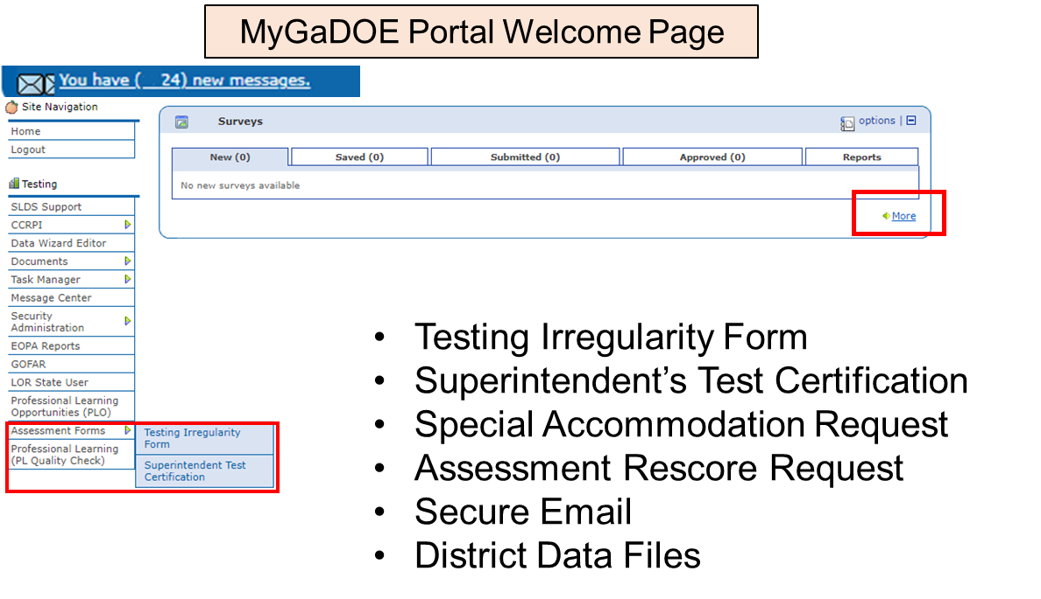
MyGaDOE Portal
https://portal.doe.k12.ga.us/login.aspx
Notes:
[Click] The Testing Irregularity Form, Superintendent Test Certification, and soon the Assessment Rescore Request are found on the Assessment Forms flyout.
[Click] The Special Accommodation Request and currently the Assessment Rescore Request are found in the surveys marked More. As mentioned the Assessment Rescore Request is soon moving to the Assessment Forms flyout.
[Click] The link to MyGaDOE portal secure email is found here. This is where you may communicate secure communication that may include student PII information, if needed.
[Click] And District Data Files are found on the district link found in the left-hand column near here.

Slide 66
Assessment Administration Resources
MyGaDOE Portal Online Forms
Special Accommodations Request Form
Guidance appears in Student Assessment Handbook
Last year, this online form replaced the need to submit requests via email
IMPORTANT: Email/Call Taiesha Adams or Mary Nesbit-McBride to notify GaDOE of request
Superintendent’s Certification Form
Tests administered January 1 – June 30: Submit no later than July 31
Tests administered July 1 – December 31: Submit no later than January 31
IMPORTANT: Email/Call Sandy Greene with questions
Assessment Rescore Request Form
IMPORTANT: Email/call appropriate GaDOE Assessment Specialist to discuss applicable fees and notify GaDOE of request
Also used for transcription requests
Testing Irregularity Form
Used to document any testing irregularity during any testing session
Contact GaDOE Assessment Specialist to discuss questions regarding irregularities and potential invalidations
Notes:
Read screen content

Slide 67
Student PPI Information Guidelines
All confidential/secure information, including student identifying information must be shared through the MyGaDOE Portal’s secure email function.
Types of information that must be shared through the MyGaDOE Secure Portal include, but are not limited to:
Student identifying information (e.g. GTID numbers, student names, etc.)
Confidential personnel information
Secure test content
Confidential student documents
Alert paper responses
Notes:
All confidential/secure information, especially student identifying information must be shared through the MyGaDOE portal secure email function or one of the forms previously shown. Work emails should not contain any student identifying information.

Slide 68
Student Assessment Handbook
Notes:
Sandy

Slide 69
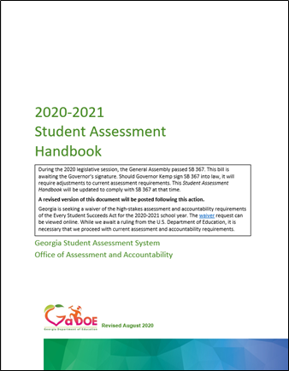
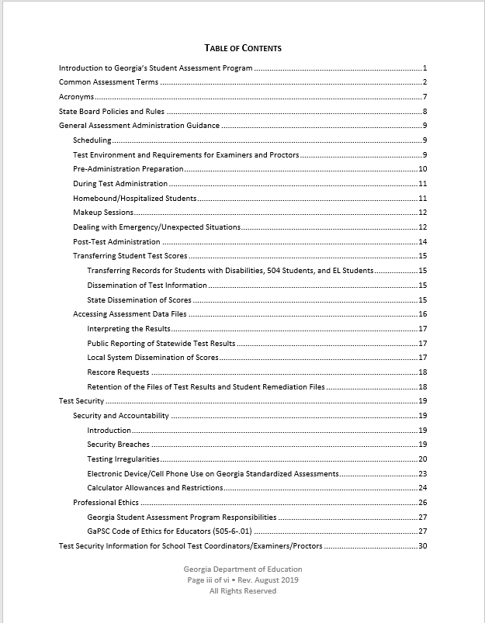
Student Assessment Handbook
Notes:
The Student Assessment Handbook is also found on the For-Educator’s site. This document contains guidance and policy information regarding assessment administration, test security and details surrounding each assessment and additional assessment resources. This document must be reviewed and forms the basis for many assessment decisions.

Slide 70
Student Assessment Handbook
Student Assessment Handbook
Test Security
Student Assessment Handbook
Electronic Devices/ Cell Phone Use
Calculator Allowances
State Board Rules
Roles and Responsibilities
Local Testing Schedules
Administration Requirements and Guidelines
Test Irregularities and Invalidations
Testing Environment
Accommodations
Professional Ethics
testing.gadoe.org
For Educators link
Notes:
Read slide.
The next set of slides will outline some key administration issues found in the Student Assessment Handbook.

Slide 71
Test Security
Security Hierarchy
Superintendent
Test Examiner
Student
School Test Coordinator
Principal
System Test Coordinator (STC)
The successful implementation of the statewide student assessment program requires a concerted effort by many individuals.
Notes:
The successful implementation of the statewide student assessment program requires a concerted effort by many individuals at the local level. Each of these roles has a place in providing an assessment program that supports instruction and student learning.

Slide 72
Test Security
Code of Ethics for Georgia Educators
Standard 10: Testing – An educator shall administer state-mandated assessments fairly and ethically.
Unethical conduct includes but is not limited to: committing any act that breaches Test Security; and compromising the integrity of the assessment.
GaPSC Ethics Division (January 2018)
See SAH | Optional Form: Test Security Information for School Test Coordinators/Examiners/Proctors
Notes:
The Georgia Professional Standards Commission includes as part of the Code of Ethics for Educators, Standard 10 which is specific to testing. An educator shall administer state-mandated assessment fairly and ethically. Local training should include a discussion of this standard and should focus on supporting examiners in administering, managing and monitoring assessment appropriately.
There are occasions that an incident occurs that warrants an investigation and referral to GaPSC. The GaDOE has made referrals to the GaPSC; however, we do support investigations by district Human Resource departments and the decision to refer to the GaPSC.

Slide 73
Roles and Responsibilities
Superintendent
The Superintendent has ultimate responsibility for all testing activities within the local school system. The System Test Coordinator shares this responsibility as the Superintendent’s designee.
The Superintendent must complete the Superintendent’s Certification Form in the MyGaDOE portal by January 31 and July 31 of each school year.
Principal
Principal has ultimate responsibility for all testing activities within the school.
The Principal must complete the Principal’s Certification Form after each administration.
See SAH | Review list of responsibilities

Slide 74
System Test Coordinator
Roles and Responsibilities
Liaison between system and GaDOE
Conduct local system trainings of School Coordinators
Know and enforce responsibilities of all other roles
Adhere to the state testing calendar and local calendars/schedules
Ensure accounts in test management systems are current
Coordinate ALL assessment administration activities
Implement plans for ordering and receipt of materials, distribution, test security, administration, collection and return shipments, receipt and dissemination of reports and data
See SAH | Review list of responsibilities

Slide 75
School Test Coordinator (SchTC)
Roles and Responsibilities
GaPSC certified Educator (per Student Assessment Handbook)
Attend and then redeliver training to Examiners and Proctors
Ensure test management systems and devices are updated and ready for online administrations
Plan for all aspects of the school’s test administration, monitor test administration environment
Ensure correct assignment of student accommodations
Implement district/school plan for inventory, storage, distribution and return of secure test materials.
Collaborate effectively with local system colleagues who have a role in the success of your system’s testing program.
See SAH | Optional Form: Test Security Information for School Test Coordinators/Examiners/Proctors

Slide 76
Test Examiner
Roles and Responsibilities
Holds GaPSC Certification (includes teachers, interpreters, counselors, administrators, and paraprofessionals)
“Certified Educator”- holds a clearance certificate as defined by the GaPSC
Use of an uncertified examiner will result in invalidation
Verifies and ensures the proper assignment of student information and accommodations on all assigned test tickets; and monitors the correct deliver of assigned accommodations in online and paper/pencil settings where assigned.
Controls the testing environment through active monitoring of students
Reads all scripts for test administration as provided in Test Administration Manuals
Follows all test administration procedures as provided in training and Test Administration Manuals and adheres to all test security guidance
Verifies and ensures the proper receipt and return of secure test materials
See SAH | Optional Form: Test Security Information for School Test Coordinators/Examiners/Proctors

Slide 77
Proctor
Roles and Responsibilities
Participates and completes all training related to test administration, test security, and ethical behavior
Monitors online test administrations and communicates with Examiner when test administration, technology, and/or student issues arise
Assists the examiner in:
Applying and enforcing prescribed calculator, cell phone, and electronic device guidelines
Distributing and collecting classroom test materials
Answers questions regarding test procedures but does not explain items or answer any questions regarding test content
Monitors student activity to discourage misconduct
Reports any unusual circumstances to Examiner immediately
See SAH | Optional Form: Test Security Information for School Test Coordinators/Examiners/Proctors

Slide 78
Training Plan
Educator Role Expectations
Activity | STC | SchTC | Examiners/Proctors
Participate in test security/ethical behavior training | GaDOE | District | School
Review Roles and Responsibilities section of the SAH | X | X | X
Review test administration procedures and protocols in the Test Administration Manual | X | X | X
Review Examiner’s Script | Monitor | X | X
Review Accommodations and Universal Tools, e.g., SAH, Tables, Test Tickets | X | X | X
Review Assessment Monitoring Protocols | District | School | Test Environment
Documentation of Training | Monitor | X | X
Optional Form: Test Security Information for School Test Coordinators/Examiners/Proctors

Slide 79
Visualizing the State Testing Windows – Yearlong
September 2020 EOC MM
January 2021 EOC MM
9/8/2020
1/11/2021
October 2020 EOC MM
February 2021 EOC MM
10/12/2020
2/8/2021
August 2020 EOC MM
November 2020 EOC MM
March 2021 EOC MM
8/3/2020
11/9/2020
3/8/2021
Jul
Sep
Nov
2021
Mar
May
Jul
2021
Today
GKIDS 2.0
7/6/2020 - 5/17/2021
Milestones Secure Practice Test Window
10/5/2020 - 5/7/2021
Winter 2020 EOC
11/30/2020 - 1/6/2021
ACCESS for ELs 2.0
1/13/2021 - 3/5/2021
NAEP (selected schools)
1/25/2021 - 3/5/2021
Spring 2021 GAA 2.0
3/22/2021 - 4/30/2021
Spring 2021 EOG
4/12/2021 - 5/21/2021
Spring 2021 EOC
4/19/2021 - 5/28/2021
Summer Retest 2021 EOG
5/10/2021 - 7/16/2021
Summer 2021 EOC
6/14/2021 - 7/16/2021

Slide 80
Scheduling of Assessments
All local district testing windows must be within posted state testing windows and must be consistent with guidance found in the Student Assessment Handbook.
Requests for exceptions outside of allowed flexibility must have prior approval by the GaDOE.
The order of administration is determined by the guidance provided in Test Administration Manual for each assessment.
In scheduling each assessment, districts/schools must adhere to the testing times prescribed in the Test Administration Manuals.
Determine the plan for communication of local testing windows to parents/guardians and other stakeholders, including school-level leaders and educators.
Notes:
Local testing calendars for state assessments must be compliant with the calendars posted in the Georgia Assessment and Training calendar as well as guidance found in the Student Assessment Handbook. Because of the time allowed in the state windows and flexibility allowed for some of the state assessments, careful consideration by the STC and the assessment team should support a meaningful testing calendar that allows for the administration and quality results.

Slide 81
Test Environment
Set-Up and Materials
Test Administration Manual
Testing – Do Not Disturb sign
No Electronic Devices sign
Blank Scratch Paper
Student Test Roster
Test Tickets
List of Accommodations
Calculators, if needed
Active Monitoring Plan
Space and/or dividers between computers
Cover instructional materials
Software on devices
Materials Management
Notes:
The Student Assessment Handbook provides guidance regarding the provision of an appropriate test environment for students – one that is intended to allow for a positive testing experience. Each testing setup is unique so System and School Test Coordinators will need opportunities to discuss and ensure that planned test environments are designed to consider how desks, tables, or computers are distributed and the proximity of students to each other.
Collaboration with district and school technical support should ensure that online test platforms and devices are updated and ready for assessment. Physical barriers between students may be needed and planned for to limit distractions and discourage cheating. Additionally, a plan should be in place for the gathering and collection of cell phones and other electronic devices in compliance with cell phone policy.

Slide 82
Understanding Your Students
Hospital Home Bound Students
Makeup Sessions
Should administer assessment similar to or the same as the local testing calendar
Test materials must be checked out and returned the same day
Must be within the state and local testing window
May not be used for personal student activities
May not be used due to school-sponsored activities such as field trips
May be used for national or state-wide events for which the local system has no control

Slide 83
Unexpected Event Contingency Plan
State-Wide School Closures
Widespread Internet or Power Outage
Emergency/Unexpected Situations
Guidance will be provided to superintendents through the offices of the Governor and/or the State Superintendent
Information provided by GaDOE Assessment & Accountability will be reviewed and cleared through the State Superintendent’s office
Any waiver requests to the U.S. Department of Education will be submitted by the State Superintendent’s office, if needed
Known or anticipated weather events should be monitored locally
District STC notifies GaDOE Assessment Specialist of outage and impact to students
Assessment Specialist will provide guidance and monitor continuing assessments
Emergency drills should not be scheduled during a test administration window
Educators must first act to assure the safety of all children and adults
District STC notifies GaDOE Assessment Specialist if the event is one of a lengthy duration

Slide 84
Communicating Test Results
Summary Reports are embargoed until they are released by the GaDOE.
Summary Reports including district and state data are embargoed until released by the State Superintendent.
Embargoed data may not be shared at public board meetings or with the media until notification has been received from the State Superintendent.
Preliminary reports are not embargoed and may be shared with parents, students, teachers and staff related to the student as soon as they are received for the purpose of assigning grades (EOC only), promotion/retention decisions, and other individual student-focused needs.
Notes:
District may not share embargoed data with the public. However, preliminary reports may be shared with parents, students and staff related to the student.

Slide 85
Test Irregularities
Notes:
Sandy

Slide 86
Guidance and Reporting
Test Irregularities
The System Test Coordinator will provide guidance to investigate all testing irregularities.
The School Test Coordinator must provide information to the System Test Coordinator that details:
What happened
Who was involved
To what degree was the student disadvantaged or advantaged
Supports the district’s recommendation(s) or conclusions (e.g., written statements, video…)
See SAH | Assessment Administration Protocol Manual

Slide 87
Irregularity Response Process
All personnel in the local system must follow protocol as they become aware of testing irregularities
Signs of any testing irregularity must be dealt with immediately
All irregularities must be reported to the GaDOE by completing the Testing Irregularity Form (TIF) in the MyGaDOE Portal.
The Incident Reporting Guide (Appendix N) may be found in the Assessment Administration Protocol Manual.
Test Examiner
System Test Coordinator
GaDOE
School Test Coordinator
Keep Principal Informed
TIF
Notes:
Discuss the process of investigating an irregularity.

Slide 88
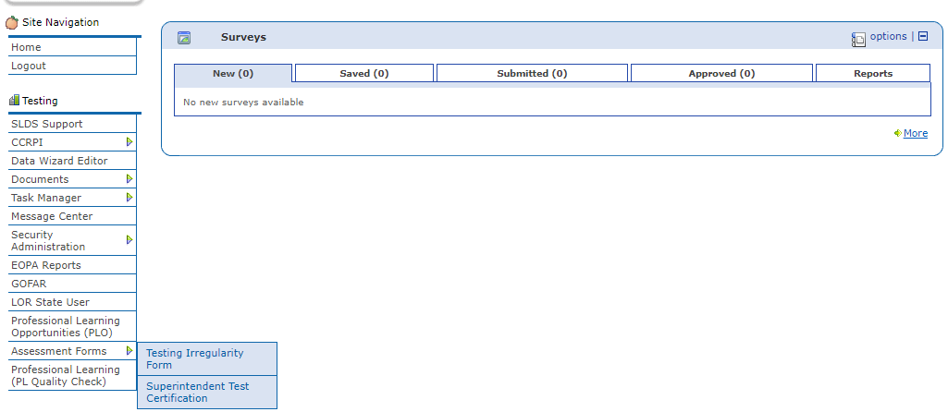
Recording Test Irregularity Forms
Testing Irregularity Form Summary Page
Refer to User Guide
Open for form review
Defaults to current active administration
Link to User Guide
Link to Training Video
Notes:
Review the process of entering a Testing Irregularity Form in the MyGaDOE portal.

Slide 89
Test Irregularities
Common Types
Reporting Procedures
Minimize Risks & Handle
Notes:
Read slide.

Slide 90
Types of Test Irregularities
Security Breaches
Staff or student sharing of any secure test material or content (social media, texting, email, verbal discussions, photographs, etc.)
Test Irregularities
Test Administration
Student Behavior
Staff failure to follow security regulations for distribution and return of secure test materials
Cell Phones/ Electronic Devices
Staff or student interference in student responses
Use of cell phones/electronic devices
Staff failure to follow assessment administration directions from the Examiner’s Manual
Security Procedures
Notes:
Security Breaches are any action that compromises test security or leads to the invalidation of an individual student’s or a group of students’ test scores. Please note the examples given in this slide are by no means all that could happen. Some time will be spent in the next set of slides to discuss minimizing risk of test security breaches and test irregularities.

Slide 91
Accommodation Error
Examiner Responsibility
Minimize Risks
Examiners should know what accommodations students are scheduled to receive prior to testing
Review Test Ticket for student name and accommodations
Check devices and online assessment platforms to ensure accommodations noted on test ticket have been applied and are functioning properly
Ensure accommodations that do not function in an online testing platform (e.g. extended time) are applied
Examiners should ensure they have space for accommodated materials and assistive technology
Large Print Booklets
Braille Booklets
Communication devices
Notes:
Read slide.

Slide 92
Accommodation Error
Student Preparation
Minimize Risks
Students should be familiar with their testing accommodations
Students should be familiar with the online testing platform including the use of universal tools and online accommodations
Students should know when and where their sessions are being held
Notes:
Read slide.

Slide 93
Accommodation Error
Educator Responsibility
Minimize Risk
Consider the daily schedules of students with extended time
Student test sessions begin should begin early enough to avoid interfering with lunch and school dismissal
Confirm all Scribes, Interpreters, and Human Readers have been trained in administration procedures specific to these special roles
scribing procedures include the requirement that student responses are entered into online test platform according to test administration guidance
Human Read-aloud and Interpreters must follow all guidelines
Notes:
Read slide

Slide 94
Specific Scenarios
Accommodations Error
Examiners give students the wrong accommodation or do not provide students with the correct accommodation.
Notify the parent/guardian (as soon as possible).
Enter the incident as an irregularity on the Test Irregularity Form in the MyGaDOE portal.
Test scores may be invalidated by GaDOE.
Students refuse their accommodations.
School or system notifies parent (prior to the beginning of testing, if possible).
Enter the incident as an irregularity on the Test Irregularity Form in the MyGaDOE Portal.
Add the Accommodations code in the online platform according to guidance found in the Test Administration Manual and/or Pre-Administration training since the school attempted to provide the accommodation.
Notify the student’s educational team of the incident.

Slide 95
Failure to Follow Directions
Student Preparation
Minimize Risks
Ensure students understand test directions before testing begins
Tell them about the no-calculator section
Show them the warning messages before testing
Handling the Situation
Note how many items the student completed inappropriately
Alert the System Test Coordinator
Notes:
Read slide.

Slide 96
Failure to Follow Directions
Student and Examiner Preparation
No-Calculator Online Warning
No-Calculator Paper Warning
End of Test Section

Slide 97
Cell Phones & Electronic Devices
Student Malpractice
If suspected, examiner must with minimal disruption:
collect the device,
allow the student to complete testing,
notify the School Test Coordinator immediately, and
when appropriate attempt to confirm use.
Simple possession of a device (including ringing of a phone) may be addressed locally and does not require an irregularity report to the GaDOE.
If confirmed, examiner, must with minimal disruption:
collect the device,
stop testing that student,
remove the student from the testing session, and
notify the School Test Coordinator immediately.
STC must complete a Test Irregularity Form in the MyGaDOE portal
If confirmed, the student test will be invalidated.
Notes:
Read slide.

Slide 98
Student Malpractice
Examples:
Sharing answers
Assisting peers during testing
Using electronic devices to copy, send, share answers or test information
Plagiarism

Slide 99
Student Malpractice
Cheating
Minimize Risk
Ensure students have been prepared for assessments
Prepare the testing environment
Actively monitor test environment
Handling Situations
If suspected, students involved should be moved or redirected, but testing should not be suspended
If confirmed, GaDOE will invalidate scores

Slide 100
Alert Papers
Communication regarding Alert Papers will be shared within the MyGaDOE Portal secure messaging system.
An email will be sent to the primary System Test Coordinator (STC) alerting him/her that a secure message is within the MyGaDOE Portal.
The STC will log into their MyGaDOE Portal email account https://portal.doe.k12.ga.us to retrieve the secure message.
Upon reviewing the secure message within the MyGaDOE Portal, the STC is to respond to the secure message alerting GaDOE the message has been received.
Upon reviewing the secure message, if the STC needs additional direction from the GaDOE, please contact your GaDOE Assessment Specialist.
Notes:
Alert papers are provided to STCs for any one of the following reasons:
A potential cheating incident
A student has written a response eliciting concern for the student’s safety and well-being
A student has written a response which is particularly concerning and may have implications for the student’s safety and well-being.
Read slide.
All confidential/secure information, especially student identifying information must be shared through the MyGaDOE portal secure email function or one of the forms previously shown. Work emails should not contain any student identifying information.

Slide 101
Staff Misconduct
Examples:
Coaching of student during testing
Altered or interfered with student responses in any way
Responses made available to students
Failure to follow regulations and/or procedures for test security (e.g. test tickets; inappropriate viewing of secure test materials; missing materials; failure to ensure student receives assigned accommodation)
Verbal communication or copying of shared test content including prompts and/or test items by electronic device, machine, handwriting, and any form of social media

Slide 102
Staff Misconduct
Test Examiner
Minimize Risks
Train staff
Follow script in Test Administration Manual
May answer procedural questions
Review test security guidance contained in Test Administration Manual
Provide manuals to Examiners before testing (digital or paper)
Handling Situations
If the incident involves improper conduct on the part of staff, a referral to the Georgia Professional Standards Commission for disciplinary action may result.
Notes:
Read slide.

Slide 103
Assessment Administration Contact Information
http://testing.gadoe.org
Toll-Free (800) 634-4106 and (404) 656-2668
Sandy Greene, Ed.D., Director of Assessment Administration 404-656-0478; sgreene@doe.k12.ga.us
Taiesha Adams, Ed.D., Assessment Specialist, Georgia Milestones, BEACON 404-656-5975; taadams@doe.k12.ga.us
Bobbie Bable, Assessment Specialist, National Assessment of Educational Progress (NAEP), Georgia Kindergarten Inventory of Developing Skills (GKIDS) 404-657-6168; bbable@doe.k12.ga.us
Joe Blessing, Program Manager, Georgia Milestones, TestPad, BEACON 404-232-1208; jblessing@doe.k12.ga.us
Kelli Harris-Wright, Assessment Specialist, Formative Instructional Practices (FIP) 404-463-5047; kharris-wright@doe.k12.ga.us
Mary Nesbit-McBride, Ph.D., Assessment Specialist, ACCESS for ELLs 2.0, Georgia Alternate Assessment (GAA) 404-232-1207; mnesbit@doe.k12.ga.us
Missy Shealy, Project Manager, Georgia Milestones 404-657-7651; mshealy@doe.k12.ga.us
Notes:
Contact Information.

Slide 104
Summary
8/11/2020
104

Slide 105
Questions

