Slide 1
Georgia Milestones
Winter EOC 2014
Online Test
Technical Set-up Training
November 3, 2014
10:00 am – 12:00 pm
Webinar Etiquette:
- Please use the Audio Setup Wizard in the Tools Menu to configure and test your audio settings before the presentation begins.
- To eliminate interference from background noise in your area, please leave the Talk Button on mute if you are not speaking.
- Due to the number of participants, we request that questions be submitted via Chat at the designated times in the presentation.
Notes:
This is the GA Milestones Winter EOC Technical Set-up Training. Although it is mainly directed towards Technology Coordinators, Test Coordinators are welcome as they can learn about the functions Technology Coordinators must complete for a good student experience.
Thank you for joining this training today. Let’s get started.

Slide 2
Introductions
Georgia Department of Education
Tony Eitel, Director, Assessment Administration
Dr. Robert McLeod, Assessment Specialist
CTB/McGraw-Hill
Kim Block, Senior Program Manager
Nadia Greer, Program Associate
Frank McClure, Customer Care Project Lead
Yogesh Vazirani, Online Implementation Manager
Renita Kelley, Briljent Presenter
Charity Flores, Senior Program Manager
Dr. Mary Nesbit-McBride, Assessment Specialist
Michael Huneke, Assessment Specialist
Ed Molin, Senior Program Manager
11/4/2014
2

Slide 3
EOC Winter Online Test - 3 Step Process
Today’s focus Checkpoint 2
Checkpoint 1
RTS data entry open
Checkpoint 2
Site Readiness Training
November 3rd and 10th
Test Delivery Client (TDC)Installation
Site Support and Troubleshooting
Site certification
Checkpoint 3
Test Administration System (TAS) Training
November 7th and 13th
Content Installation
Test Setup/ Assignment
Final Workstation Check
Slide 3
Notes:
Today we’ll review the technical aspects of online testing. Let’s go ahead and get started.
The checkpoint process (shown here) is meant to assist systems and schools with guidance as we prepare for the test administrations.
Checkpoint 1 focuses on the Registration and Technology Survey (RTS). The window is currently open so if you have not already done so, please log in and provide contact, workstation and network information for your High Schools and any other sites that will have Winter EOC test takers.
Checkpoint 2 is the focus of our session today. The goals for Checkpoint 2 are to install the Test Delivery Client and Site Certification by verifying a few of the workstations. Today is the first of 2 sessions. The second session is on November 10th
Before the Fall Mid-Month administration you were provided DEMO user accounts which gave you access to the DEMO content. The new TDC for winter is Version 15.1 and it will be made available on November 4th. This client will also be used to administer the spring Mid-Month tests.
If you downloaded version 15.0 for the Mid-Month administration you will need to uninstall that version and install the new TDC. It is recommended that you complete all of your November Mid-Month tests as soon as the window opens on November 10th, and then update to the new TDC for winter.
However, if you would like to update the TDC as soon as it’s available and then complete your November Mid-Month tests, that is an option as well.
We will have two training sessions for Checkpoint 3. The focus will be on the Test Administration System (TAS), the final content installation, and the final workstation check.
If you need to access the PowerPoint or the recorded training, please go to the CTB Georgia portal at: www.ctb.com/ga

Slide 4
Agenda
Roles and Responsibilities
Network and Workstations Requirements
Site Preparation Considerations
Support Resources
Q&A
Winter and Spring Mid-Month EOC Test Information, Milestones and TDC Updates
System Overview
Site Readiness Steps
Important Dates
11/4/2014
4
Notes:
Here is the agenda for todays session.
First, we’ll discuss the Winter and Spring Mid-Month EOC Test Information, Milestones, and TDC Updates
Then, we’ll review the Roles and Responsibilities for Test and Technology Coordinators.
After that, we’ll give you an overview of the testing system, followed by the Network and Workstation Requirements for testing.
Then, we’ll review the steps for site readiness.
We’ll also discuss some considerations for site preparation.
And finally, we’ll finish up by offering some support resources, important dates, and a Question and Answer session.
The slides that we are using today will also be posted at the CTB Georgia portal: www.ctb.com/ga
As a reminder, we’d like you to use the chat window for any questions that you have throughout the webinar.

Slide 5
EOC Online Test
(Winter & Spring Mid-Month )
Tests
GA Milestones Winter EOC Online Tests
Test Administration
GA Milestones Spring Mid-Month Online Tests
Feb 9th , 2015 to Feb 20th , 2015
Operational: Dec 1st, 2014 to Jan 9th, 2015
Winter EOC
Spring Mid-Month
Jan 20th , 2015 to Jan 30th , 2015
Mar 2nd , 2015 to Mar 13th , 2015
Practice: Nov 12th , 2014 to Jan 9th, 2015
11/4/2014
5
Notes:
Now I’d like to discuss the EOC Online Test administration. The tests that will be administered include the Milestones Winter OEC Online Tests and the Milestones Spring Mid-Month Online Tests. As you can see, the test administration dates are listed here as well. Please note that administrative activities in preparation for testing can take place at any time – the dates you see here are the testing windows for student test administration.

Slide 6
EOC Student Data
(Winter and Spring Mid-Month)
Spring Mid-Month
Online Pre-code window from Dec 1st 2014 to Jan 6th 2015
Student Pre-code data provided by the State will be loaded to Test Administration System
Winter
Online Pre-code window Nov 10th to Nov 14th
Manual entry of students in TAS
Online Pre-code file loaded to TAS
Manual entry of students in TAS
11/4/2014
6
Notes:
For Winter EOC testing, student data from the State-provided pre-code file will be loaded to the Test Administration System (TAS) automatically.
If you have additional online test takers, then you will have the opportunity to provide student data during the online pre-code window from November 10th through November 14th. Data from this window will then be loaded to the Test Administration System (TAS).
Student data can also be entered manually in the Test Administration System (TAS). We will cover this topic in the TAS training sessions.
For Spring Mid-month testing, you will have the opportunity to provide student data during the online pre-code window from December 1st thru January 6, 2015.

Slide 7
EOC Student Data
(Winter and Spring Mid-Month)
Precode User Guide (Available on Nov 4th)
  Purpose of Precode
  Step-By-Step instructions for completing the task
  Helpdesk Contact Information
  Frequently Asked Questions
Precode Window (Nov 10th to 14th for Winter)
  Nov 10th to 14th for Winter EOC
  Dec 1st to Jan 6th for Spring Mid-Month EOC
  During the window CTB will contact systems to resolve any inconsistencies in the Precode data
11/4/2014
7
Notes:
The Pre-code User Guide will be made available on Nov 4th. This will contain the purpose of the pre-code, step-by-step instructions for completing the task, Georgia (GA) Helpdesk Information, and Frequently Asked Questions (FAQs).

Slide 8
EOC Online Test Scope
Ninth Grade Literature & Composition
American Literature & Composition
Coordinate Algebra
Content Areas
Analytic Geometry
Biology
Physical Science
United States History
Economics/Business/Free Enterprise
11/4/2014
8
Notes:
Here are the content areas that will be administered for winter EOC and spring mid-month:
Ninth Grade Literature & Composition
American Literature & Composition
Coordinate Algebra
Analytic Geometry
Biology
Physical Science
United States History
Economics/Business/Free Enterprise

Slide 9
Important Dates
Milestones | Dates
Checkpoint 1 - RTS Registration and Technology Survey (RTS) Checkpoint 1 Window | Oct 15th to Nov 30th
Checkpoint 2 - TDC Test Delivery Client (TDC) for Desktops and Laptops | Nov 4th
TDC App for iPad (OAS GA) | Nov 25th
Checkpoint3 - TAS Test Administration System (TAS) Operational Accounts – Final Content, Student Management and Test Scheduling | Nov 12th
Administer EOC Winter Practice Tests | Nov 12th to Jan 9th
Notes:
Here are some upcoming milestones and important dates to remember:
Checkpoint 1 should be completed in the Registration and Technology Survey (RTS) by November 30th.
The Test Delivery Client (TDC) will need to be installed as part of Checkpoint 2, and this will be released by November 4th.
The TDC App for iPads will be released by November 25th.
Checkpoint 3 involves installation of the final content by Technology Coordinators. Student data management and test scheduling will need to be completed by the Test Coordinators. We will release the TAS Operational Accounts to Test Coordinators by November 12th.
Administration of the EOC Winter Practice Tests begins on November 12th, and runs through January 9th. All students should be given an opportunity to take the practice test to familiarize themselves with the OAS environment.

Slide 10
Important Dates
Milestones | Dates
Technical Setup Training – Session 2 (Repeat) | Nov 10th, 2014 1:00 pm – 3:00 pm, EST
Test Administration Training - Session 1 | Nov 7th, 2014 10:00 am – 12:00 pm, EST
Test Administration Training - Session 2 (Repeat) | Nov 13th, 2014 10:00 am – 12:00 pm, EST
Complete Site Readiness activities | Min one week prior to your site testing online
11/4/2014
10
Notes:
Here are some additional key dates for the EOCT Online Testing, including training. The recordings for the training sessions will be available at: www.ctb.com/ga.
Also, please note that the site readiness activities must be completed a minimum of one week prior to your site testing online. For your reference, the recordings for these webinar training sessions will be available at: www.ctb.com

Slide 11
Online Testing Program
Version Display on Login Screen
A built-in 20 minute Inactivity timer.
A 20 min timer displayed when student pauses Test.
New TDC Version 15.1 for Winter EOC & Spring Mid-Month
Notes:
Please also note that a new version of the TDC (Version 15.1) will be available for download on Nov 4th. This version will be used to administer Winter EOC and Spring Mid-month tests.
Those Systems and Schools that downloaded and installed the Test Delivery Client (Version 15.0) for the Fall Mid-Month EOCT Program would need to uninstall that version and install the new TDC. This is a very critical process step that needs to happen in order to ensure that tests are delivered correctly on student workstations for the Winter EOC and spring mid-month programs
Version 15.1 is the latest version. So, if you see that shown on the login screen, then you’ll know you have the latest version. It is important that you remove all older versions of the client from your servers and/or workstations prior to installing the latest version.
Also, there is a built-in 20 minute inactivity timer. If the workstation is idle for 20 minutes, it will time out the test session. Moving the mouse is sufficient to keep the test from timing out.
Additionally, students can pause the test, if needed. Once paused, the 20 minute timer will start. If that timer runs out, the student will not be able to continue with that subtest. To continue testing, an administrator will need to log into the TAS and reset the subtest. To avoid the timer from timing out, students will need to log back into the test and click on the “pause test” button again. This will reset the timer back to 20 minutes.

Slide 12

Roles Overview
Roles Overview
System Test Coordinator
Assessment policies, procedures and possible test scheduling
School Test Coordinator / Test Examiner
Test scheduling, student management, test administration, and invalidations
School Technology Coordinator
Setting up hardware and installing software for each school computer
System Technology Coordinator
Equipment and ISP, proxy servers, firewalls and WAN connections at each school
Notes:
Here is an overview of the test administration roles:
As you’ll see in the top-left corner, the System Test Coordinator is responsible for assessment policies, procedures and possible test scheduling.
In the top-right corner, you’ll see that the School Test Coordinator/Test Examiner is responsible for test scheduling, student management, test administration, and invalidations
In the lower left corner, you’ll see that the School Technology Coordinator is responsible for setting up hardware and installing software for each school computer
And finally, in the lower right corner, you’ll see that the System Technology Coordinator is responsible for equipment and ISP, proxy servers, firewalls and Wide Area Network (WAN) connections at each school.
The roles listed here are typical to an online test, however, depending on the size of the school system it’s possible that some people may have dual roles, or the responsibilities may overlap between roles.

Slide 13
Roles and Responsibilities
Tech Coordinator
Before Test
Receive Login and Password Emails
Complete Site Readiness Activities
Review Site Readiness and Installation Instructions
Verify network and workstation configuration
Run Network Utility software
Install test software
Download test content
Complete practice test
During Test
Assist Test Examiners with technical issues
Monitor Network utilization and Bandwidth to ensure optimum student testing experience
Notes:
Here you’ll see the roles and responsibilities of the Tech Coordinator:
Before the test administration window, the Tech Coordinator is responsible for:
Receiving Login and Password Emails
Completing Site Readiness Activities
Reviewing Site Readiness and Installation Instructions
Verifying network and workstation configuration
Running Network Utility software
Installing test software
Downloading test content
Completing practice test
During the test administration window, the Tech Coordinator is responsible for the following:
Assisting Test Examiners with technical issues
Monitoring Network utilization and Bandwidth to ensure an optimum student testing experience
Please note that these are typical activities that Tech Coordinators are required to perform. Depending on your site, there may be more items or other activities that your Test Coordinator may require assistance with.

Slide 14
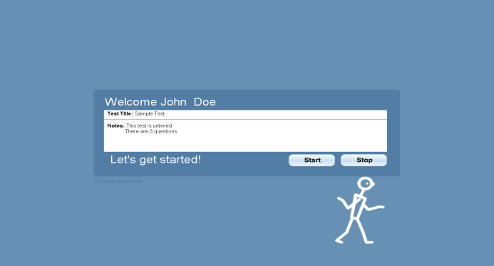
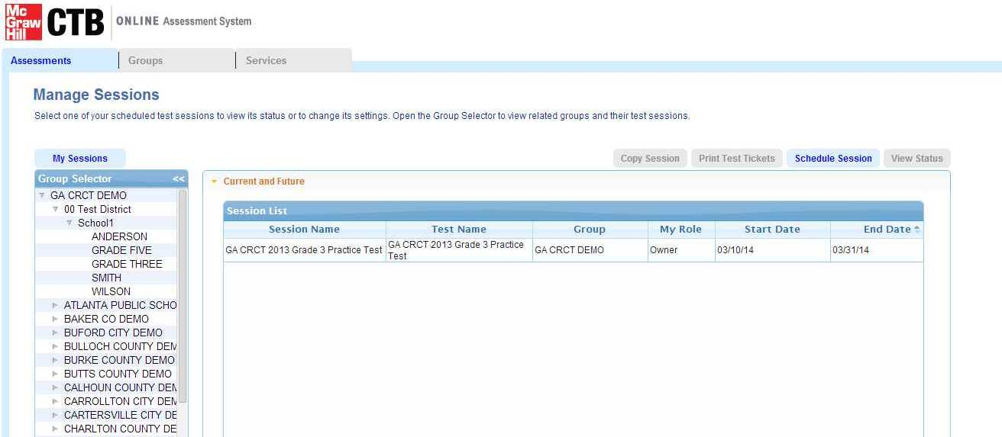
Online System Overview
Test Delivery Client (TDC)
Student testing software (TDC)
Lock down browser
Testing status
Test assignments
Student data management
Test Administration System (TAS)
Notes:
The Georgia Online Testing Program consists of 2 main components, the Test Delivery Client (TDC), and the Test Administration System (TAS) website.
The TDC is the software that students will use to take the online testing. It includes a locked down browser component, which keeps students from minimizing the software or accessing any other windows during testing.
The TAS is a web-based app where Test Coordinators can log in and update student data, handle test assignments, and check on testing status.

Slide 15
Test Delivery Client Agenda
Test Delivery Client
Network Requirements
Workstation (Desktop & Laptop) & iPad Requirements
Site Readiness Steps
For a Positive Testing Experience…
Select a Standard or Custom Install (suggested for large systems)
Notes:
Now, we’ll talk in more detail about what you need to do to set-up the workstations in preparation for testing.
We’ll start with the Network & Workstation Requirements; review the requirements for iPads; followed by detailed Site Readiness Steps and then we’ll conclude with considerations for a positive testing experience.

Slide 16
Network Requirements
Network Requirements
Bandwidth
T1, high-speed cable, or high-speed DSL recommended
Minimum 1.5 Mbps upload and download
Firewalls
Port 80 and 443 must be open
Proxy Servers
Do Not Cache Dynamic Pages
Prioritize traffic to and from *.ctb.com
Users must have credentials if proxy authentication is enabled
Web Content Filtering
Exclude *.ctb.com from content filtering
LAN
Allow both HTTP and HTTPS traffic for *.ctb.com
Wireless OK – Do not overload WAP
Do not block MP3 files – used for Text to Speech (TTS)
Allow traffic from *.readspeaker.com; IPs: 79.136.80.253 & 79.136.80.254
If your site uses IPs: 192.243.90.150, 192.243.90.229, 192.243.90.230, 192.243.82.18, 192.243.82.63, 192.243.82.64
Notes:
Here are the network requirements for online testing:
First, confirm network bandwidth. The minimum is 1.5 Mbps (megabits per second) upload and download speed. T1, high-speed cable, or high-speed DSL are recommended.
The next step is to setup the firewall. Ports 80 and 443 must be opened. Ctb.com also needs to be whitelisted. If you wish to enter IPs, please see the addresses listed here.
Continuing with proxy servers, make sure you do not allow caching of dynamic pages. Also, allow both HTTP and HTTPS traffic for *(star).ctb.com and *(star).readspeaker.com, and exclude these domains from content filtering. Also confirm that users have credentials if proxy authentication is enabled.
We’ve also provided IP addresses, if needed for certain equipment on your network.
As for web content filtering, please do not block MP3 files. The TDC uses MP3 files to deliver the audio for text to speech accommodated students.
Finally, using wireless is okay for online testing, just make sure you consider the distance from the Wireless Access Point and the number of connections to the Wireless Access Point (WAP).

Slide 17
TDC Installation
Site Readiness Steps
Step 2 - Uninstall Older Version of Test Delivery Client Software (MUST)
Step 3 – Install Software
Step 5 -Install Test Content
Step 4 – Run Network Utility (Standard Install)
Step 6 – Verify Installation - Take a Practice Test
Step 7 – Confirm Readiness
Step 1 – Confirm Minimum Requirements
Step 2 – Determine Installation Method and Access/Download Installer
Notes:
Here you will see the Site Readiness Steps:
As a reminder, if you downloaded version 15.0 for the Mid-Month administration you will need to uninstall that version and install the new TDC. It is recommended that you complete all of your Nov Mid-Month tests as soon as the window opens on Nov 10th and then update to the new TDC for winter.
However, if you would like to update the TDC and then complete your Nov Mid-Month tests, then that is an option as well.
If you have a version of the TDC that does not display 15.1 on the login screen, please un-Install that version from your workstations and servers.
The correct version of the client (Version 15.1) will be displayed on the login screen after successful completion of the installation process.
Next, install the Test Delivery Client and download the practice test content. And finally, confirm the installation by spot checking a few workstations.

Slide 18
Student Workstation Minimum Requirements
Workstation Requirements
Desktop, Laptop, Netbook, Thin Client* (*ex: NComputing)
Windows | MAC OS X | Linux
Windows Vista SP1 | Lion 10.7 (Intel) | Fedora 11 (Red Hat), 17
Windows 7 (32 & 64) | Mountain Lion 10.8 (Intel) | OpenSUSE 11.1, 12.2
Windows 8 (64) |  | Ubuntu 9.04, 12.04, 12.10
Processor / RAM Requirements
1.3 GHz Processor | 1.8 GHz Processor | 1.3 GHz Processor
1 GB RAM, 2 GB recommended | 1 GB RAM, 2 GB recommended | 2 GB RAM, 4 GB recommended
1 GB disk space available | 1 GB disk space available | 1 GB disk space available
Ancillary Software
Java (JRE) 6 or 7, 32 or 64 bit to match OS | Java (JRE) 7, 32 or 64 bit to match OS | Java (JRE) 6 or 7, 32 or 64 bit to match OS
Adobe Air v15 | Flash Player 13 | Adobe Air v 2.6
Screen Size / Resolution
Screen – “10-inch class” | Screen – “10-inch class” | Screen – “10-inch class”
Resolution - 1024 x 768 | Resolution - 1024 x 768 | Resolution - 1024 x 768
Notes:
As mentioned on the previous slide, the first step is to confirm the minimum requirements and here we have the workstation requirements for the TDC.
Several versions of Windows are supported as well as MAC and Linux operating systems.
Please refer back to this slide for processor and RAM/memory requirements for the testing software.
Note that JAVA, Flash and Adobe Air are required components for testing. Please install these ancillary applications prior to the TDC.
Refer to bottom of this slide for the screen size and resolution requirements for testing.
The workstation minimum requirements document will be located in the Technology section of CTB GA Portal at www.ctb.com/ga

Slide 19
Workstation Requirements Additional Software
Windows | Java (JRE)** | Adobe Air** | Adobe Flash**
Windows Vista SP1 | 1.7_0_55 1.7.0_67 | 4.0 15.0 | N/A
Windows 7 (32 & 64 bit)
Windows 8, 8.1
MAC OS X
Lion 10.7 (Intel) | 1.7_0_55 1.7.0_67 | N/A | 13.0, 15.0 14.0 is not recomendad
Mountain Lion 10.8 (Intel)
Linux
Fedora 11, 17 | 1.7.0_55 1.7.0_67 | 2.6 | N/A
OpenSUSE 11.1, 12.2
Ubuntu 9.04, 12.04, 12.1
** If newer versions of ancillary software are released, CTB will require a period of time for testing to certify for use with the Test Delivery Client.
Notes:
Here are the specific version requirements for the supporting software components.
Java 7 Update 55 is the most recent release that is certified by CTB for testing.
Please review this slide whenever you are ready to install the ancillary software.

Slide 20
iPad Requirements
Hardware
iPad®2 or newer, No iPad® mini’s
Monitor/ Speakers
Operating System
iPad® – iOS6 or newer
Additional Software
Guided Access (should be resident on the iPad). Guided Access use is required to allow iPad use for the TDC application only. Other apps cannot be started while Guided Access is on and locked for TDC.
Minimum screen size – 10” Class (No iPad® mini)
Sound On and Headset for “Text To Speech” Accommodated Students
Notes:
New for this administration is the fact that iPad2 or newer will be supported for testing. No other tablets are supported for winter EOC and spring Mid-Month testing.
If a site plans to use iPads for testing, the devices must be iPad 2 or newer with iOS6 or newer installed. The device must be in the 10 inch class of machines, which means the iPad Mini is not supported. Guided access is required to lock down the TDC.
Regarding Additional Software, Guided Access (should be resident on the iPad). Guided Access use is required to allow iPad use for the TDC application only. Other apps cannot be started while Guided Access is on and locked for TDC.

Slide 21
Installation Methods St
Installation Methods Standard and Custom
Option 1: Standard Installer
Option 2: Custom Installer
Standard interactive installation process
Places installed client into default installation directory
    c:\program files\ctb\Online Assessment
    (Windows, for example)
TDC is run by launching executable from directory
Non-interactive installation process
Places client files into common application data directory
    c:\documents and settings\all users\Application Data\CTB” (Windows 7, for example)
Unpacked TDC client immediately runs from directory
Key Differences between Option 1 and Option 2
Client file location on local disk is different between the 2 options
  Option 2 flexibility
    Installation executable launch point can be anywhere accessible to workstation (network, removable media, workstation, etc.)
    Directory used for unpacking / execution accessible to all users
    System administrators not required for running installation package
    Options to mass deploy executable to workstations via systems management tools, network share, images, etc.
Notes:
Now, we’ll quickly review the two installation options and some key differences. Option 1, the Standard Installer follows a standard interactive installation process whereas Option 2, the Custom Installer, will unpack, install and launch the client in one step whenever the student clicks on the Custom shortcut.
The Standard Installer must be used in thin client configurations. For those sites that use the custom installation method, please consider the bandwidth impact on the local network.
Each site should consider the differences between the 2 options and choose the method that best suits their site.

Slide 22
Installation Methods Standard and Custom
Installation Methods Standard and Custom
Which Installer Method Should I Use?
Standard Installer
Recommended for MAC, Thin Client and Deepfreeze (or similar) sites
Custom Installer
There are several options to install using the Custom TDC Installer. This presentation will cover three methods. Choose the method best suited for your location.
Standard Software Installation Process
Option 1: Install from/on Workstation
Option 2: Install from Server to Workstation
Option 3: Install from Workstation with Content on the Server
Sites can use silent Install Scripts.
Users must have read/write permissions.
Slide 22
Notes:
Choosing the correct installer is the first step in the process. As mentioned, the standard installer follows a normal software installation process. During the install, users are asked to provide the installation location along with other standard questions. When choosing this option, make sure that students will have write access to the installed directories. This option is also the recommended version for sites that are Thin Client or have Deepfreeze (or similar software) present. This version is also recommended for sites that do not have a dedicated technology staff.
The custom installer requires a bit more technical interaction to install. There are a few options for installing the testing software using this method, which we will cover in just a few moments in greater detail. As noted here, there are several options for installing using the custom package. We’ll review 3 options in this presentation.
Option 1: Install from the Workstation
Option 2: Install from Server to Workstation
Option 3: Install from Workstation with Content on the Server

Slide 23
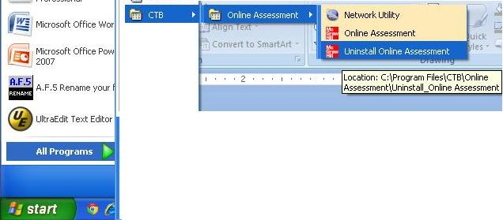
Site Readiness Steps
Step 2 – Uninstall* the Test Delivery Client (TDC)
PC – Uninstall via Test Delivery Client Uninstall Tool
2. Locate CTB
3. Online Assessment and Choose Uninstall
3. Online Assessment and Choose Uninstall
1. PC – Choose Start/ All Programs
*Uninstall step is only applicable to sites that have installed Version 15.0 or earlier
Notes:
The next step is to uninstall the old TDC version (15.0), which is an essential step. Only one version of TDC should exist on the workstations at any time and 15.1 is the most updated TDC. To uninstall, find the “Uninstall Online Assessment” icon in the Start menu.

Slide 24
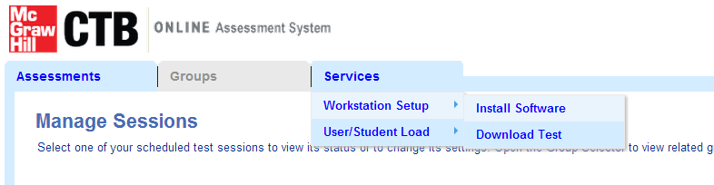
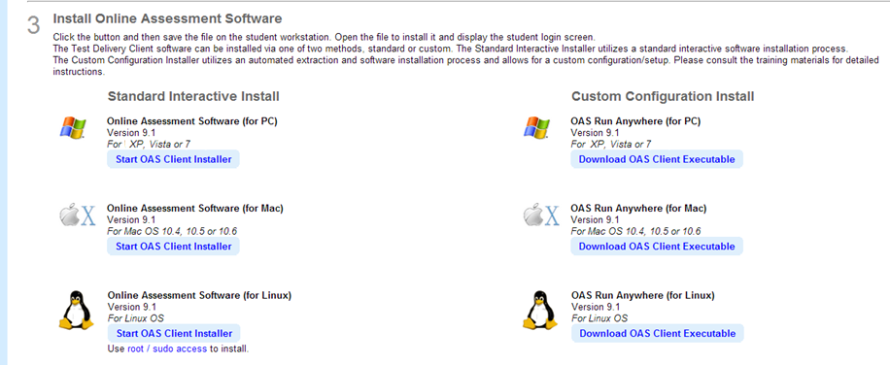
Looking Ahead
Access the Test Delivery Client Software
Test Administration System DEMO Web site
Navigate to this menu shown and click on Install Software
Slide 24
Notes:
To access the Test Delivery Client Software, please use the accounts that you were provided for the DEMO site before the Fall Mid-Month. You can log into https://oas.ctb.com with your Demo Login and Password and browse to the page shown on this slide. If you can’t remember your login credentials, please contact the Georgia (GA) Helpdesk.
Once you’ve logged into the DEMO site, click on the “Services” tab, “Workstation Setup,” and “Install Software” menu items. Here you will be able to access and download the latest version of the TDC. You will have access to both the Standard and Custom versions of the TDC from this page.

Slide 25
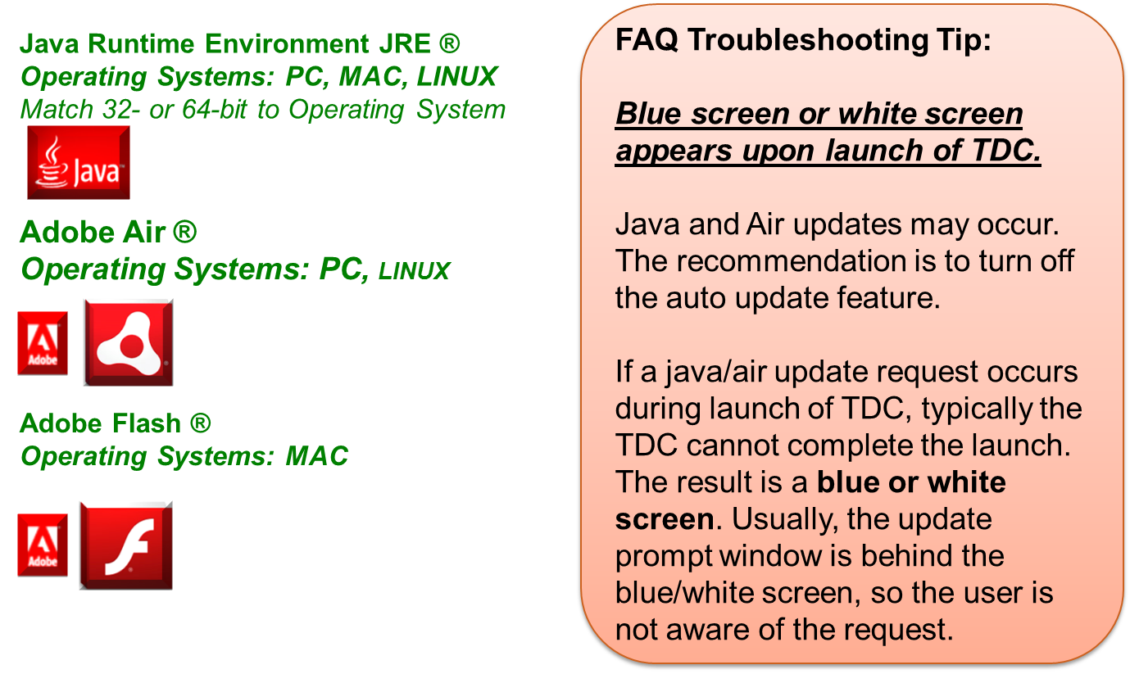
TDC Step 2 Install Ancillary software
Site Readiness Steps
Step 3 – Install Software - Ancillary Software
Notes:
The next step is to install the software. Adobe Air is required for PC and Linux. Flash is required for Mac.
Java and Flash are still required components to run the test client.
Due to 3rd party license requirements, CTB is not able to bundle these applications with the TDC installation.
You may install these applications as soon as you want.
Here we have a frequently asked question related to the ancillary software: Each year, we have a few reports of a blue or white screen appearing at the startup of the Test Delivery Client. In almost all cases, this is caused by an auto-update request from one of the ancillary software components. What happens is, the test delivery client begins the start up process. During the process, the auto-update request attempts to display a dialog box to the user. The timing of the auto-update request dialog box display coincides with the test delivery client lock down browser launch. The result is that the test delivery client cannot complete the launch sequence and freezes on a blue or white screen. If possible, disable the auto-update feature of the ancillary software components.

Slide 26
Site Readiness Steps
Step 3 – Ancillary Software – Key Points to consider
Use the version of Java and Adobe Air/Flash that apply to your Operating System.
Java 7 Update 67 is the most recent version certified for TDC for PC Operating Systems.
Turn off auto update for Java and Adobe Air during testing.
Adobe Air 15.0 was the most recent version certified for TDC.
Disable Screen Saver during testing. No system level workstation updates should be pushed out during test sessions.
Notes:
Here are some additional points to consider:
Please refer back to Slide #18 of this presentation for detailed software requirements.
We recommend that you turn off Auto-Update for Java and Adobe Air. You can download the Adobe Settings Manager to turn-off auto-updates for AIR.

Slide 27
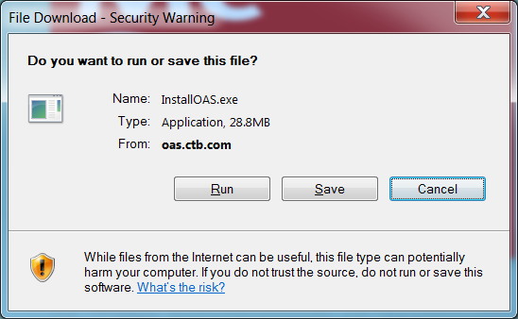
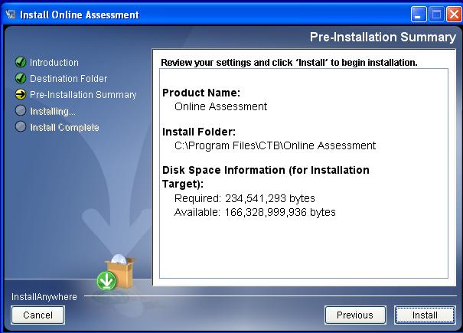
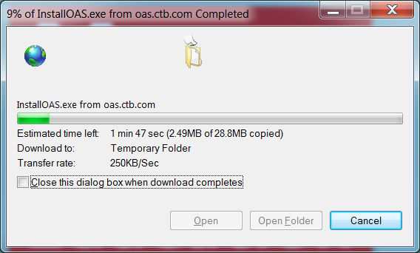
TDC Step 3 – Access 2011 TDC installer
Site Readiness Steps
Step 3 – Install Software - Access the TDC Installer and Install TDC
Download executable and run installer on each machine
Operating System Platform | Live Links
WINDOWS Vista SP1, Windows 7, Windows 8 | https://oas.ctb.com/downloadfiles/InstallOAS.exe
MAC 10.7, 10.8 Intel Only | https://oas.ctb.com/downloadfiles/InstallOAS.zip
LINUX Fedora 11, OpenSuse 11.1, Ubuntu 9.04 | https://oas.ctb.com/downloadfiles/InstallOAS.bin
1. Click the appropriate link above
3. Follow Installation Steps
2. Choose to Run the File
Notes:
Regardless of the type of workstation, there are four key steps when using the standard install process;
install the client (TDC),
configure the proxy.properties file (if authentication is required by the site)
load the testing content to the objectbank folder and
launch the client.
The links shown on this slide are for the Standard Installation Process. Demo content can be downloaded by using the demo logins provided to you.
The final content (which we will discuss in a few slides) will be available at a later date.
If the content becomes available sooner, we will communicate that through email to the participants of this training.

Slide 28
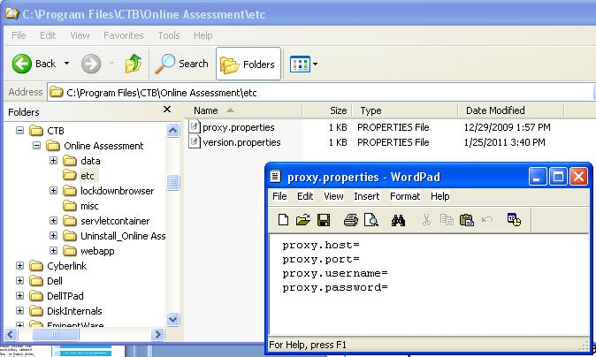
TDC Step 3 – Set Proxy Credentials
Site Readiness Steps
Step 3 – Install Software - Set Proxy Credentials if Needed
Enter Proxy Information if Required at Site
1. Open “etc” folder
2. Open “proxy.properties” file in text editor.
3. Enter proxy info (if needed) and save.
Notes:
Next, for those sites that require proxy authentication, find and open the proxy.properties file, add the required credentials, and then save. To find this file, navigate to the installed location, CTB folder, Online Assessment folder and finally the etc folder as shown on the slide. The proxy.properties file can be opened and saved using word pad. In some cases, only the proxy.host and proxy.port are required. This depends on the proxy configuration at the local site.

Slide 29
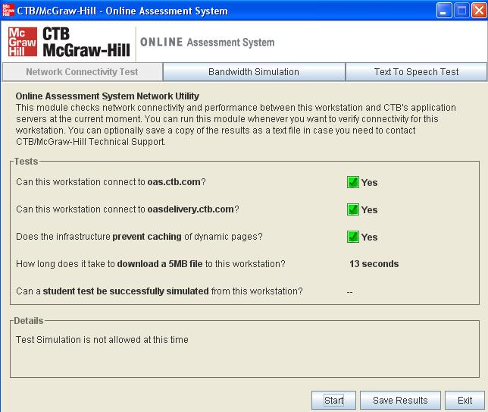
TDC Step 5 – Confirm Readiness
Site Readiness Steps
Step 4 – Run the Network Utility
From the “Network Connectivity Test” tab, click “Start”. The first three questions should result with “Yes” which confirms that the application has been correctly installed.
Confirm application installation and connectivity by using the Test Delivery Client’s network utility:
On the First Tab (Network Connectivity Test), click Start.
Questions 1, 2 and 3 should return “Yes” which indicates that the application has been correctly installed.
This method does not confirm content installation.
Launch the Network Utility
Notes:
Next, you can partially confirm the workstation set up by running the network utility.
Confirm application installation and connectivity by using the Test Delivery Client’s network utility:
On the First Tab (Network Connectivity Test), click Start.
Questions 1, 2 and 3 should return “Yes” which indicates that the application has been correctly installed.
Keep in mind that this method does not confirm content installation.
From the “Network Connectivity Test” tab, click “Start”. The first three questions should result with “Yes” which confirms that the application has been correctly installed.

Slide 30
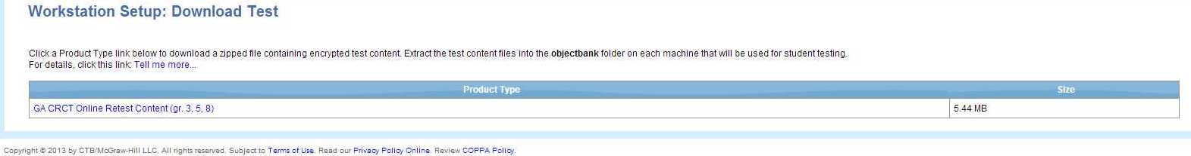
Looking Ahead
Access the Test Content
Test Administration System DEMO Web site
Navigate to this menu and click on Download Test
Slide 30
Notes:
You can access the DEMO test content by logging in to https://oas.ctb.com with your DEMO login credentials, and then navigating to the location shown on this slide.
Then, download and save the zipped content file from CTB.

Slide 31
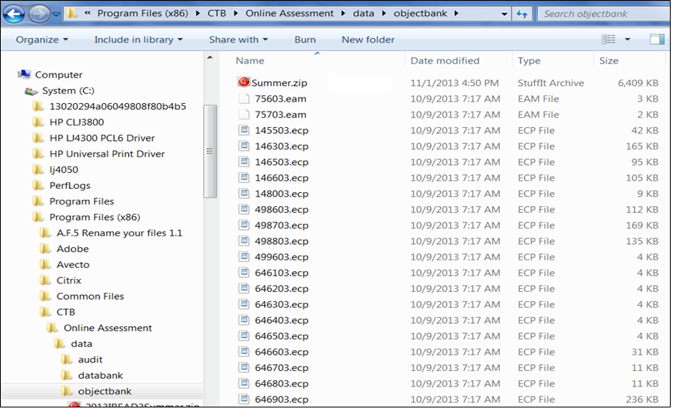
Load the Test Content(Standard)
Navigate to “objectbank” folder location.
Download content zip package and unzip into this folder and delete zip file
Notes:
Then, to load the test content, navigate to the objectbank folder found in the installed location using the following path: CTB folder, Online Assessment folder, data folder. Open the objectbank folder, add the zipped content file, unzip the content and delete the zip file as noted on the slide.

Slide 32
TDC Step 5 – Confirm Ready – 2nd method
Site Readiness Steps
Step 6 - Verify Setup on a few select workstations
Attempt to launch and login to the Test Delivery Client (TDC):
Log in the Test Administration Demo site
Create a fake student “John Doe” then schedule and assign a practice test
Print the test ticket
Launch Test Delivery Client software and login as the “John Doe” student using the information on the test ticket
If the application launches and you can see the welcome screen, then the application have been setup correctly.
Notes:
The final step is to launch the client by clicking the online assessment icon. If the client login screen displays, the test delivery client has been successfully installed. To confirm the content installation, you will need to use login credentials specific to the content loaded.
The DEMO site will contain a few DEMO students for whom you can schedule a practice test, and then launch the client to take the test.
A Quick Start Guide to set up and manage student/test sessions will be made available at www.ctb.com/ga, under “Documentation.”

Slide 33
Test Delivery Client Setup – Standard
In order for the TDC to work properly and deliver an assessment, the following conditions must be met on each workstation:
Appropriate versions of AIR (or Flash, on the Mac) and the Java Runtime Environment must be installed and runnable by the logged-in user during testing.
The Test Delivery Client must be installed, and the Test Delivery executable must be runnable by the logged-in user during testing.
This executable must not be prevented from executing other processes, specifically java.exe.
The java executable must not be prevented from executing other processes.
The java executable must be able to make HTTP/HTTPS connections on ports 80/443 to *.ctb.com addresses.
The java executable must be able to bind and listen on TCP port 12345. The java component uses this port to receive requests from the Flash UI component.
The logged-in user during testing must have write access to [TDC installation location] and subfolders.
Slide 33
Notes:
In order for the TDC to work properly and deliver an assessment, the following conditions must be met on each workstation:
Appropriate versions of AIR (or Flash, on the Mac) and the Java Runtime Environment must be installed and runnable by the logged-in user during testing.
The Test Delivery Client must be installed, and the Test Delivery executable must be runnable by the logged-in user during testing.
This executable must not be prevented from executing other processes, specifically java.exe.
The java executable must not be prevented from executing other processes.
The java executable must be able to make HTTP and HTTPS connections on ports 80 and 443 to *(star).ctb.com addresses.
The java executable must be able to bind and listen on TCP port 12345. The java component uses this port to receive requests from the Flash UI component.
The logged-in user during testing must have write access to [TDC installation location] and subfolders.

Slide 34
TDC Step 3 – New 2012 TDC installer
Test Delivery Client Setup – Custom
Custom Installer Options
Several options
Option 2: Install from Server
Option 3: Install from Workstation with Content on the Server
Option 1: Install from Workstation
Slide 34
Notes:
Next, we’ll review the custom install process. There are four key steps when using the custom install process: Create a shortcut to the Test delivery client executable, create a content source folder and download the testing content from CTB, configure switches that will update the proxy.properties file (if required) and point to the content source folder, and finally, launch the client to complete the setup and content copy.
To launch the client, double-click the online assessment icon. If the client login screen displays, the test delivery client has been successfully installed. To confirm the content installation, you will need to use login credentials specific to the content loaded. Just to reiterate Thin Client Sites and DeepFreeze sites should not use the custom install. They must use the Standard Install Process.
The first option we’ll cover is installing the client and content from a workstation. We will download the installer executable and content to a workstation and create a shortcut from the installer and point to the content. Students will click the shortcut to launch the test delivery client.
The second option we will cover is installing the client and content to the workstation from a server. We will download the installer executable and content to a server. We’ll create a shortcut from the installer and point to the content. The shortcut will then be copied to all workstations. Students will click the shortcut to launch the test delivery client.
The third option we’ll cover is installing the client from the workstation and the content from a server. We’ll download the installer executable to a workstation. We’ll download the content to a server location. We’ll create a shortcut from the installer and point to the content on the server. Students will click the shortcut to launch the test delivery client.
Please keep in mind, for all of these options, if the site uses a proxy server for authentication, the “proxy.properties” file will need to be updated as well.

Slide 35
TDC Step 3 – New 2012 TDC installer
Test Delivery Client Setup – Custom Option 1
Custom Installer – Option 1: Install from Workstation
Download the TDC Client executable link to the local workstation desktop.
Download and Add Content to a local workstation folder (determined by site).
Right click on Shortcut and choose Properties.
Double click shortcut to install (TDC), content and launch TDC.
Edit Shortcut “Target” by adding “Configuration Switches” for proxy (if site required) and Content folder location (added in 2nd step above.)
Right click on Executable link and choose to “Create a Shortcut.”
Verify few workstations by logging in to the Test using a fake account from the TAS Training Site.
Slide 35
Notes:
Now, We’ll review Custom Option 1 in greater detail:
Download the TDC Client executable link to the local workstation desktop.
Download and Add Content to a local workstation folder (determined by site).
Right click on Executable link and choose to “Create a Shortcut.”
Right click on Shortcut and choose Properties.
Edit Shortcut “Target” by adding “Configuration Switches” for proxy (if site required) and Content folder location (added in 2nd step above.)
Double click shortcut to install (TDC), content and launch TDC.
Verify a few workstations by logging into the Test using a fake account from the TAS Training Site.
As a reminder, with custom option 1, the executable and content reside on the workstation.

Slide 36

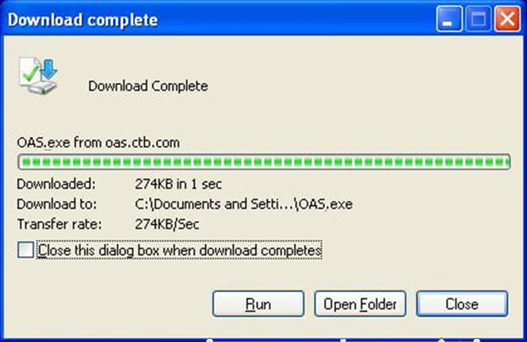
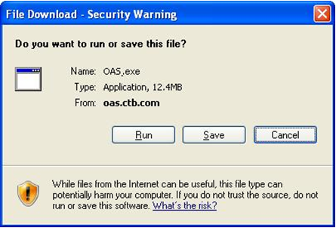
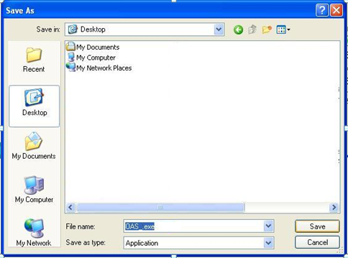
TDC Step 3 – New 2012 TDC installer
Test Delivery Client Setup – Custom Option 1
Custom Installer - Option 1: Install from Workstation
Place executable, shortcut and content on a workstation.
Use shortcut to launch the testing client.
Operating System Platform | Live Links
WINDOWS Vista, Windows 7, Windows 8 | https://oas.ctb.com/downloadfiles/OAS.exe
MAC 10.7, 10.8 Intel only | https://oas.ctb.com/downloadfiles/OAS.zip
LINUX Fedora 11, OpenSuse 11.1, Ubuntu 9.04 | https://oas.ctb.com/downloadfiles/OAS.bin
1. Click the appropriate link above
2. Choose to Save executable to desktop.
3. Choose Close.
Slide 36
Notes:
The first step of the Custom Option 1 is to access and download the Custom test delivery client executable from CTB. Place it into the final source location (on the server or workstation) and then create a shortcut to the test delivery client executable. You can use the direct links above or you can login into the DEMO site and access the software.

Slide 37
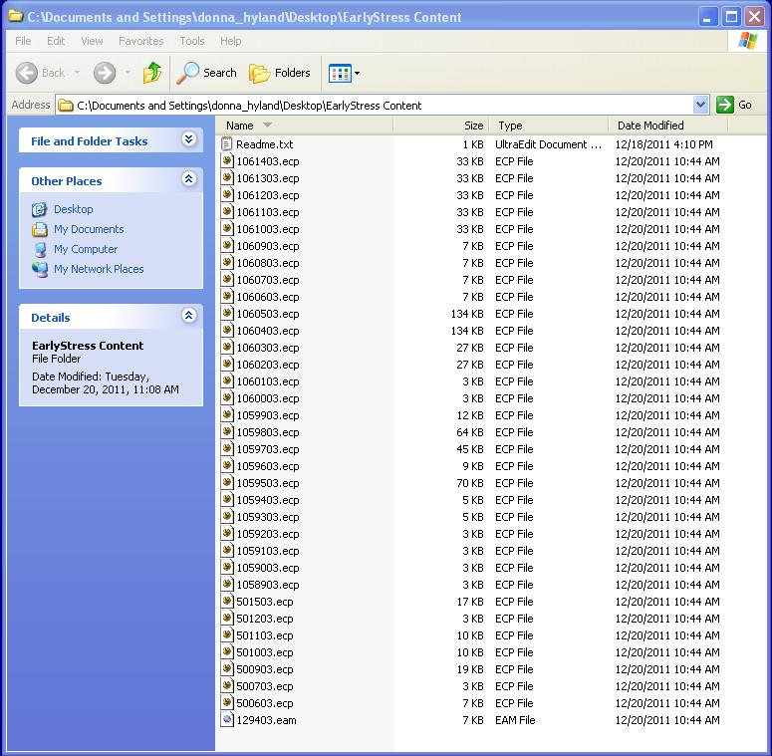

TDC Step 3 – New 2012 TDC installer
Test Delivery Client Setup – Custom Option 1
Custom Installer - Option 1: Install from Workstation
4. Create a content folder on the workstation. (example: EarlyStressContent).
5. Add the test content into the workstation content folder you just created.
Slide 37
Notes:
Create a content source folder and download the content zip package from CTB. Place the zipped package into the content source folder. Unzip the content package and then delete the zip file.

Slide 38
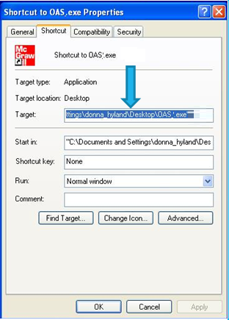

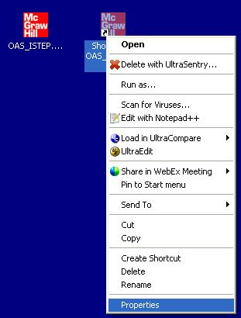

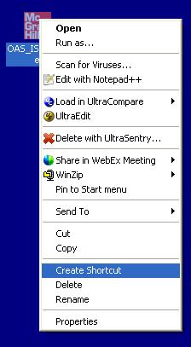
TDC Step 3 – New 2012 TDC installer
Test Delivery Client Setup – Custom Option 1
Custom Installer - Option 1: Install from Workstation
6. Next, right click on the test delivery client exe and create a shortcut.
8. Next, right click on the shortcut and choose properties. You can set the configuration points for the application for
proxy and content.
7. Now there are 2 OAS TDC icons on the desktop
Slide 38
Notes:
6. Next, right click on the test delivery client exe and create a shortcut.
7. Then, you’ll see that there are 2 OAS TDC icons on the desktop
8. Next, right click on the shortcut and choose properties. You can set the configuration points for the application for
proxy and content.
As shown, here you will add the proxy details and content source folder location into the Target line of the test delivery client shortcut properties.

Slide 39
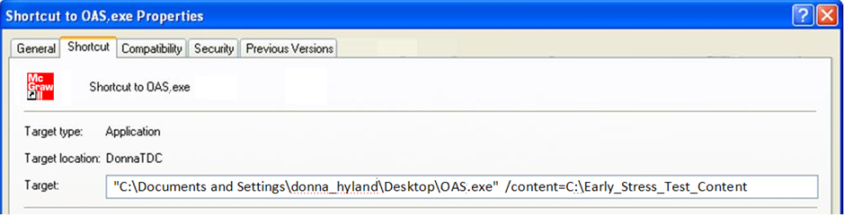
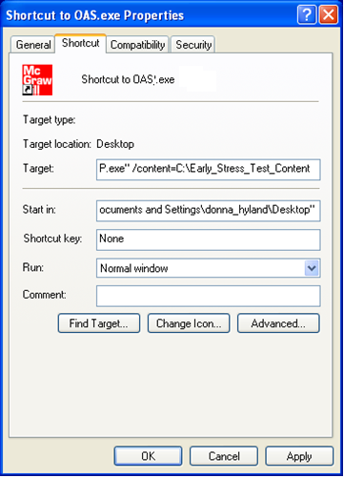
TDC Step 3 – New 2012 TDC installer
Test Delivery Client Setup – Custom Option 1
Custom Installer - Option 1: Install from Workstation
8. Add configuration points for Proxy (if applicable at site) and Content Choose to apply, save and close the shortcut.
Content Only
"C:\Documents and Settings\[your_computer]\Desktop\OAS.exe" /content=C:\Test_Content
Proxy and Content
"C:\Documents and Settings\[your_computer]\Desktop\OAS.exe"
/proxy=[domain]\[user]:[password]@hostname: port
/content=C:\Test_Content
It is not necessary to name the content folder Test_Content.
This is just an example. You will use this folder for all content.
Slide 39
Notes:
If you do not require proxy authentication, you will only need to add the content source folder location. The content source folder location is required regardless of where you place the content source folder – whether it resides on a server or each workstation. The test delivery client will retrieve content from the source folder and load it to the TDC objectbank folder. The final content must be loaded to the objectbank folder – this is no different than if using the standard install process. The custom installer will place the content into the objectbank folder for you – if the switch is configured to point to the source folder and the workstation logged-on user has access to the content source folder.
Keep in mind, that for some operating systems, you may not need to use the quotes as shown in the example. If on initial launch of the test delivery client, the content does not copy to the location workstation objectbank folder or the proxy properties do not set correctly, try adding/removing the quotes. Also, confirm that the logged-on workstation user has access to the content source folder location. Finally, choose the apply option, save and close the shortcut.

Slide 40

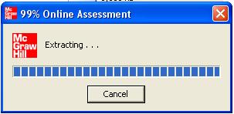
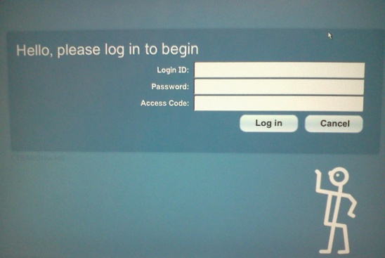
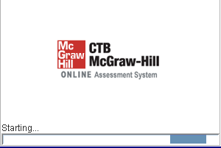
TDC Step 3 – New 2012 TDC installer
Test Delivery Client Setup – Custom Option 1
Custom Installer - Option 1: Install from Workstation
9. Students will click on the shortcut to run the application.
On first run, the shortcut will access the executable and locally install the TDC software, grab the content from the location you indicated and copy to the objectbank folder on the workstation, set proxy (if you added to the configuration) and launch the TDC. The student can then begin the test.
Login …
Begin Test…
**Note - You can copy the content folder and shortcut you created, along with the TDC executable to other testing workstations rather than repeat these steps on all machines.
Slide 40
Notes:
Next, students will click on the shortcut to run the application.
On the first run, the shortcut will access the executable and locally install the TDC software, grab the content from the location you indicated and copy to the objectbank folder on the workstation, set proxy (if you added to the configuration) and launch the TDC. The student can then begin the test.
Please note that you can copy the content folder and shortcut you created, along with the TDC executable to other testing workstations rather than repeat these steps on all machines.

Slide 41
TDC Step 3 – New 2012 TDC installer
Test Delivery Client Setup – Custom Option 2
Custom Installer – Option 2: Install from Server
Download the TDC Client executable to a server.
Download and Add Content to a folder on the server. (determined by site).
Right click on Shortcut and choose Properties.
Double click shortcut at workstation to install TDC, content and launch TDC.
Edit Shortcut “Target” by adding “Configuration Switches” for proxy (if site required) and Content folder location (added in 2nd step above.)
Right click on Executable link and choose to “Create a Shortcut.”
Verify few workstations by logging in to the Test using a fake account.
Push Shortcut Executable to all Testing Workstations.
Slide 41
Notes:
Now we will cover the Custom Install Option 2 in greater detail:
Download the TDC Client executable to a server.
Download and Add Content to a folder on the server. (determined by site).
Right click on Executable link and choose to “Create a Shortcut.”
Right click on Shortcut and choose Properties.
Edit Shortcut “Target” by adding “Configuration Switches” for proxy (if site required) and Content folder location (added in 2nd step above.)
Push Shortcut Executable to all Testing Workstations.
Double click shortcut at workstation to install TDC, content and launch TDC.
Verify few workstations by logging into the Test using a fake account.
As a reminder, with custom option 2, the executable and content reside on a server.

Slide 42
TDC Step 3 – New 2012 TDC installer
Test Delivery Client Setup – Custom Option 2
Custom Installer – Option 2: Install from Server
Place executable, shortcut and content on a server.
Copy the shortcut to the workstations.
Use shortcut to launch the testing client.
Operating System Platform | Live Links
WINDOWS Vista, Windows 7, Windows 8 | https://oas.ctb.com/downloadfiles/OAS.exe
MAC 10.7, 10.8 Intel only | https://oas.ctb.com/downloadfiles/OAS.zip
LINUX Fedora 11, OpenSuse 11.1, Ubuntu 9.04 | https://oas.ctb.com/downloadfiles/OAS.bin
1. Click the appropriate link above
2. Choose to Save executable to server.
3. Choose Close.
Slide 42
Notes:
Custom Installer - Option 2: Install from the Server:
Place executable, shortcut and content on a server.
Copy the shortcut to the workstations.
Use shortcut to launch the testing client
Click the appropriate link above
Choose to Save executable to the server
Choose Close

Slide 43
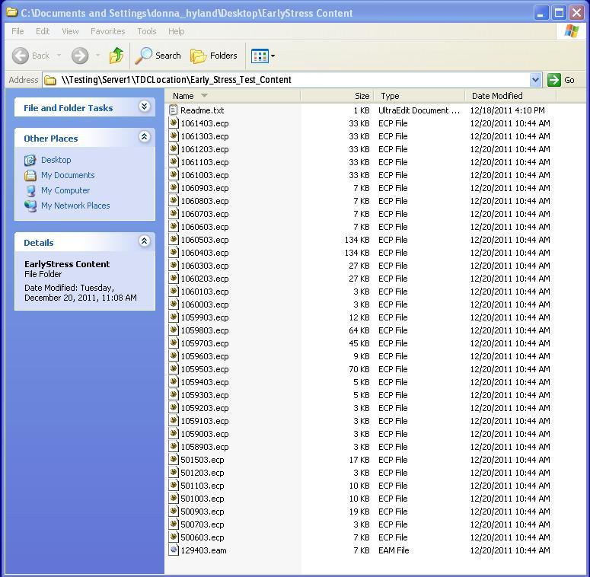
TDC Step 3 – New 2012 TDC installer
Test Delivery Client Setup – Custom Option 2
Custom Installer – Option 2: Install from Server
4. Create a content folder on the server. (example: EarlyStressContent).
5. Add the test content into the server content folder you just created.
Slide 43
Notes:
4. Create a content folder on the server. (example: EarlyStressContent).
5. Add the test content into the server content folder you just created.

Slide 44

TDC Step 3 – New 2012 TDC installer
Test Delivery Client Setup – Custom Option 2
Custom Installer – Option 2: Install from Server
6. Next, right click on the test delivery client exe and create a shortcut.
8. Next, right click on the shortcut and choose properties. You can set the configuration points for the application for
proxy and content.
7. Now there are 2 TDC icons on the Server
Slide 44
Notes:
6. Next, right click on the test delivery client exe and create a shortcut.
7. Now there are 2 TDC icons on the Server
8. Next, right click on the shortcut and choose properties. You can set the configuration points for the application for
proxy and content.

Slide 45
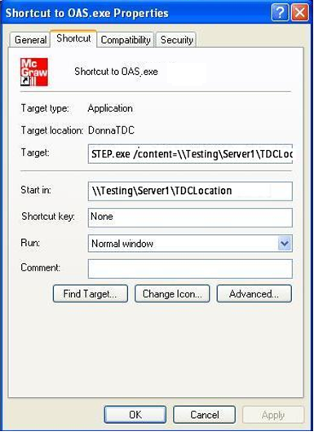
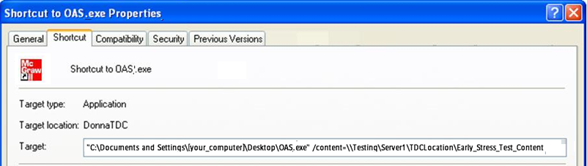
TDC Step 3 – New 2012 TDC installer
Test Delivery Client Setup – Custom Option 2
Custom Installer – Option 2: Install from Server
9. Add configuration points for Proxy (if applicable at site) and Content .
Content Only
" \\Testing\Server1\TDCLocation\OAS.exe”
/content=\\ Testing\Server1\TDCLocation\Test_Content
Proxy and Content
" \\Testing\Server1\TDCLocation\OAS.exe”
/proxy=[domain]\[user]:[password]@hostname: port
/content=\\ Testing\Server1\TDCLocation\Test_Content
10. Choose to apply, save and close the shortcut.
UNC/Mapped Drives are ok to use in the configuration. It is not necessary to name the content folder Test_Content. This is just an example. You will use this folder for all content.
Slide 45
Notes:
9. Add configuration points for Proxy (if applicable at site) and Content.
10. Choose to apply, save and close the shortcut.
Refer back to this slide for examples of custom install command line options.

Slide 46
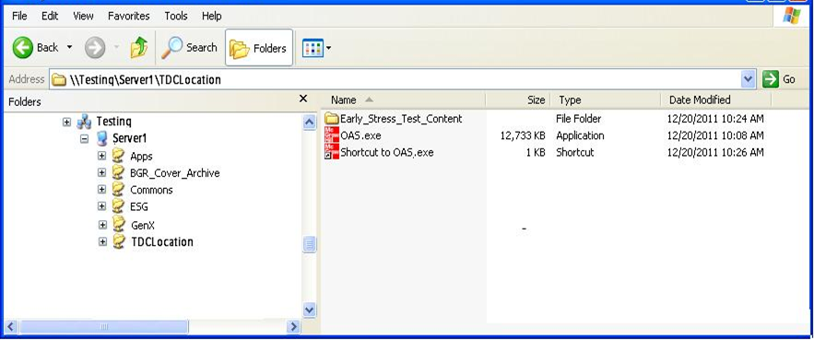
TDC Step 3 – New 2012 TDC installer
Test Delivery Client Setup – Custom Option 2
Custom Installer – Option 2: Install from Server
11. The Server should now contain a Content Folder, OAS.exe and Shortcut to OAS.exe. Copy the Shortcut to all testing workstations.
Note – It is not necessary to name the content folder Test_Content.
This is just an example. You will use this folder for all content.
Slide 46
Notes:
11. The Server should now contain a Content Folder, OAS.exe and Shortcut to OAS.exe. Copy the Shortcut to all testing workstations.
If you chose to place the test delivery client executable and content source folder on the server, you need to copy the test client shortcut to each testing workstation.
Confirm that all testing workstations have permissions/access to the source files (TDC Executable and the Source Content Folder)

Slide 47
TDC Step 3 – New 2012 TDC installer
Test Delivery Client Setup – Custom Option 2
Custom Installer – Option 2: Install from Server
12. Students will click on the shortcut to run the application. On first run, the shortcut will access the executable from the server, locally install the TDC software, grab the content from the location you indicated and copy to the objectbank folder on the workstation, set proxy (if you added to the configuration) and launch the TDC. The student can then begin the test. On subsequent runs, the application will verify the content and only download locally if newer content exists on the server.
Login …
Begin Test…
Slide 47
Notes:
Next, students will click on the shortcut to run the application. On the first run, the shortcut will access the executable from the server, locally install the TDC software, grab the content from the location you indicated and copy to the objectbank folder on the workstation, set proxy (if you added to the configuration) and launch the TDC. The student can then begin the test. On subsequent runs, the application will verify the content and only download locally if newer content exists on the server.

Slide 48
TDC Step 3 – New 2012 TDC installer
Test Delivery Client Setup – Custom Option 3
Custom Installer - Option 3: Workstation Install. Content on Server
Download the TDC Client executable link to a workstation.
Download and Add Content to a folder on the server. (determined by site).
Right click on Shortcut and choose Properties.
Double click shortcut at workstation to install Test Delivery Client (TDC), content and launch TDC.
Edit Shortcut “Target” by adding “Configuration Switches” for proxy (if site required) and Content folder location (added in 2nd step above.)
Right click on Executable link on workstation and choose to “Create a Shortcut.”
Verify few workstations by logging in to the Test using an Test Account.
Copy Shortcut and Executable to all Testing Workstations.
Slide 48
Notes:
Now we will cover the Custom Install Option 3 in greater detail:
Download the TDC Client executable link to a workstation.
Download and Add Content to a folder on the server. (determined by site).
Right click on Executable link on workstation and choose to “Create a Shortcut.”
Right click on Shortcut and choose Properties.
Edit Shortcut “Target” by adding “Configuration Switches” for proxy (if site required) and Content folder location (added in 2nd step above.)
Copy Shortcut and Executable to all Testing Workstations.
Double click shortcut at workstation to install Test Delivery Client (TDC), content and launch TDC.
Verify few workstations by logging in to the Test using an Test Account.
As a reminder, with custom option 3, the executable resides on the workstations, but the content resides on a server.

Slide 49
TDC Step 3 – New 2012 TDC installer
Test Delivery Client Setup – Custom Option 3
Custom Installer - Option 3: Workstation Install. Content on Server
A) Place executable and shortcut on workstations. D) Push shortcut out to all testing workstations.
B) Place content on a server,. E) Use shortcut to launch the testing client.
C) Pre-set the configuration on the shortcut before you copy to workstations.
Operating System Platform | Live Links
WINDOWS Vista, Windows 7, Windows 8 | https://oas.ctb.com/downloadfiles/OAS.exe
MAC 10.7, 10.8 Intel only | https://oas.ctb.com/downloadfiles/OAS.zip
LINUX Fedora 11, OpenSuse 11.1, Ubuntu 9.04 | https://oas.ctb.com/downloadfiles/OAS.bin
1. Click the appropriate link above
2. Choose to Save executable to desktop.
3. Choose Close.
Slide 49
Notes:
Custom Installer - Option 3: Workstation Install (Content on the Server):
A) Place executable and shortcut on workstations.
B) Place content on a server,.
Pre-set the configuration on the shortcut before you copy to workstations.
Push shortcut out to all testing workstations
Use shortcut to launch the testing client.
Click the appropriate link above
Choose to Save executable to desktop.
Choose Close

Slide 50
TDC Step 3 – New 2012 TDC installer
Test Delivery Client Setup – Custom Option 3
Custom Installer - Option 3: Workstation Install. Content on Server
4. Create a content folder on the SERVER. (example: Create a content folder on the desktop).
5. Add the test content into the SERVER content folder you just created.
Slide 50
Notes:
4. Create a content folder on the SERVER. (example: Create a content folder on the desktop).
5. Add the test content into the SERVER content folder you just created.

Slide 51

TDC Step 3 – New 2012 TDC installer
Test Delivery Client Setup – Custom Option 3
Custom Installer - Option 3: Workstation Install. Content on Server
6. Next, right click on the test delivery client exe and create a shortcut.
8. Next, right click on the shortcut and choose properties. You can set the configuration points for the application for
proxy and content.
7. Now there are 2 TDC icons on the desktop
Slide 51
Notes:
6. Next, right click on the test delivery client exe and create a shortcut.
7. Now there are 2 TDC icons on the desktop
8. Next, right click on the shortcut and choose properties. You can set the configuration points for the application for proxy and content.

Slide 52
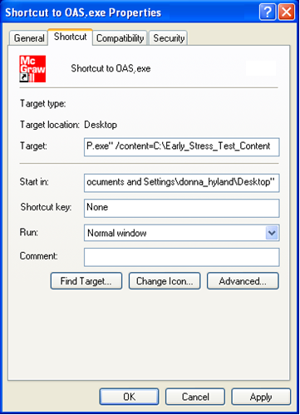
TDC Step 3 – New 2012 TDC installer
Test Delivery Client Setup – Custom Option 3
Custom Installer - Option 3: Workstation Install. Content on Server
8. Add configuration points for Proxy (if applicable at site) and Content.
9. Choose to apply, save and close the shortcut.
Content Only
"C:\Documents and Settings\[your_computer]\Desktop\OAS.exe" /content=\\Testing\Server1\TDCLocation\Test_Content
Proxy and Content
"C:\Documents and Settings\[your_computer]\Desktop\OAS.exe"
/proxy=[domain]\[user]:[password]@hostname: port
/content=\\Testing\Server1\TDCLocation\Test_Content
Slide 52
Notes:
8. Add configuration points for Proxy (if applicable at site) and Content
9. Choose to apply, save and close the shortcut.
Refer back to this slide for examples of custom install command line options.

Slide 53
TDC Step 3 – New 2012 TDC installer
Test Delivery Client Setup – Custom Option 3
Custom Installer - Option 3: Workstation Install. Content on Server
9. Students will click on the shortcut to run the application.
On first run, the shortcut will access the executable and locally install the TDC software, grab the content from the location you indicated and copy to the objectbank folder on the workstation, set proxy (if you added to the configuration) and launch the TDC. The student can then begin the test.
Login …
Begin Test…
**Note - You can copy the content folder and shortcut you created, along with the TDC executable to other testing workstations rather than repeat these steps on all machines.
Slide 53
Notes:
9. Students will click on the shortcut to run the application.
On first run, the shortcut will access the executable and locally install the TDC software, grab the content from the location you indicated and copy to the objectbank folder on the workstation, set proxy (if you added to the configuration) and launch the TDC. The student can then begin the test.

Slide 54










Install the TDC – Custom Launch Server
Test Delivery Client Setup Custom Option
Local server
where content
source resides.
Local server
where TDC EXE
resides.
Slide 54
Notes:
The next couple slides illustrate the impact the Custom Option has on the network. Please consider this if choosing this method of installation
If there are few workstations, pointing to the same servers launching the client at the same time during the initial install, should be fine. The result is that the launch time is short.

Slide 55
Install the TDC – Custom Launch Server
Test Delivery Client Setup Custom Option
Local server
where content
source resides
Local server
where TDC EXE
resides.
Slide 55
Notes:
Here we see the network impact of the custom install if multiple labs or schools, pointing to the same server(s) launch the client at the same time during the initial install. Depending on the bandwidth of the network you may see a lag in the initial launch. If you use the custom install, consider placing the test delivery client executable and content source folder on several servers to support multiple labs or schools.

Slide 56
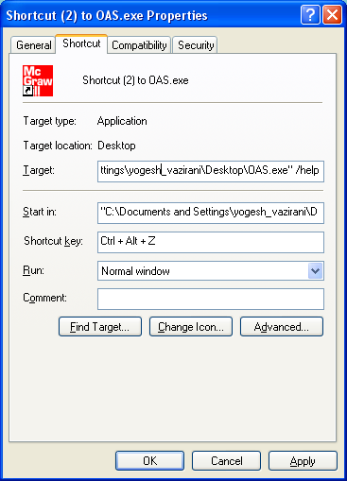
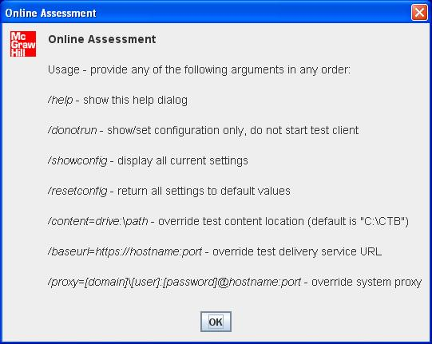
TDC Step 3 – Set configuration
Test Delivery Client Setup – Access Help
Custom Installer – How to Access “Help”
How to Access Help
Help Options
Double clicking the shortcut will display the below
help options.
Create a shortcut from the Testing Executable. Add /help as the switch.
Slide 56
Notes:
Now, we’ll discuss how to access help. If the site chooses to automate the test delivery client configuration, adding the switch “/help” (forward slash, help) to the shortcut will display the Online Assessment help window. The “switches” in the Online Assessment help window can be added to the shortcut, or a batch file, if the site chooses to automate the configuration. This is especially helpful for sites that want to place the testing content on a server location rather than on each workstation. When the configuration executes, the workstation will automatically look to the site-defined location to access and download the content. The content would not be manually loaded to each workstation.

Slide 57
TDC Step 5 – Confirm Ready – 2nd method
Test Delivery Client Setup Verify – Custom
Custom Installer – Verify Setup on a few workstations
Launch Test Delivery Client software.
Login using a fake login from the (OAS) training site.
If the application launches and login completes, then the application and content have been setup correctly.
Slide 57
Notes:
The best method to verify workstation setup is to use a few of the test logins and try a few machines. This method works regardless of which type of installer was used. If you login and the Welcome screen appears, the workstation has been properly configured. Remember to look for version 15.1 on the login screen to confirm that you have the correct version of the TDC.

Slide 58
iPad Setup
Download TDC App from Apple Store
Install TDC App with Content
Launch TDC, Guided Access, Allow Client Access, Verify Install
**Available Nov 25th
Visit Apple Store.
  An Apple ID is required to use the app store.
Install the TDC app.
Disable Assistive Touch
Turn on Guided Access and enter Passcode
Launch the TDC app.
Content
Content is included with the app download; the EOC Winter Operational & Practice Test content..
Launch Guided Access and enter a passcode.
  The app will auto set landscape lock.
  Adjust settings as needed
Locate and Download the TDC app.
  Search in Education apps.
  Name – OAS GA
Verify the Install:
  Login using a Demo Test ticket.
  Allow TDC app access to photo gallery.
  If the application launches and login completes, then the application has been setup correctly.
Download (free)
Notes:
As mentioned earlier, iPad2 or newer will be supported for testing.
You will need an Apple User ID to download and install the TDC App for Winter EOC – OAS GA from the Apple App store.
The EOC Operational and Practice Test content is included in the app.
Assistive Touch should be disabled to prevent students from taking screen shots.
Under Settings Turn on Guided Access and enter a passcode.
Open the App, Launch Guided Access and adjust the settings as required for online testing
Verify installation by using a Practice Test Ticket from TAS

Slide 59
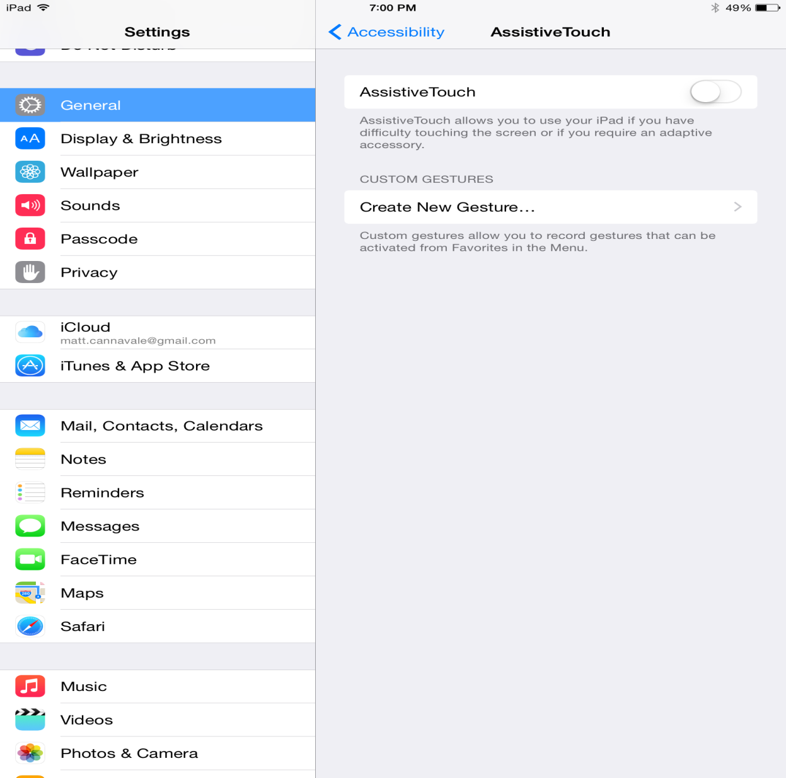
iPad Setup
1
3
Turned off
2
Notes:
This slide shows you how to ensure that Assistive Touch is turned off.
On the iPad you will go to Settings, under Setting tap General, Accessibility, and then ensure that the Assistive Touch slider is in the off position.

Slide 60
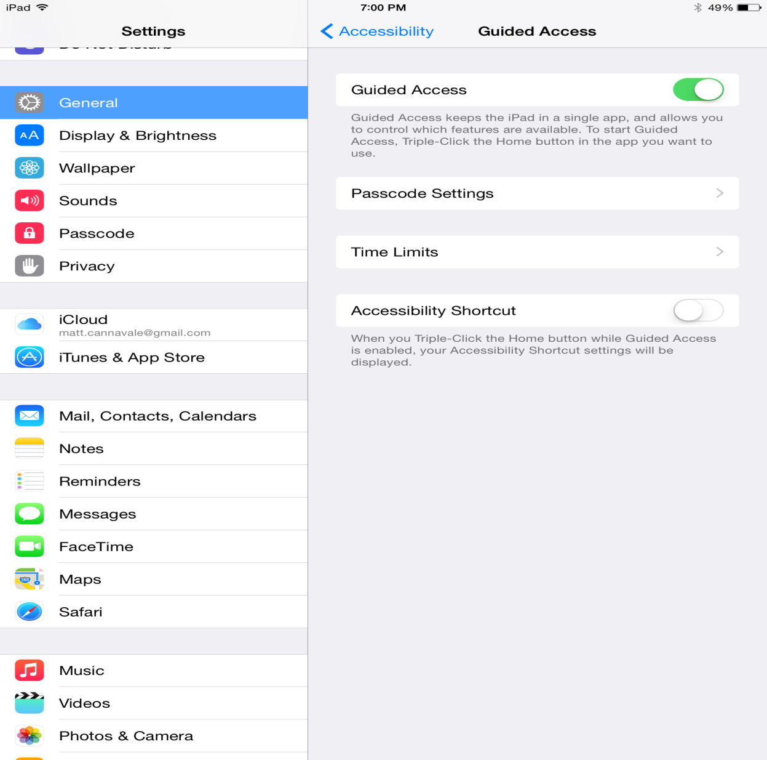
iPad Setup
1
3
Turned on
2
4
Notes:
This slide shows you how to ensure that Guided Access is turned on.
To turn it back on, turn the slider for Guided Access to the on position, and then select Passcode Settings.

Slide 61
iPad Setup
Guided Access Information (from Apple iPad ® user guide)
http://manuals.info.apple.com/en_US/iPad_User_Guide.pdf
Use Guided
Access:
(per Apple)
Guided Access limits iPad® [use] to a single app, and lets you control which app features are available.
Disable the iPad® hardware buttons.
Notes:
If you are unfamiliar with guided access, please refer to the Apple user guide. The link is displayed on the slide. Per Apple, you can use guided access to: limit iPad® [use] to a single app, and control which app features are available; and disable the iPad hardware buttons.

Slide 62
User Accounts (Key Differences)
DEMO Account to Complete Site Readiness/Certification Activities
  Existing Login credentials to access https://oas.ctb.com
  All Districts & School names appended with the word DEMO
  Fake Students created for every school
  Download and Install TDC Client (Standard or Custom)
  Download and Install DEMO content package.
  Schedule DEMO Tests, Launch Client and Complete Workstation Readiness
Operational Account to take the GA Milestones Winter EOC Online Test
  Login credentials to access https://oas.ctb.com (November 12th)
  Download and Install TDC Client (Standard and Custom)
  Download and Install FINAL Operational Test content package.
  Perform Final Workstation Check.
  Schedule Operational Tests
Notes:
Now, we’ll review the DEMO and Operational accounts and key differences:
Your DEMO account will be used to Complete Site Readiness and Certification Activities. Your existing login credentials can be used to access the website at https://oas.ctb.com. Once you’ve logged in, you’ll notice that all districts and school names are appended with the word “DEMO,” and fake students names have been created for every school. Within your DEMO account, you can download and install the TDC Client (Standard or Custom) as well as the DEMO content package. Then you’ll schedule DEMO tests, launch the TDC testing client and complete the workstation readiness activities.
Your OPERATIONAL account will be used for the FINAL operational content for the GA Milestones Winter EOC Online Test. Your accounts will be enabled to access the website at https://oas.ctb.com by November 12th. From within the operational account, you can download and Install TDC Client (if you haven’t already downloaded it using your DEMO account), and then download and install the FINAL Operational Test content package. After that, you can perform the final workstation checks, and the operational tests can be scheduled.
It’s important to note that the 2 accounts give you access to 2 different sites. However, the TDC client software is the same. If you download and install using your DEMO account you do not need to download it when you get your Operational Account credentials. However, you will need the Operational Account to download the Final Content Package. You CANNOT schedule EOC Winter Operational Tests using your DEMO account credentials. You will use the DEMO account to download the software and also create fake test sessions with fake student logins for the purposes of testing the setup of your workstations.

Slide 63
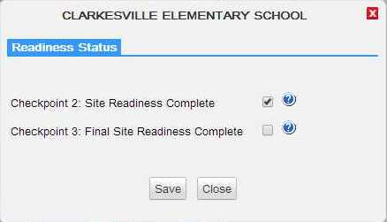
RTS – Readiness Panel
Notes:
Once you have installed the client and tested your workstations you will need to login to RTS and mark the Checkpoint 2 checkbox as shown on this slide for each school in your system.

Slide 64
Positive Testing Experience
For a Positive Testing Experience…
Anti-virus software full scans scheduled after testing hours
All other applications closed on testing machines during the test
Screen savers/power management set to a longer timeout
Restrict when possible intensive bandwidth use during testing (VoIP, Payroll, Drop box) DO NOT stream educational content during testing.
For a Positive Testing Experience…
Restore software (Deep Freeze, etc.) configured to retain test data after reboot
Laptop protocol – Use AC power, wired access, wireless check
Whitelist *.ctb.com (or CTB IPs if applicable)
Notes:
Here we have a few reminders about things that need to be done in order to ensure a positive testing experience for your students.
Anti-virus software full scans are scheduled after testing hours
All other applications closed on testing machines during the test
Screen savers/power management set to a longer timeout
Restore software (Deep Freeze, etc.) configured to retain test data after reboot
Restrict when possible intensive bandwidth use during testing (VoIP, Payroll, Drop box) DO NOT stream educational content during testing.
Laptop protocol – Use AC power, wired access, wireless check
Whitelist *(star).ctb.com (or CTB IPs if applicable)

Slide 65
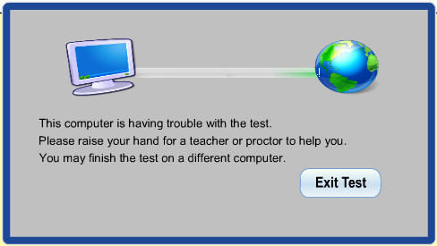
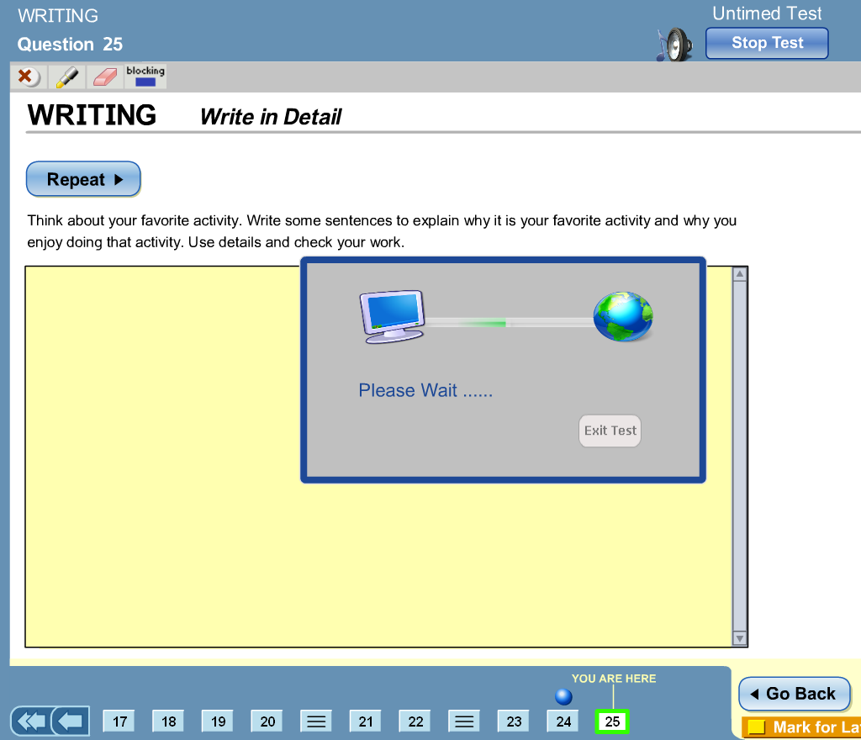
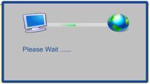
TDC Application Enhancements
Student Experience – Lost Network
Lost connectivity
Wait screen notification (60 seconds)
Option to exit after retry
Proctor alert
Graphical indicator of network retry
Zero time log back into test
1. Connectivity between workstation and CTB server disrupted.
3. Failure to reconnect after 60 seconds – “Exit Test”
2. Attempts to Reconnect to Test for 60 seconds
Successful reconnection within 60 seconds – Test automatically resumes
Notes:
Now we’ll take a minute to review the “60 second wait screen” which is an important feature of the student interface:
When and if a workstation loses connectivity, the machine will go into a 60 second wait mode.
The student will be instructed to “please wait”. During the “please wait” phase, the workstation will attempt to reconnect to the CTB server.
If after 60 seconds, the workstation cannot reconnect, the student will receive instructions on next steps.
If the workstation is able to reconnect, the message will go away and the test client will begin again from the most recent test question. If after 60 seconds the machine cannot reconnect, the student can exit the test by clicking Exit Test. The student can attempt to login from another machine and continue to take the test if the session cannot be re-established at the current machine.

Slide 66
Online Testing Support Resources
Test Coordinators
Students locked out of the system before completing the test
CTB.com/ga
Technology documentation
Troubleshooting Guide
CTB Support
Questions about site readiness
Technical issues that do not appear to be local
Issues creating/obtaining user accounts for the system
Assistance with application functions
DOE
Testing policies and procedures
11/4/2014
66
Notes:
We’ve highlighted several support resources here for online testing:
Test Coordinators can fix issues with students locked out of the system before they’ve completed their test.
You can visit the CTB Georgia portal at www.ctb.com/ga for support documentation.
CTB technical support is also available for any questions or issues related to testing technology.
For any questions regarding policy or procedure, please contact the DOE.
The information provided here is a guideline. If in doubt you can always contact CTB Support and we will assist you the best we can or refer you to the appropriate resources.
A Troubleshooting Guide will also be posted www.ctb.com/ga website; this guide also includes recommendations for who to contact when a problem occurs during testing
Common problems examples:
Students are interrupted during testing and need to switch computers → move student to a different workstation
Student logged out of the test accidentally before finishing the test → Test Administrators can reopen the student test

Slide 67
Managing Online Testing Issues
Unexpected
Events
Technological
Test Administration
Resolution Approach
Contact GADOE
Local Issues
Local Site Collaboration /Troubleshooting
    LAN / WAN / ISP
    Bandwidth intensive applications
CTB Customer Service Assistance
  General TAS / TDC functionality
  questions/ issues
Notes:
From a local perspective there a several categories of problems to be aware of and their possible resolution approach.
During the Test Administration & while the students are testing, our CTB support team will be there to assist with normal functionality questions or issues.
Technological issues like internet connectivity, LAN, WAN, ISP troubleshooting should be done in collaboration with local IT staff, CTB’s tech support and other resources.
For unexpected events like severe weather conditions and other acts of nature, or your site’s Internet line being cut, please contact the DOE to determine the best way to proceed with testing.

Slide 68
Resources
Administration Policies and Procedures Assistance
Georgia Department of Education
-Dr. Mary Nesbit-McBride, Assessment Specialist
404-232-1207 MNesbit@doe.k12.ga.us
-Dr. Robert McLeod, Assessment Specialist
404-656-2589 RMcLeod@doe.k12.ga.us
Michael Huneke, Assessment Specialist
404-232-1208 MHuneke@doe.k12.ga.us
Website:
http://www.gadoe.org/Curriculum-Instruction-and-Assessment/Assessment/Pages/Georgia-Milestones-Assessment-System.aspx
EOC Support
Phone: 866-282-2249
Hours of Operation:
6:30 am - 6:30 pm EST
CTB/Georgia Help Desk
GeorgiaHelpDesk@ctb.com
http://www.ctb.com/ga or http://www.ctb.com/netcaster/categoryIndex.html?directoryId=8413&categoryId=8532
11/4/2014
68
Notes:
For policy and procedure questions, please contact the Department of Education (DOE). For all other questions, or if you are unsure of who to contact, reach out to the CTB helpdesk. Documentation for Test Administration as well as Technology set-up will be available on the CTB Georgia portal at: www.ctb.com/ga. This URL should be active in a day or two. In the mean time if you need access to the website you can use the link provided here.

Slide 69
Looking Ahead C3 Slide 2
Looking Ahead
Choose the Best Installation Method for your site
Verify Workstation Readiness.
Test Delivery Client and Demo Content – Available using Demo User Accounts
Mark RTS “Readiness Progress” entry for Checkpoint 2
Final Test Content – Practice & Operational
Schedule and Administer Practice Test starting Nov 12th
CTB staff resources are available to support installation and troubleshooting
Slide 69
Notes:
Finally, I’d like to point out several takeaways from today’s session:
Use your DEMO accounts to login to https://oas.ctb.com to download the TDC client from this Demo Site. You can also download the DEMO content package. Fake student data has been created. You can set up test sessions and as discussed earlier in the presentation you can use this method to verify proper installation of the client on your workstations.
If you have not received your Demo Login and Password please contact the CTB GA Helpdesk
Regarding the test delivery client, consider the pros/cons for each installation method and choose the option that works better for your site. Staff resources are available to support you through the process. We recommend to install the test delivery client as soon as you can and contact the CTB support team if you run into any issues.
After Site Readiness Verification is complete please login to RTS and mark the Readiness Progress checkbox.
Use your Operational User Account to download the Operational and Practice Test Content Package. Important to note here is that these credentials are different from your DEMO account. You will not be able to access the Operational Test Content with your DEMO Account credentials.

Slide 70

Q & A
11/4/2014
70
Notes:
At this time, I’d like to give the floor back to _____ for the Q & A session.

Slide 71
Winter EOC & Spring Mid-Month Online Test
Thank you for your participation!
11/4/2014
71

