Slide 1
Georgia’s Writing Assessments
Grade 8 Writing Assessment Pre-Administration Workshop January 8 – 10, 2014
Recorded Session 1/8/14 Link Recorded Session 1/9/14 Link Recorded Session 1/10/14 Link
Main Administration : Jan. 22, 2014
Makeup Administration: Jan. 23, 2014
Webinar Etiquette
Please use the Audio Setup Wizard in the Tools Menu to configure and test your audio settings before the presentation begins.
To eliminate interference from background noise in your area, please leave the Talk Button on mute if you are not speaking.
Due to the number of participants, we request that questions be submitted via Chat.
You will receive a prompt to download this PowerPoint. You can also go to Window, File Transfer to download any files sent through this webinar.
Please log-in with your name and the name of your district beside it (e. g., Michael Huneke – Appling). If you have already logged-in, please place your name and district in the chat box.
The timer above indicates when we will begin.

Slide 2
Resources
Grade 8 Writing webpage: http://www.gadoe.org/Curriculum-Instruction-and-Assessment/Assessment/Pages/Grade-8-Writing-Assessment.aspx
Grade 8 Writing Update Bulletin for 2014
Manuals, Interpretive Guides, and Other Ancillary Documents
School and System Coordinators’ Manual
Examiner’s Manual
Answer Document
Interpretive Guide
Grade Eight CCGPS Connections Resource Guide
Grade 8 Writing Performance Level Descriptors
Presentations
Rubrics
Released prompts and sample papers from previous years

Slide 3
Additional Resources
For Educators webpage: http://www.gadoe.org/Curriculum-Instruction-and-Assessment/Assessment/Pages/Information-For-Educators.aspx
Testing Calendar 2013 - 2015 (Updated August 2013)
Student Assessment Handbook 2013-2014
Accommodations Manual (Updated September 2013)

Slide 4
2014 Dates
Jan. 07 – 10 Materials arrive in systems
Jan. 08 – 10 Pre-Administration Webinars
Jan. 22 Main Administration – Green
Jan. 23 Make-up Administration – Lavender
Jan. 29 Final day for answer documents to GCA
Mar. 10 – 14 Results arrive in systems

Slide 5
Who Should Test?
All eighth-grade students must participate – with the exception of those assessed using the GAA as prescribed in their IEP.
EL students in their first year (12 months) of
enrollment in a U. S. school may receive a one
time deferment if their proficiency in English
indicates that testing is not in the best educational interest of the student.
Students with disabilities should be tested using the guidelines included in the coordinators’ and examiners’ manuals.

Slide 6
Grade 8 Writing Assessment Materials
Examiner’s Manual contains information for completing answer documents and administering the assessment.
Writing Topic Page:
Forms 102 and 202 – Main Administration printed on green paper
Form 209 – Make-up topic printed on lavender paper
Collect ALL main topic pages at the end of testing on January 22, 2014.
Do not distribute make-up topic page until January 23, 2014.

Slide 7
Grade 8 Writing Assessment
Measures student competency in one of two genres: expository or persuasive.
Topics will be spiraled, and students will receive either an expository or a persuasive topic.
Writing Topics must be distributed as packaged except in the case of students with IEPs, 504/IAPs, or EL/TPC plans requiring topics be read aloud (only in English).
Student writing will be assessed analytically in four domains: Ideas, Organization, Style, and Conventions. Analytic scoring will provide detailed information on student writing including scale scores and performance levels.

Slide 8
Grade 8 Writing Assessment
Two genres of writing:
Expository
Persuasive
Analytic scoring in four domains:
Ideas (40%)
Organization (20%)
Style (20%)
Conventions (20%)
Five score point rubric
1 through 5 in each domain

Slide 9
Grade 8 Writing Assessment
The total time for administration is approximately 135 minutes with 100 minutes of actual writing time. The time limit is to be enforced.
Extended time beyond the 100 minutes must derive from an IEP, 504/IAP, or EL/TPC.

Slide 10
Answer Document
The Answer Document is 4 pages folded.
Page 1 includes student demographic information.
Page 2 provides directions for the assessment, steps of the writing process, and recommended times to spend in each step.
Note: Suggested times are not absolute. Encourage students to monitor themselves.
Page 3 is the first writing page for the final draft. Students must enter Form Numbers on page 3.
Page 4 is the second writing page.

Slide 11
Answer Document
Form numbers (topic numbers) are three-digit numbers. Form numbers must be coded on pages 1 and 3.
A GTID should be coded as well as FTE.
SDU A and/or SDU B should only be coded by School or System Test Coordinators.
SDU A should be used for GNET programs. A separate header should be used to identify the school at which the student’s GTID/FTE resides. Codes of 6XXX should not be used.
Pre-Id labels should be used if ordered by the system. Incorrect labels should not be used (please note that not all information from the pre-id file is displayed on the label due to space).

Slide 12
Answer Document
SRC section must be completed on page 1 if a student has an IEP, 504/IAP or an EL/TPC plan.
Accommodations section must be completed on page 1 if a student has an accommodation in their IEP, 504/IAP or their EL/TPC plan.
If a student requires large print, the System Test Coordinator may enlarge the materials.
If a student was present for the test but did not attempt to write, mark the PTNA bubble. Please note: If students attempt to write (e.g. draft page), the PTNA bubble should not be marked despite the answer document being blank.
The Student Writing Checklist is located on the Writing Topic Page.

Slide 13
Answer Document
Examiners should monitor students to ensure they proceed through the writing process and that they write their final drafts in the answer document.
Student responses must begin on Pg. 3 of the answer document.
Examiners may explain directions but not topics.

Slide 14
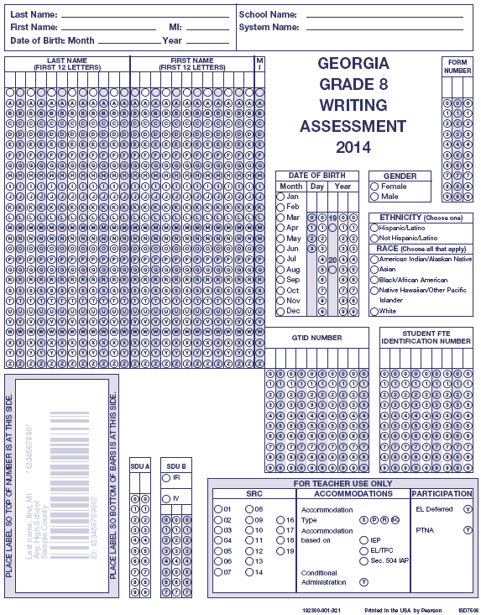
2014 Answer Document
Old answer documents will not scan.
DO NOT USE OLD ANSWER DOCUMENTS!
Complete for all students
Complete for students without a Pre-ID label
Complete when applicable
SDUA: Code as Directed by page 9 in the Coordinator’s Manual
SDUB: Code as Directed by GaDOE
SRC, Accommodations & Participation: Code as Directed in the Coordinator’s Manual starting on page 6
Pre-ID Label goes here!
DO NOT CODE CONDITIONAL UNLESS APPROVED BY THE GADOE!

Slide 15
Answer Document – Pages 2, 3, and 4
Students should begin writing on page 3. Examiners should verify this as students begin their final copy.
Answer Document – Pgs. 2, 3, and 4

Slide 16
Grade 8 Writing Assessment
Main Writing topics (2) will be spiraled (Green Paper) at the student level. Topic pages MUST be distributed in the order they are spiraled. Again, the creation of “read-aloud” groups would be the exception to this.
Make-up topic is different (Lavender Paper) from the main administration topic.
The main writing topics with sample scored papers will be released after each administration.
School systems will receive scale scores and performance levels for students, schools, and system.

Slide 17
Understanding the Writing Topic: The Directions for Writing
The Directions for Writing tell what the students are supposed to do for the writing assessment.
The first sentence of the Directions for Writing provides the students with a format for writing and gives the students an identifiable audience.
The final sentence of the Directions for Writing reminds the students to give many specific examples and ideas to elaborate their supporting ideas.
Notes:
It is not necessary for the paper to adhere to the conventions of formal letter writing if students are asked to write a letter to the audience. Students will not be penalized if they fail to address the letter or provide a closing. The students’ writing ability is being evaluated, not their knowledge of formatting letters.
Some students incorrectly interpret the phrase “reasons, examples, and evidence” and produce one paragraph of “reasons,” one of “examples,” and one of “evidence.” This strategy is not recommended.

Slide 18
Format of the Writing Task
The Directions for Writing specify a format - such as a letter, speech, or a newspaper article - to give students a writing task that is similar to real world writing situations.
Regardless of the specified format, students should have a clear controlling idea that is well developed with relevant details and examples.
Adhering to the conventions of a particular format is not evaluated on the state writing assessment.
Notes:
It is not necessary for the student to open with, for example, “Dear Principal,” or close the letter with “Sincerely, Grade 8 Student.”

Slide 19
Format of the Writing Task
Likewise, it is not necessary for students to write their responses in two columns to simulate a newspaper article.
For example, if students are asked to write a letter, they will not be penalized if they fail to address the letter to the person named in the prompt or sign their name at the end of the letter.
6. The students’ writing ability is being evaluated, not their knowledge of formatting letters, speeches, or newspaper articles.

Slide 20
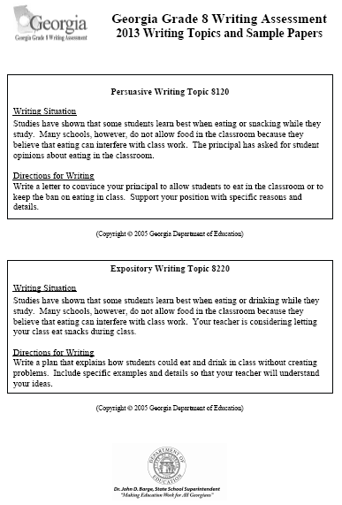
Writing Topic Page

Slide 21
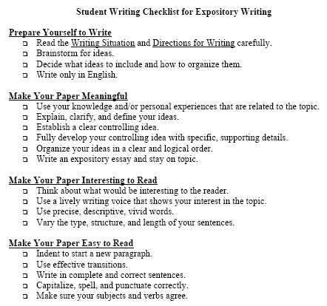
Student Writing Checklists On the bottom of the Topic page

Slide 22
Grade 8 Writing Assessment Materials
System/School Coordinator’s Manual – Used for training
Includes information for receiving, distributing, and returning materials
Examiner’s Manual – Used for training
Includes examiner’s script on how to fill out demographic page and assessment directions

Slide 23
Assessment Materials
Main Topic Page
Planning/Pre-writing Pages
Drafting Pages
Answer Document
Barcode labels – don’t use old ones; check for accuracy
Make-up Topic Page
Pencils are for document coding, and may be used for Planning/Pre-writing Pages and Drafting Pages
Responses must be completed in pen on pages 3 and 4 of the Answer Document
There should be timing devices for timing the test administration and “Testing—Do Not Disturb” signs posted.
Packaged together

Slide 24
Grade 8 Writing Assessment Materials
Classroom Answer Sheet Transmittal Forms.
Use of these are optional. Use only if class level reports are desired.
School Building Answer Document Transmittal Forms.
There should be a transmittal form for each school.
It is pre-coded with your system and school number.
Please verify that the code is correct.
Each School Coordinator should be provided a form with the correct school code.

Slide 25
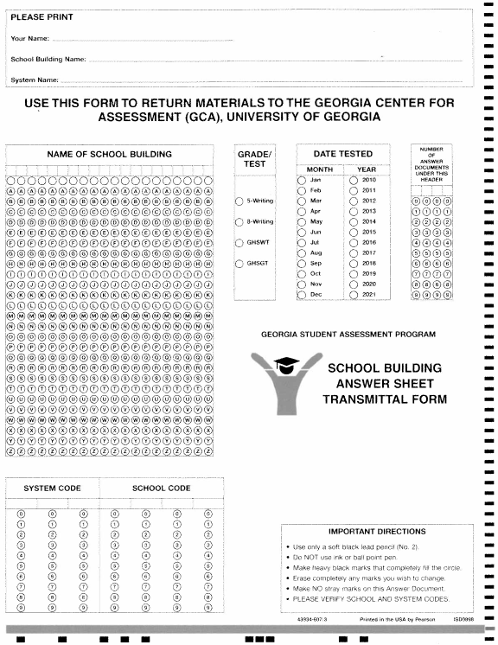
School Building Answer Sheet Transmittal Form
Print information
Bubble in building Name
Bubble Assessment (8-Writing)
Bubble “Jan” and “2014”
Bubble number of answer documents sending in and paper banded to transmittal form (right justify)
Bubble in System Code
Bubble in School Code

Slide 26
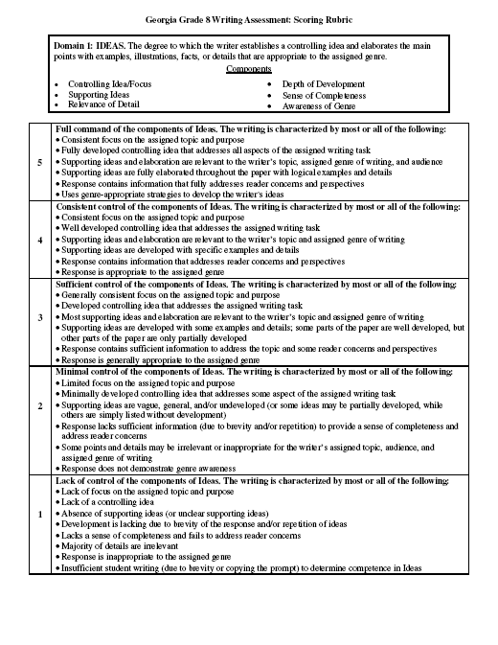
Using the Grade 8 Scoring Rubric:
Domain Title and Overview
Domain Components
Level of Competence
Score Point Descriptions (1-5)
Notes:
The Overview Statement has two parts: what is being evaluated and to what degree.
The levels of competence are consistent and parallel across all four scoring domains. A “1” in every domain will represent a “lack of control” of the elements of that domain. A “2” in every domain will represent a “minimal control” of the elements of that domain. A “3” in every domain will represent a “sufficient control” of the elements of that domain. A “4” in every domain will represent a “consistent control” of the elements of that domain. A “5” in every domain will represent a “full command” of the elements of that domain.
Few papers perfectly match every bulleted descriptive statement. Often papers have qualities of more than one score point in the rubric. The second bolded statement is a reminder that not every bulleted description applies to every paper.
The same rubric is used for scoring both Persuasive and Expository writing.

Slide 27
Accommodations
Only approved accommodations listed in the Student Assessment Handbook (SAH) may be used.
There are no state-approved conditional accommodations.
If a student’s IEP, 504/IAP, or EL/TPC calls for an unapproved accommodation, please contact the Assessment and Accountability Division by calling the main number at (404) 656-2668 or submitting the form by fax at (404) 656-5976 for approval at least 6 weeks in advance.
Use of unapproved accommodations may result in an invalidation.
Types of accommodations must be coded on the answer document
Watch for cases of unexpected injuries to dominant hands/wrists/arms. Prepare in advance for students with existing injuries.

Slide 28
Braille Availability
Systems that require Braille testing materials should contact Jeremy Granade (888-392-8977 or jgranade@uga.edu) at the Georgia Center for Assessment by January 10, 2014. If requested by January 10, 2014, delivery should occur no later than January 14, 2014.

Slide 29
Word Processor and Enlarged Copies
A word processor is not allowed in grade 8 unless it is a part of the student’s IEP or 504/IAP and is a part of the regular instructional program accommodations.
If a word processor is used, place the print out inside the answer document with the student’s GTID and form number in the upper right hand corner of the print out.
System Test Coordinators may enlarge a copy of the writing topic for students requiring a large print version as prescribed in a student’s IEP or 504/IAP .
If pages 3 and 4 of the Answer Document is enlarged, please place the enlarged copy inside the answer document with the student’s GTID and form number in the upper right hand corner of the enlarged paper.

Slide 30
Reminders
ALL responses must be written in English.
Prompts may be read aloud (only in English) if specified in the IEP, 504/IAP, or EL/TPC plan.
Examiners may read or clarify directions. They may NOT clarify the prompt.

Slide 31
Irregularities (IR)
Events and circumstances that depart from standardized testing procedures are irregularities.
They may have an impact on student performance that is not possible to define.
They are reported and student scores flagged simply to say, “There is something different about the conditions under which this score was obtained. Use caution in interpreting the score.”

Slide 32
Some Examples of Irregularities
Irregularities in Security:
Examinee was given access to test questions or prompts prior to testing.
Test Examiner or other personnel copied or reproduced and distributed secure test materials.
Test Examiner or other personnel coached examinee(s) during testing.
Test Examiner or other personnel altered or interfered with examinee’s responses in some way.
Test Examiner or other personnel made responses available to the examinee.
Test Examiner or other personnel failed to follow regulations and/or procedures for test security.
Test Examiner or other personnel used or handled the test materials for a purpose other than test administration (i.e. teacher takes a test home to review; teacher/administrator reads a test booklet after school, etc.)

Slide 33
Some Examples of Irregularities
Irregularities in Test Administration:
Test Examiner or other personnel failed to follow administration directions for the test.
Examinee’s test booklet, answer sheets, or portfolio entries (for GAA) became lost.
Teaching aids are displayed in the testing environment (i.e. a bulletin board containing instructional materials) during testing.
Test Examiner fails to provide an examinee with a documented accommodation or with an accommodation that is not documented and therefore is not appropriate.

Slide 34
Invalidations (INV)
Irregularities that significantly affect student performances or compromise the integrity of the testing may result in invalidation of student scores.
Cheating, altering responses, or disclosing content early are examples of irregularities resulting in invalidations.
New wording in the Examiner’s Manual (page 13)
The use, or intended use, of an electronic device to photograph, post, retain, or share information/images from any portion of a secure writing prompt and/or answer document will result in invalidation.

Slide 35
Reporting Irregularities and Invalidations
Irregularities MUST be handled and reported promptly.
wrong topic of the test used
wrong accommodations
cheating
etc.

Slide 36
Reporting Irregularities and Invalidations
Procedures for reporting are in the Student Assessment Handbook.
Examiner provides full report to school coordinator
School Coordinator reports to System Coordinator
System Coordinator contacts GaDOE
Coding is decided
Codes for IR and IV will be different
STC reports in the MyGaDOE portal (include statements)

Slide 37
Entering IRs into the MyGaDOE Portal
In the MyGaDOE Portal, find the “Surveys” section and click on “More”
https://portal.doe.k12.ga.us/login.aspx
Click on “View Summary” next to Testing Irregularity Form
Click on “Add New Record”
Click on “Start”

Slide 38
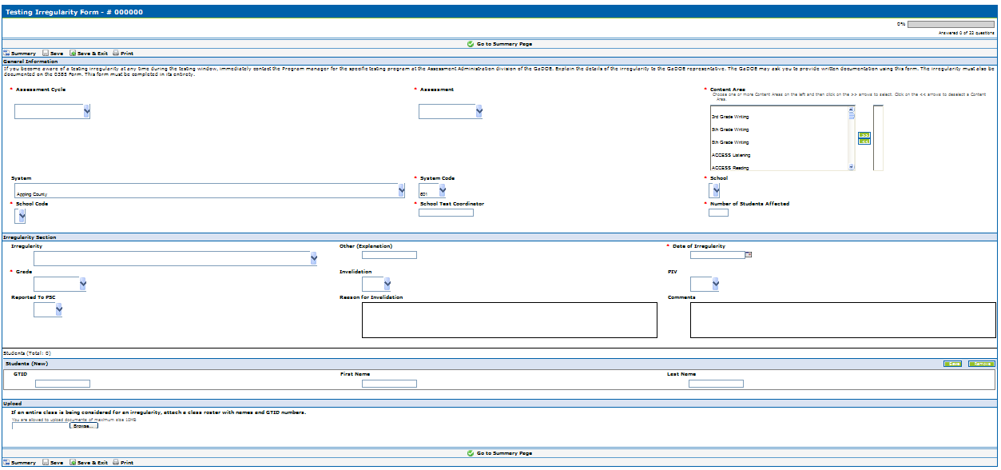
Entering IRs into the MyGaDOE Portal
Pick Assessment Cycle
“Winter 2014”
Pick the Assessment
Pick the Content Area(s)
Pick your system
Pick your system code
Pick the school
Pick the school code
Type the STC
Type the number of students
Select an IR
Explain only if “Other”
Pick date of IR
Select Grade of Student
IV - Yes or No
PIV - Yes or No
PSC - Yes or No
Explain why the IR is an IV
Explain what happened here
Enter student(s) GTID here. First and last name will populate automatically and you may add more students if needed.
Attach a class list and/or statement(s)/evidence by browsing and selecting file on your computer. You may only attach one document so multiple items will need to be zipped or combined into one document..
Fill out the irregularity form and then click on “Save & Exit”
Click on “Submit for Approval”

Slide 39
Breach of Professional Ethics Professional Standards Commission
coaches examinees during testing, or alters or interferes with examinees’ responses in any way;
gives examinees access to test questions or prompts prior to testing;
copies, reproduces, or uses in any manner inconsistent with test security regulations all or any portion of secure test booklets/online testing forms;
makes answers available to examinees;
reads or reviews test questions before, during (unless specified in the IEP, 504/IAP, or EL/TPC), or after testing;
questions students about test content after the test administration;
fails to follow security regulations for distribution and return of secure test materials as directed, or fails to account for all secure test materials before, during, and after testing (NOTE: lost test booklets constitute a breach of test security and will result in a referral to PSC);
uses or handles secure test booklets and answer documents for any purpose other than examination;
fails to follow administration directions for the test;
fails to properly secure and safeguard pass codes/usernames necessary for online test administration;
participates in, directs, aids, counsels, assists, encourages, or fails to report any of these prohibited acts;
erases, marks answers, or alters responses on an answer document.

Slide 40
Irregularities/Invalidations
Some common ways to reduce the irregularities in your system/school:
Examiners should move about the room during the entire testing session.
Examiners should not dismiss students until all counts have been verified.
Schools should count materials before distributing to examiners.
In-depth training should be provided and documented for all examiners and proctors.

Slide 41
Irregularities/Invalidations
Some common ways to reduce the irregularities in your system/school:
Review IEP, 504/IAP, and EL/TPC documents in advance of testing to plan accordingly.
Examiners may only read and clarify instructions. Prompts may not be clarified. Prompts may not be read unless specified in an IEP, 504/IAP, or EL/TPC.
Cell phones should not be allowed in the testing environment. If it is determined the cell phone was not used to cheat, then the incident is a behavior referral and not an invalidation.

Slide 42
PLANNING FOR TEST ADMINISTRATION
Conducive Environment
Seating spaces and writing surfaces are large enough
Seating arranged to prevent cheating.
NO cell phones, PDAs, or other electronic devices in the exam room.
Take any discovered devices away immediately . Return them at a later time.
Pens and pencils available.
Keep a timing device visible - You should have a clock or watch to keep track of time during test administration.
Verify that the correct topic is being used (Main vs. Make-up).

Slide 43
PLANNING FOR TEST ADMINISTRATION
EXAMINERS
Be certain that student Answer Documents are prepared correctly.
Verify that the correct topic is being used before distributing to students (Main vs. Make-up).
Be certain that students respond in the appropriate sections of the Answer Document. Marking responses in the wrong content area, even if later erased, can cause scoring errors.
Monitor students – be prepared for the unexpected.
Be certain students code the correct form number/letter on their Answer Documents.

Slide 44
PLANNING FOR TEST ADMINISTRATION
PROCTORS
When 30 or more students are to be tested in one room, the assistance of a Proctor is required. At least one Proctor is required for each additional 30 students. If students are tested in groups of less than 30, a Proctor is highly recommended.
Proctors must be trained in appropriate test procedures before testing begins. Tasks which they must perform should be clearly specified. They may help in distributing and collecting materials, assisting students with coding on the Answer Document, observing students from different points in the room while tests are being administered, and answering students’ questions concerning the test directions. To prevent the neglect of any students in large groups, Proctors may be assigned to specific areas of the room during test administration. Proctors must not explain the test items or coach students in any way.

Slide 45
PLANNING FOR TEST ADMINISTRATION
Resources and Aids
NO dictionaries, textbooks or any other aids and/or resources that would provide assistance. Any instructional materials displayed in the room that could provide an advantage during the assessment period (such as posters, helpful writing hints, etc.) should be covered or removed during testing.
Exception: Word to Word dictionaries as prescribed in an EL/TPC plan.

Slide 46
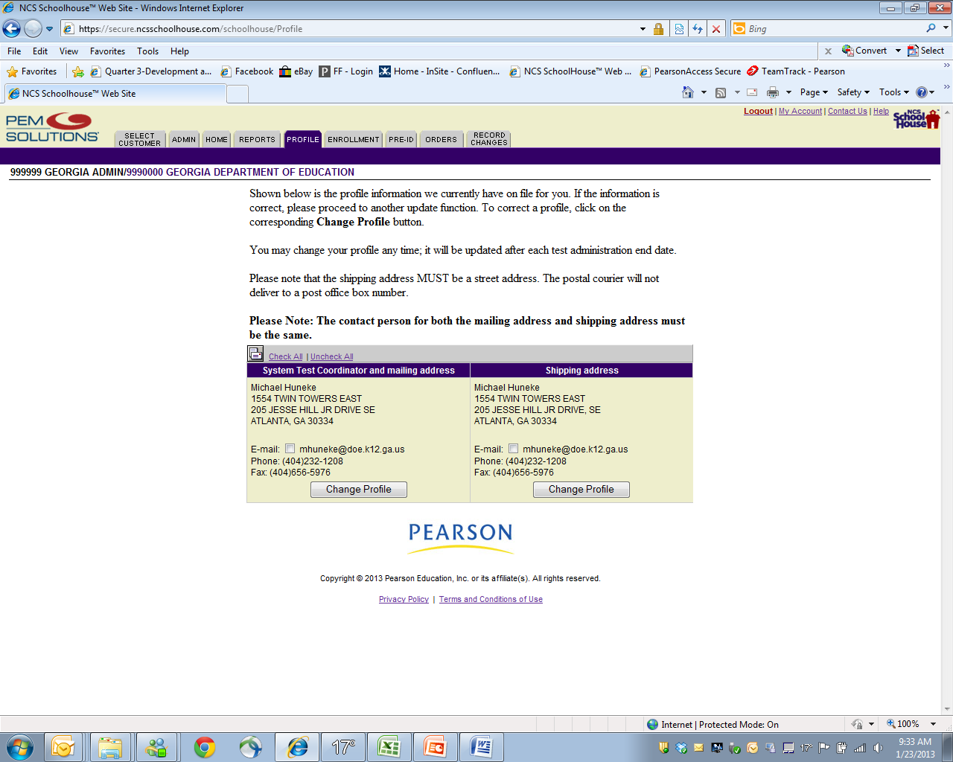
System Coordinator Information

Slide 47
Enrollments/School Codes
To close a School or to Update a School name
To add a School

Slide 48
Update a School

Slide 49
Enrollment Totals
Click on Reports
School information

Slide 50
Ordering Additional Materials Please make only one additional order for your system.
Click on the Orders Tab

Slide 51
Order Additional Materials Please make only one additional order for your system.
Click on Order Additional Materials

Slide 52
Order Tracking
Click on Order History and Tracking
To Order Materials Click on Order Additional Materials

Slide 53
Tracking Orders
Click on the Tracking Number to View Status of Shipment

Slide 54
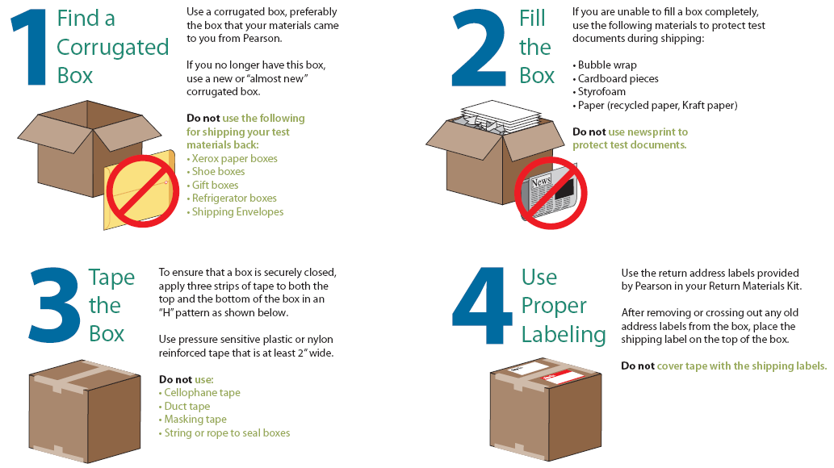
Instructions for Returning Boxed Materials to GCA

Slide 55
Results
Comparisons can not be made to QCC (2006 and prior writing assessments) results.
A new base line was established with the implementation of the new writing assessments in 2007.
Systems should receive results between March 10 – 14, 2014 dependent upon the following:
Your system shipment was received on time
Form numbers were coded correctly
Answer documents were completed correctly
* Please Note: The dates that results will be delivered to systems are posted on the State Testing Calendar and the Update Bulletin found on the GaDOE website.

Slide 56
Writing Assessment Contacts
GaDOE
Michael Huneke
404-232-1208
mhuneke@doe.k12.ga.us
GCA
Jeremy Granade
888-392-8977
jgranade@uga.edu

