Slide 1
Introduction to the Georgia Student Growth Model
Student Growth Percentiles

Slide 2
Why focus on student growth?
A growth model will allow educators to move beyond status-based questions to ask critical growth-related questions.
Status
What percentage of students met the state standard?
Did more students meet the state standard this year compared to last year?
Growth
Did this student grow more or less than academically-similar students?
Are students growing as much in math as in reading?
Are students on track to reach or exceed proficiency?
The GSGM will provide student-level diagnostic information, improve teaching and learning, enhance accountability (CCRPI), and serve as one of multiple indicators of educator effectiveness (TKES and LKES).

Slide 3
Describing Student Achievement
Status
Comparing student achievement to a target (e.g., AMOs used to calculate AYP)
Improvement
Comparing student achievement using different students across time (e.g., 3rd grade math achievement in 2009 vs. 2010)
Growth
Measuring student achievement across time using the same students

Slide 4
Growth vs. Value-Added
A growth model describes change in student achievement across time
A growth model becomes value-added when the growth is attributed to an entity (a teacher, a school, etc.)
In many models, the value-added is the difference between predicted performance and actual performance
The model uses information about a student (prior achievement, demographic information, etc.) to predict how that student will perform. The student’s actual performance is compared to his predicted performance. The difference is considered value-added.
The GSGM does not predict performance; it describes observed student growth.

Slide 5
Addressing Common Concerns
Understandability
Ownership of methodology and data
Cost and operations
Missing data
Stability
Outliers
Growth at the extremes / floor and ceiling effects

Slide 6
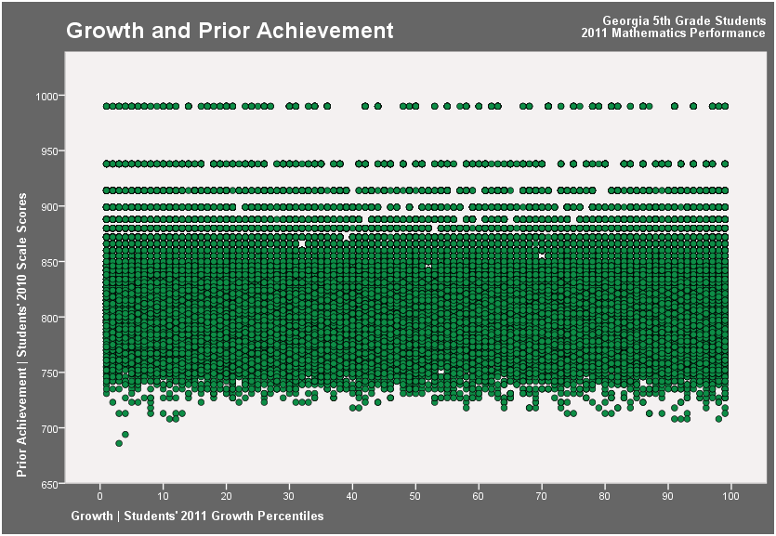
2011 SGP = 1
2010 4th Grade Math Scale Score = 990
2011 5th Grade Math Scale Score = 850
2011 SGP = 99
2010 4th Grade Math Scale Score = 990
2011 5th Grade Math Scale Score = 990
Notes:
This chart plots current SGPs on the X axis and prior year scale scores on the Y axis.
It shows that for every level of prior achievement, students demonstrate all levels of growth. In other words, no matter how a student scored on the CRCT one year, it is possible to grow at any rate the next year.

Slide 7
What are Student Growth Percentiles?
A student growth percentile (SGP) describes a student’s growth relative to other students statewide with similar prior achievement
Calculations based solely on achievement
SGPs not only show how individual students are progressing, but they also can be aggregated to show how groups of students, schools, districts, and the state are progressing

Slide 8
SGPs for Individual Students
Each student obtains a growth percentile, which indicates how his or her current achievement compares with that of his or her academic peers
Academic peers are other students statewide with a similar score history
Priors are the historical assessment scores used to model growth
Growth percentiles range from 1 to 99
Lower percentiles indicate lower academic growth and higher percentiles indicate higher academic growth
Students also receive growth projections and growth targets, which describe the amount of growth needed to reach or exceed proficiency in subsequent years

Slide 9
Understanding Percentiles
50th percentile
50%
50%
A distribution, for example, of height, weight, or academic growth
The 50th percentile is the value below which 50% of the distribution lies.

Slide 10
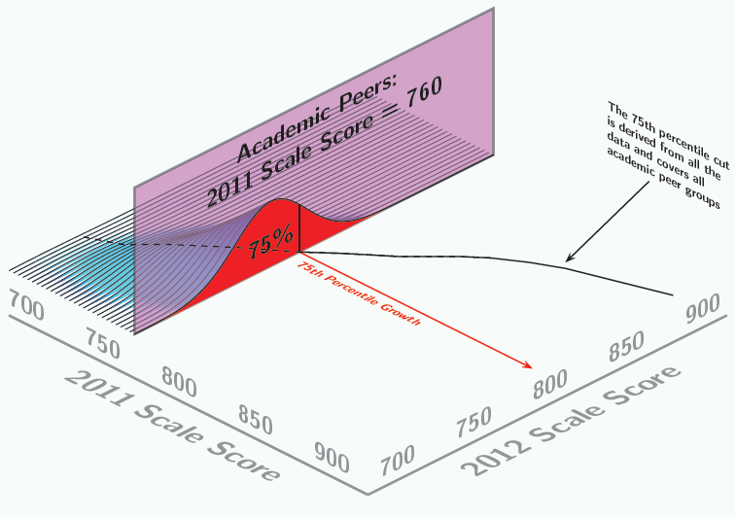
Understanding Academic Peers

Slide 11
Aggregating SGPs
There are multiple ways of aggregating SGPs (such as for a classroom, school, or district)
Median – the median growth percentile for all students
Growth distribution – divide the growth percentile range (1-99) into intervals and report the percentage of students demonstrating growth in each interval
Percentage meeting a goal – the percentage of students demonstrating at or above a specified level of growth

Slide 12
Calculating the Median SGP
Name | SGP
Marvin M. | 26
Olive O. | 29
Donald D. | 31
Minnie M. | 33
George J. | 38
Charlie B. | 40
Bugs B. | 46
Scooby D. | 49
Fred F. | 51
Betty B. | 53
Elmer F. | 57
Imagine that the list of students on the left are all of the students in a 5th grade class.
The 11 students are sorted in order of their SGP from low to high.
The median SGP is the middle value, where 50% of students have a lower SGP and 50% have a higher SGP.

Slide 13
Exploring Growth Distribution
Low growth Typical growth High growth
median
Percentile Range
median
Note: For illustrative purposes only.

Slide 14
Interpreting SGPs
Anna’s reading growth percentile is 54
Anna grew at a rate greater than 54% of academically-similar students in reading
Lower growth Typical growth Higher growth

Slide 15
Interpreting SGPs
The median reading growth percentile for Anna’s school is 65
The typical student in Anna’s school grew at a rate greater than 65% of academically-similar students
Anna grew at a lower rate in reading compared to the other students in her school on “average”
Lower growth Typical growth Higher growth

Slide 16
Growth Over Time
Because SGPs are normative, meaning growth percentiles describe a student’s growth relative to other students in the state in a given year, how do we compare results over time?
A baseline will be used as a reference point so change in overall growth can be observed from year to year
Without using a baseline, the median SGP for the state would be 50 every year – absolute changes in a school’s growth could not be observed since the state as a whole is moving too
The baseline is an average of multiple years of data in order to allow for a more stable comparison
A baseline has been set for CRCT reading, ELA, math, and science. Due to changes in the social studies test, the social studies baseline will be set in 2013. EOCTs are a mix of baseline- and cohort-referenced SGPs.

Slide 17
Growth Over Time
Without setting a baseline…
State Median
This year = 50
Next year = 50
Two years = 50
etc.
…the state median will always be 50 with half of students below 50 and half above 50

Slide 18
Growth Over Time
With setting a baseline…
State Median
This year = 50
Next year = 55
Baseline year
Two years = 60
…the state median can change from year to year, representing statewide change in growth over time

Slide 19
Growth to Proficiency
How do we know if a student’s growth is enough to be on track to reach or exceed proficiency?
SGPs analyze historical student assessment data to model how students perform on all state assessments and the amount of growth they demonstrate in between
This information is used to create growth projections and growth targets for each student
The growth projection tells us where on the assessment scale a student may score next year for all levels of possible growth (1st-99th percentile)
The growth target tells us, based on where students are now, how much they need to grow to reach or exceed proficiency in the future

Slide 20
Growth Projections and Targets
Exceeds
Meets
Does Not Meet
High
Target 2
Typical
Target 1
Low
This Year Future

Slide 21
Assessment Inclusion
The CRCT and EOCT assessments will be included in the model.
The model will transition to the use of PARCC assessments once they are implemented in Georgia.
While growth percentiles can be reported when PARCC is first implemented, baselines and growth projections will be delayed. Multiple years of data are necessary.
Retests for both CRCT and EOCT (beginning in 2012) will be utilized. The higher of the main administration and retest score will be used.

Slide 22
Priors
Priors are the historical assessment scores being used to model growth
The immediate consecutive prior is required to produce growth percentiles
For example, an 8th-grade student must have a 7th-grade CRCT score in order to receive a growth percentile
Two years of priors will be used (one year will be used when two years are not available)
For example, growth percentiles for an 8th-grade student would have his or her 7th- and 6th-grade CRCT scores as priors

Slide 23
EOCT Course Progressions
For EOCTs, both prior achievement and course progressions (including year taken) must be considered.
Students engaging in a common sequence will receive SGPs:
ELA: CRCT reading/ELA → 9th Grade Lit → American Lit
Math: CRCT math → Math I → Math II
Science: CRCT science → Physical Science/Biology → Biology/Physical Science
Social Studies: US History → Economics
EOCT SGPs will be a mix of cohort- and baseline-referenced SGPs until enough years of data is available
Cohort: Math I, Math II, US History
Baseline: 9th Grade Literature, American Literature, Physical Science, Biology, Economics

Slide 24
Model Features
Conceptually easy to understand, communicate, and utilize
Can be communicated to educators as well as parents and other stakeholders
Everyone will be involved in the process and can understand, make meaning of, and utilize the data
Does not require a vertical or developmental scale
We are not examining the change in scale scores, rather, we are examining student performance relative to other students
Provides an appropriate reference point for the amount of growth a student demonstrates (the growth of academically-similar peers)
Utilizes multiple years of prior achievement data

Slide 25
Model Features
Serves as both a norm-referenced and criterion-referenced measure of growth
Provides information on observed and future growth (the amount of growth needed to meet state standards)
Does not have floor or ceiling effects
Students can demonstrate all levels of growth regardless of achievement level
Robust to outliers
Extreme observations do not drastically affect summary measures
Methodology is freely available, enabling GaDOE to build the infrastructure to support and sustain the model
Have external technical support to implement and verify the model

Slide 26
GSGM Visualization Tool

Slide 27
Questions?
For questions regarding the Georgia Student Growth Model, please contact:
Melissa Fincher
Associate Superintendent of Assessment and Accountability
mfincher@doe.k12.ga.us or (404) 651-9405
Allison Timberlake
Program Manager, Growth Model
atimberlake@doe.k12.ga.us or (404) 463-6666

