Slide 1


LEXILES:
Making Sense of a Reading Measure
Updated August 2014
Updated September 2014

Slide 2
Goal of Presentation
Provide education stakeholders with background information for understanding, interpreting, and then using a student’s Lexile measure to improve the student’s reading ability.
  Lexiles and the College and Career-Ready Georgia Performance Standards (CCGPS)
  Georgia’s Plan for Lexiles
  Definition of Lexile
  Overview of Lexile Framework
  Find a Book Search Engine
  Using Lexiles to Build Partnerships
    In schools
    In libraries
    In the home
  2014 Lexile Data
  Relating Lexiles to Tests and Other Reading Measures

Slide 3
Lexiles and the CCGPS
The CCGPS promote that students should be ready for college and career after high school.
The most important factor for readiness is a student’s ability to read and understand texts of steadily increasing complexity as they progress through school.
The Lexile® Framework provides valuable insights into student readiness by measuring both the complexity of reading materials, including college and career texts, and a student's ability to comprehend these texts.

Slide 4
Lexiles Stretch Bands &
College- and Career-Readiness
The Lexile Framework has been realigned to match the college- and career-ready text complexity grade bands.
  The “stretch” bands of the Lexile Framework show an upward trajectory of reading comprehension development through the grades to indicate that all students should be reading at the college- and career-readiness level by no later than the end of high school.

Slide 5
Lexile Bands
Grade Band | “Stretch” Lexile Band
K-1 | N/A
2-3 | 420-820L
4-5 | 740-1010L
6-8 | 925L-1185L
9-10 | 1050L-1335L
11-CCR | 1185L-1385L
These “stretch” Lexile bands are the basis for determining at what text complexity level students should be reading—and at which grades—to make sure they are ultimately prepared for the reading demands of college and careers.

Slide 6

Georgia’s Plan for Lexiles
GaDOE will continue to issue Lexile measures for the Georgia Milestones Assessment System.
Students will receive a Lexile measure along with their regular scale score for the Milestones EOG or EOC in ELA.
A student’s Lexile measure is a tool
  for teachers to use in targeting reading material for students.
  for parents to use in selecting reading material for their children.
CCGPS promotes literacy in ELA and Math as well as other subject areas.
  Teachers in such areas as social studies and science must also help students develop literacy.

Slide 7
Georgia’s Plan for Lexiles
In the spring of 2015, the GaDOE and MetaMetrics will conduct a research study to link the Lexile metric to Georgia Milestones.
  About 2,500 students will take a parallel Lexile test prior to the spring administration of the Milestones EOG and EOC.
  By matching these scores to performance on the subsequent operational test, the relationship between Lexiles and Georgia Milestones can be established.

Slide 8
How will Lexiles be reported?
Student Score Report will provide:
Lexile information in parent-friendly format.
Lexile score and Lexile range.
An explanation on how to use the information.
Sample book titles individualized for each student based on their Lexile range. These are categorized into a Leisure reading range and a Challenging reading range.
Lexile information will also be provided in the data files supplied to districts.

Slide 9
What is the Lexile Framework?
Developed by MetaMetrics
Based on research funded by National Institute for Child Health Development (NICHD)
Combined the work of reading experts Chall, Flesch, Carroll, and Bormuth, with measurement expert, Rasch

Slide 10
What is the Lexile Framework?
An educational tool that links text and readers under a common metric known as Lexiles.
Allows educators to forecast the level of comprehension a reader is expected to experience with a particular text
Most commonly used reading measure
  Over 19 million students receive Lexile scores through commercial and state assessments
  Over 100,000 books and tens of millions of articles have Lexile measures

Slide 11
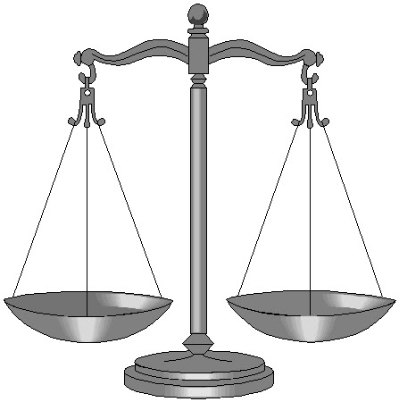
Lexile Measure
Reading Ability
Text Complexity
A Lexile is a standard score
developed by MetaMetrics
Matches a student’s reading ability with difficulty of text material
Interpreted as the level of book that a student can read with 75% comprehension
75% comprehension is the level identified by experts as offering the reader a certain amount of comfort and yet still offering a challenge

Slide 12
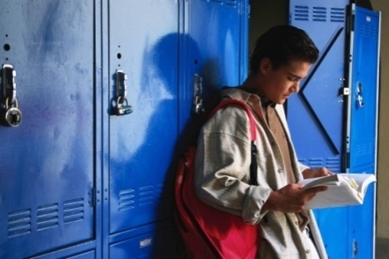
The Lexile Scale
Lexiles typically range from 200 for beginning readers to 1700 for advanced readers
Lexile text below 200L represents beginning-reading material.
  A student’s Lexile score may have a number in the 100s or the code of BR (for Beginning Reader).
Applies to both reader ability and text difficulty
  When reader and text measures are the same, the student is expected to read with 75% comprehension.
Can be used to track reading growth over time

Slide 13
More About the BR Lexile Code
ISBN | Title | Author | Lexile
0152020632 | "Fire, Fire!" Said Mrs. McGuire | Martin Jr., Bill | BR
0813620082 | "POP" Pops the Popcorn | Egan, Bob | BR
0478126123 | "Who Took the Cake?" | Medina, Eduardo | BR
BR is used for any text or student ability that has a Lexile measure of zero or below. Some students, particularly at the lower grades, have CRCT or CRCT-M scores that generate a BR Lexile score (BR means beginner reader) or a score less than 200L.
ISBN | Title | Author | Lexile
0478204418 | "Happy Birthday, Estela!" | Bingley, Anne M. | 70L
047820454X | "Smile!" said Dad | Jane Buxton | 20L
0679886893 | 6 Sticks | Coxe, Molly | 120L
051622879X | A Lunch With Punch | Kittinger, Jo S. | 80L

Slide 14
How are Lexiles calculated?
Semantic Difficulty
  Word Frequency
Syntactic Complexity
  Sentence Length

Slide 15
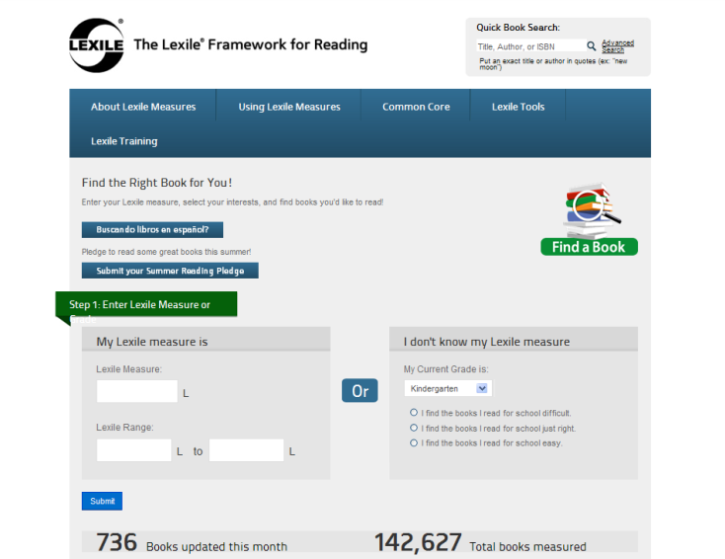
Accessing the Find A Book Tool http://lexile.com/fab/GA

Slide 16

What if a book or document isn’t in the Lexile database?
Use the Lexile Analyzer – it’s free, but you must register.
Create a text document (file extension is .txt) with multiple 175-word slices from the book or document.
Submit via the Lexile Analyzer.
  http://lexile.com/analyzer/
Also can approximate the Lexile by seeing other books by the same author or in same series. At least a good place to begin with to determine if book is close to a student’s Lexile range.

Slide 17
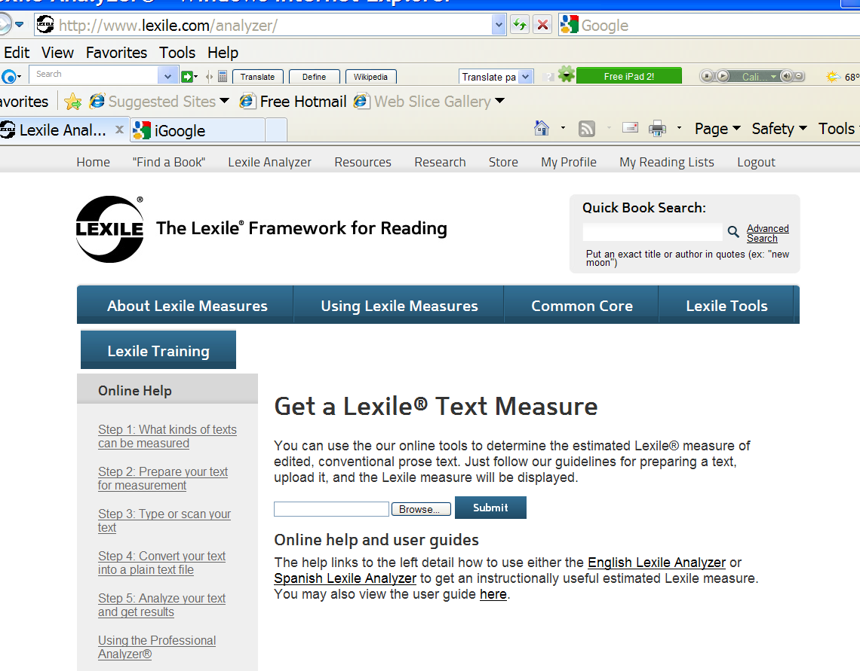
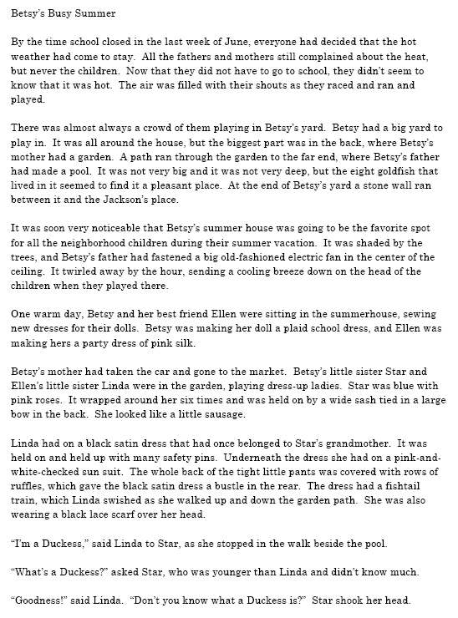
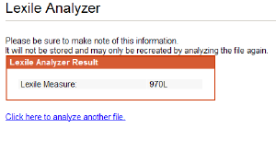
Lexile Analyzer
Lexile Analyzer
Txt file
Result

Slide 18
Alternate Method
The book Betsy’s Busy Summer is not in Lexile database.
Other books by Carolyn Haywood are:
  B is for Betsy – 660L
  Back to School with Betsy – 570L
  Betsy and the Boys – 560L
If book is in same series, then book is most likely somewhere in this range.
Also see what other “leveling” might be done for the author or series. The reading level for many “Betsy” books is 9 to 12-year-olds; this translates roughly into 3rd to 5th grade or about 500L to 950L.

Slide 19



Making Connections Using Lexiles
HOME
LIBRARY
SCHOOL
The Lexile Framework is a tool for teachers, media specialists, librarians, and parents to use in conjunction with existing reading programs and is not a replacement for existing reading programs.

Slide 20
How to Use Lexiles
It is recommended that readers choose texts within their Lexile range.
  A Lexile range is 50L above and 100L below a student’s reported Lexile measure.
Selection for pleasure reading should also be based on student’s interests
Practice with a variety of texts.
Use Lexiles to set goals.

Slide 21
Using Lexiles in the Classroom
Teachers can use Lexiles to help them:
Develop individualized or classroom reading lists tailored to provide appropriately challenging reading.
Enhance thematic teaching by building a bank of titles at varying levels that support the theme, but also allows all students to participate successfully in the theme with material at their own reading level.
Sequence materials, for example by increasing the difficulty of read-aloud books throughout the year.
  Source: http://www.lexile.com/m/uploads/downloadablepdfs/Lexiles-in-the-Classroom.pdf

Slide 22
Using Lexiles in the Classroom
Teachers can use Lexiles to help them:
Develop a reading folder that goes home with students and comes back for weekly review. Folder might contain:
  a reading list of books within the student’s Lexile range
  reports of recent assessments
  a form for parents to record reading that occurs at home.
Vary reading difficulty of material to the situation:
  Choose texts lower in the student’s Lexile range when factors make the reading situation more challenging, threatening or unfamiliar.
  Select texts at or above the student’s range to stimulate growth when a topic is of extreme interest to a student, or when you will be giving additional support such as background teaching or discussion.
  Source: http://www.lexile.com/m/uploads/downloadablepdfs/Lexiles-in-the-Classroom.pdf

Slide 23

More Instructional Uses of Lexiles
Teachers can use Lexiles to:
Set measurable goals for instruction and special intervention programs
Monitor progress of various reading programs
Make parents “partners to the classroom” by giving them a tool for selecting appropriate reading material for their children (e.g., Summer Reading Lists, visiting library, etc.)
Help students set goals for themselves and use annual CRCT results to see if they have progressed towards their goals.
  Source: http://www.lexile.com/m/uploads/downloadablepdfs/Lexiles-in-the-Classroom.pdf

Slide 24

More Instructional Uses of Lexiles
Lexiles can help teachers:
Adjust materials to the purpose of reading.
  For increased fluency and automaticity, teacher selects text that measures well below reader ability.
  As a strategy for teaching students how to attack “hard” text, the teacher selects text that measures above reader ability.
  Source: http://www.lexile.com/m/uploads/downloadablepdfs/Lexiles-in-the-Classroom.pdf

Slide 25

More Instructional Uses of Lexiles
Teachers can use Lexiles to target fiction and non-fiction material to students’ abilities and thus promote learning of all subjects.
  Avoids student frustration when reading text is too difficult.
  Avoids undermining student self-confidence.
  Avoids the fostering of bad work habits and unrealistic self-expectations when a student is always presented with too easy material.
  Learning occurs best when the text material can be comprehended at a 75% rate.
  Source: http://www.lexile.com/m/uploads/downloadablepdfs/Lexiles-in-the-Classroom.pdf

Slide 26
Summer Reading Is Essential!
Research studies show that ---
students can have up to a 2-3 month loss in reading ability over summer.
lower income students may suffer most due to lack of books in home and transportation access to public libraries.
rural area students also lack easy access.
innovative partnering of schools, publishers, and public libraries have great promise for solving the summer reading loss dilemma.

Slide 27
Using Lexiles to Promote Reading
Improve students’ reading fluency and increase enjoyment of reading.
  Students who spend a minimum of 3 hrs/week reading at their own level for their own purposes develop reading fluency which leads to improved mastery.
It is recommended that readers choose texts within their Lexile range.
  A Lexile range is 50L above and 100L below a student’s reported Lexile measure.
Use Lexiles to set goals.
Practice with a variety of texts.
Challenge the BEST readers.
Success breeds enjoyment.

Slide 28
Using Lexiles in Media Centers and Public Libraries
Media specialists and librarians can assist classroom instruction by
Helping to develop individualized or classroom reading lists tailored to provide appropriately challenging reading.
Guiding teachers in selecting a bank of titles at varying levels that support an instructional thematic unit. This allows all students to participate successfully in the theme with material at their own reading level.
Locating and sequencing materials for classroom use. For example, increasing the difficulty of read-aloud books throughout the year.
  Source: https://d1jt5u2s0h3gkt.cloudfront.net/m/uploads/downloadablepdfs/Lexiles-in-the-Library.pdf

Slide 29
Use Lexiles to Build Partnerships
School media specialists and public librarians should be partners.
  Jointly create reading lists
  Complement catalogue holdings
Assist students in selecting reading material.
  Remember to vary reading difficulty of material to the situation.
  Ask for Lexile information. Schools might create a library card with Lexile information on it.
  Choose texts lower in the student’s Lexile range when factors make the reading situation more challenging, threatening or unfamiliar.
  Select texts at or above the student’s range to stimulate growth when a topic is of extreme interest to a student, or when you will be giving additional support such as background teaching or discussion.
Make parents “partners” by giving them a tool for selecting appropriate reading material for their children (e.g., Summer Reading Lists, visiting library, etc.)
  Source: http://www.lexile.com/m/uploads/downloadablepdfs/Lexiles-in-the-Classroom.pdf

Slide 30


Parents Can Use Lexiles
Promotes family-school connections.
Know your child’s Lexile measure.
Know your child’s Lexile range.
  50L above and 100L below their reported Lexile measure. This range represents the boundaries between the easiest kind of reading material for your child and the hardest level at which he/she can read successfully.
Use the Lexile Find a Book Database (at http://lexile.com/fab/) to find books in the child’s Lexile range.
Source: http://www.lexile.com/m/uploads/downloadablepdfs/Lexiles-at-Home.pdf

Slide 31

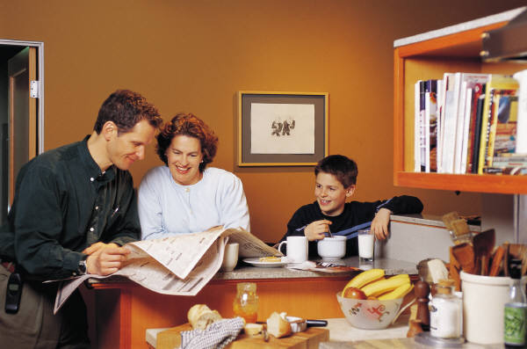
Parents Can Use Lexiles
Ensure that your child reads every day.
Parents should read to set a good example. Reading newspapers and magazines will show children that reading is a wonderful pastime as well as a window to the world of learning.
Ask school or library for book lists within Lexile range.
Student’s interests should play a part in book selection.
Visit public libraries often.
Participate in summer reading programs.
Source: http://lexile.com/m/uploads/downloadablepdfs/Lexiles-at-Home.pdf

Slide 32
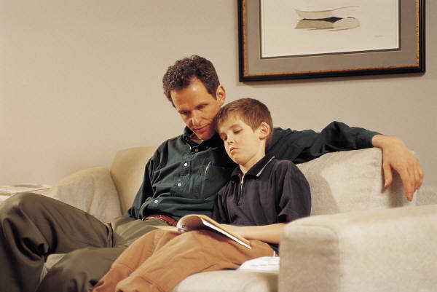
Parents Can Use Lexiles
When a reading assignment proves to be too difficult, provide adult-directed assistance:
  Review words and definitions from glossary or dictionary.
  Review questions at end of chapter before child reads text.
  Pair-share read – Parent and student alternate reading the text. Stop, discuss, and ask questions along the way to see that student understands.
  Return to end of chapter questions and glossary to make certain your child understands the material.
Celebrate your child’s reading accomplishments.
  Set goals –
    number of books read
    variety of books
    stretch to books at higher Lexile
Source: http://www.lexile.com/m/uploads/downloadablepdfs/Lexiles-at-Home.pdf

Slide 33
Georgia’s Lexile Results
The next few slides provide a brief overview of students’ Lexile measures from the
2013-14 school year.

Slide 34
Relationship of Lexiles & Grade Levels
Grade | Reader Measures, Mid-Year | Text Demand Study 2009 | "Stretch" Text Measures
 | 25th percentile to 75th percentile (IQR) | 25th percentile to 75th percentile (IQR) | 25th percentile to 75th percentile (IQR)
1 | Up to 300L | 230L to 420L | 190L to 530L
2 | 140L to 500L | 450L to 570L | 420L to 650L
3 | 330L to 700L | 600L to 730L | 520L to 820L
4 | 445L to 810L | 640L to 780L | 740L to 940L
5 | 565L to 910L | 730L to 850L | 830L to 1010L
6 | 665L to 1000L | 860L to 920L | 925L to 1070L
7 | 735L to 1065L | 880L to 960L | 970L to 1120L
8 | 805L to 1100L | 900L to 1010L | 1010L to 1185L
9 | 855L to 1165L | 960L to 1110L | 1050L to 1260L
10 | 905L to 1195L | 920L to 1120L | 1080L to 1335L
11 and 12 | 940L to 1210L | 1070L to 1220L | 1185L to 1385L
Column 2 shows the range of Lexiles in which the middle 50% of readers fall at a grade level. 25% of students fall below this range and 25% above.
Column 3 shows the typical range of reading material at a grade level. These are based on a 2009 study.
Column 4 shows the "stretch" text measures (defined in 2010 through studies related to the development of the Common Core State Standards for English Language Arts) and represents the demand of text that students should be reading to be college and career ready by the end of Grade 12.
http://www.lexile.com/about-lexile/grade-equivalent/grade-equivalent-chart/

Slide 35
Lexile Data from 2014 CRCT & EOCT
Grade Level | N Count w/ Lexiles | Mean | Range |  | Distribution |  |  | Lexile Associated with Cut Scores
 |  |  | Minimum Lexile | Maximum Lexile | 25th Percentile | 50th Percentile (Median) | 75th Percentile | Lexile at Meets | Lexile at Exceeds
3 | 126,745 | 702.30 | BR* | 890 | 570 | 755 | 890 | 410 | 790
4 | 124,872 | 841.98 | BR* | 990 | 735 | 915 | 990 | 570 | 915
5 | 123,653 | 924.65 | 205 | 1085 | 815 | 965 | 1085 | 650 | 1040
6 | 124,746 | 1031.97 | 190 | 1155 | 945 | 1075 | 1155 | 685 | 1120
7 | 127,269 | 1074.57 | 240 | 1210 | 980 | 1120 | 1210 | 800 | 1210
8 | 126,232 | 1159.60 | 295 | 1265 | 1090 | 1265 | 1265 | 805 | 1265
9** | 112,505 | 1218.73 | 380 | 1505 | 1090 | 1225 | 1365 | 985 | 1290
11** | 93,689 | 1263.07 | 420 | 1545 | 1145 | 1270 | 1390 | 1020 | 1320
* BR = Beginning Reader - is reported on score reports.
** Grades 9 and 11 reflect information for EOCT in 9th Grade Literature & Composition and American Literature & Composition, respectively.

Slide 36
Exploring the Relationship of Lexiles to CRCT and EOCT
How can we relate this information in the chart about Lexile measures for typical readers and “stretch” text measures at each grade to Georgia’s assessments?
  The next slide shows these typical reader and “stretch” text measures along with actual Lexile measures associated with the CRCT and EOCT.
  The second slide graphically shows this relationship.
  Other slides provide explanations on how to interpret this information.

Slide 37
Grade Level “Stretch” Text and Reader Lexile Boundaries, Median Lexiles, & Lexiles at Cut Scores
 | Grade 3 | Grade 4 | Grade 5 | Grade 6 | Grade 7 | Grade 8 | Grade 9 | Grade 11
Stretch Text -Lower | 520 | 740 | 830 | 925 | 970 | 1010 | 1050 | 1185
Stretch Text - Upper | 820 | 940 | 1010 | 1070 | 1120 | 1185 | 1260 | 1385
Meets | 410 | 570 | 650 | 685 | 800 | 805 | 985 | 1020
Exceeds | 790 | 915 | 1040 | 1120 | 1210 | 1265 | 1290 | 1320
Reader - Lower | 330 | 445 | 565 | 665 | 735 | 805 | 855 | 940
Reader - Upper | 700 | 810 | 910 | 1000 | 1065 | 1100 | 1165 | 1210
GA 2014 Median | 755 | 915 | 965 | 1075 | 1120 | 1265 | 1225 | 1270

Slide 38
Grade Level “Stretch” Text & Reader Lexile Boundaries with Median Lexiles & Lexiles at Cut Scores

Slide 39
Interpreting the Graph
The graph illustrates the relationship of reader ability, text difficulty, and the cut scores on the CRCT and EOCT.
The blue lines represent the range of “stretch text” Lexiles that represent the demand of text that students should be reading to be college and career ready by the end of Grade 12. To be college and career ready, students should fall in this “river of text.”
The red lines represent the range of Lexiles for readers that comprise the middle 50% of readers within a grade level. Note that the lower limits of this range are not in the “river of text.”
The green line with triangles shows the Lexiles associated with Meets on CRCT (grades 3-8) and EOCT – 9th Grade Lit and 11th Grade American Lit.
The green line with squares shows the Lexiles associated with Exceeds on CRCT (grades 3-8) and EOCT – 9th Grade Lit and 11th Grade American Lit.
The purple line represents the 2014 median Lexile for students at each grade.

Slide 40
Interpreting the Graph
The span of reader ability (red lines) is greater than the span of text difficulty (blue lines).
Students with Lexile scores that fall toward the lower band of reader ability (the bottom red line) and outside of the text difficulty (the blue lines) will probably experience some difficulty comprehending the “stretch” text demands for that grade level.
In most cases the Lexiles associated with the Meets cut scores on the CRCT and the EOCT fall on or above the lower band of reader ability (lower red line) but below the lower bound of text difficulty (lower blue line).
The Lexiles associated with the Exceeds cut scores on the CRCT are typically at or above the typical upper limit of the “stretch” text difficulty (the upper blue line) and the typical upper bound of the interquartile of reader ability (the upper red line).

Slide 41
Good News from Lexile Data
A Longitudinal Look
The table on the next slide shows the median Lexile at each grade for the last six years along with the “stretch text” Lexile range.
The 2014 median Lexile for each grade shows an increase from the 2007 median.
As of 2014, the median Lexile for each grade is falling within the “stretch” text bands for grades 3-5, 7, 9, and 11. For grades 6 and 8, the median Lexile exceeds the upper limit of the “stretch” text band.

Slide 42
Median Lexile from CRCT & EOCT by Grade from 2007 – 2014 with “Stretch Text” Lexiles
Grade | 2007 | 2008 | 2009 | 2010 | 2011 | 2012 | 2013 | 2014 | Stretch Text DemandLower Limit | Stretch Text Demand Upper Limit
3 | 610 | 670 | 645 | 685 | 720 | 740 | 790 | 755 | 520 | 820
4 | 740 | 770 | 790 | 810 | 805 | 840 | 860 | 915 | 740 | 940
5 | 825 | 870 | 840 | 885 | 925 | 935 | 940 | 965 | 830 | 1010
6 | 910 | 955 | 980 | 980 | 1000 | 1025 | 1070 | 1075 | 925 | 1070
7 | 965 | 995 | 1020 | 1020 | 1040 | 1065 | 1095 | 1120 | 970 | 1120
8 | 1060 | 1080 | 1110 | 1150 | 1170 | 1180 | 1210 | 1265 | 1010 | 1185
9th Lit |  |  |  |  |  | 1205 | 1215 | 1225 | 1050 | 1260
11th Am Lit |  |  |  |  |  | 1220 | 1240 | 1270 | 1185 | 1385

Slide 43



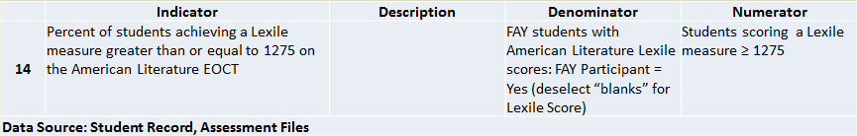
Lexiles and CCRPI

Slide 44
Lexiles and CCRPI
Targets for the Lexiles indicators in CCRPI were based on the Lexile “stretch” bands and longitudinal data from state tests.
Targets represent reading ability that firmly plants student within the college and career ready stretch bands for their grade level.
Grade | Stretch Text Band Lower Limit | Stretch Text Band Upper Limit | CCRPI Target
3 | 520 | 820 | 650
5 | 830 | 1010 | 850
8 | 1010 | 1185 | 1050
11 | 1185 | 1385 | 1275

Slide 45
Relating Lexiles to
Other Measures
GaDOE often receives questions on how to relate Lexiles to other measures.
The next few slides show correspondence of Lexiles to other reading level models.

Slide 46
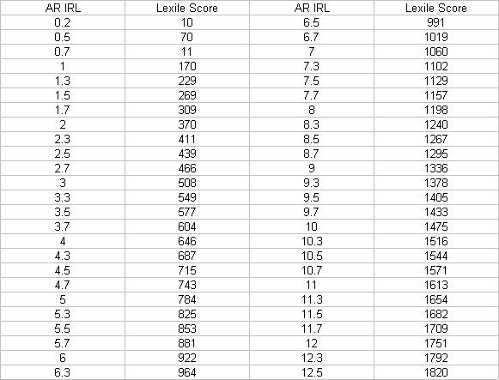
Accelerated Reader* and Lexiles**
*This relational table is from Renaissance Learning, Inc. (2002). **Lexile is a trademark of MetaMetrics, Inc.
Source: http://www.nacs.k12.in.us/mcms/6thGrade/ARLEX.html

Slide 47
Comparison of Various Reading Level Models
*This chart was retrieved from the following website: http://www.oema.net/lexiles/ReadingLevelComps.pdf.
This chart was provided to the Oregon Educational Media Association by Steven Zimmerman of Harcourt. It provides a comparison by grade level of different book leveling systems including Lexiles, Fountas and Pinnell (Guided Reading), Basal, DRP (Degrees of Reading Power), Reading Recovery and DRA.

Slide 48
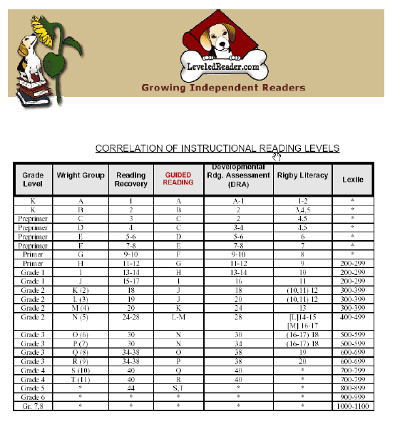
Relating Different Reading Level Models
This table is from https://www.leveledreader.com/docs/Leveling_Guide.pdf

Slide 49
Georgia’s Summer Reading Challenge
A student’s growth in reading ability doesn’t happen only at school.
Research has shown that students can have up to a 2-3 month loss in reading ability over the summer.
Therefore, summer reading at home is essential!
Visit Georgia’s Summer Reading Challenge webpage for more information: http://www.gadoe.org/Curriculum-Instruction-and-Assessment/Curriculum-and-Instruction/Pages/Georgia-Summer-Reading-Challenge.aspx

Slide 50
Want to Know More . . .
GA Department of Education has Lexile information at:
  http://www.gadoe.org/Curriculum-Instruction-and-Assessment/Assessment/Pages/Lexile-Framework.aspx
  https://www.georgiastandards.org/Resources/Pages/Tools/LexileFrameworkforReading.aspx
MetaMetrics’ website: http://lexile.com/
Contact:
  Dr. Melodee Davis, Director
    Assessment Research and Development Division
    Georgia Department of Education
    Phone: 404-657-0312
    Email: medavis@doe.k12.ga.us

Slide 51




Read every day!

