Slide 1

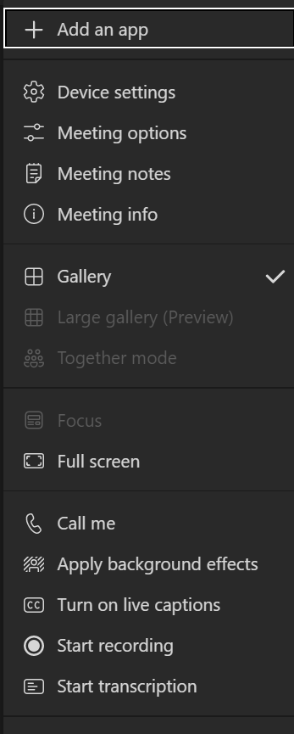
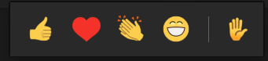
Welcome!
Post questions throughout the webinar using this link. This link will be on every slide.
Disconnect from the Meeting
Teams Toolbar Options
Show Participants
Team Notifications
More
Actions
View the content in
Full screen
If you experience audio problems, enter your phone number to change audio from the computer to your phone.
(option only available in the Teams app)
Live closed captions for yourself only
(option only available in the Teams app)
Notes:
Review the new Teams presentation options for Closed Caption (Teams app only), where to post questions.
Presentation is posted to NAEP assessment page of DOE website.

Slide 2
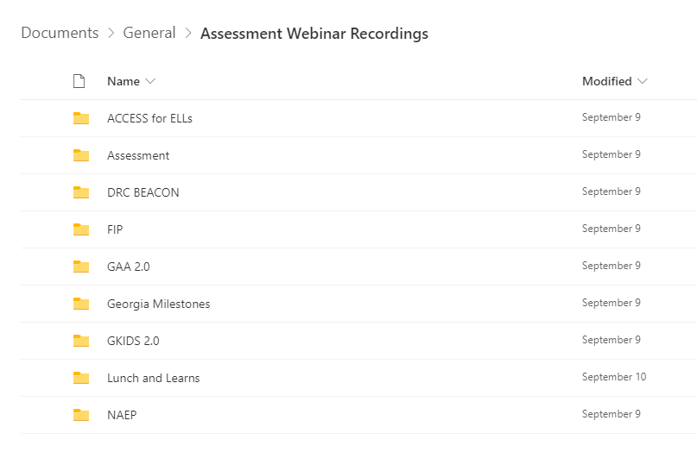

Webinar Recordings
PowerPoint presentations are posted to the Resources webpage no later than the day of the presentation.
Recordings are shared through a single link in a folder of prior webinars.
Recordings are available a day after the live session.
A link to the recording folder is available in the Assessment Update.
Webinar Recordings
Notes:
Review location of recordings, this is also in the Assessment Update newsletter.

Slide 3
NAEP 2021-2022
Pre-Administration Workshop
10/14/2021
Notes:
Good afternoon and welcome to all of you to the pre-admin session for the National Assessment of Educational Progress (NAEP) for 2022. I am Bobbie Bable, the NAEP Coordinator for the state of Georgia. This session is being recorded and the recording can be accessed through the recordings link or in the Assessment newsletter. The presentation is in the handout section of the presentation screen and will also be posted on the NAEP page of the DOE website. Feel free to post any questions to the questions link and they will be addressed before we end our time together here today.

Slide 4
Agenda
Overview
Sampling
School Coordinator Responsibilities
Assessment Process
Results
Resources
Notes:
Our agenda for today’s session will include an overview of NAEP. I will cover some basic information about sampling that is done for this assessment, at the school and student level. The responsibilities for school coordinators will be covered, general assessment process and information about the results that are compiled from the test. We will close out with a reminder about the resources that are available for NAEP.

Slide 5
Overview

Slide 6
General Information
National Assessment of Educational Progress (NAEP)
Under the umbrella of the U.S. Department of Education
Georgia law and State Board of Education rules require participation in all NAEP assessments.
Results released as The Nation’s Report Card
Notes:
[Read Slide]

Slide 7
Unique Features of NAEP
National testing program, same assessment in every state
Sample of schools to represent demographics of state
Students in selected schools are sampled
Each student is only assessed in one pre-assigned subject
Results for state or selected district only
Assessed subjects vary by year
Contracted assessment team
Six-month results window
Results can be aggregated by demographic variables
Special research studies
Notes:
NAEP is quite different from Milestones, the state mandated assessment with which you are all familiar.
[Read Slide]

Slide 8
NAEP Grade Levels and Content Areas
Developed by the National Assessment Governing Board (NAGB)
Grades and ages
  Grades 4, 8 and 12
  Ages 9, 13, and 17 (Long-Term Trend - LTT)
Developed frameworks and assessments
  Reading - Economics
  Mathematics - Civics
  Science - Foreign language
  U.S. History - Writing
  Geography - The Arts
Notes:
[Read /slide]

Slide 9
NAEP Purpose
To measure student achievement in the context of instructional experiences.
To track achievement of fourth-, eighth-, and twelfth-graders or ages 9, 13, and 17 over time in selected content domains.
To provide the only comparison to the achievement of students in every other state in the nation.
To provide the comparison of the students in each state to the students enrolled in the nation’s public schools.
Notes:
In addition to having some unique administration features of NAEP, the purposes are also very different from the state assessment.
[Read Slide}

Slide 10
SAMPLING
Notes:
Now I will go into some detail about the sampling techniques used for NAEP. This is a very frequently asked question, especially for districts and/or schools that are selected often for participation.

Slide 11
NAEP Representative Sample
NAEP is designed to report results at the national and state level
Results for selected trial urban districts (TUDA); Atlanta is a TUDA
Every student in every school not required to take the assessment
A sampling frame created using the Common Core of Data (CCD)
NAEP administered to a sample of students from this frame who represent the student population of the nation as a whole and of individual states and districts participating in the Trial Urban District Assessment (TUDA).
Notes:
To ensure that a representative sample of students is assessed, NAEP is given in a sample of schools whose students reflect the varying demographics of a specific jurisdiction, be it the nation, a state, or a district. Within each selected school and grade to be assessed, students are chosen at random to participate in NAEP. Every student has the same chance of being chosen—regardless of race/ethnicity, socioeconomic status, disability, status as an English language learner, or any other factors.
[Read Slide]

Slide 12
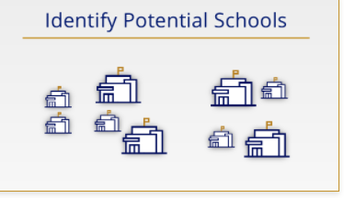
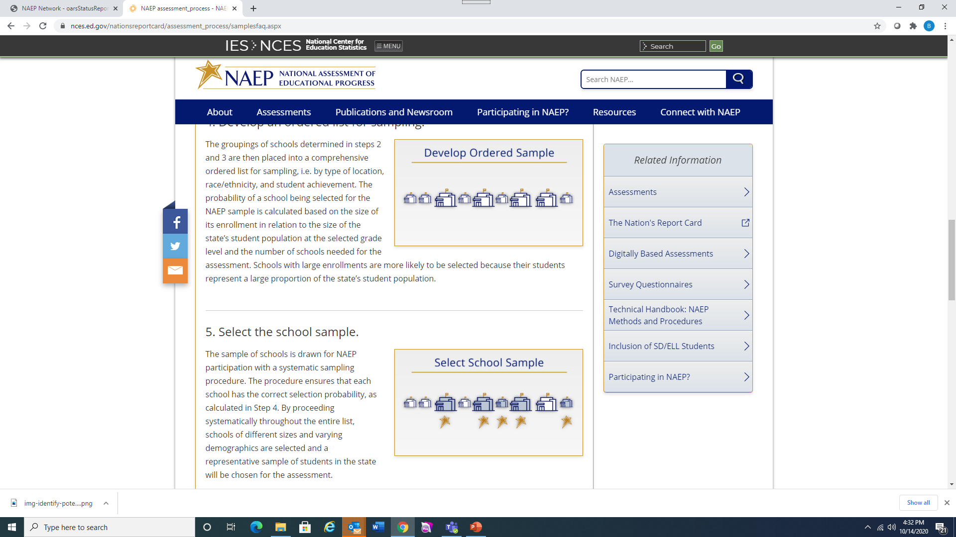
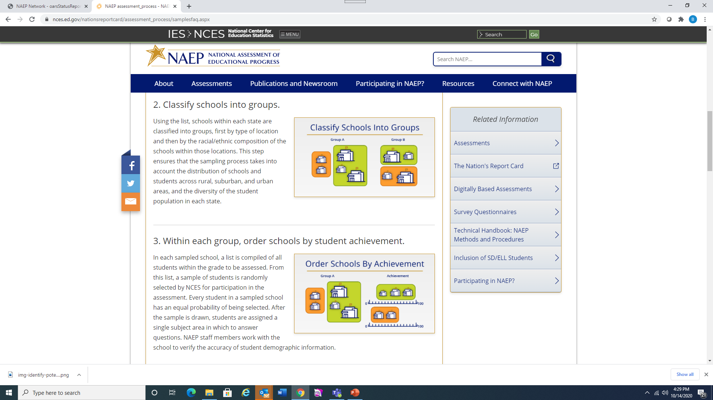
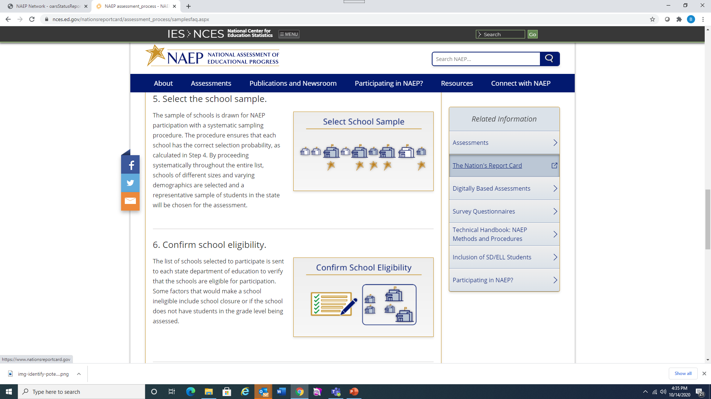
School Selection
Identify Potential Schools
Classify Schools into Groups
Order Schools by Achievement
Develop Ordered Sample
Select School Sample
Confirm School Eligibility
Notes:
The first step in the school selection is the identification of potential schools. A list of all public schools in the nation is compiled based on the most current list from the US Department of Education. This list is separated by state to begin the sampling process.
Schools within the state are classified into groups, first by location (urban, suburban, and rural), and then by the ethnic/racial composition of the schools within each of these locations.
The third step in the school sampling process is to order the student achievement on the state assessment within each of the groups developed in step 2.
The groupings of schools determined in steps 2 and 3 are then placed into a comprehensive ordered list for sampling, i.e. by type of location, race/ethnicity, and student achievement. The probability of a school being selected for the NAEP sample is calculated based on the size of its enrollment in relation to the size of the state’s student population at the selected grade level and the number of schools needed for the assessment. Schools with large enrollments are more likely to be selected because their students represent a large proportion of the state’s student population.
The sample of schools for the state is then drawn.
The list of schools is sent to the state coordinator to verify that each school is still open and has the grade that is scheduled to be tested.

Slide 13
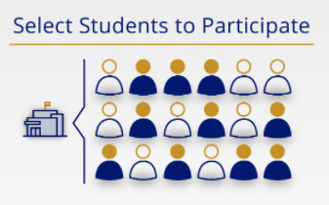
Student Selection
Students selected based on grade (4, 8 or 12) or age
List of all enrolled students submitted to NCES
Students randomly selected
Every student is eligible to be selected
SD and EL students can receive NAEP approved accommodations
Notes:
Once the participating school list is developed and verified, students are randomly sampled at the grade level in each of the schools. [Read Slide}

Slide 14

Subject Selection
Notes:
Once students are selected, each student is assigned a section of a test in only one subject. All students test at the same time in the same location but may not be working on the same set of questions even if they are taking the same test. All the results from each subject are spiraled together in order to calculate a score for a particular subject.

Slide 15




NAEP 2022 Program
 | State/TUDA Math or Reading | Puerto Rico Math | National Civics or U.S. History | Long-term trend Math or Reading
# of sessions | 2 | 1 | 2 | 1 or 2
# of students per session | 25 | 25 | 25 | 50 or 25
Session duration | ~2 hours | ~2 hours | ~2 hours | ~90 minutes
# of subjects per student | 1 | 1 | 1 | 1
Sampled grade(s) | 4,8 | 4,8 | 8 | Age 9
Multi-team possible? |  |  | Few schools may overlap with M/R | Few schools may overlap with Gr 4 M/R
Assessment window | January 24 to March 4, 2022 |  |  | Jan 10 to Mar 18
Questionnaires | School, teacher, student questionnaires & additional COVID-19 questions |  |  | No teacher questionnaire
Notes:
[Read Slide]

Slide 16
NAEP 2021-2022 Georgia Sample
Georgia Schools
  Grade 4: 77 schools
  Grade 8: 100 schools
  Age 9 LTT: 15 schools
  Schools selected from 80 districts
Atlanta Public Schools (TUDA)
  67 schools
Notes:
[Read Slide]

Slide 17
School Coordinator Responsibilities
Notes:
Now that we have covered some general information about NAEP, we will go into a discussion about what is required of school coordinators. We understand the stress that many of you are under during this time and considerations for that have been taken into account by NCES also.

Slide 18
NAEP Important Dates
District Superintendents and System Test Coordinators notified of school selection in September
Principals of sampled schools notified in September; school coordinator responsibilities sent in October; reschedule requests being taken now
Contact from NAEP assessment team close to assessment window
Assessment dates: January 24 – March 4, 2022
Notes:
Everything happened later this year than originally planned. Usually the school selection is done in May and districts are notified in early to mid June, shortly after the regular school year has ended. The NAEP program had to receive approval from Congress and the US Department of Education regarding this year’s testing. [Read Slide}

Slide 19
Designate a School Coordinator
The ideal school coordinator (SC) will be…
  available to complete tasks during the preassessment period
  comfortable collecting student information and entering it online
  identified early
Notes:
State coordinators depend heavily on the cooperation of schools and the efficiency of the school coordinators. [Read Slide]

Slide 20
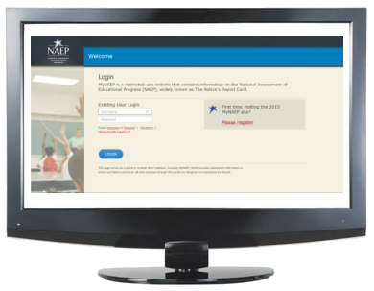
What is MyNAEP?
MyNAEP serves as the primary resource and action center for the NAEP assessment.
  All preassessment activities are completed via MyNAEP.
  The site contains confidential information, so all users will be prompted to accept a confidentiality agreement.
  Requires a username and password.
www.mynaep.com
Notes:
[Read Slide]

Slide 21
Getting Started on MyNAEP
How to Register for MyNAEP
The first MyNAEP School Coordinator task is to:
Register on the MyNAEP website and become familiar with the website.
All required tasks and information will be posted here.
Review the list of School Coordinator activities
Notes:
[Read Slide]

Slide 22
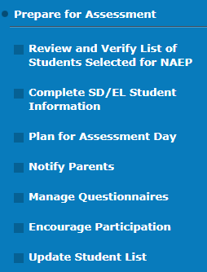
MyNAEP for Schools: Purpose
Allows schools to prepare for assessment day
All Prepare for Assessment tasks should be done before the preassessment review call (PRC)
Keeps track of preparation tasks
  White check = school has completed some or all of the tasks
  Green check = task is complete and confirmed by NAEP representative during Preassessment Review Call (read only mode for schools)
Notes:
[Read Slide]

Slide 23
How do I register for the site?
Each school will receive a MyNAEP registration ID.
Notes:
Thanks to many of the school coordinators who have already registered at the MyNAEP site and have begun completing their initial task. Registration does need to be completed by tomorrow, October 15th. These registration instructions have already been sent to all the school coordinators with their unique school registration code.

Slide 24
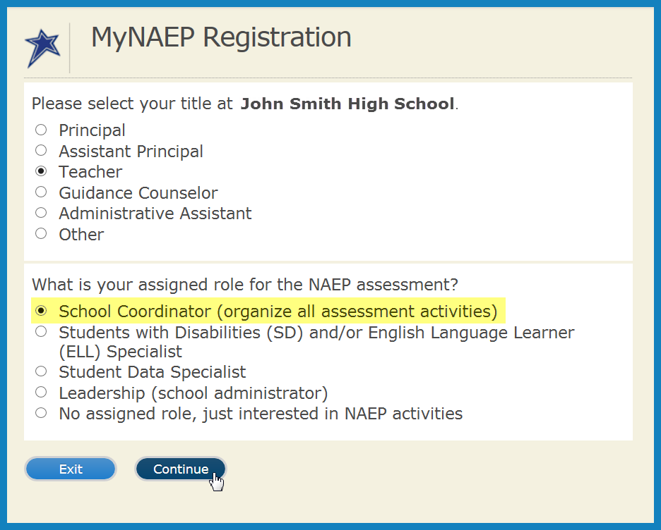
How do I register for the site (cont’d)?
Notes:
These are additional instructions about registering at the MyNAEP site and designating your role as the selected school coordinator.

Slide 25
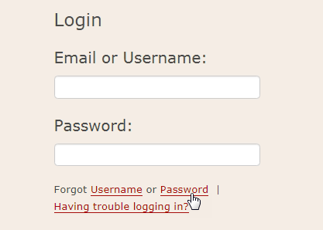
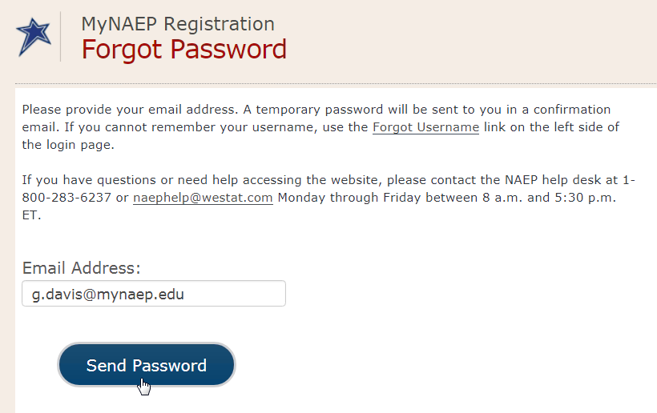
How do I recover my password?
Select the “Forgot Password” link
  Enter your email address
  Receive email with temporary password
  Login with temporary password
  Create new password
Notes:
Password recovery is embedded in the website itself and these are the instructions.

Slide 26
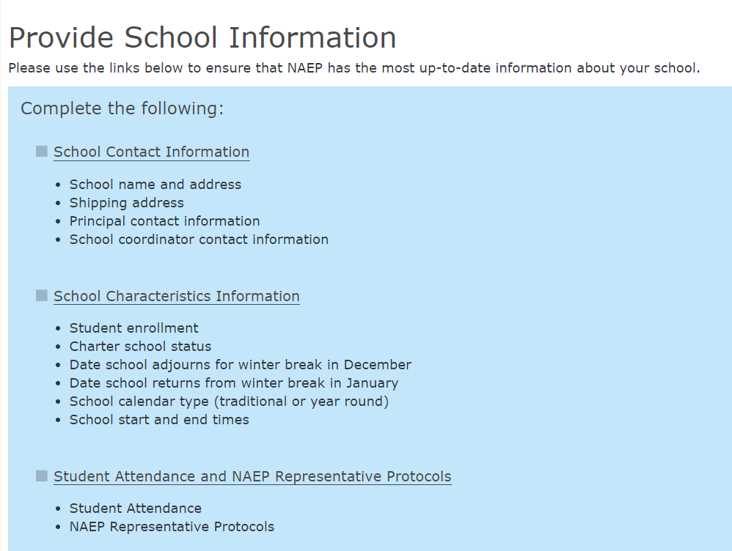
MyNAEP – Provide School Information
Three sections
  School Contact Info
  School Characteristics Info
  Student Attendance and
  NAEP Rep Protocols
School name/address changes and characteristics monitored/ approved through PSI Approval Form
Student Attendance and NAEP Rep Protocols monitored through Reports
Notes:
These are the three sections to be completed under the PSI section. The student attendance and NAEP rep protocols are new for this year.

Slide 27
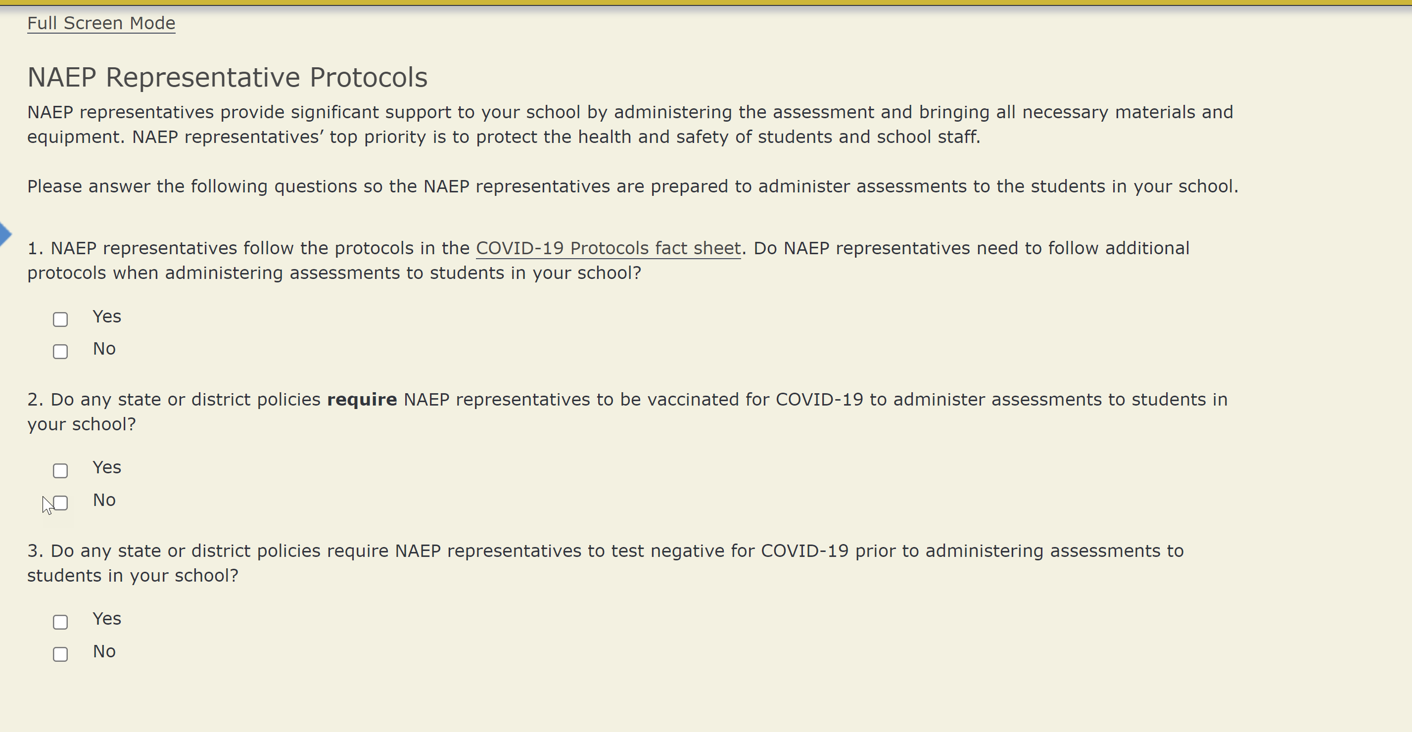
MyNAEP – Provide School Information
Notes:
These are the three sections to be completed under the PSI section. The student attendance and NAEP rep protocols are new for this year.

Slide 28
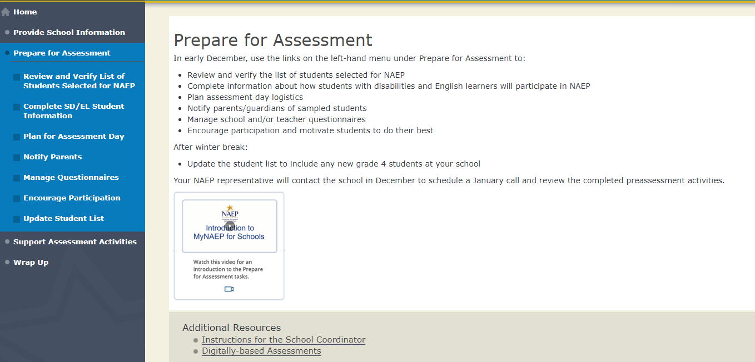
Prepare for Assessment Tasks
Landing page:
  Introduction to MyNAEP for Schools video
  Instructions for School Coordinator brochure
DBA: 7 tasks
LTT: 6 tasks
  No Update Student List
Notes:
[Read Slide]
Please note that if your students are selected for the LTT, the school coordinator does not have to update the student list.

Slide 29
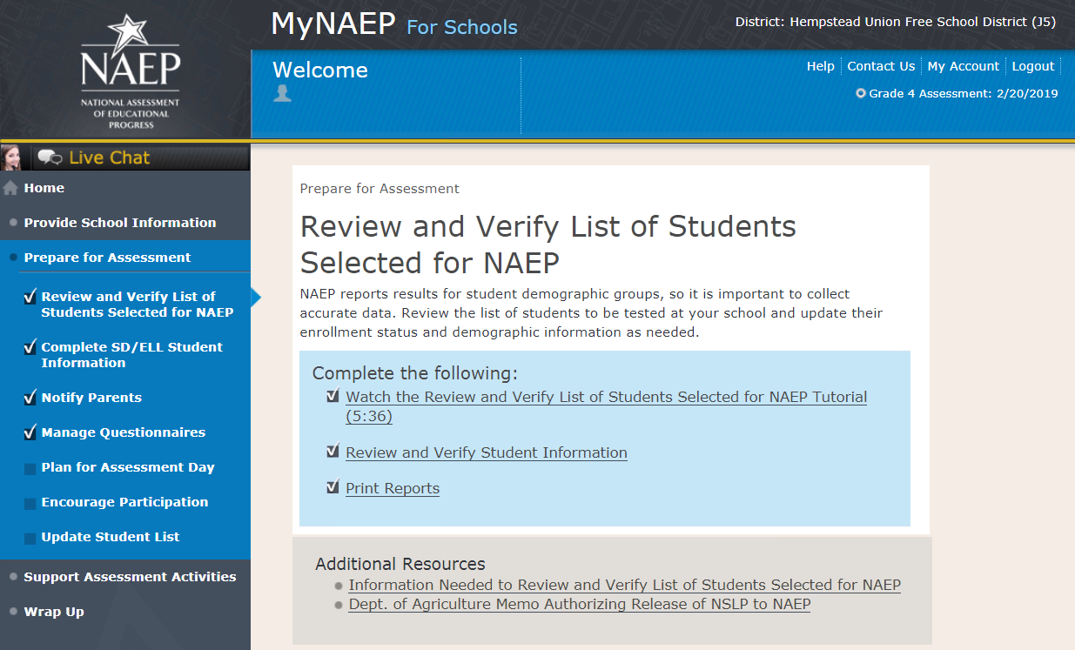
Prepare for Assessment:
How does it work?
The menu serves as a “virtual checklist”
Checkmarks will appear after activities are completed
White checkmarks indicate information that will be confirmed by your NAEP representative during the Preassessment Review Call (PRC)
Notes:
[Read Slide]

Slide 30
How is the PRC scheduled?
Schools should receive their preassessment packet via email (sent by Westat, no storage envelope needed)
  Instructions for the School Coordinator brochure
  Quick overview video on how to prepare for the assessment
AC will conduct a short call to schedule the preassessment review call
  Ask school coordinator if they have questions,
  Will confirm contact information, key school dates
Notes:
[Read slide]

Slide 31
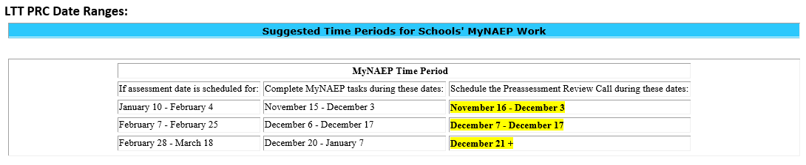
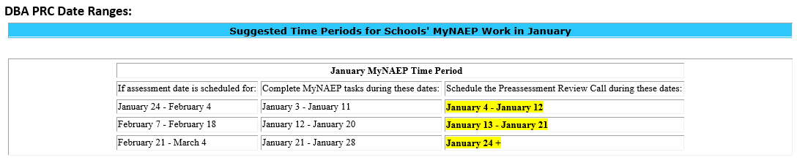
Preassessment Review Call
Date Ranges
Notes:
The field staff staggers the assignment of the PRCs with the school coordinator. These are the windows of the calls that will be scheduled.

Slide 32
Submission of Student List
(Due in mid-November)
List submitted by state coordinator from state database
School coordinator can update demographic information later
Student Information
  Name
  GTID
  MOB, YOB
  Gender
  Ethnicity
  Race
  SD
  EL
  Lunch Status (Provided by school later)
  Economically Disadvantaged
Notes:
[Read Slide]

Slide 33
Review & Verify – Purpose
School coordinators need to…
  Review demographic data of selected students to make sure it is correct
  Add any missing demographic data
    Gender, Race/Ethnicity, Disability Status, English Learner Status
    Free/Reduced Lunch Status (if shown to schools)
  Identify 504 Plan students that require NAEP accommodations
  Identify students who cannot take NAEP
  New: Identify remote/virtual learners (full or part time)
  Identify displaced students
Notes:
[Read Slide]

Slide 34
Identify students who cannot take NAEP
Student deceased
Withdrawn
Graduated
Expelled
Attends all classes on a different campus
Traditional homeschool learner – parent provides curriculum
Student listed more than once
Not in selected grade
Long-term illness/homebound (will not be in school during NAEP testing)
Full-time virtual learner (does not attend school in-person¹
Foreign exchange student
Parent notified about NAEP and refused NAEP testing¹
Student notified about NAEP and refused NAEP testing¹
Student meets (or met) participation criteria for the state alternate assessment (applies to SD only)¹
Student is classified as an English learner and has been enrolled in U.S. schools less than 1 full academic year before the NAEP assessments and cannot access NAEP (applies to EL only)¹
¹ Collecting SD/EL information for these students
New or changed descriptions for NAEP 2022
*Reasons in blue only show if a student is coded as SD or EL.
Notes:
[Read Slide]
Make note of the information that has changed for NAEP 2022

Slide 35
Review & Verify Timeline
Available to LTT schools starting on Monday, November 1
  Schools with submitted and approved E-Files
  Available on a rolling basis for schools with E-Sampled students after November 1
Available to DBA schools on Monday, December 6
Includes PDF “List of Students Selected for NAEP”
Schools should complete this task before moving on to Complete SD/EL Student Information
  If students are not identified as SD or EL here, they will not show in the SD/EL section
  Must identify 504 Plan students that need accommodations
Notes:
[Read slide]

Slide 36
New for NAEP 2022
Is this student a virtual learner?
New column to track if students are full-time or hybrid (part-time) virtual/remote learners
Response options:
  No (100% in-person) – Default
  Hybrid (Part-time) virtual learner
  Full-time virtual learner
  Information not available
Could affect the number of students that can be assessed
  Full-time virtual/remote learners are not eligible for NAEP
    Do not attend school in-person
    If selected, automatically populates as a “Reason Student Cannot Take NAEP”
  Hybrid (part-time) virtual/remote learners are eligible for NAEP
    Attend school in-person part of the time
Notes:
[Read slide]

Slide 37
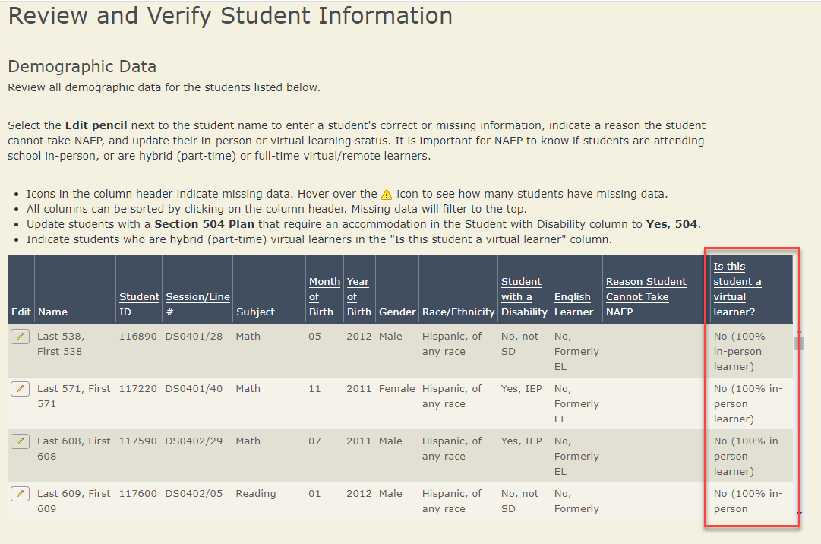
Identify Virtual Learners
Identify virtual learners
  No (100% in-person)
  Hybrid (Part-time)
  Full-time
  Information not available
Notes:
This is an image of how the worksheet of selected students will appear. The new column to identify virtual learners is the last one.

Slide 38
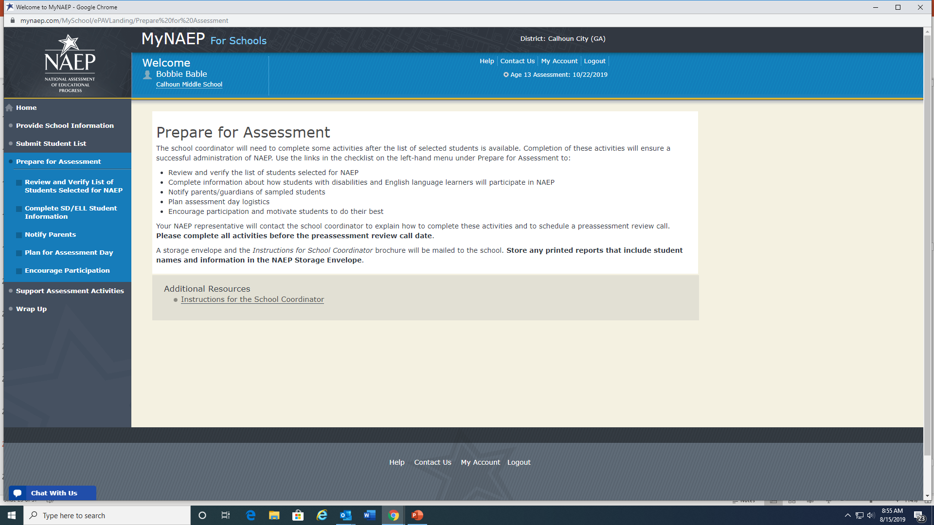
Complete SD/EL Information
Provide additional information about students with disabilities (SD) and English language learners (EL)
  How each student is assessed on the state assessment
  Testing accommodations that each student typically receives
  The IDEA category that best describes the student’s disability
  How long each student has been enrolled in U.S. schools (EL)
  Level of English proficiency (EL)
  State Inclusion Policies are posted on MyNAEP page
Notes:
After the information for the selected students is verified, the SD/EL information needs to be updated.
[Read Slide]

Slide 39
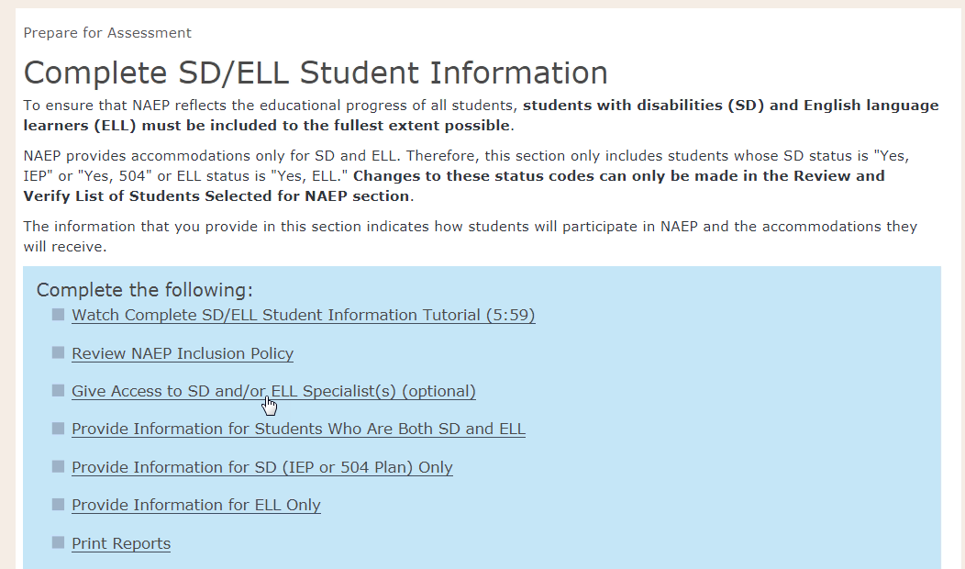
Complete SD/EL Information
School coordinators can assign this task to SD/EL specialists
  Enter the names and email addresses of up to 5 specialists
  They will receive an email with registration info
Notes:
[Read slide]

Slide 40
Plan for Assessment Day
The Purpose
Schools use Plan for Assessment Day to schedule assessment sessions and finalize assessment day logistics.
The information from this section writes to Support Assessment Day Activities that the schools use the week before the assessment.
Notes:
[Read slide]

Slide 41
NAEP 2022 Scheduling Flexibility
School coordinators may select two assessment dates for consideration
Students can be divided into as many as 8 groups
  4 groups in the morning, 4 in the afternoon (including accommodated groups)
  Can accommodate groups as small as 8 students
Notes:
These are the adjustments that have been made by the scheduling team to accommodate schools and students.
[Read Slide]

Slide 42
Plan for Assessment Day Timeline
Available to LTT schools starting on Monday, November 1
  Schools with submitted and approved E-Files
  Available on a rolling basis for schools with E-Sampled students after November 1
Available to DBA schools on Monday, December 6
Schools should complete this after the Review and Verify and Complete SD/EL Student Information
Schools should complete this before moving using Support Assessment Day Activities
Notes:
The Assessment Day planning is done after the SD/EL information is entered because this is information will impact the number of rooms needed and the number of assessment administrators that will be needed.

Slide 43
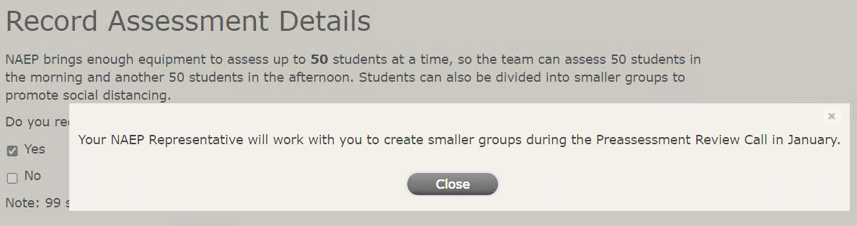
Determine if Additional Groups are Needed
If schools need to put students in groups smaller than 25 students, they can let us know and the NAEP representative will work with the school to add more groups.
Notes:
[Read Slide]

Slide 44
Notify Parents
Download and distribute the parent/guardian notification letter template
  Customize text and include school letterhead
  Verify that parents/guardians of all sampled students were notified by entering the date the letter was sent
  Upload an electronic copy of the customized parent letter
Notes:
Parents of selected students must be notified of their student’s selection but permission for participation is not required.
The other sections of Prepare for Assessment that will not be covered here include:
Manage the questionnaires that will be sent to the teachers of the tested subjects (online or hardcopy)
Encourage Participation – materials are made available to share with students, other school staff and parents
Update Student List – this is done in January prior to testing to allow any students who have enrolled since the student selection was done to be sampled also for testing; not needed for LTT

Slide 45
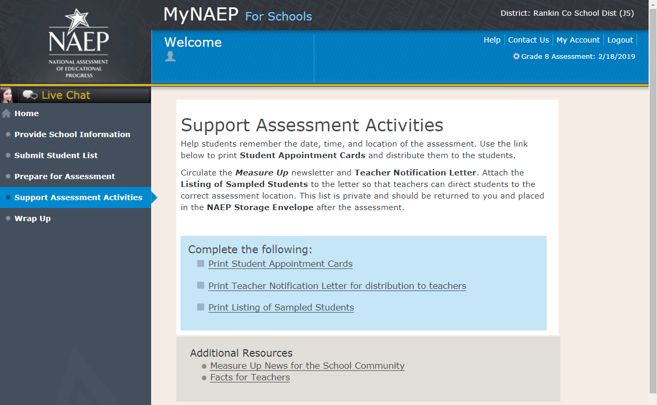
Support Assessment Activities
Print reminders about the scheduled NAEP assessment
  Student appointment cards
  Teacher notification letter
  List of sampled students (attachment for letters)
  Optional section
  Recommended timeframe: 1 week before the assessment
Notes:
These are some ways that the school coordinator can support the assessment activities.
[Read Slide]

Slide 46
MyNAEP Resources
Live chat
Videos*
Tutorials
NAEP Help Desk, 1-800-283-NAEP(6237) or NAEPHelp@westat.com
*Videos available for each step of the process, will answer many questions that might arise
Notes:
There are several resources, in addition to the field staff representative, that can provide assistance to the school coordinator.
[Read Slide]

Slide 47
Assessment Process
Notes:
Now we will delve into the assessment process.

Slide 48
Assessment Details
Contracted assessment team
Assessment team will follow federal, state and local district COVID guidelines
All materials brought to school on assessment day
Pre-determined locations
Separate accommodations sessions
Notes:
[Read slide]
The COVID guidelines list that will be followed by the assessment team has already been provided to you. Feel free to contact me if you have questions about any of these.

Slide 49
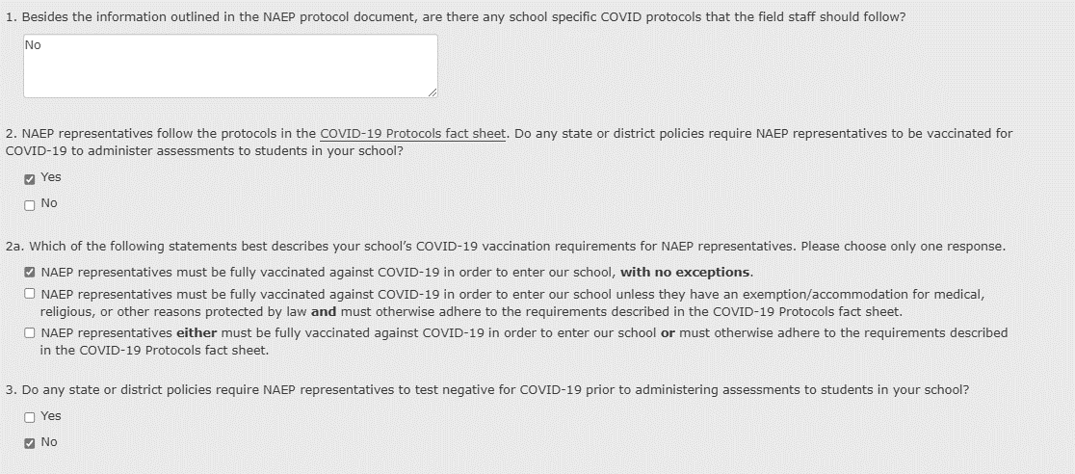
New for NAEP 2022: COVID-19 Policies

Slide 50
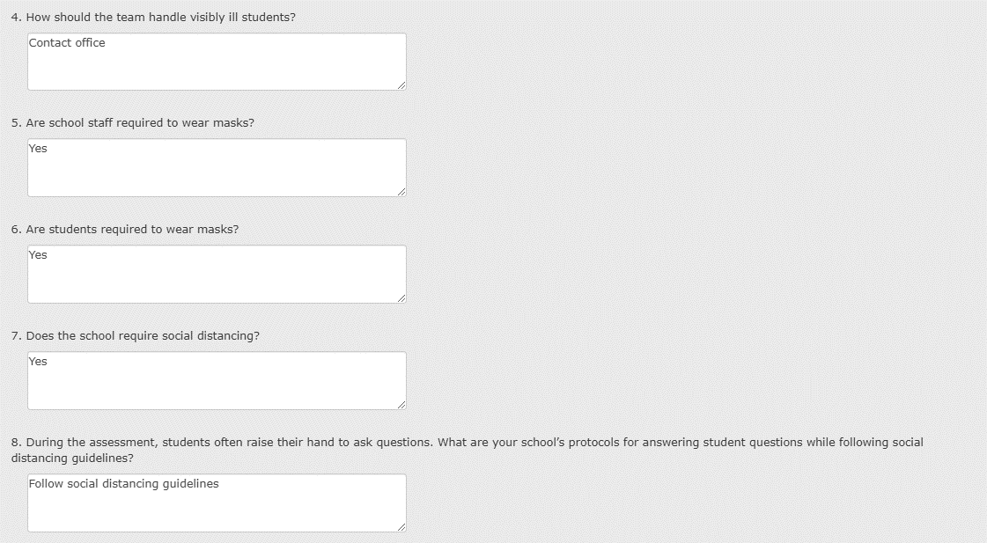
New for NAEP 2022: COVID-19 Policies

Slide 51
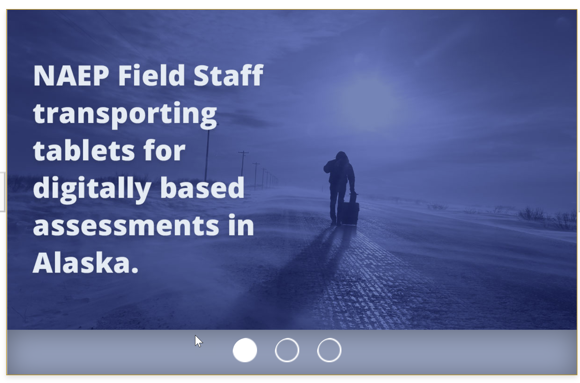
Assessment Details
Notes:
[Read slide]
The COVID guidelines list that will be followed by the assessment team has already been provided to you. Feel free to contact me if you have questions about any of these.

Slide 52

Assessment Details
Notes:
[Read slide]
The COVID guidelines list that will be followed by the assessment team has already been provided to you. Feel free to contact me if you have questions about any of these.

Slide 53

Assessment Details
Notes:
[Read slide]
The COVID guidelines list that will be followed by the assessment team has already been provided to you. Feel free to contact me if you have questions about any of these.

Slide 54
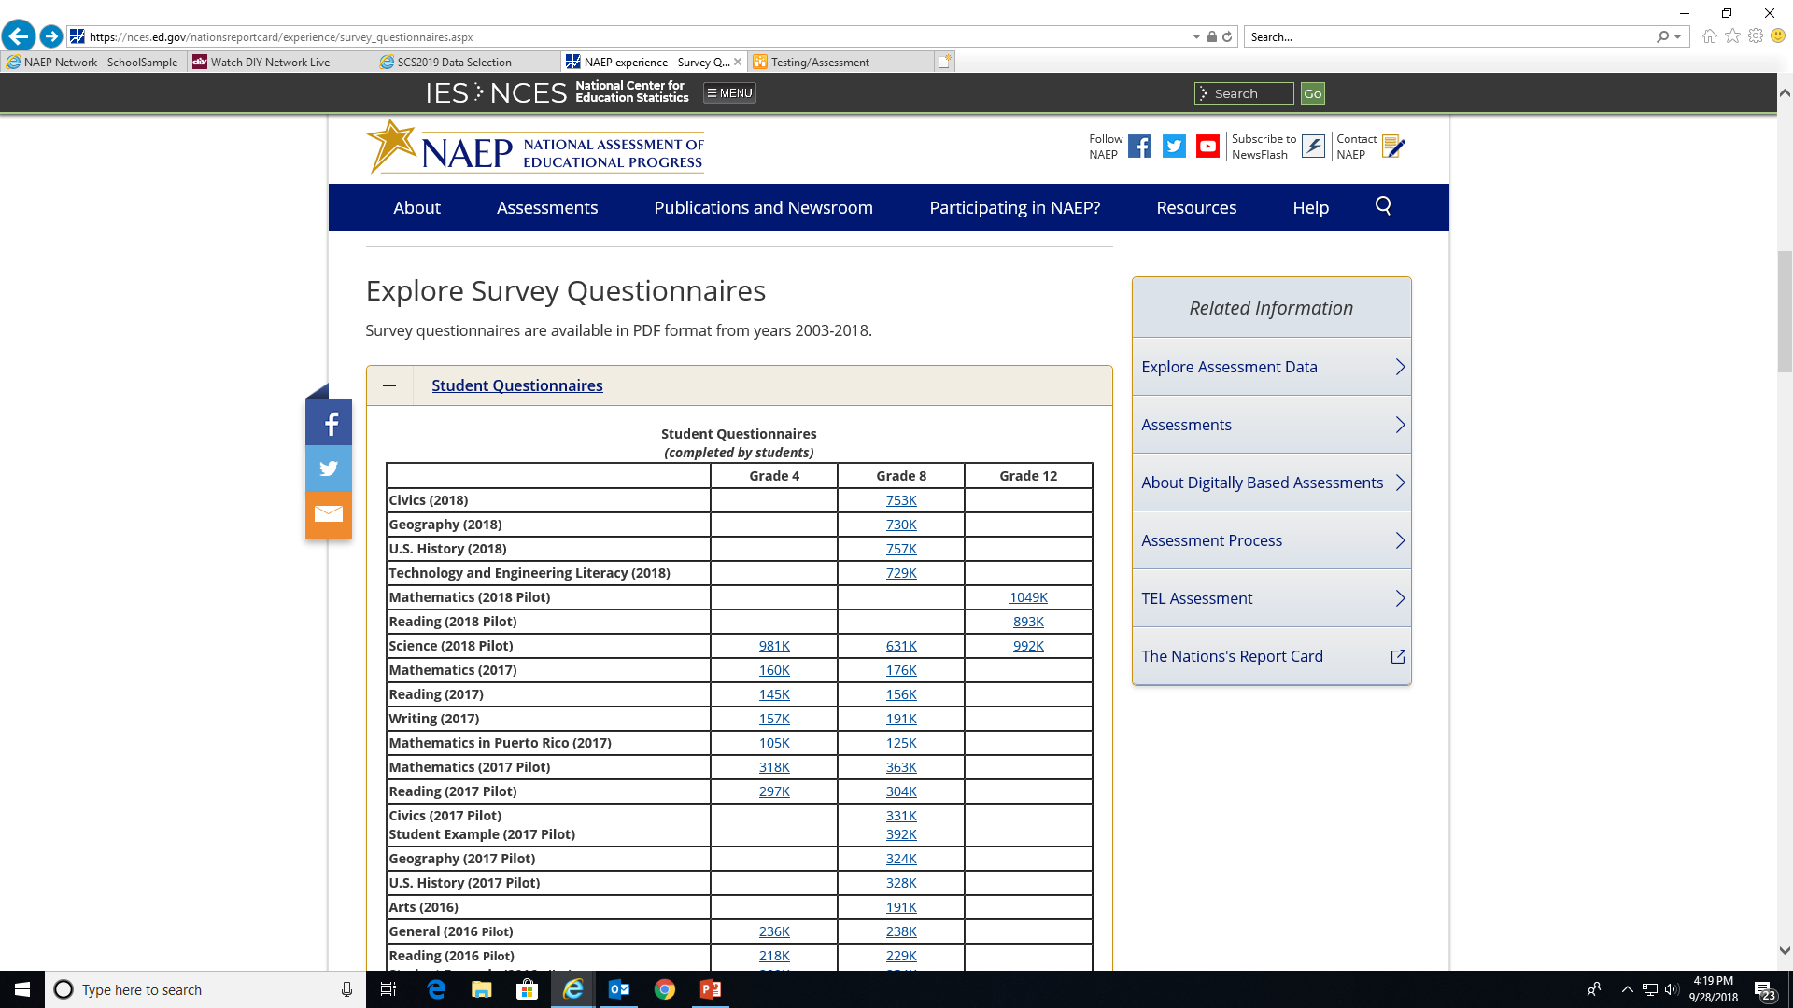
Questionnaires
https://nces.ed.gov/nationsreportcard/experience/survey_questionnaires.aspx
Notes:
In addition to completing the cognitive sections, students also complete a student survey based on the subject in which they have tested. This is a link to student questionnaires that are associated with the assessed subjects. There are also questionnaires for the teachers of the assessed subjects and for the school principal or his/her designee.

Slide 55
Results
Notes:
Now some general information about results.

Slide 56
NAEP Test Score Ranges
Average scale scores and achievement levels reported for reading, mathematics and science.
Example scale scores
  Range is 0-500 for reading, mathematics and other subjects
  Range is 0-300 for science
Achievement levels
  Advanced, Proficient, Basic
  Indicate the percentage of students within the total population, or in a particular subgroup, that meet or exceed expectations of what they should know and be able to do.
Notes:
[Read Slide]

Slide 57
Use of NAEP Data
Large database of released items
Sub-group aggregation of results
Comparison of results to other states
Results in context of teacher and school characteristics
Results in context of student experiences
Notes:
[Read Slide]

Slide 58
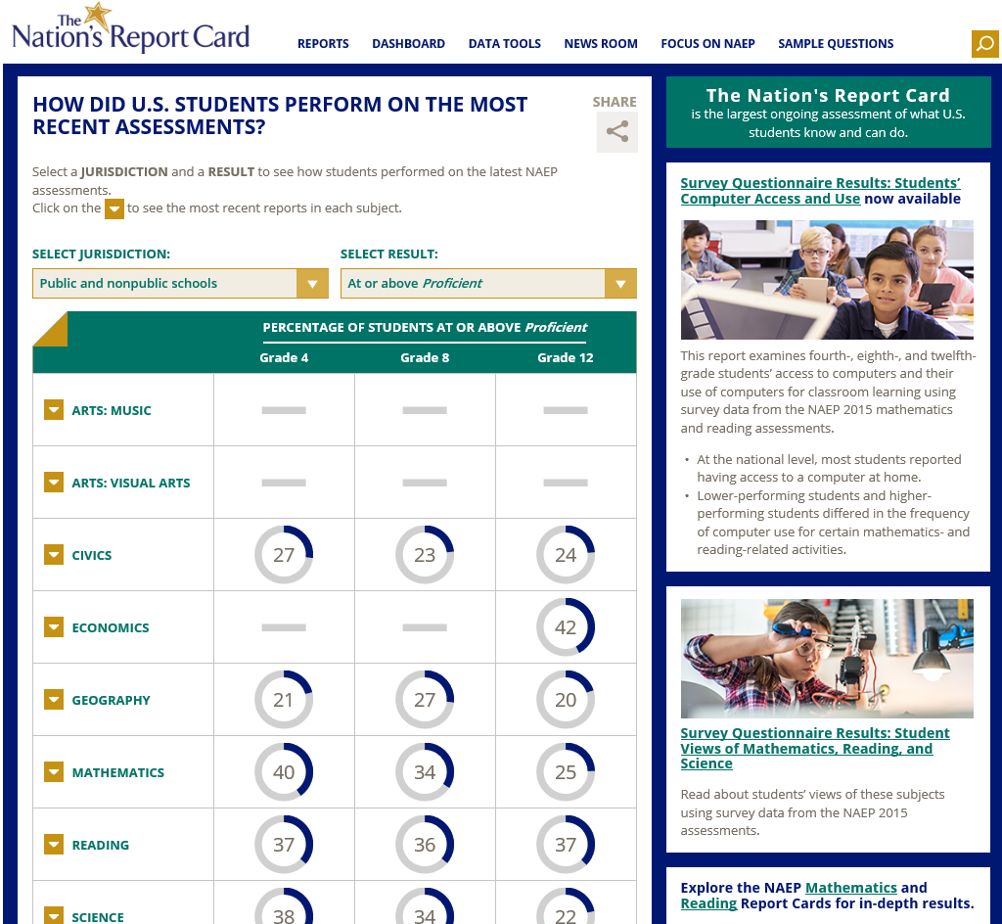
NAEP Results
NAEP website - All previously released results
http://nces.ed.gov/nationsreportcard/
Notes:
[Read Slide]

Slide 59
Resources
Notes:
A reminder about resources that are available through NCES for the information collected from NAEP testing.

Slide 60
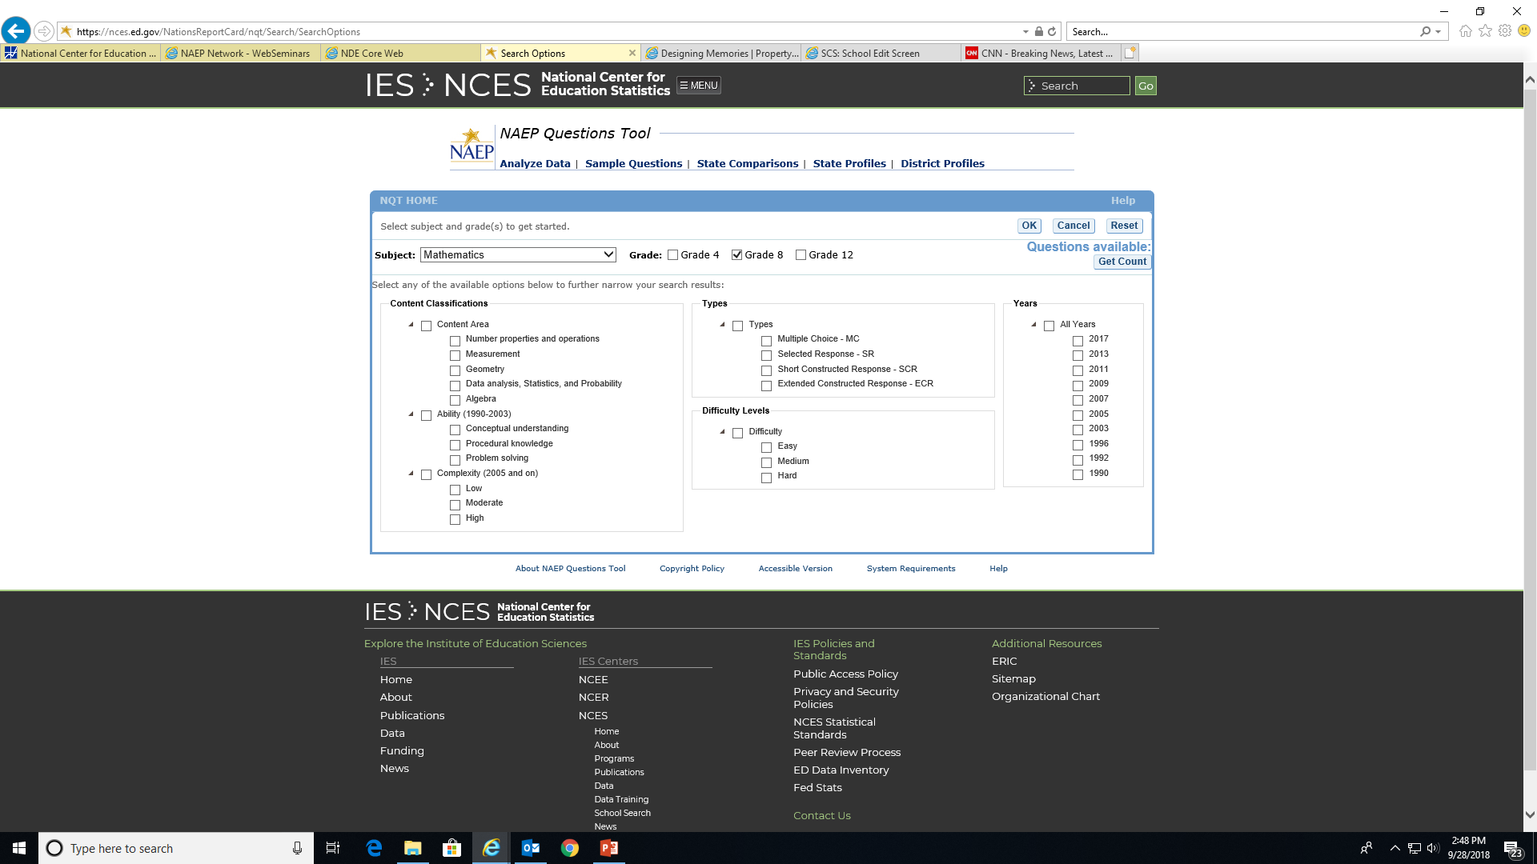
NAEP Questions Tool
More than 2000 questions from previous assessments
Scoring guide
Actual student responses
Question performance data
http://nces.ed.gov/nationsreportcard/itmrlsx/default.aspx
Notes:
[Read Slide]

Slide 61

NAEP Questions Tool (cont’d)
Notes:
[Read Slide}

Slide 62
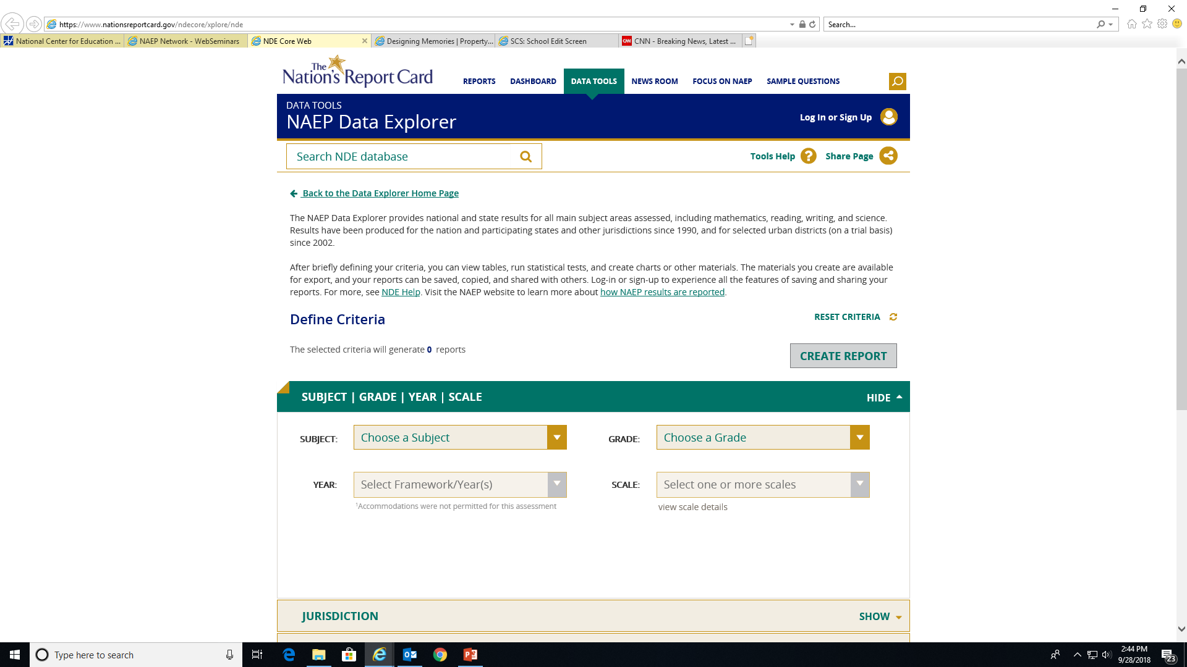
NAEP Data Explorer
National, state, region, district, and subgroup results
Demographic survey data
http://nces.ed.gov/nationsreportcard/naepdata/
Notes:
[Read Slide}

Slide 63
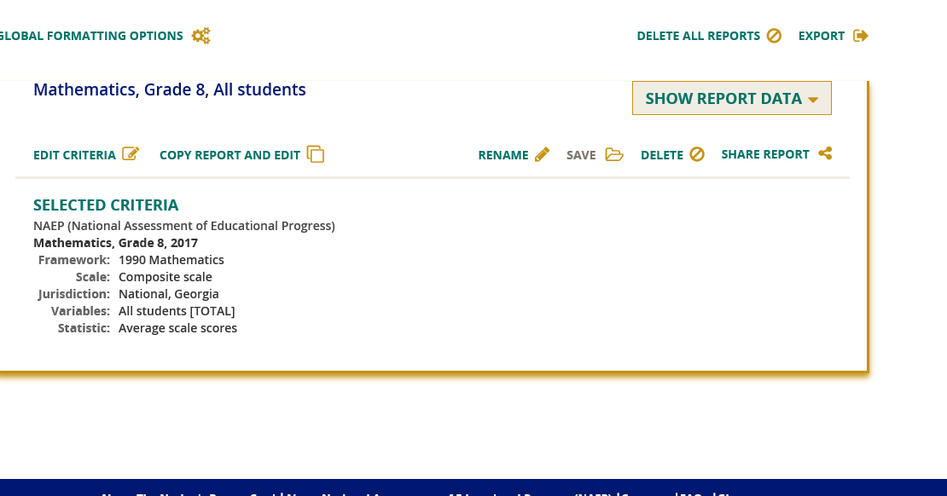
NAEP Data Explorer (cont’d)
Notes:
[Read Slide}

Slide 64
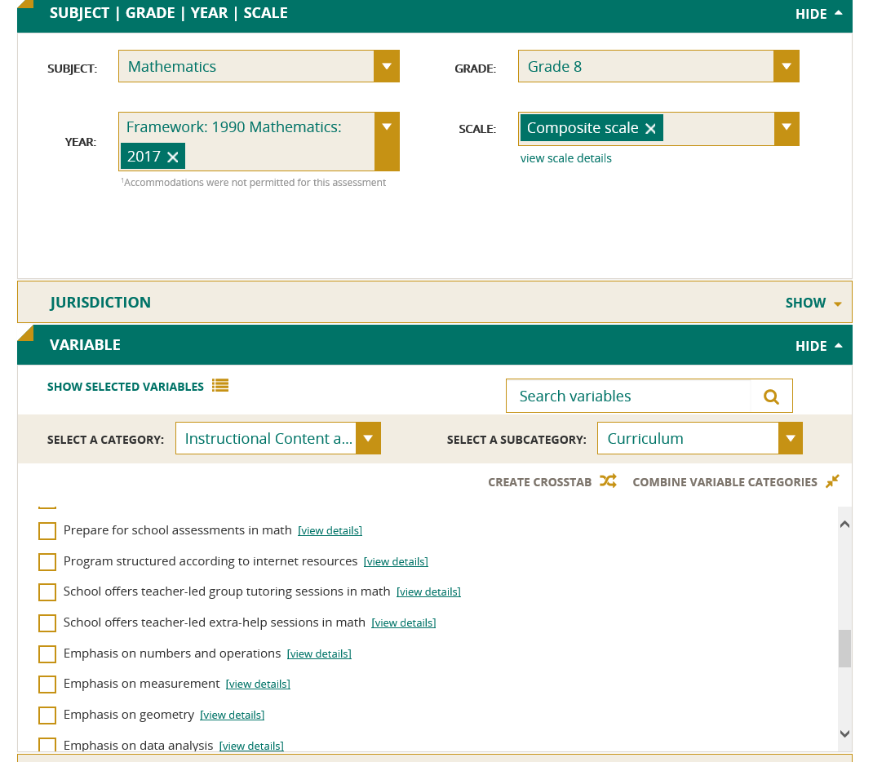
NAEP Data Explorer (cont’d)
Notes:
[Read Slide}

Slide 65
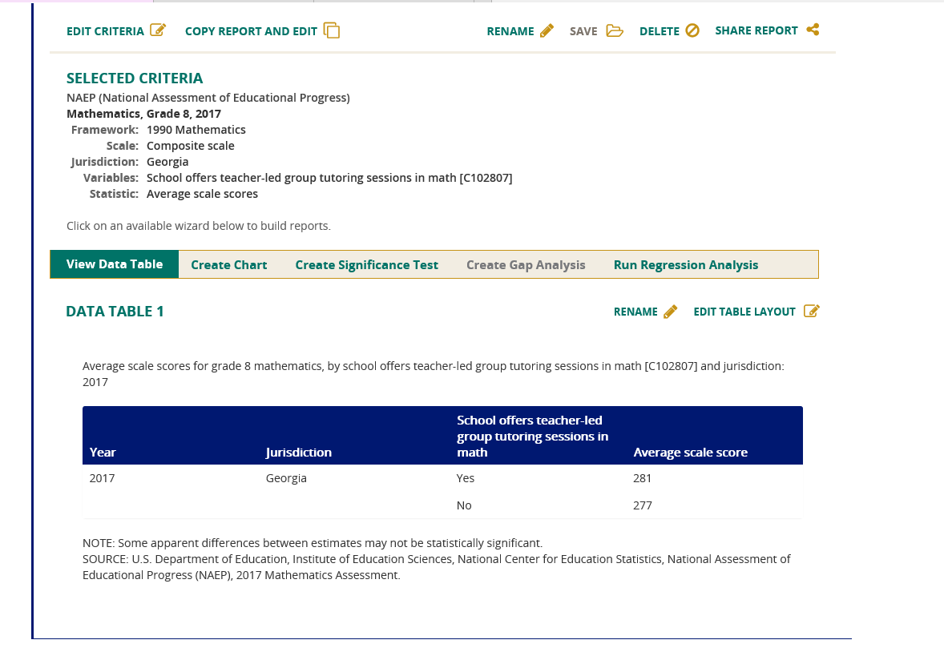
NAEP Data Explorer (cont’d)
Notes:
[Read Slide]

Slide 66
NAEP Informational Video
Posted on NAEP page of Assessment link of DOE website
http://www.gadoe.org/Curriculum-Instruction-and-Assessment/Assessment/Pages/NAEP.aspx
Notes:
[Read Slide]

Slide 67
NAEP State Coordinator
Bobbie Bable
bbable@doe.k12.ga.us
470-579-6324
67

