Slide 1
Where to Access TE Items
Experience Online Testing Georgia
Embedded by Grade Band
(3-5, 6-8, EOC) or
All TE Items
as a Separate Test
Secure Practice Test
Embedded by Grade Level
www.gaexperienceonline.com
Notes:
This demo will show the different types of new Technology Enhanced or TE items that will be field tested in the spring of 2019.
DO: Go to gaexperienceonline.com and log in.
SAY: I am going to log into Experience Online and show you just a few examples of the different types graphing and drag-and-drop items you may encounter on the test.

Slide 2
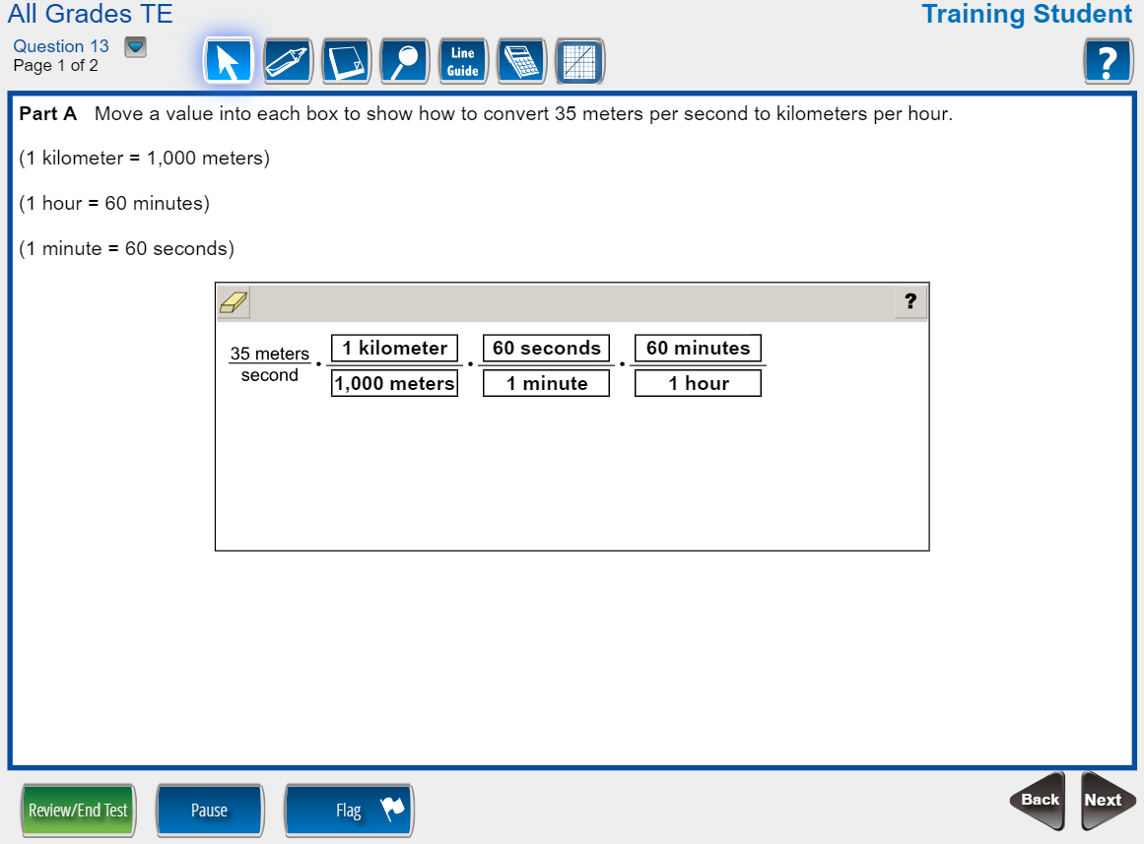
13a
Notes:
Coordinate Algebra
Say: This first example is a two-part drag-and-drop item. You are asked to complete the table converting meters per second to kilometers per hour. To respond, drag the different values into the correct location by clicking a response and moving it into the desired response area.
Do: Enter values into the correct location.
Say: You can change a response by dragging it back outside of the response area….or placing another response on top of the one you wish to remove.
Do: Show dragging responses outside of the response area and placing one on top of another.
Say: You can erase all responses and start over by clicking the Reset All icon in the top left of the response box. This button is available for all new Technology Enhanced items.

Slide 3
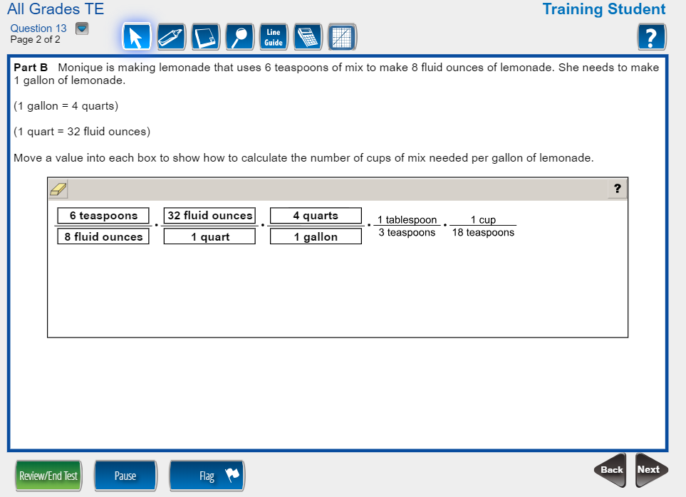
13b
Notes:
Coordinate Algebra
Say: Part B also shows a drag-and-drop interaction. Drag values into the response area to show how to calculate the cups of mix needed per gallon of lemonade. Again, click your desired responses and move them into the correct box within the response area.
Do: Enter the values into the table.

Slide 4
14a
Notes:
Algebra I
SAY: The next example is a graphing item. This item asks you to graph a new function from an existing function. You are shown a graph of f(x) and are asked to graph f(x) – 2. The closed point tool is available for use to plot points on the line if you desire. To use the closed point tool, select it from the drop down menu first then drop the point on the graph in the desired location. Notice as I hover over the coordinate plane a faint point appears.
To graph the answer, choose the line from the drop down menu…click on a point on the line, hold down and move your mouse to adjust the line as needed.
DO: Demo how to graph the line first plotting points in the coordinate plane.

Slide 5
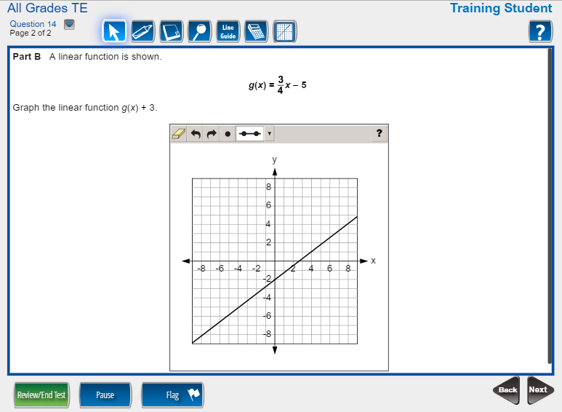
14b
Notes:
Algebra 1
SAY: Part B is similar to Part A as it asks you to graph the function g(x) + 3. Here g(x) is not graphed for you. You do not need to graph g(x) but it can certainly assist as you graph g(x) +3. You will only receive credit for the graph of g(x) + 3.
DO: Graph g(x) and g(x) + 3

Slide 6
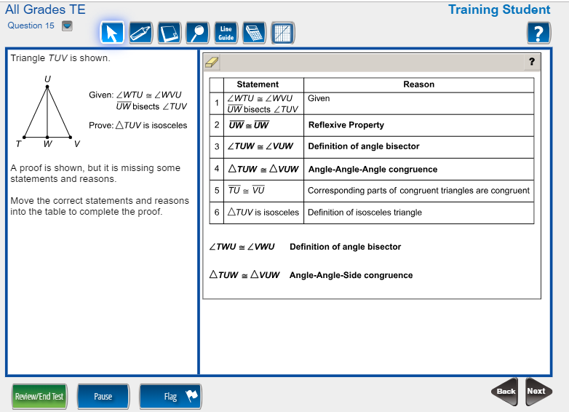
15
Notes:
Analytic Geometry
Say: This is another example of a drag-and-drop item. You are asked to complete the proof by dragging the correct statement and reason pairs into the table.
Do: Enter the answer.
Say: Answers can be replaced by dragging a new response on top of an incorrect one ….. or simply moving it outside of the response area and replacing it with a new response.
Do: Change a response.

Slide 7
16a
Notes:
Analytic Geometry
Say: Here we have another example of a drag-and-drop item. Part A asks you to choose and graph a shape that shows the given triangle after the reflection across line x=-1. Click and move your response to the correct location within the coordinate plane. Remember, you can replace a response by dragging it outside of the response area and dragging a new response into it OR simply by moving another response into the area. Again, the ‘Reset All’ icon is always available.
Do: Enter the responses into the correct location

Slide 8
16b
Notes:
Analytic Geometry
Say: For Part B you are asked to graph the image after a rotation. This is also a drag-and-drop item. Choose the desired triangle and move it to the correct location within the coordinate plane.
Do: Enter the responses into the correct location

Slide 9
19
Notes:
Physical Science
SAY: Drag-and-drop items may also appear in Science and Social Studies courses. Here is another drag-and-drop Physical Science item with a slightly different interaction than seen in previous examples. Here the answer options repopulate and can be used more than once. In this example, after reviewing an investigation, you are asked to complete the chart to identify the likely effects of changes to a circuit.
DO: Enter the answers into the boxes. Replace phrases to show how students can easily replace their responses.
SAY: Notice how the answer options repopulate so that you are able to use the responses more than once.
DO: Enter all answers correctly.

Slide 10
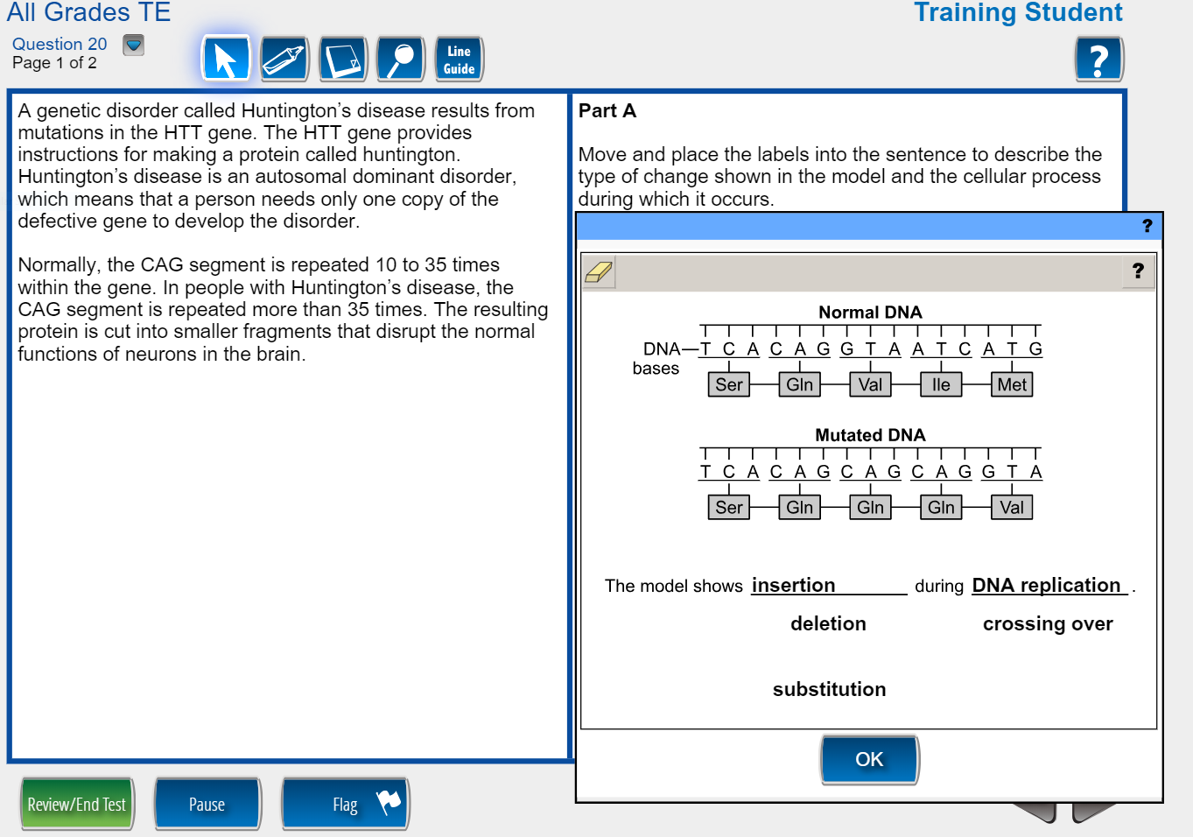
20a
Notes:
Biology
Say: In this two part Biology item you are asked to complete a sentence. First click to enlarge the response area. Then, click and drag terms into the sentence to describe the type of change shown in the model. When finish responding, click OK. Notice that your response is still visible even after the response is minimized.
Do. Click on Click to respond and respond to the answer changing the response at least once to show how to change the answer.

Slide 11
20b
Notes:
Biology
Say: The second part of this item is also an example of a drag-and-drop interaction that asks you to move a sentence into a box to make an argument to support or refute a claim.
Do. Enter the answers into the boxes. Replace claims to show how students can easily replace their responses.

Slide 12
23a
Notes:
Economics
SAY: In this two-part economics item you are asked to drag and drop options to complete a graph for Part A.
DO: Enter the answers into the boxes. Replace phrases to show how students can easily replace their responses.

Slide 13
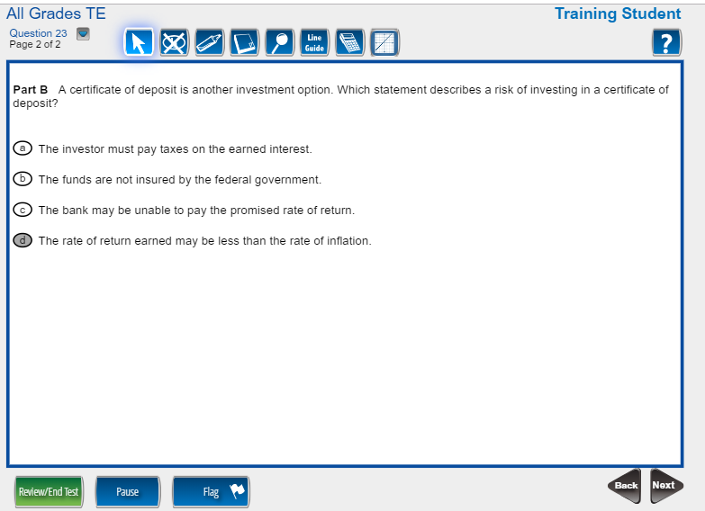
23b
Notes:
Economics
SAY: This example is included to show you that not all items require you to drag-and-drop or graph for both parts. Part B here is a standard multiple choice item.
DO: Enter the correct answer option.

Slide 14
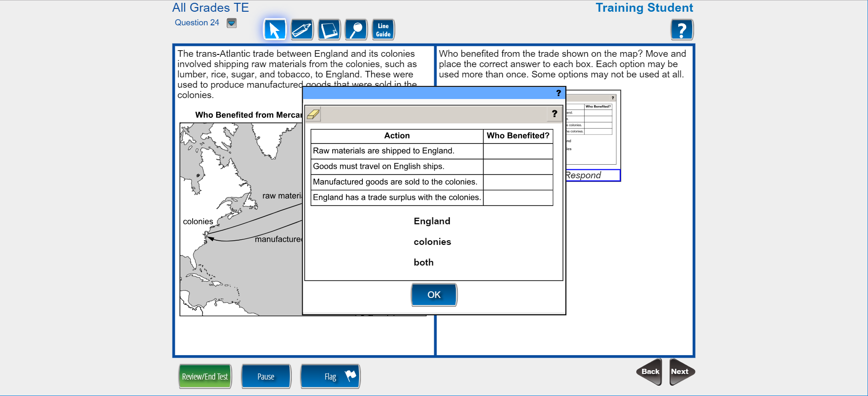
24
Notes:
US History
Say: In this last US History example you are asked complete the table to show who benefitted from the trade shown on the map. This item allows you to use any of the responses multiple times or not at all.
Do: make some choices demonstrating how to add and replace responses.

Slide 15
End of Demo
Notes:
This concludes the GA Milestones Technology Enhanced training video for High School courses.

