Slide 1
Georgia FinTech Academy

Slide 3
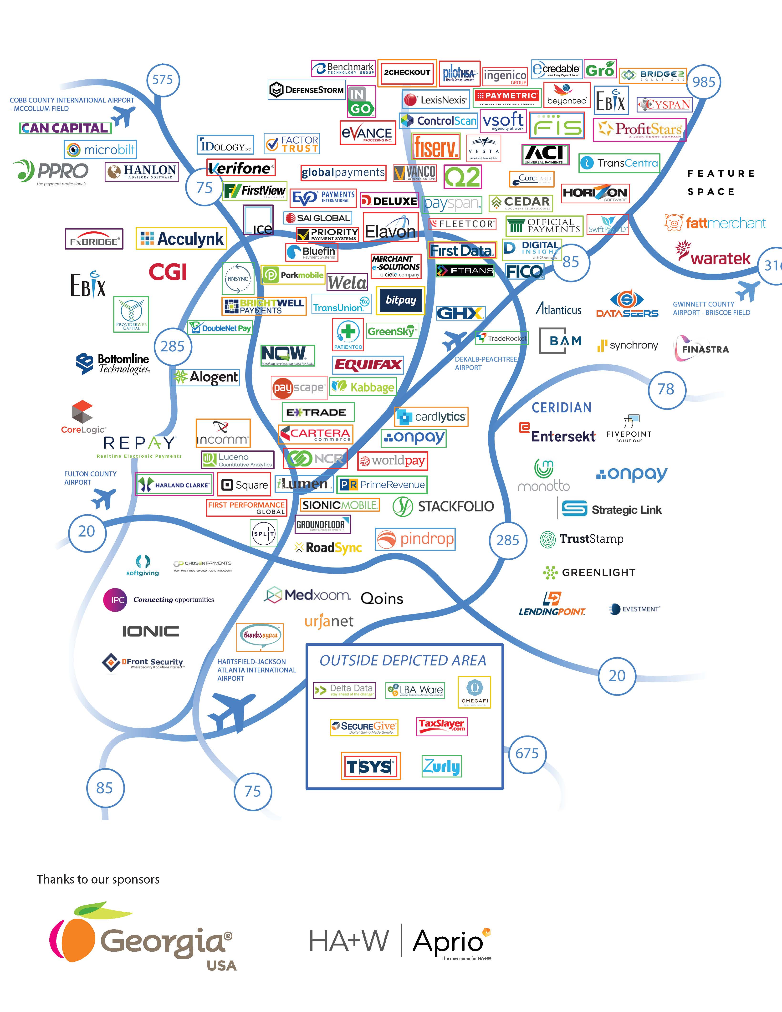
Georgia: The best place for business, especially fintech
More than 120 financial technology firms
70% of all transactions processed through Georgia
Over $72 billion in annual economic impact

Slide 4
Georgia:
The need
The best state in the nation for business needs fintech-ready professionals.
In fact, we need 5,000 fintech professionals…
TODAY.
Add to that an additional need for
2,000 more each year, following 2025.

Slide 5
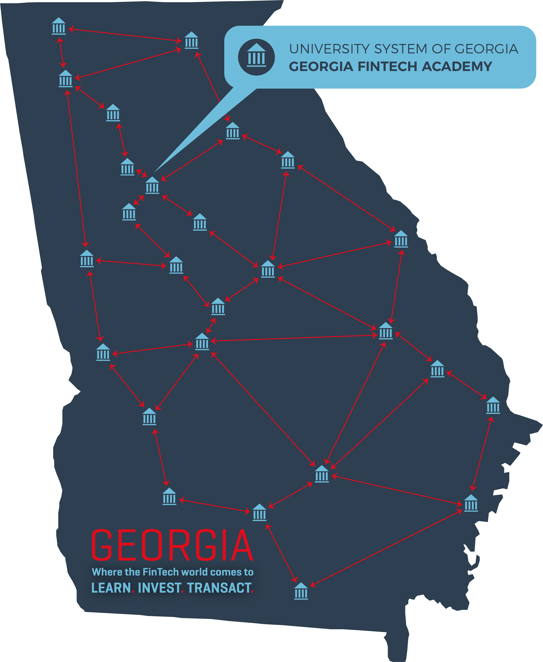
The Georgia FinTech Academy
With 26 institutions,
325,000+ students,
199 information technology-related degree programs,
the cutting-edge Cyber Center in Augusta,
and the nation’s first FinTech Academy,
the University System of Georgia is providing
the workforce you need.

Slide 6
We develop talent in:
Software development
Data Science
Cybersecurity
Client Services and Business Development
Product Development and Innovation

Slide 7
our talent pool spans the entire state
The Power of Collaboration

