Slide 1
Bullying Facts Laws Policies Resources
Jeff Hodges
Program Specialist
Georgia Department of Education
Garry McGiboney, Ph.D.
Deputy Superintendent
Georgia Department of Education

Slide 2
What is Bullying?
Bullying is unwanted emotional or physical abuse that has three characteristics:
Deliberate - intent to hurt someone
Repeated – pattern of behavior
Power Imbalance – victim is perceived as weak or vulnerable

Slide 3
Why should we care about bullying, after all… “…it happens all the time.” “…it’s a rite of passage.” “…everybody has to deal with it.” “…there is nothing we can do about it.”

Slide 4
Why should we care about bullying?

Slide 5
In a recent survey of 455 adults, over 60% said they still think about being bullied as a child.
“I’m 70 years old … that bully, that one kid changed my attitude about school. I still remember that…I wont’ forget – I can’t forget…I was bullied, humiliated every day on the school bus and then in the hallway. It never ended.”
Notes:
Bullying is a health issue for children that can have a long term negative impact, even into adulthood.

Slide 6
"I just want the bullying to stop. That is all I ever wanted. I used to love going to school. Now I hate it."
10 year-old student
Notes:
Children want and deserve a safe, bullying-free environment.

Slide 7
“Research links chronic bullying to school climate…the negative impact on school climate is revealed in a decline in student attendance and student achievement.”
Notes:
There is an unmistakable connection between student achievement and school climate. Bullying unabated can negatively impact school climate and consequently undermine student achievement efforts.

Slide 8
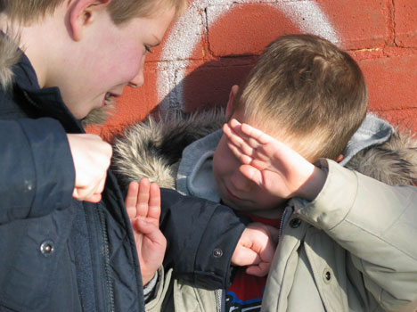
Almost 30% of youth in the United States (or over 5.7 million) are estimated to be involved in bullying as either a bully, a target of bullying, or both.
Notes:
Researchers are now discovering how widespread bullying is the United States. Almost 6 million children are effected by bullying each year.

Slide 9
Bullying
In a recent national survey of students in grades 6-10:
35% reported being the target of bullying at some time during their school career.
Notes:
The percentage of students being bullied and who are bullying other students has reached levels that are becoming problematic for teachers, administrators, counselors, and parents.

Slide 10
Over 90 percent of the calls to the
Georgia School Safety Hotline
are related to bullying incidents in schools.
1-877-SAY-STOP
Notes:
Well over 80 percent of all calls to the GaDOE Hotline are reports about bullying.

Slide 11
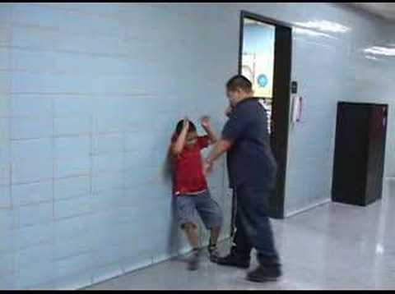
The Bully
Notes:
Adults too often minimize how fearful children are of being bullied.

Slide 12
Bully
Students who bully are more likely to:
Get into frequent fights
Be injured in a fight
Steal, vandalize property
Drink alcohol
Smoke
Be truant
Drop out of school
Be underachievers
Perceive a negative climate at school
Carry a weapon
Notes:
If bullying is not stopped, there are consequences and long-term effects on both the bully and the victim of bullying. Students who bully are much more likely than normal to develop behaviors that are self-detrimental in the short term and in the long term. One misconception about bullies is that they are loners and misfits. The fact is that many bullies are sociable and have friends, which means that dealing with the behavior of popular bullies directly affects the behavior of many of students.

Slide 13
Bully
Longitudinal study of bullies reveal that:
60% of boys who were bullies in middle school had at least one conviction by age 24.
40% had three or more convictions.
Bullies were 4 times more likely as peers to have multiple convictions.
Notes:
Look at the long term negative impact unchecked bullying behavior has on the bully. Pay special attention to the last bullet: “Bullies were 4 times as likely as peers to have multiple convictions.”

Slide 14
Bullying Victims
Notes:
Look at the long term negative impact unchecked bullying behavior has on the bully. Pay special attention to the last bullet: “Bullies were 4 times as likely as peers to have multiple convictions.”

Slide 15
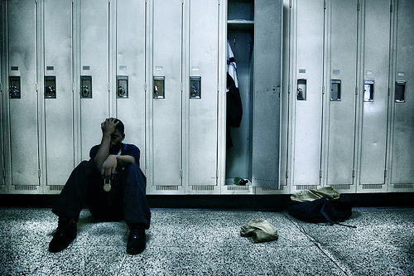
Bullying Victims
Victims of bullying have:
Lower self esteem
Higher rates of depression
Higher absenteeism rates
More suicidal ideation
Notes:
Bullying is a multi-victim behavior. Now, look at the impact on the victim. Each of these consequences can last a life time. Recently, at a parents’ meeting I discussed bullying. I asked the audience to close their eyes. I then asked them to raise their hands if they were bullied in school. Almost 75% raised their hands. I asked them to keep their hands raised IF the thought of that bullying experience still troubled them at times. Almost every hand remained raised. Think of that: almost 75% of over 100 parents (adults) still recall the pain of bullying.

Slide 16
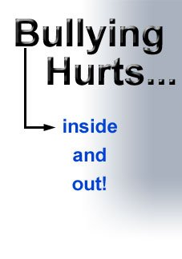
Bullying Victims
Bullied Not bullied
Headache 16% 6%
Sleep problems 42% 23%
Abdominal pain 17% 9%
Feeling tense 20% 9%
Anxiety 28% 10%
Feeling unhappy 23% 5%
Depression scale 49% 16%
Notes:
Research is beginning to reveal many causes of school absences that are related to bullying directly or indirectly. Also, think of the impact these physiological conditions can have on student achievement.

Slide 17
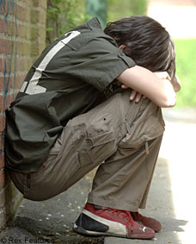
Bullying and Threat Assessment
Notes:
Bullying is indeed serious.

Slide 18
Secret Service Threat Assessment
Notes:
For those who do not think bullying is serious, they should read the report produced by the United States Secret Service and the United States Department of Education.

Slide 19
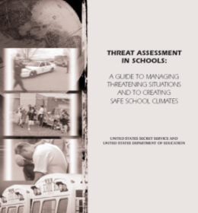
Secret Service Study
Studied 37 incidents of targeted school violence involving 41 attackers
75% of attackers felt persecuted, bullied prior to the incident
33% of attackers characterized as “loners”
25% socialized with students who were disliked by most mainstream students
Notes:
Secret Service investigators and forensic experts studied 37 incidents of school violence that involved 41 attackers. What they found was startling to many people. 75% of the attackers were bullied prior to the incident and over a third of the attackers felt isolated. If they did have a friend, it was another student who also felt bullied and isolated.

Slide 20
Secret Service Study
Incidents of targeted violence at school are rarely sudden, impulsive acts.
Prior to most incidents, other students knew about the attacker’s idea and/or plan to attack.
Most attackers engaged in some behavior, prior to the incident, that caused concern or indicated a need for help.
Notes:
The study found that schools cannot have “secrets”. There are always students who know who the bullies are and who the victims of bullying are, and even how the victims are suffering. Seeds of anger and retaliation are spread when bullying is unabated.

Slide 21
Secret Service Study
Many attackers felt bullied, persecuted, or were injured by others prior to the attack.
In many cases, other students knew about the bullying but failed to report it.
Notes:
Of the 75% of the attackers who felt bullied, many of them felt persecuted and were actually physically injured. And too often other students watched it happen while offering no intervention or consolation to the victim.

Slide 22
Secret Service Study
“In a school with a culture of safety and connection, both the bully and the student who is the victim of the bullying are attended to in a respectful manner. Schools with climates of safety and respect are establishing foundations for pro-social behavior.”
Notes:
The Secret Service reports that healthy school climates can prevent violence associated with bullying.

Slide 23
Secret Service Study
“Positive school climates teach conflict resolution, peer mediation, active listening, and other non-violent ways to solve problems. In a safe school climate, adults do not bully students and do not bully each other - and they do not turn a blind eye to bullying behavior when they know that it is going on in the school, on the playground, or on a school bus.”
Notes:
Note the finding here: “In a safe school climate, adults do not bully students and do not bully each other, and they do not turn a blind eye to bullying.”
\

Slide 24
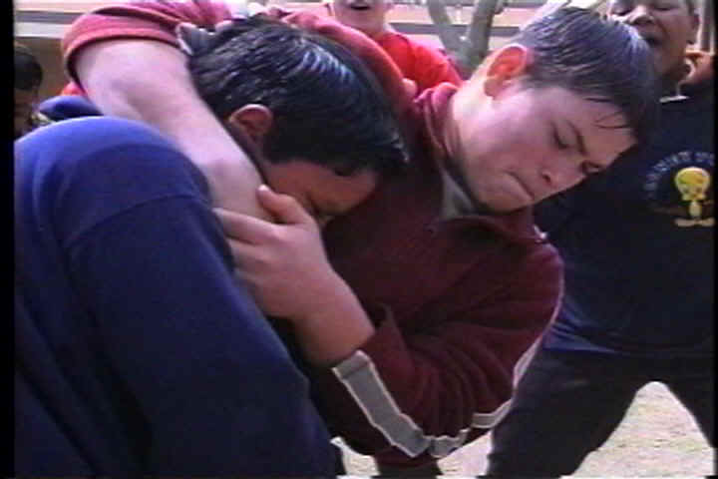
What do we look for?
Notes:
What does bullying look like and what do you for? This is a good question. Bullying comes in many forms.

Slide 25
Direct Bullying
Hitting, kicking, shoving, spitting
Taunting, teasing, name-calling, degrading racial or sexual comments
Threatening, obscene gestures
Notes:
Sometimes the obvious is not so obvious. These behaviors are NOT typical behavior for anyone except bullies. Consequently, they must not be dismissed as typical, “kids will be kids” behavior.

Slide 26
Indirect Bullying
Getting another person to assault someone
Spreading lies and rumors
Deliberate exclusion from a group or activity
CyberBullying
Notes:
Indirect bullying can be very insidious, and this is noted in the Secret Service report we referenced earlier. I’ll give you an example. Walk into a school cafeteria during lunch and see if you see students walking around with a food tray trying unsuccessfully to find a place to sit. Or watch kids on a playground keep another student away from their group or off of a piece of playground equipment. Watch for students laughing at another student in the hallway. These are subtle but powerful examples of bullying, and they occur all too often.

Slide 27
Verbal Bullying
Much of bullying is verbal with an equal number of girls and boys participating.
It dehumanizes the victim, making it appear that he/she deserves the abuse.
The language typically emasculates boys and either refers to girls’ sexuality or attempts to infantilize them.
Notes:
Often the victim internalizes the dehumanization and too often the victim begins to feel that he or she deserves this type of treatment.

Slide 28
Non-Verbal
Non-verbal bullying messages are conveyed using body language, gestures, looks and stares.
Notes:
As a practical matter, it is probably not possible for local schools to respond every time a student reports concern about looks, stares, and gestures. However, if other students report the same concern and if the non-verbal behavior continues, school staff should take the reports seriously and look into the situation before it escalates.

Slide 29
Bullying or Harassment?
Although bullying and harassment sometimes overlap, not all bullying is harassment and not all harassment is bullying. Under federal civil rights laws, harassment is unwelcome conduct based on a protected class (race, national origin, color, sex, age, disability, religion) that is severe, pervasive, or persistent and creates a hostile environment.
Harassment and bullying have been linked to 75% of school-shooting incidents.

Slide 30
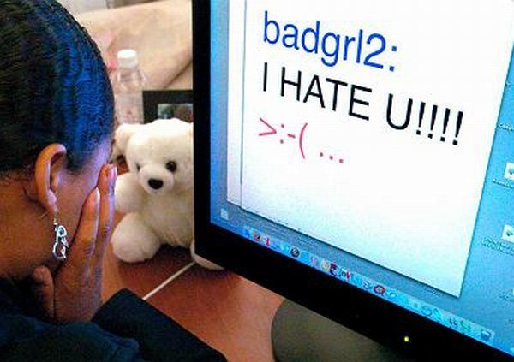
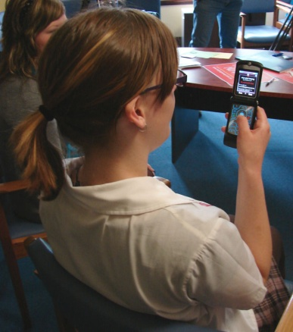
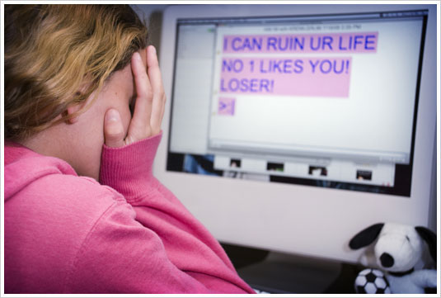
CyberBullying
Occurs electronically through text messaging, instant messaging, emails, and chatrooms.
Often referred to as a ‘cyber threat’ because the focus is on the threat.
Posting personal information, pictures or videos online.
Since contact and emotions are masked, cyber assaults can be harsher (i.e., assault or death threats) and many messages have sexual overtones.
Notes:
Cyber Bullying is rapidly becoming a major challenge for schools, students, and parents. This type of bullying comes in many forms.

Slide 31
CyberBullying
42% of kids have been bullied or threatened online.
21% of kids have received mean or threatening email or other messages.
58% of kids admit someone has said mean or hurtful things to them online.
53% of kids admit having said mean or hurtful things to others online.
58% have not told their parents or an adult about something mean or hurtful that happened to them online.
Notes:
Look at these survey results to see how cyberbullying is growing. 42% of kids have been bullied or threatened online. And as with school secrets, the kids are not telling adults about cyberbullying, but it is a phenomenon that has many negative implications for students and school districts. We encourage school administrators to work closely with Informational Technology and Media Center staff members to develop programs that address cyberbullying.

Slide 32
Types of Cyberbullying
Flaming: Online fights using electronic messages with angry and vulgar language.
Harassment: Repeatedly sending offensive, rude, and insulting messages.
Cyber stalking: Repeatedly sending messages that include threats of harm or are highly intimidating. Engaging in other on-line activities that make a person afraid for his or her own safety.
Denigration: ‘Dissing’ someone online by sending or posting cruel gossip or rumors about a person to damage his or her reputation or friendships.
{Source: Nancy Willard, M.S., J.D., Director of the Center for Safe and Responsible Internet Use}

Slide 33
Types of Cyberbullying
Impersonation: Pretending to be someone else and sending or posting material online that makes that person look bad, gets that person in trouble or danger, or damages that person’s reputation or friendships.
Outing and Trickery: Sharing someone’s secret or embarrassing information online or tricking someone into revealing secrets or embarrassing information which is then shared online.
Exclusion: Intentionally excluding someone from an on-line group, like a ‘buddy list’.
{Source: Nancy Willard, M.S., J.D., Director of the Center for Safe and Responsible Internet Use}

Slide 34
Hazing
Hazing, a subset of bullying, is the intentional infliction of harm or humiliation on a student as a condition of membership in a club or other group of students, or even a grade level in school.
Hazing is a crime in Georgia regardless of the target’s willingness to participate in the activities.

Slide 35
Official Code of Georgia Annotated 16-5-61
As used in this Code section, the term ‘Haze’ means to subject a student to an activity which endangers or is likely to endanger the physical health of a student, regardless of a student's willingness to participate in such activity.
It shall be unlawful for any person to haze any student in connection with or as a condition or precondition of gaining acceptance, membership, office, or other status in a school organization.

Slide 36
Formula used by courts
to determine liability:
Knowledge by a school official of hazing activities
+
Power to control students’ involvement in the activities
+
Sufficient connection between the activities and the school
=
Duty on the part of the school to take reasonable steps to protect students from the hazing activities.

Slide 37
Do Students Report Bullying?
Notes:
So, with bullying becoming more of problem, more students are willing to report it, right? Not really.

Slide 38
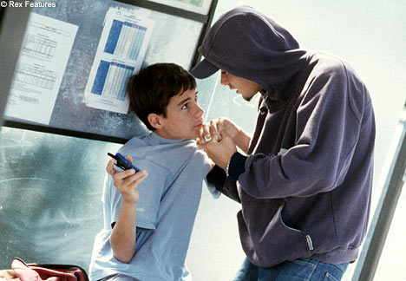
Students
Why children do not report bullying:
85% of victims felt that staff responded poorly or did not respond at all to reports of bullying.
6% believed that staff responded very well.
9% were undecided.
Notes:
It’s very difficult for most students to report being bullied; it’s embarrassing. So if they do finally get the courage to report bullying and then nothing is done, what are the odds that they will try again to report bullying?

Slide 39
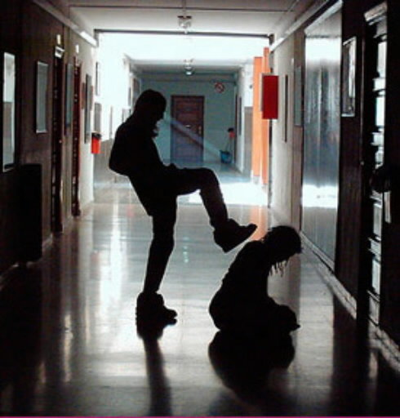
Students
Only 35% believed teachers were interested in stopping bullying.
Only 25% believed administrators were interested in stopping bullying.
Only 20% believed others were interested in stopping bullying.
Notes:
Remember, the Secret Service report expressed concern about schools having “secrets”. Where students knew about bullying, victimization and even knew about the anger and retaliation thoughts of victims but told NO ONE! Look at these percentages and you see why.

Slide 40
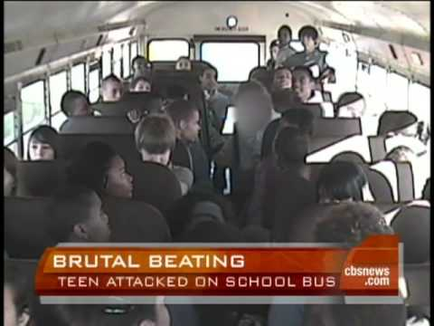
For many students, bullying starts on the school bus.
Notes:
For many students, the bullying and harassment starts on the school bus.

Slide 41
Bus Bullying
"When kids get on the bus early in the morning and are immediately humiliated and degraded, that has a particularly destructive resonance, especially if it's day in and day out.”
"It's difficult to reset the climate at school to (be) welcoming for a student who has just spent 45 minutes being bullied on a school bus."
-Stephen Wessler
Center for the Prevention of Violence
University of Maine
Notes:
Imagine if your day started like this every day.

Slide 42
Bus Bullying
“…and then when the student is picked on at school the overall impact can be devastating.
School staff must realize that bullying is one of the most fearful things children face today in public schools, private schools, and neighborhoods.”
-Stephen Wessler
Center for the Prevention of Violence
University of Maine
Notes:
Adults too often minimize how fearful children are of being bullied.

Slide 43
Why we should care about bullying
Where Bullying occurs
Kamaron Institute Study

Slide 44
Bullying Consequences: Legislation and Policies
HB 131 (2015)
“The End to Cyberbullying Act”
Notes:
Let’s shift now to laws, rules, policies, codes and how they relate to bullying.

Slide 45
Official Code of Georgia Annotated
20-2-751.4
As used in this Code section, the term 'bullying' means
Any willful attempt or threat to inflict injury on another person, when accompanied by an apparent present ability to do so;
Any intentional display of force such as would give the victim reason to fear or expect immediate bodily harm; or
Notes:
During the 2010 Georgia legislative session, the General Assembly revised the state law pertaining to bullying in schools.

Slide 46
O.C.G.A 20-2-751.4
3) Any intentional written, verbal, or physical act, which a reasonable person would perceive as being intended to threaten, harass, or intimidate, that:
Causes another person substantial physical harm within the meaning of Code Section 16-5-23.1 or visible bodily harm as such term is defined in Code Section 16-5-23.1;
Has the effect of substantially interfering with a student's education;
Notes:
But several new sections were added to the state law.

Slide 47
O.C.G.A 20-2-751.4
Is so severe, persistent, or pervasive that it creates an intimidating or threatening educational environment; or
Has the effect of substantially disrupting the orderly operation of the school.
Notes:
But several new sections were added to the state law.

Slide 48
O.C.G.A 20-2-751.4
Bullying applies to acts:
Which occur on school property; on school vehicles; at designated bus stops; at school related functions or activities; by use of data or software that is accessed through a computer, computer system, computer network, or other electronic technology of a local school system: and

Slide 49
O.C.G.A 20-2-751.4
Bullying also applies to acts of cyberbullying which occur through the use of electronic communication, whether or not such electronic act originated on school property or with school equipment, if the electronic equipment:
Is directed specifically at students or school personnel,
Is maliciously intended for the purpose of threatening the safety of those specified or substantially disrupting the orderly operation of the school, and
Creates a reasonable fear of harm to the students’ or school personnel’s person or property or has a high likelihood of succeeding in that purpose.

Slide 50
O.C.G.A 20-2-751.4
Each local board of education shall adopt a policy that prohibits bullying of a student by another student and shall require such prohibition to be included in the student code of conduct for schools in that school system.
Notes:
By no later than August 1, 2011 each local board of education shall adopt a policy that prohibits bullying.

Slide 51
O.C.G.A 20-2-751.4
Each local board policy shall require that, upon a finding by the disciplinary hearing officer, panel, or tribunal of school officials provided for in this subpart that a student in grades six through 12 has committed the offense of bullying for the third time in a school year, such student shall be assigned to an alternative school.

Slide 52
O.C.G.A 20-2-751.4
Each local board of education shall ensure that students and parents of students are notified of the prohibition against bullying, and the penalties for violating the prohibition, by posting such information at each school and by including such information in student and parent handbooks.
Notes:
The law includes notification requirements, as well as a responsibility on the GaDOE to develop a model bullying policy. That model policy can be found on the GaDOE website that I will reference later.

Slide 53
O.C.G.A 20-2-751.4
The Department of Education shall develop a model policy regarding bullying, that may be revised from time to time, and shall post such policy on its website in order to assist local school systems.
The Department of Education shall develop and post on its website a list of entities and their contact information which produce anti-bullying training programs and materials deemed appropriate by the department for use in local school systems.

Slide 54
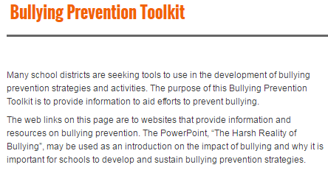
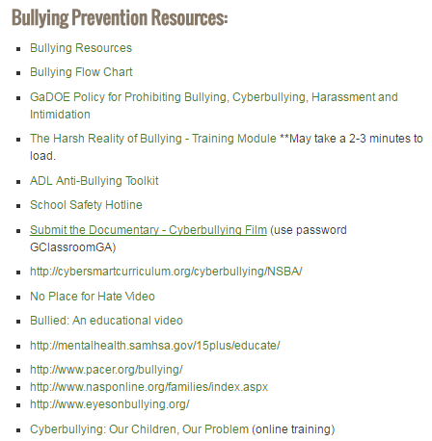
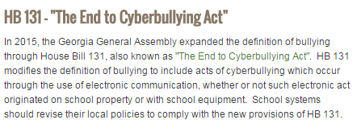
www.gadoe.org

Slide 55
How Do We Apply the Georgia Bullying Law to Schools?

Slide 56
Intervention Phases
Report (documentation)
Investigate (documentation)
Notify (duty to inform parents/guardians)
Discipline (appropriate consequence)
Follow Up (prohibits retaliation)
Notes:
School districts are advised to develop an operational procedure for addressing bullying that provides intervention and documentation. This is a four-phase model or example of intervention: investigation, notification, discipline (consequences), and follow up. This model is consistent with the expectations imbedded in the new state law.

Slide 57
Investigate
The _____________________School District will take the following actions when bullying is reported:
Investigate
Upon receipt of any report of bullying, schools should direct an immediate investigation involving appropriate personnel. This investigation may include interviewing the alleged perpetrator(s) and victim(s), identified witnesses, teacher(s), staff, review of video surveillance, etc. School police, school counselors, school social workers and/or other support staff may be utilized for their expertise as determined by the circumstances of the matter.
Notes:
The investigation shows that the school did not ignore the report of bullying, and in fact tried to intervene.

Slide 58
Notify
At some appropriate time during or after the investigation, parents/guardians of the accused and the victim must be notified. If the incident involves an injury or similar situation, appropriate medical attention should be provided and the parent/guardian should be notified immediately.
Notes:
It is important to notify the parents of the alleged victim of bullying, and this is required in the new state law.

Slide 59
Discipline/Consequences
Upon confirming that bullying has occurred, the accused student should be charged with bullying and given an age-appropriate consequence which shall include, at minimum and without limitation, disciplinary action or counseling as appropriate under the circumstances. Students in grades six through twelve found to have committed the offense of bullying for the third time in a school year shall be assigned to an alternative school. Schools should clearly communicate to all parties that retaliation following a report of bullying is strictly prohibited and may result in strong penalties.
Notes:
Upon confirmation that bullying has occurred, the appropriate consequence is determined by the local school district.

Slide 60
Follow-Up
Take care of the needs of the accused and the victim through a planned method of after-care and follow up. Reiterate previously stated prohibition on retaliation of any type.
Notes:
Follow up with the victim of bullying is important. It also prevents the victim from being bullied again and it discourages retaliation.

Slide 61
What Can Parents/Guardians Do About Bullying?
Notes:
Look at these survey results to see how cyberbullying is growing. 42% of kids have been bullied or threatened online. And as with school secrets, the kids are not telling adults about cyberbullying, but it is a phenomenon that has many negative implications for students and school districts. We encourage school administrators to work closely with Informational Technology and Media Center staff members to develop programs that address cyberbullying.

Slide 62
Help your child understand bullying. Keep open lines of communication with your child daily. Check in with your child and listen to any concerns about friends and other students. Encourage your child to pursue interests. Doing what he/she enjoys may help with confidence among peers and make friends with other kids with similar interests.
Bullying Proofing Your Child
Notes:
Look at these survey results to see how cyberbullying is growing. 42% of kids have been bullied or threatened online. And as with school secrets, the kids are not telling adults about cyberbullying, but it is a phenomenon that has many negative implications for students and school districts. We encourage school administrators to work closely with Informational Technology and Media Center staff members to develop programs that address cyberbullying.

Slide 63
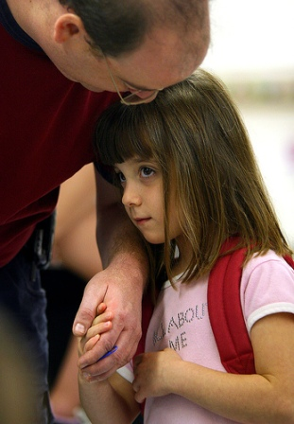
Talk to your child about seeking help from a trusted adult when feeling threatened by a bully. Talk about whom he/she should go to for help and role-play what should be said. Assure your child that he/she should not be afraid to tell an adult when someone they know is being bullied.
Teaching Children About Bullying
Notes:
Look at these survey results to see how cyberbullying is growing. 42% of kids have been bullied or threatened online. And as with school secrets, the kids are not telling adults about cyberbullying, but it is a phenomenon that has many negative implications for students and school districts. We encourage school administrators to work closely with Informational Technology and Media Center staff members to develop programs that address cyberbullying.

Slide 64
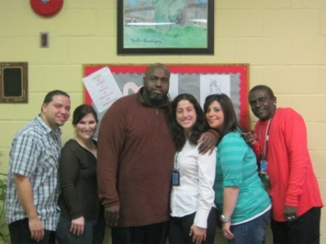
Know what is going on in your child's school. Visit the school website, visit the school, do volunteer work at the school, join the PTA. Get to know other parents, school counselors, and staff. Contact the school by phone or e-mail if you have suggestions to make the school a safer and better learning place.
Parent Involvement
Notes:
Look at these survey results to see how cyberbullying is growing. 42% of kids have been bullied or threatened online. And as with school secrets, the kids are not telling adults about cyberbullying, but it is a phenomenon that has many negative implications for students and school districts. We encourage school administrators to work closely with Informational Technology and Media Center staff members to develop programs that address cyberbullying.

Slide 65
Talk with your child, but mostly listen. Focus on your child and not yourself. Maintain a calm demeanor. Express your concern and make it clear that you want to help. Say bullying is wrong and that you are glad he/she had the courage to tell you about it.
My Child is Being Bullied!
Notes:
Look at these survey results to see how cyberbullying is growing. 42% of kids have been bullied or threatened online. And as with school secrets, the kids are not telling adults about cyberbullying, but it is a phenomenon that has many negative implications for students and school districts. We encourage school administrators to work closely with Informational Technology and Media Center staff members to develop programs that address cyberbullying.

Slide 66
Document ongoing bullying or suspected bullying. Work with your child to keep a record of all bullying incidents. This will help you understand the nature of the bullying and it will provide useful information for the school. If it involves cyberbullying, keep a record of all messages or postings. Learn about cyberbullying, social networking, etc.
My Child is Being Bullied!
Notes:
Look at these survey results to see how cyberbullying is growing. 42% of kids have been bullied or threatened online. And as with school secrets, the kids are not telling adults about cyberbullying, but it is a phenomenon that has many negative implications for students and school districts. We encourage school administrators to work closely with Informational Technology and Media Center staff members to develop programs that address cyberbullying.

Slide 67
Work together to find solutions. Ask your child what he/she thinks can be done to help. Your child may be reporting the bullying to you because he/she does not know what to do and wants your advice, or he/she has tried to resolve the problem and needs your intervention. These are two very different situations. Reassure your child that the situation can be handled.
My Child is Being Bullied!
Notes:
Look at these survey results to see how cyberbullying is growing. 42% of kids have been bullied or threatened online. And as with school secrets, the kids are not telling adults about cyberbullying, but it is a phenomenon that has many negative implications for students and school districts. We encourage school administrators to work closely with Informational Technology and Media Center staff members to develop programs that address cyberbullying.

Slide 68
Help your child develop strategies and skills for handling bullying. Provide suggestions for ways to respond to bullying, and help your child gain confidence by rehearsing their responses. Stay vigilant to other possible problems that your child may be having. Share your concerns with a counselor at your child's school.
My Child is Being Bullied!
Notes:
Look at these survey results to see how cyberbullying is growing. 42% of kids have been bullied or threatened online. And as with school secrets, the kids are not telling adults about cyberbullying, but it is a phenomenon that has many negative implications for students and school districts. We encourage school administrators to work closely with Informational Technology and Media Center staff members to develop programs that address cyberbullying.

Slide 69
Can We Stop Bullying?
work together
Notes:
We have a significant problem. So, what can schools and communities do?

Slide 70
How Do We Stop Bullying?
work together
“What is required to reduce bullying in schools is nothing less than a change in the school climate and in norms for behavior.
This requires a comprehensive, school-wide effort involving the entire school community.”
-National Association of State Boards of Education
Notes:
To stop bullying and other forms of harassment is not easy and CANNOT be done in isolation. It cannot be a one-time event or activity. It will take a comprehensive, whole-hearted approach. What is the payoff of this great effort? A positive school climate; increased student attendance; reduced student misbehavior; safer classrooms, hallways and buses. And it’s possible, even likely, that student achievement will increase.

Slide 71
What Can We Do?
Notes:
What can be done? It will take policy development, data collection and analysis, and implementation of prevention and intervention strategies.

Slide 72
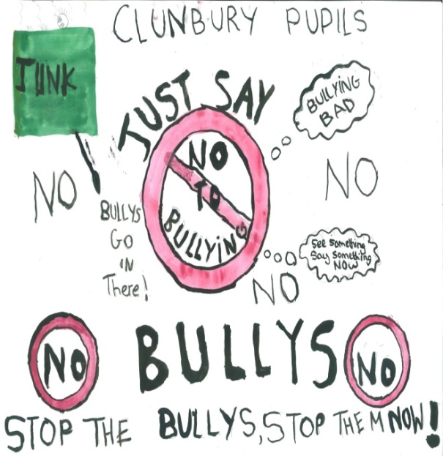
Bullying
Approaches that simply crack down on individual bullies are seldom effective.
However, when there is a school-wide or district-wide commitment to end bullying, bullying can be reduced significantly.
Notes:
Something can be done to stop bullying. Let’s look at specific strategies and methods.

Slide 73
Review School Data
Notes:
Look at this data set. If you were planning an intervention strategy, would you take a look at the fighting and bullying problems in the restrooms, gym, A-Hall and B-Hall?

Slide 74
Implement the Plan
Raise Awareness About Bullying
Professional Development
Certified and Non-Certified Staff
Have a Plan!
Increase Staff Involvement and Supervision
Train the staff and inform students and parents.
Share survey data with all staff to identify and
then target supervision to the problem areas.
Give staff procedures to follow for intervening
and reporting bullying incidents.
Fully implement the Anti-Bullying Plan.
Notes:
Staff awareness is an essential component of a bullying prevention and intervention plan.

Slide 75
Develop
Strategies…
…Be creative
Notes:
Many schools have developed creative ways to change the school climate attitude about bullying. Some have recruited kids to look out for each other.

Slide 76
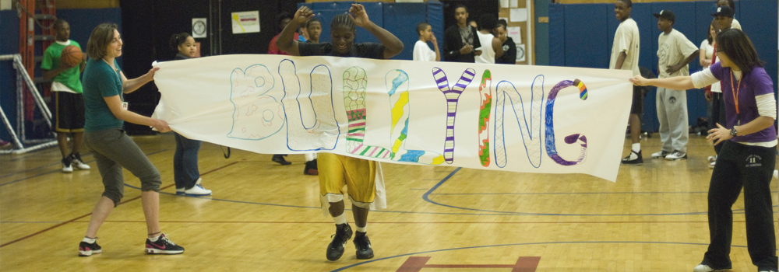
Develop
Strategies…
…Be creative
Notes:
Many schools have developed creative ways to change the school climate attitude about bullying. Some have recruited kids to look out for each other.

Slide 77
Bullying prevention and intervention
Encourage
Students to
Be part of
The
solution
Notes:
Engaging students in anti-bullying efforts is a key component. Watch this video, which schools have shown to students to illustrate how they can prevent bullying in non- confrontation ways. (NOTE: Make sure you have internet access for this YouTube video).

Slide 78
SAVE Program
Notes:
The National Association of Elementary School Principals recommends this 9-Step anti-bullying process. Note several things on this process list, including the opportunity for students to report bullying anonymously through the use of the “bully box”.

Slide 79
Notes:
This is an example of a school district’s efforts to stop bullying. Every bulletin board was dedicated to “Say No to Bullying.” This district also implemented the student contracts and many other strategies to stop bullying.

Slide 80
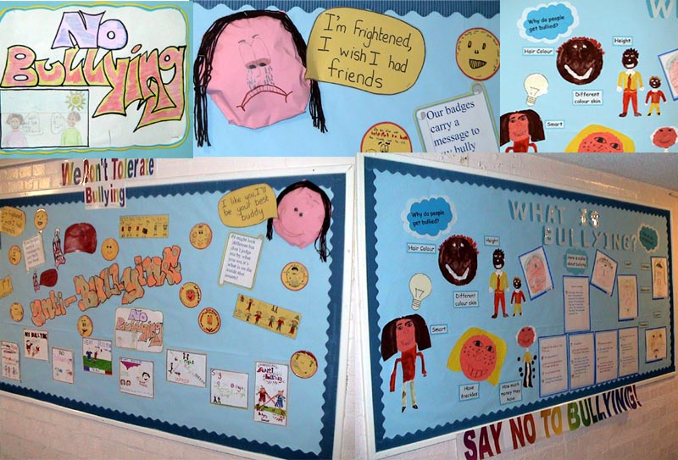
Notes:
This is an example of a school district’s efforts to stop bullying. Every bulletin board was dedicated to “Say No to Bullying.” This district also implemented the student contracts and many other strategies to stop bullying.

Slide 81
Positive Behavioral Interventions and Supports (PBIS)
PBIS is an evidence-based, data-driven framework proven to reduce disciplinary incidents, increase a school’s sense of safety, improve school climate and support improved academic outcomes. More than 10,000 schools across the United States are implementing PBIS. Over 200 schools in Georgia are implementing PBIS, and with significant results.
PBIS schools apply a multi-tiered approach to prevention, using disciplinary data and principles of behavior analysis to develop school-wide, targeted and individualized interventions and supports to improve school climate.
Notes:
Some schools have implemented Positive Behavior Support as a comprehensive school climate strategy to reduce bullying and intimidation.

Slide 82
“Team training for implementation of PBIS provided by the Georgia Department of Education helps schools gain the knowledge and skills needed to establish behavioral support and create a positive school climate….”
Notes:
Some schools have implemented Positive Behavior Support as a comprehensive school climate strategy to reduce bullying and intimidation.

Slide 83
Notes:
Some schools have implemented the No Place for Hate campaign from the Anti-Defamation League that focuses on self-respect and respect for others as a message to prevent and reduce bullying.

Slide 84
Notes:
These are other free resources.

Slide 85
FREE
Bullying is NOT a Fact of Life:
A Guide for Parents/ Teachers
Provides greater insight into how parents, teachers, or school personnel can target their conversations about bullying.
Conversation starter cards promote behaviors that protect against bullying or the potential for becoming a bully. In playing card format, these cards provide specific questions about bullying that a parent or teacher can discuss with children or youth.
Notes:
SAMHSA has developed and published a free publication (shipping and handling costs) entitled “Bullying is NOT a Fact of Life”. This is an excellent way to start the conversation about bullying with teachers, parents and students.

Slide 86
Get the Community
Involved …
… to help stop
bullying.
Notes:
More communities are now partnering with local schools and school districts to send an anti-bullying, anti-harassment message throughout the entire community: billboards, Public Service Announcements, community meetings/forums, etc. Community-wide efforts like this send a strong message to students.

Slide 87
You Can Stop Bullying!
Notes:
Be a messenger. Be part of the solution.

Slide 88
Georgia Department of Education
Marilyn Watson
mawatson@doe.k12.ga.us
Jeff Hodges
jhodges@doe.k12.ga.us
Garry McGiboney, Ph.D.
gmcgiboney@doe.k12.ga.us
Notes:
Let us know if we can assist in anyway.

