Slide 1
A Review of Georgia’s Mathematics Program
2012 GAEL Summer Conference
July 9, 2012
Sandi Woodall
State Mathematics Program Coordinator
swoodall@doe.k12.ga.us
Notes:
Thank you – I have two goals for this session – to share with you Georgia’s successes in mathematics and to detail our next steps – I want to provide you with the same information we are giving teachers

Slide 2
Georgia’s Mathematics Program Indicators of Success
WOW!!
GHSGT Mathematics
Spring 2010 QCC Mathematics SWD 35.6% Passing Rate
Spring 2011 GPS Mathematics SWD 51.5% Passing Rate
FIRST EVER GPS GHSGT Mathematics
2012 Education Week’s Quality Counts Report
Georgia experienced the 4th largest reduction in the 8th Grade Poverty Gap for mathematics in the nation.
Notes:
This is the beginning of a long list, and I’m certainly not going to read this to you, however, I want to point out at least one thing - Look at the first item. SWD made great gains in 2011. This is due to the depth and rigor required under GPS. Thank you for a job well done.

Slide 3
Georgia’s Mathematics Program Indicators of Success
The Nation’s Report for Mathematics 2011
Georgia was one of only 18 states in which mathematics scores for public school students improved from 2009 to 2011.
Georgia, along with only seven other states and the District of Columbia, reported an increase in the 4th grade average NAEP mathematics scores from 2009 to 2011.
While there was no significant change in Georgia’s eighth grade average NAEP mathematics score from 2009 to 2011, Georgia was one of only 15 states to demonstrate a significant increase in the 8th grade average NAEP score from 2007 to 2009.
Georgia was one of only four states in which score gaps between higher- and lower-income students narrowed from 2003 to 2011.
Georgia was one of 16 out of the 35 participating states with samples large enough to report results for Black students in which the White – Black score gaps narrowed from 1992 to 2011.
Notes:
…bullet number four…wow, that is impressive.

Slide 4
Notes:
Why is this an indicator of success for us? Let’s have a look at the next image.

Slide 5
Notes:
Note which recommendations have a strong level of evidence-
Reflecting on the problem solving process, and use of visual representations.
These are directly related to what we’ve done under GPS, particularly in the implementation of the process standards.

Slide 6
Success breeds success! – Mia Hamm
Notes:
As you continue successful practice, you may be asking yourself, “What are my next steps, what are the next steps to continue in a successful manner?”

Slide 7
“You may be on the right track but you will get run over if you just sit there!” -Will Rogers

Slide 8
CCSS Tenets of Design
Standards must align to the requirements for College and Career readiness
Standards must offer a new platform for better instructional systems and better ways of managing instruction
Notes:
Let’s start with the CCSS authors’ guiding principles - The authors recognized that the learning cannot be too general as it becomes fuzzy and incoherent or too specific as it becomes fragmented (lessons) and again incoherent. Authors realized early on that mathematics does not break down into lesson size pieces, but fortunately does into unit size pieces, so what we need to focus on is the collaborative planning of units which address the mathematics that students will walk away with – then we can break the unit into lessons all of which are directed by the cluster(s) of standards associated with the unit – so it’s not about ‘what standard are you teaching today, but rather what standards are the students mastering in this unit.’

Slide 9
CCSS Tenets of Design
Focus and Coherence must become the major design principles, based on evidence provided by:
achievements of last 2 decades
lessons learned in last 2 decades
Honesty about time constraints must be paramount in the design phase
Notes:
CCGPS: cut important, but not coherently essential, content – major changes for us includes much less attention to data in K-5, allowing for more attention to be given to numbers and operations and algebraic thinking, authors admit that MS and HS are still a little content heavy – MS emphasizes expressions and equations & the number system, HS algebra – other major changes in HS: modeling category; shift in geometry from Euclidean to transformational – which keeps algebra alive, is the geometry actually used, and is more closely and transparently related to alg and functions;

Slide 10
So…we are all committed to moving forward to embrace the CCGPS implementation, but we must first have a concise understanding of the vital instructional shifts as we move from GPS to CCGPS
Notes:
The authors took the time to organize their tenets into 6 lens on which to build a framework for change – those of you who viewed the Spring GPB videocasts will remember …

Slide 11
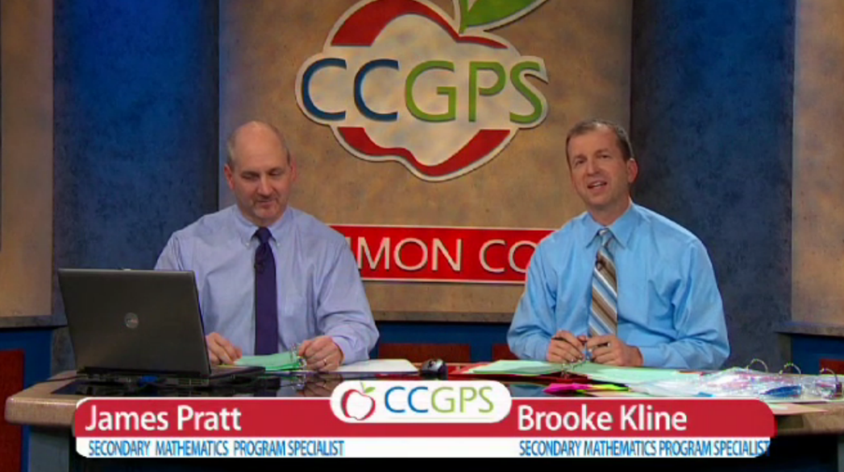
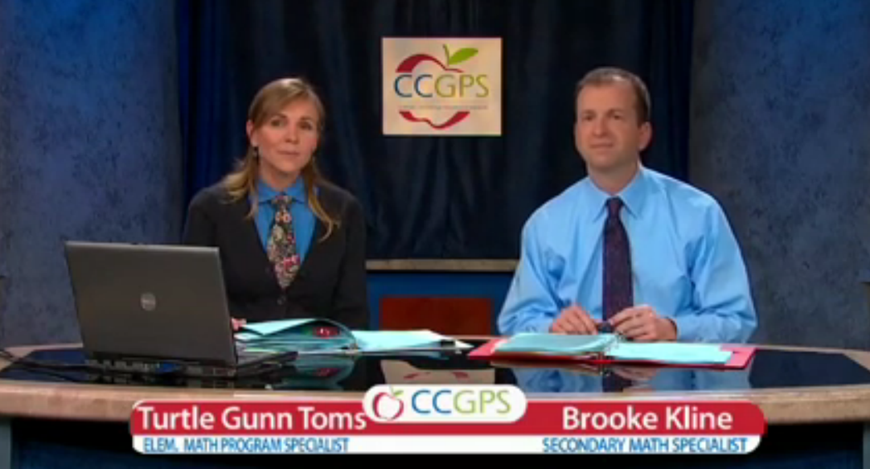
Focus
Coherence
Fluency
Deep Understanding
Applications
Balanced Approach
Notes:
…that the mathematics program specialists introduced you to those lenses -the first two encompassing the major design principles of CCSS …well since then the authors realized that even that list was a little cumbersome and chose to compress …

Slide 12
Focus
Coherence
Fluency
Deep Understanding
Applications
Balanced Approach
Notes:
…Fluency, Deep Understanding, Applications, and Balanced Approach – you might remember that the specialists often referenced the other 3, when talking about any of the 4 -- for instance when they talked about fluency, they commented that, “fluency, which is not just about being quick and rattling off an algorithm, it is about teachers and students having a deep understanding which allows both to be flexible in their thinking (balanced approach), and to decide which methods and strategies would be most efficient and appropriate (Application)”

Slide 13
Focus
Coherence
Rigor
Notes:
So the authors have compressed those four lenses (F, DU, A, & BA) into the one lens of rigor – and we now have three lenses which provide a framework through which to address the necessary changes in instruction demanded by the Common Core.

Slide 14
Focus
Notes:
So what about focus – what does it really mean to mathematics instruction?

Slide 15
Focus
Focus - strongly where the standards focus
Notes:
We will need to commit to laser focus on the content where the standards focus - remember that covering does not translate into better test score. The authors were committed to fewer standards, with higher expectations for mastery and understood that depth ensures retention and transfer
Remember that the authors discerned that mathematics breaks down into unit size pieces, so we will need to ensure that every lesson in the unit targets mastery of the cluster or cluster of standards associated with that unit – we need to focus on - What mathematics we want students to walk away with at the end of the unit- and student response being the primary focus when deciding on the amount of time spent on lessons

Slide 16
Focus
Focus is the deliberate choice of not only what to teach but the level of which to teach it, in the support of the critical areas.
The Common Core is asking teachers to focus deeply on the concepts that are prioritized in the standards, so students can reach a strong foundational knowledge and deep conceptual understanding, which will allow them to transfer their mathematical skills and understanding across concepts and grades. CCSS Authors
Notes:
Take a few seconds to read some of the thoughts of the authors regarding focus… We want to teach diagnostically early in the unit – could even use a problem from the end of the unit to encompass this – the diagnosis tells me what I will dwell on most or help me determine areas of focus for the unit. Another consideration might be to pair students to optimize peer tutoring– which in turn allows the teacher to diagnose and determine areas of focus. We can converge the student learning later in the unit. Focus is required within the unit, across the units, and across grade levels… for instance, how do we focus on a conceptual understanding of fractions throughout a student’s education…

Slide 17
Focus on Fractions
Units are things you count.
Units add up.
Fractions are explicitly unitized in the common core.
Unitizing links fractions to whole number arithmetic and to algebraic thinking.
Notes:
How does this focus develop fraction understanding through the grades?
Read first 3 bullets
4th bullet - If you unitize fractions you can apply whole number concepts to fractions.
This is the most reliable mathematical expertise students have.
It makes sense, and provides a solid foundation. (Thanks, Phil Daro!)
So critical for middle and high school work…so important to develop concretely

Slide 18
www.achievethecore.org
Notes:
In the spirit of focus, we have some support materials available to us from the authors of the CC, in collaboration with organizations like Achieve, Student Achievement Partners (founding members include David Coleman, Jason Zimba and Bill McCallum), and state assessment/curriculum teams.
They have outlined the clusters at each grade level and are currently working on high school course cluster delineation.
Not all of the content in a given grade is emphasized equally in the standards. Some clusters require greater emphasis, or focus, than the others based on the depth of the ideas, the time that they take to master, and/or their importance to future mathematics or the demands of college and career readiness.
In addition, an intense focus on the most critical material at each grade allows depth in learning, which is carried out through the Standards for Mathematical Practice.
To say that some things have greater emphasis is not to say that anything in the standards can safely be neglected in instruction.
This table identifies the Major Clusters, Additional Clusters, and Supporting Clusters for this grade.
So, my first thought is are these three categories creating power standards?
Major clusters are not to be confused with power standards which often create an exclusive curriculum in which other standards are often neglected, or not taught at all, and this can leave gaps in student skill and understanding creating negative consequences on learning progressions.
Good way to think of it…major clusters are like the posts on a fence, posts are very important to that fence, but we still the rest of the fence for it to be considered a fence and to keep it standing.
The additional and supporting clusters can not be ignored and they help connect the posts and keep the fence standing. Without the additional and supporting clusters, we have no fence.

Slide 19
Coherence
Notes:
So how is coherence different from focus – it’s like the linkage between and among mathematics concepts…

Slide 20
Coherence
Coherence - Think across grades and link to major topics within grades
Notes:
The relationship among the standards is a critical aspect of the CCGPS. The design invites us to think across grades and to link major topics within each grade. We want to carefully connect the learning within and across grades so that students can build new understandings onto foundations built in previous years. That emphasis will allow us to begin to count on solid conceptual understanding of core content and build on it.
Each standard is not a new event, but rather an extension of previous learning - and again, depth ensures retention and transfer

Slide 21
Coherence
“The coherence and sequential nature of mathematics dictate the foundational skills that are necessary for the learning of algebra. The most important foundational skill not presently developed appears to be proficiency with fractions (including decimals, percents, and negative fractions). The teaching of fractions must be acknowledged as critically important and improved before an increase in student achievement in algebra can be expected.”
Final Report of the National Mathematics Advisory Panel (2008, p. 18)
Notes:
Take a minute to read the statement from the National Mathematics Advisory Panel. The CC writers definitely responded to that thinking and we want to keep the teaching of fractions in the forefront as students progress through the grade levels -
The 8 Standards of Mathematical Practice are integral to the super-structure – they hold the clusters together –

Slide 22
Standards for Mathematical Practice
2. Reason abstractly and quantitatively.
3. Construct viable arguments and critique the reasoning of others
Reasoning and explaining
4. Model with mathematics.
5. Use appropriate tools strategically.
Make sense of problems and persevere in solving them.
6. Attend to precision.
Modeling and using tools
7. Look for and make use of structure.
8. Look for and express regularity in repeated reasoning.
Seeing structure and generalizing
(McCallum, 2011)
Notes:
They are the habits and attitudes of mathematical thinkers and define the way knowledge comes together and gets used – we want administrators to focus not only on content coverage but on these practices of students when they evaluate the effectiveness of our teaching as practices are central to our classroom cultures and to our delivery of unit lessons – this is how our students’ mathematical characters are developed and remember that research has revealed the impact of these standards in improving students’ mathematical problem solving skills – particularly 2, 3, 4. It is prudent to consider that SMP 3 assumes that students are talking to each other.

Slide 23
Notes:
In 3rd grade, multiplication & division and properties of operations are clearly linked to finding area of rectangles.

Slide 24
Fractions Progression
Notes:
This progression is from the work of Phil Daro…
Understanding the arithmetic of fractions draws upon 4 prior understandings
equal partitioning, unitizing, number line, and operations
connecting fractions to whole number arithmetic solidifies student understanding
And understanding arithmetic of whole numbers and fractions contributes greatly to understanding of algebra

Slide 25
Rigor
Notes:
Rigor is a word we bounced around a lot with GPS, but defining it is not easy…

Slide 26
Rigor
Rigor –
Requires solid conceptual understanding, fluency, and application
Notes:
We attended to the facets of rigor in GPS – those being conceptual understanding, procedural skill and fluency, and applications – we connected those facets in a balanced approach, but CCGPS is asking us to take it to another level by pursuing each of the facets WITH EQUAL INTENSITY in time spent, activities designed, and resources utilized and remembering that all three deserve class time

Slide 27
Rigor
Rigor is more than what you teach and which standards are addressed; it is how you teach and how students show you they understand. True rigor is creating an environment in which each student is expected to learn at high levels, each student is supported so that he or she can learn at high levels, and each student demonstrates learning at high levels.
Blackburn 2008
Notes:
These practices are central to our classroom cultures and to our delivery of unit lessons – this is how our students’ mathematical characters are developed and remember that research has revealed the impact of the mathematical practice standards in improving students’ mathematical problem solving skills.
So what is the takeaway? If you embraced GPS and the process standards you should be well prepared to implement CCGPS!
On a related note, this bears repeating…Depth ensures retention and transfer

Slide 28
SOLID CONCEPTUAL UNDERSTANDING
Examples:
Write 4 fractions that are equal to 5.
2 hundreds + 3 ones > 5 tens + 9 ones
Is this comparison true or false? Explain your
thinking.
Notes:
Dr. Daro suggests that ‘correct responses are essential…but they’re part of the process, not the product. The product is the mathematics the kids walk away with in their heads.’
He also recommends that wrong answers be used to figure out why the instruction didn’t work, rather than being used singularly to diagnose and remediate – think of the canary in the mine shaft – the wrong answer could involve more cogent thinking than a right answer that is not necessarily robust or even due to lucky assumptions.

Slide 29
FLUENCY
The standards require speed and accuracy in calculations, so…
we need to structure class and homework time for students to practice core functions, so that they are able to understand and manipulate more complex concepts.
Notes:
Fluency in whole number and fraction operations, in algebraic expressions and equations

Slide 30
Notes:
Is this fluency when you look through the three lenses?

Slide 31
APPLICATION
We want students to use appropriate concepts and procedures even when not prompted, so…
we need to provide opportunities at all grade levels for students to apply mathematics concepts in ‘real world’ situations, recognizing that this means different things in K-5, 6-8, and High School.

Slide 32
What Now?
Say YES to:
Say NO to:
Teaching CCGPS
Planning like Goldilocks
Embracing ‘answer getting’ as simply part of the process
Consistent terminology
Retrofitting/Crosswalks
Teaching standard by standard
Focusing on only getting the correct answer
Inconsistent terminology
Notes:
Bullet 1 - this means know and teach CCGPS and making a concerted effort to infuse formative assessment, including formative assessment lessons into your instructional delivery - Don’t go back and try to make what you used to do fit these new standards.
Bullet 2 - Planning like Goldilocks- Strands are generally too big, standards are too small and fragmented, and units which address clusters of related standards are just the right size. - It’s not about which standard you are teaching today, but rather, what standards are students mastering in this unit.
Bullet 3 - We have traditionally been focused on answer getting in the US.
Unfortunately, a right answer is not necessarily a reliable indicator of mathematical understanding.
Correct responses are essential, but as a part of the process, not the product. (Daro)
A student can give a right answer, but have huge misunderstandings about mathematics.
Wrong answers, and particularly, their accompanying explanations, should serve as canaries in the mathematical mine.
They indicate where misunderstandings lie, possibly held by many students.
Bullet 4 - Consistent use of terminology and understanding of that terminology across the grades, particularly where it impacts mathematical understanding, makes life easier for everyone. - Doing so ensures less to learn along the way, and nothing to undo as students progress through the standards.
For example, the definition of a trapezoid has been inconsistent. The inclusive definition assists in the development of a hierarchical understanding of properties of plane figures. (at least vs exactly)

Slide 33
What Now?
Say YES to:
Say NO to:
Solving an equation with understanding- the power of the properties
The strength of the distributive property
Deep understanding of place value
Deep understanding and the most important ideas in CCGPS which need our attention
Canceling, proportions and cross-multiplying
FOIL – things that only work in certain circumstances
Lining up the whole numbers on the right/lining up decimal points
‘Covering’ topics and the over-reliance on pacing guides
Notes:
5th Bullet - Mnemonics and tricks add additional curriculum.
If we ask students to expand x^3/x^3 and then cancel, we shouldn’t be surprised if students find the answer to be 0 – in fact, 50% of test takers will - Why confuse our middle schoolers by suggesting a new process – why not stick with the properties of operations to solve these equations and not introduce cross-multiplication which becomes a meaningless algorithm for students - We use the same properties in 3rd grade and in pre-calculus – just nine – learn to use them with deep understanding as they are very powerful to mathematical flexibility.
6th Bullet - We teach FOIL for multiplication of binomials, then confuse students when this doesn’t transfer to multiplication of larger polynomials.
7th Bullet - In 2nd grade, line up numbers on the right to add/subt – but in 4th, line up decimals to compare? -True understanding of place value greatly exceeds these superficial ideas.
8th Bullet - It is not always necessary to firmly establish the mathematics, prior to providing problem solving situation - making sense of the mathematics through problem situations is frequently neglected, when in fact the problem can actually assist students in learning the relevant mathematics - A problem can actually be an effective strategy to begin a unit – it enables us to diagnose what students are bringing to the unit, demonstrates the variety among students in what they are bringing, and enables us to productively sketch our plan.

Slide 34
Final thoughts…
Jump into CCGPS with both feet rather than cross-walking from GPS to CCGPS
Make the Standards for Mathematical Practice the way knowledge comes together and gets used by students
Focus strongly where the standards focus and be mindful of the connections between previous and future learning
Plan at the unit level with colleagues with an emphasis on the mathematics you want your students to walk away with

Slide 35
Mathematics List Serve
Send an email with no message to:
join-mathematics-k-5@list.doe.k12.ga.us
join-mathematics-6-8@list.doe.k12.ga.us
join-mathematics-9-12@list.doe.k12.ga.us
join-mathematics-districtsupport@list.doe.k12.ga.us
join-mathematics-administrators@list.doe.k12.ga.us
join-mathematics-resa@list.doe.k12.ga.us
Notes:
Step up communication – notices and announcements sent directly to teachers

Slide 36
GaDOE GeorgiaStandards.org
Notes:
Fall 2011 webinars – Spring 2012 GPB Videocasts – Spring 2012 Unit 1 webinars – Calendars for 2012-2013 unit-by-unit webinars – Framework units – high needs schools/districts – email me if you are interested in joining the mathematics supervisor wiki

Slide 37
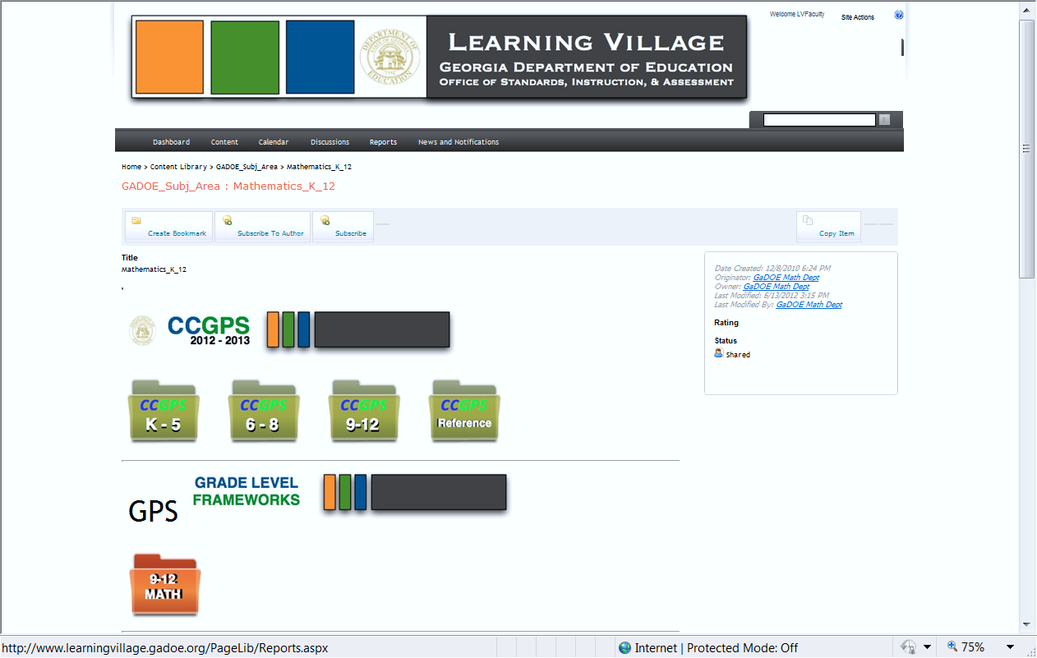

Slide 38
"Man's mind, stretched to a new idea, never goes back to its original dimensions." ~Oliver Wendell Holmes, Jr.
Notes:
Go on today, continue to grow, and continue to stretch the minds of your colleagues and your students. Thank you for all you do, and for your obvious dedication to your practice.

Slide 39
…frequently asked questions
How will K-HS teachers teaching CCGPS in 2012-2013 be supported by the state mathematics team?
In which grade levels/courses will state assessments be administered in 2012-2013?
Which middle school students will benefit by enrolling in high school courses while in middle school? Which are best served in CCGPS Grade 8 Advanced?
Which high school students should be directed to the accelerated pathway?

Slide 40
…frequently asked questions
If high school students have successfully completed a GPS mathematics course, should we consider shifting them to CCGPS?
If students have successfully completed Accelerated Mathematics III, is it in their best interest to enroll in Mathematics IV?
What are the graduation requirements for students who entered ninth grade in 2011-2012?
What are the best fourth course options for students who have successfully completed Accelerated Mathematics III/GPS Pre-Calculus? Mathematics III/GPS Advanced Algebra?

Slide 41
GAEL Session Handout

Slide 42
CCGPS Mathematics
CCGPS Professional Learning Opportunities and Resources
https://www.georgiastandards.org/Common-Core/Page/Math.aspx
Points of Emphasis
In CCGPS mathematics, content is divided into clusters of standards and addressed in unit size pieces.
In CCGPS mathematics, not all grade level clusters of standards are emphasized equally, but none of the clusters can be neglected or ignored without negative consequences to the learning progression.
In CCGPS mathematics, grade level content is not a new event, but rather an extension of previous learning and a prelude to future learning.
In CCGPS K-5 mathematics, less attention is given to data and statistics than in GPS.
In CCGPS 6-8, expressions, equations, and the number system are emphasized.
In CCGPS 9-12, modeling has been added to the list of traditional high school strands.
In CCGPS 9-12, there is a decided shift from Euclidean geometry to transformational geometry, as transformational geometry is more closely and transparently related to algebra and functions and is the geometry actually used in real world situations.
Starting Points
The framework for change is best viewed through the lenses of focus, coherence, and rigor. Mathematics educators are encouraged to focus strongly where the standards focus and to be mindful of the connections between previous and future learning. The three facets of rigor, which are conceptual understanding, fluency, and application, must be pursued with equal intensity.
Educators are encouraged to plan for CCGPS instruction at the unit level, with an emphasis on the mathematics they want students to walk away with at the end of the unit. In CCGPS, it’s not about what standard the teacher is teaching today, but rather what cluster of standards the students will have mastered at the conclusion of the unit.
Educators will find benefit in the CCGPS Mathematics Teaching Guides which further articulate the Standards for Mathematical Practice and describe the CCGPS in the familiar language of GPS.
Georgia Department of Education
Dr. John D. Barge, State School Superintendent
June 27, 2012

Slide 43
CCGPS Standards for Mathematical Practice
Make sense of problems and persevere in solving them
6. Attend to precision
Reason abstractly and quantitatively
Construct viable arguments and critique the reasoning of others
Model with mathematics
Use appropriate tools strategically
Look for and make use of structure
Look for and express regularity in repeated reasoning
Reasoning and explaining
Modeling and using tools
Seeing structure and generalizing
Overarching habits of mind of a productive mathematical thinker
The Standards for Mathematical Practice represent the habits and attitudes of mathematical thinkers and are integral to the super structure of CCGPS mathematics. The practice standards define the way knowledge comes together and gets used by students. Administrators are encouraged to focus on the practice standards when evaluating the teaching and learning process.
Georgia Department of Education
Dr. John D. Barge, State School Superintendent
June 27, 2012

