Slide 1
What I know for sure is…

Slide 2
A quality teacher makes a world of difference, and a difference in the world.

Slide 3
“It is easier to build strong children than to repair broken men.” ― Frederick Douglass

Slide 4
“Live as if you were to die tomorrow.
Learn as if you were to live forever.” ― Mahatma Gandhi

Slide 5
“One is not born into the world to do everything, but to do something.”
---Henry David Thoreau

Slide 6
“What counts in life is not the mere fact that we have lived. It is what difference we have made
to the lives of others that will determine the significance of the life we lead.”
~Nelson Mandela

Slide 7
We must do everything in our power to ensure that all children receive a quality education. The future of our nation depends on it.

Slide 8
Many problems start with communication problems; if we can respectfully communicate, we can often avert issues.

Slide 9
The limits of my language are the limits of my world.

Slide 10
Balance
is an equalizer that connects opportunity with talent.

Slide 11
What we dwell on is who we become. –Oprah Winfrey

Slide 12
Children are excited to learn- sometimes they just need the right spark.

Slide 13
The arts create a society of creative citizens who are involved in their communities.

Slide 14
“Will this matter in ten years?” is a good way to filter what’s important from the noise of life.

Slide 15
I know for sure that all students can learn; facilitating their learning experiences is my responsibility as the teacher.

Slide 16
First and foremost children have to be set to learn each day- getting set includes a good breakfast, a good night’s sleep, physical activity, and feeling safe and secure.

Slide 17
Social Studies can create the Context, that engages students in all other Contents.

Slide 18
Education is the most powerful weapon which you can use to change the world. - Nelson Mandela

Slide 19
Humans are naturally inquisitive.

Slide 20
The very best teachers often have personalities and people skills. This along with content knowledge makes a good teacher great.

Slide 21
Communication matters – building relationships, building trust with other administrators, teachers and students leads to problem solving and finding what works best for children.

Slide 22
The best prize that life has to offer is the opportunity to work hard at work worth doing.
Theodore Roosevelt

Slide 23
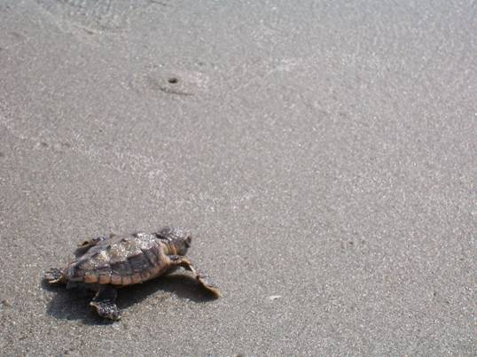
Teachers must nurture students, yes, but our teachers must be honored and respected as well; for they have been given the responsibility of educating our most precious natural resource – our children!

Slide 24
I TOUCH THE FUTURE.
I TEACH…
Christa McAuliffe

Slide 25
What I know for sure is…

