Slide 1
Whatever happened with that Personalized Learning thing?

Slide 2
The Convergence
Tools – Statewide Longitudinal Data System (SLDS), Teacher Resource Link (TRL), Online Assessment System (GoFAR), Learning Tool (LT), Instructional Improvement System (IIS)
Personalized Learning
Tools, training, and infrastructure to provide every teacher in Georgia the ability to give every public school student a learning experience customized to his or her pace and style of learning.
Training – Face to Face, Summits, Conferences, Online, Manuals, Testimonials
Infrastructure – PeachNet Project, 4 Tier Grants, E-Rate

Slide 3
Georgia’s Path to Personalized Learning
Audience
Longitudinal Data
Actionable Info Resources
Metrics
SLDS Provides longitudinal data and
analysis to assist in differentiation of students.
Tools:
Dashboards
Reports
LEXILE Reading Scores
Growth Model
District Data Exchange
IIS 2.0
Provides teachers with the ability to quickly find digital resources and professional development that are aligned to standards.
Tools:
TRL-Digital Resources linked to GPS & Common Core standards
IIS 2.5 Provides districts with the ability to load local resources into the LOR to be presented to teachers in TRL.
Tools:
LOR- Learning Object Repository
IIS 3.0
Provides teachers with the ability to assign digital resources to students and monitor use. Provides student with access to personalized learning.
Tools:
LT-Learning Tool
Georgia Online Individual Education Plan (GOIEP)
IIS 4.0
Provides teachers with the ability to measure effectiveness of instruction.
Tools:
IIS-Learning Progression Maps
IIS-Data Analysis Tool
Formative Assessment Upload
OAS/GOFAR
Financial Systems
IIS 5.0
Provides teachers, students, and parents with the ability to store longitudinal data.
Tools:
Backpack
Teachers, Students,& Parents
Personalized Learning Environment for Every K12 Student
Teachers,
School & District Personnel
(i.e., Principals, Guidance Counselors, School Psychologist, etc.)
IIS 6.0
Improve Teacher Skills
Tools:
IIS-Professional Development System
Tool kit for teacher prep program
IIS 7.0
Measure Teacher Skills
Tools:
Performance Index
Growth Model
Observations
Surveys
IIS-High School Feedback Report
IIS-Data Analysis Tool
High Quality 21st Century Classroom Instruction
SLDS – Statewide Longitudinal Data System
IIS – Instructional Improvement System
LOR – Learning Object Repository
TRL – Teacher Resource Link
OAS – Online Assessment System

Slide 4
Technology Tiers
Education Technology Ecosystem

Slide 5
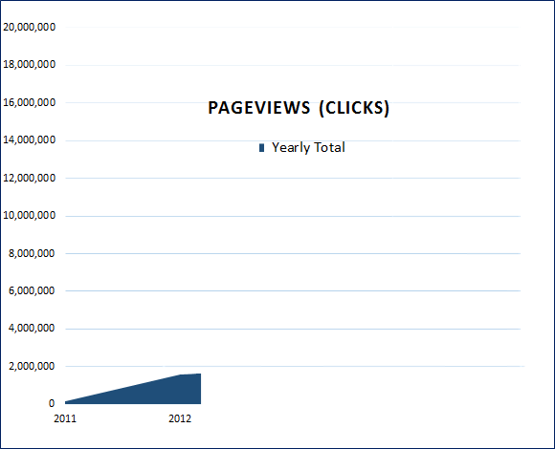
LDS Usage 2011

Slide 6
LDS Usage 2012

Slide 7
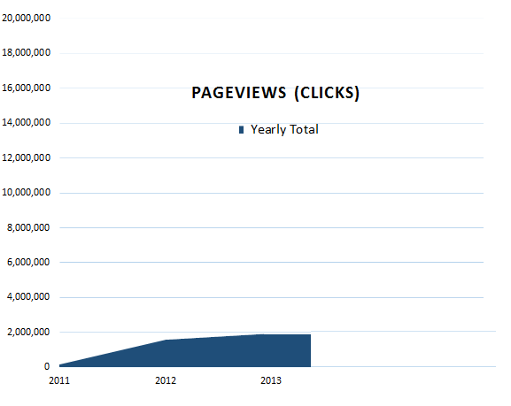
LDS Usage 2013

Slide 8
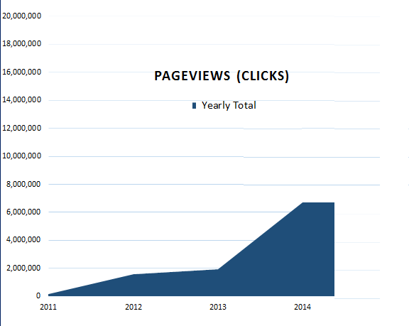
LDS Usage 2014

Slide 9
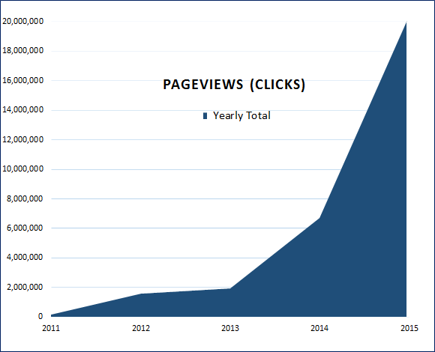
LDS Usage 2015

Slide 10
That over 30,000,000 times data was requested by Teachers
Longitudinal Data for-
Attendance
Assessments (All of them!)
Enrollment
Grades
Lexiles
Digital Resources (25,000) tied to Georgia Standards.
Growth Data- used in CCRPI
Go IEP- Statewide IEP
Instructional Improvement Dash Board
High School Feedback
Usage Reports

Slide 11
What’s new in LDS?

Slide 12
Parent Portal

Slide 13
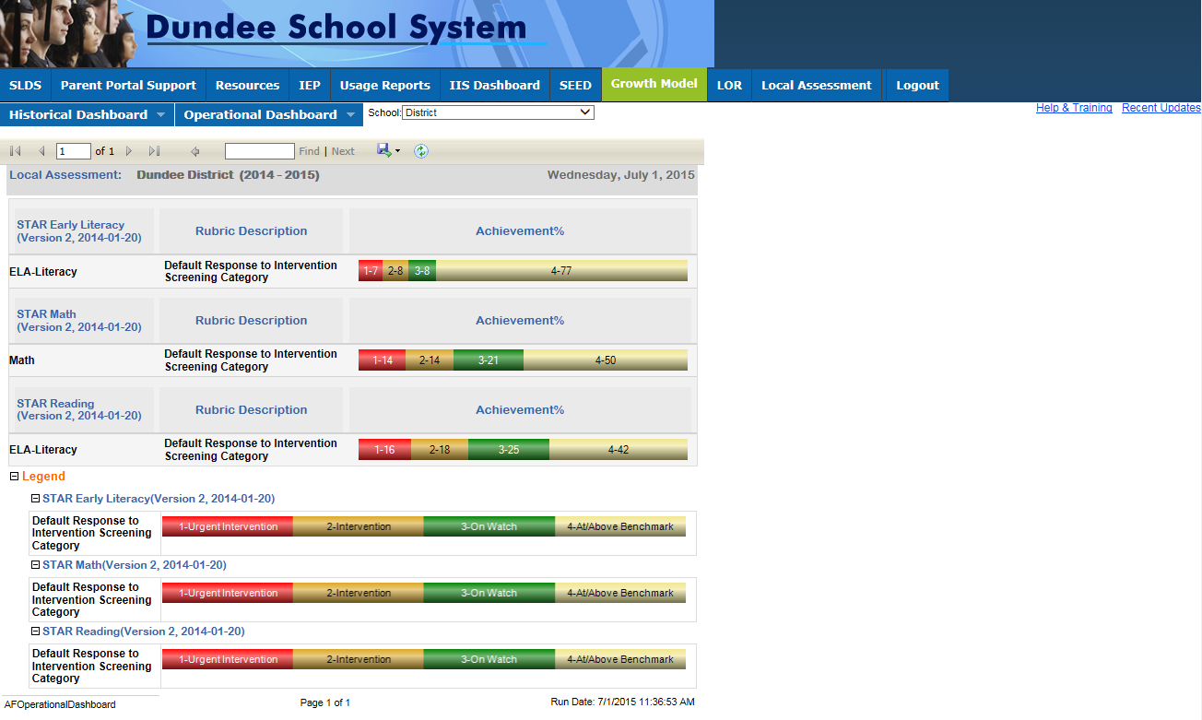
Formative Assessment

Slide 14
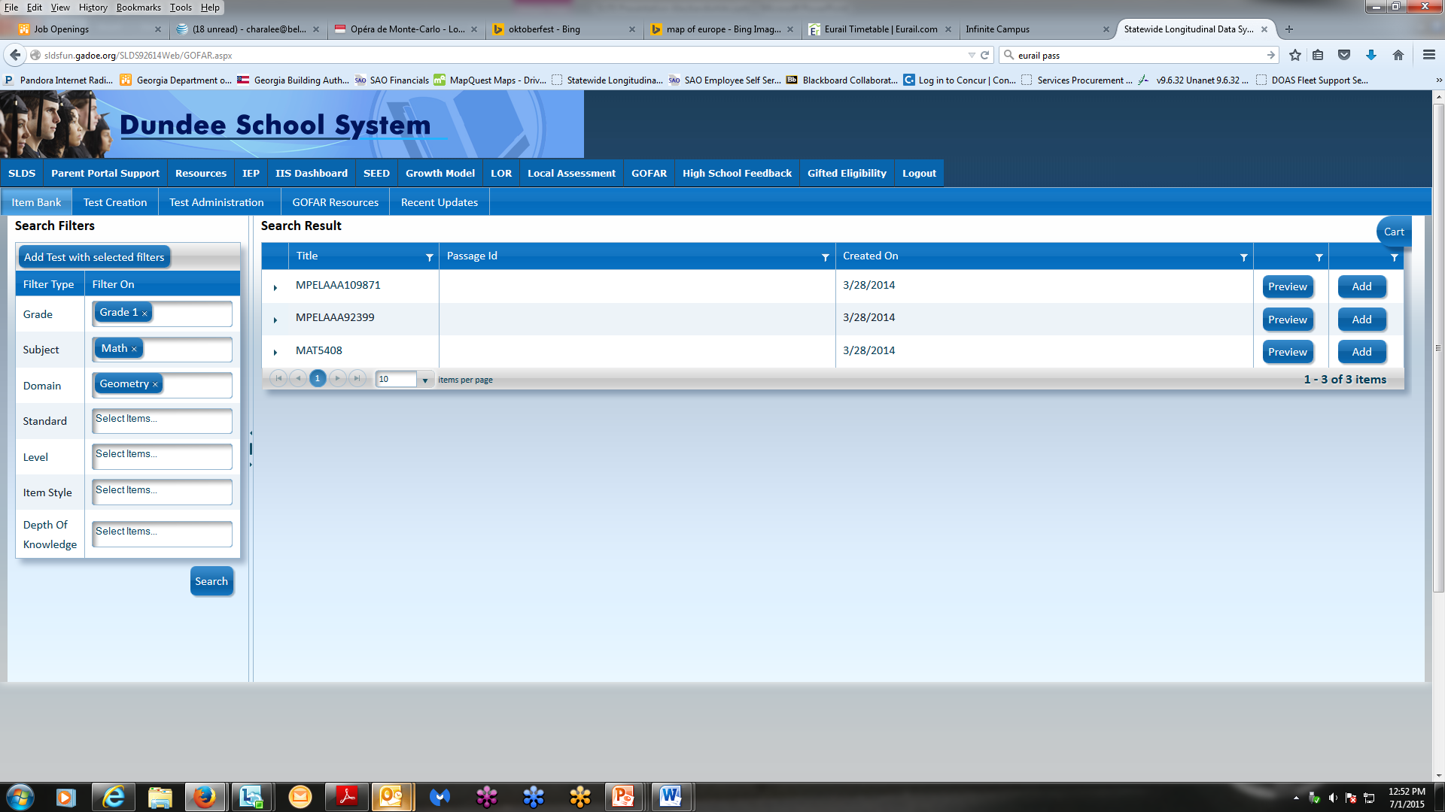
Go FAR

Slide 15
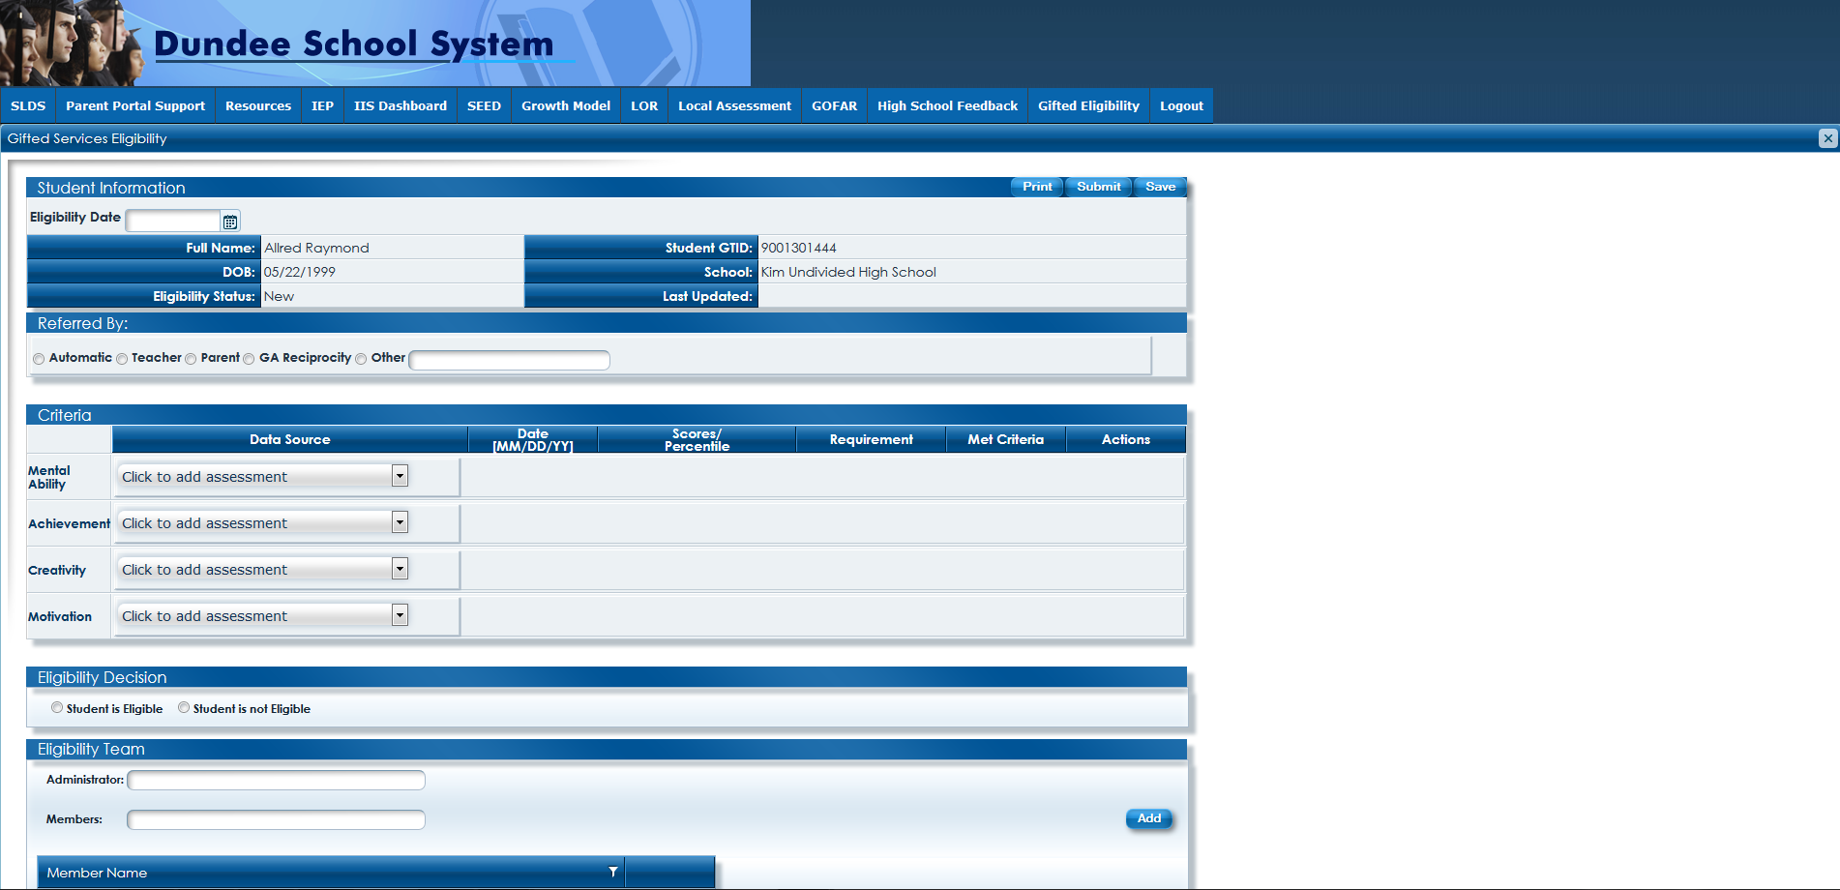
Gifted Eligibility

Slide 16
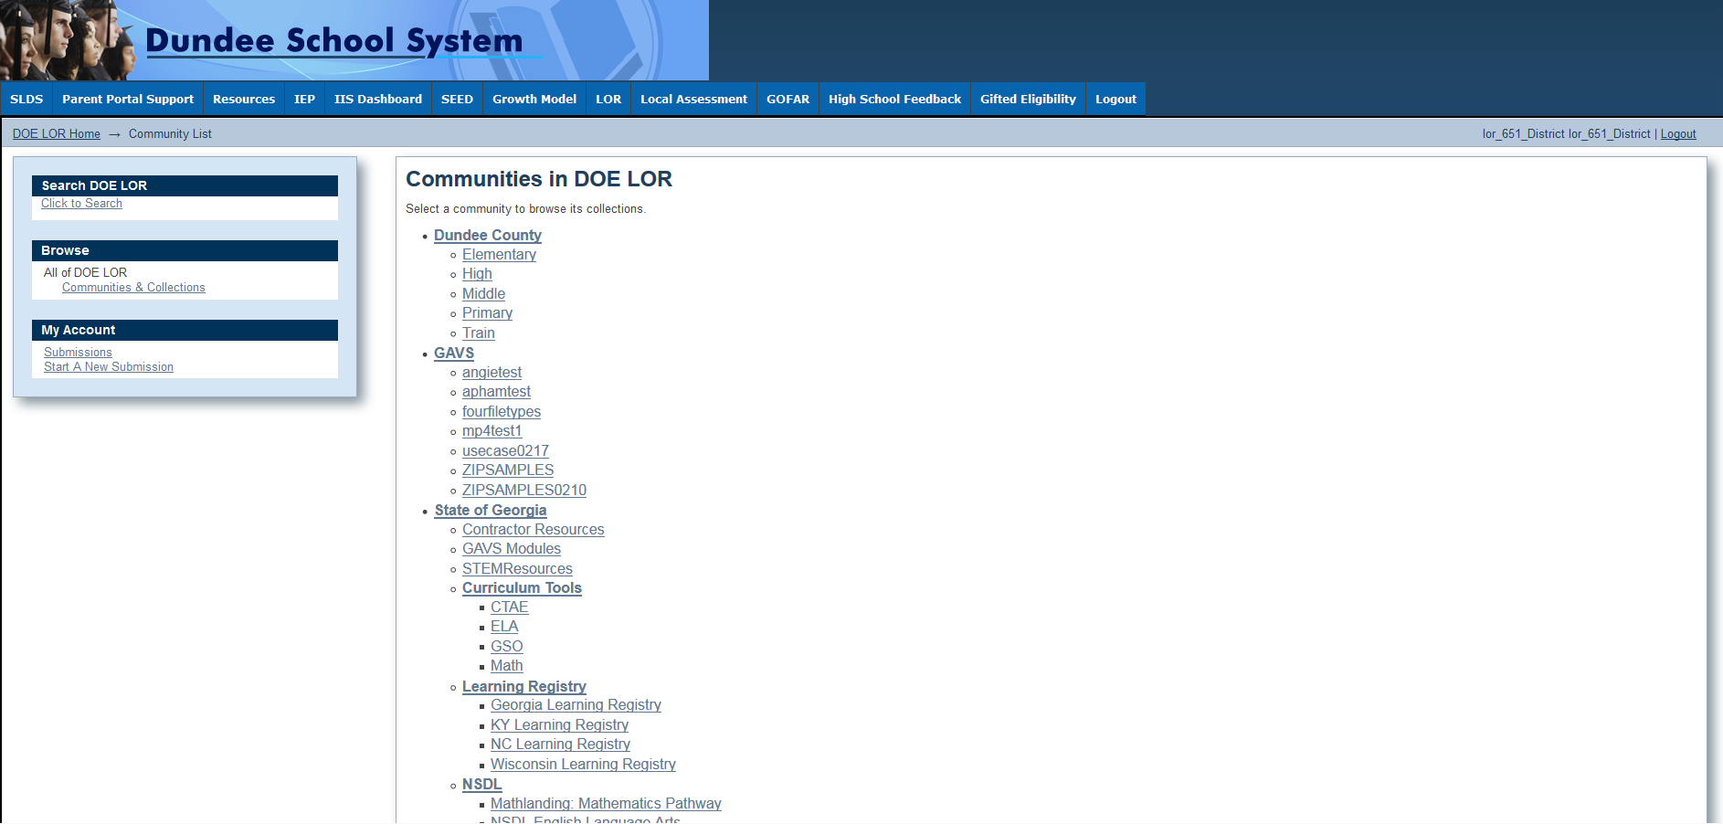
In the LDS- District Resources

Slide 17
What’s coming to LDS?

Slide 18
Learning Tool

Slide 19
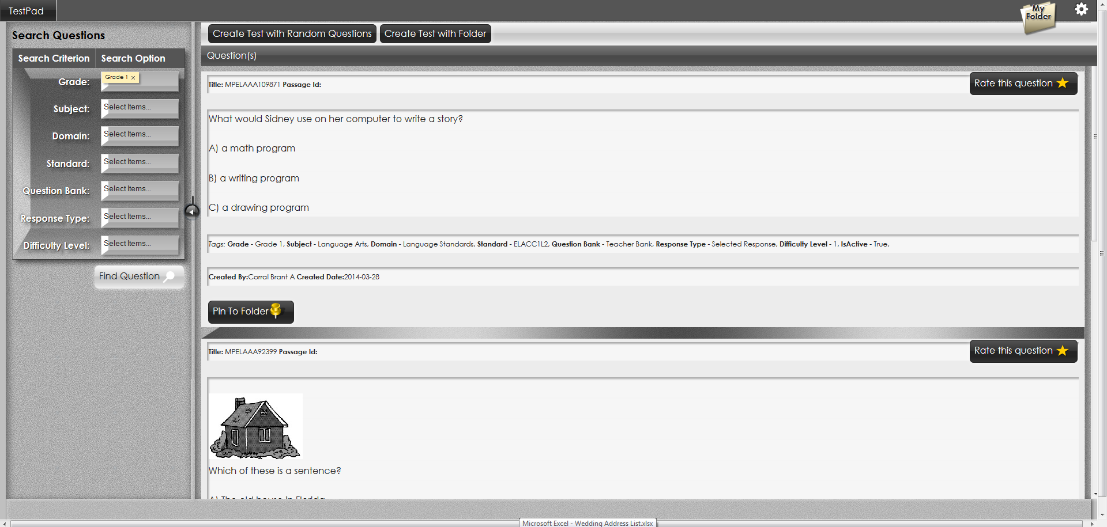
Student Learning Objectives

