Slide 1
Evidence-based Strategies and Practices for Improving Learning Opportunities
April 14, 2021
Caitlin McMunn Dooley, Ph.D.

Slide 2
Compassion over Compliance

Slide 3
Learning Opportunity Loss

Slide 4
Accelerate! Don’t “remediate”

Slide 5
What NOT TO DO!

Slide 6
What To Do: Formative Assessment and Instructional Practices
Establish a formative assessment structure for identified content areas.
BASED ON STUDENT NEEDS, reduce the learning targets to what is needed for grade-level progression.
Maintain grade-level performance expectations.
Continue to ensure access to the arts, PE/sports, and other high-interest, engaging opportunities.
Do NOT retain without significant purpose.

Slide 7
Guiding Questions
What data need to be collected and synthesized to determine student needs caused by learning opportunity loss?
Analyze data to identify strengths and challenges and determine outcomes.
What are you currently using (interventions, strategies, resources, community partnerships) to address learning opportunity loss?
What data have you collected to know if current efforts have been successful?
What data will you collect and analyze to identify ongoing needs?

Slide 8
Highly Effective Strategies
Accelerated Learning
TNTP-Learning-Acceleration-Guide-Updated-Nov-2020.pdf
EdResearch for Recovery_School Practices to Address Student Learning Loss (brown.edu)
Broad-Based Academic Supports for All Students (brown.edu)
Review-of-Expanded-Learning-Opportunities.pdf (hanoverresearch.com)
EdResearch for Recovery_Bringing Evidence-Based Decision-Making to School Safety (brown.edu)
High Frequency Tutoring
Accelerating Student Learning with High-Dosage Tutoring (brown.edu)
Community Engagement in K-12 Tutoring Programs: A Research-Based Guide for Best Practices

Slide 9
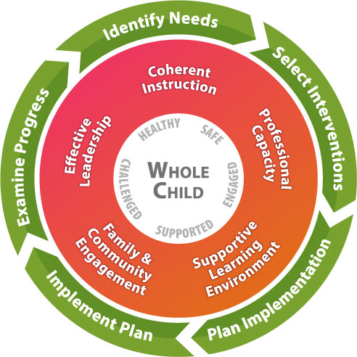
Georgia’s Systems for Continuous Improvement

Slide 10
Why a comprehensive approach?
Effectiveness will hinge on collaborative approaches
Budgets will include several funding streams for strategic priorities
Monitoring will be essential to success!

Slide 11
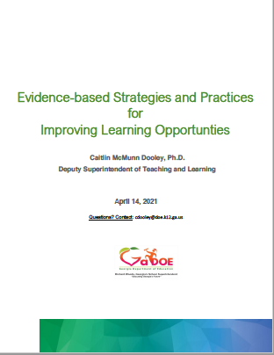

Slide 12
Q & A

