Slide 1

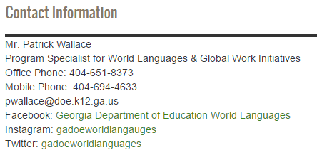
Richard Woods, Georgia’s School Superintendent
“Educating Georgia’s Future”
gadoe.org
Georgia’s Seal of Biliteracy
Mr. Patrick Wallace
Program Specialist: World Languages &
Global Workforce Initiatives
pwallace@doe.k12.ga.us
Facebook: Georgia Department of Education World Languages
Instagram: gadoeworldlanguages
Twitter: gadoeworldlang

Slide 2
What is a Seal of Biliteracy?
The Seal of Biliteracy is an award made by the state to recognize a student who has attained proficiency in both English and one or more other world languages by high school graduation.
The Seal of Biliteracy takes the form of a seal on the diploma and/or a notation that appears on the transcript of the graduating senior.
It is a statement of accomplishment that helps to signal evidence of a student’s readiness for career and college, and to engage as a global citizen.

Slide 3
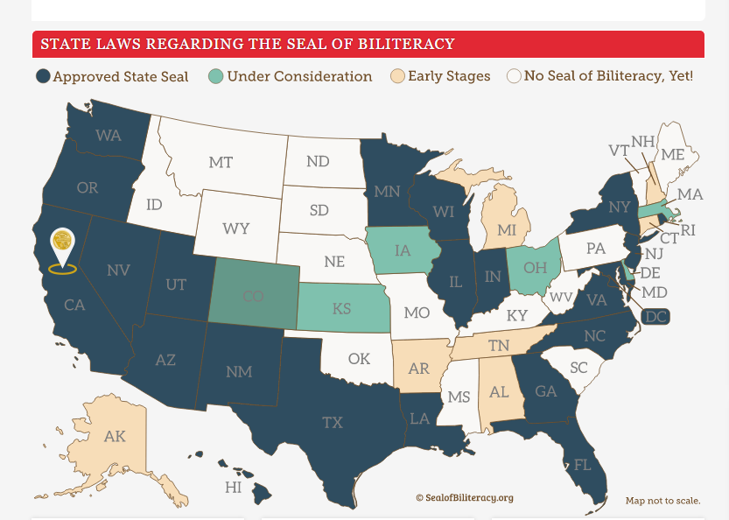
States with Seals of Biliteracy
22 states have passed a Seal of Biliteracy.

Slide 4






Why a Seal of Biliteracy?
Language learners
Bilingual students
Intercultural competence

Slide 5
International Business & World Language Education in Georgia
International Business in GA:
World Languages Offered:
# 1: Germany - 490
# 2: Japan - 402
# 3: UK - 284
# 4: France - 255
# 5: Canada – 230
# 6: Netherlands – 149
# 7: Switzerland – 129
# 8: Sweden - 113
# 1: Spanish – 409,043 students
# 2: French – 81,232 students
# 3: Latin – 17,211 students
# 4: German – 14,767 students
# 5: Chinese – 7,227 students
# 6: Japanese – 1,401 students
# 7: ASL – 1,330 students
# 8: Arabic – 940 students
#9: Portuguese – 708 students
#10: Russian – 168 students

Slide 6
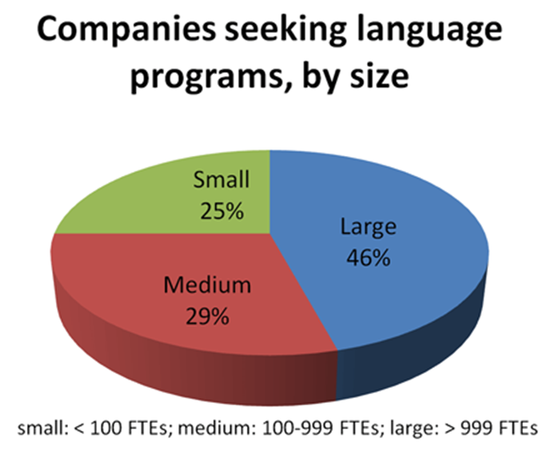
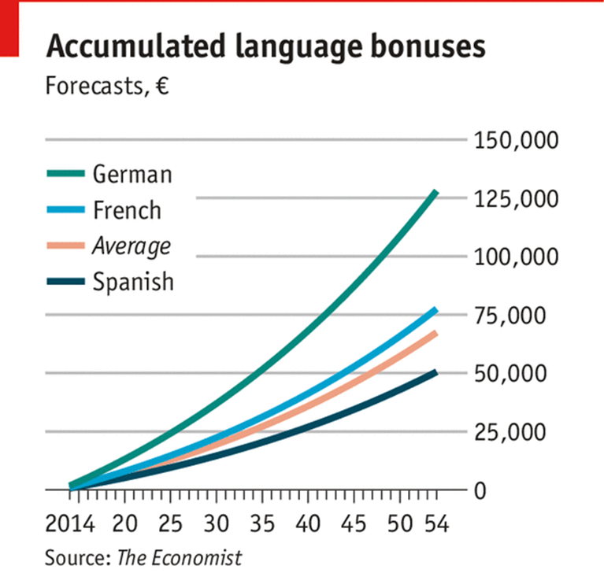

Global Competence is a Job Soft Skill

Slide 7
Requirements for the Seal of Biliteracy
(1) Completion of all English language arts requirements for graduation with an overall grade point average of 3.0 or above in those classes; and
(2) Proficiency in one or more languages other than English, demonstrated by passing a foreign language advanced placement examination with a score of 4 or higher or an international baccalaureate examination with a score of 5 or higher; provided, however, that for languages in which an advanced placement examination is not available, the Department of Education may provide a listing of equivalent summative examinations that local school systems may use in place of such an advanced placement examination.

Slide 8
Districts’ Responsibilities
Georgia’s Seal of Biliteracy will be awarded upon high school graduation. Schools that wish to award the Seal should
designate a contact person at each participating high school that is responsible for
  collecting applications from students in their senior year
  checking the qualifications of applicants, and
  awarding qualified students with the Seal
  reporting students that were awarded the Seal to GaDOE through data collection
The Seal may be added to the high school diploma or transcript as well as displayed on a certificate or medal awarded to the student.
The Seal may be noted on the high school transcript as this is the credential that is viewed by colleges and universities and future employers.
Districts and schools are encouraged to make the awarding of Georgia’s Seal of Biliteracy a prominent component at graduation and any senior award ceremonies.

Slide 9
Who Qualifies
ALL Georgia public school students are eligible to attain Georgia’s Seal of Biliteracy based on evidence of achieving the required level of language proficiency in English plus one or more other languages during their high school years.
To obtain this Seal, students must demonstrate the determined level of proficiency in English, as well as one or more additional languages, be that language a native language, a heritage language, or a language learned in school or another setting.
Some components for Georgia’s Seal of Biliteracy may be completed prior to high school for some students (as with dual language immersion programs, English learners, and other populations). The focus is on achieving the level of proficiency required for English and the level of proficiency required for one or more other languages.

Slide 10
Who will check that students have met the required qualifications for the Seal of Biliteracy?
Schools and districts will develop procedures locally to determine who at the school level will be responsible for verifying the qualifications of interested students and keeping records of qualifications for each student that is awarded the Seal.
Records should be kept on accepted local and state retention schedule.

Slide 11
How will schools award the Seal of Biliteracy if AP and IB scores are not reported back until July?
Many students may not take the AP World Language exam or IB exam until their senior year in high school and then will have the scores reported after graduation in July. The Seal of Biliteracy can be awarded retroactively if the required scores have been met [a minimum score of 4 on the AP World Language exam and a minimum score of 5 on an IB Diploma Program Language B exam (Standard Level or Higher Level; excluding ab initio)].

Slide 12
How will schools obtain the actual seals?
By May 1 of each school year, senior counselors should contact the Program Specialist for World Languages at GaDOE, Mr. Patrick Wallace pwallace@doe.k12.ga.us, and request the number of seals required at graduation. (A copy of the report sheet is available on our website) The number must match the number indicated in data reporting.
For students that take the AP or IB World Language exam in their senior year, please request the Seal by September 1 of the same year that the exam was taken. Seals will be mailed to the school.

Slide 13
What IB exams will count for the Seal of Biliteracy?
All diploma program Language B exams (Standard and Higher Level); ab initio exams will not count towards the Seal of Biliteracy.
In order to qualify for the Seal of Biliteracy, students need to have a minimum score of 5 on the SL or HL Language B exam.

Slide 14
Can ASL and Latin students apply for the Seal of Biliteracy?
Yes. Due to unique characteristics of certain languages, special allowances will be made: in cases where language assessments across all three modes of communication defined by ACTFL (interpersonal, interpretive and presentational) may not be appropriate or available, the Georgia Department of Education reserves the right to accept a different assessment that meets the spirit of Georgia’s Seal of Biliteracy.
Students seeking the Seal through languages not characterized by the use of listening, speaking, reading, or for which there is not a writing system, will demonstrate the expected level of proficiency on an assessment of the modalities that characterize communication in that language.

Slide 15
Who will pay for the proficiency exams?
Districts and schools are encouraged to investigate all possible funding sources, e.g., federal funds, grants, local funding sources, etc. Districts will determine the source of funding for proficiency testing of students.

Slide 16
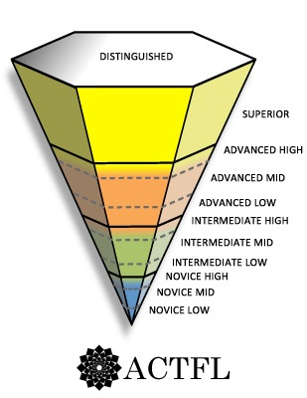
What proficiency level do students need to demonstrate?
The minimum target level should be Intermediate High based on the ACTFL Proficiency Guidelines.
For many languages, including English, specific assessments exist and provide a valid and reliable means of measuring students’ language proficiency. The evidence needs to evaluate students’ use of the language, not knowledge about the language.

Slide 17
When and how do students learn about the Seal of Biliteracy?
Counselors should provide all students and their families information on Georgia’s Seal of Biliteracy upon entering middle and high school settings so that students are able to organize their schedules and meet the requirements necessary to receive this honor.

Slide 18

Chart of approved proficiency exams that meet the minimum requirement
for Georgia’s seal of biliteracy
Please see the table below for approved proficiency exams and required minimum scores or proficiency levels. Please contact the Program Specialist for World Languages, Mr. Patrick Wallace at pwallace@doe.k12.ga.us, to inquire about languages that are not listed.
Further clarification on these tests can be found on the GaDOE Website for the Seal of Biliteracy
 | Test Name | Testing Organization | Minimum Qualifying Score
Tier 1 | AP Language Exams SL or HL Language B exam | College Board International Baccalaureate | 4 5 (SL or HL only)
Tier 2 (When Tier 1 test are not available at the school for tested language) | OPI,RPT, WPT or OPIc STAMP Test ACTFL - (AAPPL) ACTFL – (ALIRA) - Latin DELE – Spanish DSD – German DELF – French Youth Chinese Test (YCT) HSK – Chinese SLPI – ASL TOPIK - Korean | Language Testing International Avant-STAMP 4S Assessments Language Testing International Language Testing International Cervantes Institute German Educational Ministers Office International Centre for French Studies Hanban Hanban National Technical Institute for the Deaf National Inst. Internatl. Education (NIIED) | Intermediate High 6 Intermediate High Intermediate 4 B1 DSD Level 1 Level B1 Level 3 Level 3 Intermediate Plus 4

Slide 19
Dual Language Immersion (DLI) in Georgia
2013-2014 = 3 schools
2015-2016 = 19 schools
2016-2017 = 38 schools
2017-2018 = ??? >>>

Slide 20

The Georgia DLI Model
50/50
each child =
1 immersion language teacher + 1 English partner teacher
separation of languages

Slide 21

Benefits of DLI
Second Language Skills: DLI students achieve higher proficiency in the second language than with traditional Foreign Language instruction.
Cognitive Skills: DLI students typically develop greater cognitive flexibility, demonstrating increased attention and memory, superior problem-solving skills as well as an enhanced understanding of their primary language.
Performance on Standardized Tests: DLI students perform as well as or better than English-only students on standardized tests in English, including students from a range of socioeconomic and ethnic backgrounds, as well as with diverse cognitive and linguistic abilities.
Intercultural Competency: DLI students are more aware of and generally show more positive attitudes towards other cultures and an appreciation of other people.
Long-Term Benefits: DLI students are better prepared for the global community and job markets in the 21st century.
Higher Attendance-Rates and Fewer Drop-Outs: Students from DLI programs have higher attendance rates and lower drop-out rates compared to regular programs.

Slide 22

Program Goals
Proficiency in English
Proficiency in a new language
Academic achievement
Intercultural competence

Slide 23

Questions?

Slide 24
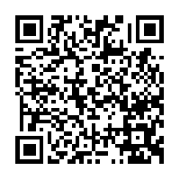
Presenter Survey
The Georgia Department of Education believes in continuous improvement and would appreciate your feedback to ensure the presentations we provide are of the highest quality and meet the needs of the specific audience. Access the QR code below to take the survey on your phone or tablet. All responses are anonymous.
http://www.gadoe.org/External-Affairs-and-Policy/communications/Pages/surveys/CI-3WVZ6RW.aspx

