Slide 1
Changes in the Science Standards and Professional Learning Plan
Dr. Juan-Carlos Aguilar
Science Program Manager
Georgia Department of Education
Mr. Kenneth Linsley
Science Program Specialist
Georgia Department of Education

Slide 2
A Series of Webinars for School Leaders
Date | Webinar
Aug. 18, 2016 | Highlights of Changes and Professional Learning Plan https://attendee.gotowebinar.com/register/8932206341082294275
Oct. 13, 2016 | Understanding Instruction Under the New Science GSE https://attendee.gotowebinar.com/register/8238264970374426115
Nov. 15, 2016 | Making Thinking Visible, A Way to Assess Science Learning https://attendee.gotowebinar.com/register/5987578961968194819
Dec. 12, 2016 | Addressing Differentiation In The Science Classroom https://attendee.gotowebinar.com/register/5943492943740955139
Jan. 18, 2017 | Universal Design for Learning Supporting Science Instruction https://attendee.gotowebinar.com/register/3134890546145352707

Slide 3
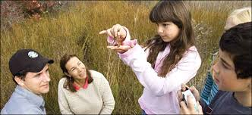
Vision of Science Education
A vision of science education in which all students’ experiences over multiple years foster progressively deeper understanding of science.
Students actively engage in scientific and engineering practices in order to deepen their understanding of crosscutting concepts and disciplinary core ideas.
In order to achieve the vision embodied in the standards and to best support students’ learning, all three dimensions should to be integrated into the system of standards, curriculum, instruction, and assessment.
NRC Framework Page 217

Slide 4
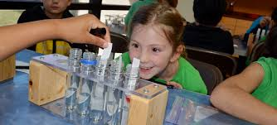
Vision for Students
“In the past, standards focused on students knowing core ideas(concepts); the new vision is for students to use core ideas to support science performances. Moving from students knowing what and that to understanding how and why is central to the new vision.”
Moulding, B. D., Bybee, R. W., & Paulson, N. (2015). A Vision and Plan for Science Teaching and Learning. Essential Teaching and Learning Publications.

Slide 5
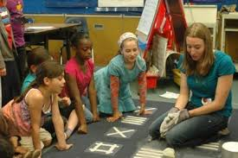
Vision for Science Teaching
To a greater focus on the practices of scientists and engineers embedded with the core science ideas(concepts)
To instruction that engages students in making sense of the interconnection across all disciplines of science as well as mathematics and language arts (http://stemteachingtools.org/brief/1)

Slide 6
Science Georgia Standards of Excellence
Kindergarten - 8th grade
Biology
Chemistry
Earth Systems
Environmental Science
Physical Science
Physics
K-5 standards address physical science, life science, and Earth and space science at each grade level.
6-8 standards are divided by scientific discipline
Earth and space science in sixth grade
Life science in seventh grade
Physical science in eighth grade

Slide 7
Major Changes to the Standards
Characteristics of science and nature of science standards have been embedded in the content standards.
Content was modified when appropriate to bring it up to date with current scientific knowledge.
Wording in the standards have been modified in some cases to reflect the following suggested changes:
increase of rigor
additional clarification
A few standards or elements were moved to a different grade level in response to survey data.
Included elements that addressed engineering practices (e.g. the engineer design process)
Use of “obtain, evaluate, and communicate information to” as a lead in to each standard.
Use of color coding to enhance clarity of connections between the standard and the supporting elements.

Slide 8
From
To
Students will
Obtaining, evaluating, and communicating information to
Understand
Be familiar with
Differentiate between
Analyze
Investigate
Demonstrate relations
Design and construct a device
Model
Plan and carry out investigations
Ask questions
Interpret data to make predictions
Construct explanations

Slide 9
Science Georgia Performance Standards
S6E2. Students will understand the effects of the relative positions of the earth, moon and sun.
Demonstrate the phases of the moon by showing the alignment of the earth, moon, and sun.
Explain the alignment of the earth, moon, and sun during solar and lunar eclipses.
c. Relate the tilt of the earth to the distribution of sunlight throughout the year and its effect on climate.
How?

Slide 10
Sixth Grade – Earth Science Georgia Standards of Excellence
S6E2. Obtain, evaluate, and communicate information about the effects of the relative positions of the sun, Earth, and moon.
Develop and use a model to demonstrate the phases of the moon by showing the relative positions of the sun, Earth, and moon.
Construct an explanation of the alignment of the sun, Earth, and moon during solar and lunar eclipses.
c. Analyze and interpret data to relate the tilt of the Earth to the distribution of sunlight throughout the year and its effect on seasons.

Slide 11
Science Georgia Performance Standards Biology
SB3. Students will derive the relationship between single-celled and multi-celled organisms and the increasing complexity of systems.
Explain the cycling of energy through the processes of photosynthesis and respiration.
Compare how structures and function vary between the six kingdoms (archaebacteria, eubacteria, protists, fungi, plants, and animals)
Examine the evolutionary basis of modern classification systems.
Compare and contrast viruses with living organisms.

Slide 12
Georgia Standards of Excellence Biology
SB4. Obtain, evaluate, and communicate information to illustrate the organization of interacting systems within single-celled and multi-celled organisms.
Construct an argument supported by scientific information to explain patterns in structures and function among clades of organisms, including the origin of eukaryotes by endosymbiosis. Clades should include archaea, bacteria, eukaryotes, fungi, plants, and animals.
(Clarification statement: This is reflective of 21st century classification schemes and nested hierarchy of clades and is intended to develop a foundation for comparing major groups of organisms. The term 'protist' is useful in describing those eukaryotes that are not within the animal, fungal or plant clades but the term does not describe a well-defined clade or a natural taxonomic group.
Analyze and interpret data to develop models (i.e., cladograms and phylogenetic trees) based on patterns of common ancestry and the theory of evolution to determine relationships among major groups of organisms.
Construct an argument supported by empirical evidence to compare and contrast the characteristics of viruses and organisms.

Slide 13
Science Professional Learning Goals
Provide teachers with the core disciplinary content knowledge needed to support student learning
Provide teachers with the appropriate tools (i.e., instructional and assessment strategies) that will facilitate student learning
Provide teachers with skills to develop a culturally diverse curriculum that makes knowledge accessible to a broader section of the student population
Provide administrators in charge of supervising science teachers with the tools to identify and value “good science practices” and provide the needed support when necessary.

Slide 14
Science Professional Learning First Phase – Science Ambassador Program
The first phase of the professional development model calls for the formation of a cadre of science educators, the Science Ambassadors.
Science Ambassadors’ goals
To provide local professional development in their regions based on local needs
To support state wide professional development institutes in the summer of 2017 and 2018
Preparation
This group will participate in a four-day professional development workshop between May 2016 and November 2016. These workshops will
provide a deep understanding of science instruction that integrates practices, content knowledge, and crosscutting concepts as described in the Science Georgia Standards of Excellence.
provide preparation and the necessary tools for the Science Ambassadors to conduct their own professional development programs.

Slide 15
Science Professional Learning First Phase – Science Ambassador Program
RESAs | Number of Science Ambassadors | Number of School Systems in RESA
Central Savannah River | 23 | 12
Northwest Georgia | 11 | 16
North Georgia | 12 | 6
Pioneer | 33 | 15
Metro | 72 | 15
Northeast Georgia | 13 | 13
West Georgia | 21 | 8
Griffin | 28 | 8
Middle Georgia | 22 | 8
Oconee | 5 | 6
Chattahoochee-Flint | 13 | 15
Heart of Georgia | 5 | 10
First District | 16 | 18
Southwest Georgia | 21 | 15
Coastal Plains | 16 | 12
Okefenokee | 6 | 8
Organizations | # of Science Ambassadors
Non-Formal | 1
University | 6
GYSTC | 8
DJJ | 3
Atlanta International School | 1
International Charter School of Atlanta | 1
State Charter School | 1
Professional Development Provider | 1
Based on funding and space availability we were able to support 335 participants, instead of the original maximum number of 130.

Slide 16
Science Professional Learning First Phase – Online Component
Dissemination and Support
This series of four workshops will be videotaped and edited to create an online professional development series that will be placed on the Georgia Virtual School (GAVS) platform, the Georgiastandards.org site, and the Teacher Resources Link (TRL) so teachers can access on their own time at home or within a professional learning community at their school.
The videos will also function as professional learning resources that will be easily available to the Science Ambassadors to use to support professional learning events they may conduct independent of the Georgia Department of Education.

Slide 17
Science Professional Learning Second Phase - Pending Funding
Face-to-face professional development will be provided to teachers at each one of the RESA regions using a similar model as the one used to support Mathematics and English Language Arts teachers. These will include three-day academies during the summer.
During the summer of 2017, the academy will focus on enhancing understanding of the changes that have taken place in the standards and building familiarity with vertical articulation of concepts and practices.
Four online professional learning sessions will be conducted during the 2017-2018 school year, two in the fall of 2017 and two in the winter/spring of 2018 to reinforce the work done during the summer academies.
During the summer of 2018, the academy will focus on the resources developed to support teachers. The resources will include exemplary lesson frameworks, sample videos illustrating good instructional practices, and assessment exemplars (both formative and summative) as well as online resources yet to be identified. The academy will also include building familiarity with the TRL and the resources already tagged.

Slide 18
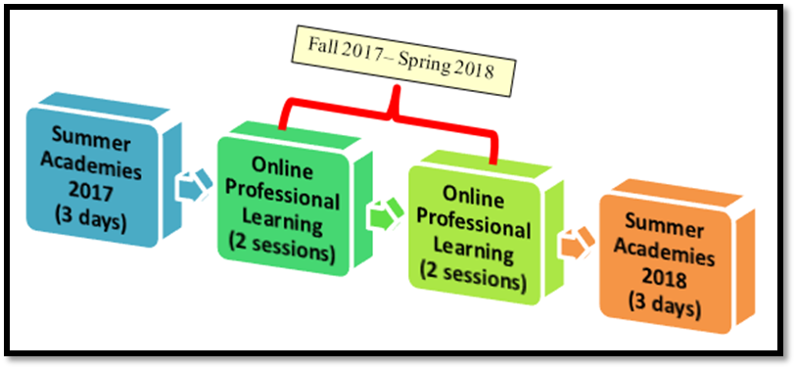
Science Professional Learning Second Phase - Pending Funding
The summer academies will offer a K-5, a Middle School, and a High School section at each RESA region. Each section will be co-presented by two Science Ambassadors. The online sessions will be led by Georgia Department of Education staff.

Slide 19
What are key questions leaders should consider during implementation?
What kind of professional development is available and how do I ensure my teachers and I have access to it?
How do I know if it’s high quality?
What GSE-aligned instructional materials do my teachers and students need and how do I make sure they get them?
How do I know if the materials are high quality?
What formative assessments are available to help teachers continually evaluate their students’ learning?
How can we connect the GSE with work we are doing to improve teaching and learning in English language arts and mathematics?

Slide 20
Coming Soon!
Standards to be implemented beginning with the 2017-2018 school year.
Assessments will be modified accordingly and the 2017-2018 school year fifth grade, eighth grade EOG and high school EOC will be based on the Science Georgia Standards of Excellence.
Resources will be developed during the spring/summer of 2017 and will be available for the beginning of the 2017-2018 school year.
New item bank is being developed to support the creation of a system of assessments that can be used by teachers as part of their formative assessment strategies.
Science Academies will take place around each RESA region in the summer of 2017 and the summer of 2018.

Slide 21
Available Resources
Georgia Department of Education
http://www.georgiastandards.org
Georgia Science Teacher Association
http://www.georgiascienceteacher.org
Northeast Georgia RESA Science
http://www.negaresa.org/science
K-12 Framework for Science Education
http://www.nap.edu/catalog/13165/a-framework-for-k-12-science-education-practices-crosscutting-concepts
Ready, Set, Science!
http://www.nap.edu/catalog/11882/ready-set-science-putting-research-to-work-in-k-8

Slide 22
Contact Information
Dr. Juan-Carlos Aguilar Mr. Kenneth Linsley
jaguilar@doe.k12.ga.us klinsley@doe.k12.ga.us
(404) 657-9072 (office) or (404) 516-1089 (Cell) (404) 657-0182 (office)
Curriculum and Instruction: http://gadoe.org/surveys/CI-3WVZ6RW

