Slide 1
Striving Reader Fluid Review Technical Assistance Session
The Striving Readers Comprehensive Literacy Grant funding is intended to improve reading performance of students from birth through grade twelve.

Slide 2
What is Fluid Review?
Fluid Review is an online data management system that will allow us to do all of our grant development and management in one location.
It allows us to set up work flow so that you will upload and manage your grant development and then we will manage the review.
Applications must be submitted in Fluid Review by 5:00 PM on December 13th

Slide 3
Creating a District Account
As the district administrator, you will set up the district account and develop the district profile

Slide 4
To Create your District Account: https://gastrivingreader13.fluidreview.com/
If you do not have an account, click on Sign Up under Need an Account? and follow the on screen prompts

Slide 5
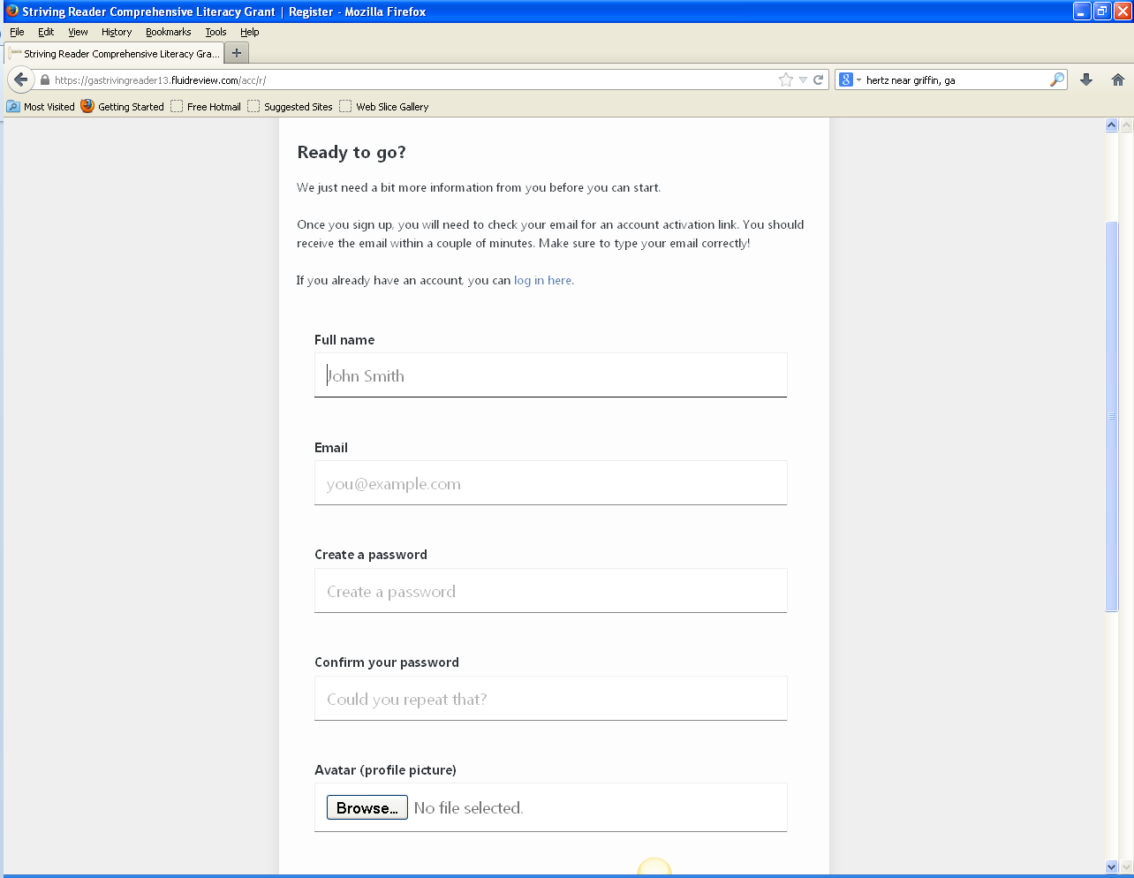
Ready to go?
You will use your district email address to set up the district account
Your password must be at least 8 characters in length

Slide 6
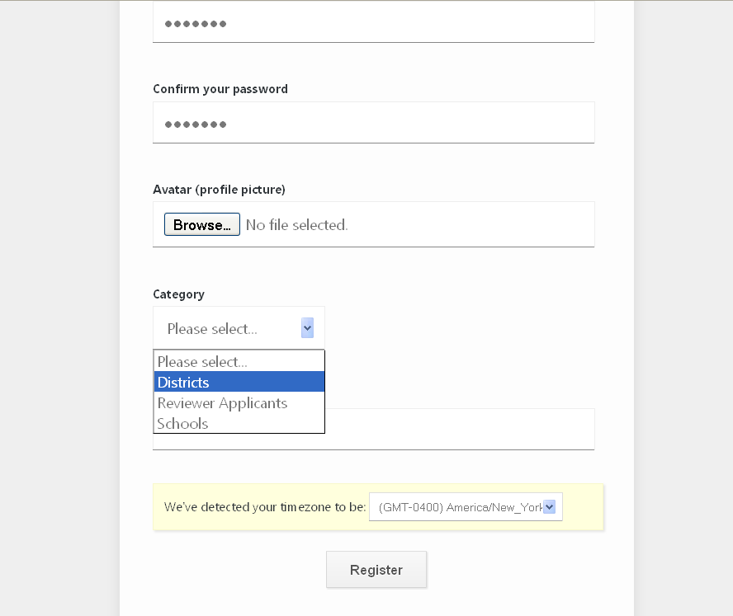
Click on the “Category” drop down and choose Districts

Slide 7
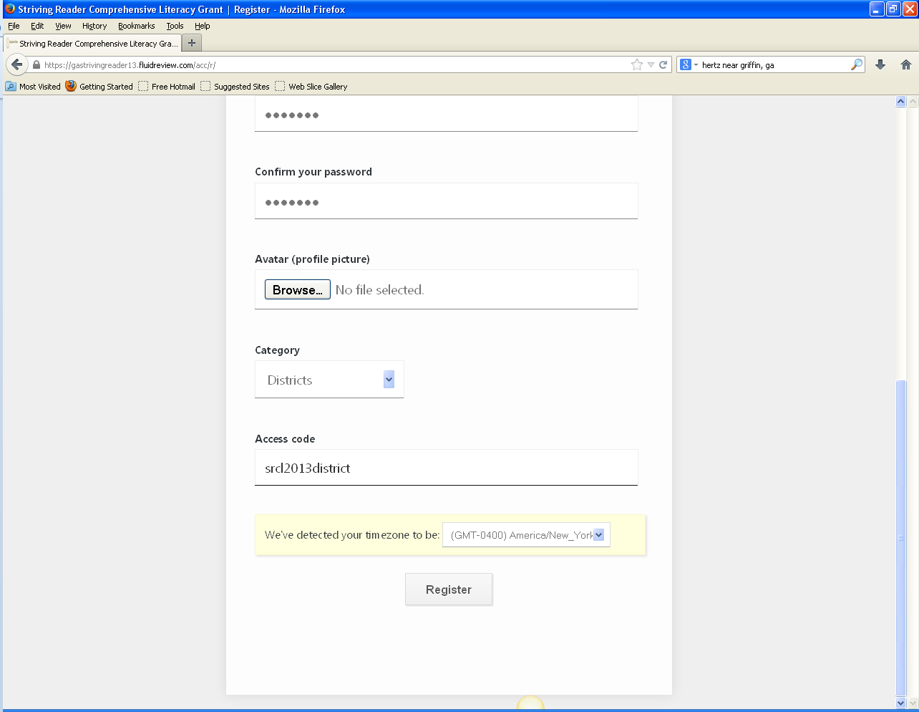
The District Access code is: srcl2013district
(it is case sensitive, no spaces):
Once you have filled out the sections and filled in the appropriate access code, click on Register

Slide 8
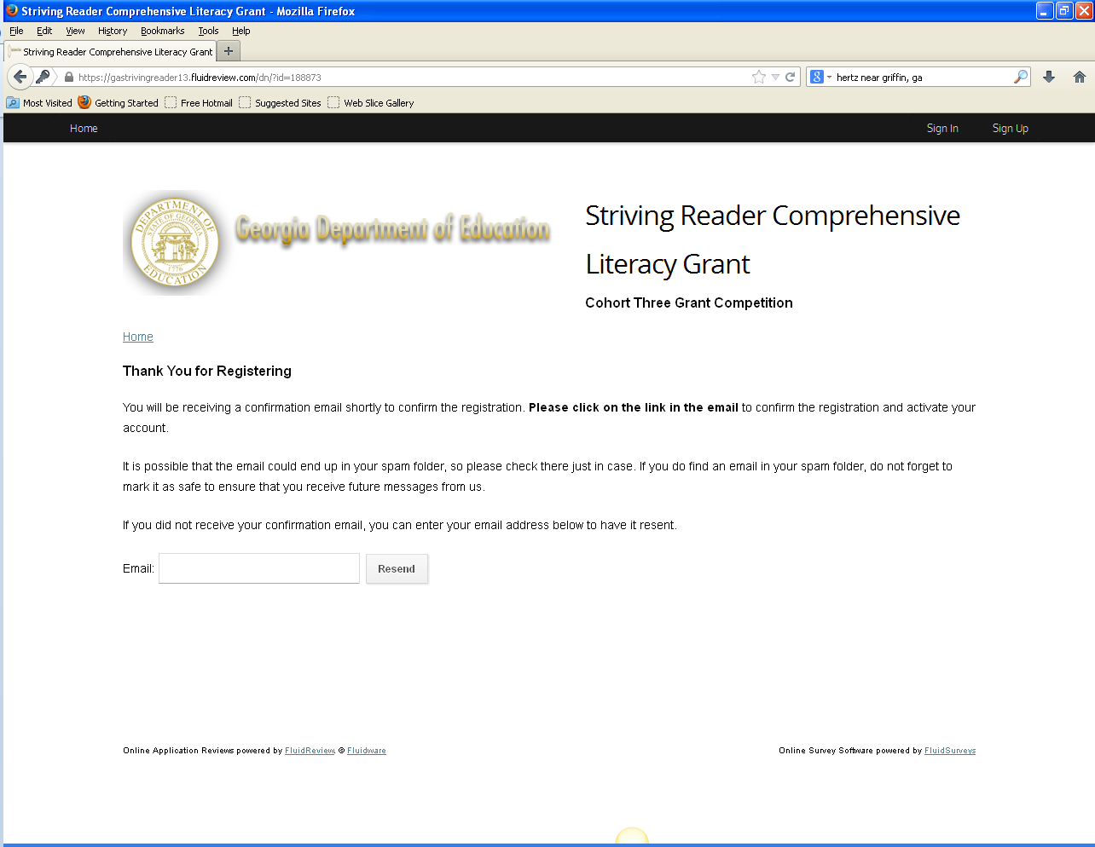
Once the registration process is complete you will be prompted to check your email to find the link to activate your account

Slide 10
Troubleshooting
It can take anywhere from a few seconds to a few minutes for you to receive the email depending on your firewall
Some systems using Microsoft Office have encountered issues receiving the emails from Fluid Review
Make sure your network servers are not blocking emails ending with fluidreview.com or "SRCL Grant Competition" <noreply@fluidreview.com>
Add @fluidreview.com to your white list and check your SPAM folders

Slide 11
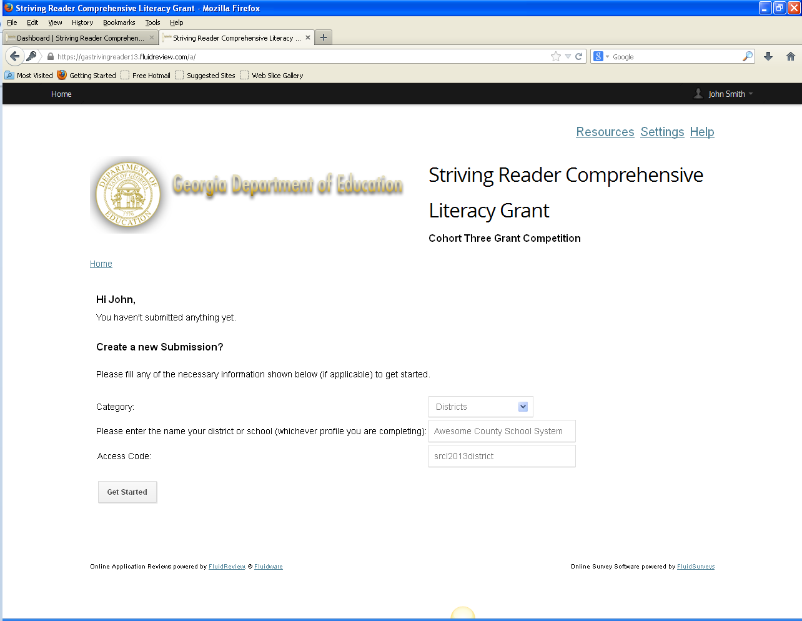
Choose category here
Enter the name of the District here
You will be prompted once again to enter the district access code
Click here to move on

Slide 12
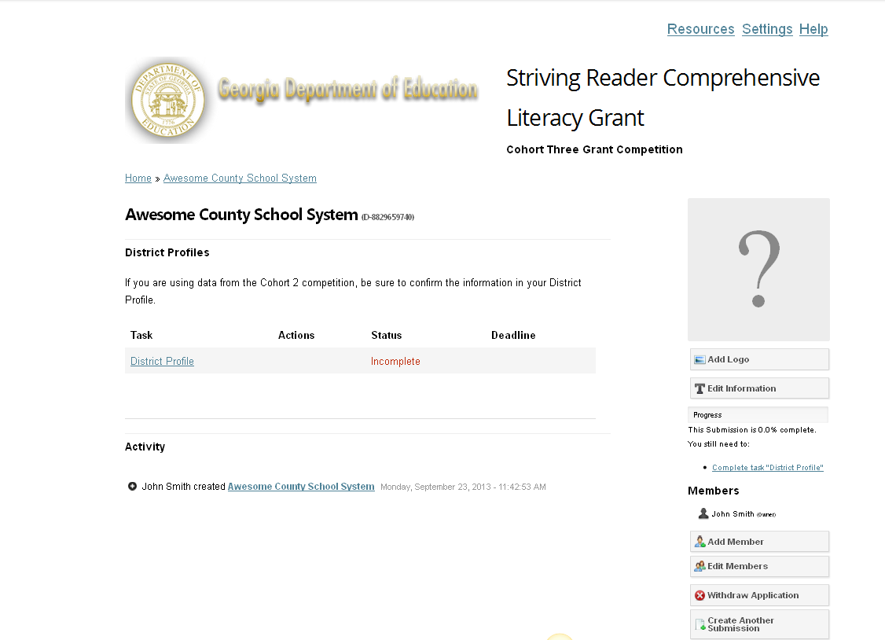
You made it!
All supplemental files can be found here in the Resources tab
Click here to begin filling out the district profile

Slide 13
Completing the District Profile

Slide 14
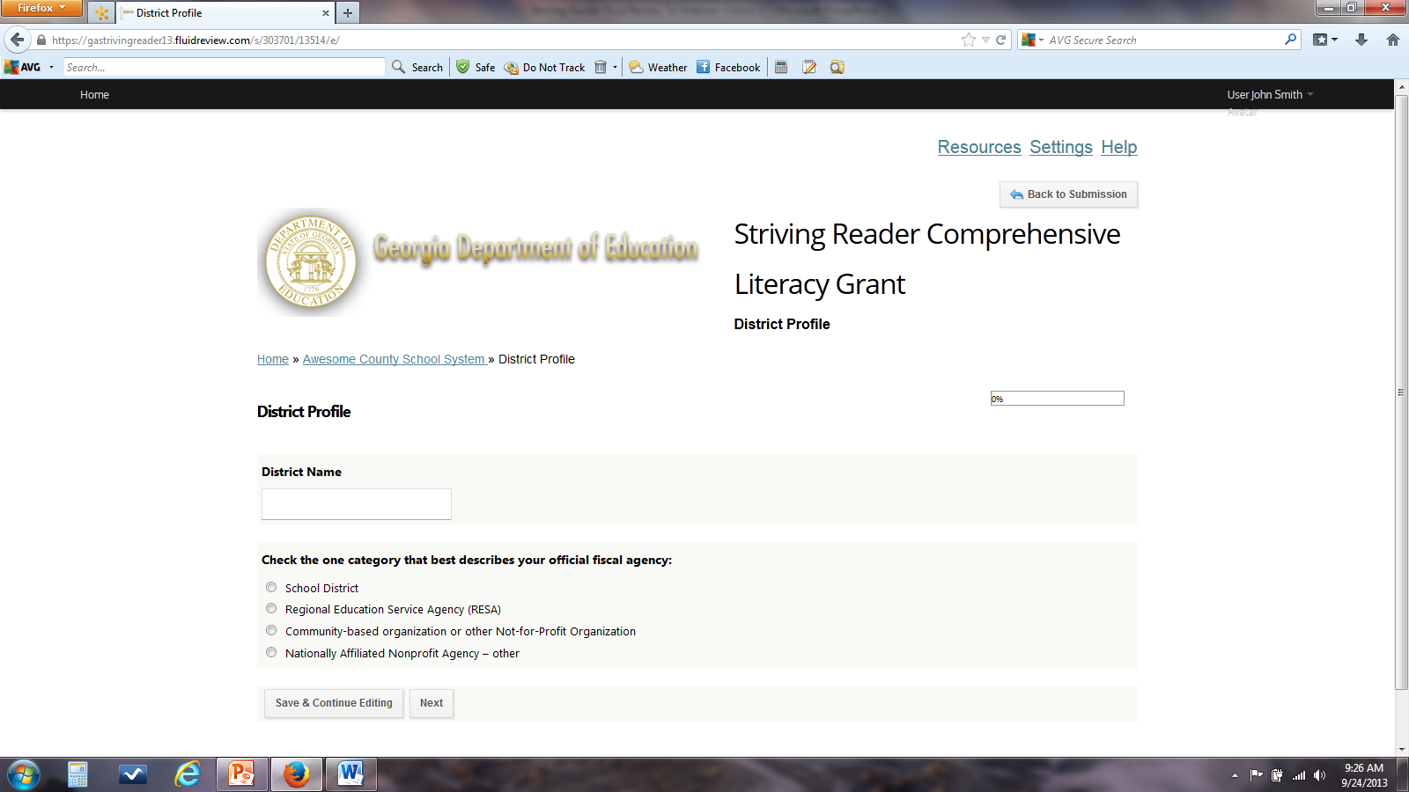
Progress bar
Enter your district name using the name you used to create your account
Choose fiscal agency category
Save and/or continue to the next page

Slide 15
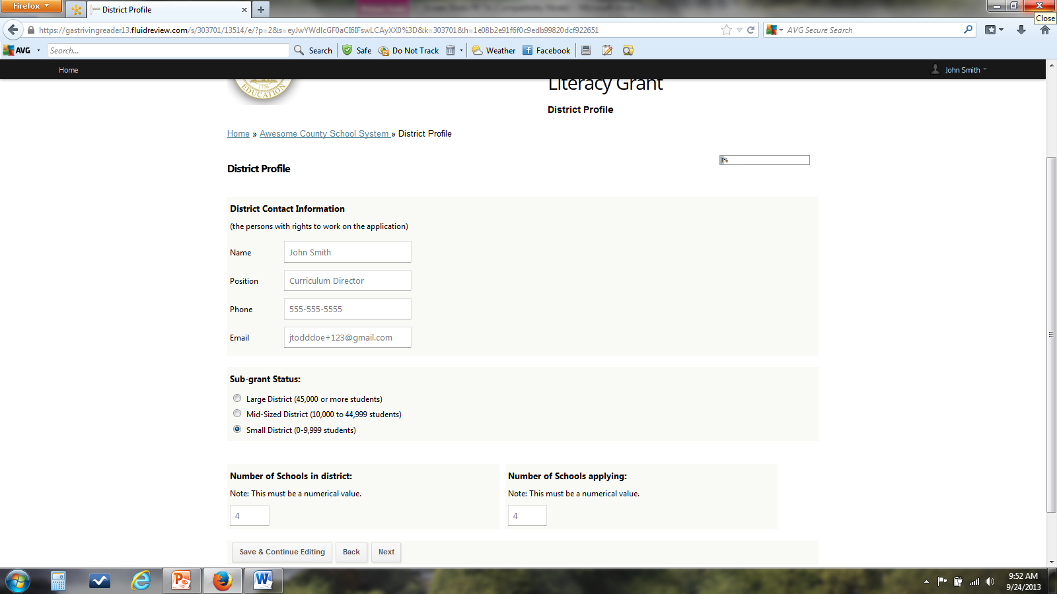
Complete the contact information using the same email address you used to create your account
Enter the # of schools in your district and the # of schools applying.

Slide 16
Each school will develop their own profile, but as the district contact you must pre-populate the school or center that will develop a grant.
You will enter the names of the schools that will be completing applications

Slide 17
Cut/paste the Link and the School Access Code to send to your schools to denote that your district is ready for them to create their school profiles

Slide 19
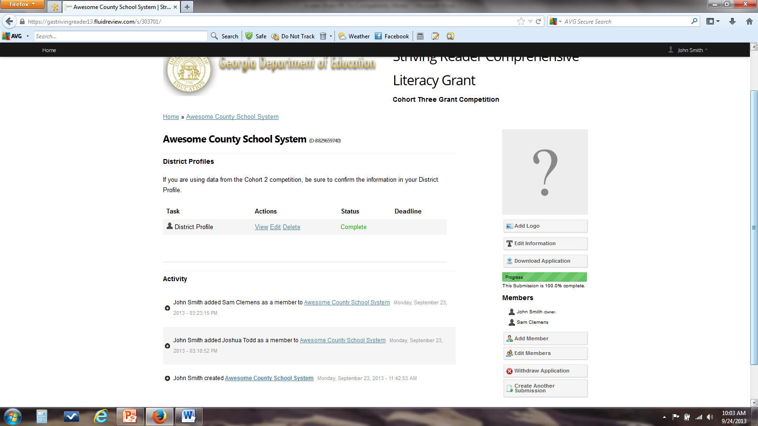
Notice under Status your district profile is now complete
now let’s walk though how to add a member to the district account

Slide 20
Adding a Member to the District Account

Slide 21
You will have three Access Level choices. Each will decrease access to information

Slide 23
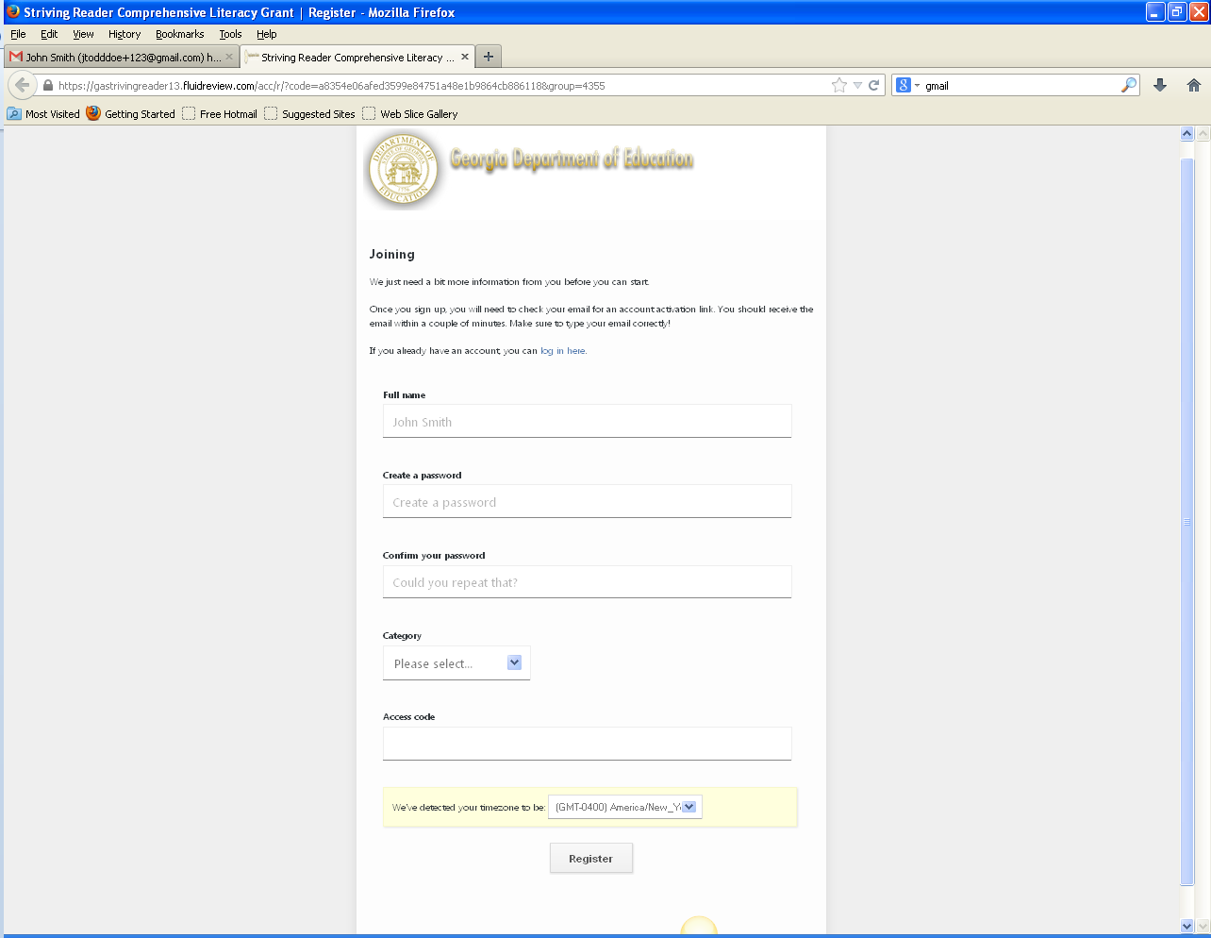
Enter the appropriate information and create a password
Be sure to select District in the Category drop down menu
Enter the District access code: srcl2013district and click Register complete the process

Slide 24
Now what?
After you have created the district profile, sent out the link and password information to schools, and added any members to your district account, you have completed the district profile process
There are several portions of the school application that the district is responsible for writing. We would encourage you to begin working through those parts of the application.
You will have to access the school application through the school accounts, which is why it is important that each school add you as a member

Slide 25
Completing the District Profile: Cohort Two Applicants
The following instructional slides are only for those re-applicants who created district profiles in Fluid Review (Review Room) for the SRCL Cohort Two grant competition

Slide 26
https://gastrivingreader13.fluidreview.com/

Slide 27
Be sure to select District in the Category drop down menu
Enter the name of your school district and then click “Get Started”

Slide 28
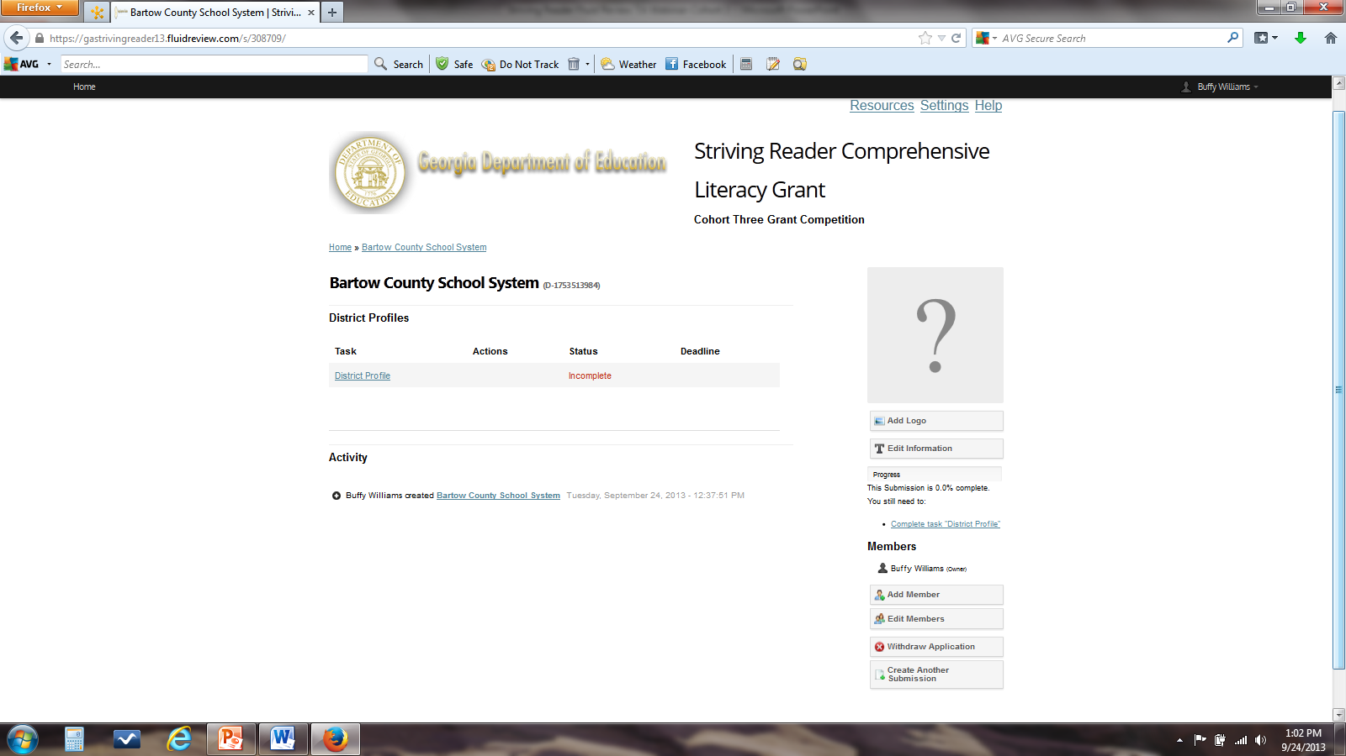
Click here to begin filling out the district profile
Add members here
Follow the instructions provided in slides 13-24 to complete the district profile and add members

Slide 29
Creating a School Account
As the school administrator, you will set up the school account and develop the school profile. At this point you should have received the email from your district administrator signaling that you should begin the school profile process

Slide 30
To Create your School Account: https://gastrivingreader13.fluidreview.com/
If you do not have an account, click on Sign Up under Need an Account? and follow the on screen prompts

Slide 31
Ready to go?
You will use your school email address to set up the school account
Your password must be at least 8 characters in length

Slide 32
Click on the “Category” drop down and choose Schools

Slide 33
The School Access code is: srcl2013school
(it is case sensitive, no spaces):
Once you have completed the sections and filled in the appropriate access code, click on Register

Slide 34
Once the registration process is complete you will be prompted to check your email to find the link to activate your account

Slide 36
Choose category here
Enter the name of the school here
You will be prompted once again to enter the school access code
Click here to move on

Slide 37
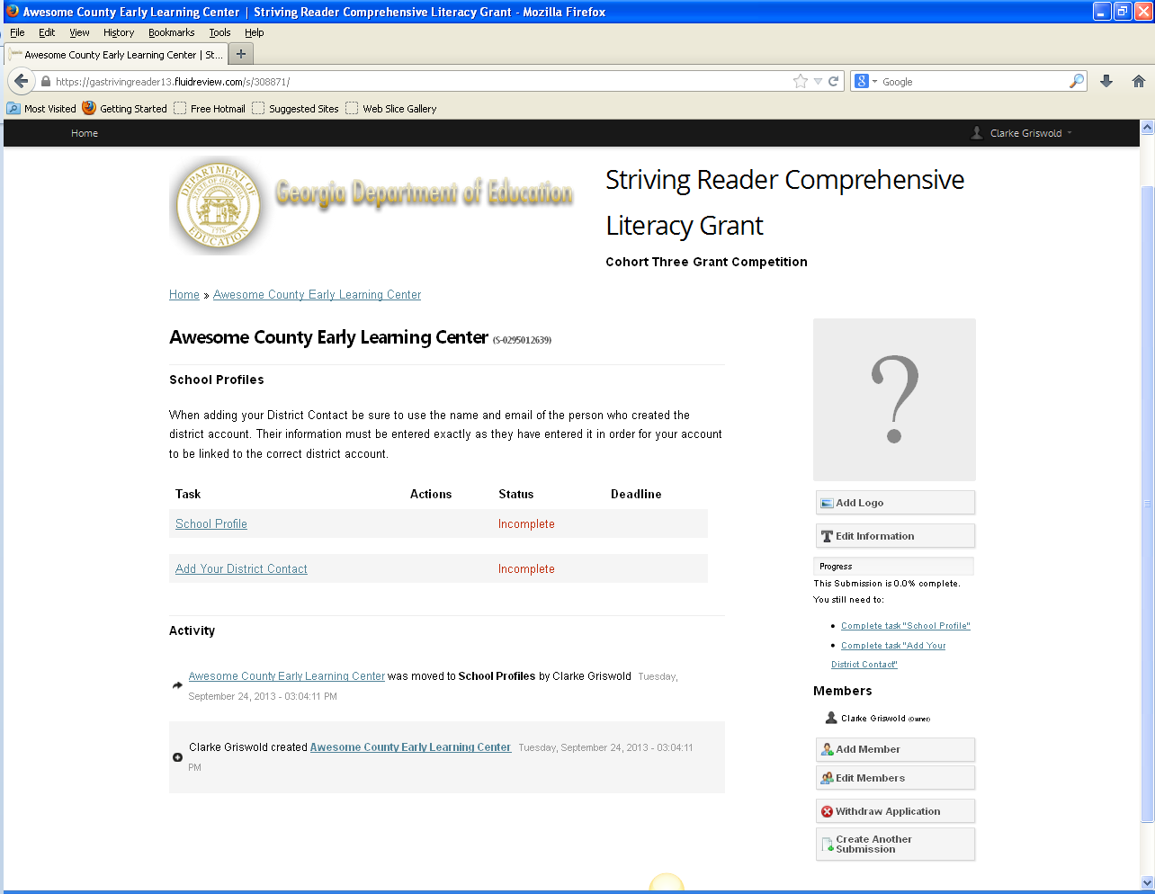
You made it!
Let’s begin with the Add Your District Contact link

Slide 38
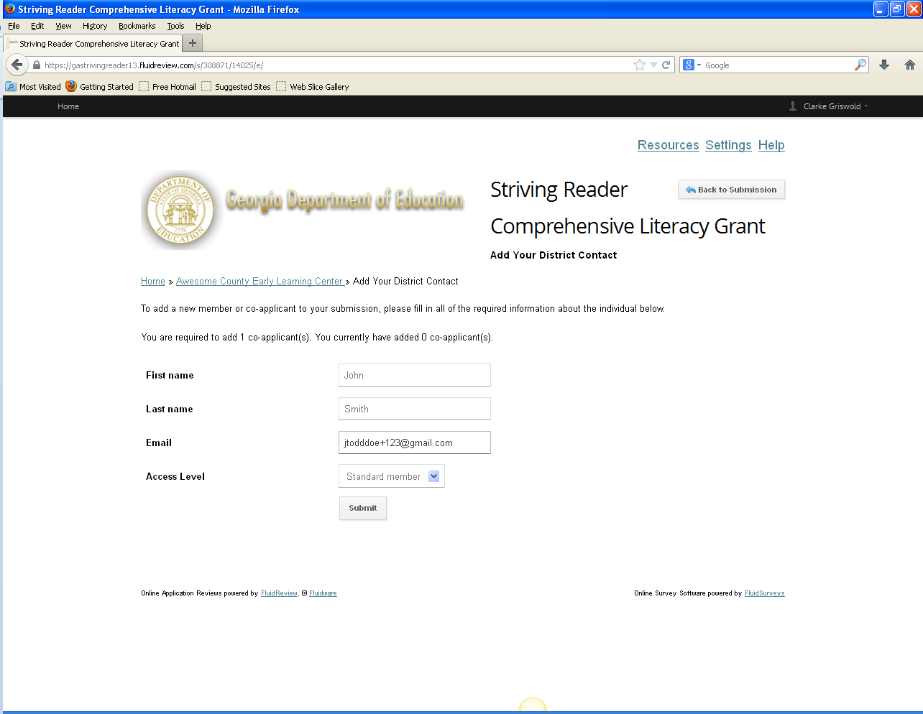
Adding the District Contact
When adding your District Contact be sure to use the name and email of the person who created the district account.
Their information must be entered exactly as they have entered it in order for your account to be linked to the correct district account

Slide 39
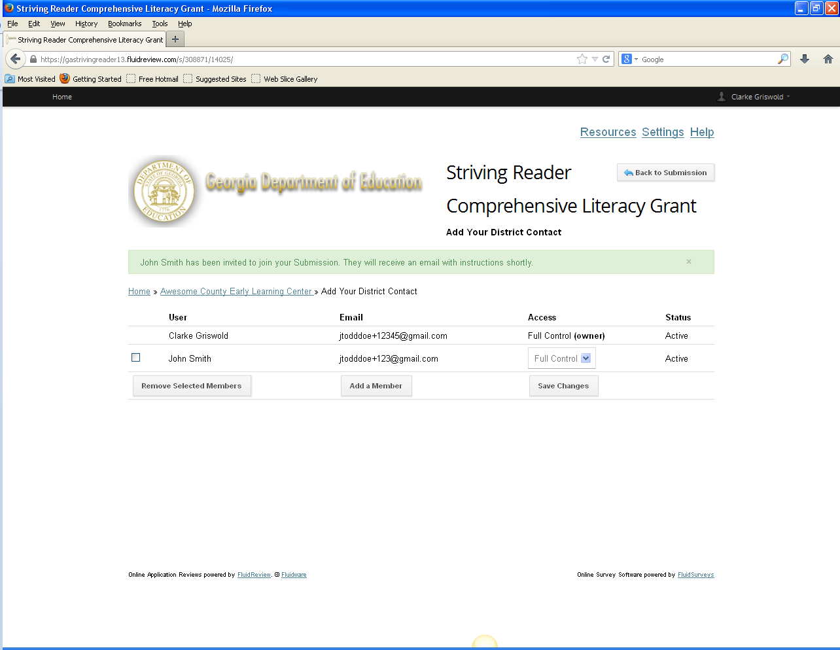
You can adjust the amount of control users have of your school accounts

Slide 40
District contact will receive this email once a school has entered them as a district contact

Slide 41
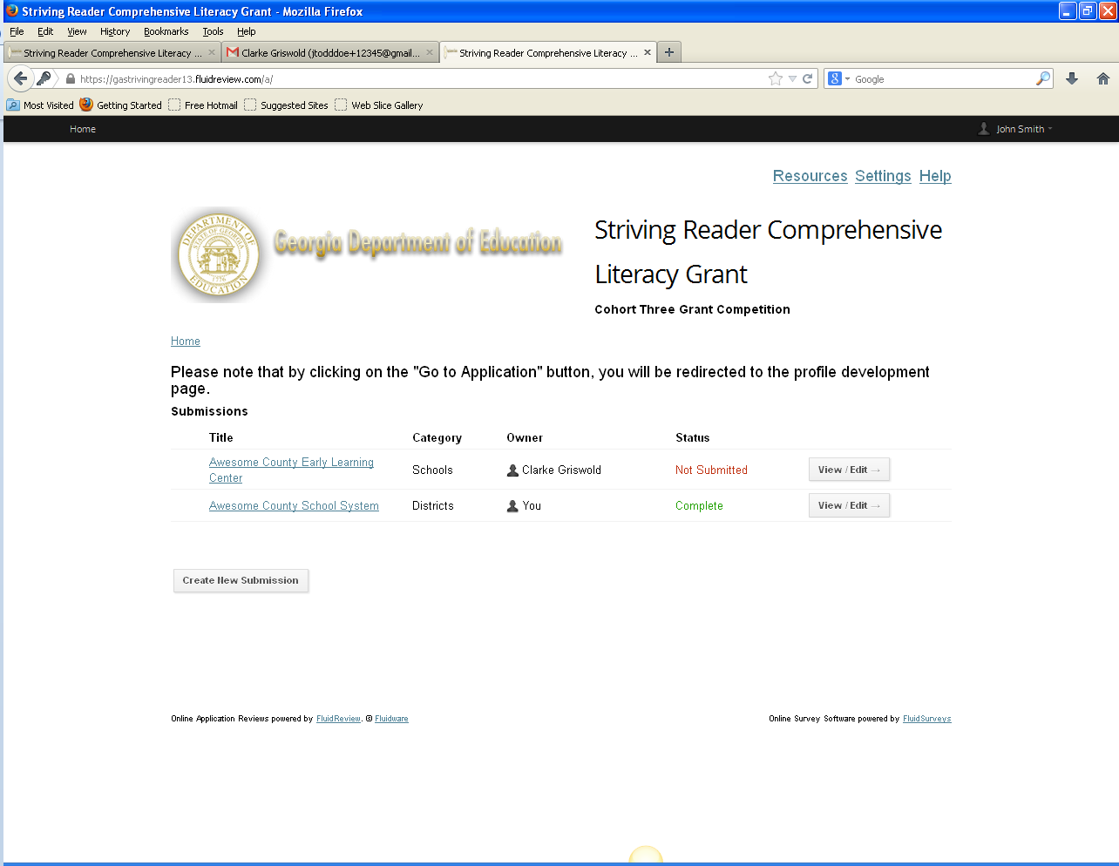
View when District contact logs in after being added to a school

Slide 42
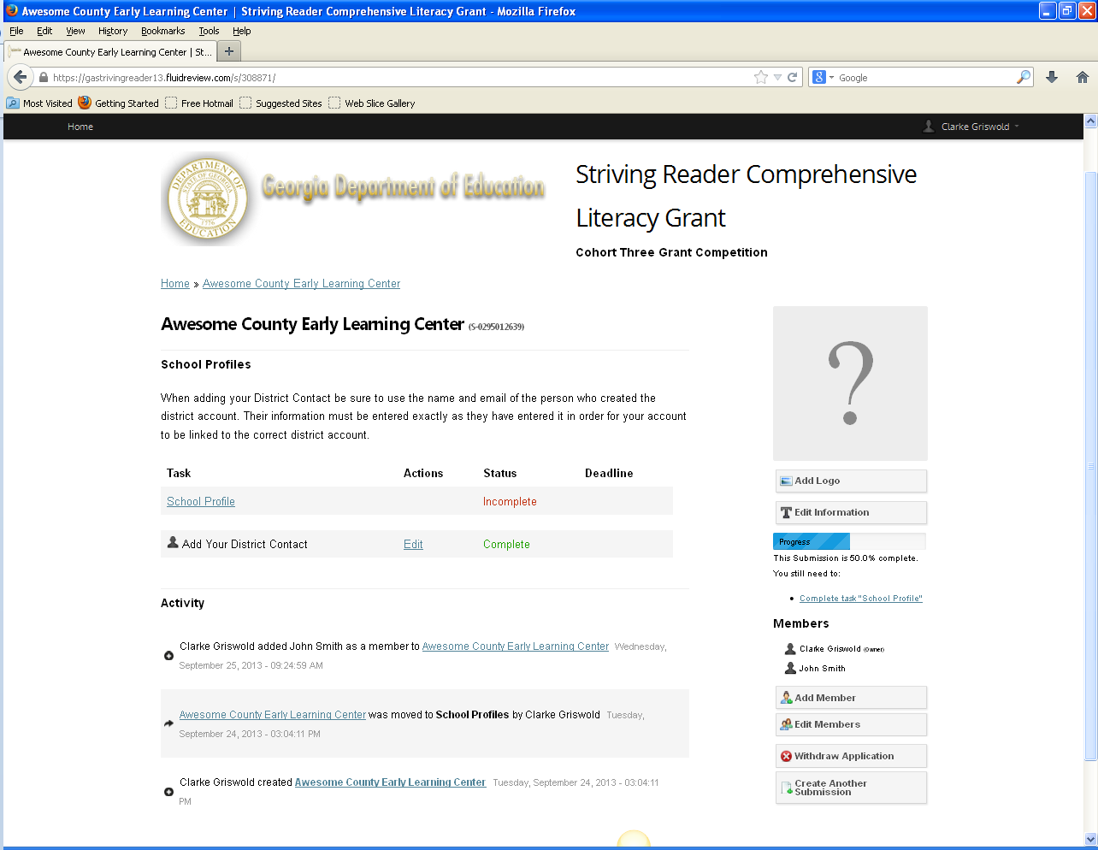
Notice under Status that Add District Contact is now complete
Click here to begin filling out the School Profile
Notice the district contact’s name has appeared because they already have an established account
You will also need to add any teachers in your school as members if you want them to be able to access the school application. Use the instructions from slides 20-23 to add members making sure they use the school access code, not the district access code when creating an account.

Slide 43
Adding a Member to School Account: Pending

Slide 44
After receiving the activation email and clicking on the link:

Slide 45
Completing the School Profile

Slide 46
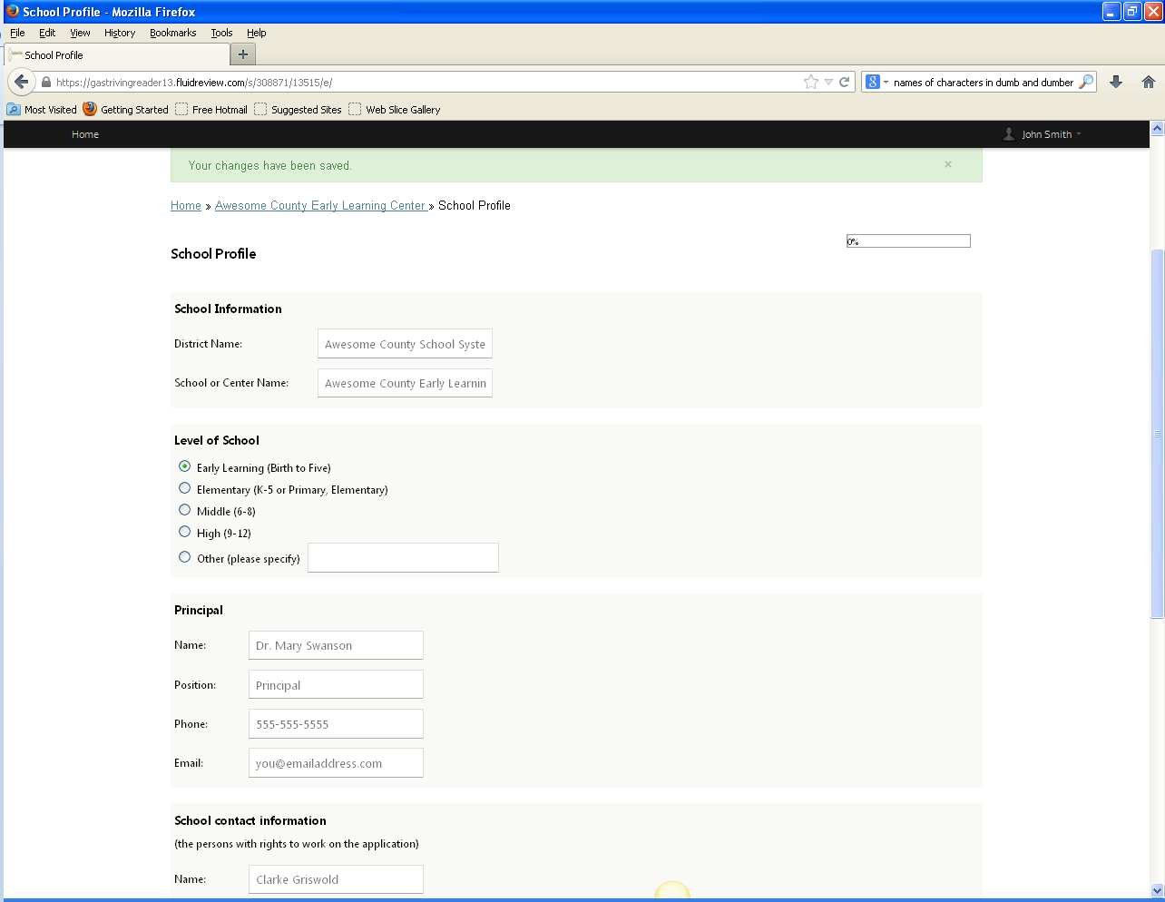
Be sure these are consistent throughout the application

Slide 47
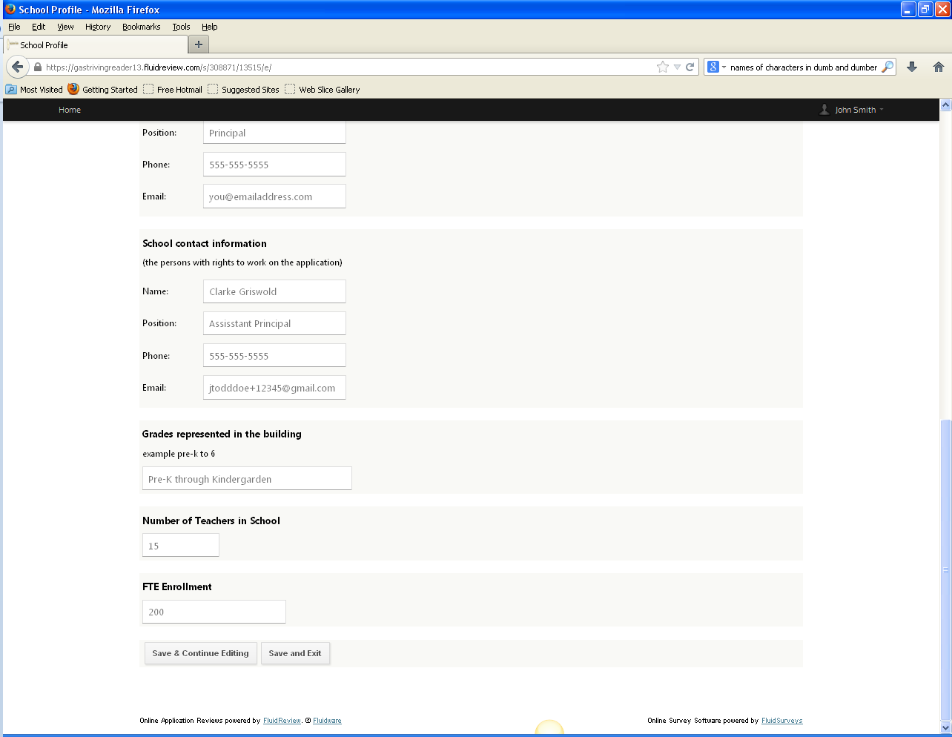
The school contact is generally the same person creating the account

Slide 48
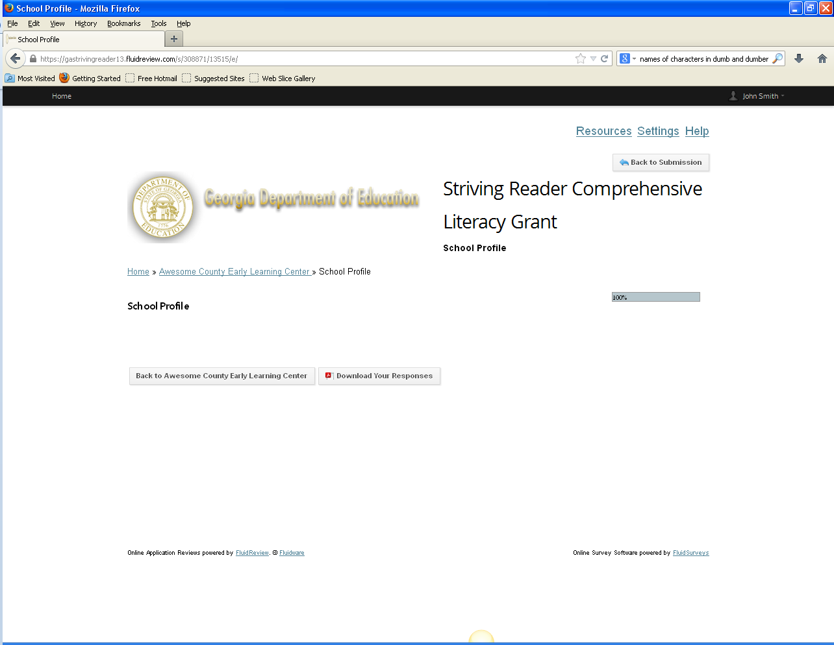
Click here to return to the school landing page

Slide 49
Once you move from the School Profile stage into the Full Application, you cannot return to the School Profile

Slide 50
Completing the School Profile: Cohort Two Applicants
The following instructional slides are only for those re-applicants who created school profiles in Fluid Review (Review Room) for the SRCL Cohort Two grant competition

Slide 51
https://gastrivingreader13.fluidreview.com/

Slide 52
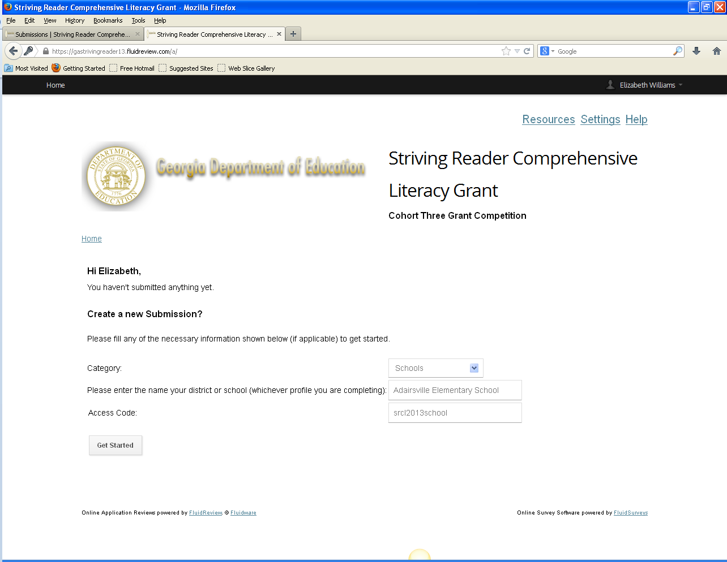
Be sure to select Schools in the Category drop down menu
Enter the name of your school and the school access code
Click here to move on

Slide 53
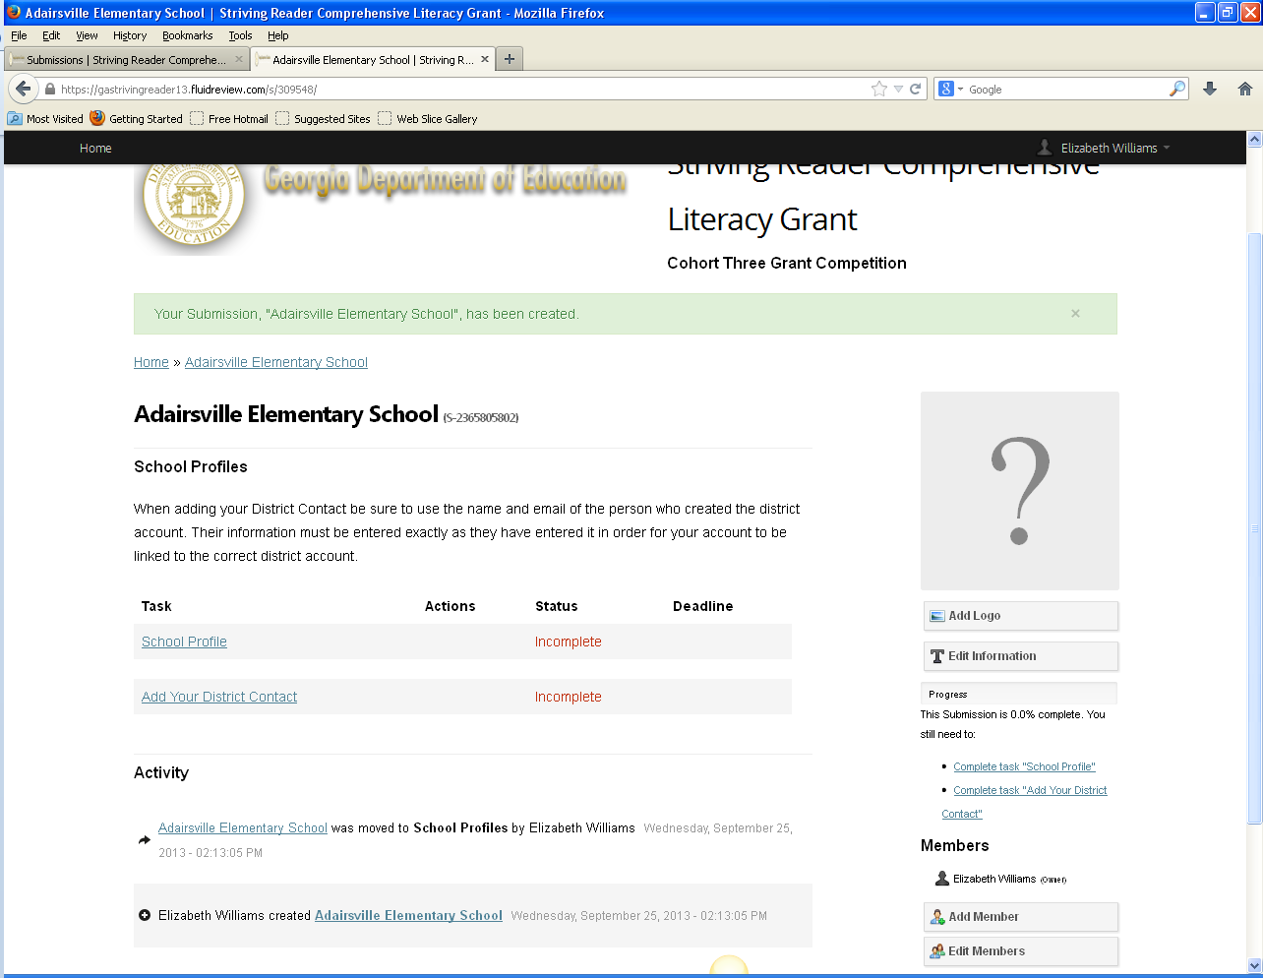
Follow the instructions provided in slides 38-49 to add the District Contact, complete the School Profile and add members as needed

Slide 54
The Full Application
Preliminary Application Questions
Striving Reader Cohort Three Application
Conflict of Interest and Disclosure Policy
Grant Assurances

Slide 55
Click here to begin the application

Slide 56
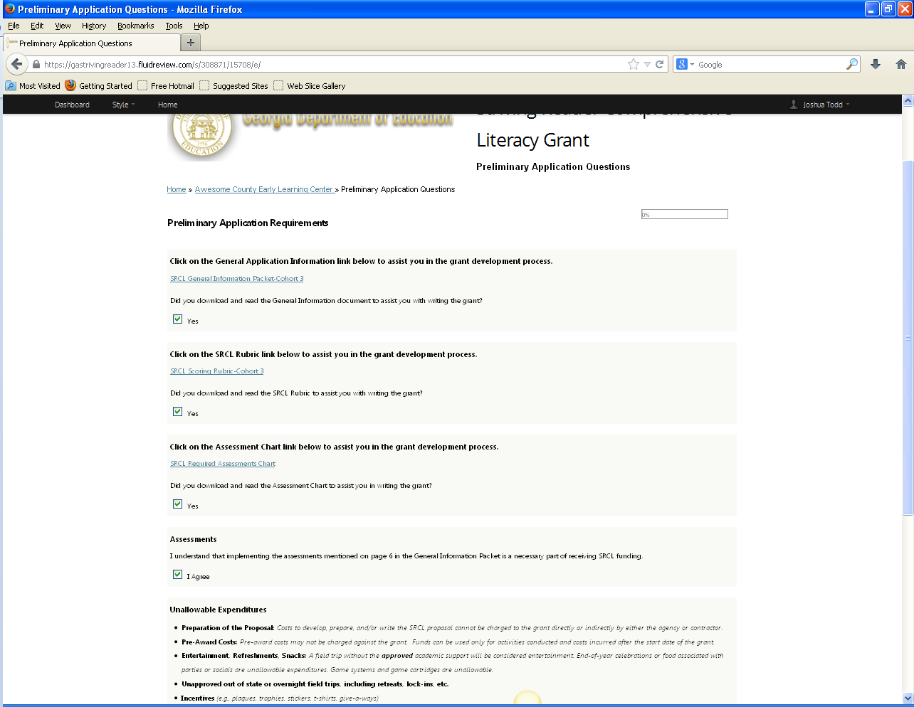
Preliminary Application Questions
Application progress
You may click on these links to access the required document
At the bottom of the page click on save and exit to continue the application

Slide 57
Notice under Status that Preliminary Application Questions is now complete
Click here to complete the next step of the full application
Submission progress

Slide 58
Striving Reader Cohort Three Application
All supplemental files are located here in the Resources link
Click on this link to access the required document
Click on Browse command to upload the file
Clicking on Next will take you to the second page of the application
Be sure to SAVE regularly!

Slide 59
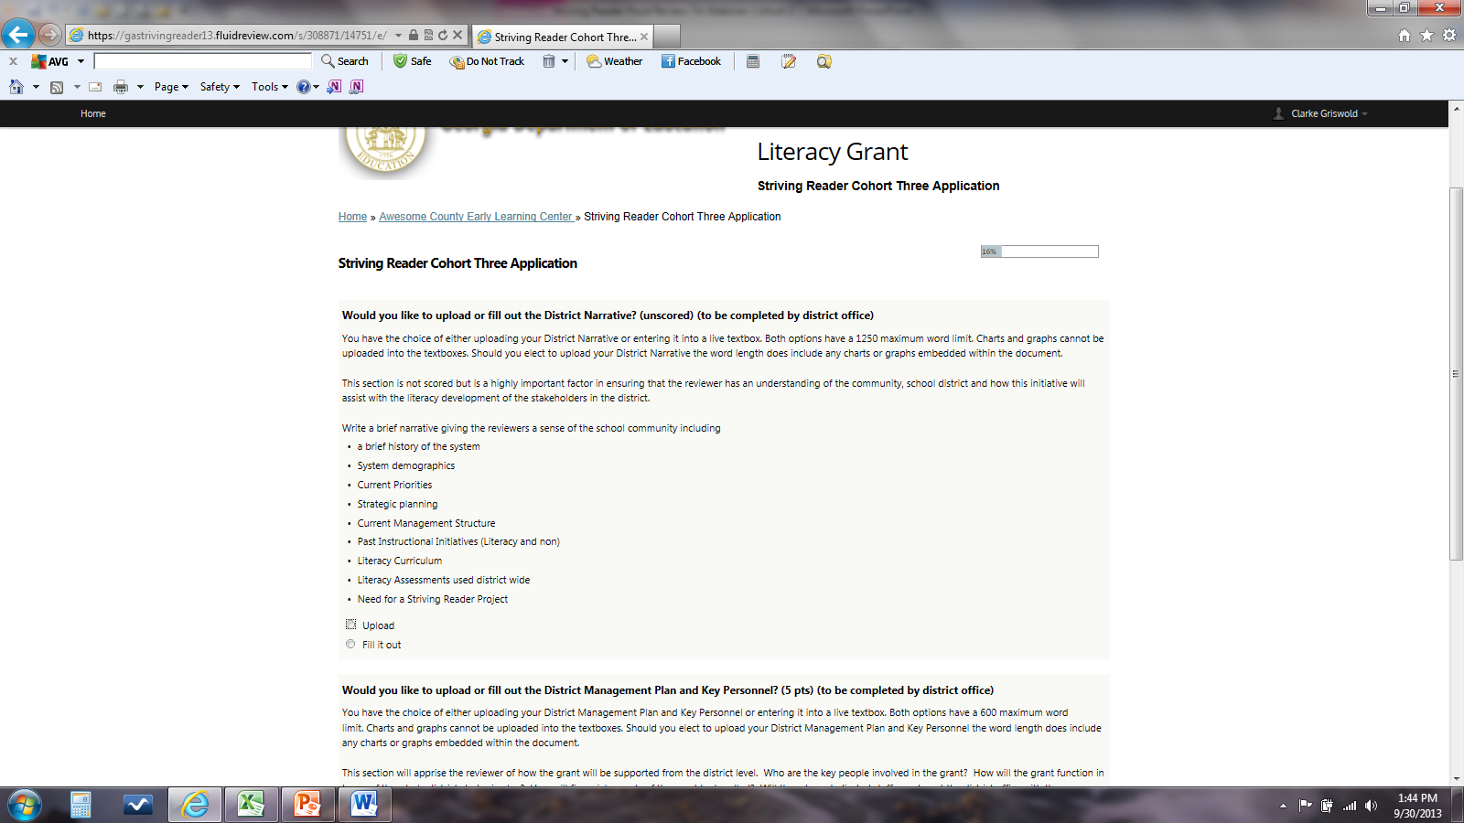
The instructions under each heading can also be located in the SRCL General Information Packet for Cohort 3
For each section you will be given the option to either Upload the section or Fill it out

Slide 60
Upload
When you click on the Upload command a Browse box will drop down and documents can be uploaded here

Slide 61
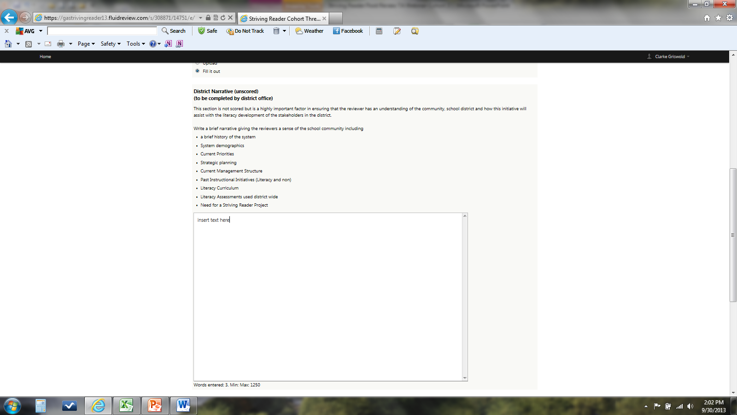
Fill it out
Should you click on the Fill it out command a text box will drop down and you can type your response there
Notice the word counter located at the bottom of each text box.
You cannot cut/paste graphs and charts into the text boxes.

Slide 62
While you can revisit a previously filled out section of the application to make edits to text boxes or uploads, you cannot go forward to a subsequent page without completing the current page on which you are working

Slide 63
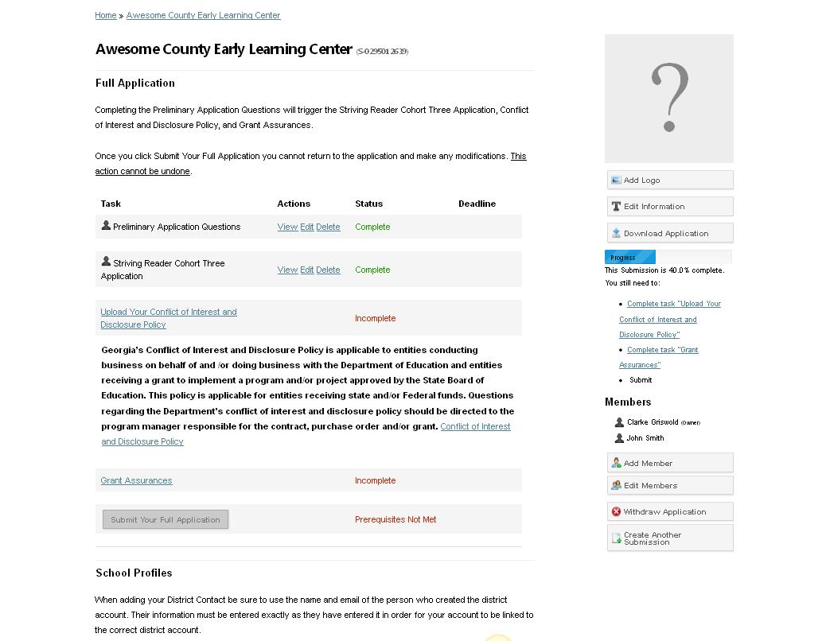
Notice under Status that Striving Reader Cohort Three Application is now complete
Click here to complete the next steps of the full application

Slide 64
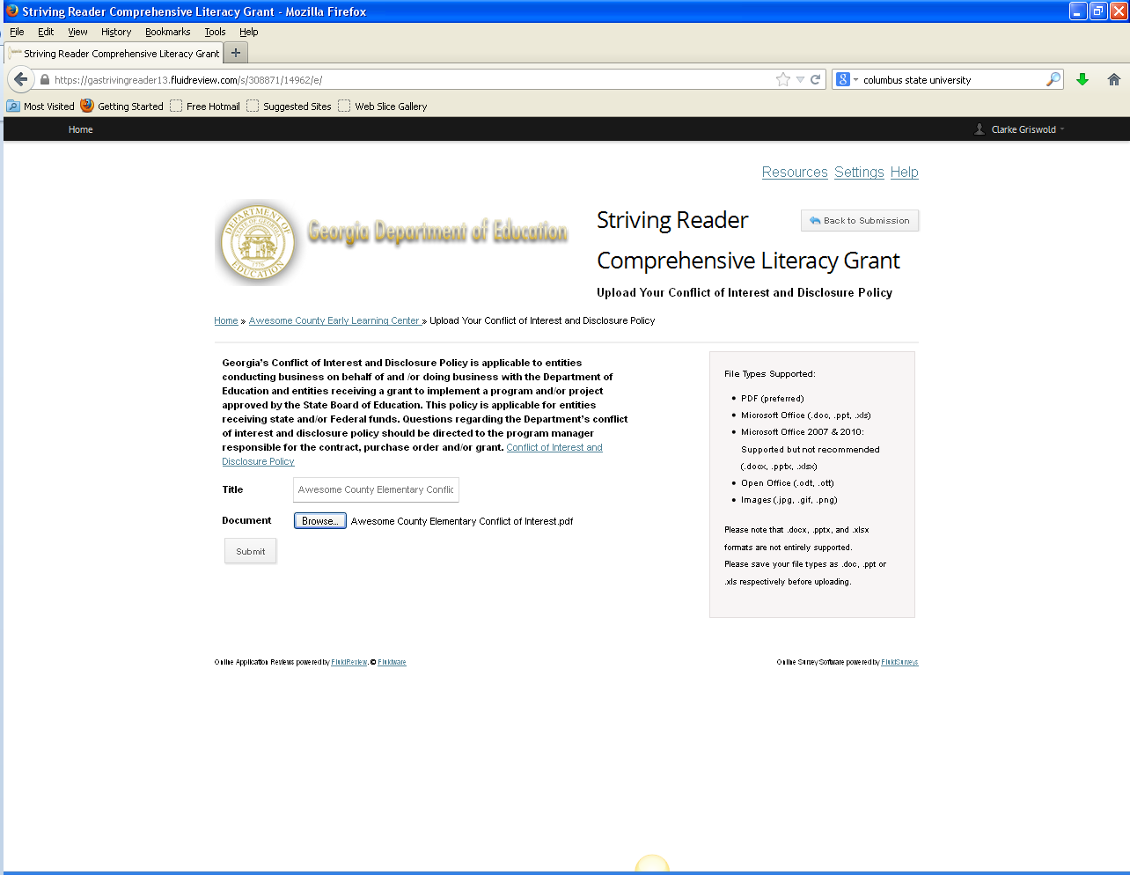
Conflict of Interest and Disclosure Policy
Click on the blue link to download the Conflict of Interest and Disclosure Policy
Make sure the Title and the name under which you save the document are the same
Click on Browse and upload the document
Click here to Submit. Once you submit the document you will be taken to a page that shows you the complete document for verification. Once you verify the document click “Back to Submission” on the verification page and you will return to the school’s landing page.

Slide 65
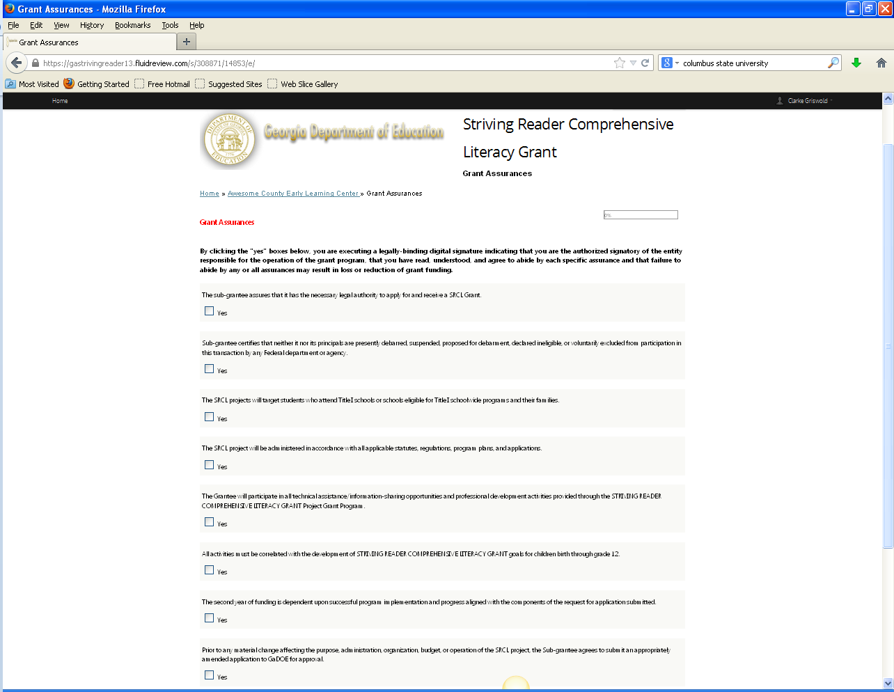
Grant Assurances

Slide 66
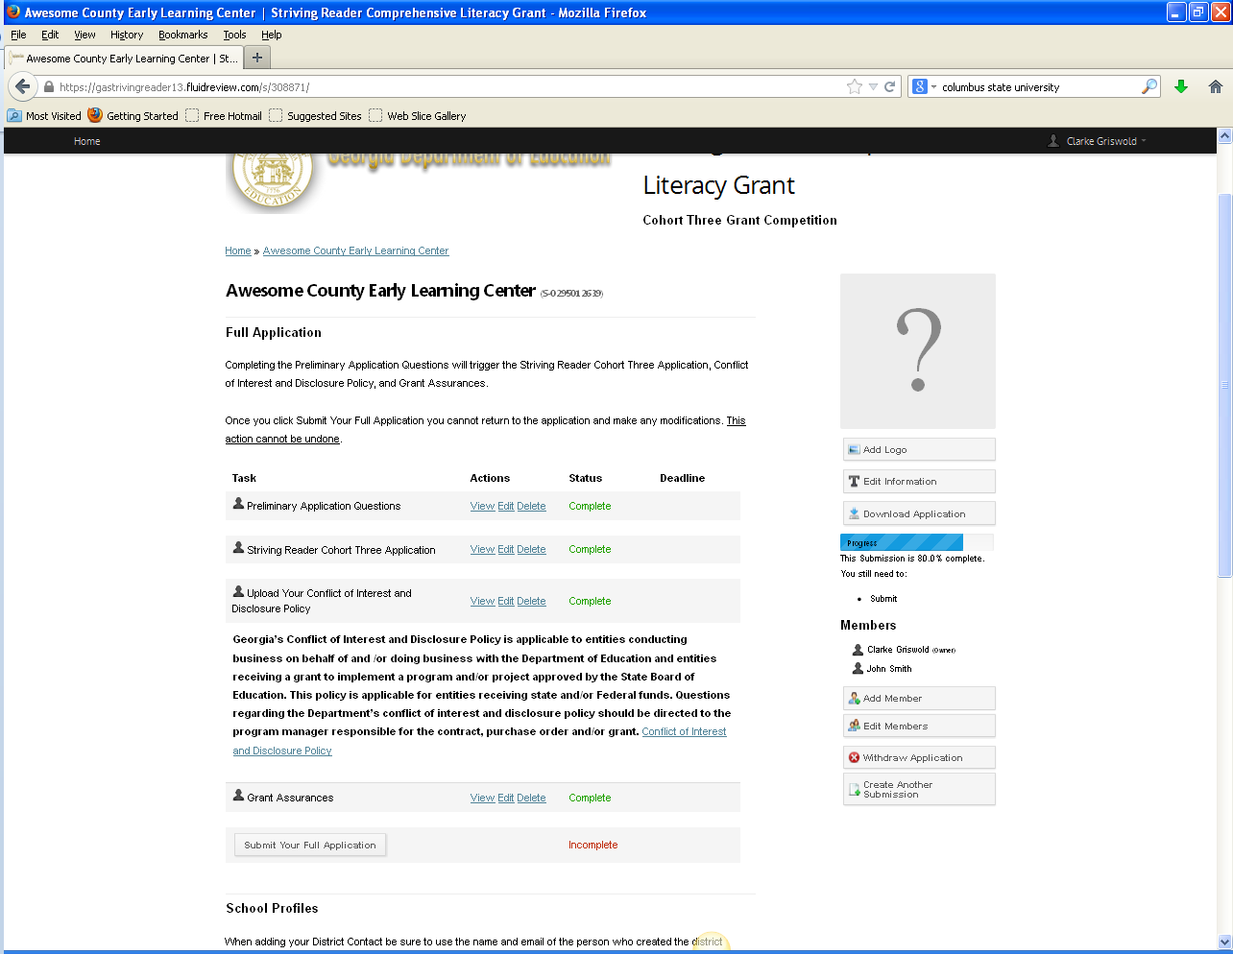
Submitting the Completed Application
Notice the Submit Your Full Application tab is now live
Application must be submitted in Fluid Review by 5:00 PM on December 13th

Slide 67
Suggestions for Setting up Documents
Running header with system and school name
Title of document
Running footer with school and title of document
Page #

Slide 68
Fluid Review Technical Assistance
Contact Joshua Todd at jtodd@doe.k12.ga.us with general issues such as password or log in problems or if there is an issue with the program itself.
Also, as part of our agreement with Fluid Review, you have 24/7 access to technical assistance from them as well. You can reach them at support@fluidreview.com
Once you move into the Full Application, DOE staff can no longer assist you with technical issues within the Full Application (i.e., uploading documents, typing in text boxes, etc.) to avoid conflict of interest issues

Slide 69
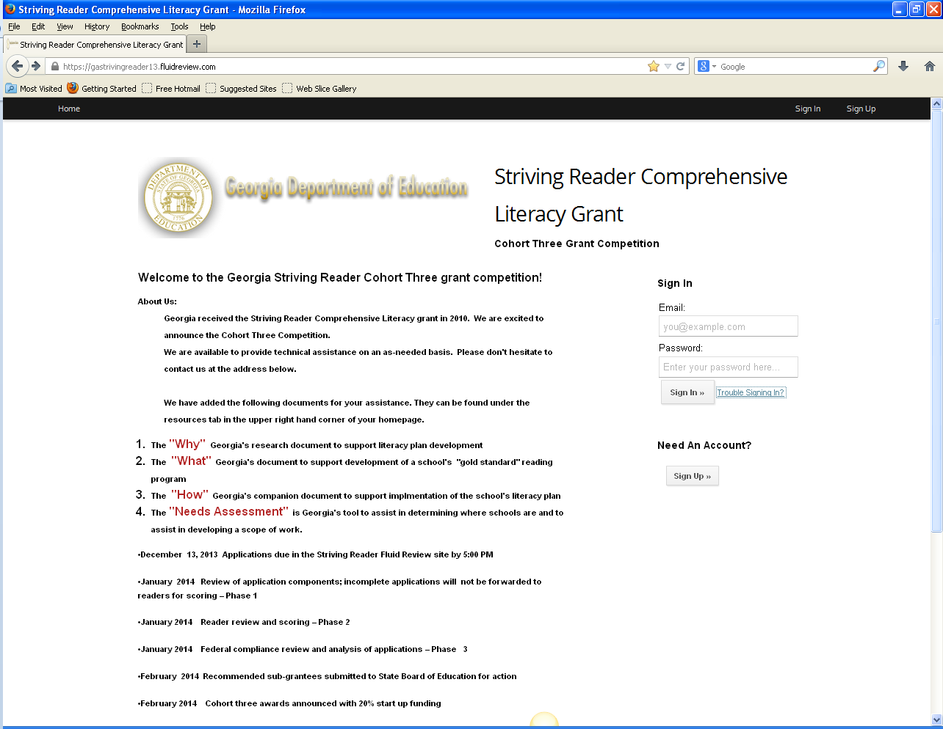
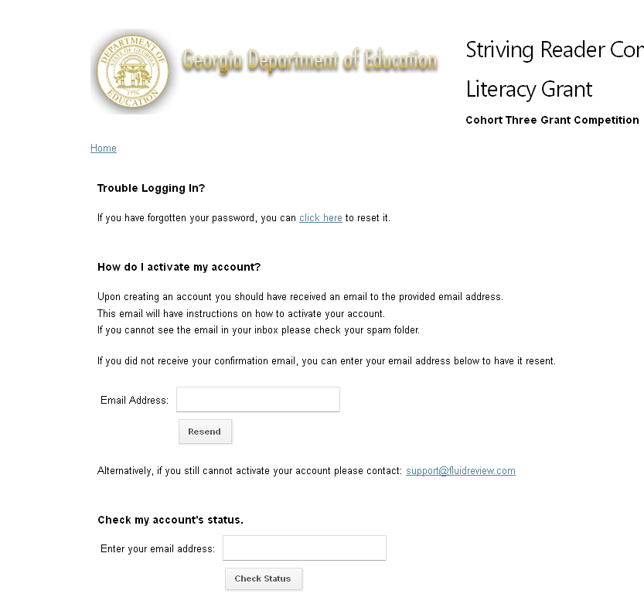
Resetting Passwords
Click here to reset password
Click on Trouble Signing In? to begin
If you did not receive your activation email after you created an account, click on Resend or you can contact Fluid Review support at any time

Slide 70
Technical Assistance
Julie Morrill
Program Manager
jmorrill@doe.k12.ga.us
706-473-3159
Joshua Todd
Program Specialist, 6-12
jtodd@doe.k12.ga.us
404-823-4901
Beverly Cox
Program Specialist, Pre-k -5
bcox@doe.k12.ga.us
404-823-4512
Joyce Kelley
Accounting clerk
jkelley@doe.k12.ga.us
404-656-2093

