Slide 1

L4GA Grant Basics
Notes:
Make introductions

Slide 2
Literacy for Learning, Living and Leading in GA
“promises to improve student literacy learning, teacher delivery of instruction, school climate, and academic outcomes across all sub-groups of children, from birth to grade 12.”
-Georgia’s approved application
Notes:
Insert the whole child slide.

Slide 3
L4GA Team
Julie Morrill
Jmorrill@doe.k12.ga.us
706-473-3159
Meghan Welch
mwelch@doe.k12.ga.us

Slide 4
Agenda
Congratulations
List of districts
Downloading scores and reviewer comments
Literacy Plans
Grant Award Notice
  Start up funding
  Expenses during the start up period
Using Fluid Review to manage grant work
Year-one performance plan
Year-one budget requests
L4GA Grant Kickoff

Slide 5
L4GA Districts (38)
SYSTEM NAME
PELHAM CITY SCHOOLS
GILMER COUNTY SCHOOLS
COLQUITT COUNTY SCHOOLS
WHITFIELD COUNTY SCHOOLS
DOUGHERTY COUNTY SCHOOLS
ROME CITY SCHOOLS
BIBB COUNTY SCHOOLS
DOUGLAS COUNTY SCHOOL SYSTEM
BALDWIN COUNTY SCHOOL DISTRICT
GAINESVILLE CITY SCHOOL SYSTEM
BROOKS COUNTY SCHOOLS
FLOYD COUNTY SCHOOLS
LAMAR COUNTY SCHOOL SYSTEM
THOMAS COUNTY SCHOOLS
FANNIN COUNTY SCHOOL SYSTEM
VALDOSTA CITY SCHOOLS
PAULDING COUNTY SCHOOLS
CLINCH COUNTY SCHOOLS
JEFFERSON COUNTY SCHOOLS
RICHMOND COUNTY SCHOOL SYSTEM
DOOLY COUNTY SCHOOLS
WILKES COUNTY SCHOOLS
CLAY COUNTY SCHOOLS
LAURENS COUNTY SCHOOL SYSTEM
CRISP COUNTY SCHOOLS
CARROLLTON CITY SCHOOL DISTRICT
RANDOLPH COUNTY SCHOOLS
STEWART COUNTY SCHOOLS
GLYNN COUNTY SCHOOLS
THOMASVILLE CITY SCHOOLS
TROUP COUNTY SCHOOL SYSTEM
GORDON COUNTY SCHOOLS
BARTOW COUNTY SCHOOL SYSTEM
JONES COUNTY SCHOOLS
BEN HILL COUNTY SCHOOLS
ATKINSON COUNTY SCHOOLS
DUBLIN CITY SCHOOLS
MARION COUNTY SCHOOLS

Slide 6
Evidenced-Based Practices
L4GA partnerships that apply for subgrants will describe how their plans align to the following:
Research-based
Data-informed
Responsive to the Community
Professionalizes educators

Slide 7
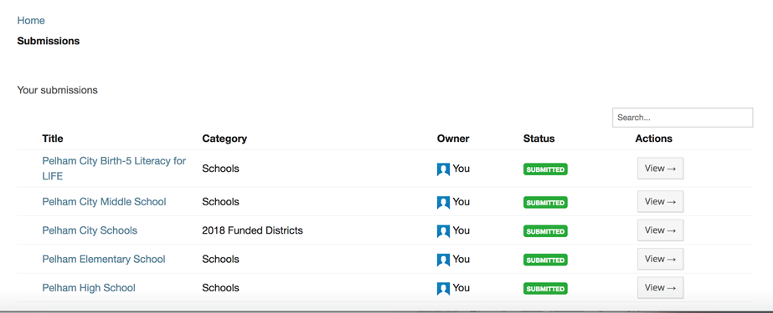
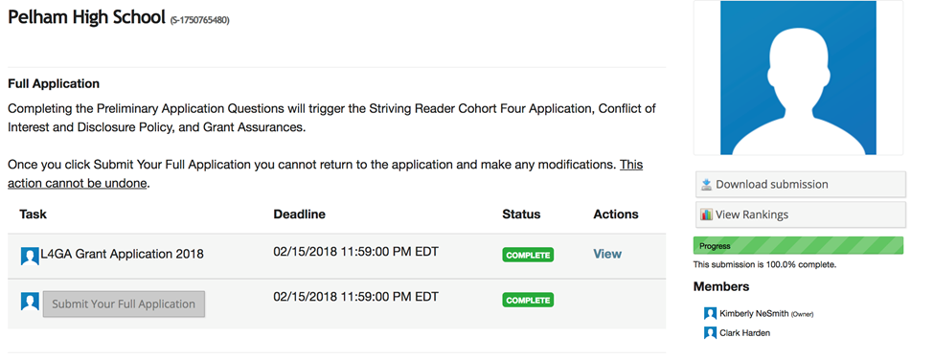
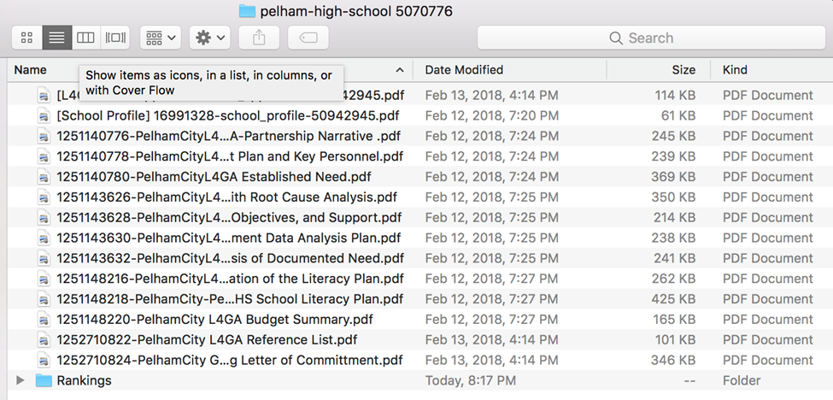
Downloading Scores and Reviewer Comments
Instruction PDF was sent with your GAN
Briefly, *District* Logs-in to Fluid Review:
1. Click View
2. Click Download Submission
3. Open “Rankings” File to see reviews
**Some applications may see two sub-folders in their Rankings folder (see example below). This is due to how we assigned the reviewers within Fluid Review. You will need to access both sub-folders to obtain all five completed reviewer comments.

Slide 8
Literacy plan revision
Any school literacy plan with a score of 11 points or less will need to review the comments and revise the plan document.
A Go To Meeting can be requested with Julie to go over the plan and work through the issues identified and make clarifying corrections.

Slide 9
Grant Award Notice
Block 5

Slide 10
Grant Period
A grant award is made available for an approved performance period of three years.
Award money must be distributed across multiple years of the life of the grant
Sub grantees for L4GA will have until September 30, 2020 to draw down, or actually spend their grants.
LEA’s will then have a 30-day time period for liquidation and to submit completion reports.

Slide 11
Grant Award Notice

Slide 12
Grant Award Notice

Slide 13
Grant Award Notice

Slide 14
Grant Award Notice

Slide 15
Title 1, Part E Elementary and Secondary Education Act of 1965
L4GA is subject to the “supplement-not-supplant” provisions as in other Title 1 programs.
Notes:
This is new for SRCL. I will be receiving guidance from USED on December 1. After that, I will be recording a brief conversation regarding the interpretation that you can share with your Title 1 colleagues.

Slide 16
Sub-grant Awards
LEAs may choose to use 5% of total funding for grant administration.
Notes:
All funding must be used to build sustainable programs.

Slide 17
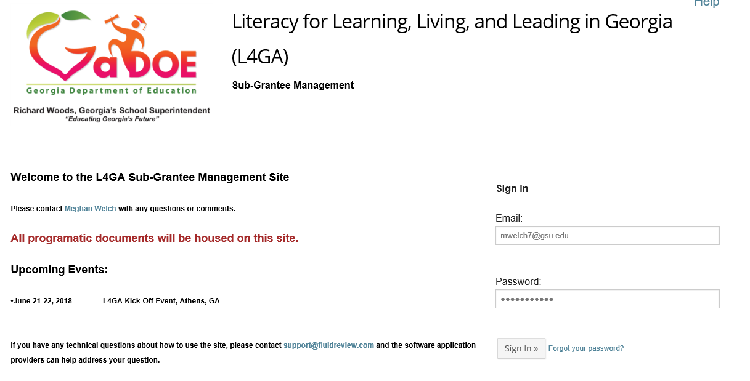
Using Fluid Review to manage grant work

Slide 18
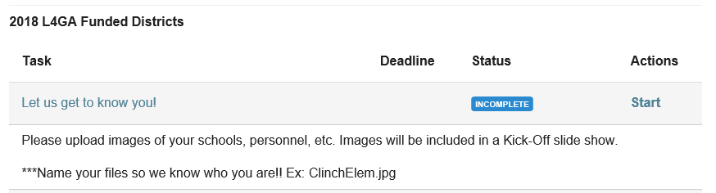
Fluid Review - Pictures

Slide 19
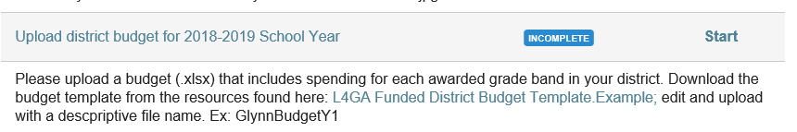
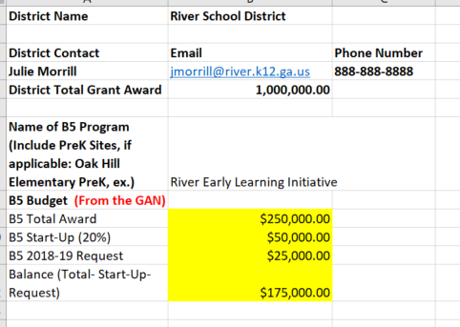
Fluid Review –
Year One District Budget
Budget requests will be combined with the start-up funds as one total in Con App

Slide 20
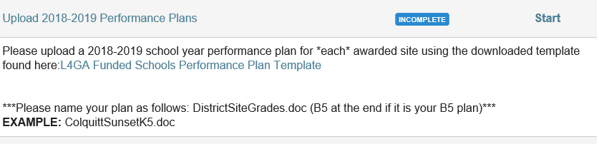
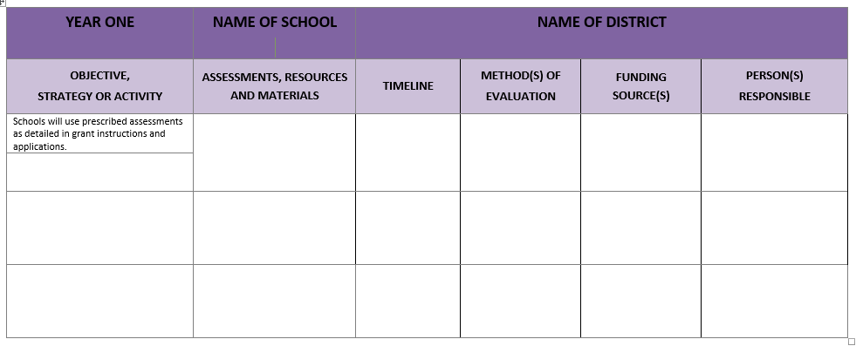
Fluid Review -
Year One Performance Plans

Slide 21
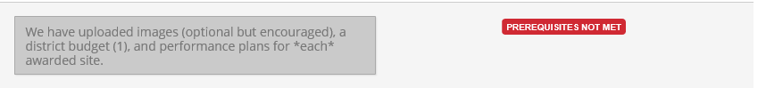
Fluid Review – Submit
After you have met requirements (uploaded budget and performance plans), you will click submit and will receive and email stating that your docs are being reviewed.
Your district information will either be moved to the “L4GA Y1 Approved” stage in Fluid Review (you will receive an email) or you will be asked to revise and resubmit.

Slide 22
Monitoring
Each site will be initially visited by the Project Director to establish program norms, provide technical assistance and to meet the team.
An annual performance evaluation will be conducted by the Project Director
Technical Assistance by program staff will be provided as needed either in-person or virtually.
Notes:
update

Slide 23
L4GA Kickoff
June 21st and 22nd
^{Classic Center in Athens, GA}
Literacy Leaders from the district, school, early learning centers and community.
Register and book accommodations at:
https://classiccenter.formstack.com/forms/l4_ga_grant_kickoff

Slide 24
Students birth to grade 12
Will have access to high-quality materials in both print and digital form, fiction and non-fiction, that support the Georgia Standards of Excellence in all content areas.
Will receive an evidence-based curriculum that will ensure adequate delivery of the Georgia Standards of Excellence.
Will receive an evidence-based literacy block that includes all elements of a comprehensive literacy program (e.g., dialogic reading, peer-assisted learning, small group reading interventions, developing academic English, explicit comprehension strategy instruction, explicit vocabulary instruction) using a variety of engaging, high-quality texts.
Will receive evidence-based instruction in Literacy (Reading, Writing,
Listening, Speaking, Viewing) within content area courses using evidence based delivery models as well as robust, engaging text.

Slide 25
Teachers of literacy birth through grade 12
Will engage learners by establishing a positive learning climate and using instructional approaches that are responsive to the community (e.g.,linguistically, culturally, developmentally appropriate).
Will implement ongoing formative and summative assessments and use data to inform instructional decisions and to evaluate the effectiveness of instruction.
Will engage in high-quality professional learning to build their competence in evidence-based practices in literacy instruction, delivery of content, and peer support.

Slide 26
School leadership teams
Will engage in high-quality professional learning to build their competence in evidence-based practices for literacy instruction and evaluation of instructional performance.
Will demonstrate commitment to literacy by convening partners (teachers, community organizations, families, students) to focus on literacy-related services and activities together.

Slide 27
School and District leaders
Will use local and state data to create literacy plans for feeder patterns, focusing on growing potential for the local community to meet the needs of children from birth through grade 12.
Will ensure that grants funded to L4GA partnerships are supported through proper and timely allocations and resources.
Will ensured that the district goals align, and do not conflict, with those of the funded schools.
Will facilitate partnerships with community organizations to provide social services for families and children attending local schools.

Slide 28
Teacher educators/literacy researchers
Will partner with B-12 teachers and leaders to lead professional learning about evidence-based practices for literacy instruction.
Will engage in a networked improvement community called the “Literacy Think Tank” to improve their own competence in evidence-based practices in literacy instruction.
Will engage with local community partners to support literacy-related activities and communications for families, youth, and children.

Slide 29
Community members
Will provide support services for children, youth and families as determined by the local needs defined by the partnership.
Will demonstrate commitment to literacy by providing and supporting literacy-related activities and communications for families, youth, and children.

Slide 30
Assessments for B-5
PPVT 4 (Pre-K)
PALS (Pre-K)
Work Sampling Online (Collected through DECAL
GKids/ Readiness Check & Gkids Performance-Based Assessment (Collected through SLDS)
Notes:
Add in our evaluators as well as the assessment plan

Slide 31
Assessments for K-5
DIBELS-Next Screener/Progress Monitoring
K = Composite
1st = Nonsense Word, Oral Reading Fluency
2nd - 3rd = Oral Reading Fluency
3X Year
Houghton Mifflin Harcourt Reading Inventory (RI)
Screener 3rd – 12th
Comprehension
3X Year

Slide 32
Assessments for 6-12
Houghton Mifflin Harcourt Reading Inventory (RI)
Screener 3rd – 12th
Comprehension
3X Year

Slide 33
Resources to get started on the literacy plan
Literacy for Learning, Living and Leading in Georgia (L4GA) State Literacy Plan
GaDOE-provided pre-populated data from the Comprehensive Needs Assessment (CNA) for Federal Programs using the framework of Georgia’s System for Continuous Improvement
GaDOE-provided pre-populated data from the Comprehensive Needs Assessment (CNA) for Federal Programs using the framework of Georgia’s System for Continuous Improvement
Georgia’s System for Continuous Improvement with links to Evidence-based IES-REL Practice Guides
Georgia’s Literacy Needs Assessment Templates B-5 and K-12 (these are adapted to align the IES/REL Needs Assessments to Georgia’s System for Continuous Improvement
Georgia’s Literacy Needs Assessment Templates B-5 and K-12 (these are adapted to align the IES/REL Needs Assessments to Georgia’s System for Continuous Improvement
Revised “Why, Who, What, and How” document to implement an evidenced-based literacy curriculum
Collection of resources for professional learning via www.comprehensivereadingsolutions.com (also available in GaDOE’s Learning Object Repository which populates the Teacher Resource Link)

Slide 34
Professional Resources and Data
Comprehensive Reading Solutions www.comprehensivereadingsolutions.com
Rollins Center for Language and Literacy- Cox Campus
https://www.readrightfromthestart.org/
Georgia Insights
http://www.gadoe.org/Georgia-Insights/Pages/default.aspx
Governor’s Office of Student Achievement
https://gosa.georgia.gov/
Ferst Foundation
http://www.ferstfoundation.org/
Imagination Library
https://imaginationlibrary.com/

Slide 35
Community Outreach and Leadership
Reach out and Read Georgia
http://www.reachoutandread.org/georgia/
Georgia Early Education Alliance for Ready Students
https://geears.org/
Georgia Communities in Schools
http://cisga.org/
Georgia Family Connections Partnership
http://gafcp.org
Vision to Learn-Atlanta
https://visiontolearn.org/where-we-work/georgia/
Georgia Public Library Service
http://www.georgialibraries.org/

