Slide 1

Session 2
The Role of the Paraprofessional

Slide 2
The Role of the Paraprofessional Video
https://www.youtube.com/watch?v=0lNGlh8b_CE

Slide 3
Paraprofessionals in special education provide opportunities for:
Expanded learning opportunities
More individualized instruction
Increased monitoring, assessment and evaluation of students
Greater consistency in services
Opportunities for vocational development
Promoting student independence and self-determination

Slide 4





Contributions made by paraprofessionals are individual and unique

Slide 5
The Paraprofessional’s Role
Behavior Management
Clerical Duties
Data Collection
Develop Materials
Health-Related Services
Organizational Skills
Reinforcement of Skills
Supervision
Team Participation
Work with Students (large- and small-group individual)

Slide 6
Behavior Management
Help students to stay on task
Collect data and document behaviors
Maintain daily logs or journals
Manage behavior charts
Follow up with rewards and consequences
__________________________________

Slide 7
Clerical Duties
Routine office duties (e.g., filing, typing, photocopying)
Maintain the database
Update teacher and student schedules
__________________________________

Slide 8
Data Collection
Collect and chart data obtained over specific time periods
Document student progress
Transfer and record classroom data
__________________________________

Slide 9
Develop Materials
(under the direction of a supervising teacher)
Create individualized learning materials
Modify existing curriculum materials
Record materials
____________________________

Slide 10
Health-Related Services
Assist with lifting and rotating
Assist with personal hygiene, including feeding and diapering
Assist with motor or mobility limitations
Use specific medical equipment
___________________________________

Slide 11
Organizational Skills
Help students organize desks and lockers
At beginning of the day, help student unpack book bags and turn in homework
At the end of the day, help students pack homework and the correct textbooks
Monitor specific students for organizational skills
_______________________________________

Slide 12
Reinforcement of Skills
Provide remedial instruction
Reteach previously taught skills
Play educational games
Assist in computer lab
______________________________

Slide 13
Supervision
Oversee small groups of students in the classroom
Monitor work completion
Supervise students during lunch, recess, and getting on and off the bus
Monitor students in common areas such as hallways
______________________________________________

Slide 14
Team Participation
Communicate with special education and general education teachers
Attend all required meetings
Ask for direction, guidance, and feedback if necessary
Avoid personal phone calls in the classroom
__________________________________

Slide 15
Work with students
(large- and small-group or individual)
Help students with activities
Help students with make-up work
Help students with interpreting and following directions
Administer individual tests
Monitor and assist students during seatwork activities
Support students with daily assignments
Read aloud to students or provide support for independent reading
Implement positive behavior intervention strategies (PBIS)
_________________________________________

Slide 16
Sample Roles and Responsibilities
Supervising Teacher | Paraprofessional
Develops the weekly lesson plans | Reinforces the lessons under the guidance of the supervising teacher
Determines the objective for the lesson | Provides support to students to help meet the lesson objective
Provides instruction for the class, small groups, and individuals | Reinforces the lesson and provides drill and practice activities
Assigns silent reading activity to entire group of students | Reads materials aloud to individuals or a small class
Administers essay tests to all students | Writes the narrative that a student dictates
Develops with student and parents a specific plan for daily homework completion | Monitors the daily homework plan with the student
**Paraprofessional should never be solely responsible for a classroom if the supervising teacher is absent, creating lesson plans, or providing the initial instruction to students.

Slide 17

What else do paraprofessionals do?
Table discussion
  Discuss with those at your table additional duties of the paraprofessionals at your school
  Share out with whole group

Slide 18
Daily Responsibilities
One classroom
Multiple classrooms
Rotate between classes
One subject
Multiple subjects
Bus
Lunchroom
Music/PE
Flexibility and patience
Substitute folder

Slide 19

Promoting Student Independence
“Ultimately, the goal of academic and social skill instruction is to enable students to function independently of external or teacher-mediated interventions and control.” Woolery, Bailey and Sugai

Slide 20
Stages of Learning
Application
Behavior extended and used in new ways
Generalization
Behavior transferred to other settings, persons
Maintenance
Fluency and accuracy of behavior retained
Proficiency
Behavior performed with high accuracy and fluency
Acquisition
Behavior performed with high accuracy
Entry
Behavior performed at slow rate or not at all
Increasing degree of independence

Slide 21
Feedback to Students
To promote success and independence
  Be explicit
    Tell student specifically what they did correctly or incorrectly
      “Good job” is nice, but doesn’t clue the student in to what it is exactly that they did well and should do again in the future
      “You carried the one into the tens column correctly – now you’ve got it!”
  Be enthusiastic

Slide 22
Feedback to Students
  Reinforcement
    Any action or event that increases the likelihood that a behavior will reoccur
      Tangible – food, drink, toys, etc.
      Social – praise, facial expression, nearness
      Preferred activity – computer time, free time, listening to music, etc.
      Tokens – tickets, points, etc. that can be “cashed in”
  Shape responses
    Expect greater degree of performance over time before providing reinforcement
    Shaping is important for reaching fluency and proficiency

Slide 23
Generalization
Three forms of knowledge
  What
    Factual information about a topic
  How
    Procedures for using the information in specific ways
    Steps to follow to complete a task
  When
    When and where to apply the information
      Students use routines across classrooms

Slide 24

Activity: Reflection
Do you find your students only display correct responses (behaviorally/academically for you, but not in the presence of other education team members or parents? Yes or No
Do you find yourself frequently needing to prompt your students to start, continue, or complete tasks? Yes or No
Do your students have frequent opportunities to demonstrate responsibility for their own learning? Yes or No
Do your students know how to evaluate their own behavior and learning? Yes or No

Slide 25
Strategies to Promote Independence
Can’t Do
Won’t Do
Methods of Prompting
Choice Making
Schedules

Slide 26
Can’t Do
If a student can’t perform a task…
  Teach the task
  Adapt the steps
    Change the motor demands of a task
    Change the sequence of steps
    Adapt the materials or use different materials
      Provide a stepstool so that they can reach items
      Use multi-sensory approach: student sees, hears, touches
  Assist to complete the task
    Work with a peer or in a small group
    Adult assistance to complete a step

Slide 27
Won’t Do
If a student won’t do a task ….
  Rearrange the set-up to the task
  Change the reinforcement options
  Use behavioral momentum
    3 or 4 easy tasks before a difficult task

Slide 28
Methods of Prompting
Provide enough prompts to prevent student from making a mistake
Then fade prompts (errorless learning)
Wait until student attempts, then prompt if they make an error
Give the least amount of assistance needed
Caution
  Some students may learn the prompts as part of the task
    A student who waits to be told to do the next step before they will do it
    Work towards independently completing a task

Slide 29
Types of Prompts
Verbal
  Direct – a clear statement of what student should do
  Indirect – ask a question, such as “What should you do next?”
Physical
  Full - hand over/under hand
  Partial - supportive guidance
Modeling
  Show student/student imitates
Gestures
  Pointing, facial expression

Slide 30
Examples of Prompts
Direct Verbal ● Indirect Verbal
Tell student to come here Ask “What do we do next?”
and get pencil
Tell student to keep working Ask “Now what?”
until timer rings
Say “Remember, you need
how many forks?”

Slide 31
Examples of Prompts
Full Physical Assistance ● Partial Physical Assistance
Hold pencil with student Support student at wrist to
to write name stabilize handwriting
Hold student’s hand to assist Tap elbow of student to
with holding a cup initiate spoon to mouth

Slide 32
Examples of Prompts
Modeling ● Gesture
Write student’s name Put your finger on your
and then they write it mouth to remind student
to be quiet
Show student how you take Point at the correct item
a drink, then they take a to pick up
drink

Slide 33
Reducing Prompt Dependency
Use systematic routines
  Students will learn the routine and begin to independently follow them
  Use pictures or symbols
  Use visual and tactual picture sequences to represent steps in activities
  Make sure the sequence of steps in the routine make sense, and goal is clear to student
Use wait time
  Do not repeat a prompt unless it is necessary
  If you keep repeating a prompt, the student will come to expect it – or worse learn it as part of the routine
  Use positive reinforcement as the student initiates the next step

Slide 34
Reducing Prompt Dependency
Plan to fade prompts
  Students may become “prompt dependent” through our teaching techniques
  Prompt dependency can occur if prompts are not regularly changed, and faded over time
  As student moves through the stages of learning, do not automatically prompt each step
    If you know the student has the skill, show them that you have confidence in them

Slide 35
Strategies to Promote Independence
Choice-making
  Reduces behavior problems
  Increases motivation
  Prevents learned helplessness
    Sometimes we unintentionally guide students into the habit of saying “Just tell me what to do and I’ll do it.” That is a very compliant student, but not a very independent student
  Increases attention to task
  Promotes generalization
  Prepares student for independence
    Linked to personal independence, dignity and self-worth

Slide 36

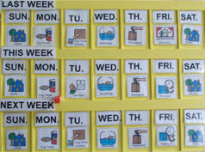
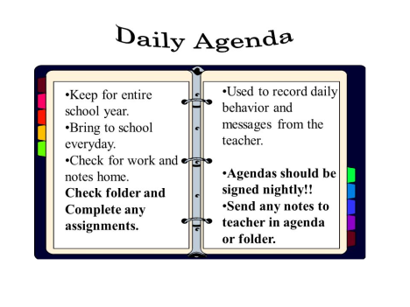
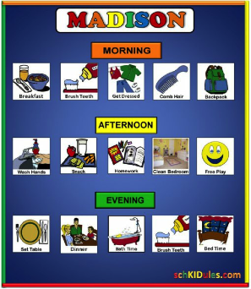
Strategies to Promote Independence
Schedules
  To do lists
  Calendars
  Planners/agendas
  Visual activity/task schedules

Slide 37
Effective Communication Strategies
Verbal
  Put as much energy into listening as you do into speaking with others
  Paraphrase what you hear others saying
  Ask how to do a task rather than why
  Avoid using words such as never and always
  Use “I” statements when speaking
  Ask for clarification if you do not understand
  Emphasize the most important areas when discussing students

Slide 38
Effective Communication Strategies
Written
  Report students’ performance (successes and difficulties) daily
  Remember confidentiality
  Use appropriate forms/logs provided by school or supervising teacher
  Include student’s name, the time, the day, and the setting
  Remain objective

Slide 39
What about Communication with Parents/Guardians?
Defer to the teacher for guidance
Keep all information confidential (aunts, uncles, friends, etc.)
Avoid conversations in public areas
  In school setting (hall ways, media center, lunchroom, teacher’s lounge, etc.)
  Out of school (Walmart, Beauty Salons, etc.)
When unsure how to answer a parent who questions you, say “The teacher or I will get back with you concerning……”

Slide 40
“Pick Your Neighbor”
Adapted from activity
from Affirmative Action/Diversity Education Planning Office,
June, 2006.

Slide 41
You can live in this exclusive neighborhood that has eight families. You can choose the neighbor who will be closest to you. The following are your choices:
A minister and his family
A Jewish family
A hard rock band
A single woman, never been married and has five children and an older woman living in the home
An interracial couple with children
A doctor and nurse couple
A lawyer and business executive couple
A deaf-blind couple with children
Remember you can only choose one neighbor.
Write down your choice and list reasons for choosing that neighbor.

Slide 42

Minister and family
Devout devil worshipers that often sacrifices animals.

Slide 43
Jewish family
Speak little English, keep traditional Jewish values and seldom get out.

Slide 44

Hard Rock Band
Seldom home, very reserved and practices across town in a studio.

Slide 45

Single Woman
The mayor of the city. Adopted five underprivileged children. Has elderly mother living with her. Family of the year.

Slide 46

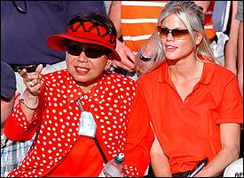
Interracial Couple
Highly successful Asian and African American business couple. Always involved in community service. Has very successful son.

Slide 47
Doctor and Nurse Couple
Addicted to prescription drugs. Holds wild parties. Police frequently raid house.

Slide 48
Lawyer and business executive
Supports extremist groups.

Slide 49
Deaf and blind couple
Very wealthy, supports charities, children are grown and successful.

Slide 50

This was an exercise in stereotypes. Everyone has biases even though they do not readily admit them. You often choose your response based on past experiences, media influences, stereotypes, and/or education.
Let’s learn the truth about your students…

Slide 51

Lesson: Don’t judge a book by the cover!
Dig Deeper!!!

Slide 52
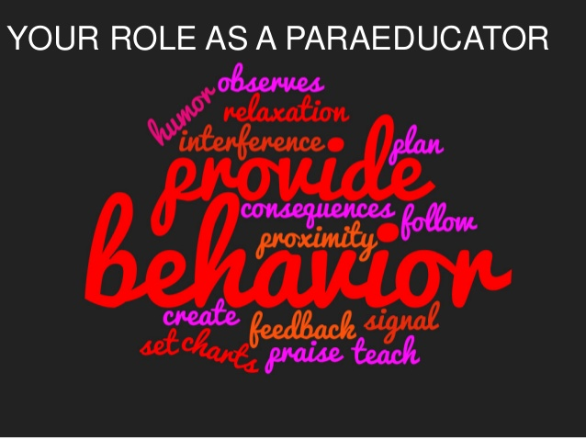

Slide 53
Frequently Asked Questions
Discuss the three questions below with peers at your table.
Assign a note taker to write answers to share with whole group.
Is it okay to work with students who are not special education students?
What do I do if the student is unable to complete the assignment even with prompts and support?
I do not feel comfortable in some classrooms because I do not know the subject material. What should I do?

Slide 54
Frequently Asked Questions
Is it okay to work with students who are not special education students?
  At times you may review a lesson, provide practice activities, or reinforce a specific skill that would benefit general education students as well
  General education students should not become a permanent part of the special education group
  Guidelines for working with general education students are provided by the general education teacher

Slide 55
Frequently Asked Questions
What do I do if the student is unable to complete the assignment even with prompts and support?
  While working with the student, increase or decrease the amount of support
  Supplement with appropriate and pre-determined alternative activities
  Check with supervising special education teacher
  Encourage the student
  Provide positive support

Slide 56
Frequently Asked Questions
I do not feel comfortable in some classrooms because I do not know the subject material. What should I do?
  Often you may work across grade levels and curriculum areas
  You are not expected to be an expert in every field
  Read the specific chapters in advance
  Access teacher’s guide to preview the unit
  Review skills, especially in math

Slide 57
