Slide 1
Our session will begin momentarily. While you are waiting, please make sure you are connected to audio:
Please join the webinar through your computer using the invitation provided via e-mail.
Technical Issues? Please go to http://help.webex.com.
Notes:
Technology check

Slide 2
Managing Your Federal Grant Award
Charter Schools Division
Georgia Department of Education
January 28th, 2021
Notes:
Good morning and welcome to the “Managing Your Federal Grant Award” webinar sponsored by the Charter Schools Division of the Georgia Department of Education. I am Kim Wiggins. I would like to go ahead and verify attendance.
After attendance: Throughout this webinar and at the end, questions will be allowed.

Slide 3
Agenda
Budget Submission and Approval
Monitoring
Reimbursement
Timeline
Notes:
Here’s an overview of what this training will cover for you, the subgrantee. Being awarded grant money means you get both the rights and responsibilities! The right to spend, and the ultimate RESPONSIBILITY of making sure your grant is used and reported appropriately.
Let’s talk expectations – at the Department, we have limited staff to provide technical assistance. Therefore, it’s very important that you follow the chain of command regarding your grant. If you have a question – 1) first, do a little research 2) local district grants staff (for non state charters) and 3) GaDOE. This method will probably result in a quicker solution if the problem + your research + a suggestion solution is provided v. just problem.

Slide 4
Timeline
Must expend funds within the grant period. The grant period started upon SBOE approval.
Review timelines found in the application.
Please make every effort to expend your funds by September 30, 2022.
Notes:
By now, each of you should have received an award letter containing a period of performance. For year 1, please try to expend your funds by September 30, 2021 Reports are provided to the U.S. Department of Education based on your expended funds and this will help the Charter Schools Division tremendously.

Slide 5
Period of Performance for Planning, Implementation, and Dissemination
Planning
Up to $75,000
Performance period: January 13th, 2022 through September 30th,2022 or the date the school opens, whichever comes first.
Implementation
Up to $775,000
Initial start-up costs and implementation activities after opening
Dissemination
Up to $225,000
Disseminate best practices that improve student academic achievement among charter schools and traditional public schools
Performance period: January 13th, 2022 through September 30th, 2022.
Initial planning and project design costs prior to opening
Performance period: January 13th, 2022 through September 30th, 2022.
Notes:
This slide should be relatively familiar. One item has been changed – the period of performance now contains dates.
Please remember, an already-operating charter school CANNOT use these funds to open a new campus. This program is NOT about expanding franchises to more sites.

Slide 6
Budget Submission and Approval
State Charter Schools will submit budgets directly to the Consolidated Application (Con App)
Locally-approved charter schools will submit budgets to the local district for entry into Con App
CSD will review the budget within 30 days of submission
Notes:
Typically budgets will be reviewed twice a week or more. BUT, please note, we do have 30 days to review. Given the limited time, we will make every effort to do it as quickly as possible. Please take your time, make sure your budgets are loaded correctly.

Slide 7
The Consolidated Application
What is the Con App?
The system by which the State manages disbursement of federal and state funds.
How do I get access to the Con App?
Every school must have a school code.
State Charter Schools will be able to access the Con App via the My GaDOE Portal.
Locally-approved charter schools do not have direct access. The local district, as the fiscal agent, has access on behalf of locally-approved schools.
Notes:
I provided the LEA Consolidated Application Navigation document within your invite. Does anyone else think they need a school code?

Slide 8
Guidance for Submitting Budgets
Submission should be timely
The budget submitted should substantially align with your grant application and should not contain unallowable expenses
Cannot access grant funds until budget approval
Accuracy matters – budget amendments are required for 10% variances or more between function codes and can take valuable time to process
Notes:
Your budget should look very much like your budget submitted within your application. If it does not, your approval can be delayed. Your application was approved for a specific project plan. You should not deviate from that project plan without a VERY GOOD reason. As a result – we will be strict on budget amendments. The 10% variance refer to the function code from which the funds are being moved.

Slide 9
Drawing Down Funds
Once GaDOE CSD approves a budget in Con App, a school can draw down funds
State Charter Schools will submit proof of paid invoices via email to Kim Wiggins at kwiggins@doe.k12.ga.us for GaDOE approval
Remember, these are reimbursement grants
Locally-approved charter schools will submit invoices to the local district for approval
Submit invoice to receive reimbursement after invoice is approved

Slide 10
Reimbursement Guidance
Expenses must be allowable
School’s responsibility
Expenses should align with your budget
Documentation should be correct
Only paid invoices should be reimbursed
A 10% or more variance between function codes requires an amendment
District and GaDOE check-and-balance
Notes:
1.) Allowable expenses – Please ensure that expenses are allowable before spending.
3.) Reimbursement for invoices that have not been paid or quotes should not be requested. Do not spend, seek reimbursement, and because your local district approves it, deem it to be allowable. If it’s unallowable, when we monitor you, we will request that you repay the $.
Any questions about submitting budgets and getting reimbursed before we move on?

Slide 11
Grant Monitoring and the Monitoring Visit
What To Expect
The Monitoring Visit
The Grant Binder
The Monitoring Tool
Notes:
Next, we are going to cover the grant monitoring and the monitoring visit. Please take your monitoring visit extremely seriously. If things are not in order you risk losing your grant funding. We try to be very clear about the requirements and our expectations, as we want your visit to go well.

Slide 12
Grant Monitoring and What to Expect
Mission - Ensure stewardship over Federal funds awarded by conducting:
Desk-based financial reviews
Approval of budgets and invoices
Resolution of audit reports
Audit reports are due to CSD by November 1 each year
On-site financial and programmatic reviews
Monitoring visit within the first 6 months of the grant with follow-up visits as needed
Technical assistance to grantees
As needed
Notes:
“Monitoring” is a very broad term which includes a variety of practices. The monitoring occurs on the front end through the process of approving budgets and invoices. Then we also monitor after through the monitoring visit and audit reports. Audit reports – please make sure that your finances are in good shape. A bad audit could risk you losing your grant funding.

Slide 13
The Monitoring Visit
Within the first 6 months and as needed
CSD will contact you to schedule your visit
Who should be present at the visit?
How should you prepare?
The Grant Binder
The Monitoring Tool
After the visit
Notes:
This list includes some of the things we’ll discuss in the monitoring visit section…

Slide 14
Who should be present at the visit?
Required Attendees
Board Chair
Treasurer
School Leader
School's Business Manager
Preferred Attendees
Representative from local district
Representative from management company (if applicable)
Notes:
It is STRONGLY encouraged to have the preferred list of attendees present.

Slide 15
How should you prepare?
Review and place the following documents in your grant binder:
Budget and Invoices
Most recent audit report
Grant application
Internal Control and Business Policies
Conflict of Interest Policy
Code of Conduct
Notes:
Why’s this binder so important? This is your proof that you are spending funds appropriately and that you are taking actions to ensure that you’re a good steward. Next, we are going to look at some specific binder examples, but this slide, generally contains what should be included.

Slide 16
The Grant Binder
Should contain your complete set of grant records
Binders should include:
Grant application, award letter and approved budget
Invoices for which the school received reimbursement and accompanying backup documentation
Academic performance data related to the project goals
Any previous monitoring reports
Inventory
Applicable policies and procedures
Charter Contract
Separate Grants, Separate Binders
Notes:
Only include invoices, not POs or quotes (although both are great backup docs), please only include INVOICES. If we monitor in February or March of next year and you have no invoices, that could indicate an issue. It could potentially show that you do not have the capacity to spend your grant funds as planned. Financial docs – like links in a chain, they should connect (PO, invoice, delivery slip).

Slide 17
The Grant Binder - Guidance
Organization is key
Source documentation is your friend
Example 1: If a school is reimbursed for professional development, in addition to the invoice, the binder should include itineraries or course descriptions.
Example 2: Invoices should be accompanied by a PO, proof and method of payment, and documentation showing shipment and receipt of goods.
Timely academic data
Inventory Management is crucial
Notes:
Timely academic data – when you’re monitored, you will not typically have final academic data. What you should have is some sort of benchmark testing that indicates you are making progress toward meeting your goals. It should be simple, direct, easy to understand.
Inventory Management – more is provided on this in the next slide, but why is it important? We want to make sure that you actually have and are properly safeguarding the property on which you spent federal dollars!

Slide 18
Inventory Management
Subgrantees must track their inventory
Subgrantees must implement internal controls to track and manage equipment
Where is it, who has access, and how do you determine if equipment is missing or damaged?
Notes:
Inventory purchased with CSP funds must be distinguished from inventory purchased with other funds (Title 1, etc.) by affixing an asset tag to each item that says “CSP” (for example) and has a bar code/tracking number. The asset tag must be on every single item (each book, computer, etc. except for consumable items like pencils). Slide 28 will provide a detailed spreadsheet example of inventory tracking.

Slide 19
Common Issues
Incomplete records in grant binder
Poor inventory management
Salary and taxes
Unallowable expenses
EMO fees
Office furniture v. classroom furniture
Cafeteria equipment
Extracurricular activities
Leases
Notes:
You can pay salary (according to certain parameters) but NOT taxes.
EMO fees – these are fees paid directly to the EMO for their services. If you are purchasing materials from an EMO then it 1) must be a true “purchase” not “lease” or “license and 2) you must be able to show that they are the best vendor and that their materials are particularly suited to your needs. If it looks like you’re purchasing from them simply because they’re your EMO, then that is unallowable. Also, invoice issue – the vendor MUST invoice the school. The vendor should not invoice the EMO who then invoices the school. You will not be reimbursed.
Office furniture is not allowed
Cafeteria equipment – ongoing operational expense not about implementing an academic program
Extracurricular – not about implementing an academic program
Leases or licenses are not allowed. Must have ownership.

Slide 20
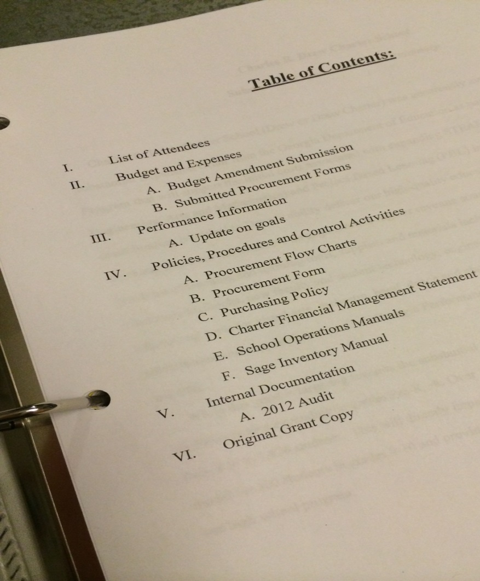
Grant Binder Examples Table of Contents
Notes:
Let’s take a look at some specific examples. Thanks to Drew Charter School which provided these examples. HOWEVER, this is one school and their grant. Every school and every grant will be different. Also want to note that there are some black boxes where info has been redacted. Here’s a sample TOC. Note what they have. Does anyone notice anything missing or have questions about anything that they have included?
Slide 15
-Conflict of Interest Policy
-Code of Conduct

Slide 21
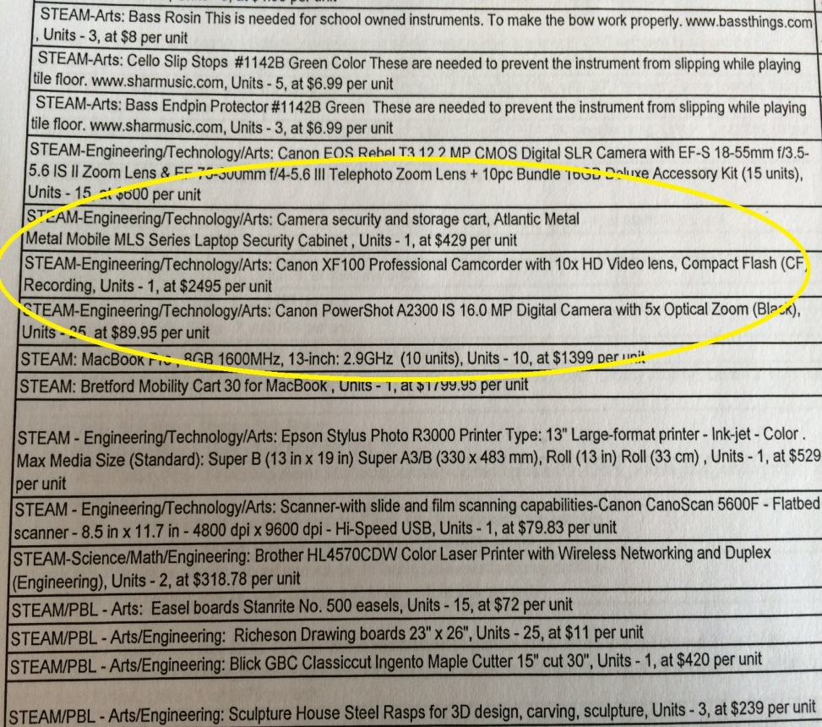
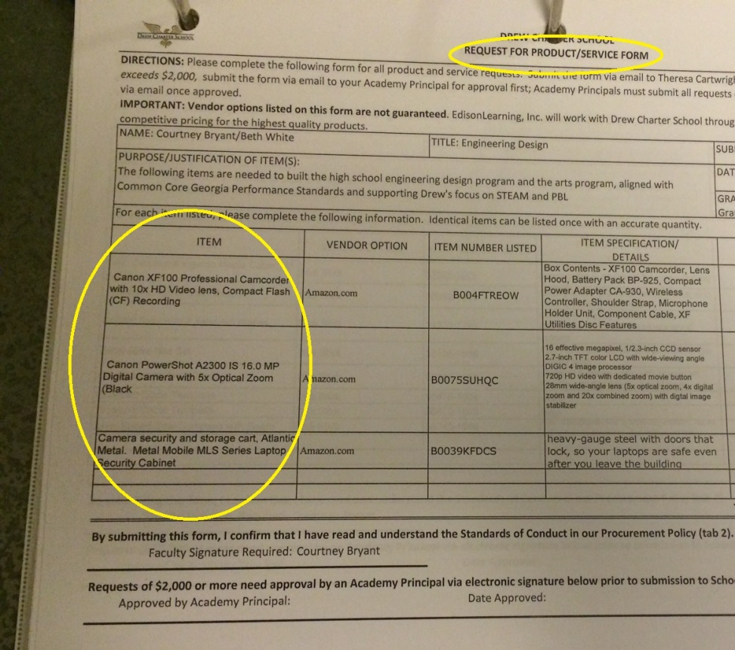
Grant Binder Examples Budget and Purchase Order
Notes:
A chain of documentation should exist from purchasing through reimbursement. Note, when Drew were monitored, they had not yet been invoiced for the equipment. Upon revisiting, either an invoice and some sort of proof of delivery had to be provided.

Slide 22
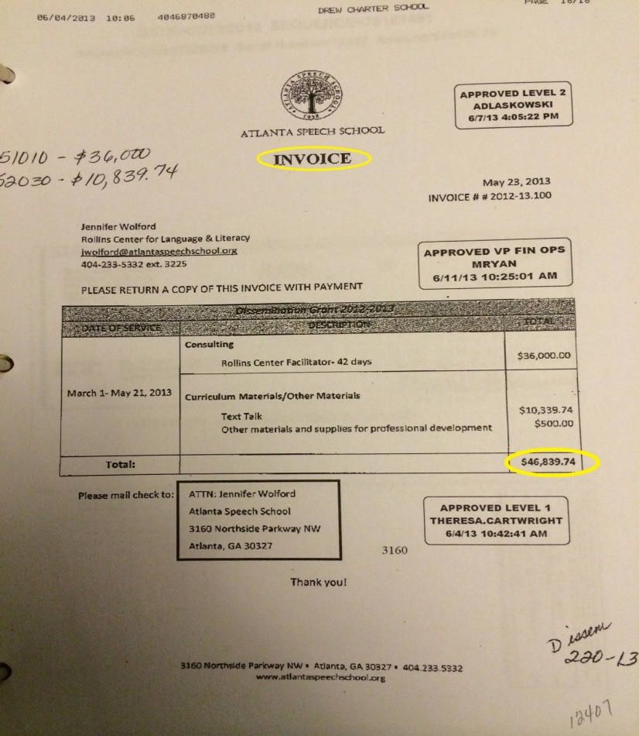
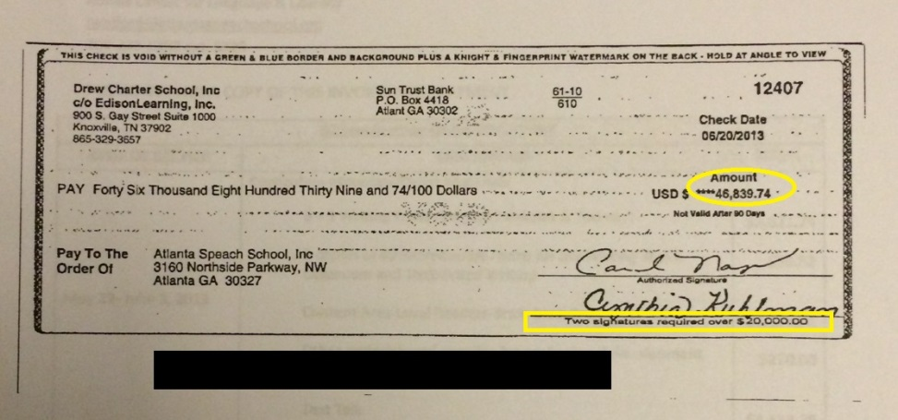
Grant Binder Examples Invoice and Proof of Payment
Notes:
Invoice for consulting services and proof of payment. Notice the invoice is clearly marked invoice. Also notice on the check, the two signatures, which aligns with their signature policy.

Slide 23
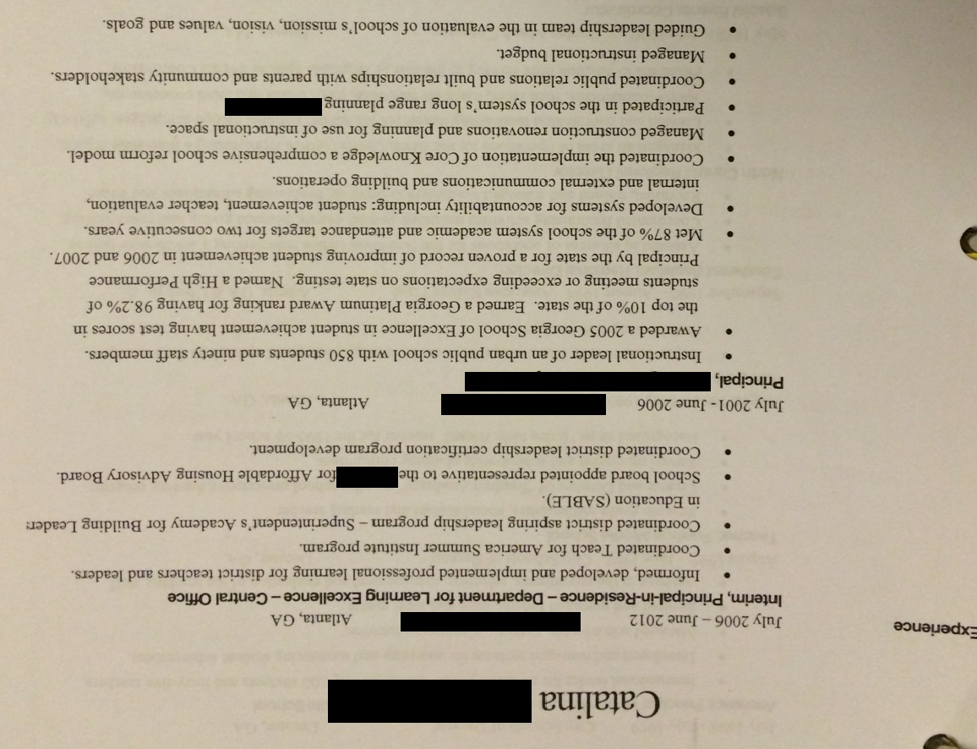
Grant Binder Examples Consultant Resume
Notes:
Let’s look at the supporting or source documentation for reimbursement of consulting expenses.

Slide 24
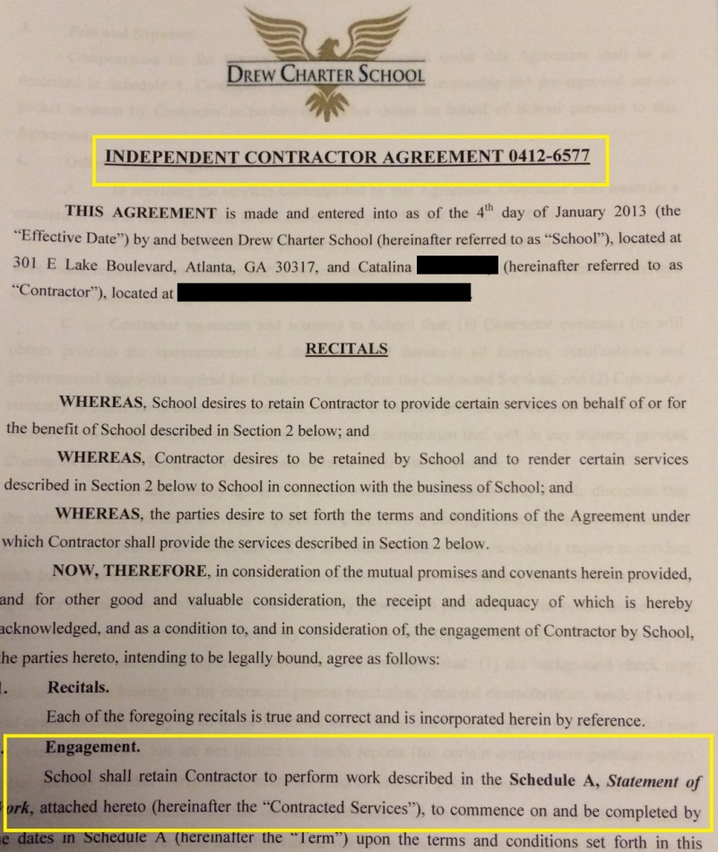
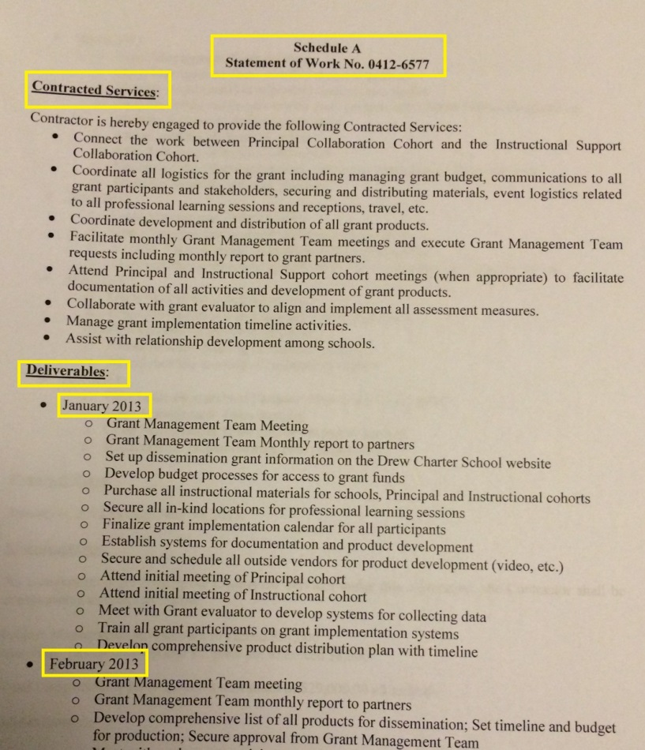
Grant Binder Examples Consultant Agreement and Statement of Work
Notes:
Notice the agreement, the scope/statement of work is complete with deliverables and milestones. So far – they have this person and she is going to do this work.

Slide 25
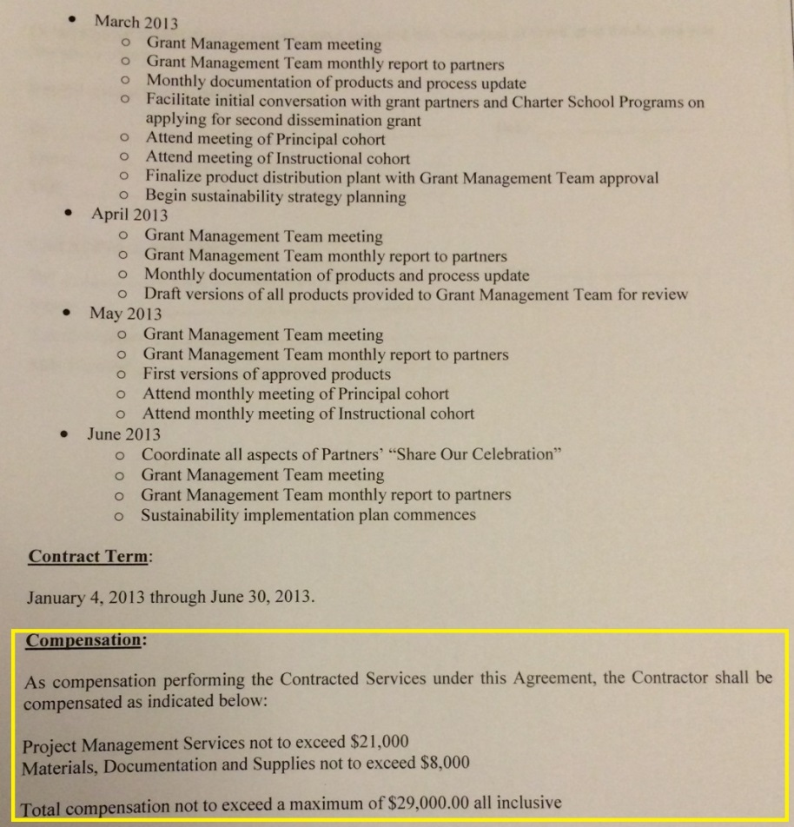
Grant Binder Examples Compensation Clause
Notes:
Now, they add for this amount within the compensation clause.

Slide 26
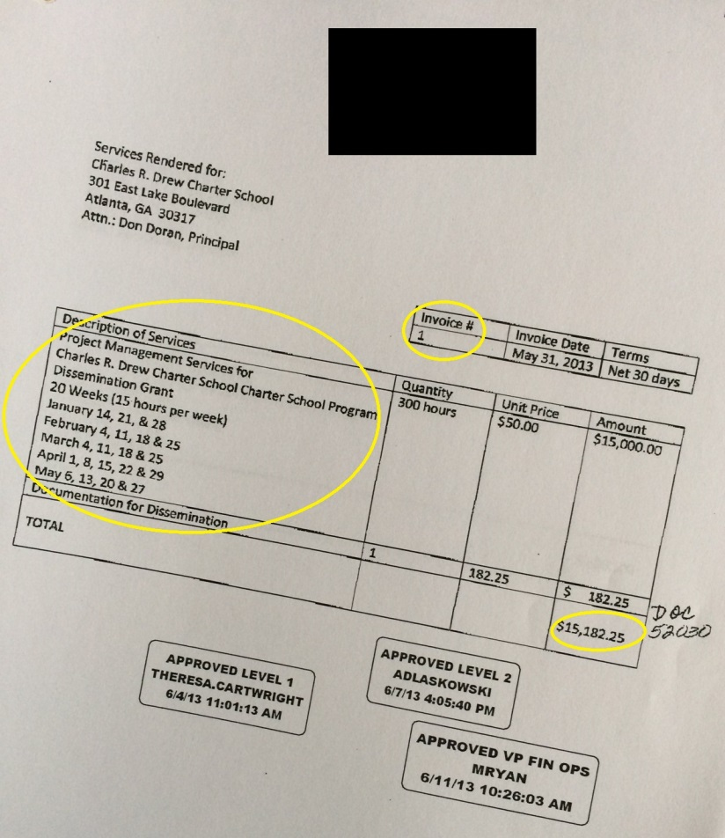
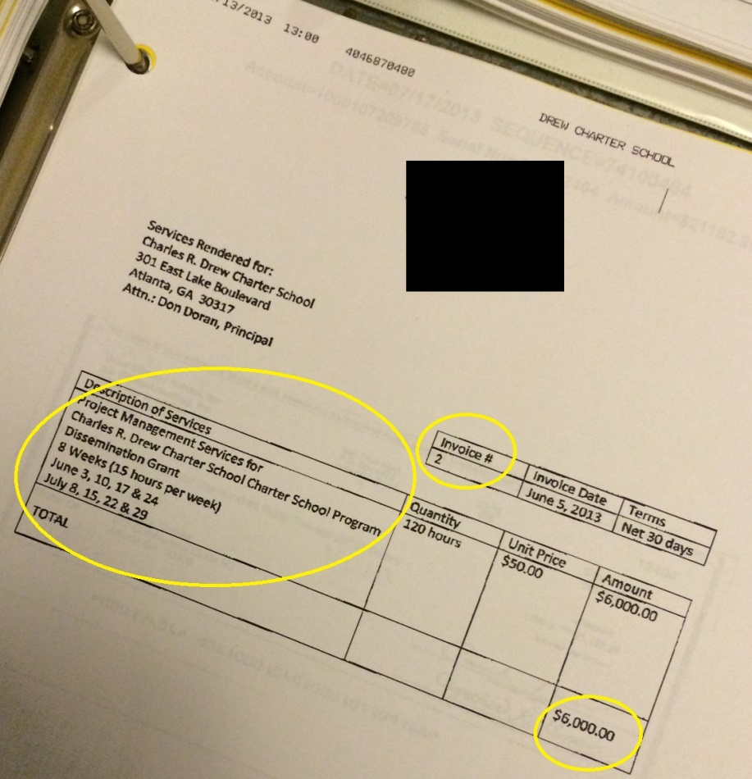
Grant Binder Examples Invoices
Notes:
Now, we can see where the consultant INVOICES the SCHOOL for the services provided. Note the description of services and that the amounts align.

Slide 27
Grant Binder Examples Checks
Notes:
Finally, they provide proof of payment in the amount of the invoices. This is what every grant binder should show with regard to every purchase for which they were reimbursed. Any questions?

Slide 28
Grant Binder Examples Inventory List
Notes:
During the grant monitoring visit, GaDOE may ask questions that are not necessarily related to the grant (ex. student access questions given in the grant monitoring tool). Also, let’s look at an example of an inventory log. If I go to room N-325 I should be able to locate each Lenovo computer listed. The additional comments (last column) would tell me if something were lost, damaged, stolen etc.

Slide 29
Grant Binder Examples Policies and Procedures
Notes:
Finally, an example of the policies and procedures this school included. Other things that you should have – conflict of interest, usage policies. Any questions on the grant binder and documentation?

Slide 30
After the Monitoring Visit
Each school receives a summary of findings and recommendations
If the findings of the first visit warrant a follow-up visit, CSD will determine the appropriate time for a follow-up visit
If issues are not corrected, CSD will take steps to recoup grant money
Notes:
I cannot stress enough – you should not have issues, but if you do, you must correct them immediately. This is federal money and we will have to withhold it if we determine that it is not being used appropriately.

Slide 31
Can you spot the potential issues?
Question: Achievement Charter School (ACS) wishes to purchase 15 computers at $300/each for a total of $4,500. ACS budgeted $7,000 for computers and plans to use the money they saved on Professional Development. After purchasing the computers, ACS submits the quote to their local district for reimbursement. The district reimburses ACS.
Notes:
$7000 x .10 = $700. They’re moving more than 10% from that function code. Requires a budget amendment. Quote not invoice. If the district reimburses, does that mean the school is in the clear?

Slide 32
Can you spot the potential issues?
Answers:
1.) $7,000 * 10% = $700 and ACS is requesting to move $2,500 from the function code. Therefore, a budget amendment is required.
2.) A quote and not an invoice was submitted to the district.
3.) Refer to slide 10

Slide 33
District Flexibility and Charter Schools Division
Allen Mueller
Director
amueller@doe.k12.ga.us
(404) 657-2529
Alvenease Jackson
Data Manager
aljackson@doe.k12.ga.us
(404) 230-3314
Yoshana Hill
Division Attorney
yoshana.hill@doe.k12.ga.us
(404) 656-0027
David “Kim” Wiggins
Grants & Financial Manager
kwiggins@doe.k12.ga.us
(470) 279-9454
Notes:
Take questions
Powerpoint will be sent to readers and will also be available on the Charter Schools Division website
Thank you for attending

