Slide 1
2022-2023
Data, Privacy, and Cybersecurity Conference
August 23 – 24

Slide 2
Updating Facilities and School Registry “Getting it Right and Keeping it Right”
Kelland Waldrep
Sarah Morris

Slide 3
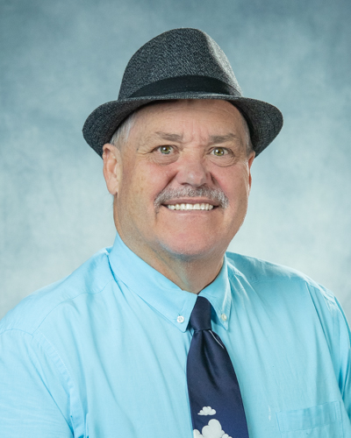
Introduction – Kelland Waldrep
33 years with Laurens County
  6 years as Paraprofessional
  7 years as Middle School Math Teacher
  20 years in Administration – School Level and District Level
4 years with GaDOE
  Facilities Services Division
  Research and Evaluation Specialist

Slide 4

Introduction – Sarah Morris
17 years in Program and Financial Management
9 years with GaDOE ​
  Facilities Services & Pupil Transportation
  Assistant Director

Slide 5
Objectives / Learning Targets
To be able to access Facilities and School Registry
To be able to navigate within FSR Program
To understand difference between Site Code, Facility Code and School/Program Code
To understand the process for updating a facility code and to update a school code.
To understand the difference between Superintendent’s Certification window and the FSR Update window.

Slide 6
Site Facility and School codes
Site Code
The code given to the piece of land in which a facility may be located. A site may have multiple facilities located on it.
Facility Code
The code given to a building or group of buildings on one campus.
School Code
A school is a group of learners. The code is given to the school located in a facility. There may be multiple schools located within a building.

Slide 7
Facility School Registry (FSR)
The database is the backbone of data collected for or about students.
The site itself is foundation for all other data collections.
The facility is then attached to the site.
The school is then attached to the facility so that student reporting can continue as needed by GaDOE and the local school system.

Slide 8
Why separate Facility and School Codes?
In the past, there was one code that was used for both facility and school.
For AYP and other reporting reasons, changes to grade levels housed at a facility/school caused a new code to be issued.
All facilities history, funding and planning are tied to the facility code.
It was necessary to establish a facility code separate from a school code to stabilize the facility code.

Slide 9
Obtaining a Site/Tract Code
Submit Site Application and all required documents to GaDOE Facilities
Application and documents will be reviewed
Site Code will be generated by GaDOE Facilities
Approval Letter will be sent to Superintendent

Slide 10
Facility Code
A facility code describes the buildings located on a site/tract.
The facility code will be issued by GaDOE Facilities after a copy of a warranty deed or lease for the site/tract is received.
The facility code will not change.

Slide 11
School Code
The School Code describes the group of learners housed at a facility. It may change when the group of learners changes.
One facility may house more than one school.
The school code is requested by school system employees through the Portal. It is not needed until the fiscal year the facility is ready to be occupied.

Slide 12
Updating FSR
Window for updating FSR begins July 1, 2022 and Ends September 23, 2022.
Requirements for creating new School Codes.
  Request a New School\Program Code form from Kelland Waldrep at kwaldrep@doe.k12.ga.us

Slide 13
Updating FSR Data
Review grades assigned to school and facility for SY23
  These should match.
Review the address of the site, facility and school
  Hint – These should match
Review school phone number
Review Superintendent – Update if necessary
Review/update school principal
  Hint principal must be credentialed in GaDOE Portal
Review names of facilities and schools
  Hint – Name the facility to match the school

Slide 14
Updating FSR – Opening New Facility
Change status from proposed to open.
Move school codes from old facilities into the new facility.
Close or rename any facilities not being used by students.
Close any school or program not being used any longer.
Contact Kelland Waldrep for help.

Slide 15
FSR Certification
FSR Certification of Records must be completed to report FTE I.
FSR Certification of Records will begin September 5th and end September 23rd.
The Superintendent of your school system must certify that the records are correct.
System’s Principals must have logged into their GaDOE portal within the last 60 days, or you will get a red error light.

Slide 16
Contact Information
  Georgia Department of Education
    Facilities Services Unit
    Kelland Waldrep
    kwaldrep@doe.k12.ga.us
    478-697-1783

Slide 17
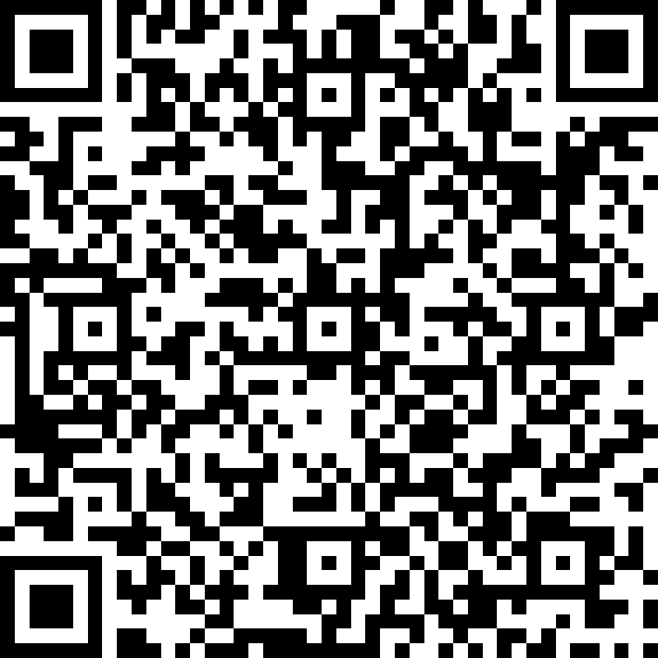
Feedback
2022-2023 Data, Privacy, and Cybersecurity Session Feedback

