Slide 1
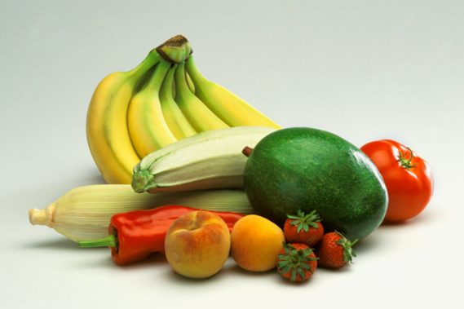
USDA
Fresh Fruit & Vegetable Program Training
2015 - 2016
July 7, 2015
Notes:
Welcome. Table tent. House rules. Introduce state staff.

Slide 2
Training Objectives
Operate a FFVP that meets Administrative Review requirements.
Implement a Financial Management and Budget Plan for 2 grant periods of the SY 2016 FFVP which uses all of the allotted funds.

Slide 3
Training Objectives Cont.
Create FFVP snack menus which include variety and Georgia-grown produce.
Identify FFVP nutrition education activities and uses for resources received.

Slide 4

How well do we know our Fruits & Veggies?

Slide 5
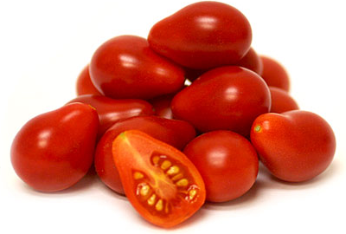
Teardrop Red Cherry Tomatoes

Slide 6
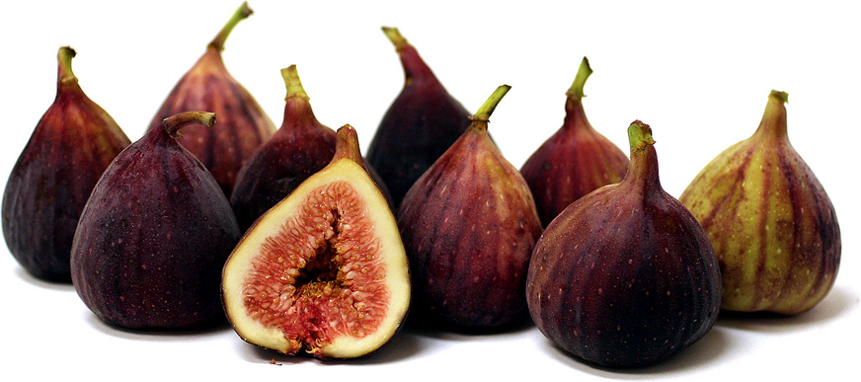
Brown Turkey Figs
Notes:
Let’s hear the name of this one. (wait for audience to respond.) ADVANCE to SLIDE IN NAME OF ITEM
Good job! Thank you for participating in that quiz. I hope those pictures got you excited about this program for your students next year. Students are often eager to learn about new foods, sometimes they are hesitant to taste them, and sometimes they like them after tasting them several times or later on in their school years. Foods should be offered more than once for students to learn about them and taste them. And, their opinion and acceptance of different foods does change over time. ADVANCE SLIDE

Slide 7

Orange Cauliflower
Notes:
Have you seen this one in the grocery store lately? Was is at the local farmer’s market recently?
ADVANCE SLIDE to ALLOW FRUIT NAME TO ADVANCE
Good job to those who know this one. Let’s have a show of hands of those who have tasted this one before.
Now, raise both hands if you think your produce vendor can get this ordered for you.
Before you see the next slide, I invite you not to shout out the name, but stand up after you see the picture if you know the name of the item. Ready, ….set, …..look
ADVANCE SLIDE

Slide 8

Ya Pear
Notes:
Stand up if you know the name of this item. (after one or more stand, ask them one-by-one to name it until you find the correct name.) ADVANCE SLIDE TO SLIDE WITH FRUIT NAME
Congratulations to those of you who know this one. You may sit down. And now, the last one is…… ADVANCE SLIDE

Slide 9
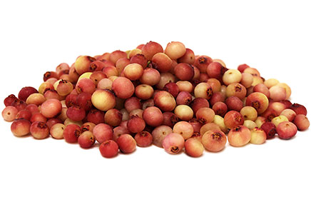
Pink Lemonade Blueberries

Slide 10

Is there a Handbook?
http://www.fns.usda.gov/cnd/ffvp/
Notes:
Yes – this is the current handbook. USDA tells us they will be providing an updated handbook sometime in the future. Until then, this is your guidance.

Slide 11

What are the goals?
1. Expand variety that children experience
2. Increase consumption
3. Impact children’s present & future health

Slide 12
Who does what?
National Level – administered by USDA Food & Nutrition Service (FNS)
State Level - administered through the State Department of Education

Slide 13
History:
The purpose of the pilot was to determine the best practices for increasing fresh fruit and fresh vegetable consumption in schools.
Notes:
This program started as a pilot with only 4 states Iowa, Indiana, Michigan and 1 Indian Tribal Organization in 2002. Two years later 4 more states (NC, Mississippi, PA, WA)were added to the pilot and in 2006 6 more states were added.

Slide 14
5 pilots
2002
+4 & permanent
2004
6 more
2006
In
the beginning
Notes:
This program started as a pilot with only 4 states Indiana, Iowa, Michigan, Ohio and 1 Indian Tribal Organization in NM in 2002. Two years later 4 more states (Mississippi, NC, PA, WA)were added to the pilot and in 2006 6 more states were added.

Slide 15
The Food, Conservation, and Energy Act of 2008
Notes:
Aka, the FARM BILL made FFVP a permanent program nationwide. That’s when GA got on the program.

Slide 16
Notes:
This and the next two slides refer to Georgia only.

Slide 17
How are schools selected?
Page 7
Elementary school
Operate NSLP
Submit application
Minimum 50% students eligible for F/R meals

Slide 18
How are schools selected?(cont.)
Highest priority - schools with highest percentage of low-income students in good standing with GaDOE.
Per student allocation $50 - $75 per year.

Slide 19

What’s new this year??
161 Schools participating
$50.42 per student allocation
Notes:
162 schools up from 156 schools last year. $50.11 per student allocation up from $50.08 last year.

Slide 20
Why 2 allocations?
October 1 – June 30 2016
Oct 1 –
June 30
2015
STATE first quarter
July 1 – Sept 30 2015
July 1 – Sept 30 2015
FEDS last quarter

Slide 21
Allocations
When do I get my allocation?
MONTHLY
After claim month

Slide 22
Allocations
How do I get my allocations?
School Nutrition Online (SNO)
Claim for reimbursement

Slide 23
FFVP Accounting Codes
Fund | 478
Program | 1861
Revenue | 4520
Function | 3100
Objects: |  | Description
 | 610 | Small Supplies
 | 630 | Fruits & Veggies ( All Produce)
 | 184 | Labor - Cafeteria employees
 | 191 | Labor - Central Office Staff
 | 200 -290 | Benefits & Taxes
 | 730 | Large Equipment

Slide 24
ALLOWABLE EXPENSES
Description
Small Supplies
Fruits & Veggies ( All Produce)
Labor - Cafeteria employees
Benefits & Taxes
Labor - Central Office Staff
Large Equipment
Operating
Administrative

Slide 25

2 Grant Periods
X
2 Allocations each Period
=
4 Bags of Money

Slide 26
4 Bags of Money

Slide 27
Claims and Reimbursement Process

Slide 28
Claims and Reimbursement Process
Purchase food and supplies
Submit claim
Receive reimbursement
by the 20th

Slide 29

Monthly Claim for Reimbursement
Supporting documentation:
  invoices
  timesheets with hourly wage & benefits
  APPROVED Equipment Pre-Approval
Nutrition Ed games, fact sheets, lessons, photos, activities, menus*, etc.
Notes:
We love to see what you are doing in your programs. Please share with us your newsletters, special promotions, nutrition education, any and everything you have going on with the Fresh Fruit and Vegetable Program. We very much want to see your menus.

Slide 30
Monthly Claim for Reimbursement
Usually school level
Operating Cost
  Fresh Fruits & Veggies
  Labor to prepare snacks
  Small Supplies
  Examples: napkins, paper plates, serving containers, utensils, knives, cutting boards, and low-fat dip
Notes:
Anyone know why low-fat dip is considered a supply? Because it’s not a Fresh Fruit or Veggie or labor. Also, Claude pointed out to me vendors are promoting hummus as a healthy alternative to dip. I had some hummus at home and 2 T was 70 calories and 50 of those were fat calories. So, hummus, being high fat means it, is not reimbursable.

Slide 31
Monthly Claim for Reimbursement
Administrative Cost
Kitchen Equipment, scanners, camera & accessories, etc.
Leasing equipment
Labor costs: planning, budgeting, etc.
Usually central office
Notes:
Include Pre-Approval form

Slide 32
SNO FFVP Invoice Application

Slide 33
SNO Navigational Instructions
Multi-page full color document
Step-by-step instructions to submit claim
Print & review reports BEFORE submitting

Slide 34
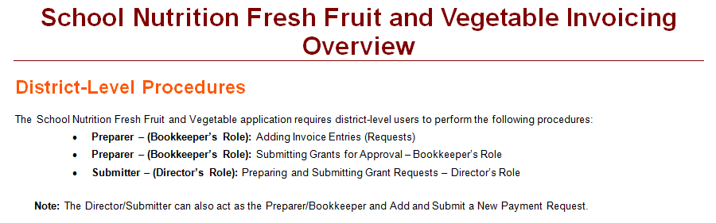
SNO instructions includes general information

Slide 35
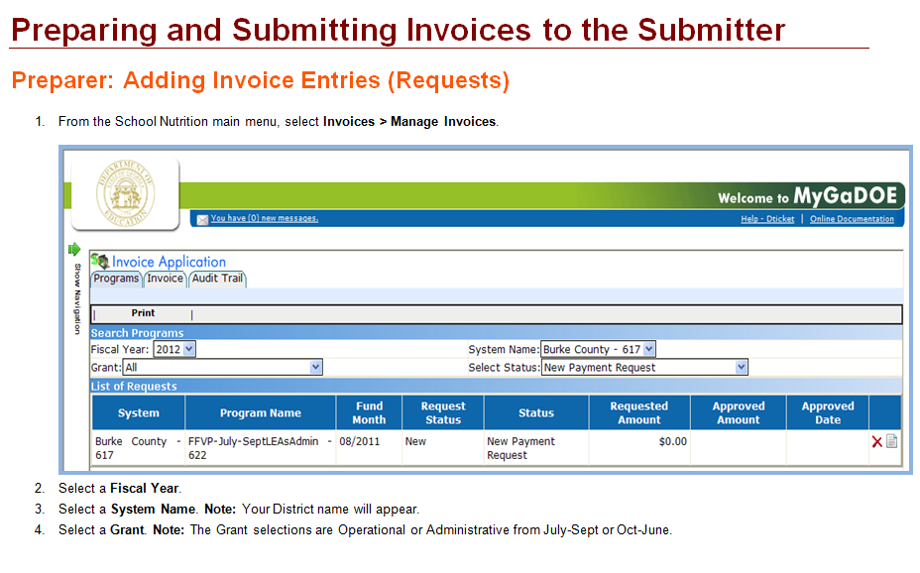
Step-by-step and screenshots

Slide 36
FFVP Reports
MyGaDOE Login
School Nutrition
Invoice
Reports
Report Category
  Detailed Monthly Expenditure
  Monthly Expenditure
  https://portal.doe.k12.ga.us/login.aspx

Slide 37

Budget vs.
Luck

Slide 38
BUDGET Example
October-June allotment: $25,000
October-June serving days: 132
$25,000 ÷ 132=$189.39 daily allotment
Oct. serving days: 18 x $189.39=$3409.02
Nov. serving days: 16 x $189.39=$3030.24
Dec. serving days: 11 x $189.39=$2083.29
March serving days: 21 x $189.39=$3977.19
Notes:
BUDGET ACTIVITY December serves the fewest days so their budget is almost half of March that serves the greatest days.

Slide 39
BREAK
Please return promptly in 17 minutes
http://timer.onlineclock.net

Slide 40

Michelle Coker
Walker County Schools
SNP Director

Slide 41

PURCHASING
Janett L. Adams
Purchasing Compliance Officer, School Nutrition Division
Georgia Department of Education
Office: 404-657-6167
Cell: 404-938-8710
jadams@doe.k12.ga.us

Slide 42
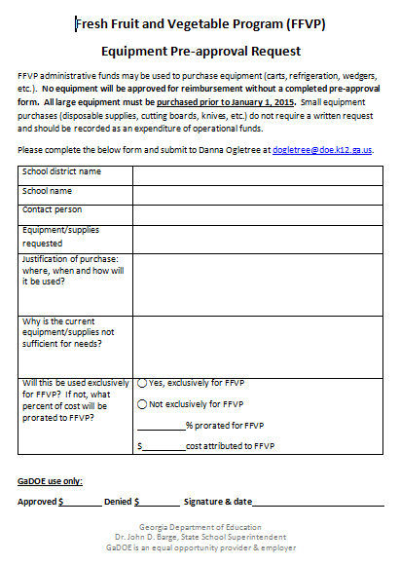
Equipment Pre-Approval Request Required

Slide 43
Equipment Pre-Approval Request
PRE – Approval
Spec sheet
How many, e.g., carts
Prorated
Submit approved form with claim
Out of the ordinary purchases

Slide 44
Documenting Labor
Claiming labor: Time & Effort
Not claiming labor: Semi-annual Certification
  Check with your HR

Slide 45
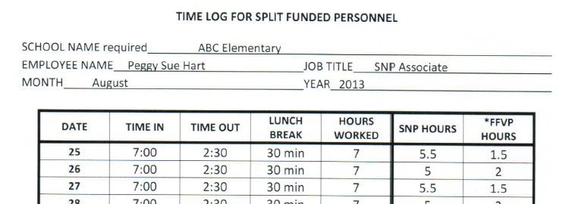
Prototype

Slide 46
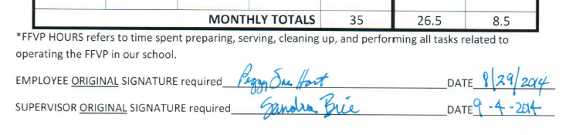
Prototype continued

Slide 47
Time and Effort cont..
Q. Where can I find the regulations?
A. Per OFM OMB Circular A-87, Attachment B, Section 8.h
  Check with your HR

Slide 48
What about Food Safety?
ServSafe Certified??

Slide 49
LUNCH
Lunch Buffet -----Enjoy!
Please return promptly in 49 minutes
http://timer.onlineclock.net

Slide 50
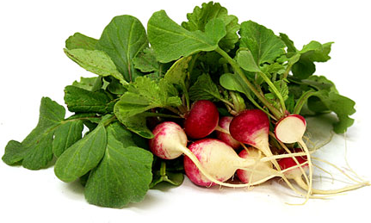
Sparkler Radishes

Slide 51
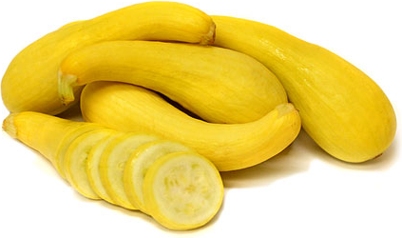
Yellow Crookneck Squash

Slide 52
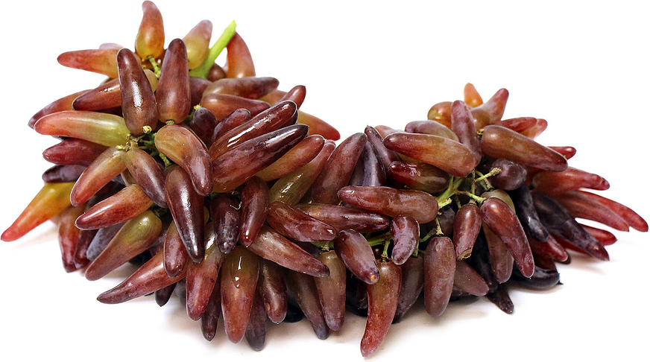
Witch Finger Grapes

Slide 53
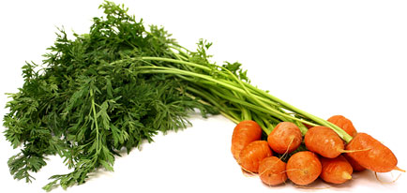
Planet or Round Carrots

Slide 54

Bing Cherries

Slide 55
Administrative Reviews
FFVP Portion (#1900 - #1910)
FFVP Self-Monitoring encouraged
SY 16 – 8 school systems
Notes:
FFVP AR is scheduled at the same time as the rest of your Administrative Review.

Slide 56

How are you serving fruits & vegetables in your school?
Notes:
It is suggested that you begin the conversations with principals, teachers, nutrition staff, janitors, vendors, parents, media center professionals, and community resource persons before school begins. Let’s look at what is Allowable and not Allowable to use in the menus. ADVANCE SLIDE

Slide 57
MENU PLANNING
Notes:
Consider the Tools you can use for menu planning to ensure smooth operations during the school year. (hold up calendar sample and Food Management or SNA Journal magazines). Use your school’s calendar as a guide and refer to professional tools such as industry publications and the nutrition association’s publications and web sites. You can begin to map out a whole school year of menus. Involve the Principal, Teachers, Managers and staff in the schools who will be serving the snacks as well as other school staff who may be interested. Find resources that highlight fruits and vegetables that are in season and keep those lists handy as you proceed through the calendar months. As you know if the food is “in season” the purchase price will probably be lower than out of season times. The produce vendors can also be a great resource during planning. Refer to page 8 in the Handbook; it suggests you calculate a monthly budget to track spending. What other tools are you thinking you may use?
(receive input from audience, reward participant with a prize). Great job. Now that you have your “menu planning” caps on, let’s see if we’ve covered a lot of the items needed. ADVANCE SLIDE

Slide 58
MENU PLANNING
School Calendar Portion size
Deliveries Serving time
Holidays Frequency
Staffing Variety
Testing dates Pack?
Seasonal Serving place
# of servings Dice/Slice
Notes:
MENU PLANNING ACTIVITY

Slide 59
Who can receive snacks?
Page 10
  All children attending the school
  Head Start, split-session kindergarten, or child care center located in your school
  Adults serving the snack
Notes:
The grant is very flexible in its scope and implementation criteria. Some evidence of the creativity of some Georgia school nutrition Program staff is available for you to see today. The program encourages and allows the adults who are in the classroom presenting the nutrition education and serving the snacks to model healthy eating and enjoy the snack along with the students. ADVANCE SLIDE

Slide 60
When can snacks be served? Page 12
  During the school day only.
Notes:
The Fresh Fruit & Vegetable Program snacks are to be served at times other than meals or other snack programs. All the attention should be focused on the objective of the snack and giving the students an opportunity to see, feel, smell, taste, and learn about fresh fruits and vegetables. Care should be taken to offer different fruits and vegetables that are not used in the regular breakfast, lunch, or after school snack programs. Since portion sizes are not specified, the new fresh fruit or vegetable can be served in a smaller portion for tasting—smaller than the minimum portions for the meal programs. ADVANCE SLIDE

Slide 61
When can’t snacks be served?
  Before or after school
  During afterschool programs
  Summer school sessions. (Year round schools okay)
  During the NSLP or SBP meal service periods

Slide 62
Where can snacks be served?
Page 12
Inside classrooms
In hallways
At kiosks
In free vending machines
During nutrition education activities
Notes:
WHAT ABOUT THE PLAYGROUND, FIELD TRIPS?

Slide 63
What can be served?
Foods allowed
Foods not allowed
Notes:
Now that you know how much money is available for your school’s grant, it is time to plan the details. The menu is one of those details. In food service, there is a widely-known principal which is “The Menu is the Driving Force”. When you think about it, menus can help program budgets survive or crash. Menus drive other program areas such as equipment needs, amount of labor needed, speed of service, and customer satisfaction. The objective of this grant is to offer a variety of fresh fruits and vegetables in their natural state to students. This allows students to taste the foods, learn about the health benefits of these foods which are healthy and tasty alternatives to snacks high in fat, sugar, or salt. This additional funding assists your school to provide an additional snack of nutritious, delicious foods with another opportunity for nutrition education. ADVANCE SLIDE

Slide 64

Which Fruits and Veggies to serve? Page 14
  New and different: kiwi, star fruit, kohlrabi, jicama
    Apple varieties
    Banana varieties
    Orange varieties
Easily recognizable
Make connections with veggies without dip
Natural state
Notes:
Again, remember the KEY word is FRESH. Plan and serve fruits and vegetables in their “natural state” without additives and serve them so the students can easily recognize them. They may be sliced or diced for ease in eating. A “whole” piece of the fruit should be sent to each classroom or a picture of the whole fruit or vegetable shown to demonstrate what the item looks like before it is cut. ADVANCE SLIDE

Slide 65
Which Fruits and Veggies to serve? Cont.
    Apple varieties:
    Honey Crisp
    Golden Delicious
    Braeburn
    Pink Lady
    Cameo
    Jazz
Empire
Rome
Winesap
McIntosh
Fuji
Gala

Slide 66
Which Fruits and Veggies to serve? Cont.
“Orange” varieties:
Blood orange
Cara Cara orange
Navel orange
Temple orange
Valencia orange
Mandarinquat
Sumo orange
Minneola Tangelo
Satsuma Tangerine
Cutie Tangerine
Honey Tangerine
Clementine Tangerine

Slide 67
Items NOT allowed
Page 14
Processed or preserved
Dip for fruit
Jellied fruit
Nuts
Cottage cheese
Flavorings
Juice
Notes:
This is again a list of items that are not allowed as snacks in this program even though they may contain fruit or vegetable foods or foods usually served with fruits or vegetables. ADVANCE SLIDE

Slide 68
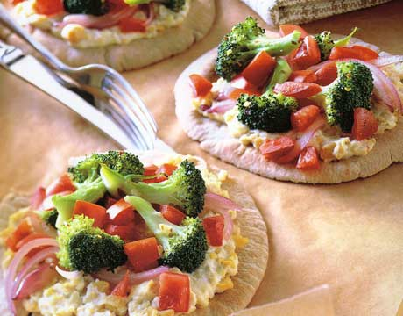
Items not allowed
Page 14
Snack-type fruit products
Vegetable or fruit pizza
Smoothies
Carbonated fruit
Notes:
There are creative ways to use fruits and vegetables in menus for meals and after school snacks, however, these items are not allowable for the FRESH Fruit & Vegetable Snack Program. ADVANCE SLIDE

Slide 69
FFVP Limits
Page 15
  Low fat or fat free dip for vegetables
  Prepared vegetables:
    Max once per week
    Include nutrition education
Notes:
Dips used with vegetables must be low-fat or yogurt-based or fat-free only. These are categorized as “supplies” when itemizing expenditures each month. Cooked vegetables must be limited to no more than once a week; there is no limit on raw vegetables. Thank you for your participation and interest in the “allowable” and “not allowable” segment. The next topic is the Production Record ADVANCE SLIDE

Slide 70
What kind of production records are required?
Date
Item served
Number of servings*

Slide 71
Number of Servings
All students in attendance
Cannot deny snack for discipline
Adults serving the F/V snack

Slide 72
FFVP Production Record
Prototype
Date & Day | # of Projected Servings - Students | # of Projected ServingsTotal | Serving Size | Food Items Used | Amount of Food Prepared | Leftover | Unit Cost | Total Cost
9-16-13 Monday | 460 | 500 | 1 | Apple-Honey Crisp (125/cs) | 4 cases | 0 | $35.00 | $140.00
9-17-13 Tuesday | 460 | 500 | 2 oz. 1 | Celery (100 2 oz. ind. Packs) Ind. FF Ranch Dressing (100/cs) | 5 cases 5 cases | 0 0 | $30.00 $ 8.54 | $150.00 $ 42.70
9-18-13 Wednesday | 460 | 500 | 1 | Pluots (100/cs) (Dinosaur Egg) | 5 cases | 0 | $30.00 | $150.00
9-19-13 Thursday | 460 | 500 | 1 | Pre-Packed Fresh Pineapple (100/cs) | 5 cases | 0 | $40.00 | $200.00
9-20-13 Friday | 460 | 500 | 1 | Pears (GA Grown) (150/cs) | 4 cases | 100 | $25.00 | $100.0

Slide 73

BREAK
Please return promptly in
14 minutes
http://timer.onlineclock.net

Slide 74
NUTRITION EDUCATION
Required with cooked vegetable
No funding
Handbook, pp. 20-21, 28-30
Connect with school Curriculum Department

Slide 75
Nutrition Ed Handouts
Availability Chart of GA Grown
FFVP State Links & Nutrition and Health Resources Links
F & V Word find
FFVP Parent Brochure
Brochure for Teachers & Staff

Slide 76
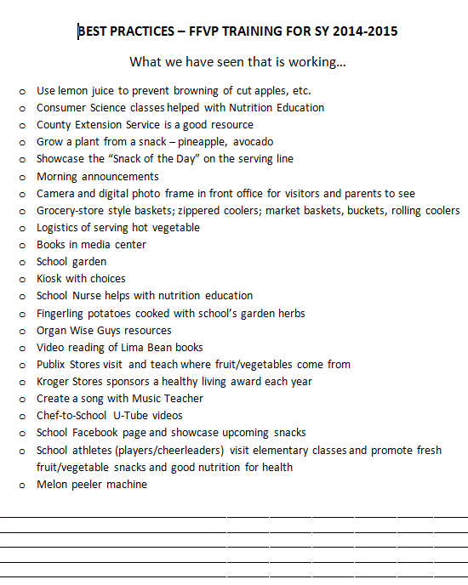
BEST PRACTICES

Slide 77
Remember . . .
Congressional intent and primary purpose of the FFVP is to provide fresh fruits and vegetables to school children.
This purpose should not be diminished.

Slide 78
What may we clarify?

Slide 79
EVALUATION
SY 16
Fresh Fruit & Vegetable Program Training
Please complete the evaluation!
Your ideas help us improve.

Slide 80
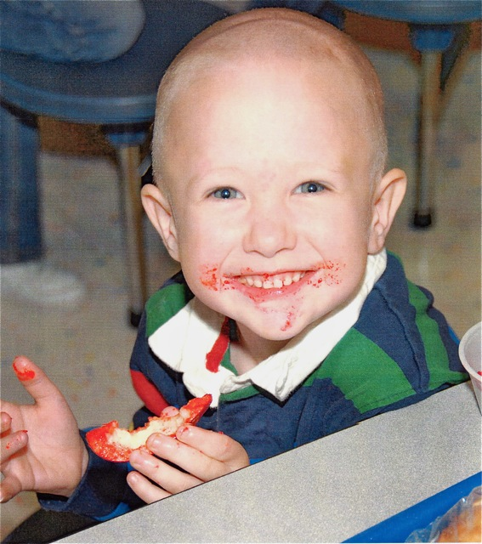
Thank you
for participating !

