Slide 1


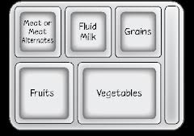
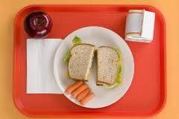

Recognize Reimbursable
Meals
Notes:
Many schools are required to, or choose to, implement the Offer versus Serve (OVS) provision of the school lunch and school breakfast programs. Today we will focus only on the school lunch program.
Every school nutrition employee must know what is necessary for meals to be reimbursable under this program. All student meals we serve are paid for in part or entirely by public funds. We must be sure that meals meet the requirements if the system is receiving funds for them.
It is each employee’s responsibility to ensure that meals served are reimbursable. The manager or cashier cannot assume this responsibility alone.

Slide 2
What Do
You Know?
Notes:
Some of you may have had a little experience with Offer versus Serve. For others, this is brand-new territory. Let’s take a few minutes to find out “What Do You Know?”
(Give each participant a copy of the “What Do You Know?” handout. Allow 5-6 minutes to complete the questions. Do not review answers at this time.)
Don’t worry if you weren’t able to fill in all the blanks—we’ll make sure you get the answers during the training.

Slide 3
OBJECTIVES
You will be able to:
Recognize a reimbursable meal using Serve or Offer versus Serve (OVS)
Identify food items, food components,
full components, and choices
Notes:
Our objectives for today’s training are…
(Read objectives.)

Slide 4
Lunch Meal Pattern
 | Grades K-5 | Grades 6-8 | Grades 9-12
Meal Pattern | Amount of Food Per Week (minimum per day)
Fruits (cups) | 2.5 (0.5) | 2.5 (0.5) | 5 (1)
Vegetables (cups) | 3.75 (0.75) | 3.75 (0.75) | 5 (1)
Dark green | 0.5 | 0.5 | 0.5
Red/Orange | 0.75 | 0.75 | 1.25
Beans and peas (legumes) | 0.5 | 0.5 | 0.5
Starchy | 0.5 | 0.5 | 0.5
Other | 0.5 | 0.5 | 0.75
Additional Veg to Reach Total | 1 | 1 | 1.5
Grains (oz eq) | 8-9 (1) | 8-10 (1) | 10-12 (2)
Meats/Meat Alternates (oz eq) | 8-10 (1) | 9-10 (1) | 10-12 (2)
Fluid milk (cups) | 5 (1) | 5 (1) | 5 (1)
Other Specifications: Daily Amount Based on the Average for a 5-Day Week
Min-max calories (kcal) | 550-650 | 600-700 | 750-850
Saturated fat (% of total calories) | < 10 | < 10 | < 10
Sodium (mg) | < 640 | < 710 | < 740
Trans fat | Nutrition label or manufacturer specifications must indicate ZERO grams of trans fat per serving.
Notes:
(Give each participant a copy of the “Lunch Meal Pattern” handout.)
Let’s look at the Lunch Meal Pattern first. As you know from a previous lesson, they are the new meal requirements for lunch. We will only be training on the new lunch requirements today.
These requirements went into effect July 1, 2012.
Let’s look at the chart and see how it’s set up.
The first thing to notice is that there are 3 age/grade groups: K-5 (orange) 6-8 (green) and 9-12 (blue). Where does your school fall in these groupings?
The grade groups are more narrow than in the past in order to provide age-appropriate meals. That is, 6-8 graders do not need the same amount of food as 9-12 graders.
This plan allows a school to use one meal pattern for students in grades K through 8 since food quantity requirements for groups K-5 and 6-8 overlap.
If your grades overlap, your system’s menu planner will be required to plan carefully to ensure requirements are met whenever two grade groups overlap. Who is your system’s menu planner?
Your job will be to learn the differences between the two (or three) groups and serve each grade group the appropriate portions on the serving line.
The manager and his or her staff, working as a team, must put into action what the menu planner writes.
How many of you have overlapping grade groups?
Now let’s look at another part of the chart.
Do you see the 5 food components? Where are they located on the chart? (in the white Meal Pattern column) What are they? (fruits, vegetable, grains, meats/meat alternates and fluid milk)
It’s important to learn how each group is measured. What measure do we use for fruits and vegetables? (cups) Do you see C-U-Ps in parentheses?
What is the measure for grains? (ounce equivalent—oz is the abbreviation for ounce) The menu planner and manager use a chart from USDA to determine ounce equivalents for foods in this group.
What is the measure for meats/meat alternates? (ounce equivalent) The menu planner and manager use the Food Buying Guide to determine ounce equivalents for this group.
Milk? (cups) Since this measure is fluid ounces, not ounces by weight, it translates to an exact number of ounces. For example, 1 cup = 8 fluid ounces.
Any questions?

Slide 5

Reimbursable Lunch
Five (5) full components must be offered or served at lunch
Five (5) components at lunch include:
  Fruits
  Vegetables
  Meats/Meat Alternates
  Grains
  Milk
Notes:
The full amount of each component must be made available for students to choose. We’ll talk about the difference between “offered” and “served” in a few minutes.
For example, if the fruit component requirement of one cup for grades 9-12 is offered in two half-cup servings, students must be able to take both ½ cup servings if they want the full serving of fruit.
Questions?

Slide 6
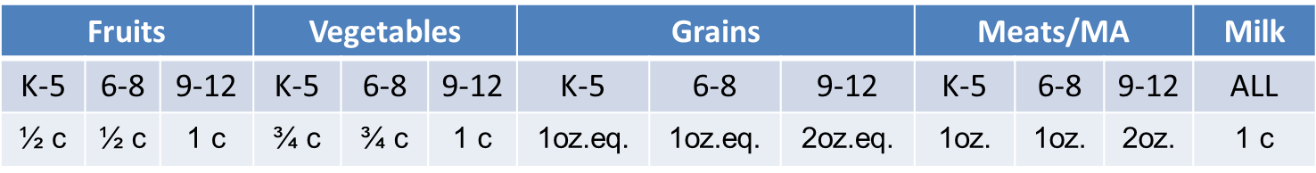

Reimbursable Lunch Definitions
Food Component - One of five food groups that make up reimbursable school lunch, school breakfast, and afterschool snack programs
Full Component (ex. lunch daily requirements)-
Food Item - A specific food offered within the five food components for lunch
¾
Notes:
There are a few definitions that will help you understand what makes a lunch reimbursable.
A FOOD component is a group of foods that make up a reimbursable school lunch or breakfast.
What are the 5 components for lunch?
Fruits
Vegetables
Grains
Meats/meat alternates
Fluid milk
A full component can be determined by the daily requirement on the NMP chart; today we’ll be looking at the one for lunch;
Knowing and understanding FULL component becomes very important for schools participating in OVS.
Look at the amounts by grade group and by component.
What is the full component of vegetable for 6-8 graders? (¾ cup)
What is the meats/meat alternates full component for 9-12 graders? (2 ounce equivalent)
A food item is a specific food within the five food components for lunch.
For example: A hamburger with bun is a food item. The hamburger patty is the meat component, and the bun is the grain component.

Slide 7
Definitions (cont.)
  Serve – students must take
  all 5 components, regardless of choices
Offer vs. Serve – allows students to decline up to any 2 components at lunch to minimize plate waste; schools are required to offer more food item choices
  Choice – several food items available as a
  component selection; choice is not OVS
Notes:
Another important concept to learn is the difference between “Serve” and “Offer versus Serve.” You will also need to know how “Choice” fits in with each. It’s critical that cashiers and servers understand these definitions.
If you work in a school that does not have OVS, you have a “Serve” program. Under “Serve,” all students must take all 5 components regardless of choices that are offered.
How many of you have OVS in your school? How many of you do not have OVS, and, therefore, have a “Serve” program?
Offer versus Serve allows students to decline no more than 2 of the 5 food components at lunch to meet their preferences. OVS helps minimize plate waste and requires schools to offer more choices to their customers.
Choices means that several food items are available as a component selection. Choices within components can be offered in “Serve,” but the student does not have the option to decline any of the 5 components. Choices are required in Georgia when schools participate in OVS.
Signage is very important. Even small children can learn how to participate in OVS with good signage.
Any comments or questions?

Slide 8
Show What You Know!
Using the food models and tray at your table:
Find 5 food items (don’t worry about portion or components), place on tray
Select 5 food items to represent the 5 components
Identify 3 choices within the vegetable component and within the fruit component
ACTIVITY
Notes:
(For this activity you may want to borrow one or more sets of food models or cut out pictures from magazines. Cafeteria trays will make the activity more realistic. If you use trays, you may want to put 2-sided tape in each of the compartments to hold the food models selected during the activity.
Between each activity, discuss other options. For example, food items could be the hamburger, pizza, juice.
The 5 components must include a low-fat (plain) or non-fat milk (plain or flavored).
Examples of 3 choices within the vegetable and fruit components include green salad, carrots, and squash; applesauce, orange, and juice.
Ask volunteers to stand up and show what they have on their trays for each activity.)

Slide 9
What is OVS?
An alternative way to start a tennis match
A way to offer more food choices to students on school menus
An option to reduce food waste and give students flexibility
Required in all Georgia schools
Notes:
What is Offer vs. Serve?
(C. An option to reduce food waste in the school meals programs and to give students the flexibility to select the foods they prefer.)

Slide 10
More on Offer vs. Serve
Required in grades 9 - 12 at lunch
Optional in grades K - 8 at lunch
Optional in ALL grades at breakfast
Notes:
(Read the slide.)
Stand up if you work in a school with OVS. What grades are in your school? Would OVS be optional or required? (Help participants with the answers if they seem hesitant.)
(Reinforce the following points.)
Just having choices is not OVS. You can have several choices and not be participating in OVS.
However, you must offer choices when you participate in OVS .
It’s a Georgia thing!
Comments? Questions?

Slide 11
Share what you have learned
ACTIVITY
Notes:
(Ask for volunteers to share a few things they’ve learned about Offer versus Serve under the Healthy School Meal Pattern.)

Slide 12

Healthy School Meal Pattern
We don’t know what you’ve been told,
The old meal pattern’s got to go.
Add leafy dark greens and black-eyed peas,
Red/orange veggies are sure to please.
At least 1/2 cup of fruit or veggie is the rule,
On the tray when you eat at school…
the MEAL PATTERN!!!!!
Notes:
(Lead class in the “Meal Pattern Song” cadence—the rhythm is based on the old “Sound Off” cadence.)
The purpose of a cadence when groups are marching is to get everyone in sync. Our school nutrition team needs to be in sync as we implement the different phases of the Healthy School Meal Pattern.

Slide 13
Offer vs. Serve - Rules
1. A student may select 3, 4 or all 5 food components offered at lunch
2. 5 full components must be offered
NEW this year!
All students must select at least ½ cup vegetable or fruit
AND at least 2 other full components for a reimbursable lunch
Notes:
(Read the rules.)
The option to decline items remains with the child although he or she must take at least ½ cup of fruit or vegetable.
(Review:)
The meal is still priced as a unit.
The price is the same whether the child takes the full reimbursable meal or declines one or two or zero items.
The full amount of each component must be made available to choose. For example, if the fruit component requirement of one cup for grades 9-2 is offered in two half-cup servings, the student must be able to take both ½ servings if he or she wants the full serving of fruit.

Slide 14

What Does the Required Fruit or Vegetable in OVS Look Like?
One or more servings of any fruit that equals at least ½ cup for lunch
Notes:
You can mix different fruits to reach the minimum required serving. For example, a student can choose ¼ cup of peaches and ¼ cup of apples to arrive at the ½ cup minimum.
You can mix different vegetables to reach the minimum required serving. For example, the student could choose a pizza with 1/8th cup vegetable and a 3/8th cup broccoli to meet the ½ cup minimum.
The student may take any combination of fruits and vegetables to meet the ½ cup. Students may select ¼ cup of fruit and ¼ cup of vegetable to meet the ½ cup requirement. For example, students may select a carrot raisin salad to meet the requirement. (Note: if students select ½ cup of fruit and vegetable, then for OVS the 2 other full components must be things other than fruit or vegetable components.)
(Mention: 1/8 cup is the minimal amount creditable toward a component.)

Slide 15

Examples of Required Vegetable or Fruit in OVS
One or more servings of any vegetable that equals at least
½ cup for lunch
Notes:
For example, carrots.

Slide 16

Examples of Required Vegetable or Fruit in OVS
One or more servings of a mixture of fruits and vegetables that equals at least ½ cup for lunch
Notes:
Here you have a salad that is a mixture of carrots, raisins, and pineapple.

Slide 17



Examples of Required Vegetable or Fruit in OVS
1 serving of a combination of fruit and vegetable that equals to at least
½ cup for lunch
Plus
Notes:
A combination could be coleslaw plus apple when they are served separately. A recipe for apple-cabbage coleslaw, however, would be a mixture.

Slide 18


Notes:
This poster (back and front showing on slide) was developed by several state school nutrition staff members here in Georgia. One thing you will learn as you work with our program is that Georgia is a national leader and innovator when it comes to school nutrition!
The poster was distributed to your system in September 2012. Every serving line in your school should have some kind of signage.
This poster is primarily for use in helping your students identify what they must have on their tray for the meal to meet the requirements for reimbursement.
It’s also a great tool for school administrators and teachers.
Remember:
A single-priced, nutritious meal is the goal of a federal reimbursable meal.
In order to enhance a student’s ability to choose wisely, the new meal pattern guidance requires that all serving lines have an easy method of identifying reimbursable food components in front or near the front of the serving line that constitute the unit priced reimbursable school meal(s).
Which side of this poster would you use if you participate in OVS? (Left side) What if you have “Serve”? (Right side)

Slide 19
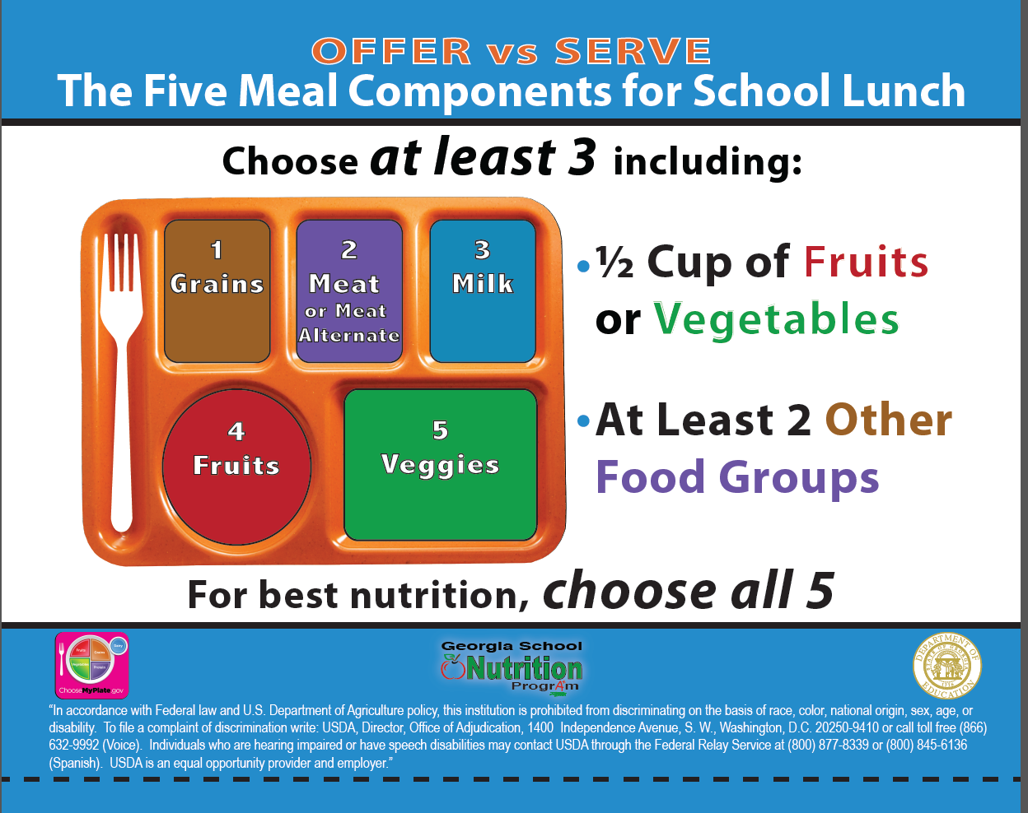
Notes:
There are 2 basic questions that a cashier must ask himself or herself when claiming a meal at lunch as reimbursable:
Is there at least ½ cup vegetable or fruit on the tray?
AND
Are there at least 2 other FULL COMPONENTS on the tray?
These are the minimum requirements for OVS.

Slide 20

Is it reimbursable for lunch?
ACTIVITY
Notes:
Now, let’s look at a few slides and get a little practice with a new game…“Is it Reimbursable?”

Slide 21
-Is this meal
reimbursable?
YES NO
-For what grade
level(s)?
K-5 6-8 9-12
Choose 1 or more
-Is this Serve or
Offer vs. Serve?
Serve OVS
Check your
meal pattern
chart.
½ cup
1 cup
1 medium
½ cup
1 ½ oz.eq.
WGR 2 slices
(2 oz.eq.)
½ cup
Notes:
(Show slide and ask for volunteers to answer questions. If desired, make a copy of the following activity slides. Encourage participants to circle the correct answers.)
(Note that the corn is ½ cup, the winter squash is ½ cup, the apple is ½ cup, and the bread is 2 ounce equivalent whole-grain-rich, abbreviated as WGR.)
For what grade level is this meal reimbursable?
(Because of the 1½ ounce meats/meat alternates, it is for K-5 and 6-8; therefore, K-8.)
So, is it reimbursable?
(Yes, it offers 5 full components. It is reimbursable for both SERVE and Offer vs. Serve.)

Slide 22
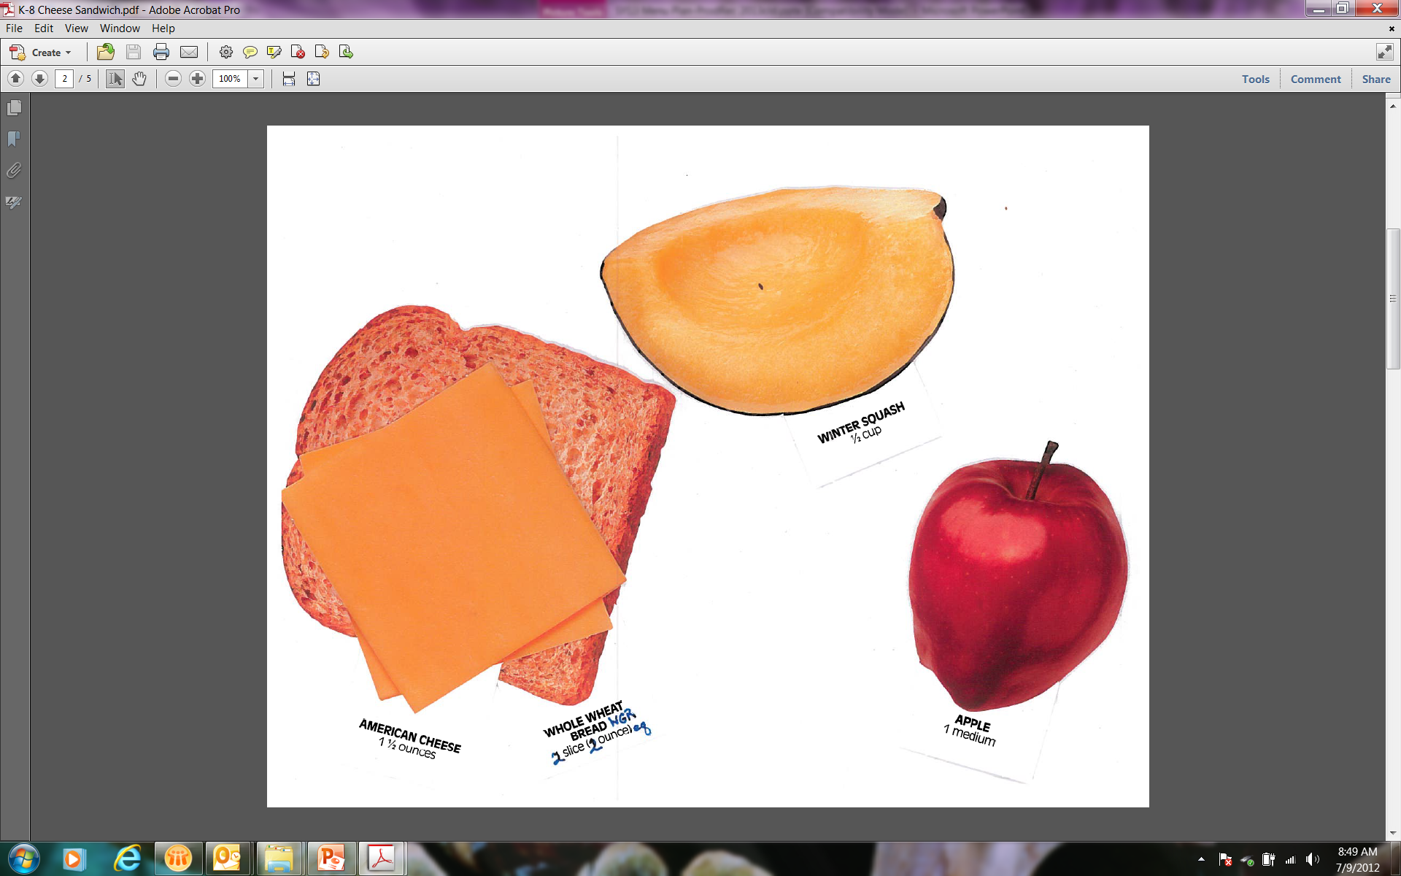
-Is this meal
reimbursable?
YES NO
-For what grade
level(s)?
K-5 6-8 9-12
Choose 1 or more
-Is this Serve or
Offer vs. Serve?
Serve OVS
Check your
meal pattern
chart.
½ cup
WGR 2 slices
(2 oz.eq.)
1 medium
½ cup
1 ½ oz.eq.
Notes:
The student chose a cheese sandwich, squash, and an apple.
Grade level is K-5 and 6-8
Is this meal reimbursable under SERVE? (No, because it needs 5 components.) What’s missing? (Milk and enough vegetables—there is no corn.)
Is it reimbursable under OVS? Let’s ask our 2 questions.
1st question: Does it have at least ½ cup vegetable or fruit? (Yes--½ cup squash or ½ cup apple.)
2nd question: Does it have 2 other FULL components? (Yes, it has 3 full components: cheese, bread, and fruit for K-5 and 6-8 (not 9-12.)
(Note: A full component of vegetables would be ¾ cup, so the squash cannot be counted as one of the 2 other FULL components. In this situation, the squash needs to be counted as the at least ½ cup vegetable or fruit in order for the meal to be reimbursable.)
Is this OVS meal reimbursable for K-8? (Yes.)

Slide 23
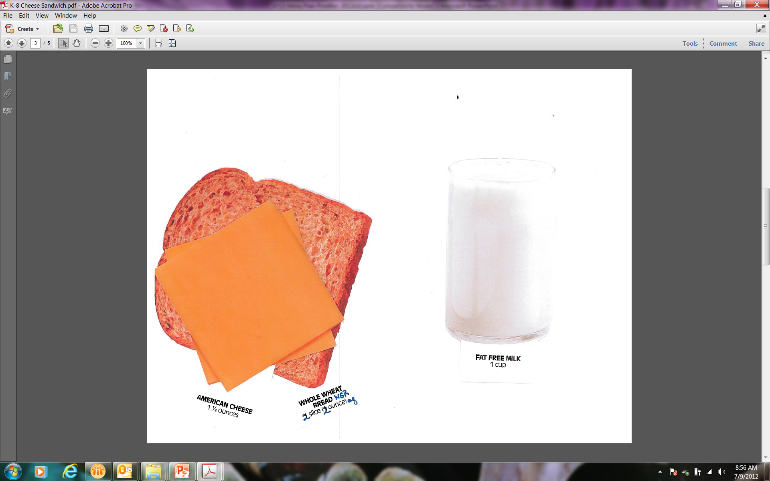
-Is this meal
reimbursable?
YES NO
-For what grade
level(s)?
K-5 6-8 9-12
Choose 1 or more
-Is this Serve or
Offer vs. Serve?
Serve OVS
Check your
meal pattern
chart.
1 cup
1 ½ oz.eq.
WGR 2 slices
(2 oz.eq.)
Notes:
The student chose this tray under OVS: cheese sandwich and milk.
Is it reimbursable for grades k-8? (NO) Why? Let’s ask our two questions.
Is there at least ½ cup vegetable or fruit? (NO)
The student must be sent back to pick up at least ½ cup vegetable or fruit.
Are there two other full components? (YES) There are three: grain (bread), meat alternates (cheese), and milk. However, the components alone are not enough for a reimbursable meal without the vegetable or fruit.

Slide 24

-Is this meal
reimbursable?
YES NO
-For what grade
level(s)?
K-5 6-8 9-12
Choose 1 or more
-Is this Serve or
Offer vs. Serve?
Serve OVS
Check your
meal pattern
chart.
1 medium
½ cup
1 cup
½ cup
Notes:
Is this meal reimbursable for K-8 under OVS?
Yes. It has at least ½ cup vegetable (squash) or fruit and 2 other FULL COMPONENTS! (1/2 cup apple for fruit and 1 cup milk)

Slide 25
-Is this meal
reimbursable?
YES NO
-For what grade
level(s)?
K-5 6-8 9-12
Choose 1 or more
-Is this Serve or
Offer vs. Serve?
Serve OVS
Check your
meal pattern
chart.
1/2 cup
1/2 cup
1/2 cup
1/2 oz. eq.
Turkey
2 oz. eq.
2 slices WGR
2 oz. eq.
2.5 oz=
2oz. eq.
Notes:
Does this menu offer all 5 components?
Note that there are 2 slices of bread (2 ounce equivalent).
Turkey and cheese are 3 total meat/meat alternates (2 ounce equivalent turkey, 1 ounce equivalent cheese—in this case, 2 slices of ½ oz. eq. cheese).
The fruits are ½ cup peaches and ½ cup blueberries.
The salad is 1 cup creditable total greens and other veggies (3/4 cup raw leafy greens plus 3/4 cup of tomato, carrots, and radishes).
French fries are ½ cup.
The milk is flavored low-fat milk.
For what grade level is this reimbursable? It can be for any grade group, but for this exercise let’s say it is for grades 9-12.
Since it is grades 9-12, and it is a lunch menu, it’s required to be OVS.
So is it reimbursable?
NO. The milk is flavored low-fat milk. Is that allowed? No. Only fat-free flavored milk is allowed.

Slide 26
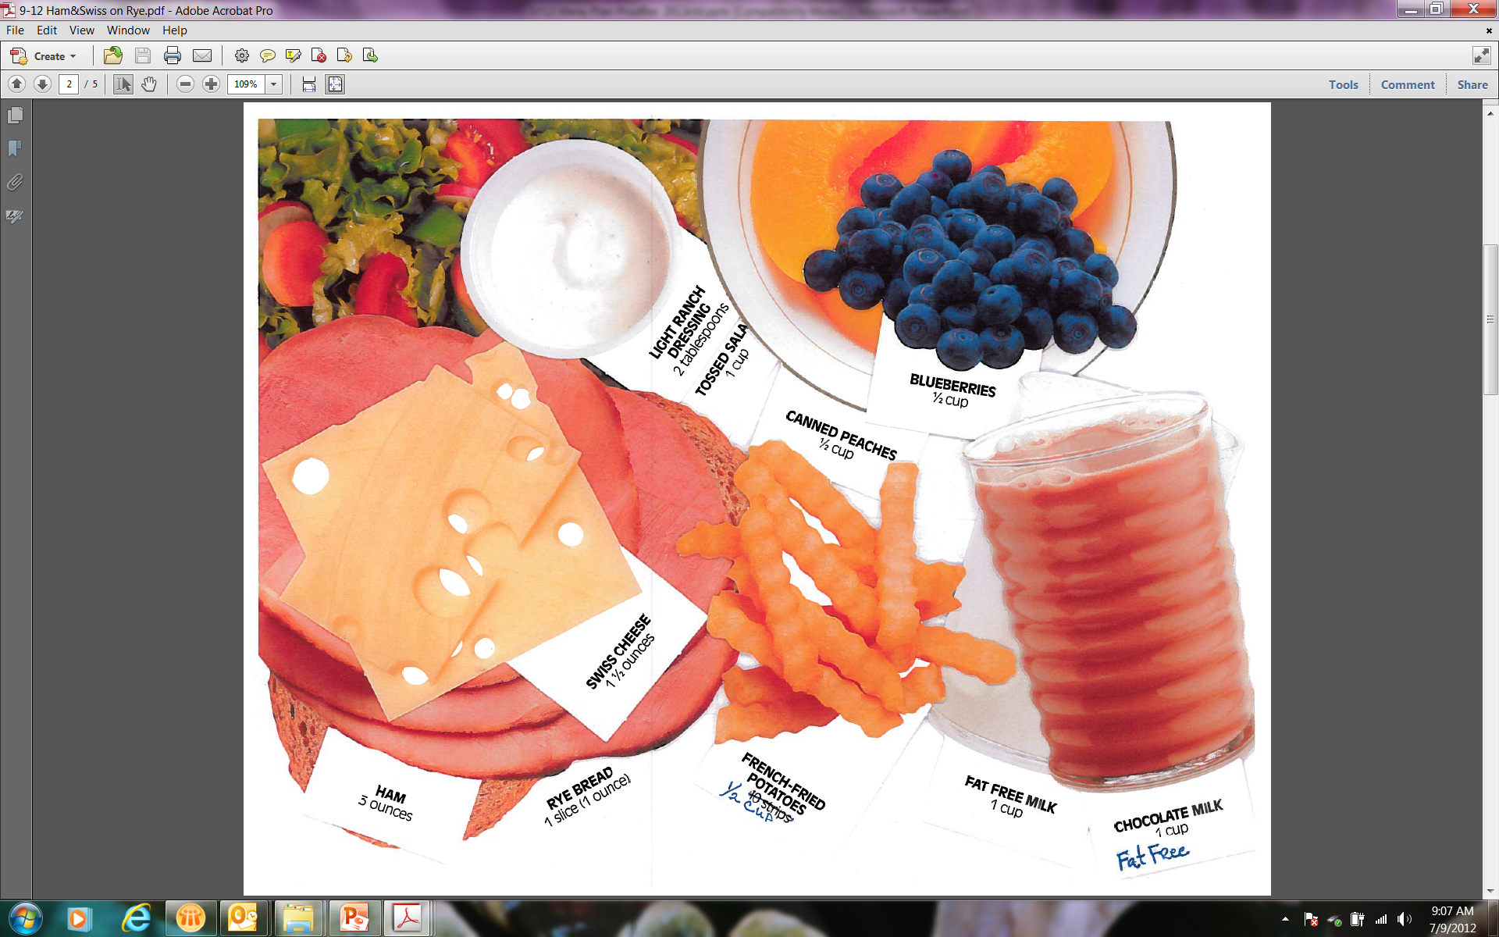
-Is this meal
reimbursable?
YES NO
-For what grade
level(s)?
K-5 6-8 9-12
Choose 1 or more
-Is this Serve or
Offer vs. Serve?
Serve OVS
Check your
meal pattern
chart.
1/2 cup
1/2 cup
1/2 oz. eq.
Turkey
2 oz. eq.
2 slices WGR
2 oz. eq.
1/2 cup
1 cup
fat-free
1 cup
fat-free
Notes:
Now is it reimbursable? Note the fat-free flavored milk.
Yes. The milk is fat-free, both flavored and unflavored.
Fruit is a total of 1 cup.
vegetable is a total of 1 cup.
Grain is 2 slices of rye bread (2 ounce equivalent WGR).
Meat/meat alternate is 3 ounce equivalent, total.

Slide 27
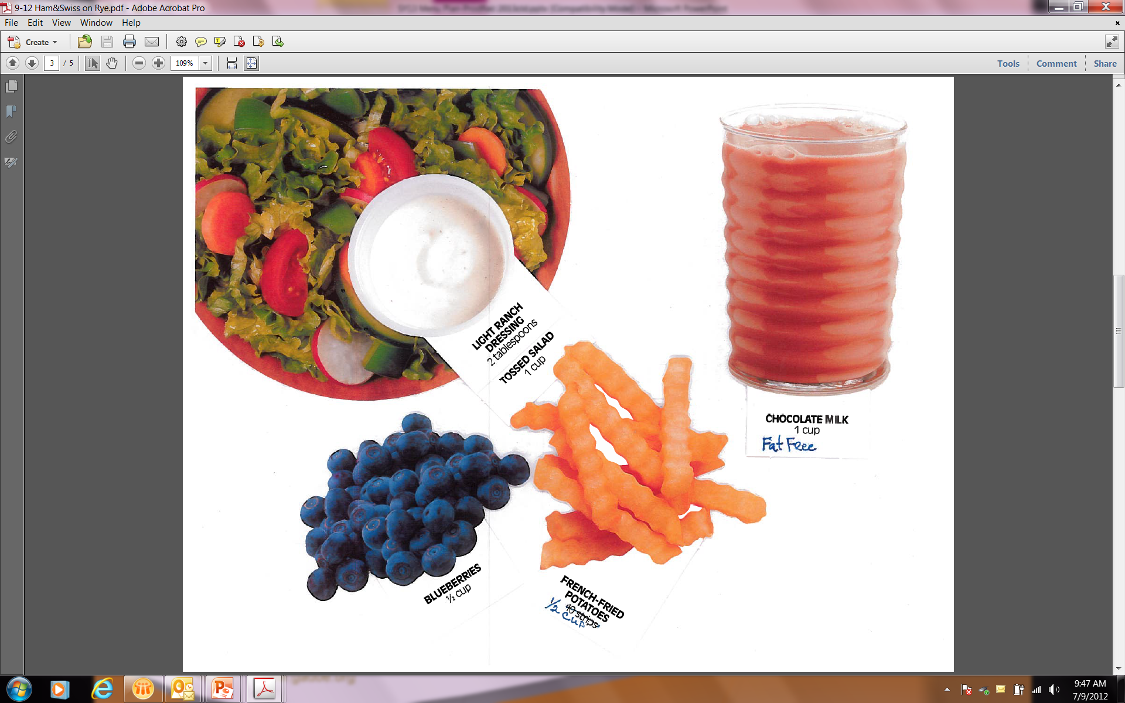
-Is this meal
reimbursable?
YES NO
-For what grade
level(s)?
K-5 6-8 9-12
Choose 1 or more
-Is this Serve or
Offer vs. Serve?
Serve OVS
Check your
meal pattern
chart.
1 cup
fat-free
1/2 cup
1/2 cup
Notes:
Is this meal reimbursable under OVS? YES
Is there at least ½ cup vegetable or fruit? (It is at least ½ cup requirement for 9-12, too.)
and at least 2 other full components?
Yes and Yes

Slide 28
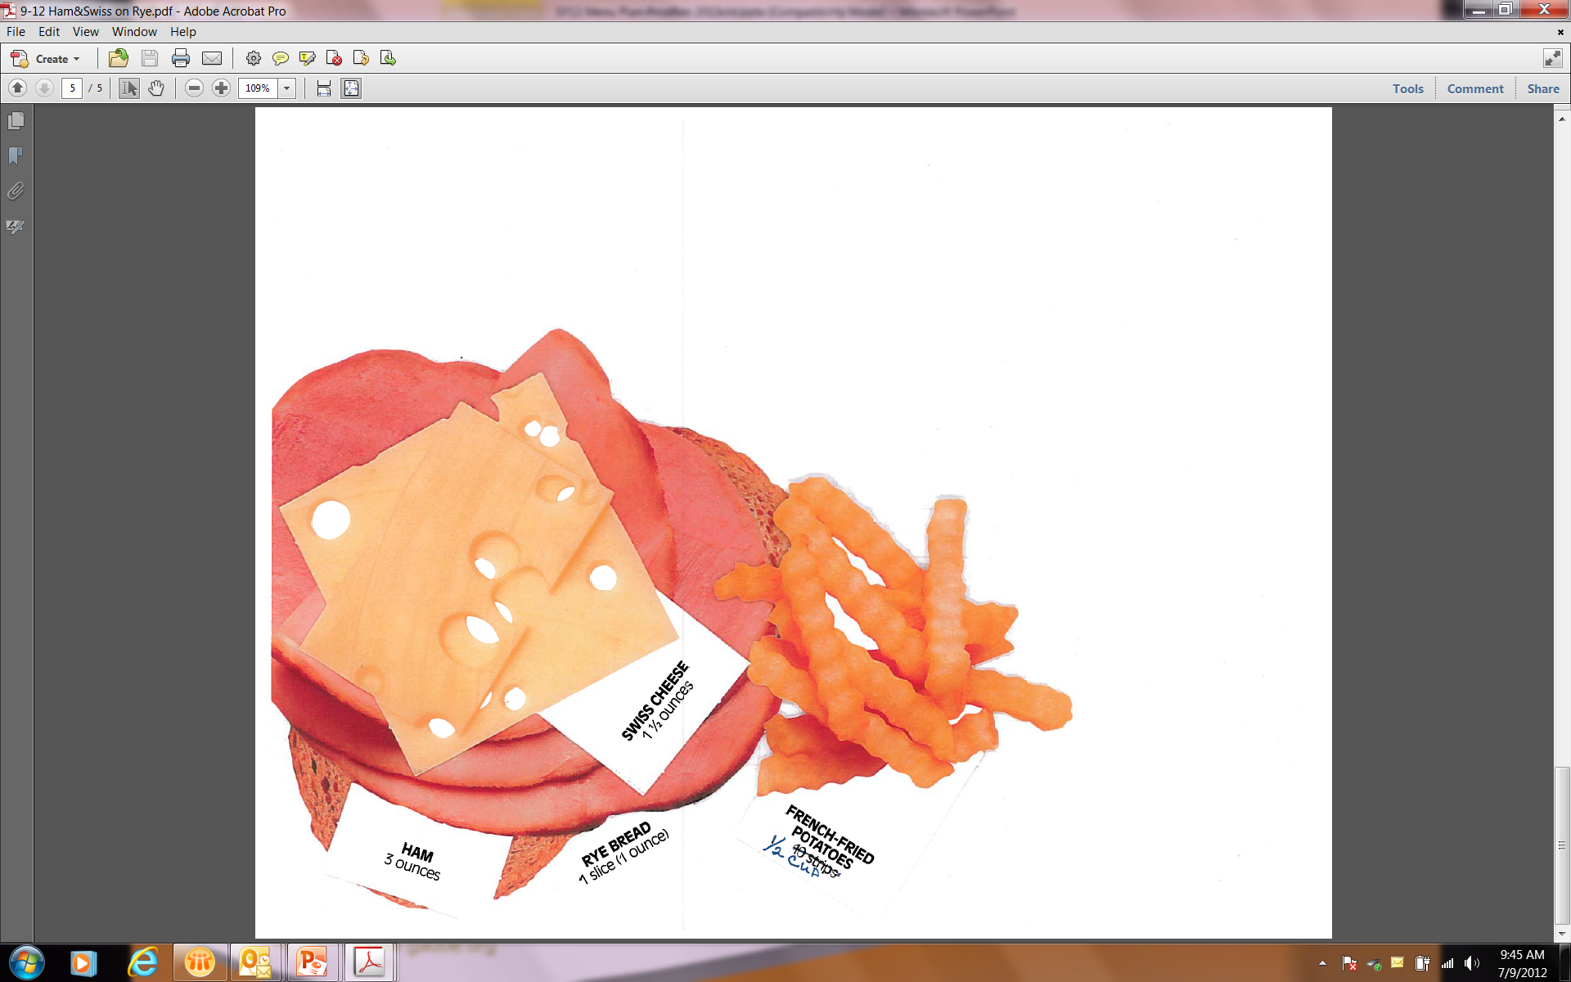
-Is this meal
reimbursable?
YES NO
-For what grade
level(s)?
K-5 6-8 9-12
Choose 1 or more
-Is this Serve or
Offer vs. Serve?
Serve OVS
Check your
meal pattern
chart.
1/2 oz. eq.
Turkey
2 oz. eq.
2 slices WGR
2 oz. eq.
1/2 cup
Notes:
Is this reimbursable under the new Healthy School Meal Pattern (OVS)?
Does this student tray have:
at least ½ cup vegetable or fruit
and at least 2 other full components?
Yes (1/2 cup french fries) and Yes (2 grains and 3 ounces of meat/meat alternate).
So, yes, it is REIMBURSABLE.

Slide 29
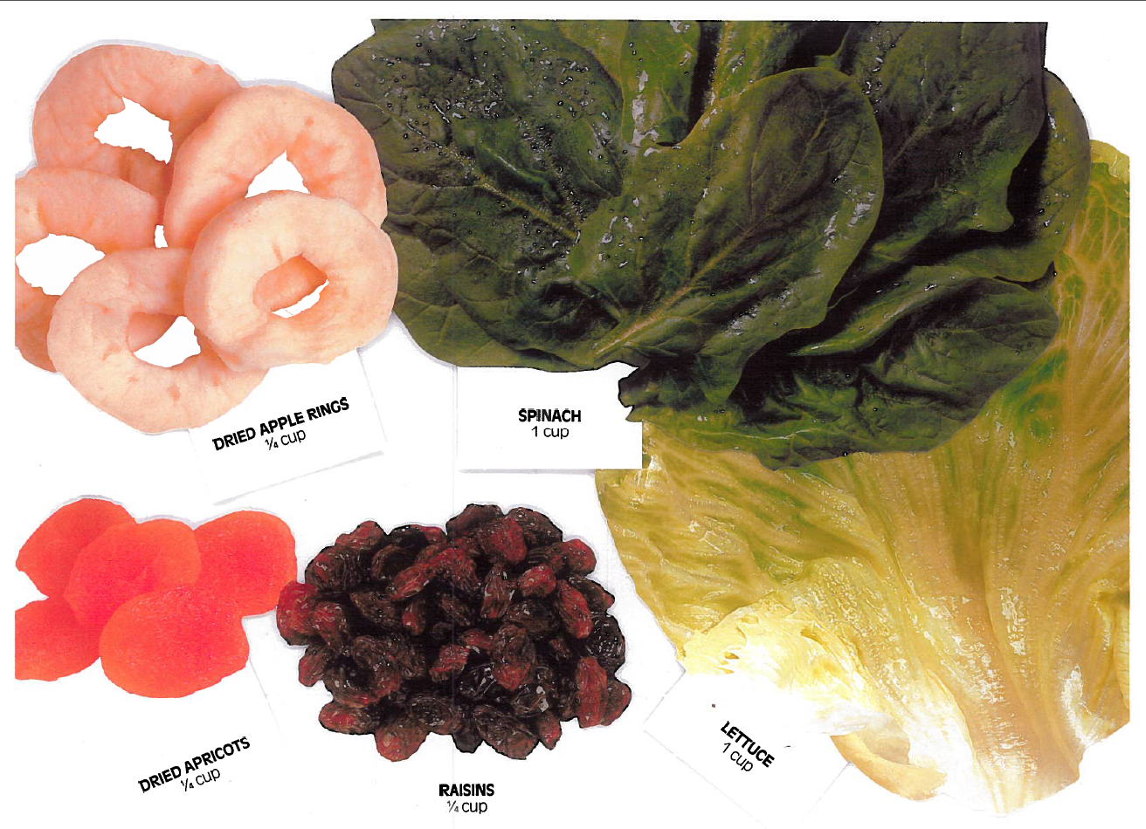
Notes:
What’s different about these fruits and vegetables?
They are dried fruits and leafy green vegetables.
How does dried fruit credit toward the fruit component?
Dried fruit credits DOUBLE. For example, ¼ cup raisins credits as ½ cup fruit.
How do raw leafy greens credit toward the vegetable component?
Raw leafy greens credit as HALF. For example, 1 cup raw spinach credits as ½ cup vegetable.

Slide 30
Your manager will…
Review daily menu with staff before meal service
Ensure correct serving sizes
Discuss possible combinations of offerings
Observe that Serve or OVS is being implemented correctly
Notes:
Your manager plays a key role in making sure that correct serving sizes are being offered or served and that meals served to students are reimbursable. However, he or she needs help from everyone on staff.
The manager needs to ensure all staff members know what is being offered and the serving sizes required.
The manager needs to check serving lines before meal service to be sure correct serving utensils or portions are available on the line.
The manager needs to discuss possible menu combinations and what will be acceptable for reimbursement. This information is particularly important for cashiers since they will be checking trays for reimbursable meals. However, servers also need to recognize a reimbursable meal in case they need to encourage a student to pick up an additional item.
Working with the team, the manager will keep a watchful eye out to ensure that Serve or OVS is being implemented correctly.
Are there other questions you would like to ask before we wrap up today?

Slide 31
SUMMARY
What do you
know, NOW?
Notes:
(Ask participants to pull out their “What Do You Know?” handout. Read the questions, and ask for them to “shout out” the answers. See Answer Key. Then ask for volunteers to share a question they can answer now that they were not able to answer at the beginning of class.
Thank them for their participation and encourage them to continue asking questions as we implement more parts of the Healthy School Meal Pattern.)

