Slide 1
2018 GaMEP Summer Programs
Georgia MEP High School Summer Leadership Academy at Abraham Baldwin Agricultural College; Tifton, GA.
  June 3-15, 2018
  30 rising 9th -12th grade students will be selected
Georgia MEP Middle School Program at Valdosta State University; Valdosta, GA.
  June 3-8, 2018
  30 rising 6th – 8th grade students will be selected
Applications submitted within the April 13-30, 2018 window, will be reviewed first.
Applications submitted after April 30, 2018 will be considered for open slots, when available.

Slide 2

Depth of Knowledge
Online Professional Development
Part 2
Education of Migratory Children Resource Specialist Team
Cindell Mathis Sabrina Rivera Pineda April Roberts | Miriam Blaisdell-Ndaayezwi Mary Clare Tarpley
April 17, 2018
Notes:
Cindell
Good afternoon, everyone! Welcome to Part 2 of the online webinars our Migrant agency will be hosting this month. I’m Cindell Mathis, Resource Specialist with Region 1 South, and today I have with me our Resource Specialist team: Miriam, Sabrina, April, and Mary Clare. As you know, there are 5 of us supporting you across the State, but to keep it simple; you will only hear from Miriam, Sabrina, and myself today. We want to thank you for being with us and hope that this professional development webinar will prepare you for key concepts that we will all be using during the third part of this series, which is our in-person ID&R training that is coming soon.

Slide 3
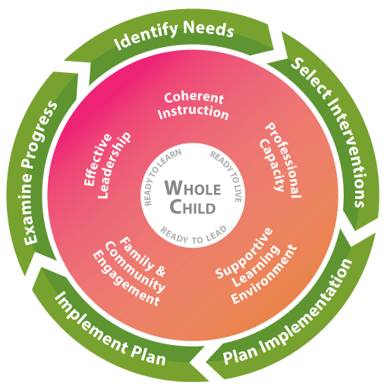

Georgia's Systems of Continuous Improvement to Improve Migrant Student’s Academic Achievement
Depth Of Knowledge
Notes:
Cindell
If you recall from our first webinar, what we will be talking about today connects to Georgia's Systems of Continuous Improvement as it relates to our Service Delivery Plan’s professional development goal, as well as supporting our migrant students’ ongoing academic achievement.

Slide 4
Overview
Part 1:
What is DOK?
How can I apply DOK Question Stems to my work?
Part 2:
Connecting DOK concepts to my work:
Introduction to Close Reading
Part 3:
In-person training
Notes:
Cindell
As we mentioned earlier, this is part 2 of our professional development series. We hope this presentation will relate to all the roles that you may have as an SSP in your work – whether you work with K-12, Preschool, or OSY.
In part 1, you learned about DOK and how to use DOK question stems when working with students.
Today, we hope to connect those concepts to your work and introduce you to the process of Close Reading.
Some of you may have questions about what we discussed in part 1 or may have questions about what we will discuss today, but we are going to ask that you please hold all of your questions until the end of the webinar today. We will be more than happy to stay on after we are done, and get all of your questions answered so you can be fully prepared for part 3, which is the in-person training.

Slide 5
Depth Of Knowledge
What is it?
  Depth of Knowledge (DOK) is a way to help students think more deeply about what they are learning.
  It is not simply increasing the difficulty of the content, but rather changing how students engage with it.
  It is moving from unengaged learner to engaged learner.
How can it be used?
  Across the content areas
  Across grade levels
  Preschool
  OSY
Notes:
Cindell
So, you may remember from Part 1, that DOK stands for Depth of Knowledge and it is a way to help students engage more deeply with the content they are learning.
We also gave you some examples on how it can be used across content areas and with OSY.

Slide 6
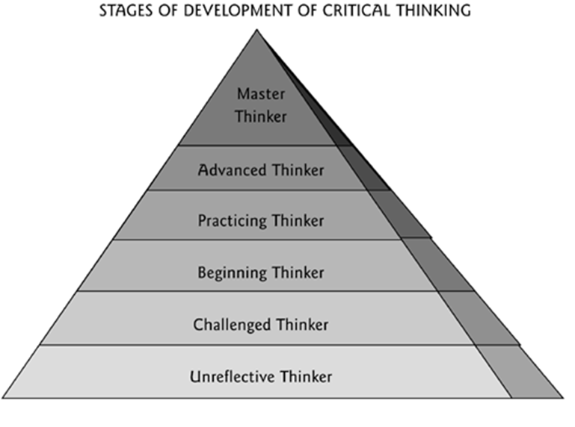
Framework for Critical Thinking
Fully engaged
DOK Levels
Unengaged
Source: The Paul-Elder Framework for Critical Thinking, Foundation for Critical Thinking
Notes:
Cindell
You will also recall this pyramid which shows the stages of development for critical thinking and how this ties into DOK concepts. As you increase the levels of DOK you can see the progression from an unreflective thinker to a master thinker. Also, if you think back to the practical example that we used in the first webinar, which was cooking, we described the growth from a beginner cook to a master chef.

Slide 7
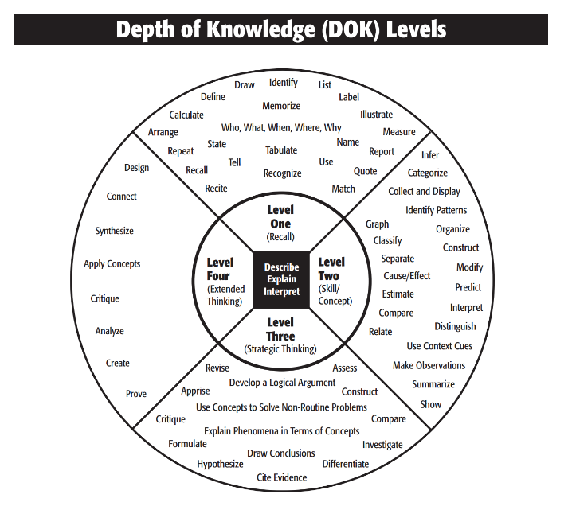
Four Levels of DOK
Level 1:
What is the knowledge?
Level 2:
How can the knowledge be used?
Level 3:
Why can the knowledge be used?
Level 4:
How else can the knowledge be used?
Webinar 1 Homework:
Which levels of DOK questioning did you use in your tutoring this past week?
Notes:
Cindell
In the first webinar you learned about the 4 levels of DOK:
You can remember that Level 1 is just “Simple recall” (Having an OSY simply stating their name or other demographic information when you are completing an OSY profile)
In Level 2, you can see that students are moving from simply recalling information to being able to develop a skill and interact with a concept (Asking an OSY to explain why getting their GED would be important to improving their current situation)
At Level 3, you will see a student begin to use strategic thinking (Continuing with the OSY example, you could ask him to apply what they have learned in a GOSOSY Life Skills Lesson)
By the time you are at Level 4, the student is engaged in extended thinking (A perfect example of this, is completing the action plan on the back of the OSY profile and having an OSY set specific goals for themselves)
We hope you had a chance to engage with your students with the four levels of DOK as part of your homework from the last webinar.
(Transition is quick)

Slide 8

Question/Chat Box Time!
Time to turn in your homework!
Notes:
Cindell
Now, we are going to give you 2 minutes to:
Think back to the homework that you had from webinar 1. In the chat box, tell us which DOK question stems you used in your personal tutoring last week and at which level?
For example, if I worked with a student in earth science, I may have used a Level 2 question stem by asking “How are volcanic ash and lava alike? How are they different?”.
Facilitator (Miriam): Call out some examples that people may be typing in the chat box – different content areas, different levels.

Slide 9

Connecting DOK concepts to my work:
Science projects
Writing assignments
Math tasks
Preschool lessons
OSY Health/ESL lessons
Grammar practice
Social studies reports
Close Reading*
Notes:
Cindell
Based on your experience using the different DOK question stems in your work, you can probably begin to see that you may easily connect DOK concepts to your everyday work with students. This can be done through assisting with students with Science projects, writing assignments, helping with math tasks, during preschool lessons and OSY Health/ESL lessons, through grammar practice, guiding students with social studies reports, and Close Reading*.

Slide 10
Framework for Critical Thinking: Close Reading
Close Reading:
Fully engaged
DOK Levels
Skimming Text: Unengaged
Source: The Paul-Elder Framework for Critical Thinking, Foundation for Critical Thinking
Notes:
Cindell
Close reading is a strategy to help students move up the DOK levels when reading a passage. Referring back to the pyramid of the stages of critical thinking, you can see that Close reading is a process that would help move students from unengaged readers (doing only a quick skim of a text) to fully engaging through a close reading of the text.
Sabrina will talk more about this cool process on the next slide.

Slide 11
Introduction to Close Reading
Close reading is a tool to:
Promote reading comprehension
Strengthen students' abilities to interact with texts
Encourage careful and purposeful rereading of a text
Allow students to focus on what the author had to say
Assist students in thinking critically and understanding what they are reading
Support questioning or tasks at the DOK levels
Notes:
Sabrina
So what exactly is close reading?
(Read slide)

Slide 12
Close Reading Steps
Preview passage/assignment features with student (i.e. title, graphics).
Ask student to listen and look for words s/he does not know, something surprising, important ideas, etc.
Read passage out loud to student (model reading fluency).
Read the passage again (you or the student).
Ask him or her to use specific symbols during the second read-through.
Notes:
Sabrina
To do Close Reading effectively you could follow these very specific steps:
First, you will want to preview the FEATURES, such as title or any graphics, of passage or assignment with students.
Second, you will ask the students to listen and look for words they do not know - something surprising, important ideas, etc.
Then, you will model reading fluency by reading the passage out loud to students.
Next, you will read the passage AGAIN and ask the student to use specific symbols during this second reading. (We will describe these symbols in detail later on)

Slide 13
Close Reading Steps Continued…
Review and discuss the student’s symbols with him/her. NOTE: The student may not use all symbols.
Use DOK questioning to help the student explore and better understand the passage, using the areas the student marked with symbols to help guide questioning and discussion.
Note: You won’t always use all levels of DOK! Sometimes you’ll only use 1 and 2 or 2 and 3. You may use level 4 only on rare occasions.
Notes:
Sabrina
Continuing with the Close reading steps, you will now review the symbols that the student used during the second reading and take some time to discuss these symbols with them.
Finally, using the symbols they used as a guide; you will apply DOK questioning - which will help the student better understand the passage.
Now, I know what you are probably thinking at this point: “This is a lot of steps to remember!”, but really – all you are doing is previewing the passage, reading it twice and marking it up, then talking about it.
These steps are meant as a guide to accomplish the task of Close Reading, which is to help a student comprehend the text fully.

Slide 14
Close Reading:
Explanation and Tips
https://www.youtube.com/watch?v=I_hhMeE7Osw
While you watch:
Think of a particular student with whom you could use Close Reading.
Notes:
Sabrina
So, with that said, now we are going to watch a short video so you can get an idea of how Close Reading can be used. You’ll notice that the teacher in the video, doesn’t necessarily follow every step in the order we have listed it, and that’s OK! Again, the idea is to get students engaged with the text and understanding it.
As you watch the video, we would like you to think of a particular student with whom you could use Close Reading. Then, we will ask you to share in the chat box again after the video.
CINDELL TAKE OUT HEADPHONES…..CC

Slide 15
Question/Chat Box Time!
In the chat box, tell us what grade level and content area you will use Close Reading with.
Don’t share names!
Notes:
Sabrina
Now that you have a better understanding of Close Reading, we will give you one more moment to think about one student that is on your tutoring schedule right now who you can use this strategy with in the next week or two before our in-person training.
Once you have identified someone, please type in the chat box the GRADE and CONTENT AREA that you plan to use Close Reading in. Please remember to not share names.
We will take a couple of minutes to allow everyone to respond.

Slide 16
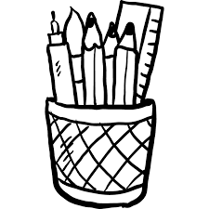
Tools for Close Reading
Passage
Writing tools
Highlighter
Post-it notes
Close Reading Symbols
Bonus!
Low prep time is required; few materials are needed.
Cooking example: Based on your experience with cooking this recipe and with people you know who have allergies, how would your cooking differ to accommodate a wider range of people?
Notes:
Sabrina
These are some tools you can use when doing Close reading with students. For example, (Read slide)
To help you as you begin to implement this strategy with your students, you will be able to build your own Close Reading tool kit during our in-person training.

Slide 17
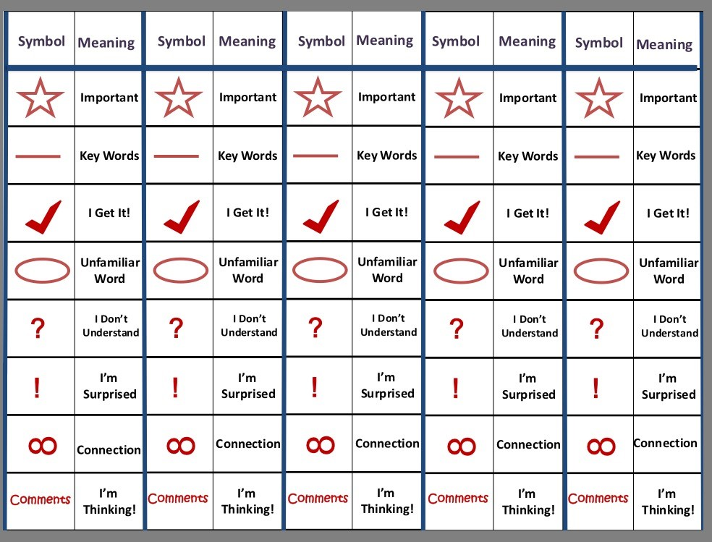
Close Reading Symbols
Source: https://www.cowan.k12.in.us/UserFiles/Servers/Server_248890/File/Title%20I/Annotation%20Bookmarks.pdf
Notes:
Sabrina
Earlier we mentioned that there are several steps you need to follow when conducting a Close reading. During the second reading of the text students utilize symbols to mark up the text with important details, key words, etc.
After this webinar you will receive an email with this as an attachment. This is a bookmark that contains the different symbols that students would use for this part of the process. For example, a star would signify something that is important to them in the story or they may circle an unfamiliar word or use a check mark to indicate that they understand what they are reading. When you receive this document please print it and cut it apart to create five separate bookmarks. You will need this for your homework which we will discuss on the next slide.

Slide 18

Close Reading Practice
Obtain a copy of a text (passage) or assignment you recently read/completed with a student.
Pretend you are one of your own students.
Use the Close Reading symbols bookmark that we will send to you after this webinar, to mark up the passage as you think your student might do.
Bring the marked-up passage with you to the last ID&R training, as you’ll need it for an activity.
Notes:
Sabrina
(Read slide)
We hope that as you do your “homework” in the next few days, you will become more comfortable with using Close Reading and find that it is a valuable strategy.

Slide 19
Thank you for attending!
Region 1 Resource Specialists
201 West Lee St.
Brooklet, GA 30415
Office: 912-842-5400
Cindell Mathis:
cmathis@doe.k12.ga.us
Sabrina Pineda:
spineda@doe.k12.ga.us
April Roberts:
aroberts@doe.k12.ga.us
Region 2 Resource Specialists
221 N. Robinson Street
Lenox, GA 31637
Office: 229-546-3248
Mary Clare Tarpley:
mctarpley@doe.k12.ga.us
Miriam Ndaayezwi:
mndaayezwi@doe.k12.ga.us
Notes:
Sabrina
Thank you for attending our second webinar in our series of Professional Development. We will stay on for any questions that you may have about this or the previous webinar. Otherwise, here is our contact information should you need to reach out to us before the next training.

Slide 20
2018 GaMEP Summer Programs
Georgia MEP High School Summer Leadership Academy at Abraham Baldwin Agricultural College; Tifton, GA.
  June 3-15, 2018
  30 rising 9th -12th grade students will be selected
Georgia MEP Middle School Program at Valdosta State University; Valdosta, GA.
  June 3-8, 2018
  30 rising 6th – 8th grade students will be selected
Applications submitted within the April 13-30, 2018 window, will be reviewed first.
Applications submitted after April 30, 2018 will be considered for open slots, when available.

