Slide 1
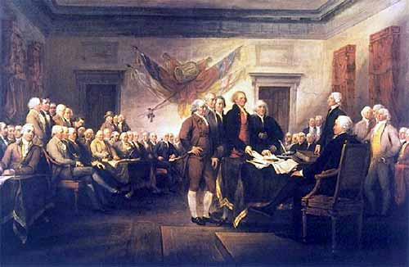
Georgia’s Title III Consortium

Slide 2
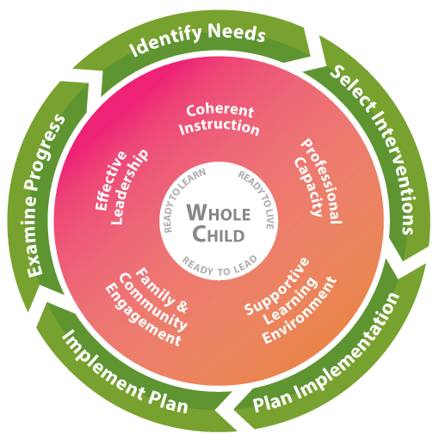
Supporting Systematic Improvement

Slide 3
2008: Why a Consortium?
Under, NCLB the law did not permit grants of less than $10,000. Awarded on a per EL basis, many, many districts with low EL numbers could not reach that $10,000 minimum.
What did this mean?
It meant that OVER HALF of Georgia’s school districts had a…
Lack of EL accountability
Lack of EL-related professional learning
Lack of outreach to parents of English learners
Lack of programmatic oversight

Slide 4
So what did we do?
Because NCLB allowed LEAs to create consortia, pooling funds to meet the $10,000 minimum, the State of Georgia decided to request approval from the US Dept. of Ed to pool all the LEAs’ funds and let the State administer the grant. This created a “Statewide” Consortium.

Slide 5
How did it work?
Financially, the Consortium pooled its funds. Southwest GA RESA serves as its fiscal agent, retaining 2% of the grant to perform its fiscal functions. Each member LEA must request to expend funds to meet the requirements of the law. By agreement, a DOE Title III specialist was required to review LEA requests for allowability and scalability Consortium-wide.
Programmatically, LEAs were responsible for fulfilling the student language support, PD and parent outreach components of Title III.
DOE Staff acted as “director” of the Consortium-LEA in managing trainings and Consortium-wide PD, providing ESOL endorsement opportunities and ensuring compliance with supplanting laws.

Slide 6
Growing Numbers…
School Year | # of ELs for Independent Allocation | LEAs offered Consortium membership
2009-10 | 53 | 93 LEAs
2010-11 | 57 | 96 LEAs
2011-12 | 60 | 95 LEAs
2012-13 | 62 | 101 LEAs
2013-14 | 72 | 103 LEAs
2014-15 | 69 | 97 LEAs
2015-16 | 69 | 106 LEAs
2016-17 | 75 | 113 LEAs
2017-18 | 77 | 115 LEAs

Slide 7
2018: New Era, New Opportunities
Increase in # of Charter Schools
District flexibility contracts (SWSS/Charter)
Consolidation of Funds option (Shaun Owen)
ESSA implementation
EL numbers vs. Title III allocation
Administrative costs
Increased LEA Expertise
Notes:
As excited as we are about the innovations that Charter schools can bring about for our ELs, because of their status as independent LEAs (due to their low enrollment), they’ve caused an explosion in our membership - but they often have unique needs that are different from those that stand-alone school districts have. And this huge conglomerate doesn’t have the capacity to serve their unique needs. Also, since they’re treated as though they’re a district….they are sometimes finding keeping up with the district-level responsibilities of managing Title III requirements to be very challenging in their small-school environment.
All but 2 school districts in the state have requested and been granted significant flexibility in how to carry out their academic programming – including ESOL - outside the bounds of State education rules. This freedom comes with increased accountability and responsibility, however.
We’ve also completed a pilot year in which a number of districts have consolidated their Federal Funds in Title I schoolwide schools in order to allow for even MORE flexibility in their administration of Federal programs. The Consortium is a roadblock to this flexibility because districts don’t ‘hold’ the money themselves, and thus cannot consolidate Title III funds.
ESSA has come along. The main purpose of the Consortium - district-level (or in this case…Consortium-wide) accountability for ELs – is no longer an option under Title III. Accountability is now at the school level – a level very granular in relation to what programming decisions we are capable of making on a statewide basis. In addition, notification to parents concerning the federal funded language support moved to Title I, and is now district-specific. The Consortium-wide template we used under Title III is no longer valid, and Consortium members must develop and translate their own, unique programs on this letter.
And as we saw on the last slide, EL numbers are growing exponentially. We’re the fastest growing demographic, but the federal funding isn’t keeping up. This has resulted in a nearly 50% growth in the number of ELs required for a district to get its own allocation. Therefore, we now have a huge number of districts in the Consortium who have numbers that – in the past – would have qualified them to be making independent decisions as to how to expend their Title III funds.
You, as the Title III director, with these larger numbers – have Title III job and reporting responsibilities related to Consortium membership…however because the fiscal agent must be the recipient of the 2% Administrative funds, no Title III funds may be drawn upon to support any part of your salary that relates to Title III administration.
When the Consortium began 10 years ago, district staff were less aware of and experienced in language support programs than they are today. At that time, the State ‘took over’ the management of and many decisions related to Consortium programming. But with the passage of time and the explosion in the number of ELs in our state – coordinators are now much more aware of what services should look like for ELs.

Slide 8
LEA Title III Consortia: Flexibility-Driven
Districts access and control their own funds.
PD is contextual & specific; it’s district or small Consortium-determined.
District purchases are internally approved.
Consortium districts develop their own Title III program plans based on their own individual student achievement goals.
Flexibility is gained – supporting LEA goals!
Notes:
SCHOOLS will be held accountable for student achievement now under ESSA; districts should be given the freedom to choose programs and activities to meet their improvement plans and their achievement goals set under state flexibility. The construct of a Statewide Consortium impedes on those freedoms. The accountability is the law – it’s happening. We need to regroup and allow you to make district-level decisions about your programming in order to meet the goals of your district.

Slide 9
Your Next Steps
Today: Find potential partner LEAs
Consider: Title III Allotment (group of LEAs must total > $10,000 for ‘18-’19 allocation); Regional proximity; School calendars; Philosophy on EL education; Unique resources partner LEAs could offer; Ideal # of partner LEAs
Next Week: Discuss with your district superintendent
By Thanksgiving: Review the sample LEA Consortium contract
Discuss: Who would be responsible as the lead LEA? How would the group collaborate to develop the Title III Program Plan and CLIP? Would Title III PD be planned and held as a consortium group or individually? How would purchasing be handled? Determine responsibilities for annual Title III data gathering and reporting to GaDOE.
Notes:
Unique resources – in-house qualified translators or interpreters, a university in an LEA that might be contracted with for PD; a strong parent outreach program or bilingual parent liaison; large migrant population and program with which to collaborate on outreach and initiatives

Slide 10
IMPORTANT!
We will not know next year’s ACTUAL allocation amounts until July, 2018. It is ALWAYS POSSIBLE that districts ‘on the cusp’ of $10,000 this year could move into “INDEPENDENT” status next year!
BE PREPARED for this possibility. Have a backup plan. (Would the LEA consortium disband? Would different LEAs be sought out for membership, in order to meet the $10,000 minimum?) You MUST plan for this eventuality BEFORE it happens!

Slide 11

Annual Timeline
Fall
1. Discuss next year’s potential membership and assign responsibilities;
2. Consider member backup plan(s);
3. Begin LEA Consortium contract (use sample or create your own)
Jan. – Mar.
1. Coordinate on, and Prepare LEA Consortium “Title III Program Plan” for the ConApp (‘17-’18 questions are included in your packet);
2. Begin budget planning with your anticipated group allotment.
April
Submit draft Consortium contract to Title III Unit.
(This is “Draft” until true allocations are known, and final membership is assured.)
(cont.)

Slide 12
Annual Timeline (cont.)
Aug.-Sept
1. CLIP/DIP due from each Consortium member
(Why not just Lead LEA? b/c Title III elements are required if using Title III funds.);
2. Final LEA Consortium contract due to Title III unit.
October 1
Title III program plan and Consortium budget due in ConApp (inputted by Lead LEA, as grant recipient)
May-June
Compile data and prepare narrative for annual Title III Self-Reporting Instrument (elements included in this packet)
Due July 1 from Lead LEA

Slide 13


Independence!

