Slide 1
Moving from the Resource Board for Teachers of Students with Significant Disabilities to the Notebooks of the Teacher Resource Link on SLDS

Slide 2
Migration from the Resource Board to SLDS/TRL
Instructional tasks for students with the most significant disabilities that are on the Resource Board are being moved to the Teacher Resource Link that is accessible through the SLDS.
At this time, ELA and Math instructional tasks have been organized into Microsoft Notebooks that are accessible through TRL.
The Notebook application can be accessed as a “guest user” through TRL and no login is required. The Notebook Application is a part of Office365.
Science and Social Studies items will be moved to this TRL but arestill available in the Resource Board.

Slide 3
One Note Notebooks The Notebooks are arranged by subject area and grade band
K-2 ELA
K-2 Integrated Literacy Units
K-2 Math
3-5 ELA
3-5 Integrated Literacy Units
3-5 Math
6-8 ELA
6-8 Integrated Literacy Units
6-8 Math
9-12 ELA
9-12 Integrated Literacy Units
9-12 Math
Science and Social Studies are still on the current resource board, and will be available in Notebooks through TRL soon! NOW AVAILABLE!!!!!!!

Slide 4
Notebook content
Notebooks contain the materials from the Resource Board for Teachers of students with significant cognitive disabilities.
Tasks were created by teachers in Georgia for teachers in Georgia to use in giving access to the Georgia Standards of Excellence.
Integrated Units Notebooks contain Units based on an adapted piece of literature with instructional materials and tasks from different subject areas.

Slide 5
Accessing the Teacher Resource Link
Log in to the SLDS through your School Information System
Access the TRL (Teacher Resource Link) according to your school system’s procedures

Slide 6
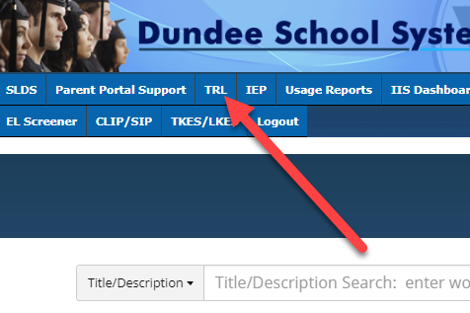
Select “TRL” from Menu Bar

Slide 7
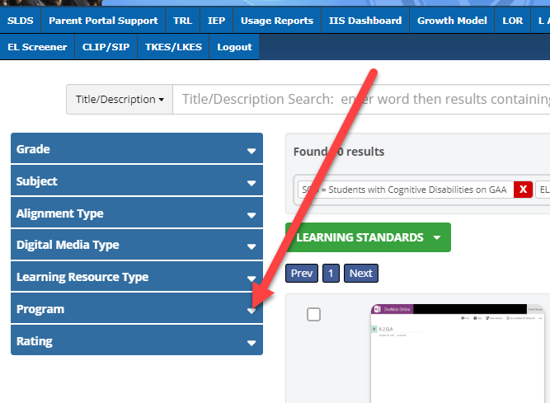
Click on “Program” And the selection expands

Slide 8
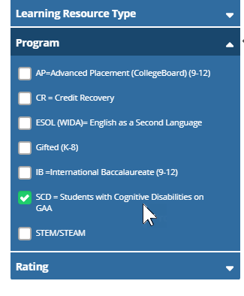
You can see that you have an option- “SCD = Students with Cognitive Disabilities on GAA” Check the box.

Slide 9
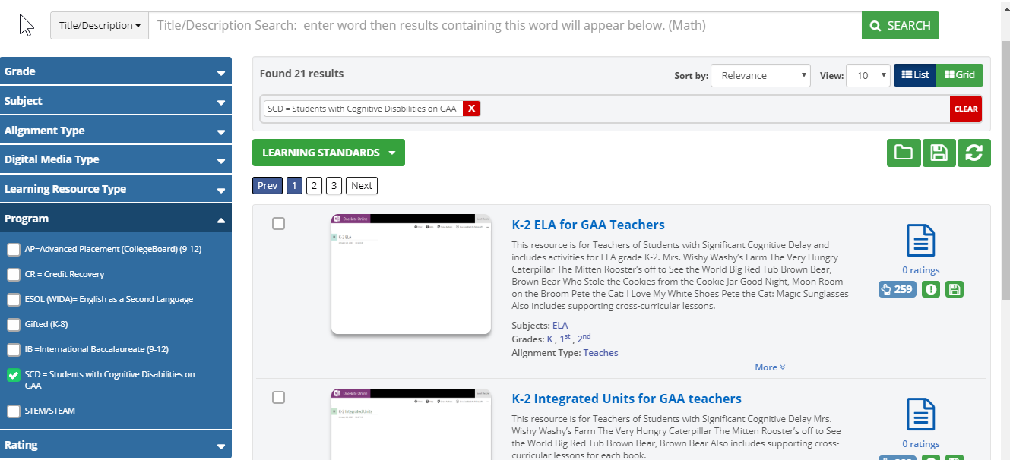
All of the Notebooks will display for all grade bands.

Slide 10
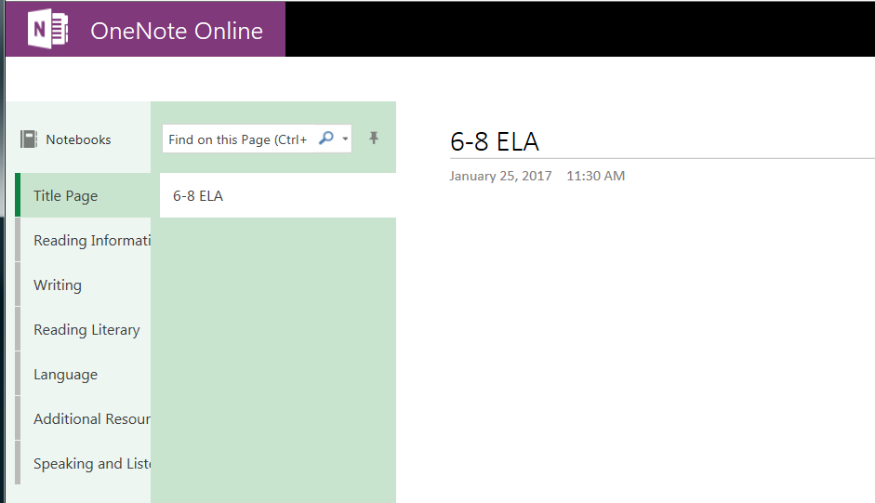
Notebook for 6-8 ELA
Categories of Subject Area

Slide 11
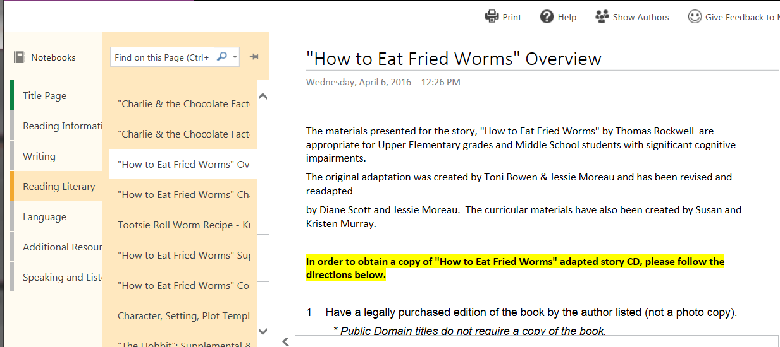
Each page contains an instructional task

Slide 12
Tasks in the TRL notebooks are the same tasks that have been moved from the resource board.
As time permits, edits are being made.
Some instructional tasks were created with BoardMaker and require that the user have the BoardMaker Program. The file suffix on these files is .bm2.
https://mayer-johnson.com/collections/boardmaker-software
This is a work in progress!

