Slide 1
School Climate Star Rating
Cheryl Benefield
Program Manager
Safe and Drug-Free Schools
Jeff Hodges
Program Specialist,
Safe and Drug-Free Schools

Slide 2
What is School Climate?

Slide 3

What is School Climate?
“School Climate refers to the quality and character of school life. School Climate is based on patterns of students’, parents’, and school personnel’s experience of school life and reflects norms, goals, values, interpersonal interactions, teaching and learning practices and organizational structures.” -National School Climate Center

Slide 4

Research has demonstrated that a positive school climate is associated with:
Academic achievement
Student engagement in school
Positive social skills development
Studies show that there is a significant difference in student achievement between schools with a good school climate and those with a poor school climate.

Slide 5
Students:
If students do not feel safe at school, do not feel welcomed at school, are not treated with respect, and do not have positive relationships with adults at school, they are less likely to attend school, behave appropriately, and meet their academic potential.
Schools:
If the school climate is not positive, students will underperform, student attendance and student discipline are not likely to improve, school safety could be compromised, and teacher retention may be negatively affected.

Slide 6
Improving School Climate
A positive school climate has been shown to:
Mitigate the negative effects of self-criticism (Kuperminic)
Improve a wide range of emotional and mental health outcomes (Way, Reddy, & Rhodes)
Increase student self-concept (Cairns)
Lower levels of drug use (LaRusso)
Reduce psychiatric problems among high school students (LaRusso)
Increase psychological well-being of students and their ability to cope with stressful situations (Ruus)

Slide 7
How Do We Measure School Climate?

Slide 8
Measuring School Climate in Georgia
Georgia Student Health Survey 2.0
    Administered annually to students in grades 6-12
    Grades 3-5 added in school year 2013-2014
Georgia School Personnel Survey (GSPS)
  Administered annually to teachers, staff and administrators
Georgia Parent Survey
  Administered annually to parents online
School Climate Star Rating
  Diagnostic tool for College and Career Ready Performance Index (CCRPI)

Slide 9

School climate surveys are administered online:
91 questions on GSHS 2.0 (grades 6-12)
15 questions on GSHS 2.0 (grades 3-5)
24 questions on Georgia Parent Survey
31 questions on Georgia School Personnel Survey

Slide 10
Georgia Student Health Survey 2.0
Georgia is one of the first states with a defined method in the collection and analysis of school climate and student health data through the implementation of the Georgia Student Health Survey 2.0.
The GSHS 2.0 is an anonymous, statewide survey instrument developed by the Georgia Department of Education (GaDOE) in collaboration with the Georgia Department of Public Health, Georgia State University and the University of Connecticut. The GSHS 2.0 identifies safety and health issues that can have a negative impact on student achievement and school climate.

Slide 11
GSHS 2.0 is administered annually from October – March.
2011-2012: 350,000+ students took the Survey
2012-2013: 657,000+ students took the Survey
2013-2014: 895,000+ students took the Survey
      2014-2015: 1,097,870 students took the Survey
      2015-2016: 1,135,150 students took the Survey
      2016-2017: Over 1 million students took the Survey
      2017-2018: Over 1 million students took the Survey

Slide 12
Did You Know?
All Georgia public schools must participate in the school climate surveys.
Schools must give parents the opportunity to review the student survey and opt out if desired.
Student survey responses are anonymous and self-reported.
GaDOE has internal control measures in place to ensure the integrity of the survey responses.
Student survey data is FERPA protected and GaDOE will not make personally identifiable, student-level data available to any person or entity outside the GaDOE.
Schools use survey data to guide school prevention and intervention programs.

Slide 13
Student Alcohol / Drug Use Patterns
(middle and high school surveys only)
  Use of alcohol/drugs in past 30 days
  Where students use alcohol or tobacco (home, school, friend’s house, etc.)
  Age of onset (age of first use)
  Perception of risk or harm (do students think it’s harmful to use alcohol, marijuana, tobacco, etc.?)
  Social disapproval (My friends and parents would disapprove if I used alcohol, marijuana, tobacco, etc.)

Slide 14
School Climate, Risk & Protective Factors
(middle and high school surveys only)
School Connectedness - likes school, looks forward to going to school, etc.
Social Support – gets along well with other students/staff, has friends, treated with respect, etc.
Cultural Acceptance – students show respect for others regardless of race, ethnicity, culture and academic ability, etc.

Slide 15
School Climate, Risk & Protective Factors
(middle and high school surveys only)
Social/Civic Learning- treats others fairly, open towards different opinions, shows courtesy to others, etc.
Physical Environment – school building is well maintained, classrooms are clean and organized, etc.

Slide 16
School Climate, Risk & Protective Factors
(middle and high school surveys only)
School Safety – feels safe at school, concerned about physical safety, students fight a lot, etc.
Peer Victimization – bullied or threatened by other students, cyberbullying, etc.
Mental Health – seriously considered or attempted suicide, self-harm, etc.

Slide 17
Student survey results are available at the school, district and state levels.
Each school and school district that participates in the Survey receives a comprehensive summary report that allows school administrators and other staff members to compare outcomes and plan prevention and intervention strategies and programs.
  Survey results are available on the GaDOE webpage.
  Raw survey data (for student, personnel and parent surveys) are available to school district personnel on the GaDOE portal.

Slide 18
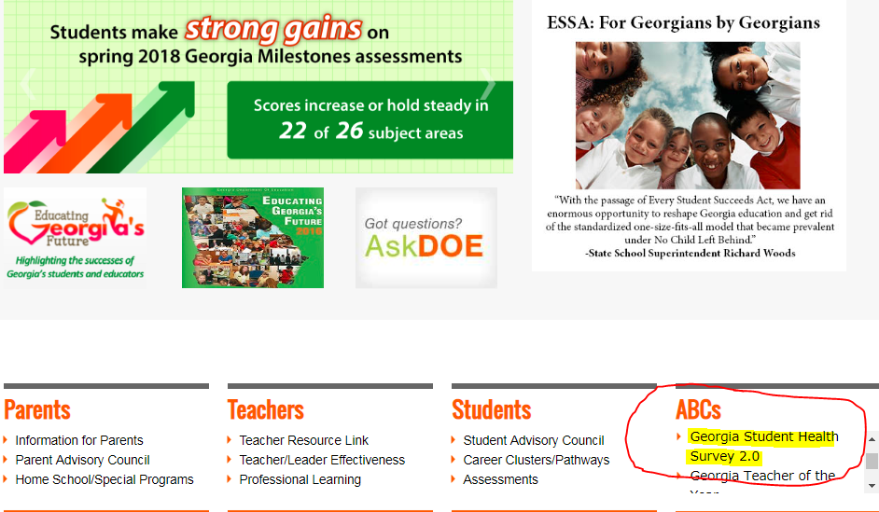

Slide 19
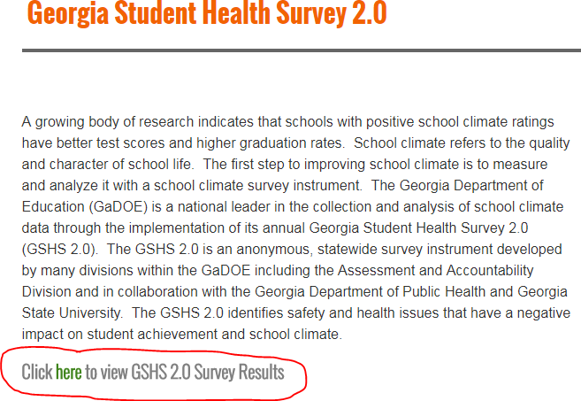

Slide 20
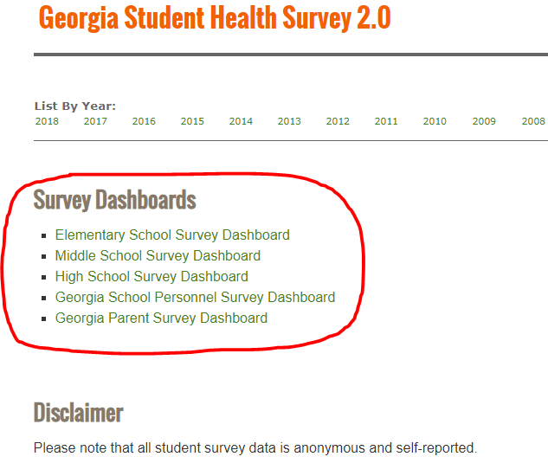

Slide 21
What does the GSHS 2.0 data tell us?

Slide 22
2017-2018 Student Survey Results
*Statewide results - 674,354 students (grades 6-12)
20% (134,170 students) have been bullied or threatened by other students in the past 30 days.
28% (191,508 students) have been picked on or teased at school in the past 30 days.
19% (131,082 students) do not feel safe in their school.
49% (329,232 students) say that students fight a lot at their school.

Slide 23
2017-2018 Student Survey Results
*Statewide results - 674,354 students (grades 6-12)
9% (60,936 students) have been mocked, tormented, or harassed on a social networking site by other students.
7% (45,635 students) have been offered, sold or given illegal drugs on school property in the past 12 months.
4% (24,039) students have brought a weapon to school in the past 30 days.

Slide 24
2017-2018 Student Survey Results
*Statewide results - 674,354 students (grades 6-12)
77% (518,496 students) know an adult at school they can talk to if they need help.
9% (60,112 students) had at least one drink of alcohol in past 30 days.
6% (41,295 students) used marijuana in the past 30 days.
3% (20,958 students) smoked cigarettes in the past 30 days.
7% (50,435 students) smoked an electronic vapor product in the past 30 days.

Slide 25
2017-2018 Student Survey Results
*Statewide results - 674,354 students (grades 6-12)
12% (78,969) students have seriously considered attempting suicide in the past 12 months.
Most common reasons given by students for seriously considering attempting suicide:
  Other (most common answer)
  Family reasons
  Being bullied
  Problems with peers or friends
  Because of the demands of school work
  I do not feel safe at school

Slide 26
2017-2018 Student Survey Results
*Statewide results - 674,354 students (grades 6-12)
6% (37,508 students) have attempted suicide in the past 12 months.
Most common reasons given by students for attempting suicide:
  Other (most common answer)
  Being bullied
  Family reasons
  Problems with peers or friends
  Because of the demands of school work
  I do not feel safe at school

Slide 30

Suicide Prevention Resources
http://www.gadoe.org/External-Affairs-and-Policy/Policy/Pages/Suicide-Prevention.aspx

Slide 31
GSHS 2.0
Mental Health Indicators
In an effort to establish a baseline of mental health status for Georgia’s students and to acquire information that may be useful in developing strategies and programs to address mental health issues, REACH (Resource for Advancing Children’s Health) mental health indicators were embedded into the GSHS 2.0 in 2014 (grades 6-12).

Slide 32
Schools as Mental Health Providers
Schools are often one of the first places where mental health crises and mental health needs of students are recognized and initially addressed (Froeschle and Meyers)
Of school-age children who receive any type of mental health services, 70 percent to 80 percent receive them at school (Atkins et al)

Slide 33
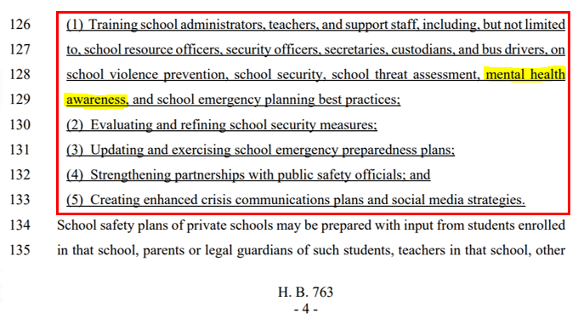
HB 763

Slide 34
New Funding for Student Mental Health Awareness Training
FY 2019 state budget provides $1,600,000 for student mental health awareness training as a component of school climate and safety

Slide 35
Mental Health Awareness Trainings
NAMI (National Alliance on Mental Illness) Ending the Silence for School Staff
CIT-Youth / Youth in Crisis
Mental Health First Aid (Adults)
Trauma 101for School Professionals
Brain Development 101: Understanding the Impact of Trauma on Brain Development
Trauma/Brain 201: Building Resiliency
DECAL: Early Childhood Training
ASIST (Applied Suicide Intervention Skills Training)
QPR (Question, Persuade, Refer)

Slide 36
Available Resources
PBIS (RESAs, Georgia Appleseed)
Youth Mental Health First Aid (Mental Health America)
Signals I (NAMI)
APEX Project (GaDBHDD)
Suicide Prevention (GaDOE, NAMI, MHA, BHDD, DPH, GBI, Mercer U., GSU, American Academy of Pediatrics, SPAN-GA, Behavioral Health Link, Willowbrooke, Amerigroup)
Trauma-Informed Schools (Child Welfare Training Consortium – state agencies, advocates, NGOs)
2nd Step Violence Prevention (State DFCS grants)
GEMA (Safe School Plans, on-site safety assessments, training, etc.)

Slide 37
School Climate Star Ratings

Slide 38

Georgia Law & School Climate
State law (O.C.G.A. § 20-14-33) requires the development and use of a “star rating” to address school climate and financial efficiency.

Slide 39

What is the School Climate Star Rating?
In response to the compelling body of research that underscores the importance of school climate, Georgia is the first state in the nation to include school climate as an early indicator in its academic accountability system, the College and Career Ready Performance Index (CCRPI). The School Climate Star Rating is a diagnostic tool to determine if a school is on the right path to school improvement.
Georgia School Climate Star Rating

Slide 40
O.C.G.A. § 20-14-33
Star Ratings
(1) "5-star" schools ranked excellent according to the state determined financial efficiency or school climate index, as appropriate;
(2) "4-star" schools ranked above average according to the state determined financial efficiency or school climate index, as appropriate;
(3) "3-star" schools ranked average according to the state determined financial efficiency or school climate index, as appropriate;

Slide 41
O.C.G.A. § 20-14-33
Star Ratings
(4) "2-star" schools ranked below satisfactory according to the state determined financial efficiency or school climate index, as appropriate; or
(5) "1-star" schools ranked unsatisfactory according to the state determined financial efficiency or school climate index, as appropriate.

Slide 42
School Climate Star Ratings
Schools have access to each School Climate Star Rating component.
Rating is intended to be prescriptive not punitive.
Rating does not affect the CCRPI score.
Improving school climate depends on effective change of each component (identifying patterns and clues).

Slide 43
School Climate Star Rating Components
25%
25%
25%
25%
Survey (Student, Staff and Parent Surveys) | Student Discipline (Student Discipline Data and Enrollment = Weighted Suspension Rate) | Schoolwide Attendance (Attendance data for students, teachers, staff and administrators) | Safe and Substance-Free Learning Environment (Ratio of drugs, alcohol, bullying, & violent incidents)
School Climate Star Rating (Scale 1-5: Negative to Positive)

Slide 44
Survey Component
Student Responses – Georgia Student Health Survey 2.0
  75% participation required for each grade level (3 -12) based on Fall FTE. Schools with less than 75% participation will be penalized.
Personnel Responses – Georgia School Personnel Survey
  75% participation required for certified and classified staff members. Schools with less than 75% participation will be penalized.
Parent Responses – Georgia Parent Survey
  No participation requirement for parents; however, schools with zero parent responses will be penalized. Parent perception scores will not be calculated for schools with less than 15 parent responses.

Slide 45
Student Discipline Component
Weighted Suspension Rate
  Maximum value for each student – each student counted once
  Suspension Weights:
    Any # of ISS: 0.50 pts.
    1 – 2 OSS: 1.00 pts.
    3 – 4 OSS: 3.00 pts.
    5 – 9 OSS 5.00 pts.
    10+ OSS: 7.00 pts.
    Alternative School Assignment 6.00 pts.
    (for disciplinary reasons only)
    Expulsion 7.00 pts.
Scores will be on a 0 – 100 scale
  Schools receiving a negative student discipline output will be recoded to 0.

Slide 46
    Any # of ISS: 0.50 pts.
    1 – 2 OSS: 1.00 pts.
    3 – 4 OSS: 3.00 pts.
    5 - 9 OSS: 5.00 pts.
    10+ OSS: 7.00 pts.
    Alternative School Assignment: 6.00 pts.
    Expulsion: 7.00 pts.
Student ID | # of ISS | # of OSS | Alternative Schools Assignment | Expulsion | Final Student Suspension Weight
Student 1 | 0 | 0 | No | No | 0
Student 2 | 2 | 2 | No | No | 1
Student 3 | 0 | 4 | Yes | No | 6
Student 4 | 1 | 5 | No | Yes | 7
Student 5 | 4 | 0 | No | No | 0.5

Slide 47
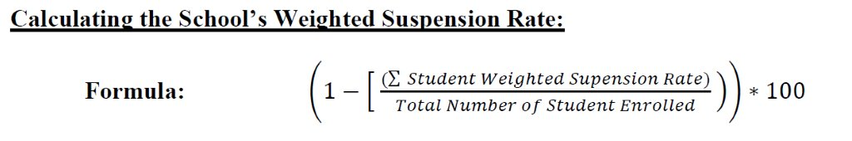
Student Discipline Component

Slide 48
Safe and Substance-Free Learning Environment Component
% of students not engaged in violent discipline incidents (Student Record) and violent incidents on survey questions (GSHS 2.0)
% of students not engaged in drug/alcohol related incidents (Student Record) and student drug use on survey questions (GSHS 2.0)
% of students not experiencing bullying or harassment (Student Record) and on survey questions (GSHS 2.0)
Scores will be on a 0 – 100 scale
  Schools receiving a negative student discipline output will be recoded to 0.

Slide 49
Safe and Substance-Free Learning Environment
(Student Survey data)
Student Alcohol/Drug Use (middle and high school surveys only)
In the last 30 days I have used:
    Alcohol, cigarettes, other tobacco products, electronic vapor products, marijuana, methamphetamines, heroin, prescription drugs not prescribed to me
Bullying and Harassment Incidents (middle and high school surveys only)
During the past 30 days: I have been bullied or threatened by other students; I have been picked on or teased at school; I have received a threatening or harassing text messages from other students; I have been mocked or harassed on a social networking site
Violent Incidents (middle and high school surveys only)
During the past 30 days I have brought a weapon to school.
During the past 30 days I have participated in illegal gang activity.
During the past 12 months have you been in a physical fight on school property?

Slide 50
Safe and Substance-Free Learning Environment
(Student Record Data)
Drug-Related Incidents | Bullying & Harassment Incidents | Violent Incidents | Total Incidents
Alcohol, Drugs, Tobacco | Bullying, Threat/Intimidation | Arson, Battery, Burglary, Fighting, Gang-Related, Homicide, Kidnapping, Robbery, Sexual Battery, Sexual Harassment, Sex Offenses, Weapons (includes knife, handgun, rifle, other, other firearm, and serious bodily injury) | Total number of incidents across all categories

Slide 51
Schoolwide Attendance Component
Student Attendance – Percentage of students absent less than 10% of enrolled days (Student Enrollment = October FTE)
Teacher Attendance - Average Daily Attendance Rate (Contract Days)
  Includes those who have a job code designated as a teacher (CPI data)
  Removes individuals who have more than 30 days of total leave (vacation leave and professional development not included)
Administrator Attendance - Average Daily Attendance Rate (Contract Days)
  Includes those who have a job code designated as an administrator (CPI data)
  Removes individuals who have more than 30 days of total leave (vacation leave and professional development not included)
Staff Attendance - Average Daily Attendance Rate (Contract Days)
  Includes those who have a job code designated as staff (CPI data)
  Removes individuals who have more than 30 days of total leave (vacation leave and professional development not included)

Slide 52
Additional Considerations
Unsafe School Choice Option (USCO)
  Schools designated as “persistently dangerous” with three consecutive years of USCO incidents will lose two stars on School Climate Star Rating.
  Schools with two consecutive years of USCO incidents will lose one star on School Climate Star Rating.

Slide 53
Additional Considerations
PBIS
  Schools can earn additional points on School Climate Star Rating for implementing Positive Behavioral Interventions and Supports (PBIS) as approved by GaDOE PBIS Team.
  “Exceeding the Bar” indicator is no longer available.
    No “Personalized Climate” or “Innovative Practices” application.

Slide 54
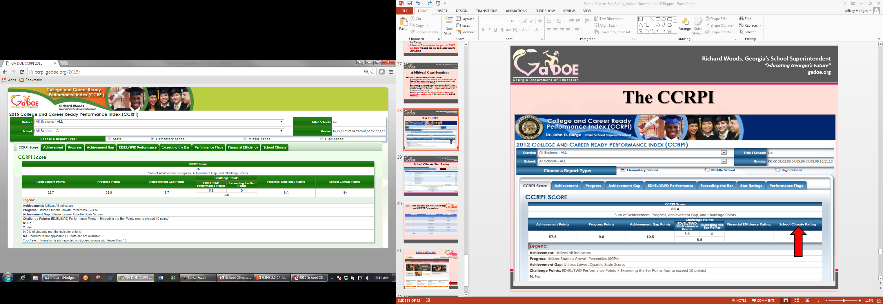
The CCRPI

Slide 55
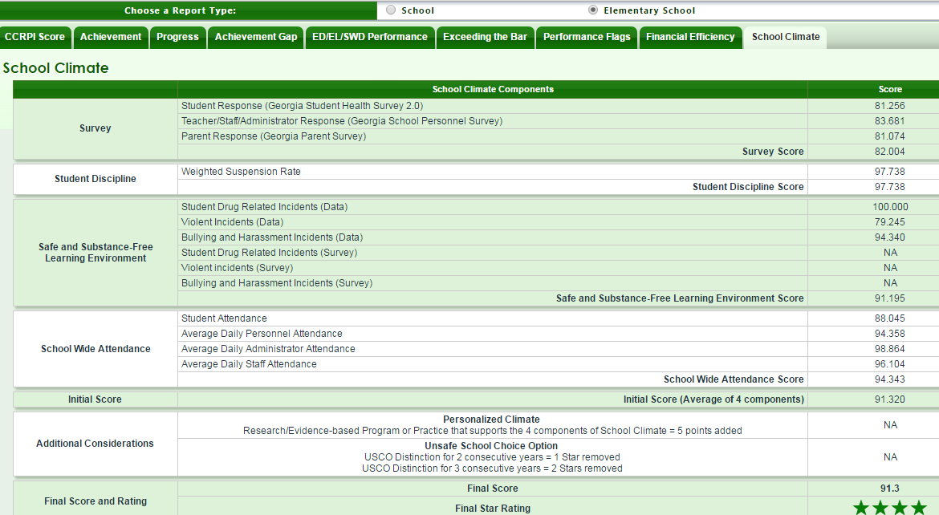

Slide 56
2017 School Climate Star Rating and CCRPI Comparison
2017 Star Rating | Number of Schools | Mean CCRPI Score
1 - Unsatisfactory | 62 | 56.29
2 - Below Satisfactory | 194 | 62.22
3 - Average | 585 | 70.29
4 - Above Average | 891 | 77.60
5 - Excellent | 403 | 81.80
Total | 2135 | 74.37

Slide 57
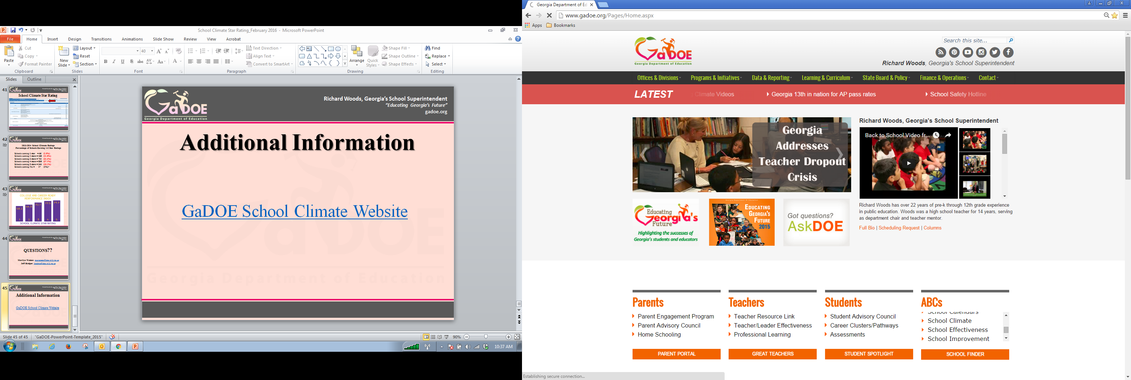
www.gadoe.org

Slide 58
QUESTIONS??
Jeff Hodges: jhodges@doe.k12.ga.us
Cheryl Benefield: cbenefield@doe.k12.ga.us

