Slide 1
Is Your School Safe?
Are You Sure?

Slide 2
“He is most free from danger, who, even when safe, is on his guard.” - Publilius Syrus (85 BC-43 BC)

Slide 3
School safety encompasses a succinct plan to prevent and respond to threats of danger, natural disasters, violent criminal acts and any event that places faculty, staff and students at risk.

Slide 5
School Safety Checklist The Checklist Manifesto In fields such as construction, aviation, and medicine, the usage of checklists has saved many lives.

Slide 6
School Safety Checklist Components
Safety and Security of Buildings & Grounds
School Procedures/Guidelines
Review of the Emergency/Crisis School Safety Plan
Administrative Procedures
Staff Training on Safety
Self-Assessment

Slide 7
Look at it, again. No, really look this time. See what you don’t see.
Alice in Wonderland

Slide 8
School Interior
The designated entrance door has clearly visible signs showing the location of the main office and advising visitors to report to the office.
The entrance lobby is visible from the main office. If not, secure the area.
Staff members, volunteer personnel, or a security camera monitor the main entrance lobby.
Visitors are required to sign in at the main office.
Hallways are free of travel impediments.
Hallways leading to required exit doors are kept clear and unencumbered with rugs or furniture which might impede traffic flow from building in an emergency.
Blind spots in hallways and stairwells are equipped with parabolic mirrors (or similar surveillance device).
Remote and isolated hallways are monitored by security cameras or other monitoring methods.
Stairwells are monitored.

Slide 9
School Entrance

Slide 10
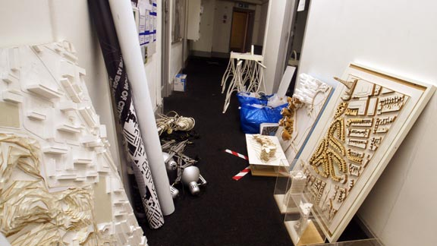
Dark or Isolated Stairwells
Cluttered Hallways

Slide 11
School Interior
Restrooms are inspected for cleanliness and safety on a regular basis.
Restroom walls and stalls are free of graffiti.
Restrooms have a smoke detector.
All cafeteria food and perishables are stored properly.
Choking guidelines are clearly posted in cafeteria dining area.
Cafeteria staff can hear school alarms and announcements.
A staff member is assigned to make sure the cafeteria staff are contacted in the event of a lockdown or severe weather threat.
If a classroom is vacant, students are restricted from entering unsupervised.
Clear and precise emergency evacuation routes are posted at critical locations, including classrooms.
Surveillance cameras and monitors are installed in strategic locations, with monitors in locations visible to staff.

Slide 12
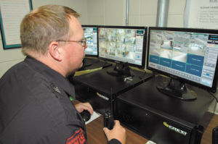
Do Not Place Surveillance
Camera Monitors in Closets

Slide 13
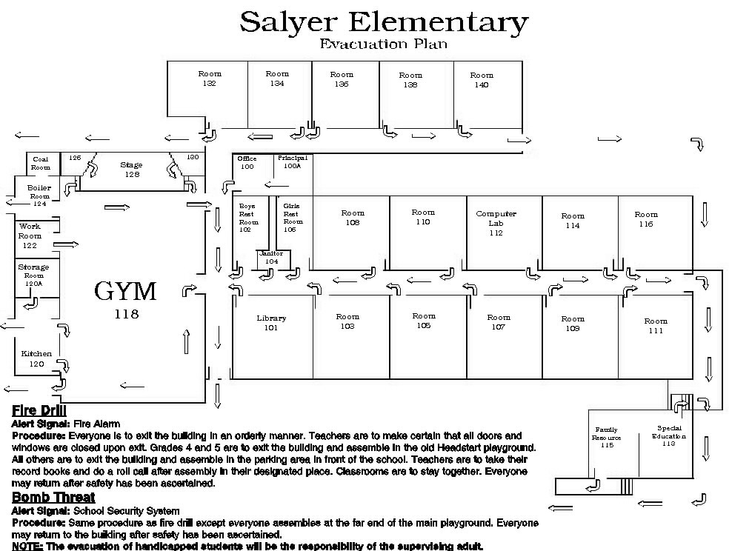
Clear and precise emergency evacuation routes are posted in each classroom and teachers have rosters.
Emergency Go Bag
Classroom Roster
Evacuation Plan
Emergency Procedures

Slide 14
School Interior
Fire extinguisher locations are clearly marked and inspected.
School staff is trained on the use of fire extinguishers.
Access to catwalk and prop areas is restricted.
Access to electrical panels is restricted.
Hallways have emergency lighting and are tested.
Main lobby is properly lighted.
Hallways, bathrooms, and classrooms are properly lighted.
Faculty members are required to lock classrooms upon leaving.
Multiple entries to the building are controlled and supervised.
Areas accessible to intruders are secure.
All doors are properly labeled and numbered.
Exit signs are properly lighted, clearly visible, and point in the correct exit direction.

Slide 15
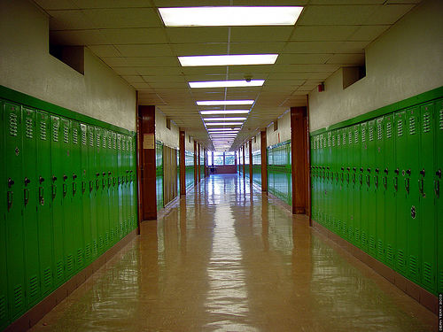
What’s wrong with this picture?
Lighted Emergency Exit Signs?

Slide 16
Boiler Room
“Schools do not realize the possible danger of improperly operated, maintained, or repaired boilers until the unimaginable happens: injury or death. Numerous boiler room school incidents dot the landscape: Spencer, Oklahoma; Gallup, New Mexico; Baltimore, Maryland; Atlanta, Georgia and others.” -NBBPVP
Knowledge is powerful, as are boilers.
Ensure all personnel who operate or maintain the boiler room are properly trained on all equipment, controls, safety devices, and up-to-date operating procedures.
Look for potential problems.
Before startup, ensure the boiler room is free of all possible dangerous situations, such as flammable materials or mechanical or physical damage to the boiler or related equipment. Clear intakes and exhaust vents; check for deterioration and possible leaks.

Slide 17
Inspection matters.
Ensure a thorough inspection by a properly qualified inspector.
Re-inspection matters, too.
After any extensive repair or new installation of equipment, make sure a qualified boiler inspector reexamines the entire system.
Observe new equipment.
Monitor all new equipment closely until safety and efficiency are demonstrated.
Develop a maintenance schedule.
Use boiler operating log sheets, maintenance records, and manufacturers’ recommendations to establish a preventive maintenance schedule based on operating conditions, as well as on past maintenance, repairs, and replacements performed on the equipment.

Slide 18
Create thorough checklists.
Establish a checklist for proper startup and shutdown of boilers and all related equipment according to manufacturers’ recommendations.
Don’t overlook automated systems.
Observe equipment extensively before allowing an automated operation system to be used with minimal supervision.
"School districts are likely to have several hundred pressure-retaining items, each posing a potential explosion hazard. School administrators rarely make the connection between awareness and the adverse effect on reliability, safety, and operation of the affected equipment. Consequently, maintenance of school boilers and related devices get a low priority in safety reviews." National Board of Boiler and Pressure Vessel Inspectors

Slide 19
Lincoln Park School Boiler Explosion

Slide 21
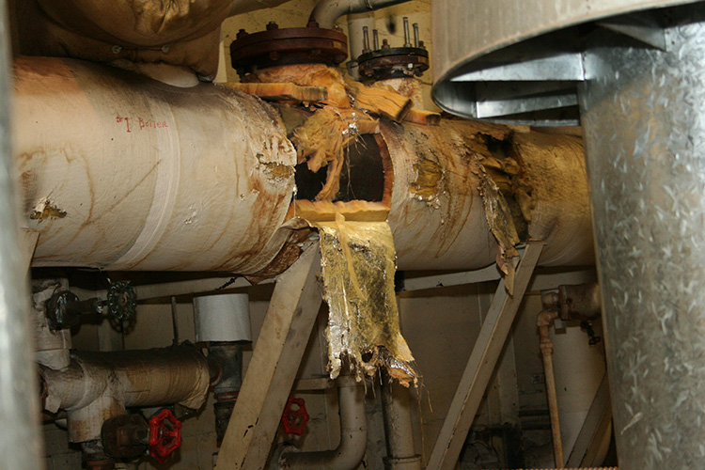
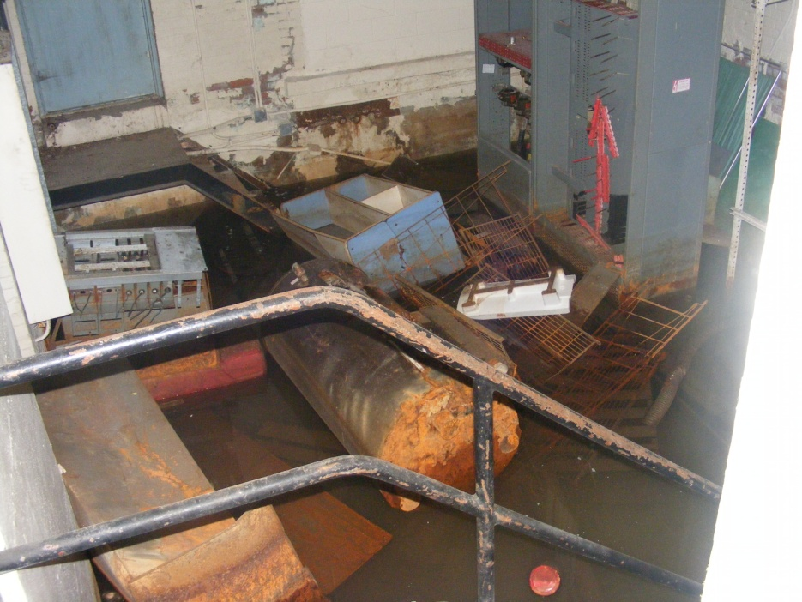
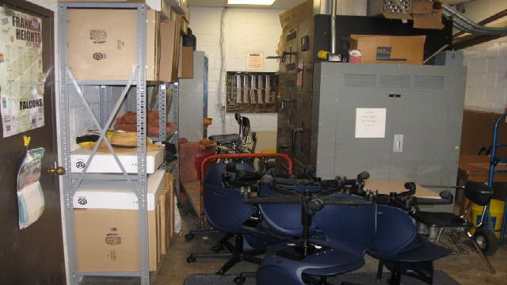

Slide 22
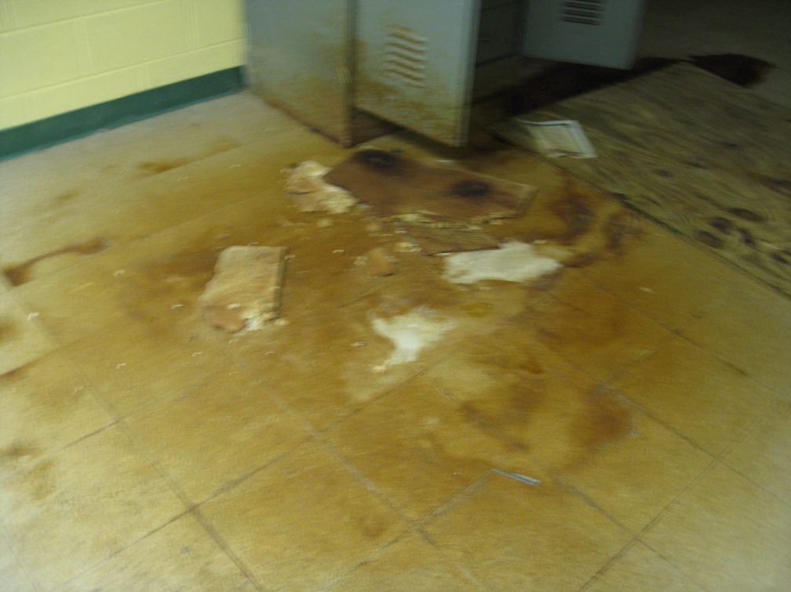
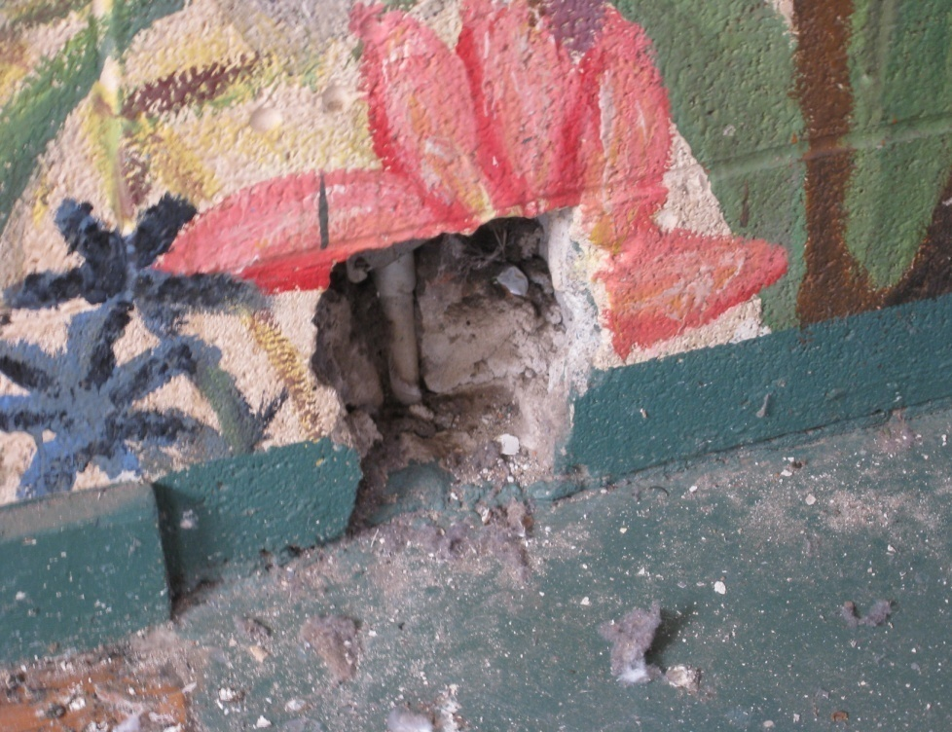
School Interior
The school building interior is clean and free from debris, standing water, rust, deteriorating tiles, peeling paint, etc.

Slide 23
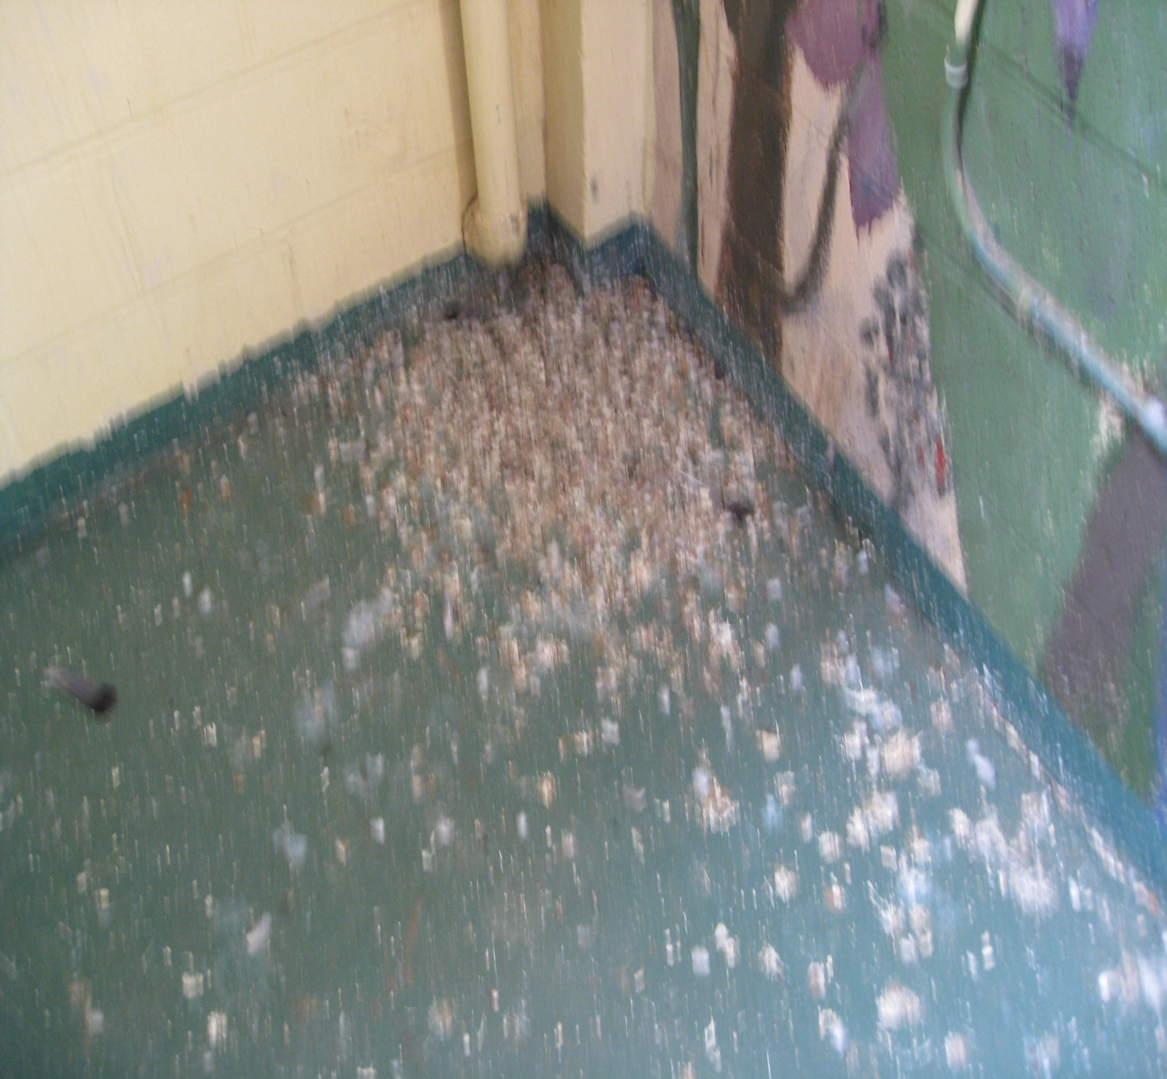
Pigeon Droppings
Inside the Gym

Slide 24
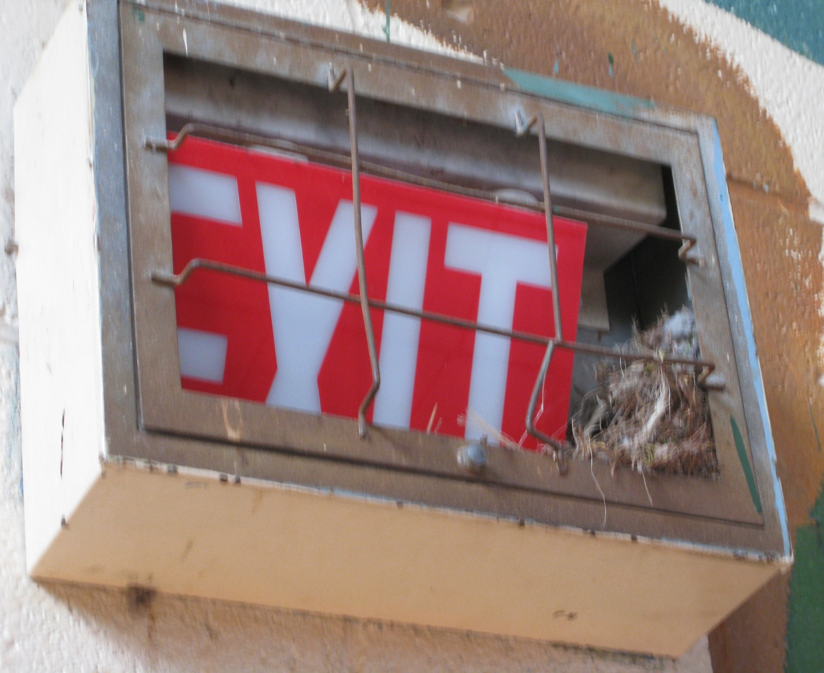
Active Bird Nest
Inside the gym

Slide 25
Science Lab Safety
Lab safety procedures are reviewed and clearly posted.
Chemical storage areas are locked, cleaned, and Material Safety Data Sheets (MSDS) contains information regarding the proper procedures for handling, storing, and disposing of chemical substances.
An MSDS accompanies all chemicals or kits that contain chemicals.
Save all MSDSs and store in a designated file or binder using a system that is organized and easy to understand.
Place the MSDS collection in a central, easily accessible location known to all workers and emergency personnel.
Know what chemicals cannot be stored together (e.g., store mineral oxidizing chemicals separate from organic acids).
Lab preparation areas, hazardous storage areas and mechanical rooms are properly protected from unauthorized access.
Eye wash station in labs are in working condition.

Slide 26
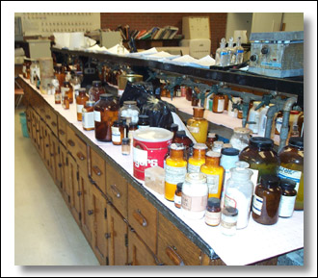

Slide 27
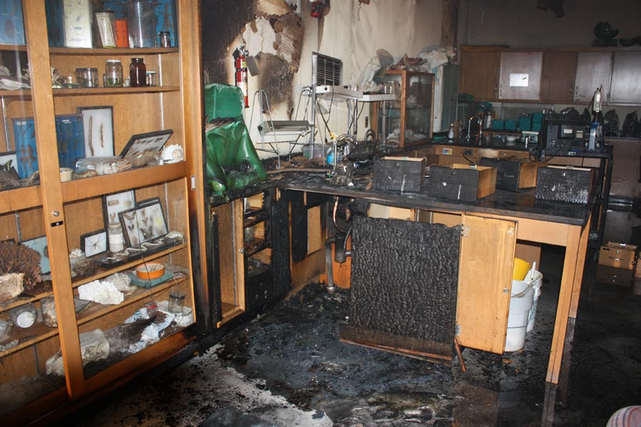

Slide 28
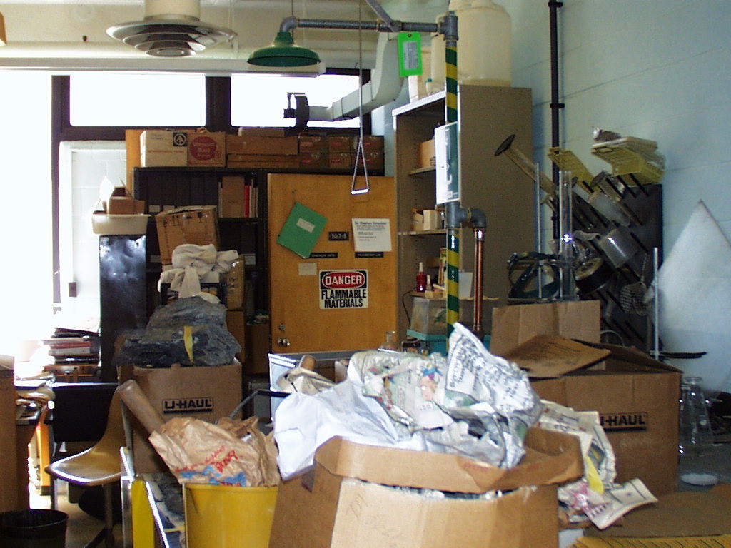
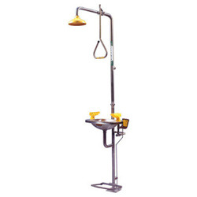

Slide 30
School Exterior
Visitor signs are posted near entrance advising visitors to report to the main office.
All exterior doors are locked (plan for multiple buildings or mobile units access).
Emergency vehicles can access play and athletic fields easily.
Storage and field houses can be secured for safety and security.
Surveillance cameras are installed in strategic locations.
Mechanical, electrical and other equipment on school grounds are surrounded by a protective enclosure.
Deep recesses in buildings with wings are fenced for safety.
The school grounds are free of obstacles, graffiti, trash and debris.
School grounds equipment is in good repair.

Slide 32
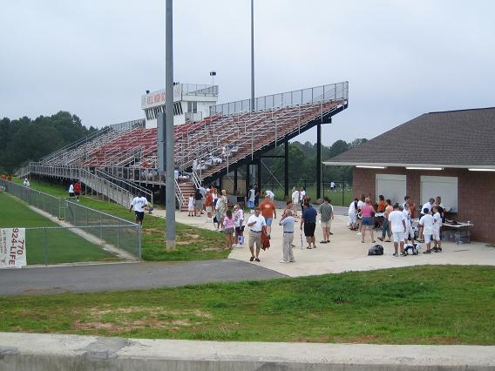
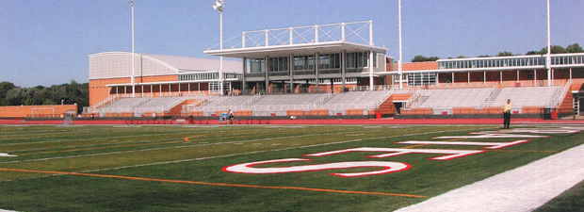
Does your school have a stadium evacuation plan?

Slide 33
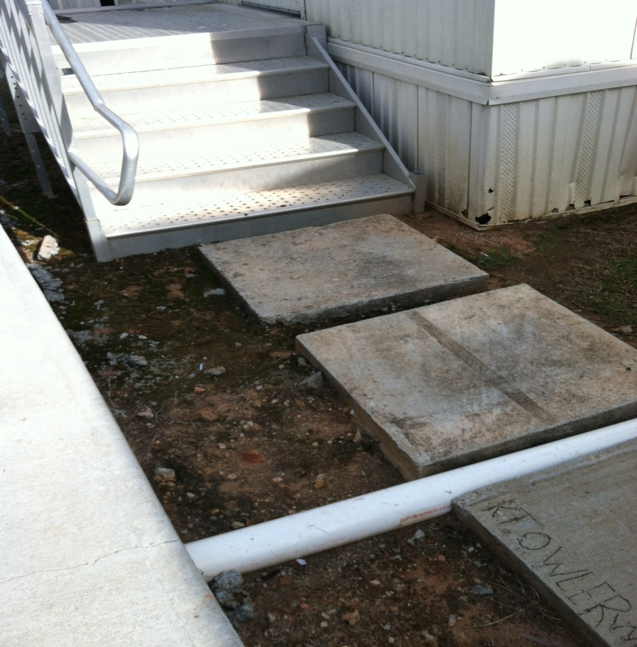
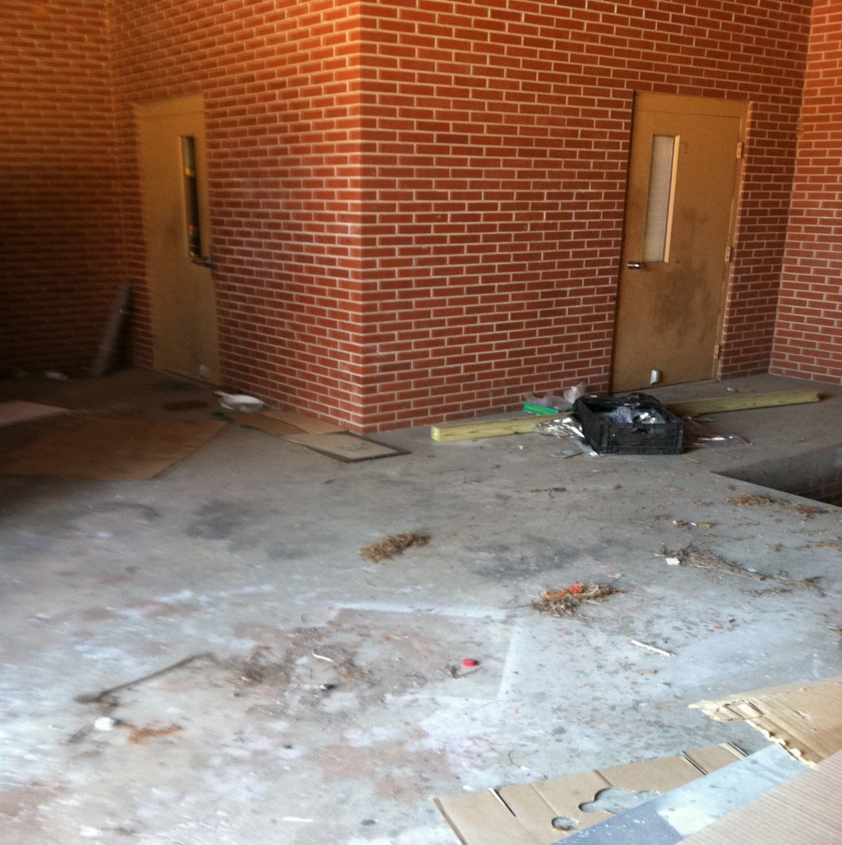
Evacuate through backdoors in the school?
Evacuate from a mobile classroom?

Slide 34
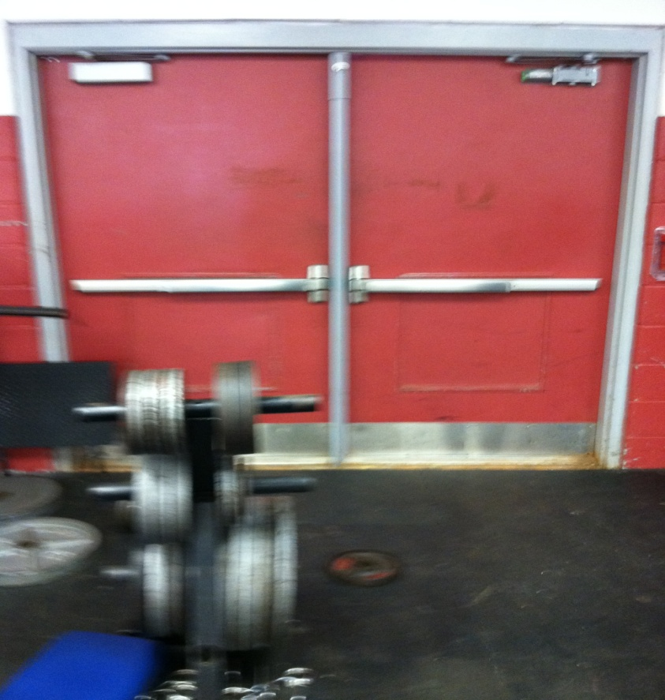
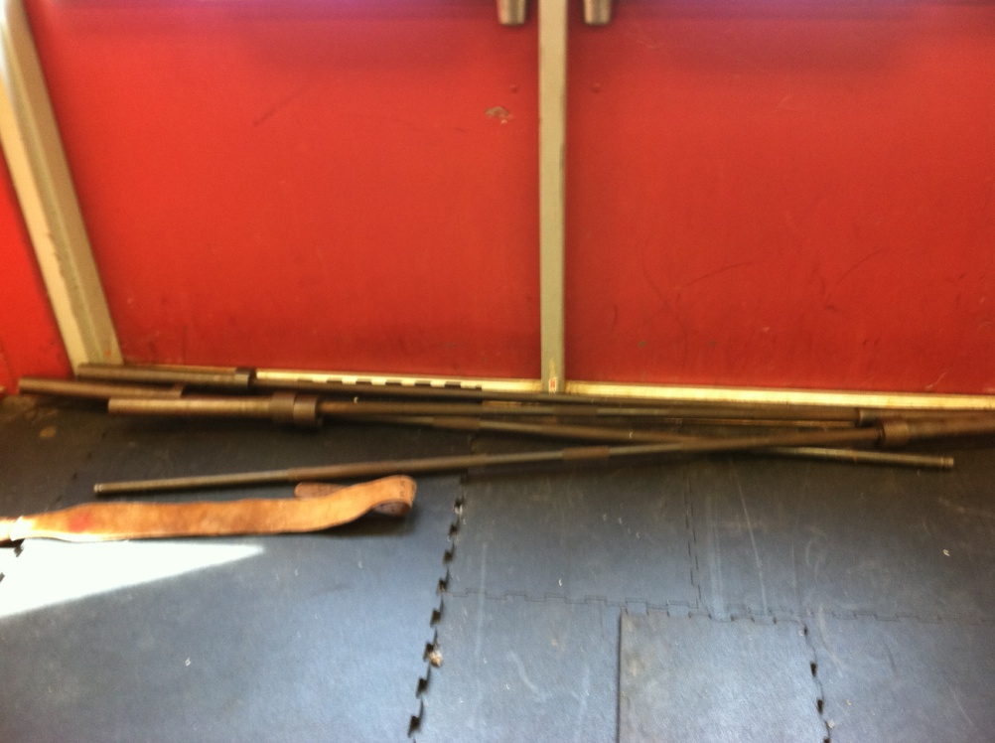
Evacuate through the weight room?
Evacuate from the gym?

Slide 35
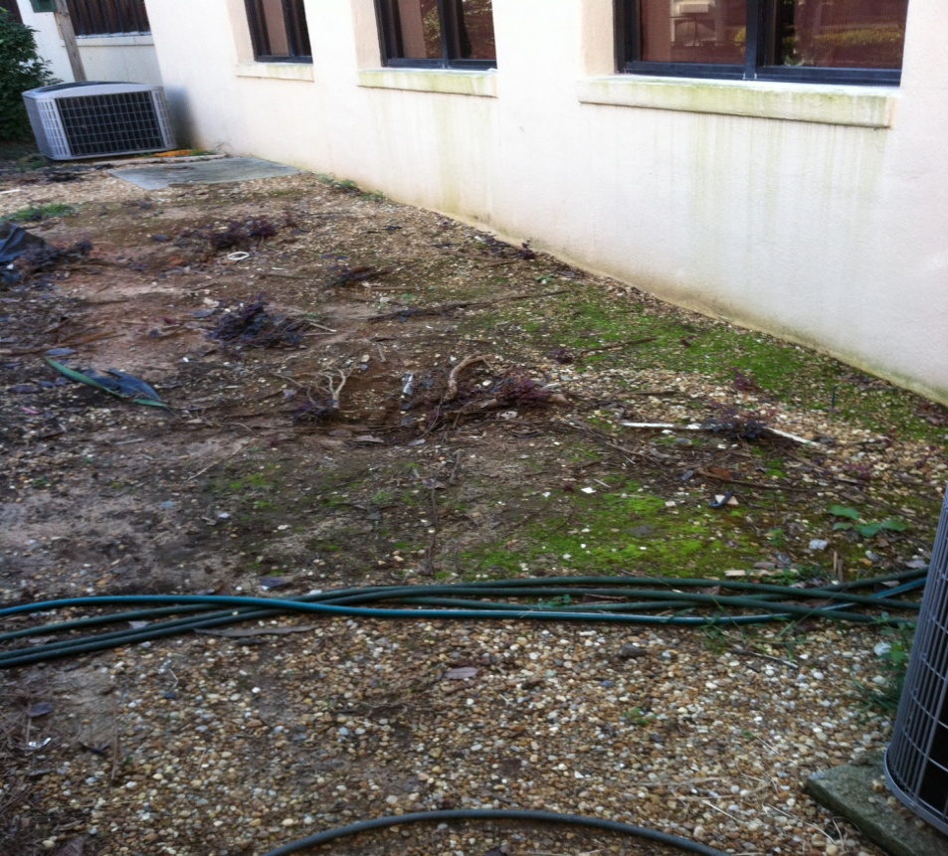
Evacuate through the courtyard?

Slide 36
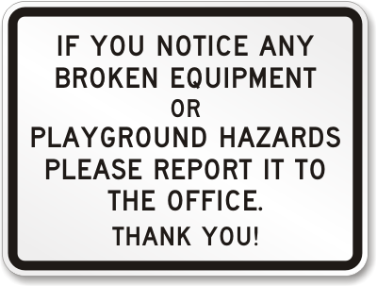
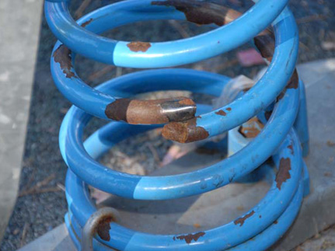
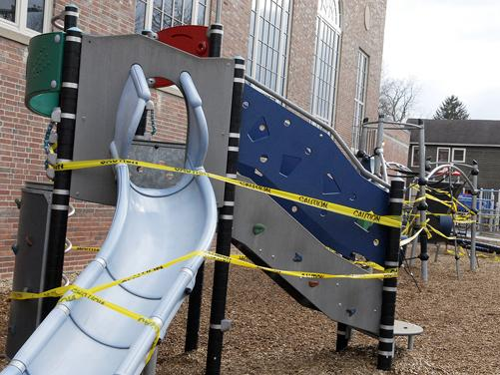
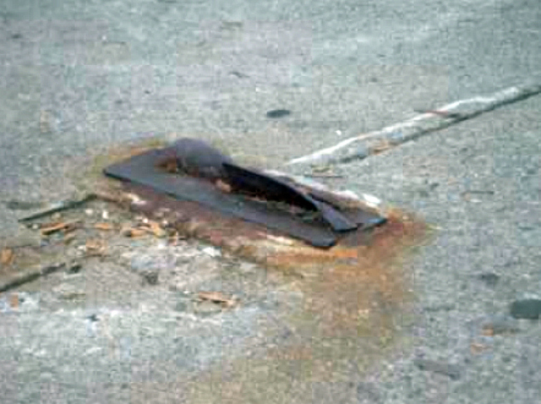

Slide 37
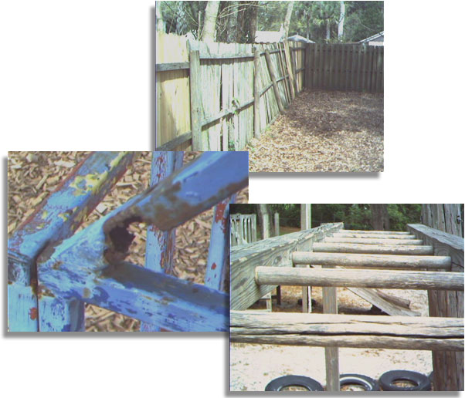
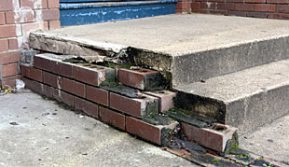
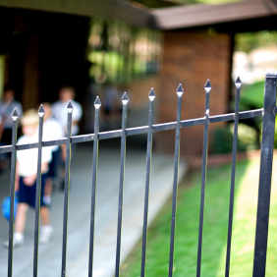
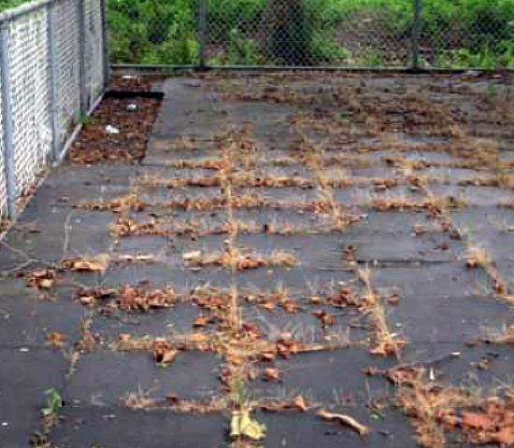
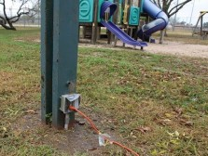

Slide 38
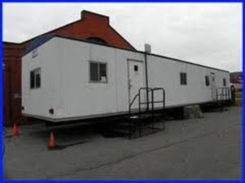
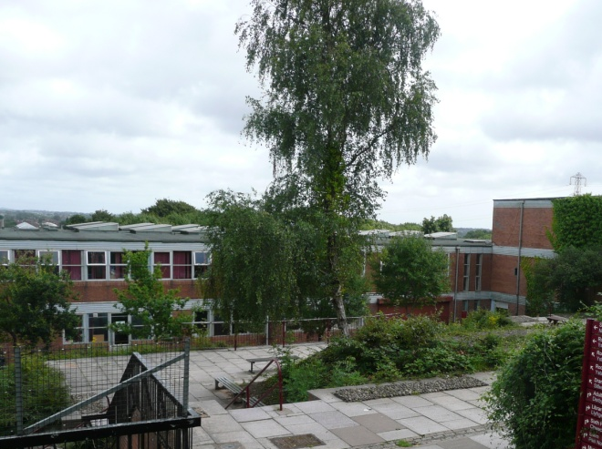
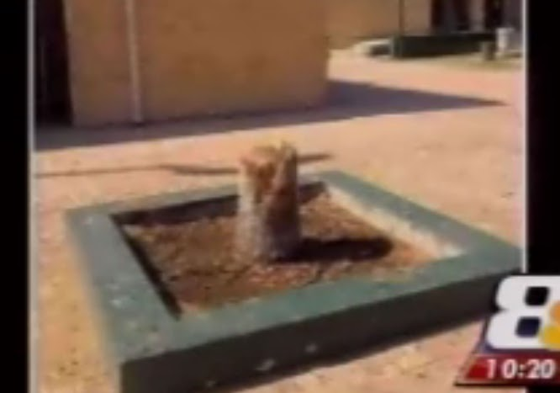
School Exterior
The school has designated points of entry which are monitored.
Routinely monitor parking lots.
The location of trailers/portable classrooms enables surveillance.
If located in isolated areas, the trailers/portable classrooms are monitored with security cameras.
Trailers/portable classrooms are connected to the school’s central alarm system and can be contacted during an emergency.
Crawl spaces below trailers are closed off.
Shrubbery and trees are well maintained.

Slide 39
School Safety Checks
Windows and doors are in good repair.
Windows and doors are adequately secured.
Exit doors are not propped open.
Building perimeter is free from trees, branches, and telephone poles that may provide unauthorized access to upper floor levels or roof.
All exterior doors have non-removable hinge pins.
Exterior double doors have an astragal (plate) covering the gap between doors
Required exit doors are equipped with panic hardware.
Doors accessing internal courtyards are tied into the central alarm system.
Emergency lighting is in working condition.
The school has developed written regulations regarding access to and use of the building by school personnel after regular school hours.

Slide 40
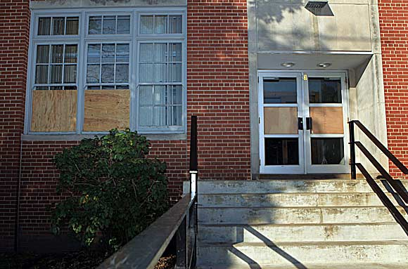
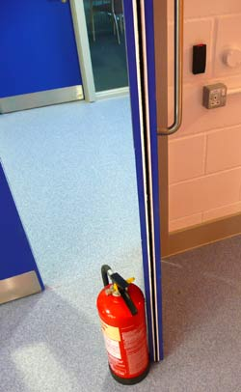
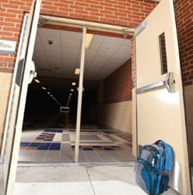
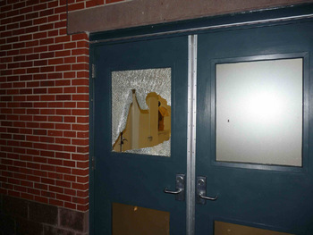

Slide 41
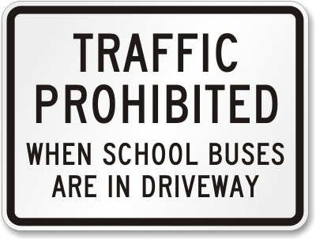
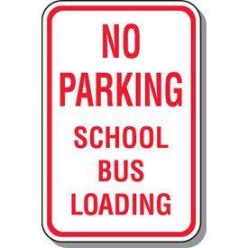
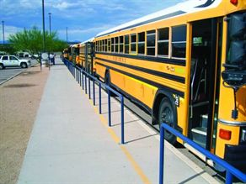
Transportation
Staff members check bus loading/unloading area before buses arrive to identify any possible hazards or impediments, and to make certain no unauthorized persons or vehicles are in the area.
Staff members are assigned to bus area during loading/unloading and the staff members understand their responsibilities for reporting any problems.
Access to bus loading/unloading areas is restricted during arrival/ dismissal.
An area is designated as the pick-up/drop-off zone for non-bus riders and is supervised by assigned staff members.

Slide 42
Transportation
Staff members check pick-up/drop-off area before vehicles arrive to identify any possible hazards or impediments, and to make certain no unauthorized persons or vehicles are in the area.
An emergency dismissal procedure is in place (i.e., secondary site for loading buses and a separate non-bus riders pick-up area).
Ensure that all field trips have a manifest on the school bus and at the school. In the event of an emergency, it is essential to account for all students, faculty and volunteers.
Staff members stay with and supervise students at all times during the field trip.

Slide 43
School Procedures/Guidelines
School has a procedure for handling all cash collected.
An escort is available for school personnel responsible for money collected or deposited during the school day.
Unused areas of the school can be closed off during and after school activities.
Two-way communication is possible between and among administrators (and School Resource Officers where applicable).
Teachers have the capability of communicating to office from classroom (e.g. emergency call-back buttons in classrooms).
There is a central alarm system.
Alarm system is tested on a regular basis.
Photo ID badges are issued to all employees (including support staff and bus drivers) and are clearly visible at all times.
Proper photo ID is required of vendors, repairmen, etc. and staff members check ID’s as a matter of routine.

Slide 44
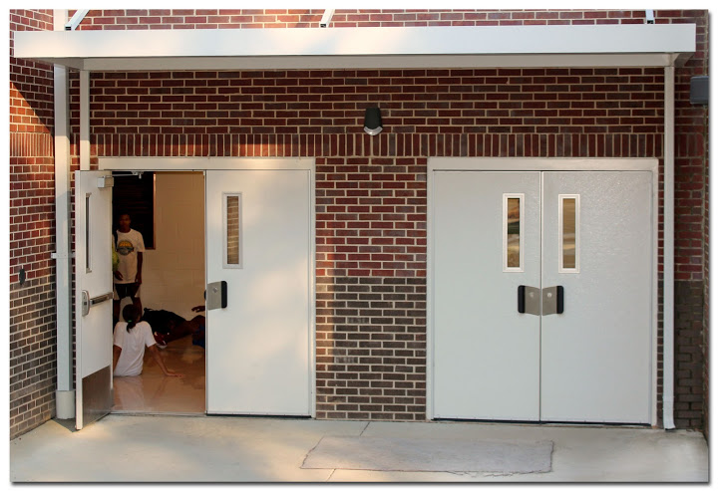
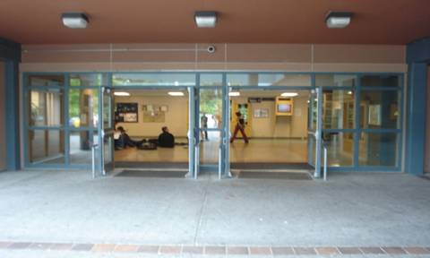
School Procedures/Guidelines
Staff member(s) is designated to perform the following security checks at the end of each day:
Check that all classrooms and offices are locked.
Check all areas of the school (restrooms, locker rooms, etc.) to ensure that everyone has left the building.
Check the security alarm system.
Check all exterior entrances to ensure that they are locked.

Slide 45
School Procedures/Guidelines
School has an updated School Safety Emergency Crisis Plan and all staff members are familiar with the plan, including bus drivers and substitute teachers.
Law enforcement, juvenile court and other emergency responders are involved in the development of the School Safety Emergency Crisis Plan.
The plan includes all categories as required by Georgia law (OCGA 20-2-1185).
The plan is reviewed, updated, and practiced each year.
The staff has received training on emergency procedures.
The staff has access to the plan.
The plan has been submitted to Georgia Emergency Management Agency.
The plan includes a component for post-crisis response, such as the availability of counseling services for students and staff members, dealing with the probability of “copy cat” incidents and dealing with post-traumatic stress.

Slide 46
School Procedures/Guidelines
The plan includes clear strategies for dealing with the media in the event of a crisis.
Primary and secondary evacuation sites have been pre-determined for fire (500’) & bomb threat (1000’).
School has developed an evacuation plan to accommodate students and staff with physical disabilities in the event of a crisis and staff members have been assigned to ensure that students and staff with physical disabilities have been evacuated.
Table top exercises and practices have been conducted with staff.
A reunification site has been established in case of long-term emergency evacuation.
An appropriate number of staff members are trained in CPR.
School has access to an AED/defibrillator(high schools).
An appropriate number of staff members are trained in the use of AED/defibrillator.

Slide 47
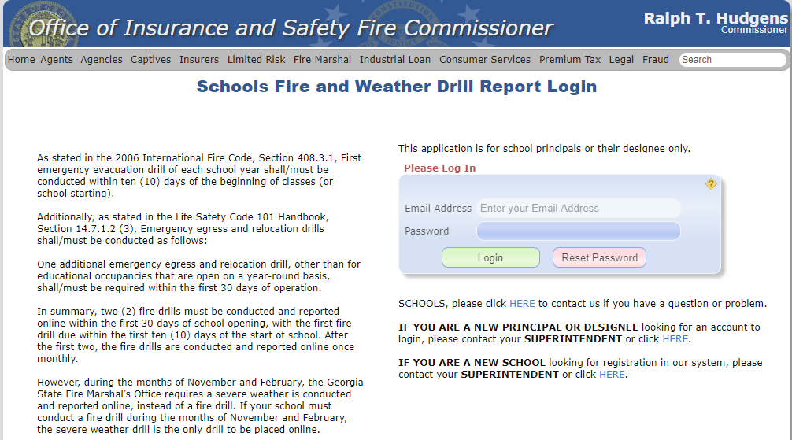
School Procedures/Guidelines
Fire/severe weather drills are conducted as required by Georgia law.
The school maintains a record of fire inspection by the local or state fire officer.
Fire drills are reported to the Office of Insurance and Safety Fire Commissioner in a timely manner.

Slide 48
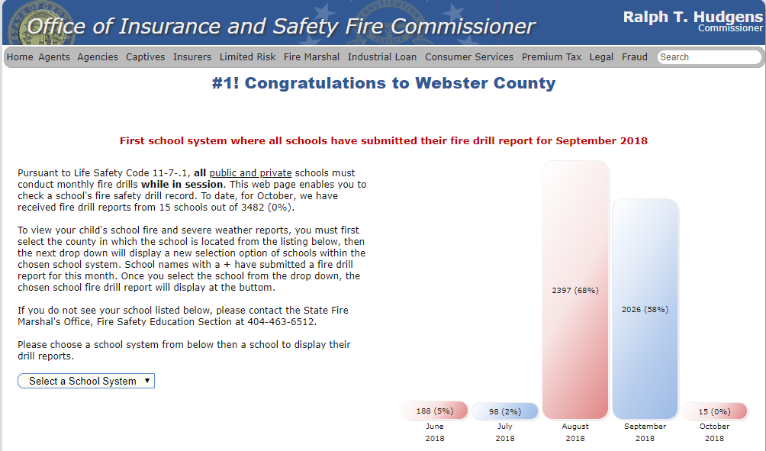

Slide 49
School Procedures/Guidelines
Intruder alert procedures are developed and drills are conducted.
Ask local law enforcement to review intruder alert procedures and observe intruder alert drills. Ask for feedback.
When the lockdown/intruder alert is given, the response is immediate and complete.
Going on lockdown means doors locked, lights out, and students and staff are out of sight.
School principal has given office staff have the authority to lock down the school in the event of an emergency.
Staff and students must understand that they will be in that position if this was the real thing until police, fire, and first responders come and remove them from the room or until the “all clear” message has been given by administrative staff.

Slide 50
School Procedures/Guidelines
Intruder alert procedures are developed and drills are conducted.
Staff must be trained to go into lockdown without waiting for instructions.
Shots in the building
Suspicious person in the hallway
Screaming and shouting
Staff and students must understand that they will be in that position if this was the real thing until police, fire, and first responders come and remove them from the room or until the “all clear” message has been given by administrative staff.

Slide 51
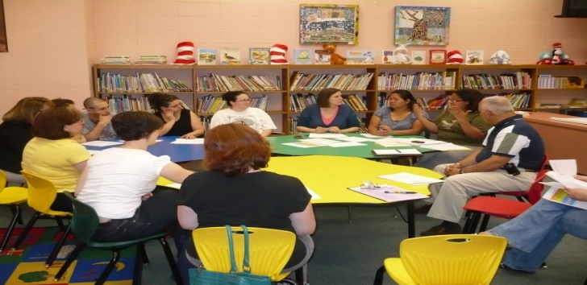
School Procedures/Guidelines
Intruder alert procedures are developed and drills are conducted.
Intruder alert procedures must include procedures when students are in the cafeteria, gymnasium or on the playground.
Intruder alert procedures must include a method to inform bus drivers on field trips to delay returning to the school until the “all clear” signal is given.
After each intruder alert drill, assess the drill, including the opinion of observers, and share the findings with the entire staff and make any necessary adjustments to the intruder alert procedures.

Slide 52
http://emilms.fema.gov/IS907/index.htm
United States Homeland Security Active Shooter

Slide 55
The Plan, Prepare, React: Active Shooter Response Options for Students, Faculty and Staff is a training program developed for the Board of Regents of the University System of Georgia by the University of Georgia and by several other University System of Georgia institutions. The Plan, Prepare, React training program's intended audience is students, staff and faculty associated with the State of Georgia's 35 colleges and universities. This comprehensive training program includes a ten-minute video, a PowerPoint presentation, a training activity and resource materials.

Slide 56
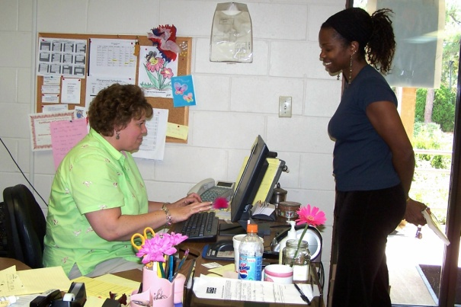
School Procedures/Guidelines
The principal and administrative staff are highly visible throughout the building.
A chain-of-command has been established when the principal is away from the building (NOTE: Intruder Alert authority is clearly established).
Security measures/administrative supervision is established for extracurricular activities.
Staff members are assigned to supervise students (halls/bus/restrooms/cafeteria).
Student medicines are secured (locked cabinet/desk).
Student check-out procedures are in place - only to an authorized adult.

Slide 57
Prevention
Bullying prevention programs or strategies are in place.
Staff members have been trained to recognize early warning signs of potentially suicidal students and where to refer them for help.
Students have access to conflict resolution/peer mediation programs.
School policy provides a system whereby staff and students may report problems, incidents, or potential dangers anonymously.
Students and parents are aware of school student support resources.
School has a well-developed network of service providers to which students can be referred.
School has reviewed results of Georgia Student Health Survey 2.0 or locally administered survey to identify possible areas of safety concerns.

Slide 58
Additional School Safety Resources

Slide 63
Crisis Management and Prevention in Georgia Public Schools​
Prevention/Mitigation is the action schools take to prevent a threatened or actual incident from occurring or reducing the likelihood that an incident will happen.
Preparedness focuses on ongoing actions that protect students, teachers, staff, visitors, networks, and property from a threat or hazard.
Response is the capability necessary to stabilize a crisis once it has already happened or is certain to happen in an unpreventable way; establish a safe and secure environment; save lives and property; and facilitate the transition to recovery.
Recovery the capability necessary to assist schools affected by a crisis in restoring the learning environment.

Slide 64
Crisis Management and Prevention in Georgia Public Schools​

Slide 65
Crisis Management and Prevention in Georgia Public Schools​

Slide 66
Sample Crisis Preparedness for Other Crisis Situations
Stadium Emergency Evacuation
Emergency Shelter Protocol
Other Hazards
Railroads
Is the school near railroad tracks? If “yes,” does the school have an evacuation plan based on a possible derailment? Does the local fire department have an emergency plan? If so, does it include the school?
Airport
Is the school near an airport? If “yes,” does the school have an evacuation plan based on the location of the airport and flight patterns? Does the airport staff know how to communicate with the school in the event of an emergency at or near the airport? Does the school have a way to communicate with the airport staff? Does the local fire department have an airport emergency plan; if so, does it include the school?

Slide 67
Sample Crisis Preparedness for
Other Crisis Situations
Other Hazards
Chemical
Is the school near above-ground chemical storage tanks or an industrial park? If “yes,” does the school have an evacuation plan based on the location of the storage tanks or industrial park? Does the chemical storage company or companies in the industrial park know how to communicate with the school in the event of an emergency? Does the school have a way to communicate with companies with the chemical storage tanks or with companies in the industrial park? Does the school have identified staff that can turn off the HVAC fresh-air mix? Does the local fire department have an emergency plan? If so, does it include the school?

Slide 69
On-Site Safety Assessment
Georgia Department of Education and Georgia Emergency Management Agency conduct on-site safety assessments.
Process
Immediate Feedback
Full Report
Follow-up

Slide 70
Is Your School Safe?
Are You Sure?

Slide 71
Georgia Department of Education
Garry McGiboney
gmcgiboney@doe.k12.ga.us
Cheryl Benefield
cbenefield@doe.k12.ga.us
Jeff Hodges
jhodges@doe.k12.ga.us

