Slide 1
Georgia Migrant Education State Recruiters

Slide 2
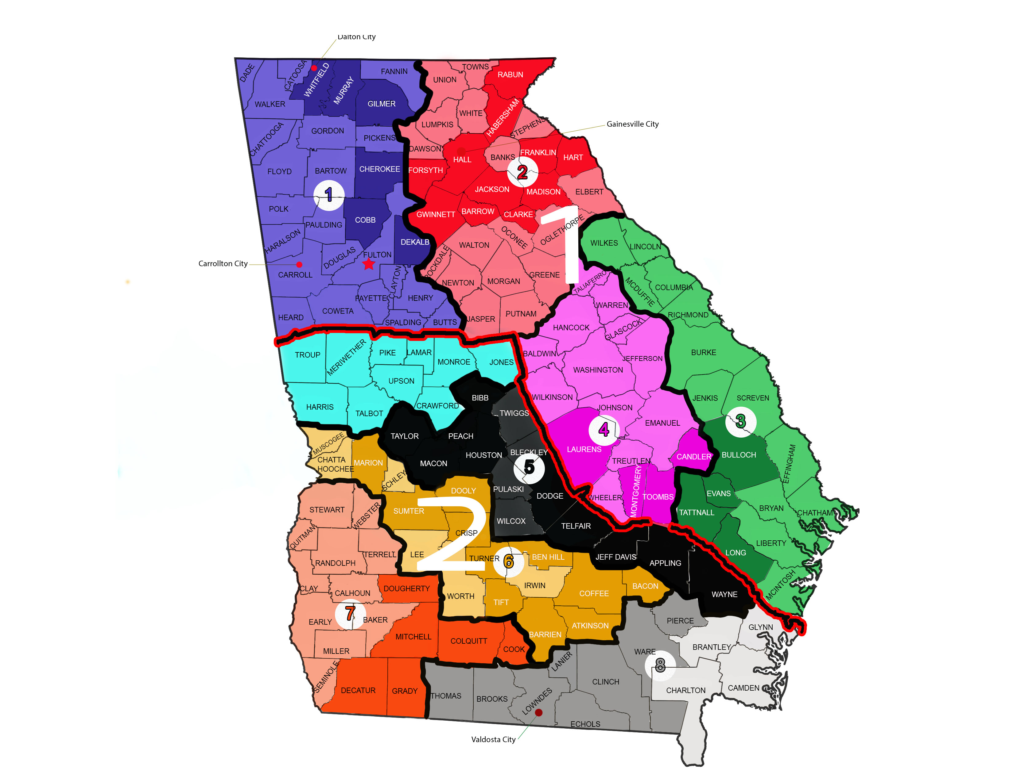
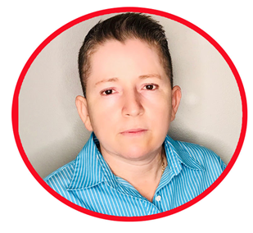
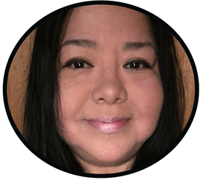
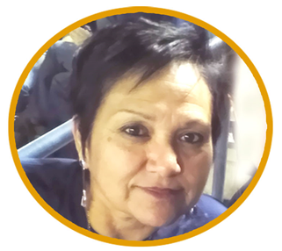
GEORGIA STATE RECRUITERS
REGION 1
Jesus A. Mercado
Evelyn S. Arevalo
Sandra Morales
Jorge Araque
REGION 2
Fidela Sanchez
Sylvia O. Camargo
Grisdelia Dominguez
Edgar A. Perez

Slide 3
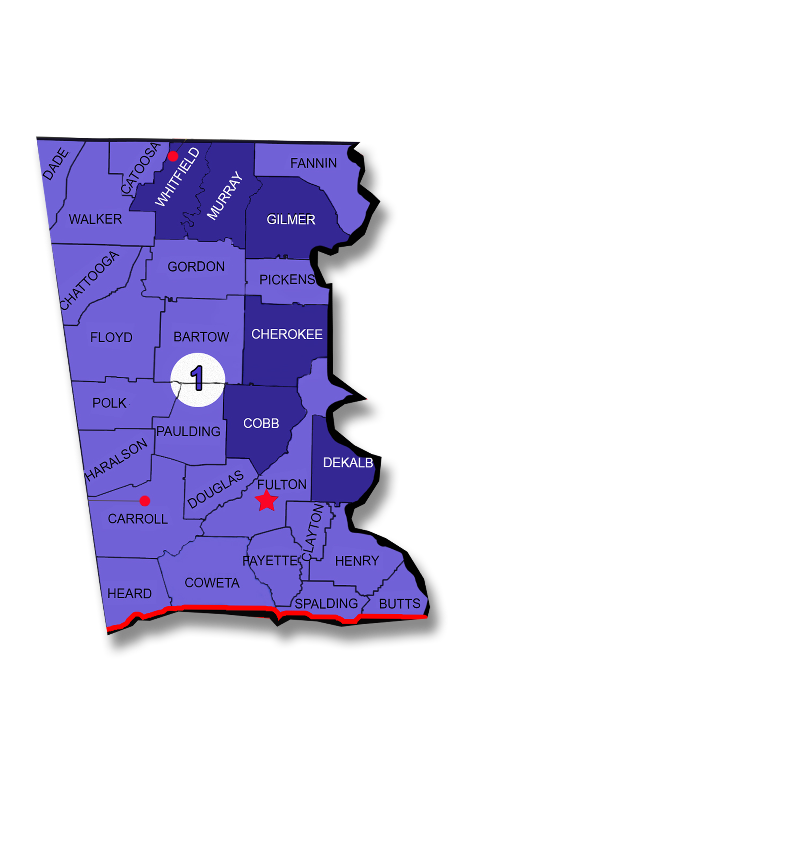
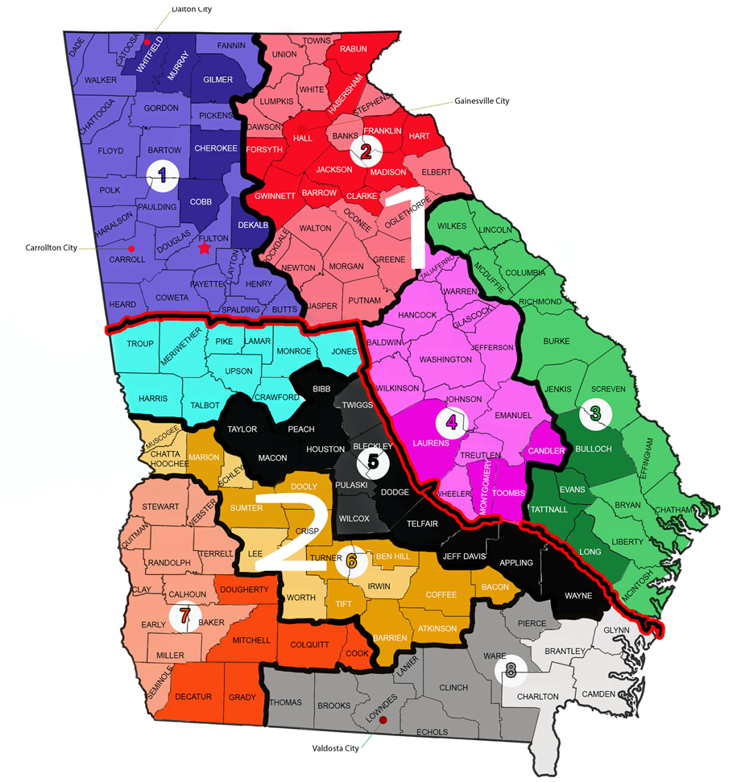
Jesus A. Mercado 404-617-6836

Slide 4
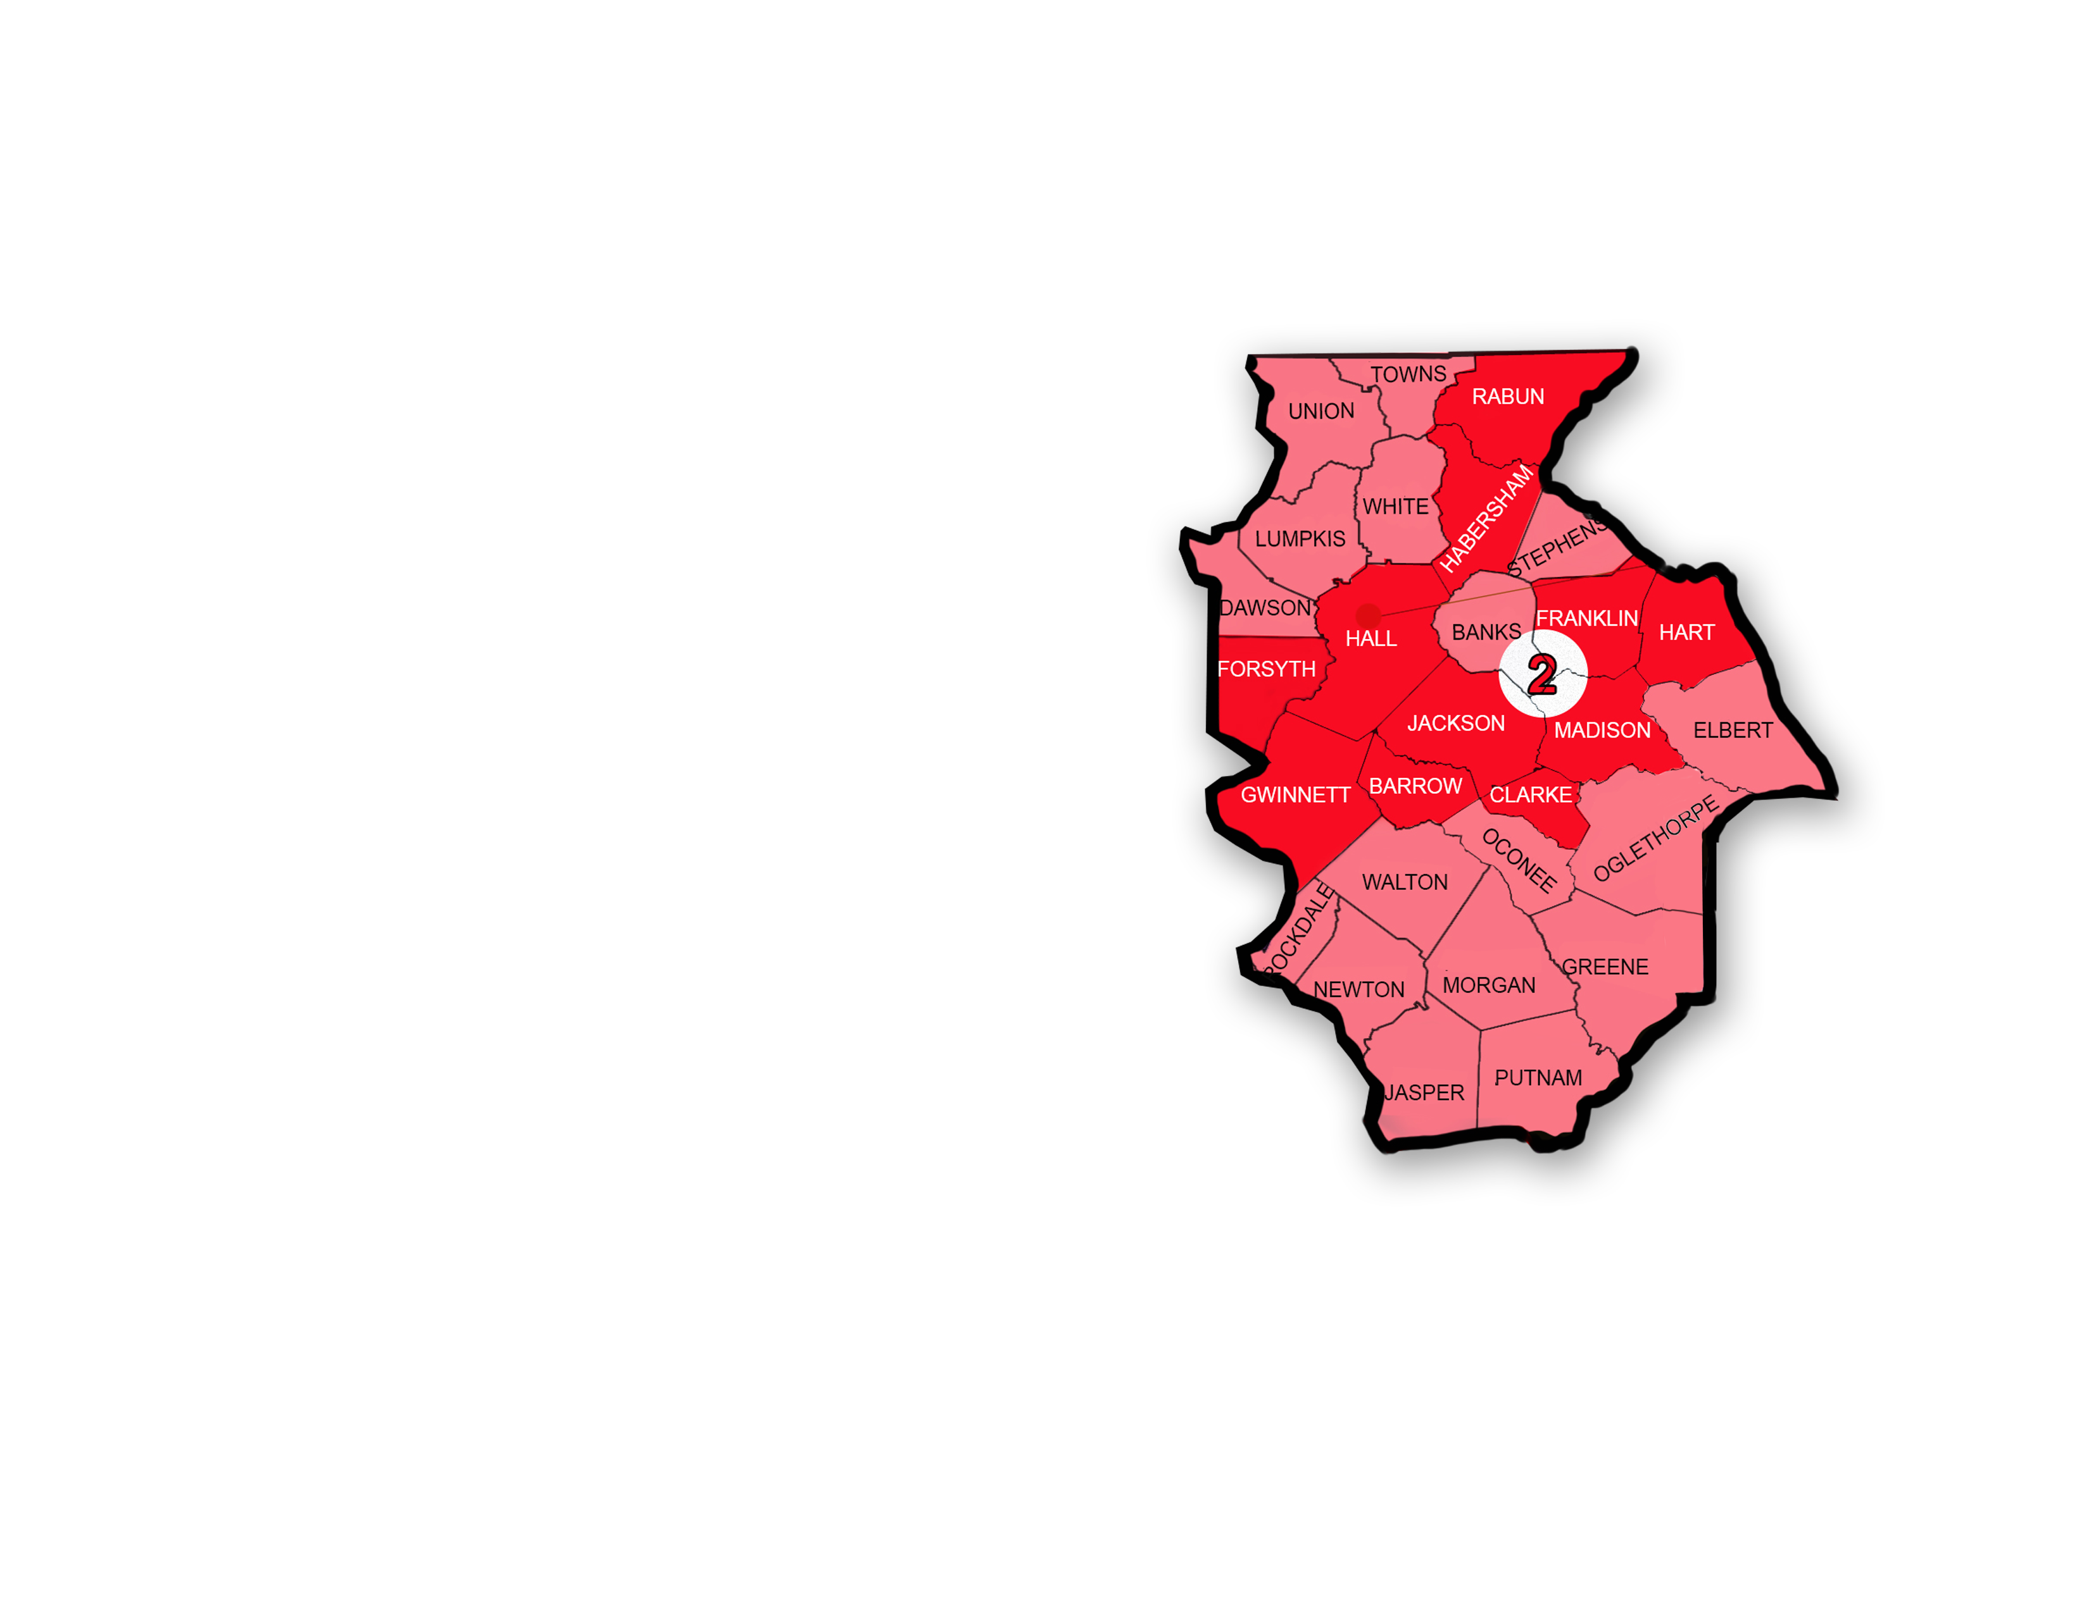
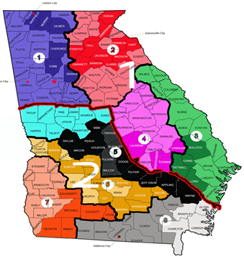
Evelyn S. Arevalo 404-557-2880

Slide 5
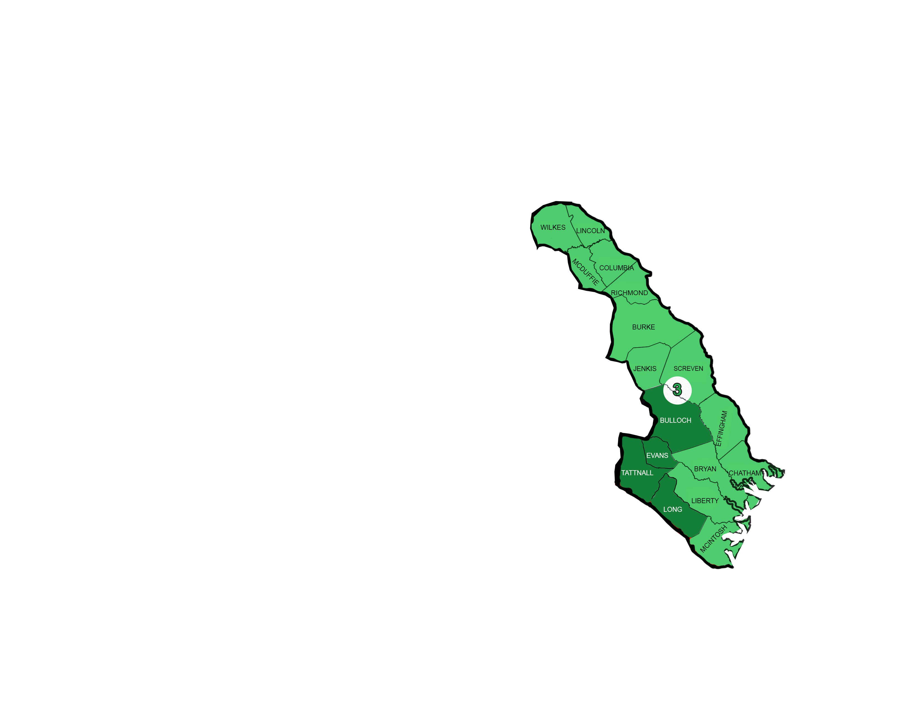
Jorge Araque 404-823-1654

Slide 6
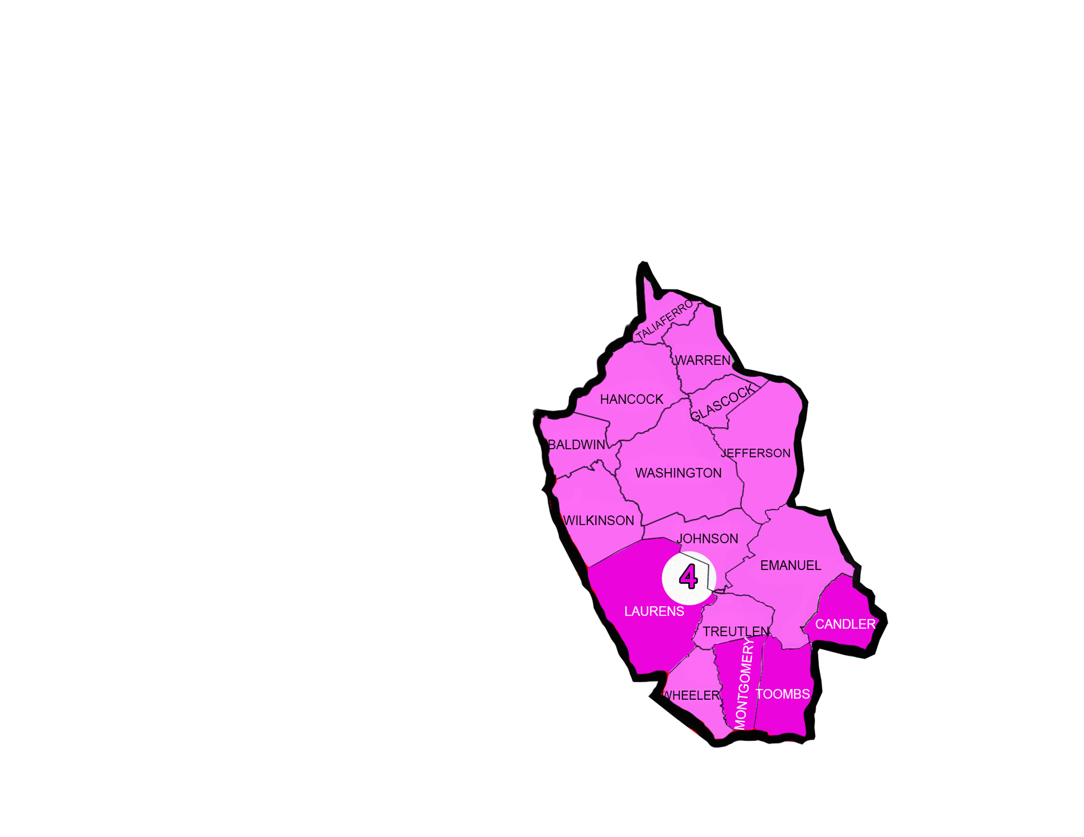
Sandra Morales 404-617-4995

Slide 7
Fidela Sanchez 470-218-5361

Slide 8
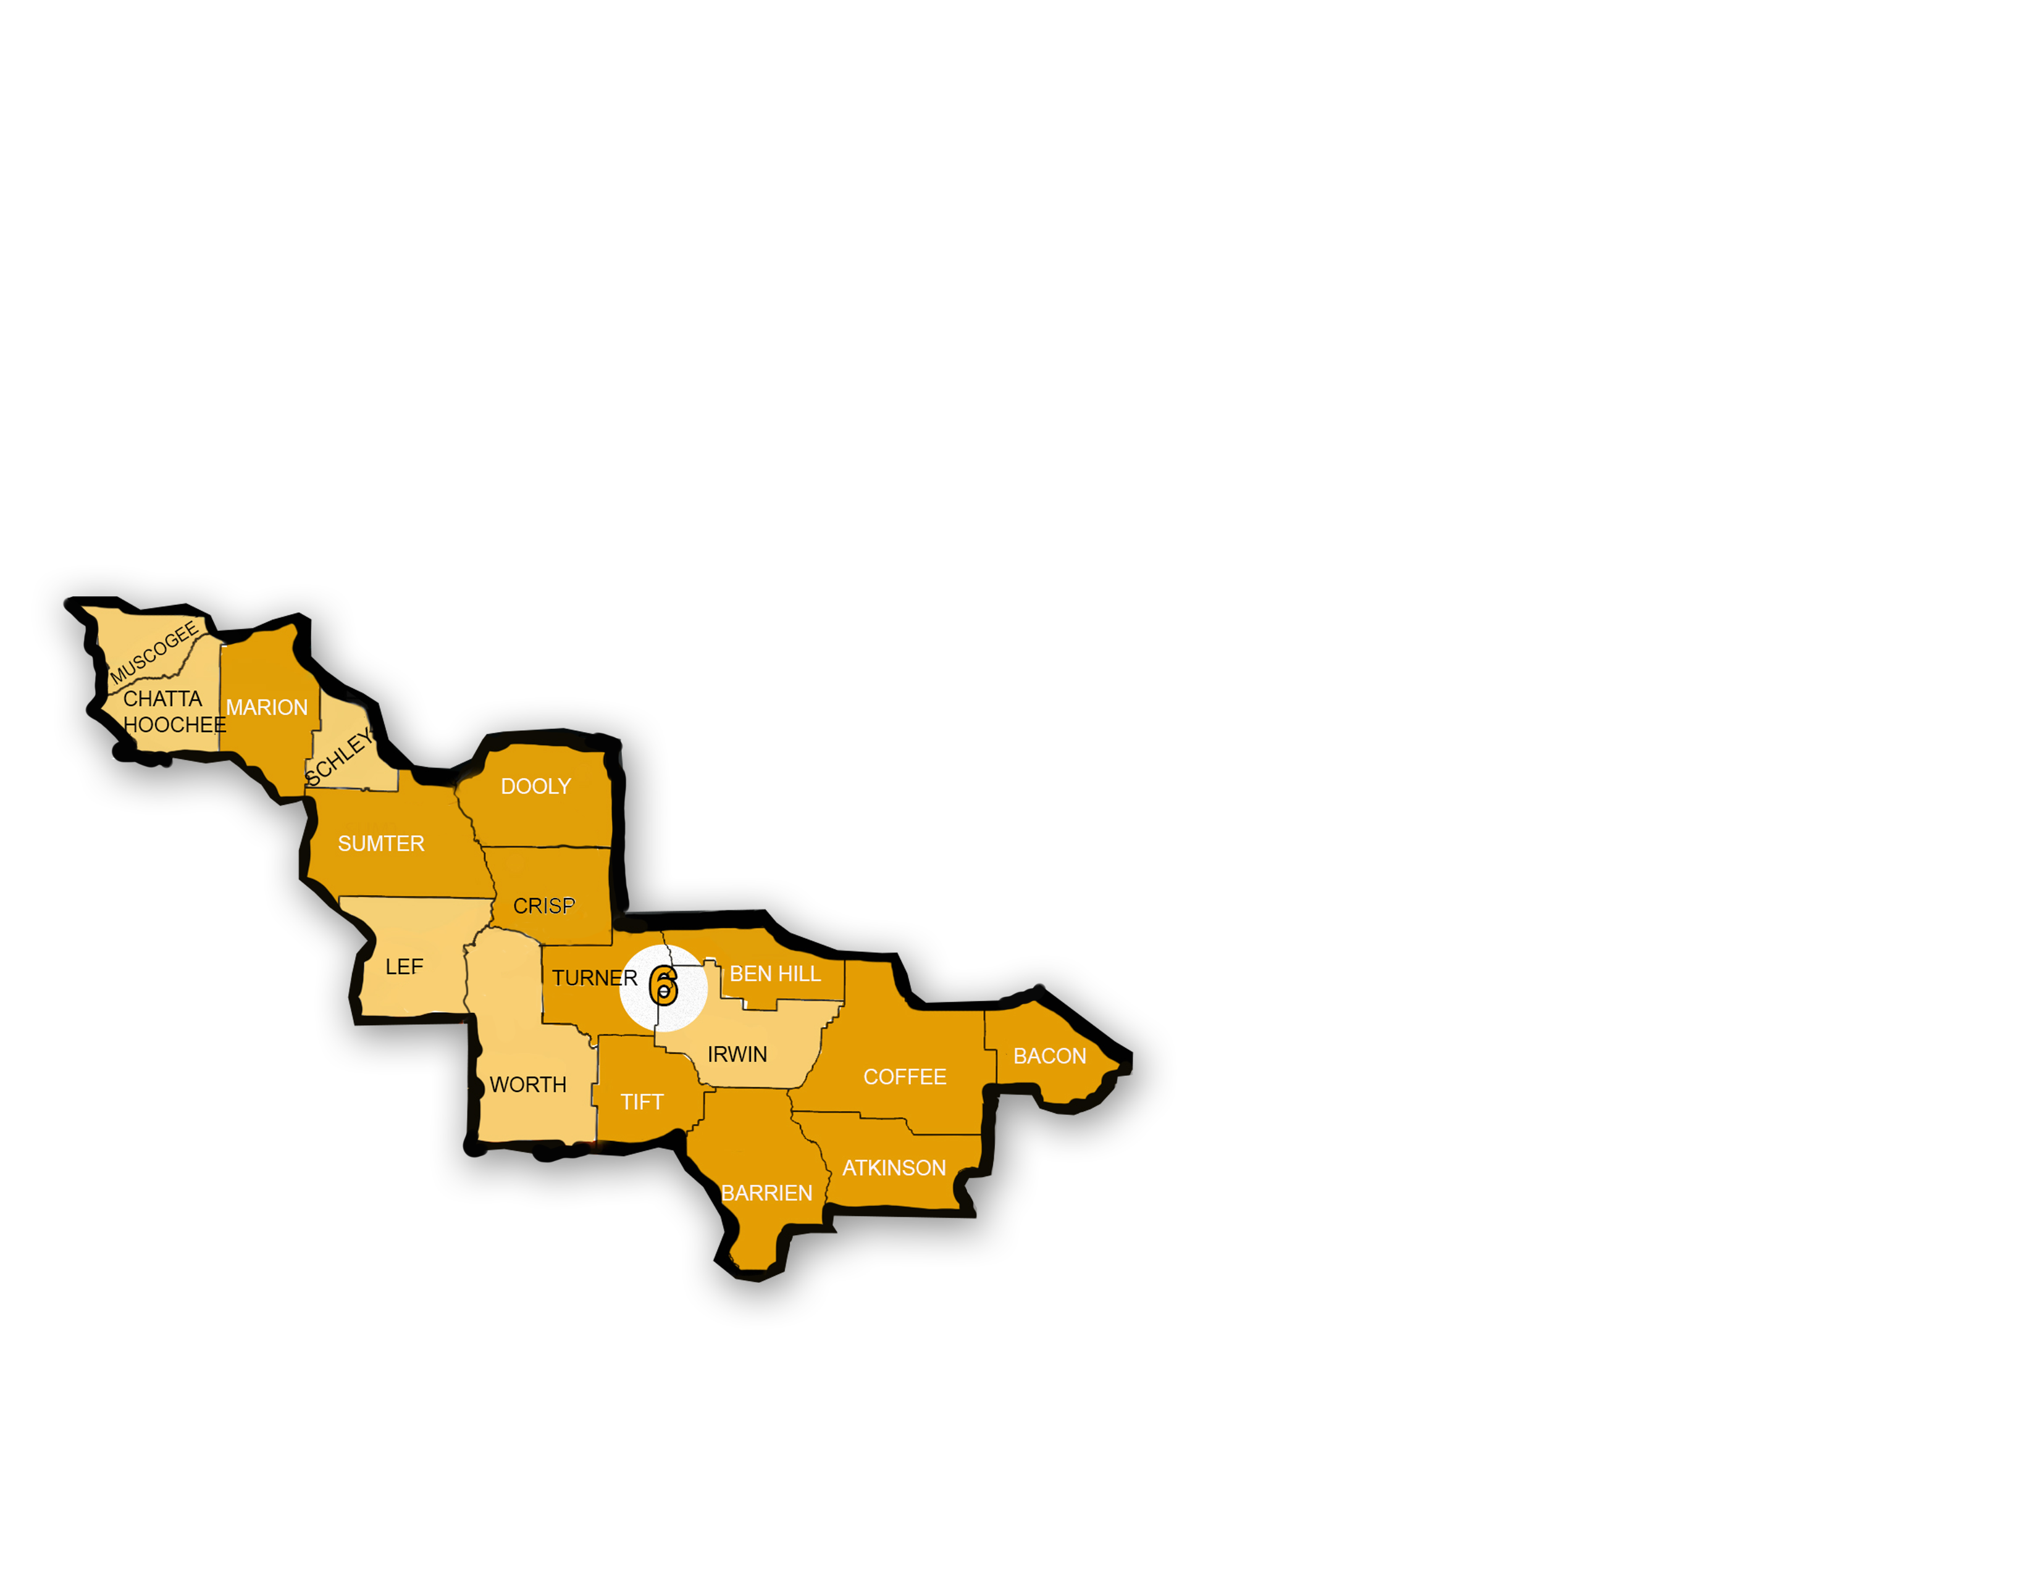
Sylvia O. Camargo 678-492-0650

Slide 9
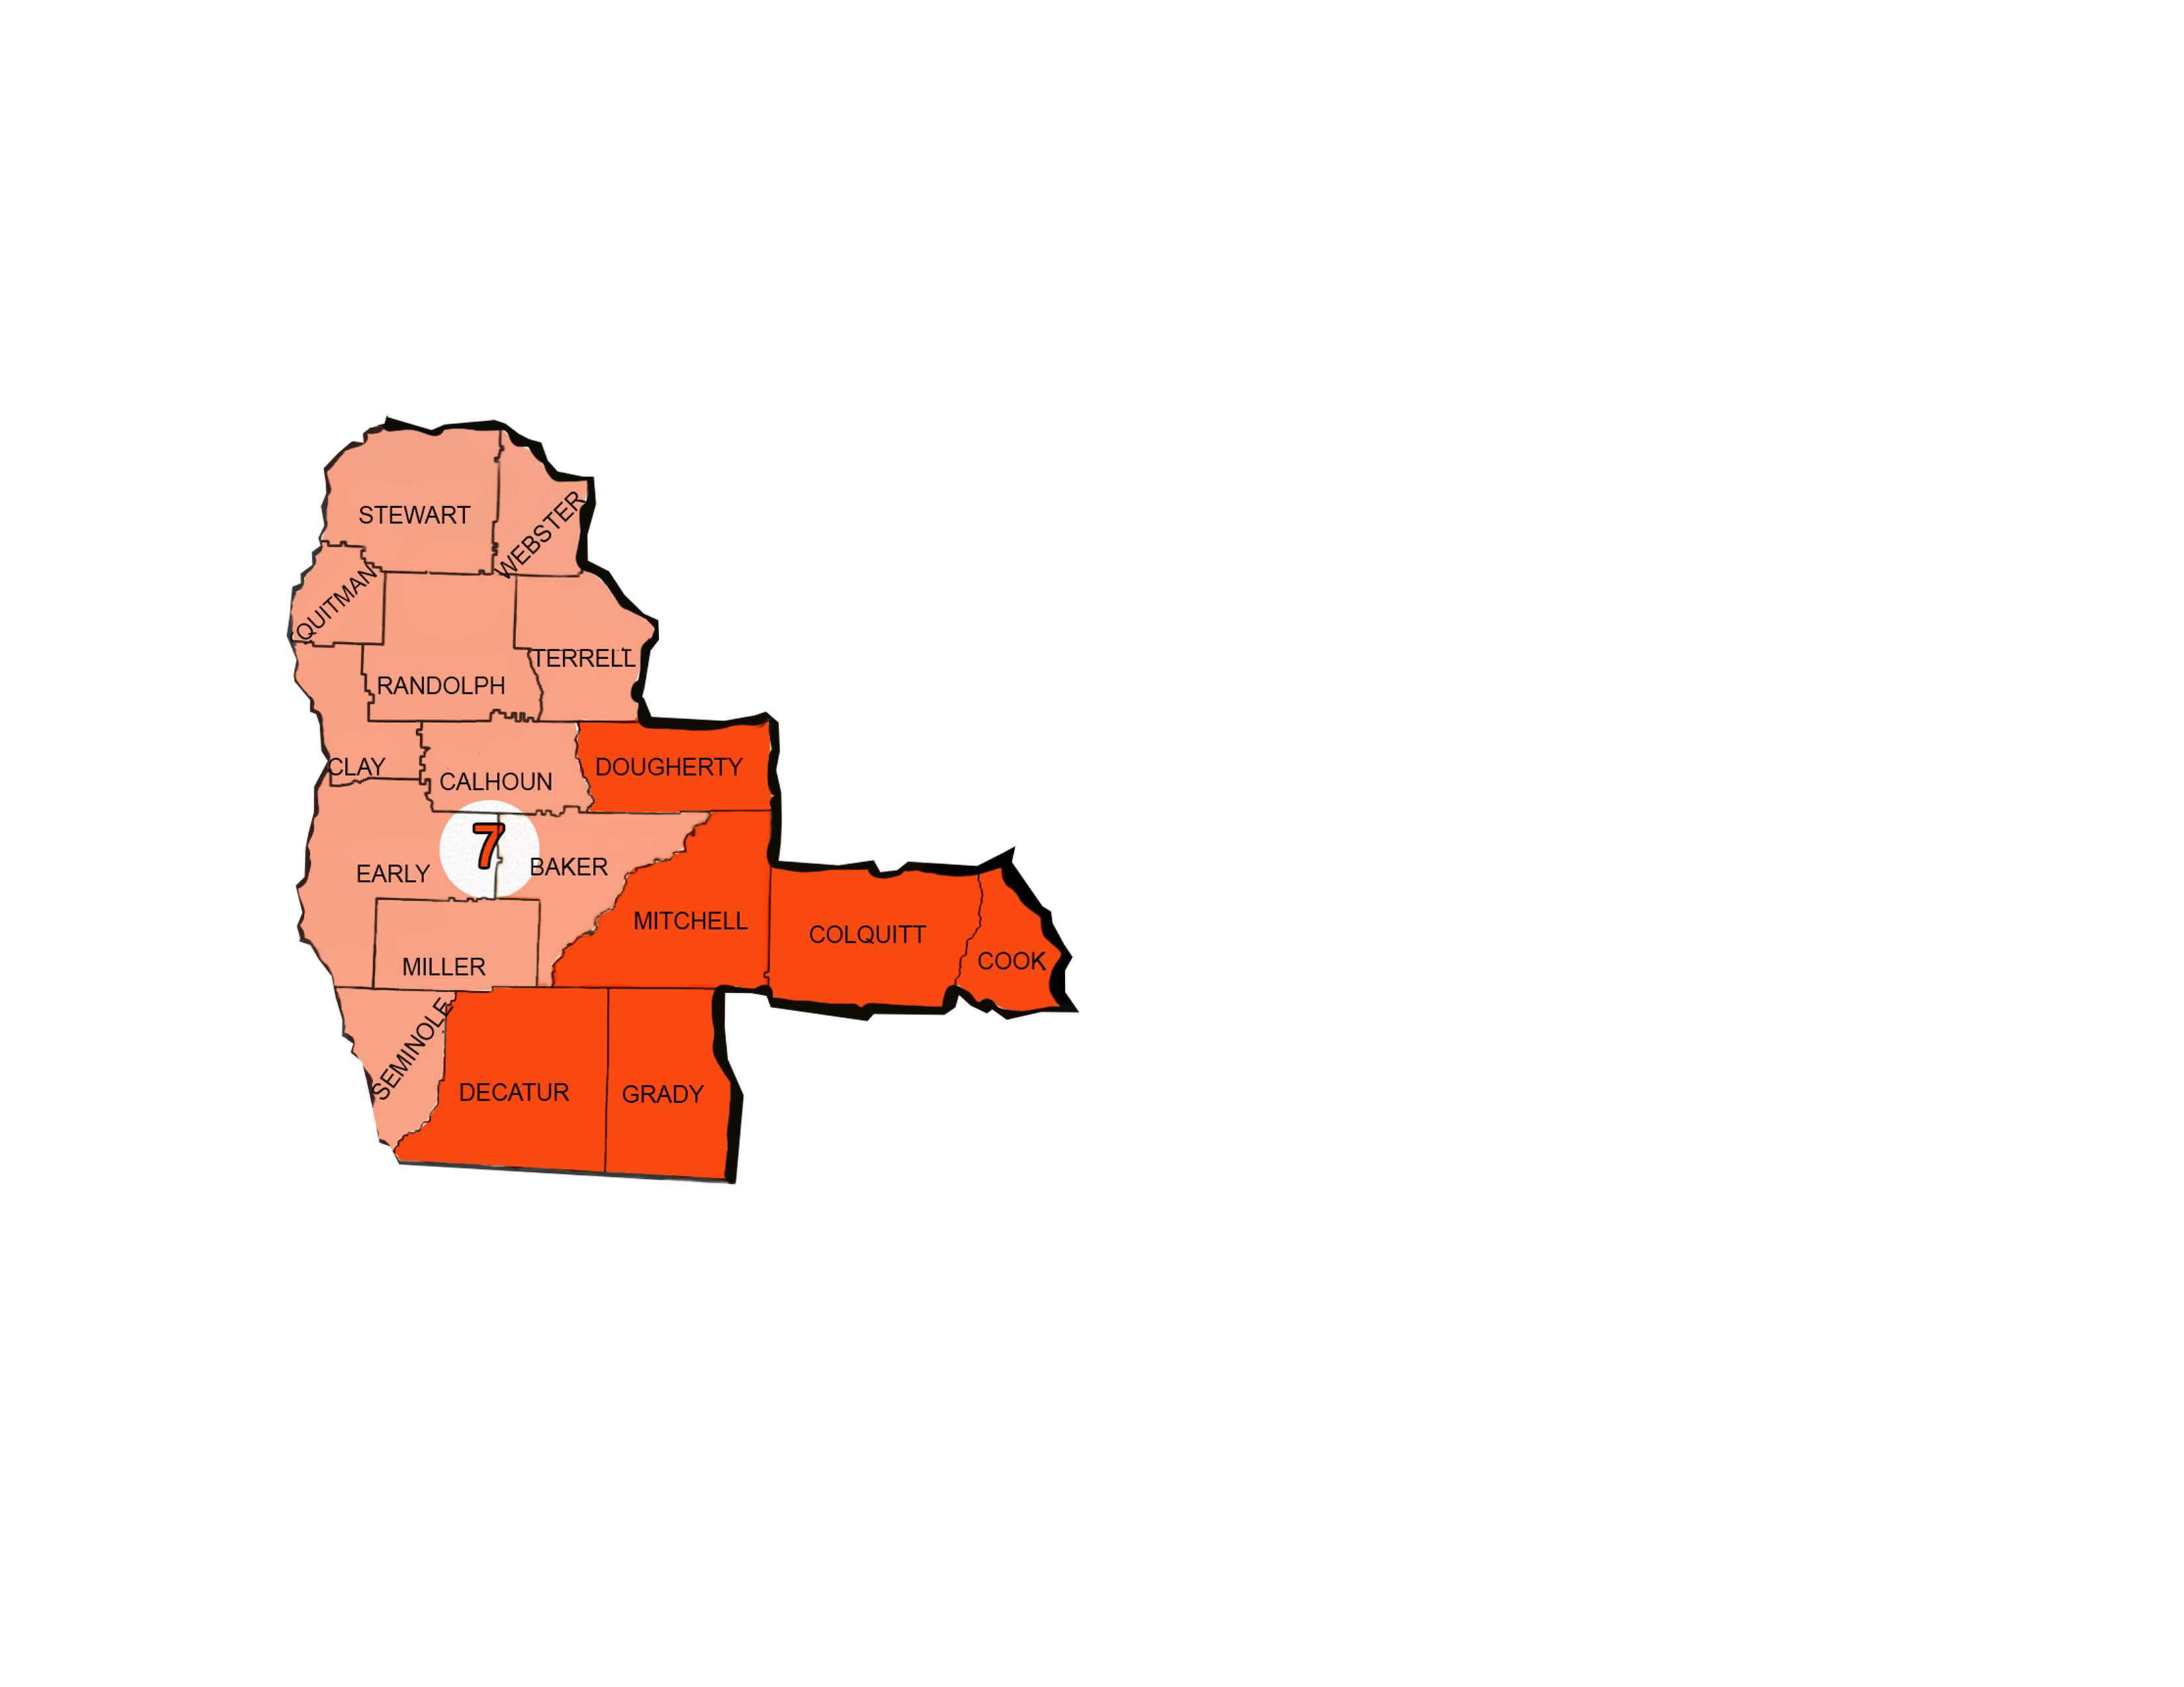
Grisdelia Dominguez 404-617-5083

Slide 10
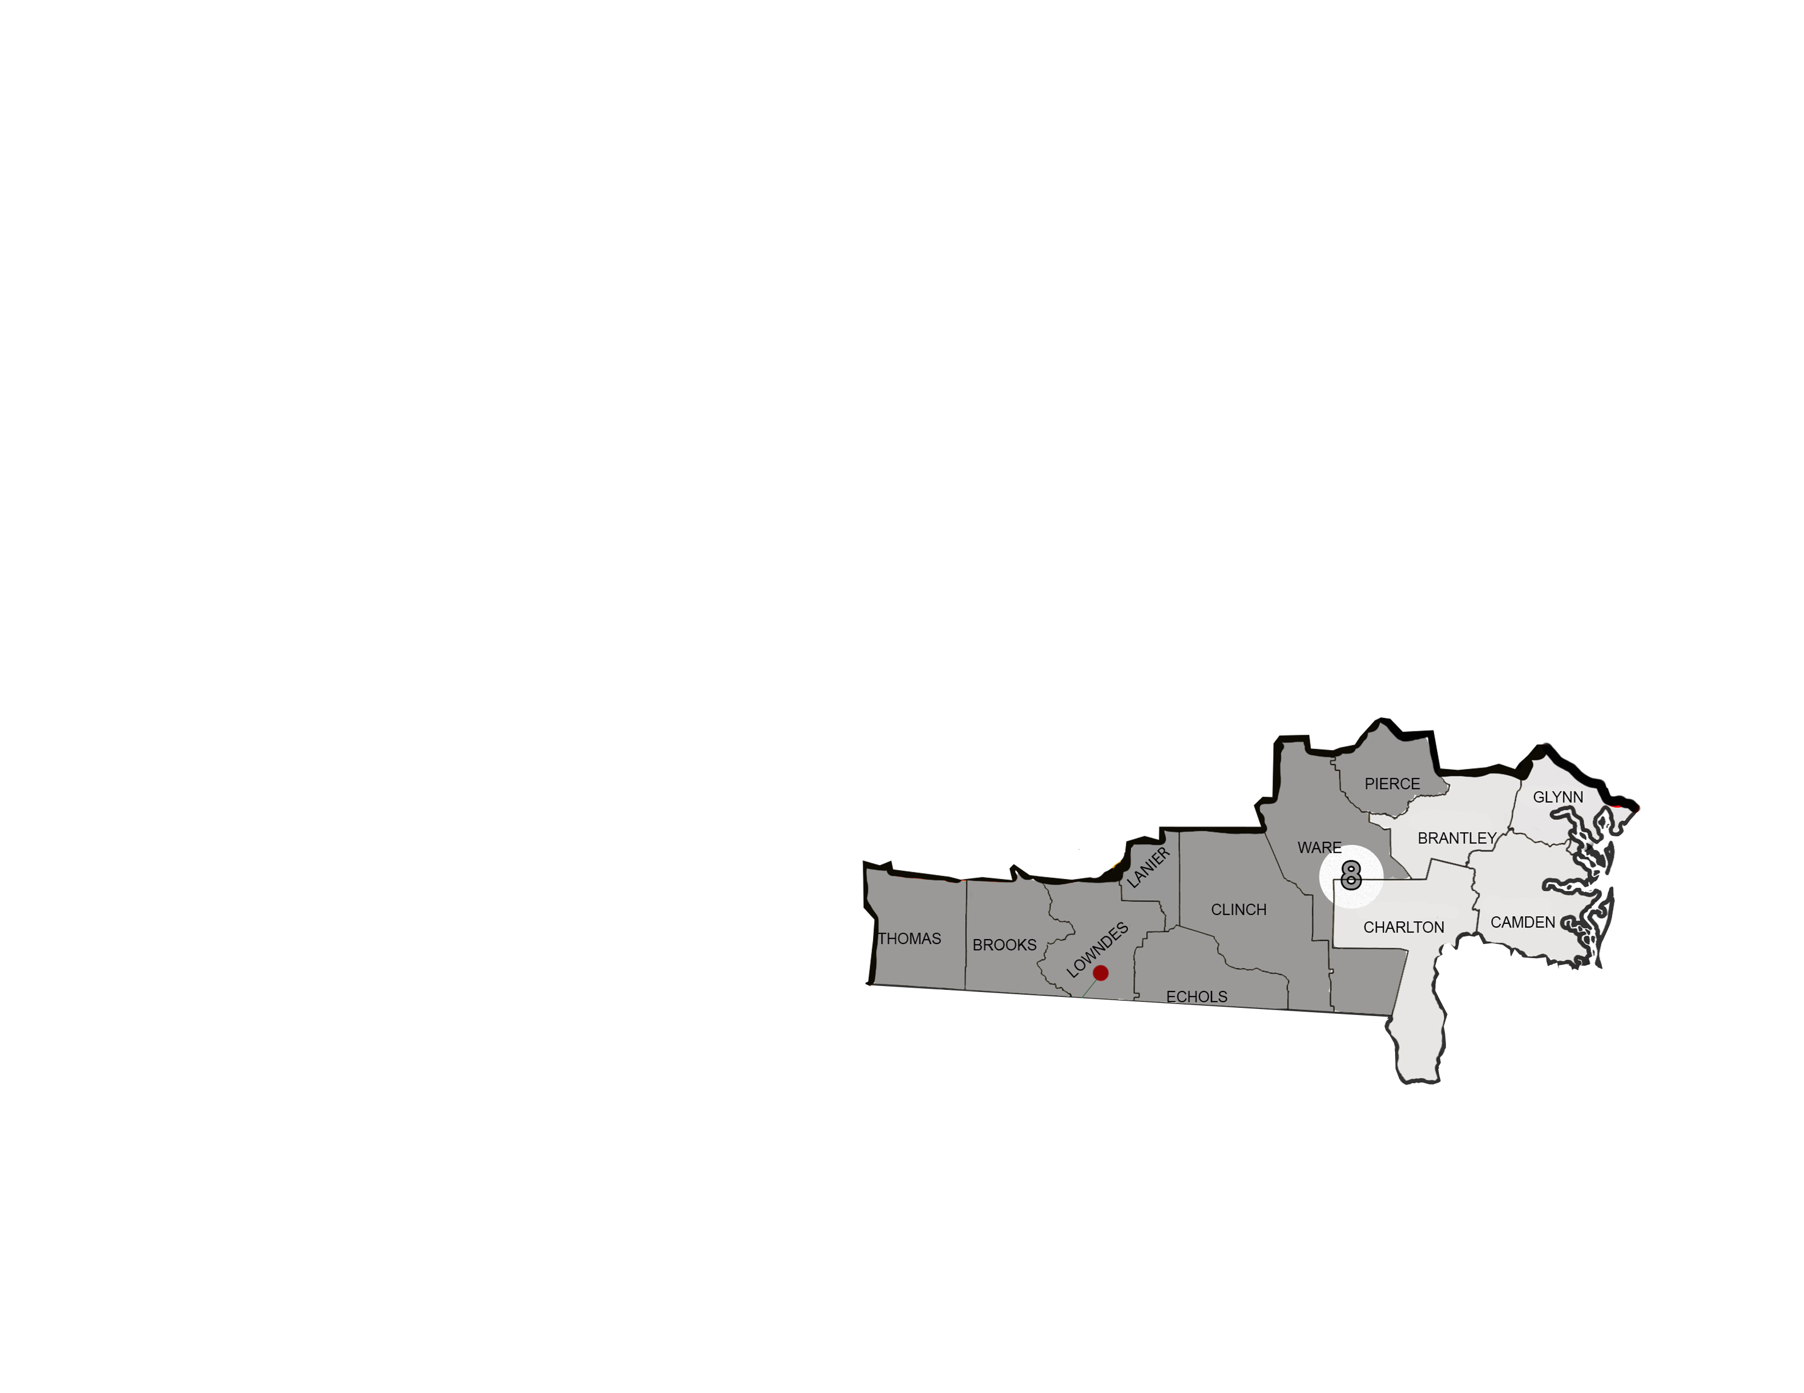
Edgar A. Perez 404-430-8600

Slide 11
AGRICULTURE ACTIVITIES
Farming
Fishing
Planting or Growing Trees
Nursery
Forestry
Dairies
Processing (Meat, Poultry, Seafood)
Chicken Galleys
Mending Fences (only in farms)
Cultivo de Productos Agricolas
Pesca
Plantar o Cultivar Árboles
Viveros
Silvicultura (Plantacion y Corta de Arboles Para Reforestacion)
Lecherias
Procesamiento (Carne, Aves de Corral, Mariscos)
Galeras de Pollo
Reparación de Cercas (solo en granjas)

Slide 12
GEORGIA MEP RECRUITERS

Slide 13
GEORGIA MEP REGIONAL OFFICES
Region 1
201 West Lee St.
Brooklet, GA 30415
(912) 842-5400 Office
(800) 621-5217 Toll Free
Region 2
221 N. Robinson St. Lenox, GA 31637 (229) 546-3248 Office
(866) 505-3182 Toll Free

