Slide 1
Extended Content Standards: A Support Resource for the Georgia Alternate Assessment

Slide 2
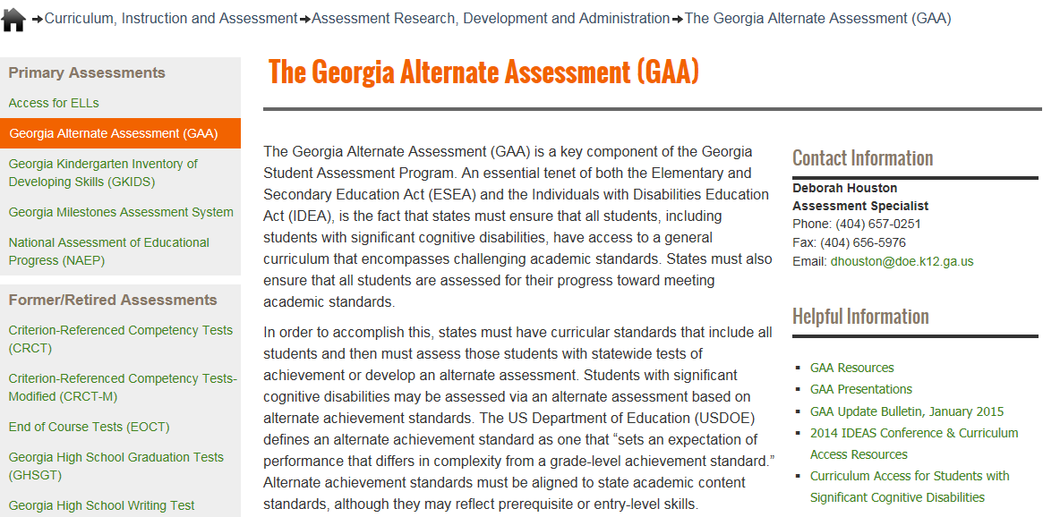
Links to Presentations are on the GaDOE website (shown below)
http://www.gadoe.org/Curriculum-Instruction-and-Assessment/Assessment/Pages/GAA.aspx

Slide 3
Questions & Answers
You are invited to submit questions you may have using the “Questions” feature of the GoToWebinar anytime throughout each session.
The “Questions” feature will be monitored throughout the session and questions will be addressed.

Slide 4
Overview

Slide 5
Purpose of Extended Content Standards
Several states and assessment consortiums have developed a series of extended standards to assist teachers with the task of alignment.
GaDOE is providing a similar RESOURCE to its teachers who administer the GAA.
This resource is a support for teachers. It is not required that teachers document its use within their GAA portfolio.
Nor does it represent a new requirement for the GAA program or for student portfolios.

Slide 6
Purpose of Extended Content Standards
Extended standards identify student skills that align to each standard included in an alternate assessment.
Extended standards include a variety of student skills that are based upon the cognitive characteristics of the range of students appropriate for the alternate.
The extended standards would allow a teacher to better understand the main purpose of an individual standard and align current and future student skills to the standard.
Teachers can then develop learning activities that focus on aligned skills.

Slide 7
Purpose of Extended Content Standards
It is anticipated that the use of extended standards by teachers will:
increase the ability of teachers to provide appropriate academic instruction to their students and the ability of students with significant cognitive disabilities to show what they know and can do within their grade-level academic content.
The use of the extended standards will not:
automatically ensure a score point of 2 or above in any area of the GAA;
automatically ensure that none of the entries will receive a non-scorable code of not aligned.

Slide 8
Overview of the Georgia’s Extended Standards
Extended standards are broken into four levels from “least complex” to “most complex”.
Some extensions will only have skills listed in three levels. It is important that each level of skill align to the overall standard/element. Extension to a “least complex” level may negatively impact the alignment of that standard.
The skills listed within the extended standards should be complete but not necessarily exhaustive. Teachers should understand that additional skills may align to the standard/element.

Slide 9
Overview of the Georgia’s Extended Standards
Each standard will include student skills which are points along a continuum.
Extended standards can begin and end at different points in relation to the overall standard/element.
For example, a “less complex” skill for one standard could be a more complex skill than a “less complex” skill for another standard.
Likewise, a “most complex” skill for one standard could be a much less complex skill than a “most complex” for another standard.

Slide 10
Alignment in the GAA
The GAA is a portfolio-based assessment comprised of student work provided as evidence that a student is making progress toward grade-level academic standards, often at a prerequisite or entry level.
Evidence within the GAA must show student work that is aligned to specific grade-level content standards, adapted to meet the student’s cognitive, communication, physical, and/or sensory impairments.
The GAA (and alignment of student skill to the standards) is mandated by ESSA and IDEA.

Slide 11
Alignment
Alignment is the connection between the written, taught, and tested curriculum.
Alignment demonstrates the linkage of the student work/skill to the intent of the grade-level standard and element/indicator on which the student is being assessed.
Students being assessed by the GAA can access the standard with skills that are at a different level from those of their grade-level counterparts (including pre-requisite skills).
However, the intent of the standard must remain within the alignment.
Notes:
Intent- what are the standard and element designed to teach?
Consider alignment first and foremost when designing assessment tasks.
The task must be true to the standard.
The task must address the distinct aspects of the element (focusing on one is acceptable).
The task must be appropriately challenging for the individual student.
All four tasks, though distinct events, must provide evidence of what the student knows and can do across the same skill.
A consistent skill must be present and carried across both collection periods

Slide 12
Alignment–Prerequisite Skills
A prerequisite skill is one that is essential to the acquisition of the standard and element/indicator.
Prerequisite skills allow the student to be exposed to and assessed on the standard/element at a level that is meaningful and purposeful for the student.
Prerequisite skills must still focus on the intent of the grade level standard and element.
Can working on this skill eventually lead the student to the skill targeted by the standard and indicator?
Does the prerequisite skill allow the student to understand the intent of the standard?

Slide 13
Alignment - the Intent of the Standard and Indicator
The intent of the standard and indicator refers to the “Big Idea”– that which they were designed to teach.
ELAGSE9-10.W.2: Write informative/explanatory texts to examine and convey complex ideas, concepts, and information clearly and accurately through the effective selection, organization, and analysis of content.
a. Introduce a topic; organize complex ideas, concepts, and information to make important connections and distinctions; include formatting (e.g., headings), graphics (e.g., figures, tables), and multimedia when useful to aiding comprehension.

Slide 14
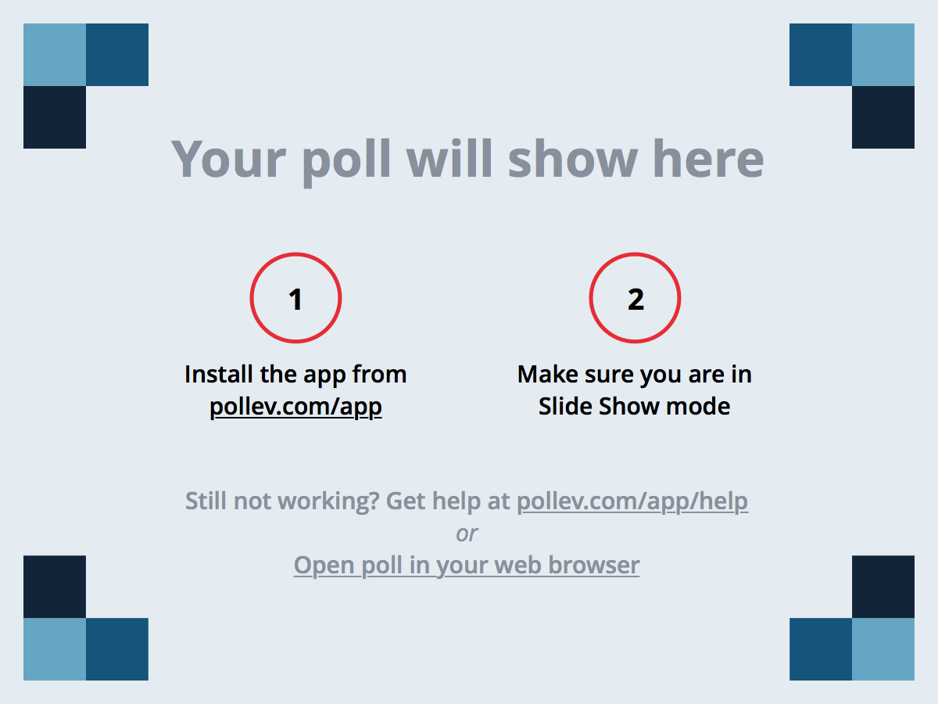
Notes:
Poll Title: What is the intent of this Writing standard? https://www.polleverywhere.com/multiple_choice_polls/RJGvPPUFky7Yy5k
What is the intent of this Writing standard?
The student will physically copy a given sentence.
The student will tell the teacher the topic of an informational text.
The student will generate a topic sentence which will be used in a written narrative.
The student will identify a sentence which introduced the topic of an informational text read.

Slide 15
Alignment - the Intent of the Standard and Indicator
MGSE5.OA.3: Generate two numerical patterns using a given rule. Identify apparent relationships between corresponding terms by completing a function table or input/output table. Using the terms created form and graph ordered pairs on a coordinate plane.

Slide 16
Notes:
Poll Title: What is the intent of this Math standard? https://www.polleverywhere.com/multiple_choice_polls/sD01enS7VhmlBY3

Slide 17
Features and
Additional Considerations

Slide 18
Understanding the Format of Extended Content Standards
Every extension will include:
Grade, Subject Area, Domain
Standard Description
Level
Extended Content Standard
Footer
Some extensions will include:
Indicator/Element Level
Implementation Text
Math-specific Definitions

Slide 19
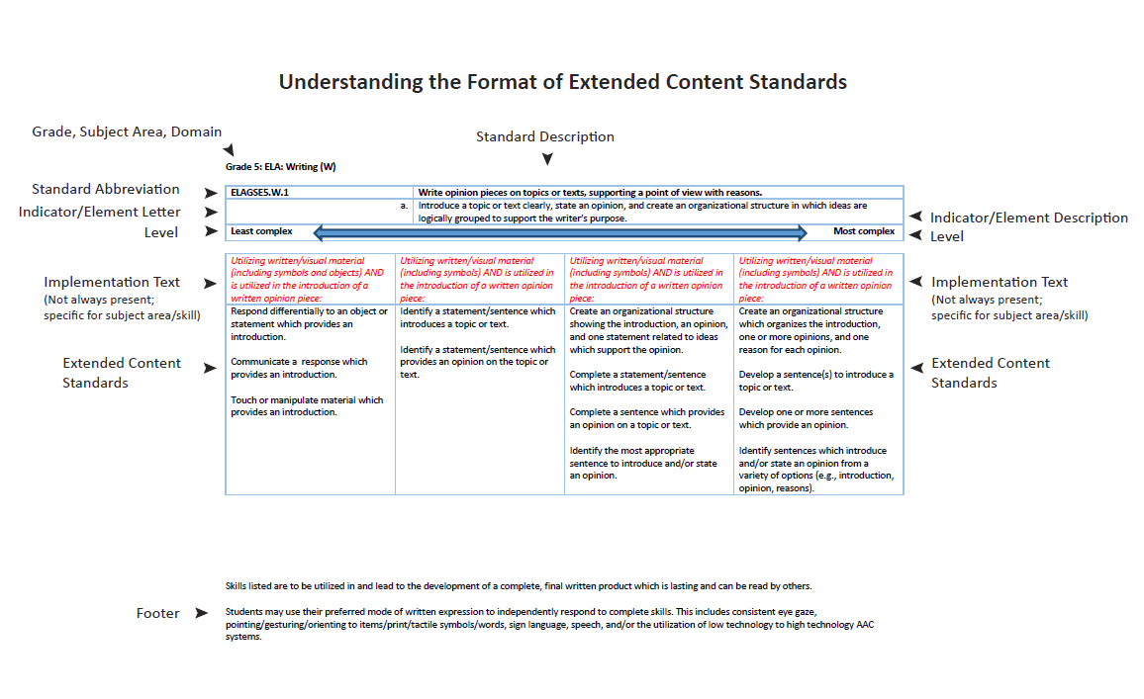

Slide 20
Understanding the Footers
The use of the student’s preferred mode of communication is expected across all extended standards.
The preferred mode of communication will allow the student to respond independently to show what they know and can do within the standard.
Materials utilized by students can and should be adapted to meet the student’s cognitive, physical, and sensory needs.
Materials utilized by students can and should be adapted to reflect real-world applications.

Slide 21
Utilizing the Extended Content Standards Resource for Instruction
The extended content standards within this resource are appropriate for assisting educators in identifying skills to be instructed within any standard that is a part of the student’s overall educational program.
As part of the educational program, more than one skill within a standard/element may be identified as a target for instruction.
Systems of prompting by the teacher, utilizing cues added to materials, and expanding the number of options for responding (e.g., number of choices given for an answer) are appropriate instructional strategies that support the learning of skills aligned to the standard.

Slide 22
Utilizing the Extended Content Standards Resource for Assessment
There are three important caveats to the use of this resource as teachers identify specific skills.
The use of the content standards extensions that comprise this resource is not required when developing a GAA portfolio.
Identification and use of a skill listed within this resource does not ensure a scorable GAA portfolio entry.
The utilization of skills within a specific level neither precludes nor ensures a student will receive a certain score point within a portfolio entry.

Slide 23
Utilizing the Extended Content Standards Resource for Assessment
When using this resource, it is important to remember that consistency of skill must be maintained across all pieces of evidence within an entry.
While a student may receive instruction on a variety of skills within a standard, evidence of learning related to a single skill across both collection periods is the focus for the GAA.

Slide 24
Additional Considerations for Language
The Language Extended Content Standards are related to the understanding of specific words/phrases which leads to a better understanding of the text in which they appear.
The adaptation of grade-level text and the method through which students can show understanding can include the use of objects, symbols, word-symbol combinations, and high interest/low readability material.

Slide 25
Additional Considerations for Reading
The Reading Foundations and Reading standards relate to the understanding of a given text.
The adaptation of grade-level text, including the method through which students can answer questions about the text, can include the use of objects, symbols, word-symbol combinations, and high interest/low readability material.

Slide 26
Additional Considerations for Writing
The Writing standards relate to the development of a text, incorporating ideas provided by the student, which is lasting (versus speaking, which is temporary) and can be read/utilized by others as a single product (versus numbering sentences as part of a worksheet activity).
Students may produce statements/sentences/written pieces in a variety of ways, based upon their cognitive, physical, and sensory needs. Students may utilize objects, symbols, symbol/word combinations, and/or written words to express ideas.
Students may also communicate a statement, verbally or through the use of an AAC device, which is then scribed and included in a piece of writing.
However, the fine motor skill of copying or tracing words which were not generated by the student as part of a complete written piece is not aligned to these standards.

Slide 27
Additional Considerations for Speaking and Listening
The most effective and efficient (considered the preferred) mode of communication should be utilized by the student when interacting with others.
Communication must be between the student and another individual or group of individuals.
As the skills move from Least to Most Complex, students can also utilize communication skills in different activities and/or environments.

Slide 28
Additional Considerations for Mathematics
Students with significant disabilities often require the use of "hands-on" materials in order to understand and express learning in mathematics.
Unless otherwise noted, manipulatives which are appropriate for student use, related to the standard, and reflect a real-world application of the concept can and should be provided to and be utilized by the student to show skill.

Slide 29
Additional Considerations for Science and Social Studies Extended Content Standards
The extended content standards provided for Science and Social Studies are a cross-section of Georgia Performance Standards available for assessment via the GAA.
These standards were targeted for extensions due to their overall relevance for students with significant disabilities.
However, all standards/elements listed in the GAA blueprint are available for inclusion within an individual student’s portfolio for these content areas.
The provision of an extended content standard in Science and Social Studies does not imply that only those standards/elements extended are appropriate for this group of students, available for assessment, or will be scored within a portfolio.

Slide 30
Definition of Terms Used within Extended Content Standards
A glossary of commonly used words is provided to:
support an understanding of skills;
ensure consistent use of terminology.

Slide 31
Extended Standards Online Tool
Aids teachers in quickly referencing the expanded standards in the classroom environment
Allows teachers to select and save standards for each student
Works across all grades and content areas
Uses the built-in Word mail merge feature, so functionality and support is standardized
Quick-start materials and support will be provided

Slide 32
System and School Support
The Georgia Center for Assessment will be providing support to systems and schools through December 2016 via support sessions as well as customer support.
October 3rd, October 17th, October 24th, November 14th, December 5^{th,} December 12th (4:00-5:00 PM)
October 10th, October 31st, November 28th (7:00 AM-8:00 AM)
Join these optional support sessions using the link below: https://global.gotomeeting.com/join/136621357 You can also dial in using your phone. United States +1 (646) 749-3122 Access Code: 136-621-357

Slide 33
Contact Information
Questions about how to administer the GAA?
GaDOE Assessment Division
(800) 634-4106
Deborah Houston, Assessment Specialist
(404) 657-0251
dhouston@doe.k12.ga.us

Slide 34
Contact Information
Need information about access to the state-mandated content standards for students with significant cognitive disabilities?
Kayse Harshaw, Division for Special Education Services
(404) 463-5281
sharshaw@doe.k12.ga.us
kharshaw@doe.k12.ga.us

Slide 35
Contact Information
Questions about the Resource Guide or the Electronic Tool?
Georgia Center for Assessment
1-888-392-8977
gca@uga.edu

Slide 36
Questions?

Slide 37
Webinar Survey
We Want your Feedback!
Please use the below link to provide feedback regarding this GAA training session.
http://gadoe.org/surveys/AsAc-H8PBVZM

