Slide 1
Georgia Alternate Assessment (GAA 2.0)
Overview and Eligibility
Thursday, October 21, 2021

Slide 2
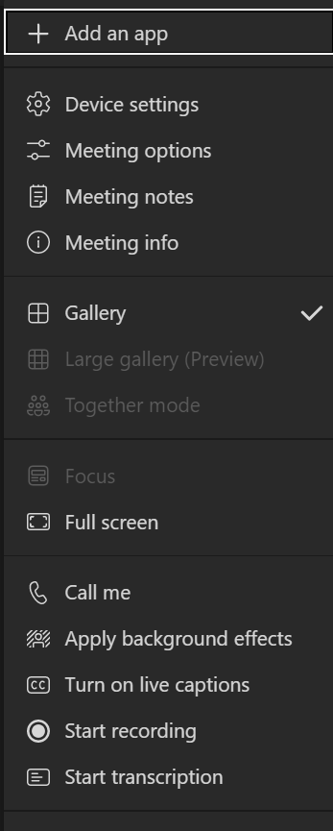
Welcome!
Post questions throughout the webinar using this link. This link will be on every slide.
Disconnect from the Meeting
Teams Toolbar Options
Show Participants
Team Notifications
More
Actions
View the content in Full screen
If you experience audio problems, enter your phone number to change audio from the computer to your phone. (option only available in the Teams app)
Live closed captions for yourself only (option only available in the Teams app)

Slide 3
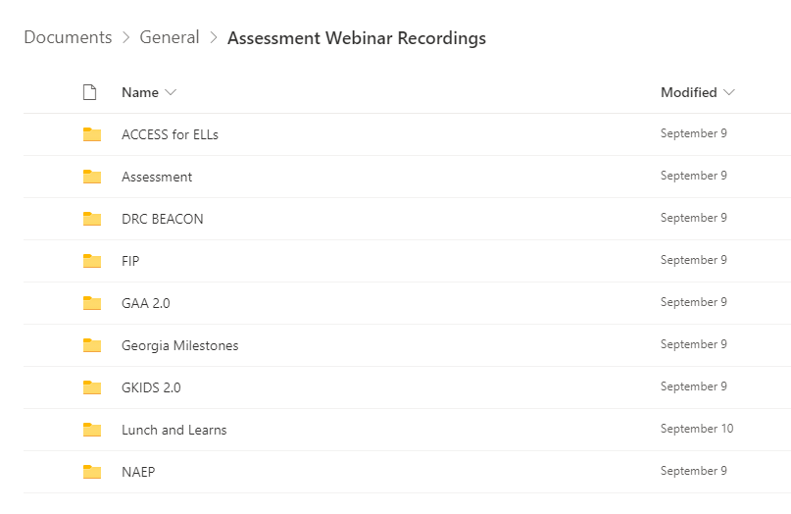
Webinar Recordings
Recordings are now shared through a single link that takes you to a folder of prior webinars.
Recordings are available a day after the live session.
The link to the webinar recording folder will be available within the Assessment Update.
Webinar Recordings

Slide 4
Agenda
Overview
Resources
Eligibility Criteria and Participation
Test Features
Data and Materials Management

Slide 5
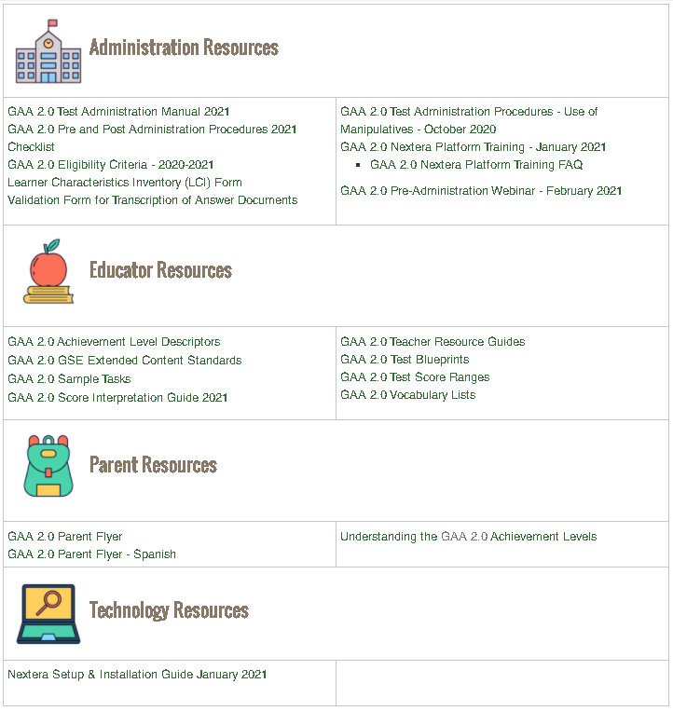
GAA 2.0 Resources
10/21/2021
5
Notes:
Georgia Alternate Assessment (GAA 2.0) resources are provided on the GAA 2.0 webpage. These resources are organized in four broad categories, including administration, educator, parent , and technology. I would like to highlight a few key resources for educators that are available to facilitate the successful implementation of this assessment program. For example, one can find the GAA 2.0 Eligibility Criteria 2021-2022. IEP teams must complete this (electronically) fillable document for every GAA 2.0 participant. The Learners Characteristics Inventory must also be completed for each GAA 2.0 participant, and it located right below the GAA 2.0 Eligibility Criteria. Teachers can find sample tasks and the newly created Teacher Resource Guide in the Educator Resources section. Teachers should use the sample items to become familiar with item format and to consider how best to present test content to individual students and obtain responses from them.
The GAA 2.0 Teacher Resource Guides are supplemental resources and are provided to complement other instructional resources developed by school district staff and by the Special Education Division of the Georgia Department of Education. It is important mention that a team of teachers were involved in the development of the information shared regarding test development, test administration tips, and classroom best practices.

Slide 6
Key Dates
Testing Dates | Event
10/26/2021 - 11/6/2021 | Braille Materials Survey
1/20/2021 | Nextera Platform Training
2/3/2022 | Test Administration Procedures Training
2/17/2022 | Pre-Administration Training
3/21/2021 – 4/29/2022 | Test Administration Window

Slide 7
Overview
The Georgia Alternate Assessment (GAA) 2.0 is the state’s AA-AAAS for those students with significant cognitive disabilities who cannot participate in the general statewide assessment program, even with maximum allowable accommodations.
The GAA 2.0 has been developed to ensure that students with the most significant cognitive disabilities are provided access to the state academic content standards and given the opportunity to demonstrate achievement of the knowledge, concepts, and skills inherent in the standards.

Slide 8
Eligibility and Participation

Slide 9
Federal and State Board Rule
Under the federal Individuals with Disabilities Education Act (IDEA), the Every Student Succeeds Act (ESSA) and the Georgia State Board of Education (SBOE) Rule 160-3-1- .07, all students, including students with disabilities (SWD) and English learners (ELs), must participate in the state’s academic content standards and assessments.

Slide 10
SBOE Rule 160-4-2-.48
Significant Cognitive Disabilities are defined as –
Students with significant intellectual disabilities or intellectual disabilities concurrent with motor, sensory or emotional/behavioral disabilities who require substantial adaptations and support to access the general curriculum and require additional instruction focused on relevant life skills and participate in the Georgia Alternate Assessment (GAA).

Slide 11
SBOE Rule 160-4-2-.48 1
Students with significant cognitive disabilities who entered the ninth grade for the first time prior to the 2020-2021 school year may graduate and receive a regular high school diploma when the student’s IEP team determines that the student has:
Completed an integrated curriculum based on the GPS that includes instruction in mathematics, English/language arts, science and social studies as well as career preparation, self-determination, independent living and personal care to equal a minimum of 23 units of instruction, and
Participated in the GAA during middle school and high school, and
Reached the 22nd birthday OR has transitioned to an employment/education/training setting in which the supports needed are provided by an entity other than the local school system.

Slide 12
SBOE Rule 160-4-2-.48 2
Students with significant cognitive disabilities who entered the ninth grade for the first time on or after the 2020-2021 school year may graduate and receive an alternate diploma when the student’s IEP team determines that the student has:
completed an integrated curriculum based on the Georgia Standards of Excellence (GSE) that includes instruction in mathematics, English/language arts, science and social studies as well as career preparation, self-determination, independent living and personal care to equal a minimum of 23 units of instruction, and
participated in the GAA during middle school and high school, and
has transitioned to an employment/education/training setting in which the supports needed are provided by an entity other than the local school system.

Slide 13
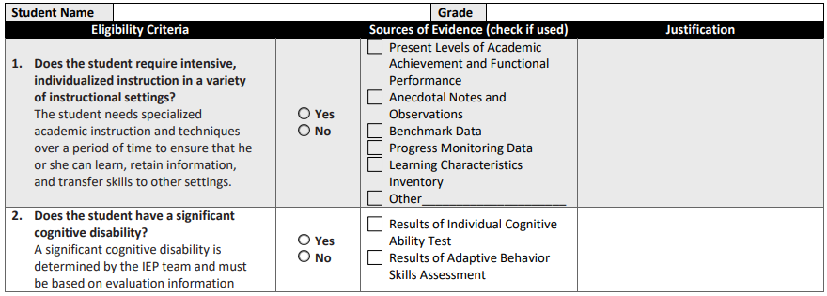
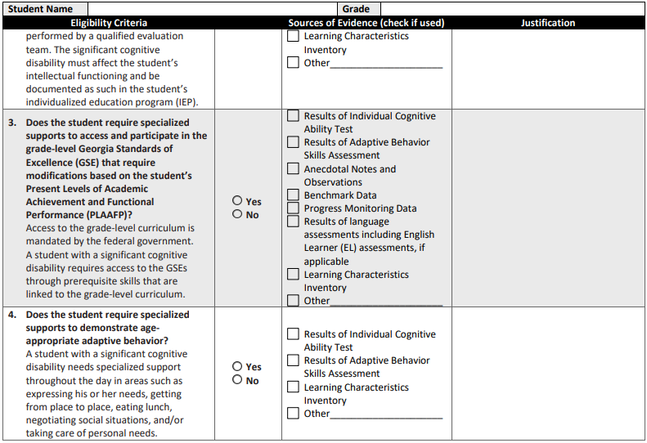
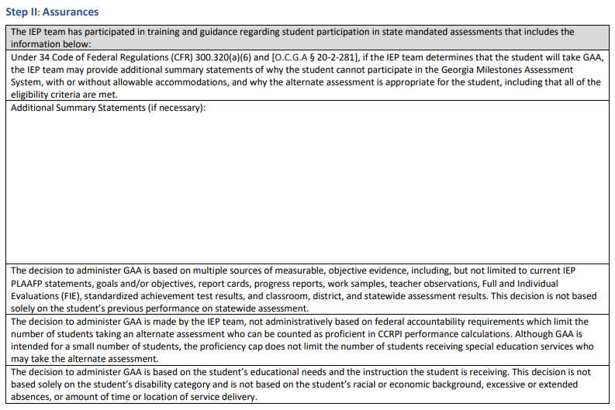
Notes:
Let’s review the key questions that IEP teams must consider when determining whether a student is eligible for GAA 2.0. Teams must ask…

Slide 14
Assessment Placement

Slide 15
Participation
Data Collections - FTE
STCs and Special Education Directors should always work together to ensure students whose instructional program is based on alternate content standards (ACS) are considered for GAA 2.0.
STCs, Special Education Directors, and Student Data Coordinators should ensure those students whose instructional program is based on ACS are marked YES in the ACS data field during the October FTE count.
The ACS data element was previously labeled GAA.
Students enrolled in non-assessed grades and receiving instruction using ACS due to IEP decisions should also be coded YES in the ACS data field.

Slide 16
Participation 2
Data Collections – FTE
Questar will upload those students in grades 3-11 who have YES coded in the ACS data field into test sessions.
STCs must manually input the student information of new enrollees.
STCs must manually input the student information of seniors who did not test last year.

Slide 17
Test Design

Slide 18
Assessment Areas
Grades | ELA | Mathematics | Science | Social Studies
K
3 | x | x
4 | x | x
5 | x | x | x
6 | x | x
7 | x | x
8 | x | x | x | x
HS | x | x | x | x

Slide 19
Blueprints
The GAA 2.0 blueprints include:
claims that describe what students know and can do in the content area;
targets that describe the specific skills in the prioritized content standards, which are part of the larger claim;
content standards that will be assessed within each target;
Depth-of-Knowledge (DOK) that represents the range of complexity within the extended standards; and
relative proportional weighting of each claim.

Slide 20
Extended Standards
The extensions demonstrate how a grade level standard can be made accessible for students with significant cognitive disabilities for both instruction and assessment.
They are broken down into extensions, starting with the least complex and moving to the most complex.

Slide 21
Extended Standards: Example
ELA Grade 3
Notes:
The far-left extension represents the entry point for students to engage with the content.

Slide 22
Test Format
Standardized and scripted tasks with multiple access points.
Each content area assessment includes 10 tasks and 1 field test task.
Each task includes a scenario and three parts.
Each task includes built-in supports and additional scaffolding, when applicable.
Student responses are recorded on an answer document by the Test Examiner.

Slide 23
Embedded Features
Large print and simple graphics
Short simple sentences free of extraneous wording
Use of common proper nouns (names)
Directive questions
One-on-one administration with content read aloud

Slide 24
Non-Embedded Features
Familiar testing location with a familiar administrator
Breaks and multiple short testing sessions
Opportunity to preview test materials
Use of familiar manipulatives
Variable presentation and response modes allowed
Manipulatives are allowed to support access to content

Slide 25
Balancing Available Supports with Test Security and Fidelity
Valid Test Result
Accessibility Supports

Slide 26
Sample Tasks

Slide 27
Task Structure
Each task includes:
a scenario or passage that serves as an introduction.
three parts that are related and increase in complexity.
support, as well as additional scripted scaffolding when applicable, is built in to increase a student’s ability to access increasing levels of complexity.
Scenario
Part A
Least Complex
Part B
Part C
Most Complex
Notes:
Scaffolding:
is built into the task to increase a student’s ability to access various levels of complexity within a task.
includes additional information that is provided via standardized script and does not require the Test Examiner to do anything outside of administering a task.

Slide 28
Tasks
Scenario
Engages student in concept of standard
Sets stage for the following activities (Parts A – C)
Reminder of previous learning
May provide relevant graphics
For ELA, the passage is the scenario.

Slide 29
Part A
Task 1 and Scaffolding
Notes:
Scaffolding is included at each part, to be administered if needed.
Part A:
Low complexity content
Model – direct step-by-step model without directly cueing the answer

Slide 30
Part B
Moderate Complexity/Moderate Support
Notes:
Part B
Moderate complexity content

Slide 31
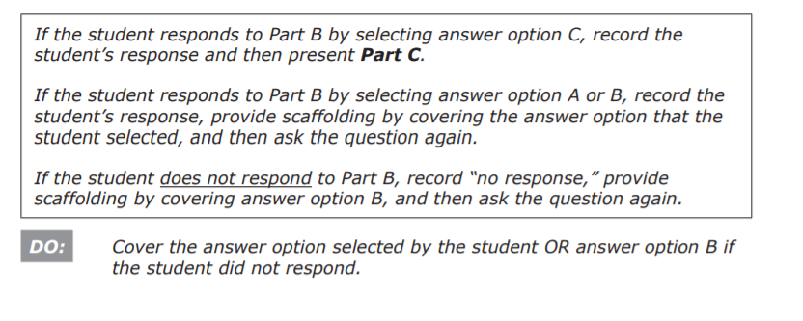
Part B – Scaffolding
Notes:
Scaffolding:
Gestural – covering one incorrect response option.

Slide 32
Part C
High Complexity
Notes:
Part C
High complexity content

Slide 33
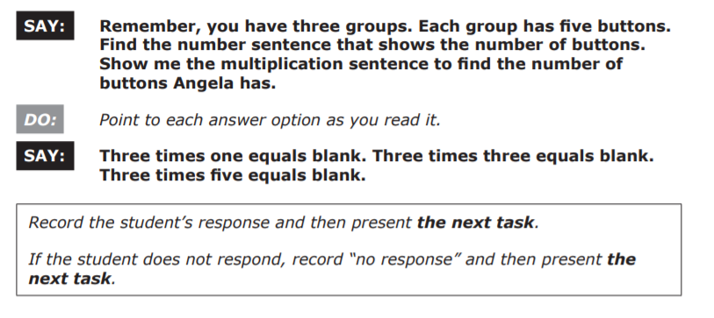
Part C – Scaffolding
Notes:
Part C
Scaffolding Verbal – verbally provides additional content information (i.e., definition, re-read passage part or sentence(s) with correct answer in it; describe first step or steps to solve a problem; etc.).

Slide 34
Mary Nesbit-McBride, Ph.D. Assessment Specialist mnesbit@doe.k12.ga.us 470-579-6345
Sandy Greene, Ed.D. Director, Assessment Administration sgreene@doe.k12.ga.us 470-579-5395

