Slide 1
Fall 2014 Pre-Administration Webinar
Georgia High School Graduation Test
August 19 & 22, 2014
Recorded Session 8/19/14 Link Recorded Session 8/22/14 Link
2014-2015 Retest Administration Dates
September 8-12, 2014
November 3-14, 2014
March 16-27, 2015
Webinar Etiquette
Please use the Audio Setup Wizard in the Tools Menu to configure and test your audio settings before the presentation begins.
To eliminate interference from background noise in your area, please leave the Talk Button on mute if you are not speaking.
Due to the number of participants, we request that questions be submitted via Chat.
You will receive a prompt to download this PowerPoint. You can also go to Window, File Transfer to download any files sent through this webinar.
Please log-in with your name and the name of your district beside it (e. g., Michael Huneke – Appling). If you have already logged-in, please place your name and district in the chat box.
The timer above indicates when we will begin.

Slide 2
Important Reminders and What’s New in 2014-2015
New: In 2014-2015 there are only 3 administrations (Fall, Winter and Spring)
New: Georgia Center for Assessment (GCA) is the new vendor for the GHSGT and booklets will be returned to GCA after each administration.
  Reminder: Students who enrolled in grade 9 for the first time on or after July 1, 2011, SHOULD NOT be assessed the GHSGT. This cohort is not required to pass the GHSGTs for diploma eligibility.
Reminder: GHSGT pre-id labels will not be provided.
Reminder: Enrollment counts will be pre-populated but the STC may change the number if needed by emailing Stephanie A. Lai, Ph.D. with GCA at slai823@uga.edu and receiving GaDOE approval (see next slide for more details).
Reminder: Material orders are carefully monitored. Only materials needed should be ordered. Materials may be transferred from one high school to another within a system. Please place only one extra order for your system when materials are needed after initial shipment arrives.
Reminder: Rescore and Special Administration costs are $40 per content area, per answer document.

Slide 3
What’s New in 2014-2015
Enrollment counts for the GHSGT are prepopulated based on the number of tests processed during a previous assessment. In order for a system to change the number of booklets ordered, the system test coordinator will need to email Stephanie A. Lai, Ph.D., with GCA at slai823@uga.edu and make a request for an enrollment change along with the rationale for the requested change. Any requests for an increased number of materials must be approved by Michael Huneke, GaDOE GHSGT Assessment Specialist.
GPS forms are rounded up to the nearest multiple of five and then a 10% overage is given to the district.
Transitional (GPS/QCC) Science, Transitional (GPS/QCC) Social Studies and QCC Math forms are rounded up to the nearest multiple of five and then a 5% overage is given to the district.
Transitional (GPS/QCC) ELA forms are rounded up to the nearest multiple of 5 and no overage is given. (Please note that only 10 booklets were scored state-wide during the Spring 2014 administration. We expect these orders to be very, very minimal.)

Slide 4
Administration Windows and
Deadlines for Answer Documents
Fall 2014 GHSGT
Materials Delivery: August 19-22, 2014
TESTING WINDOW Sept. 8-12
DOCUMENT DEADLINES
Scorable @ GCA Sept. 17, 2014
Nonscorable @ GCA Sept. 24, 2014
Paper reports in systems October 7-14, 2014
Please note that late return of answer documents can impact scoring of the system and potentially other systems. If one system sends in their answer documents late, it could delay results for the entire state.

Slide 5
Administration Windows and
Deadlines for Answer Documents
Winter 2014 GHSGT
Materials Delivery: October 20-24, 2014
TESTING WINDOW DOCUMENT DEADLINES
Nov. 3-7 Scorables @ GCA Nov. 12, 2014
Nov. 10-14 Scorables @ GCA Nov. 19, 2014
Nonscorables @ GCA Nov. 26, 2014
Paper reports in systems Dec. 8-12, 2014
Please note that late return of answer documents can impact scoring of the system and potentially other systems. If one system sends in their answer documents late, it could delay results for the entire state.

Slide 6
Administration Windows and
Deadlines for Answer Documents
Spring 2015 GHSGT
Materials Delivery: March 2-6, 2015
TESTING WINDOW DOCUMENT DEADLINES
March 16-20 Scorables @ GCA March 25, 2015
March 23-27 Scorables @ GCA April 1, 2015
Nonscorables @ GCA April 8, 2015
Paper reports in systems May 4-8, 2015
Please note that late return of answer documents can impact scoring of the system and potentially other systems. If one system sends in their answer documents late, it could delay results for the entire state.

Slide 7
Planning for Time
For planning purposes, students are expected to complete the tests in the following times:
English Language Arts in 60 minutes,
Mathematics in 60 – 90 minutes,
Science in 90 minutes, and
Social Studies in 90 minutes.
However, all students may have up to three (3) hours to complete each GHSGT.
School coordinators may choose to move those students requiring more time to another room. Although most students have been able to complete the GHSGT in the recommended times, it is essential that ALL students be given adequate opportunity to do their best work.

Slide 8
Make-Ups
Make-up days should be scheduled within your system’s test administration week.
The purpose of the make-up days is to administer the tests to students who are unexpectedly absent during the regularly scheduled administration.
Make-up days are not alternate testing dates for students whose activities conflict with the regular test administration dates.
Make-up days should be scheduled within your system’s test administration week. Therefore, any student who cannot take the test(s) during this period will need to take the test(s) at the next scheduled administration.

Slide 9
Who Tests?
All students who entered grade nine for the first time after July 1, 1991 through June 30, 2011, must pass the GHSGT in order to earn a high school diploma. School systems are responsible for notifying students and parents of the requirements for obtaining a high school diploma.
Individuals who have already left school with a Certificate of Performance or a Special Education diploma may present themselves for testing or re-testing. Re-test students must pre-register in advance of test administration so that the System Test Coordinator will know how many retest materials will be needed. Examiners are responsible for verifying student identity.
Be certain to require photo identification of any “unfamiliar” students.
  Please Note: Students who enrolled in grade 9 for the first time on or after July 1, 2011, SHOULD NOT be assessed using the GHSGT. This cohort is not required to pass the GHSGTs for diploma eligibility.

Slide 10
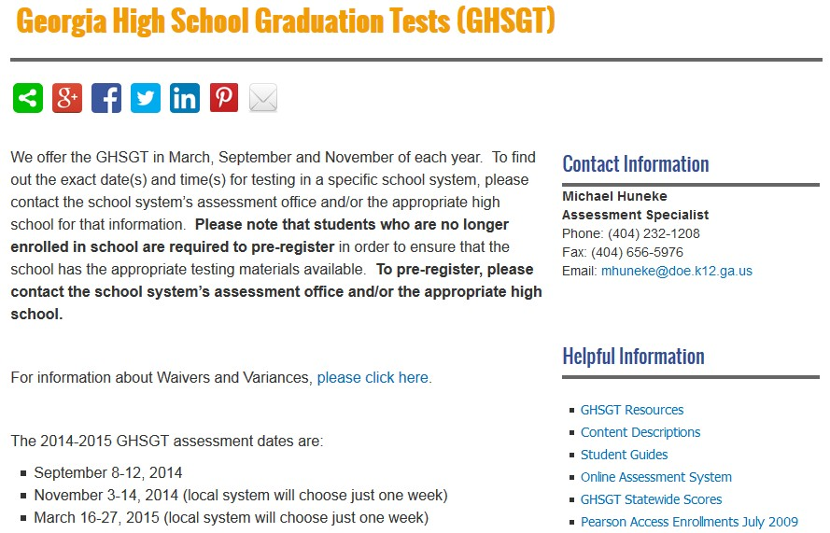
Who Tests?
Please note the GaDOE webpage to help with the pre-registration process in your school system. If your school system has not implemented a pre-registration process, your system should to do so as soon as possible.
  See pages 8 and 10 in the Coordinator’s Manual
  See the GHSGT section in the Student Assessment Handbook
  State Board rule (160-3-1-.07) requires that districts/schools have a pre-registration process for the GHSGT and GHSWT for those wanting to retest at the next administration window.

Slide 11
Who Tests?
Impact of the Secondary Assessment Transition Plan
Students who entered grade nine for the first time between July 1, 2008 and June 30, 2011
  Testing Rule Amendments for this cohort include:
  Flexibility – allowing a passing score on one of the two EOCTs in each content area to serve as an alternate demonstration of proficiency and stand in lieu of the requirement to pass the corresponding content area GHSGT.
  Retaining the requirement to pass the Georgia High School Writing Test.
Statewide Passing Score Rule amendments include:
    Retaining the contribution of the EOCT to the course grade at 15%.

Slide 12
Who Tests?
The 2014-2015 GHSGT Retests should be administered to the following categories of students:
Individuals who are subject to the GHSGT requirement, have exited high school with a Certificate of Performance or Special Education Diploma, and have returned to retest.
Students currently in high school (entered grade nine for the first time prior to July 1, 2008) who have taken but not passed one or more of the GHSGTs.
Students currently in high school (who entered grade nine for the first time between July 1, 2008, and June 30, 2011) who have taken but not passed the GHSGT and who have not achieved a passing score on one of the corresponding content area Georgia EOCTs.
Students who entered grade nine for the first time prior to July 1, 2011, who are enrolled in grade eleven, and who have not yet taken the GHSGT. These students shall test for the first time during the spring administration. These students are only required to test in the GHSGT content area in which they have not achieved a passing score on one of the corresponding content area Georgia EOCTs and they enrolled in grade nine for the first time between July 1, 2008 and June 30, 2011.
Students who enroll in grade twelve (e.g. a move-in from out of state) who have not yet taken the GHSGT and who are subject to the GHSGT requirement. These students may test for the first time at their first opportunity. These students (if enrolled in grade nine for the first time between July 1, 2008 and June 30, 2011) are only required to test in the GHSGT content area in which they have not achieved a passing score on one of the corresponding content area Georgia EOCTs.
PLEASE NOTE: Students who are not classified as eleventh graders, but who meet specific criteria are eligible to take the GHSGT if they entered grade nine for the first time on or before June 30, 2011 (see next slide).

Slide 13
Who Tests?
This includes students who:
(1) have accumulated at least nine Carnegie units (or twelve Carnegie units if the school is operating on a block schedule in which students may earn up to eight units per year) or 135 quarter hours (first time grade 11 test takers will assess in March 2015), and
(2) have not achieved a passing score on the graduation assessments.
To allow students who earn credit in a nontraditional manner more than one testing opportunity, GaDOE may allow, on a case-by-case basis and when requested by a local system, students to be tested for the first time during a retest opportunity of the GHSGT rather than the main administration. When making this request, the district shall verify and demonstrate that the students received sufficient credit hours, as noted above in (1), and courses to have the opportunity to learn the subjects tested.
NOTE: Students who dropped out of school without having met all graduation assessment requirements applicable to them at the time, and have returned without having been enrolled in any Georgia public school for one academic year or more, must meet the assessment requirements for the current class in which they will enroll which includes the GHSGT.

Slide 14
Secondary Assessment Transition Plan
 | Ninth Graders | Tenth Graders | Eleventh Graders | Twelfth Graders
2011 / 2012 | EOCT = 20% of course grade Pass the GHSWT | EOCT = 15% of course grade [Pass one EOCT in each of the four content areas or pass the corresponding subject test of GHSGT] Pass GHSWT | EOCT = 15% of course grade [Pass one EOCT in each of the four content areas or pass the corresponding subject test of GHSGT] Pass GHSWT | EOCT = 15% of course grade [Pass one EOCT in each of the four content areas or pass the corresponding subject test of GHSGT] Pass GHSWT
2012 / 2013 | EOCT = 20% of course grade Pass the GHSWT | EOCT = 20% of course grade Pass the GHSWT | EOCT = 15% of course grade [Pass one EOCT in each of the four content areas or pass the corresponding subject test of GHSGT] Pass GHSWT | EOCT = 15% of course grade [Pass one EOCT in each of the four content areas or pass the corresponding subject test of GHSGT] Pass GHSWT
2013 / 2014 | EOCT = 20% of course grade Pass the GHSWT | EOCT = 20% of course grade Pass the GHSWT | EOCT = 20% of course grade Pass the GHSWT | EOCT = 15% of course grade [Pass one EOCT in each of the four content areas or pass the corresponding subject test of GHSGT] Pass GHSWT
2014 / 2015 | EOCT = 20% of course grade * As a result of amendments to State Board of Education rule 160-3-1-.07 on August 21, 2014 | EOCT = 20% of course grade * As a result of amendments to State Board of Education rule 160-3-1-.07 on August 21, 2014 | EOCT = 20% of course grade Pass the GHSWT | EOCT = 20% of course grade Pass the GHSWT

Slide 15
2014 Spring GHSGT Documents Scored
Approximately 460 high schools
GHSGT Content | ELA | Mathematics | Science | Social Studies
Spring 2014 GHSGT Scored | GPS: 4,312 T: 10 | GPS: 11,996 Q: 167 | GPS: 4,286 T: 286 | GPS: 10,165 T: 192

Slide 16
Booklet Overages
All booklets are shipped by system and not by school
GPS Booklets
  Systems will receive a 10% overage of booklets ordered rounded up to the nearest multiple of 5
QCC and Transitional Booklets
  Systems will receive a 5% overage of booklets ordered rounded up to the nearest multiple of 5
  ELA will not receive an overage, only a rounding up to the nearest multiple of 5 (please note: the most one school tested of the 10 students tested during the Spring 2014 administration were 2 students, all other schools tested only 1 student)
BST Materials
  Requests for materials may be made via email to Michael Huneke (mhuneke@doe.k12.ga.us)

Slide 17
QCC Form Phase Out
ELA, Science and Social Studies
Effective with the Fall 2011 administration QCC forms will no longer be offered. Students who originally tested using the QCC forms in English/Language Arts, Science, and Social Studies should be tested using the transitional form of the GHSGT (Form T).
As you will recall, the transitional GHSGT forms are developed based on a carefully constructed blueprint built to ensure students have had an opportunity to learn the content and skills assessed regardless of the curriculum under which they were instructed (whether it was the QCC or the Georgia Performance Standards (GPS)). In other words, the transitional forms are dually aligned to both the QCC and the GPS. Importantly, these forms are scored and reported on the QCC scale and are statistically equated (of equivalent difficulty) to the QCC forms.
We are confident that no student will be placed at a disadvantage for the following reasons: (a) the transitional forms are aligned to the QCC; (b) the transitional forms are statistically equated to the QCC forms; and (c) remediation opportunities are likely based on the GPS (as the QCC is no longer used as the basis of instruction in our state).
Please note that QCC forms will continue to be available for the Mathematics GHSGT for those students who received mathematics instruction based on the QCC and who originally tested on the QCC version.

Slide 18
Making Certain Students
Get the Correct Version of the Tests
Those who entered grade 9 for the first time on or after July 1, 2008 through June 30, 2011 should take the following:
Content Curriculum Form Numbers
ELA GPS (101)
Mathematics GPS (301)
Science GPS (501)
Social Studies GPS (701)
Covers of books will be labeled and have a form number.
Form Number MUST be coded on the answer document. Failure to do so or incorrect coding could delay scoring, result in an incorrect score or result in no score reported.

Slide 19
Making Certain Students
Get the Correct Version of the Tests
Retesters in 2014-2015
May be taking a GPS version of the test in English Language Arts, Mathematics, Science, and Social Studies
OR
A transitional, dually aligned (GPS/QCC) ELA, Science, or Social Studies test. These transitional tests will be identified with Form Letter (T).
OR
A QCC version Mathematics test. The QCC tests will be identified Form Letter (Q).
Failing to administer the correct version of the GHSGT is an Irregularity that may result in an Invalidation.

Slide 20
Transition of the GHSGT to the GPS
- Completed as of Spring 2011 -
First Time Test Taker In: | Spring 2005 | Spring 2006 | Spring 2007 | Spring 2008 | Spring 2009 | Spring 2010 | Spring 2011
English Language Arts | QCC/GPS | QCC/GPS | QCC/GPS | GPS | GPS | GPS | GPS
Science | QCC/GPS | QCC/GPS | QCC/GPS | GPS | GPS | GPS | GPS
Social Studies | QCC/GPS | QCC/GPS | QCC/GPS | QCC/GPS | QCC/GPS | GPS | GPS
Math | QCC | QCC | QCC | QCC | QCC | QCC | GPS

Slide 21
BST, GHSGT and GHSWT Forms
Dates are based on when students entered grade 9 for the first time:
*Contact Michael Huneke for BST materials at mhuneke@doe.k12.ga.us when needed
Subject | BST * | QCC/Transitional | GPS
English Language Arts | July 1, 1981 – June 30, 1991 | July 1, 1991 – June 30, 2005 (Transitional) | July 1, 2005 – June 30, 2011
Mathematics | July 1, 1981 – June 30, 1991 | July 1, 1991 – June 30, 2008 (QCC) | July 1, 2008 – June 30, 2011
Science | NA | July 1, 1994 – June 30, 2005 (Transitional) | July 1, 2005 – June 30, 2011
Social Studies | NA | July 1, 1993 – June 30, 2007 (Transitional) | July 1, 2007 – June 30, 2011
Writing | July 1, 1987 – June 30, 1991 | July 1, 1991 – June 30, 2005 (QCC) | July 1, 2005 – June 30, 2013 * As a result of amendments to State Board of Education rule 160-3-1-.07 on August 21, 2014

Slide 22
Test Score Ranges and Cut Scores
Georgia High School Graduation Test
GPS | Below Proficiency | Basic Proficiency | Advanced Proficiency | Honors
English/Lang. Arts | 100 to 199 | 200 to 234 | 235 to 274 | 275 to 350
Mathematics | 100 to 199 | 200 to 234 | 235 to 284 | 285 to 400
Science | 100 to 199 | 200 to 234 | 235 to 274 | 275 to 370
Social Studies | 100 to 199 | 200 to 234 | 235 to 274 | 275 to 450
Transitional and QCC | Does Not Meet or Fail | Pass (Student Accountability) | Pass Plus (Student Accountability) | Proficient (School Accountability) | Advanced (School Accountability)
English/Lang. Arts (Transitional) | Below 500 | 500 to 537 | 538 or Above | 511 to 537 | 538 or Above
Mathematics (QCC) | Below 500 | 500 to 534 | 535 or Above | 516 to 524 | 525 or Above
Science (Transitional) | Below 500 | 500 to 530 | 531 or Above | -- | --
Social Studies (Transitional) | Below 500 | 500 to 525 | 526 or Above | -- | --

Slide 23
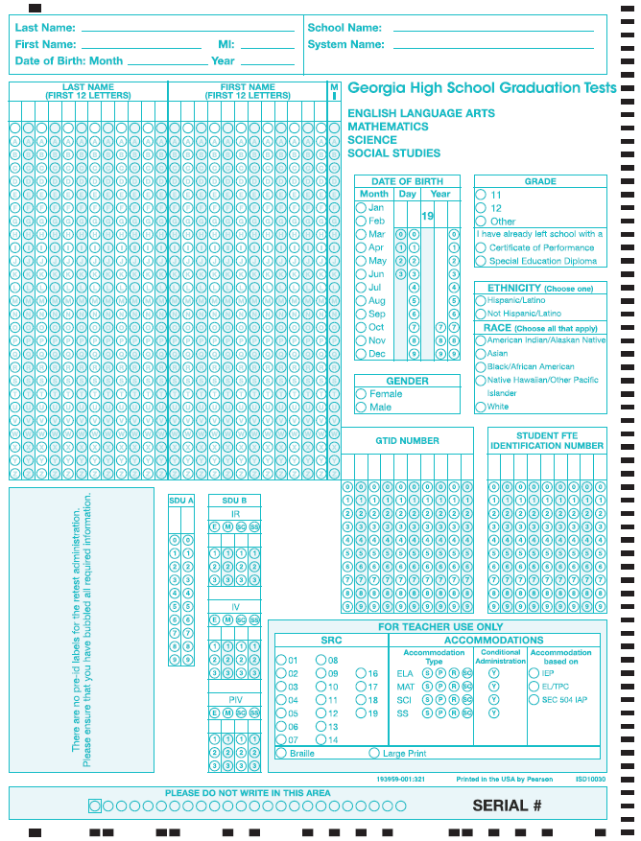
GHSGT
ANSWER DOCUMENT PAGE 1
Complete for all students
Complete when applicable
  SDU A: Code as Directed by page 9 in the Coordinator’s Manual
  SDU B: Code as Directed by GaDOE
  SRC, Accommodations & Participation: Code as Directed in the Coordinator’s Manual starting on page 24
Note: The black timing tracks on the edge must be clean of stray marks to be able to be scanned.
Old answer documents will not scan! The answer document must be BLUE and the pre-id watermark should be absent (see image to the left)!
DO NOT USE OLD ANSWER DOCUMENTS!

Slide 24
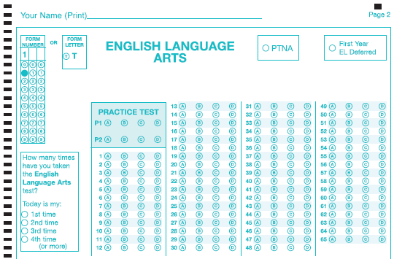
Answer Document – Top of Pg. 2
Marking both Form Number and Form Letter will result in an Invalid Form Number
ELA, Science, and Social Studies are all similar
Mark one! Notice: No “Q”
Examiner or STC Completes
Not on Science Section
Student Marks

Slide 25
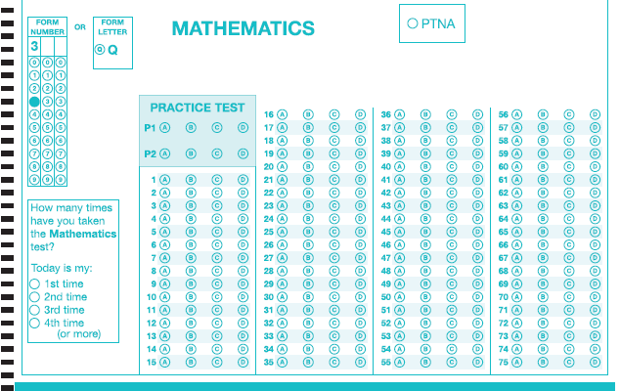
Answer Document – Bottom of Pg. 2
Marking both Form Number and Form Letter will result in an Invalid Form Number
Examiner or STC Completes
Mark one! Notice: No “T”
Mathematics is the only section with “Q”
Student Marks

Slide 26
Invalid Form Codes
Due to the various versions of the GHSGT (GPS, GPS/QCC, QCC), students must code their answer document with the appropriate form number (301, 501, etc.) or letter (T or Q). The scoring vendor, the Georgia Center for Assessment (GCA), will create system level spreadsheets that include students with missing or invalid form numbers or letters. These spreadsheets will be placed on the MyGaDOE Portal for System Test Coordinators to retrieve and complete. When missing/invalid form code spreadsheets are available for download, System Test Coordinators will receive an email message to alert them from PortalSupport@doe.k12.ga.us. The file will be located in the GHSGT folder under DISTRICT ASSESSMENTS and will be named 'Invalid Form Codes.xls'. Please download, complete, and fax back to GCA. If all form numbers or letters are correct for the district, the System Test Coordinator will not receive any spreadsheets on the Portal.
The Georgia Center for Assessment's Fax: 706.542.5364
Please note that delaying the return of this information via fax can impact scoring of the system and potentially other systems. If one system does not fax their form back or is late, it could delay results for the entire state. Please fax your form back within 48 hours or less of its arrival in the MyGaDOE portal.

Slide 27
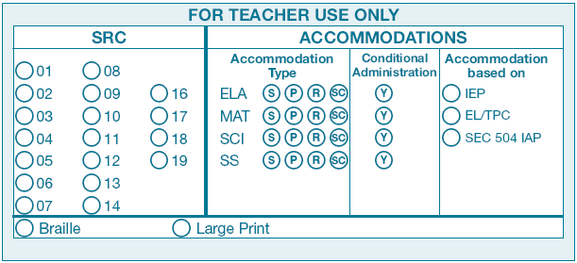
For Teacher Use Only
Special Populations
Remember: There are NO APPROVED Conditional Accommodations for the GHSGT – so this bubble should NOT be coded. The only exception would be if the GaDOE has approved a request for an accommodation that does not appear on the chart of state-approved accommodations.

Slide 28
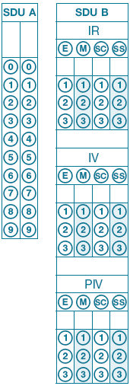
For Teacher Use Only
GNETS and Irregularity/Invalidation/Participation Invalidation
GNETS Coding
IR, IV, and PIV Coding
Ensure that these boxes are not coded in error . . . If coded, students will not receive a score. SDU B should be coded only at the direction of the GaDOE.

Slide 29
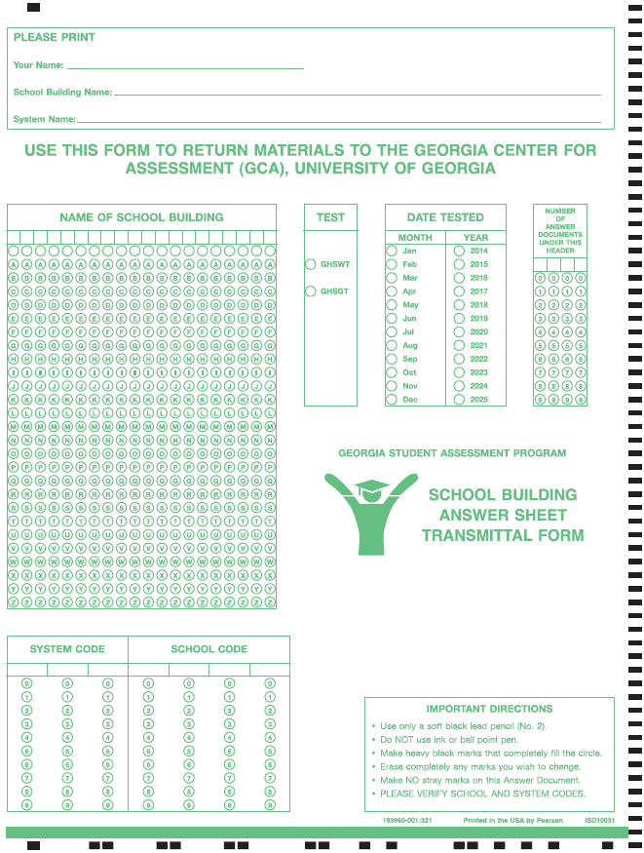
School Building Answer Sheet Transmittal Form
Print information
Bubble in building Name
Bubble Assessment (GHSGT)
Bubble “Sep”, “Nov”, or “Mar” and “2014” or “2015”
Bubble number of answer documents sending in and paper banded to transmittal form (right justify)
Bubble in System Code
Bubble in School Code

Slide 30
Testing Students With Disabilities, 504 Plans, or EL Test Participation Plans
State required coding (SRC)
Use the SRC section on the Answer Document to code eligible students with disabilities, English Learner (EL) students, Title I students, and migrant students. These codes should be provided by site test coordinator.
The type of accommodation provided should be coded in the Accommodations box: S indicates setting; P indicates presentation; R indicates response; and SC indicates scheduling.
The SRC, Accommodations, and SDU boxes on page 1 of the Answer Document should be filled in by you or the School Coordinator. The State-Directed Use Only (SDU B) section should be used only when instructed by the GaDOE.

Slide 31
Irregularities (IR)
Events and circumstances that depart from standardized testing procedures are irregularities.
They may have an impact on student performance that is not possible to define.
They are reported and student scores flagged simply to say, “There is something different about the conditions under which this score was obtained. Use caution in interpreting the score.”

Slide 32
Some Examples of Irregularities
Irregularities in Security:
Irregularity due to content being disclosed, coached, or distributed
Irregularity due to cheating
Irregularity due to someone altering responses during or after testing
Irregularity due to lost test materials
Irregularities in Test Administration:
Irregularity due to materials being distributed inappropriately
Irregularity due to directions not being followed
Irregularity due to accommodations not being given

Slide 33
Invalidations (INV)
Irregularities that significantly affect student performances or compromise the integrity of the testing may result in invalidation of student scores.
Cheating, altering responses, or disclosing content early are examples of irregularities resulting in invalidations.

Slide 34
Reporting Irregularities and Invalidations
Irregularities MUST be handled and reported
promptly.
  wrong test version of the test
  wrong accommodations
  cheating

Slide 35
Reporting Irregularities and Invalidations
Procedures for reporting are in the Student Assessment Handbook.
  Examiner provides full report to school coordinator
  School Coordinator reports to System Coordinator
  System Coordinator contacts GaDOE
  Coding is decided
  Codes for IR, IV, and PIV will be different
  STC reports in the MyGaDOE portal (include statements)

Slide 36
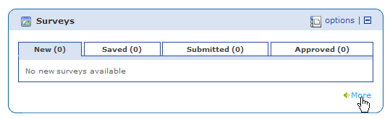
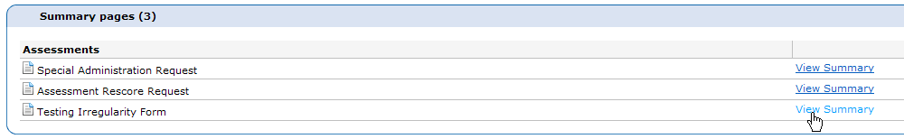
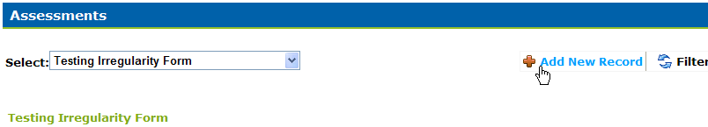
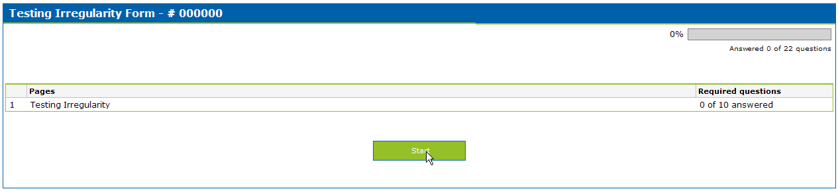
Entering IRs into the MyGaDOE Portal
In the MyGaDOE Portal, find the “Surveys” section and click on “More”
https://portal.doe.k12.ga.us/login.aspx
Click on “View Summary” next to Testing Irregularity Form
Click on “Add New Record”
Click on “Start”

Slide 37
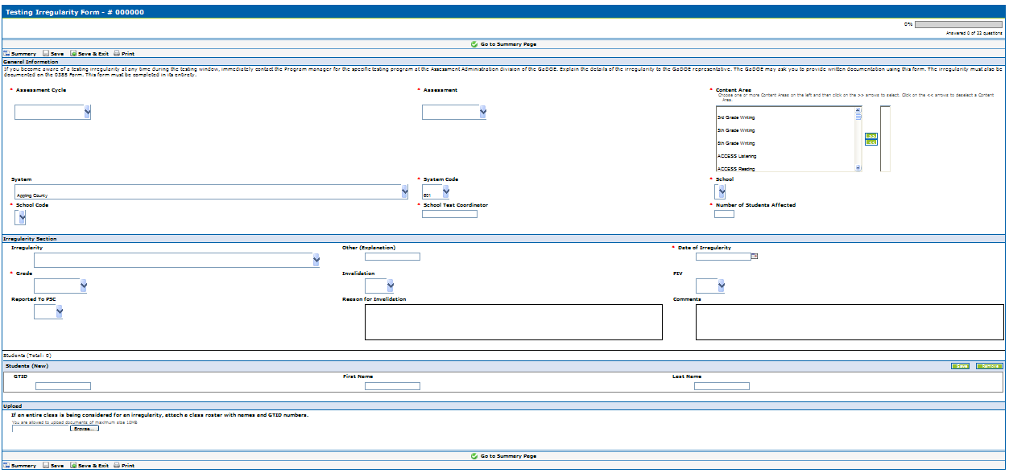

Entering IRs into the MyGaDOE Portal
Pick Assessment Cycle
Pick the Assessment
Pick the Content Area(s)
Pick your system
Pick your system code
Pick the school
Pick the school code
Type the STC
Type the number of students
Select an IR
Explain only if “Other”
Pick date of IR
Select Grade of Student
IV - Yes or No
PIV - Yes or No
PSC - Yes or No
Explain why the IR is an IV
Explain what happened here
Enter student(s) GTID here. First and last name will populate automatically and you may add more students if needed.
Attach a class list and/or statement(s)/evidence by browsing and selecting file on your computer. You may only attach one document so multiple items will need to be zipped or combined into one document..
Fill out the irregularity form and then click on “Save & Exit”
Click on “Submit for Approval”

Slide 38
Breach of Professional Ethics
Professional Standards Commission
Gives examinees access to test questions prior to testing;
Copies, reproduces, or uses in any manner inconsistent with test security regulations all or any portion of secure test booklets;
Coaches examinees during testing, or alters or interferes with examinees’ responses in any way;
Makes answers available to examinees;
Fails to follow security regulations for distribution and return of secure test materials as directed, or fails to account for all secure test materials before, during, and after testing;
Uses the secure test booklets for any purpose other than examination; or
Participates in, directs, aids, counsels, assists, encourages, or fails to report any of these prohibited acts.

Slide 39
Characteristics of a Quality Investigation
Examiner should notify Principal and School Test Coordinator of incident.
School Test Coordinator should notify System Test Coordinator.
Request detailed written statements from all parties involved if necessary.
  Follow up on details (connect the dots)
Follow district procedures regarding misconduct.
Provide a written summary of incident and investigation findings.
  Consult with GaDOE as needed.
System Test Coordinator is responsible for reporting to GaDOE.
Note:
  Report to GaDOE immediately, before investigation.
  Final documentation should be entered into portal.

Slide 40
Keys To Test Security
Lock tests up!
Count and recount/Sign-in and Sign-out
Material counts must be verified before students leave the test setting
Don’t let them out of your sight
Make students put their names on the Test Booklets and sign for them
Students must sign-in . . . including their name and Form Number/Letter
No peeking
Do not copy
Monitor students

Slide 41
PLANNING FOR TEST ADMINISTRATION
Conducive Environment
Seating spaces and writing surfaces are large enough
Seating arranged to prevent cheating.
NO cell phones, PDAs, or other electronic devices in the exam room.
Take any discovered devices away immediately . Return them at a later time
No. 2 Pencils - Each student should be told to bring two No. 2 pencils with erasers on days tests are to be administered. However, there should be a supply of extra pencils and erasers available for students who forget.
Keep a timing device visible - You should have a clock or watch to keep track of time during test administration.

Slide 42
PLANNING FOR TEST ADMINISTRATION
Roles and Responsibilities
Refer to Student Assessment Handbook for detailed information.
Superintendent has ultimate responsibility for all testing activities within the local school system. The System Test Coordinator shares this responsibility as the Superintendent’s designee.
Principal has ultimate responsibility for all testing activities within the school.
  Emphasis: The Principal must complete the Principal’s Certification Form after each administration.

Slide 43
PLANNING FOR TEST ADMINISTRATION
Roles and Responsibilities
System Test Coordinator
Liaison between system and GaDOE
Conduct local system trainings of School Coordinators
Coordinate ALL administration activity
Know and enforce responsibilities of all other roles
Adhere to the state testing calendar and local calendars/schedules
Implement plans for ordering and receipt of materials, distribution, test security, administration, collection and return shipments, receipt and dissemination of reports and data
Detailed list of responsibilities in SAH

Slide 44
PLANNING FOR TEST ADMINISTRATION
Roles and Responsibilities
School Test Coordinator
Must hold a PSC-issued certificate (per Student Assessment Handbook)
Count and secure all test materials
Materials distribution/return, signing out and signing in materials
Attend and then redeliver training
Plan for all aspects of the school’s test administration, monitor test administration environment
Receive/verify test material counts after testing each day
Collaborate effectively with local system colleagues who have a role in the success of your system’s testing program.
Detailed list of responsibilities in SAH

Slide 45
PLANNING FOR TEST ADMINISTRATION
Roles and Responsibilities
Examiner
Must hold a Georgia PSC-issued certificate (teachers, counselors, administrators, paraprofessionals) . . . This is required per SBOE Rule 160-3-1-.07. GaDOE is compelled to invalidate when this does not occur (!).
Security/verification of test materials
Control of testing environment and active monitoring
Accuracy of demographic/student information on answer documents
Correct delivery of assigned accommodations
Follows procedures for testing as given in Examiner’s Manuals, including reading all directions/script to students
Test materials are not to be used for any purpose other than test administration
Detailed list of responsibilities in SAH

Slide 46
PLANNING FOR TEST ADMINISTRATION
Roles and Responsibilities
EXAMINERS
Be certain that students’ Answer Documents are prepared correctly.
Be certain that students respond in the appropriate sections of the Answer Document (e.g., that Social Studies items are answered in the section marked SOCIAL STUDIES). Marking responses in the wrong content area, even if later erased, can cause scoring errors.
Be certain students code the correct form number/letter on their Answer Documents.
All students may have up to three (3) hours to complete each GHSGT.

Slide 47
PLANNING FOR TEST ADMINISTRATION
Roles and Responsibilities
Proctor
Must be trained
With examiner supervision, ensures that students are managing test materials appropriately
Active monitoring
Detailed list of responsibilities in SAH

Slide 48
PLANNING FOR TEST ADMINISTRATION
PROCTORS
When 30 or more students are to be tested in one room, the assistance of a Proctor is required. At least one Proctor is required for each additional 30 students. If students are tested in groups of less than 30, a Proctor is highly recommended.
Proctors must be trained in appropriate test procedures before testing begins. Tasks which they must perform should be clearly specified. They may help in distributing and collecting materials, assisting students with coding on the Answer Document, observing students from different points in the room while tests are being administered, and answering students’ questions concerning the test directions. To prevent the neglect of any students in large groups, Proctors may be assigned to specific areas of the room during test administration. Proctors must not explain the test items or coach students in any way.

Slide 49
PLANNING FOR TEST ADMINISTRATION
Resources and Aids
NO dictionaries(*), textbooks, or other aids and/or resources that would provide assistance. (*EL Word to Word Dictionaries would be an exception to this if prescribed in an EL-TPC plan)
Any instructional materials that are displayed in the room, such as posters, must be covered or removed during testing.
The following calculator features are NOT allowed:.
  Graphing calculators
  Calculators that store text and/or have QWERTY keyboards or typewriter-like keyboards
  Calculators that have programs stored in the memory other than those that are factory installed
  Non-calculators such as cell phones, PDAs, laptops, minicomputers, pocket organizers, iPods, etc.
  Calculators with beaming capabilities
  Calculators with wireless communication technologies and/or Internet access
  Calculators with built in Computer Algebra Systems – CAS
  Calculators that make noise, have paper tape, or that have voice
Students may use rulers (or another straightedge) for the Social Studies test, if needed.
No scratch paper.

Slide 50
Plan for Accommodations
Know who your SWD, EL, and 504 students are who require accommodations . . . And plan well in advance for their needs
Plan for small groups and the need for the same form number/letter
Know who your visually impaired students are and ensure you have supply
Make provisions (even though all may have up to 3 hours) for Extended Time students
Plan in advance for any Word to Word (EL) Dictionary needs
Ensure that examiners are familiar with the proper way to deliver the necessary accommodations
Collaborate with others as needed to ensure that “paperwork” (IEP’s, EL-TPC’s, 504 Plans, etc.) is in order
The transfer of student responses to a student answer document (in cases such as Lg. Print and Braille administrations) should be completed with a witness present . . . The witness should hold a PSC-issued certificate

Slide 51
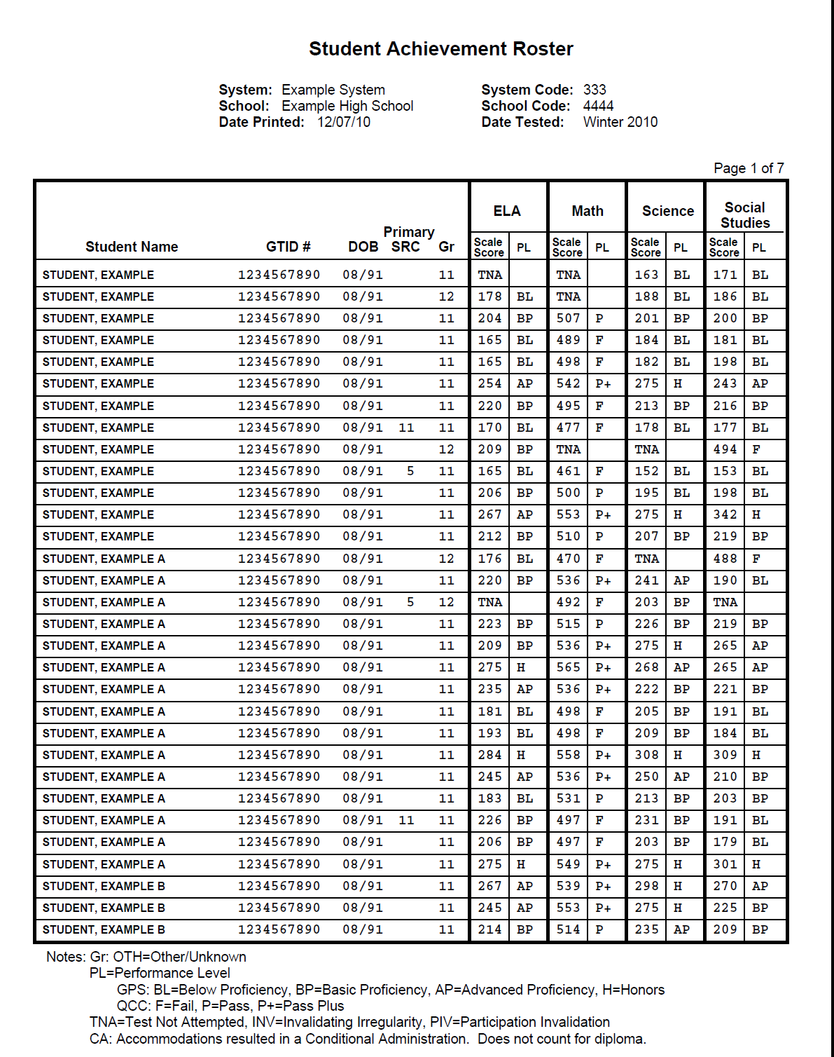
PDF Student Achievement Rosters

Slide 52
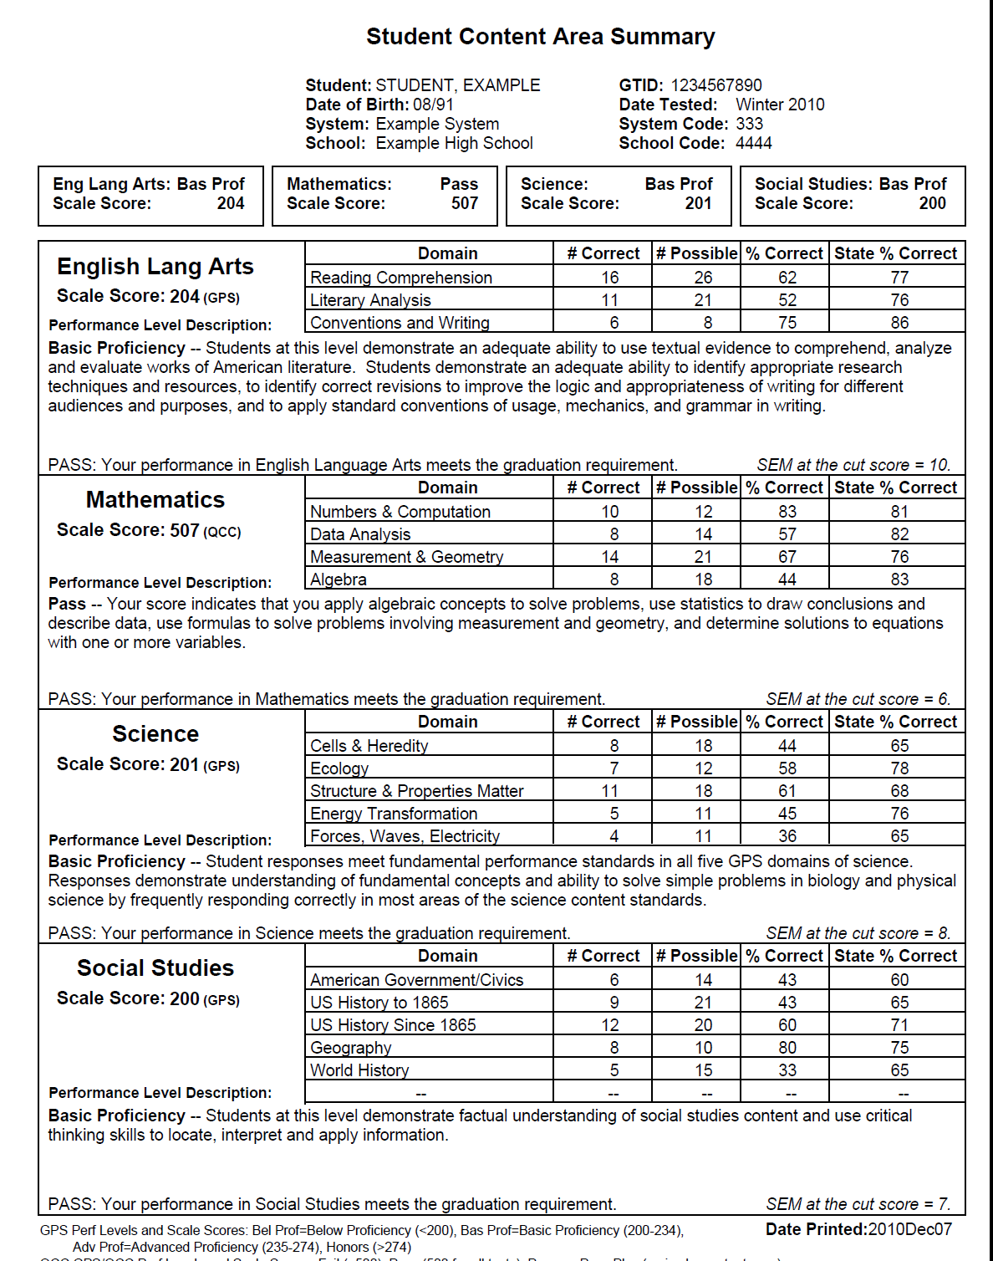
Individual Student Report

Slide 53
Other Important Topics
Use of Manuals—Manual is for all 2014-2015 administrations
Advanced reading aids supplied by GPAT
LP, Braille
BST
Accommodations
Test Booklet Pick-up – Security Reports
Update Bulletin and Web Postings
Returning Materials – See Manuals
http://www.gadoe.org/Curriculum-Instruction-and-Assessment/Assessment/Pages/default.aspx

Slide 54
Resources for Administering the GHSGT
Student Assessment Handbook
Accommodations Manual
System/School Coordinator’s Manual
Examiner’s Manual
Presentations
Additional Orders (made via TestTime)
All are posted on the Testing web site:
  http://www.gadoe.org/Curriculum-Instruction-and-Assessment/Assessment/Pages/default.aspx

Slide 55
Contact Information
GaDOE
Michael Huneke
  404-232-1208
  mhuneke@doe.k12.ga.us
GCA
Stephanie A. Lai, Ph.D.
  1-888-392-8977
  slai823@uga.edu

