Slide 1
Assessment Update
GACIS Fall Conference
September 26, 2019

Slide 2
Topics
Georgia Milestones
Updates and new resources
A look at narrative writing
GAA 2.0
Overview of results
Newest Formative Assessments
GKIDS 2.0
Keenville
Innovative Assessment Demonstration Authority

Slide 3
Georgia Milestones
Updates and New Resources

Slide 4
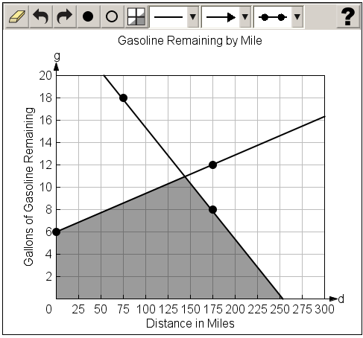
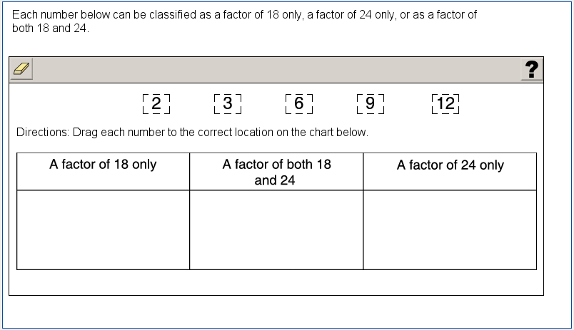
2019-2020 Updates
Georgia Milestones
Technology Enhanced Items – Operational Use
Two types of TE items field-tested in 2018-2019 will be eligible for operational use in 2019-2020.
Graphing (mathematics)
Allows students to graph and label points and lines and shade regions
Allows students to demonstrate depth of understanding and ability through performance on math tasks
Drag and drop (mathematics, science, social studies)
Response choices (such as numbers, words, or phrases) can be moved and placed in another location (such as a chart or map)
Allows students to demonstrate depth of understanding by identifying, classifying, comparing, or organizing information

Slide 5
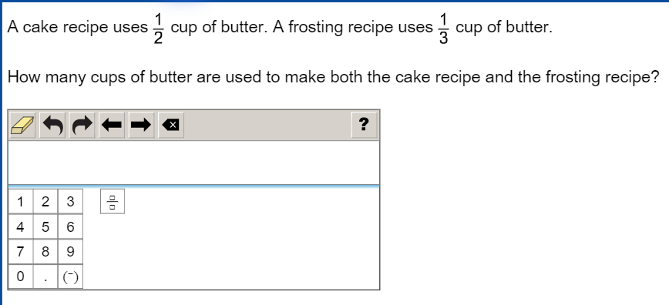
2019-2020 Updates
Georgia Milestones
Technology Enhanced Items – Field Test Only
Drop down input (all content areas)
Allows a student to select the word, number, or symbol to complete a sentence, table, or equation
Scorable equation (mathematics)
Allows a student to input numbers, symbols, equations, or inequalities with a configurable scoring engine that can find equivalencies
Also adding drag and drop field test items for ELA
Two new types of TE items will be field-tested in 2019-2020.

Slide 6
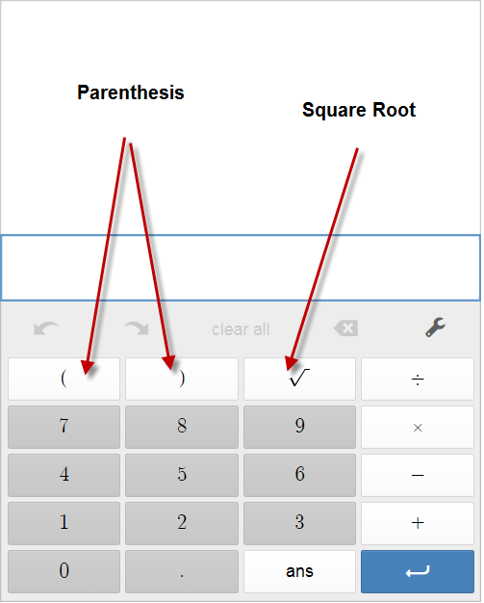
2019-2020 Updates
Georgia Milestones
Online Calculator – Switching to Desmos
Accessibility
Desmos can be used on mobile devices
Students will not have to log into DRC system to practice
Easier access for teachers and student use at home
Easy to use for instruction and assessment
More capabilities and functions than current calculator
Equitable
Provides a free resource
Layout is friendly and visually pleasing
Four-Function Calculator: https://www.desmos.com/fourfunction
Scientific Calculator: https://www.desmos.com/scientific
Graphing Calculator: https://www.desmos.com/calculator
Classroom Activities: https://teacher.desmos.com/

Slide 7
2019-2020 Updates
Georgia Milestones
Narrative Writing Resources
Based on recent feedback around narrative writing, the following additional resources are in development:
Narrative Writing Checklist
Similar to the Writer’s Checklist provided for the extended writing prompt, this resource will support students in responding to the narrative writing prompt.
A unique checklist will be developed for each grade/course, based on the narrative writing rubric.
Narrative Writing Item & Scoring Sampler
1 narrative prompt per grade/course with 3 annotated student responses per score point (high, mid, low)
Study Guide – Narrative Section
Creating a Writing Unit within the Study Guide to include opinion/argumentative, informational/explanatory, and narrative
Now Available
Available in December
Available in February

Slide 8
Georgia Milestones
A Look at Narrative Writing

Slide 9
Trends in Reading Status
Georgia Milestones
Grade/Course | Percentage of Students at Grade Level or Above
 | 2017 | 2018 | 2019 | Change from 2018 to 2019 | Change from 2017 to 2019
3 | 71 | 68 | 73 | 5 | 2
4 | 60 | 63 | 64 | 1 | 4
5 | 70 | 70 | 73 | 3 | 3
6 | 63 | 61 | 61 | 0 | -2
7 | 72 | 71 | 75 | 4 | 3
8 | 78 | 73 | 74 | 1 | -4
9th Grade Literature & Composition | 82 | 79 | 83 | 4 | 1
American Literature & Composition | 75 | 75 | 75 | 0 | 0
Increase ≥ 5 points
Increase
No change
Decrease

Slide 10
Achievement Level Performance: EOG
Georgia Milestones
Grade | Content Area | % Developing and Above |  |  |  |  | % Proficient and Above
 |  | 2017 | 2018 | 2019 | Change from 2018 to 2019 | Change from 2017 to 2019 | 2017 | 2018 | 2019 | Change from 2018 to 2019 | Change from 2017 to 2019
3 | English Language Arts | 70 | 67 | 71 | 4 | 1 | 36 | 37 | 42 | 5 | 6
 | Mathematics | 80 | 83 | 82 | -1 | 2 | 42 | 46 | 52 | 6 | 10
4 | English Language Arts | 73 | 73 | 75 | 2 | 2 | 42 | 41 | 42 | 1 | 0
 | Mathematics | 82 | 84 | 82 | -2 | 0 | 45 | 47 | 49 | 2 | 4
5 | English Language Arts | 74 | 76 | 76 | 0 | 2 | 38 | 41 | 45 | 4 | 7
 | Mathematics | 75 | 75 | 76 | 1 | 1 | 37 | 39 | 41 | 2 | 4
 | Science | 69 | 70 | 70 | 0 | 1 | 39 | 39 | 43 | 4 | 4
 | Social Studies | 74 | 76 | 78 | 2 | 4 | 29 | 30 | 31 | 1 | 2
6 | English Language Arts¹ | 70 | 69 | 74 | 5 | 4 | 40 | 39 | 46 | 7 | 6
 | Mathematics² | 76 | 76 | 78 | 2 | 2 | 38 | 38 | 40 | 2 | 2
7 | English Language Arts¹ | 71 | 71 | 72 | 1 | 1 | 37 | 38 | 39 | 1 | 2
 | Mathematics² | 78 | 77 | 78 | 1 | 0 | 42 | 43 | 43 | 0 | 1
8 | English Language Arts¹ | 79 | 79 | 81 | 2 | 2 | 42 | 45 | 49 | 4 | 7
 | Mathematics² | 79 | 79 | 78 | -1 | -1 | 42 | 42 | 44 | 2 | 2
 | Science² | 65 | 68 | 69 | 1 | 4 | 38 | 39 | 41 | 2 | 3
 | Social Studies | 75 | 77 | 78 | 1 | 3 | 39 | 41 | 41 | 0 | 2
¹Per Georgia’s ESSA waiver, 2018 and 2019 results (excluding the mean scale score) include the EOC performance of middle school students who took the corresponding content area End-of-Course (EOC) assessment in lieu of the EOG assessment.
²Per Georgia’s ESEA and ESSA waivers, 2017, 2018, and 2019 results (excluding the mean scale score) include the EOC performance of middle school students who took the corresponding content area End-of-Course (EOC) assessment in lieu of the EOG assessment.
10

Slide 11
Achievement Level Performance: EOC
Georgia Milestones
Course | % Developing and Above |  |  |  |  | % Proficient and Above
 | 2017 | 2018 | 2019 | Change from 2018 to 2019 | Change from 2017 to 2019 | 2017 | 2018 | 2019 | Change from 2018 to 2019 | Change from 2017 to 2019
Ninth Grade Literature & Composition | 84 | 82 | 87 | 5 | 3 | 53 | 52 | 61 | 9 | 8
American Literature & Composition | 81 | 80 | 80 | 0 | -1 | 49 | 47 | 47 | 0 | -2
Coordinate Algebra | 70 | 70 | 69 | -1 | -1 | 31 | 32 | 34 | 2 | 3
Analytic Geometry | 68 | 63 | 67 | 4 | -1 | 32 | 32 | 35 | 3 | 3
Algebra I | 71 | 72 | 73 | 1 | 2 | 35 | 38 | 41 | 3 | 6
Geometry | 74 | 69 | 71 | 2 | -3 | 38 | 39 | 41 | 2 | 3
Biology | 70 | 72 | 71 | -1 | 1 | 45 | 49 | 49 | 0 | 4
Physical Science | 67 | 73 | 74 | 1 | 7 | 39 | 43 | 47 | 4 | 8
United States History | 75 | 76 | 78 | 2 | 3 | 45 | 47 | 48 | 1 | 3
Economics/Business/ Free Enterprise | 72 | 77 | 74 | -3 | 2 | 45 | 49 | 48 | -1 | 3
11

Slide 12
Deeper Dive Into Narrative Writing
Georgia Milestones
Reading and Vocabulary
Writing and Language
# Item Type | # Points
21 Selected Response | 21
2 Evidence-Based Selected Response | 4
2 Constructed Response (2 points each) | 4
Total Points | 29
# Item Type | # Points
15 Selected Response | 15
1 Extended Writing Prompt | 7
Idea Development, Organization, and Coherence (4 points) Language Usage and Convention (3 points)
1 Extended Constructed Response Narrative | 4
Total Points | 26
Lexile
Reading Status Designation

Slide 13
Narrative Prompt
Georgia Milestones
Students are asked to develop a narrative response based on real or imagined experiences or events using effective techniques, descriptive details, and clear event sequences based on a text that has been read.

Slide 14
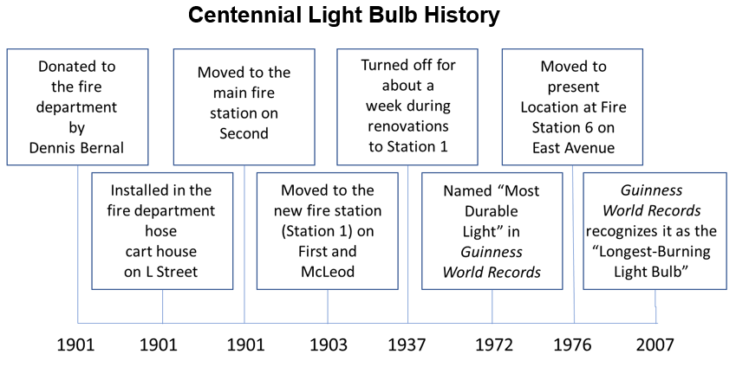
Narrative Prompt – Grade 5 Example
Georgia Milestones

Slide 15
Narrative Prompt – Grade 5 Example
Georgia Milestones
Imagine that you are a Livermore firefighter in 1903. Write an original story in which a firefighter convinces the fire chief that they should take the Centennial Light Bulb with them when they move to Station 1.
Be sure to use information from “A Bright Little Worker” to help you develop details in your story. Type your answer in the space provided.

Slide 16
Narrative Prompt
Georgia Milestones
Scored on a 4-point holistic rubric; overall, a:
4 = Response is a well-developed narrative
3 = Response is a complete narrative
2 = Response is incomplete or oversimplified
1 = Response provides evidence of an attempt
0 = Condition code
Rubric includes 8 bulleted criteria that address narrative elements (1-6), source material use (7), and conventions (8).

Slide 17
Narrative Rubric – Grade 5 Example
Georgia Milestones
Rubric Element | 4 | 3 | 2 | 1
Overall Criteria | The student’s response is a well-developed narrative that fully develops a real or imagined experience based on text as a stimulus. | The student’s response is a complete narrative that develops a real or imagined experience based on text as a stimulus. | The student’s response is an incomplete or oversimplified narrative based on text as a stimulus. | The student’s response provides evidence of an attempt to write a narrative based on text as a stimulus.
Establishes situation | Effectively established | Established | Vague | Weak
Event sequence | Unfolds naturally | Clear, logical | Some gaps or ambiguity | May be too brief to demonstrate sequence of events
Use of narrative techniques | Used effectively to develop rich, interesting experiences and events | Used to develop experiences and events | Attempts to use narrative techniques | Shows little or no attempt to use narrative techniques
Use of words and phrases to signal the sequence of events | Uses a variety of words and phrases to signal the sequence of events | Uses words and/or phrases to indicate sequence | Uses occasional signal words to indicate sequence | Uses words that are inappropriate, overly simple, or unclear
Use of words and phrases to convey experiences or events | Uses concrete words, phrases, and sensory language consistently to convey experiences or events precisely | Uses words, phrases, and details to convey experiences and events | Uses some words or phrases inconsistently to convey experiences and events | Provides few, if any, words that convey experiences or events
Concluding statement | Conclusion follows from the narrated experiences or events | Appropriate conclusion | Weak or ambiguous conclusion | Minimal or no conclusion
Integration of ideas and details from text | Integrates ideas and details from source material effectively | Integrates some ideas and/or details from source material | Attempts to integrate ideas or details from source material | May use few, if any, ideas or details from source material
Language conventions | Very few or no errors | A few minor errors | Frequent errors; sometimes interfere with meaning | Frequent major errors; interfere with meaning

Slide 18
Scoring Philosophy
Georgia Milestones
Students are awarded credit for what they do well.
Students are not penalized for errors unless they permeate the response and impact or interfere with overall understanding.
Student responses are to be viewed as first drafts and are not expected to be polished papers.
For narrative writing, students use the text(s) as a stimulus or “launch pad” to complete their narrative response, thus allowing for individual creativity.

Slide 19
Narrative Writing Scores – Spring 2019
Georgia Milestones
Percentage of Student Responses
Well developed
Complete
Incomplete
Attempted
Condition code
19

Slide 20
Writing Condition Codes
Georgia Milestones
Writing responses receive a score of zero (0) points for any of the following reasons:
Blank
Copied
Too Limited to Score
Non-English/Foreign Language
Off-Topic
Offensive
Illegible/Incomprehensible
#2 – 32% of condition codes
#1 – 50% of condition codes

Slide 21
Writing Condition Codes – Spring 2019
Georgia Milestones
Percentage of Condition Codes
Too Limited
Copied
Blank
21

Slide 22
Copied Text Condition Code – Spring 2019
Georgia Milestones
Percentage of Student Responses
22

Slide 23
Narrative Writing
Georgia Milestones
Tips for Effective Integration of Ideas and Details from Source Material
Narrative writing is mainly judged according to the strength of the narrative elements in the response.
Use information from the text to inspire the writing and serve as a knowledge base for detail and description in the story.
Ideas and details from the text should be integrated into the narrative and become a natural part of it, rather than interrupting the flow of the story being told.
Generally avoid copying or closely paraphrasing large blocks of writing from the text.
Let the story drive the selection of what to include from the text.

Slide 24
Narrative Writer’s Checklist
Georgia Milestones
Be sure to:
Write a narrative response that develops a real or imagined experience.
Establish a situation and introduce a narrator and/or characters.
Organize events in a clear and logical order.
Use a variety of transitional words and phrases to sequence the events.
Use dialogue, description, and/or pacing to:
develop events.
show how characters respond to situations.
Use concrete words, phrases, and sensory details to describe the events.
Include a conclusion.
Use ideas and/or details from the passage(s).
Check your work for correct usage, grammar, spelling, capitalization, and punctuation.
Now type your narrative in the space provided. Refer to the Writer’s Checklist as you type and proofread your narrative.

Slide 25
GAA 2.0
Overview of Spring 2019 Results

Slide 26
GAA 2.0 – Spring 2019
Georgia Alternate Assessment 2.0
The GAA 2.0 is Georgia’s alternate assessment based on alternate academic achievement standards for students with the most significant cognitive disabilities.
It is comprised of a series of standardized tasks that include a scenario, multiple parts that increase in complexity, built-in supports, and additional scaffolding, when applicable.
13,142 Students
1,555 Schools
199 Districts

Slide 27
Extended Content Standards
Georgia Alternate Assessment 2.0
The knowledge and skills measured in the GAA 2.0 are aligned to Georgia’s alternate academic content standards, the Extended Content Standards.
The Extended Content Standards identify skills that connect to the grade-level content standards, allowing students to show learning of concepts at reduced levels of complexity.
More information on Georgia’s alternate academic content standards is available here.

Slide 28
Policy ALDs
Georgia Alternate Assessment 2.0
Level 1:
Students at this level demonstrate a limited understanding of the knowledge and skills specified in Georgia’s alternate academic content standards. They are actively working with adapted grade-level content that focuses on essential knowledge and skills and may need substantial academic support as they transition to the next grade/course, inclusive postsecondary education, or competitive integrated employment.
Level 2:
Students at this level demonstrate a partial understanding of the knowledge and skills specified in Georgia’s alternate academic content standards. They are actively working with adapted grade-level content that focuses on essential knowledge and skills and may need frequent academic support as they transition to the next grade/course, inclusive postsecondary education, or competitive integrated employment.
Level 3:
Students at this level demonstrate an adequate understanding of the knowledge and skills specified in Georgia’s alternate academic content standards. They are actively working with adapted grade-level content that focuses on essential knowledge and skills and may need occasional academic support as they transition to the next grade/course, inclusive postsecondary education, or competitive integrated employment.
Level 4:
Students at this level demonstrate a thorough understanding of the knowledge and skills specified in Georgia’s alternate academic content standards. They are actively working with adapted grade-level content that focuses on essential knowledge and skills and may need limited academic support as they transition to the next grade/course, inclusive postsecondary education, or competitive integrated employment.
limited understanding
may need substantial academic support
partial understanding
may need frequent academic support
adequate understanding
may need occasional academic support
thorough understanding
may need limited academic support

Slide 29
Summary of Results
Georgia Alternate Assessment 2.0
Notes:
Updated 5/9

Slide 30
Percent of Students at Level 3 or Above
Georgia Alternate Assessment 2.0

Slide 31
Spotlight On: Development
Georgia Alternate Assessment 2.0
In 2017-2019, over 200 Georgia educators, specialists, and higher education representatives participated in the development process of the Georgia Alternate Assessment 2.0.
October 2017
November 2017
March 2018
May 2018
July 2018
Design & Expectations Meeting
Assessment Specifications Meeting
Task Development & Review
Small Scale Pilot
Blueprint, Extended Standards, and Task Review
September 2018
March – May 2019
February 2019
Content and Bias Review
Achievement Level Descriptor Meeting
GAA 2.0 Spring 2019 Administration
June 2019
Item and Data Review
July 2019
Standard Setting

Slide 32
Spotlight On: Georgia’s Teachers
Georgia Alternate Assessment 2.0
Following this year’s administration of the GAA 2.0, Georgia teachers shared their experience. Here are some of the things they had to say:
“I enjoyed the GAA 2.0 and being able to actually teach standards throughout the year and then test on them.”
“I like the format. There has been a lot of thought put into the structure of the test. I especially like the blueprints and extended standards. They have given much-needed guidance and structure to how I plan and prepare my lessons.”
“The test was easy to understand. The different complexity of the tasks was very much needed to get a valid picture of the students’ understanding.”
“I was very pleased with all the materials that I used for the GAA 2.0. The standards were modified appropriately for my students too.”
“I was very pleased with this assessment. I truly believe it will give a better indication of what our students actually know!”

Slide 33
Enhancements for 2019-2020
Georgia Alternate Assessment 2.0
Training
Updated (earlier) training schedule
Webinars on administration procedures, video-based modules on platform use, and updated manuals
Developing additional sample tasks
Administration rules
Adding turn-page directions, read-aloud guidelines with adaptations for students with special needs, and a streamlined process for answer entry in the online platform
Layout and format
All materials are color-coded by content area
Providing guidance on cutting/manipulating materials to reduce flipping or to present answer/questions simultaneously as needed by the student
Content
All content as been reviewed by educator committees with Spring 2019 performance data
Edits made to reduce length, simplify vocabulary, increase clarity, and modify visuals/art

Slide 34
Newest Formative Assessments
GKIDS 2.0 and Keenville

Slide 35
GKIDS 2.0
GKIDS 2.0
Operational Statewide in 2019-2020!
GKIDS 2.0 is a yearlong, progression-based formative assessment that is integrated into classroom work.
A big idea describes the integration of concepts and skills from the kindergarten standards that are most important for success in first grade.
A learning progression shows where the student is in the learning continuum of content and reasoning development regarding the big idea from the GSE.
This new assessment design:
Provides teachers with one source of real-time information to adjust instruction
Identifies what a student already knows, what the student needs next, and allows teachers to monitor growth

Slide 36
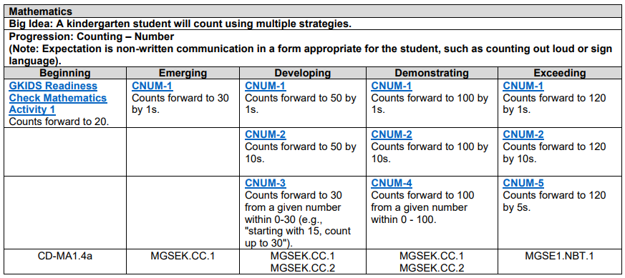
GKIDS 2.0
GKIDS 2.0
Non-Academic Domains:
Approaches to learning
Personal and social development
Motor skills (optional)
Academic Domains:
English language arts
Mathematics
Science (optional)
Social studies (optional)

Slide 37
GKIDS 2.0 – Alternate
GKIDS 2.0
During the 2019-2020 school year, GaDOE will be developing and piloting a GKIDS 2.0 Alternate for students with significant cognitive disabilities.
The GAA 2.0 will include Kindergarten in 2019-2020.
Students with significant cognitive disabilities can participate in the GKIDS 2.0 (non-alternate version) if appropriate.
Beginning in 2020-2021, students with significant cognitive disabilities will participate in GKIDS 2.0 or the GKIDS 2.0 Alternate, as appropriate.
The GAA 2.0 will no longer include Kindergarten.

Slide 38
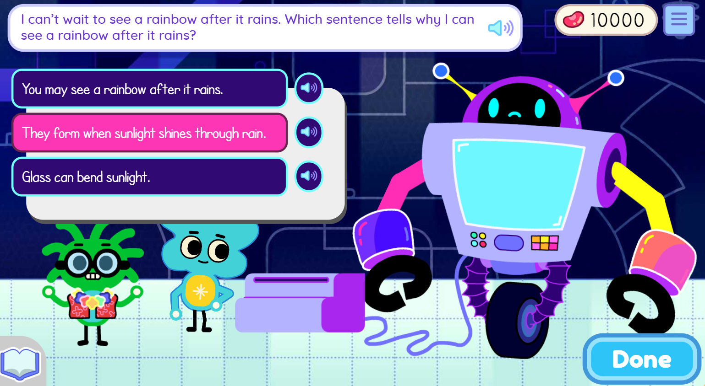
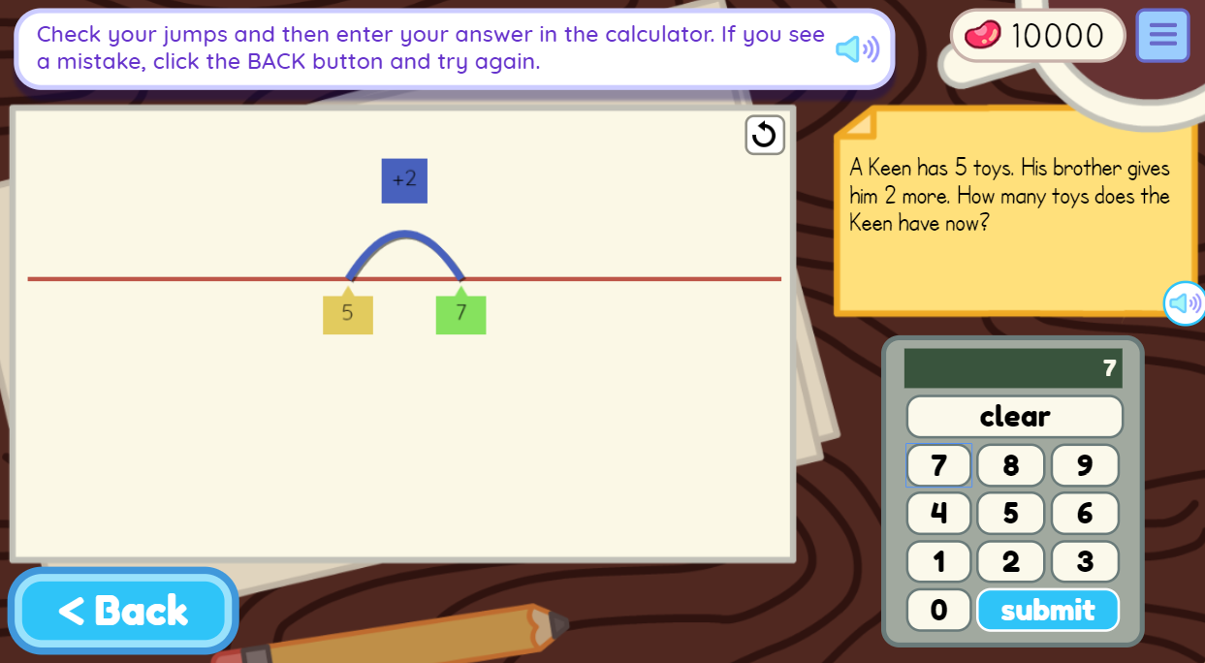
Welcome to Keenville!
Keenville
Keenville is Georgia’s game-based, formative assessment in literacy and mathematics for grades 1 and 2.
Games are highly engaging, age-appropriate, and relevant to young learners.
It is accessible via the Statewide Longitudinal Data System (SLDS).
Keenville is fully operational for the 2019-2020 school year.
Notes:
We are nearing completion of the development of Keenville, Georgia’s game-based formative assessment in literacy and mathematics for grades 1 and 2. New games and dashboards will arrive this spring and summer. The assessment will be fully operational for the 2019-2020 school year.
We are excited about the new games and have received excellent feedback from the teachers and students who participated in development and testing. Upcoming enhancements to the teacher dashboards include features such as student progress reports, play history, and item-level details. School and district leaders will soon have access to real-time dashboards featuring data for students in their school or district. We appreciate the ongoing feedback we are receiving from your districts to help us make refinements and enhancements to this assessment system.

Slide 39
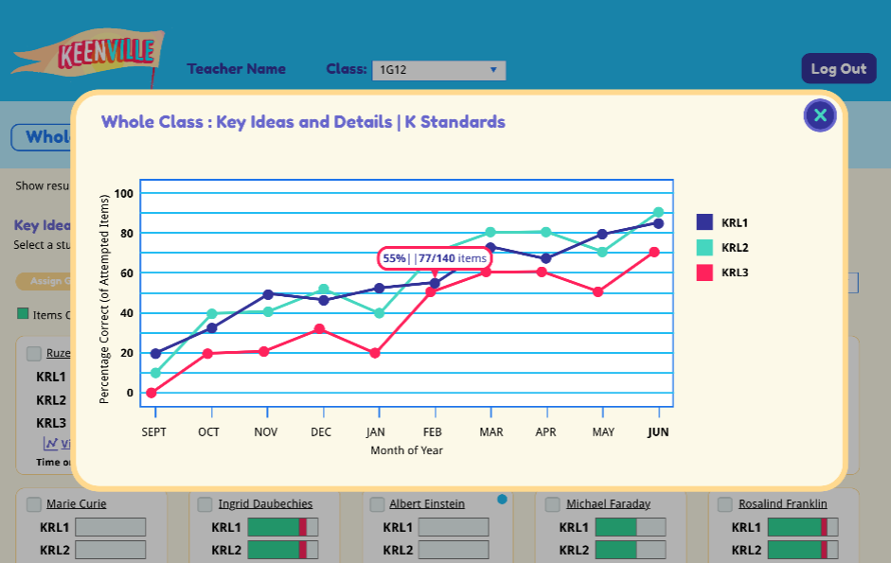
Features
Keenville
Designed to engage students through features such as an avatar builder; earning rewards; decorating their house; and fun sights, sounds, and reactions
Students receive ongoing support through motivational prompts and feedback
Games often include Georgia-specific themes and integrate other standards and initiatives, such as science, arts, and nutrition.
Teachers can access interactive dashboards that provide real-time data to help guide instruction and enhance instructional practices.
Each game is designed with multiple levels of learning to:
identify students’ current level of knowledge, skill, and concept development.
provide students, with varying abilities, access to content based on their learning needs.

Slide 40
What’s in Keenville?
Keenville
English Language Arts
Mathematics
Literary reading comprehension
Informational reading comprehension
Phonics and word recognition
Vocabulary acquisition and use
Reading and writing numerals
Time, money, and measurement
Place value and comparing numbers
Solving word problems and equations
Shapes and fractional parts to whole
Addition and subtraction
Using repeated addition to understand multiplication
Interpreting data with tables, graphs, and line plots

Slide 41
Innovative Assessment Demonstration Authority
Update

Slide 42
IADA Approval
IADA
Georgia’s IADA application was approved by the U.S. Department of Education in July 2019.
This provides a 5-year period during which the approved assessment consortia can develop, implement, and scale their innovative assessment systems.
During this time, GaDOE will manage the authority, collect stakeholder feedback, and oversee an external technical evaluation.
At the end of the authority (the close of the 2023-2024 school year), the state will determine whether either of the innovative assessment systems will be administered statewide.

Slide 43
IADA Consortia
IADA
Georgia MAP Assessment Partnership
MAP Growth for Georgia
A through-year assessment that leverages adaptive interim assessments to provide timely insights on students’ command of grade-level standards, measure academic growth, provide norm-referenced test results, and produce summative proficiency scores.
Putnam Consortium
Navvy
An on-demand assessment system that leverages cutting-edge data science to provide real-time diagnostic data.

Slide 44
IADA Next Steps
IADA
Both consortia are continuing development of their assessment systems and building comparability evidence.
Each assessment system must be comparable to Georgia Milestones and comparability must be demonstrated annually.
The consortia will have the opportunity to present their comparability evidence to the newly formed innovative assessment technical advisory committee as early as this fall.

Slide 45
Thank you!

