Slide 1
Georgia Student Assessment Program 2019-2020 Fall Conference - Part 2
Fall Assessment Conference – Part 2
September 3, 2019
September 5, 2019
Notes:
Good morning, everyone. Today’s session continues our training for System Test Coordinators regarding Georgia’s student assessment program. Please note, the links to these sessions are embedded in the dates here on the title slide, should you need those to review anything presented today. As always, the link to the recording will be sent to those who registered for this training within 48 hours.

Slide 2
Agenda
District Assessment Planning
Nomination of Educators for Test Development Activities
Developing the District Testing Calendar
Technology and Site Readiness
Training Expectations
Communications
Creating a School Assessment Plan
Notes:
Today’s session, and the live repeat scheduled for September 5, will focus on understanding the pattern of assessments across the academic year. We hope the information presented will support your work and guide you to providing meaningful assessments for your district leadership as well as parents, teachers, and students. The agenda will focus on aspects of test development and district assessment readiness and will then close with a discussion of supporting schools within your district in creating a school assessment plan.

Slide 3
Nomination of Educators for Test Development Activities
Notes:
Jan Reyes, Director of Assessment Development

Slide 4
District Nominations
Each year, the GaDOE seeks nominations of highly-qualified educators to participate in various test development activities.
Includes Georgia Milestones and the Georgia Alternate Assessment (GAA)
A memo will be emailed to Assessment Directors, Curriculum Directors, and Special Education Directors in early-mid January.
Memo is also posted under For Educators (link below)
Deadline for nominations: early February
http://www.gadoe.org/Curriculum-Instruction-and-Assessment/Assessment/Pages/Memoranda--Announcements.aspx
Please share information with nominees so they can understand the process and know what to expect.
Georgia Milestones
Rangefinding: June
Item & Data Review: July
Georgia Alternate Assessment (GAA)
Content & Bias Review: June

Slide 5
Georgia Milestones
 | Content Area | Grade Levels/Courses | # of nominees requested
End of Grade | English Language Arts | 3, 4, 5, 6, 7, 8 | 4
 | Mathematics | 3, 4, 5, 6, 7, 8 | 4
 | Science | 5, 8 | 2
 | Social Studies | 5, 8 | 2
End of Course | English Language Arts | Ninth Grade Literature, American Literature | 4
 | Mathematics | Coordinate Algebra, Analytic Geometry, Algebra I, Geometry | 4
 | Science | Biology, Physical Science | 2
 | Social Studies | United States History, Economics | 2
Total |  |  | 24

Slide 6
Georgia Alternate Assessment (GAA 2.0)
Content Area | Grade Levels/Courses | # of Special Education nominees requested | # of General Education nominees requested
English Language Arts | Kindergarten, 3, 4 | 2 | 1
 | 5, 6, 7
 | 8, High School
Mathematics | Kindergarten, 3, 4 | 2 | 1
 | 5, 6, 7
 | 8, High School
Science | 5, 8, High School | 1 | 1
Social Studies | 5, 8, High School | 1 | 1
Total |  | 6 | 4

Slide 7
Committee Selection Process
Educator Application & Availability Survey (February)
Meeting dates and a brief description are provided.
Educators must be available for the entire duration of the meeting.
We ask that educators hold the dates for which they have indicated availability.

Slide 8
Committee Selection Process
Initial Committee Invitations (late March – April)
Rolling schedule based on meeting dates
6-10 participants per grade/content area or course
Balanced representation
Gender
Ethnicity
Region
Experience
Special populations
Accepting an invitation is a commitment to attend.
Last minute cancellations place an undue burden on other participants.

Slide 9
Expense Reimbursement for Educator Meetings
Expenses paid directly (by testing contractor)
Hotel accommodations (participants 50+ miles from the meeting location)
Parking, if applicable
Breakfast, lunch, and snacks are provided at the meeting
Expenses reimbursed to participant (from testing contractor)
Dinner (reimbursed at current state rate) for those staying overnight
Mileage (reimbursed at current state rate)
Expenses reimbursed to school or district (from testing contractor)
Substitute teacher expense, if applicable
Participants are provided a reimbursement form to return to their school/district.
Participants are paid an honorarium if a meeting occurs during off-contract time (e.g. spring break, summer break, etc.)
Typically $125 per day
In lieu of substitute reimbursement

Slide 10
District Assessment Plan: Developing the District Testing Calendar
Notes:
Many of you have developed your district testing calendar by this time, but the information provided in this section may help you gain a high-level look at state mandated assessments and fitting teams together to accomplish the work.

Slide 11
State Mandated Tests: Who, What, and Why
Students | Assessment | Reason
K-12 ELs in the ESOL program | ACCESS for ELLs | Determine English proficiency in the areas of speaking, listening, reading and writing
ELs with significant cognitive disabilities | Alternate ACCESS for ELLs | Determine English proficiency in the areas of speaking, listening, reading and writing
Students with significant cognitive disabilities | Georgia Alternate Assessment (GAA 2.0) | Provides meaningful information about classroom instruction and identifies students’ areas of strength and improvement
All Kindergarten Students | Georgia Kindergarten Inventory of Developing Skills (GKIDS 2.0) | Documents and communicates students’ progress on the Kindergarten instructional standards
All Kindergarten Students | GKIDS 2.0 Readiness Check | Provides information about the skills of students entering kindergarten
All 3-8 and high school students except those eligible for GAA 2.0 | Georgia Milestones Assessment System End of Grade and End of Course | Measures knowledge and skills outlined in the state-adopted content standards in English language arts, mathematics, science, and social studies. EOG – promotion in grades 3, 5, and 8 EOC – 20% of the final course grade
Selected Students in grades 4, 8, and 12 or ages 9, 13, and 17 | National Assessment of Educational Progress (NAEP) | Obtains comprehensive and dependable achievement data on a national basis
Notes:
As you are aware, Georgia’s state mandated assessments include ACCESS for ELLs and Alternate ACCESS for ELLs, Georgia Milestones and Georgia Alternate Assessment, Georgia Kindergarten Inventory of Developing Skills and GKIDS Readiness Check going on right now, and the National Assessment of Educational Progress or NAEP. These assessments provide data that works to support an understanding of students academically and contributes to the portfolio of data collected in classrooms and across your district to allow teachers to guide instruction and support student learning.

Slide 12
Fitting Partnerships Together
System Test Coordinator (STC)
GKIDS 2.0 –
SIS Coordinators
Georgia Milestones – Technology Directors
NAEP –
Principals and School Test Coordinators
ACCESS for ELLs 2.0 –
ESOL/Title III Coordinators
GAA 2.0 –
Special Education Directors
District Holidays –
School Board
District Benchmarks – Curriculum Directors
Other Tests – ACT, AP, SAT, PSAT – Curriculum Directors
Keenville –
SIS Coordinator; SLDS access
Notes:
You as the System Test Coordinator must take the time to think through these assessments to bring the right people to the table. No longer is the role of System Test Coordinator left to one person to manage completely. There are too many variables that must be considered such as technology components, special populations, calendaring, and accurate student information in order to facilitate this work. System Test Coordinators should consider forming district and school assessment teams to review need and communicate protocols.

Slide 13
Back Map Your Calendar Based on Instructional Progress and Need for Student Results
Testing Calendar
(Reports, Retest, End of Year Activities, Graduation, Close of school)
Training – District and School Level
Communications with schools, parents, staff
Assessment Reports
Student Instruction and Assessment
Review of Technology
Notes:
A quality plan includes a look at the academic school year and then back-maps those activities. With that said, understanding projected dates for reports and then moving calendar dates back and forth from that to ensure proper communication is in place with results, training, and assessment windows will better balance the expectations and allow a plan for contingencies.

Slide 14
Reporting Expectations for Reference
Assessment | Preliminary | Final
ACCESS for ELs 2.0 | N/A | Mid-May
Georgia Milestones EOC Winter 2019 | Business days after submission Math and ELA - 10 Science and Social Studies - 5 | Mid-February
Georgia Milestones EOC Spring 2020 | Business days after submission Math and ELA – 12 Science and Social Studies – 5 | Late July
Georgia Milestones EOG Spring 2020 | Business days after submission ELA and Math G 3, 5, 8 - 11 ELA and Math G 4, 6, 7 – 16 Science and Social Studies - 5 | Early July
Georgia Alternate Assessment 2.0 | N/A | June
GKIDS 2.0 | Available throughout the year | Determined by school system
NAEP | N/A | Fall 2019
Keenville | Available throughout the year | Determined by school system
Notes:
Taking time to review the expectations for reporting when looking at local testing calendars, enables you to consider your communication to parents and stakeholders, planning for graduating seniors, scheduling of field trips and performances, as well as end of year activities. This office will continue to provide projected dates when they become available.

Slide 15
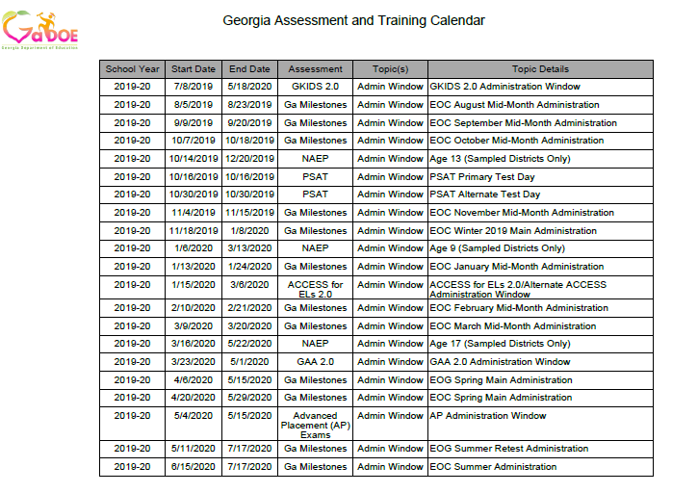
Central source for administration windows, training dates, checkpoints…
http://www.gadoe.org/Curriculum-Instruction-and-Assessment/Assessment/Pages/Information-For-Educators.aspx
Notes:
All district testing windows must be set within the state testing windows found on the Georgia Assessment Training Calendar. Guidance around the state calendar is found in the Student Assessment Handbook and must be reviewed and followed when setting local calendars.

Slide 16
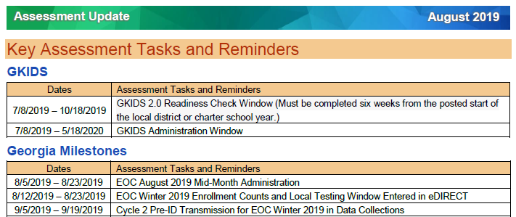
Central source for administration windows, training dates, checkpoints…
Notes:
This office prepares and posts a monthly Assessment Update that includes information specific to all state mandated assessments. This is the one central location for this communication and allows for the elimination of most other emails sent in previous years. It is vital that this tool becomes part of your monthly review of activities, training, and key information. You are welcome to share this information with the district or school assessment team where appropriate to help those individuals better prepare and support students and staff throughout the process.

Slide 17
Visualizing the State Testing Windows – Yearlong
September 2019 EOC MM
January 2020 EOC MM
9/20/2019
1/24/2020
October 2019 EOC MM
February 2020 EOC MM
10/18/2019
2/21/2020
August 2019 EOC MM
November 2019 EOC MM
March 2020 EOC MM
8/23/2019
11/15/2019
3/20/2020
Jul
Sep
Nov
2020
Mar
May
Jul
2020
Today
Winter 2019 EOC
11/18/2019 - 1/8/2020
ACCESS for ELs 2.0
1/15/2020 - 3/6/2020
Spring 2020 GAA 2.0
3/23/2020 - 5/1/2020
Spring 2020 EOG
4/6/2020 - 5/15/2020
Spring 2020 EOC
4/20/2020 - 5/29/2020
Summer Retest 2020 EOG
5/11/2020 - 7/17/2020
Summer 2020 EOC
6/15/2020 - 7/17/2020
2019
NAEP 13-year-olds
10/4/2019 - 12/20/2019
NAEP 9-year-olds
1/6/2020 - 3/13/2020
NAEP 17-year-olds
3/16/2020 - 5/22/2020
51 days
GKIDS 2.0
7/8/2019 - 5/18/2020
52 days
40 days
40 days
40 days
68 days
33 days
77 days
68 days
68 days
316 days
Notes:
This graphic represents the state testing calendar. The flags above are the Georgia Milestones Mid-Month administrations and the bars below are the main windows for all other administrations. As you can see, we are currently in the GKIDS window with all districts participating in the GKIDS Readiness Check phase, we have completed the August EOC mid-month administration and will begin the September Mid-month administration soon.

Slide 18
Focus on GKIDS 2.0
Mid-year checkpoint (Webinar only, no datafile provided)
2/11/2020
Website closes for the 2019-2020 school year.
Pre-Administration Training
7/30/2019
6/10/2020
Jul
Aug
Sep
Oct
Nov
Dec
2020
Feb
Mar
Apr
May
Jun
2020
Today
GKIDS Readiness Check Data Entered
7/8/2019 - 10/18/2019
Must be completed six weeks after school start date.
Entries may be entered for the current school year after the Readiness Check Data has been entered.
7/8/2019 - 5/18/2020
2019
103 days
316 days
Notes:
The following graphics isolate each assessment across the year. For GKIDS, notice the green bar for Readiness Check data entry. This is marked as going through October, but that date is set to allow for a 30-business day or roughly a 6-week window for all districts to complete this task. The window is set as the opening day of school and then runs through the 30th school day, excluding holidays. The window closes when that date is met for readiness check data. Following that date, only GKIDS data may be entered.

Slide 19
Focus on Georgia Milestones – Jul-Dec 2019
INSIGHT/eDIRECT Training
9/24/2019
EOC Winter 2019/Spring 2020 MM Pre-Admin Training
10/15/2019
Fall 2019 EOC MM Online Test Setup & eDIRECT Enrollment Count Training
Winter 2019/Spring 2020 EOC MM Online Test Set-Up Training
7/23/2019
10/22/2019
Jul
Aug
Sep
Oct
Nov
Dec
2020
2020
Today
August 2019 EOC MM
8/5/2019 - 8/23/2019
September 2019 EOC MM
9/9/2019 - 9/20/2019
October 2019 EOC MM
10/7/2019 - 10/18/2019
November 2019 EOC MM
11/4/2019 - 11/15/2019
Winter 2019 EOC
11/18/2019 - 1/8/2020
2019
19 days
12 days
12 days
12 days
52 days
Notes:
In this graphic the flags indicate the training sessions for Georgia Milestones and the windows in the bars below. This graphic runs through the winter EOC main administration.

Slide 20
Focus on Georgia Milestones – Jan-Jul 2020
eDIRECT Enrollment Count Training
1/7/2020
INSIGHT/eDIRECT Training
2/11/2020
Spring/Summer 2020 EOG & EOC Pre-Admin Training
2/25/2020
Spring/Summer 2020 EOC & EOG Online Test Set-Up Training
EOG/EOC Post-Assessment Training
3/3/2020
5/26/2020
Jan
Feb
Mar
Apr
May
Jun
Jul
2020
January 2020 EOC MM
1/13/2020 - 1/24/2020
February 2020 EOC MM
2/10/2020 - 2/21/2020
March 2020 EOC MM
3/9/2020 - 3/20/2020
Spring 2020 EOG
4/6/2020 - 5/15/2020
2020
Spring 2020 EOC
4/20/2020 - 5/29/2020
Today
Summer Retest 2020 EOG
5/11/2020 - 7/17/2020
12 days
Summer 2020 EOC
6/15/2020 - 7/17/2020
12 days
12 days
40 days
40 days
68 days
33 days
Notes:
This graphic is set up the same way as the previous one with training opportunities flagged above the timeline and state windows found below for the spring semester. Most of you may be aware that there is flexibility allowed for the End-of-Grade assessments that may also support your planning.

Slide 21
Planning for EOC/EOG Scheduling – Flexibility
Georgia Milestones Assessments
Can utilize entire state testing window
Content order of administration set by system
Start date for EOG grade content / EOC course must be the same system-wide
*See the Student Assessment Handbook for additional details.
Notes:
The Student Assessment Handbook goes into greater detail about this, and System Test Coordinators should take the time to read and review this guidance. Districts are not restricted to a set number of days for administration as has been the case in the past. The entire state testing window may be utilized to administer the assessments. The order of content may also be set by the system. No longer is it required to administer ELA, Math, Science and Social Studies in a set order. You may begin with whatever content works best for your district. This is where a conversation with your elementary and middle school principals may be needed as part of the assessment team.
Certain guidelines itemized in the Student Assessment Handbook remain: ELA section 1 must still be on day 1 of ELA, section 2 and 3 must follow on a separate day or days. No section from any content area may be separated by a weekend. All sections must be completed in the same week. The start date for an EOG grade or EOC course content area such as 4th grade math or 6th grade Science or 9th grade literature must be the same district-wide. Again, a review of the Student Assessment Handbook outlines these details and others and should be reviewed while planning for local testing calendars.

Slide 22
Scheduling Flexibility Examples – EOC
Georgia Milestones Assessments
 | Monday | Tuesday | Wednesday | Thursday | Thursday | Friday
Nov. 18-22 | Econ | Makeup
Nov. 25-29 | Thanksgiving Break
Dec. 2-6 | 9th Lit | 9th Lit | Am Lit |  | Am Lit | Makeup
Dec. 9-13 | Biology | Physical Science | Makeup
Dec. 16-20 | US History | Makeup
Dec. 23-27 | Winter Break

Slide 23
Scheduling Flexibility Examples – EOG
Georgia Milestones Assessments
 | Monday | Tuesday |  | Wednesday | Thursday | Friday
April 6-10 | G5 Math Section 1 | G 5 Math Section 2 |  | Makeup, All | G3 Math Section 1 | G3 Math Section 2
April 13-17 | G5 ELA Section 1 Makeup, All | G5 ELA Section 2 G3 ELA Section 1 |  | G5 ELA Section 3 G3 ELA Section 2 | Makeup, All G3 ELA Section 3 | Makeup, All
April 20-24 | Spring Break
April 27-May 1 | G5 Science Sections1 & 2 | Science Section 2 | Makeup, All G4 Math Section 1 | G4 Math Section 2 | Makeup, All | Makeup, All
May 4-8 | G Social Studies Sections 1 & 2 | Social Studies Section 2 | G4 ELA Section 1 Makeup, All | G4 ELA Section 2 Makeup, All | G4 ELA Section 3 Makeup, All | Makeup, All
May 11-15 | *EOG Retest window starts May 11

Slide 24
Focus on NAEP
Training (Age 9 Sampled Systems Only)
10/8/2019
Training (Age 13 Sampled Systems Only)
Training (Age 17 Sampled Systems Only)
8/7/2019
12/11/2019
Aug
Sep
Oct
Nov
Dec
2020
Feb
Mar
Apr
May
2020
Today
Age 13 (Sampled Districts Only) Assessment Window
10/14/2019 - 12/20/2019
Age 9 (Sampled Districts Only) Assessment Window
1/6/2020 - 3/13/2020
Age 17 (Sampled Districts Only) Assessment Window
3/16/2020 - 5/22/2020
2019
67 days
67 days
68 days
Notes:
This graphic represents the training sessions flagged above the timeline and the NAEP windows indicated below. NAEP is administered to selected sets of students from districts across the state. Those included in the sampling have been notified and should have begun receiving information by now.

Slide 25
Focus on ACCESS for ELLs
Return Materials to DRC
3/13/2020
Score Reports Available (Online)
ACCESS for ELLs Pre-Administration Training
5/7/2020
10/9/2019
ACCESS and Alt ACCESS for ELLs Post Assessment Training
Alt ACCESS for ELLS 2.0 Pre-Administration Training
10/11/2019
WIDA Training: Alt ACCESS for ELLs Test Admin
5/15/2020
12/3/2019
Score Reports Available (Paper)
Georgia-Specific Guidance Training
Materials Arrival
8/27/2019
1/6/2020
5/15/2020
Aug
Sep
Oct
Nov
Dec
2020
Feb
Mar
Apr
May
2020
Today
2019
Material Ordering & LEA Pre-ID
10/9/2019 - 11/25/2019
WIDA AMS Test Setup
12/5/2019 - 3/6/2020
Administration Window
1/15/2020 - 3/6/2020
48 days
LEA Data Validation (Pre-Reporting)
4/6/2020 - 4/17/2020
93 days
LEA Data Validation (Post-Reporting)
5/11/2020 - 5/22/2020
51 days
11 days
11 days
Notes:
ACCESS for ELLs is set up the same as the other graphics however this one also includes some of the tasks that are required as well.

Slide 26
Focus on GAA 2.0
Test Administration Procedures Part 2 Training
10/1/2019
Nextera Training
Test Administration Procedures Part 1 Training
1/6/2020
Pre-Administration Training
8/20/2019
2/18/2020
Aug
Sep
Oct
Nov
Dec
2020
Feb
Mar
Apr
May
2020
Today
Administration Window
3/23/2020 - 5/1/2020
2019
39 days
Notes:
The Georgia Alternate Assessment window is 3/23/20 through 5/1/20. Several trainings have been scheduled to support you as you work with your Special Education Directors, lead teachers, and local school administration.

Slide 27
Focus on GAA 2.0
Possible District Training Redelivery
Test Administration Procedures Part 2 Training
10/1/2019
Nextera Training
Test Administration Procedures Part 1 Training
1/6/2020
Pre-Administration Training
8/20/2019
2/18/2020
Aug
Sep
Oct
Nov
Dec
2020
Feb
Mar
Apr
May
2020
Today
Administration Window
3/23/2020 - 5/1/2020
District Redelivery Option
10/1/2019 - 11/29/2019
District Redelivery Option
3/1/2020 - 3/31/2020
2019
39 days
60 days
31 days
Notes:
This slide indicates a possible district training redelivery plan that closely aligns with the Georgia DOE training presentations to you and then suggested windows for redelivery training back to Test Examiners locally. Again, the partnership with Special Education leaders and teachers will be needed to support this work in preparing test examiners for this administration.

Slide 28
District Assessment Plan: Technology and Site Readiness
Notes:
Joe Blessing

Slide 29
Building a Tech Team for Assessment
Members
System Test Coordinator (STC)
Special Education Director/ESOL Coordinator
School Test Coordinators
System Technology Coordinator
School-level Technical Staff
Meet Regularly
Share training opportunities
Share technology requirements
Share testing windows and numbers of test takers
Notes:
In order to have a successful district testing administration, you should build a technology team for testing including the System Test Coordinator, Technology Coordinator, Special Education and/or ESOL coordinator and school technology staff. The team should meet regularly, share training opportunities, share technology schedules and technology requirements for each assessment.

Slide 30
Georgia Online Assessment Overview
Assessment | Vendor | Management System | Local Content Caching | Response Source
ACCESS for ELLs 2.0 | WIDA/DRC | WIDA AMS | Central Office Services* | Student login to INSIGHT*
Georgia Milestones | DRC | eDIRECT | Central Office Services* | Student login to INSIGHT*
Georgia Alternate Assessment 2.0 | Questar | Nextera | None | Teacher through website
GKIDS 2.0 | Georgia Center for Assessment | GKIDS 2.0 Data Entry and Reporting Website | None | Teacher through website
NAEP | NCES | None | None | Student login
Keenville | Georgia Center for Assessment | SLDS | None | Student login
*Software installation required
Notes:
This table shows an overview of the main state assessments, the vendors, management systems, caching requirements and response source. You can see how student login to the test can increase the technology work that needs to be done.

Slide 31
OS Breakdown Spring 2018-19 Milestones
EOG and EOC
Chrome
Windows
Mac
iPad
Notes:
This table shows the percent of operating systems taking Georgia Milestones in the Spring of 2019. One takeaway is the dominance of wireless machines during testing. All of the chrome and iPAD machines are wireless and many of the Windows machines are also wireless. The chart impresses on the importance of having a strong wireless network.

Slide 32
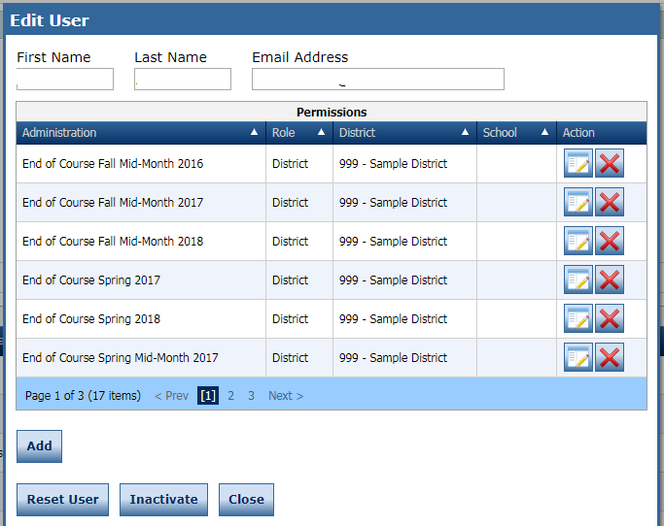
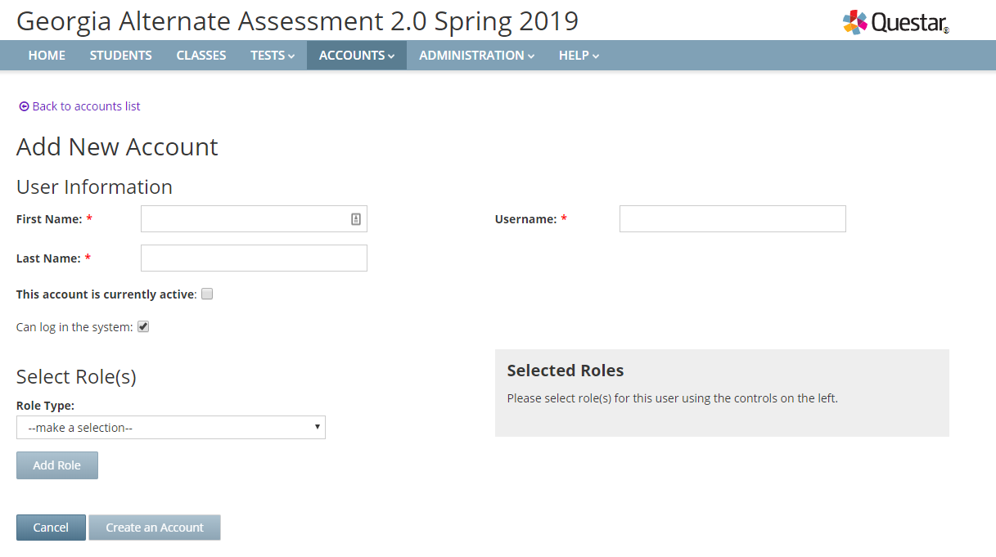
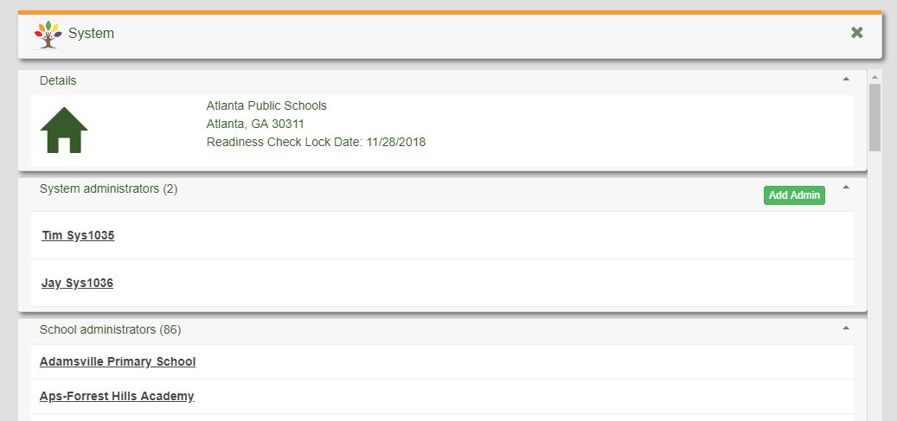
User Accounts
District STCs are responsible for ensuring administrator accounts are current.
Legacy user accounts could have access to student information.
STCs manage district level accounts. School Test Coordinators manage teacher accounts on some programs.
Milestones/ACCESS
GAA 2.0
MyGaDOE Portal
GKIDS 2.0/GKIDS Readiness Check
Notes:
It is critical to not only add new users to the different vendor portals, but legacy accounts need to be removed. When staff leaves the system, they must be inactivated as users or they will still have access to student information.

Slide 33
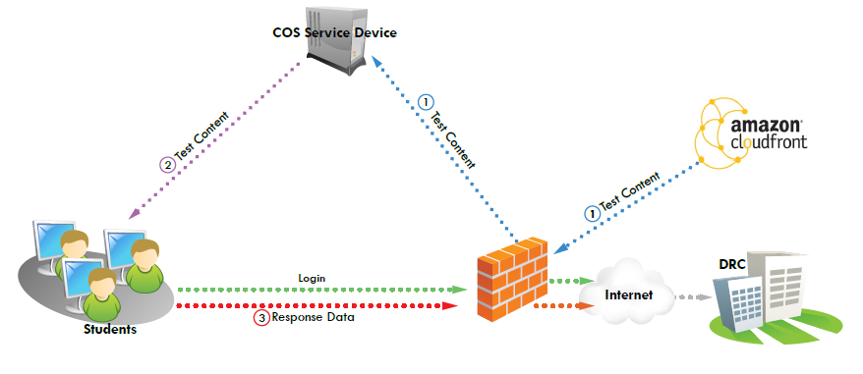
Access for ELLs and Georgia Milestones
INSIGHT
Test Content including Text to Speech and Video Sign Language (VSL) is hosted on a COS Service Device
Students test using the INSIGHT client
COS and INSIGHT devices are managed through eDIRECT
Enhanced Retries replaces caching for student responses
Testing Site Managers (TSM) and Response Caching are discontinued as of August 15
Notes:
Both Georgia Milestones and ACCESS use the INSIGHT client and the COS service devices to administer assessments. It is important to install the INSIGHT clients on all testing machines, install the COS and content on servers and setup firewalls so that content can be transmitted into the district and out to DRC. As a reminder, the TSM and response caching are discontinued as of August 15, 2019.

Slide 34
Site Technology Readiness Checklist
Site Readiness Checklist
Site planning team
Teachers, Test Administrators, Technology Coordinators, District Assessment Coordinators, EL Directors, Principals, Curriculum Directors
Consider Timeframes
2-3 Months Before Testing
1-2 Months Before Testing
2-4 Weeks Before Testing
1-2 Weeks Before Testing
Day of Testing
Categories
Communication
Site Planning, Scheduling, and Logistics
Technology – Device Setup
Technology – Network Configuration
Technology – COS Setup
Training
Notes:
Districts should develop their technology plans with month-by-month steps to ready for testing. Plans should include Communications, Site Planning, Device Setup, Network configuration, COS Setup and Training. DRC offers a Site Readiness Checklist that is linked on this page that can be used for Milestones and ACCESS but plans can be gleaned for other programs.

Slide 35
Technology Readiness Checklist
Site Readiness Checklist
2-3 Months
Meet with technology team to create awareness and define roles
1-2 Months
Perform System Readiness Check on each device
2-4 Weeks
Confirm all installations have been completed including COS and INSIGHT browser
1-2 Weeks
Day of Testing
Conduct a final technology walk through
Implement Testing Plan
Stagger logins to the testing system
Notes:
Here is a summary of items that should be completed at different stages during the year.

Slide 36
District Assessment Plan: Training Expectations
Notes:
Now let’s turn our attention to developing a training plan as a part of the overall District Assessment Plan. Effective and thorough training prior to a test administration is essential to assuring test security is maintained and the actual test is administered with integrity.

Slide 37
Test Security
Readiness – Local Training Plan
System Test Coordinator
Participation in all GaDOE webinars and training sessions
Review of resources available for System Test Coordinators
School Test Coordinator
Participation in all District-level training sessions
Test Examiners, Proctors
Participation in all School-level training sessions
Test Security
Test Security
Test Administration
Pre-, During, and Post-Test Administration Activities
Test Administration
Pre-, During, and Post-Test Administration Activities
Student Test Preparation Training
All training documentation including presentations, handouts, and sign-in sheets must be kept on file locally.
The state may request copies of these materials to ensure that the training was appropriate and adequate.
Provide professional ethics and security training to all staff, both veteran and new staff.
School Test Coordinators are responsible for training of all test examiners and proctors.
Notes:
The development of a local training plan should be based on the roles and responsibilities for each level of authority starting with the System Test Coordinator training School Test Coordinators who then in-turn train Test Examiners, Proctors, and other staff who will play a supporting role during the assessment. Personnel at each level must have an understanding their responsibility and training should promote readiness and ensure test security during assessment administrations.

Slide 38
Develop a Training Hierarchy and Timeline
GaDOE Training to
System Test and Technology Coordinator
District Staff, as Appropriate
School A Test Coordinator and Technology Specialist
School B Test Coordinator and Technology Specialist
School C Test Coordinator and Technology Specialist
All – Test Security
Examiners – Administration
Students – Orient to Testing Mode Including Online Items and Tools
All – Test Security
Examiners – Administration
Students – Orient to Testing Mode Including Online Items and Tools
All – Test Security
Examiners – Administration
Students – Orient to Testing Mode Including Online Items and Tools
Notes:
This is a representation of how the local school district fits into the state’s training plan following the train the trainer model. The Georgia Department of Education delivers administration expectations to system test coordinators on a timeline based on the various state assessment calendars that were shown earlier. This guidance then goes through a redelivery process within the district so that examiners, test takers, and other support staff are prepared for a successful and secure administration.

Slide 39
Back map local training schedule
Test Date
Train extra examiners and proctors
Student/ Examiner Training
Enough in advance of test date to allow for make up training
School Coordinator Training
Use resources and materials from GaDOE training
System Coordinator Training from GaDOE
Reiterate test security at ever level
Test and technology setup
Administration procedures
4-6 weeks prior start of state window
Notes:
Setting up a local training schedule should follow the same principle as developing the local testing calendar and is dependent on the district’s testing date and its relation to the state’s training for school districts which is usually 4 to 6 weeks in advance of the opening of the state testing window. This slide highlights some important points to consider when setting the local training schedule. Local training should be scheduled so that there is ample time for redelivery including makeup training at both the district and school level. It is important to use resources provided by the Department of Education training to assure assessment are administered consistently state-wide . One important factor is to train extra examiners and proctors to cover unexpected absences.

Slide 40
Test Security
Guiding Principles
The primary goal of assessment security is to protect the integrity of the assessment and to assure that results are accurate and meaningful.
State assessments are an important and a required tool used to monitor state, district, school, and student achievement results.
For assessments to yield fair, accurate, and valid results, they must be administered under the same standardized conditions to all students.
Notes:
Take time to review Test Security guidance every step of the way. Test Security is ongoing and not just a one-time presentation at the beginning of the year.

Slide 41
Test Security
Code of Ethics for Georgia Educators
Standard 10: Testing – An educator shall administer state-mandated assessments fairly and ethically.
Unethical conduct includes but is not limited to: committing any act that breaches Test Security; and compromising the integrity of the assessment.
GaPSC Ethics Division (Jan. 2018):
Notes:
The Georgia Professional Standards Commission includes as part of the Code of Ethics for Educators, Standard 10 which is specific to testing. An educator shall administer state-mandated assessment fairly and ethically. Each local training session should include a discussion of this standard and should emphasize that examiners should administer, manage and monitor assessments appropriately.
There are occasions that an incident occurs that warrants an investigation and referral to GaPSC. The GaDOE has made referrals to the GaPSC; however, we do support investigations by district Human Resource departments and local decisions to refer potential unethical behavior to the GaPSC.

Slide 42
Test Security Across Assessments
Required Resources
Training
Test Administration policies, protocols, and procedures
Student Assessment Handbook
Accessibility and Accommodations Manual
System Test Coordinator and Test Examiner Manuals
GaDOE Webinar and Local Training Sessions
Student Accessibility and Accommodations
Student Assessment Handbook
Accessibility and Accommodations Manual
System Test Coordinator and Test Examiner Manuals
Review of IEP/IAP and EL/TPC plans
Notes:
Discuss general remediation options.

Slide 43
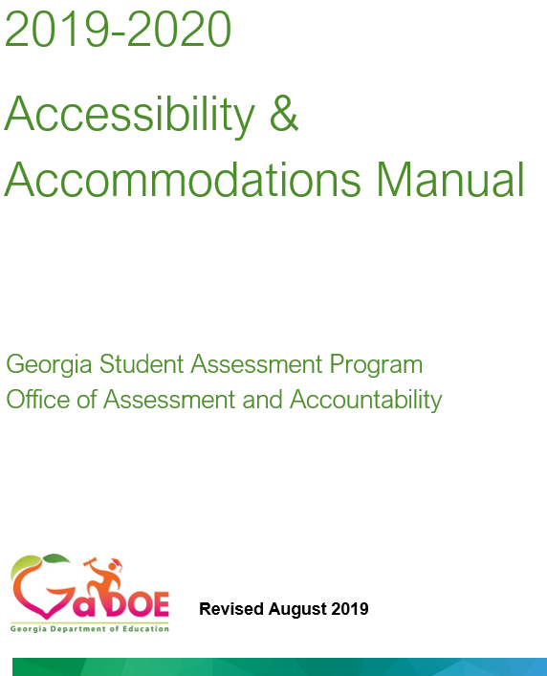
Required Resources
Notes:
The Student Assessment Handbook and Accessibility and Accommodations Manual plus…

Slide 44
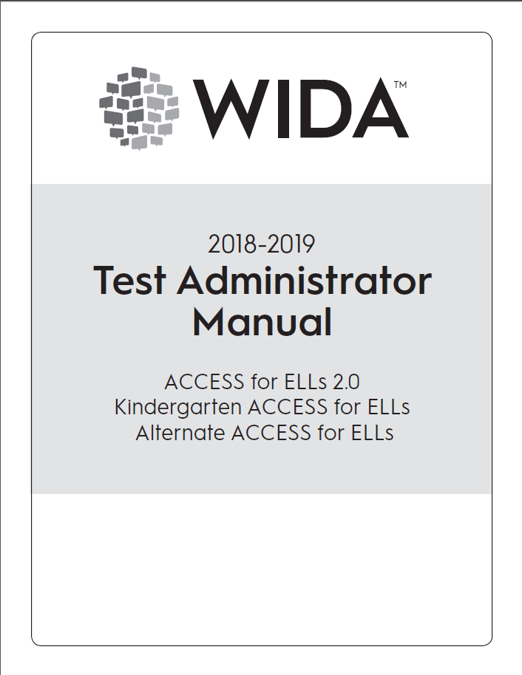
Test Examiner Manual
Train examiners about administration procedures using the Test Administration Manual
Notes:
Test Administration and Examiner’s Manuals should be review by coordinators and examiners prior to testing and should be directly referenced during training sessions.

Slide 45
Based on System Level Training, the School Test Coordinator Should
Setup
Coordinate with Technology Specialist the setup of testing devices Oversee the setup of test sessions including and importantly assigning online accommodations prior to student login
Training
Train in the use of test-taking strategies, test item format, and universal tools Train in the use of Assessment Guides, Study Guides, and other GaDOE posted Resources Train and provide guidance regarding communication plans for students, parents, and the public including what state assessments entail, when and how the tests will be administered, and how the results will be appropriately used. Train on test security and maintaining appropriate test environments
Monitoring
Arrange for supervision of testing locations including hall monitors Use reporting resources in eDIRECT to monitor student progress
Notes:
From the system level training a main outcome for the School Test Coordinators should be an understanding of their responsibility with test setup, training examiners and other staff that will support test administration, and a plan to monitor testing locations during the test administration and to monitor student progress during testing.

Slide 46
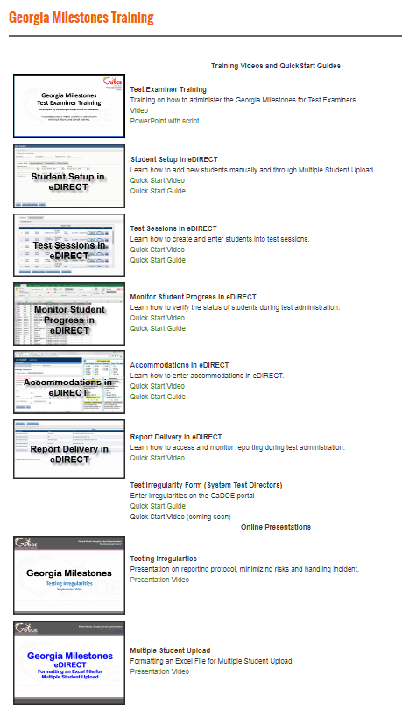
Take Advantage of QuickStart Videos and Guides
Test Examiner Training
Student Setup
Test Sessions
Monitor Student Progress
Accommodations
Report Delivery
Online Presentations
Testing Irregularities
Multiple Student Upload
Can be found off the EOG Resources or EOC Resources pages.
http://www.gadoe.org/Curriculum-Instruction-and-Assessment/Assessment/Pages/Milestones_Training.aspx
Notes:
This and some of the following examples are specific to Georgia Milestones; however, each point should be considered as it applies to planning for any assessment administration. Besides the Student Assessment Handbook, Accessibility and Accommodations Manuals, and manual specific to a given assessment, be sure School Test Coordinators are familiar with other resources that can assist with training for an upcoming administration. These can be found on the website of the Assessment and Accountability Division and the website contractor for each state assessment.

Slide 47
GKIDS 2.0 Resources
Training Modules and Webinar
GKIDS 2.0 Overview
GKIDS 2.0 Data Collection Platform
Train the Trainer
Notes:
Here is an example of the GKIDS 2.0 webpage found under the Assessment and Accountably website showing examples of links to training modules, webinars, and administration manuals.

Slide 48
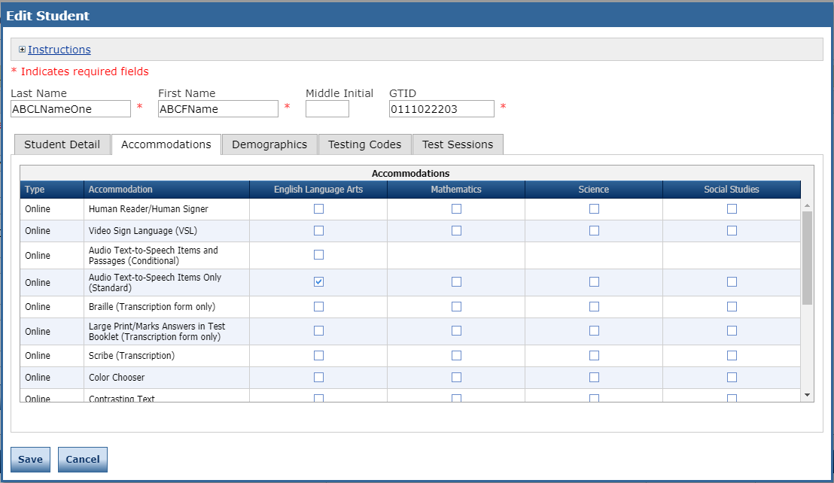
The School Test Coordinator Should
Oversee Management of Student Profiles and Accommodations
Notes:
The System Test Coordinator is responsible in setting up school level users in the management application for each assessment. The School Test Coordinator should have permissions to manage student profile information and to add or modify accommodations that are available through the test delivery client.

Slide 49
The School Test Coordinator Should
Use Resources in eDIRECT to Verify Online Accommodations
Notes:
The School Test Coordinator should be trained to use the sorting and filtering capabilities in each assessments management applications to verify student accommodations are assigned correctly.

Slide 50
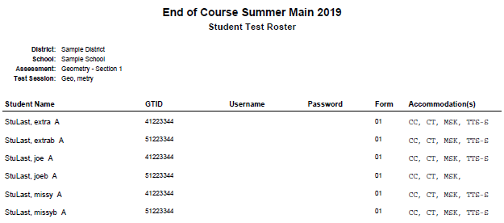
The School Test Coordinator Should
Coordinate with SPED to Provide Examiners with a Roster of Accommodated Students
Utilize Examiners to cross-reference between an Accommodation Roster and the Student Test Roster
Notes:
Train School Test Coordinators to generate a list of accommodated students to give to Examiners and utilize Examiners to verify student online accommodations will be active when the student logs into the testing client. These examples show a missing accommodation and an accommodation incorrectly selected. Accommodations errors are one of the leading causes of testing irregularities.

Slide 51
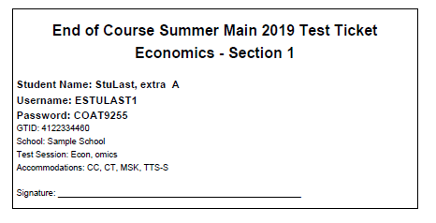
The School Test Coordinator Should
Orient Examiners to Information on Rosters and Test Tickets
Check
Test Subject
Test Section
Student Name
GTID
Test Session
Accommodations
Accommodation
TTS | Text-To-Speech
TTS-C | Text-To-Speech Conditional (with passages)
CC | Color Chooser
CT | Contrasting Text
MSK | Masking
VSL | Video Sign Language
Notes:
School Test Coordinators should be trained to orient Examiners to the information included on test rosters and student login information found on student test tickets.

Slide 52
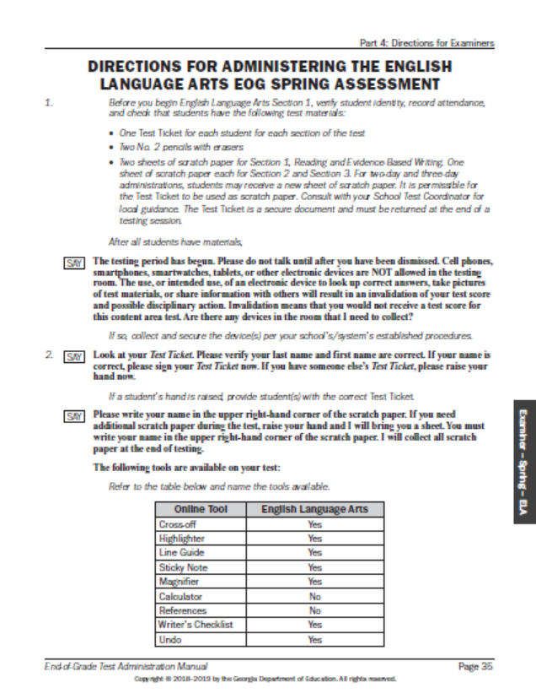
The School Test Coordinator Should
Train examiners about administration procedures using the Test Administration Manual
Notes:
The School Test Coordinator should train examiners from the manuals that will be used to the administer the test. Examiner’s should be allowed to make notes and highlight information in the actual manual that will be used to read directions to student.

Slide 53
The School Test Coordinator Should
Be sure students understand how to interact with the administration mode of an assessment
Orient students to testing with sample paper materials
Plan practice opportunities for online administrations
Make teachers, students, and parents aware of public facing resources
Notes:
Students should be comfortable with the format of the assessment especially those that are delivered online. Districts should set up practice sessions with students using online practice applications. Be sure teachers, students, parents are aware of public facing resources as well.

Slide 54
The School Test Coordinator Should
Train Students and Teachers on Strategies, Item Formats and Universal Tools
Device Familiarity – Ensure students are familiar with the operation of the device they will use during testing.
Mouse
Keyboard
Touchpad
Online Administration Familiarity – Ensure students are familiar with the tools they will use during the online testing assessment.
Ensure that students have practiced with testing devices before testing.
Notes:
Online practice sessions provide the opportunity to verify students can manipulate the keyboard and mouse or touchpad and be familiar with online tools.

Slide 55
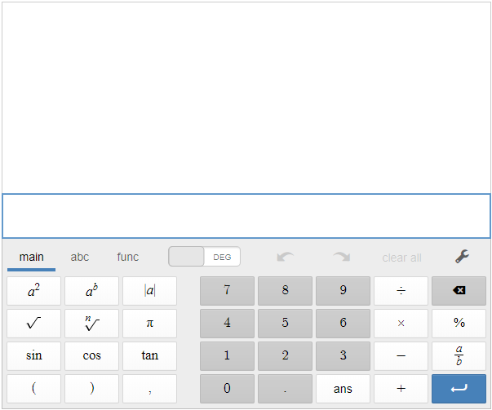
Strategies, Item Formats, and Universal Tools
Basic
Scientific
Graphing
Notes:
If appropriate, it is important that it is clear if handheld or online calculators are to be used for tests that allow their use. If an online calculator is the chosen option, students must have the opportunity to learn its functionality by practicing with sample items that simulate those that will be found on the assessment.

Slide 56
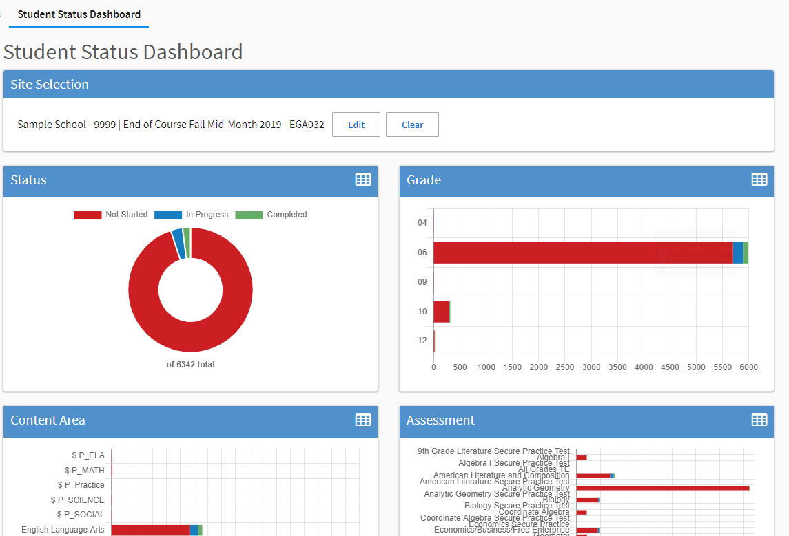
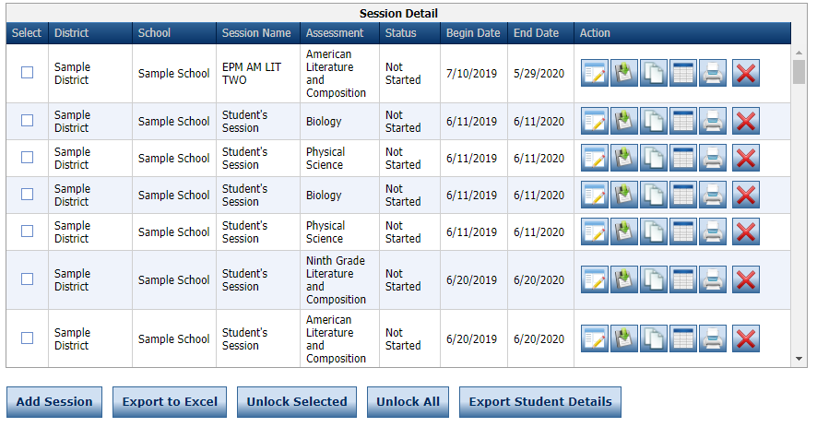
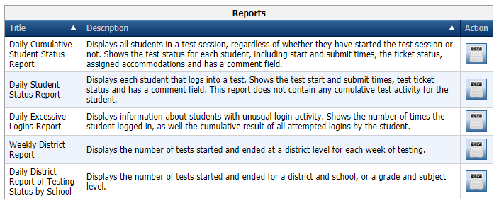
The School Test Coordinator Should
Utilize Online Resources to Monitor Student Test Progress
Notes:
The School Test Coordinator should be familiar with how to monitor student progress using resources found in test management applications

Slide 57
Putting Together the Pieces for a Successful Assessment Administration
Thorough Training
Diligent Monitoring
Thoughtful Planning
Notes:
And finally, to reiterate the focus of this section of the presentation, a thorough training plan is one of the essential pieces for a successful assessment administration.

Slide 58
District Assessment Plan: Communications
Getting the Message Out

Slide 59
Communicate Your Calendar
What
Testing Dates
Training Dates
Requirements
Reporting Dates
Who
Principals
District Administrators
Teachers
Parents
Community
How
Emails
Website
Flyers
Social Media
Notes:
A key component of a system plan is communication. After completing the district calendar, this should be share to all stakeholders. Parents should know dates for testing. Schools should know the specific dates for each content area and course. Parents should also know when and how they will receive test results.

Slide 60
Communication Suggestions
Testing calendar and reporting plan easily accessible on the system’s and schools’ website
Depending on the assessment, the calendar should be grade and content specific
Include contact information should parents have questions
Include links to GaDOE parent and student resources
Try to provide preliminary report results and prominently and clearly communicate a plan for distributing final reports
Notes:
Remember to share your calendar publicly and make it easy to find. It is good to include resources for parents to access information about what is being tested and how they will receive reports.

Slide 61
Communicating Test Results
Summary Reports are embargoed until they are released by the GaDOE.
Do not share embargoed data at public board meetings or with the media until the GaDOE releases data for that program.
Do share with parents, students, teachers and staff related to the student as soon as they are received.
Notes:
District should not share embargoed data with the public. However, embargoed data can be shared with parents, students and staff related to the student. Districts can share Individual Student Reports with parents and class reports with teachers and school administration.

Slide 62
Communicating Test Results
Preliminary Reports Can Be Shared
Preliminary individual student data
Preliminary EOC student reports
counts as 20% of the course grade
may be reported to parents/guardians and students
Preliminary EOG student reports
promotion determinations for Grades 3, 5, and 8 based on state rule or local policy
may be reported to parents/guardians and students
Class rosters can be shared with teachers and administrators
Inform school and system level staff how results will be distributed to parents
Be sure summer school staff know reporting timelines
Notes:
Milestones EOG scores can affect promotion and retention decisions. EOC scores count as 20% of the grade. These reports can be shared with parents and students. Districts and schools should have a plan for sharing this information with identified parties.

Slide 63
Creating a School Assessment Plan
Informing Teachers, Students, and Parents
Notes:
After completing a district plan, schools can also complete their local school assessment plan.

Slide 64
Assessment Plan
School Assessment Plan
Assessment Plan
Completed Plan Template
Copies of Communications
Training Materials and sign-ins
Testing Schedule
Notes:
The Assessment Plan should include an assessment plan template that we will discuss next, copies of all communications regarding the testing plan, training materials and sign-ins and the testing schedule.

Slide 65
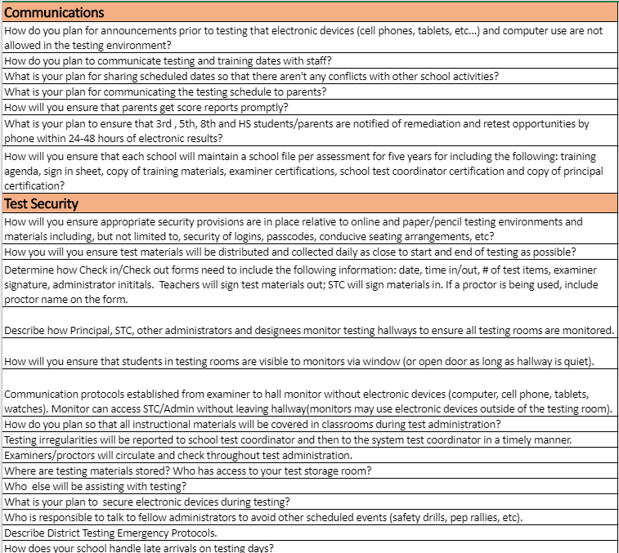
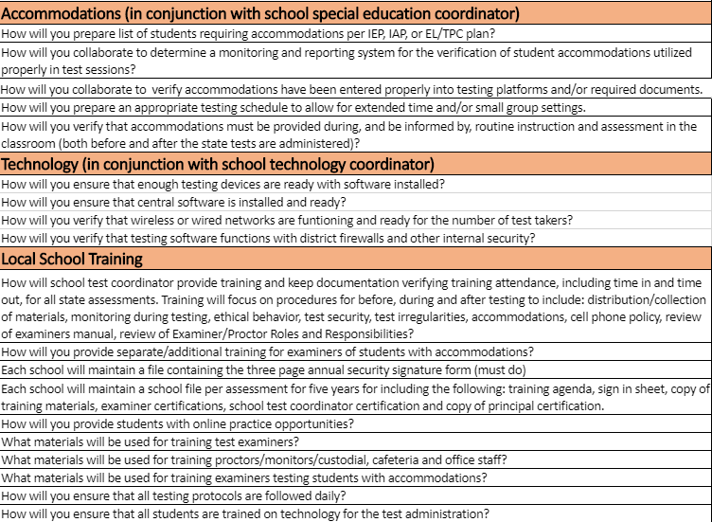
Assessment Plan
School Assessment Plan Template
Notes:
Click on the link to view a sample assessment plan template. This plan is divided into categories including communications, test security, accommodations, technology and training. Each category includes questions to drive planning for test administration.

Slide 66
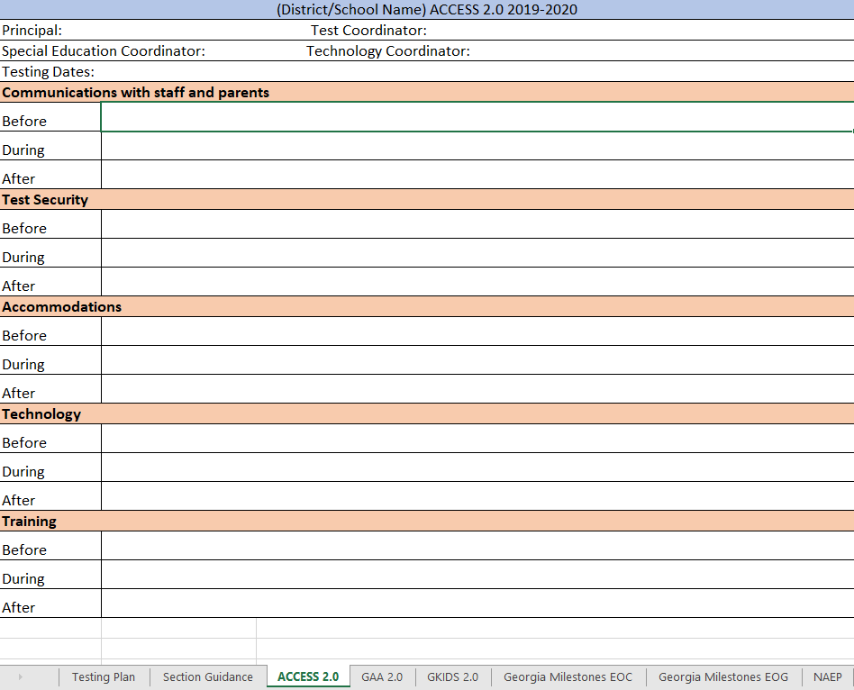
Assessment Plan
School Assessment Plan Template
Notes:
The workbook includes tabs for each of the state assessments. Schools can use the questions found in the Section Guidance to complete their plan for what will happen before, during and after testing.

Slide 67
Assessment Administration Contact Information
http://testing.gadoe.org
Toll-Free (800) 634-4106 and (404) 656-2668
Sandy Greene, Ed.D., Director of Assessment Administration 404-656-0478; sgreene@doe.k12.ga.us
Taiesha Adams, Ed.D., Assessment Specialist, Georgia Milestones 404-656-5975; taadams@doe.k12.ga.us
Bobbie Bable, Assessment Specialist, National Assessment of Educational Progress (NAEP), Georgia Kindergarten Inventory of Developing Skills (GKIDS 2.0), Assessment Literacy Resources 404-657-6168; bbable@doe.k12.ga.us
Joe Blessing, Program Manager, Georgia Milestones, TestPad 404-232-1208; jblessing@doe.k12.ga.us
Kelli Harris-Wright, Assessment Specialist, Formative Instructional Practices (FIP) 404-463-5047; kharris-wright@doe.k12.ga.us
Robert McLeod, Ed.D., Assessment Specialist, Georgia Milestones 404-656-2589; rmcleod@doe.k12.ga.us
Mary Nesbit-McBride, Ph.D., Assessment Specialist, ACCESS for ELLs 2.0, Georgia Alternate Assessment 2.0 (GAA 2.0) 404-232-1207; mnesbit@doe.k12.ga.us
Missy Shealy, Project Manager, Georgia Milestones 404-657-7651; mshealy@doe.k12.ga.us

Slide 68
Questions

