Slide 1
Georgia Student Assessment Program 2020-2021 Fall Conference ̵ Part 2
August 18, 2020
Notes:
Good morning, everyone. Today’s session continues our training for System Test Coordinators regarding Georgia’s student assessment program.

Slide 2
Agenda
Assessment Updates
District Assessment Planning
District Testing Calendar
Technology Readiness
Training Expectations
Creating a School Assessment Plan
Accessibility and Accommodations
Overview
Alternate Assessments
Allowable Accommodations
Monitoring and Auditing Assessments
GaDOE
District
School
Focused Resources:
Student Assessment Handbook
Accessibility & Accommodations Manual
Assessment Administration Protocol Manual

Slide 3
GaDOE Assessment Trainings
Required Sessions for System Test Coordinators
System Test Coordinators are expected to participate in all required sessions for each program.
A separate table of optional training opportunities are included in the posted training Memorandum.

Slide 4
GaDOE Assessment Training
Fall Conference Part 1, August 2020
Overview of Formative and Summative Programs
Assessment Administration Resources
Test Security and the Student Assessment Handbook
Updates to Accessibility & Accommodations Tables
Recording link for Fall Conference #1
Recording links are sent to registered Attendees.

Slide 5
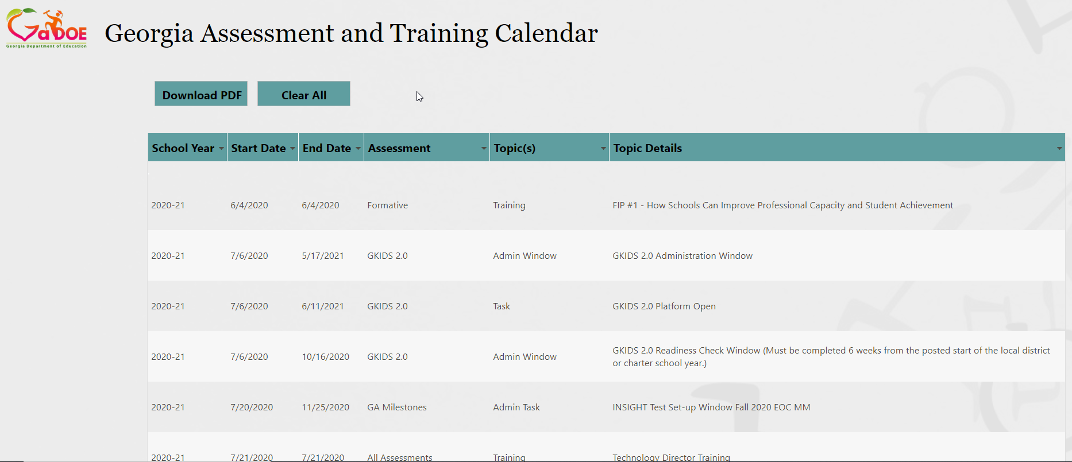
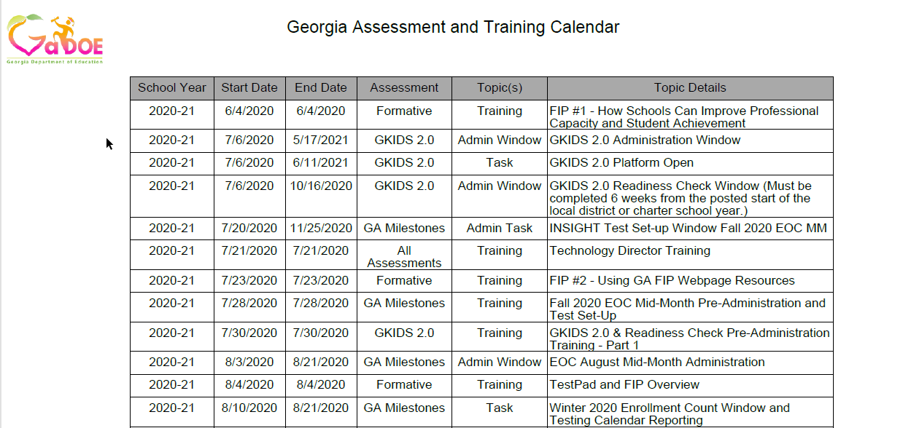
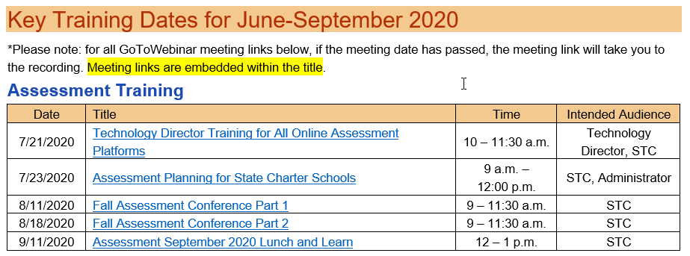
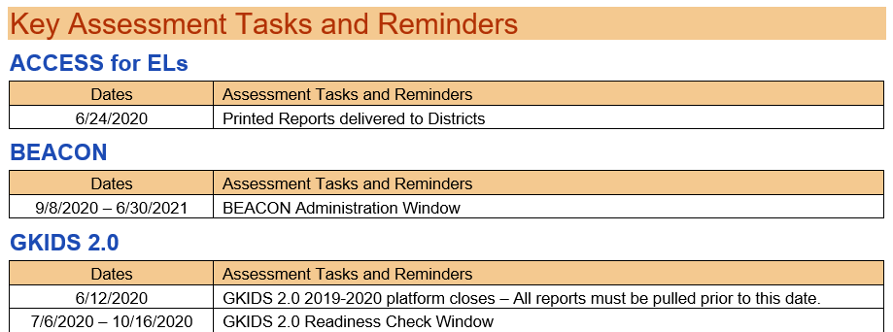
Assessment Administration Resources
Training Calendar
Assessment Update
For Educators
Notes:
The assessment updates include relevant content for all testing programs including upcoming training, tasks and announcements.

Slide 6
District Assessment Plan: Developing the District Testing Calendar
Notes:
Many of you have developed your district testing calendar by this time, but the information provided in this section may help you gain a high-level look at state mandated assessments and fitting teams together to accomplish the work.

Slide 7
Fitting Partnerships Together
System Test Coordinator (STC)
GKIDS 2.0 –
SIS Coordinators
Georgia Milestones – Technology Directors
NAEP –
Principals and School Test Coordinators
ACCESS for ELLs 2.0 –
ESOL/Title III Coordinators
GAA 2.0 –
Special Education Directors
District Holidays –
School Board
DRC BEACON District Benchmarks – Curriculum Directors
Other Tests – ACT, AP, SAT, PSAT – Curriculum Directors
Keenville –
SIS Coordinator; SLDS access
Notes:
System Test Coordinators will need to take time to think through these assessments and bring the right people to the table for discussions. Give the variables that must be addressed with virtual and face-to-face learning, as well as technology components, special populations, calendaring, and accurate student information all must work together in order to facilitate this work. System Test Coordinators should consider forming district and school assessment teams to review need and communicate protocols.

Slide 8
Visualizing the State Testing Windows – Yearlong
September 2020 EOC MM
January 2021 EOC MM
9/8/2020
1/11/2021
October 2020 EOC MM
February 2021 EOC MM
10/12/2020
2/8/2021
August 2020 EOC MM
November 2020 EOC MM
March 2021 EOC MM
8/3/2020
11/9/2020
3/8/2021
Jul
Sep
Nov
2021
Mar
May
Jul
2021
Today
GKIDS 2.0
7/6/2020 - 5/17/2021
Milestones Secure Practice Test Window
10/5/2020 - 5/7/2021
Winter 2020 EOC
11/30/2020 - 1/6/2021
ACCESS for ELs 2.0
1/13/2021 - 3/5/2021
NAEP (selected schools)
1/25/2021 - 3/5/2021
Spring 2021 GAA 2.0
3/22/2021 - 4/30/2021
Spring 2021 EOG
4/12/2021 - 5/21/2021
Spring 2021 EOC
4/19/2021 - 5/28/2021
Summer Retest 2021 EOG
5/10/2021 - 7/16/2021
Summer 2021 EOC
6/14/2021 - 7/16/2021

Slide 9
Scheduling of Assessments
All local district testing windows must be within posted state testing windows and must be consistent with guidance found in the Student Assessment Handbook.
Requests for exceptions outside of allowed flexibility must have prior approval by the GaDOE.
The order of administration is determined by the guidance provided in Test Administration Manual for each assessment.
In scheduling each assessment, districts/schools must adhere to the testing times prescribed in the Test Administration Manuals.
Determine the plan for communication of local testing windows to parents/guardians and other stakeholders, including school-level leaders and educators.
Notes:
Local testing calendars for state assessments must be compliant with the calendars posted in the Georgia Assessment and Training calendar as well as guidance found in the Student Assessment Handbook and Test Administration Manuals. This school year in particular may be particularly challenging as you anticipate the administration windows. Currently, there is an open window for all districts to enter Winter EOC enrollment count data in anticipation of the winter EOCs. We know this may be a challenging task since you are trying to work out learning with virtual and face-to-face schedules. Please complete this task in anticipation of the EOCs that will be required if you plan to administer EOCs during the Winter EOC window (11/30/2020 – 1/6/2021).

Slide 10
Planning for Georgia Milestones
Georgia Milestones Assessments
Local school systems must set the Georgia Milestones End of Grade local assessment window within 25 school days of the school system’s last school day of the regular school year. The revised state End of Grade Assessment Window is April 12 – May 21, 2021.
Local systems may set the order of content assessments based on what works best for the district.
The start date for an EOG grade and/or EOC course content area must be the same district-wide.

Slide 11
District Assessment Plan: Technology Readiness
Notes:
Joe Blessing
Georgia has moved online for state mandated assessments. Technology readiness is key to a successful implementation of assessments.

Slide 12
Georgia Online Assessment Overview
Assessment | Vendor | Management System | Local Content Caching | Response Source
ACCESS for ELLs 2.0 | WIDA/DRC | WIDA AMS | Central Office Services* | Student login to INSIGHT*
Georgia Milestones | DRC | eDIRECT | Central Office Services* | Student login to INSIGHT*
Georgia Alternate Assessment 2.0 | Questar | Nextera | None | Teacher through website
GKIDS 2.0 | Georgia Center for Assessment | GKIDS 2.0 Data Entry and Reporting Website | None | Teacher through website
NAEP | NCES | None | None | Student login
Keenville | Georgia Center for Assessment | SLDS | None | Student login
*Software installation required
Notes:
This table shows an overview of the main state assessments, the vendors, management systems, caching requirements and response source. You can see how student login to the test can increase the technology work that needs to be done.

Slide 13
Building a Tech Team for Assessment
Members
System Test Coordinator (STC)
Special Education Director/ESOL Coordinator
School Test Coordinators
System Technology Coordinator
School-level Technical Staff
Meet Regularly
Share training opportunities
Share technology requirements
Share testing windows and numbers of test takers
Notes:
In order to have a successful district testing administration, you should build a technology team for testing including the System Test Coordinator, Technology Coordinator, Special Education and/or ESOL coordinator and school technology staff. The team should meet regularly, share training opportunities, share technology schedules and technology requirements for each assessment.

Slide 14
Data File Submission
Program | Process
ACCESS | Pre-ID (.csv) in WIDA AMS
DRC BEACON | Multiple Student Upload, Batch User, and Student Groups (.csv) in DRC INSIGHT
GAA | GAA flagged in the FTE data file submitted to GaDOE Data Collections
Georgia Milestones | Pre-ID (.txt) to GaDOE Data Collections* OR Multiple Student Upload (.csv) in DRC INSIGHT Batch User (.csv) in DRC INSIGHT
GKIDS | Roster Upload in GKIDS 2.0 platform
Keenville, TestPad | SLDS
NAEP | Roster Upload by NAEP State Coordinator
* 2020-21 is the final year that districts will have the option to submit Georgia Milestones Pre-ID files. Therefore, it is recommended that districts begin the transition to the Multiple Student Upload (MSU) process through DRC INSIGHT instead.
Notes:
Student, teacher, user and class information is entered through data files for each program.

Slide 15
Technology Readiness Checklist
Site Readiness Checklist
2-3 Months
Meet with technology team to create awareness and define roles
1-2 Months
Perform System Readiness Check on each device
2-4 Weeks
Confirm all installations have been completed including COS and INSIGHT browser
1-2 Weeks
Day of Testing
Conduct a final technology walk through
Implement Testing Plan
Stagger logins to the testing system
Notes:
Here is a summary of items that should be completed at different stages during the year. The site readiness checklist linked here goes into more detail for each step.

Slide 16
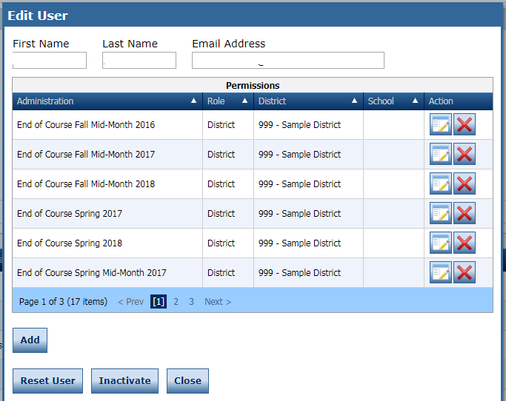
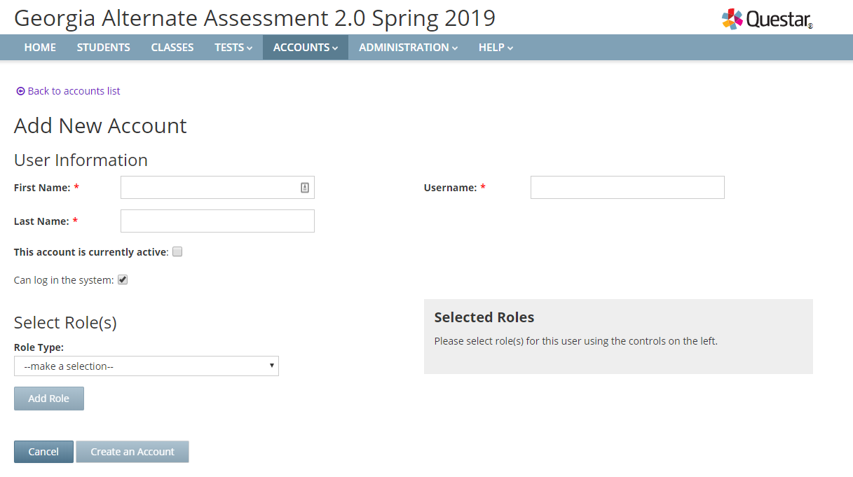
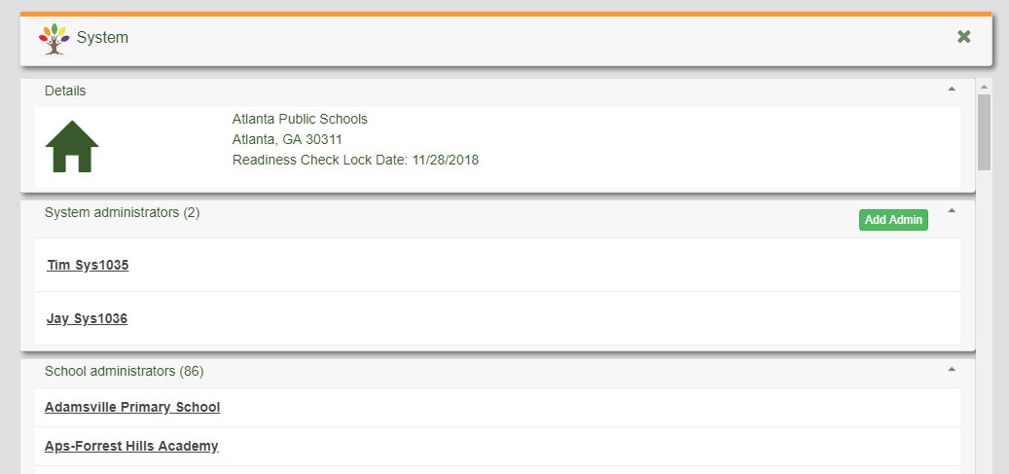
User Accounts
District STCs are responsible for ensuring administrator accounts are current.
Legacy user accounts could have access to student information.
STCs manage district level accounts. School Test Coordinators manage teacher accounts on some programs.
Milestones/ACCESS
GAA 2.0
MyGaDOE Portal
GKIDS 2.0/GKIDS Readiness Check
Notes:
It is critical to not only add new users to the different vendor portals, but legacy accounts need to be removed. When staff leave the system, they must be inactivated as users or they will still have access to student information.

Slide 17
Student Readiness/Sampling the Tests
ACCESS for ELLs 2.0 sample items
DRC BEACON Online Tools Training
Georgia Alternate Assessment 2.0 Sample Tasks
Georgia Milestones Technology Enhanced Items
Keenville – MyGaDOE Portal in the SLDS
Videos on Keenville webpage
TestPad
Let’s Go
Notes:
Teachers, parents and students can access sample items for several state assessments using the following websites.

Slide 18
Readiness – Are Students AND Teachers Ready?
Orient students and teachers to testing via an online platform:
Experience Online Testing Georgia: http://www.gaexperienceonline.com
Secure Practice Tests in INSIGHT
Ensure all examiners are trained on test administration:
District training
Test Examiner Training
Notes:
STCs should include a review of the Experience Online Testing Georgia and other practice sites with School Test Coordinators, Test Examiners, and Students.
Teachers should be given the links and resources for using the Experience Online Testing Georgia in their classrooms with students. Videos have been developed surrounding many of the Technology Enhanced items that could be used in as part of an instructional session with students helping to familiarize students with the items. All students should have the opportunity to review and work through sessions in Experience Online Testing Georgia and/or the Secure Practice Tests in the eDirect platforms to support readiness, as well as the practice exercises for ACCESS for ELLs prior to administering assessments.

Slide 19
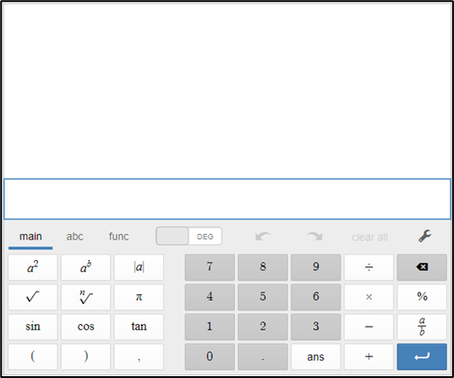
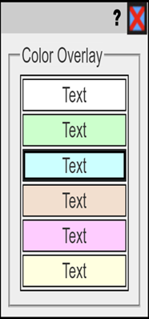
Understanding Universal Tools
Notes:
The practice experiences will allow students to experience the universal tools and supports available for all students participating in the assessment programs. Here are a few examples of the universal tools that are available for our online assessments including ACCESS for ELLs and Georgia Milestones. Provided that students have become familiar with the universal tools; these should reinforce students’ abilities to demonstrate their knowledge and skills. Educators must ensure that students have opportunities to practice using the tools and help students determine when a tool may be appropriate and useful.

Slide 20
District Assessment Plan: Training Expectations
Notes:
Now let’s turn our attention to developing a training plan as a part of the overall District Assessment Plan. Effective and thorough training prior to a test administration window is essential to assuring test security is maintained and the actual test is administered with integrity.

Slide 21
Local Training Plan
System Test Coordinator
Review Technology Readiness and Test Set-up
Review Assessment Administration Protocols and Procedures
School Test Coordinator
Review Test Administration Manual, Test Examiner Script, and Student Assessment Handbook
Discuss Assessment Administration Protocols and Procedures
Examiner, Proctor,
and Student
Review Test Administration Manual, Test Examiner Script, Test Tickets, and Student Accommodations
Discuss Assessment Administration Protocols and Procedures
Discuss Test Security, Ethical Behavior, and Assessment Monitoring
Discuss Test Security, Ethical Behavior, and Assessment Monitoring
Discuss Test Security, Ethical Behavior, and Active Student Monitoring
Provide Opportunities for Practice – Online Accessibility & Accommodations Tools, Item Types, etc.
Optional Form: Test Security Information for School Test Coordinators/Examiners/Proctors
Notes:
The local district training plan should include everything needed for system test coordinators, School Test Coordinators, and school level examiners, proctors and students.

Slide 22
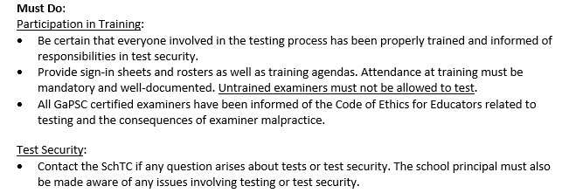
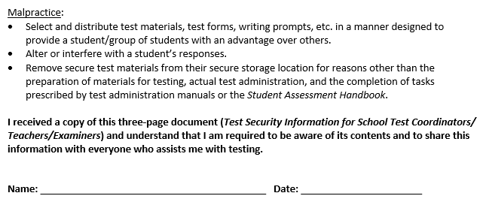
Documentation
Notes:
Districts should keep documentation for Test Security Information for School Test Coordinators for School Test Coordinators, Examiners, and Proctors. These screenshots are from the optional form found in the Student Assessment Handbook – Test Security Information for School Test Coordinators/Examiners/Proctors and may be used to document understanding of test security issues and ethical behavior surrounding assessments as part of your local training of personnel. (Click) (Click) Sign in sheets should be maintained locally as well as any handouts and presentations in the event they are requested by the GaDOE assessment team.

Slide 23
Training Across Assessments
Required Resources
Training
Test Administration policies, protocols, and procedures
Student Assessment Handbook
Assessment Administration Protocol Manual
System Test Coordinator and Test Examiner Manuals
GaDOE Webinar and Local Training Sessions
Student Accessibility & Accommodations
Student Assessment Handbook
Accessibility & Accommodations Manual
Review of IEP/IAP and EL/TPC plans
GaDOE Webinar and Local Training Sessions
Notes:
There are several required resources that cover all assessments including (see screen)

Slide 24
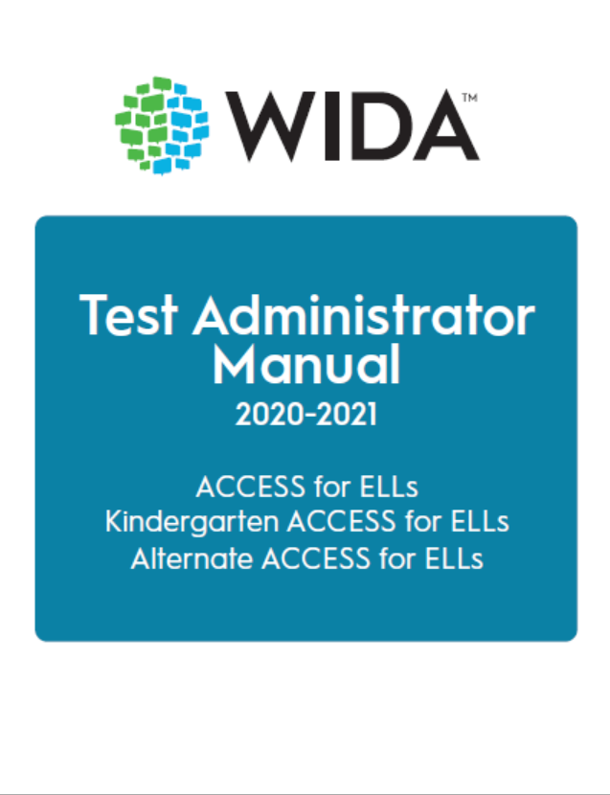
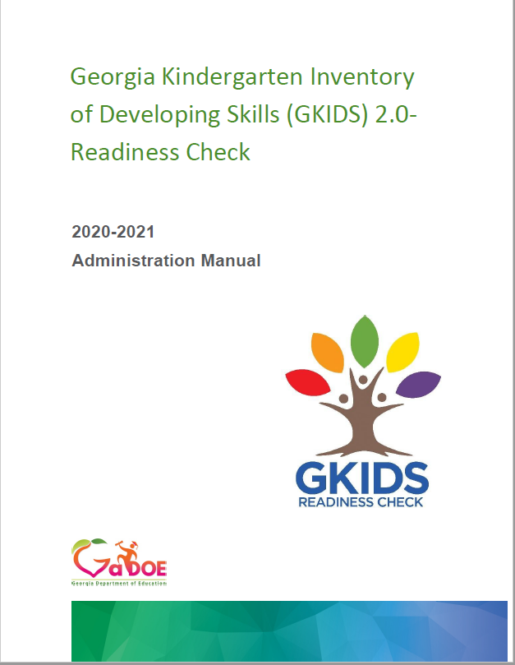
Test Examiner Manual
Train examiners about administration procedures using the Test Administration Manual
Notes:
Test Administration and Examiner’s Manuals should be review by coordinators and examiners prior to testing and should be directly referenced during training sessions.

Slide 25
Test Examiner Manual
Train examiners about administration procedures using the Test Administration Manual
Train using online tools
Interactive Board technology, laptops, tablets
Print Examiner Script Only
Print by Content Area Examiner Script Only
Use of personal cell phone not allowed
Notes:
We recognize the difficulty districts may have in not receiving TAMs this year due to the required budget cuts set forth by the governor. Districts will need to think through and consider options for training Examiners. This slide illustrates some ideas and options that may be considered. System and/or School Test Coordinators may choose to present Test Administration Manuals digitally during training for review by coordinators and examiners prior to testing. One option for trainers would be to ask examiners to bring a laptop or iPad with the TAM downloaded for review and discussion during the training meeting.
Schools and districts can print the test examiner script by content area. Test examiners can use devices such as laptops, tables, and interactive boards to read scripts. Personal cell phones are not allowed.

Slide 26
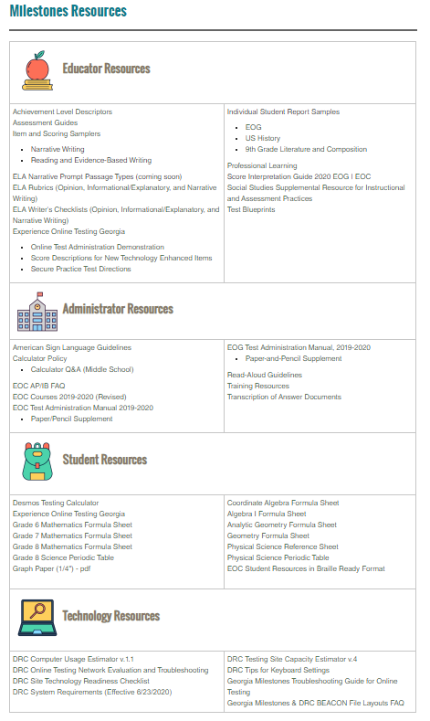
Assessment Resources
Educator Resources
Administrator Resources
Student Resources
Technology Resources
ACCESS for ELLs/ Alternate ACCESS for ELLs
Georgia Alternate Assessment 2.0
Georgia Milestones Resources
GKIDS 2.0 Resources
NAEP Resources
Notes:
Additional assessment resources are found on each of the program websites. The example shown on the right is specific to Georgia Milestones; however, a table with links to other assessments brings STCs to resources specific to that assessment which may aide you in supporting your educators and test examiners as well as help in planning for any assessment administration. Besides the Student Assessment Handbook, Accessibility & Accommodations Manuals, and the Test Administration manual specific to a given assessment, School Test Coordinators should be familiar with these other resources so they may assist educators as well as plan for training for an upcoming administration.

Slide 27
Direct Report Access for Georgia Assessments
Location | SLDS Portal |  | MyGaDOE Portal | Admin Platform |  | Print
Recipient | Parent | Teacher | STCs | Teacher | STCs | STCs
GKIDS RC |  |  | System/State Summaries, System Data | ISRs, Class Summaries | School/System Summaries, System Data
GKIDS 2.0 |  |  | System/State Summaries, System Data | ISRs, Class Summaries | ISRs, Class/School/System Summaries, System Data
Keenville |  |  |  | ISRs, Class Summaries | ISRs, Class/School/System Summary
GAA 2.0 | ISRs | ISRs | School/System/ State Summaries, System Data |  | ISRs, Class/School/System Summaries, System Data | ISRs, Labels
Georgia Milestones | ISRs | ISRs | School/System/ State Summaries, System Data |  | ISRs, Class Rosters, Remediation/Retest Roster | ISRs, Labels
ACCESS |  |  |  |  | ISRs, Rosters, Frequency Reports, System Data | ISRs, Rosters, Frequency Reports
2020-2021 additions are in red; removals are crossed out.
Notes:
This table shows how districts receive reports for each program. Changes are in red with new ISRS in the SLDS portal for Keenville and GAA 2.0 and printed ISRs and Labels removed for Georgia Milestones and GAA. Georgia Milestones will introduce new interactive reports also in 2020-2021.

Slide 28
Communicating Test Results
Summary Reports are embargoed until they are released by the GaDOE
Summary Reports including district and state data are embargoed until released by the State Superintendent.
Embargoed data may not be shared at public board meetings or with the media until notification has been received from the State Superintendent.
Preliminary reports are not embargoed and may be shared with parents, students, teachers and staff related to the student as soon as they are received for the purpose of assigning grades (EOC only), promotion/retention decisions, and other individual student-focused needs.
Notes:
District may not share embargoed data with the public. However, preliminary reports may be shared with parents, students and staff related to the student.

Slide 29
Assessment Plan
School Assessment Plan
Assessment Plan
Completed Plan Template
Copies of Communications
Training Materials and sign-ins
Testing Schedule
Notes:
The Assessment Plan should include an assessment plan template that we will discuss next, copies of all communications regarding the testing plan, training materials and sign-ins and the testing schedule.

Slide 30
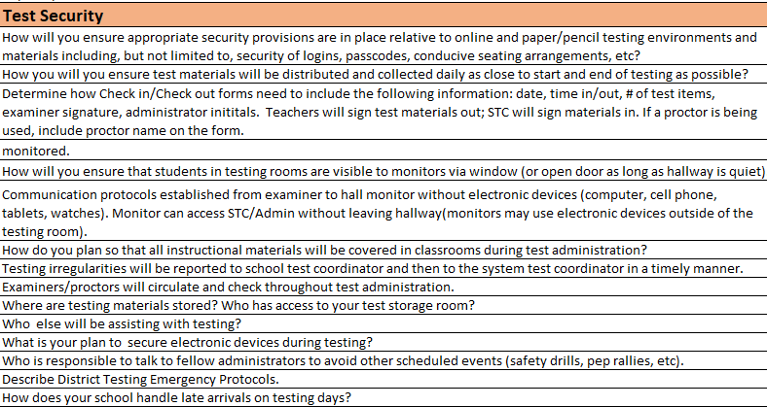
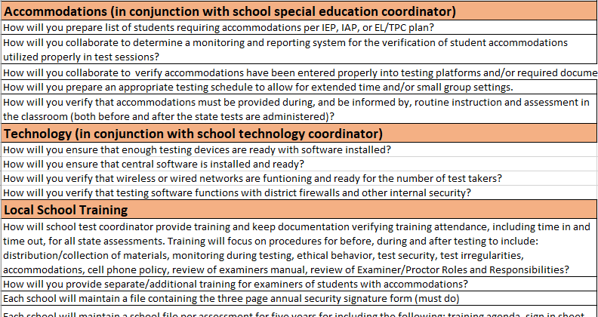
Assessment Plan
School Assessment Plan Template
Notes:
Click on the link to view a sample assessment plan template. This plan is divided into categories including communications, test security, accommodations, technology and training. Each category includes questions to drive planning for test administration.

Slide 31
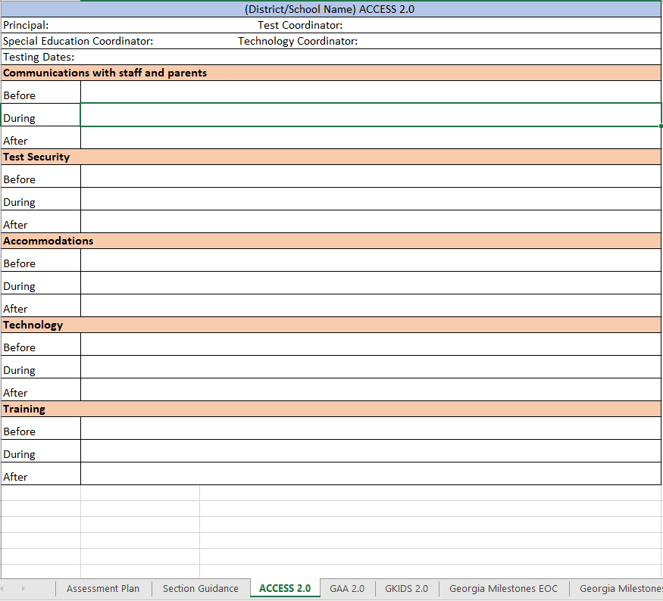
Assessment Plan
School Assessment Plan Template
Notes:
The workbook includes tabs for each of the state assessments. Schools can use the questions found in the Section Guidance to complete their plan for what will happen before, during and after testing.

Slide 32
Accessibility & Accommodations

Slide 33
General Principles
Under the federal Individuals with Disabilities Education Act (IDEA), the Every Student Succeeds Act (ESSA) and the Georgia State Board of Education (SBOE) Rule 160-3-1- .07, all students, including students with disabilities (SWD) and English learners (ELs), must participate in the state’s academic content standards and assessments.
Notes:
According to Federal and state law and federal guidance all students must participate in the state’s academic content standards and assessments. To this end, the state designs assessments with features that address the access needs of the broadest range of students. To ensure students participate to the fullest extent possible in all statewide assessments, educators must also participate in a planning process that addresses the educational needs of all students, including English Learners and students with disabilities.

Slide 34
Accessibility & Accommodations
Resources
Resource | Purpose | Location
Student Assessment Handbook | Policy Guidance | For Educators
Accessibility & Accommodations Manual | Types of Support Guidance in Choosing Supports | For Educators
Assessment Administration Protocol Manual | Monitoring Procedures before, during, and after assessments | For Educators
Test Administration Manuals | Specific test administration protocols by assessment | Program Sites
Notes:
We provide a variety of resources to educators involved with making decisions for students with disabilities. A summary of those resources are listed here including, their purpose and location on our websites.

Slide 35
The Five Step Process
Expect students to access grade-level content standards
Learn about accessibility supports for instruction and assessments
Select accessibility supports for instruction and assessment for individual students
Administer accessibility supports during instruction and assessment
Evaluate and improve use of accessibility supports in instruction and assessment
Notes:
Ensuring all students have appropriate supports in the classroom and on assessments is a five-step process. Educators must be knowledgeable of content standards and (click) expect all students to access grade-level standards. Next, teachers must (click) learn about appropriate accessibility supports. Educators should ensure that students work toward grade-level standards by using a range of instructional strategies based on the varied strengths and needs of students. The student must be provided the (click) selected accessibility supports (i.e., universal tools and accommodations) during instructional periods and test administration. Prior to the day of a test, the School Test Coordinator should ensure certain test examiners and proctors know what accessibility supports, especially accommodations, each student will be using and (click) how to administer them properly. Accessibility supports must be selected based on the individual student’s needs and must be used consistently for instruction and assessment. State regulations require accurate coding of accommodations use on student answer sheets and within the online testing platform (click). Evaluation is the final step. Data on the use and impact of accessibility supports during assessments may reveal questionable patterns of the use of accessibility supports, as well as inform the continued use of some supports or the rethinking of others. Examination of the data may also indicate areas in which teachers and test examiners need additional training and support.

Slide 36
Step 1: Expect Students to Access Grade Level Academic Content Standards
To accomplish this step:
Educators must be familiar with standards and accountability systems at the state and district level and
Educators must know where to locate standards
Educational stakeholders must collaborate for successful student access.
Educators familiar with the needs of students should make accessibility decisions.
Notes:
Teachers have the awesome responsibility of developing, implementing, and improving accessibility practices for students. This responsibility is so important because accessibility supports promote equal access to grade-level content. To ensure students have equal access to grade level academic content standards:
Educators must be familiar with standards and accountability systems at the state and district level and
Educators must know where to locate standards
Educational stakeholders must collaborate for successful student access.

Slide 37
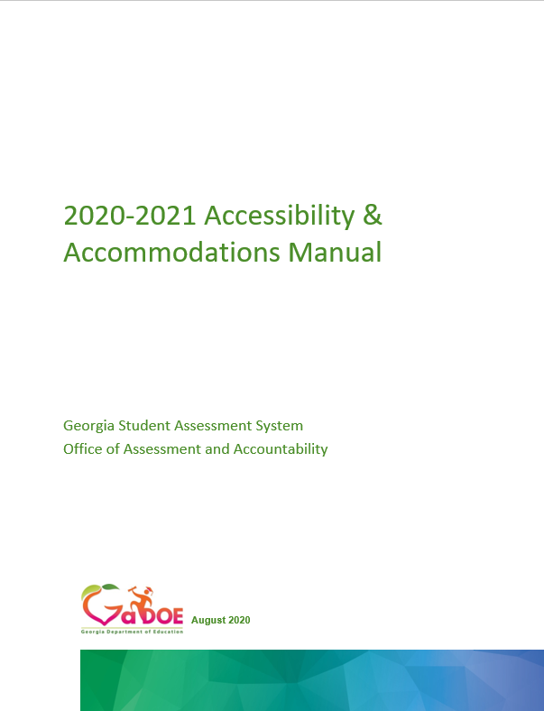
Step 2: Learn About Accessibility Supports for Instruction & Assessments
Universal Design
Administration Procedures
Universal Tools
Accommodations
Notes:
The figure on this slide illustrates the accessibility framework underpinning the Georgia Accessibility & Accommodations Manual. Accessibility supports – administrative procedures, universal tools and accommodations – empower students with a multitude of choices, enabling them to access instructional and assessment content effectively. These individualized approaches to accessibility also place greater responsibility on educator teams and individuals who make decisions about which specific supports students need and should receive among a variety of accessibility choices. (Click).
The application of universally design ensures the needs of the broadest range of learners are considered during test development. Current technology enables educators to introduce computer-based instruction and assessment accessibility supports that facilitate individualized educational processes. The purpose of these supports is to reduce or eliminate the effects of barriers that prevent students from demonstrating what they know and can do. Accessibility supports provided in the classroom do not reduce expectations for learning. Some examples of UD include: clear directions, practice opportunities, and user-friendly items and activities. (Click)
The next accessibility category is Administrative Procedures. Detailed administration guidelines for Georgia’s assessments are included in assessment-specific test administration manuals. Administrative procedures give the principal or school test coordinator the flexibility to make specific decisions regarding test schedules, assignment of examiners, or computer labs. (Click)
Universal tools are available to students participating in the Georgia assessment program to address their individual accessibility needs as they access instructional or assessment content. These supports are either embedded in the online test or provided by a test administrator at the local level during testing (i.e., scratch paper). Universal tools do not affect the construct being measured on the assessment. (Click)
Lastly, are accommodations. These are changes in the administration of an assessment in terms of how the student takes or responds to the assessment. In Georgia, accommodations may not alter, explain, simplify, paraphrase, or eliminate any test item, reading passage, writing prompt, or answer option. Further, accommodations may not provide verbal or other clues or suggestions that hint at or give away the correct response to the student.

Slide 38
Step 3: Select Accessibility Supports for Instruction & Assessment
The provision of appropriate accessibility supports begins with making appropriate instructional decisions.
Appropriate instructional decisions is facilitated by gathering and reviewing the student’s data:
Access needs
Disability
English language proficiency
Level of performance in relation to curricular standards
Notes:
To ensure students are engaged in standards-based instruction and assessments, every educator must be knowledgeable about the state and district academic standards and assessments. Effective decision making about the provision of appropriate accessibility supports begins with making appropriate instructional decisions. In turn, making appropriate instructional decisions is facilitated by gathering and reviewing good information about the student’s access needs, disability, English language proficiency, and present level of performance in relation to local and curricular standards.

Slide 39
Standard Accommodations
Those accommodations which provide access to students to demonstrate their achievement of target skills
Standard accommodations do not alter or encroach on the construct measured
As with any accommodation, it is important that the student require the accommodation and use it regularly during routine instruction and assessment
Notes:
Standard Accommodations are supports allow a student to demonstrate their achievement of target skills. The provision of Standard Accommodations do not alter or encroach on the construct measured. As with any accommodation, it is important that the student require the accommodation and use it regularly during routine instruction and assessment

Slide 40
Conditional Accommodations
These supports are more expansive accommodations that provide access for students with more severe disabilities who would not be able to access the assessment without such assistance.
Three accommodations are considered conditional for the Georgia Milestones Assessment:
Signing ELA passages (SWD only)
Oral reading of ELA passages (grades 3-12)
Use of a basic function calculator (SWD only) for students in grades 3-5 only
No student in grades 6-12 may use a calculator on the no-calculator subsection of test
Most students are expected to participate in standard administrations, with less than 3% receiving a conditional administration (State Board Rule 160-3-1.07)
Notes:
Conditional Accommodations are supports that encroach upon the construct being assessed. They are more expansive accommodations that provide access for students with more severe disabilities. Three accommodations are considered conditional for the Georgia Milestones Assessment:
Signing ELA passages (SWD only)
Oral reading of ELA passages (grades 3 – 12)
Use of a basic function calculator (SWD only) for students in grades 3-5 only.
Most students are expected to participate in standard administrations, with less than 3% receiving a conditional administration (State Board Rule 160-3-1.07).

Slide 41
Conditional Accommodations
Guidance on the appropriate use of conditional accommodations is provided in the Student Assessment Handbook and Accessibility & Accommodations Manual.
Only students meeting the guidance criteria are eligible for conditional accommodations
The educational plans for students qualifying for conditional accommodations must include specific goals that address the deficits which necessitate the accommodation
Notes:
Guidance on the appropriate use of conditional accommodations is provided in the Student Assessment Handbook and Accessibility & Accommodations Manual. It is important that IEP, 504, and EL-TPC teams under this guidance as only students meeting the guidance criteria are eligible for conditional accommodations. I’d also like to point out that the educational plans for students qualifying for conditional accommodations must include specific goals that address the deficits which necessitate the accommodation

Slide 42
Video Sign Language
Video Sign Language is available for all content area tests as a special test form.
The video development team consists of a deaf content expert, a bilingual interpreter, video production personnel and representation from the GaDOE.
The Georgia ASL guidelines are used by Georgia educators during the review of videos.
The guidelines provide specific information on how to achieve a balance between conveying the construct in a manner that reflects the linguistic rules and conventions of ASL while simultaneously maintaining the essential meaning of the item.
The guidelines are used in development of all operational and practice test videos.
All forms are updated based on feedback from educators.
Notes:
Video Sign Language is available for all content area tests as a special test form. These forms are updated based on feedback from educators.

Slide 43
Braille
Braille is available for all state-mandated assessments in all content areas for grades 3-11 as a special test form.
Tactile Graphics adhere to BANA standards.
Alternative Text is provided in Braille booklets for tables, charts, graphs, and other graphics, as appropriate.
Notes:
Braille is also available for all content area tests as a special test form. Please see the Student Assessment Handbook, Accessibility & Accommodations Manual, as well as the TAM for each assessment programs for more information on these forms.

Slide 44
Special Accommodations Requests
In rare circumstances a student with a disability may need an accommodation that is not on the approved list
Special Education Directors and System Test Coordinators should determine if a student has a unique need that is not addressed by the list of Allowable Accommodations.
If necessary, System Test Coordinators should submit a Special Accommodation Request no later than 6 weeks prior to the start of the test administration window.
System Test Coordinators are encouraged call the Assessment Division to discuss questions regarding the accessibility needs of one or more students.
Notes:
In RARE circumstances a student with a disability may need an accommodation that is not on the approved list. Special Education Directors and System Test Coordinators should determine if a student has a unique need that is not addressed by the list of Allowable Accommodations. If necessary, System Test Coordinators should submit a Special Accommodation Request no later than 6 weeks prior to the start of the test administration window. System Test Coordinators are encouraged call the Assessment Division to discuss questions regarding the accessibility needs of one or more students.

Slide 45
Special Accommodation Requests
Follow the procedures in the Student Assessment Handbook to submit a request for consideration
Such requests should be vetted locally first and should be requested only on an individual basis
We cannot approve any request which modifies test content
Notes:
Read slide content.

Slide 46
Step 4: Administer Accessibility Supports During Instruction & Assessment
School Test Coordinators are responsible for the overall conduct of assessment administration.
Coordinate and arrange accommodations and other supports before test day.
Communicate with examiners to ensure that examiners understand what accommodations students are scheduled to receive.
Ensure technology is working properly.
All staff involved in test administration must adhere to test security and administration policies and protocols.
Notes:
Once committees have identified the supports that individual students will use on assessments, they must communicate this information to School Test Coordinators as soon as possible. School Test Coordinator must map out the provision of accommodations and other student supports. They must ensure examiners understand the what accommodations students are scheduled to receive. If students are testing online, examiners must verify students' test tickets identify the appropriate accommodations and that all technology is working properly. All staff involved in testing must adhere to test security and administration policies and protocols. When test administration guidelines are not followed, it results in a Testing Irregularity.

Slide 47
Step 5: Evaluate & Improve Accessibility Supports in Instruction & Assessment
District-Level
Policies
Procedures
Professional Development
Supports
Student feedback
Student Level
Classroom Supports
Student Perception
Teacher Perceptions
Notes:
Collecting and analyzing data on the use and effectiveness of accessibility supports are necessary to ensure meaningful participation of students in state assessments. Districts should develop evaluation plans that include questions related to the effectiveness of accessibility polices, procedures, and professional development activities. Formative data collected from students and teachers might provide critical information about their perception related to the provision of key supports in the classroom and on state assessments.
A committee responsible for continuous improvement efforts can address school- and system-level questions, while the student-level questions need to be considered by educators. It is critical to stress that formative evaluation is not the responsibility of just one individual. The entire IEP, IAP/504 or EL/TPC team should contribute to the information gathering and decision-making processes.

Slide 48
Alternate Assessments
Alternate ACCESS for ELLs
&
Georgia Alternate Assessment 2.0
Notes:
Georgia’s alternate assessments have special features which are designed to meet the cognitive processing needs of eligible students, including simplified language, repetition of test items, large font, and embedded modeling and support. Test directions and administration procedures provide examiners the latitude to better create test sessions that take in to account the unique scheduling, setting, and communication requirements of participants. Before IEP teams place students on an alternate assessment, they must ensure students meet the published eligibility criteria.

Slide 49
Alternate Assessments
Participants must meet specific eligibility criteria
Participants will be eligible for the state-defined alternate diploma (SBOE 160-4-.48)
Alt ACCESS participants must be ELs & take GAA 2.0
Notes:
Prior to reviewing the eligibility criteria for GAA, the Individualized Education Program (IEP) team must understand all assessment options, including the characteristics of each assessment and the potential implications of each assessment choice. The GAA 2.0 is intended for students with the most significant cognitive disabilities. Instruction for these students is based on alternate academic achievement standards, which are aligned to the Georgia Standards of Excellence at a reduced depth, breadth, and complexity. Please note beginning with students who enroll in ninth grade for the first time on or after the 2020-2021 school year, students who participate in the GAA 2.0 will be eligible for the state-defined alternate diploma rather than the regular high school diploma (SBOE 160-4-2-.48).
To participate in the GAA 2.0, IEP teams must answer affirmatively to each requirements outlined in the eligibility criteria. The team's responses must be based on available data. This year, teams can use LCI data to assessment decisions.
For students to take Alternate ACCESS, they must be English Learners and participate in GAA 2.0.

Slide 50
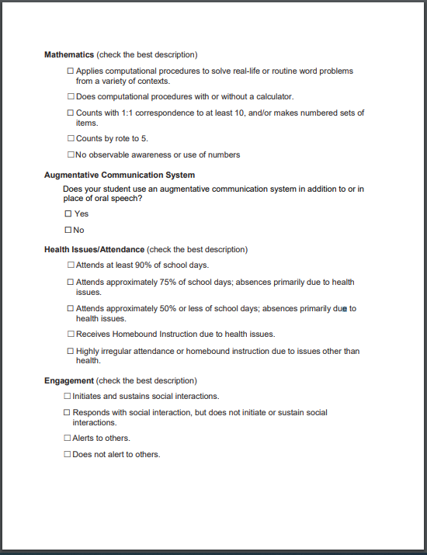
Alternate Assessments
Learners Characteristics Inventory (LCI)
Notes:
In the past, LCI data was primarily used to ensure the assessment was valid and to support the application of the “Stopping Rule.” However, educators can also use this information to support assessment placement discussions with parents and other teachers. Additionally, district administrators can use LCI summary data to better understand the academic needs of students and assessment placement decisions of educators.

Slide 51
Alternate Assessment
Understanding the Alternate Assessment Population
When making assessment placement choices, the student data available may help in answering key questions and identifying red flags.
Available Data Sources
LCI
SRC (Primary Disability)
Key Questions
Does the primary disability profile align to the eligibility requirements for the alternate assessment for students with the most severe cognitive disabilities?
Does the learner characteristic inventory information offer further information on eligibility?
What follow-up steps may be taken regarding the development of communication system?
Does assessment on the GAA 2.0 reflect the student’s instructional program on the alternate academic content standards and path to an alternate diploma?
Notes:
LEA administrators can also use LCI data with other data sources, such as, SRCs (Primary Disability codes) to better understand who took (or is scheduled to take) an alternate assessment. During data exploration, do red flags emerge? For example:
Does the primary disability profile align to the eligibility requirements for the alternate assessment for students with the most severe cognitive disabilities?
Does the learner characteristic inventory information offer further information on eligibility?
What follow-up steps may be taken regarding the development of communication system?
Does the assessment on the GAA 2.0 reflect the student’s instructional program on the alternate academic content standards and path to an alternate diploma?
In considering these questions, it may be valuable to consider primary disability and learner characteristics in conjunction, to have a more complete and individualized profile of each student’s communication and learning needs.

Slide 52
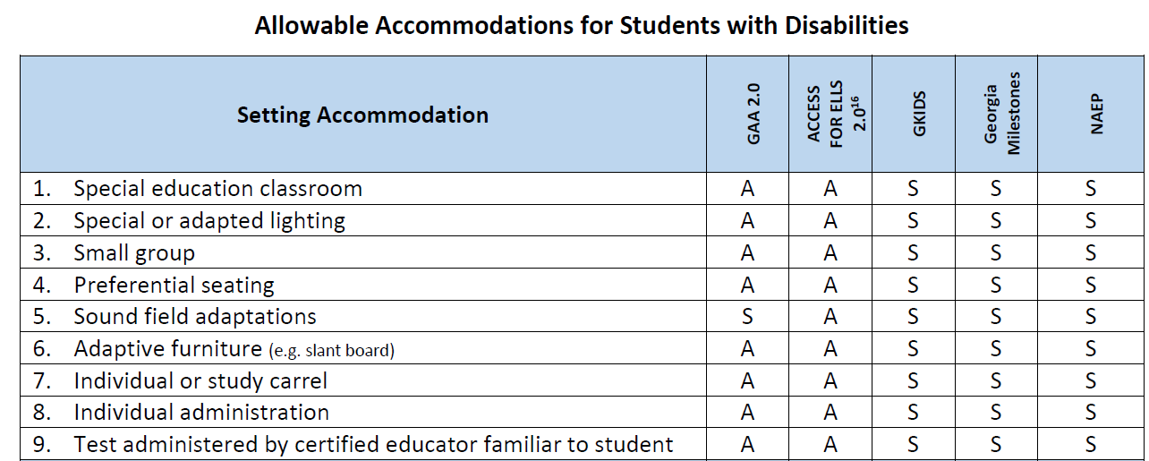
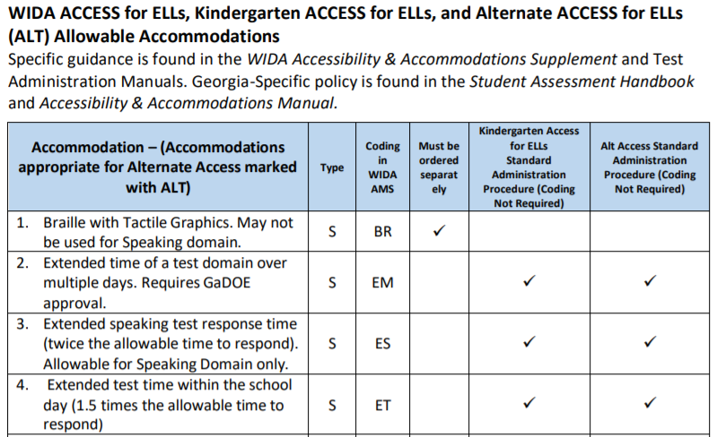
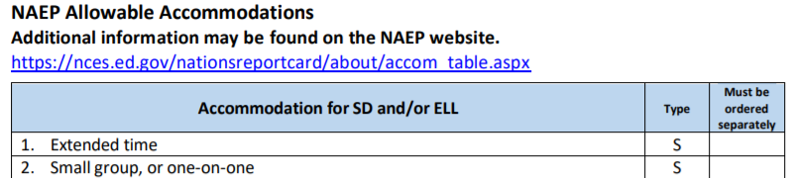
Allowable Accommodations Chart
Summary of Changes
Notes:
We have made a variety of changes to the Allowable Accommodations Chart for students with disabilities that participate in Georgia statewide assessments. In years past, accommodations for all assessment programs were recorded in a single chart. However, this is no longer the case. You will notice, starting on page 91 of the SAH, that the chart has been separated by assessment programs in this manner (click): Georgia Milestones and & GAA 2.0 (click); then WIDA ACCESS for ELLs, Kindergarten ACCESS for ELLs, and Alternate ACCESS for ELLs (ALT) (click); and lastly NAEP with it’s own chart. It is imperative that school and district personnel become familiar with the newly designed charts so that they are well aware of the changes. We’ll discuss the most noted changes in the next few slides . We are also preparing a crosswalk of the more subtle changes to assist you navigating the charts.

Slide 53
Goal of EL-TPC Guidelines
Build consistency across the state in the application of accommodations for English learners
Create a gradual release model:
As student’s level of English proficiency increases year to year, the number of testing accommodations decreases.
Accommodations should give English learners access, not advantage, in the testing experience.
Accommodations should reflect individual student need – One size does not fit all!
Notes:
ESOL/Title III staff has provided guidance for the provision of accommodations for EL students based on their level of language proficiency as measured by ACCESS for ELLs. The goal of the guidelines is to build consistency across the state in the application of accommodations for English learners and create a gradual release model. As a student’s level of English proficiency increases year to year, the number of testing accommodations decreases.

Slide 54
What is the English Learner Testing Participation Committee (EL-TPC)?
IS
IS NOT
A team decision
Testing accommodations for the Georgia Milestones and other classroom assessments.
Testing accommodations for English learners without disabilities
An individual decision
Testing accommodations for the ACCESS for ELLs
Testing accommodations for English learners with disabilities
2020-2021 Student Assessment Handbook
Notes:
The EL-TPC is a team of individuals that make decisions about the accommodations students should receive on Georgia Milestones and classroom assessments. The plan only includes supports based on the student’s level of language proficiency. Additional information about this plan can be found in the Student Assessment Handbook.

Slide 55
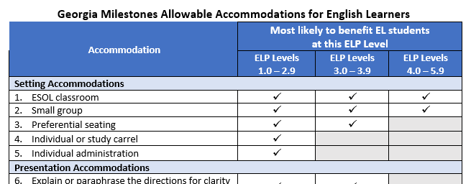
English Learners
Status | Served in ESOL | Code | Eligible for Accommodations under TPC Plan
Does not qualify for ESOL Services | No | None | No
Qualifies for EL Services | No | EL-Y | Yes
 | Yes | EL-Y
Exited from services years 1 and 2 | No | EL-1 or EL-2 | Yes
Exited from services years 3 and 4 | No | EL-3 or EL-4 | No
Exited from services year 5 + | No | None | No
Notes:
ELs who are in the two-year monitoring phase following their exit from language assistance services continue to be eligible for standard accommodations. Conditional accommodations shall be used sparingly and only under the requirements listed in the Student Assessment Handbook. Conditional accommodations shall not be assigned to EL-1 and EL-2 students. Specific to the accommodation of Extended Time, please note that specifying unlimited time is not appropriate or feasible. (click)
This slide also shows the newly revised ESOL Accommodations chart for EL/TPC teams and IEP teams to use when making accommodations decisions for EL students specific to Georgia Milestones. Decisions regarding accommodations should be made as required for individual students and based on appropriate data. Additional guidance is found in the Student Assessment Handbook and Accessibility & Accommodations Manual.

Slide 56
Assessment Administration Monitoring Expectations
GaDOE
District
School
Notes:
The Assessment Administration Protocol Manual found on the For Educators site was developed to support System Test Coordinators in ensuring that test security is understood and monitored, and the required test procedures are implemented per guidance provided by the GaDOE.

Slide 57
State Desktop Monitoring
Monitoring Reports
MyGaDOE Portal
Testing irregularities
Accommodations assigned and administered appropriately
Secure Portal email
INSIGHT
Peak concurrency
Testing on scheduled dates
Testing over weekends or evening
Completed sessions
Other
Web and Social Media Monitoring
Notes:
Over the course of the assessment windows, GaDOE assessment specialists monitor irregularities and secure portal email regarding events during testing. Specialists also monitor peak concurrency during testing and verify that districts are administering assessments during scheduled dates and not on weekends or evenings. The web and social media sites are also monitored for inappropriate sharing of test items, writing prompts, and other test content.

Slide 58
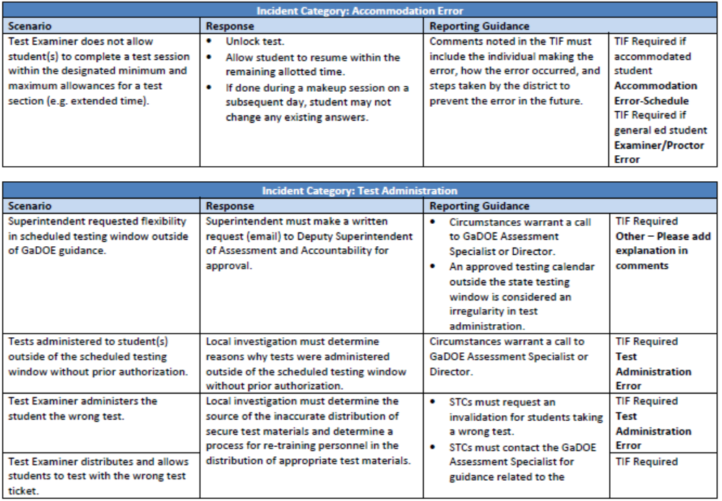
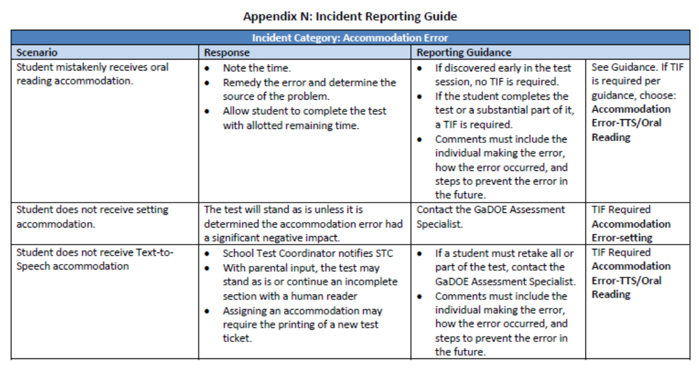
Incident Reporting Guide
Assessment Administration Protocol Manual
Notes:
Incidents may be considered a test irregularity when there has been a deviation from a standard administration which may or may not warrant an invalidation of test scores. An identified testing irregularity must be reported by the STC in the MyGaDOE portal.
The Assessment Administration Protocol Manual includes Appendix N – The Incident Reporting Guide to help clarify the actions needed as they relate to different common and uncommon scenarios. The guide only presents some of the possible scenarios that occur in the field and is intended to help simplify the process for reporting these incidents. Two example sets are presented. (Click) (Pause)

Slide 59
Categorizing Accommodations
Include details in the Comments field
Student did not receive the Scribe accommodation
TTS not setup prior to student login
Student had calculator during the no calculator section of Mathematics Section 1, Part A
Confirmed incident of student copying responses from another student
Use the category “Other” infrequently and only if a given option clearly does not apply.
Notes:
In the MyGaDOE portal, STCs must record the proper irregularity type or category by choosing the dropdown option that best describes the reported irregularity. This slide is included to provide greater detail in the making that decision. Please note that the dropdown box for Irregularities includes differences. Accommodations errors – note accommodation error – other, schedule, setting, TTS/oral reading and accommodation refused by student. A few examples for each have been noted here. (Click) This is an example of the proper choice of Accommodation error – other; (Click) (Click), (Click). The use of the choice “Other” should be infrequent and only when no other choice fits the incident. In that case, additional details must be recorded in the reason text box.

Slide 60
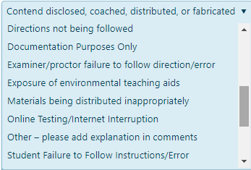
Categorizing Irregularities
Include details in the Comments field
Examiner did not read all directions exactly from the Examiners’ Script in the Test Administration Manual.
Examiner provides too little or too much time for non-accommodated students.
Examiner distributes Test Tickets to wrong students.
Use the category “Other” only if a given option clearly does not apply.
Notes:
Additional examples are provided in this slide. (Click), (Click), (Click) Again, the option of “Other” should be used unfrequently and should not be used unless no other clear option applies. You are welcome to call or email your Assessment Specialist if you have questions about an irregularity and how to properly document it in the MyGaDOE portal.

Slide 61
State Desktop Monitoring
Student Constructed Responses: Alert Papers
Suspected Plagiarism – Another Student’s Content
Suspected Plagiarism – Responding to question on another form
Disturbing Content
Sensitive Content – Personal Information
Notes:
Alert Papers are considered potential testing irregularities. Alert papers are collected through the scoring process from vendors and communicated to the GaDOE. STCs are then notified through the MyGaDOE portal.

Slide 62
State Desktop Monitoring
Student Constructed Responses: Alert Papers
As potential alerts are identified, a message is sent to the primary STC via secure messaging within the MyGaDOE Portal.
At this same time, an email to the primary STC is sent identifying that a secure message has been sent within the MyGaDOE Portal.
The STC is to reply to the email and/or secure message within the MyGaDOE Portal that the district has received the alert and proper district discovery is occurring.
If additional information is needed, please contact your primary GaDOE Assessment Specialist.
Notes:
As alerts are identified, a message is sent to the primary system test coordinator through the MyGaDOE portal and an email is sent to inform of the portal notification. The system test coordinator should reply that they have received the message and the district is responding. Because some alert papers potentially contain sensitive information that may be related to the health and well-being of a student, STCs must respond to the alert paper notice and confirm receipt through the MyGaDOE portal system.

Slide 63
State Monitoring
GaDOE Investigation
In the event of a serious breach of test security, the GaDOE may request the district take certain actions to ensure a thorough and complete investigation.
Information requested may include:
Detailed explanation and timeline of events
Written statements from all individuals involved or who may have information about the incident
Evidence of training including sign-in sheets, handouts, etc.
Other information relevant to the incident
District plan to mitigate future occurrences
Actions may require a referral to the Georgia Professional Standards Commission and/or the Governor’s Office of Student Achievement
Notes:
Read slide.

Slide 64
District Desktop Audits

Slide 65
District Desktop Monitoring
Student Management Tab > Student Status Dashboard
Are test examiners starting and ending on time?
Are test examiners testing within the district designated window?
Have students properly logged out of the test with a status of Completed?
Ensure that responses are submitted for scoring.
Ensure that students cannot return to testing.
Notes:
System test coordinators should monitor if schools are assessing students during scheduled testing dates and times. Included in that monitoring, System and School coordinators should monitor that students have properly submitted tests for scoring. Tests that aren’t submitted correctly will not go to scoring until the end of the testing window. Additionally, not properly submitting a test may raise a security issue. System and/or School Test Coordinators must ensure that all students have submitted test sessions prior to students leaving school or signing off for the day. Any student still showing as In Progress has not properly signed off and should be allowed to submit a test session with supervision prior to leaving school for the day.

Slide 66
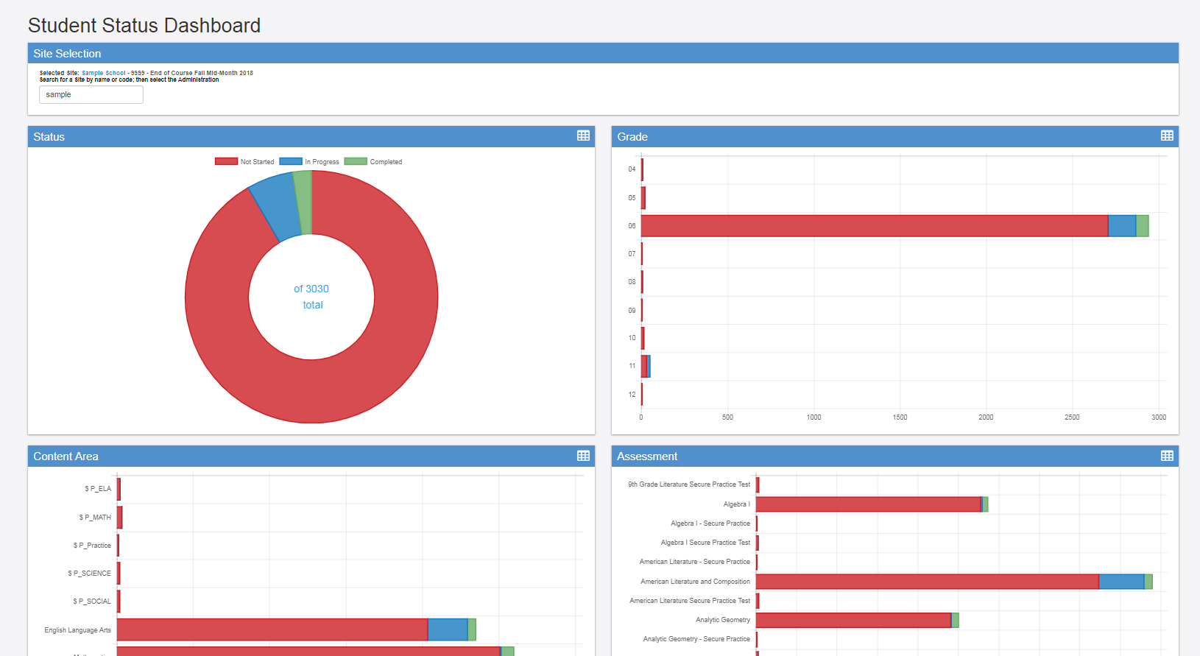
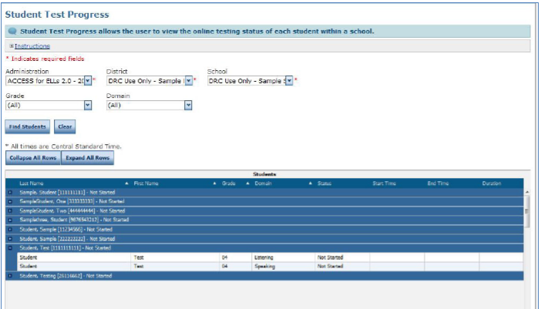
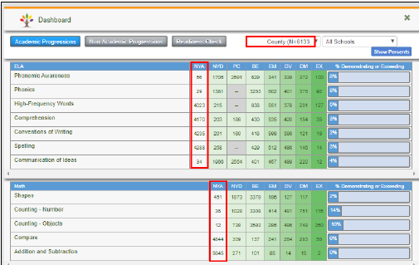
District Desktop Monitoring
Georgia Milestones
Student Status Dashboard
ACCESS
Student Test Progress
GKIDS
Academic Progressions
Notes:
These are examples from Georgia Milestones, ACCESS for ELLs and GKIDS that illustrate some of the reports that may be used to monitor student activity during assessment windows.

Slide 67
District Desktop Monitoring
Student Management Tab > Manage Students
Have all accommodations been properly coded?
Do accommodations match the student IEP/IAP or 504 plan?
Has the SRC code been coded properly?
If there is a conditional accommodation, has it been coded properly?
Manage Students also allows for assigning accommodations for multiple students.
Notes:
Another issue that requires monitoring is the verification that all students have been properly coded for accommodations. The application of accommodations should be verified prior to starting a test session by the School Test Coordinator as well as the Test Examiner. The Test Examiner must receive training in understanding the Test Ticket as well as have prior knowledge of the students that will be assessed to ensure accommodations are being received both those that are managed by online systems as well as those that are not, such as the accommodation of extended time or frequent breaks. Any discoveries of missing accommodations or those that don’t appear to be functioning in online platforms should be reported to the School Test Coordinator so that the accommodations may be checked and applied properly and a new test ticket may be generated for use by the student.

Slide 68
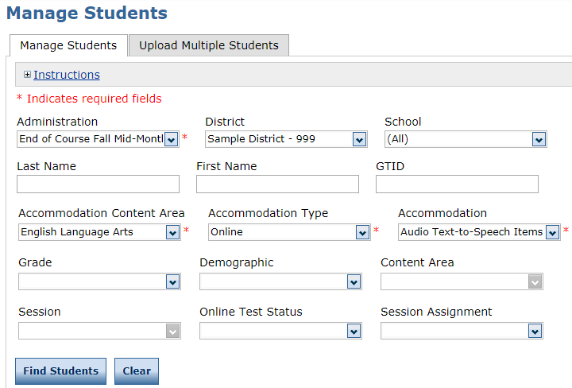
District Desktop Monitoring
Student Management Tab > Manage Students
Click Manage Students
Choose Content Area and Accommodation Type
Review the list with school special education team.
Notes:
This is one example where Test coordinators can use filters in Student Management to verify students who have been assigned accommodations. In INSIGHT, go to Manage Students, choose the administration and school. Choose the content area. Choose Online for Accommodation type and then choose the online accommodation. This will bring up a list of students that can be viewed or exported to excel. Test coordinators can compare against the list of students who are supposed to receive these accommodations.

Slide 69
School Desktop Audits

Slide 70
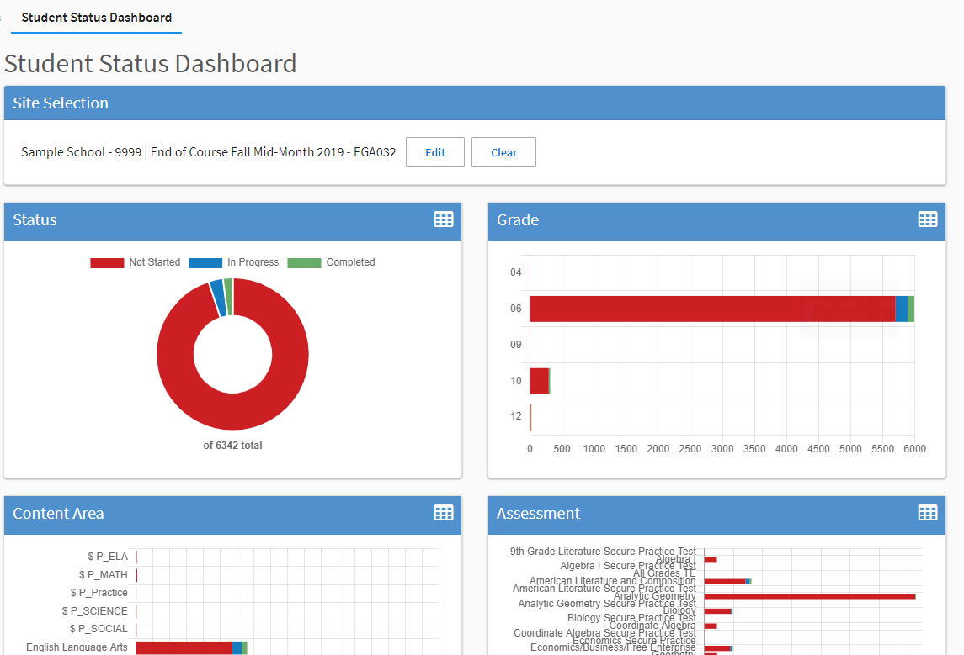
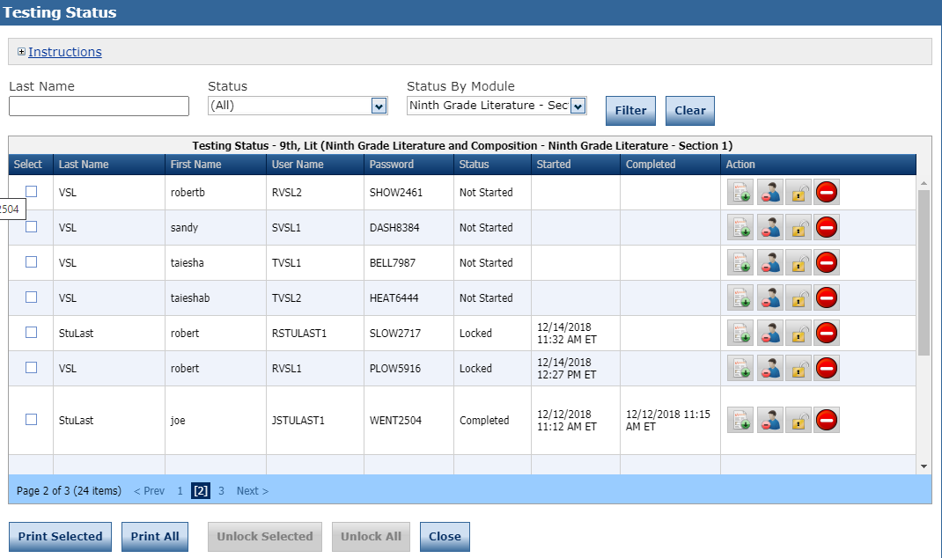
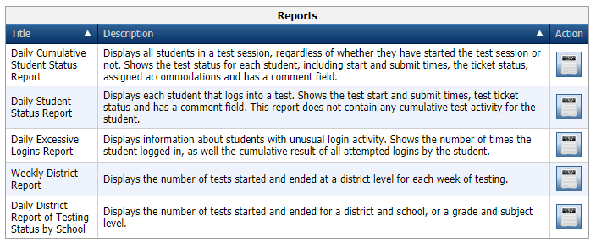
The School Test Coordinator Should
Utilize Online Resources to Monitor Student Test Progress
Look to ensure that all tests are completed. None should be In Progress
Notes:
The School Test Coordinator should be familiar with how to monitor student progress using resources found in test management applications. These reports will be discussed in Pre-Administration trainings. Any questions about these reports may be directed to your GaDOE Assessment Specialist.

Slide 71
Assessment Administration Contact Information
http://testing.gadoe.org
Toll-Free (800) 634-4106 and (404) 656-2668
Sandy Greene, Ed.D., Director of Assessment Administration 404-656-0478; sgreene@doe.k12.ga.us
Taiesha Adams, Ed.D., Assessment Specialist, Georgia Milestones 404-656-5975; taadams@doe.k12.ga.us
Bobbie Bable, Assessment Specialist, National Assessment of Educational Progress (NAEP), Georgia Kindergarten Inventory of Developing Skills (GKIDS 2.0), Assessment Literacy Resources 404-657-6168; bbable@doe.k12.ga.us
Joe Blessing, Program Manager, Georgia Milestones, TestPad 404-232-1208; jblessing@doe.k12.ga.us
Kelli Harris-Wright, Assessment Specialist, Formative Instructional Practices (FIP) 404-463-5047; kharris-wright@doe.k12.ga.us
Mary Nesbit-McBride, Ph.D., Assessment Specialist, ACCESS for ELLs 2.0, Georgia Alternate Assessment 2.0 (GAA 2.0) 404-232-1207; mnesbit@doe.k12.ga.us
Missy Shealy, Project Manager, Georgia Milestones 404-657-7651; mshealy@doe.k12.ga.us

Slide 72
Questions

