Slide 1
System Test Coordinators’ Fall 2018 Assessment Conference Part 1 General Session/Test Administration August 7 & 9, 2018 Georgia Student Assessment Program 2018 – 2019

Slide 2
Agenda
General Information
Test Security and Assessment Administration
Irregularities
Accommodations and Special Populations
Overview of 2018-2019 State Assessments
Post-Assessment Communication
Questions

Slide 3
General Information

Slide 4
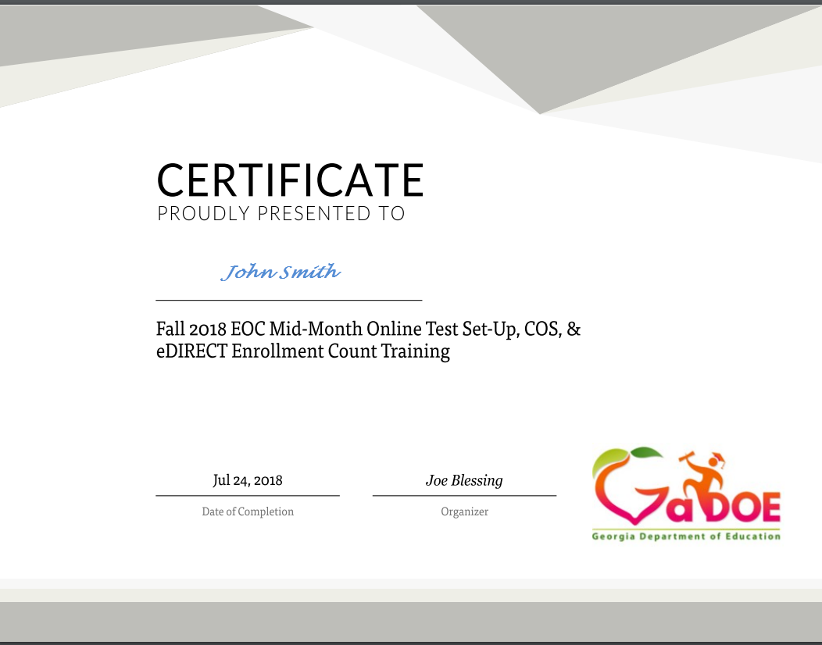
Webinar
All webinar recordings are available the day after the presentation. Click on the original registration link for any Assessment webinar to access the recording.
August 7: https://attendee.gotowebinar.com/register/9007425046048920322
August 9: https://attendee.gotowebinar.com/register/8161987465707852290
Certificates are now sent from GoToWebinar after live training sessions. Those watching recordings will not receive a certificate.

Slide 5
Link to System Test Coordinator Resources
Assessment Webinar memos posted at: www.gadoe.org/Assessment (then select For Educators...)

Slide 6
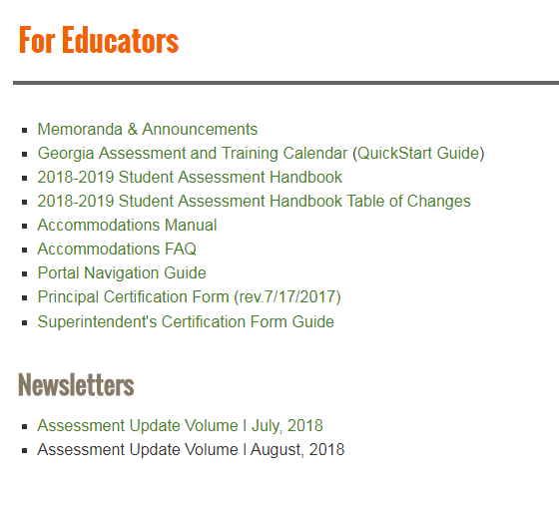
Available Resources

Slide 7
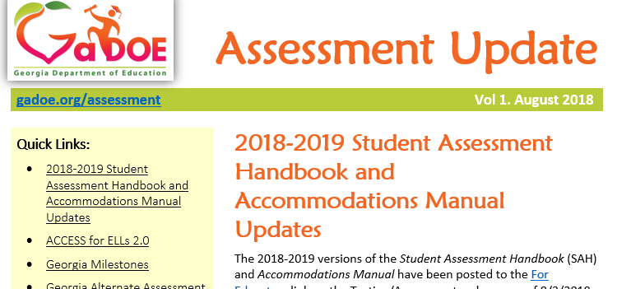
Assessment Update Newsletter
Provides monthly assessment updates
Provides training links and dates
Provides assessment tasks to remember
Provides accountability updates
July and August currently posted to the For Educators site

Slide 8
2018 Fall Assessment Conference Sessions
Date | Topic | Time
Tuesday, August 7, 2018 | Fall Assessment Conference – Part 1 | 9:00 am – 12:00 pm
Thursday, August 9, 2018 | Fall Assessment Conference – Part 1 (Live repeat of August 7) | 1:00 pm – 4:00 pm
Tuesday, September 4, 2018 | Fall Assessment Conference – Part 2 | 9:00 am – 12:00 pm
Thursday, September 6, 2018 | Fall Assessment Conference – Part 2 (Live repeat of September 4) | 1:00 pm – 4:00 pm
Tuesday, September 11, 2018 | Fall Assessment Conference – Part 3 | 9:00 am – 12:00 pm
Thursday, September 13, 2018 | Fall Assessment Conference – Part 3 (Live repeat of September 11) | 1:00 pm – 4:00 pm
New Test Coordinators should contact their assessment specialist to catch up on missed training opportunities.
Assessment Webinar memos posted at: www.gadoe.org/Assessment (then select For Educators...)

Slide 9
State Board Rules
State Board Rules relating to assessment include:
160-3-1-.07 Testing Programs – Student Assessment
160-4-2-.11 Promotion, Placement, and Retention
160-4-2-.13 Statewide Passing Score
160-4-2-.20 List of State-Funded K-8 Subjects and 9-12 Courses
160-4-2-.31 Hospital/Homebound (HHB) Services
160-4-2-.34 Dual Enrollment and Move On When Ready
160-4-2-.06 through 160-4-2-.48 (IHF) High School Graduation Requirements
160-4-5-.02 Language Assistance: Program for English Learners (ELs)
160-4-8-.12 Alternative Education Programs
160-4-9-.07 Charter Systems
160-5-1-.07 Student Data Collection
160-5-1-.14 Transfer of Student Records
160-5-1-.15 Awarding of Units of Credit and Acceptance of Transfer Credit and/or Grades
160-5-1-.33 Strategic Waivers and Title 20/No Waivers School Systems
160‐7‐1‐.01 Single Statewide Accountability System
http://www.gadoe.org/External-Affairs-and-Policy/State-Board-of-Education/Pages/PEABoardRules.aspx

Slide 10
Transmission of Secure Information
Do not include GTID or FTE numbers in emails.
In addition, please do not email other secure information such as confidential personnel information, secure test content, confidential student documents, etc.
If confidential/secure information needs to be shared via email, you may do so via the MyGaDOE Portal’s secure email function.

Slide 11
Data Reporting
GaDOE Data Collections Pre-ID Cycles 2018-2019
Cycle #1: No longer used
Cycle #2: September 8-20, 2018 – EOC Winter Main
Cycle #3: January 8-24, 2019 – EOC & EOG Spring Main
Program Codes (such as the four-digit 6000 series) may not be used as the four-digit state school number
Correct course numbers must be assigned to students to ensure proper coding related to Participation and Non-Participation.

Slide 12
Test Security and Assessment Administration

Slide 13
Professional Ethics
In the pursuit of fair and ethical testing for all students and stakeholders, the following areas shall be addressed before, during, and after testing:
Test Security – Test materials shall be secured before, during, and after testing and scoring to ensure fair assessment of all students.
Test Preparation – The test should reflect the state-adopted content standards being taught, and should be developmentally appropriate for the age and level of the test-taker. Educators should be trained on proper administration procedures and testing practices. Tests should be administered in the appropriate environment.
Test Administration – Policies and procedures should be developed to implement fair and ethical testing procedures and practices. All eligible students should be assessed.
Test Data – Test scoring should be reliable and valid. Curriculum improvement should be guided by adequate data analyses.

Slide 14
Code of Ethics for Georgia Educators
The Georgia Professional Standards Commission’s (GaPSC) Code of Ethics for Georgia Educators contains a standard specific to testing.
GaPSC Ethics Division: https://www.gapsc.com/Ethics/CodeOfEthics.aspx
Standard 10: Testing – An educator shall administer state-mandated assessments fairly and ethically.
Unethical conduct includes but is not limited to:
committing any act that breaches Test Security; and
compromising the integrity of the assessment.

Slide 15
Roles and Responsibilities
The successful implementation of the statewide student assessment program requires a concerted effort by many individuals at the local level.
The failure of personnel to assume the responsibilities described in the Student Assessment Handbook (SAH) may result in testing irregularities and/or invalidation of scores.
Failure to perform one’s responsibilities can have many far-reaching implications for schools, systems, communities, and may affect professional certification status.
Most importantly, a failure to fulfill one’s responsibilities can also have a detrimental impact upon students.
Detailed descriptions of roles and responsibilities are provided in the SAH:
Superintendent System Test Coordinator (STC)
System Special Educ. Coordinator System Title III Coordinator
System Tech Coordinator School Test Coordinator
Principal Examiner
Proctor

Slide 16
Roles and Responsibilities
Superintendent
Superintendent has ultimate responsibility for all testing activities within the local school system. The System Test Coordinator shares this responsibility as the Superintendent’s designee.
Emphasize: The Superintendent must complete the Superintendent’s Certification Form in the MyGaDOE portal by January 31 and July 31 of each school year.
Principal
Principal has ultimate responsibility for all testing activities within the school.
Emphasize: The Principal must complete the Principal’s Certification Form after each administration.
Detailed list of responsibilities in SAH

Slide 17
Roles and Responsibilities
System Test Coordinator
Liaison between system and GaDOE
Conduct local system trainings of School Coordinators
Coordinate ALL administration activity
Know and enforce responsibilities of all other roles
Adhere to the state testing calendar and local calendars/schedules
Implement plans for ordering and receipt of materials, distribution, test security, administration, collection and return shipments, receipt and dissemination of reports and data
Ensure accounts in test management systems are current
Detailed list of responsibilities in SAH

Slide 18
Roles and Responsibilities
System Technology Coordinator
Acquires and maintains current information on the statewide testing program, including technology requirements for testing programs, training manuals, and testing schedules.
Coordinates with the System Test Coordinator for the appropriate implementation of computer based test administrations.
Attends or views GaDOE assessment technology trainings and webinars.
Works with the System Test Coordinator to ensure that all schools have technology ready for online testing.
Performs readiness checks for the system and local testing devices.
Coordinates with schools so local software is installed and ready for use with each testing administration.
Detailed list of responsibilities in SAH.

Slide 19
Roles and Responsibilities
School Test Coordinator
Should hold a GaPSC-issued certificate (per Student Assessment Handbook)
Inventory and secure all test materials in a secure, locked location with restricted access and confirms access is restricted by accounting for keys
Materials distribution/return, signing out and signing in materials
Attend and then redeliver training
Plan for all aspects of the school’s test administration, monitor test administration environment
Receive/verify test material counts after testing each day
Collaborate effectively with local system colleagues who have a role in the success of your system’s testing program.
Detailed list of responsibilities in SAH

Slide 20
Roles and Responsibilities
Examiner
Certified educators (teachers, counselors, administrators, and paraprofessionals) must administer all state-mandated assessments. The term Certified Educator in this statement is defined as those educators directly involved with the instruction of students, and who must hold a clearance certificate as defined by the GaPSC.
Use of an uncertified examiner will result in invalidation.
Security/verification of test materials
Control of testing environment and active monitoring
Correct delivery of assigned accommodations
Follows procedures for testing as given in Examiner’s Manuals, including reading all directions/script to students
Test materials are not to be used for any purpose other than test administration
Detailed list of responsibilities in SAH

Slide 21
Roles and Responsibilities
Proctor
Must be trained
With examiner supervision, ensures that students are managing test materials appropriately
Helps prepare test materials for distribution to students
Reports any unusual circumstances to Examiner immediately
Active monitoring
Detailed list of responsibilities in SAH

Slide 22
Training Plan
System Test Coordinators in collaboration with System Technology Coordinators must develop and implement a district plan regarding training and technology needs for each assessment program.
Maintain detailed attendance records with the name of each participant, responsibility, date of training, and name of assessment.
Develop a specific plan for implementing accommodations for identified students.

Slide 23
Online Testing Considerations
Just a few of the most common considerations:
Hardware, test engine system requirements, support needs, bandwidth, proximity to wireless routers; how many users have access to Wireless access points… Do all staff (personal) phones/devices connect to the network? All student phones/devices?
Having all students “hit the button” to start at the same exact time school/district wide can create significant stress on your local network(s)
“Cycling” students through test settings where technology is housed; seating/space considerations
Securing log-ins, passwords, etc.
Proficiency of staff and students with technology and diligent participation in trainings and follow-up activities
Contingency planning for both expected and unexpected events such as power outages, monitoring weather during testing windows, Internet Service Provider (ISP) interruptions, construction in or near a school, etc.

Slide 24
Materials Management and Security
Plans for the effective, documented, and secure distribution and collection of test materials (online test tickets, test booklets, answer documents, scratch paper, etc.) must be in place regardless of the mode of testing.
Plans must be in place for students who become ill or have an urgent personal need (restroom).
Make certain that Pre-ID files and/or any direct student data transmissions for online testing are created accurately and uploaded in a timely manner.
Correction of school/system level errors that result in reporting errors may negatively impact students and may result in fees (potentially substantial dollar amounts) to the local system
There should be an accounting system and a documented signature trail for transfer of possession of secure test materials for all assessments. Examples would be between the district and the School Test Coordinator, the School Test Coordinator and the Examiner, and School Test Coordinators between testing sites.
All secure testing materials (inclusive of online test tickets) must be stored – under lock and key and with strict “key control” – in a secure central location.
Once an answer document has a student pre-id label on it, student information bubbled on it, and/or student responses on it… It is considered secure.

Slide 25
Materials Management and Security
Staff members who are not directly involved in testing should also be aware of the school’s responsibility for test security.
Paraprofessionals, custodial staff, and others in the school who may be in classes during testing or may be near the area where tests are stored (even though they do not have direct access to tests) should be aware of security rules.
All personnel involved in the administration must be trained in a manner appropriate to their role; this includes all staff who are involved in the handling of secure test materials (receipt, distribution, pre/post administration activities, return shipment, computer hardware management, etc.).
Volunteers who assist in the school (non-employees) should not manage test materials or manage testing logistics but may assist in the administration in other ways (front office support, hall monitors, etc.).
If needed, volunteers may serve as proctors – but MUST be fully trained. See SAH for details.

Slide 26
Scheduling Considerations
Mandated tests must be scheduled in accordance with published GaDOE testing dates. Check guidance for order of administration for each assessment program.
The Georgia Assessment and Training Calendar for 2018-2019 can be found on the GaDOE Testing web page in the ‘For Educators’ link.
In scheduling each assessment, schools must adhere to the testing times prescribed in the Examiner’s Manuals. Allowing too much or too little time may result in an invalidation.
Specific to Georgia Milestones, this assessment is to be administered 100% online.
When scheduling tests, consider the optimum time to administer the tests.
Consider logistics, including technology, time, and staff availability.

Slide 27
Security for Online Testing Environments
Test examiners should keep track of appropriate administration time for students.
Test examiners should be aware of testing sessions that include student s’ accommodations, where appropriate
Test examiners should be aware of what materials are allowed in the test session such as hand-held calculators, scratch paper, and formula sheets.
Test examiners should move between students in the testing room and monitor test sessions at all times.
Test examiners should ensure students are only reviewing their own computer monitor.
Test examiners should know in advance how to report problems that arise during an administration.
Test examiners should NOT review or memorize test content.
School and system test coordinators should monitor test activity to ensure students are testing according to district schedules.

Slide 28
Cell Phones and Electronic Devices
No electronic devices that could allow students to access, retain, or transmit information (e.g., cell phone, smartphone, smartwatch, PDA, electronic recording, camera, or playback device, etc.) allowed in the testing environment.
Announcements must be made prior to testing that such devices are not allowed in the testing environment and possible consequences for possession. Examiner’s script provides reminders
Review guidance on this subject in the Student Assessment Handbook
Should a student be found in possession, the GaDOE will determine if the assessment should be invalidated based on findings of the district’s investigation.

Slide 29
Irregularities
Avoiding Testing Irregularities
Steps for Reporting an Irregularity
Characteristics of a Quality Investigation
Irregularities – Post Testing
Entering Irregularities into the MyGaDOE Portal

Slide 30
Definitions
invalidation (IV): Testing anomaly that warrants nullifying scores.
irregularity (IR): Testing anomaly that warrants a report and coding, but test scores stand. An invalidation may be necessary following the review of a reported irregularity.

Slide 31
Avoiding Testing Irregularities
Adhere to test security policies, protocols and procedures.
Reinforce the use of active monitoring in testing environments.
Immediately report any possible testing irregularities.
Properly identify all students who should receive accommodations prior to testing including a regular review of IEP/IAP/TPC plans to determine if accommodations are still appropriate or needed.
If a student is suspected of cheating/cell phone use, but there is no proof of his or her action, allow the student to complete the section and/or entire test.
An invalidation can always occur after all of the facts are collected.

Slide 32
Irregularities
All personnel in the local system must follow protocol as they become aware of testing irregularities
Signs of any testing irregularity must be dealt with immediately
Test Examiner > School Test Coordinator > System Test Coordinator > GaDOE
All irregularities must be reported to the GaDOE by completing the Testing Irregularity Form in the MyGaDOE Portal.
Only the GaDOE may invalidate assessments
The Assessment Administration Division will review all reports of irregularities
Issue irregularity/invalidation codes
If appropriate, advise the local system as to whether a report of possible unethical conduct should be made to the Georgia Professional Standards Commission (GaPSC)
In the event of an evacuation or other unexpected event, the safety and well being of students takes priority.

Slide 33
Steps for Reporting an Irregularity
School Test Coordinator:
Communicate with the Principal and System Test Coordinator about a possible testing irregularity
System Test Coordinator will provide guidance regarding investigation if necessary
Statements should be provided by all parties involved in the irregularity… Details, Details, Details…
Return all documentation to the System Test Coordinator in the manner and at the time prescribed

Slide 34
Characteristics of a Quality Investigation
Examiner must notify Principal and School Test Coordinator of incident
School Test Coordinator must notify System Test Coordinator
System or School Test Coordinator requests detailed written statements from all parties involved if necessary
All should follow district procedures and GaDOE guidance regarding alleged employee misconduct
An optional Testing Irregularities Report Form may be found in the SAH.

Slide 35
Irregularities – Post Testing
Make certain that all irregularities and invalidations are coded correctly
Make certain that online Testing Irregularity Forms have been submitted for GaDOE review.
Communicate the GaDOE responses to irregularity forms and consequences of irregularities, invalidations, and participation invalidations
If appropriate/necessary, refer to GaPSC for review/action

Slide 36
Assessment Online Forms https://portal.doe.k12.ga.us/login.aspx
Assessment Rescore Request Form
IMPORTANT: Email/call appropriate Assessment Specialist to discuss applicable fees and notify GaDOE of request
Also used for transcription requests
Special Accommodations Request Form
Guidance appears in Student Assessment Handbook
Last year, this online form replaced the need to submit requests via email
IMPORTANT: Email/Call Mary Nesbit-McBride to notify GaDOE of request
Superintendent’s Certification Form
Tests administered Jan. 1 – June 30: Submit no later than July 31
Tests administered July 1 – Dec. 31: Submit no later than January 31
Testing Irregularity Form

Slide 37
Entering Irregularities into the MyGaDOE Portal
MyGaDOE Portal Welcome Page
Testing Irregularity Form Summary Page
Refer to User Guide
Open for form review
Defaults to current active administration
Link to User Guide

Slide 38
Accommodations and Special Populations
Test Administration Accommodations
Plan for Accommodations
Requests for Accommodations Not on the State-Approved List

Slide 39
Accommodations
Students eligible for accommodations include:
Students with Disabilities
Students with individualized educational programs
Students served under Section 504
Only in the rarest of circumstances would a 504 student qualify for a conditional accommodation
English Learners
Students qualifying for language assistance services
EL students who are also SWD
Students who have exited language assistance services in the last two years (EL-Monitored). EL-M students are ineligible for conditional accommodations based on language proficiency

Slide 40
Test Administration Accommodations
Accommodations must be required by the student in order to access the assessment
Accommodations must be provided during, and be informed by, routine instruction and assessment in the classroom (both before and after the state tests are administered)
For instance, the amount of extended time a student is given for a state assessment should be informed by the amount given during routine, daily instruction and classroom/local assessment experiences.
Specifying testing mode (online or paper) is not a standard accommodation. Paper forms are available for those students who cannot access the online assessment due to their disability.
Neither accommodations or assessment designations (such as a student’s assignment to the GAA) should be influenced by accountability concerns or influences.

Slide 41
Plan for Accommodations
Know the test accommodations identified in students’ IEPs, IAPs, and EL/TPC plans allowed for each student as specified prior to the administration of all testing sessions.
Collaborate with others as needed to ensure that “paperwork” (IEP’s, EL-TPC’s, 504 Plans, etc.) is current.
Ensure that examiners are familiar with the proper way to deliver the necessary accommodations.
Make plans for small groups, if needed.
Know who your visually impaired students are and ensure you have adequate materials.
Make provisions for Extended Time students.
Plan in advance for any Word to Word (EL) Dictionary needs.
Review scribing procedures found in the SAH for all students requiring a paper answer document due to the students’ inability to access the online assessment due to their disability. It is critical that staff confirm that this process is completed where required. A form to document this process is provided in the Student Assessment Handbook under Required Forms.
Accommodation errors should be reported as a testing irregularity.

Slide 42
Requests for Accommodations Not on State-Approved List
In rare instances, the GaDOE will consider a request for use of an accommodation that is not included in the Student Assessment Handbook, on a student by student basis.
Include detailed information for each student.
See the SAH for the required information that must be submitted.
Should be based upon the needs of individual students, requests that are identical for multiple students are not appropriate and will not be reviewed.
System Test Coordinator should screen requests prior to submitting to GaDOE
Submit in one batch 6 weeks prior to test administration
Use the Online Special Accommodations Request in the MyGaDOE Portal

Slide 43
Overview of 2018-2019 State Assessments
ACCESS for ELLs 2.0 and Alternate ACCESS for ELLs
Georgia Alternate Assessment (GAA) 2.0
Georgia Milestones
NAEP
Georgia Inventory of Developing Skills (GKIDS)
GKIDS Readiness Check
Keenville

Slide 44
ACCESS for ELLs 2.0 & Alternate ACCESS for ELLs

Slide 45
ACCESS for ELLs 2.0
Program Description
Assesses the language proficiency of students in kindergarten through 12th grade who have been identified as English language learners
Assesses each of four language domains separately:
Listening
Speaking
Reading
Writing

Slide 46
ACCESS for ELLs 2.0
Kindergarten uses a stand-alone paper-pencil kit.
Tests for students in grades 1-12 are organized in the following grade-level clusters:
The Writing domain for students in grades 4-5 may be administered online. For 2019-2020, all domains for grades 4-5 will be administered online.

Slide 47
ACCESS for ELLs 2.0
Testing Modes
The online test is a staged adaptive test, meaning students will progress through the test based on their performance.
The online test does not require test administrators/examiners to determine tier placement of students in order to administer the test.
Each student testing online will require a computer and headset with microphone for the Speaking test – and headphones for the other domains.
WIDA recommends that students take the Listening and Reading tests first (in either order) followed by the Speaking and Writing tests (in either order).
Students’ performance on the online Listening and Reading tests will determine their placement for Speaking and Writing.

Slide 48
ACCESS for ELLs 2.0
Examiners must complete online training modules and certify in order to administer ACCESS for ELLs 2.0.
Closely monitor the number of English Learners (ELs) in your systems to ensure an accurate order of any paper materials your system may require. Systems will be invoiced for excessive orders.
WIDA will charge districts $100.00 for each data correction that is not made through WIDA AMS during Pre-Reporting or Post-Reporting Data Validation.

Slide 49
ACCESS for ELLs 2.0
Clean-up inactive training accounts prior to the GaDOE ACCESS pre-administration webinars.
Uncheck all of the listed permissions and then it will effectively deactivate their WIDA.us account.
The STC may send the system name, full name of account holder, and email address of account holder to WIDA Helpdesk (help@wida.us)

Slide 50
ACCESS for ELLs 2.0
Administration Schedule
The domains may be administered in a manner that best works for scheduling purposes and the use of technology.
However, a single domain may not be broken into separate administrations.
For Speaking, it is recommended that groups of 5-7 students (or fewer) test simultaneously so that headset microphones do not capture other voices.
Students from different grades may test in the same room simultaneously
Consider student needs before taking this approach.
Target administration times range from 30 minutes up to 60 minutes.

Slide 51
Alternate ACCESS for ELLs
Measures English proficiency growth of ELs with significant cognitive disabilities
Alternate ACCESS for ELLs assesses Listening, Speaking, Reading and Writing.
Test aligned to WIDA Standards in four content areas:
Language of Language Arts
Language of Mathematics
Language of Science
Social and Instructional Language
Examiners must complete online training modules and certify in order to administer Alternate ACCESS.
Booklets must ordered from DRC through the WIDA AMS system.

Slide 52
ACCESS for ELLs 2.0 and Alternate ACCESS for ELLs
Test Materials Ordering Available in AMS | October 10, 2018 | November 28, 2018
WIDA AMS Test Setup Available for Test Sessions | December 6, 2018
Alternate ACCESS Pre-Administration Webinar | November 14, 2018
ACCESS 2.0 Pre-Administration Webinar | September 27, 2018
Districts Receive Test Materials | January 7, 2019
Test Window | January 16, 2019 | March 8, 2019
Additional Test Material Ordering Window in AMS | January 7, 2019 | March 1, 2019
Deadline for Shipping Completed Test Materials to DRC | March 15, 2019

Slide 53
ACCESS for ELLs 2.0 and Alternate ACCESS for ELLs
WIDA Training Resources
WIDA’s Technology Readiness Checklist

Slide 54
Georgia Alternate Assessment (GAA) 2.0

Slide 55
Georgia Alternate Assessment (GAA) 2.0
The purpose of the GAA 2.0 is to ensure that students with significant cognitive disabilities are:
provided access to the state-mandated content standards.
given an opportunity to show what they know and can do.
Only students meeting GAA 2.0 Eligibility Criteria may participate in the assessment.
http://www.gadoe.org/Curriculum-Instruction-and-Assessment/Assessment/Pages/GAA_2.aspx

Slide 56
Georgia Alternate Assessment (GAA) 2.0
Elementary/Middle | High School (Grade 11)
Grades 5 & 8 English Language Arts Mathematics Science Social Studies Kindergarten, Grades 3, 4, 6, and 7 English Language Arts Mathematics | Ninth Grade Literature & Composition American Literature & Composition Coordinate Algebra or Algebra I Analytic Geometry or Geometry Biology Physical Science US History Economics/Business/Free Enterprise

Slide 57
Georgia Alternate Assessment (GAA) 2.0
Test Design Features
A standardized assessment that measures student achievement.
Measures student achievement aligned with access points in English language arts, mathematics, science, and social studies.
Students will enter an item at the first access point and continue to work through each level of complexity until they answer a question incorrectly. When a student answers an item incorrectly, the examiner’s script will direct examiner to provide the student with a prescribed (predetermined) level of support that will give the student another opportunity to provide the correct response.
Students will select an answer to a question from three response options represented by pictures, text, numbers, and/or symbols in a response booklet.

Slide 58
Georgia Alternate Assessment (GAA) 2.0
Results from the assessment will help inform classroom instruction by providing information related to individual student’s areas of strength and improvement.
Provide scale scores that reflect each test participant’s level of academic achievement.

Slide 59
Georgia Alternate Assessment (GAA) 2.0
Date | Event
Test Design Webinar | August 21 and 23, 2018
Orientation to the New Assessment | October 22 and 24, 2018
Test Setup and Nextera Online Platform Training | February 25 and 27, 2019
Administration Window | March 25 – May 3, 2019

Slide 60
Georgia Milestones

Slide 61
Georgia Milestones
The Georgia Milestones Assessment System (Georgia Milestones) is a comprehensive summative assessment pro​gram spanning grades 3 through high school.
Georgia Milestones measures how well students have learned the knowledge and skills outlined in the state-adopted content standards in English language arts, mathematics, science, and social studies.
Students in grades 3 through 8 take an end-of-grade assessment in English language arts and mathematics while students in grades 5 and 8 are also assessed in science and social studies. High school students take an end-of-course assessment for each of the 10 courses designated by the State Board of Education.

Slide 62
Georgia Milestones
Georgia Milestones will be administered 100% online in the 2018-2019 school year.
Online administrations allow for flexible scheduling, different item types, ease of administration, accessibility tools and rapid return of scoring.
Online administrations allow for additional scheduling flexibility for EOG.
Paper forms are available for those students who cannot access the online assessment due to their disability.

Slide 63
Central Office Services (COS)
Replaces the content caching feature currently found in the Testing Site Manager (TSM) software.
Requires download of only the content appropriate for a specific testing site
Allows download of content once for use by multiple COS Service Devices.
Supports up to 950 testing devices per service device without manipulating settings on machine
Allows configuration and management of COS Service Devices in the COS-Device Toolkit in eDIRECT
Ability to manage Georgia Milestones and WIDA ACCESS on the same device

Slide 64
Georgia Milestones
EOG | EOC
Grades 3–8 English Language Arts Mathematics Grades 5 and 8 Science Social Studies | Ninth Grade Literature & Composition American Literature & Composition Coordinate Algebra Analytic Geometry Algebra I Geometry Biology Physical Science United States History Economics/Business/Free Enterprise

Slide 65
Participants EOG
Students to be Tested
Makeup Testing
Retest
Testing includes all students enrolled in grades 3 through 8, except for those participating in the GAA.
Make-up tests must be given within the system’s scheduled local administration window; the last day of the local window should be scheduled as a makeup day.
Students who are not on Grade Level for Reading in Grades 3,5,8
Students who score in the Beginning Learner achievement level in mathematics in Grades 5,8
For Grades 3, 5, or 8 – a new student who has not tested should participate in the required promotion/retention EOG content assessment(s) for that grade level if the state window is still open
Strategic Waivers are managed locally.
Advanced middle school students enrolled in an EOC MUST take the required EOC assessment.
Those middle school students enrolled in an ELA, mathematics or science EOC course should not take the corresponding grade-level EOG.

Slide 66
Participants EOC
Enrolled in EOC Course(s)
Enrolled in Specified Courses/Programs
Validation of Credit
Counts as 20% of grade.
AP/IB Course enrollees in EOC associated courses
GaVS **
Credit Recovery
Transfer students from home school, non-accredited entities
Includes: Students with Disabilities (SWD) and English Learners (EL)
Students concurrently enrolled in a GA public school and a private school or non-traditional entity
Dual Enrollment students*
*Dual Enrollment Students are exempt from designated EOCs. See Student Assessment Handbook (SAH) for guidance.
** Coordinators must tag GAVS students under Testing Codes in eDIRECT.

Slide 67
Participants EOC - continued
Retest
Demonstrating Subject Area Competency (“Testing-Out”)
Grade conversion score less than 70 on previous administration
Students must meet eligibility requirements
Available during Mid-Month and Summer Main administrations only
See Student Assessment Handbook (SAH) for administration parameters
Testing-Out is available during the August, September, and March Mid-Month administrations and the Summer Main administration
See SAH for guidance

Slide 68
Participants EOC - continued
Dual Enrollment
Required of All Students | Allowed Exemption
Ninth Grade Literature & Composition | American Literature & Composition
Coordinate Algebra/Algebra I | Physical Science
Analytic Geometry/Geometry | US History
Biology | Economics
Note: For exempt EOCs, the college grade is factored into CCRPI.

Slide 69
Georgia Milestones Administration Windows
End of Course
Fall Mid-Month | August 6 | August 24
 | September 10¹ | September 21
 | October 19¹ | October 19
 | November 5¹ | November 16
Winter | November 26 | January 4
Spring Mid-Month | January 14 | January 25
 | February 11 | February 22
 | March 11 | March 22
Spring | April 22 | May 31
Summer | June 17 | July 19
End of Grade
Spring | April 8 | May 17
Summer Retest | May 13 | July 19

Slide 70
Georgia Milestones EOG Scheduling Flexibility
The Milestones EOG Assessments are to be administered online.
The local testing calendar can encompass the entire state testing window; however, individual grade-level content assessments must maintain the same testing dates across all schools within the district (e.g. 3rd grade ELA sections in all elementary schools must be scheduled on the same days across the district). The same guidance can apply for the retest.
For each grade-level content assessment, systems may elect a one-day or a multiple-day administration. All sections must be completed on the same day or on consecutive days during the same week. At no time, should some students in the same grade complete a test one week and another group of students in the same grade complete the same test the following week.
The actual time of day for test administration may vary from school to school. Morning and afternoon test sessions are allowed.

Slide 71
Georgia Milestones EOG Scheduling Flexibility continued
Section 1, the Reading and Evidence-Based Writing (REBW) portion of ELA must be administered on a separate day from (and prior to) the two following sections of ELA (make-ups excluded). An exception to this guidance would occur should a student need to make up multiple content areas and there are not enough days left in the local testing window to comply with this requirement.
The system sets the order of administration for EOG grade level content. Each grade level can be scheduled independent of other grades.
The local calendar can be scheduled around spring break; however, if a grade-level content test starts before spring break, it must be completed before spring break.

Slide 72
Georgia Milestones EOG Scheduling Flexibility Example
 | Monday | Tuesday | Wednesday | Thursday | Friday
April 8-12 | ELA 3,5,8 | ELA 3,5,8 | Math 3,5,8 | Makeup
April 15-19 | ELA 4,6,7 | ELA 4,6,7 | Math 4,6,7 | Makeup
April 22-26
April 29-May 3
May 6-10 |  |  | Science 5,8 | Social Studies 5,8 | Makeup
May 13-17
*EOG Retest window starts May 13

Slide 73
Georgia Milestones EOG Scheduling Flexibility Example
 | Monday | Tuesday | Wednesday | Thursday | Friday
April 8-12 | Math Section 1 | Math Section 2 | Makeup
April 15-19 | ELA Section 1 | ELA Section 2 | ELA Section 3 | Makeup
April 22-26
April 29-May 3 | Social Studies Section 1 | Social Studies Section 2 | Makeup
May 6-10 | Science Section 1 | Science Section 2 | Makeup
May 13-17
Spring Break
*EOG Retest window starts May 13

Slide 74
Georgia Milestones Preliminary Individual Student Report Timelines for Winter EOC
Administration | ELA/Math Online | Sci/SS Online
EOC Mid-Month and Winter Main | 10 Business Days (Winter ELA Scores may be delayed due to potential post-equating*) | 5 Business Days
EOG and EOC Spring Administrations | Schedule to be shared at a later date. | 5 Business Days
EOG Summer Retest | 5 Business Days | Not tested
*Consider Winter graduates
Spring timelines will be shared later.

Slide 75
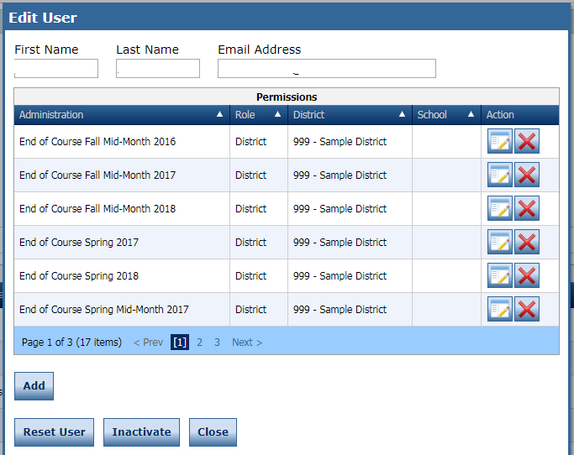
eDIRECT Accounts
District System Test Coordinators are responsible for ensuring eDIRECT accounts are current.

Slide 76
Georgia Milestones
EOG Resources
EOC Resources
Milestones Presentations
Milestones Training Videos
GOFAR
eDIRECT

Slide 77
Formative Assessment Resources
Formative Assessment Toolbox: Item and test content in GOFAR and TestPad
GOFAR: Benchmark Development Tool for use with GaDOE test items
TestPad: Tool for item creation
Formative Instructional Practices (FIP): online professional learning for teachers, coaches, and leaders

Slide 78
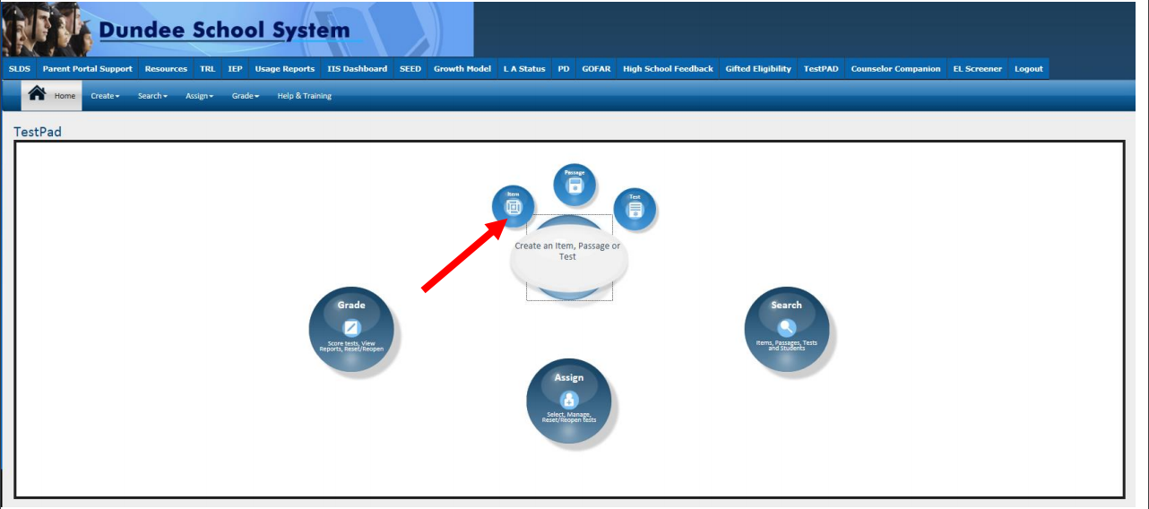
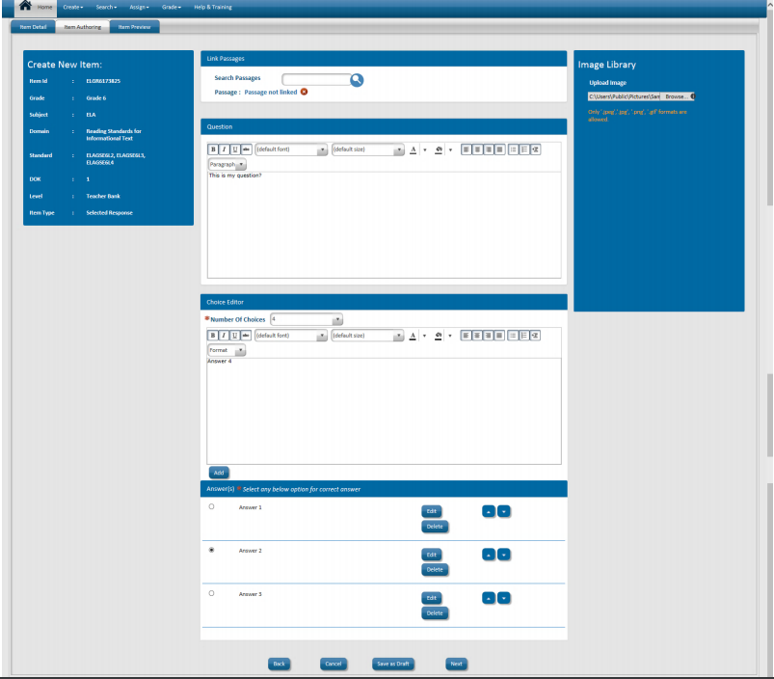
GOFAR and TestPad
New Interface
Create Test Items, Passages and Rubrics

Slide 79
National Assessment of Educational Progress (NAEP)

Slide 80
National Assessment of Educational Progress (NAEP)
Managed through the U.S. Department of Education
National assessment since 1969
Representative sample in each state
2018 school lists sent to districts in June
Measure achievement in 4th, 8th, and 12th grades
State and national results in various subjects
School and teacher questionnaires
Results released as The Nation’s Report Card

Slide 81
National Assessment of Educational Progress (NAEP)
Trends in International Mathematics and Science Study (TIMSS)
International assessment since 1995
Digitally based field test in 2018 to prepare for 2019 assessment
More than 60 countries/education systems will participate in 2019
Measure 4th and 8th grade math and science achievement
School and teacher questionnaires

Slide 82
National Assessment of Educational Progress (NAEP)
2019 Assessment
Administration Schedule
NAEP: January 28 – March 8, 2019
TIMSS: April 1 – May 31, 2019
Assessed Subjects
Grades 4 and 8 – State/TUDA Reading and Mathematics
Grades 4 and 8 – Pilot Reading and Mathematics
Grades 4, 8, and 12 – National Science
Grade 12 – National Mathematics and Reading
Grade 12 – High School Transcript Study

Slide 83
National Assessment of Educational Progress (NAEP)
Testing Modes — January 28 to March 8, 2019
Grade | Subject | Format
 |  | Tablet | Paper/Pencil
Grades 4 and 8 | Mathematics | ✓
 | Mathematics (Pilot) | ✓
 | Reading | ✓
 | Reading (Pilot) | ✓
 | Science | ✓ | ✓
Grade 12 | Mathematics | ✓ | ✓
 | Reading | ✓ | ✓
 | Science | ✓ | ✓

Slide 84
NAEP Resources
Results
https://nces.ed.gov/nationsreportcard/
NAEP Data Explorer
https://nces.ed.gov/nationsreportcard/naepdata/
NAEP Questions Tool
https://nces.ed.gov/nationsreportcard/nqt/
TIMSS
https://nces.ed.gov/timss/

Slide 85
Georgia Inventory of Developing Skills (GKIDS)

Slide 86
Georgia Kindergarten Inventory of Developing Skills (GKIDS)
GKIDS continues in its current form in 2018-2019. The GKIDS website is currently open for 2018-2019.
Teachers should contact the school coordinator first and then the system test coordinator for assistance with GKIDS.
Teachers should enter student information into the website in a timely manner.
Students who transfer from a school/classroom should be released through the GKIDS website so they can be acquired by the new teacher.
GTID issues should be addressed with the school student database contact and/or the GaDOE Technology Services Division.
There is not a state-mandated baseline or end of year summary of required elements.
Teachers are responsible for students’ end of year reports prior to the end of the administration window in May.
A mid-year data file will again be available in January 2019.

Slide 87
Georgia Kindergarten Inventory of Developing Skills (GKIDS)
Academic Domains
Math
ELA
Science (Optional)
Social Studies (Optional)
Non-Academic Domains
Approaches to Learning
Personal/Social Development
Motor Skills (Optional)

Slide 88
GKIDS Readiness Check
Developed with our partners at the Department of Early Care & Learning (DECAL)
Augments the Georgia Kindergarten Inventory of Developing Skills (GKIDS) and is administered during the first six weeks of kindergarten
Designed to highlight knowledge and skills critical for student success in learning, solely to guide instruction
Aligned to the Georgia Early Learning Development Standards (GELDS) and correlated to the Georgia Standards of Excellence for kindergarten
Assesses 20 essential concepts and skills

Slide 89
GKIDS: Administration Schedule
January 30, 2019 | Mid-Year GKIDS student data file posted to systems in the MyGaDOE Portal
May 13, 2019 | Deadline for entry of student assessment data by teachers.
June 10, 2019 | GKIDS Website closes for the 2018-2019 school year.

Slide 90
GKIDS: Resources
Administration Manual
Assessment and Instructional Guide
Reference Guide and FAQs
Parent Brochure
Roster Upload Directions and File Layout

Slide 91
Keenville

Slide 92
Keenville: Overview
Keenville is a series of interactive challenges that actively engage students and assess key literacy and numeracy skills in real-time.
Keenville offers the opportunity to:
integrate assessment alongside instruction;
support and empower teachers with information to differentiate instruction; and
hook students into the fun of learning.

Slide 93
Keenville: Benefits
Engages students in an ongoing formative assessment that is integrated with the learning process
Integrates cross-curricular content
Provides ongoing, timely feedback on student performance and progress
Empowers teachers to differentiate and target standards to individual students
Provides summative measures – Lexiles and Quantiles
Can be expanded over time

Slide 94
Keenville: What is Assessed?
Academic Domains
Math – Early Numeracy Skills,
ELA – Early Literacy Skills,
Integration of science, social studies, fine arts, physical education/health/nutrition, CTAE, etc., within texts.
Grade Levels
Grades 1 and 2
Most games also include Kindergarten and Grade 3 standards to support student enrichment or remediation needs.

Slide 95
Keenville: Resources
Pre-administration webinars are scheduled for August 14 and August 16.
Training presentations and resources will be posted soon to keenville.gadoe.org
Available resources will include:
Administration Manual
Frequently Asked Questions for Administrators
Frequently Asked Questions for Teachers
User Technical Guide

Slide 96
Keenville: Access
Keenville will be accessed by all users via the Statewide Longitudinal Data System (SLDS).
Accessing SLDS requires users to log into the district’s Student Information System (SIS).
All users will need SIS login credentials to access Keenville via the SLDS.
An email will be sent to district SIS Administrators with further details.

Slide 97
Keenville: Lexile and Quantile Linking Study
A linking study is necessary to provide Lexile and Quantile measures within Keenville.
Selected districts were notified via email on 8/6.
Selected schools will administer either a Lexile or Quantile linking test (paper/pencil) and two Keenville games during a three week window.
Additional linking studies will be necessary as new games are released.

Slide 98
Post-Assessment Communication
Communication
Dissemination of Test Scores
Transferring Student Test Scores

Slide 99
Communication
Develop
Develop a strategy
Notify
Notify parents/guardians of test dates and times
Share
Share the personal relevance of the test
Communicate
Communicate reporting timelines
Preliminary reports may be shared with parents, school, and district staff to support grading, promotion/retention, and placement decisions.
Articulate
Articulate relationship between testing and specific policies and program
e.g. Demonstrating Subject Area Competency/Testing-Out, MOWR, Promotion and Retention

Slide 100
Dissemination of Test Scores
Data files, and for some programs PDFs of reports, are released on the department’s secure portal, MyGaDOE, and/or (for some programs) via a contractor’s delivery system
To have access to these downloadable roster reports and data files, System Test Coordinators should have a login and password for both the MyGaDOE Portal and any necessary contractor sites
Requests for data from other personnel in the system (e.g. principals, teachers, parents, etc.) will be redirected to the System Test Coordinator
Individual student reports are provided in both electronic and paper format. Rosters, school and system level reports are made available to districts via electronic format only.
Most importantly, parents must receive their student’s report(s) on a timely basis – this includes test scores, growth scores (SGPs), etc.

Slide 101
Transferring Student Test Scores
It is the responsibility of local school systems to ensure that test scores become a part of students' records as soon as possible after reporting, and that such records follow students to their new schools
This responsibility to provide scores to students/parents continues even after a student withdraws/exits school. GaDOE does not issue individual student scores to students, parents, or receiving schools.

Slide 102
MyGaDOE Portal & Contractor Accounts
Assessment | Vendor | When | Contact
MyGaDOE Portal/All | Georgia Department of Education https://portal.doe.k12.ga.us/login.aspx | ASAP | Local System Technology Director
ACCESS for ELLs 2.0 | WIDA (for WIDA.us) Data Recognition Corporation (DRC) (for the WIDA Assessment Management System, WIDA AMS) | October 2017 | WIDA Customer Service (866) 276-7735 help@wida.us DRC Customer Service (855) 787-9615 WIDA@datarecognitioncorp.com
GAA 2.0 | Questar | Sent to System TCs in October by Questar | Questar Customer Service GA@QuestarAI.com (866) 997-0698
GKIDS | Georgia Center for Assessment (GCA) https://gkids.tsars.uga.edu/start | ASAP | Georgia Center for Assessment (GCA) (888) 392-8977
Georgia Milestones | Data Recognition Corporation (DRC) | ASAP | Data Recognition Corporation (DRC) (866) 282-2249 gahelpdesk@datarecognitioncorp.com

Slide 103
Assessment & Accountability Contact Information
Link to Assessment and Accountability Contacts
Link to Georgia Milestones Assessment Specialists by Assigned School District
Link to Accountability Specialists by Assigned School District
Toll-Free 800-634-4106 and 404-656-2668
http://gadoe.org/assessment

Slide 104
Questions

