Slide 1


LEXILES:
Making Sense of a
Reading Measure
Updated August 7, 2017

Slide 2
Goal of Presentation
Provide education stakeholders with background information for understanding, interpreting, and then using a student’s Lexile measure to improve the student’s reading ability.
  Overview of Lexile Framework and Lexiles
  Georgia Milestones and Lexiles
  Lexile Resources from MetaMetrics
  Using Lexiles to Build Partnerships between School, Library, and Home
  Georgia’s Lexile Results
  Relating Lexiles to Tests and Other Reading Measures

Slide 3
Overview
of
Lexile Framework & Lexiles

Slide 4
What is the Lexile Framework?
An educational tool that links text and readers under a common metric known as Lexiles.
Allows educators to forecast the level of comprehension a reader is expected to experience with a particular text
Most commonly used reading measure
  Over 19 million students receive Lexile scores through commercial and state assessments
  Over 100,000 books and tens of millions of articles have Lexile measures

Slide 5
What is the Lexile Framework?
Developed by MetaMetrics
Based on research funded by National Institute for Child Health Development (NICHD)
Combined the work of reading experts Chall, Flesch, Carroll, and Bormuth, with measurement expert, Rasch

Slide 6
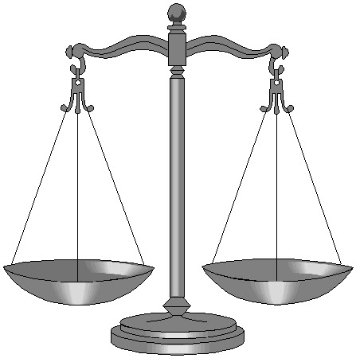
Lexile Measures Defined
A Lexile is a standard score
developed by MetaMetrics
Matches a student’s reading ability
with difficulty of text material
Interpreted as the level of book
that a student can read with 75% comprehension
75% comprehension is the level identified by experts as offering the reader a certain amount of comfort and yet still offering a challenge
Reading Ability
Text Complexity

Slide 7
How are Lexiles calculated?
Lexiles take into account the following:
Semantic Difficulty
  Word Frequency
Syntactic Complexity
  Sentence Length

Slide 8
Lexiles and the Georgia
Standards for Excellence (GSE)
The GSE promote that students should be ready for college and career after high school.
The most important factor for readiness is a student’s ability to read and understand texts of steadily increasing complexity as they progress through school.
The Lexile® Framework provides valuable insights into student readiness by measuring both the complexity of reading materials, including college and career texts, and a student's ability to comprehend these texts.

Slide 9
Lexiles, Stretch Bands &
College and Career Readiness
The Lexile Framework is aligned to match the college and career ready text complexity grade bands.
  The “stretch” bands of the Lexile Framework show an upward trajectory of reading comprehension development through the grades to indicate that all students should be reading at the college- and career-readiness level by no later than the end of high school.

Slide 10
Lexile Bands
Grade Band | “Stretch” Lexile Band
K-1 | N/A
2-3 | 420L-820L
4-5 | 740L-1010L
6-8 | 925L-1185L
9-10 | 1050L-1335L
11-CCR | 1185L-1385L
These “stretch” Lexile bands are the basis for determining at what text complexity level students should be reading—and at which grades—to make sure they are ultimately prepared for the reading demands of college and careers.

Slide 11
Georgia Milestones
and Lexiles

Slide 12

Georgia Milestones and Lexiles
GaDOE issues Lexile measures
for
Students receive a Lexile measure along with their regular scale score for a Georgia Milestones End-of-Grade (EOG) or End-of-Course (EOC) English Language Arts (ELA) assessment.
A student’s Lexile measure is a tool
  for teachers to use in targeting reading material for students.
  for parents to use in selecting reading material for their children.
GSE promotes literacy in ELA and Math as well as other subject areas.
  Teachers in such areas as social studies and science must also help students develop literacy.

Slide 13

Georgia Milestones and Lexiles
In the spring of 2015, the GaDOE and MetaMetrics conducted a research study to link the Lexile metric to Georgia Milestones.
  About 2,500 students took a parallel Lexile test prior to the spring administration of the Milestones EOG and EOC.
  By matching these scores to performance on the subsequent operational test, the relationship between Lexiles and Georgia Milestones was established.
  This was the basis for reporting a student’s reading status – “Below Grade Level” or “Grade Level or Above” on a Milestones English Language Arts assessment.

Slide 14
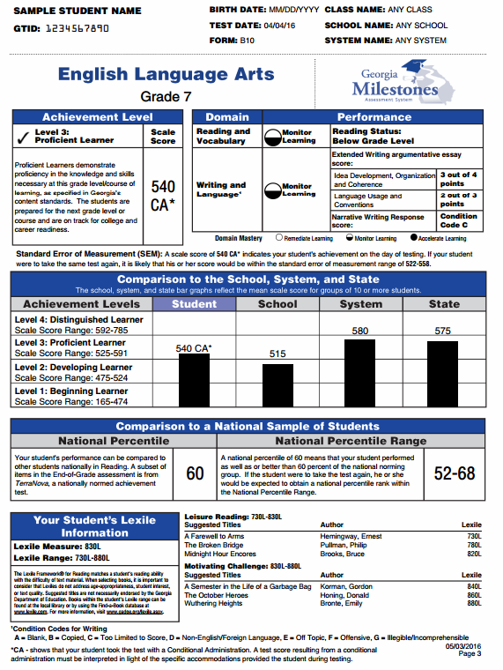
How are Lexiles reported?
Individual Student Report provides:
Lexile information in parent-friendly format.
Lexile score and Lexile range.
An explanation of how to use the information.
Sample book titles individualized for each student based on their Lexile range. These are categorized into a Leisure reading range and a Motivating Challenge reading range.
Lexile information is also provided on district summary reports and in the district data files.

Slide 15

The Lexile Scale
Lexiles typically range from 200 for beginning readers to 1700 for advanced readers.
Lexile text below 200L represents beginning-reading material.
  A student’s Lexile score may have a number in the 100s or the code of BR (for Beginning Reader).
Applies to both reader ability and text difficulty
  When reader and text measures are the same, the student is expected to read with 75% comprehension.
Can be used to track reading growth over time

Slide 16
More About the
BR Lexile Code
ISBN | Title | Author | Lexile
0152020632 | "Fire, Fire!" Said Mrs. McGuire | Martin Jr., Bill | BR
0813620082 | "POP" Pops the Popcorn | Egan, Bob | BR
0478126123 | "Who Took the Cake?" | Medina, Eduardo | BR
BR is used for any text or student ability that has a Lexile measure of zero or below.
ISBN | Title | Author | Lexile
0478204418 | "Happy Birthday, Estela!" | Bingley, Anne M. | 70L
047820454X | "Smile!" said Dad | Jane Buxton | 20L
0679886893 | 6 Sticks | Coxe, Molly | 120L
051622879X | A Lunch With Punch | Kittinger, Jo S. | 80L
16

Slide 17
Lexile Resources
From
MetaMetrics

Slide 18

MetaMetrics Resources
MetaMetrics, the developer of the Lexile Framework, provides several tools and resources for educators, parents, students, and other stakeholders.
  Find A Book
  Lexile Analyzer
  White Papers
  Teacher Resources
  Parent Resources
  And many more –
Check out https://www.lexile.com/

Slide 19
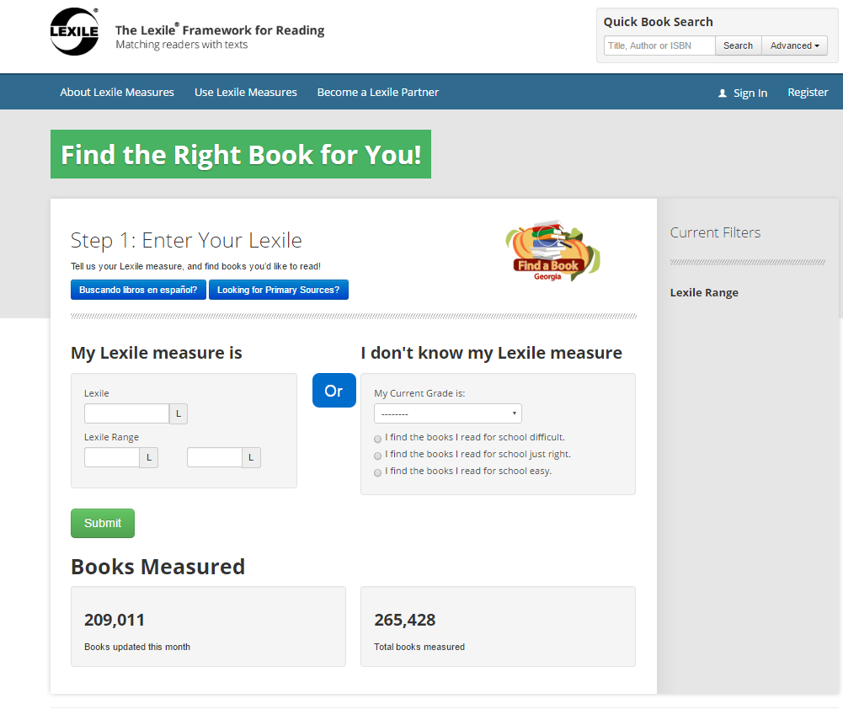
Accessing the Find A Book Tool http://lexile.com/fab/GA

Slide 20
What if a book or document isn’t in the Lexile database?
Use the Lexile Analyzer – it’s free, but you must register.
Create a text document (file extension is .txt) with multiple 175-word slices from the book or document.
Submit via the Lexile Analyzer.
  http://lexile.com/analyzer/
Also can approximate the Lexile by seeing other books by the same author or in same series. At least a good place to begin with to determine if book is close to a student’s Lexile range.

Slide 21
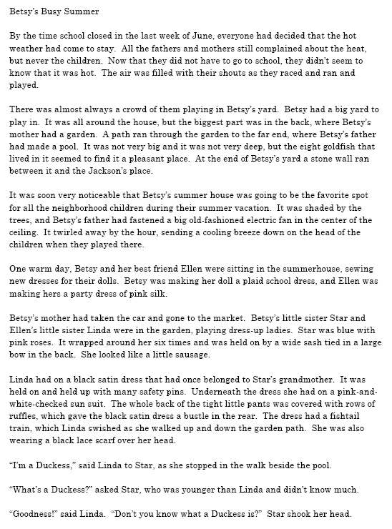
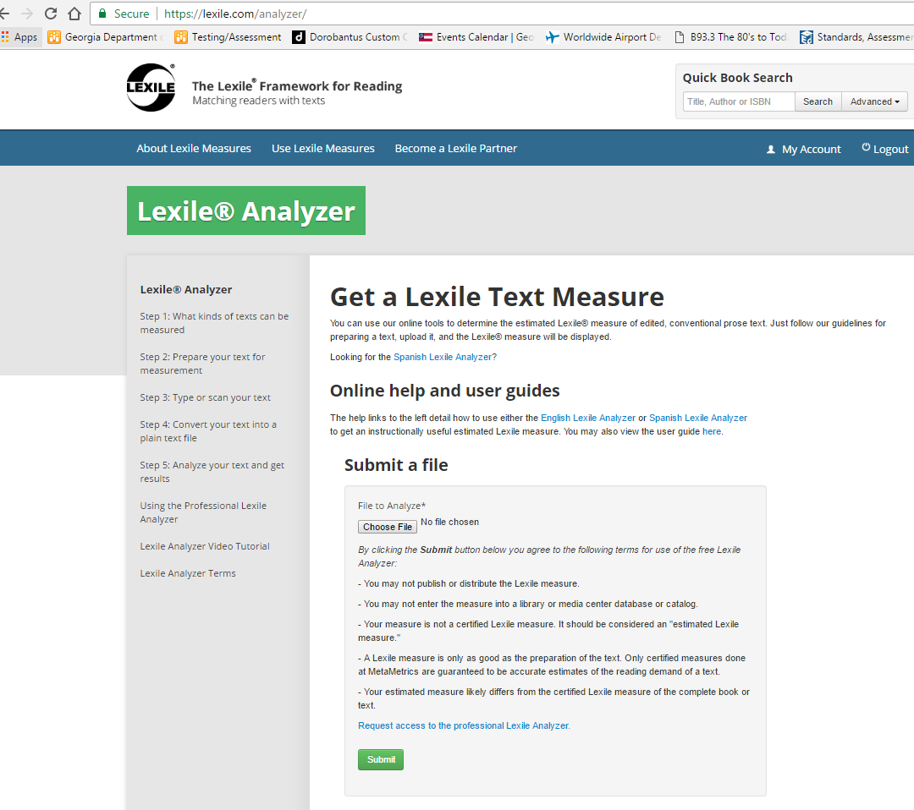
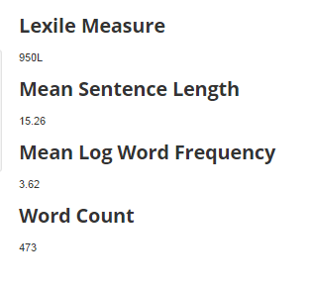
Lexile Analyzer
Txt file
Lexile Analyzer
Result

Slide 22
Alternate Method
The book Betsy’s Busy Summer is not in the Lexile database.
Other books by Carolyn Haywood are:
  B is for Betsy – 660L
  Back to School with Betsy – 570L
  Betsy and the Boys – 560L
If book is in same series, then book is most likely somewhere in this range.
Also see what other “leveling” might be done for the author or series. The reading level for many “Betsy” books is 9 to 12-year-olds; this translates roughly into 3rd to 5th grade or about 500L to 950L.

Slide 23



Using Lexiles to Build Partnerships
HOME
LIBRARY
SCHOOL
The Lexile Framework is a tool for teachers, media specialists, librarians, and parents to use in conjunction with existing reading programs and is not a replacement for existing reading programs.

Slide 24
How to Use Lexiles
It is recommended that readers choose texts within their Lexile range.
  A Lexile range is 50L above and 100L below a student’s reported Lexile measure.
Selection for pleasure reading should also be based on student’s interests.
Practice with a variety of texts.
Use Lexiles to set goals.

Slide 25
Using Lexiles in the Classroom
Teachers can use Lexiles to help them:
Develop individualized or classroom reading lists tailored to provide appropriately challenging reading.
Enhance thematic teaching by building a bank of titles at varying levels that support the theme, but also allows all students to participate successfully in the theme with material at their own reading level.
Sequence materials, for example by increasing the difficulty of read-aloud books throughout the year.
  Source: https://d1jt5u2s0h3gkt.cloudfront.net/m/cms_page_media/123/Lexiles-in-the-Classroom.pdf

Slide 26
Using Lexiles in the Classroom
Teachers can use Lexiles to help them:
Develop a reading folder that goes home with students and comes back for weekly review. Folder might contain:
  a reading list of books within the student’s Lexile range
  reports of recent assessments
  a form for parents to record reading that occurs at home.
Vary reading difficulty of material to the situation:
  Choose texts lower in the student’s Lexile range when factors make the reading situation more challenging, threatening or unfamiliar.
  Select texts at or above the student’s range to stimulate growth when a topic is of extreme interest to a student, or when you will be giving additional support such as background teaching or discussion.
  Source: https://d1jt5u2s0h3gkt.cloudfront.net/m/cms_page_media/123/Lexiles-in-the-Classroom.pdf

Slide 27

More Instructional Uses of Lexiles
Teachers can use Lexiles to:
Set measurable goals for instruction and special intervention programs
Monitor progress of various reading programs
Engage parents as “partners to the classroom” by giving them a tool for selecting appropriate reading material for their children (e.g., Summer Reading Lists, visiting library, etc.)
Help students set goals for themselves and use annual GA Milestones results to see if they have progressed towards their goals.
  Source: https://d1jt5u2s0h3gkt.cloudfront.net/m/cms_page_media/123/Lexiles-in-the-Classroom.pdf

Slide 28

More Instructional Uses of Lexiles
Lexiles can help teachers:
Adjust materials to the purpose of reading.
  For increased fluency and automaticity, teacher selects text that measures well below reader ability.
  As a strategy for teaching students how to attack “hard” text, the teacher selects text that measures above reader ability.
  Source: https://d1jt5u2s0h3gkt.cloudfront.net/m/cms_page_media/123/Lexiles-in-the-Classroom.pdf

Slide 29

More Instructional Uses of Lexiles
Teachers can use Lexiles to target fiction and non-fiction material to students’ abilities and thus promote learning of all subjects.
  Avoids student frustration when reading text is too difficult.
  Avoids undermining student self-confidence.
  Avoids the fostering of bad work habits and unrealistic self-expectations when a student is always presented with too easy material.
  Learning occurs best when the text material can be comprehended at a 75% rate.
  Source: https://d1jt5u2s0h3gkt.cloudfront.net/m/cms_page_media/123/Lexiles-in-the-Classroom.pdf

Slide 30
Summer Reading is Essential!
Research studies show that ---
students can have up to a 2-3 month loss in reading ability over summer.
lower income students may suffer most due to lack of books in the home and transportation access to public libraries.
rural area students also lack easy access.
innovative partnering of schools, publishers, and public libraries have great promise for solving the summer reading loss dilemma.

Slide 31
Using Lexiles to Promote Reading
Improve students’ reading fluency and increase enjoyment of reading.
  Students who spend a minimum of 3 hrs/week reading at their own level for their own purposes develop reading fluency which leads to improved mastery. Even 15 minutes a day is helpful.
It is recommended that readers choose texts within their Lexile range.
  A Lexile range is 50L above and 100L below a student’s reported Lexile measure.
Use Lexiles to set goals.
Practice with a variety of texts.
Challenge the BEST readers.
Success breeds enjoyment.

Slide 32
Using Lexiles in Media
Centers and Public Libraries
Media specialists and librarians can assist classroom instruction by
Helping to develop individualized or classroom reading lists tailored to provide appropriately challenging reading.
Guiding teachers in selecting a bank of titles at varying levels that support an instructional thematic unit. This allows all students to participate successfully in the theme with material at their own reading level.
Locating and sequencing materials for classroom use. For example, increasing the difficulty of books throughout the year.
  Source: https://www.lexile.com/using-lexile/lexile-at-library/

Slide 33
Building Partnerships
School media specialists and public librarians should be partners.
  Jointly create reading lists
  Complement catalogue holdings
Assist students in selecting reading material.
  Remember to vary reading difficulty of material to the situation.
  Ask for Lexile information. Schools might create a library card with Lexile information on it.
  Choose texts lower in the student’s Lexile range when factors make the reading situation more challenging, threatening or unfamiliar.
  Select texts at or above the student’s range to stimulate growth when a topic is of extreme interest to a student, or when you will be giving additional support such as background teaching or discussion.
Make parents “partners” by giving them a tool for selecting appropriate reading material for their children (e.g., Summer Reading Lists, visiting library, etc.)
  Source: https://d1jt5u2s0h3gkt.cloudfront.net/m/cms_page_media/123/Lexiles-in-the-Classroom.pdf

Slide 34


Parents Can Use Lexiles
Promotes family-school connections.
Know your child’s Lexile measure.
Know your child’s Lexile range.
  50L above and 100L below their reported Lexile measure. This range represents the boundaries between the easiest kind of reading material for your child and the hardest level at which he/she can read successfully.
Use the Lexile Find a Book Database (at http://lexile.com/fab/) to find books in the child’s Lexile range.
Source: http://cdn.lexile.com/m/cms_page_media/135/Lexiles-at-Home_2.pdf

Slide 35


Parents
Can Use Lexiles
Ensure that your child reads every day.
Parents should read to set a good example. Reading newspapers and magazines will show children that reading is a wonderful pastime as well as a window to the world of learning.
Ask school or library for book lists within Lexile range.
Student’s interests should play a part in book selection.
Visit public libraries often.
Participate in summer reading programs.
Source: http://cdn.lexile.com/m/cms_page_media/135/Lexiles-at-Home_2.pdf

Slide 36
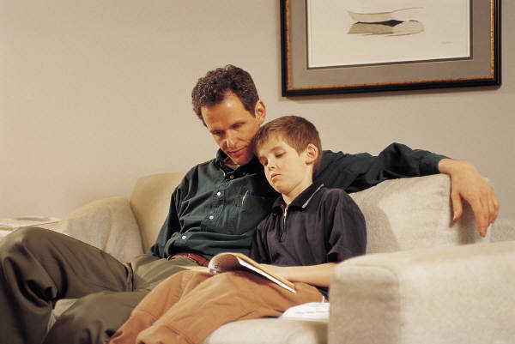
Parents Can Use Lexiles
When a reading assignment proves to be too difficult, provide adult-directed assistance:
  Review words and definitions from the glossary or dictionary.
  Review questions at the end of a chapter before child reads text.
  Pair-share read – Parent and student alternate reading the text. Stop, discuss, and ask questions along the way to see that student understands.
  Return to end of chapter questions and glossary to make certain your child understands the material.
Celebrate your child’s reading accomplishments.
  Set goals –
    number of books read
    variety of books
    stretch to books at higher Lexile
Source: http://cdn.lexile.com/m/cms_page_media/135/Lexiles-at-Home_2.pdf

Slide 37
Georgia’s Lexile Results
The next few slides provide a brief overview of students’ Lexile measures from the 2016–2017 academic year.
During the 2016-2017 school year, 1,055,369 students took an ELA Milestones assessment and those with a valid scale score also received a Lexile score.

Slide 38
Lexile Results for Georgia Students: Spring 2009 – Spring 2017
Median Lexile for Georgia Students by Grade Level/Course
Grade Level/ Course | 2009 | 2010 | 2011 | 2012 | 2013 | 2014 | 2015* | 2016 | 2017 | Suggested Text Demand: Lower Limit | Suggested Text Demand: Upper Limit
3 | 645 | 685 | 720 | 740 | 790 | 755 | 650 | 645 | 655 | 520 | 820
4 | 790 | 810 | 805 | 840 | 860 | 915 | 790 | 795 | 810 | 740 | 940
5 | 840 | 885 | 925 | 935 | 940 | 965 | 920 | 940 | 940 | 830 | 1010
6 | 980 | 980 | 1000 | 1025 | 1070 | 1075 | 975 | 980 | 990 | 925 | 1070
7 | 1020 | 1020 | 1040 | 1065 | 1095 | 1120 | 1095 | 1115 | 1100 | 970 | 1120
8 | 1110 | 1150 | 1170 | 1180 | 1210 | 1265 | 1130 | 1175 | 1170 | 1010 | 1185
9th Lit |  |  |  | 1205 | 1215 | 1225 | 1205 | 1230 | 1265 | 1050 | 1260
Am. Lit |  |  |  | 1220 | 1240 | 1270 | 1305 | 1345 | 1370 | 1185 | 1385
* Based on available preliminary spring data. The median Lexiles obtained from the Georgia Milestones Assessments are not really comparable to prior years because the new test is more rigorous with different performance standards than its predecessors.

Slide 39
Lexile Distribution by Grade/Course
Grade/ Course | Measure | Below the Stretch Band | Within the Stretch Band | Above the Stretch Band
3 | Lexile | Below 520L | 520L – 820L | Above 820L
 | Percentage of Students | 29% | 48% | 23%
4 | Lexile | Below 740L | 740L – 940L | Above 940L
 | Percentage of Students | 40% | 29% | 30%
5 | Lexile | Below 830L | 830L – 1010L | Above 1010L
 | Percentage of Students | 30% | 33% | 38%
6 | Lexile | Below 925L | 925L – 1070L | Above 1070L
 | Percentage of Students | 37% | 27% | 36%
7 | Lexile | Below 970L | 970L – 1120L | Above 1120L
 | Percentage of Students | 28% | 27% | 45%
8 | Lexile | Below 1010L | 1010L – 1185L | Above 1185L
 | Percentage of Students | 22% | 32% | 46%
Ninth Grade Literature and Composition | Lexile | Below 1050L | 1050L – 1260L | Above 1260L
 | Percentage of Students | 18% | 29% | 53%
American Literature and Composition | Lexile | Below 1185L | 1185L – 1385L | Above 1385L
 | Percentage of Students | 25% | 27% | 48%
Spring 2017 Georgia Milestones Results

Slide 40
Lexiles by Grade
Grade | Reader Measures, Mid-Year 25th percentile to 75th percentile (IQR) | "Stretch" Text Measures
1 | Up to 300L | 190L to 530L
2 | 140L to 500L | 420L to 650L
3 | 330L to 700L | 520L to 820L
4 | 445L to 810L | 740L to 940L
5 | 565L to 910L | 830L to 1010L
6 | 665L to 1000L | 925L to 1070L
7 | 735L to 1065L | 970L to 1120L
8 | 805L to 1100L | 1010L to 1185L
9 | 855L to 1165L | 1050L to 1260L
10 | 905L to 1195L | 1080L to 1335L
11 and 12 | 940L to 1210L | 1185L to 1385L
Column 1 shows grade.
Column 2 shows the range of Lexiles in which the middle 50% of readers fall at a grade level. 25% of students fall below this range and 25% above.
Column 3 shows the "stretch" text measures (defined in 2010 through studies related to the development of the Common Core State Standards for English Language Arts) and represents the demand of text that students should be reading to be college and career ready by the end of Grade 12.
http://www.lexile.com/about-lexile/grade-equivalent/grade-equivalent-chart/
40

Slide 41
Lexiles and CCRPI
Percent of students in grade 3 achieving a Lexile measure equal to or greater than 650L on the Georgia Milestones English Language Arts EOG assessment.
Percent of students in grade 5 achieving a Lexile measure equal to or greater than 850L on the Georgia Milestones English Language Arts EOG assessment.
Percent of students in grade 8 achieving a Lexile measure equal to or greater than 1050L on the Georgia Milestones English Language Arts EOG assessment.
Percent of students achieving a Lexile measure equal to or greater than 1275L on the Georgia Milestones American Literature and Composition EOC assessment.

Slide 42
Lexiles and CCRPI
Targets for the Lexile indicators in CCRPI were based on the Lexile “stretch” bands and longitudinal data from state tests.
Targets represent student reading ability within the college and career ready stretch bands for their grade level.
Grade | Stretch Text Band Lower Limit | Stretch Text Band Upper Limit | CCRPI Target
3 | 520L | 820L | 650L
5 | 830L | 1010L | 850L
8 | 1010L | 1185L | 1050L
11 | 1185L | 1385L | 1275L

Slide 43
Relating Lexiles to
Other Measures
GaDOE often receives questions on how to relate Lexiles to other measures.
The next few slides show correspondence of Lexiles to other reading level models.

Slide 44
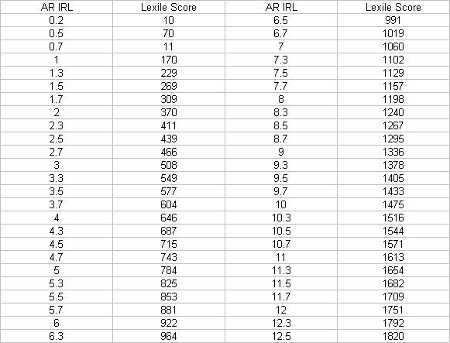
Accelerated Reader* & Lexiles**
*This relational table is from Renaissance Learning, Inc. (2002)
**Lexile is a trademark of MetaMetrics, Inc.

Slide 45
Various Reading Level Models
This chart was provided to the Oregon Educational Media Association by Steven Zimmerman of Harcourt. It provides a comparison by grade level of different book leveling systems including Lexiles, Fountas and Pinnell (Guided Reading), Basal, DRP (Degrees of Reading Power), Reading Recovery and DRA.

Slide 46
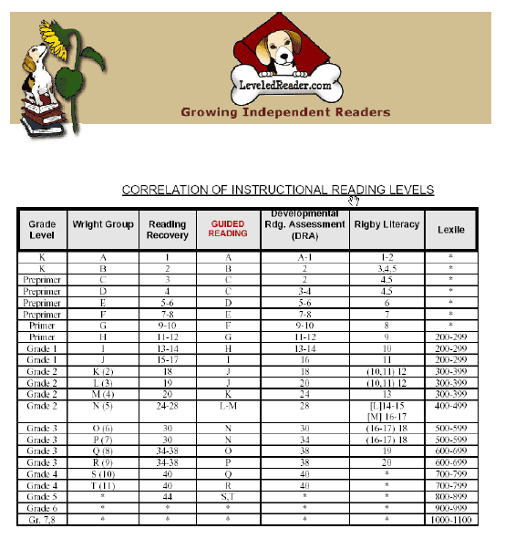
Relating Different Reading Level Models
This table is from https://leveledreader.com/leveling-guide/

Slide 47
Georgia’s Summer
Reading Challenge
A student’s growth in reading ability doesn’t happen only at school.
Research has shown that students can have up to a 2-3 month loss in reading ability over the summer.
Therefore, summer reading at home is essential!
Visit Georgia’s Summer Reading Challenge webpage for more information: http://www.gadoe.org/Curriculum-Instruction-and-Assessment/Curriculum-and-Instruction/Pages/Georgia-Summer-Reading-Challenge.aspx

Slide 48
Want to Know More . . .
GA Department of Education has Lexile information at:
  http://www.gadoe.org/Curriculum-Instruction-and-Assessment/Assessment/Pages/Lexile-Framework.aspx
  https://www.georgiastandards.org/Resources/Pages/Tools/LexileFrameworkforReading.aspx
GaDOE Contact:
  Assessment Research and Development Division
  Georgia Department of Education
  Phone: 404-656-2668
MetaMetrics’ website: http://lexile.com/

Slide 49




Read Every Day!

